Slide 1
Part IB
Materials Science and Metallurgy
Course A: Metals & Alloys
Professor Harry Bhadeshia
Lecture 12:
High Temperature Alloys

Slide 3
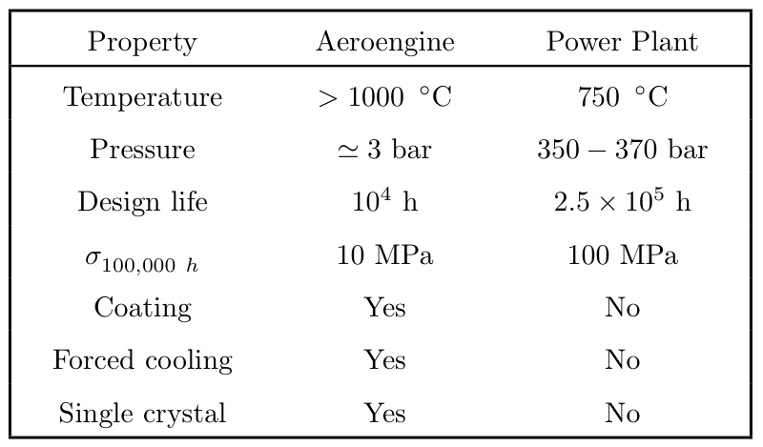

Slide 4
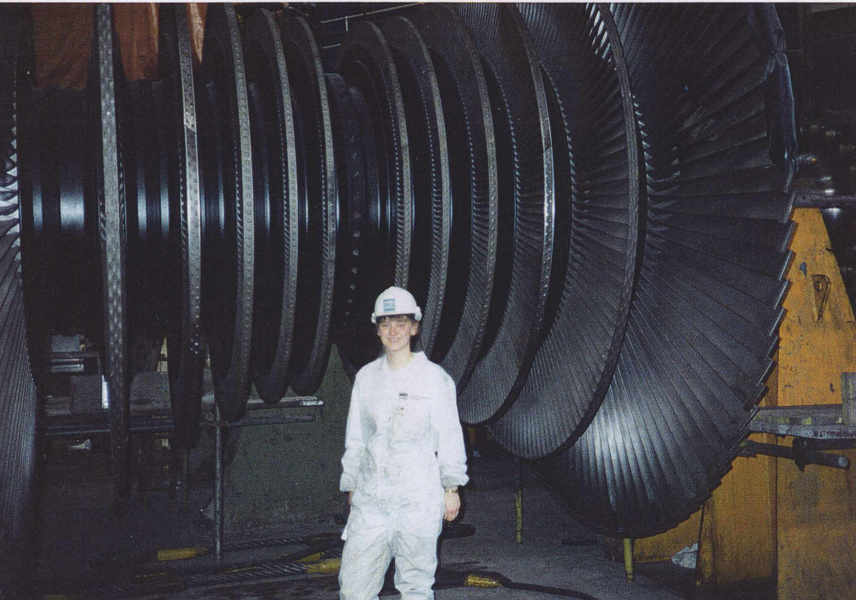

Slide 5
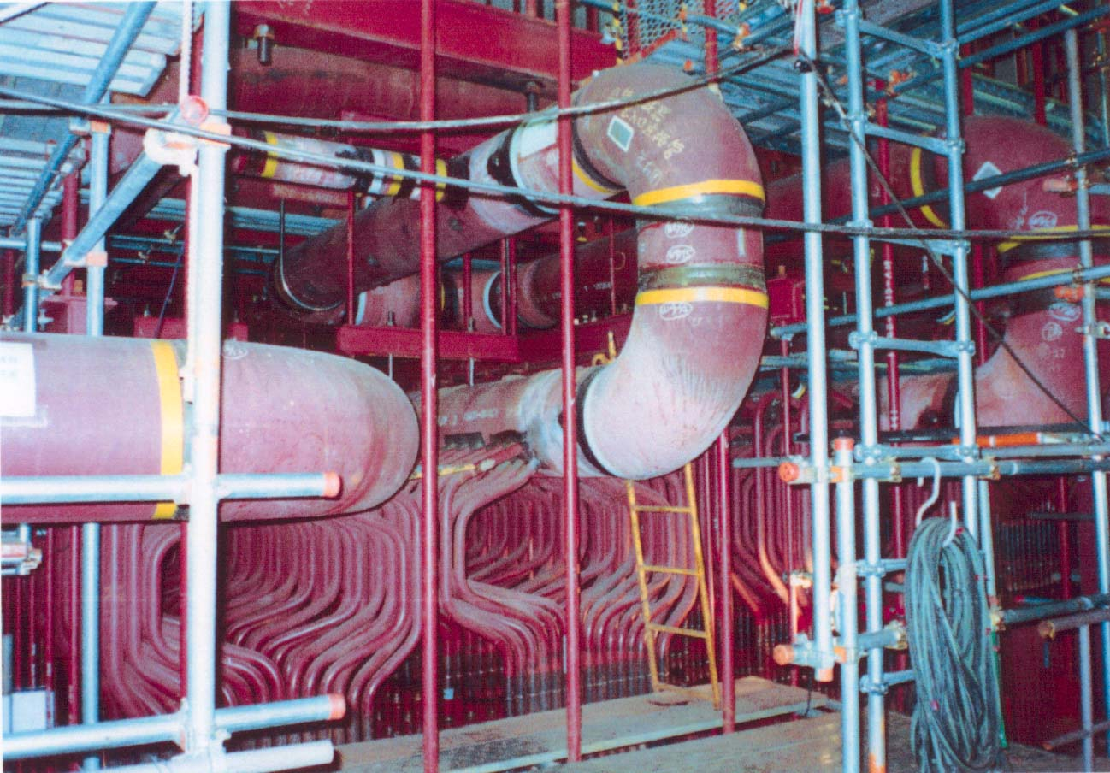
P122
P23
F. Masuyama

Slide 6
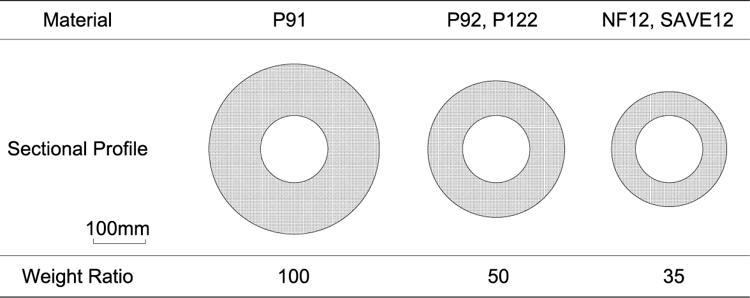
Superheater Outlet Header for 30MPa and 630℃
F. Masuyama

Slide 7
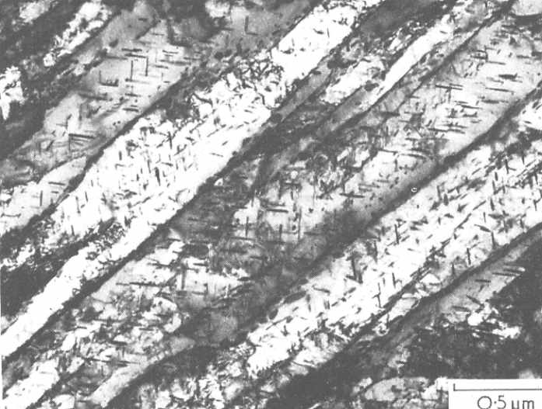
0.5 µm

Slide 8
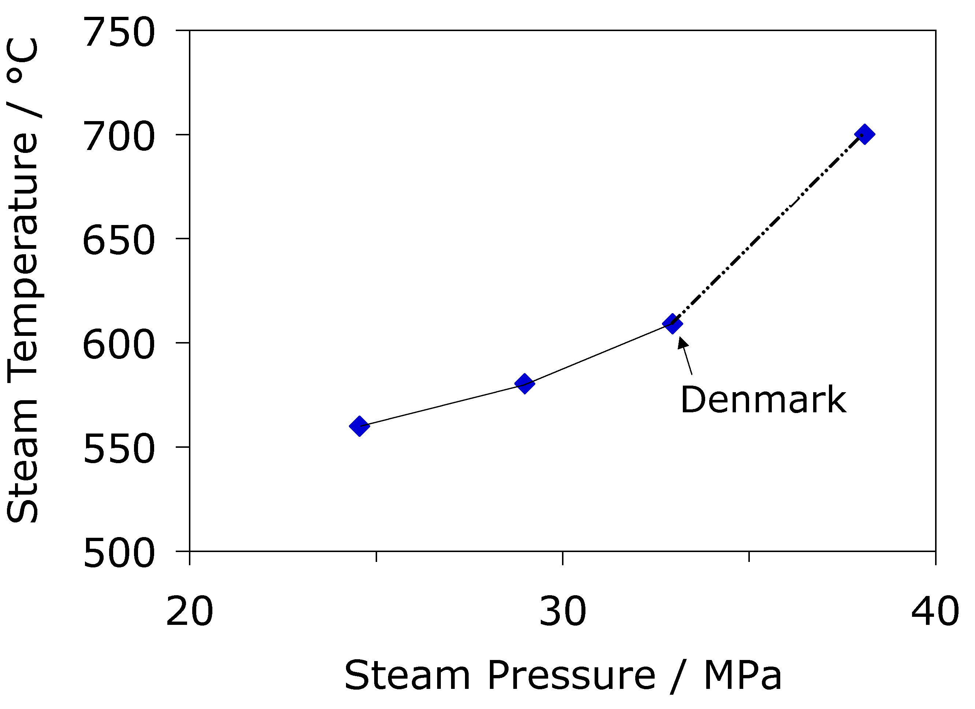

Slide 9
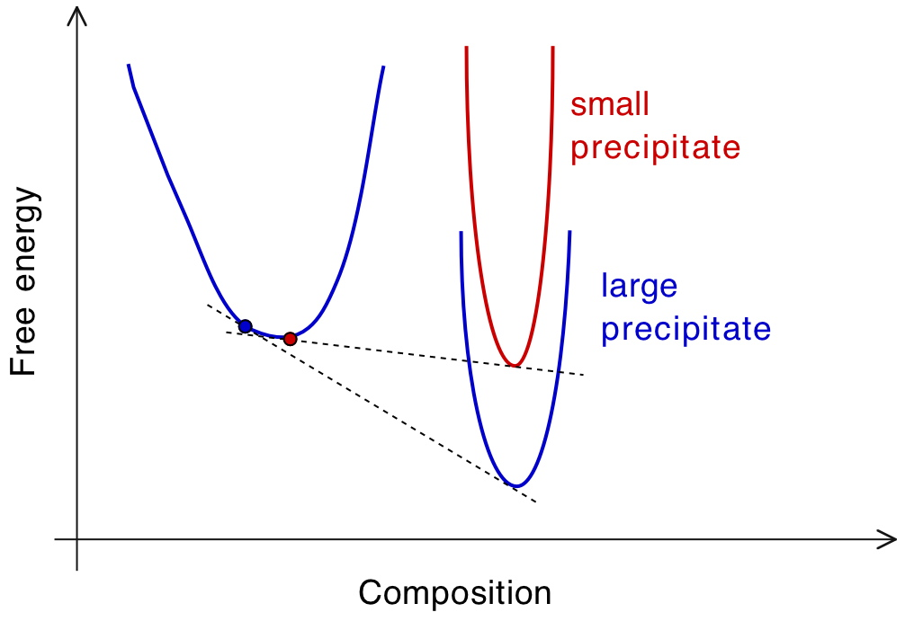
matrix

Slide 10
Coarsening
r
diffusion
r
1
flux
2
θ
α
θ
concentration
αθ
c
r
1
αθ
c
r
2
distance

Slide 11
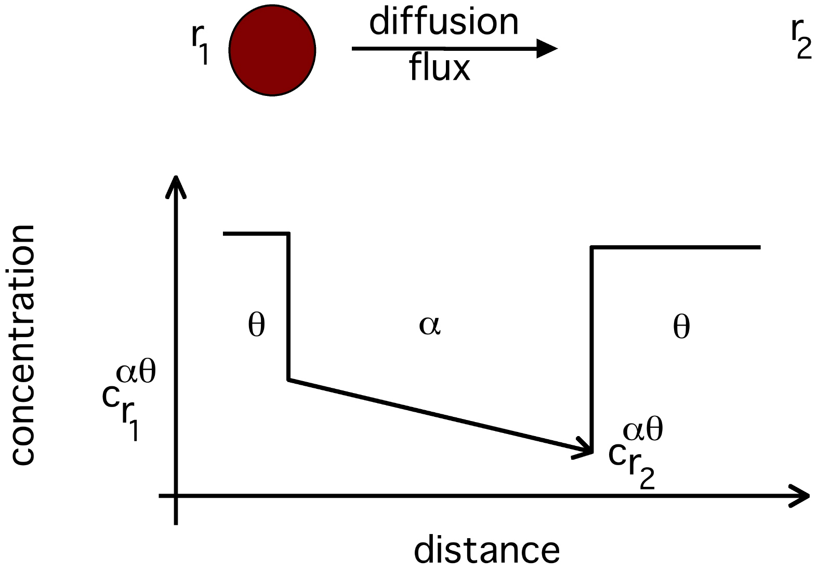
To minimise coarsening:
Reduce interfacial energy
Reduce diffusivity
Precipitates with low solubility in matrix

Slide 13
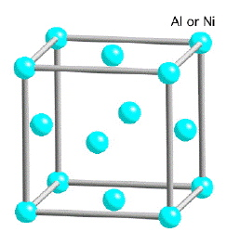
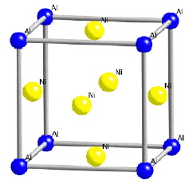
γ
γ
‘

Slide 14
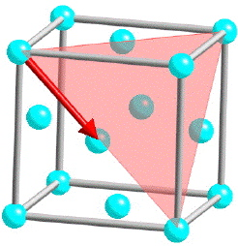
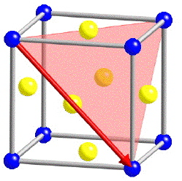

Slide 15
superdislocation

Slide 16
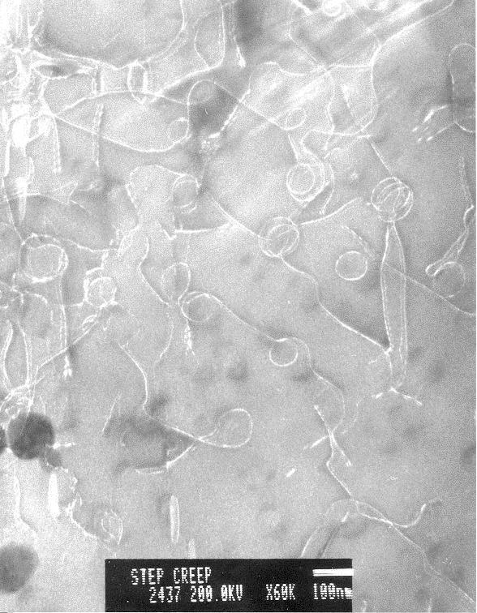
Order hardening
Dislocations finding it difficult to penetrate γ’
Yanhui Zhang

Slide 17
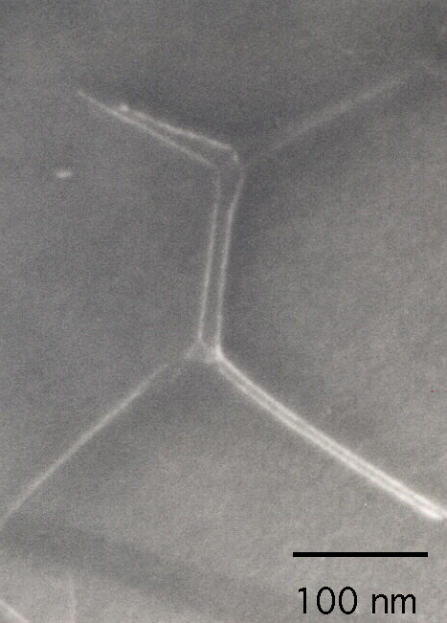
Superdislocations
Hillier, 1984

Slide 18
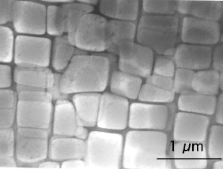

Slide 19
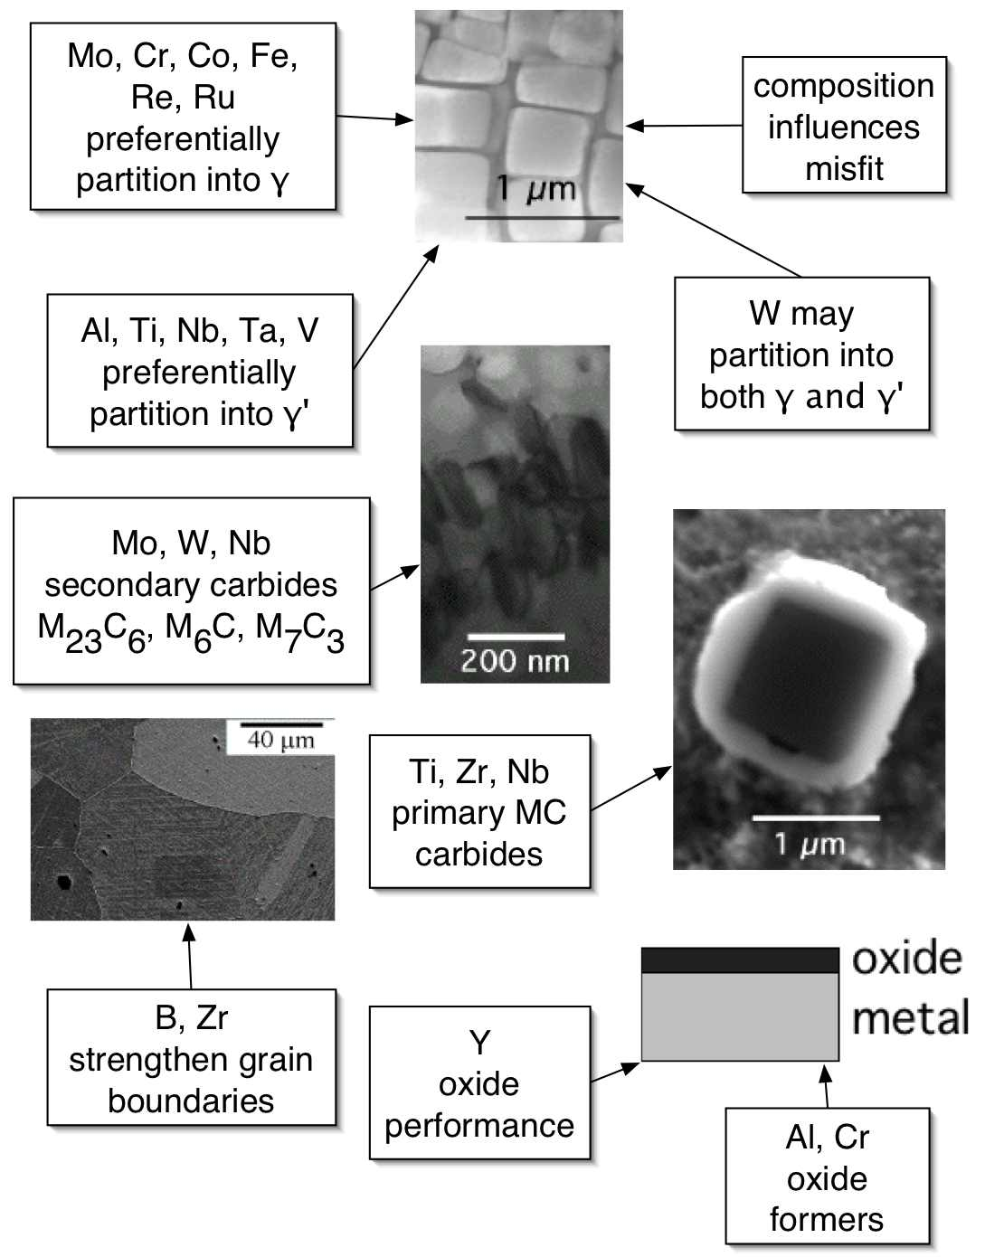

Slide 20
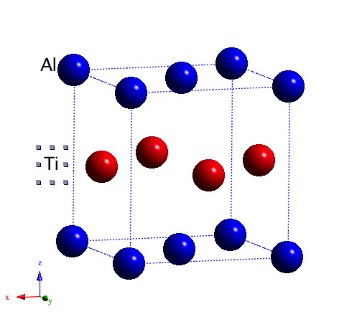
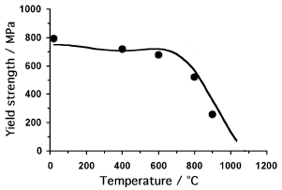

Slide 21
Page 77

Slide 22
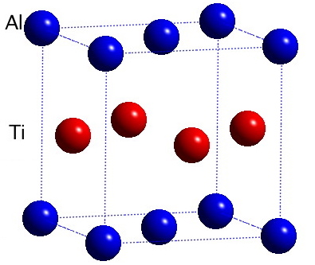
TiAl γ

Slide 23
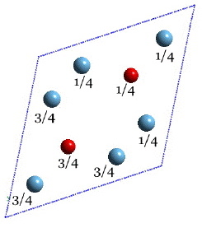
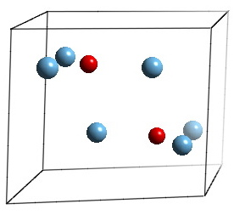
Ti₃Al
α₂

Slide 24
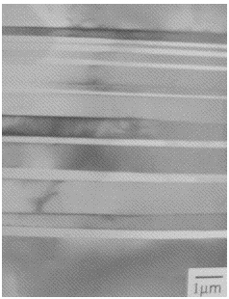
Ti-48Al at%
Alternating layers of α₂ and γ
Kim, Maruyama, 2001

Slide 25
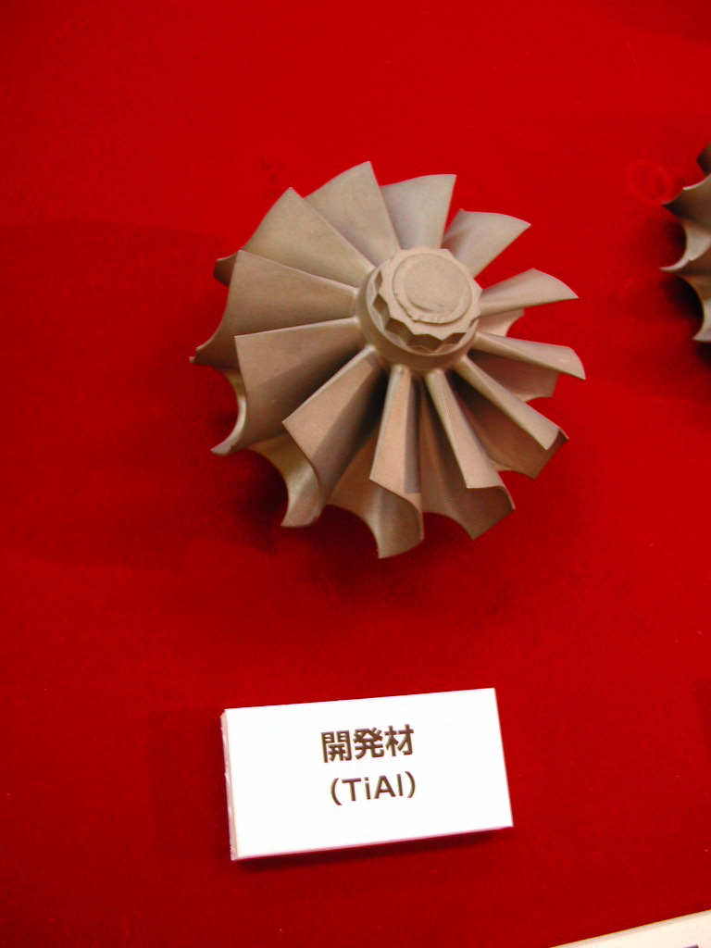
TiAl γ
Daido Steel

