Slide 1
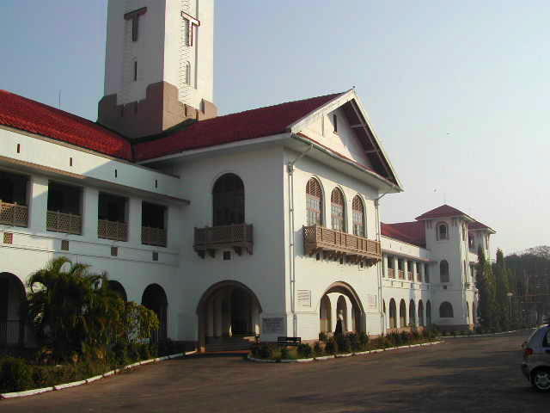

Thermodynamics
Thermodynamic functions
Equilibrium state
Case study: mechanical alloying
Computer calculation: phase diagrams
Thermodynamics - irreversible
Quasichemical models
Indian Institute of Technology
Kharagpur
https://www.phase-trans.msm.cam.ac.uk/teaching.html
H. K. D. H. Bhadeshia

Slide 2
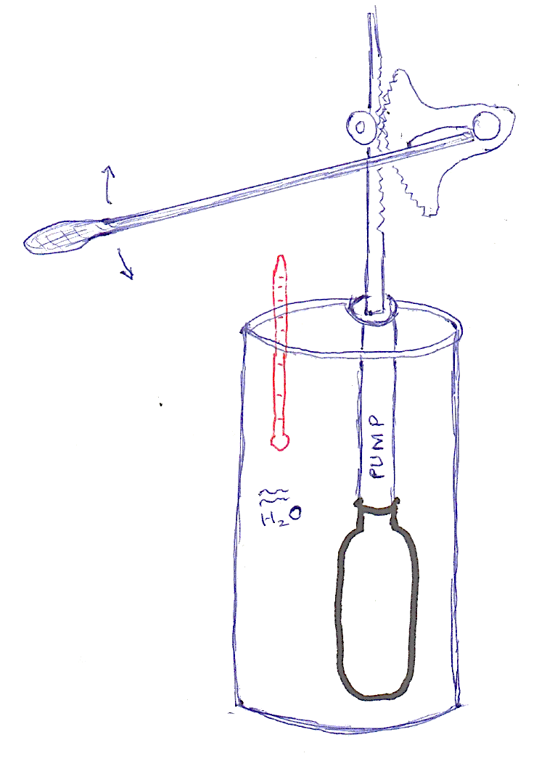
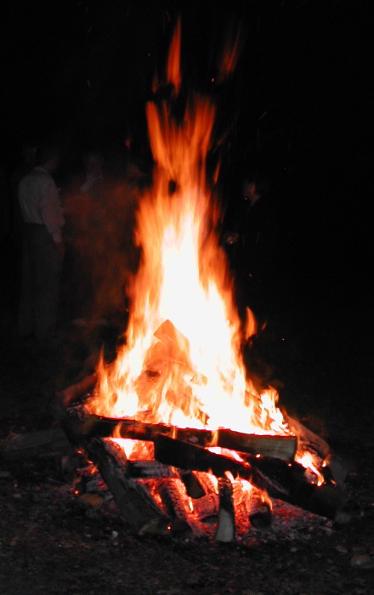
is heat a substance?
“... heat is regarded as a state of motion among ... constituent particles of bodies.
... mechanical force .... may be communicated to these particles ... to increase the rapidity of their motion”
Therefore, temperature rise.
thermometer made by
Joule and Mr Dancer
J. P. Joule, London, Edinburgh and Dublin
Philosophical Magazine and Journal of Science
26 (1845) 369-383
Graz, Austria, 2003

Slide 3
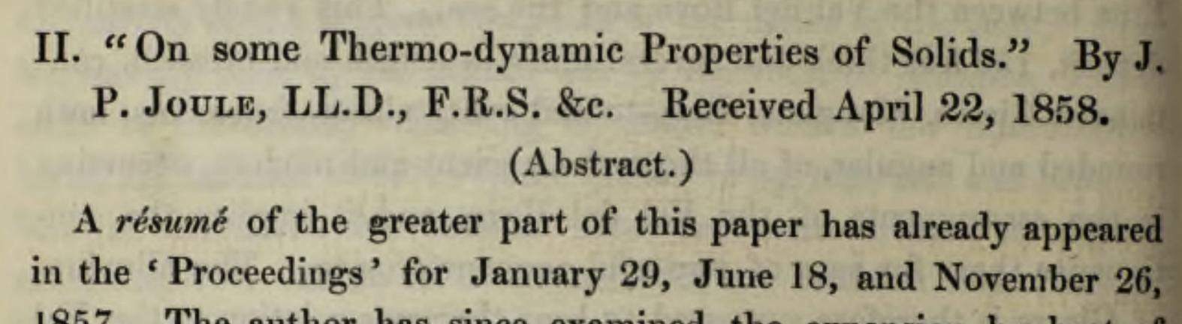
.... conservation of energy....
James Prescott Joule

Slide 4
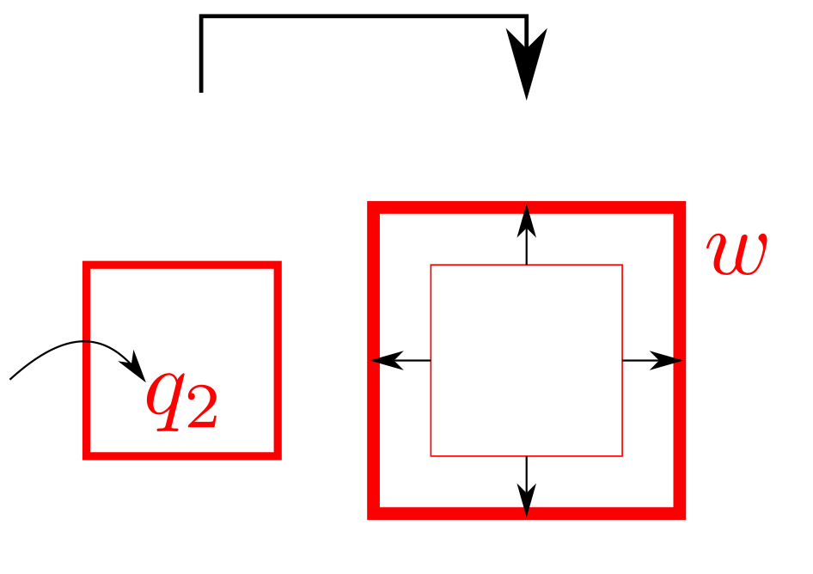
Notes:
Note sign convention. Work done by system is negative and heat into system positive

Slide 5
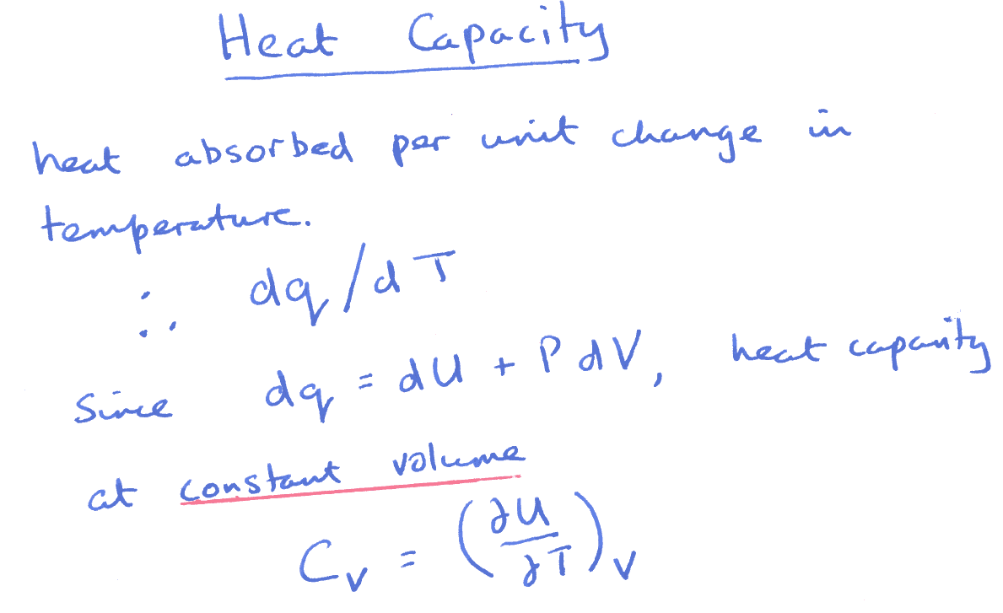

Slide 6
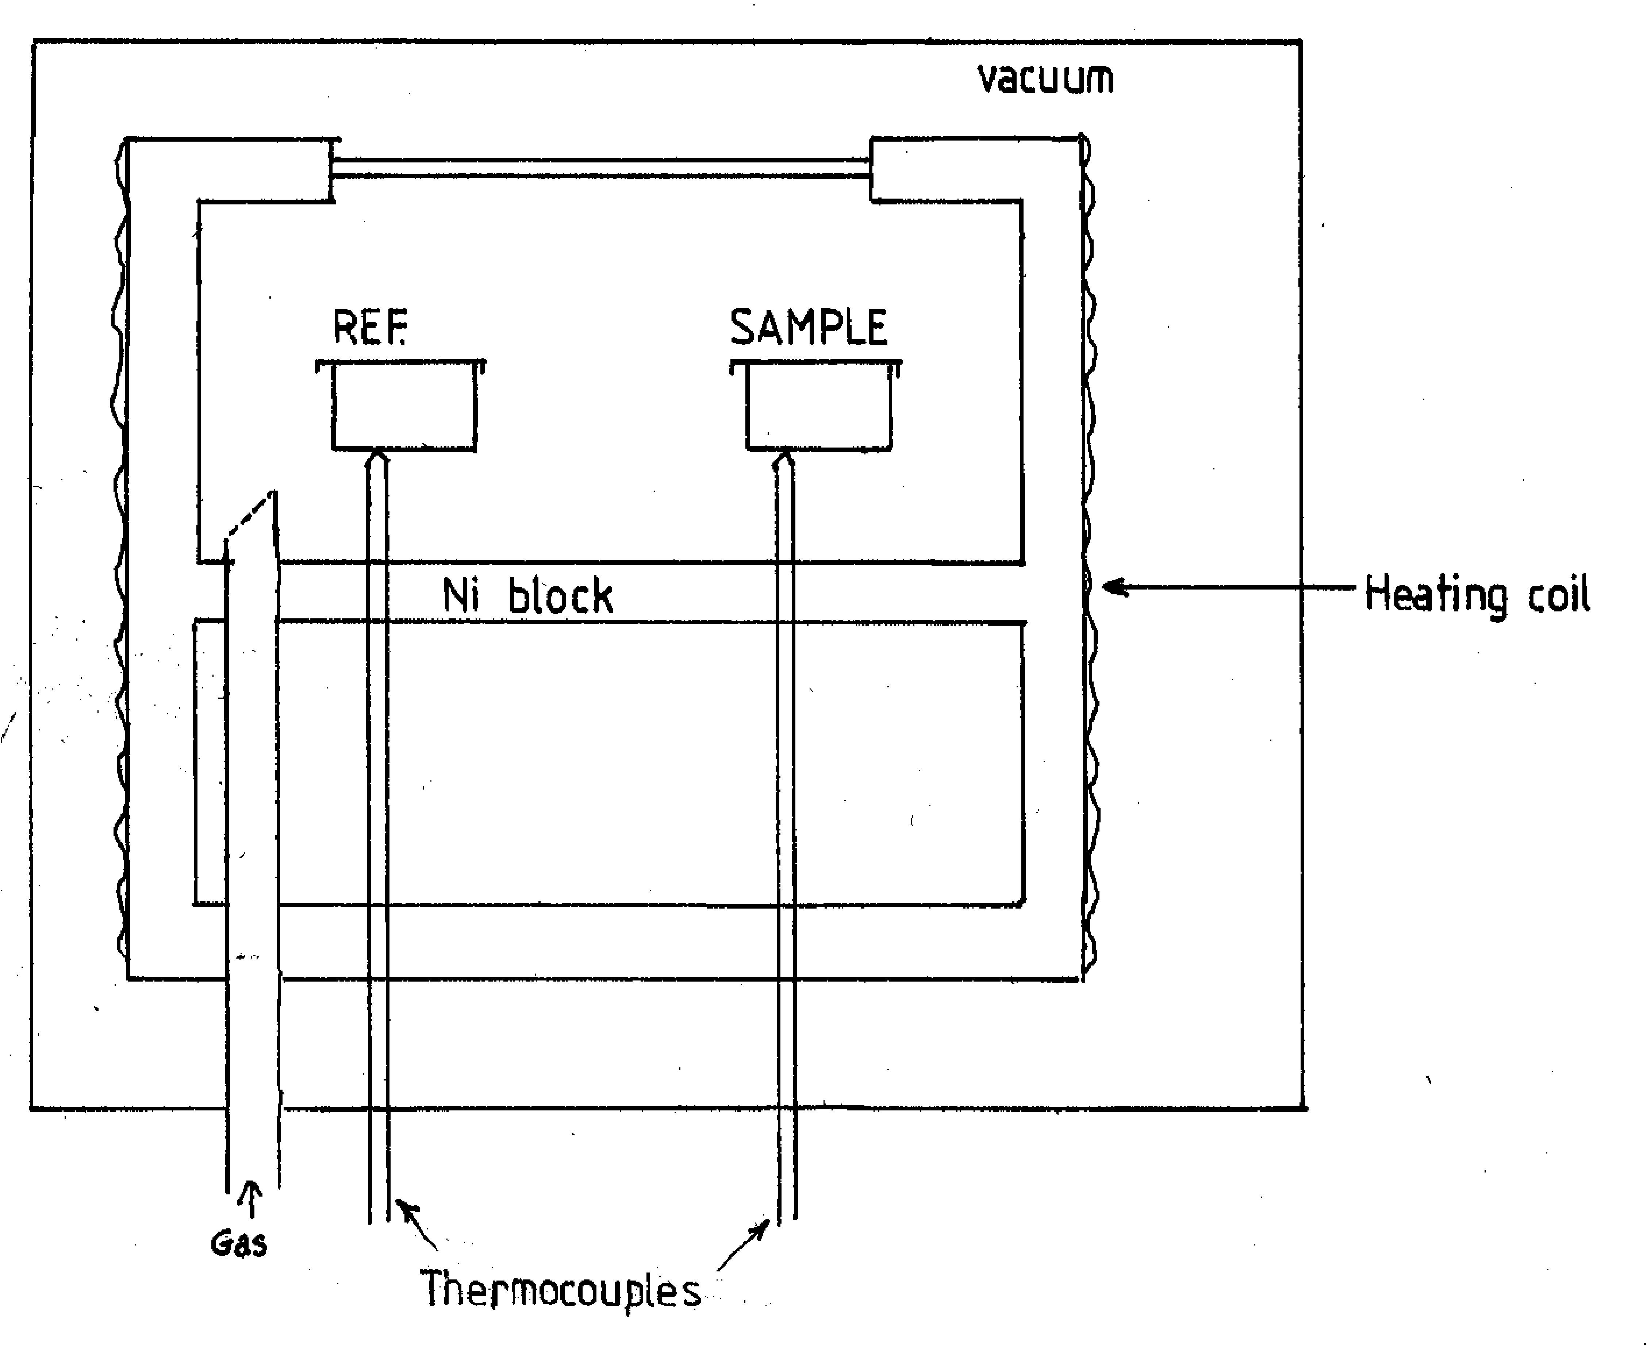

Slide 7
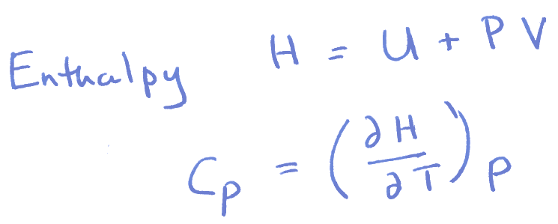
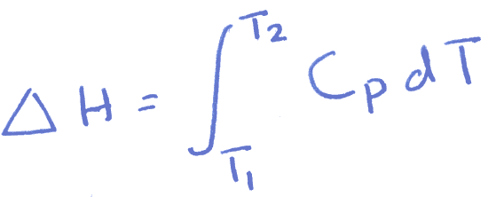
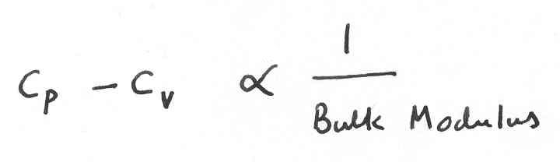

Slide 8
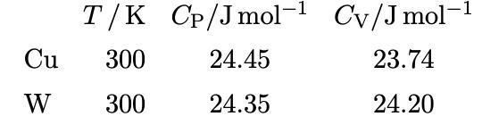
White and Collocot: Journal of Physical and Chemical Reference Data
13 (1984) 1251

Slide 9
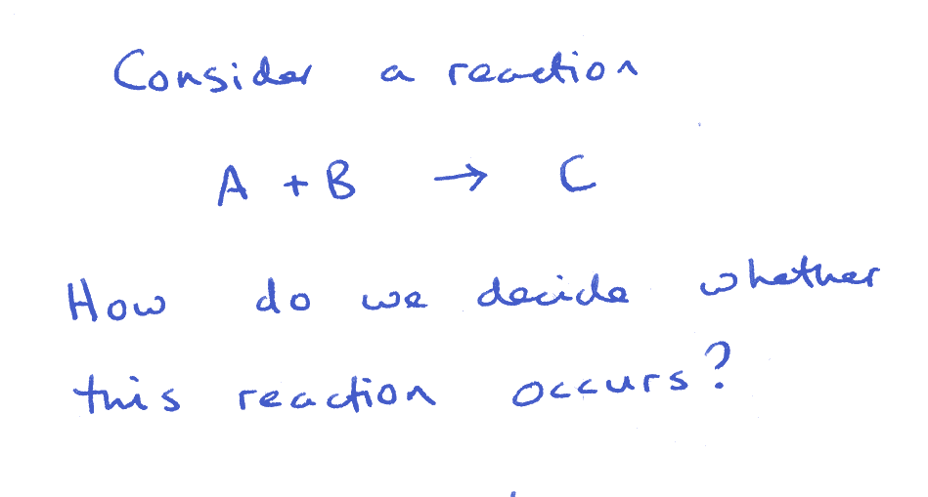

Slide 10
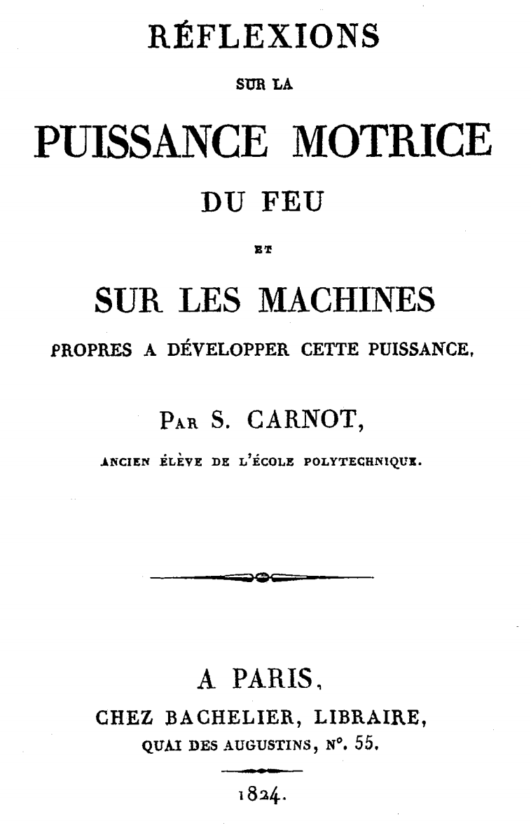
.. to give a direction

Slide 11
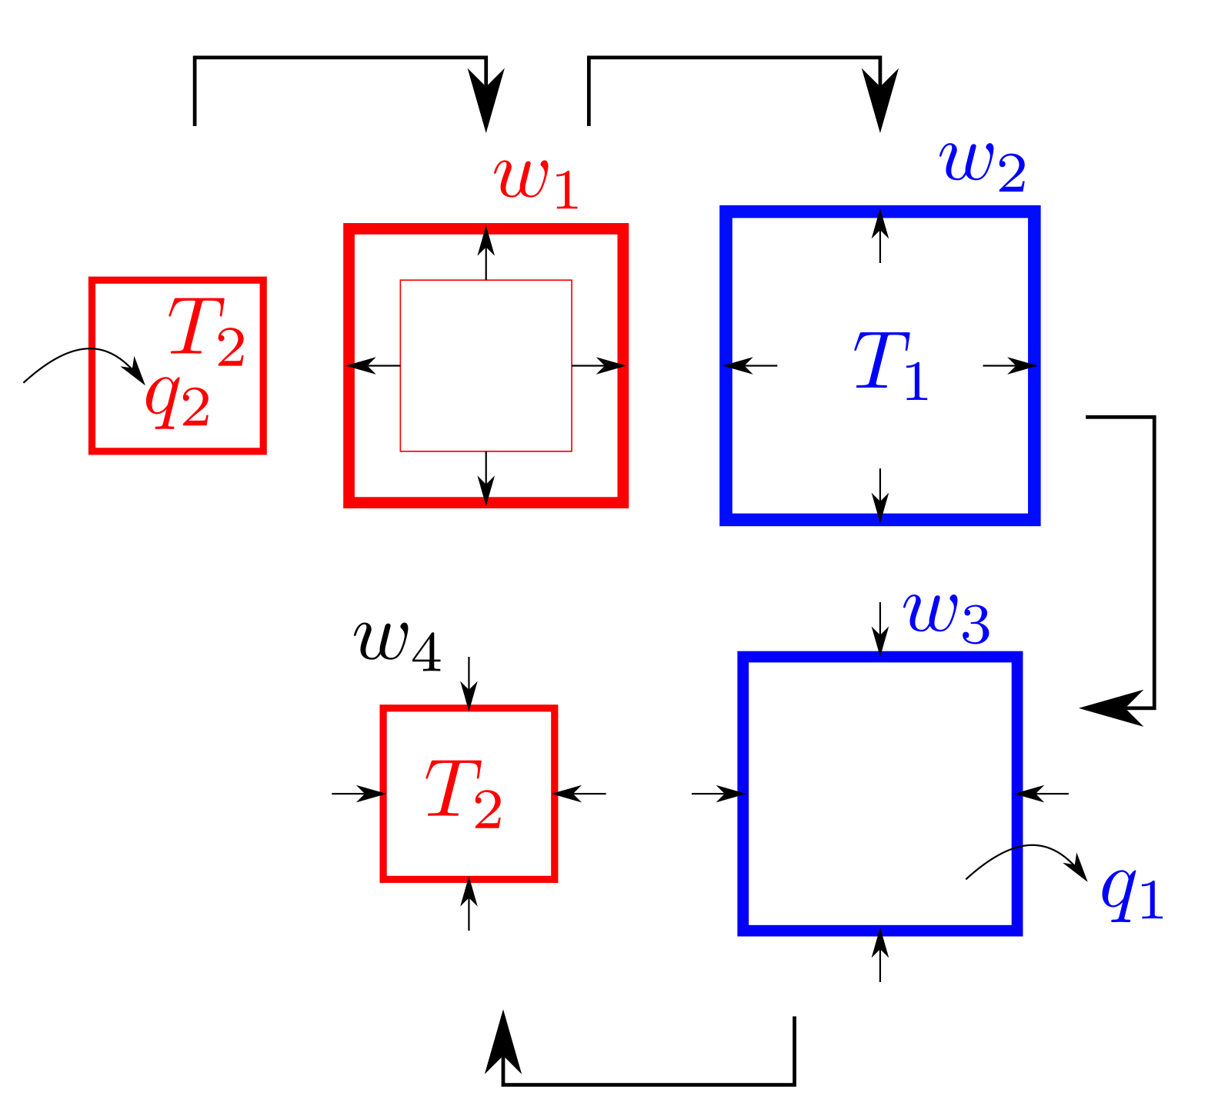

Slide 12
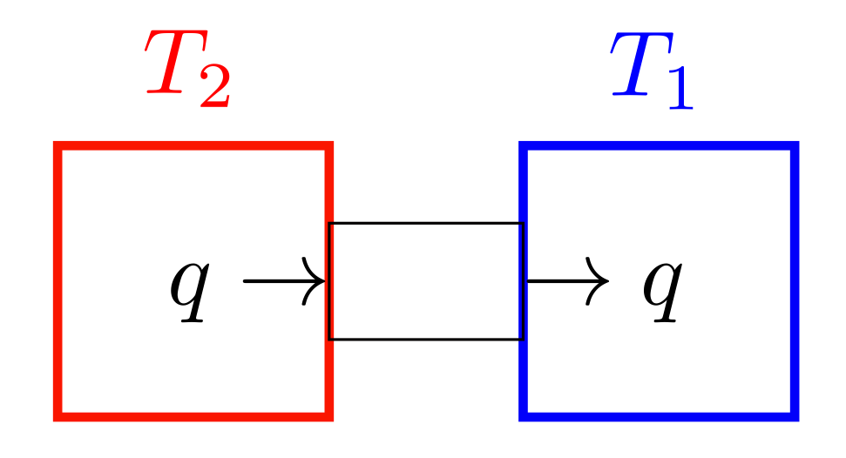

Slide 15
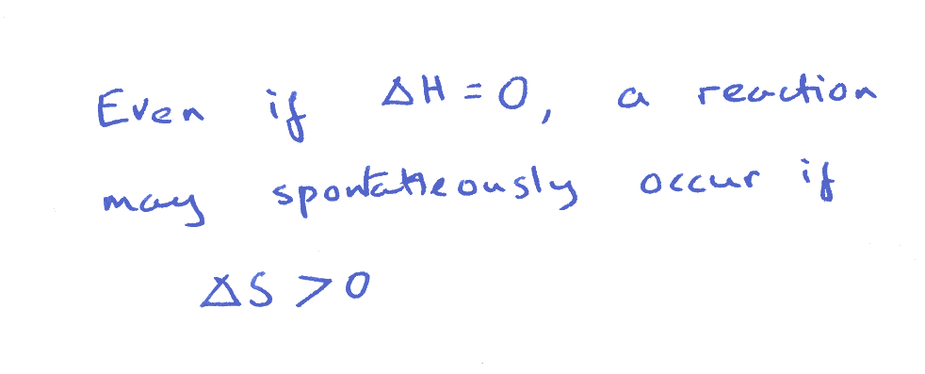

Slide 16
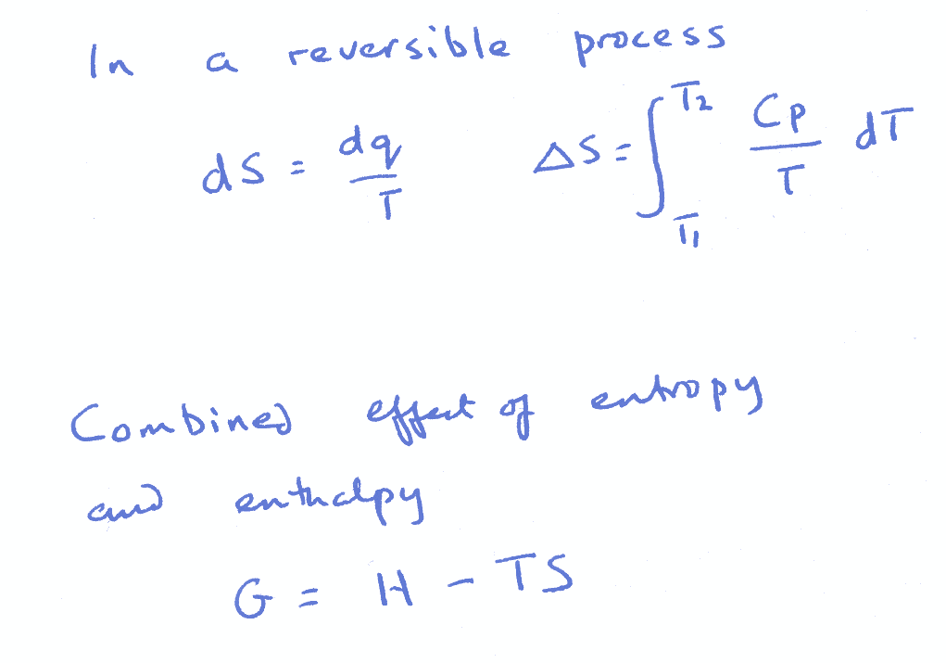

Slide 17
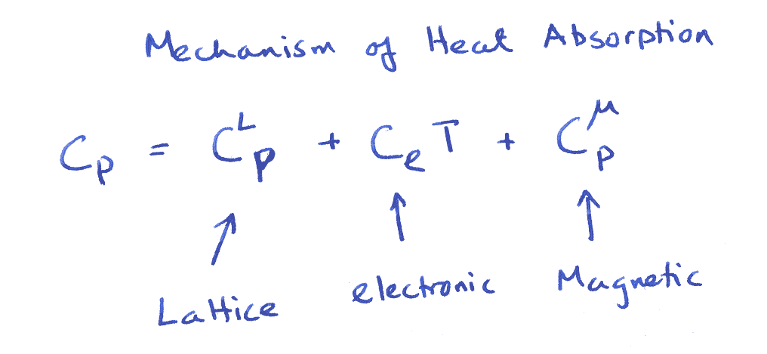
Notes:
there may be other terms in moleculer systems due to rotations etc.

Slide 19
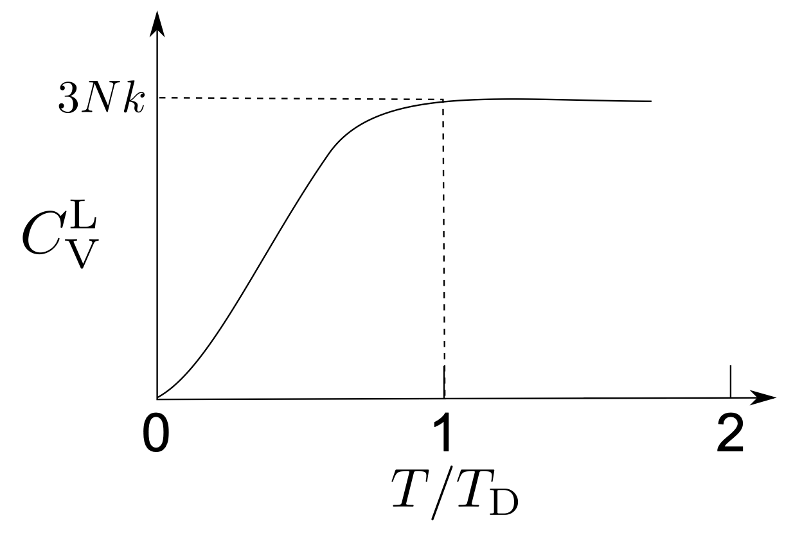
Notes:
for alpha and gamma, Debye temperatures about 400 K

Slide 20
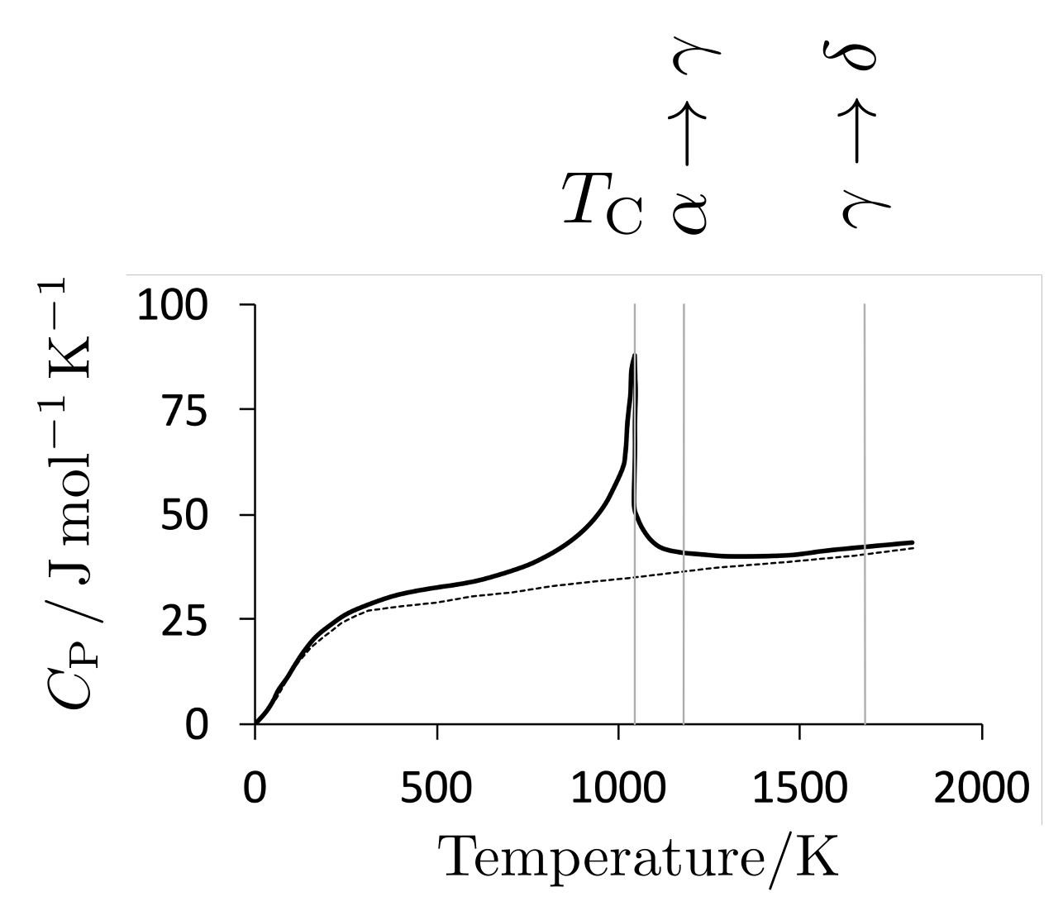
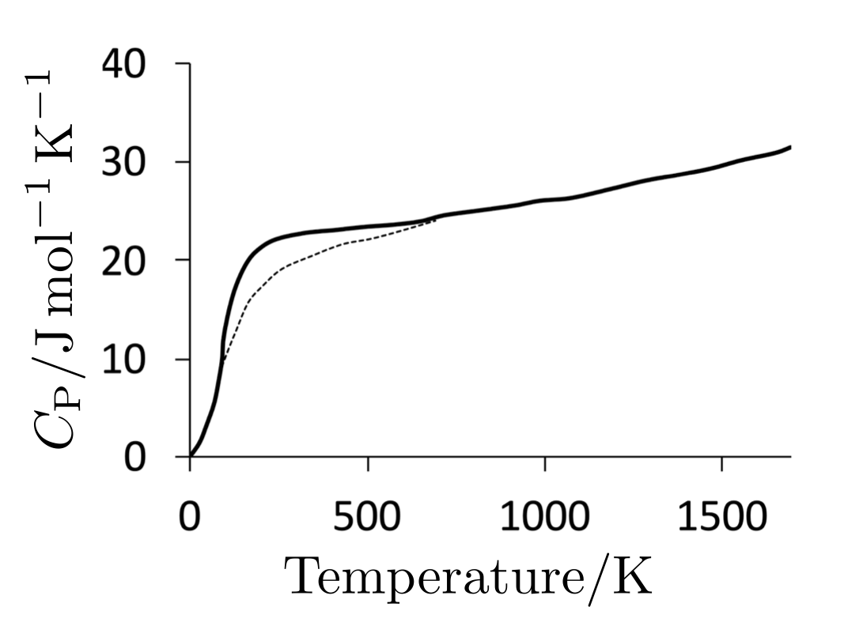

Slide 21
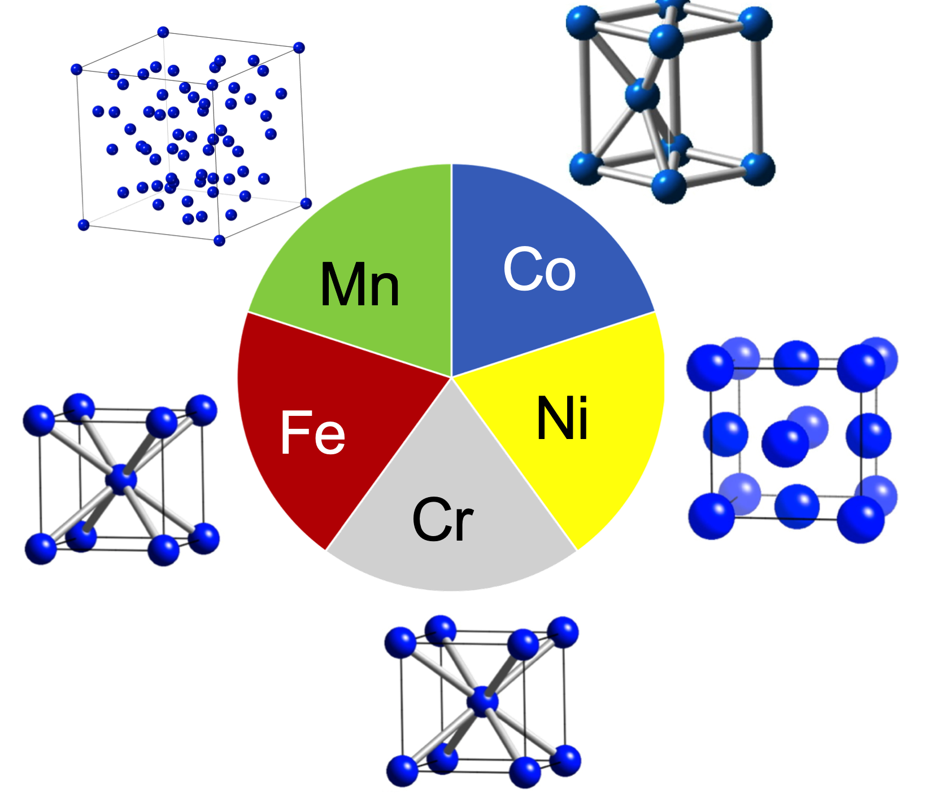
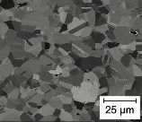
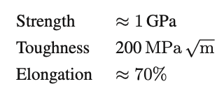
micrograph courtesy of Bernd Gludovatz, Eso George and Robert Ritchie

Slide 23
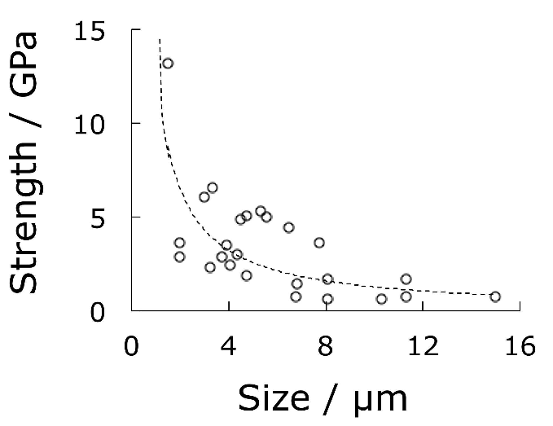
Single crystals of pure iron
Strength and size go together
Brenner:1956

Slide 24
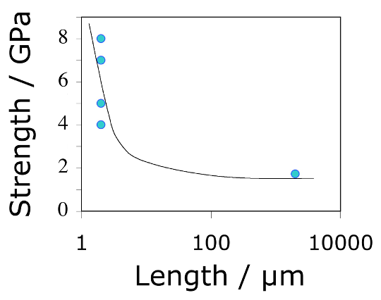
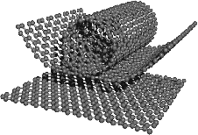
Morinobu Endo, 2004
data from Pan et al. 1999, Yu et al. 2000

Slide 25
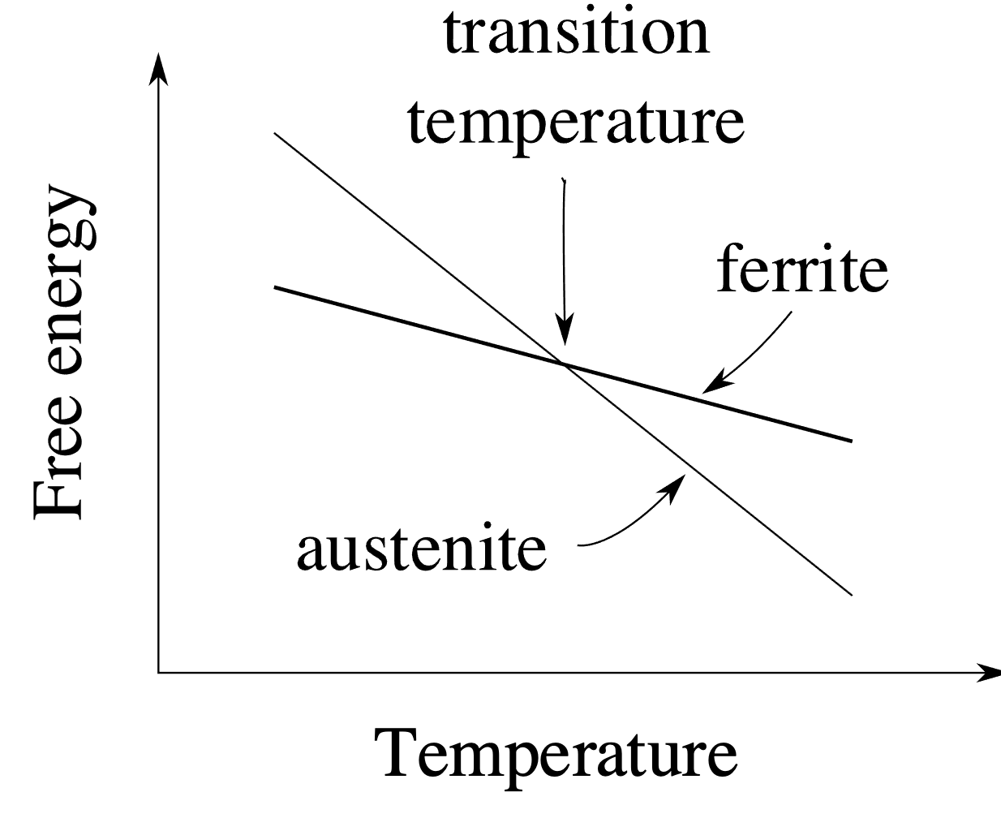
pure iron: allotropic transformation

