Slide 1
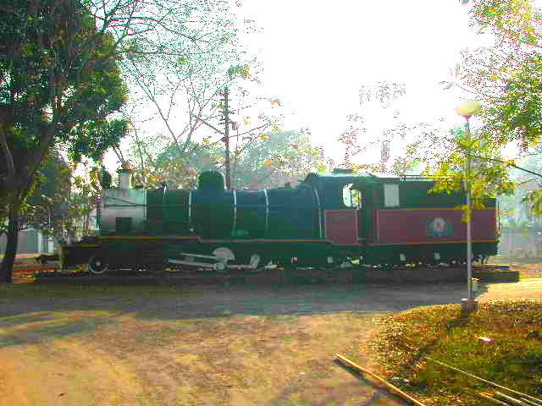

Thermodynamics
Thermodynamic functions
Equilibrium state
Case study: mechanical alloying
Computer calculation: phase diagrams
Thermodynamics - irreversible
Quasichemical models
IIT Kharagpur
https://www.phase-trans.msm.cam.ac.uk/teaching.html
H. K. D. H. Bhadeshia

Slide 2
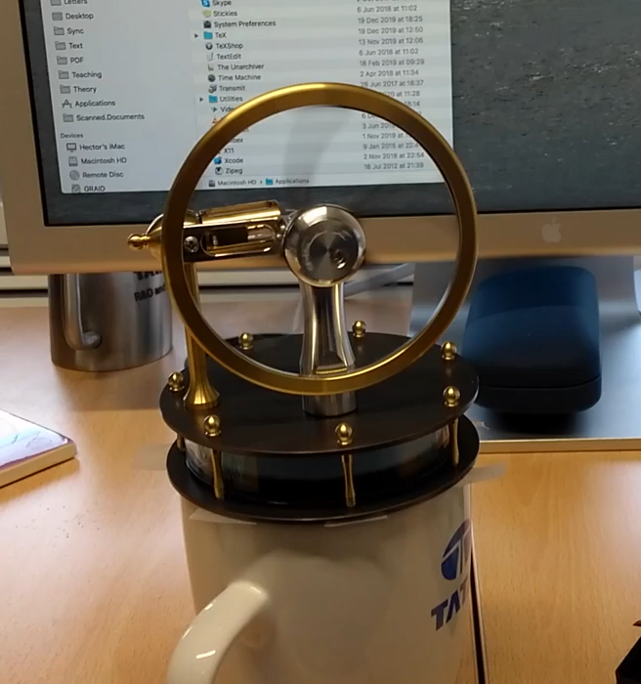
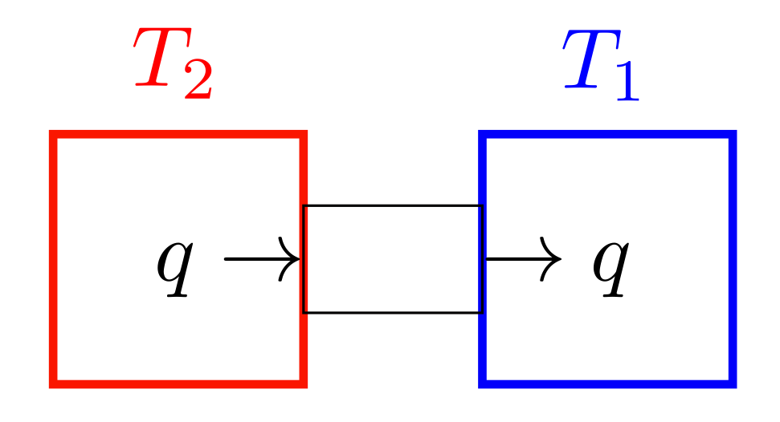

Slide 4
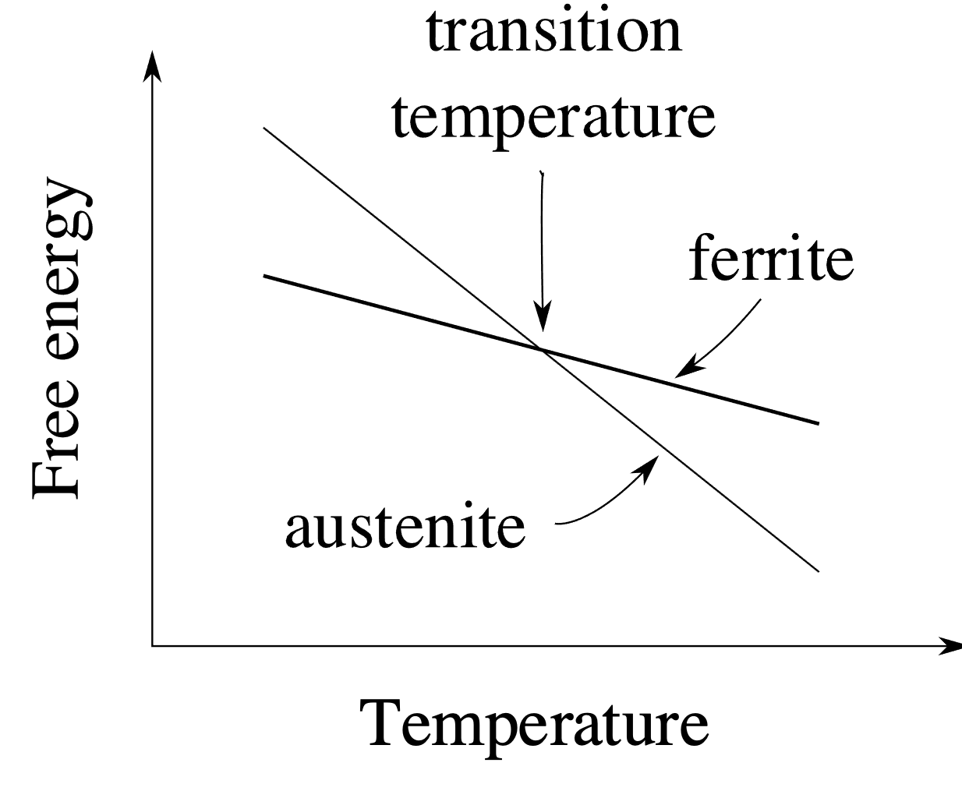
pure iron: allotropic transformation

Slide 5

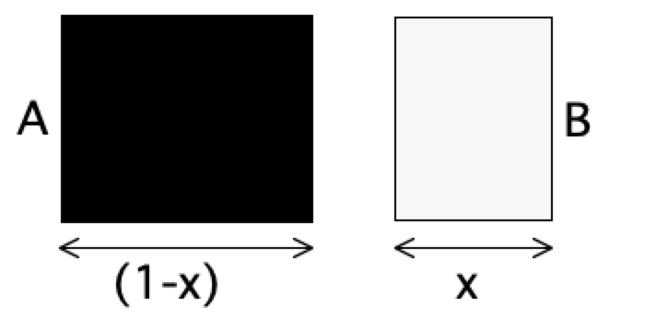
Mechanical Mixture
free energy of
mechanical
μ
o
mixture
B
G*
μ
o
Gibbs free energy per mole
A
x
1-x
A
B
Concentration x of B

Slide 6
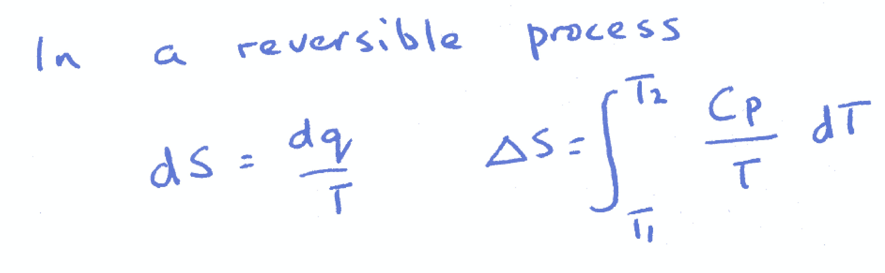
entropy is a capacity property, like mass, energy etc. Different entropies can be added: S₁+S₂=S₃
How does this fit with the probability picture?

Slide 7
Entropy
w=1
P
w=very large
P / 2

Slide 8
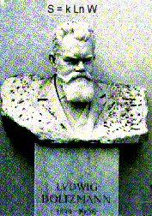
w is not a capacity property of the system.
For example, the chance of throwing two sixes with dice is (1/6)², not 1/6+1/6.
Boltzmann realised that we should use ln{w} and not w to measure disorder.

Slide 9
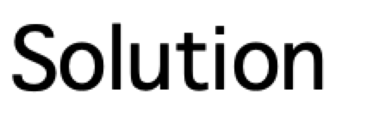
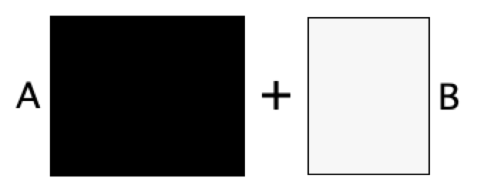


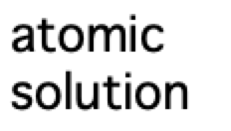
free energy of
mechanical
μ
o
mixture
B
G*
Gibbs free energy per mole
μ
o
A
∆G
M
G{x}
free energy
of solution
A
B
x
Composition

Slide 10
Binary solution

Slide 11
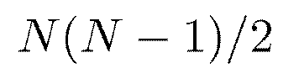
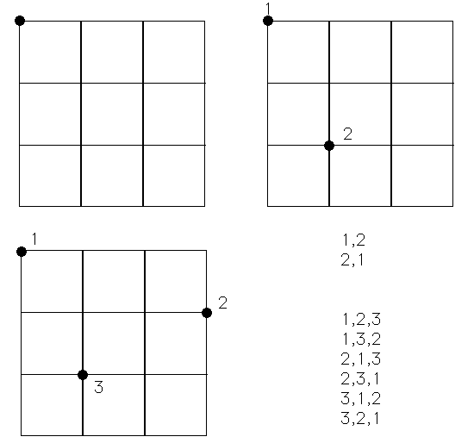


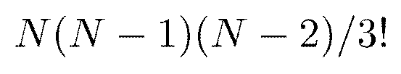

Slide 12
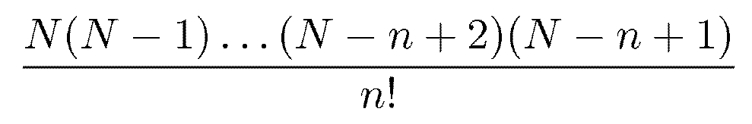
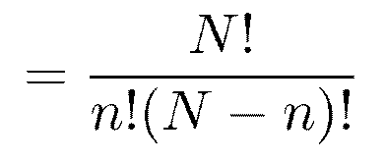

Slide 16
A-A
B-B
A-B, B-A

Slide 17
favours ordering
favours clustering

Slide 20
μ
o
B
μ
o
Gibbs free energy per mole
A
μ { }
A
1-x
G{x}
μ { }
B
x
A
B
x
Composition

Slide 22


Slide 23
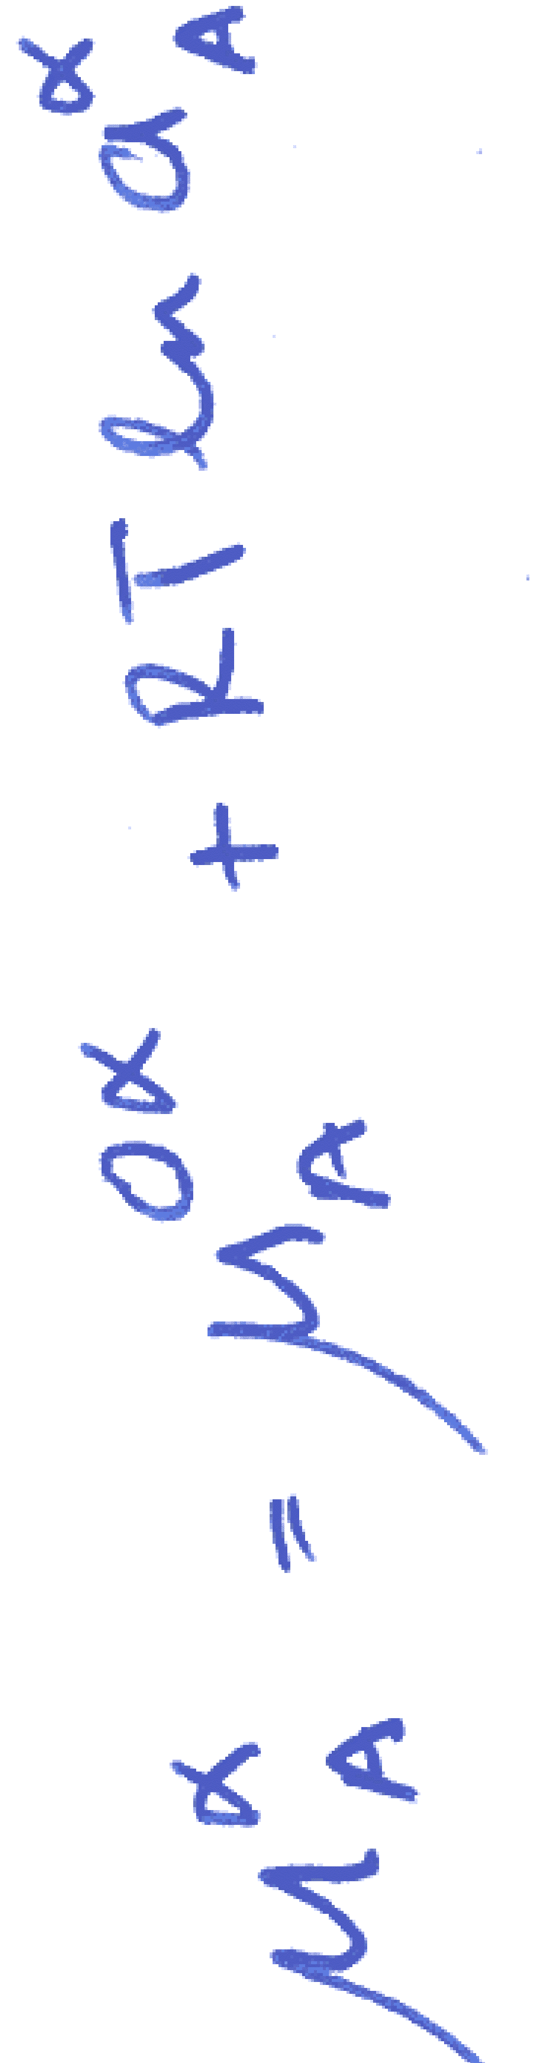
μ
o
B
μ
o
A
Gibbs free energy per mole
μ { }
A
1-x
G{x}
μ { }
B
x
A
B
x
Composition
Notes:
explain origin of RTln a term

Slide 24
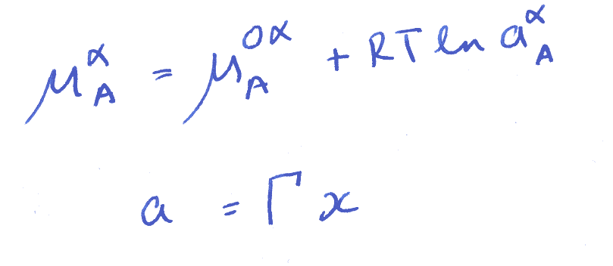

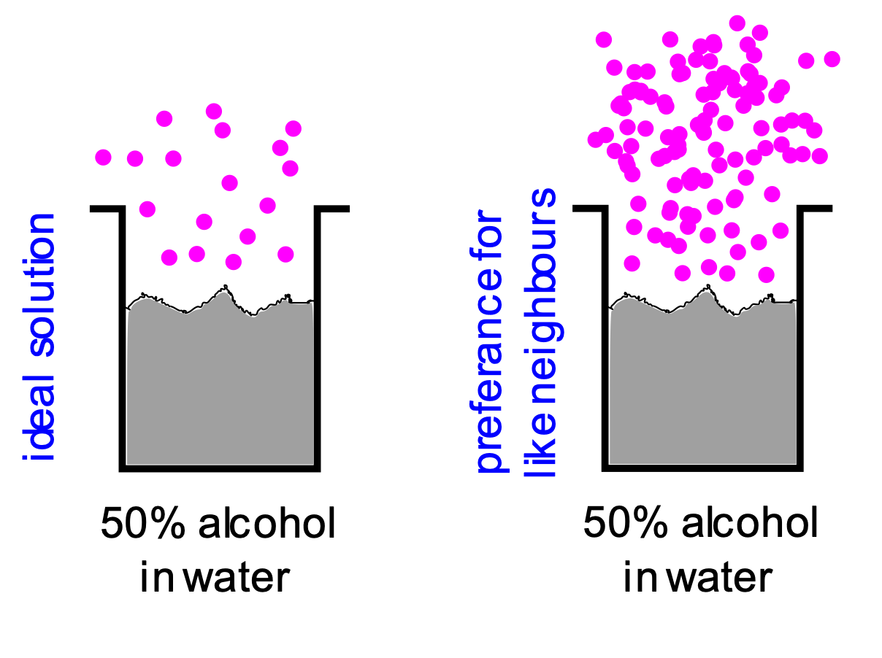
Notes:
Soft-X-Ray Fluorescence Spectroscopy

Slide 25
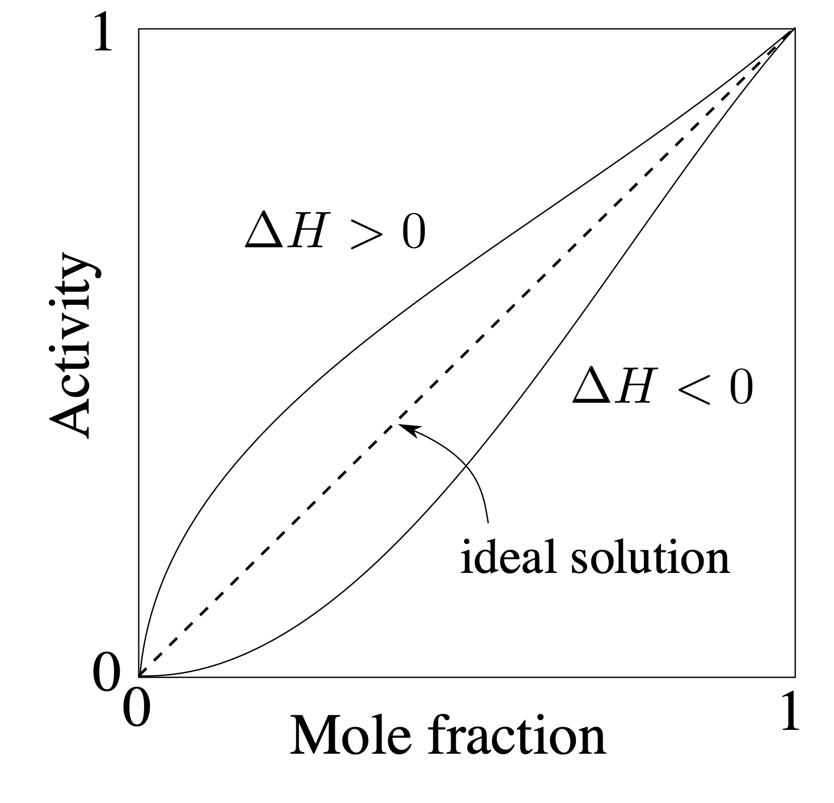

Slide 26
difference in molar volume
MgO-NiO 2.5%
MgO-MnO 17.5%
Kerrick, Darken. Geochimica et Cosmochimica Acta. 39(1975) 1431.

Slide 27
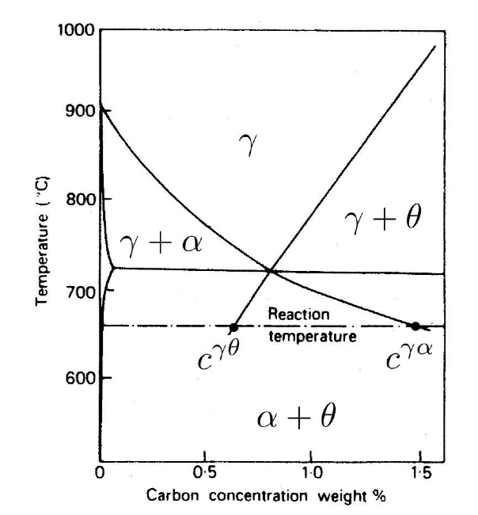
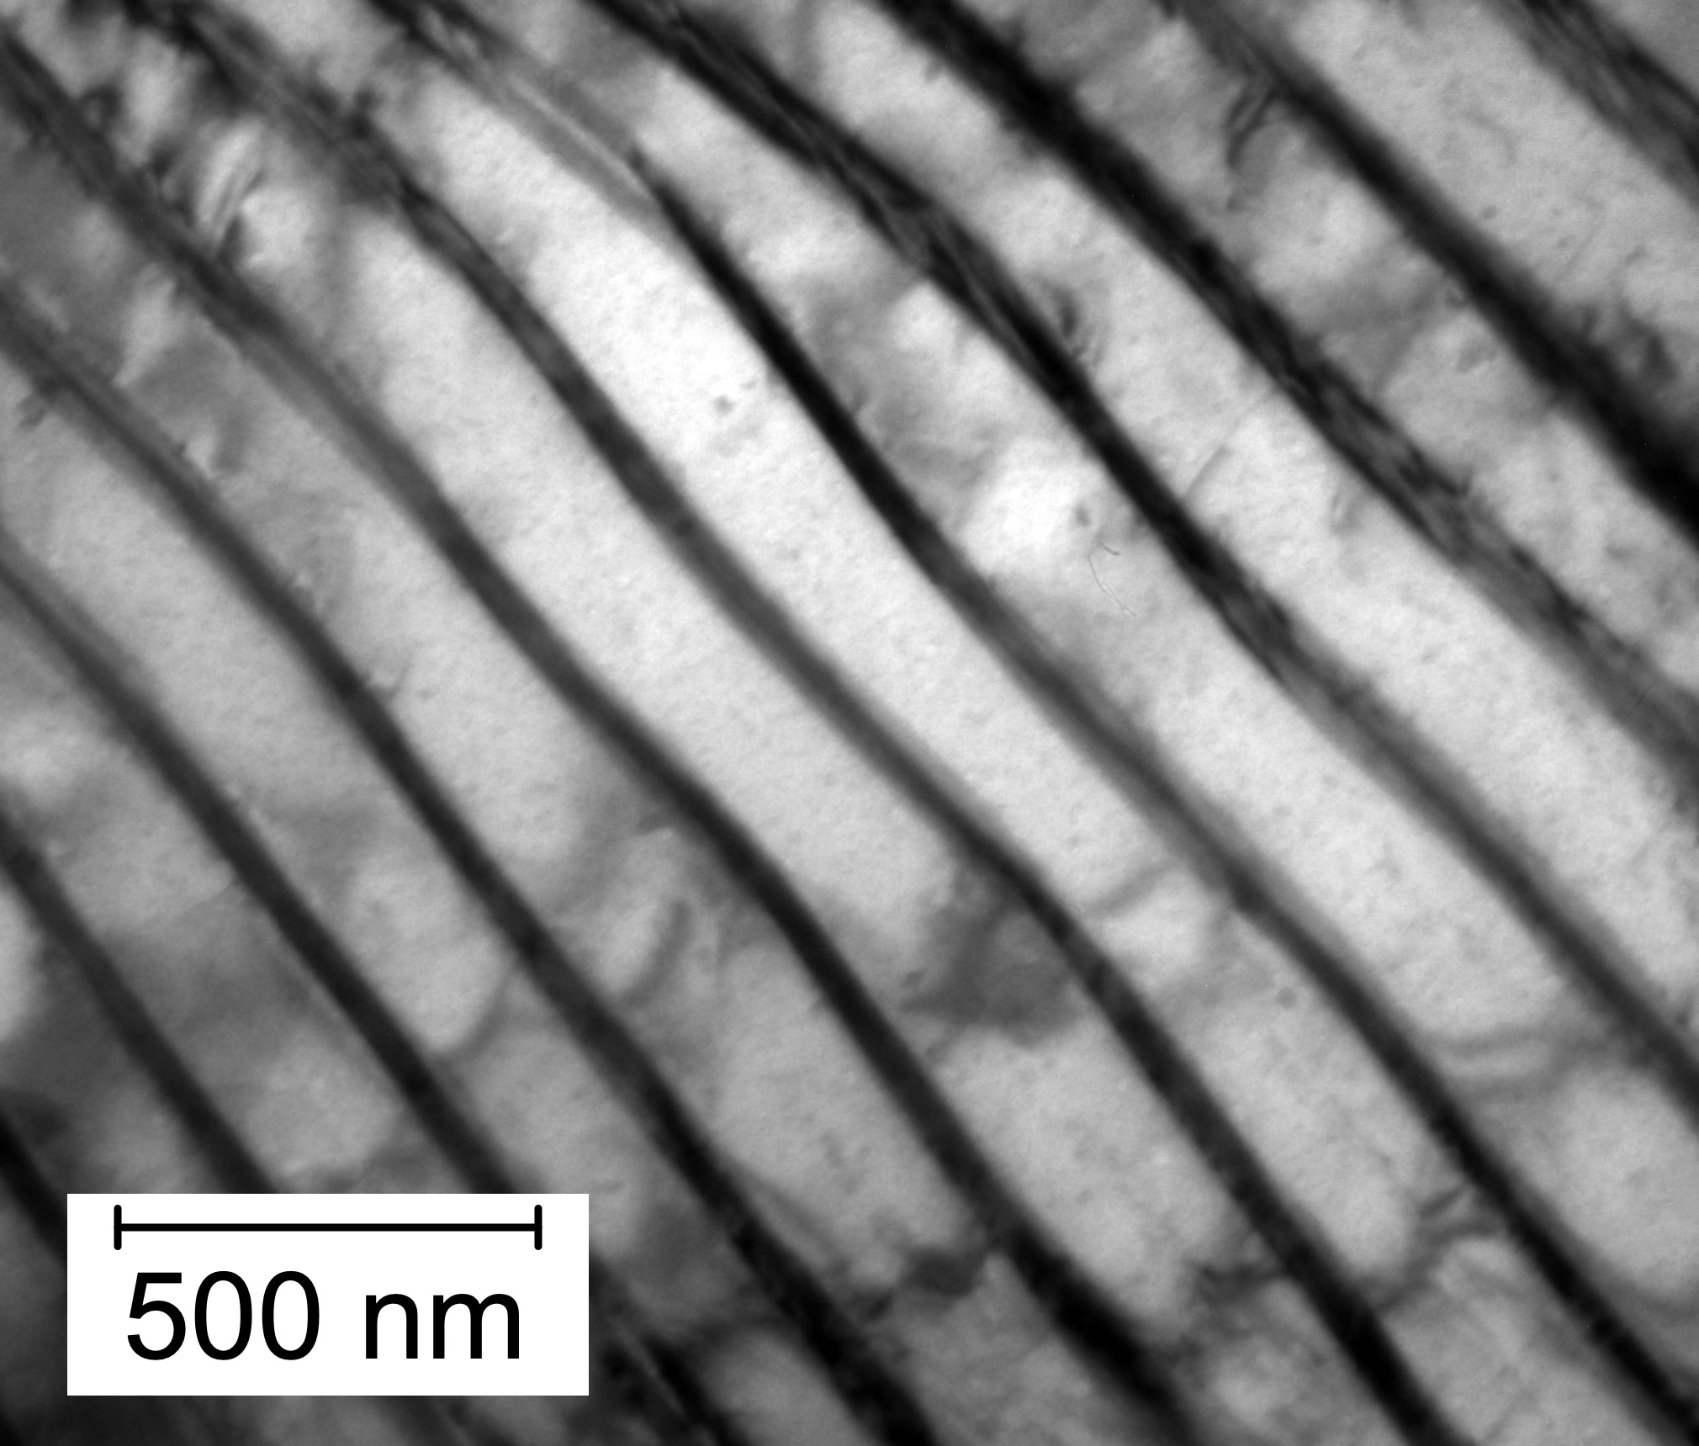
extrapolation of phase boundaries

Slide 29
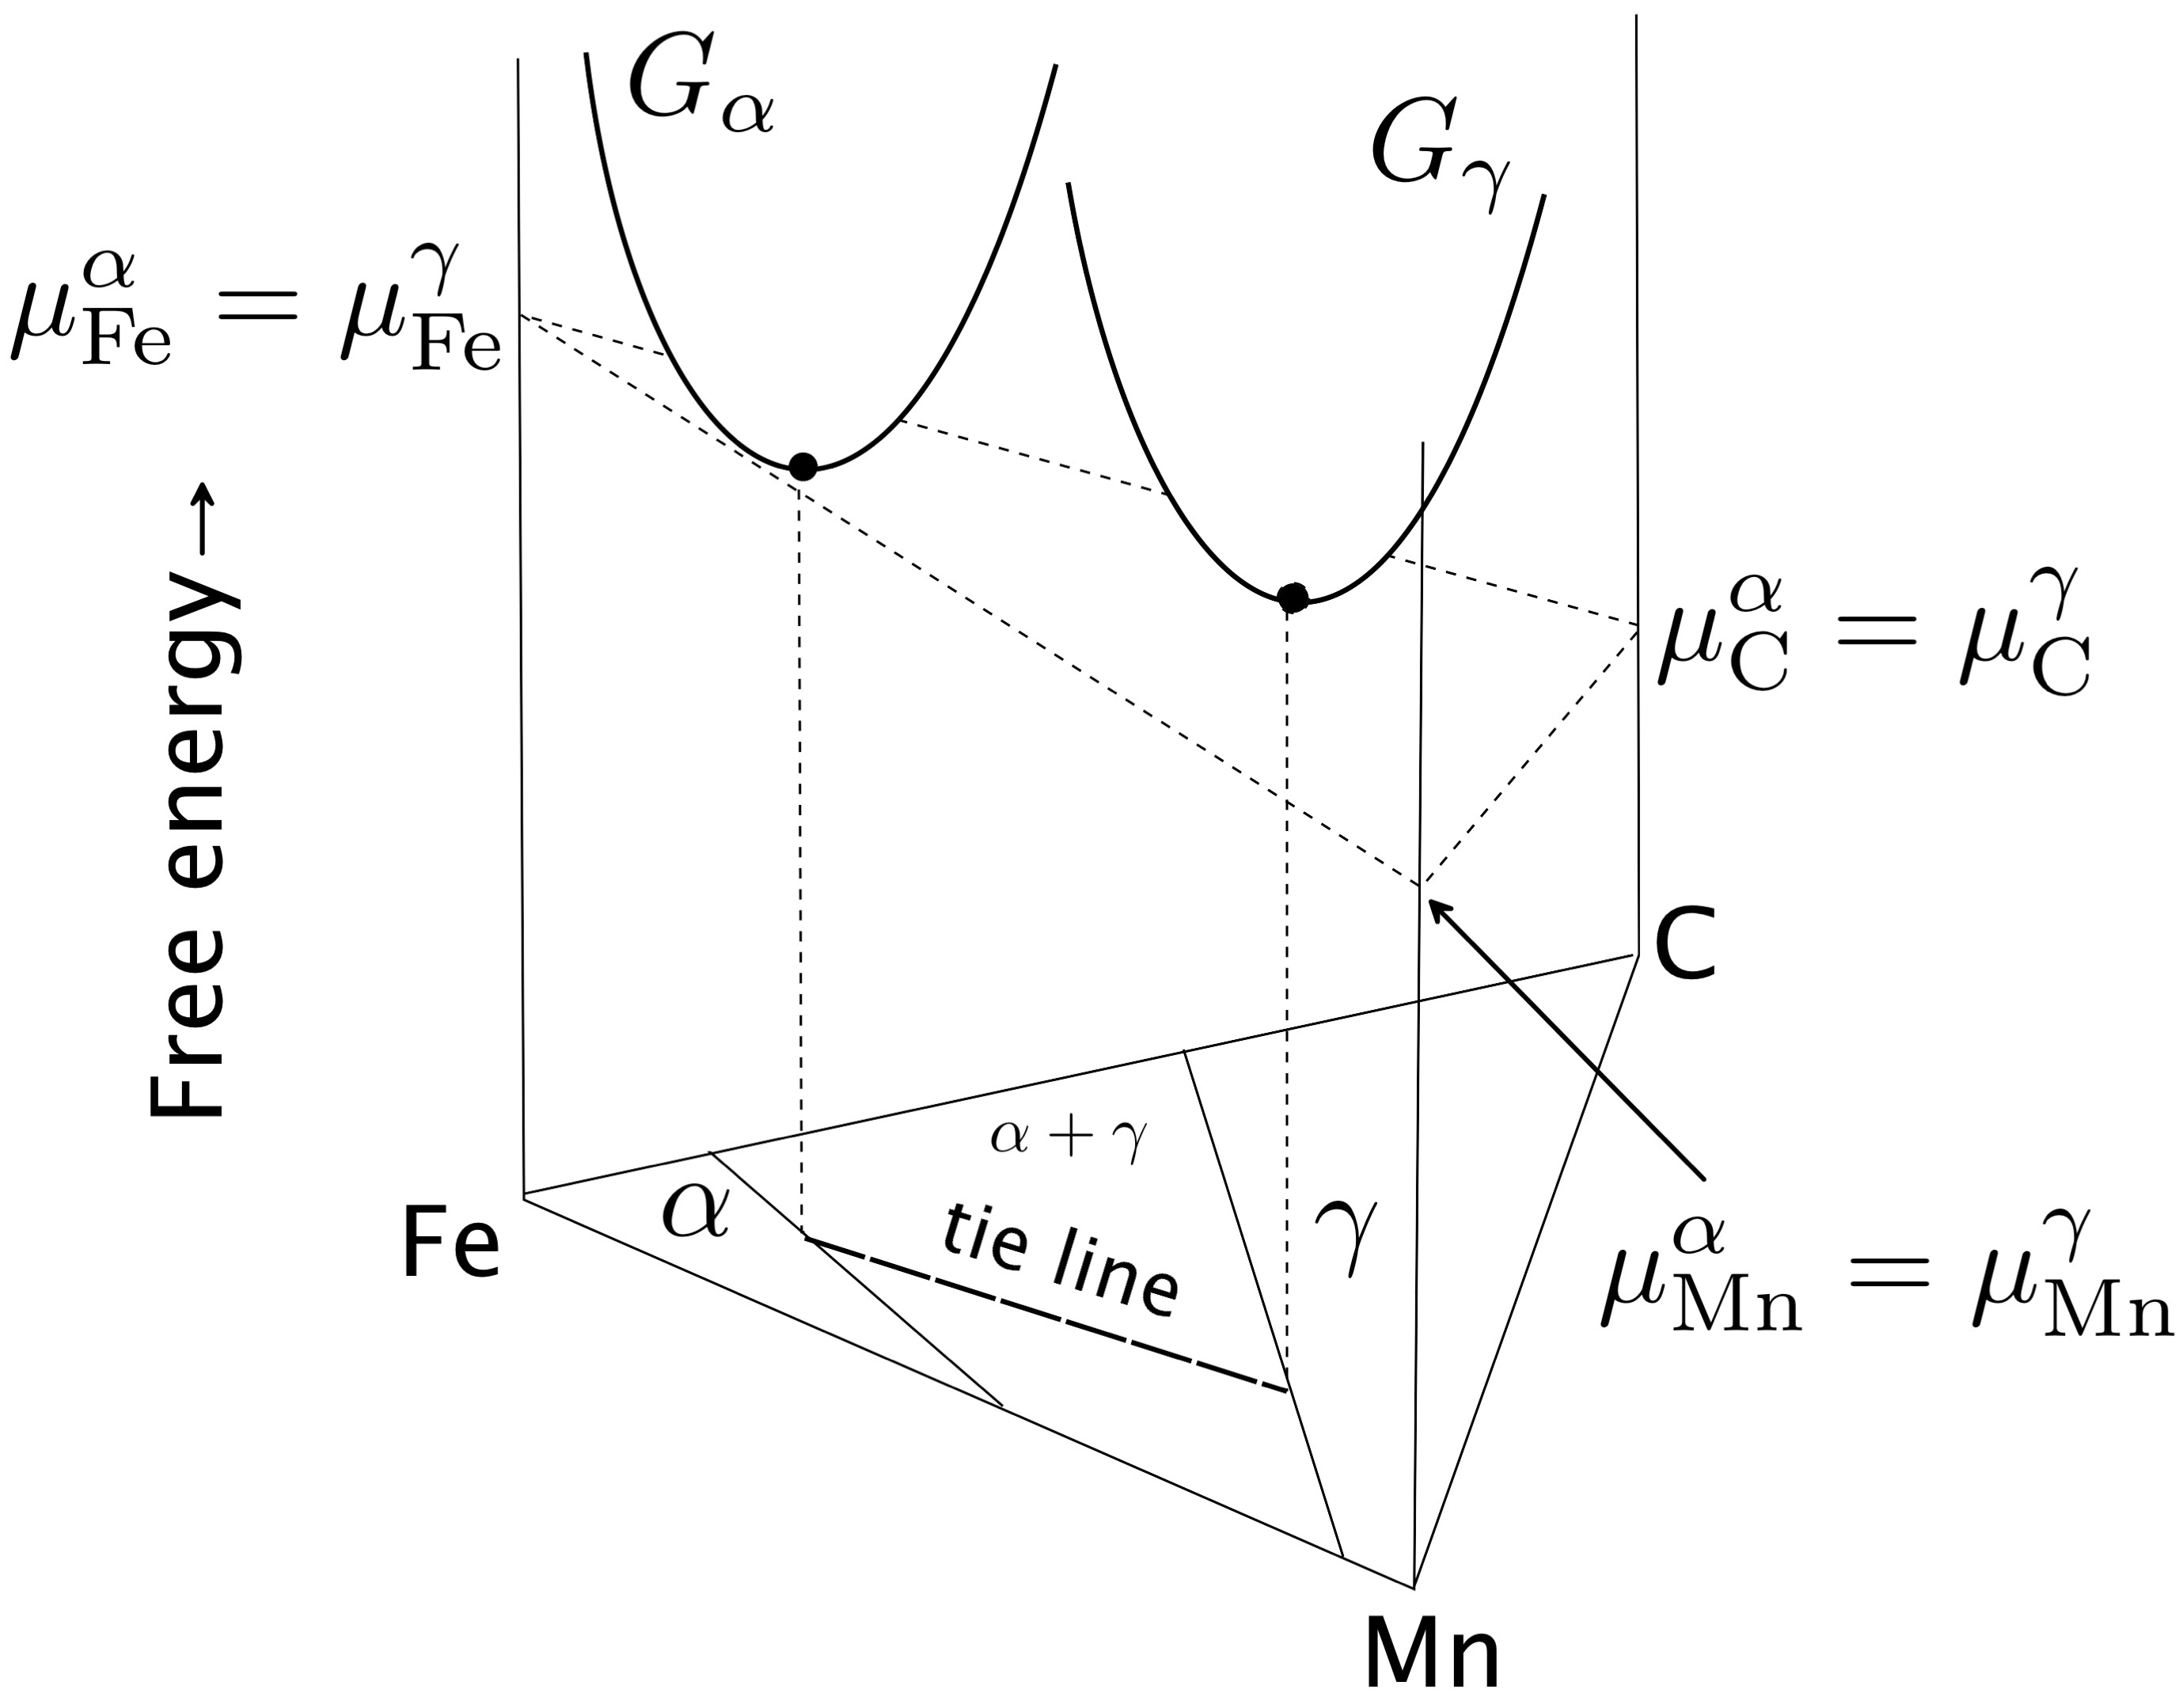

Slide 30
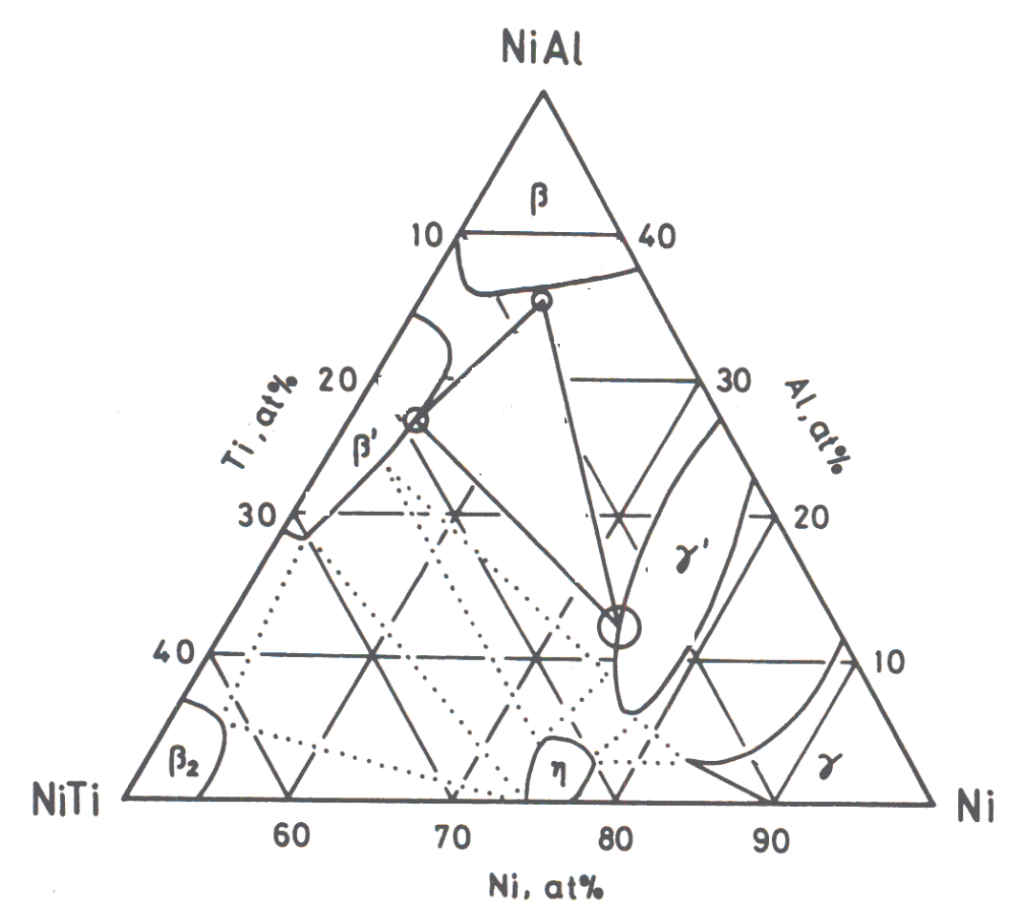
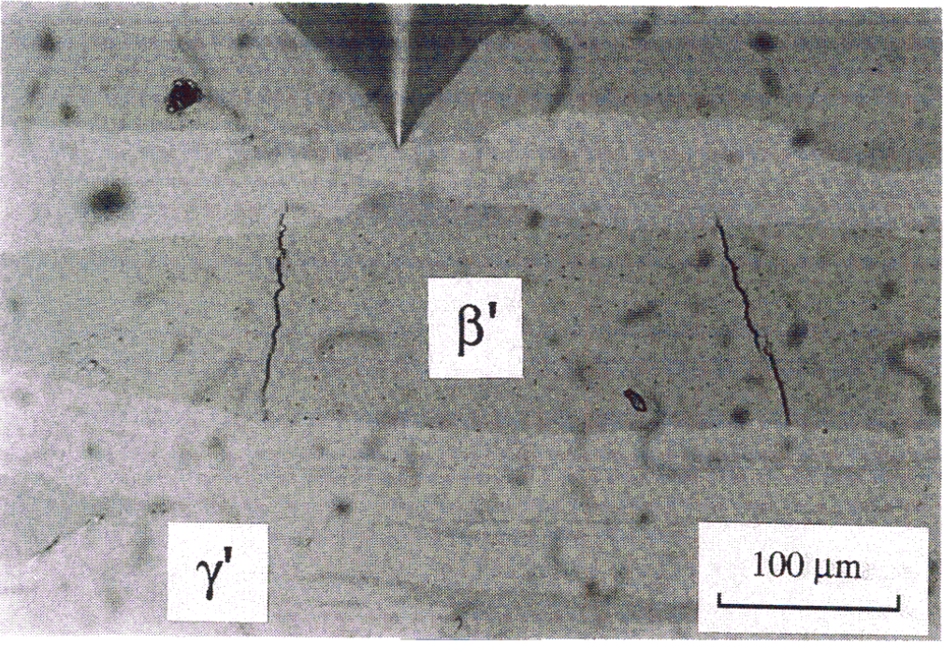
MeMeC: metal-metal-composite
Hsiung, Bhadeshia

