Slide 1


Thermodynamics
Thermodynamic functions
Equilibrium state
Case study: mechanical alloying
Computer calculation: phase diagrams
Thermodynamics - irreversible
Quasichemical models
https://www.phase-trans.msm.cam.ac.uk/teaching.html
H. K. D. H. Bhadeshia

Slide 2
difference in molar volume
MgO-NiO 2.5%
MgO-MnO 17.5%
Kerrick, Darken. Geochimica et Cosmochimica Acta. 39(1975) 1431.

Slide 3
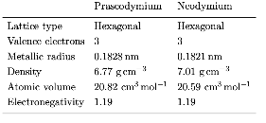
Praseodymium-neodymium solid solutions
Lundin, Pool: J. Less Common Metals 9 (1965) 48-53

Slide 4
Evolution of solutions
solution
compound

Slide 5
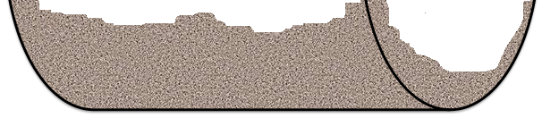
cast-iron
balls
powder
mechanical alloying

Slide 6
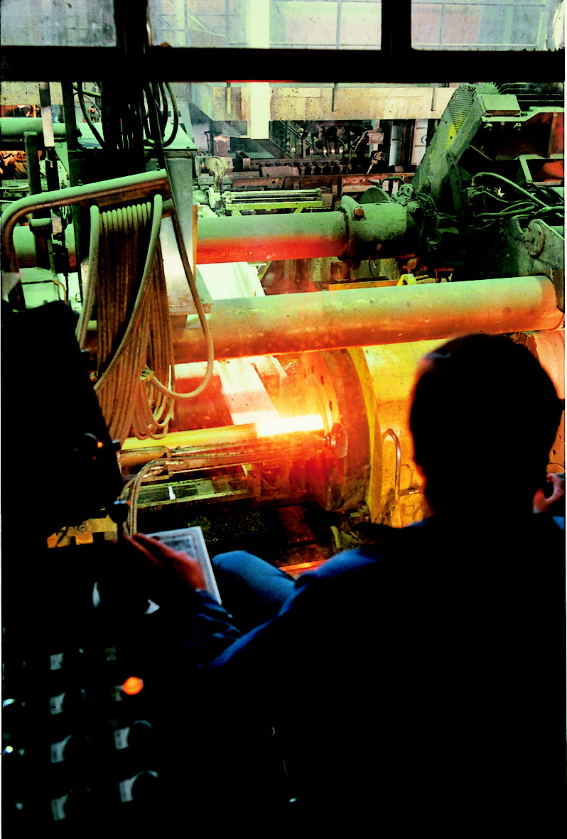
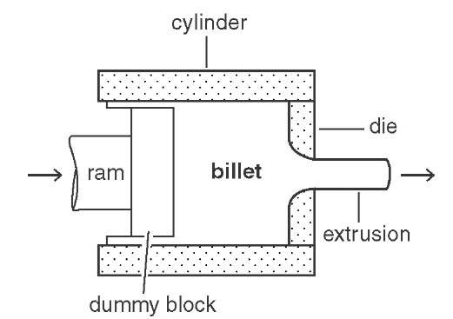
extrusion of canned powder
image courtesy of Jan-Olof Nilsson
Sandvik Materials Technology.
Extrusion of stainless steel.

Slide 7
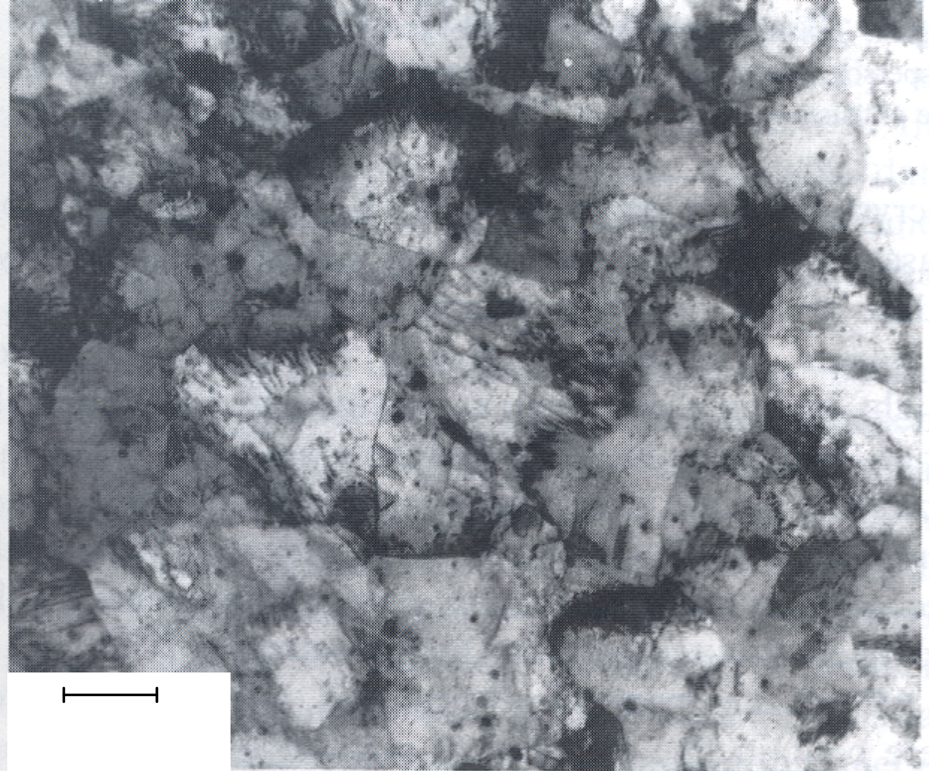
“MA956” Fe-20Cr-4.5Al-0.5Ti-0.5 yttria wt%
large driving force for recrystallisation
200 nm

Slide 8
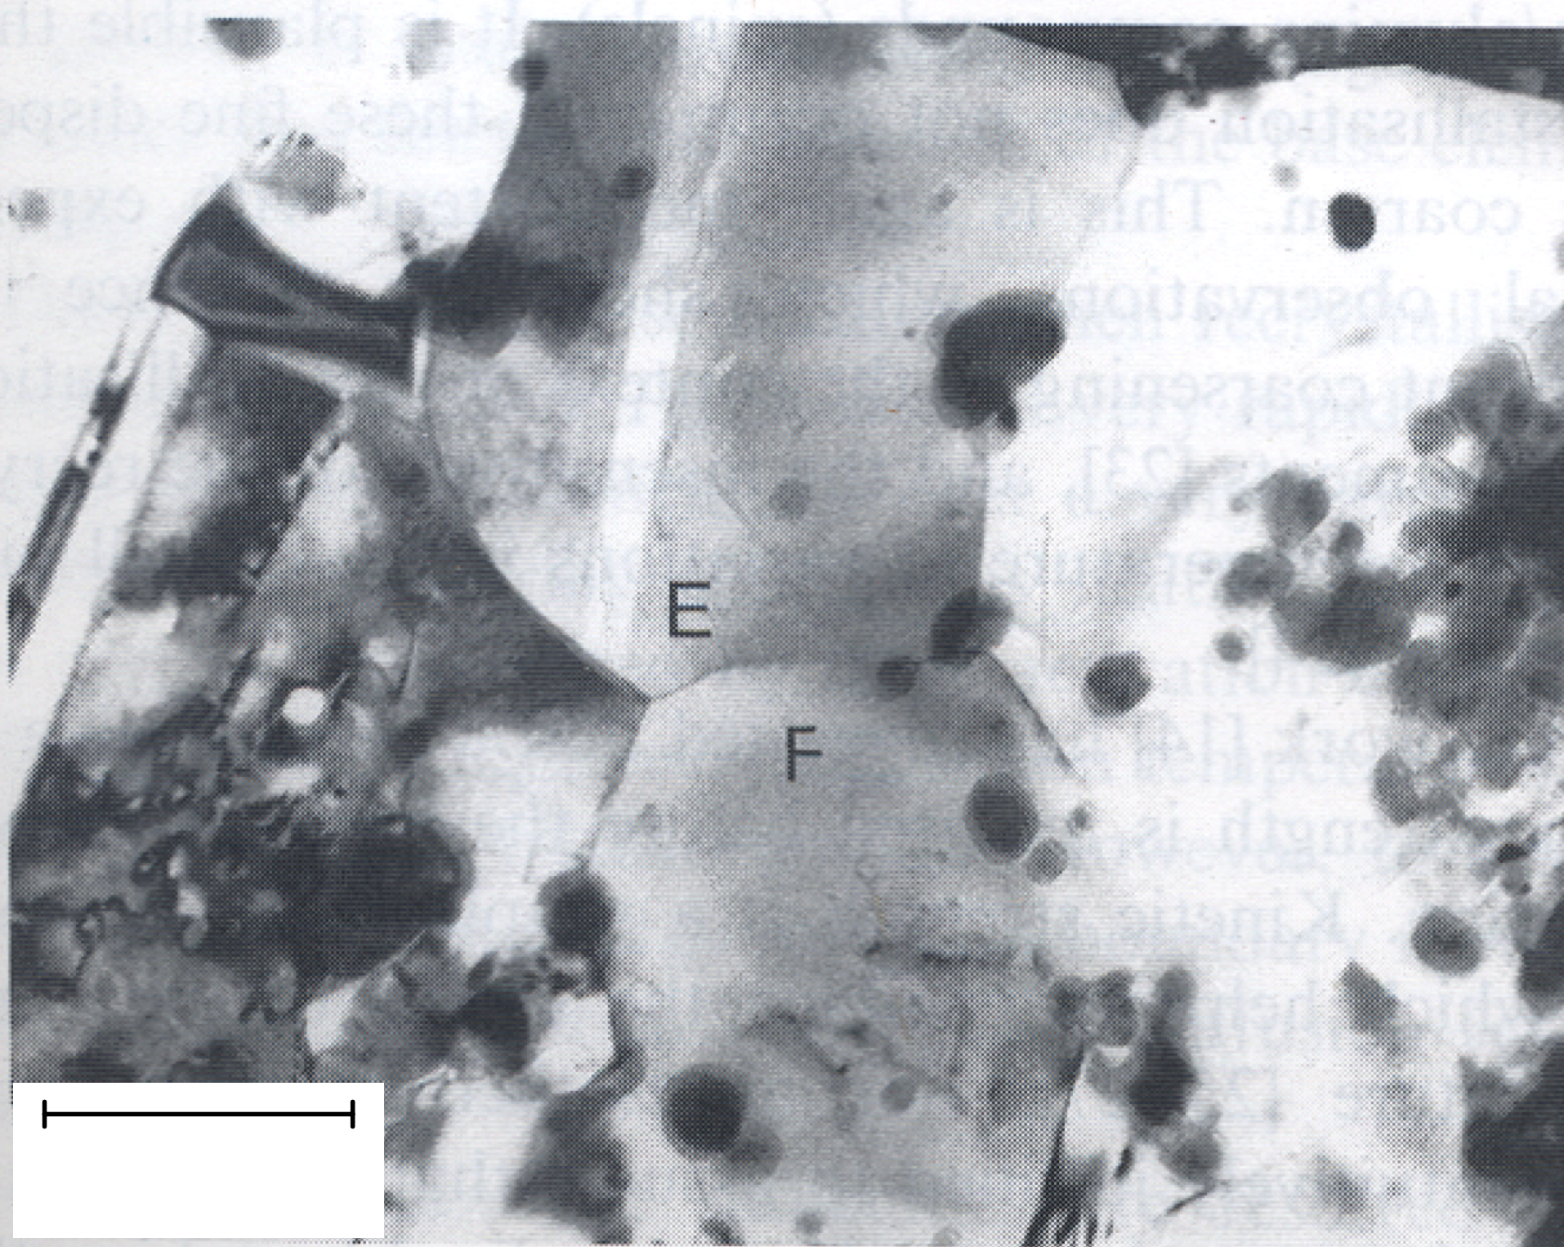
“MA6000”
Ni-15Cr-4.5Al-2.3Ti-4W-1.1 yttria wt%
large driving force for recrystallisation
200 nm

Slide 9
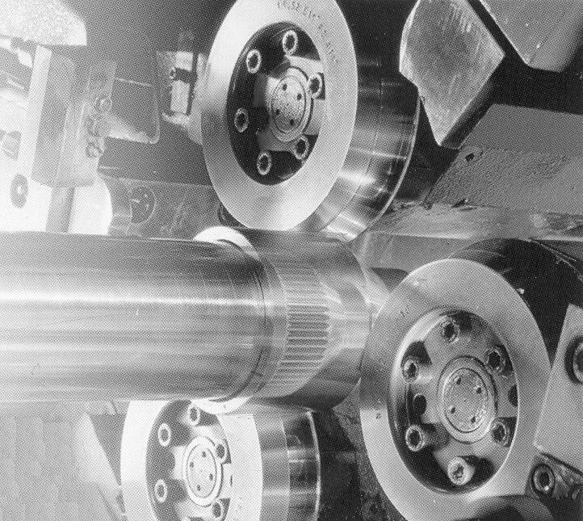

Slide 10
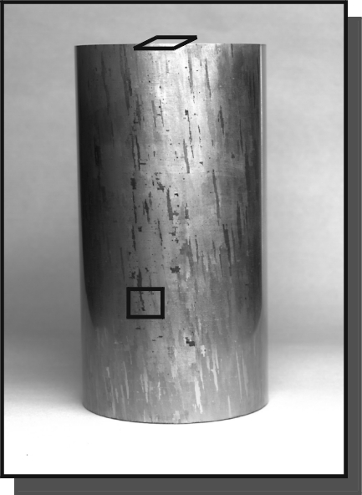
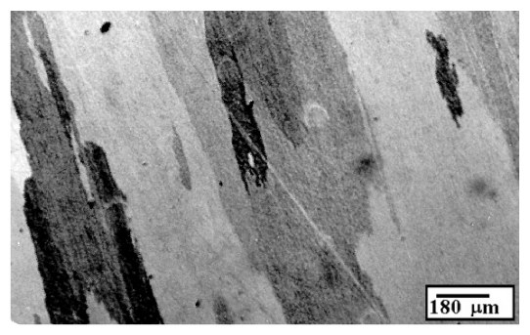
Helical grains

Slide 11
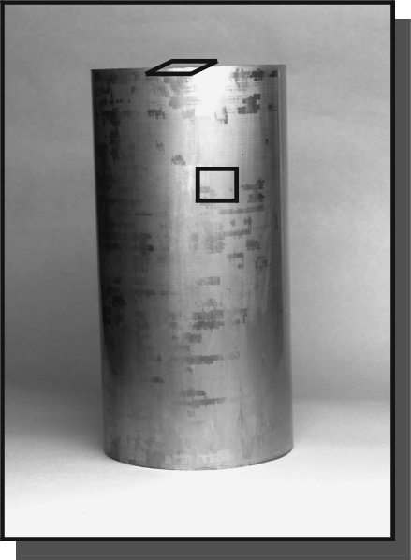
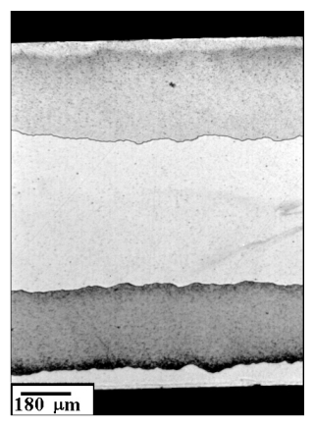

Slide 12
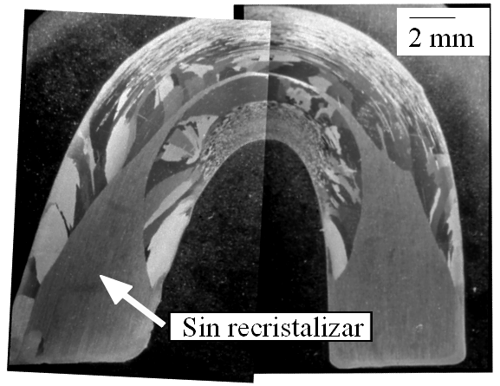
not recrystallised

Slide 13
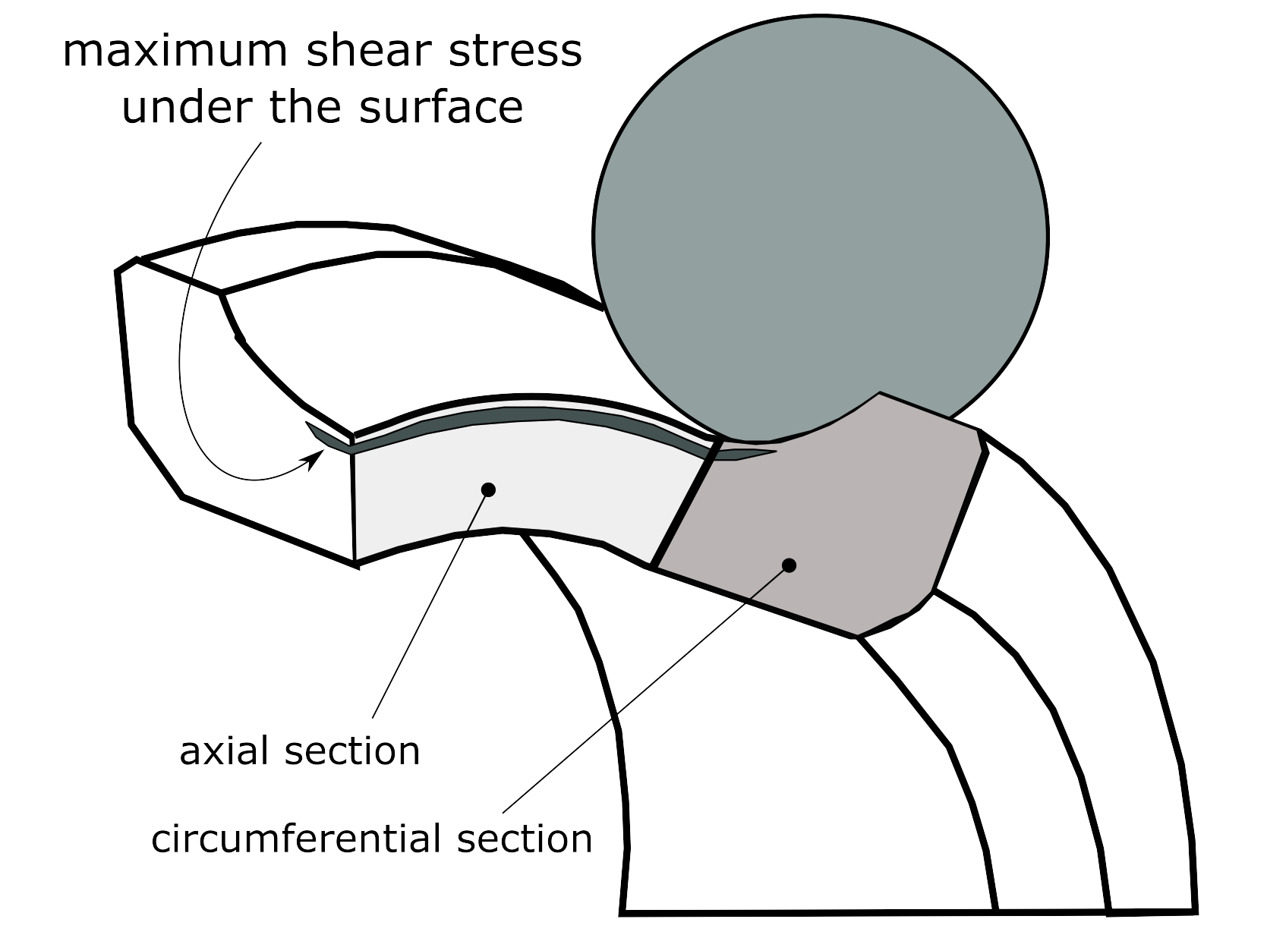
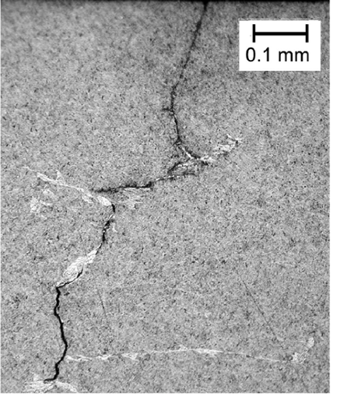
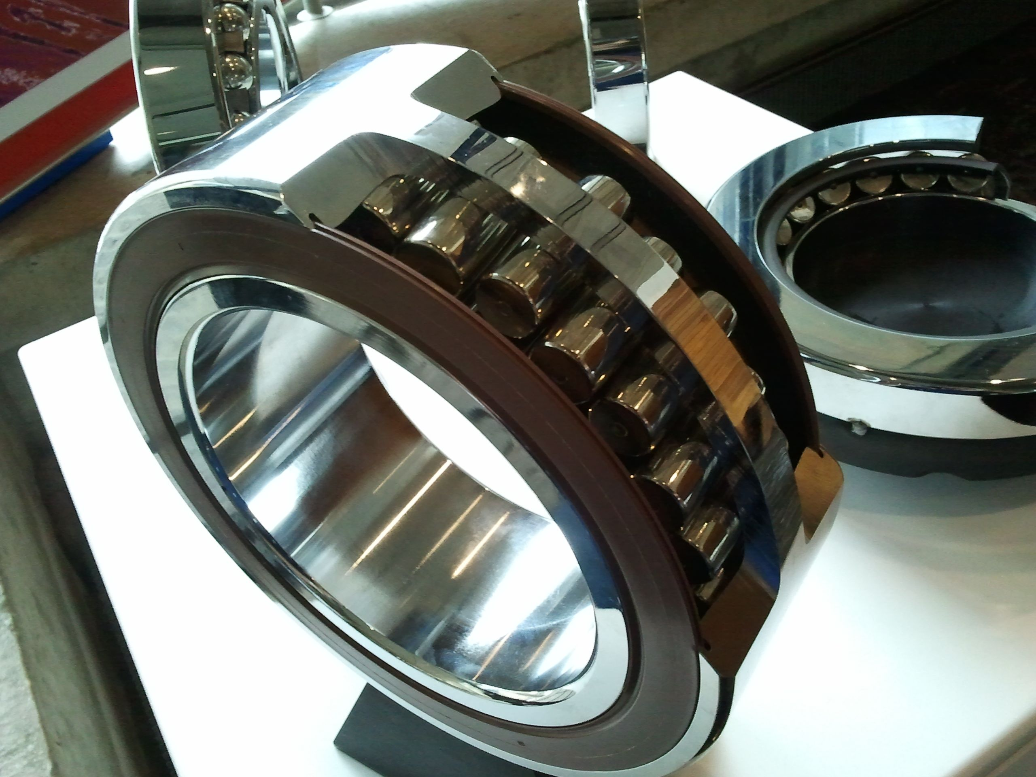
Micrograph courtesy of
R. Errichello, GEARTECH

Slide 14
How do we know that mechanical processing results in a true solution?

Slide 15
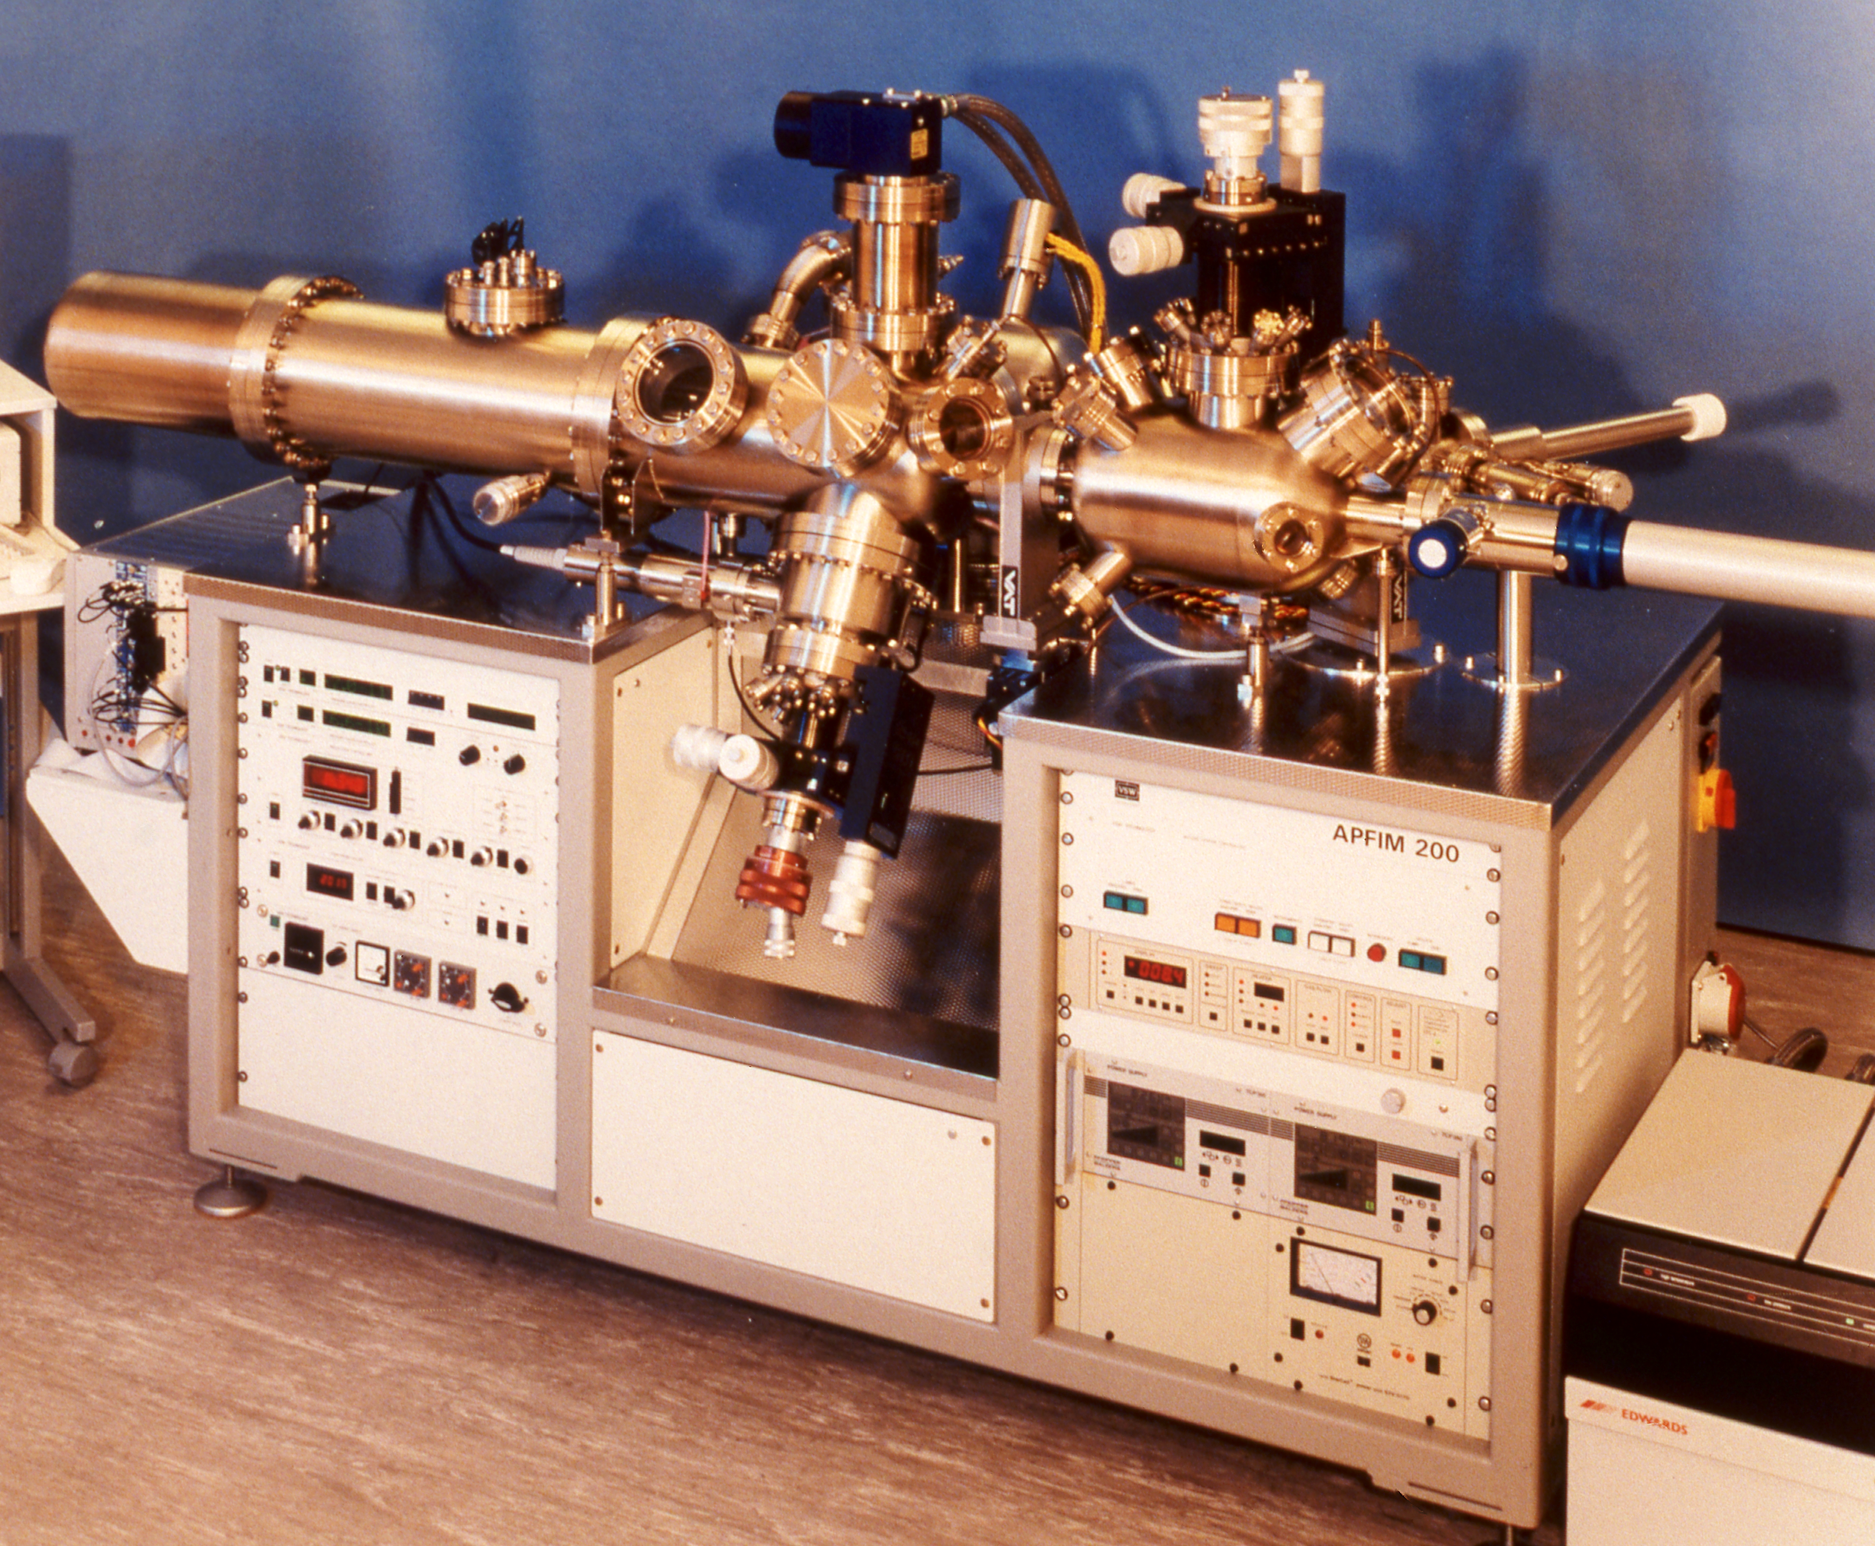
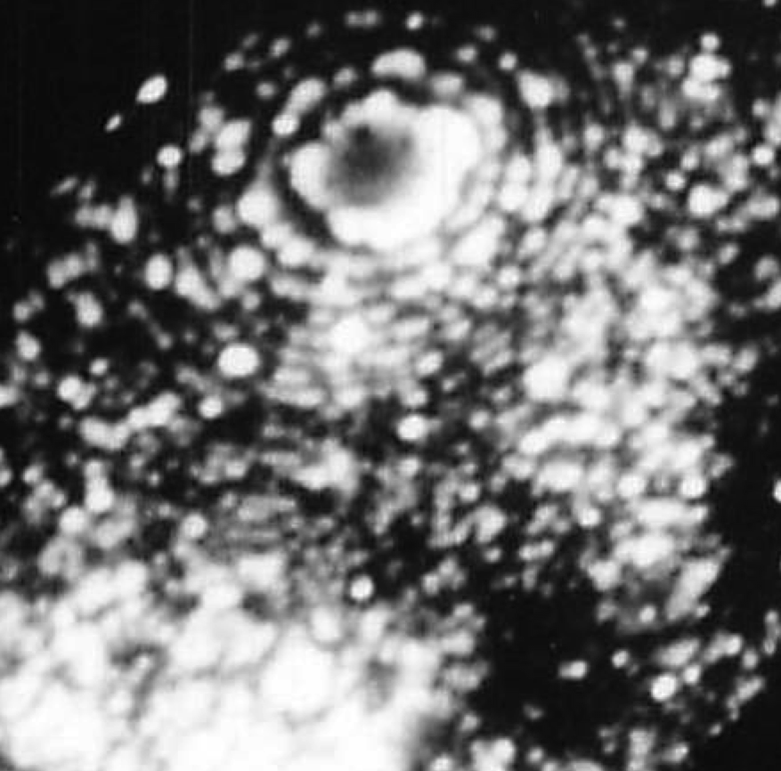
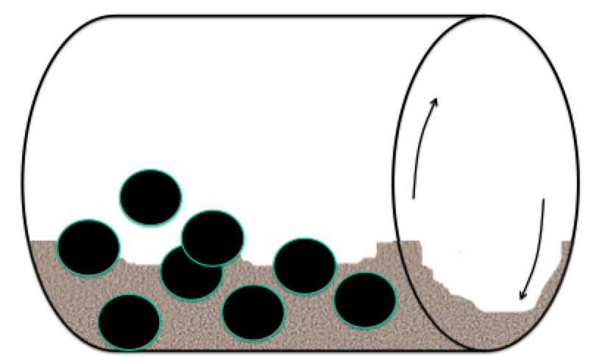
MA956

Slide 16
Chou & Bhadeshia

Slide 18
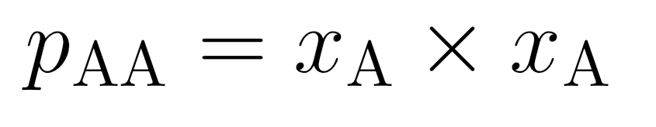
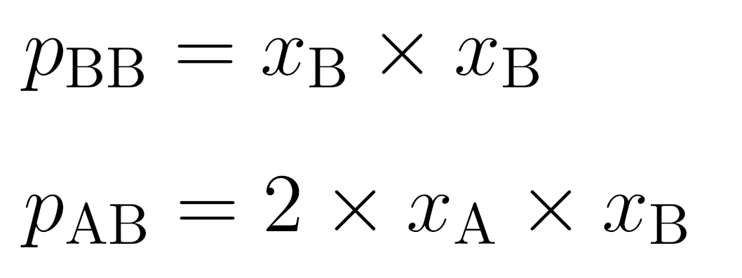
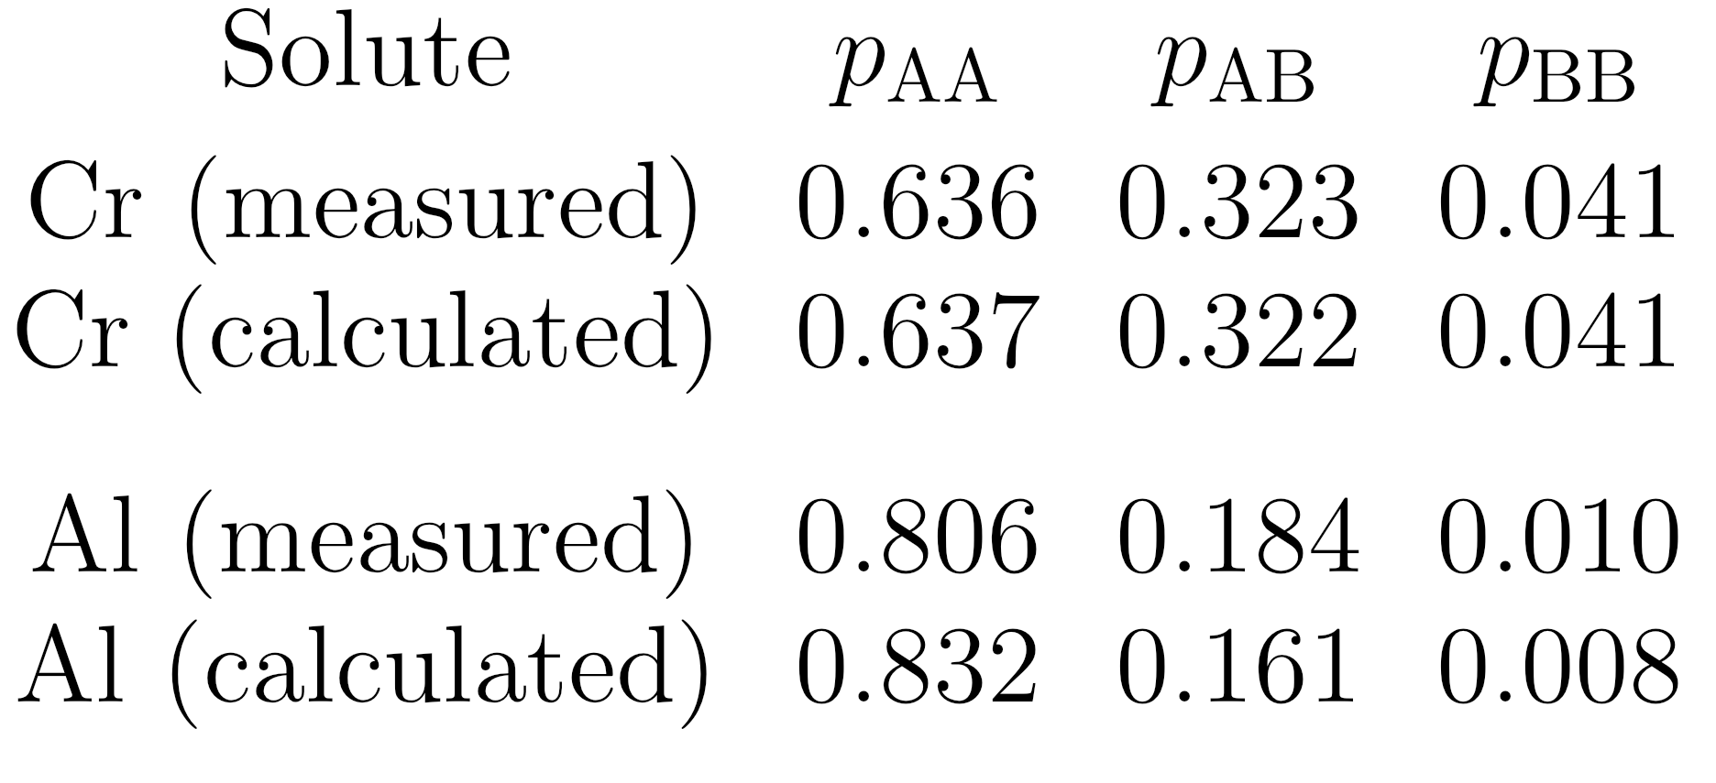
Probability of pairwise bonds in random solution

Slide 19
Mechanical Mixture
free energy of
mechanical
μ
o
mixture
B
G*
μ
o
Gibbs free energy per mole
A
x
1-x
A
B
Concentration x of B

Slide 20
free energy of
mechanical
μ
o
mixture
B
G*
Gibbs free energy per mole
μ
o
A
∆G
M
G{x}
free energy
of solution
A
B
x
Composition

Slide 21
+
=
configurational entropy?

Slide 22
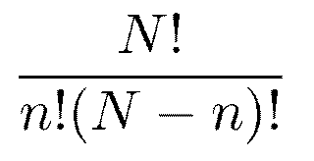
For a random mixture, number of configurations given by:

Slide 23
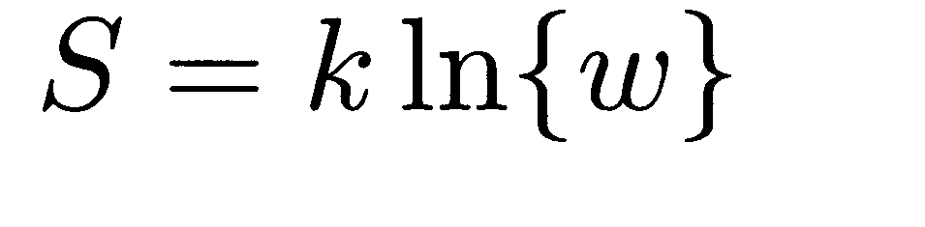
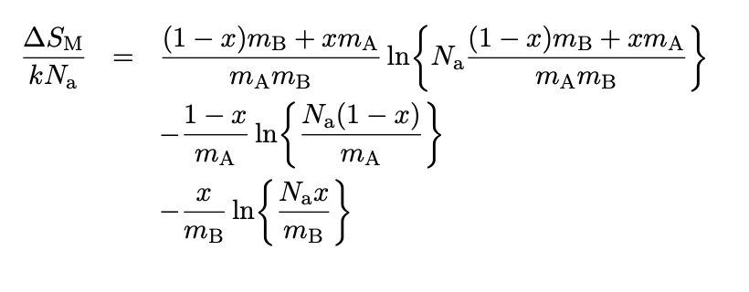

Slide 24
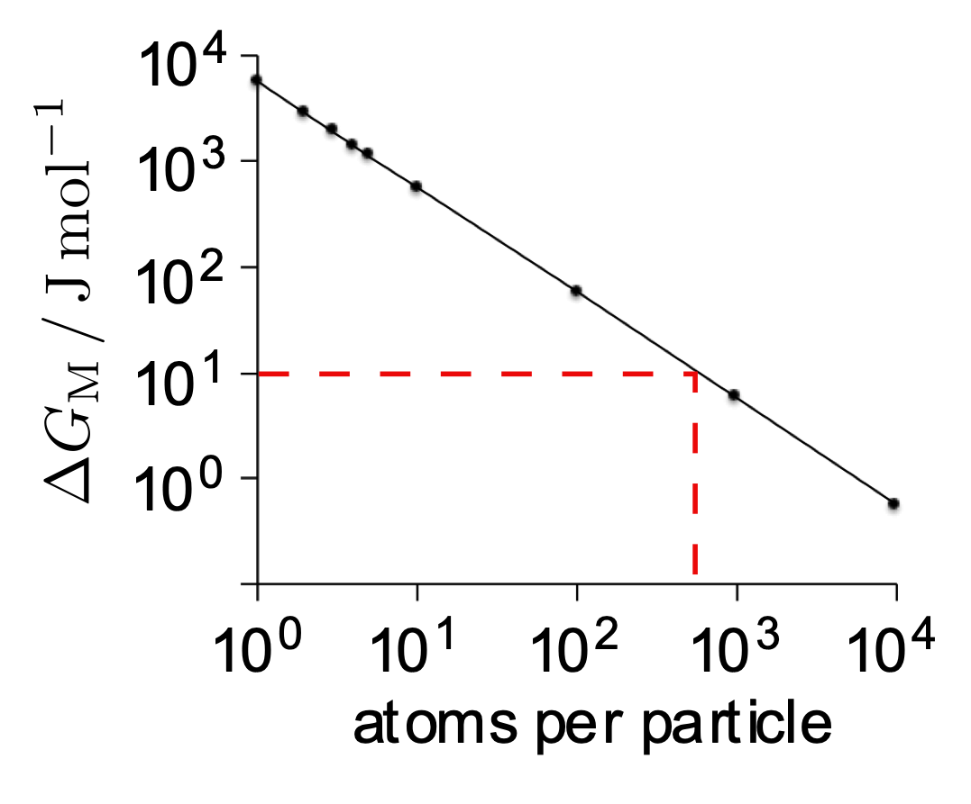
Solution-like behaviour when particles about 1000 atoms in size
Free energy of mixing due to configurational entropy alone

Slide 25
Enthalpy
chemical component of interfacial energy

Slide 26
Structural component of
interfacial energy
S_{v}
Particle size
Solution formation impossible!

Slide 27
coherent
coherent
incoherent

Slide 28
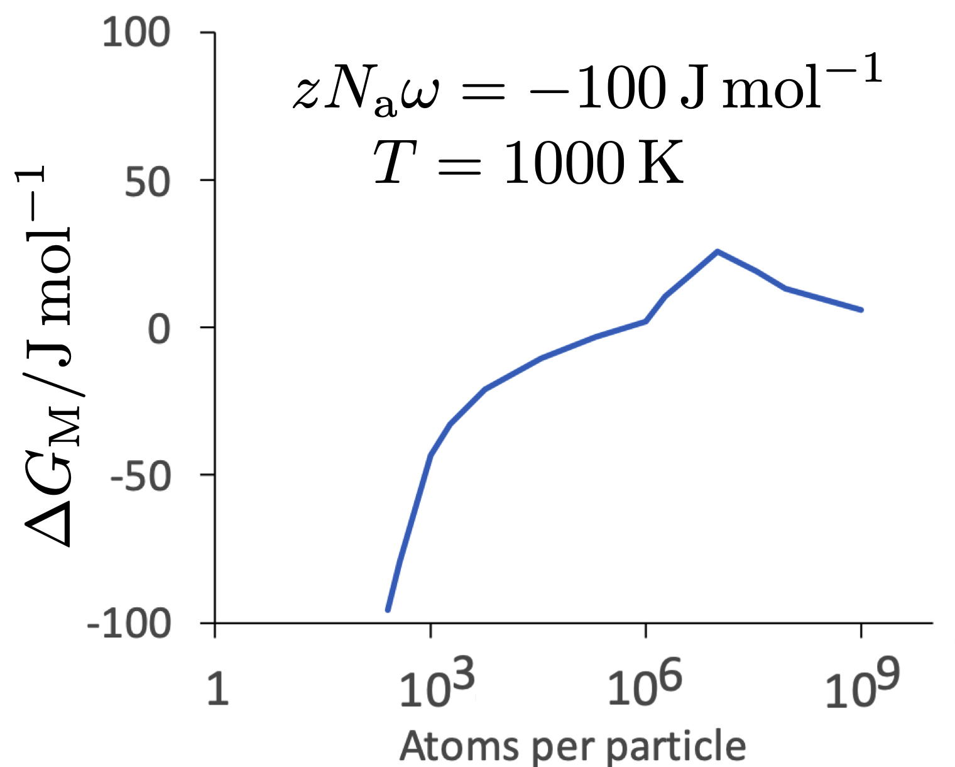
Single barrier to solution formation when components attract

Slide 29
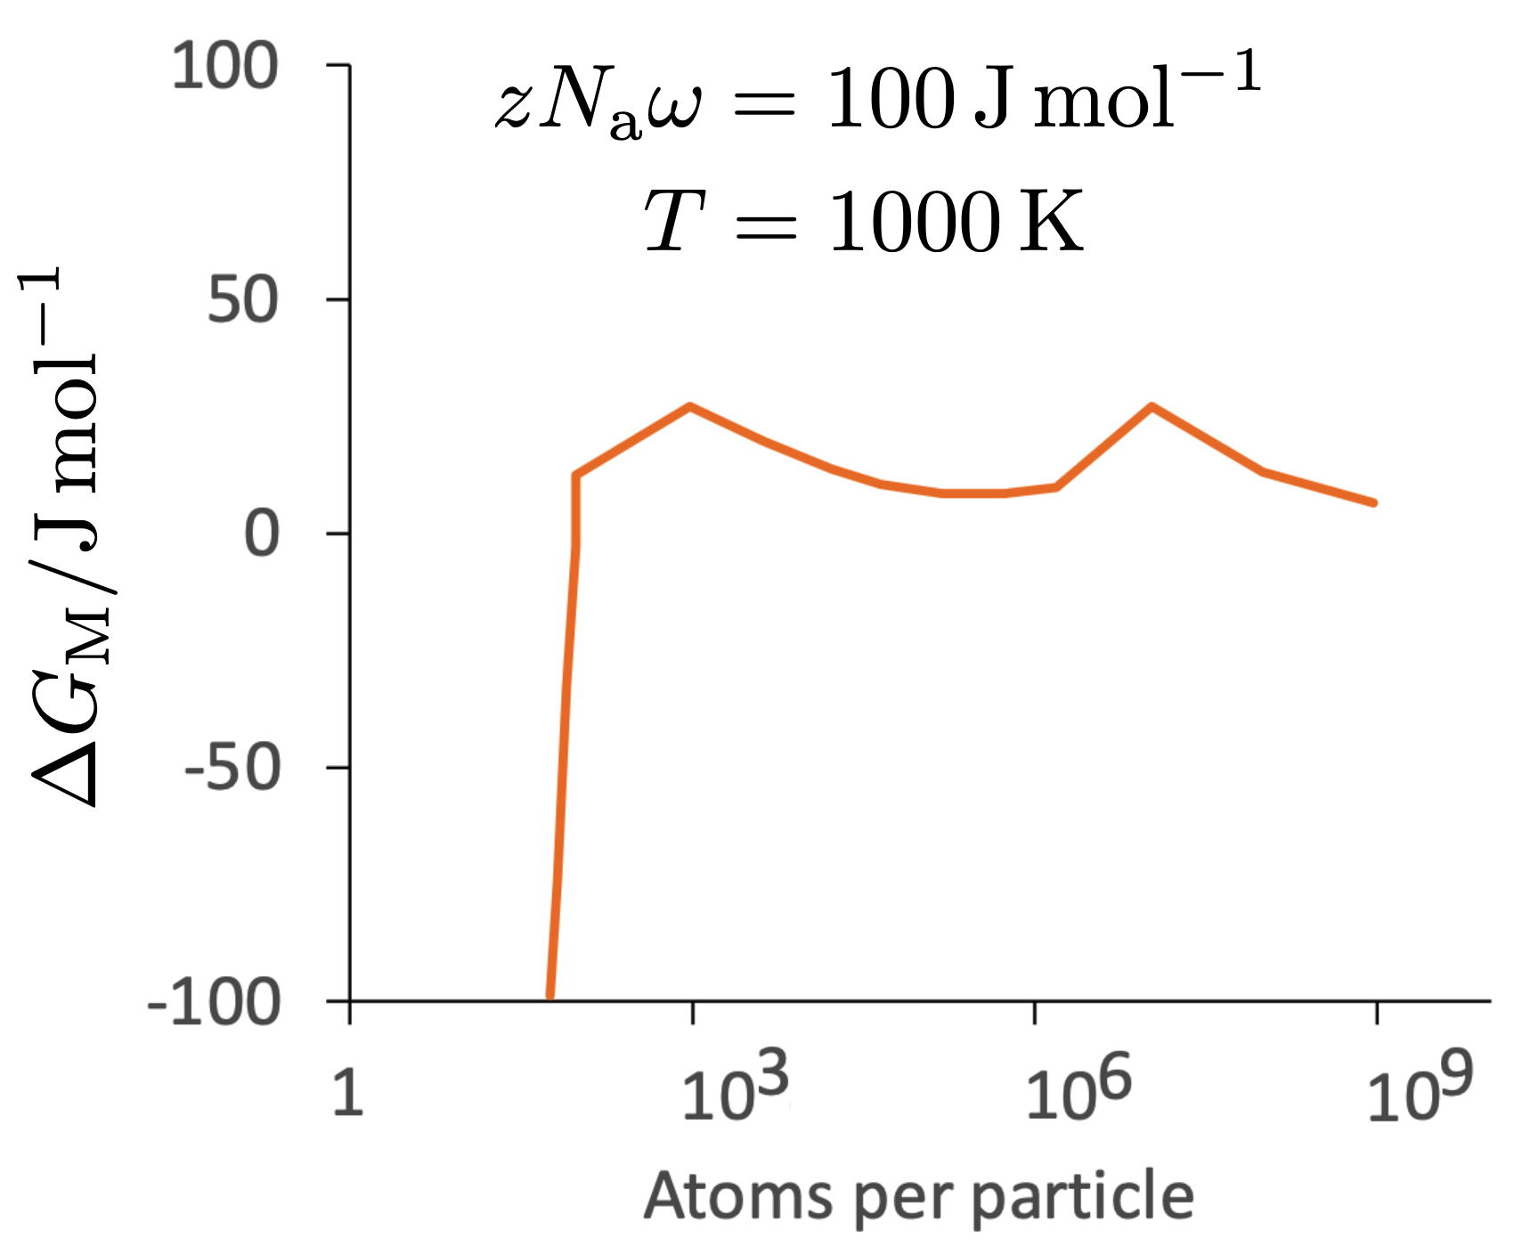
Double barrier to solution formation when components immiscible

Slide 31
μ
o
B
μ
o
A
Gibbs free energy per mole
Paradox at concentration extremities vanishes in the discrete model of concentration
A
B
Concentration x of B

Slide 32
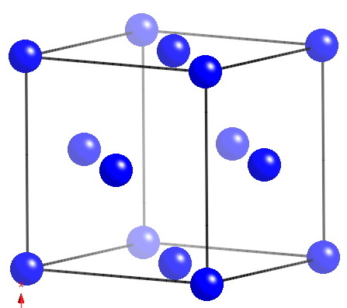
Austenite exists simultaneously in two magnetic states
High-volume, high magnetic moment, ferromagnetic
Low-volume, low magnetic moment, antiferromagnetic
Therefore, its overall expansion coefficient is much greater than that of ferrite

Slide 33
Experimental proof: force large lattice parameter by alloying with copper – unfortunately, Fe & Cu do not dissolve into each other.
Prepare Fe-Cu solution by mechanical alloying.
At low Fe concentrations, magnetic moment per iron atom is 2.3 µ_{b}, ambient conditions.
At large Fe concentrations, less than 1 µ_{b}.

