Slide 1


Thermodynamics
Thermodynamic functions
Equilibrium state
Case study: mechanical alloying
Computer calculation: phase diagrams
Thermodynamics - irreversible
Quasichemical models
https://www.phase-trans.msm.cam.ac.uk/teaching.html
H. K. D. H. Bhadeshia

Slide 2
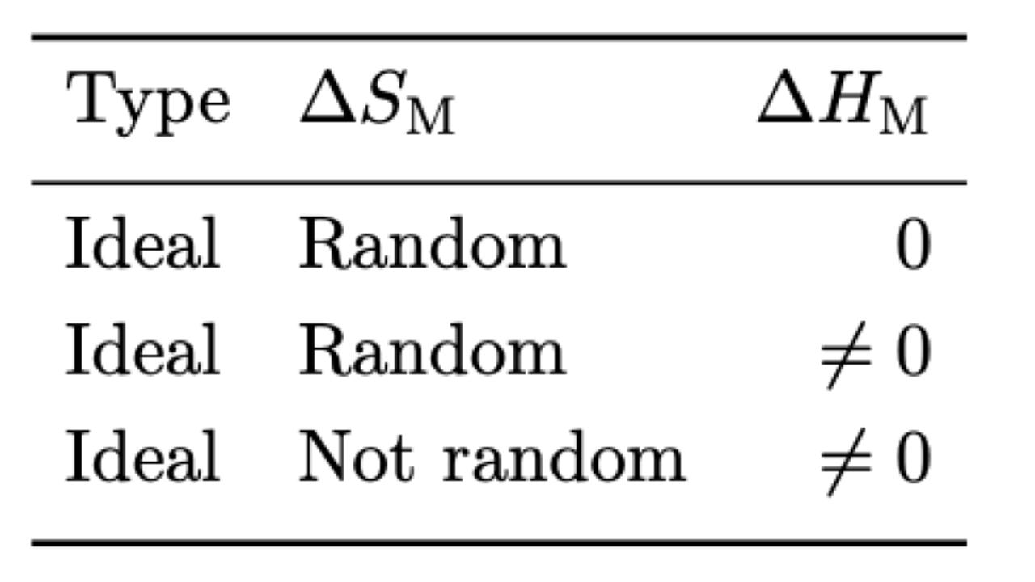
In the regular solution model, atoms are treated as independent entities.
Regular solution model is the zeroth quasichemical approximation.
In the (first) quasichemical approximation, atoms are not distributed at random, but pairs of atoms are treated as independent entities

Slide 3
N = number of atoms
N₁ = number in high energy state
N₀ = number in ground state
g₁
E₁
g₀

Slide 4
Partition Function
g₁
E₁
g₀

Slide 5
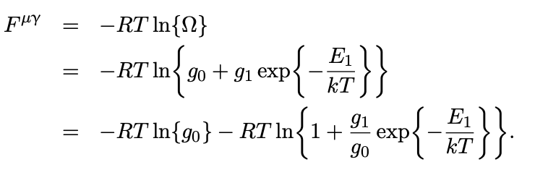
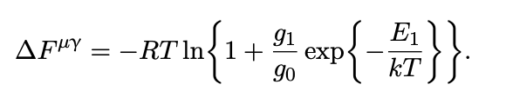

Slide 6
First order quasichemical model

Slide 7
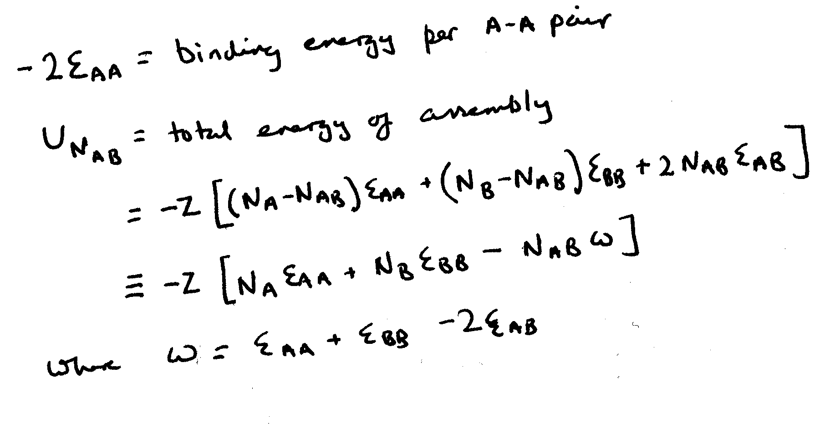

Slide 9
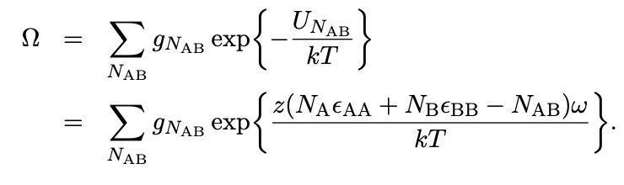

Slide 10
random configurations of [pairs of atoms]

Slide 11
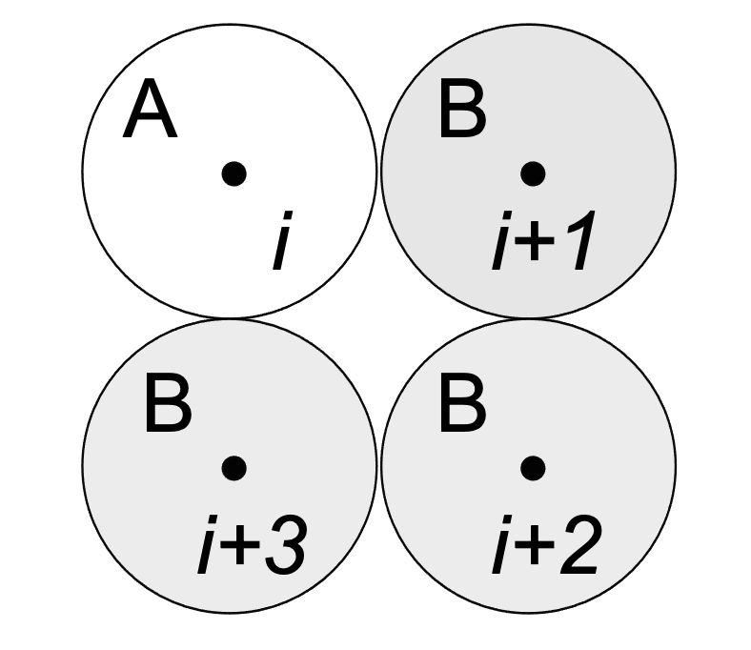

Slide 12
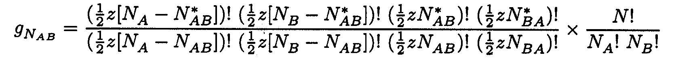
arrangement of pairs in random solution *

Slide 14
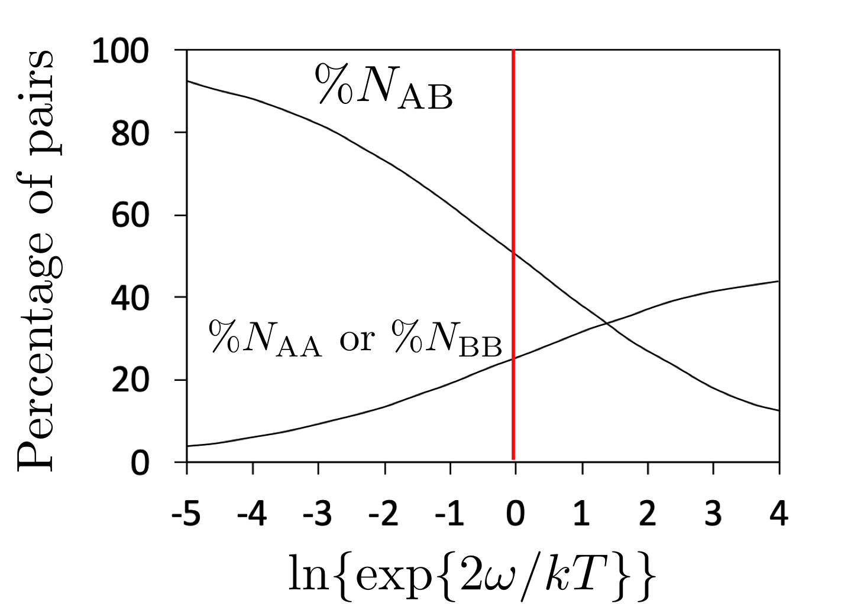

Slide 15

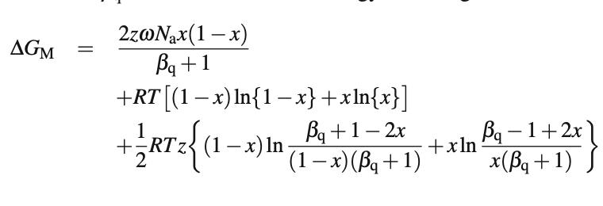

Slide 16
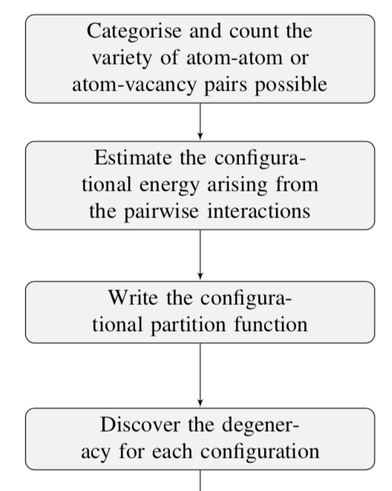
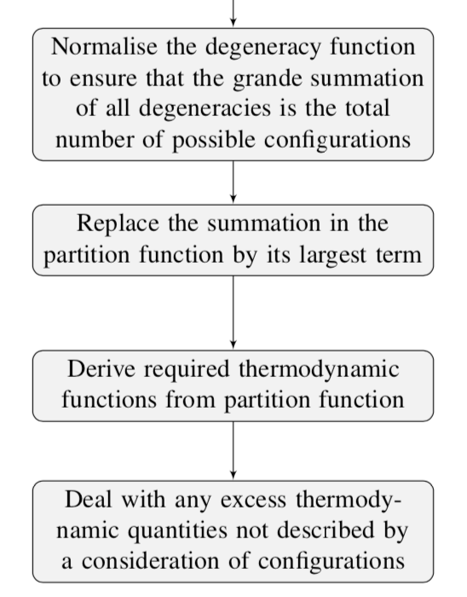

Slide 17


