Slide 1

Crystallography
Introduction and point groups
Stereographic projections
Low symmetry systems
Space groups
Reciprocal Lattice & Diffraction
Deformation and texture
Interfaces, orientation relationships
Martensitic transformations
H. K. D. H. Bhadeshia

Slide 2
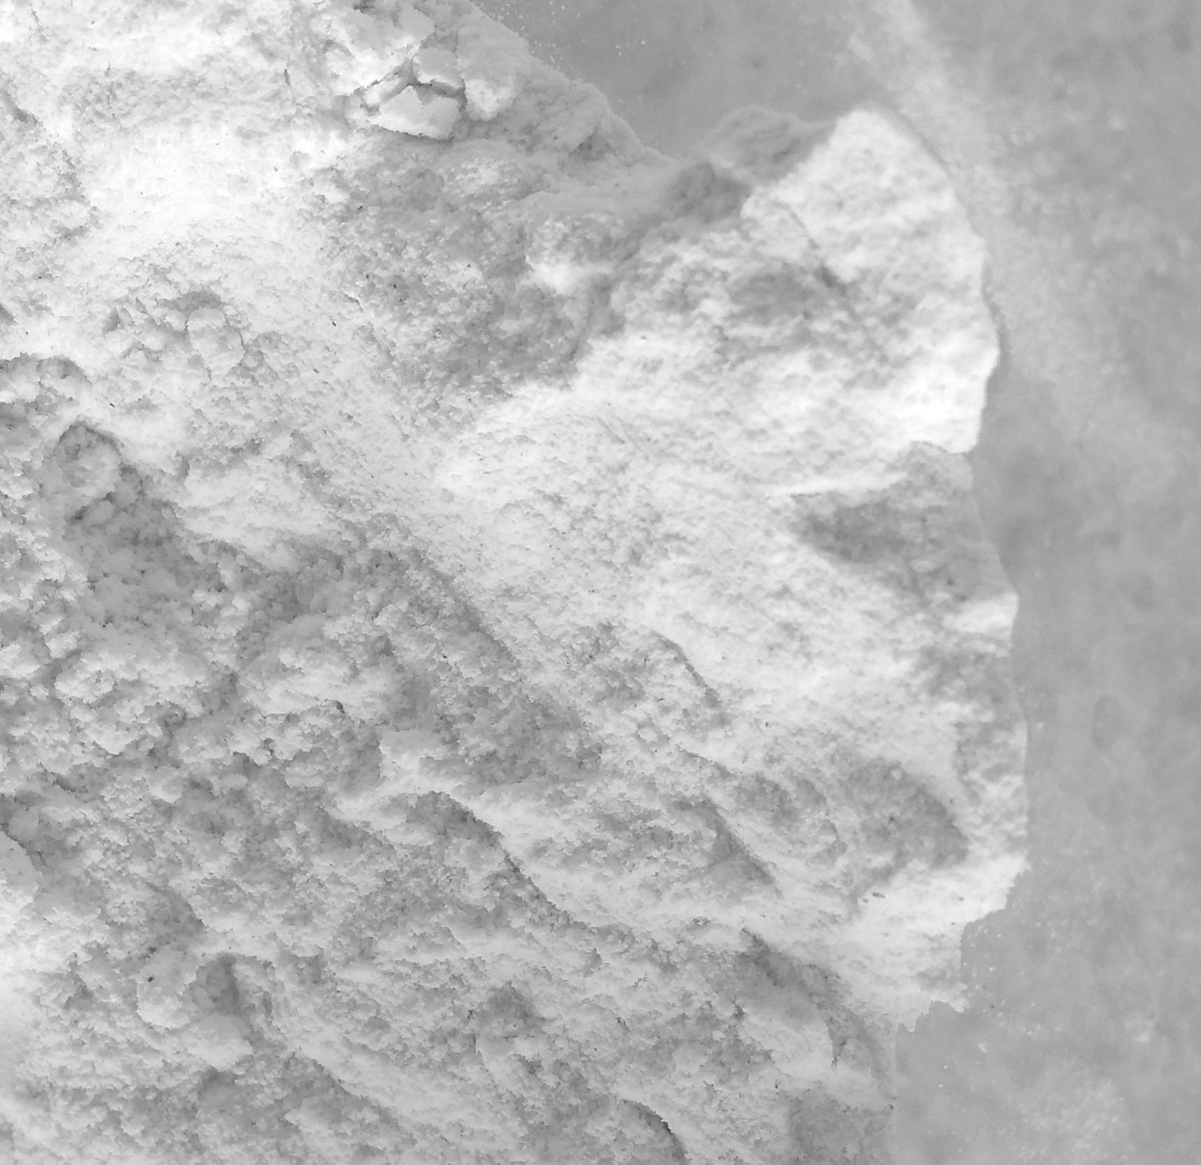
Where are the atoms in the cell?
Experimental data
Chemical formula: TiPbO₃
X-rays: tetragonal lattice
X-rays: cell volume
Density: 1Pb, 1Ti, 3O therefore P-lattice
Valency: Ti⁴⁺, Pb²⁺, O²⁻
Piezoelectric

Slide 3
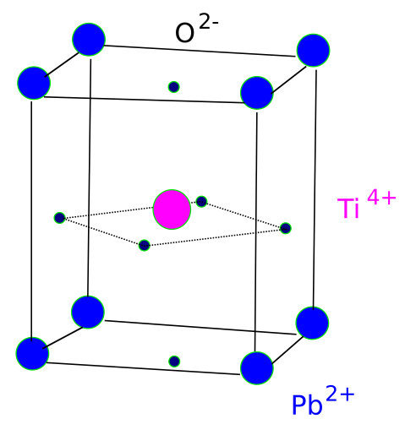
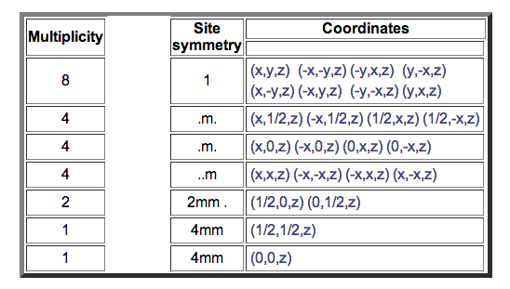
P4mm

Slide 4
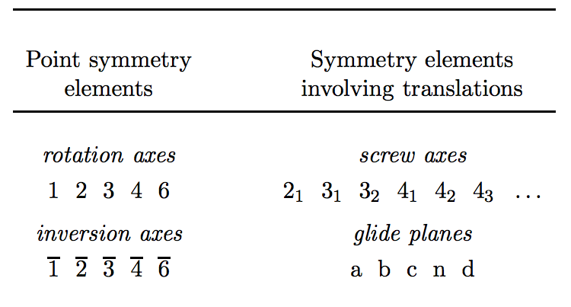

Slide 5
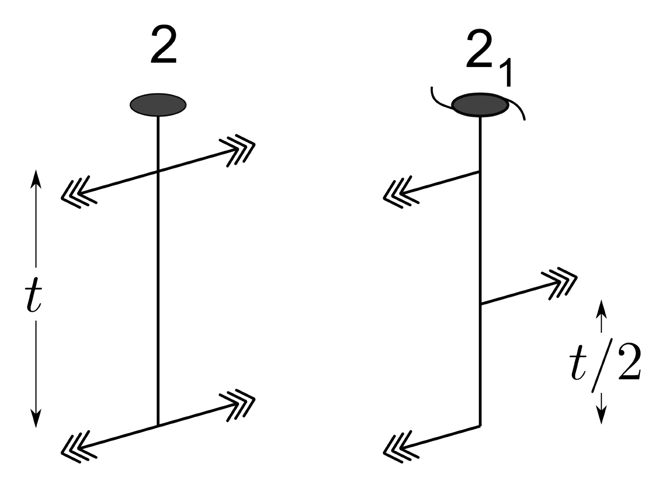
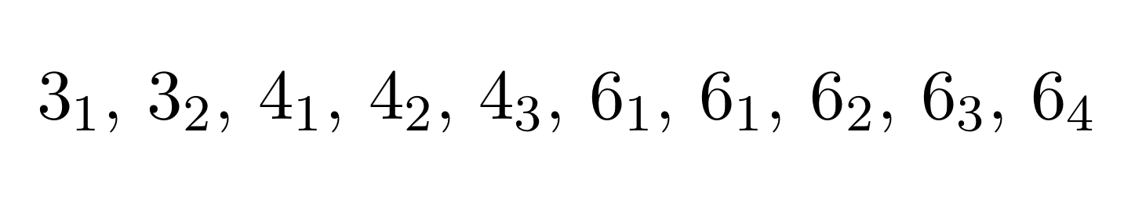

Slide 6
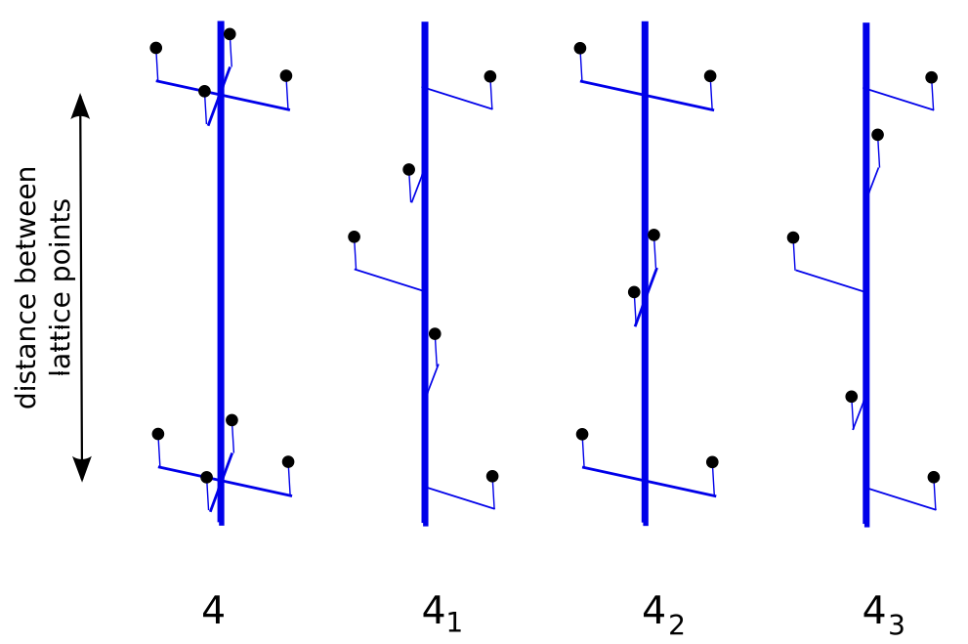

Slide 7
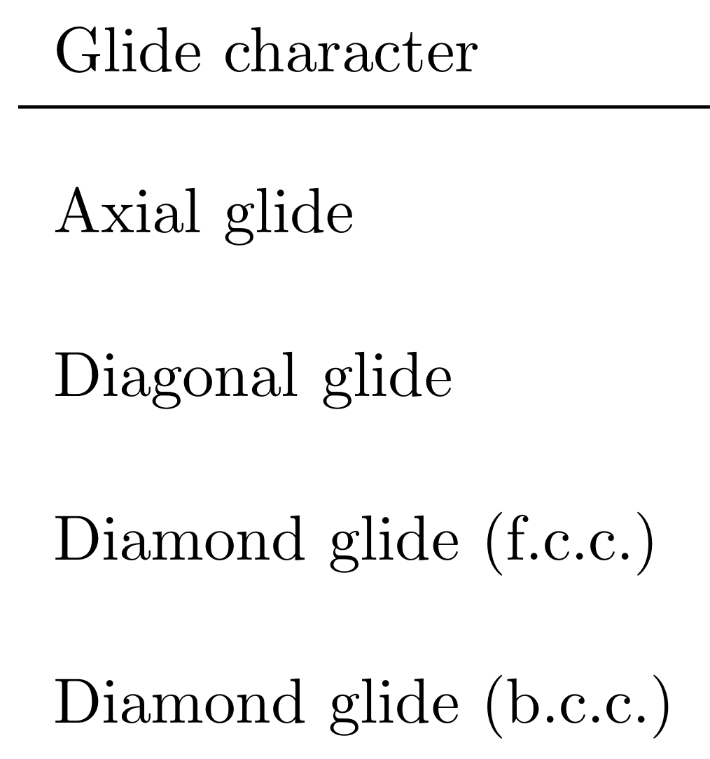
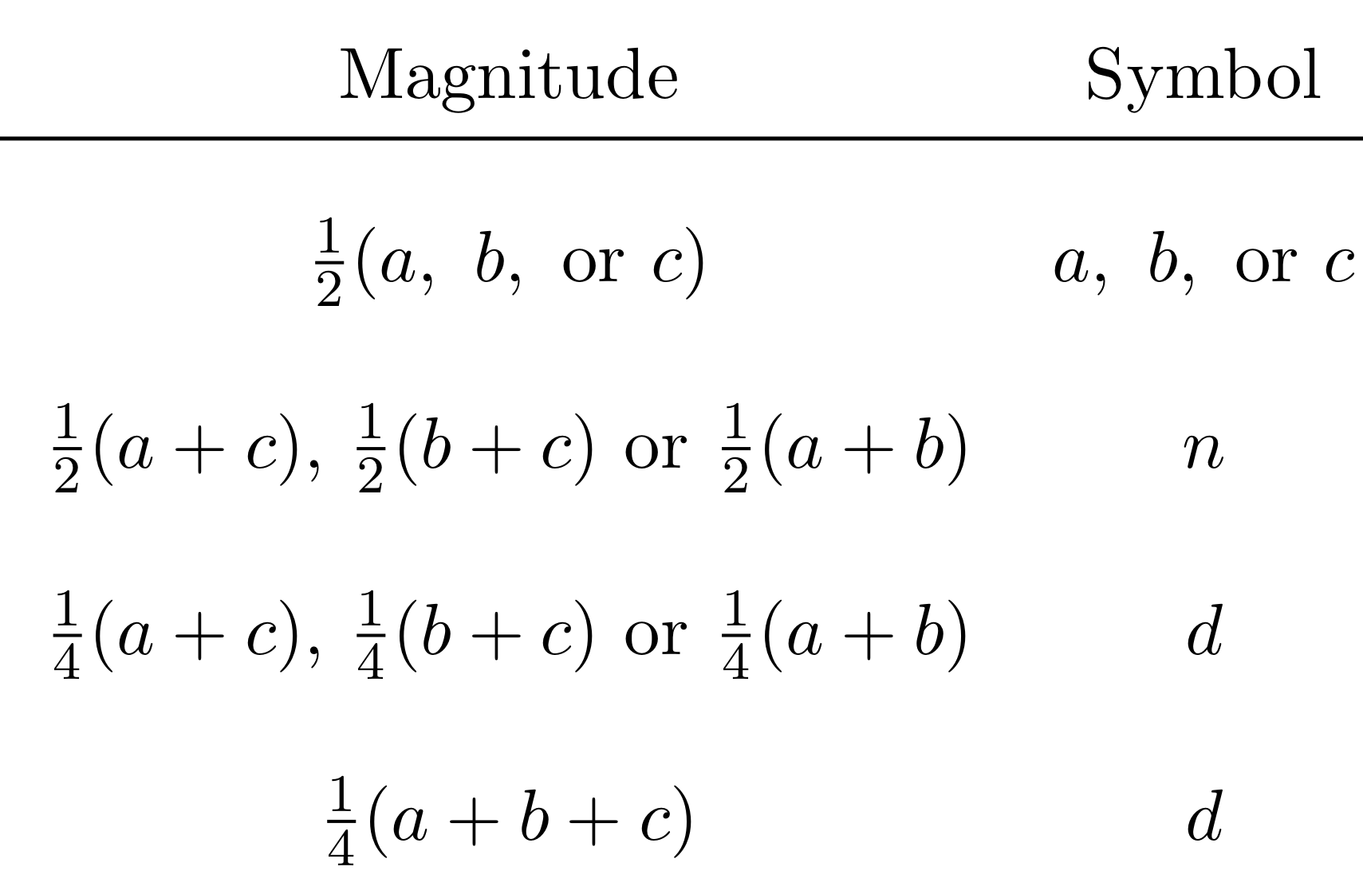
reflection and translation
axial diagonal diamond diamond

Slide 8
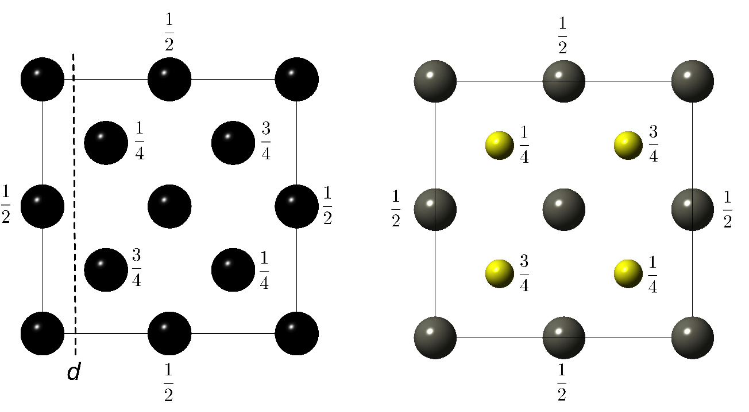

Slide 9
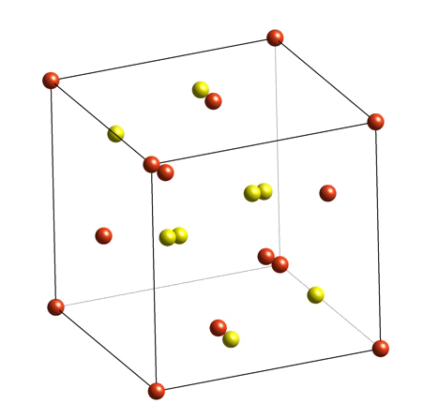
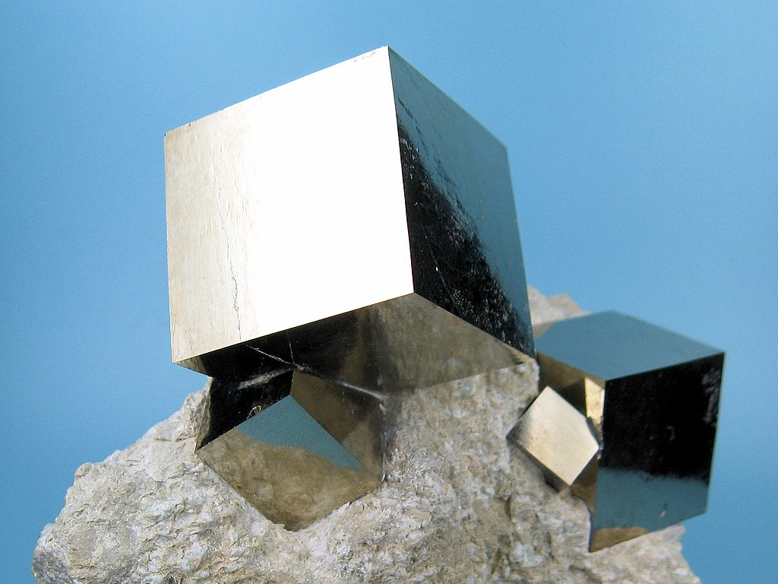
yellow atoms
are sulphur
Carles Millan, Wikimedia, CC BY-SA 3.0

Slide 10
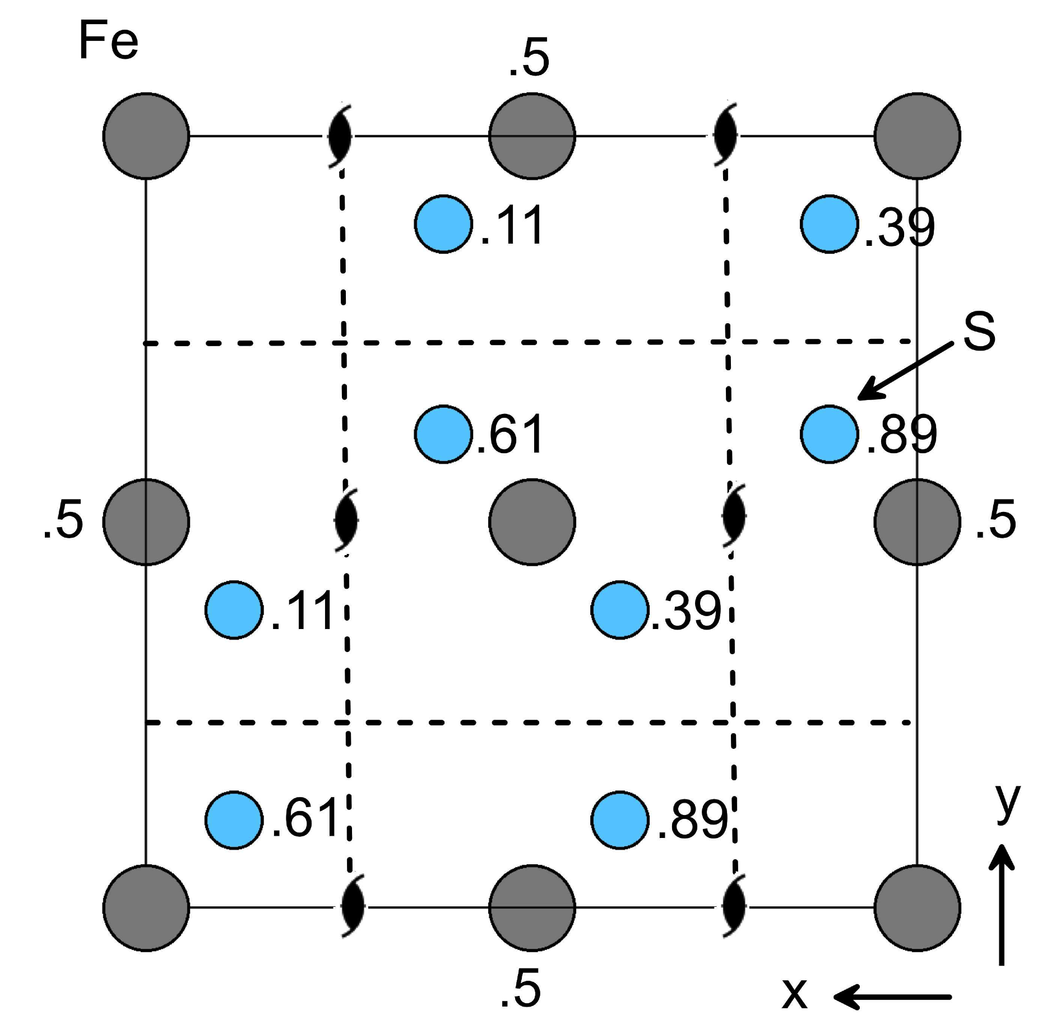
PYRITE
-
Pa3

Slide 11
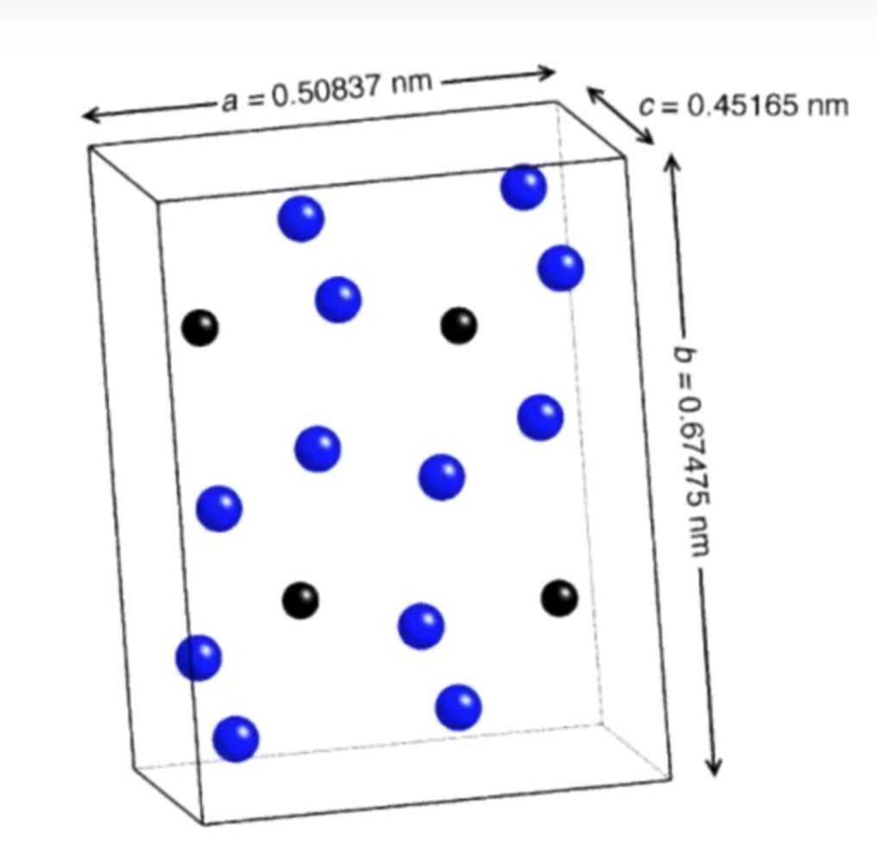

Slide 12
a=0.50837 nm
b=0.67475 nm
c=0.45165 nm
P

Slide 13
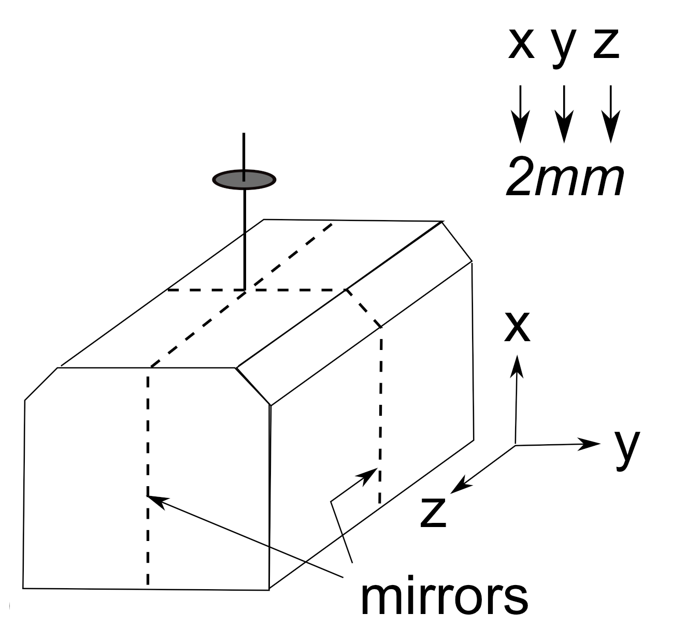

Slide 14
Pn

Slide 15
Pnm

Slide 16
Pnma

Slide 17
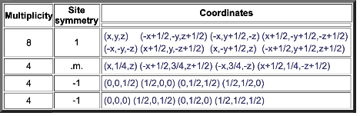

Slide 18
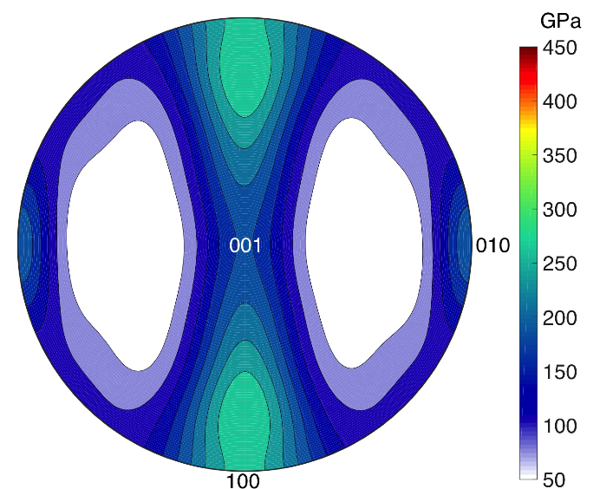


Slide 19
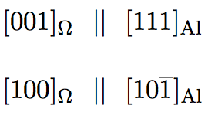
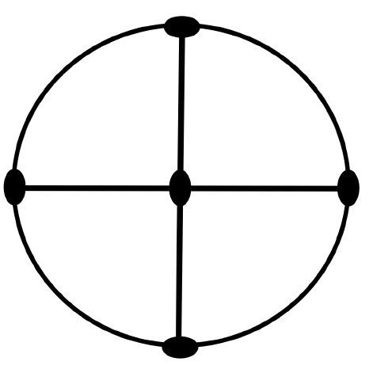

diad
triad
diad
diad
omega
aluminium

Slide 20
