Slide 1

Crystallography
Introduction and point groups
Stereographic projections
Low symmetry systems
Space groups
Reciprocal Lattice & Diffraction
Deformation and texture
Interfaces, orientation relationships
Martensitic transformations
H. K. D. H. Bhadeshia
Notes:
Today I am going to talk about a phase transformation that can occur in the solid-state, in the absence of diffusion.

Slide 2
Diffusionless
can form at incredibly
low temperatures
can form very rapidly
no composition change

Slide 3
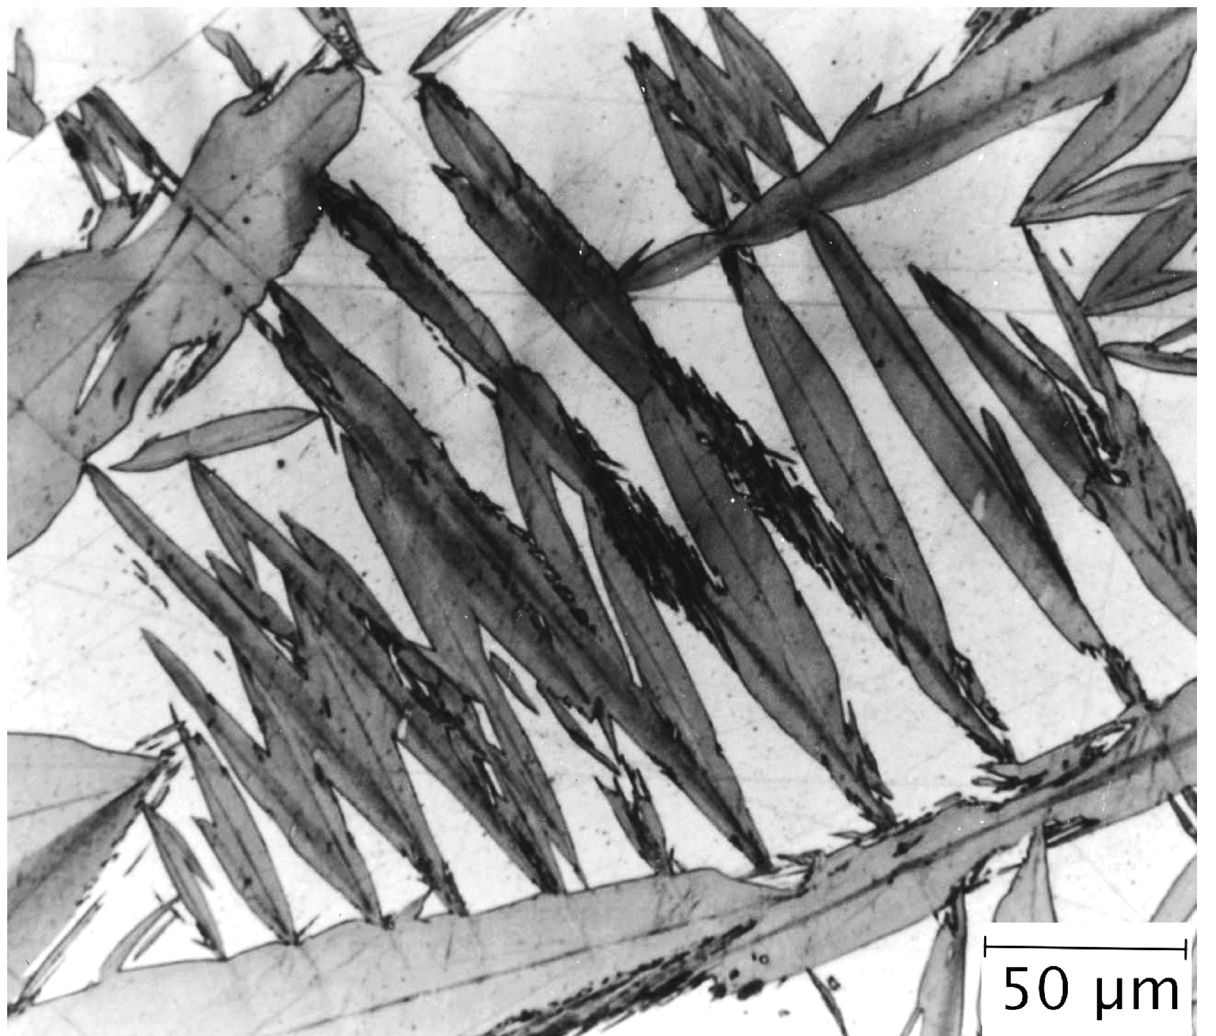
shape

Slide 4
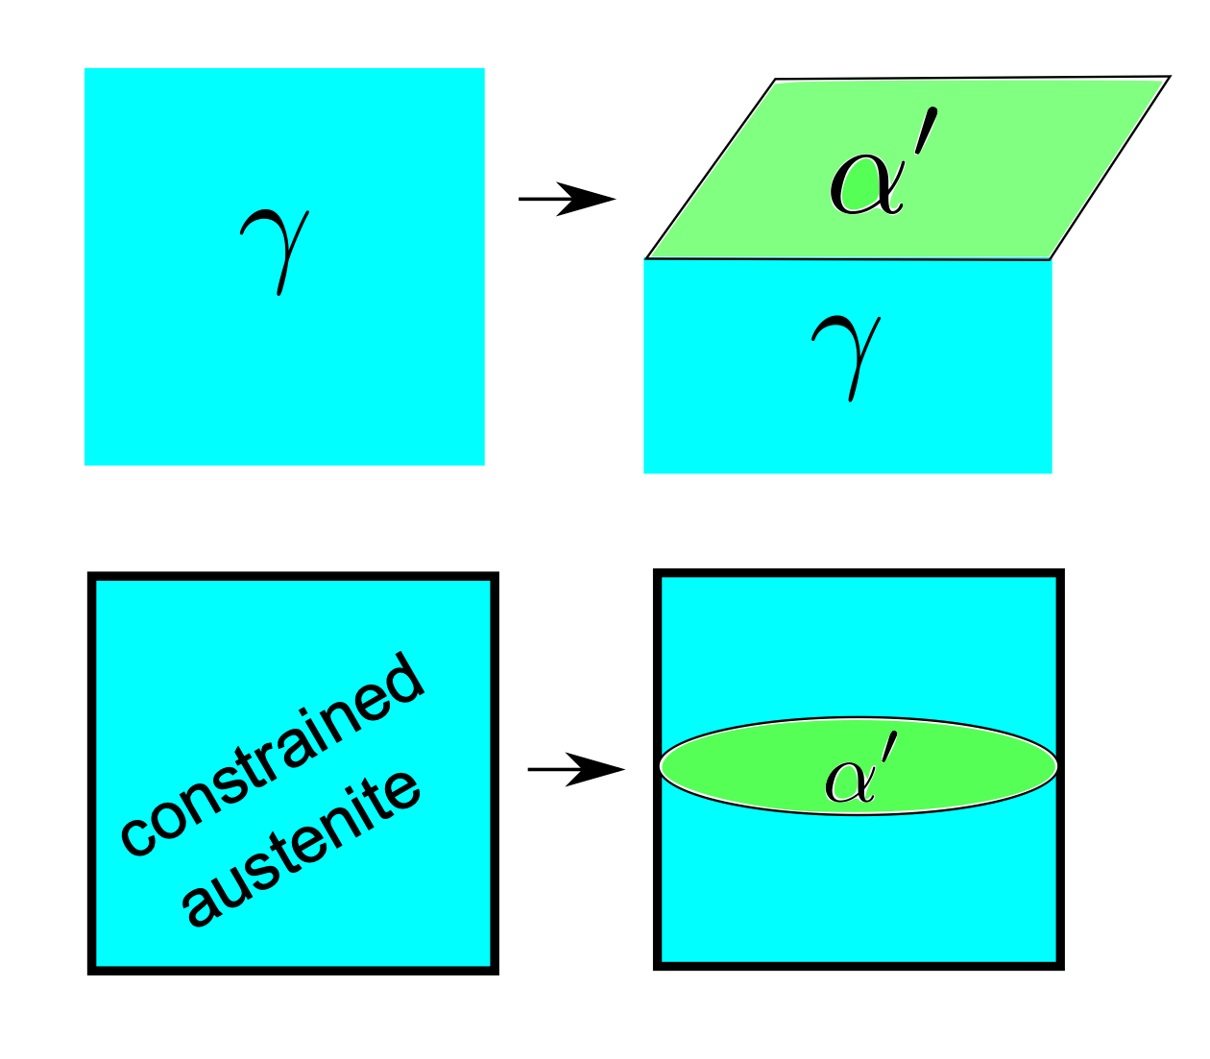
Acta Metallurgica 13 (1965) 99-107

Slide 5
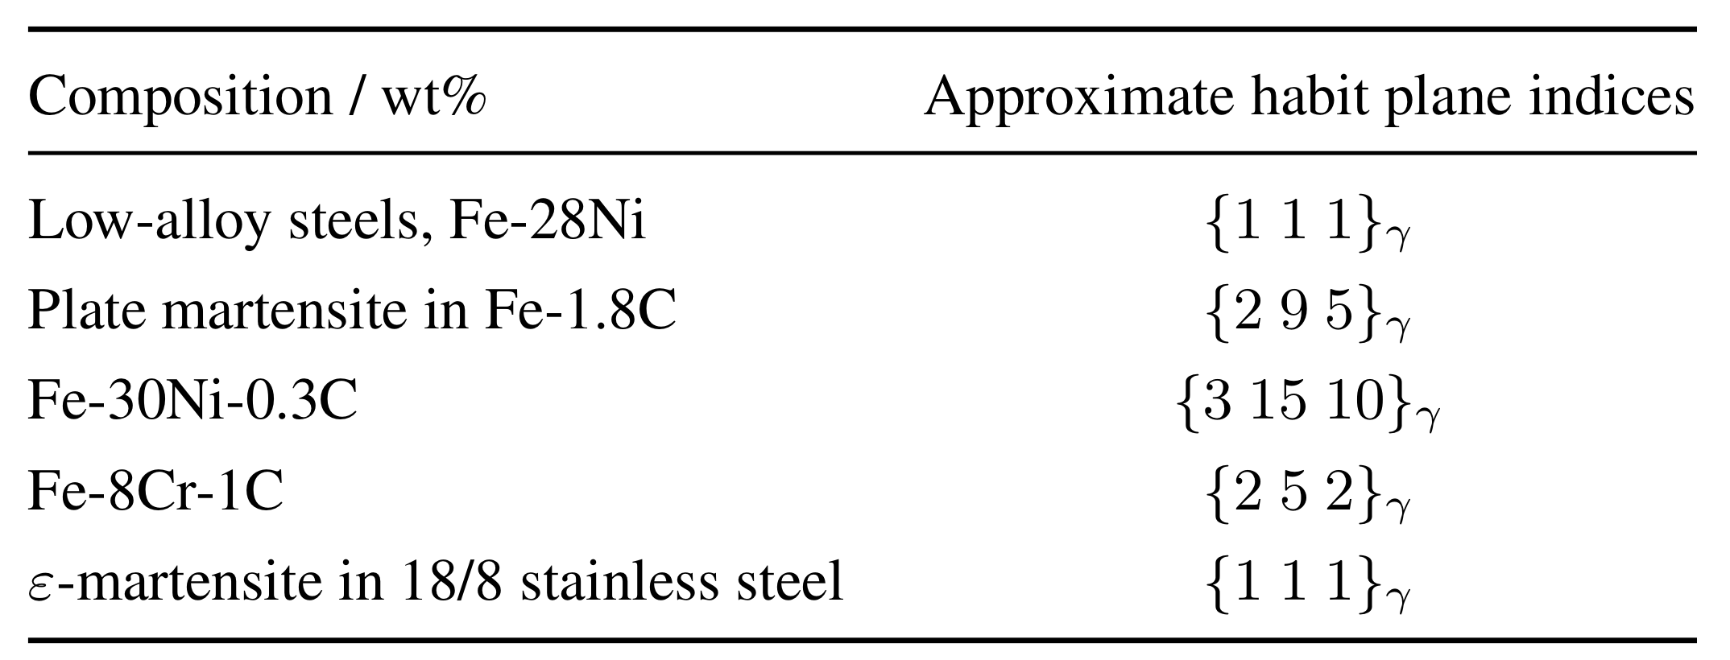
Irrational: why?

Slide 6
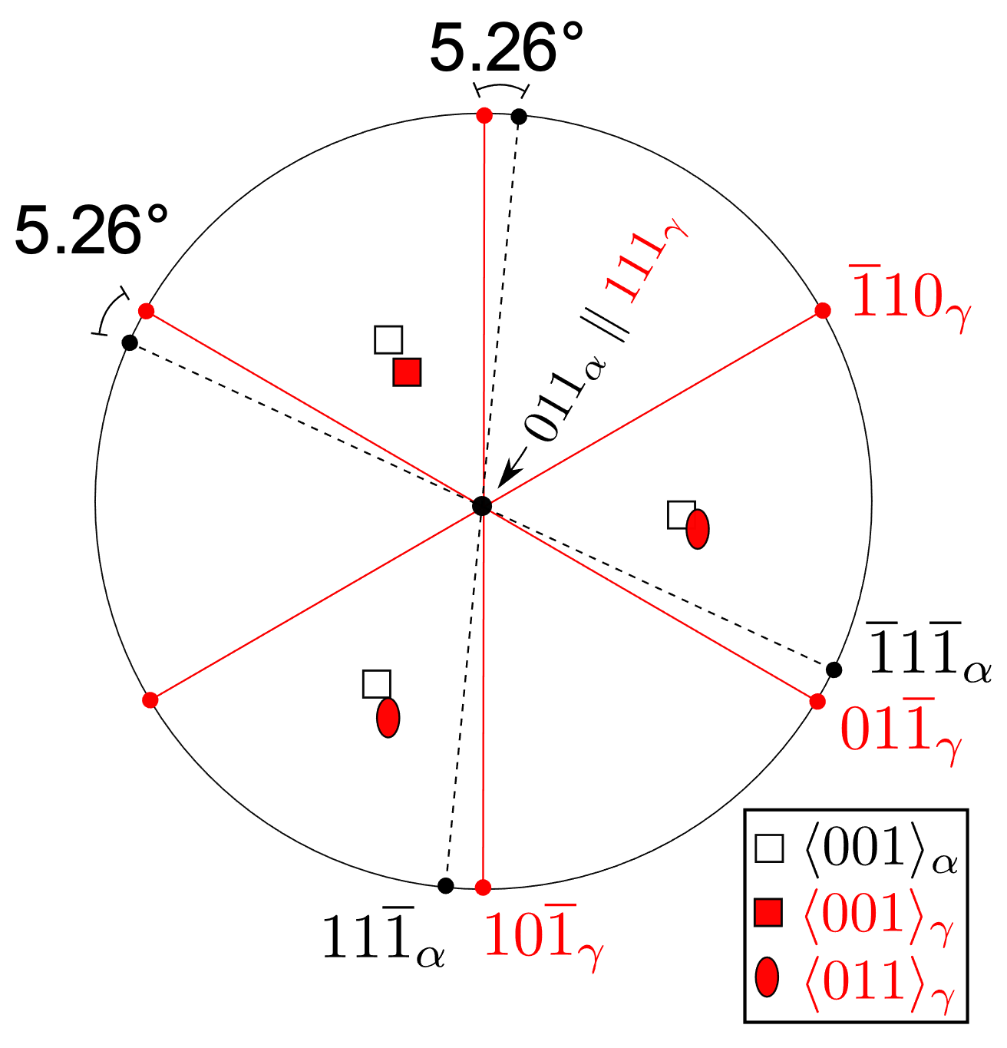
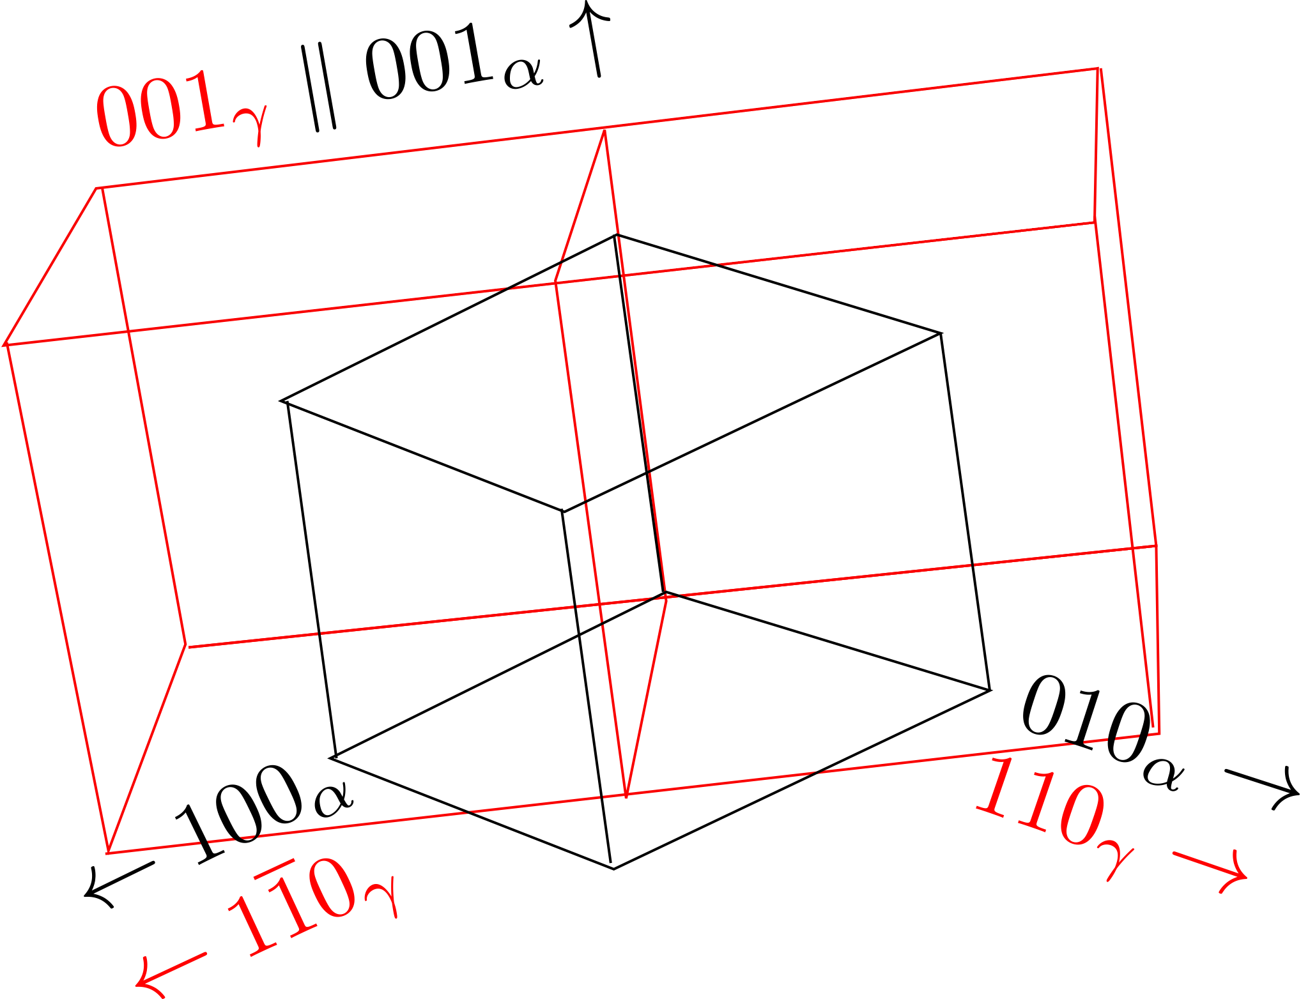
NISHIYAMA-WASSERMAN

Slide 7
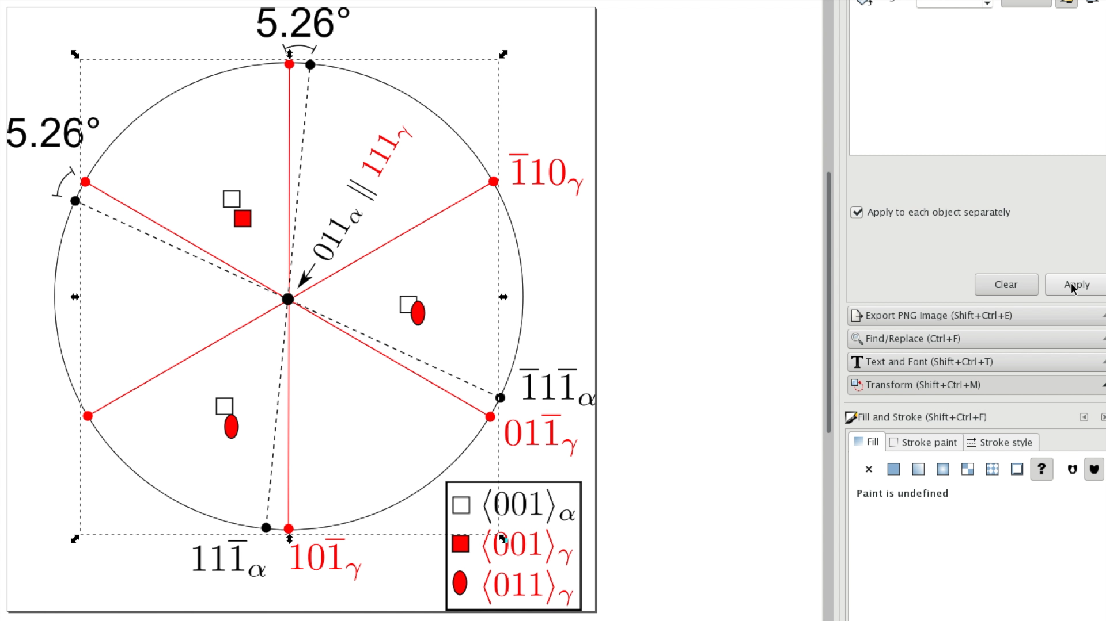
KURDJUMOV-SACHS

Slide 8
actual orientation
irrational

Slide 9
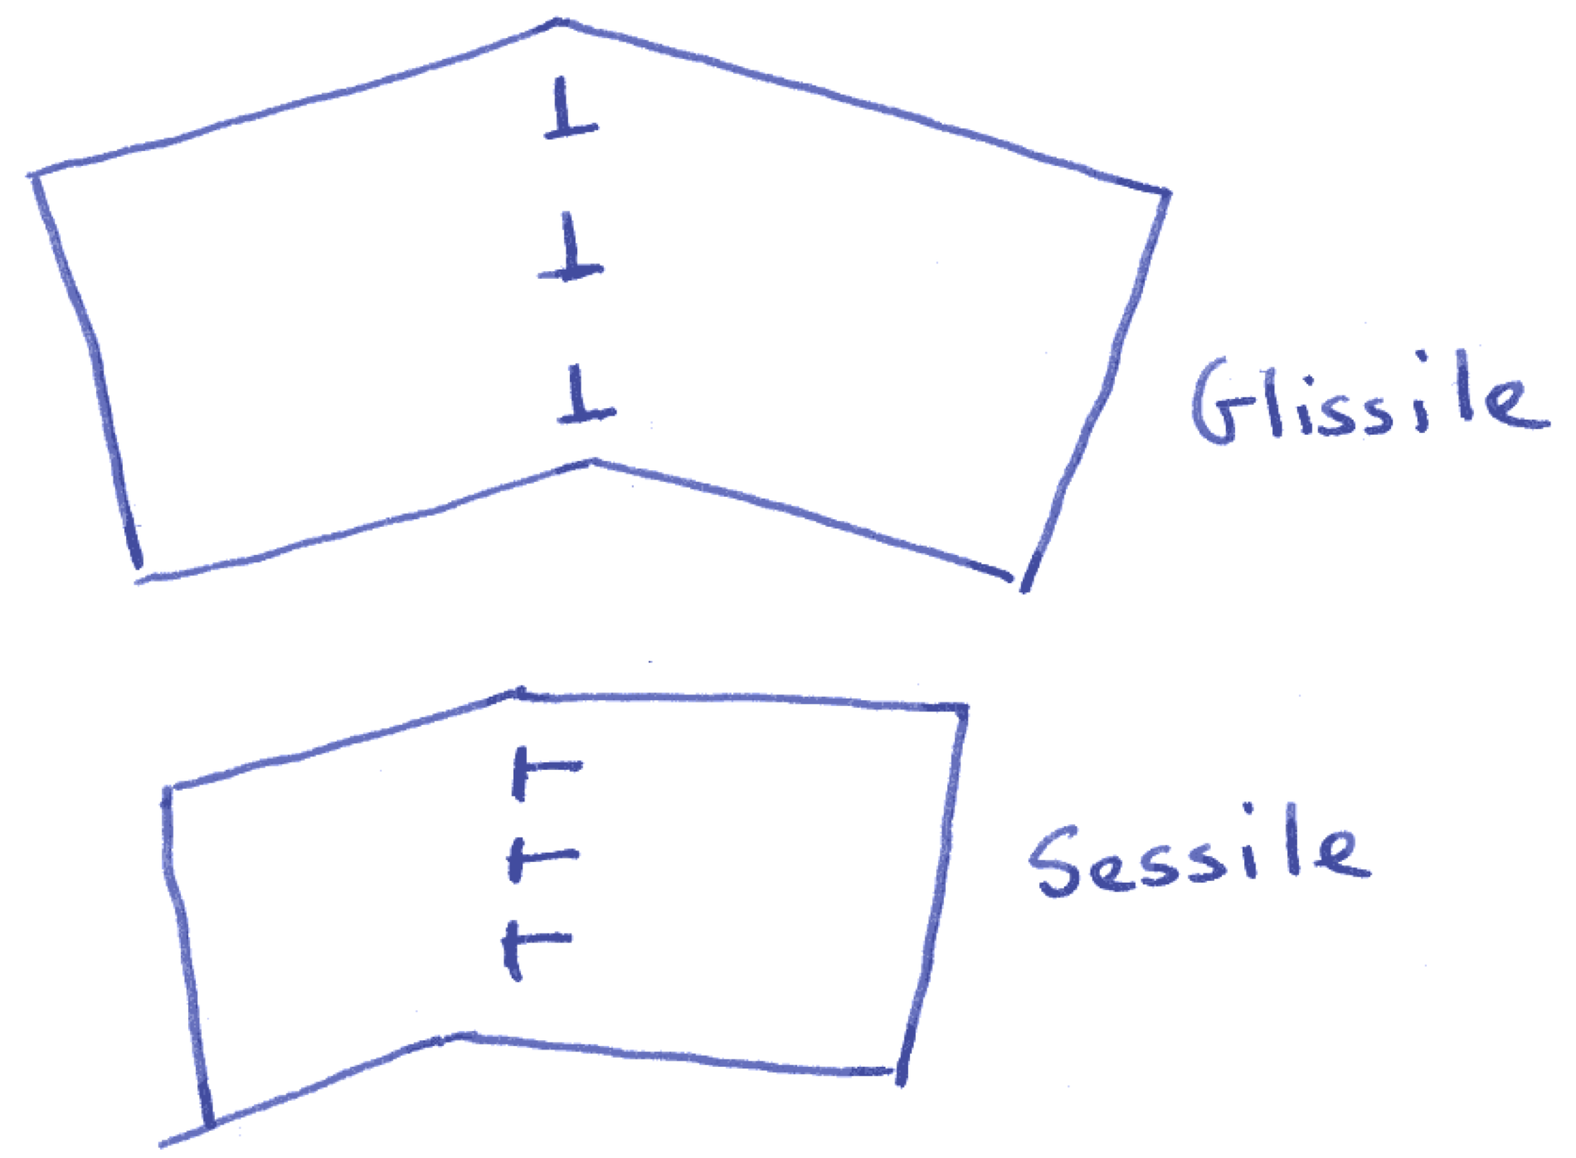

Slide 10
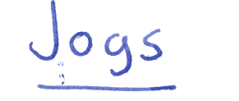
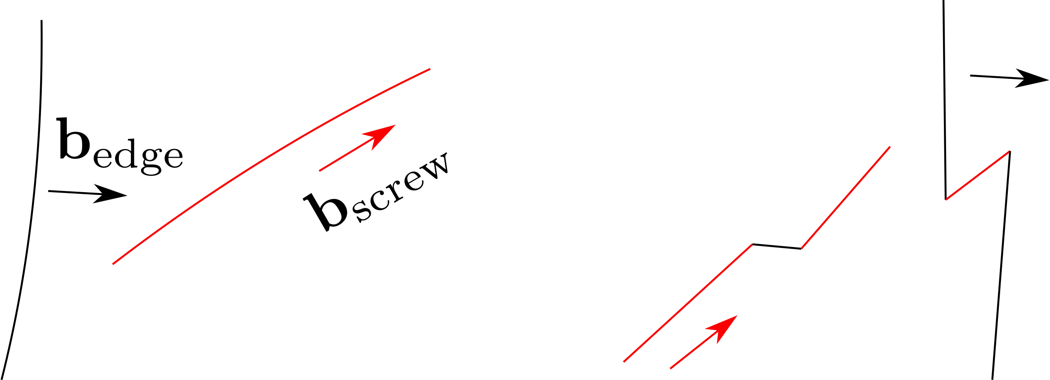

Slide 11
Glissile interface cannot contain more than one set of dislocations.
Martensitic transformation only possible if deformation which changes the parent into the product leaves one line undistorted and unrotated, i.e. an invariant-line.
Deformation is an invariant-line strain.

Slide 12
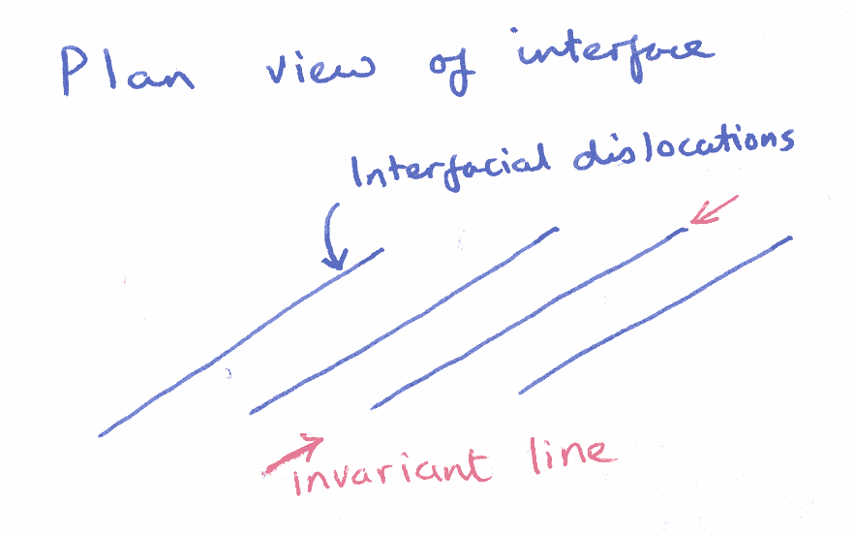

Slide 13
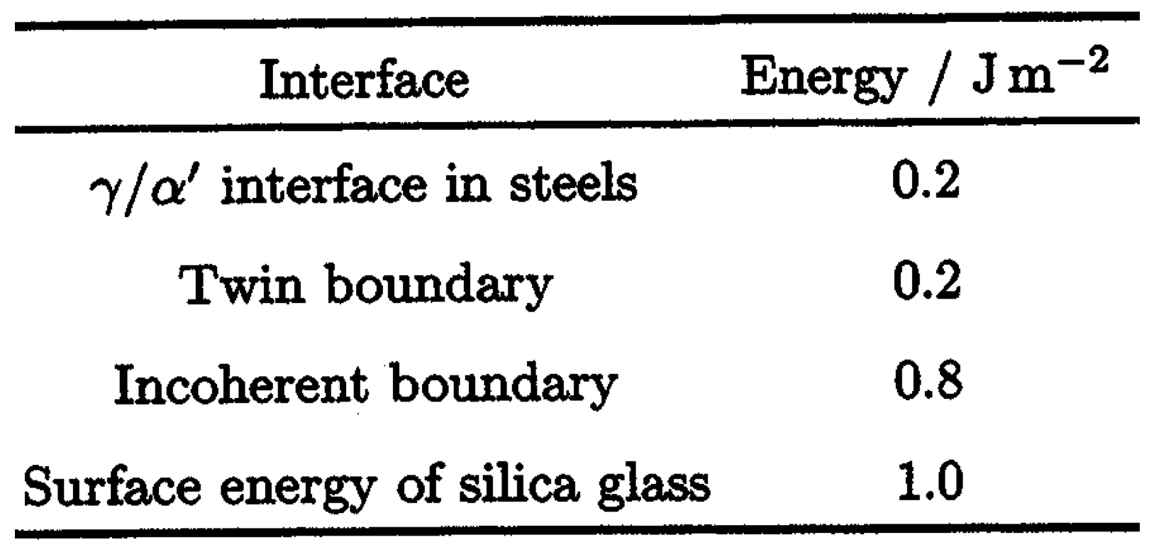

Slide 14
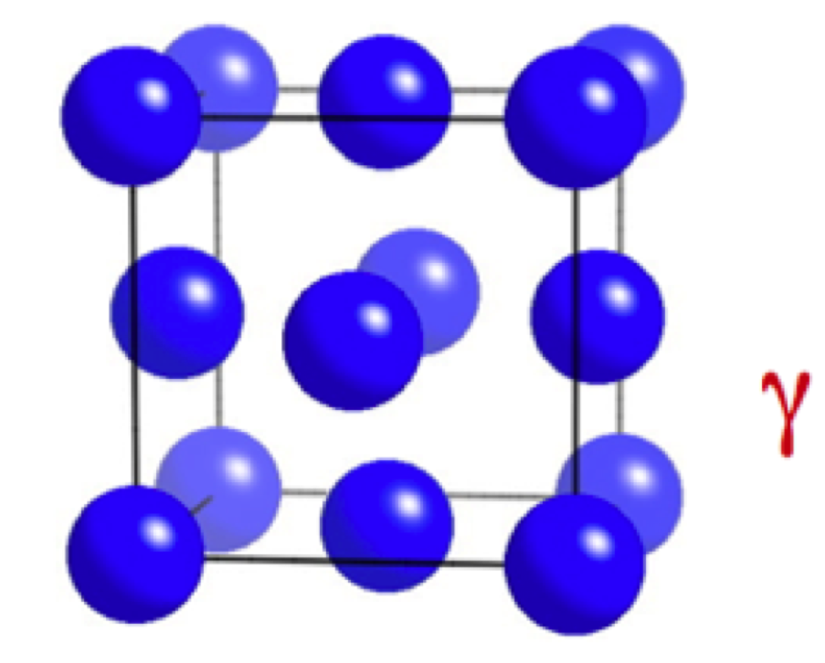
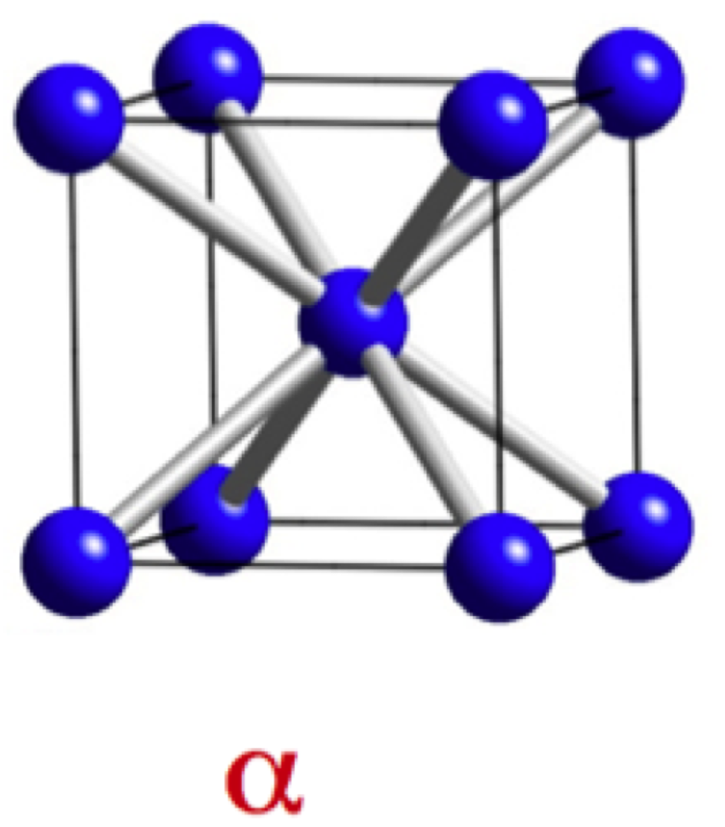

Slide 15
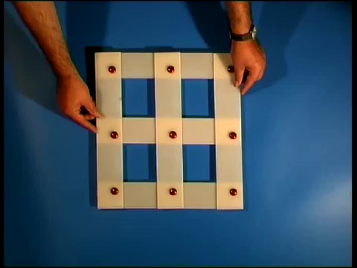

Slide 16
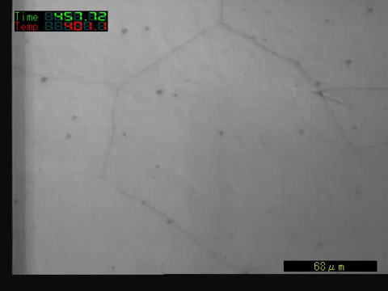
movie courtesy of
Professor Toshihiko Koseki

Slide 17
general invariant-plane strain
uniaxial dilatation
simple shear
s
s
δ
δ
1
1
1
s=0.26
δ=0.03

Slide 18
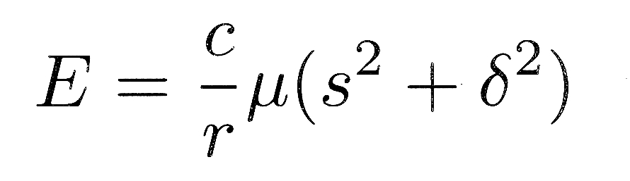
s
δ
c
r
1
Christian, 1957

Slide 19
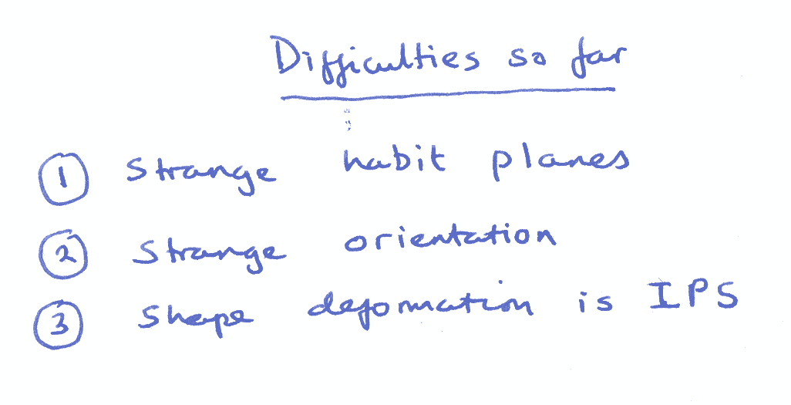

Slide 21
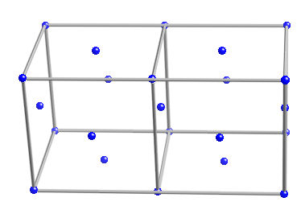
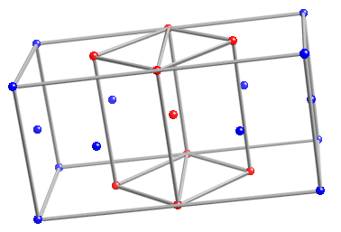
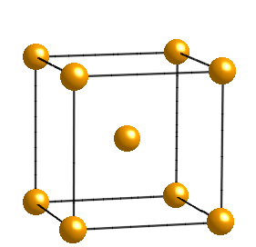

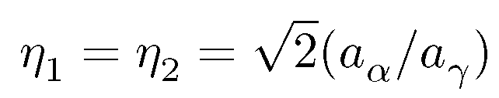
The Bain strain

Slide 22
[001]
b
b'
o
[100]
a'
a
b
(a)
o
b'
(b)
a,a'

Slide 23
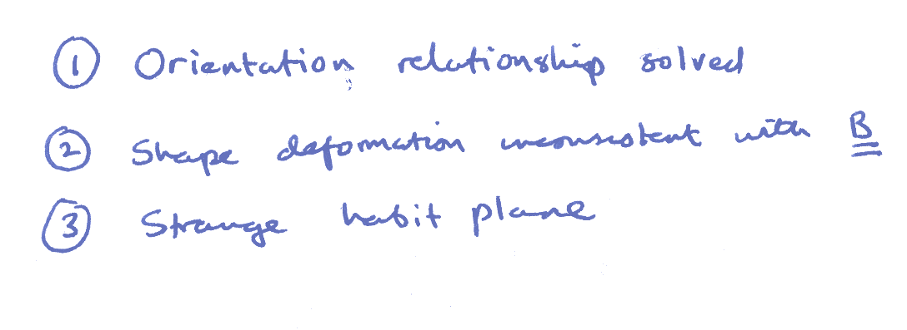

Slide 24
RB
z
w
w
z
w
z
P
Observed
P
Austenite
1
shape,
2
Martensite
wrong
(wrong
y
structure
shape)
x
x
y
x
y
(a)
(b)
(c)
LATTICE
-INVARIANT
DEFORMATION
Twin
w
z
w
z
Boundary
x
y
x
y
Twinned
Slipped
Martensite
Martensite
Correct macroscopic shape, correct structure

Slide 25
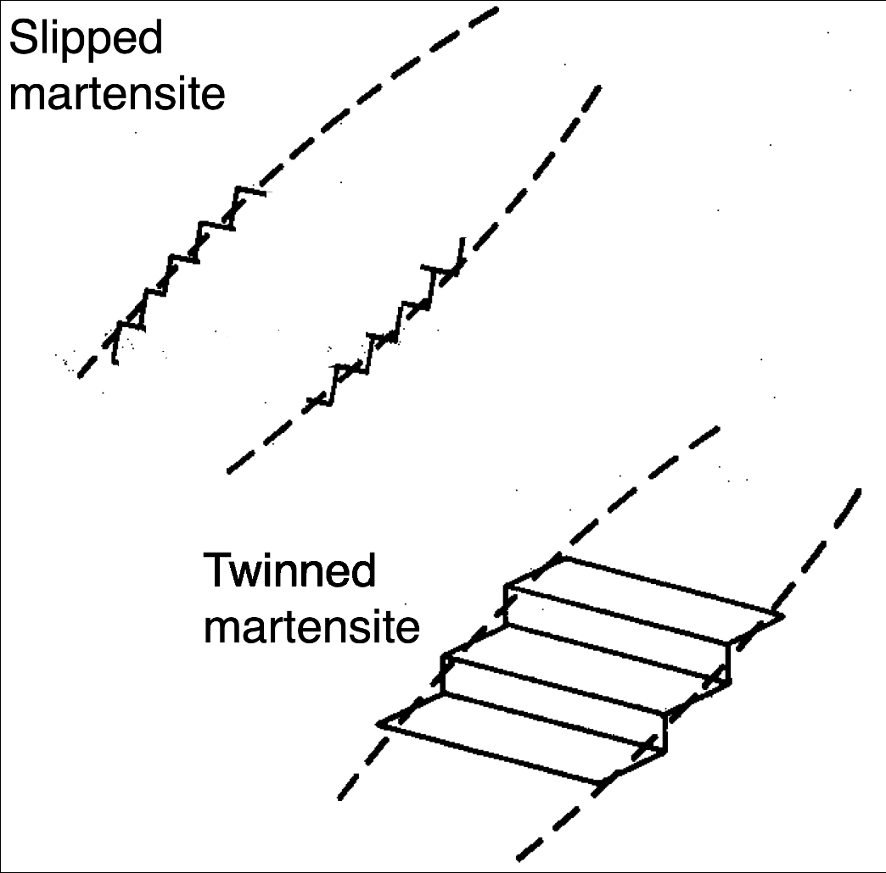

Slide 26
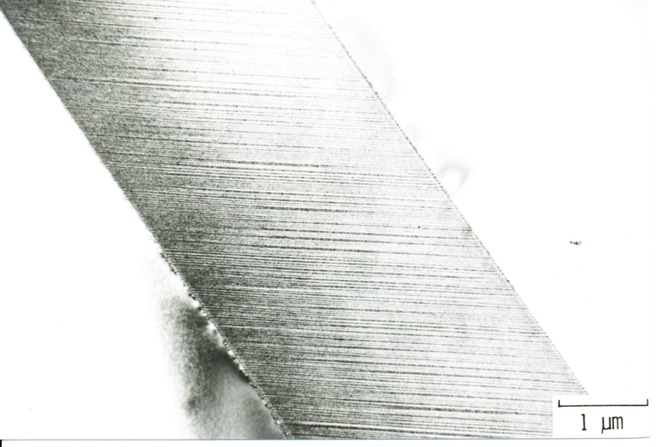
image courtesy of Professor Tadashi Maki
transformation
twins

