Slide 1
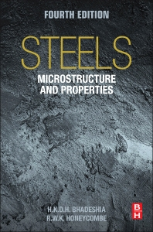

Steels
Martensite
Bainite
Alloy design: strong bainite
Widmanstaetten ferrite
Allotriomorphic ferrite
Pearlite
Overall kinetics
TRIP steel
TWIP steel
Mitigation of residual stress
Bulk nanostructured steel
www.phase-trans.msm.cam.ac.uk/teaching.html
H. K. D. H. Bhadeshia

Slide 2
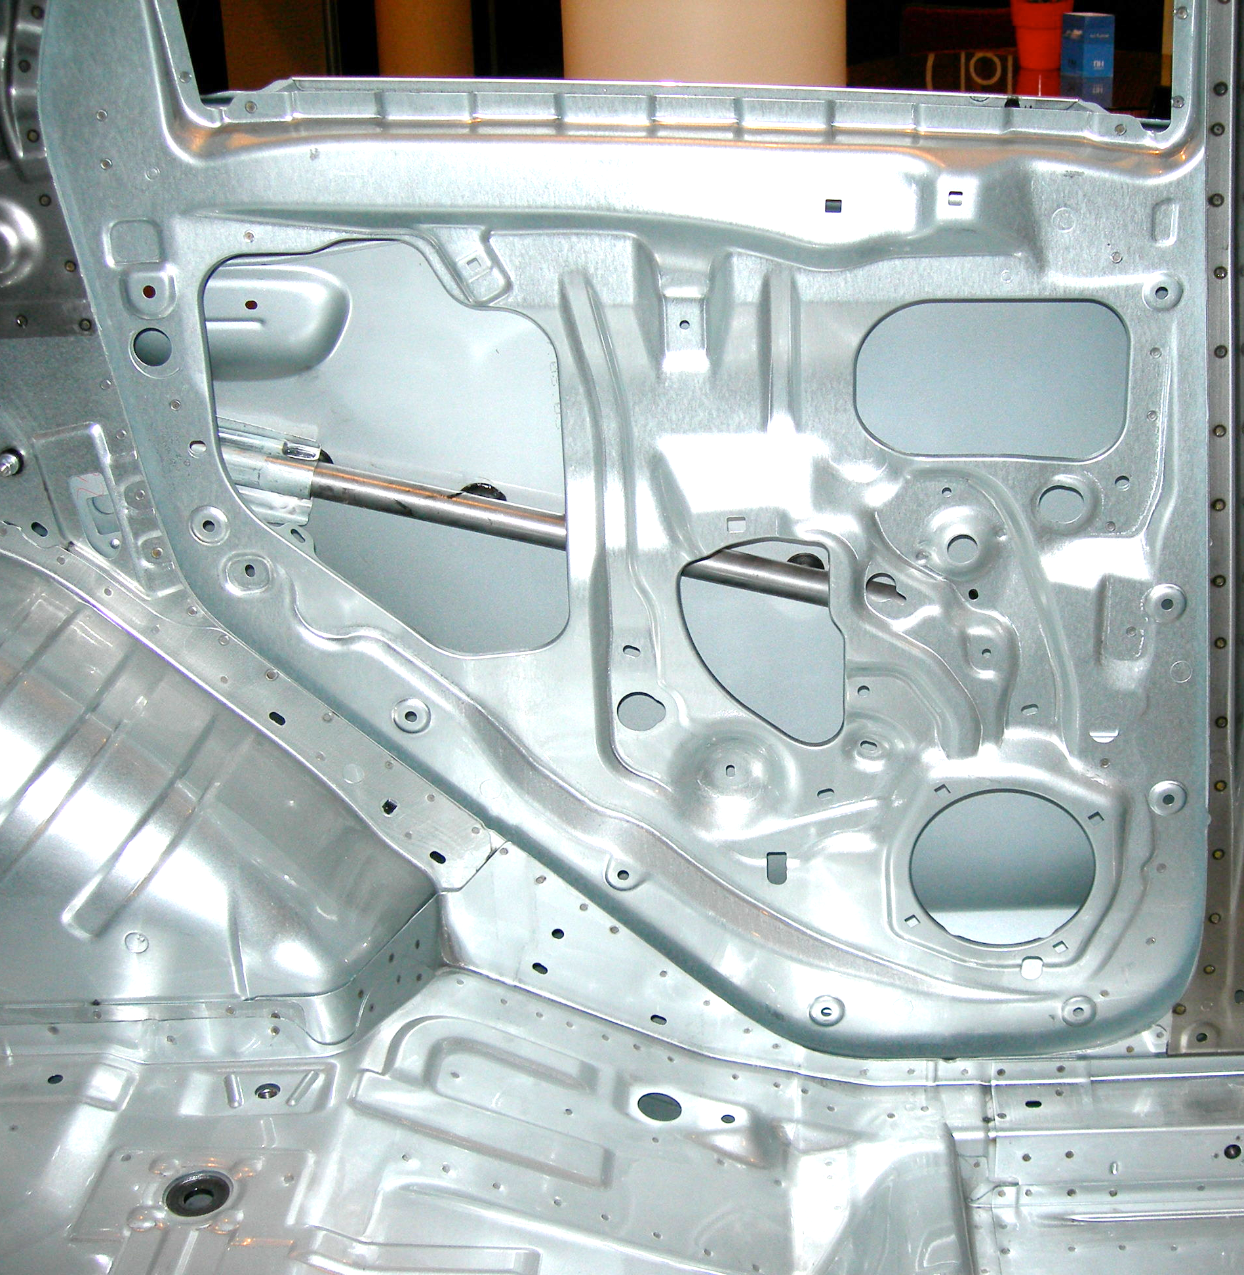
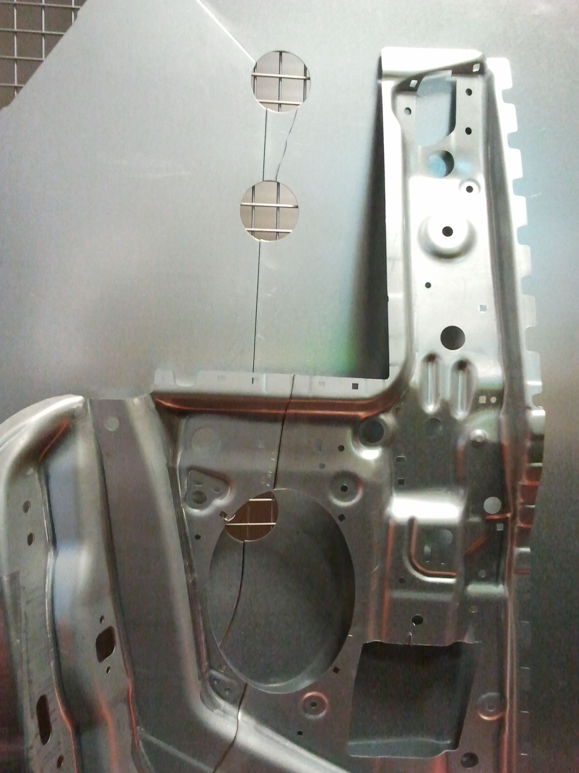
Tailored blanks

Slide 3
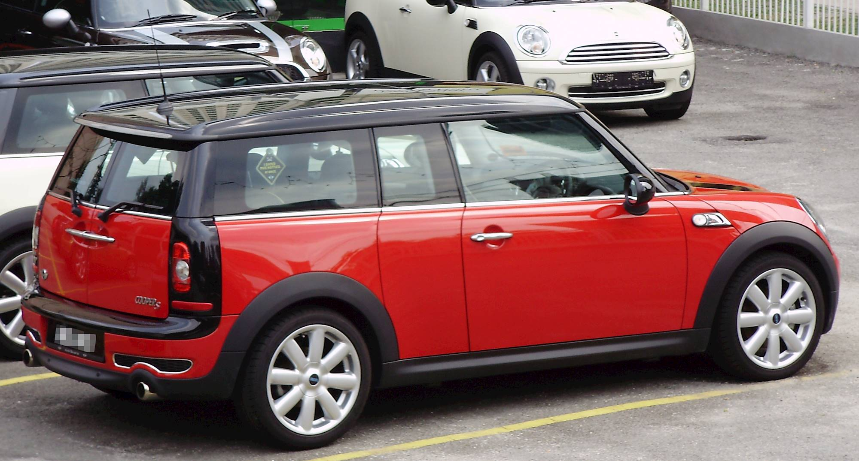
Inner panels of both doors and side panel use tailored blanks

Slide 4
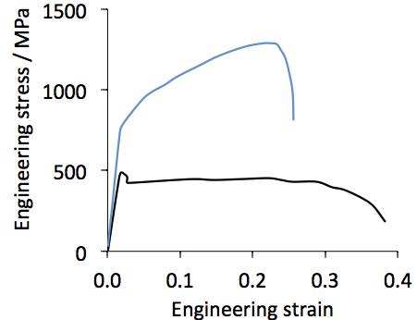
TRIP-steel
aluminium-killed
Mizui et al. (1997)

Slide 5
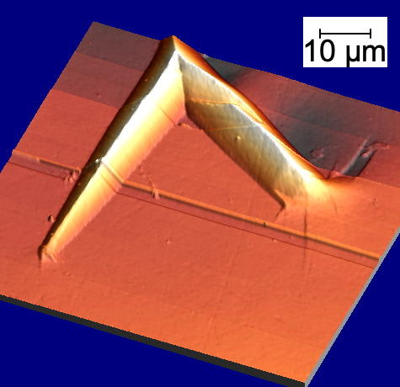
shape deformation
Fe-30.5Ni-0.32C wt%,
M_{s} = -80°C
Stefan Forsik

Slide 6
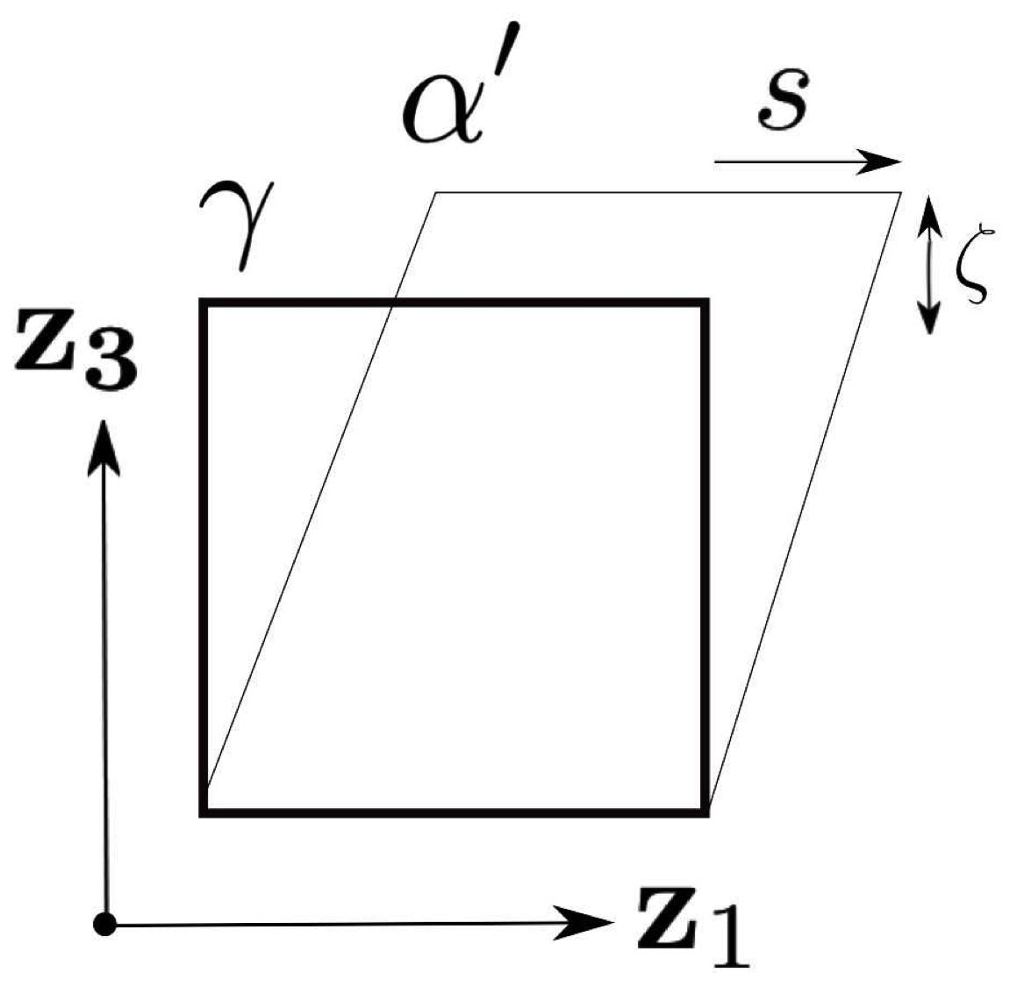
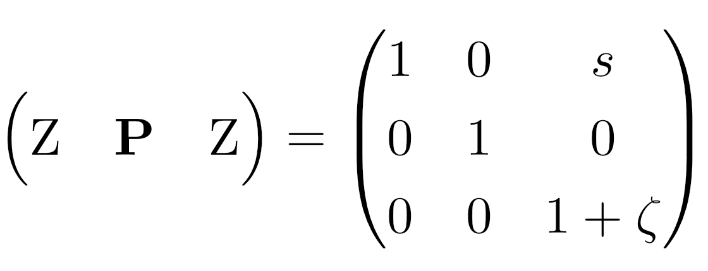
orthonormal coordinates

Slide 7
u
v

Slide 10
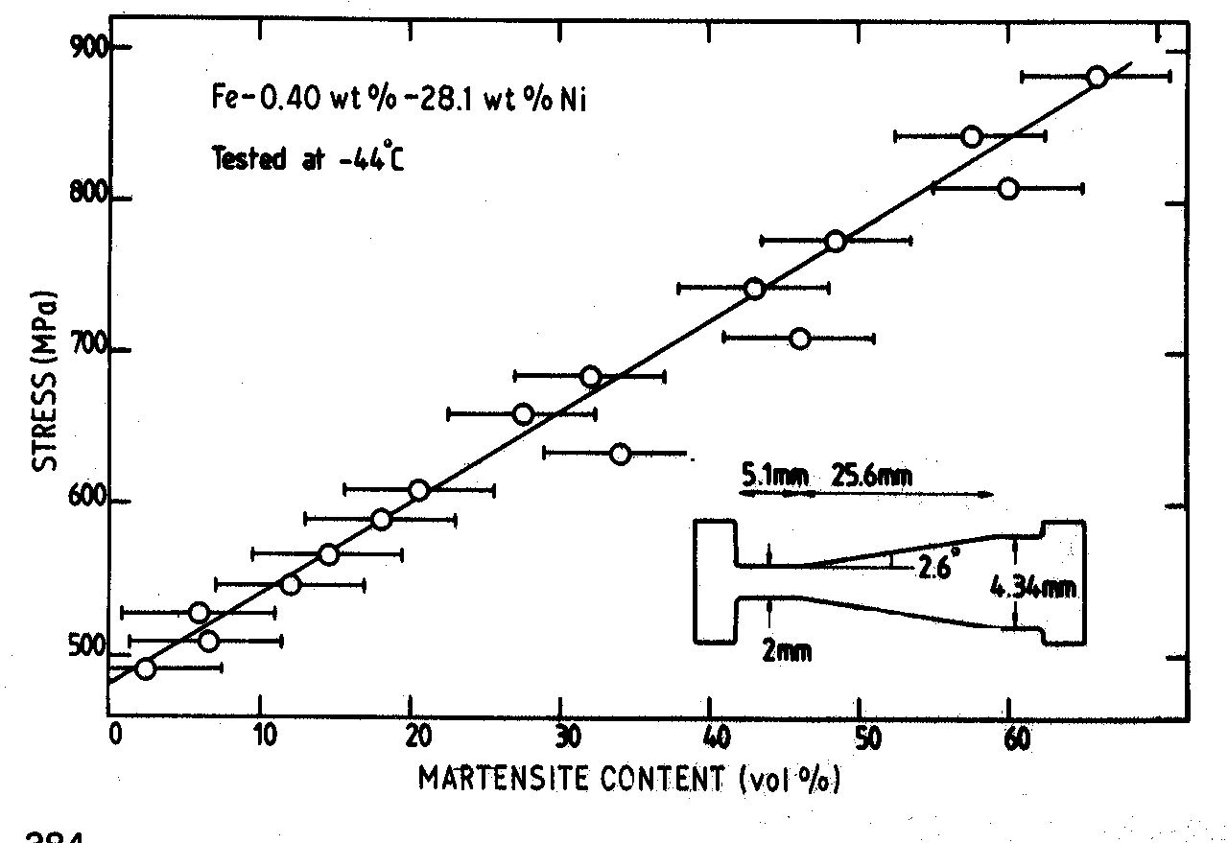
Bhadeshia, 1982

Slide 11
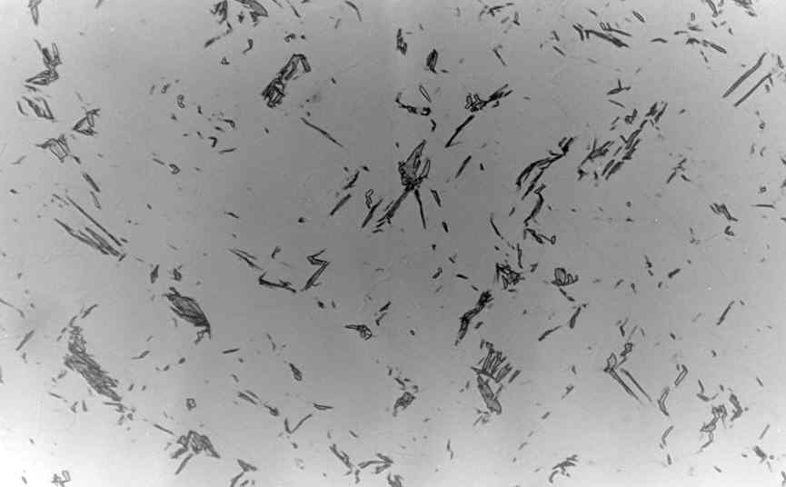
polycrystalline austenite
σ
50 μm
Bhadeshia, 1982

Slide 13
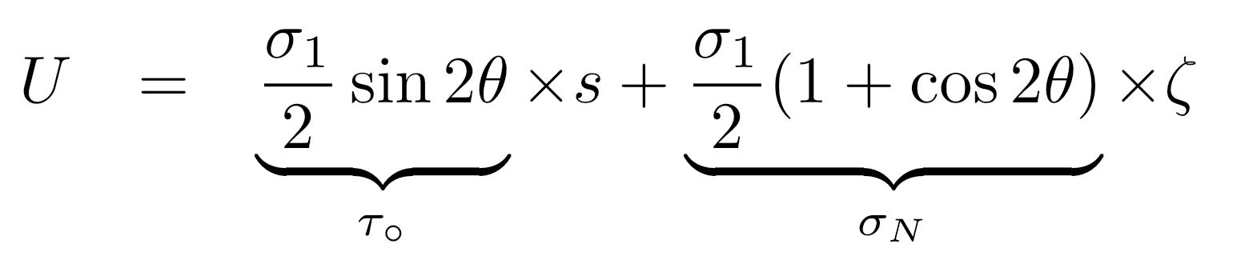
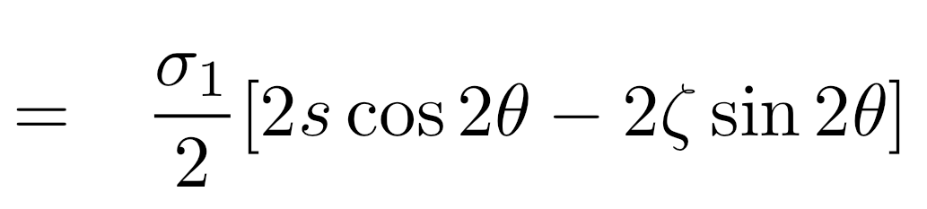


Slide 14
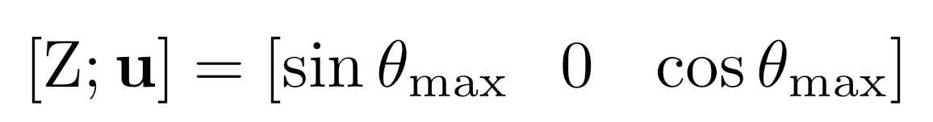
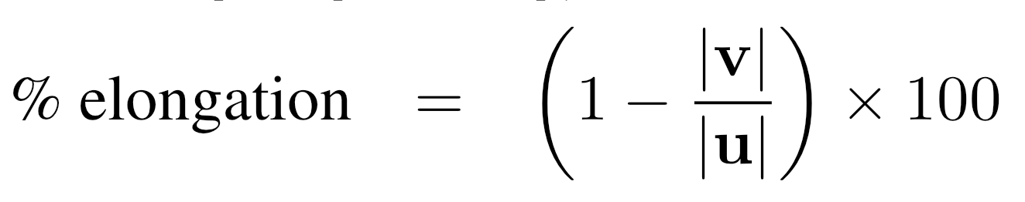
41.7°
tensile axis
= 15%

Slide 15
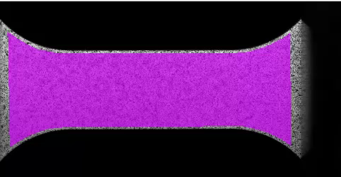
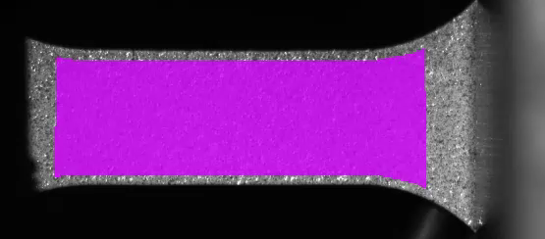
Austenitic stainless steel
25 ∘C
200 ∘C
(Courtesy Prof. N. Tsuji)

Slide 16
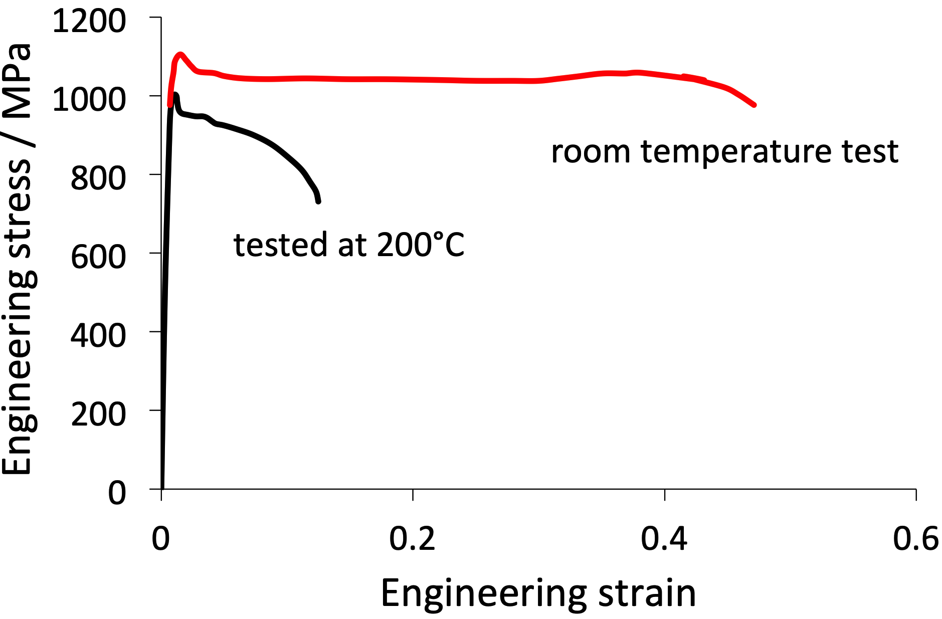
Gao et al. (2019)

Slide 17
TRIP steels that are fully austenitic are expensive
How do we produce cheap austenite?

Slide 18
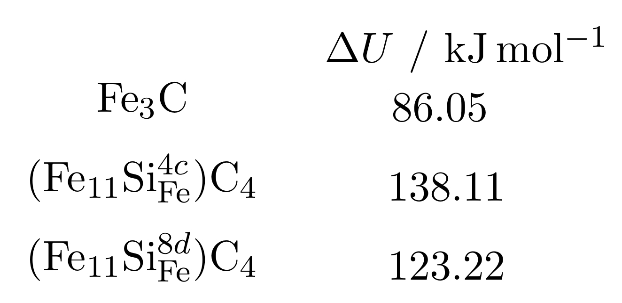
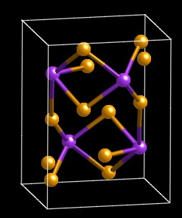
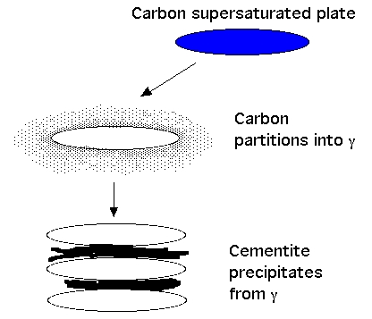
TRIP-Assisted Steels
austenite is expensive
carbon can be cheap
too much carbon is bad
Jae Hoon Jang, In Gee Kim
Notes:
18

Slide 19
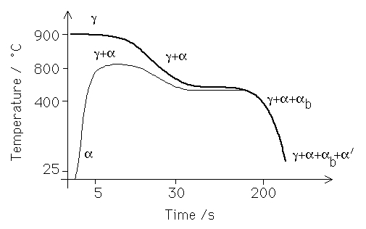

Slide 20
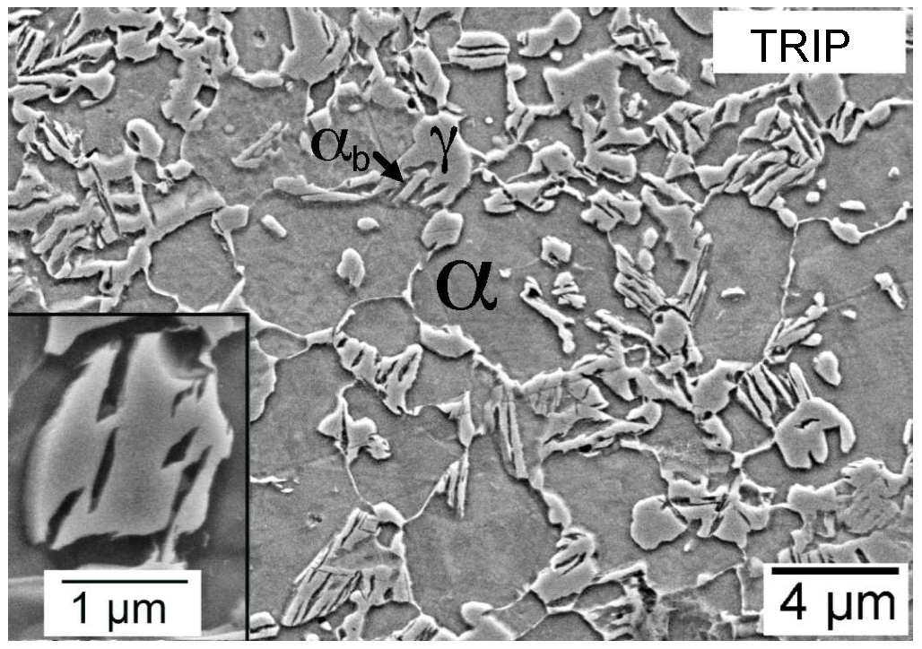
Typical composition Fe-0.15C-1.5Si-1.5Mn wt%

Slide 21

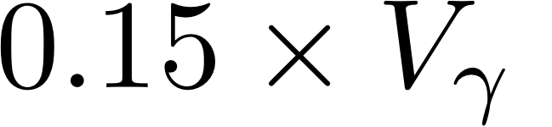
Typical microstructure:
70% allotriomorphic ferrite
16% bainitic ferrite
14% retained austenite
2.1% elongation due to TRIP

Slide 22
work hardening!
TRIP-steel
aluminium-killed
Mizui et al. (1997)

Slide 23
Elongation of TRIP-assisted steel
not due to transformation plasticity
work hardening due to hard martensite

Slide 24
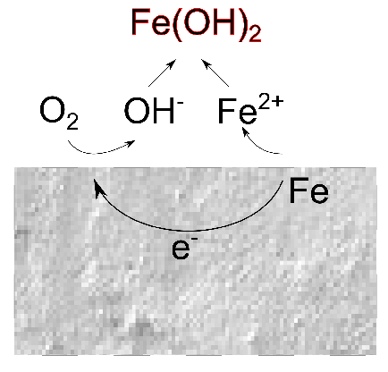
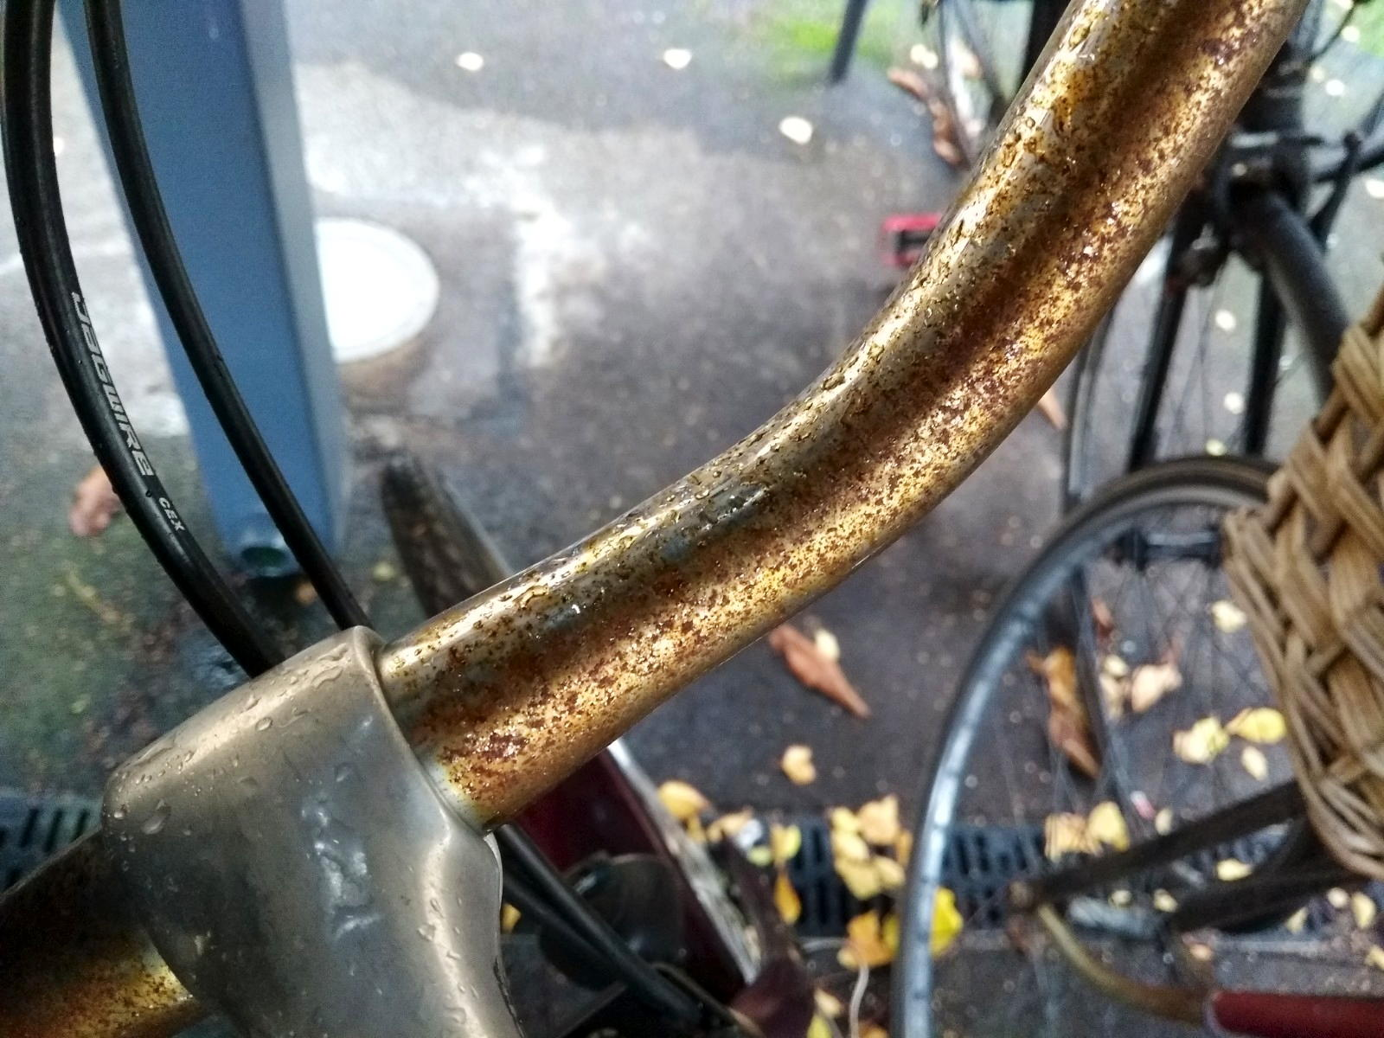

Slide 25
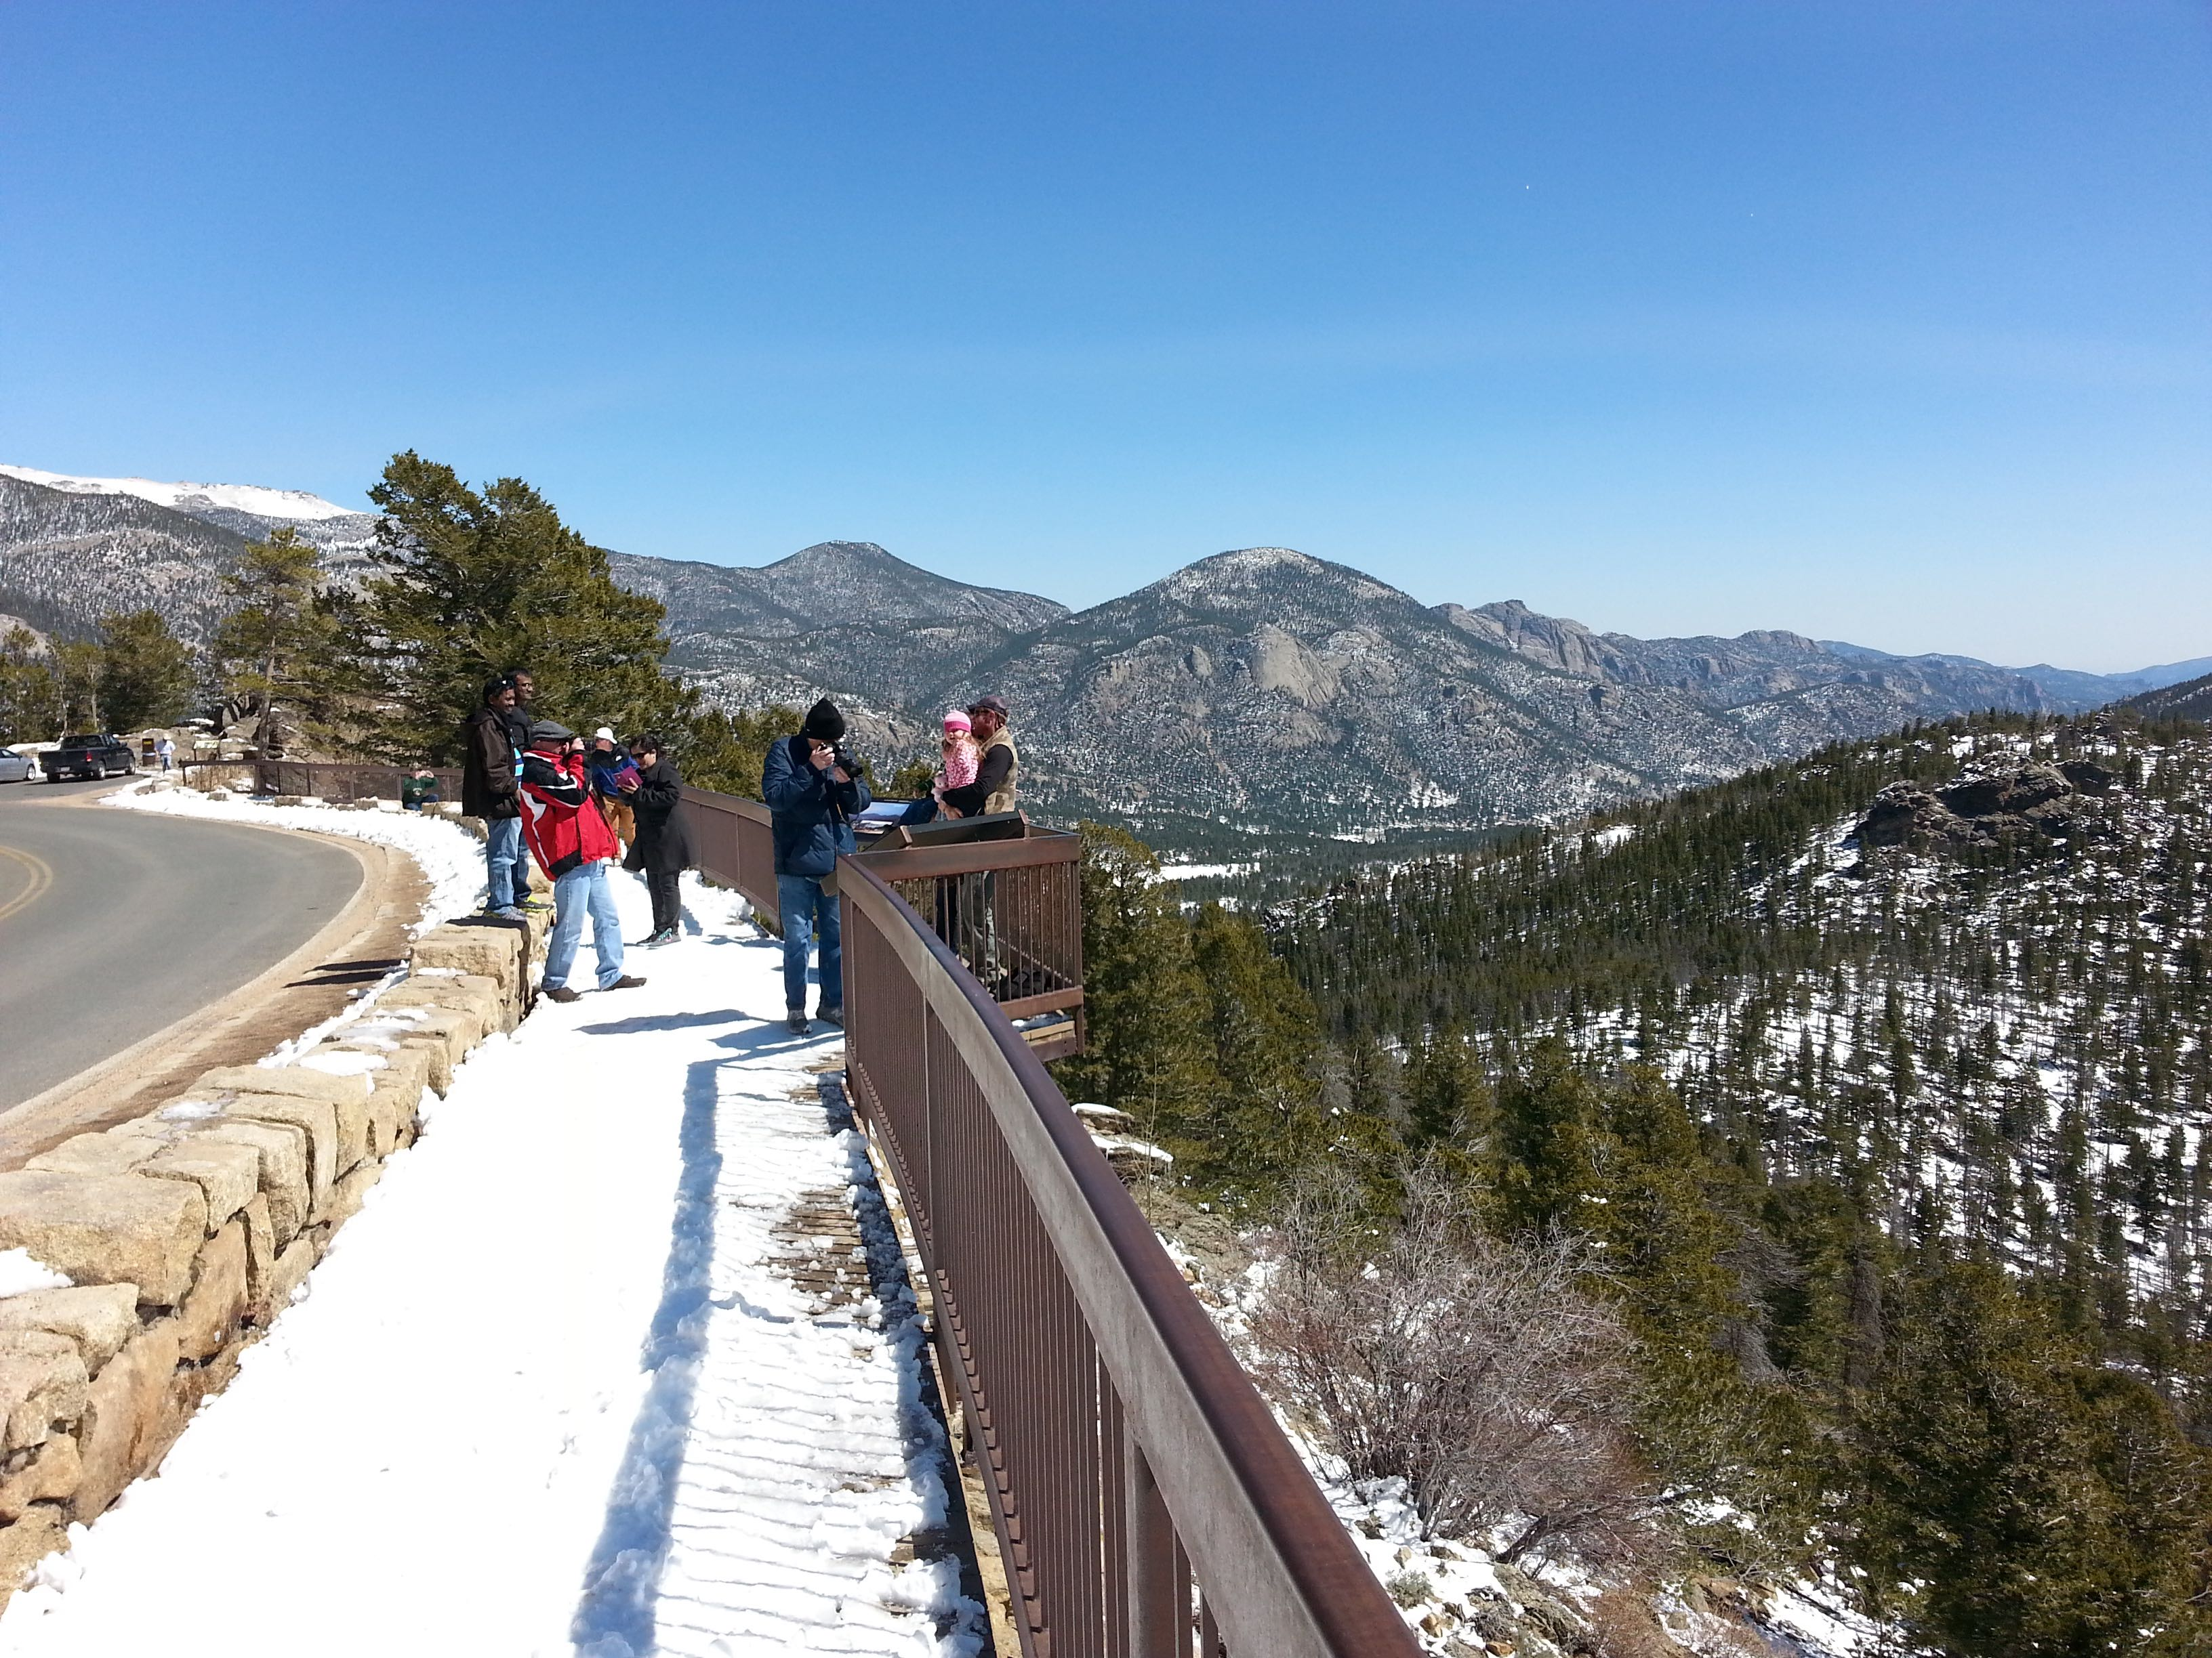

Slide 26
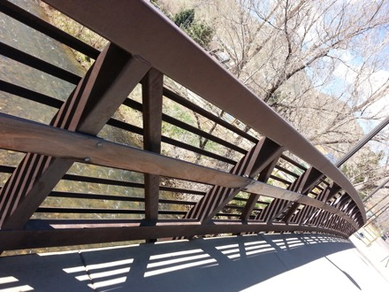
Corten is a weathering steel with 0.25-0.55Cu and 0.5-1.25Cr wt% develops a patina

Slide 27
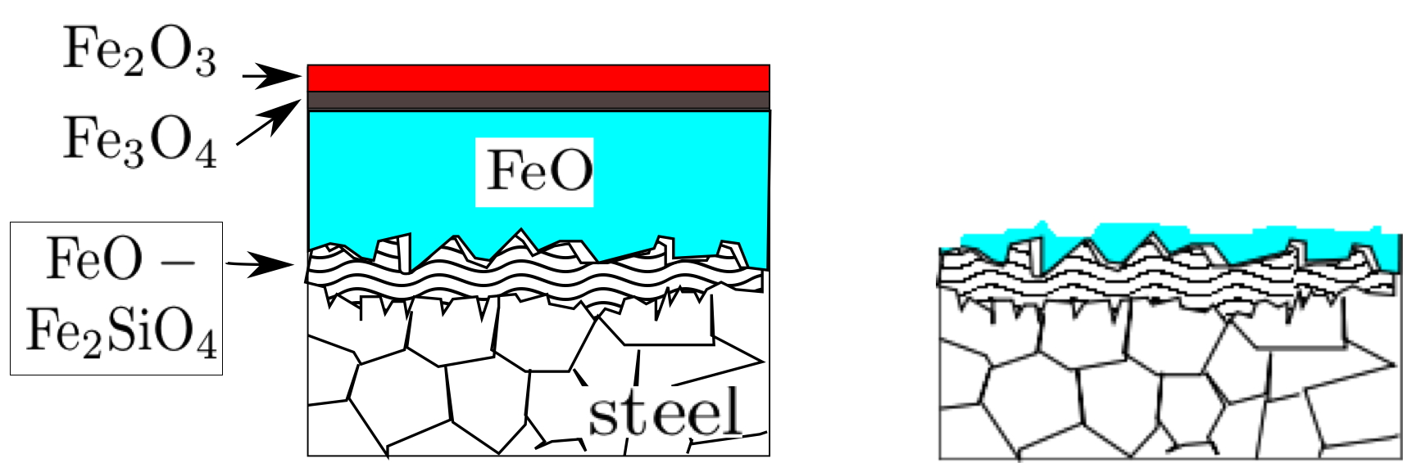
TRIP-Assisted Steels
too much silicon is bad
Notes:
27

Slide 28
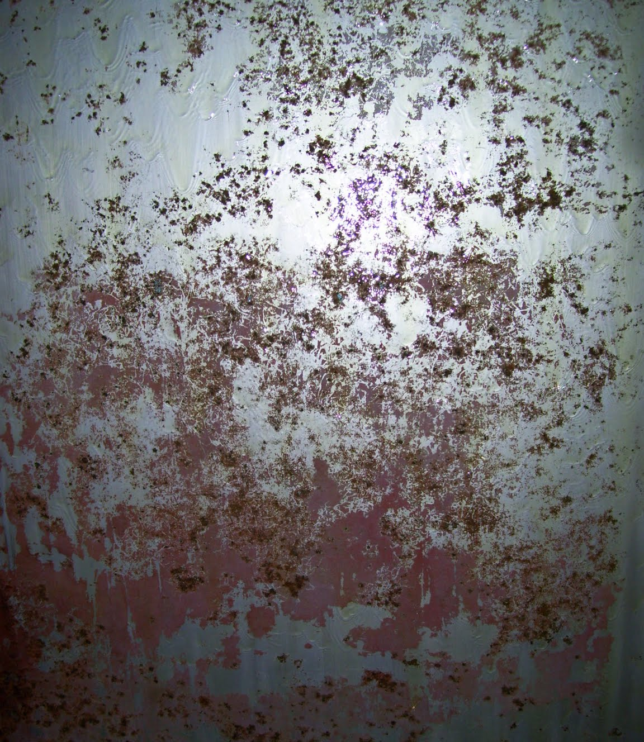

Slide 29
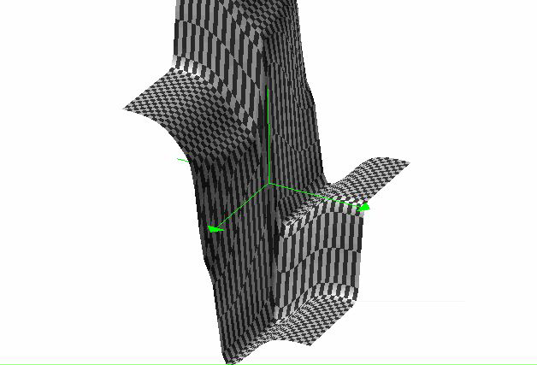
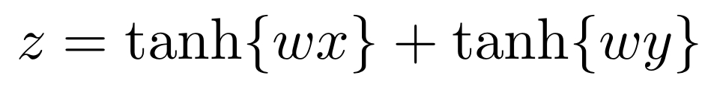
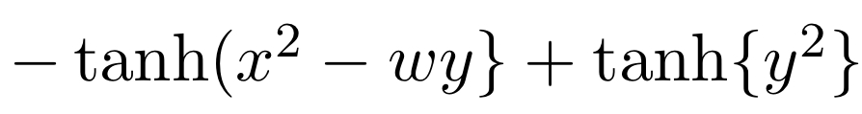

Slide 32
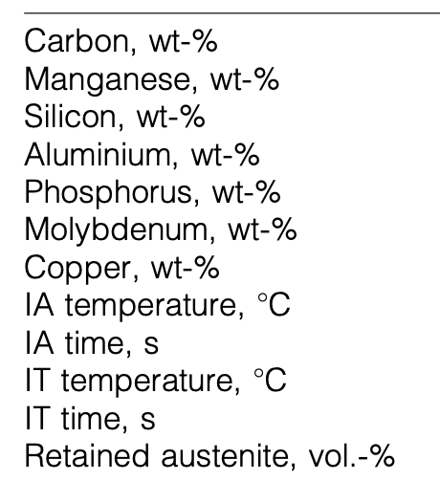

Slide 33
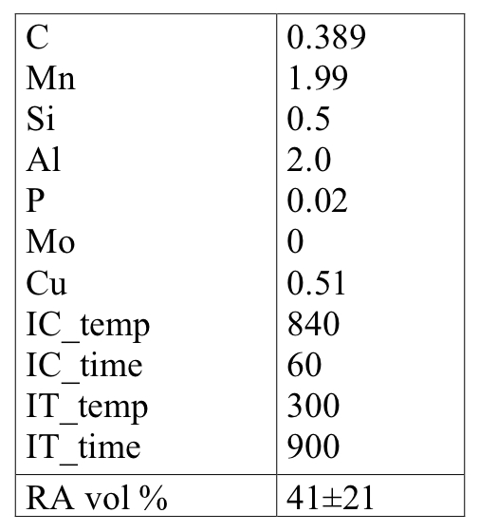

Slide 34
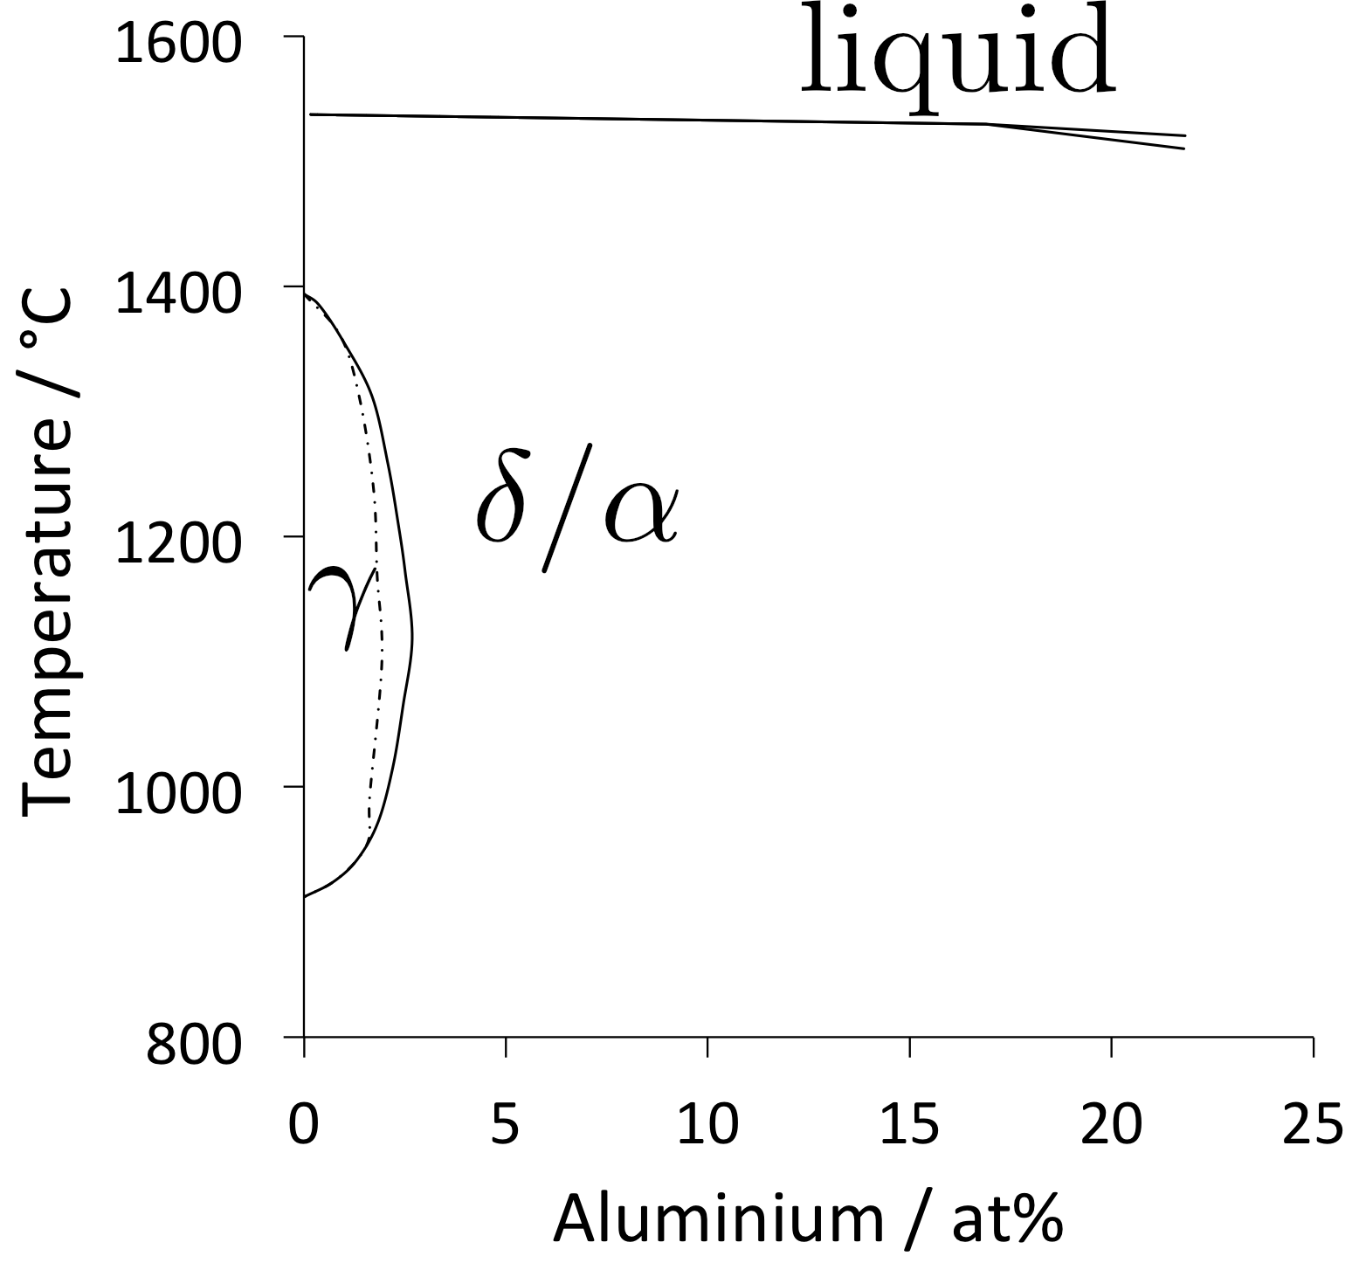

Slide 35
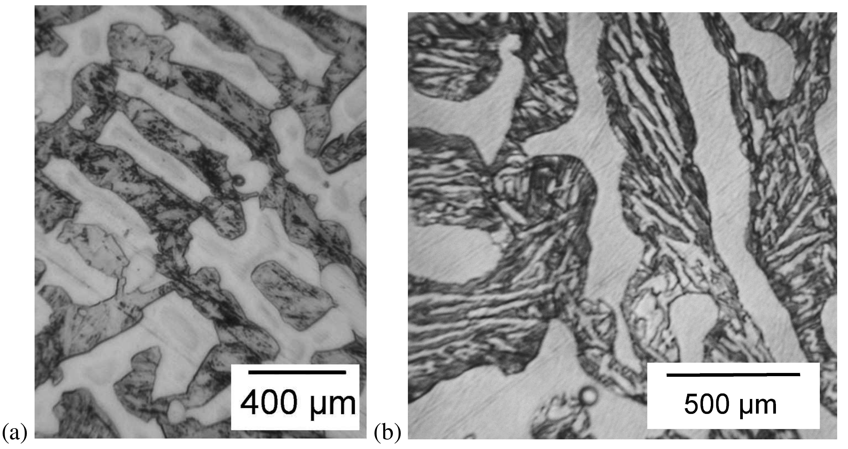
Notes:
35

Slide 36
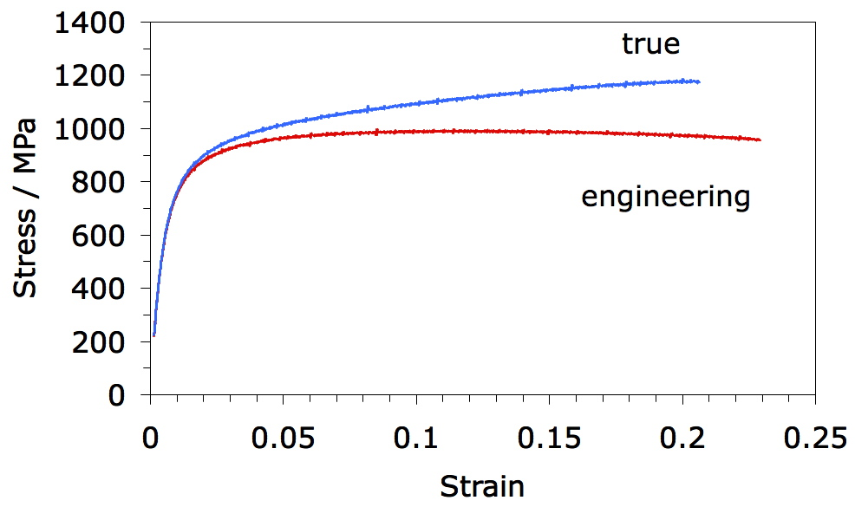
tested at room temperature
14.3% γ
7% γ

Slide 37
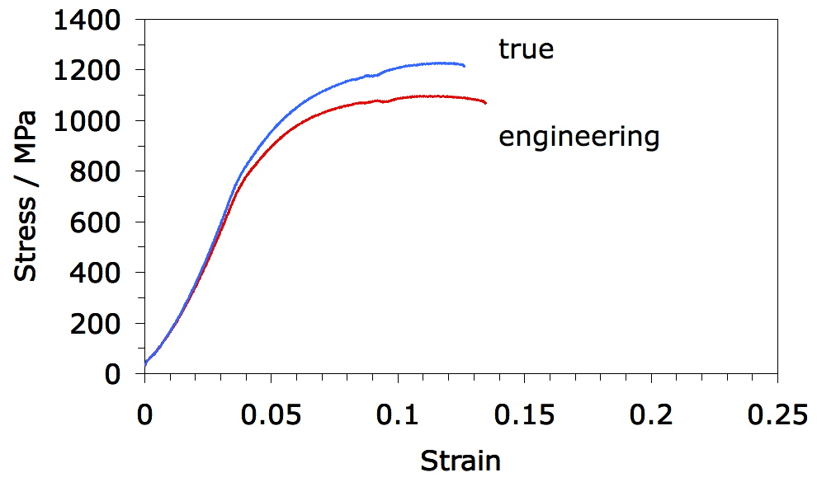
tested at 100 °C
14.3% γ
13% γ

Slide 38
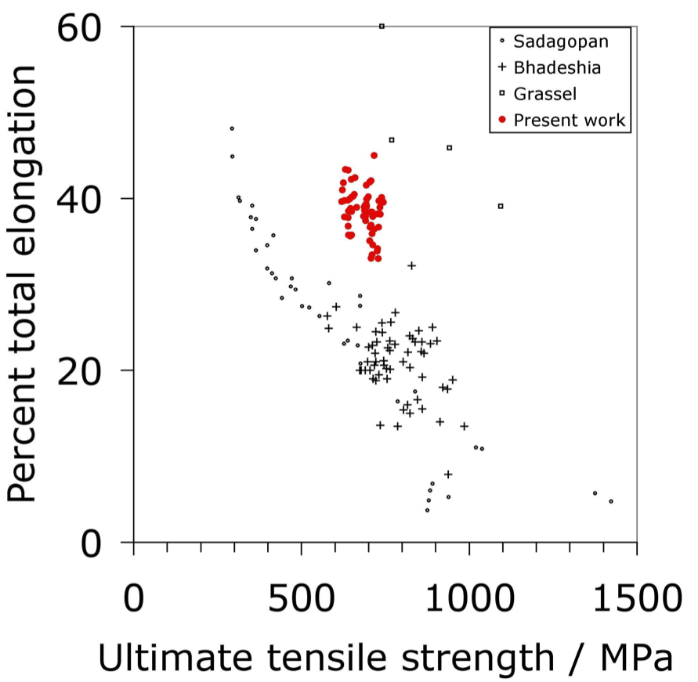
Notes:
38

Slide 39
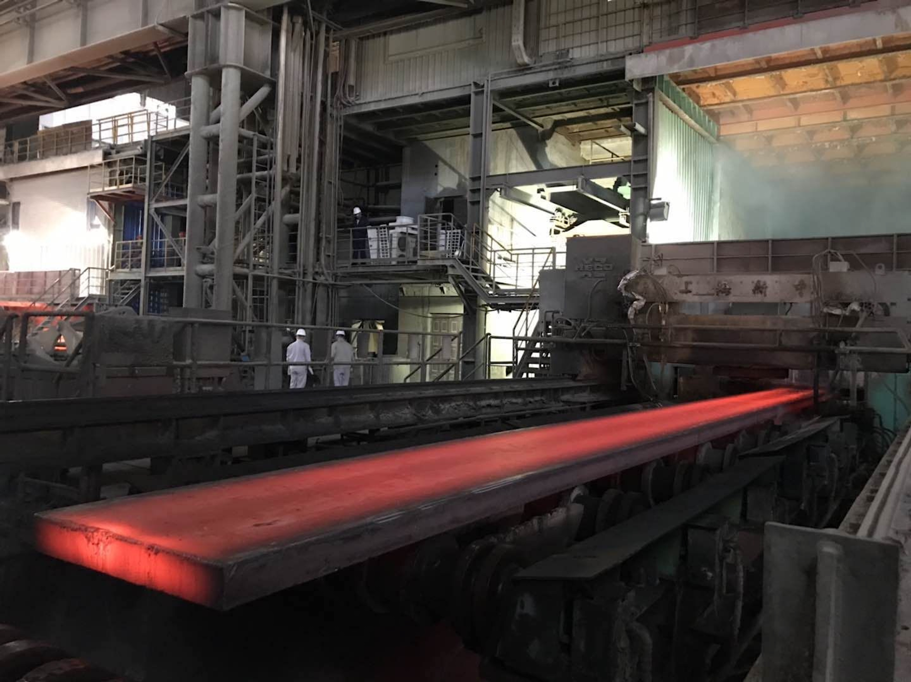
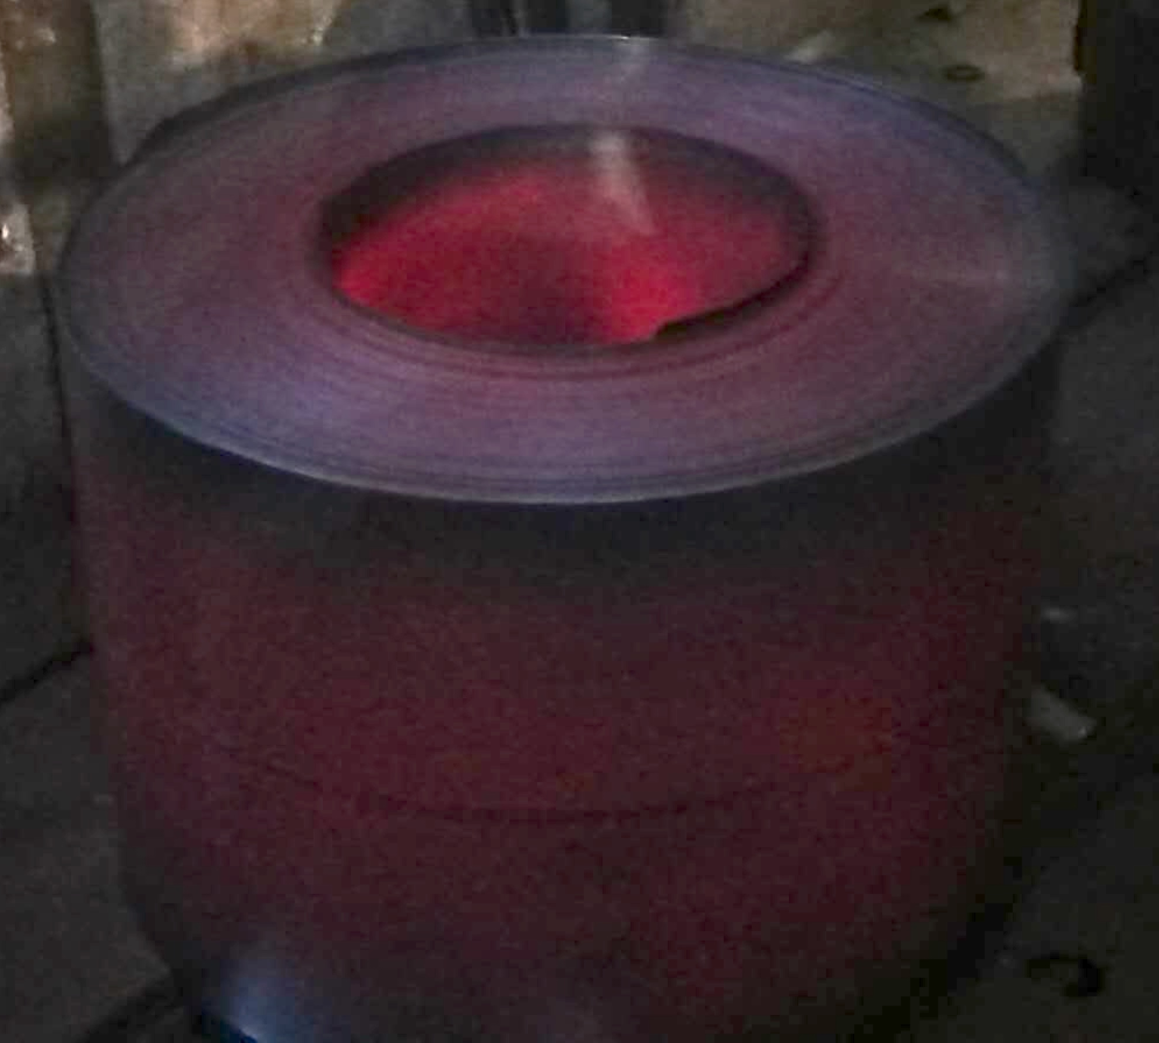
after hot-rolling
continuous casting
(Prof. Hongliang Yi, Northeastern University, China)

Slide 40
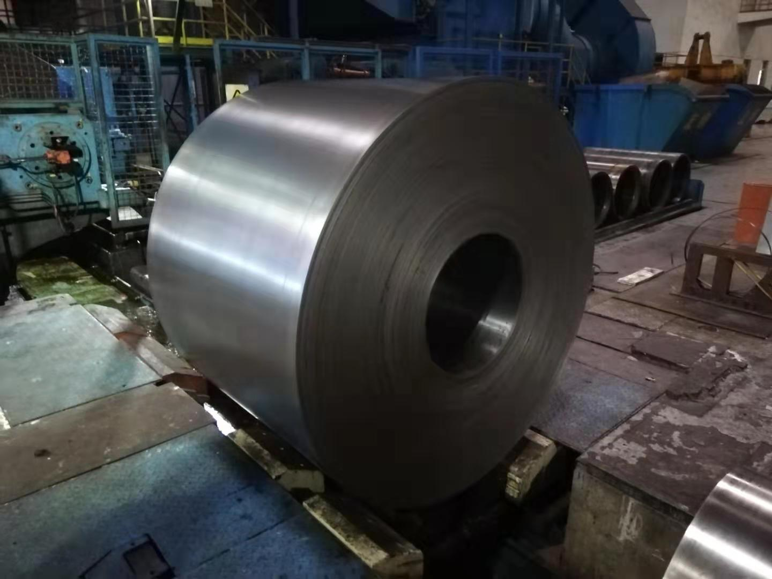
after cold-rolling
(Prof. Hongliang Yi, Northeastern University, China)

Slide 41
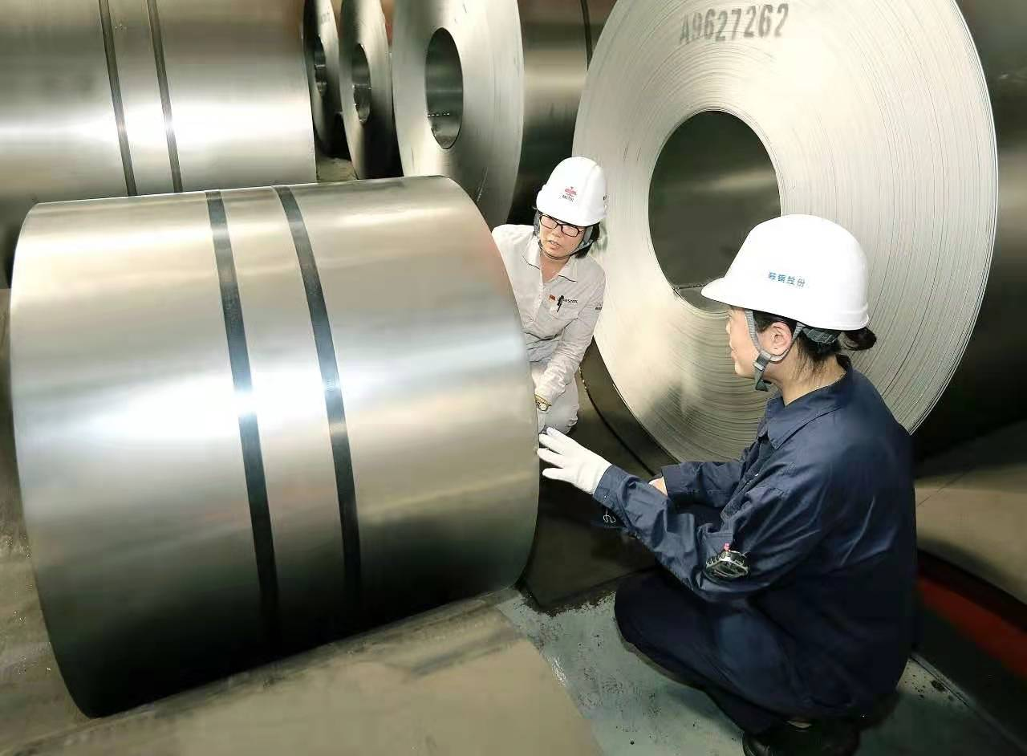
after continuous annealing
(Prof. Hongliang Yi, Northeastern University, China)

