Slide 1
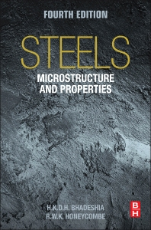

Steels
Martensite
Bainite
Alloy design: strong bainite
Widmanstaetten ferrite
Allotriomorphic ferrite
Pearlite
Overall kinetics
TRIP steel
TWIP steel
Mitigation of residual stress
Bulk nanostructured steel
www.phase-trans.msm.cam.ac.uk/teaching.html
H. K. D. H. Bhadeshia

Slide 2
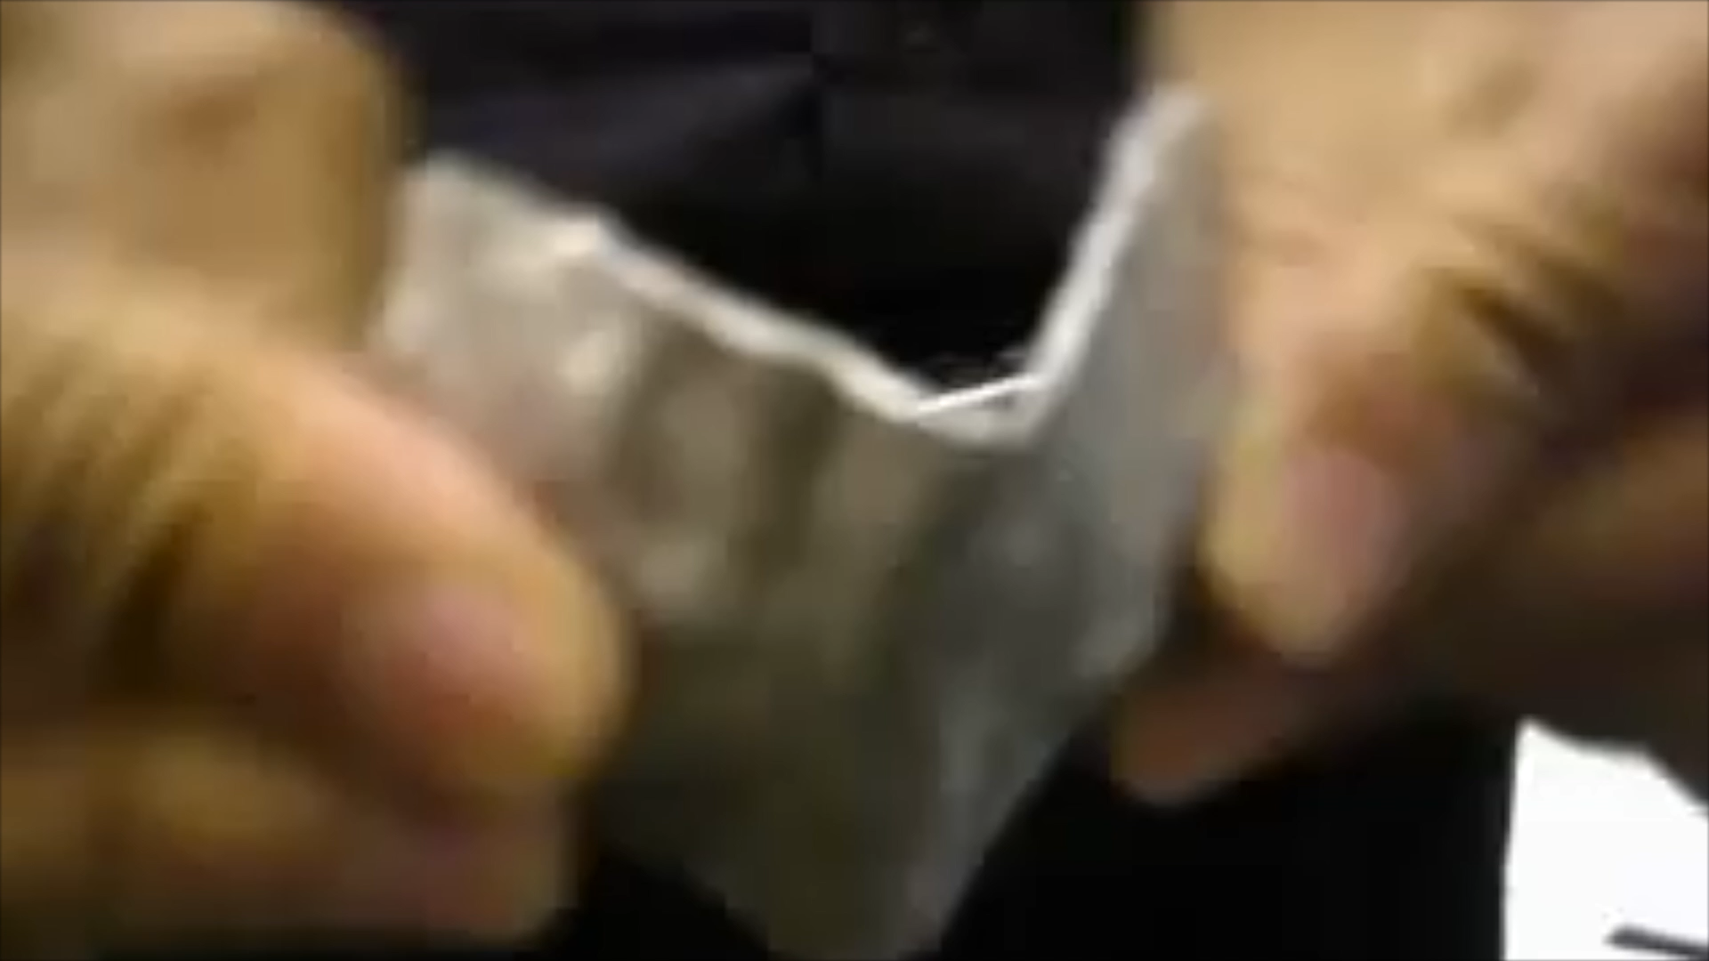
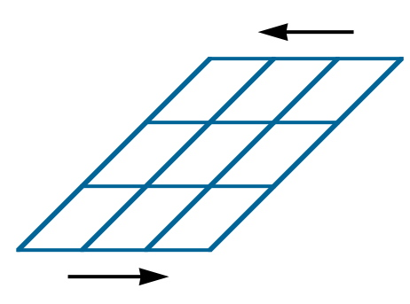
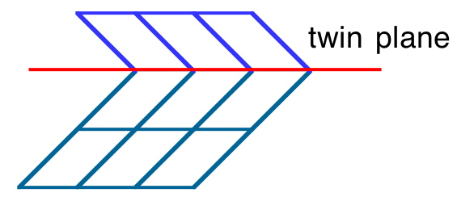
mechanical twinning

Slide 3
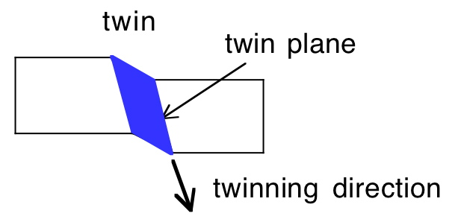
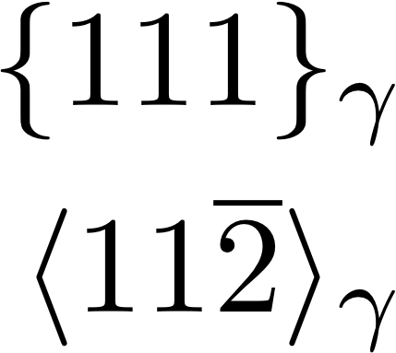

Slide 4
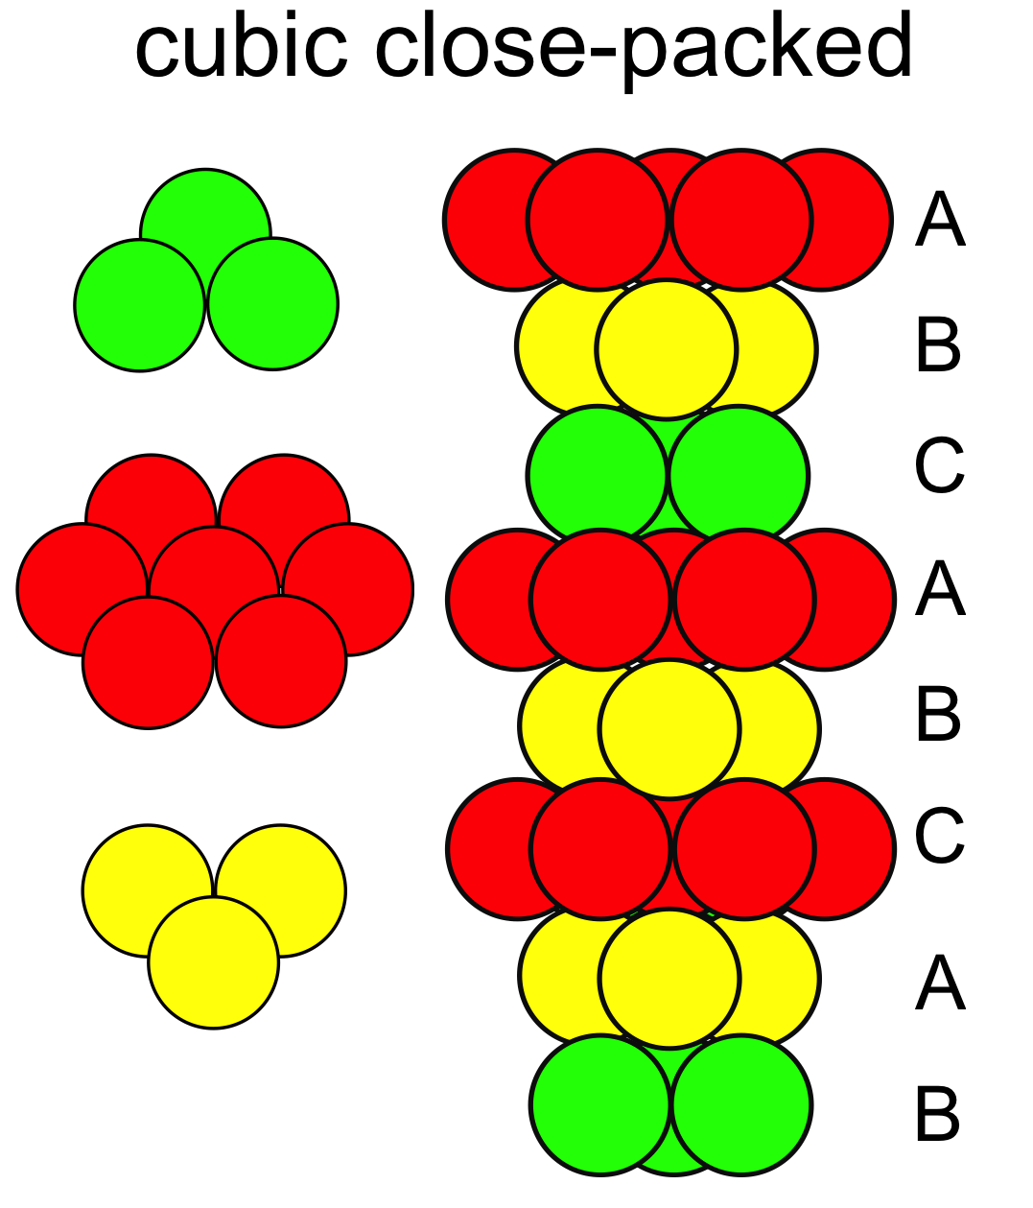


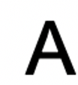
A
B
CA
B
A
B
CBC
A
B
CBA

Slide 5
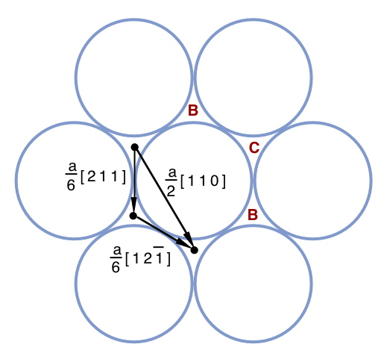

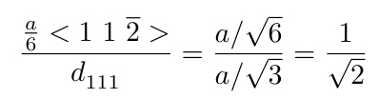

Slide 6
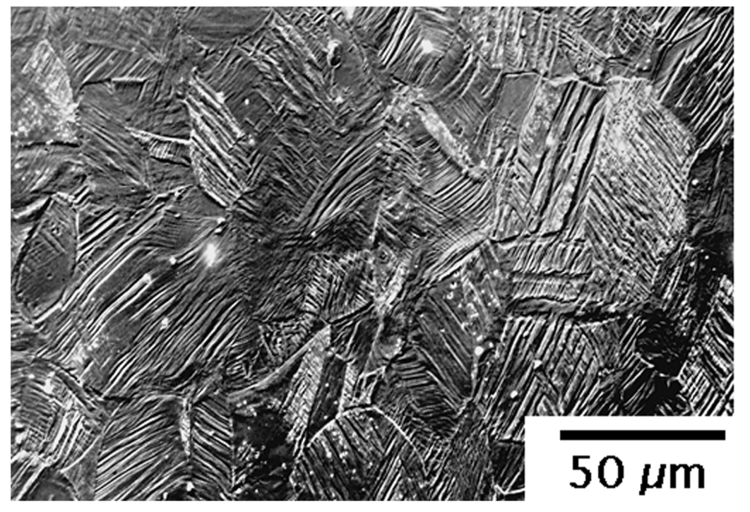
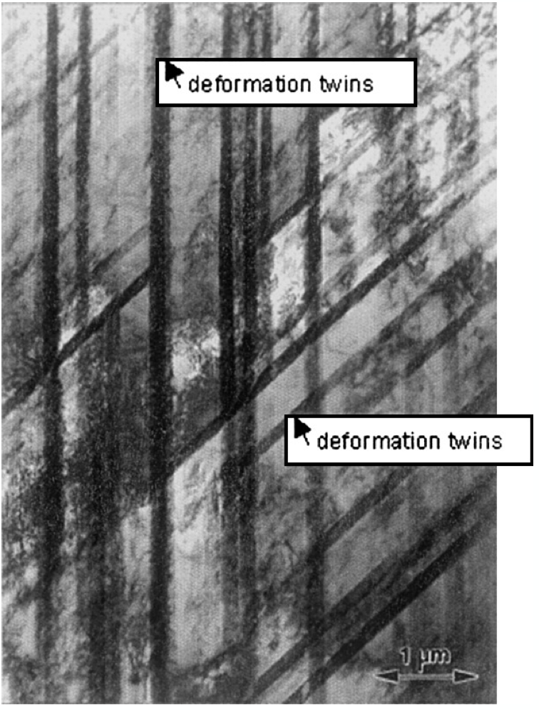
Frommeyer, Brux and Neumann

Slide 7
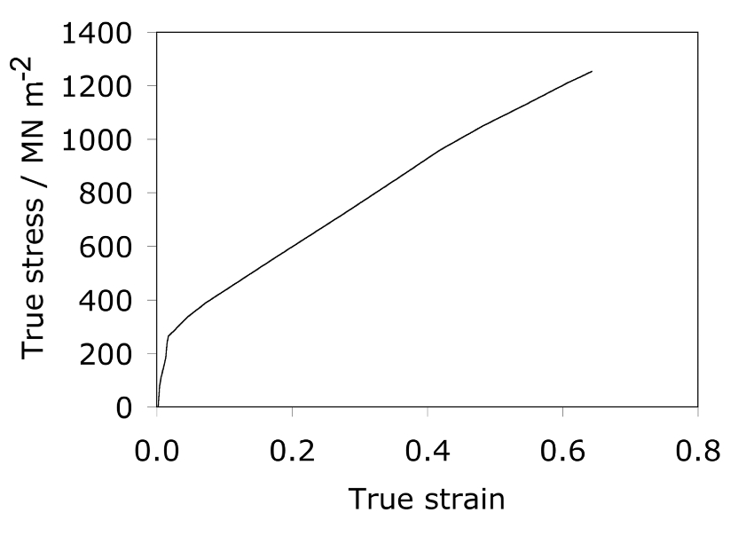
dynamic Hall-Petch effect
Frommeyer, Brux and Neumann

Slide 8
TWIP Steels
Fe-25Mn-3Si-3Al wt%
density 7.3 g cm⁻³
fully austenitic
maintain attractive properties to -150°C
and at high strain rates (10³ s⁻¹)
data from Frommeyer et al.

Slide 9
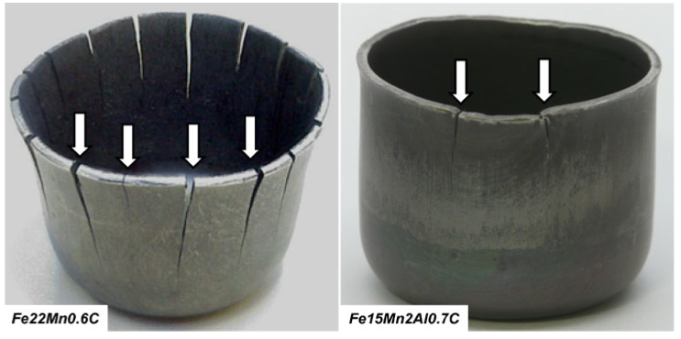
delayed fracture
difficult to produce
high thermal expansion
Bruno de Cooman

Slide 10
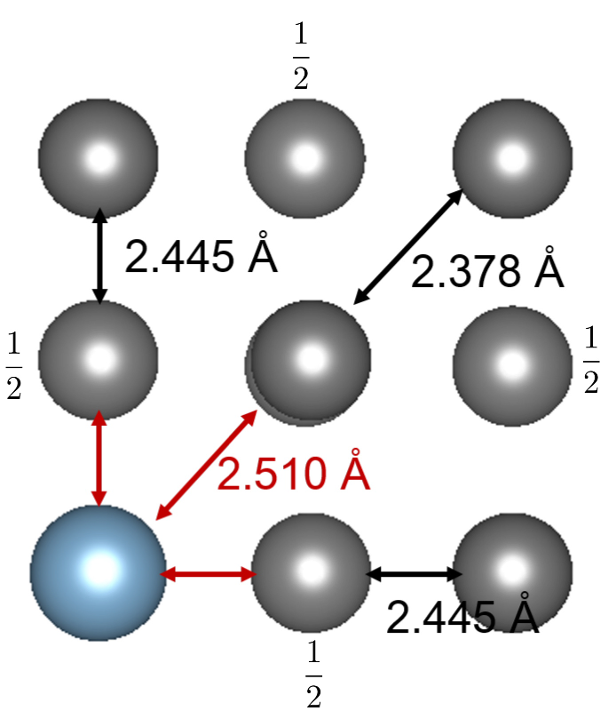
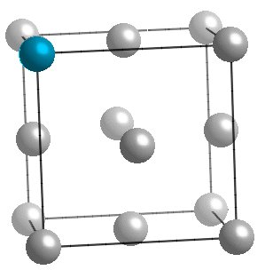
Atomic traps for hydrogen
Fe
Al
Song, Bhadeshia, Suh, 2014

Slide 11
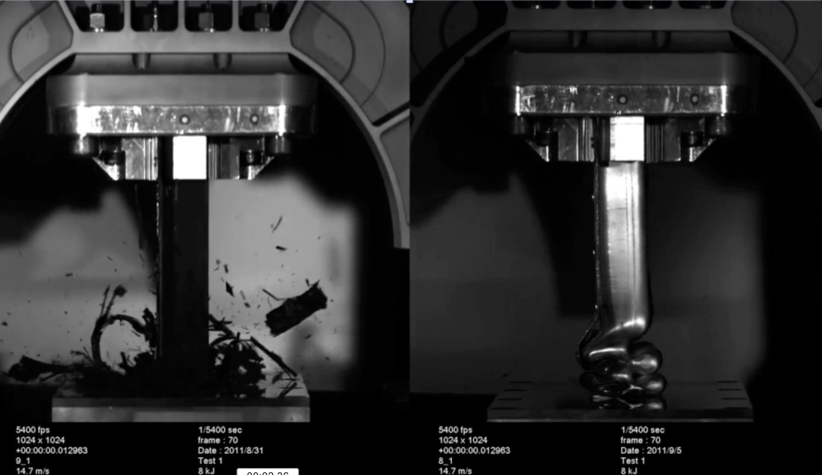
Sanjeev Sharma and Richard Dashwood of the International Manufacturing Centre, WMG University of Warwick.

Slide 12
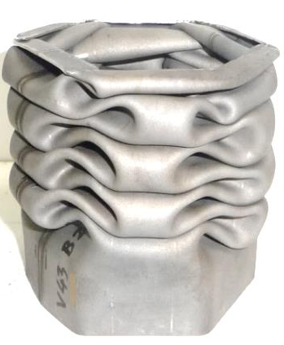
courtesy of
Professor Wolfgang Bleck

Slide 13
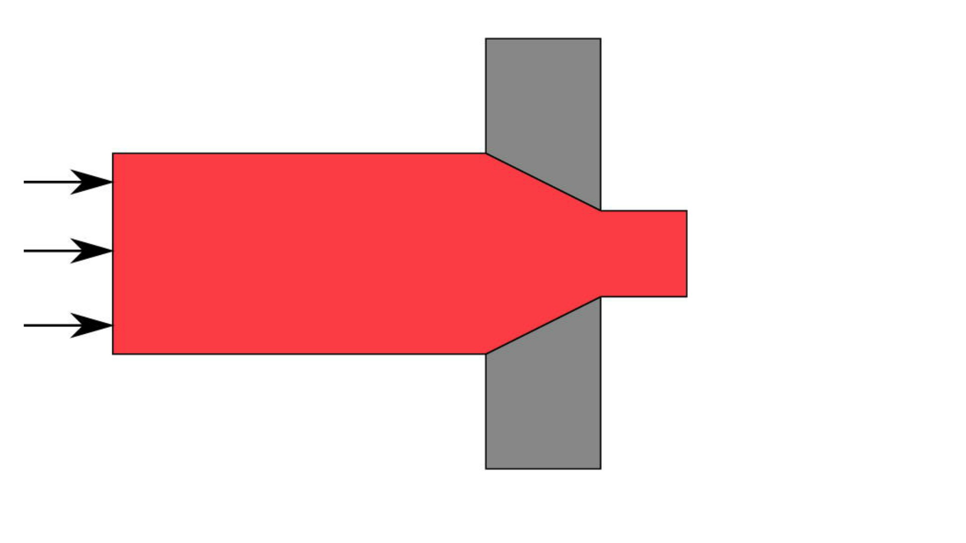

Slide 14
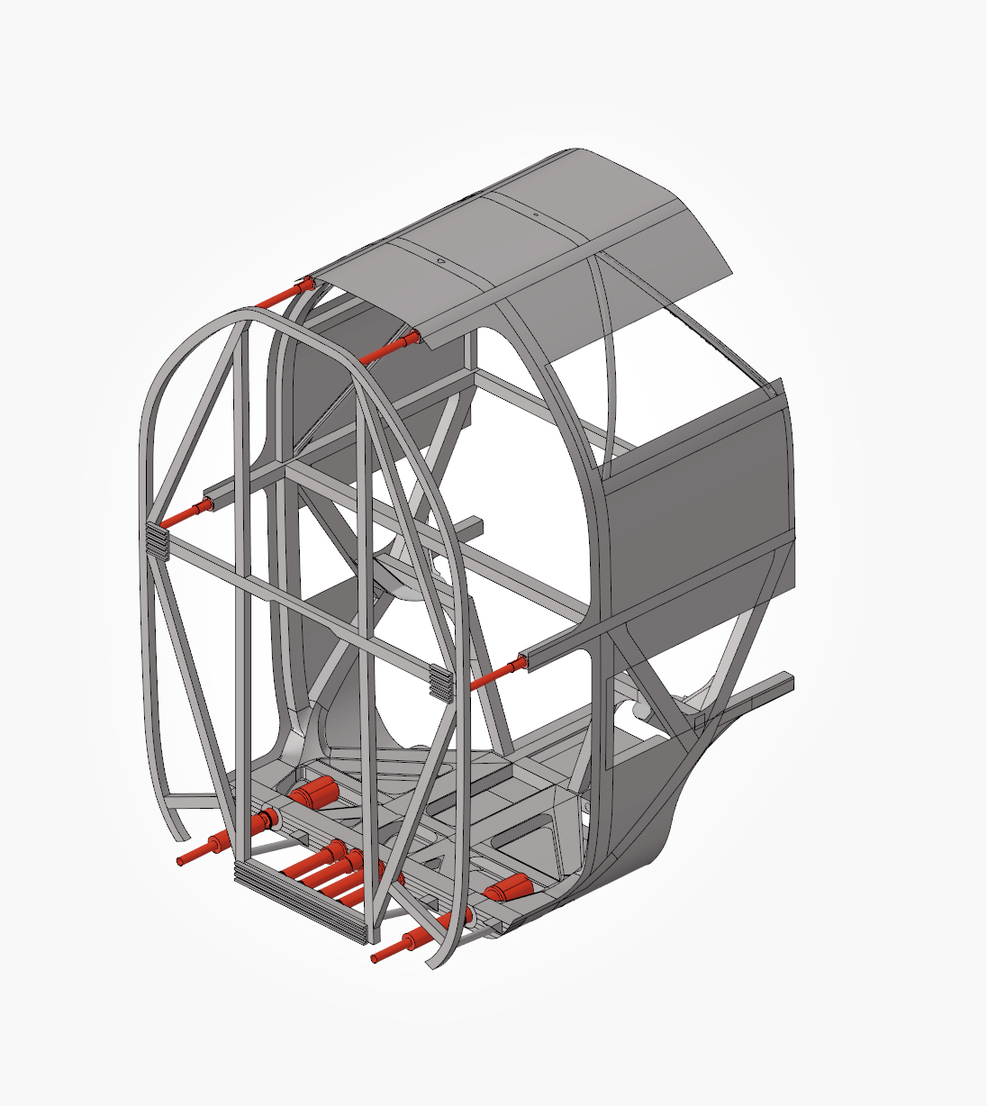
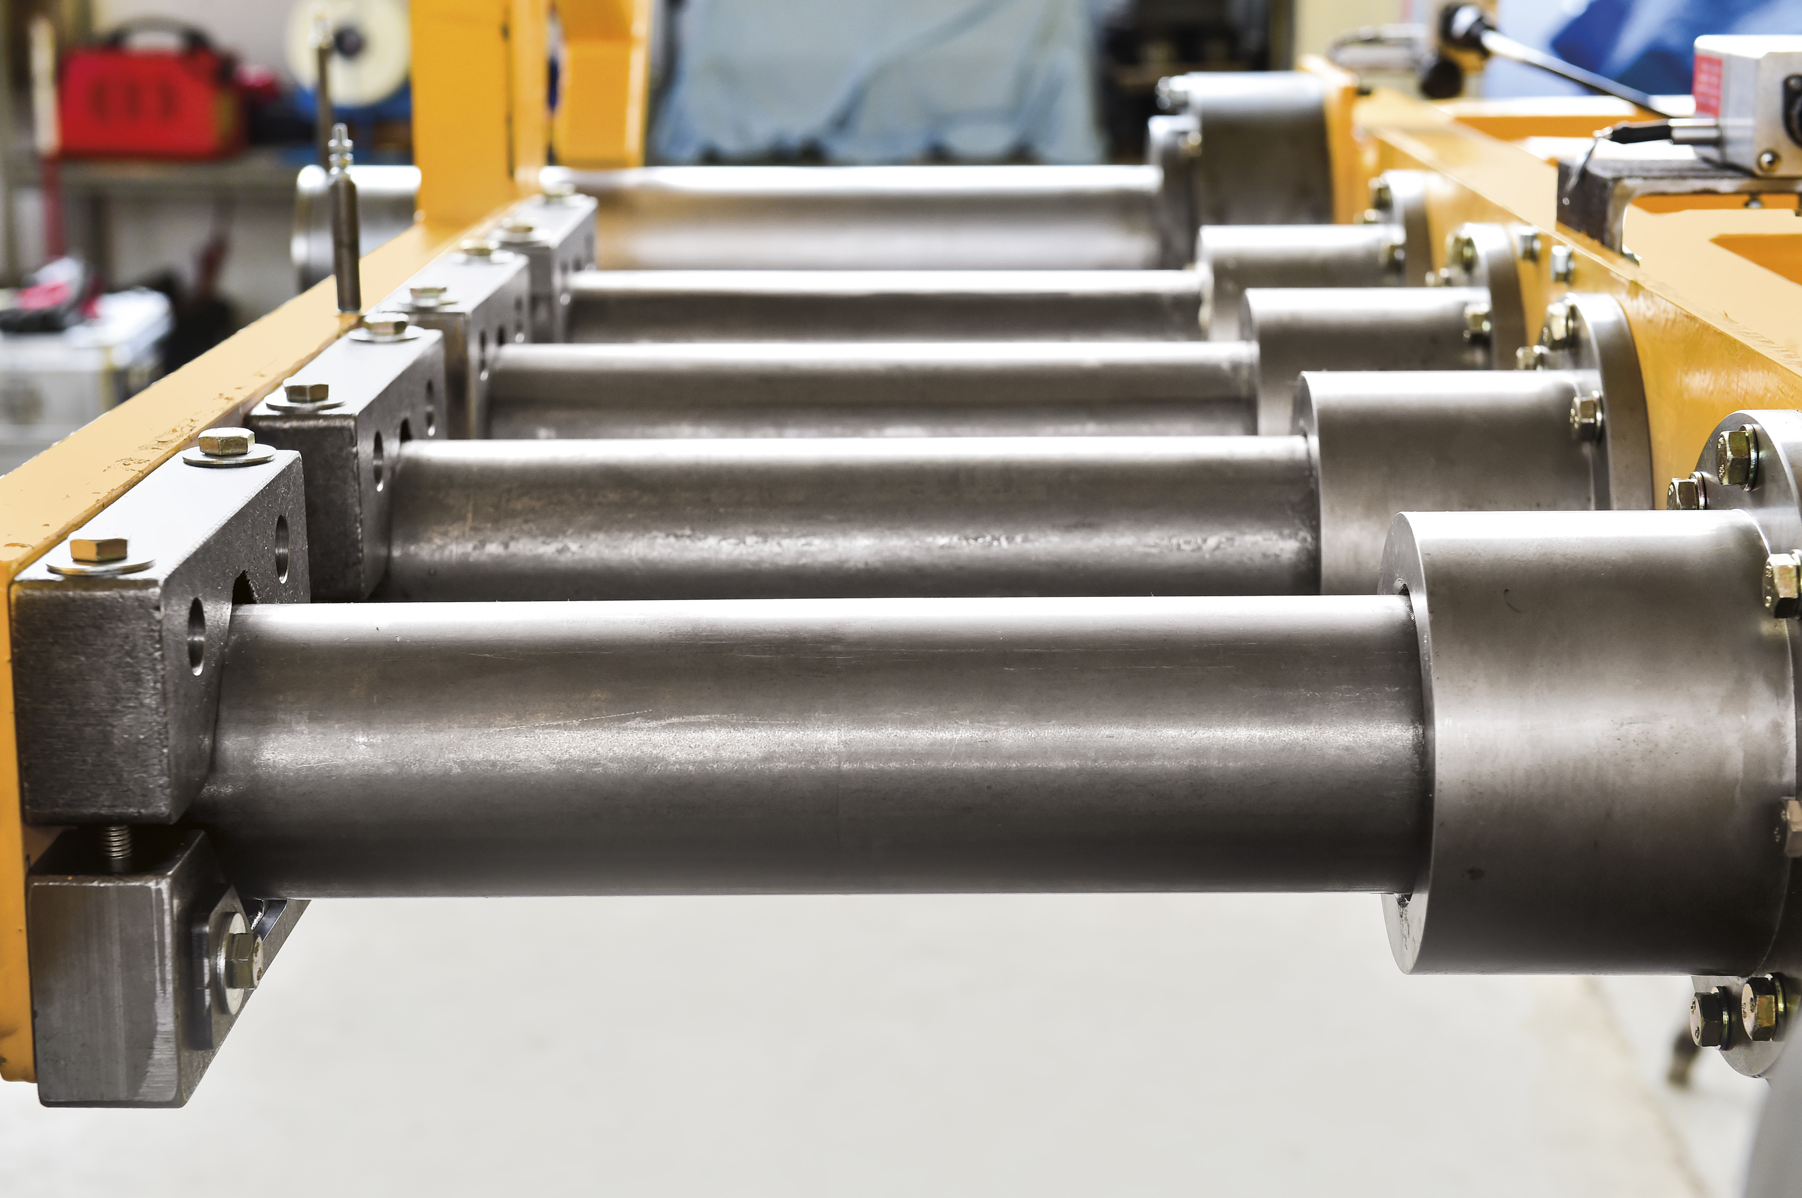
photo & graphics: DLR
https://www.stahl-innovationspreis.de/news/gewinner-2018-sichere-zuege-dank-stahlforschung-und-entwicklung/
Steel innovation award 2018

Slide 15
TRIP, TWIP:
transformation or twinning deformations under an external stress
enhanced work hardening
greater strength and ductility
Suppose a material develops internal stress:
can TRIP be used to stop that stress from developing?

Slide 16
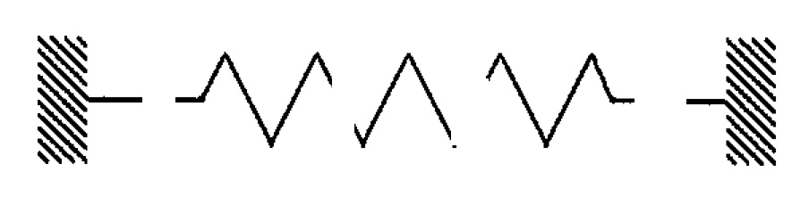
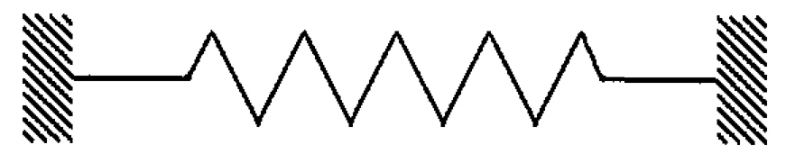
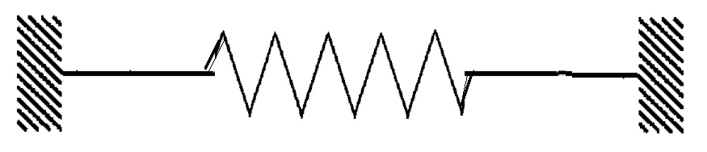
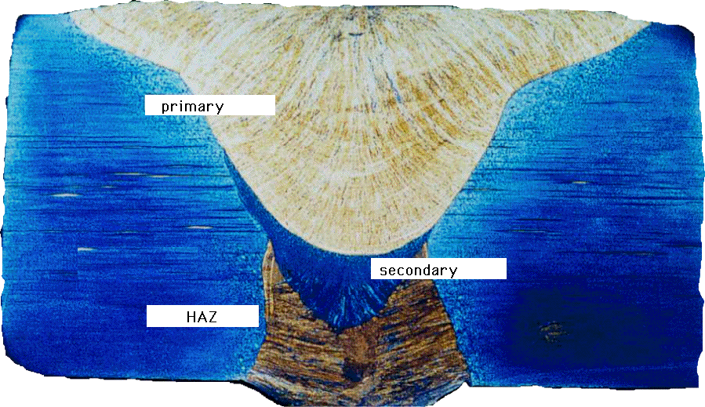
Weld: liquid metal solidifies, cools, contracts, stress
liquid
solid
contraction
Compensate for thermal contraction
Notes:
16

Slide 17
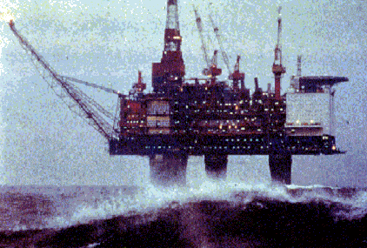
Residual stress
Notes:
17

Slide 18
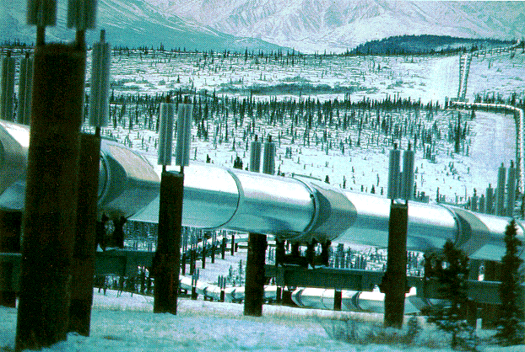
Notes:
18

Slide 19
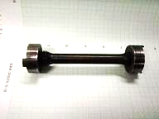
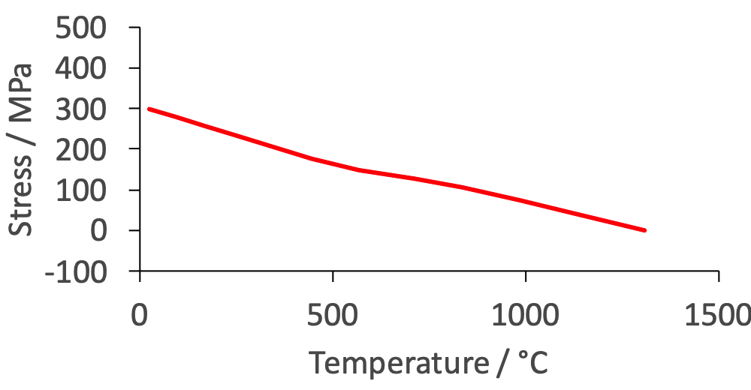
Notes:
19

Slide 20
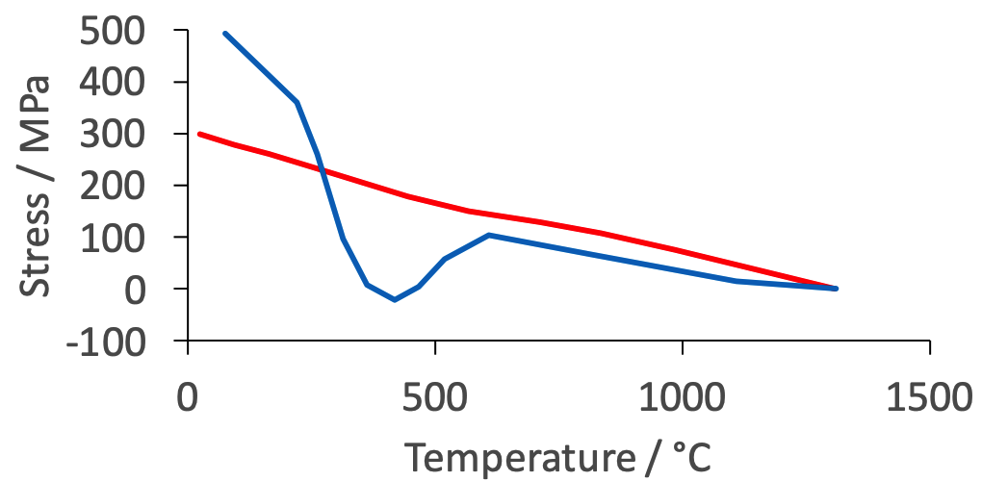
Notes:
20

Slide 21
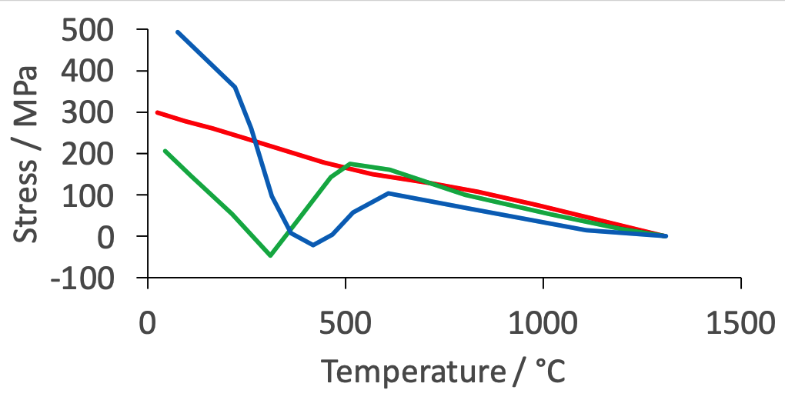
Jones & Alberry, 1977
Notes:
21

Slide 22
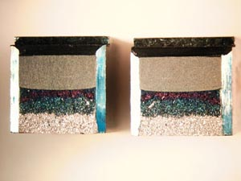
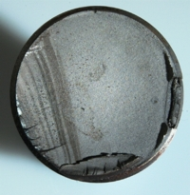
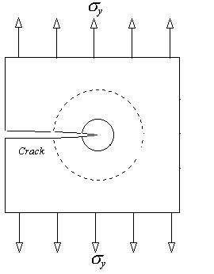
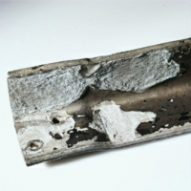
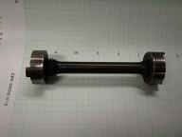
Charpy
fatigue
tensile
critical stress intensity
corrosion
Notes:
22

Slide 23
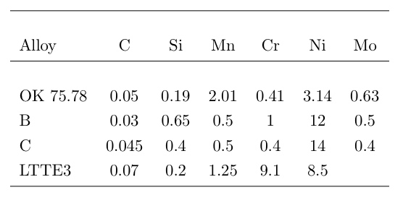
Notes:
23

Slide 24
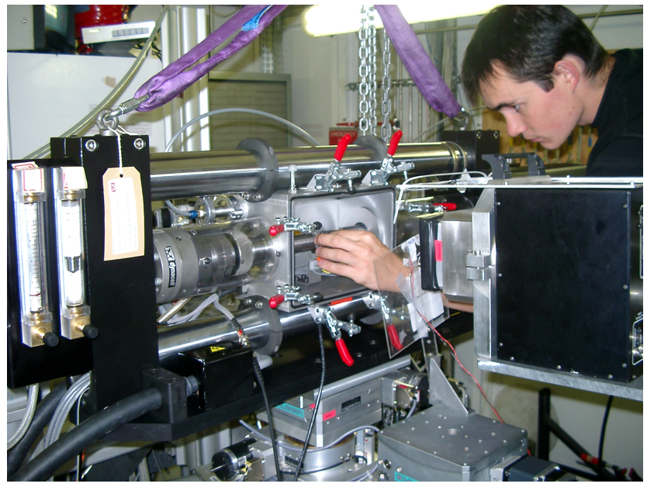
Notes:
24

Slide 25
Notes:
25

Slide 26
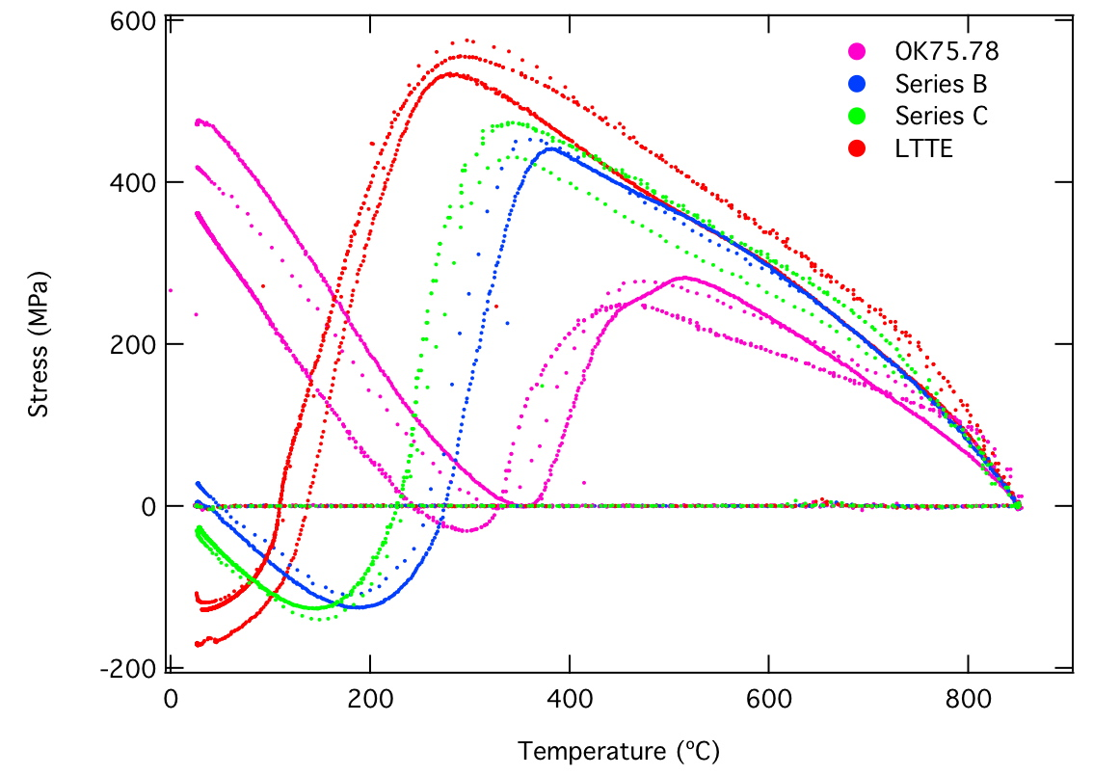
Notes:
26

Slide 27
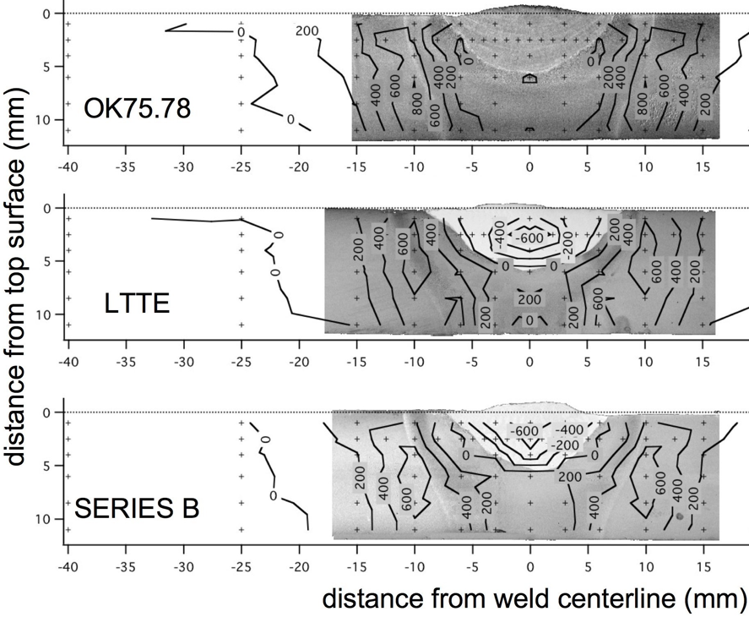
Notes:
27

Slide 28
Criteria for design of stainless steel consumable
Cr concentration > 12 wt%
Carbon concentration minimal
Low M_{S} temperature but not too low
Suppress M_{S} with solutes other than carbon
Capable of becoming fully austenitic
Solidification as δ-ferrite

Slide 29
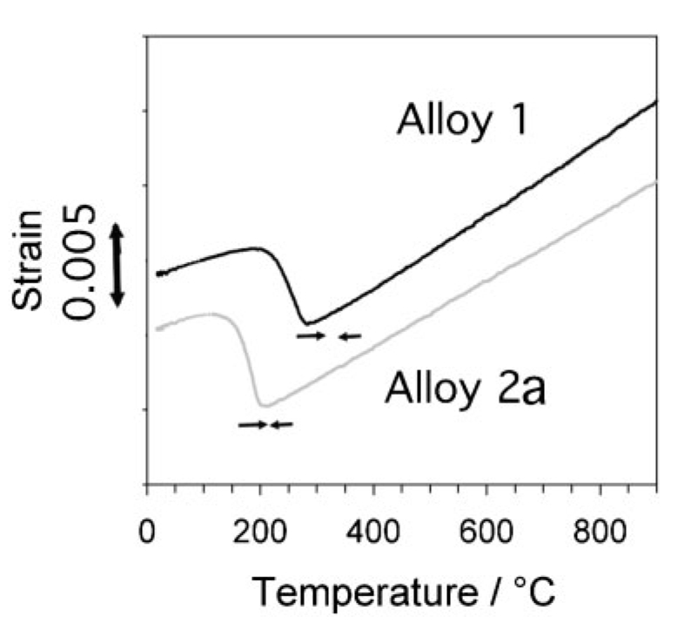
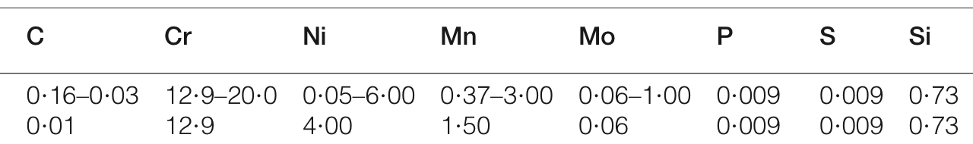

Slide 30
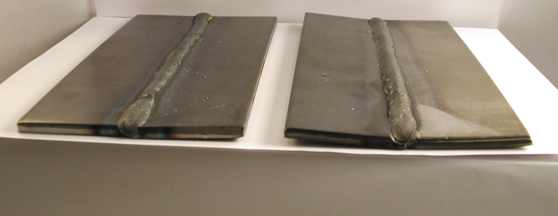
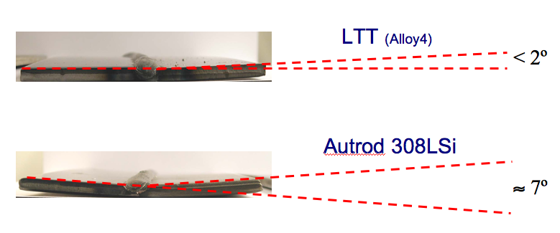
Dramatically reduced distortion
Leif Karlsson
Notes:
30

