Slide 1


Steels
Martensite
Bainite
Alloy design: strong bainite
Widmanstaetten ferrite
Allotriomorphic ferrite
Pearlite
Overall kinetics
TRIP steel
TWIP steel
Mitigation of residual stress
Bulk nanostructured steel
www.phase-trans.msm.cam.ac.uk/teaching.html
H. K. D. H. Bhadeshia

Slide 2
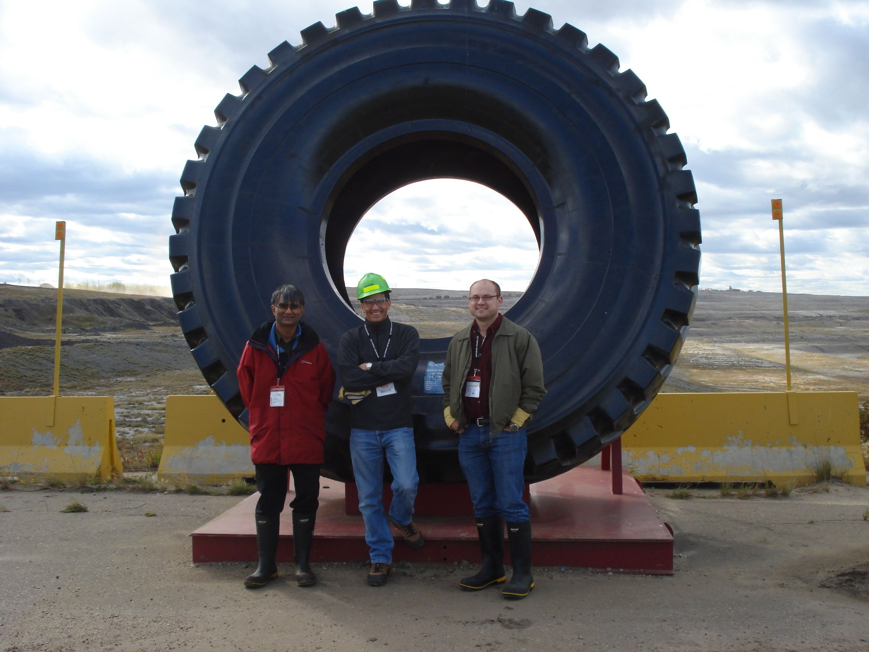
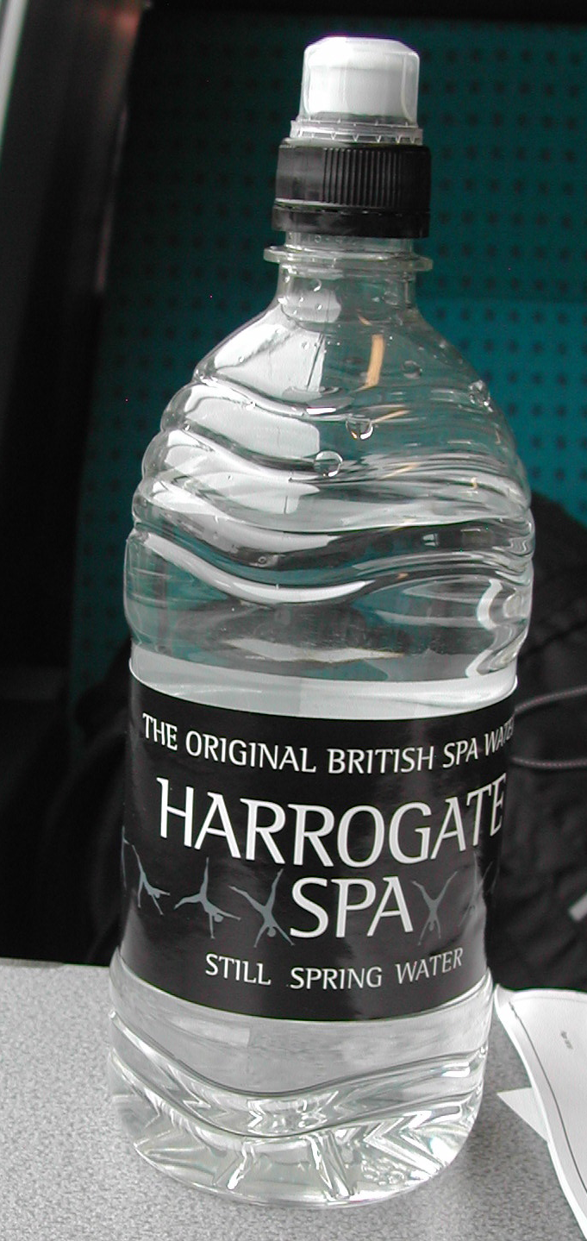
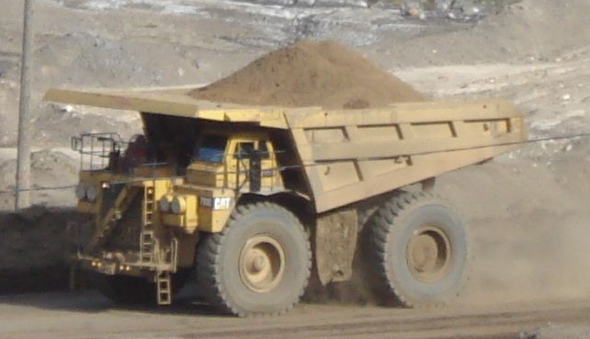
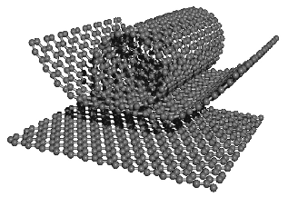
Problem: to design a bulk nanocrystalline steel which is very strong, tough, cheap ….
(courtesy of M. Endo)

Slide 3
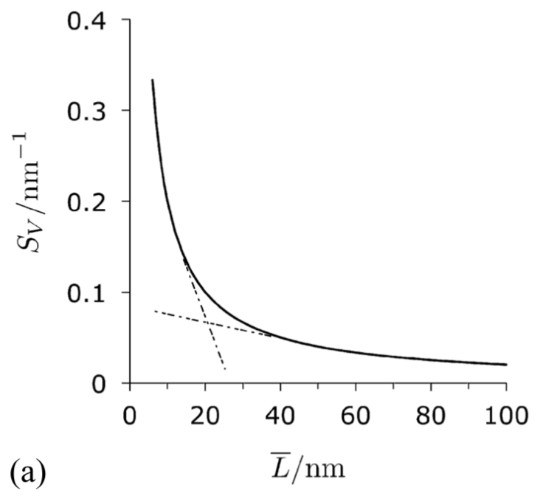

Slide 4
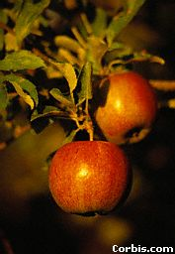

an apple weighs
1 Newton
= 1 Pa
1 m

Slide 5
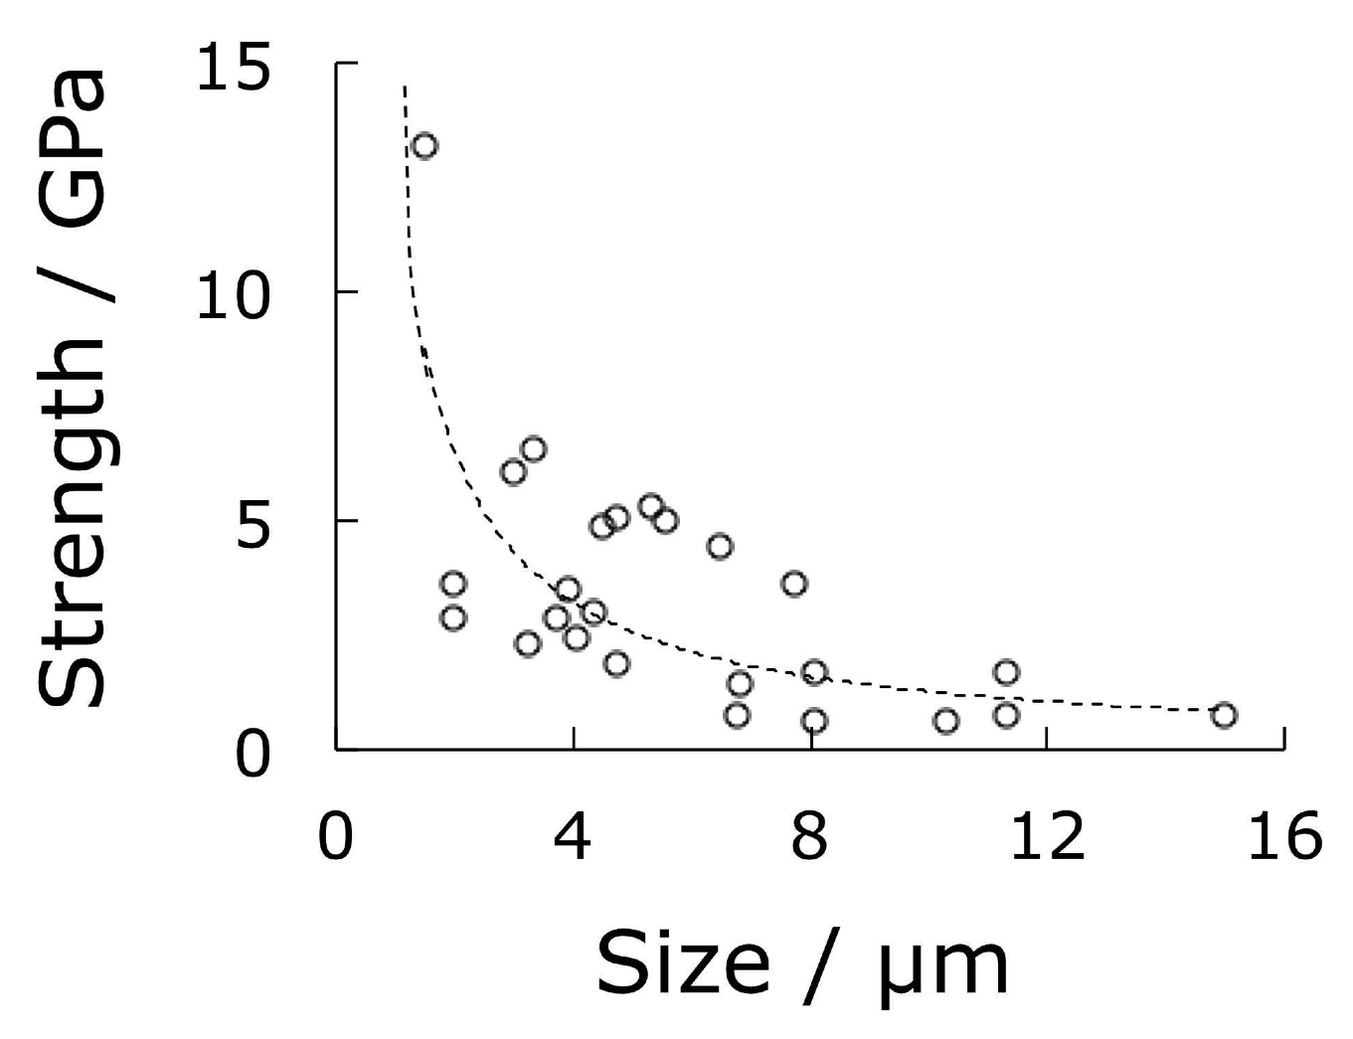
Pure iron, Brenner (1956)

Slide 6
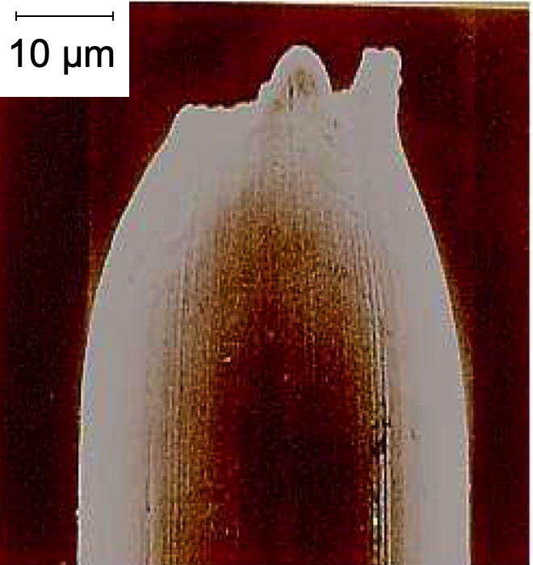
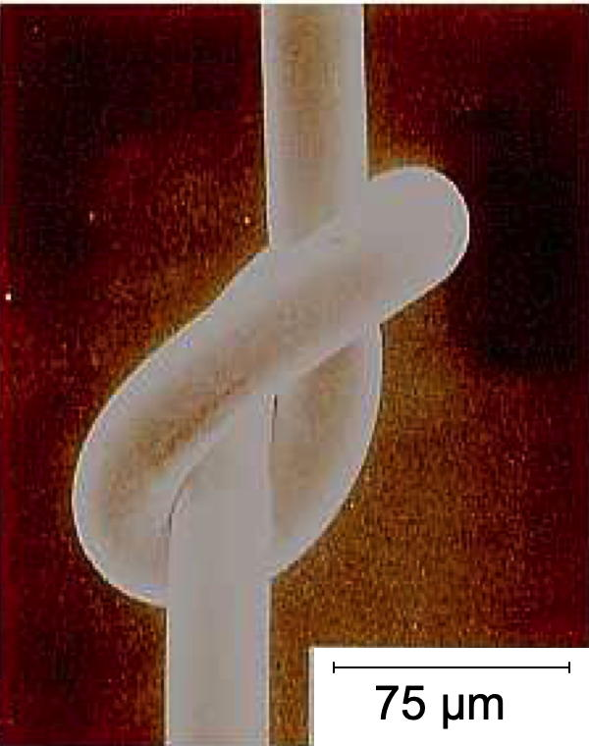
Scifer, 5.5 GPa and ductile
Kobe Steel

Slide 7
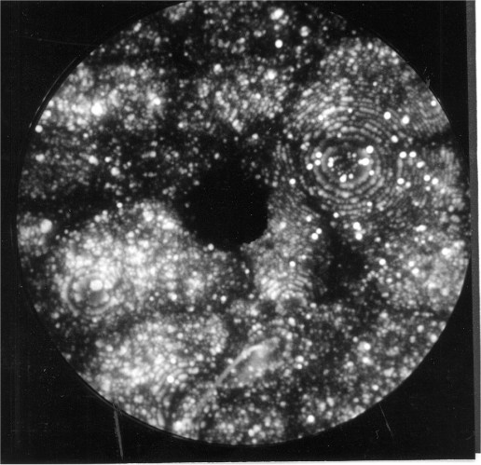
field ion microscope
image

Slide 8
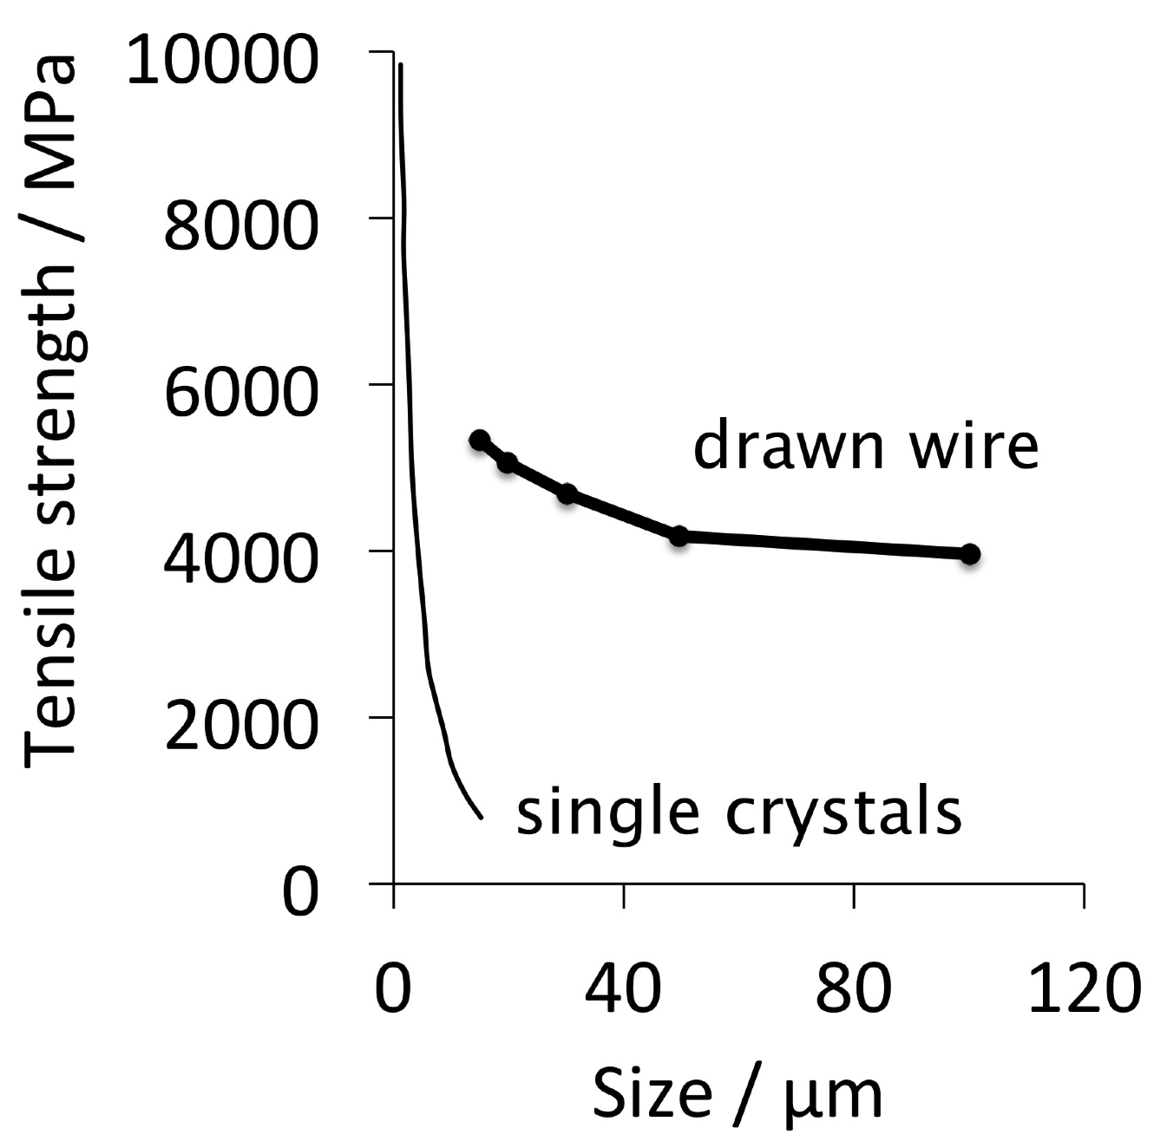

Slide 9
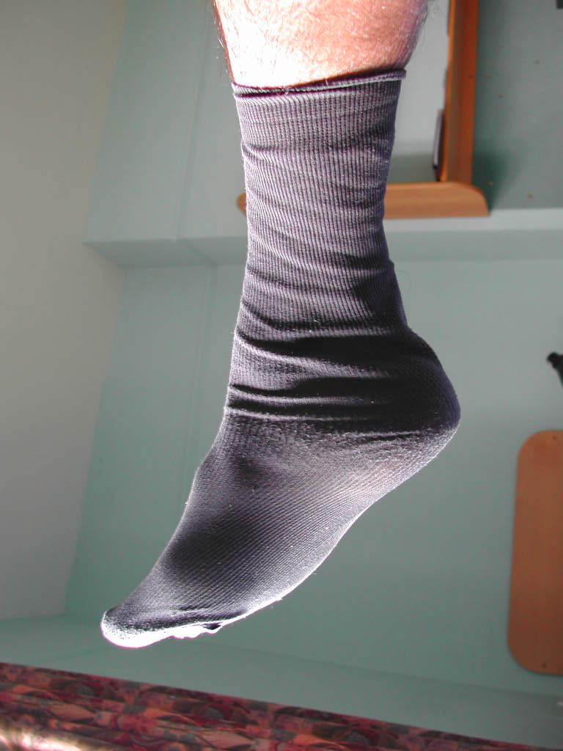
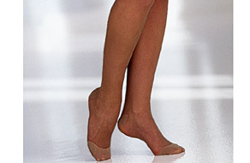
1 Denier: weight in grams, of 9 km of fibre
50-10 Denier
Scifer is 9 Denier

Slide 10
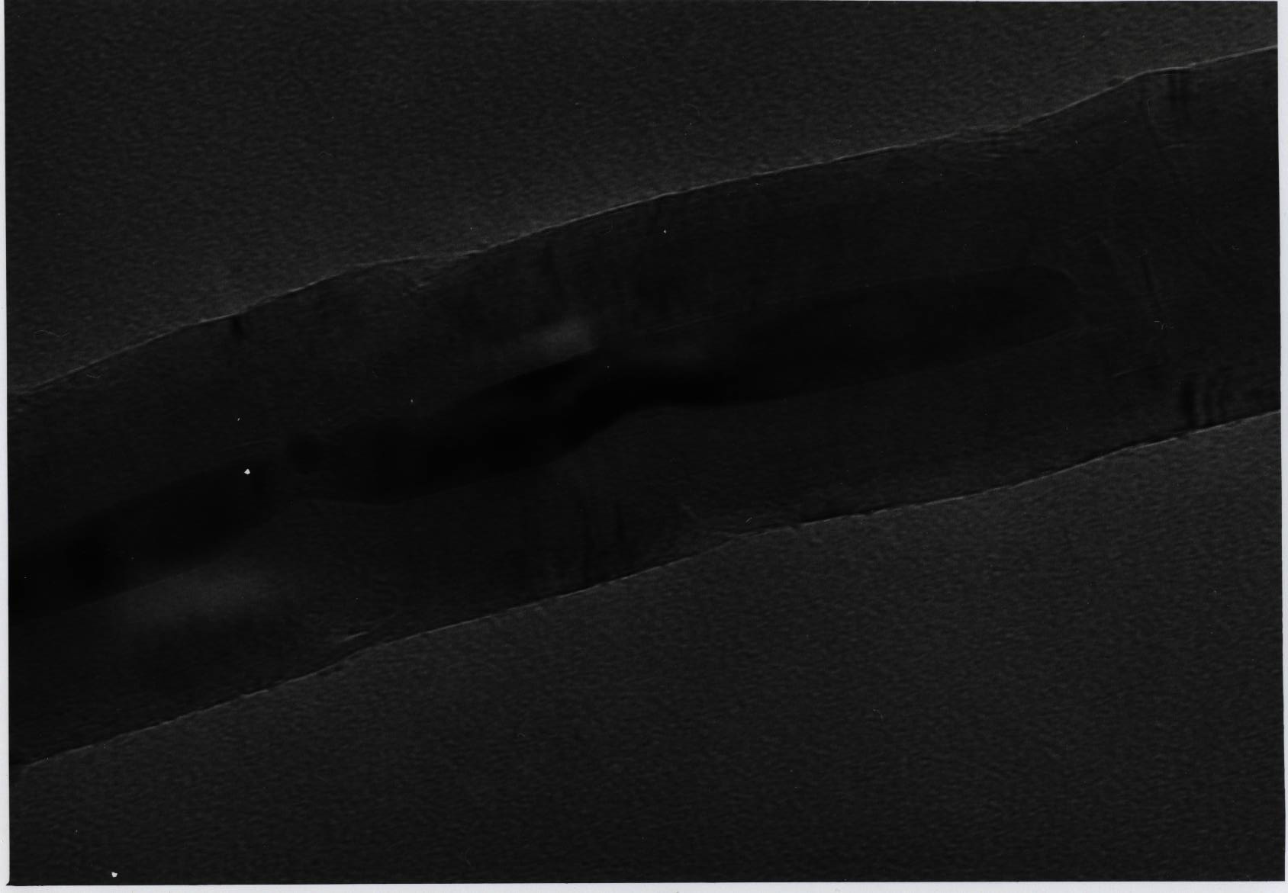
Claimed strength of carbon nanotube is 130 GPa
Edwards, Acta Astronautica, 2000
Claimed modulus is 1.2 TPa
Terrones et al., Phil. Trans. Roy. Soc., 2004

Slide 11
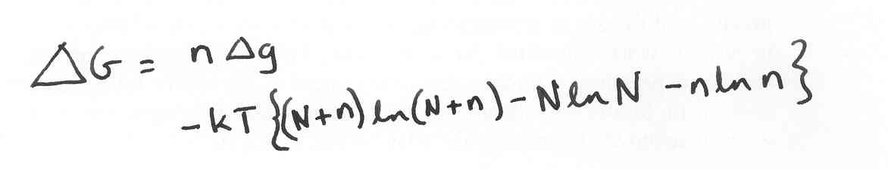
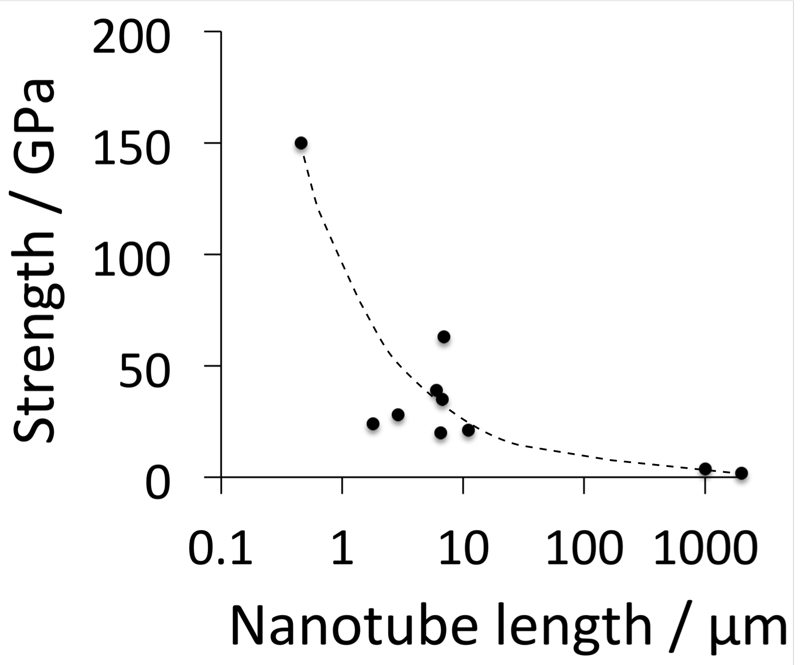
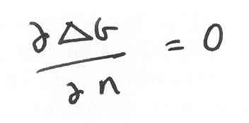
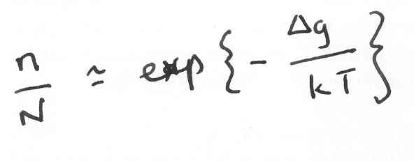
Strength of whiskers decreases with size
Strength of a nanotube rope 2 mm long is less than 2000 MPa

Slide 12
Summary
Strength produced by deformation limits shape: wires, sheets...
Strength in small particles relies on perfection. Doomed as size increases.

Slide 13
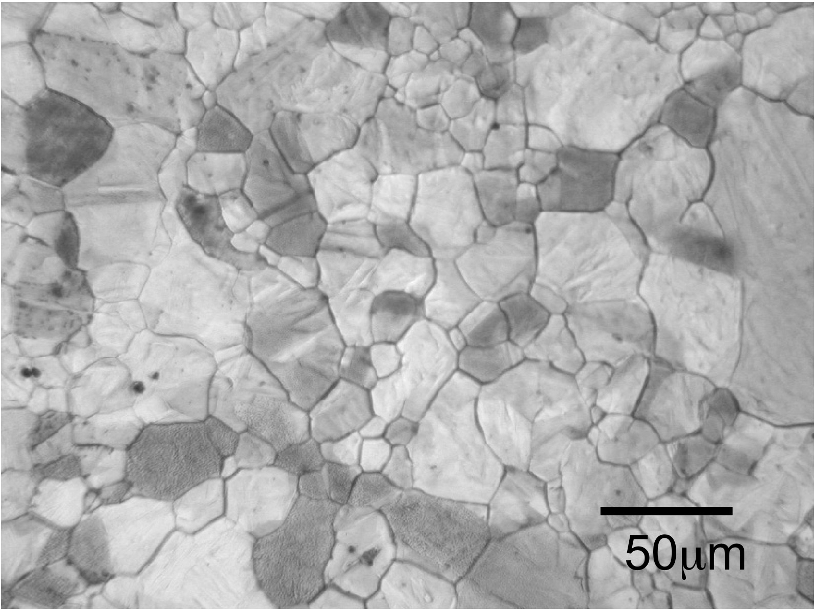
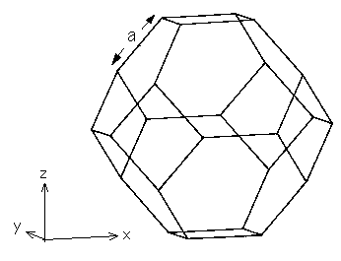
Smallest size that can be achieved in a polycrystalline substance?

Slide 14
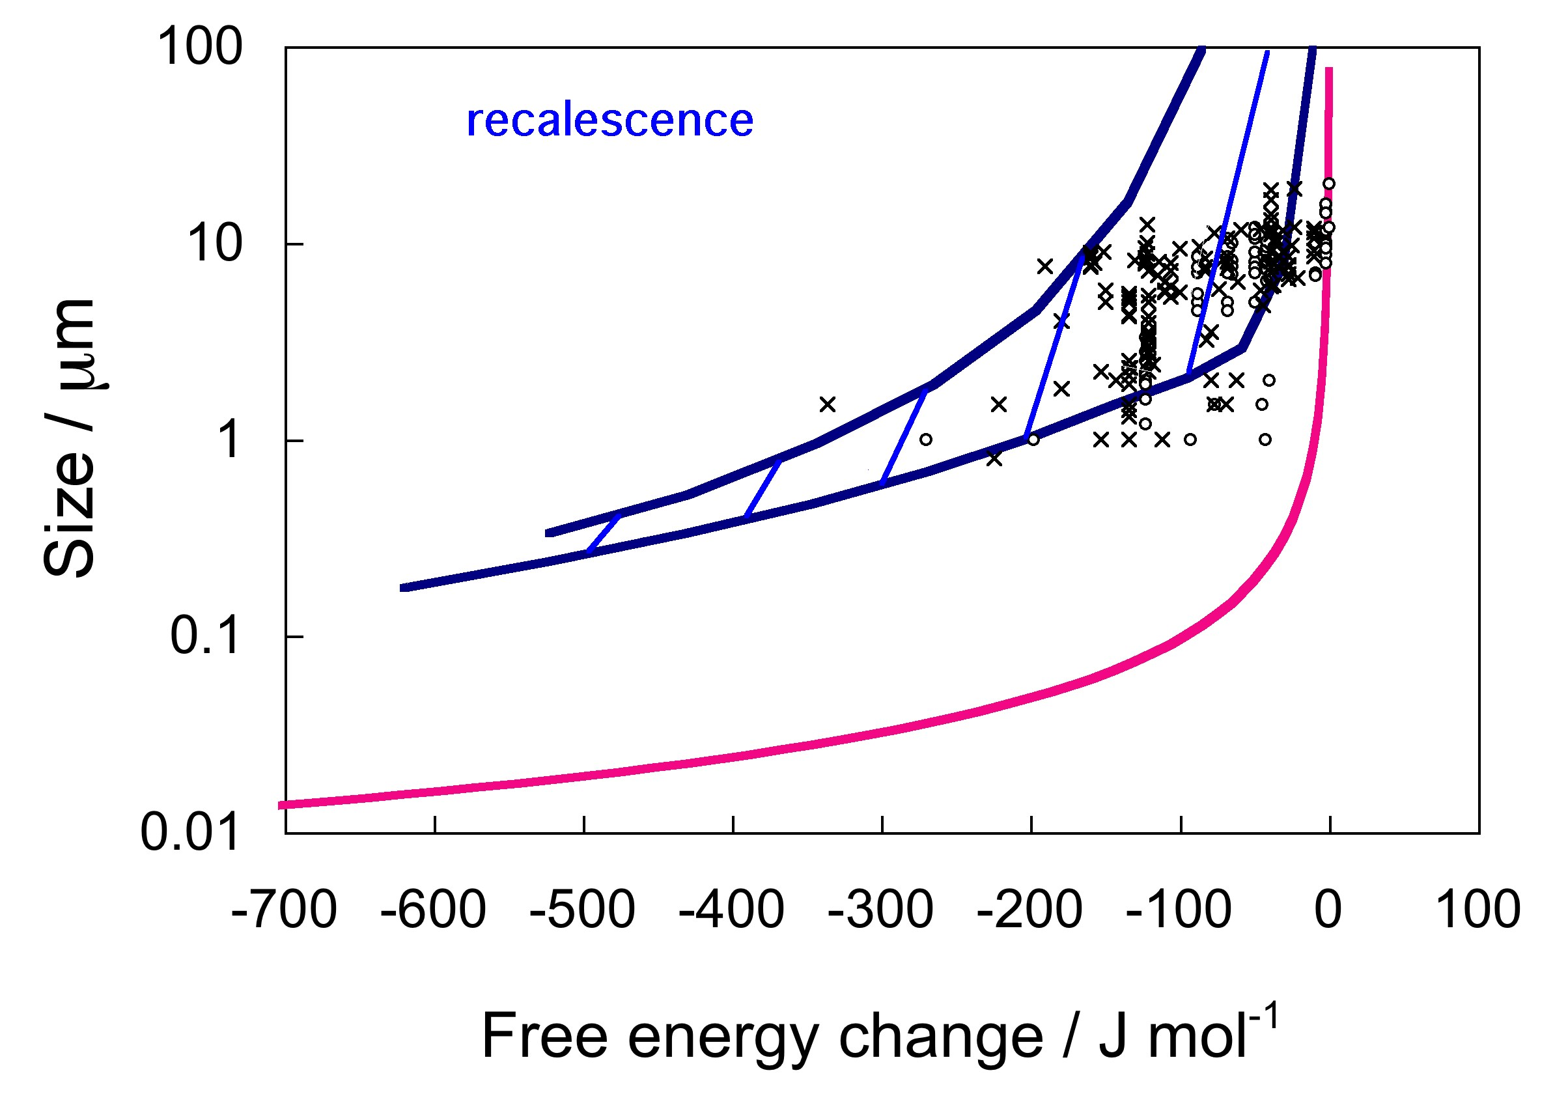
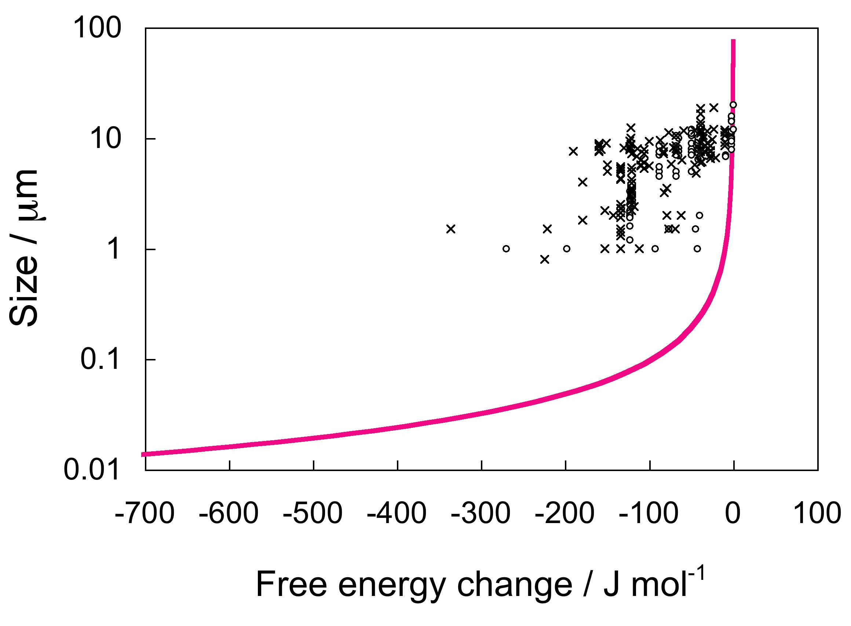
Yokota & Bhadeshia, 2004

Slide 15
Summary
Thermomechanical processing limited by recalescence
Need to store the heat
Reduce rate
Transform at low temperature

Slide 16
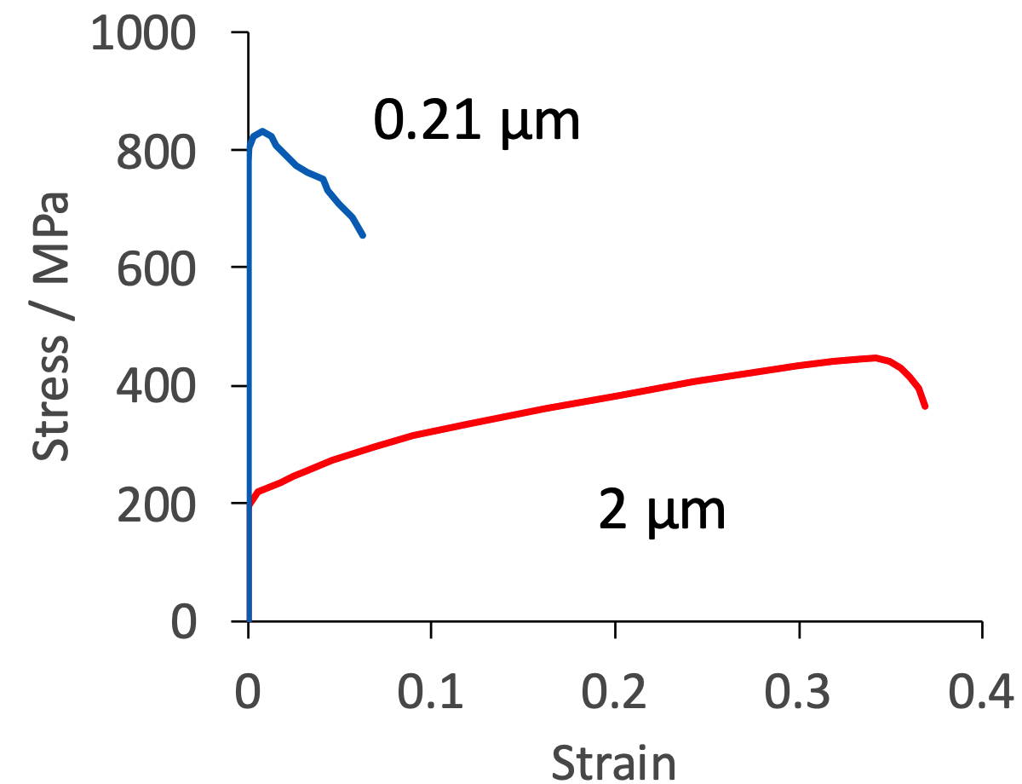
adapted using selected data from
Tsuji et al. Scripta Mat. 47 (2002) 893

Slide 17
Fine crystals by transformation
Introduce work-hardening capacity
Need to store the heat
Reduce rate
Transform at low temperature

Slide 18
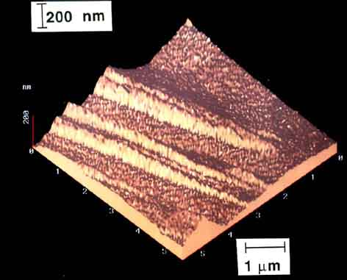
Swallow and Bhadeshia, 1996

Slide 19
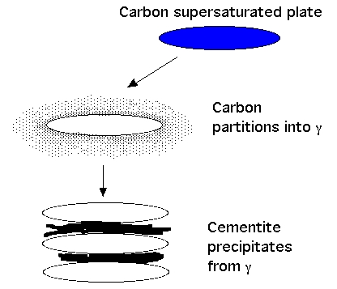

Slide 20
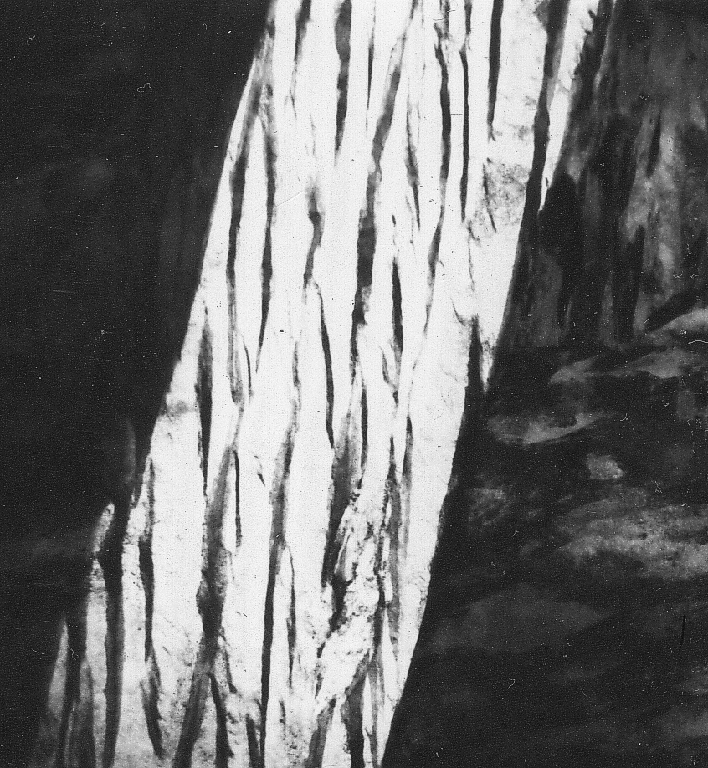
Cementite suppressed using silicon
1 µm

Slide 21
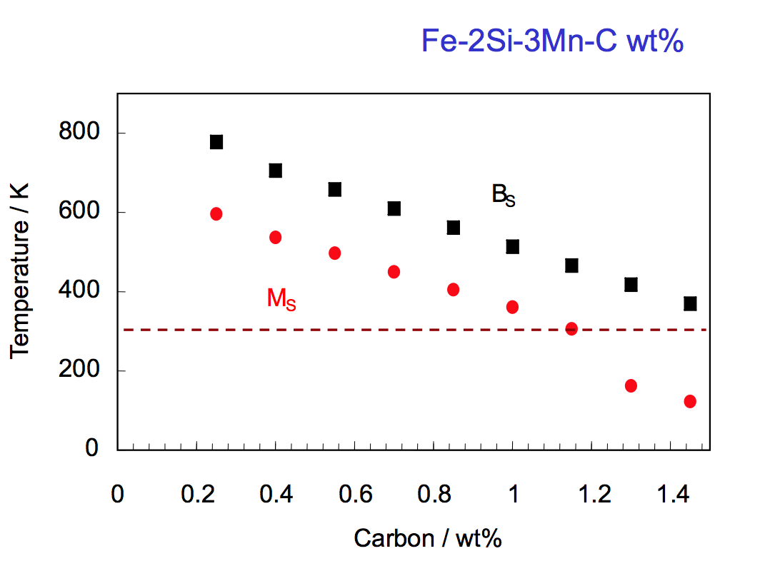

Slide 22
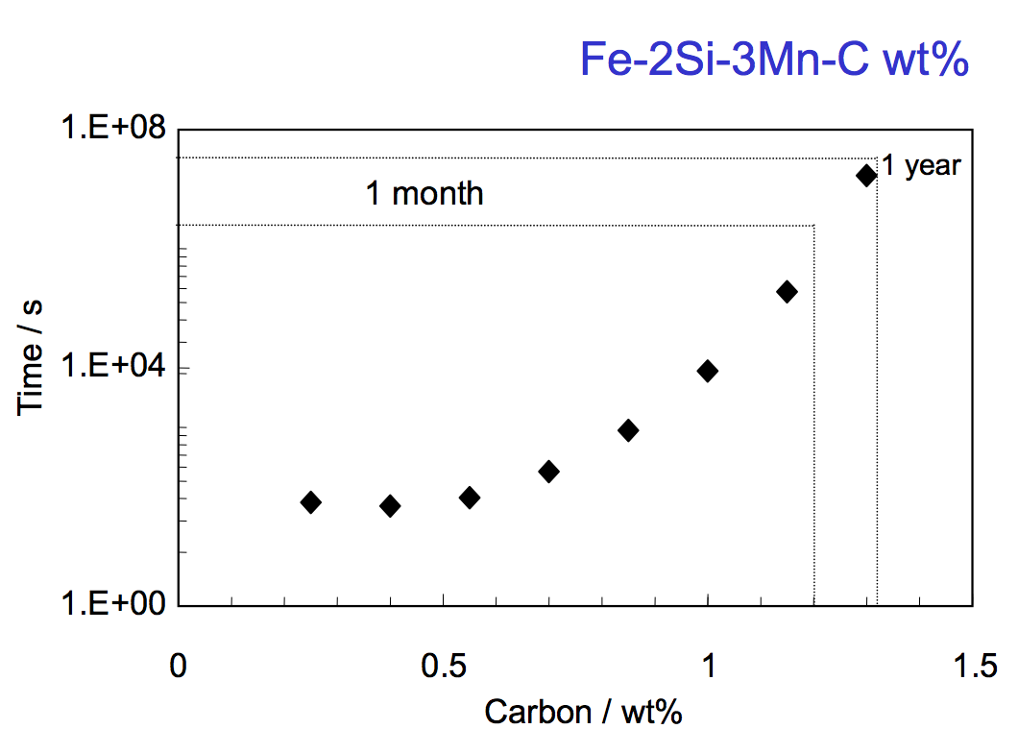

Slide 23
Low transformation temperature
Bainitic hardenability
Reasonable transformation time
Elimination of cementite
Austenite grain size control
Avoidance of temper embrittlement
wt%

Slide 24
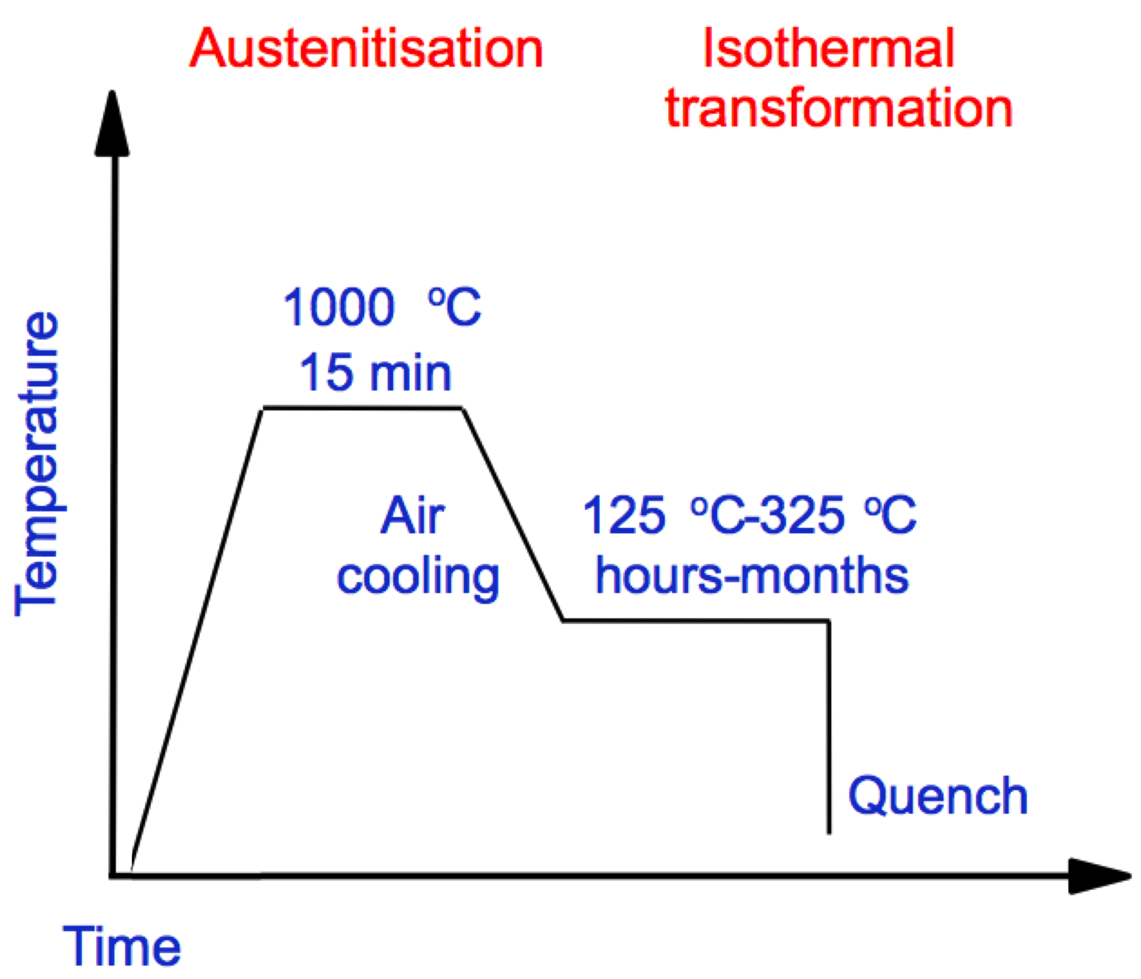

Slide 25
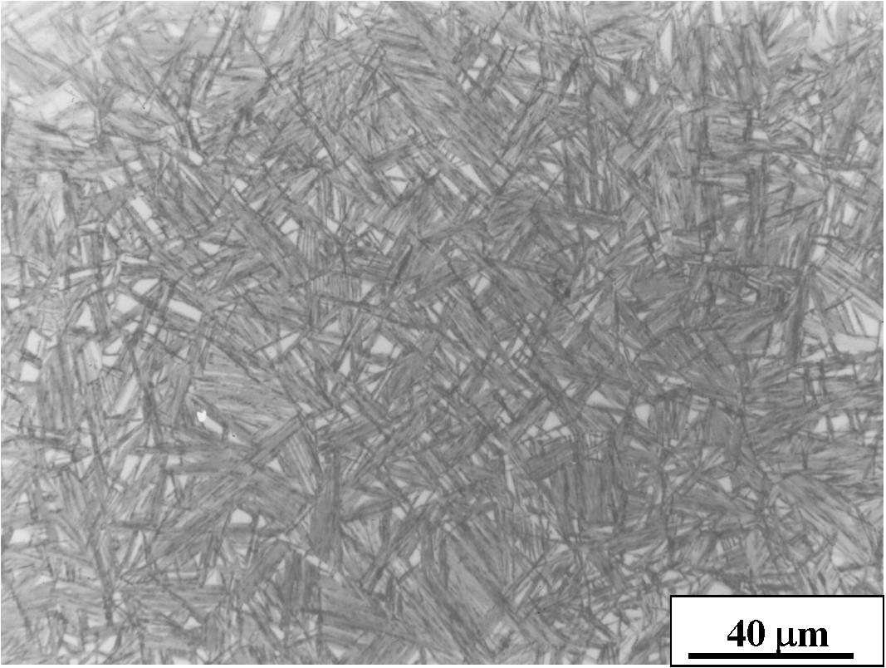

Slide 26
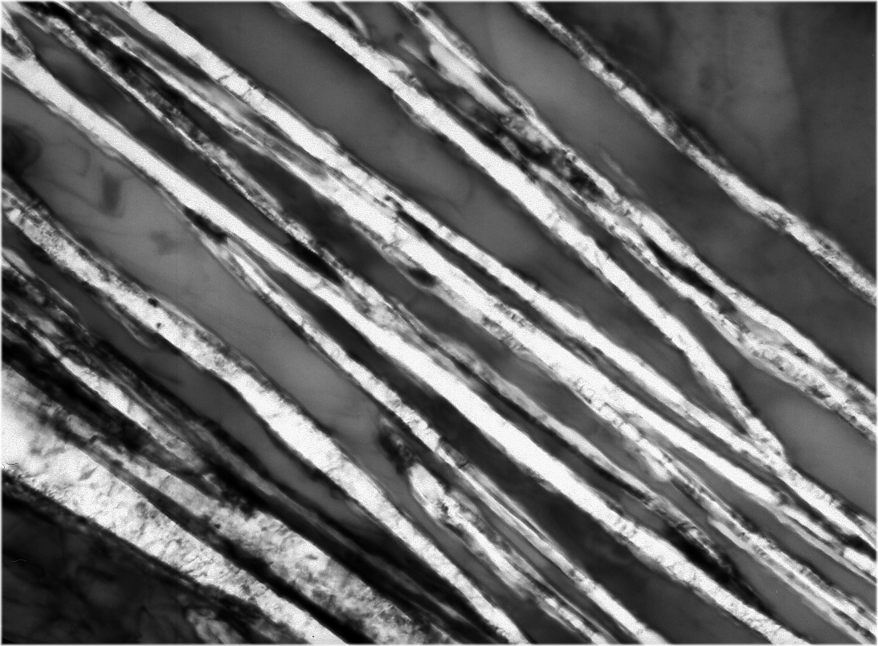
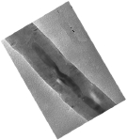
γ
γ
α
α
α
Caballero, Mateo, Bhadeshia
200 Å

Slide 27
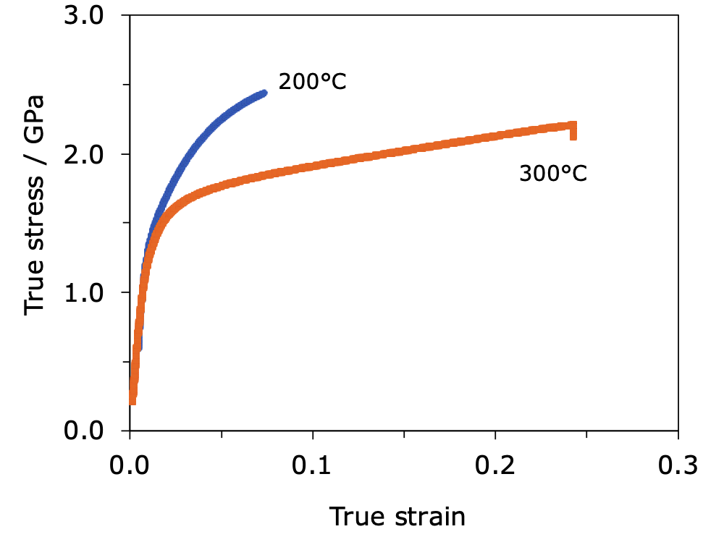

Slide 28
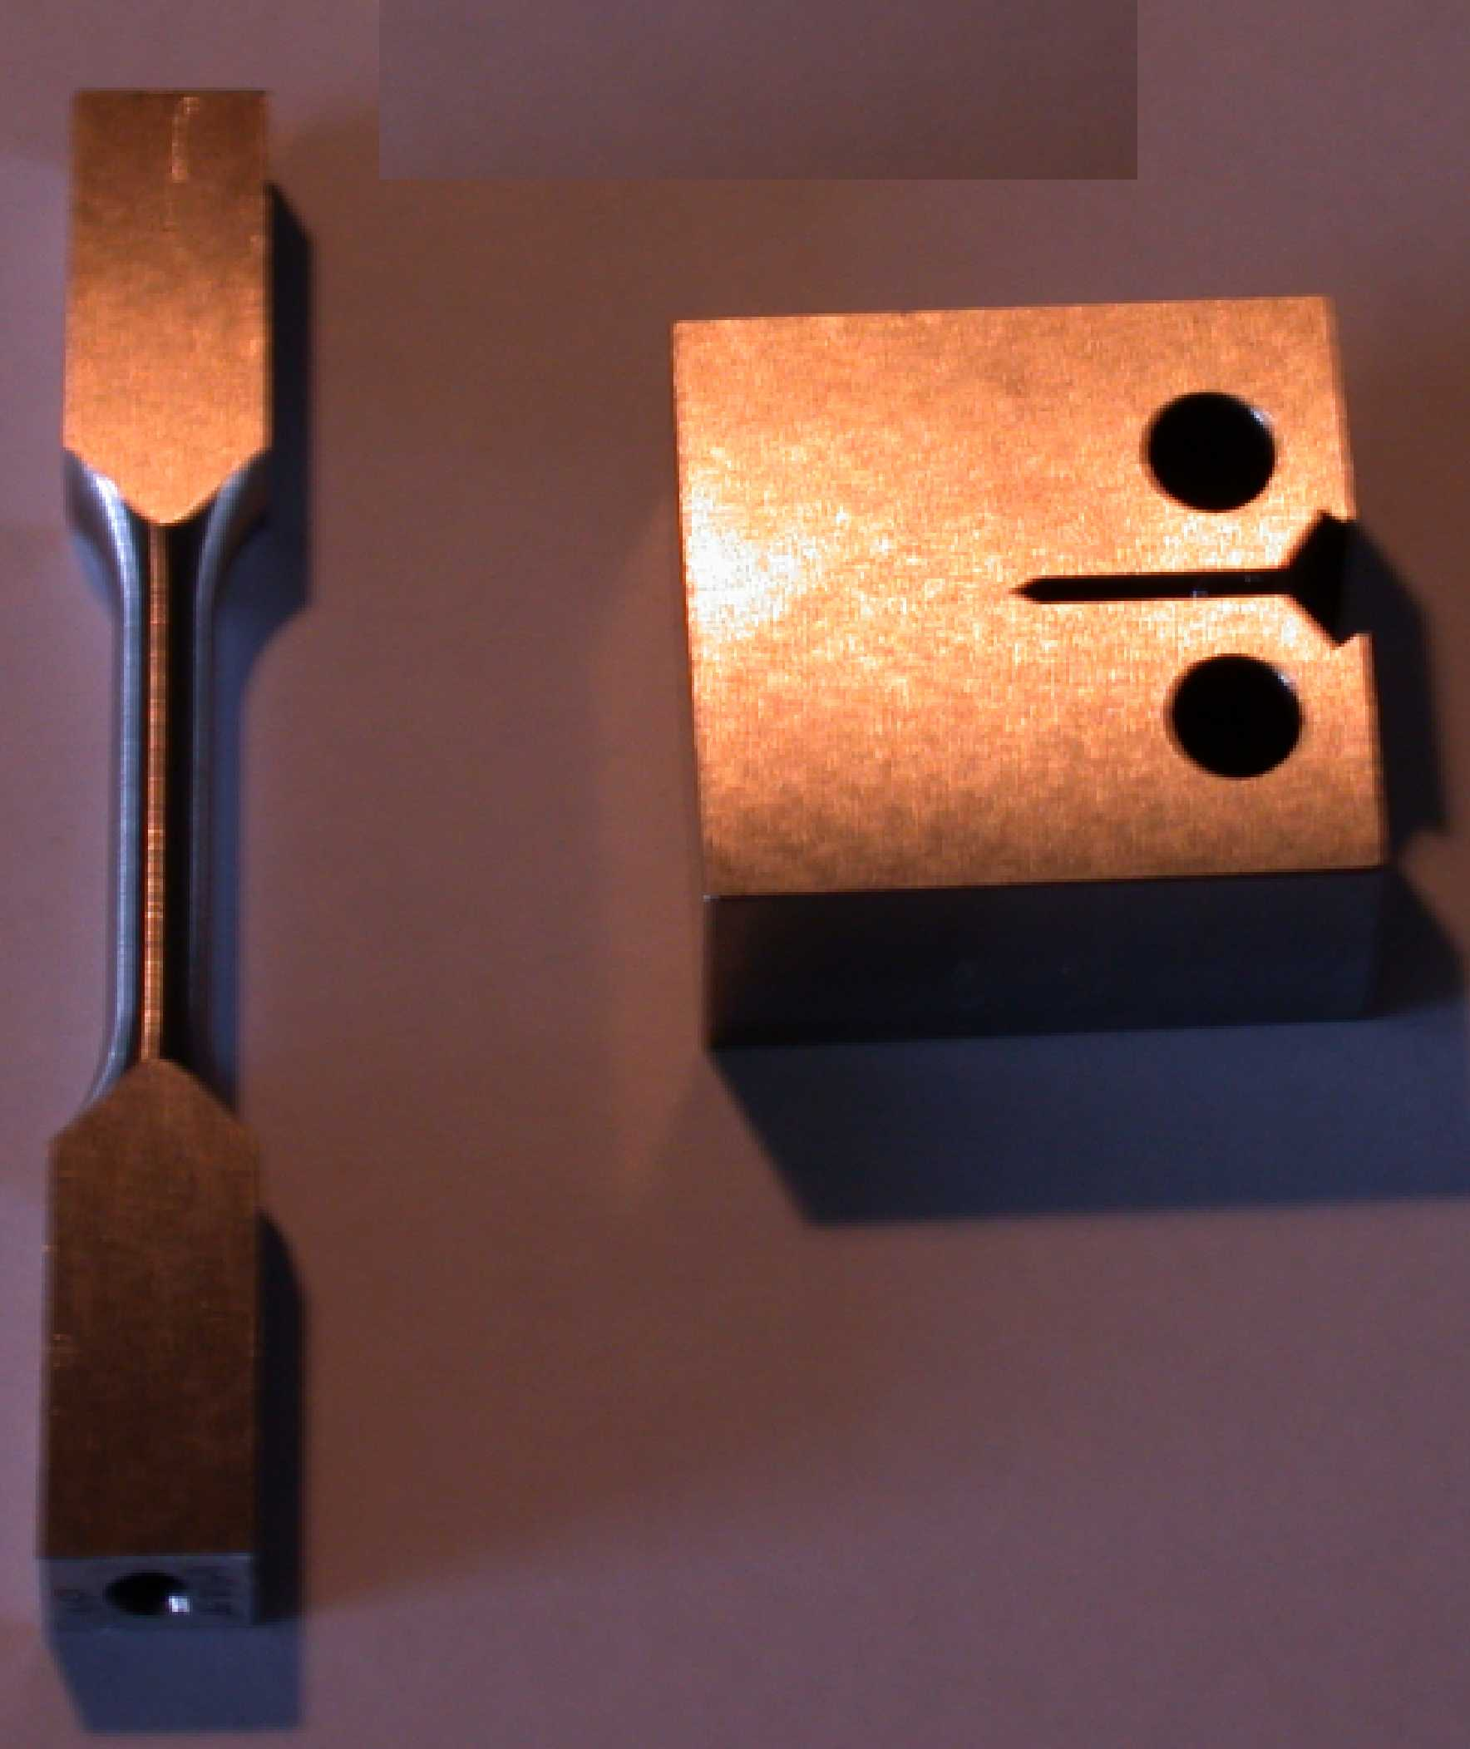
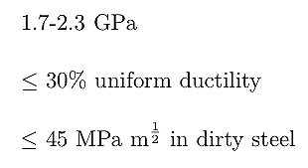
Low temperature transformation: 0.25 T/T_{m}
Fine microstructure: 20-40 nm thick plates
Harder than most martensites (710 HV)
Carbide-free
Designed using theory alone

Slide 29
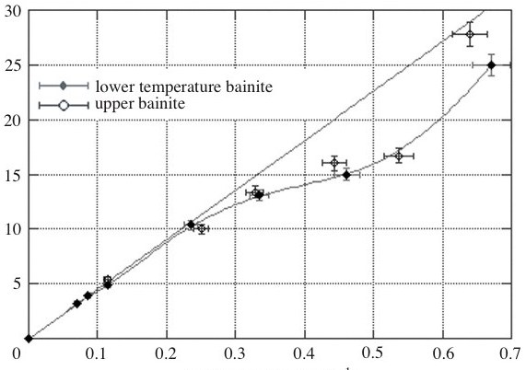
Stress / GPa
Velocity km s⁻¹
Hammond and Cross, 2004

Slide 30
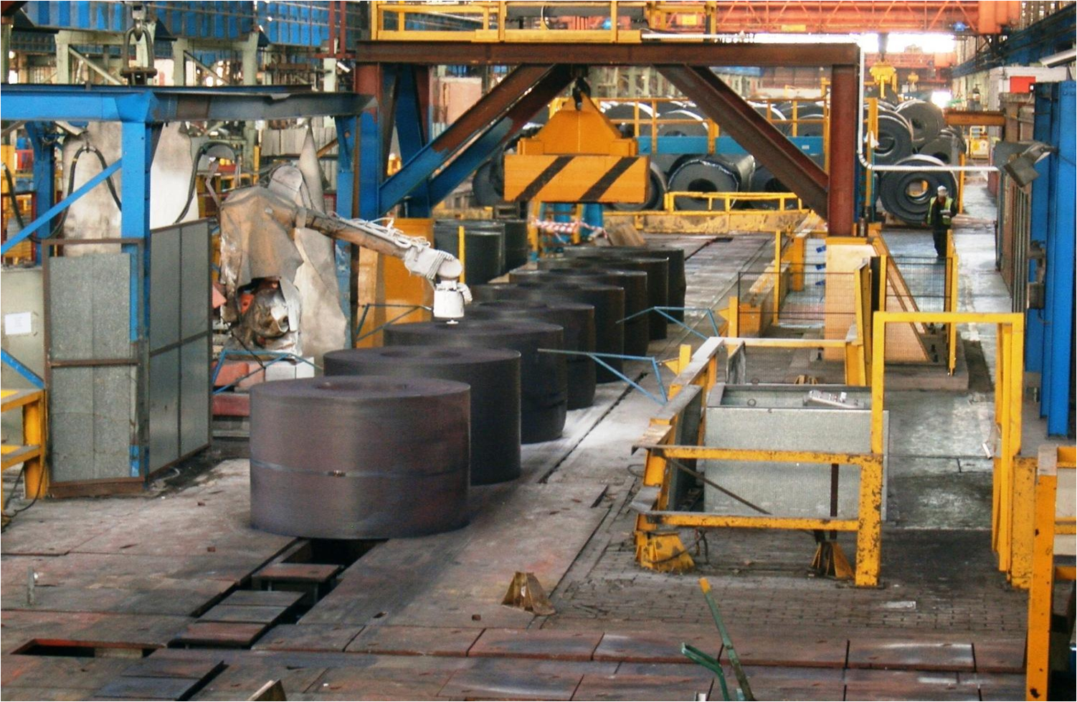
Paul Davies, Tata Steel, 2012

Slide 31
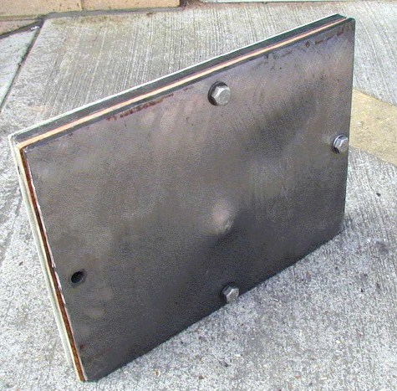
“more serious battlefield threats”

Slide 32

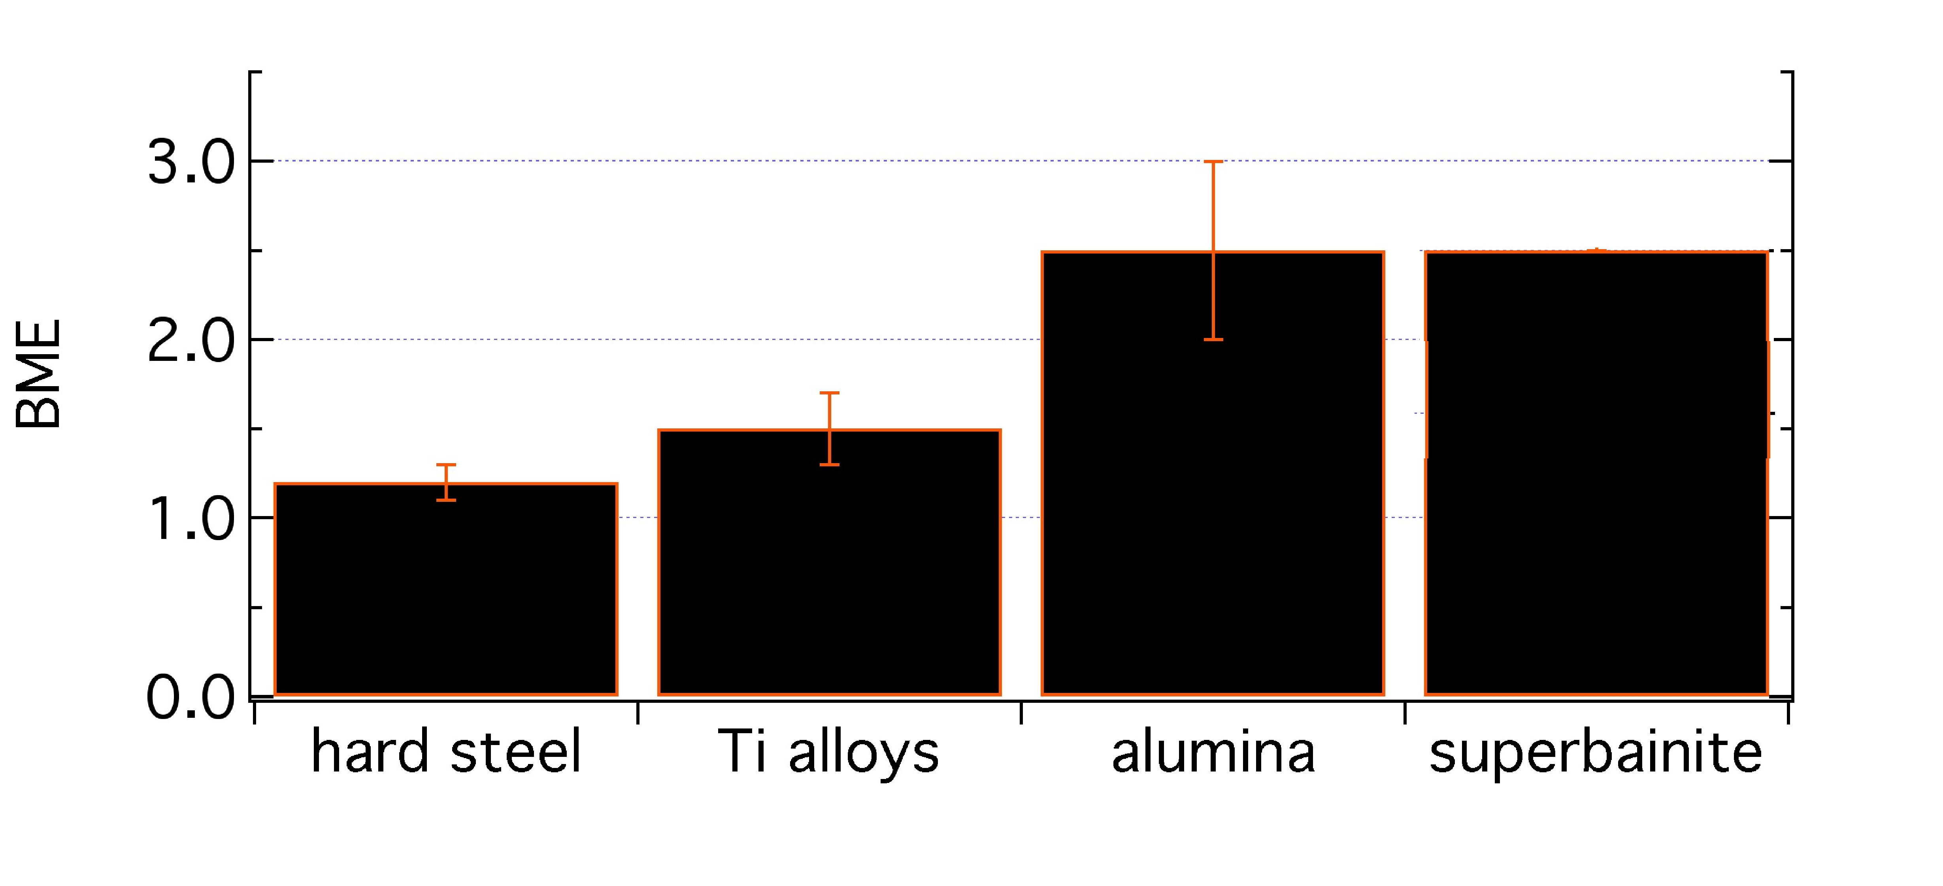
ballistic mass efficiency
consider unit area of armour

Slide 33


Slide 34
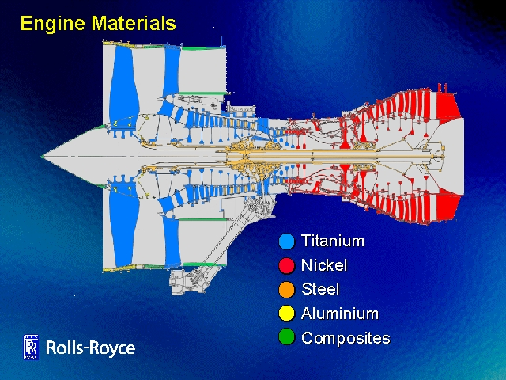
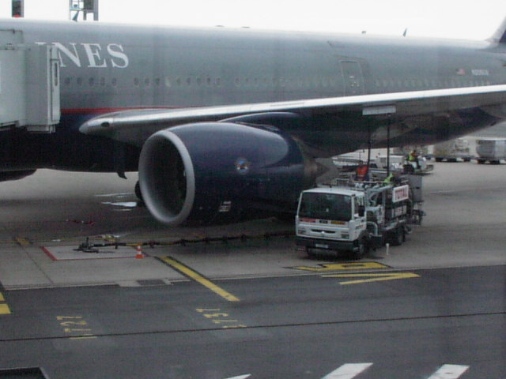

Slide 35
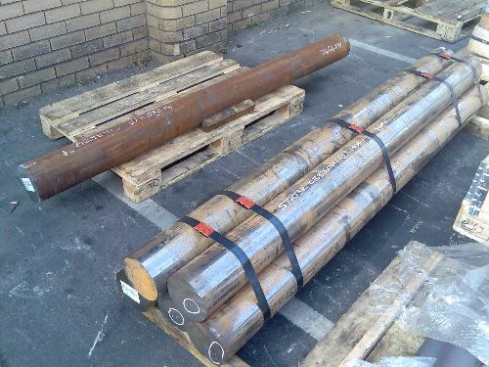

Slide 36
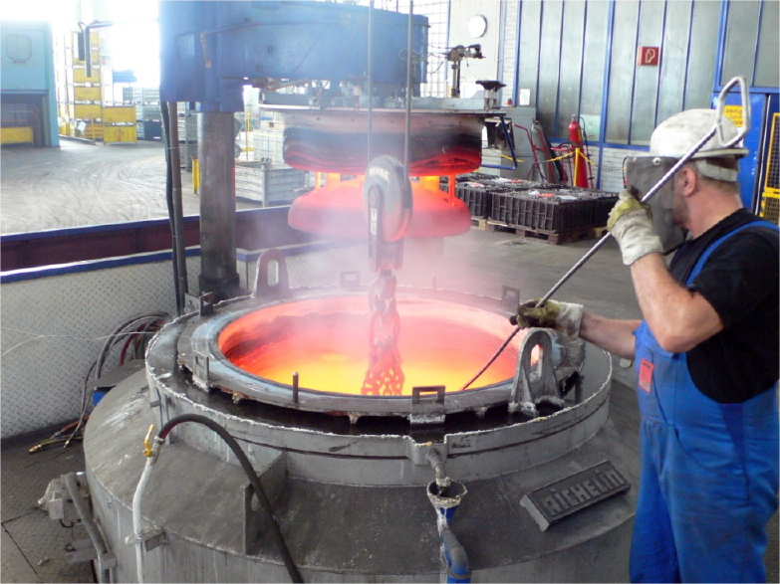

Slide 37
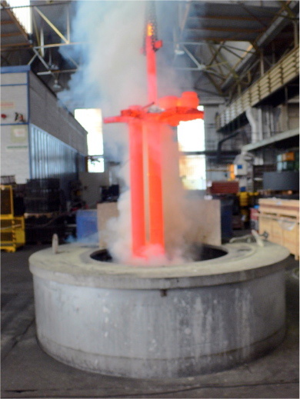

Slide 38
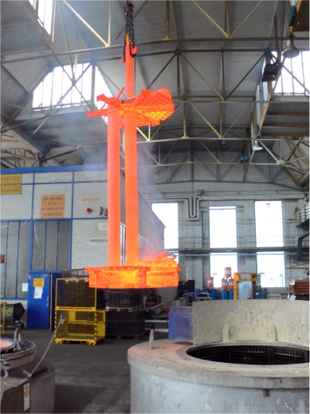

Slide 39
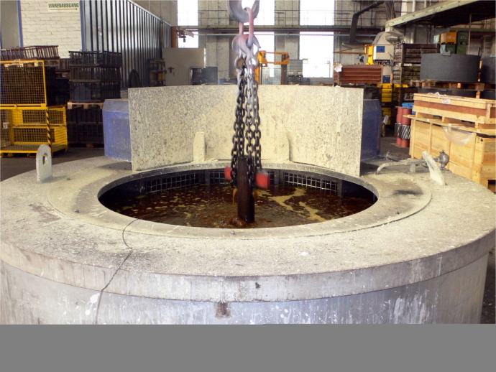

Slide 40
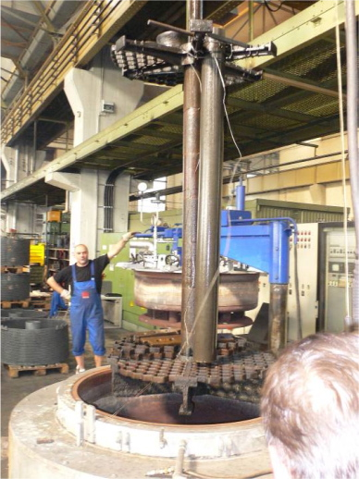

Slide 41
Very strong
Huge uniform ductility
γ
γ
α
No deformation
No rapid cooling
No residual stresses
α
Cheap
Uniform in very large sections
α
200 Å

Slide 42
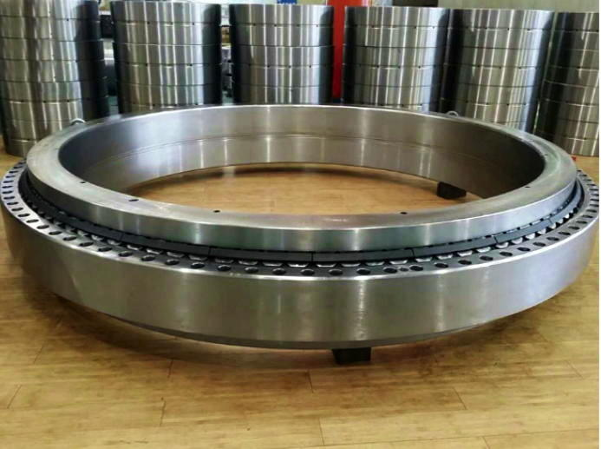
Zhang & Yang, 2019
wind turbines +rolling mill, vibration machinery

Slide 43
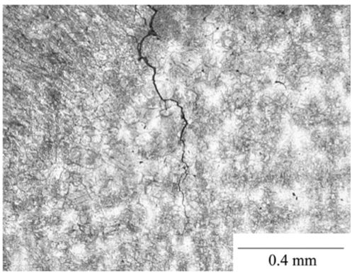
Cannot easily be welded
Fang, Yang, Liu, Song, Fang, Bhadeshia, Materials and Design, 50 (2013) 38

Slide 45
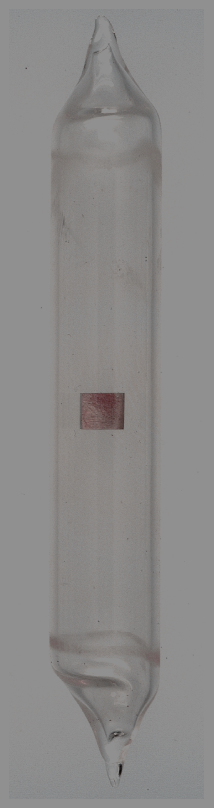

2104
Fe-1.75C-Si-Mn wt%
Chatterjee & Bhadeshia, 2004

