Slide 1


Steels: bainite, lecture 4 of 12
Martensite
Bainite: mechanism based design
Alloy design: strong bainite
Widmanstaetten ferrite
Allotriomorphic ferrite
Pearlite
Overall kinetics
TRIP steel
TWIP steel
Mitigation of residual stress
Bulk nanostructured steel
www.phase-trans.msm.cam.ac.uk/teaching.html
H. K. D. H. Bhadeshia

Slide 3
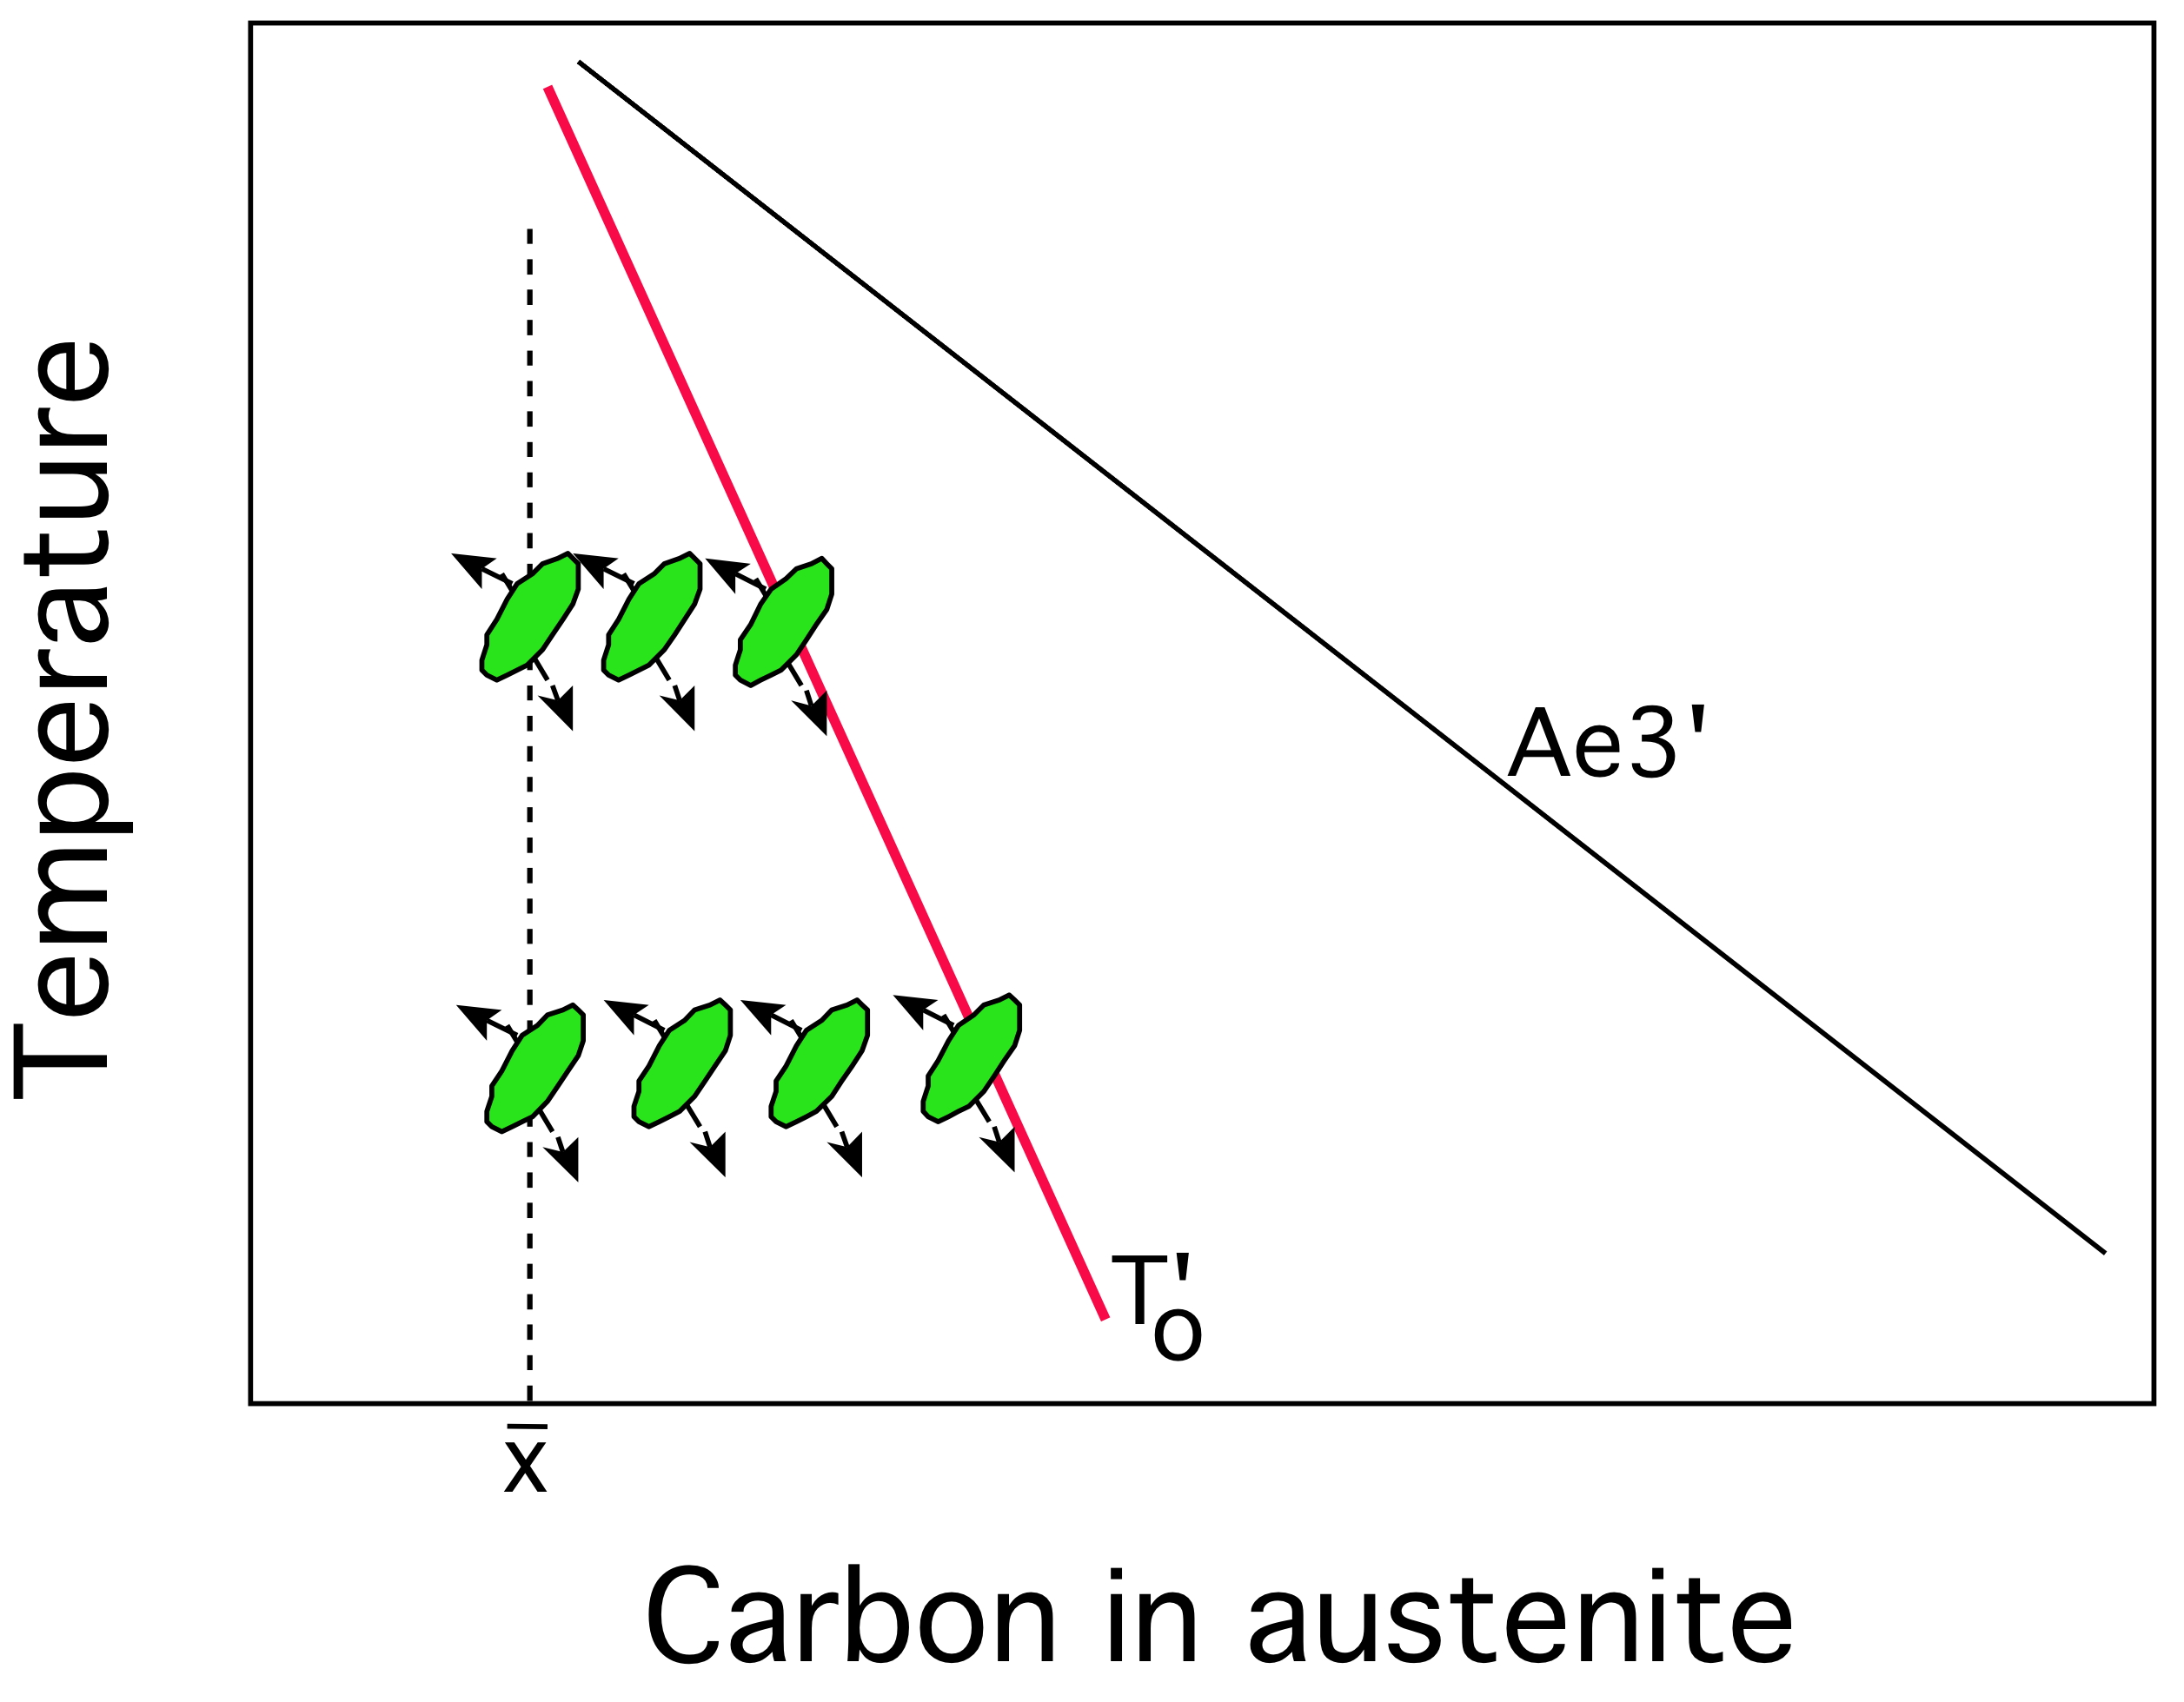

Slide 4
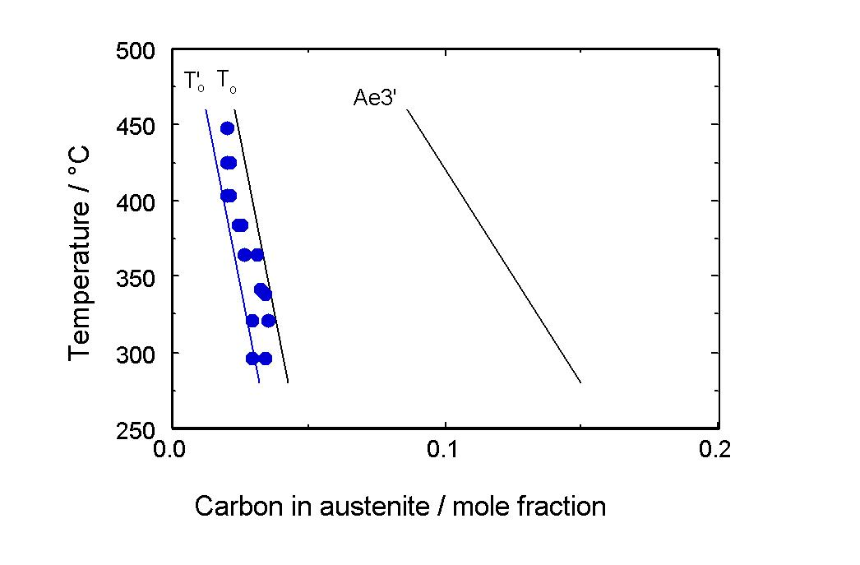

Slide 5
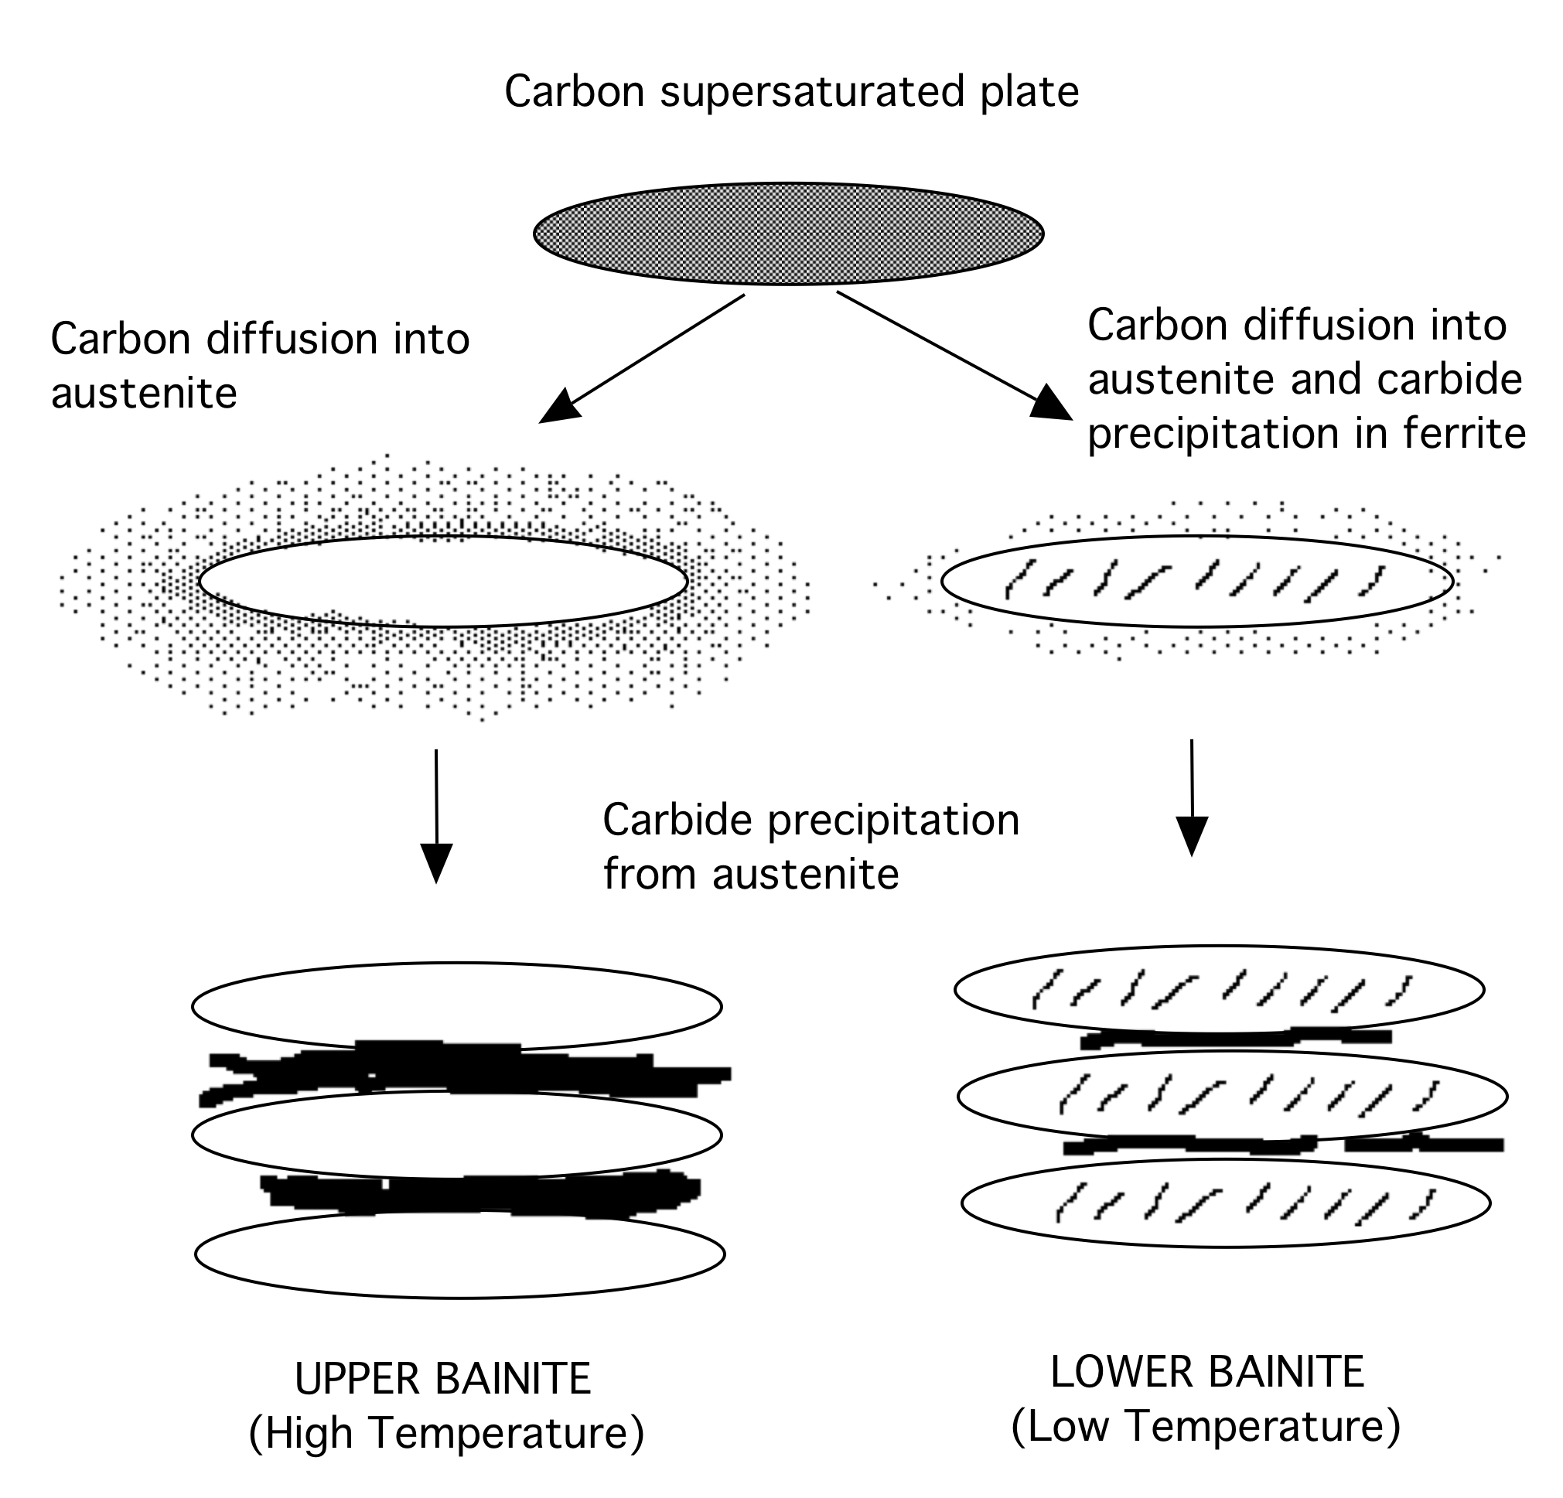

Slide 6
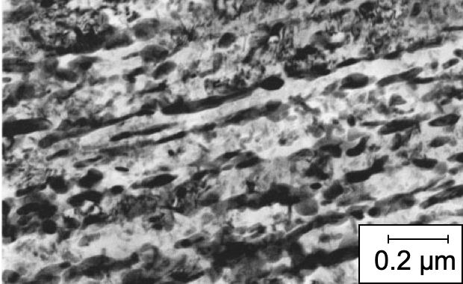

Slide 7
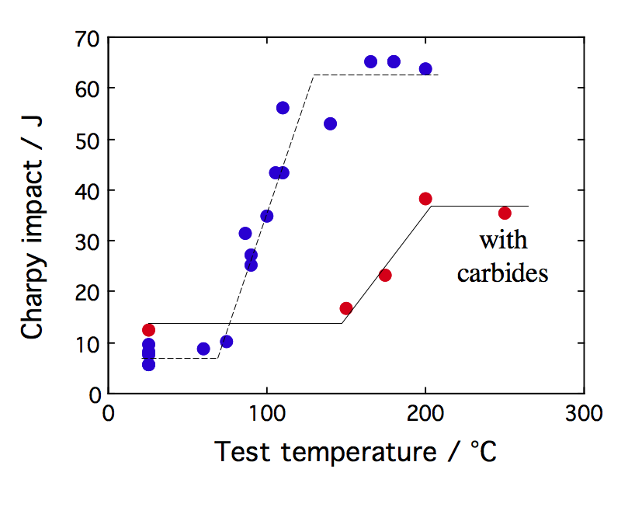

Slide 8
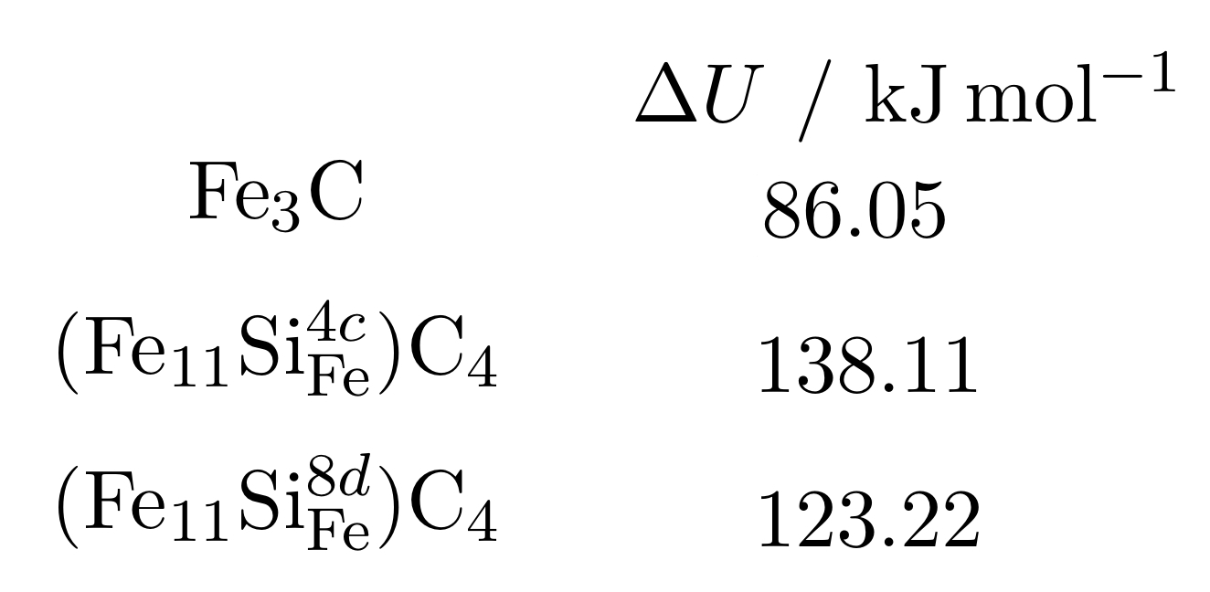
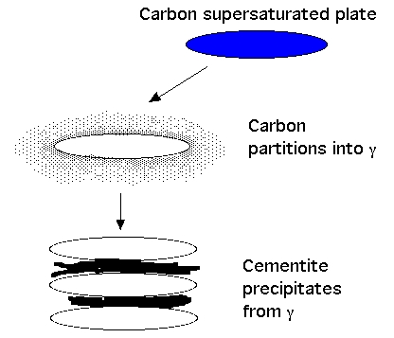
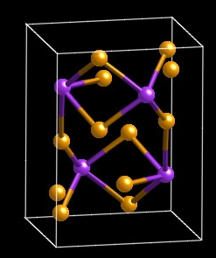
Jang, Kim, Bhadeshia (2009)
Notes:
8

Slide 9
Simple, carbide-free alloys
Fe-0.4C-3Mn-2Si wt%
hardenability
suppress
cementite

Slide 10
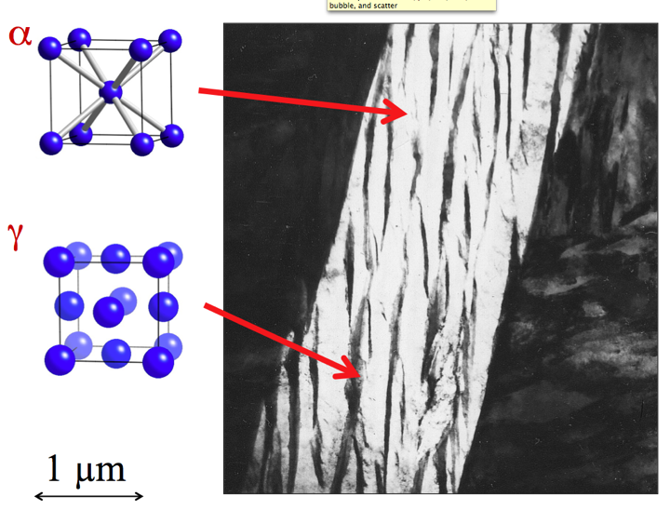
10

Slide 11
Fine structure
Retained austenite:
TRIP effect
no ductile-brittle transition
barrier to hydrogen
No cementite
Small concentration of C in ferrite

Slide 12
Very poor toughness!

Slide 13
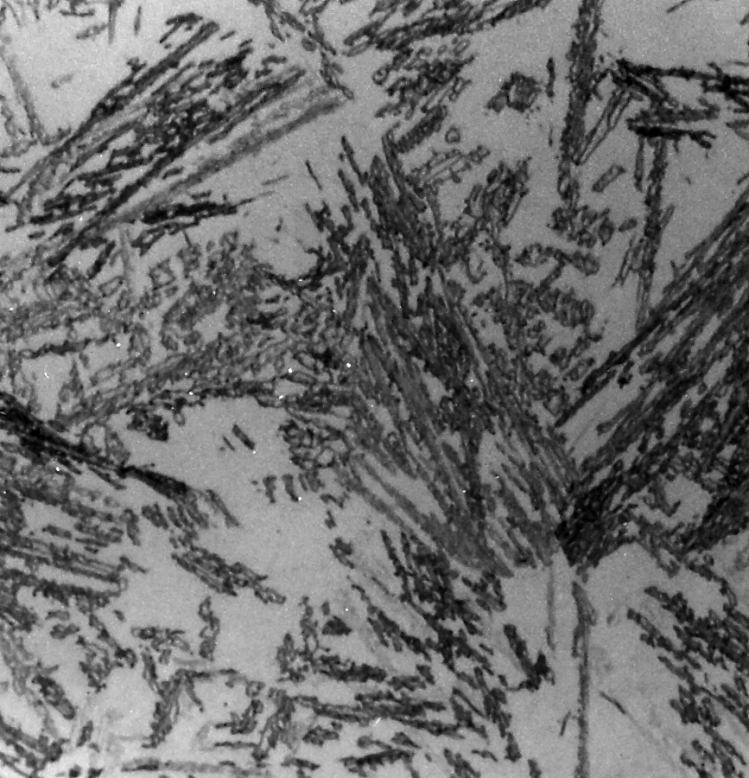
50 µm

Slide 14
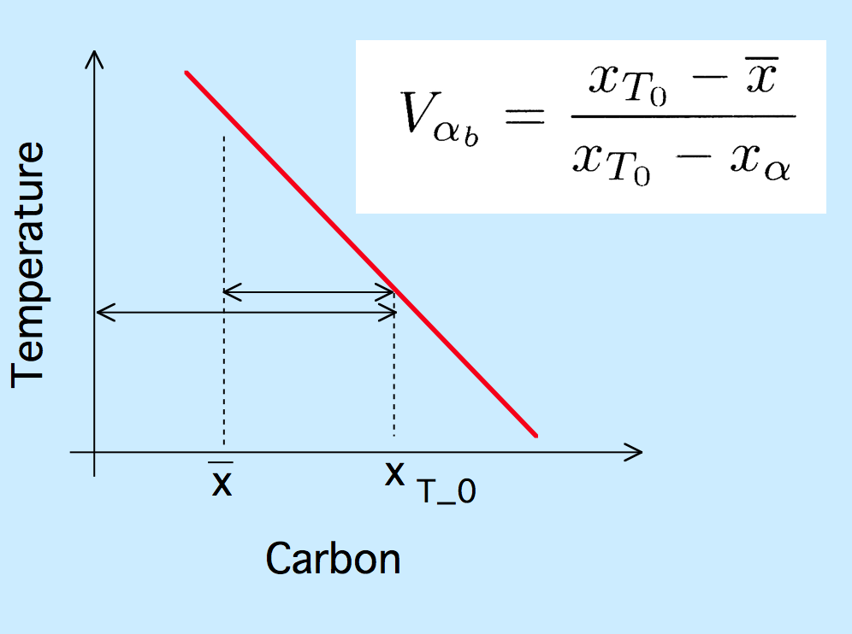

Slide 15
Carbide-free alloys
Fe-0.4C-3Mn-2Si
Fe-0.2C-3Mn-2Si
Fe-0.4C-4Ni-2Si wt%
Notes:
15

Slide 16
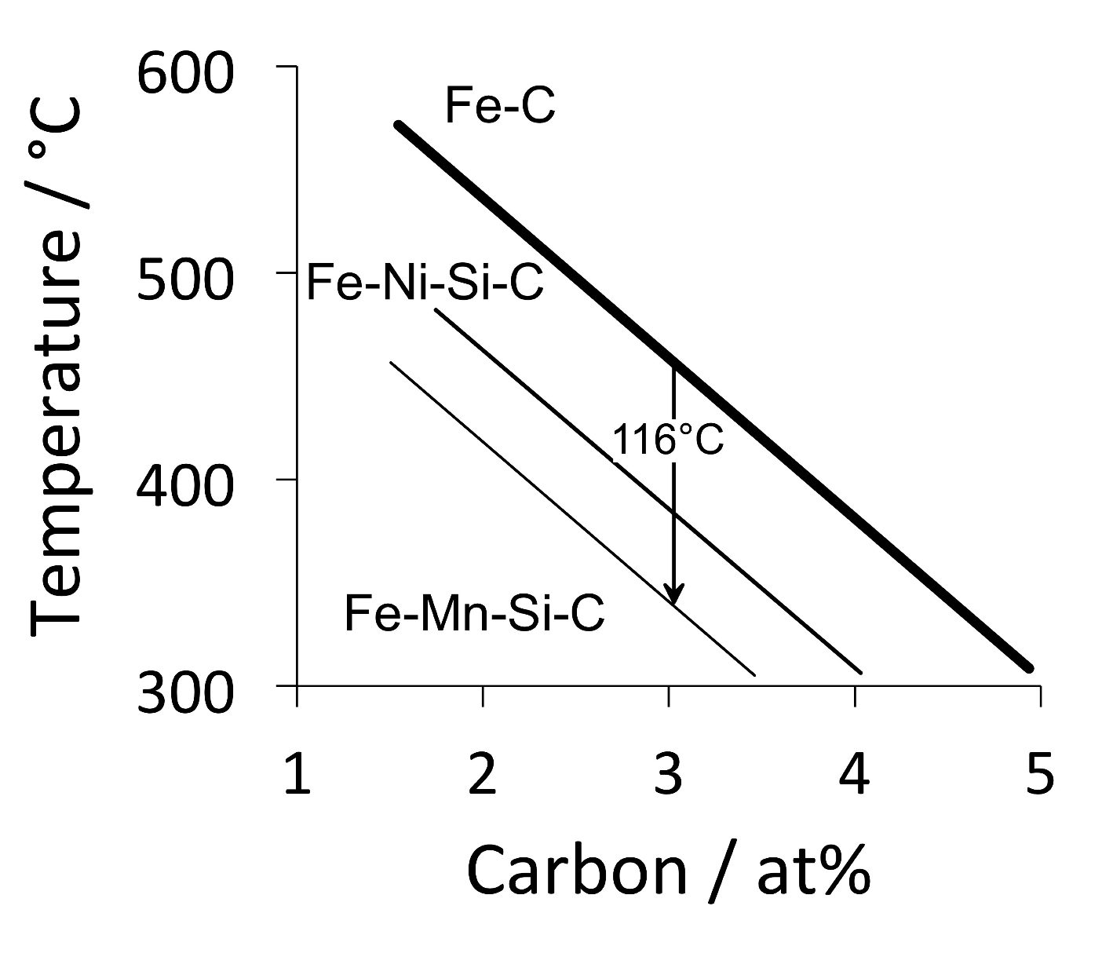

Slide 17
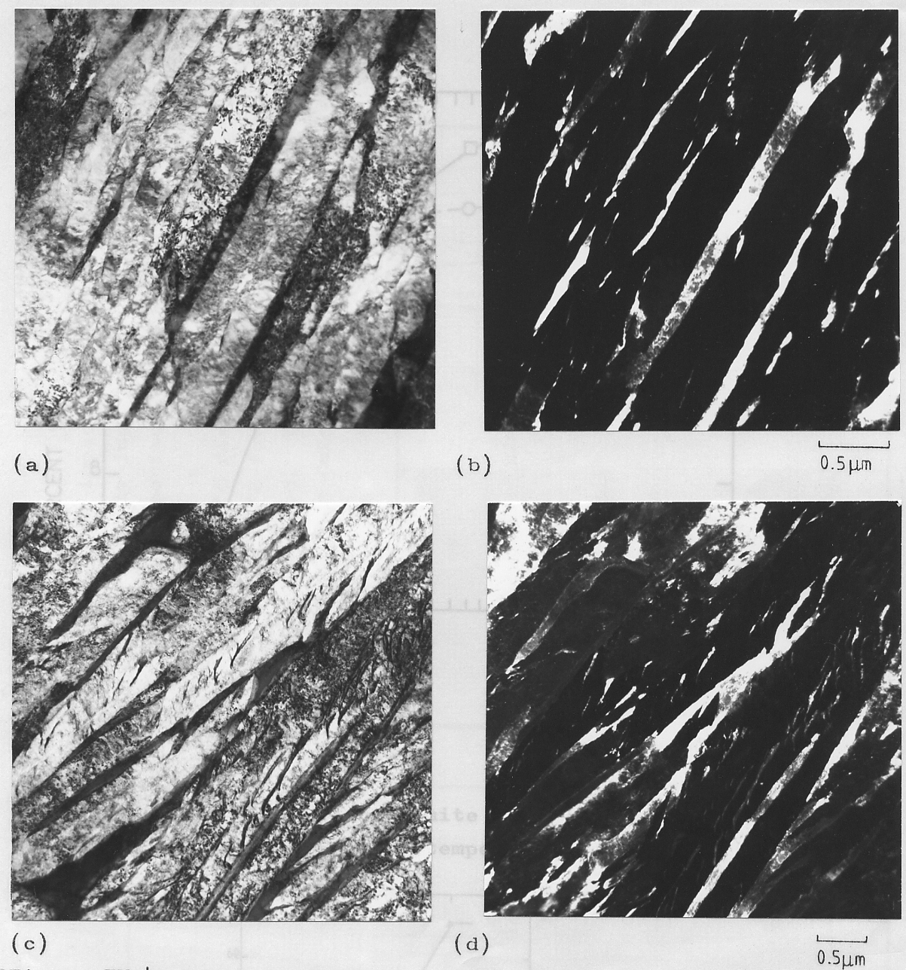
0.5 μm

Slide 18
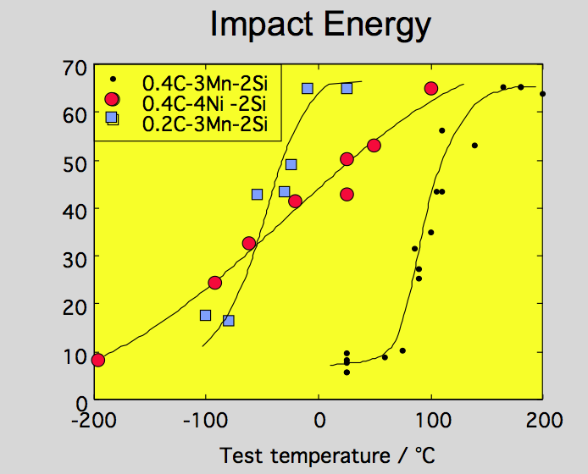

Slide 19
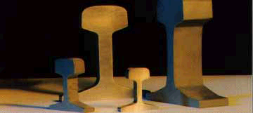

Slide 20
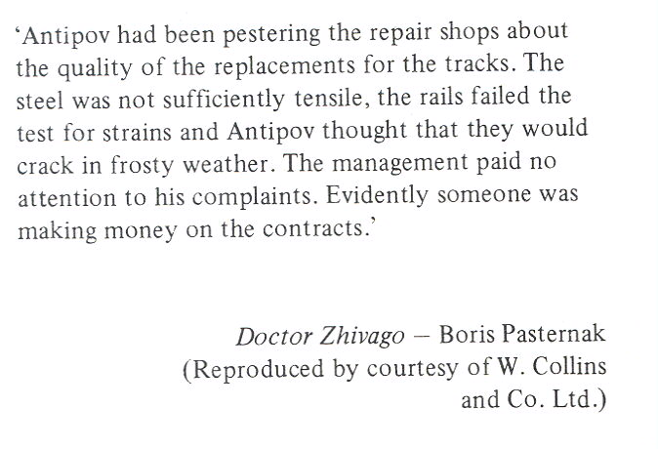

Slide 21
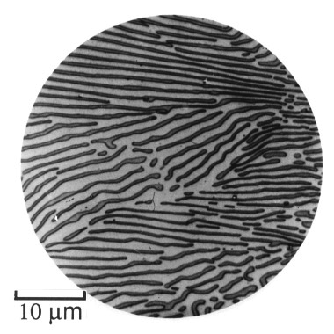
Bain: alloying elements in steels (1939)

Slide 22
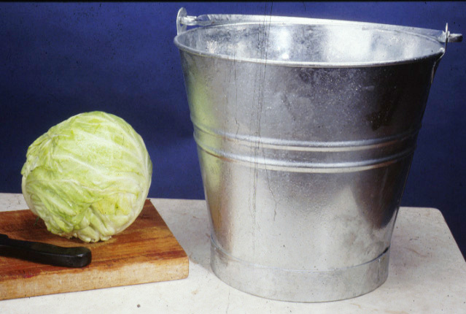

Slide 23
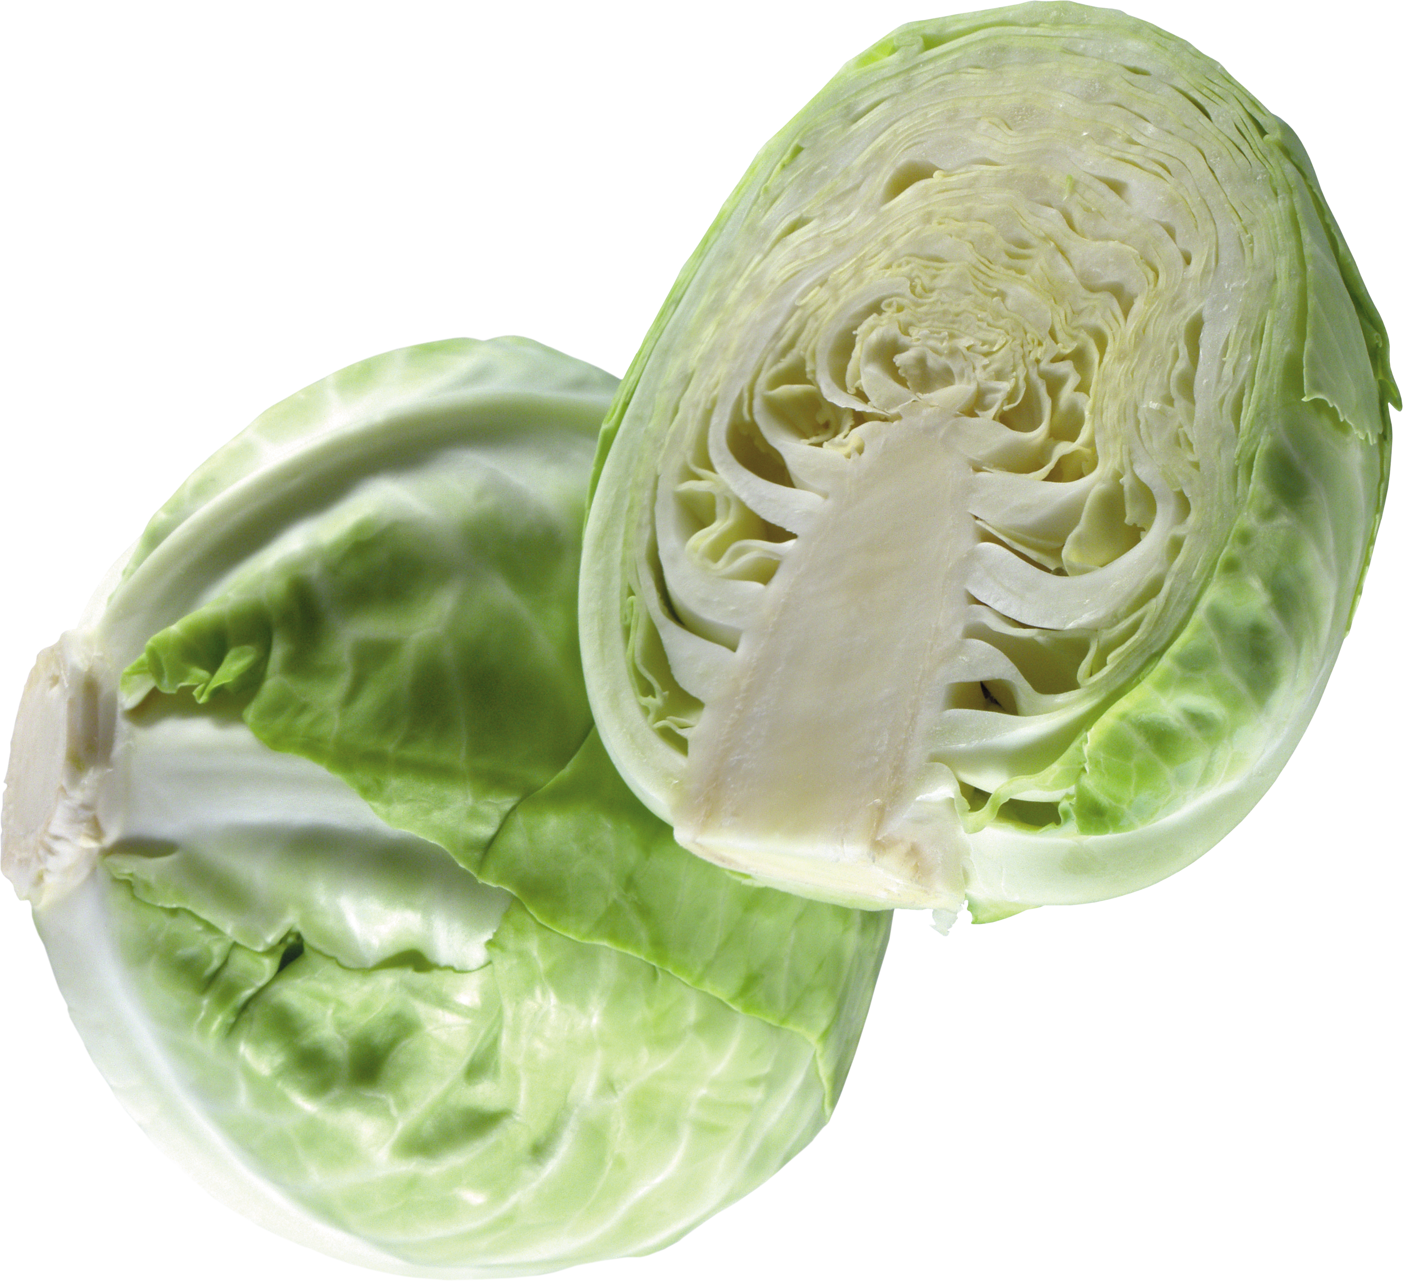
wish to design
rail steels using
the carbide-free
bainitic steel
image courtesy of pngimg.com
Creative Commons 4.0 BY-NC
https://creativecommons.org/licenses/by-nc/4.0/

Slide 24
Rail steel – requirements:
Rolling-contact fatigue.
Wear resistance.

Slide 25
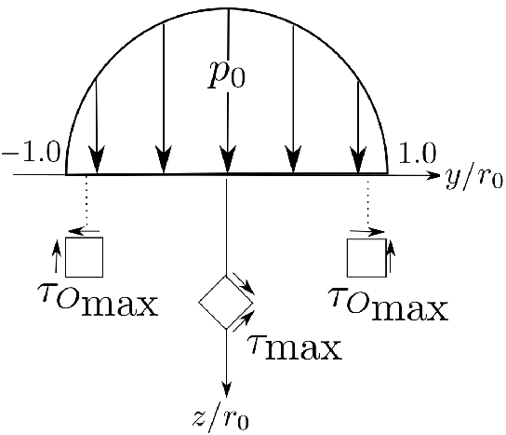
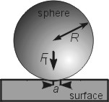
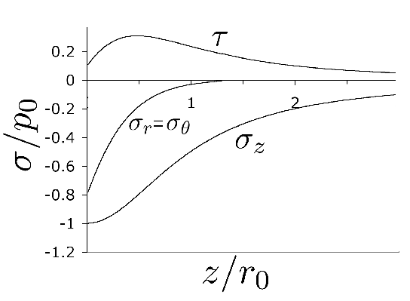

Slide 26
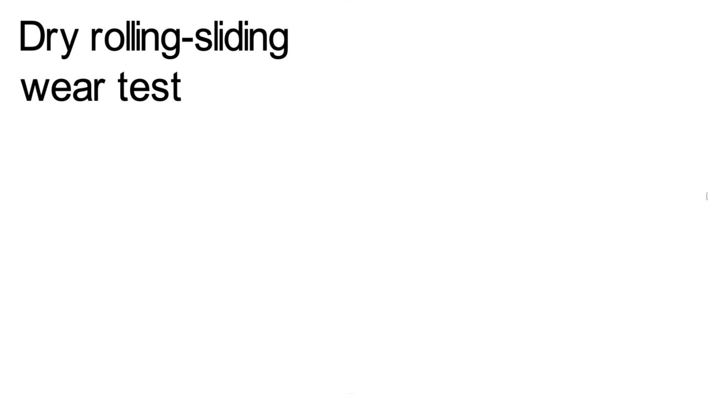

Slide 27
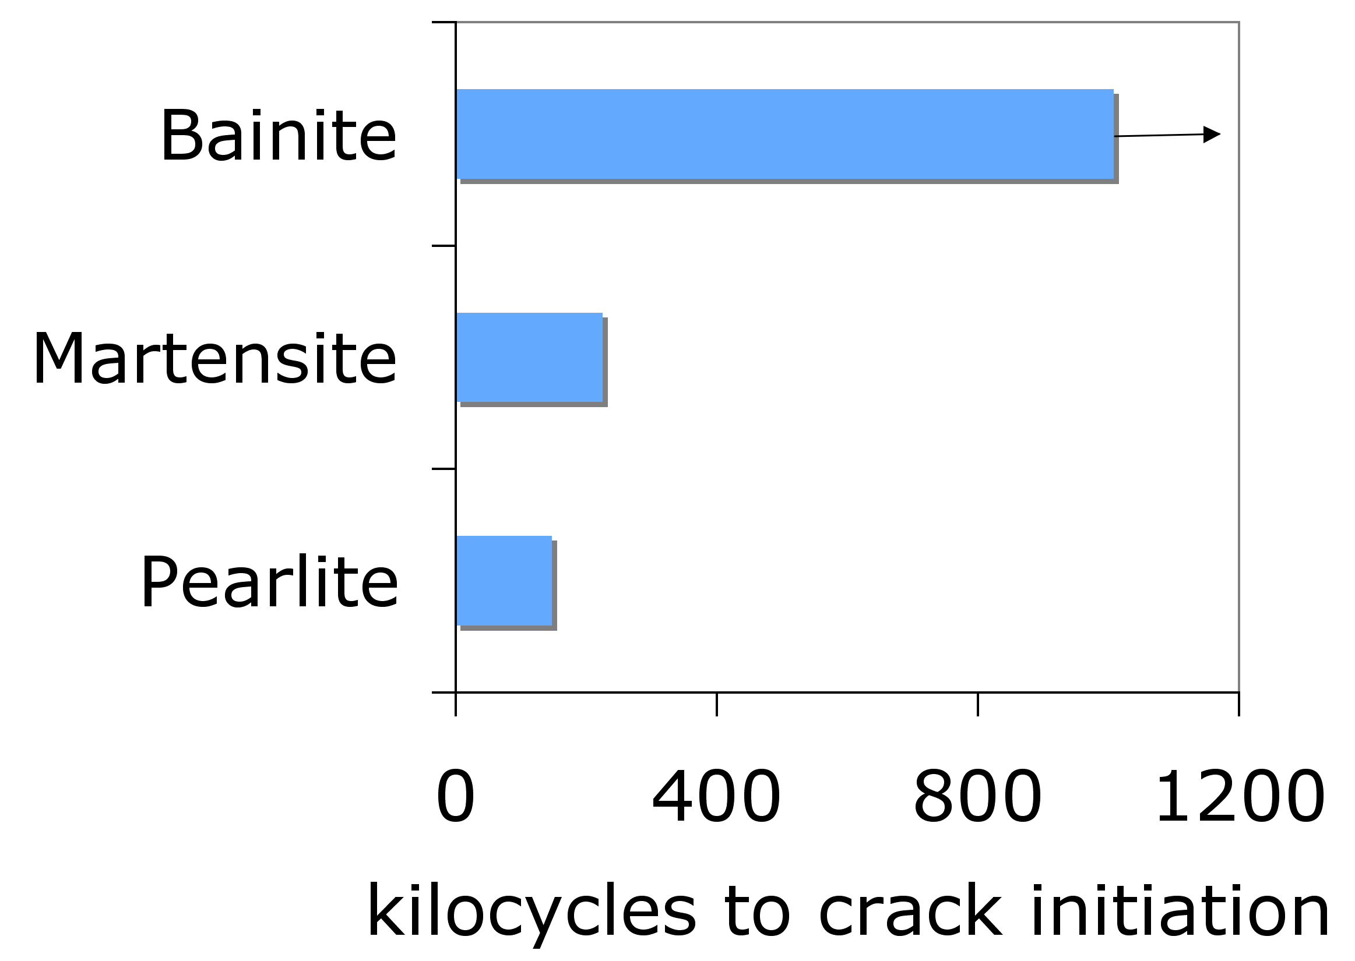
Yates, Jerath, Bhadeshia
Notes:
27

Slide 28
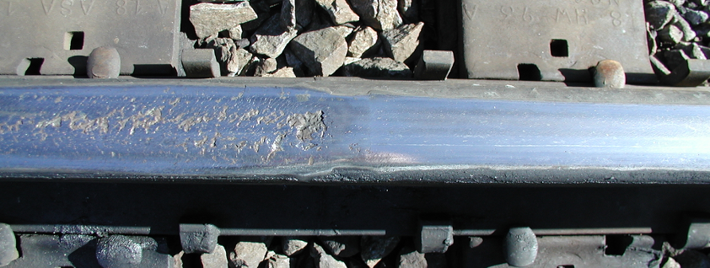
carbide-free bainitic rail
Carbide-free bainite has no hard particles,
Just bainitic ferrite and retained austenite
Kevin Sawley: 90 million gross tonnes of traffic on curve

Slide 29
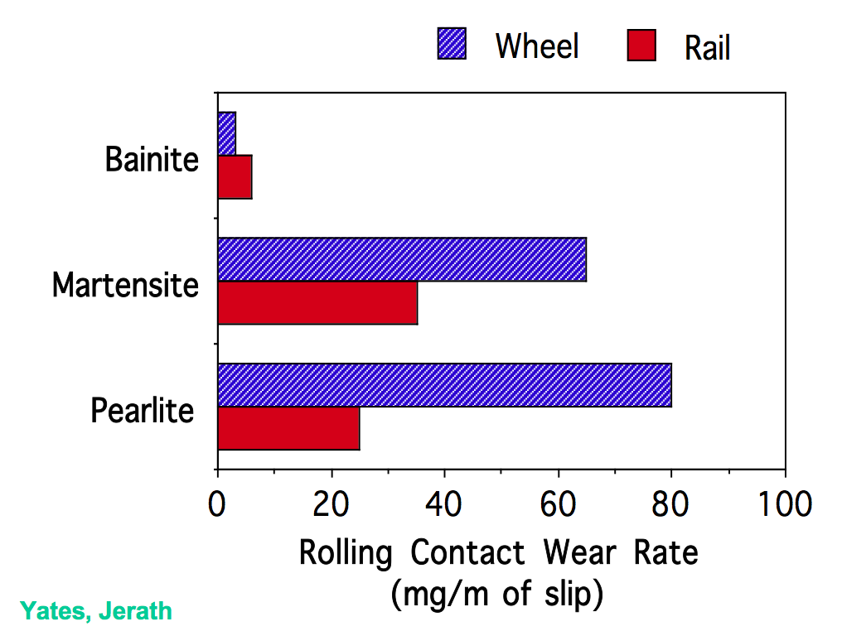
Notes:
29

Slide 30
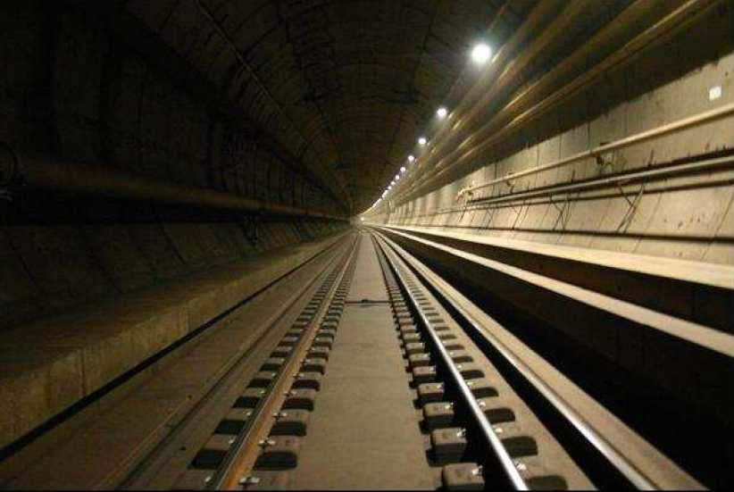
November 2019: 1 billion gross tonnes of traffic achieved
Notes:
30

Slide 31
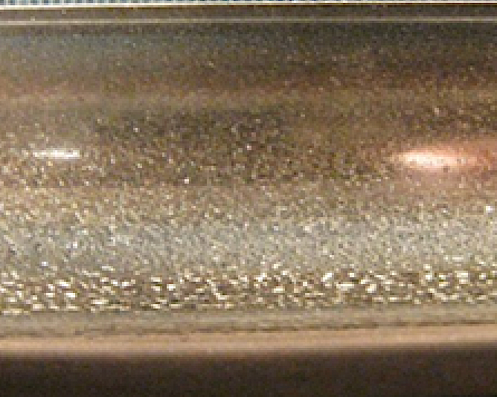
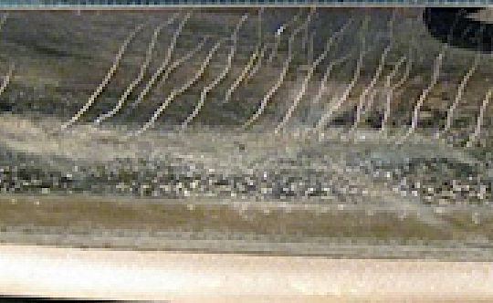
Carbide-free bainitic rail in the tunnel has
completed >1000,000,000 gross tonnes of traffic
without developing fatigue, without need for grinding.
Pascal Secordel (Francerail), Jay Jaiswal (Arrail)
April 2020

Slide 32
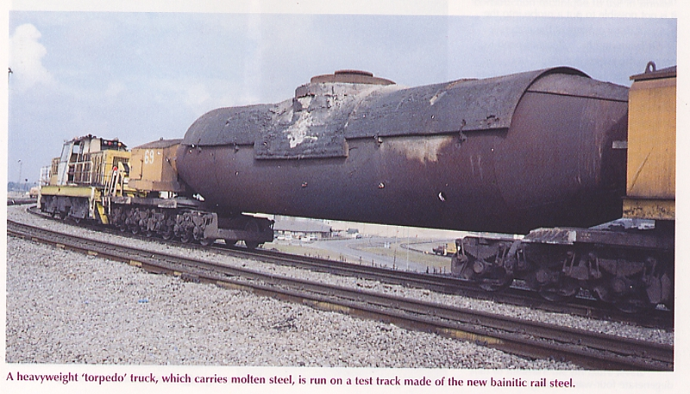

Slide 33
Advances in carbide-free bainitic steels
180
160
140
120
18 wt% Ni
maraging steel
Fracture toughness / MPa √m
100
80
60
40
QT
20
1000
1500
2000
2500
Ultimate tensile strength / MPa

Slide 34
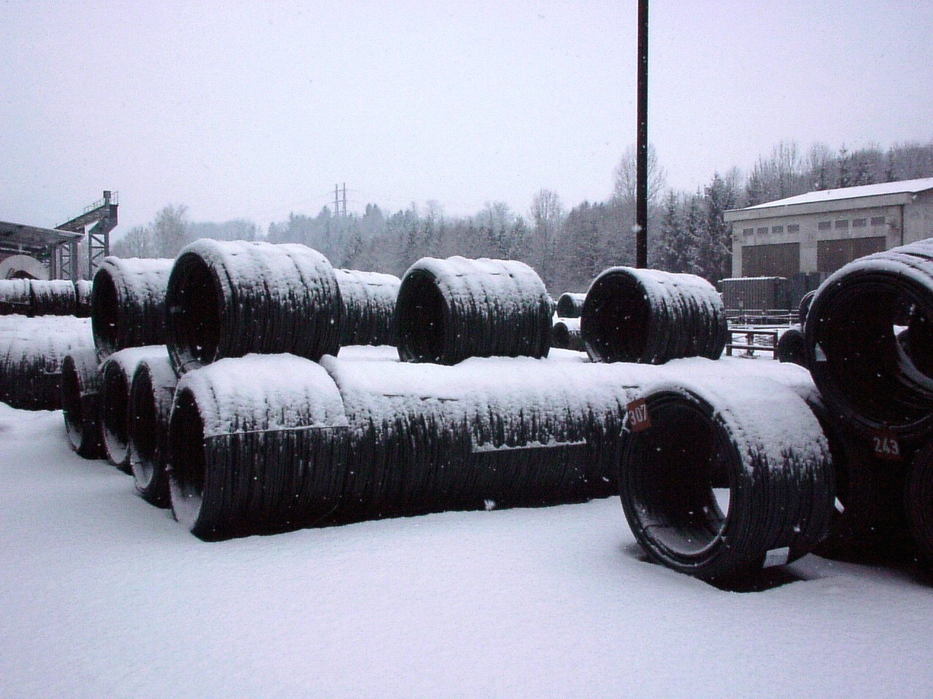
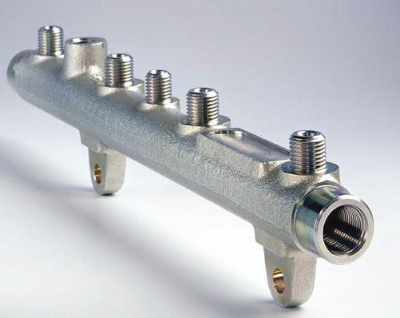
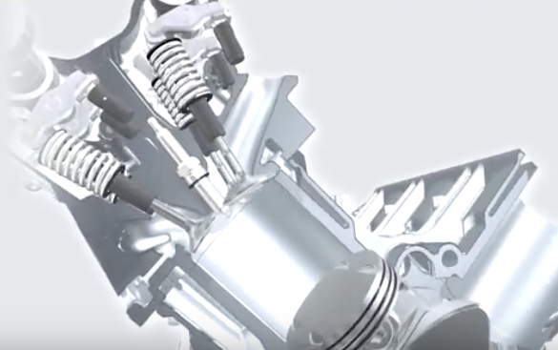
Ascometal
airbags, wheelchairs, tool holders

Slide 35
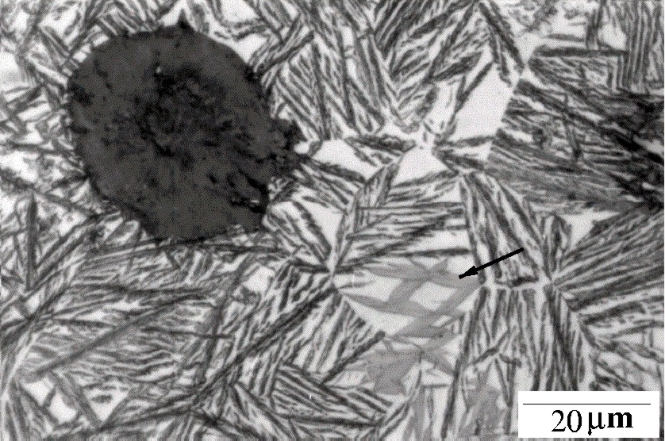
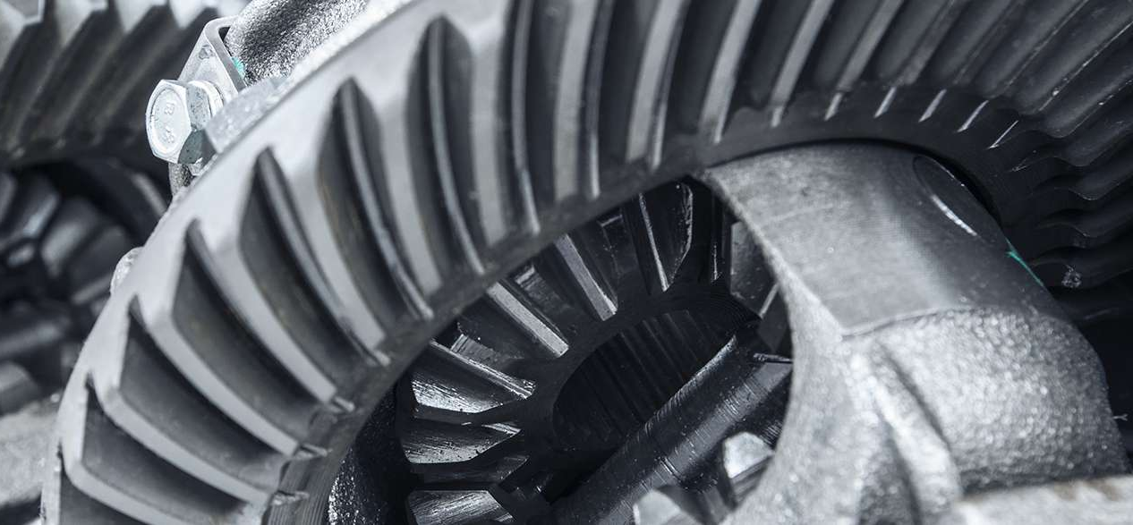
Charpy 120 J at 25°C
Strength > 1100 MPa

Slide 36
