Slide 1
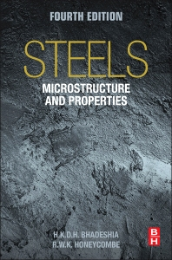

Steels: Widmanstätten ferrite,
lecture 5 of 12
Martensite
Bainite: mechanism based design
Alloy design: strong bainite
Widmanstätten ferrite
Allotriomorphic ferrite
Pearlite
Overall kinetics
TRIP steel
TWIP steel
Mitigation of residual stress
Bulk nanostructured steel
www.phase-trans.msm.cam.ac.uk/teaching.html
H. K. D. H. Bhadeshia

Slide 2
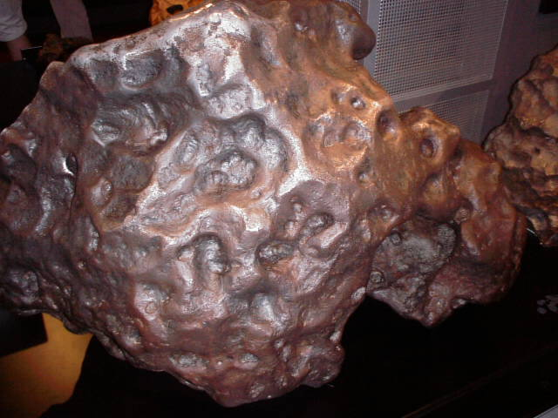
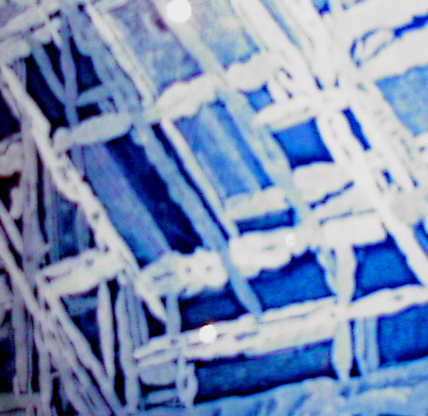
Widmanstätten ferrite
2 m

Slide 3
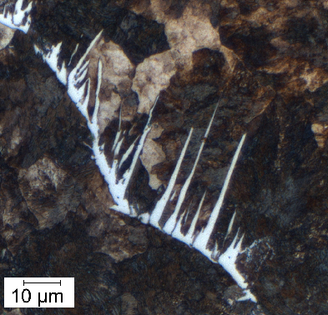
Micrograph courtesy of
Rolando M. Núñez Monrroy of the Pontifical Catholic University of Peru.
Notes:
3

Slide 4
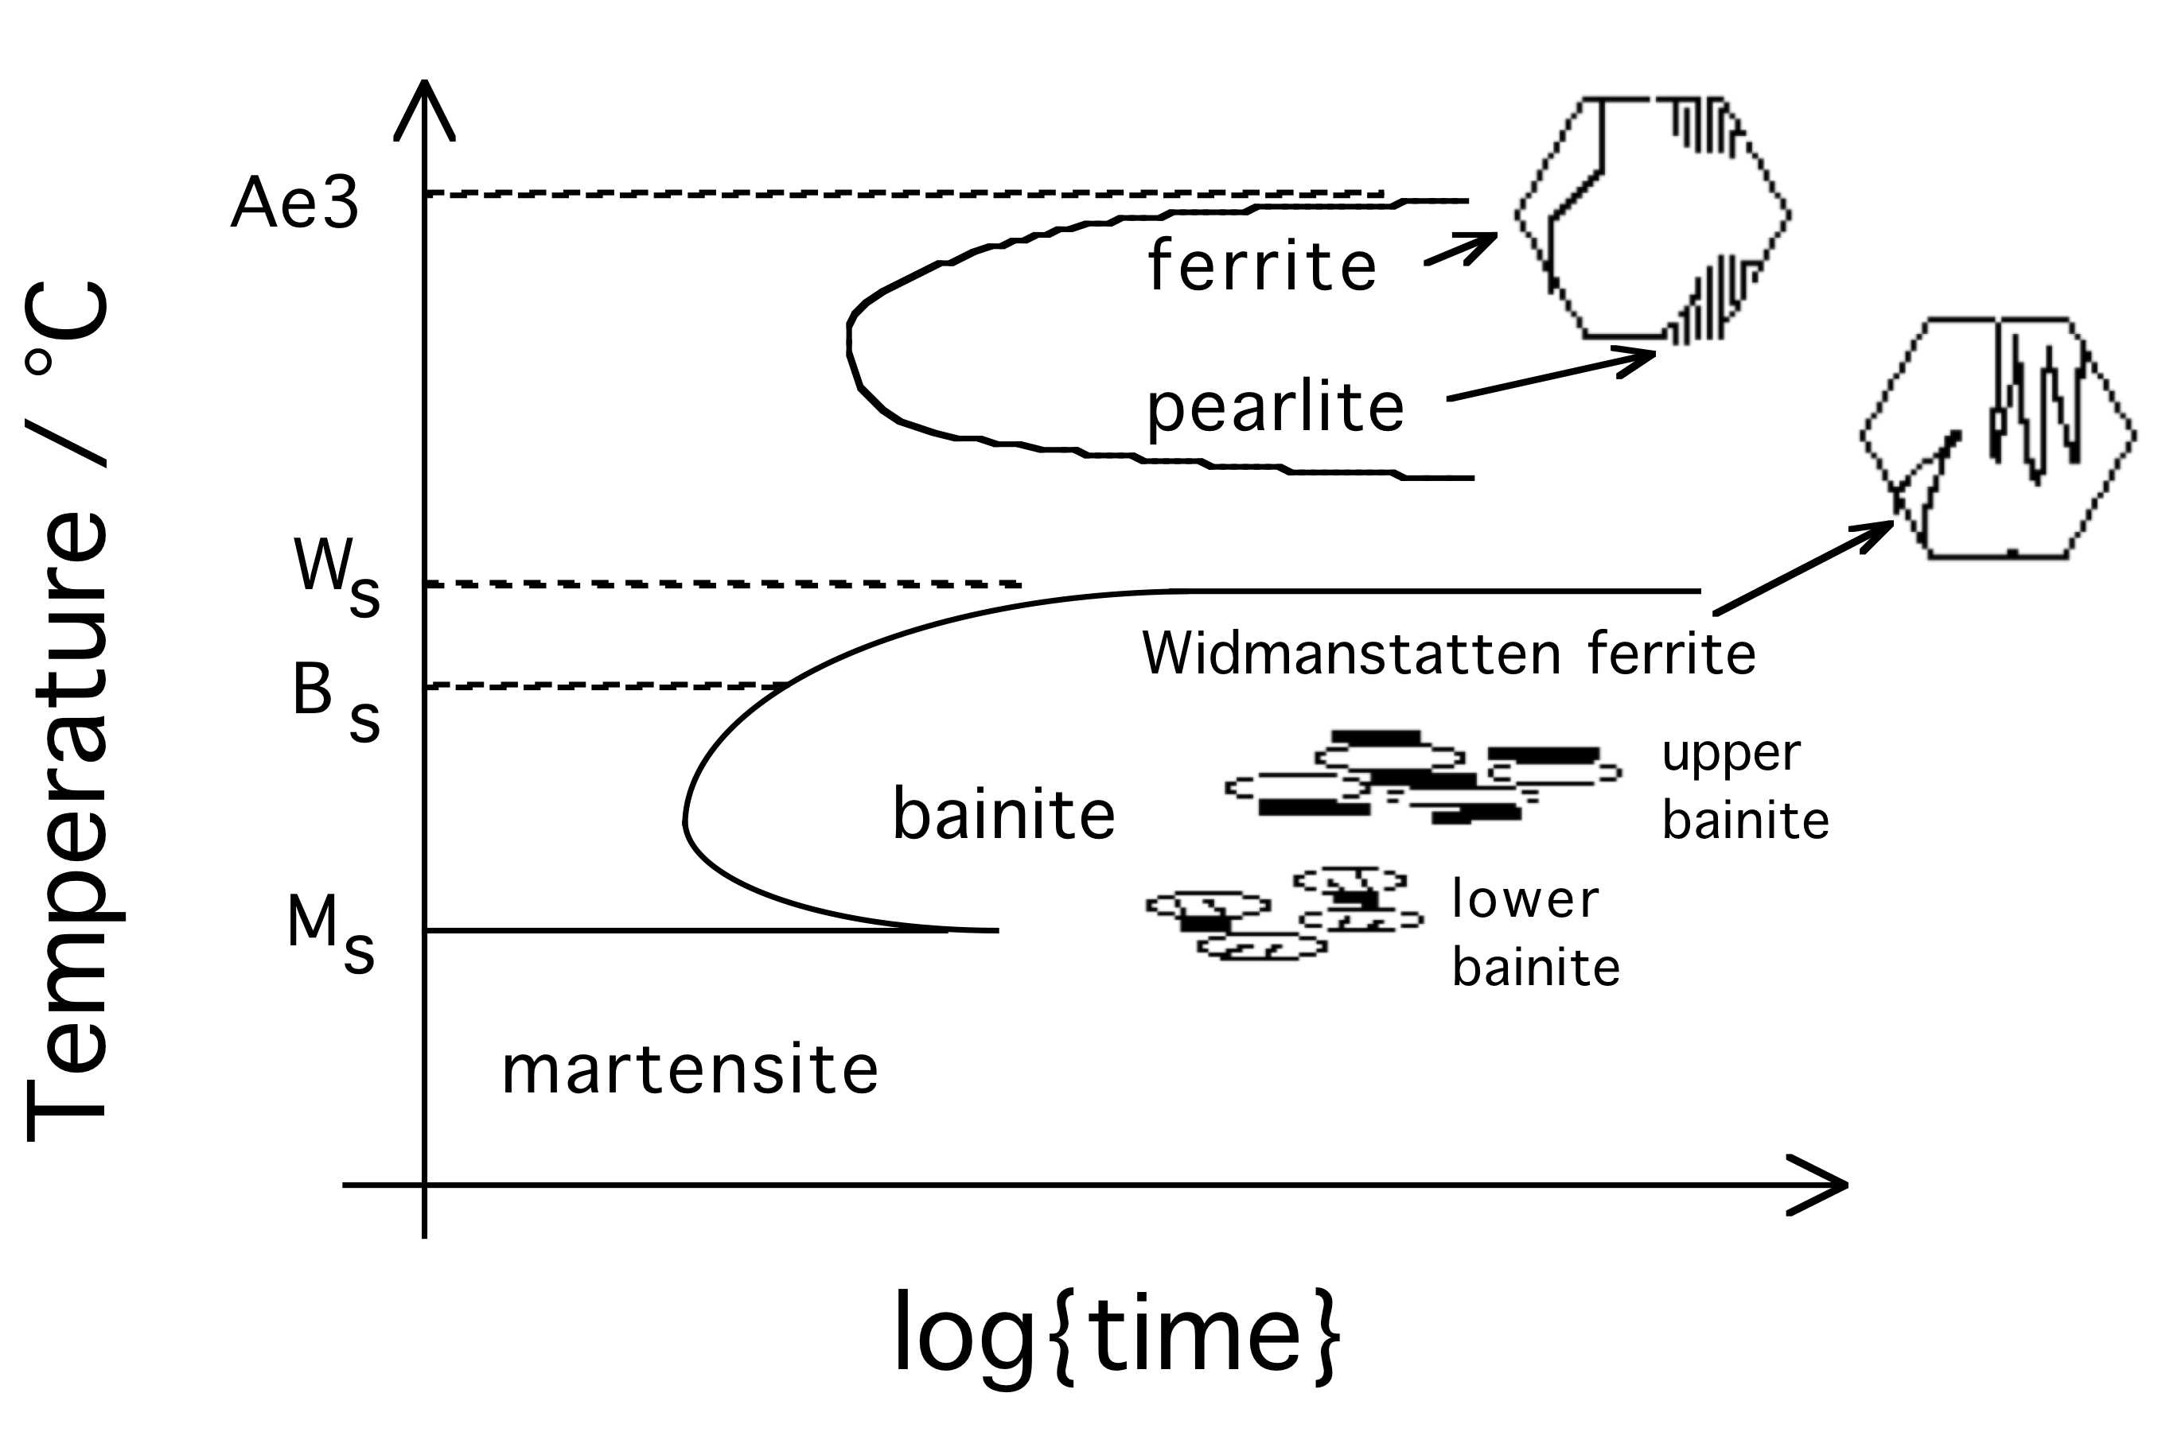
Notes:
4

Slide 5
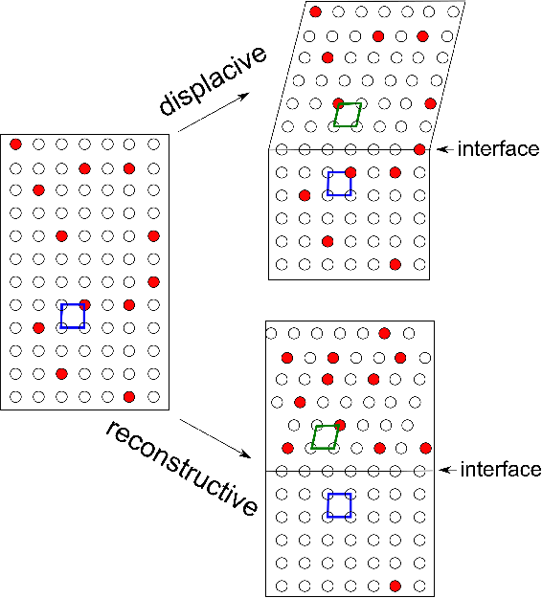
Notes:
5

Slide 6
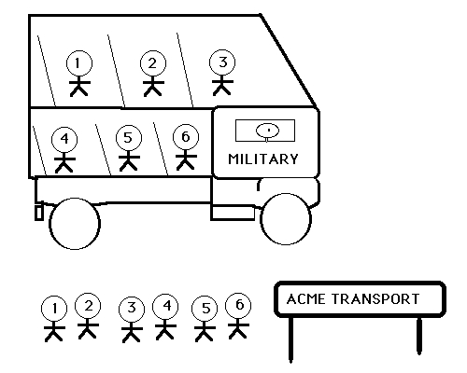
Notes:
6

Slide 7
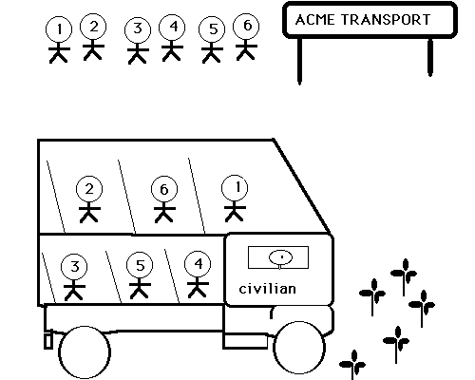
Notes:
7

Slide 8
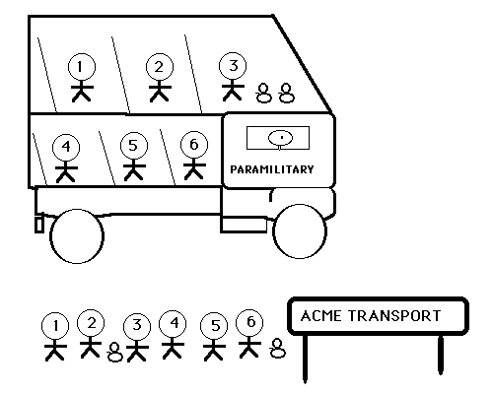
Notes:
8

Slide 9
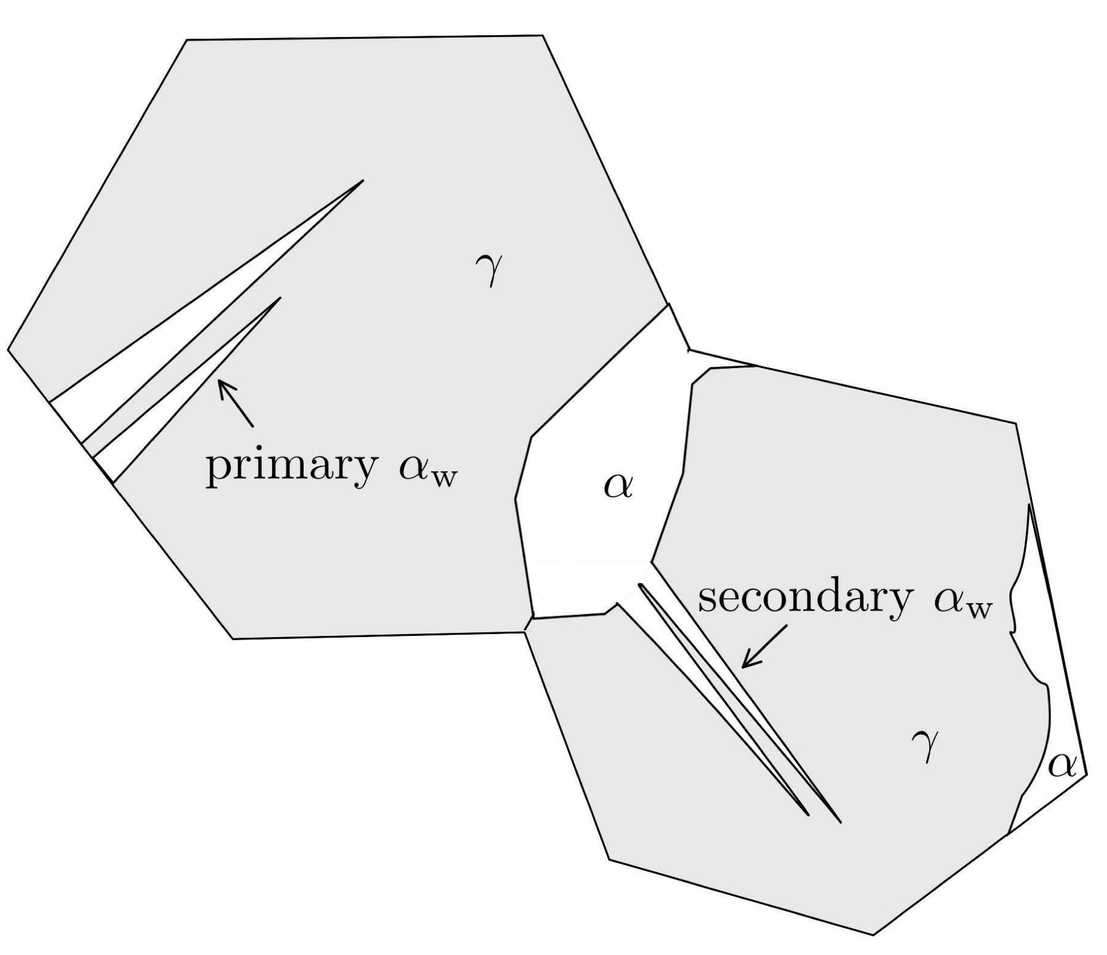
Notes:
9

Slide 10
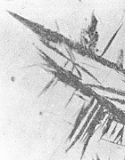
50 µm

Slide 11
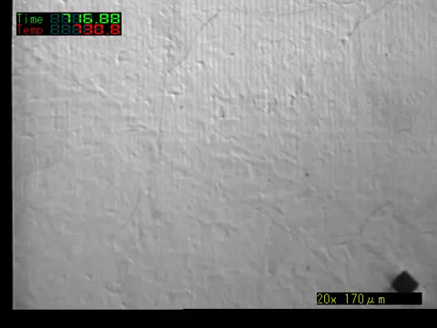
Courtesy of N. Oku, K. Asakura, J. Inoue and T. Koseki,
Tetsu-to-Hagane, Vol. 94 (2008) 363-368.

Slide 12
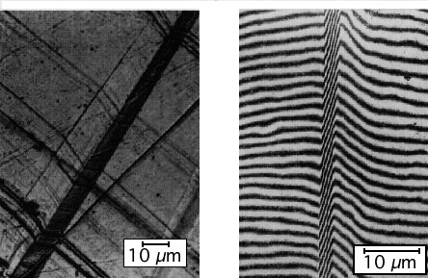
Watson and McDougall, 1973
Notes:
12

Slide 13
- Widmanstätten ferrite can grow at small undercoolings
at temperatures well above T₀
carbon diffusion essential during transformation

Slide 14
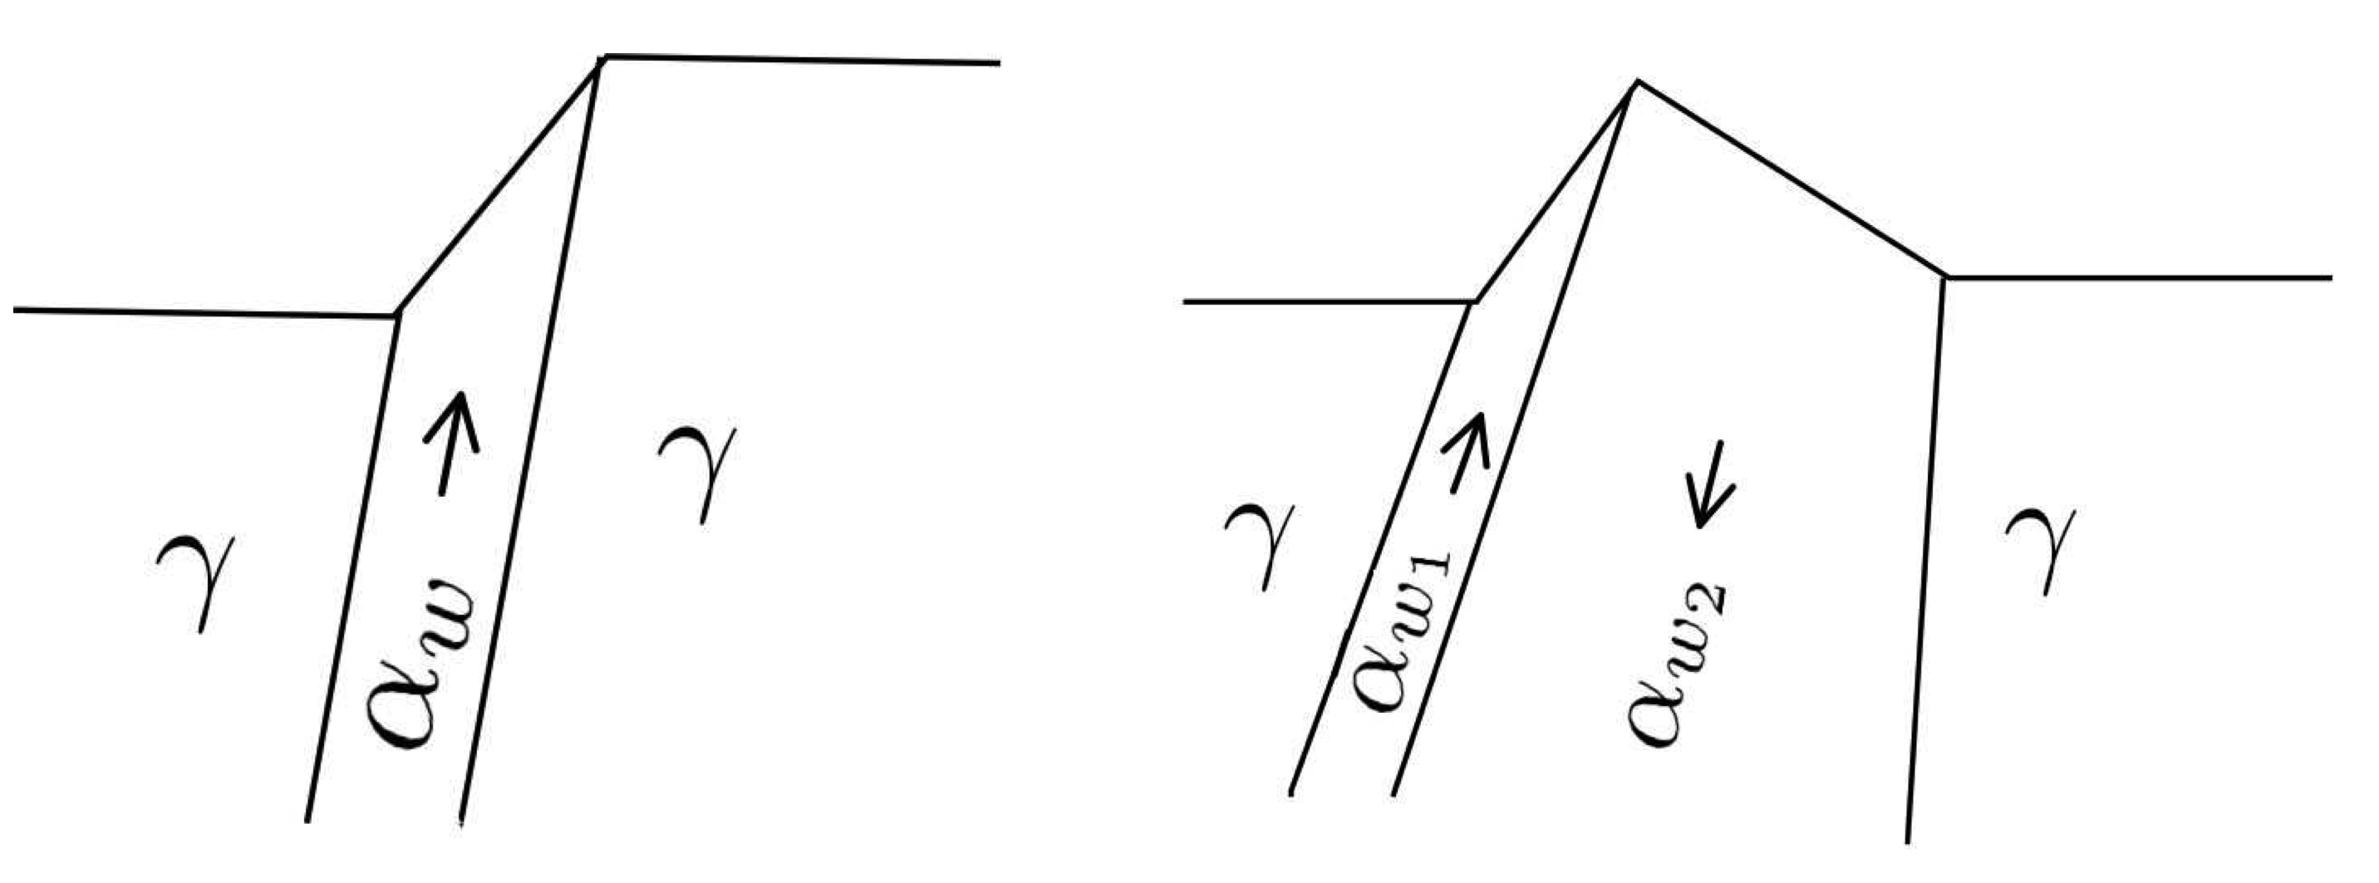
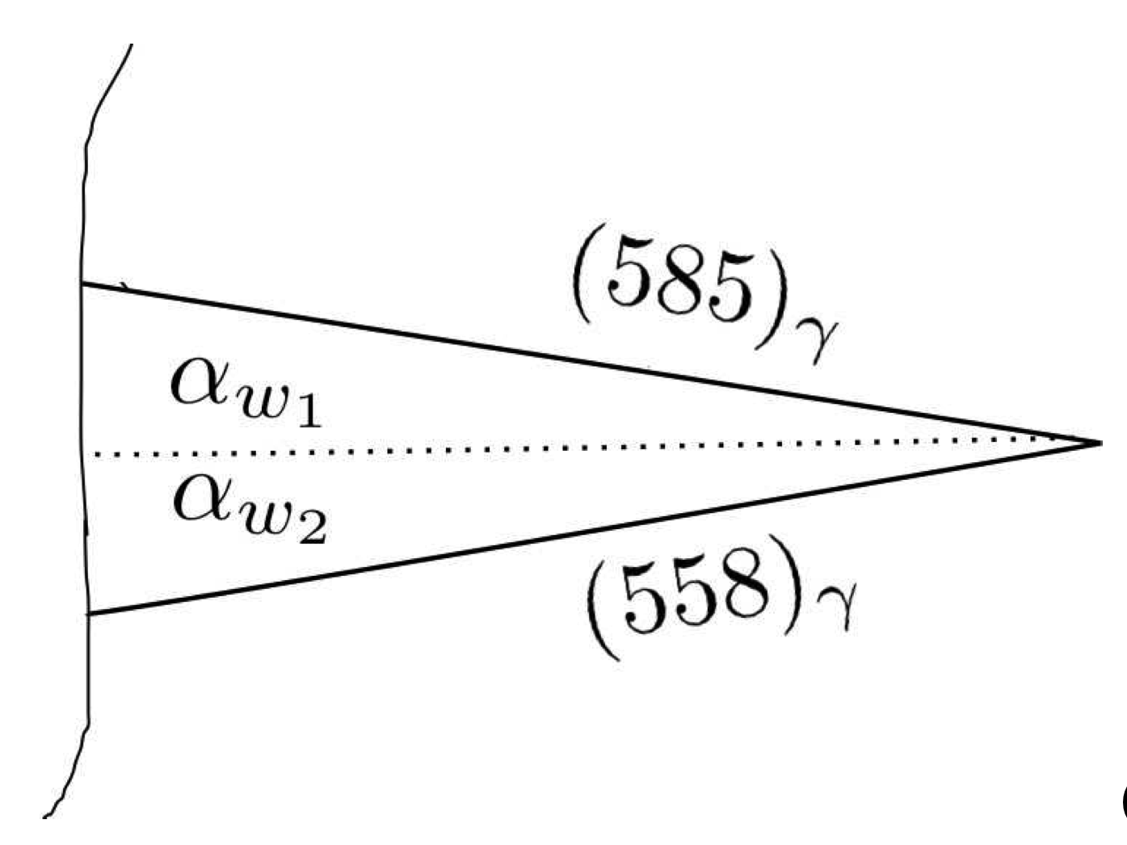
Notes:
14

Slide 15
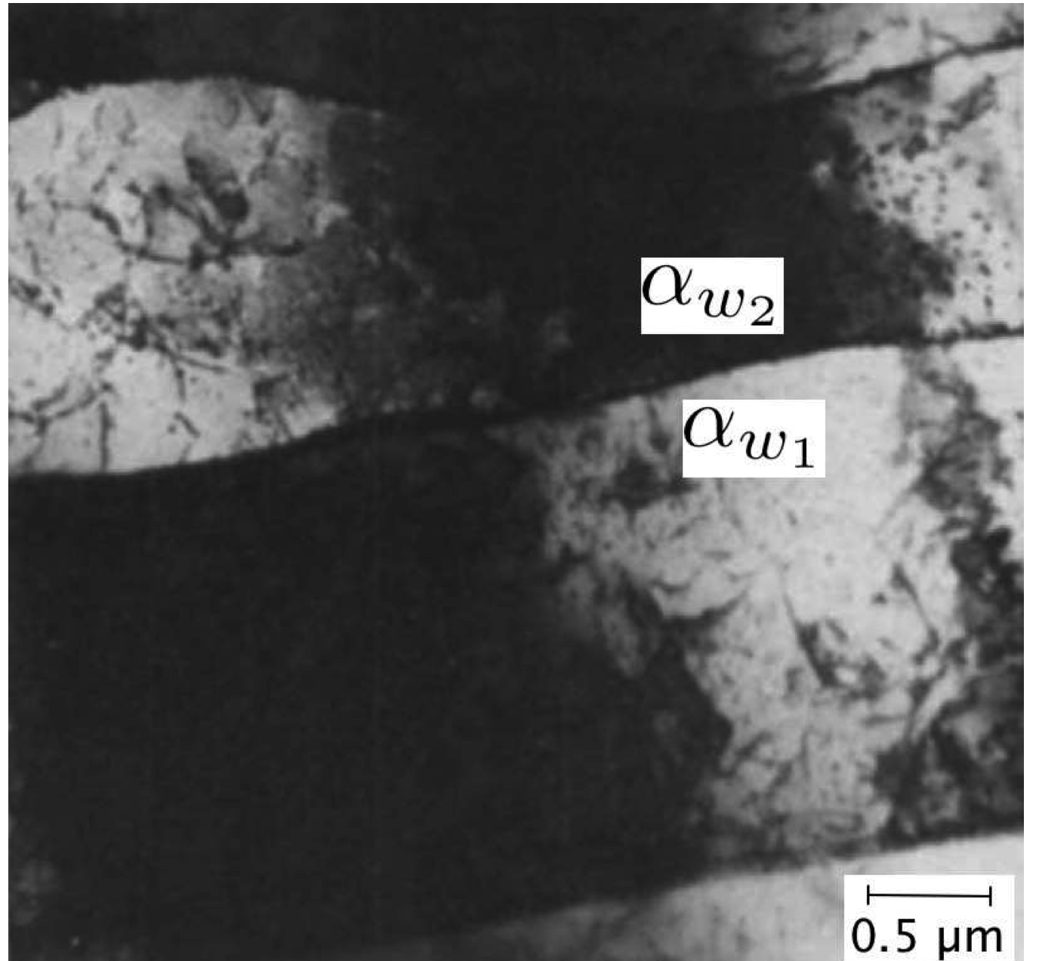
Notes:
15

Slide 16
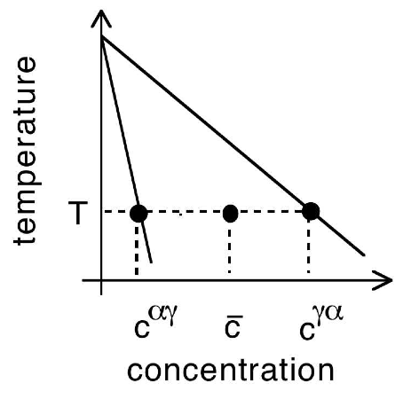
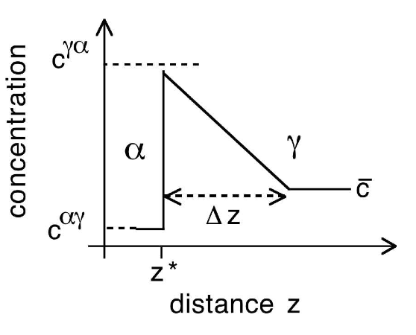
conditions at the transformation interface

Slide 17
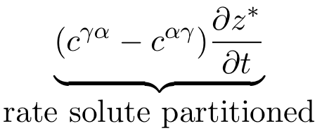
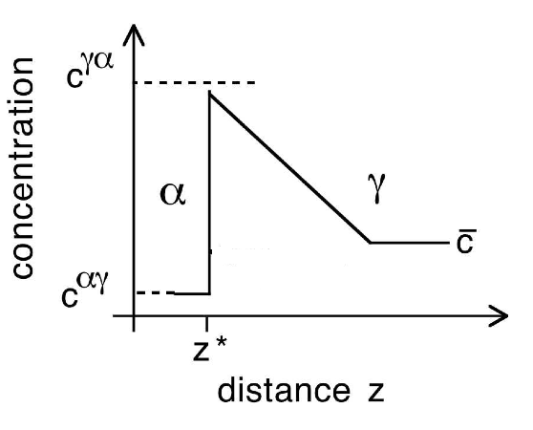

Slide 18
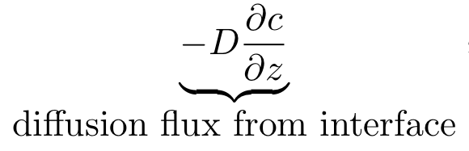
diffusion

Slide 19
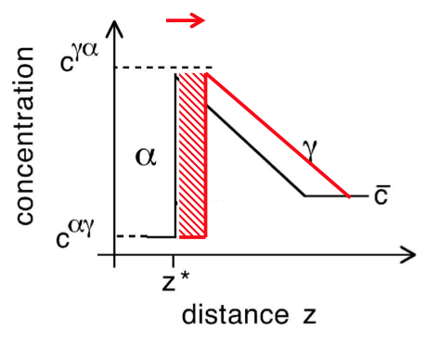
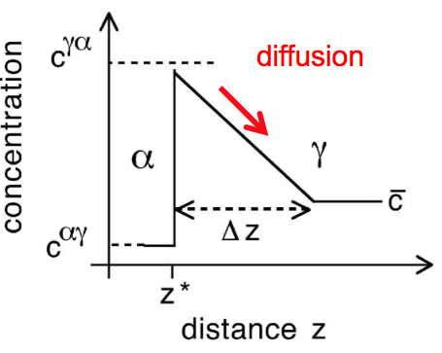
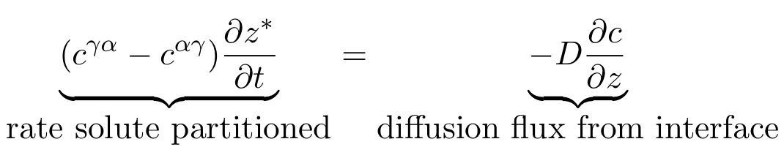
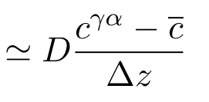

Slide 20
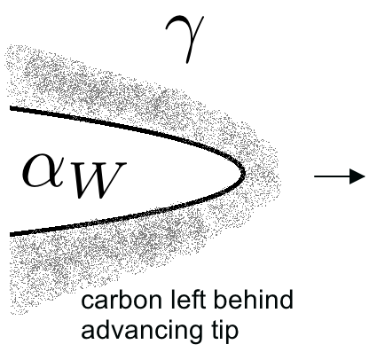

Slide 21
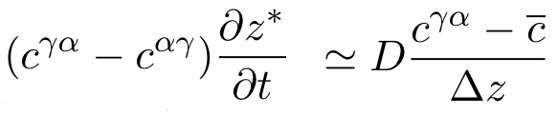
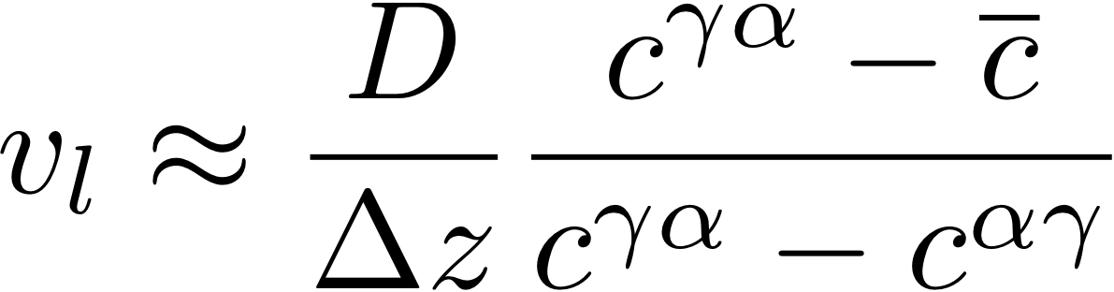
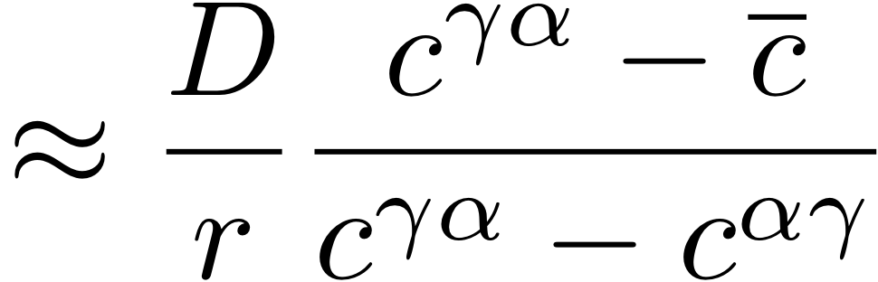
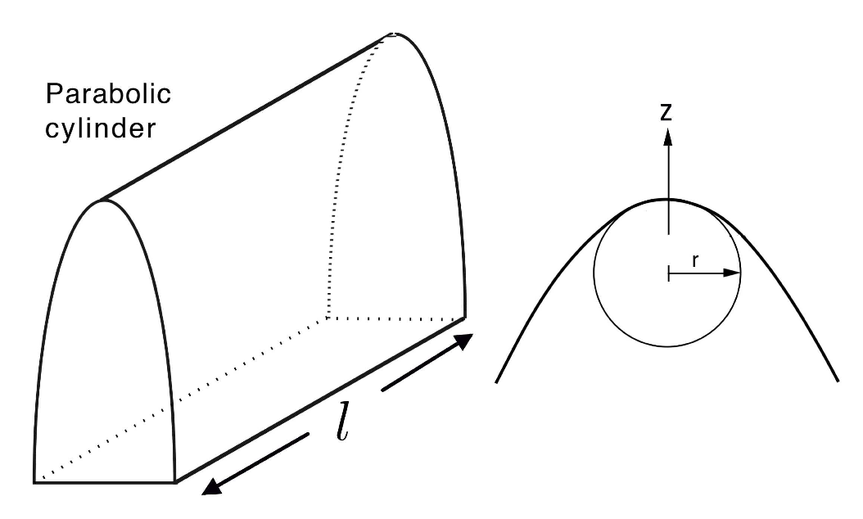

Slide 22
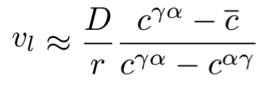

Slide 23

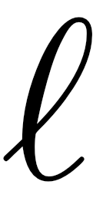
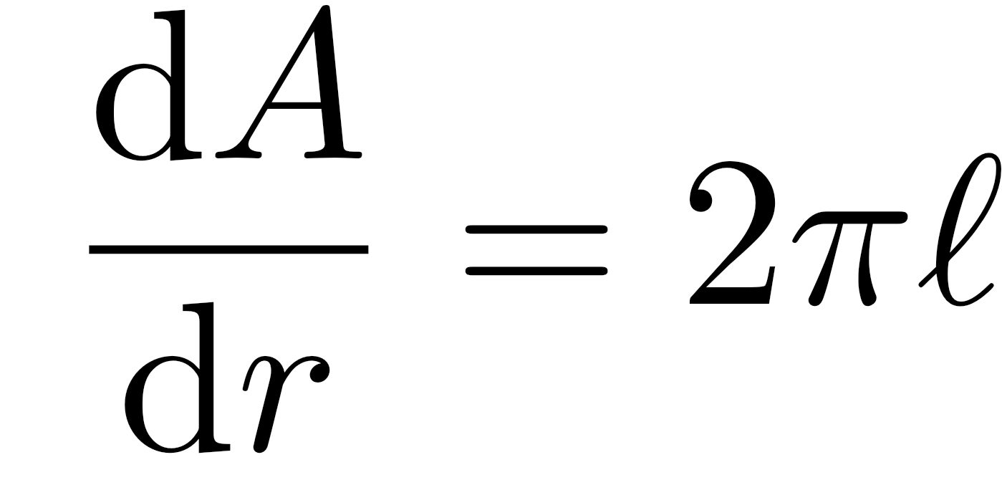
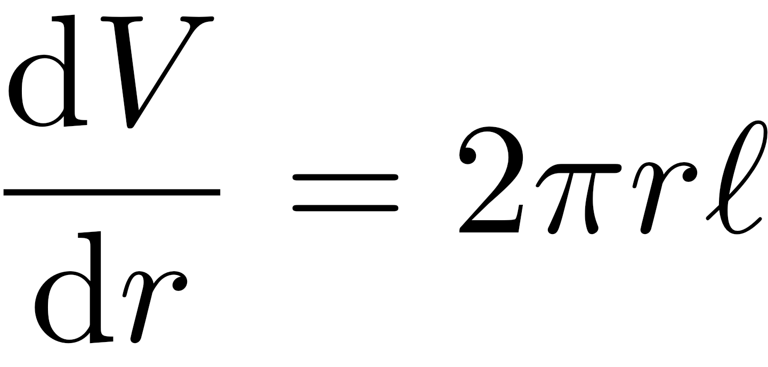
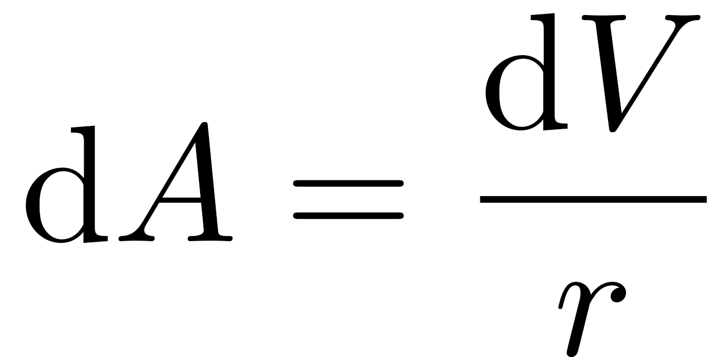
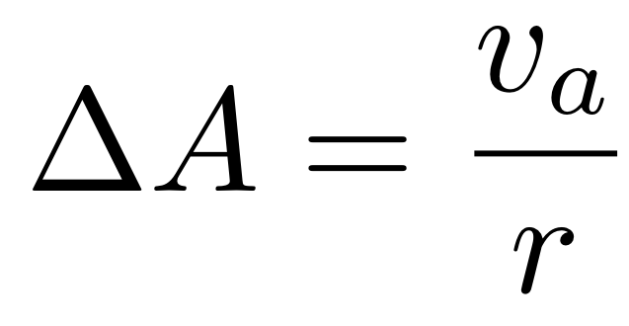
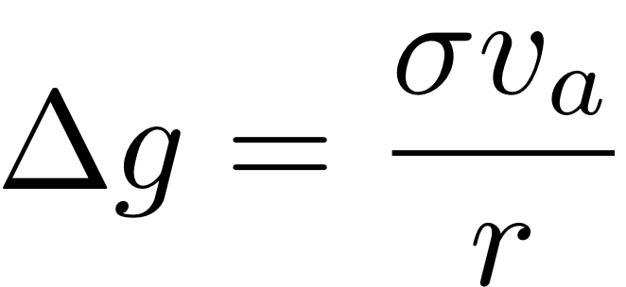
consider a cylinder

Slide 24
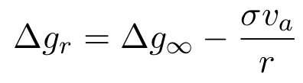



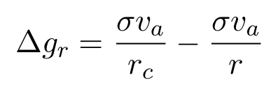
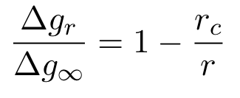
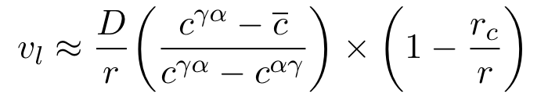

Slide 25
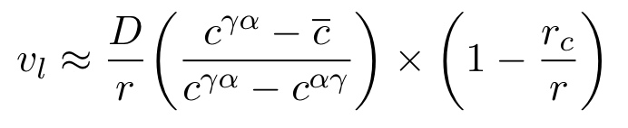

Slide 26
Notes:
26

Slide 27
Summary
Mechanism displacive but carbon must partition during growth.
Pairs of plates grow together to minimise strain.
The plates can grow in carbon-free alloys of iron, in which case, the lengthening rate would be controlled by the mobility of the glissile transformation interface.
Notes:
27

