Slide 1


Steels: overall transformation kinetics, lecture 9 of 12
Martensite
Bainite: mechanism based design
Alloy design: strong bainite
Widmanstätten ferrite
Ferrite
Pearlite
Overall kinetics
TRIP steel
TWIP steel
Mitigation of residual stress
Bulk nanostructured steel
www.phase-trans.msm.cam.ac.uk/teaching.html
H. K. D. H. Bhadeshia

Slide 2
Overall transformation kinetics

Slide 3

To calculate a TTT diagram, need:
nucleation theory
growth theory
hard impingement
soft impingement
concentration
distance

Slide 4
Nucleation

Slide 6
To calculate a TTT diagram, need:
nucleation theory
growth theory
hard impingement
soft impingement
concentration
distance

Slide 7
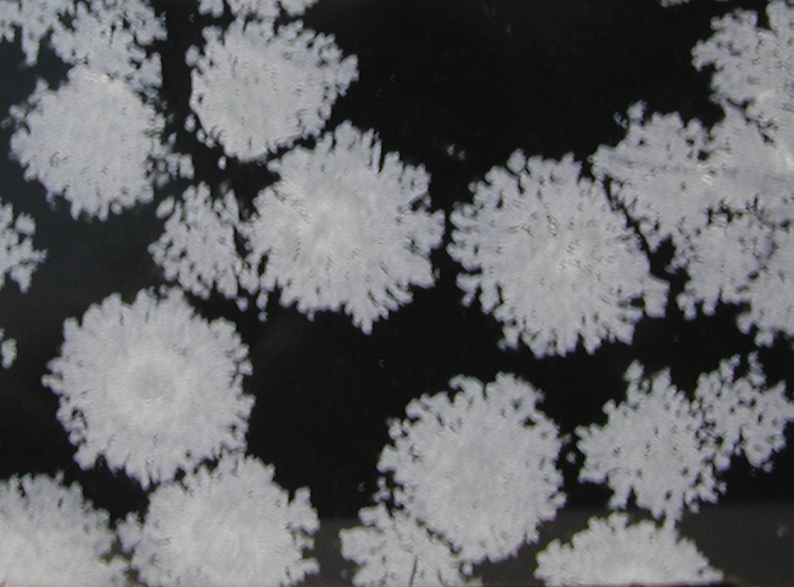
Overall Transformation Kinetics

Slide 8
α
time = t
time = t+∆t

Slide 9
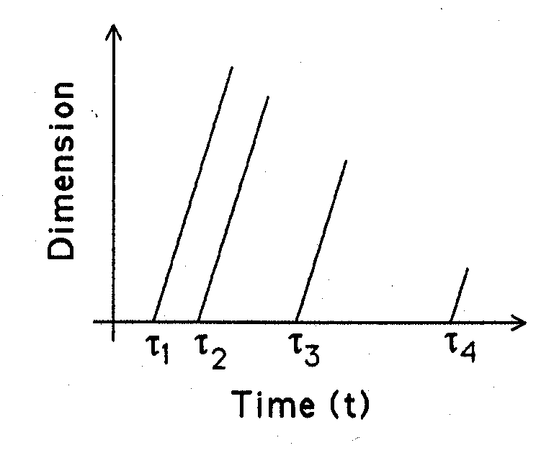
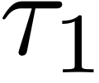
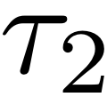
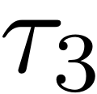

Slide 11
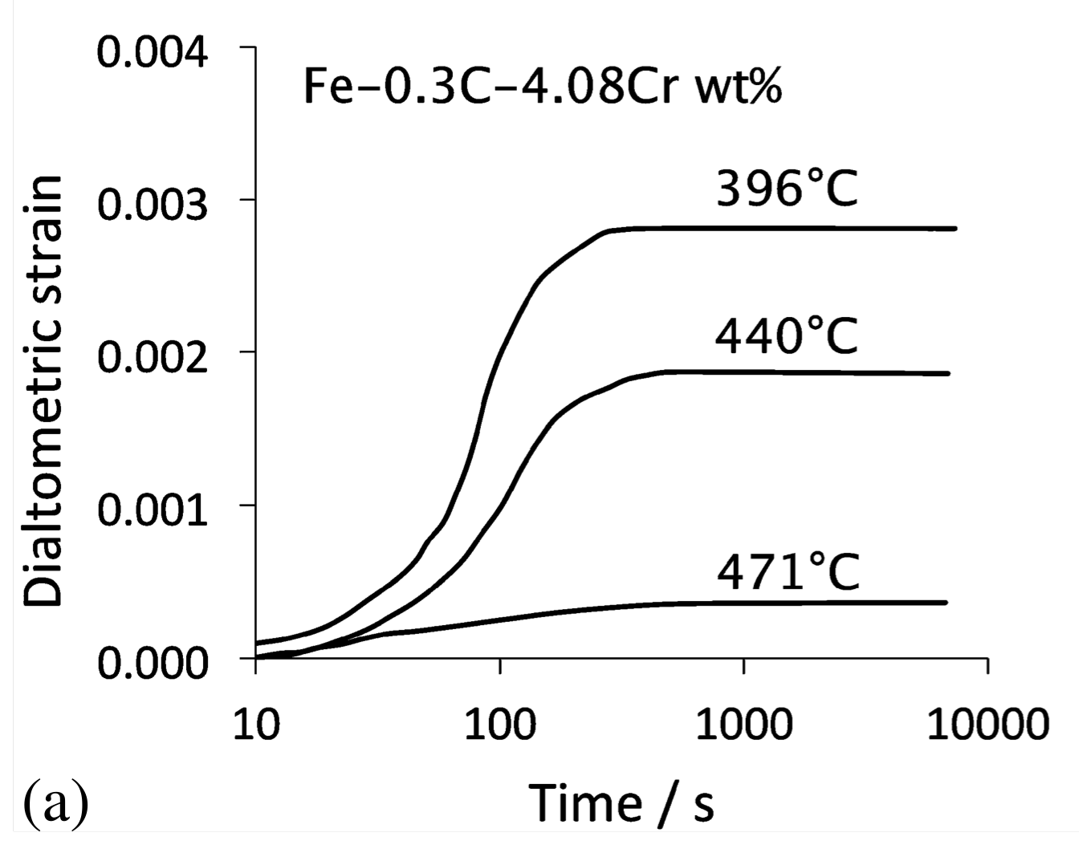


Slide 12
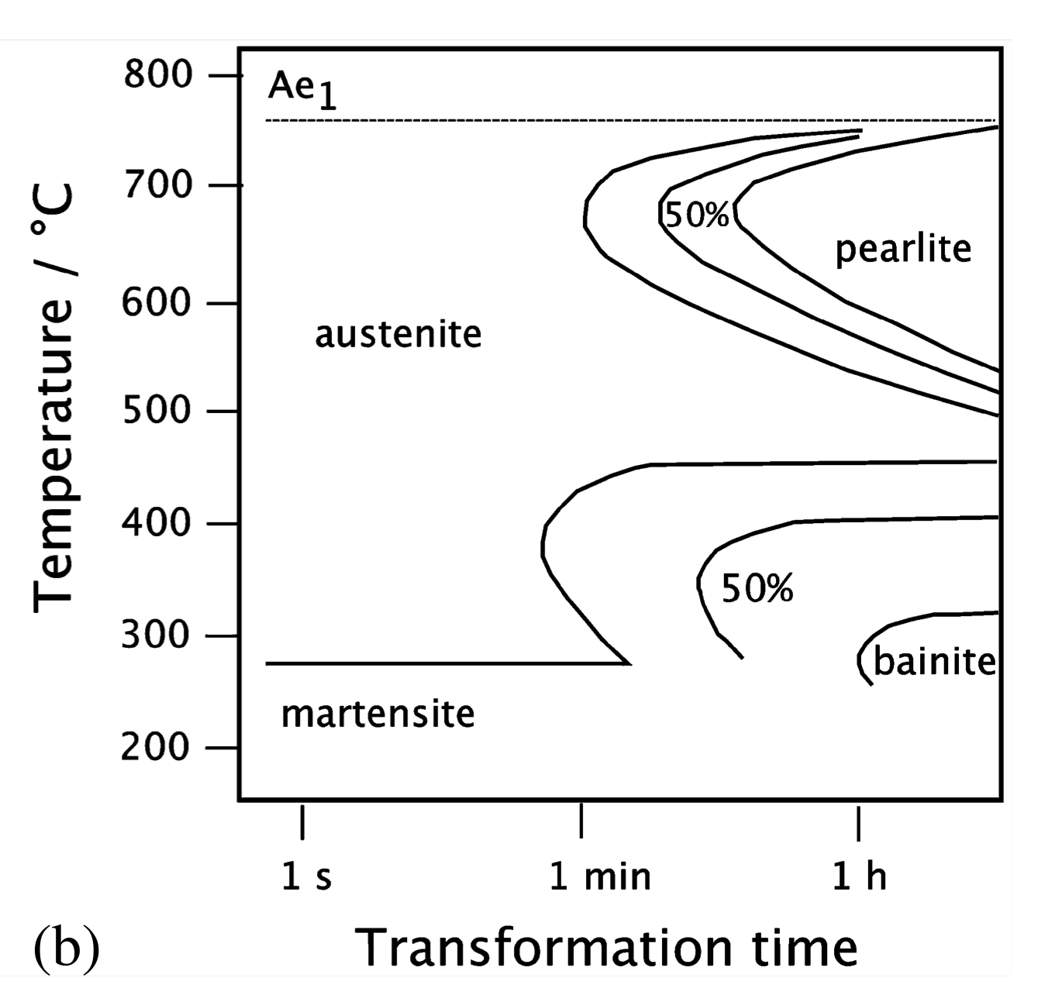

Slide 13
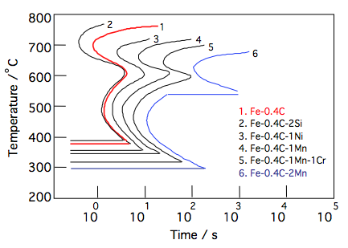

Slide 14
β
α
time = t
time = t+∆t

Slide 16
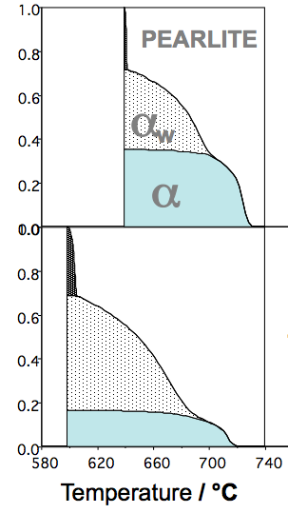
100 µm austenite grain size
11 K/min
Volume fraction
101 K/min
Jones & Bhadeshia

Slide 17
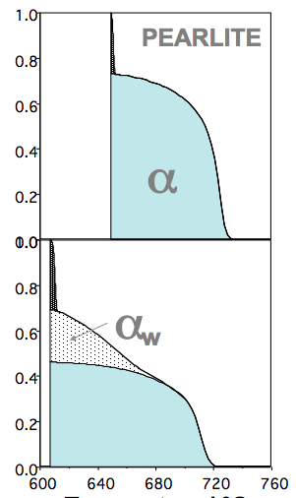
30 µm austenite grain size
11 K/min
Volume fraction
101 K/min
Jones & Bhadeshia
Temperature / °C

Slide 18
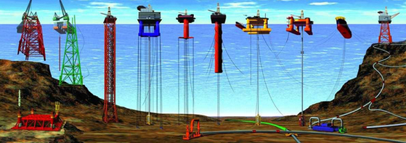
Undersea structures

Slide 19
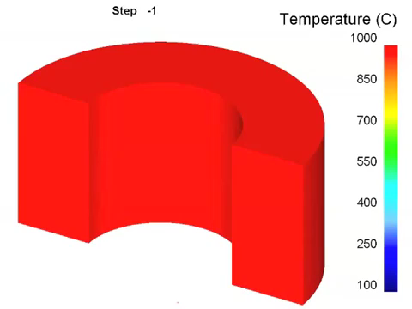
Steve Ooi

Slide 20
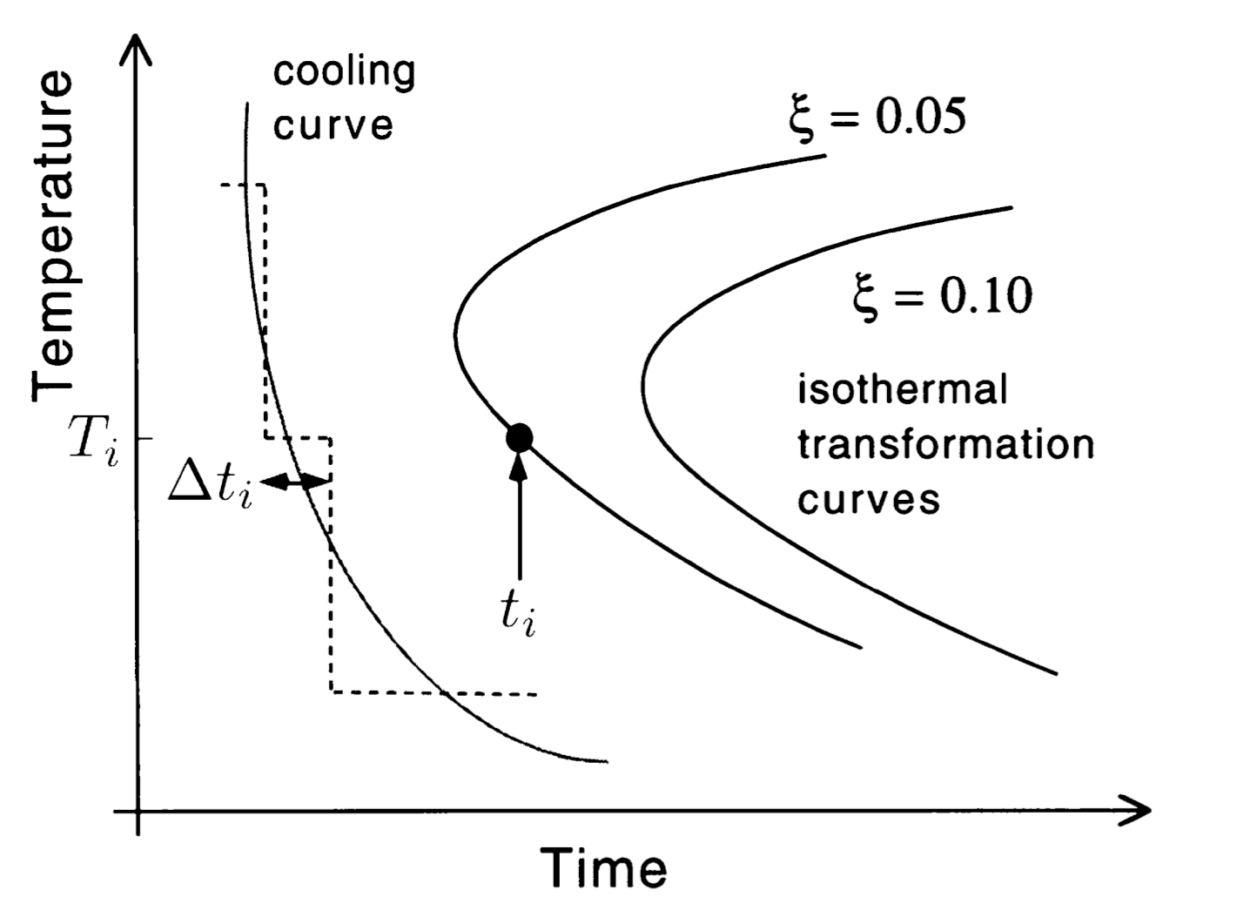
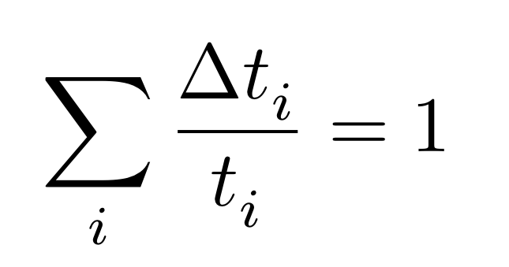

Slide 21
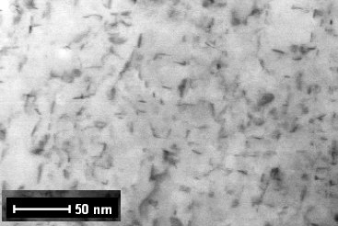

Slide 22
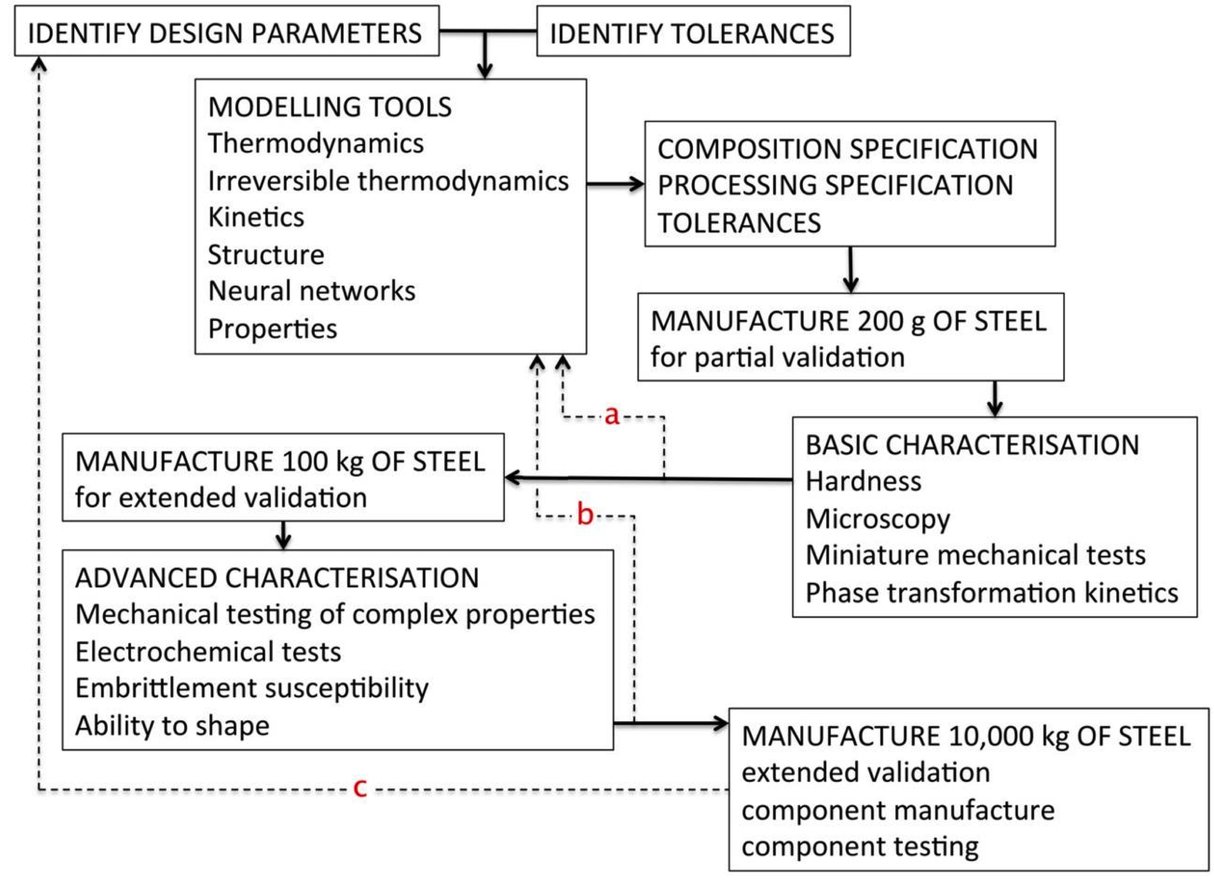
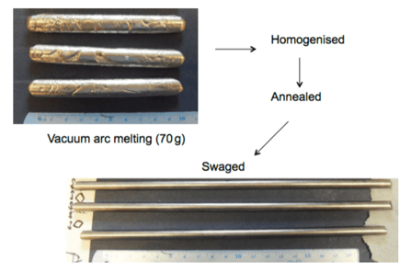


Slide 23


