Slide 1
High temperature Oxidation of Si Containing Steel
Song, Eun Ju
Computational Metallurgy Lab.
Graduate Institute of Ferrous Technology
Pohang University of Science and Technology
Notes:
1

Slide 2
Contents
Introduction
Oxidation of Steel
Red-scale
Prediction of Oxide Formation and Growth
Oxidation Test and Characterization of Oxides
Conclusions

Slide 3
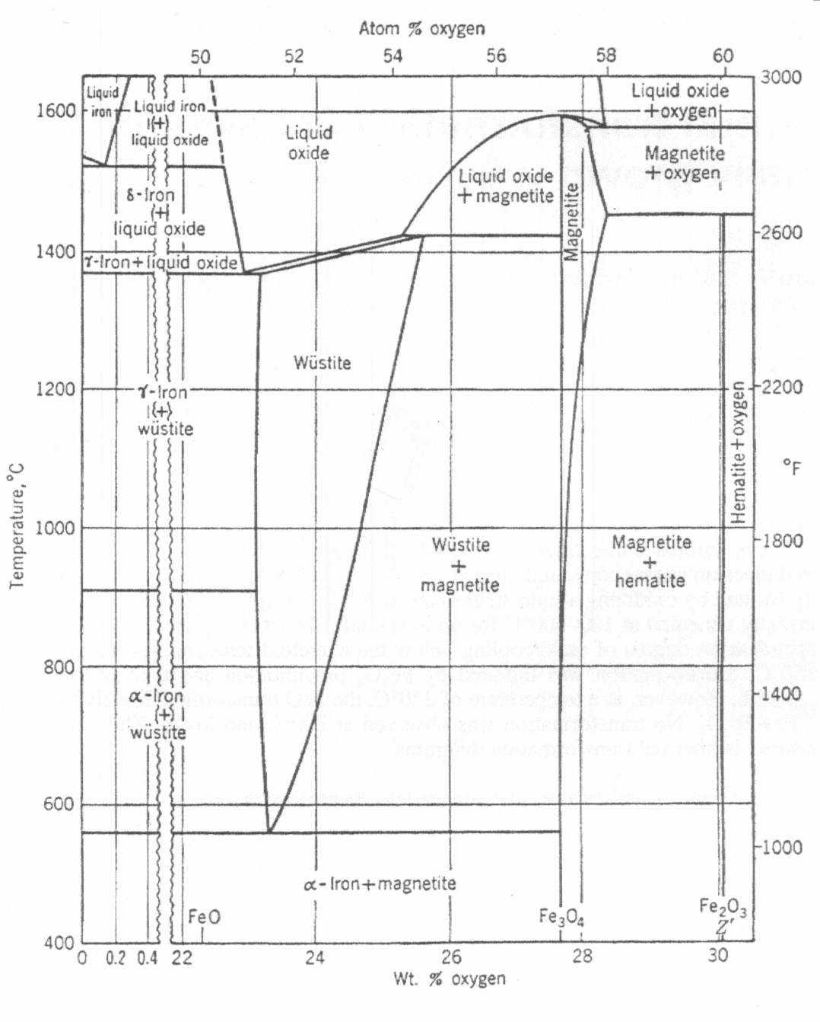
Introduction – Oxidation of Steel
Oxide of iron
Fe_{1-y}O - wüstite (0.04 <y<0.17)
Fe₃O₄ - magnetite
Fe₂O₃ - hematite
Fe_{1-y}O : Fe₃O₄ : Fe₂O₃
= 95 : 4: 1
Growth of oxides
FeO, Fe₃O₄
- controlled by outward diffusion
Fe₂O₃
- controlled by inward diffusion
Wagner C. Z. Phys. Chem (1933)
Paidassi J. Rev. Met (1957)

Slide 4
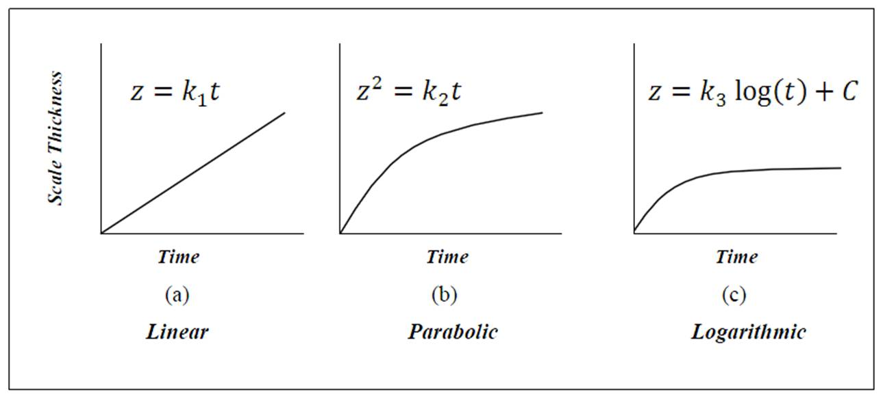
Introduction – Oxidation of Steel
Oxide growth at high temperature
- controlled by diffusion, with a parabolic behavior

Slide 5
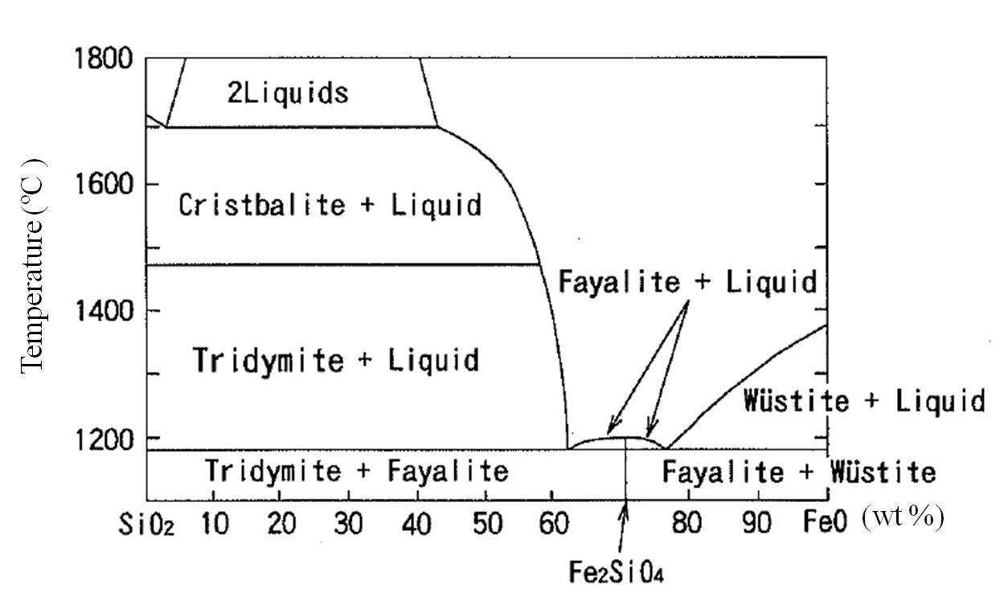
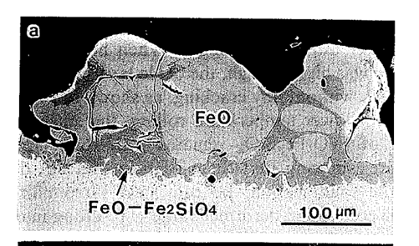
Introduction – Red-scale
Fukagawa et al. ISIJ Int. (1994)
Notes:
Silicon in the steel produce more red-scale. When silicon is added, Fe₂SiO₄ is formed at the scale/steel interface. As shown in the FeO-SiO₂ phase, the Fe₂SiO₄ starts to melt at a temperature of about 1173 ºC during the reheating process. When this happens, the liquid phase penetrates into grain boundaries of the FeO. As it cools, the eutectic compound FeO/Fe₂SiO₄ is formed with a morphology that anchors the oxide after solidification.
This makes descaling difficult and cause residual primary scale, which is the main cause of the red-scale problem. If it is fractured by hot rolling, the underlying region is exposed to air and hence increase the oxygen supply comparing with the iron. Then the fractured FeO becomes powdered Fe2O3, which is called red-scale. Powdered Fe2O3 is called red-scale.

Slide 6
Introduction – Red-scale
Effects of Ni
Oxides formed at 1250 ºC, for 1h
(d) ; Fe – 0.1 Si – 0.001 Ni wt%
(h) ; Fe – 0.1 Si – 0.1 Ni wt%
Fukagawa et al. Journal of ISIJ Tetsu to Hagane (1996)
Asai et al. ISIJ international (1997)
Notes:
As you see in this figure, Ni addition makes the interface between scale and steel uneven and it makes descale difficult. It is found that the removal of nickel reduces red-scale by improving the descalability.
The mechanism of uneven interface is illustrated in this figure. since Ni is more noble than iron, the iron in nickel-added steel is selectively oxidized and the concentration of Ni is enriched at the interface. Then the grain boundaries oxidize preferentially, internal oxides precipitate and Ni enriches around them. Heterogeneously enriched Ni makes the oxidation irregular and results in the rough scale/steel interface

Slide 7



Prediction of Oxides Formation
Formation energy of oxides
2Fe + O₂ = 2FeO,
Si + O₂ = SiO_{2,}
Fe + ½ Si + O₂ = ½ Fe₂SiO₄,
Notes:
To predict the oxide formation, free energies of the oxide per one mole of O₂ was calculated with a regarding of the actual composition of the steel and partial pressure of oxygen. the activity of FeO, SiO₂, Fe₂SiO₄, and Fe was assumed to be 1 because those phases were considered to be pure solids, which are the reference states. The values of were found in SSUB4 database with ThermoCalc.

Slide 8
Prediction of Oxides Formation
Fe - 1 Si wt% steel, P(O₂)=0.2
Fe - 10 Si wt% steel, P(O₂)=0.2

Slide 9
Prediction of Oxides Formation
Equilibrium phase
Fe - 1 Si wt% steel, 1000 ˚ C
Fe - 10 Si wt% steel, 1000 ˚ C

Slide 10



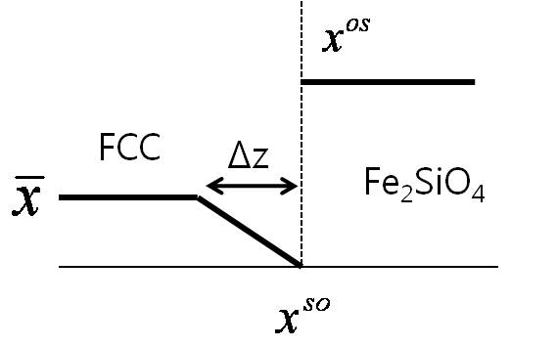



Prediction of Oxides Growth
Growth of Fe₂SiO₄, SiO₂
- controlled by outward diffusion of Si (∵ )
8.58 ×10⁻⁴ μm² s⁻¹ at 1000 °C
1.99 ×10¹ μm² s⁻¹ at 1000 °C

Slide 11



Prediction of Oxides Growth
1000 ˚ C
1250 ˚ C
Wagner C. Z. Phys. Chem (1933)

Slide 12








Prediction of Oxides Growth
Oxide,α
( μm⁻² , A=1 μm²)
Bhadeshia H. Proceedings of Solid-Solid Phase Transformations (1999).

Slide 13
Prediction of Oxides Growth
Volume Fraction of Oxides
1000 ˚ C
1250 ˚ C

Slide 14
Oxidation Tests
Steel | C / wt% | Si / wt% | Mn / wt% | Ni / wt% | Al / wt% | Fe
Alloy 1 | 0.1 | - | 1.5 | - | - | balance
Si Alloy | 0.1 | 0.943 | 1.54 | - | - | balance
Ni Alloy | 0.1 | 1.0 | 1.50 | 0.197 | - | balance
Al Alloy | 0.101 | 1.01 | 1.49 | - | 0.216 | balance
Surface polish
Oxidation at 1250 ˚ C and 1000 ˚ C for 2h in the air
Microscopy analysis with the cross section of the sample
10mm
Steel
7mm
5mm

Slide 15
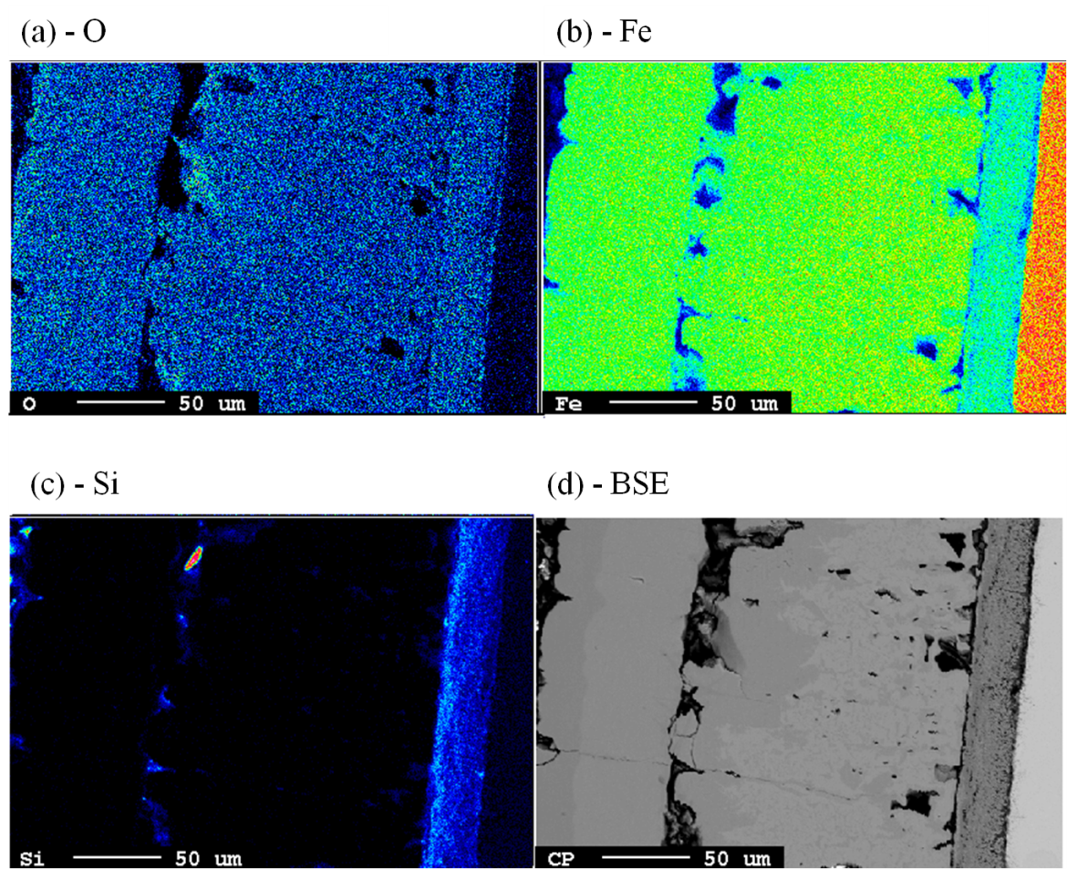
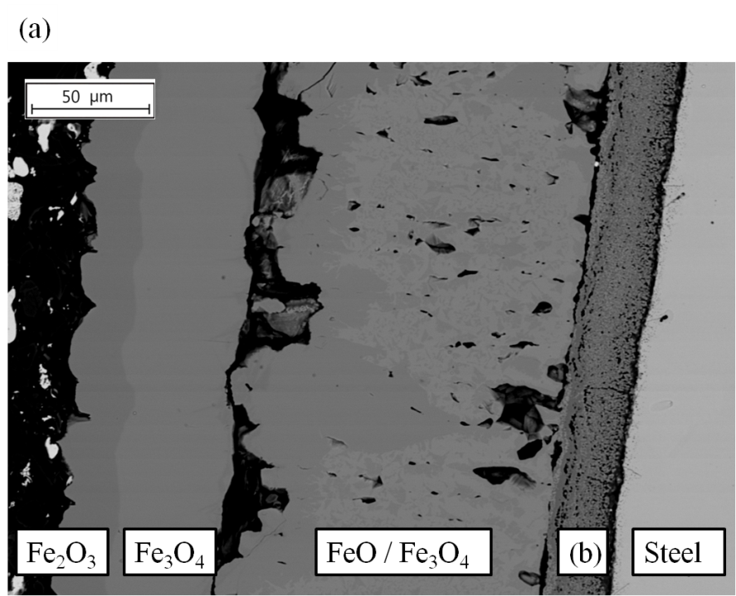
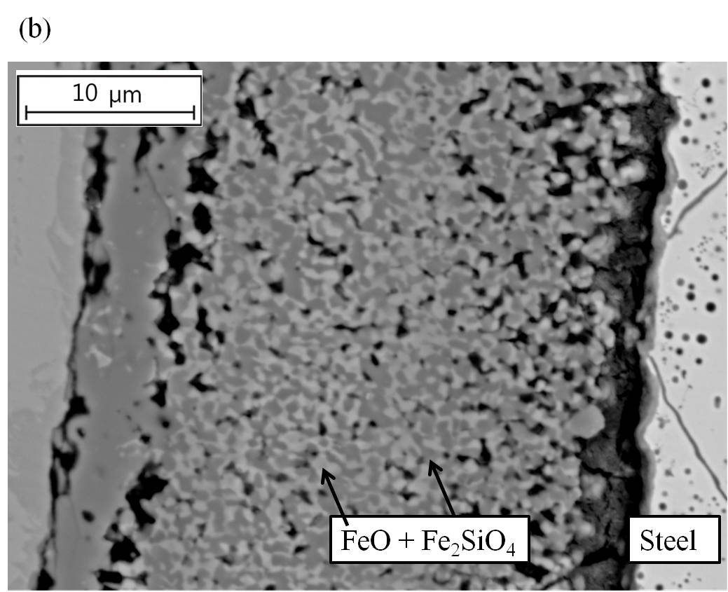
Characterization of Oxides
Si Alloy, 1000 ˚C
Volume fraction, FeO_{x} / Fe₂SiO₄
= 92 / 8 ~ 86 / 14
Notes:
Fig. 5.2.3 shows the BSE images of oxides formed on Alloy 2 at 1000 ˚C for 2 hours. The oxides were composed of Fe₂O₃, Fe₃O₄, and a mixture of FeO and Fe₂SiO₄, going from gas to the substrate. It is known that the FeO layer takes about 95% of the entire oxide. However in this study, it is not because FeO is not stable under 570C.
Since the size of Fe₂SiO₄ was less than 700 nm, phases was identified by TEM EDS. Also, the distribution of each element was obtained by EPMA
It is found that if silicon-added steel oxidizes, silicon forms Fe₂SiO₄ at the interface between steel and oxide and does not form SiO₂ in this experimental condition. The thickness of a mixture of FeO and Fe₂SiO₄ was about 30 μm and the total thickness was 200 μm.

Slide 16
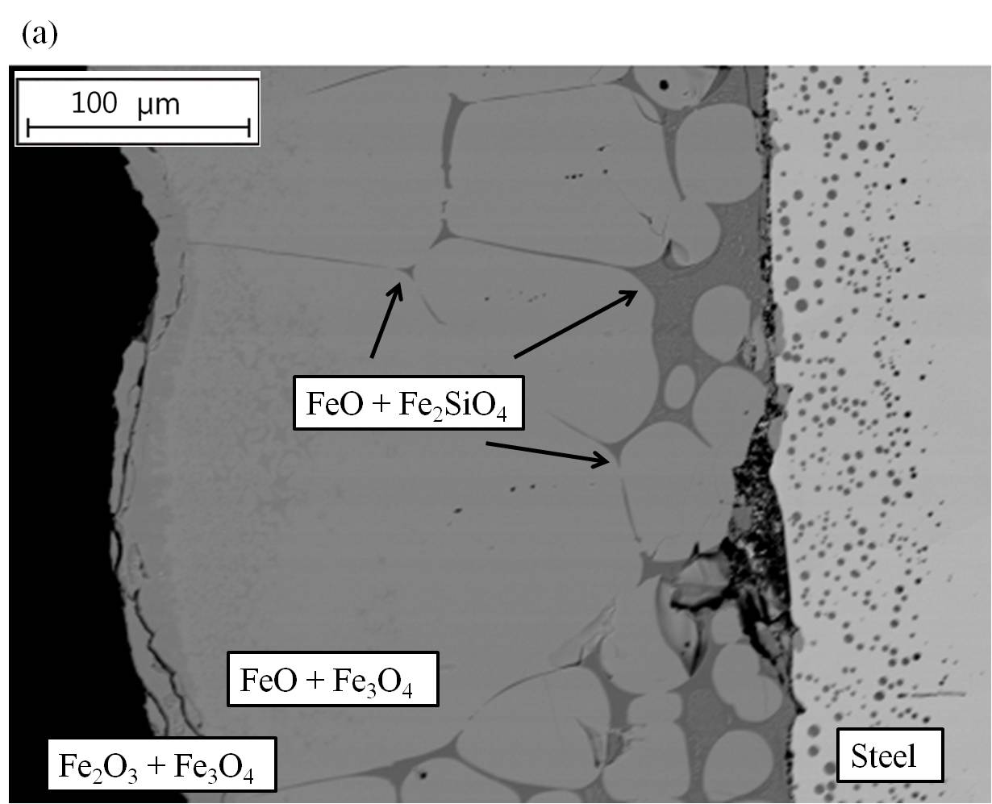
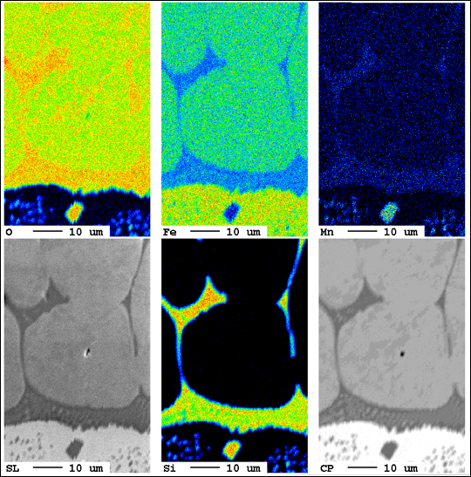
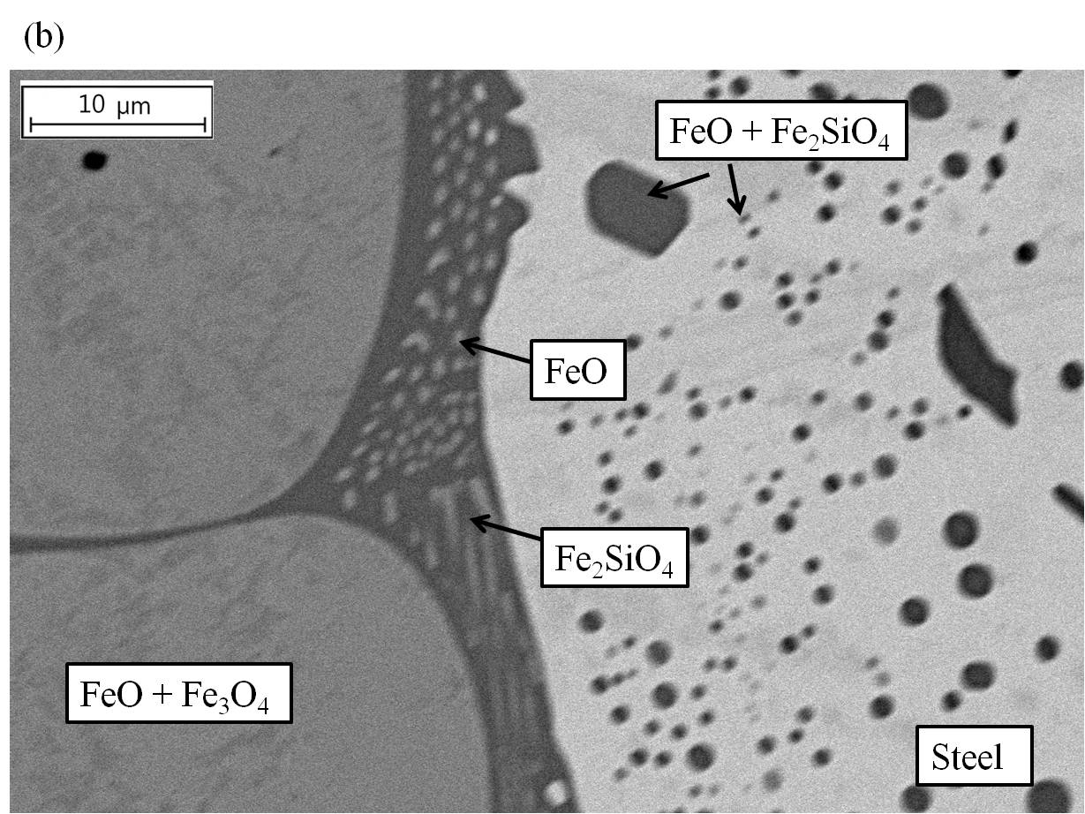
Characterization of Oxides
Si Alloy, 1250 ˚C

Slide 17
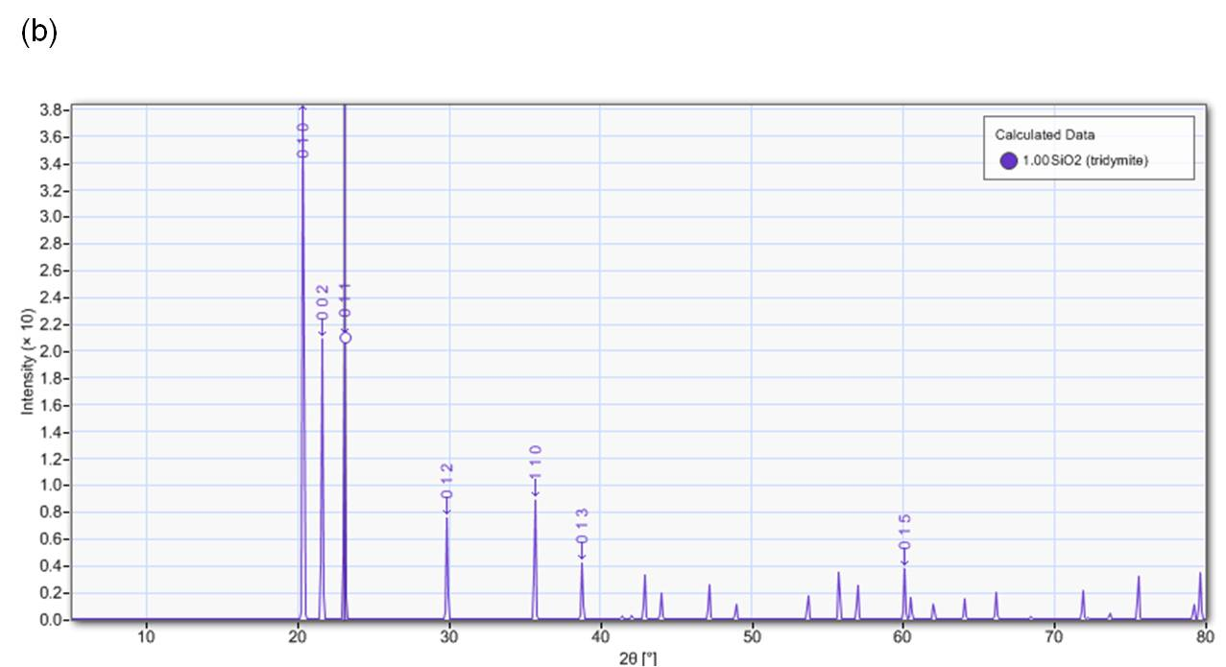
Characterization of Oxides
W = FeO
M = Fe₃O₄
F = Fe₂SiO₄

Slide 18
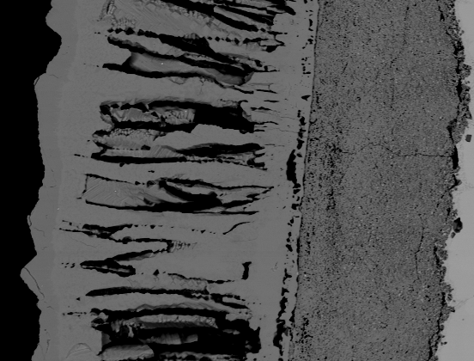
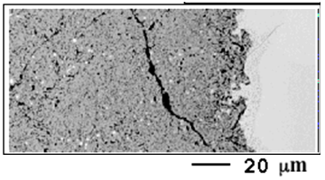

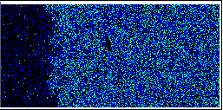
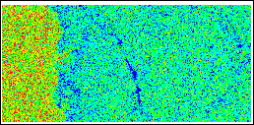
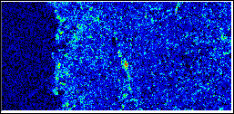
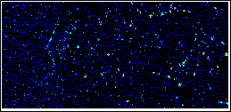
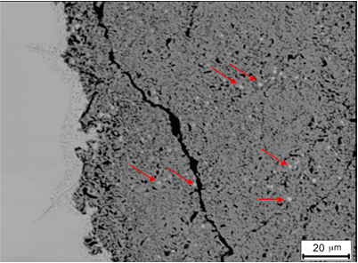
Characterization of Oxides
Ni Alloy, 1000 ˚C
(a)
(a)- BSE
(b)-O
(c)-Fe
(d)-Si
(e)-Ni
(b)
Volume fraction of FeO_{x} / Fe₂SiO₄
= 91 / 9 ~ 84 / 16

Slide 19
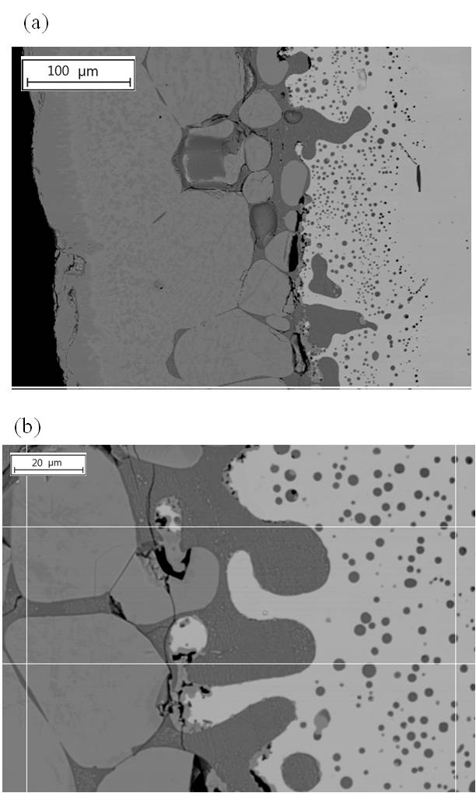
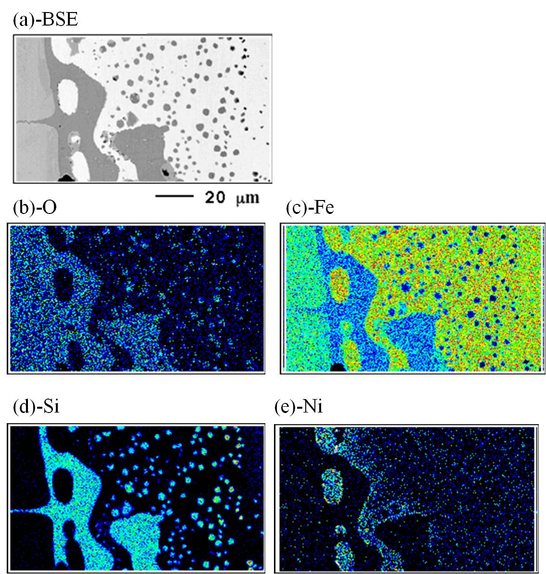
Characterization of Oxides
Ni Alloy, 1250 ˚C

Slide 20
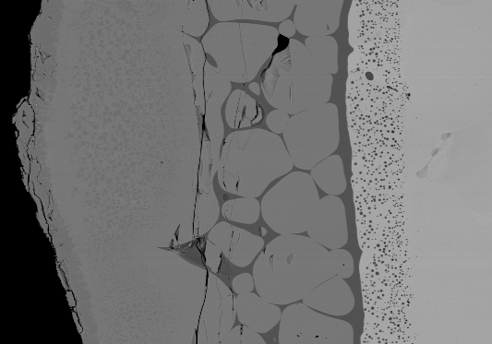
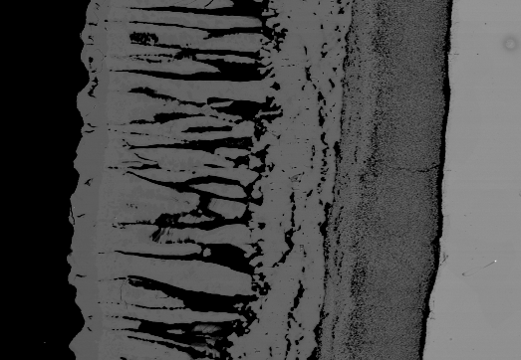


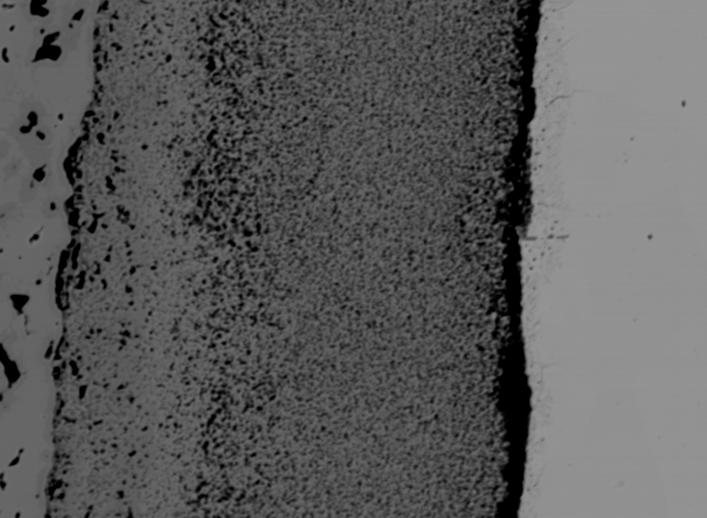
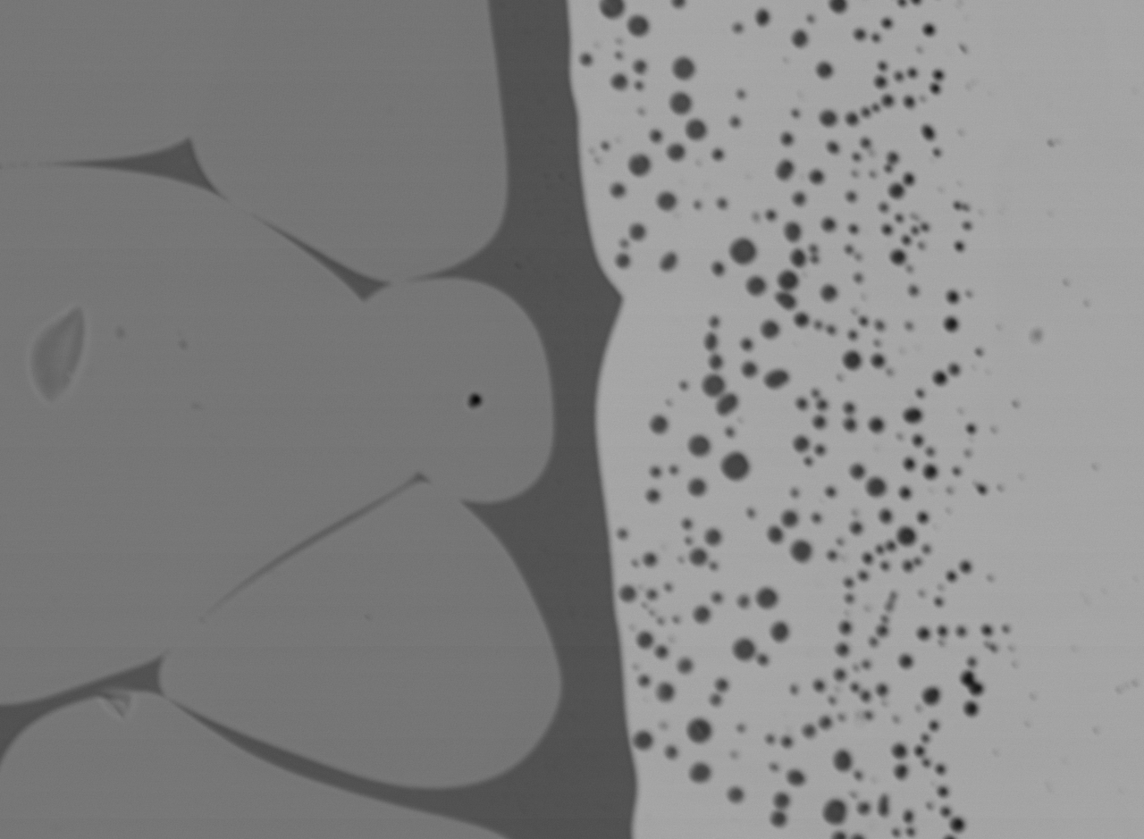


Characterization of Oxides
Al Alloy, 1000 ˚C
Al Alloy, 1250 ˚C

Slide 21
Conclusions
FeO, SiO₂, Fe₂SiO₄ can form spontaneously in the air.
Fe₂SiO₄ is more favored than SiO₂ at the Fe/FeO interface
To form SiO₂, silicon needs to diffuse more comparing with Fe₂SiO₄.
The growth of Fe₂SiO₄ more favored than SiO₂ with 0<x(si)<14 wt%.
At 1000 ˚C, the mixture of FeO and Fe₂SiO₄ was observed.
At 1250 ˚C, the eutectic compound of FeO /Fe₂SiO₄ was observed.
Ni addition (> 0.05 wt%) makes the scale/steel interface uneven because of the noble property and low diffusivity.
Al addition (< 0.2 wt%) has no significant effect on Fe₂SiO₄.

Slide 22
THANK YOU!!

Slide 23
Prediction of Oxides Formation
Formation energy of oxides
2Fe + O₂ = 2FeO,
Si + O₂ = SiO_{2,}
Fe + ½ Si + O₂ = ½ Fe₂SiO₄,
Notes:
To predict the oxide formation, free energies of the oxide per one mole of O₂ was calculated with a regarding of the actual composition of the steel and partial pressure of oxygen. the activity of FeO, SiO₂, Fe₂SiO₄, and Fe was assumed to be 1 because those phases were considered to be pure solids, which are the reference states. The values of were found in SSUB4 database with ThermoCalc.

Slide 24
Prediction of Oxides Formation
Fe - 1 Si wt% steel, 1000 ˚ C
Fe - 1 Si wt% steel, 1250 ˚ C
Fe - 10 Si wt% steel, 1000 ˚ C
Fe - 10 Si wt% steel, 1250 ˚ C
Notes:
at 1000 °C and 1250 °C, the oxides, FeO, SiO₂, Fe₂SiO₄, can be all form from a thermodynamic point of view in the air.but it can vary depending on the partial pressure of oxygen. In this calculations, SiO₂ is more stable than Fe₂SiO₄.
But this calculation assumes that only one phase formation. If more than one phase could form at the same time, it should be considered together.

Slide 25
Prediction of Oxides Growth
Fe - 1 Si wt% steel, 1000 ˚ C
Fe - 1 Si wt% steel, 1250 ˚ C
Notes:
These are calculated thickness of FeO, SiO2, Fe2SiO4 according to the time. It can be confirmed that growth of FeO is much faster than Fe2SiO4 and SiO2. Since SiO2 needs more silicon diffusion, its growth is slow compared with the Fe2SiO4.

Slide 26
Prediction of Oxides Growth
Volume Fraction of Oxides
Steel / wt% | Temp. / ˚C | Fe₂SiO₄ | SiO₂ | FeO
Fe - 0.1 Si | 1000 | 1.82×10⁻¹⁴ | 5.18×10⁻¹⁶ | 1.00
 | 1250 | 3.33×10⁻¹³ | 9.49×10⁻¹⁵ | 1.00
Fe - 1 Si | 1000 | 2.01×10⁻¹¹ | 5.34×10⁻¹³ | 1.00
 | 1250 | 3.68×10⁻¹⁰ | 9.77×10⁻¹² | 1.00
Fe - 10 Si | 1000 | 1.09×10⁻⁷ | 7.42×10⁻¹⁰ | 1.00
 | 1250 | 2.00×10⁻⁶ | 1.36×10⁻⁸ | 1.00
Volume fraction of FeO_{x} / Fe₂SiO₄
= 91 / 9 ~ 86 / 13
Notes:
For oxides on Fe – 1 Si wt% steel, the volume fraction of FeO is almost 1. It can be explained the growth rate of FeO is much faster than SiO₂ and Fe₂SiO₄ The volume fraction of SiO₂ is less than 10⁻¹². It is reasonable because the diffusion of Fe in FeO is much greater than the diffusion of Si in austenite. Moreover, SiO₂ needs more silicon diffusion than Fe₂SiO₄.
For oxides on Fe – 10 Si wt% steel, the volume fraction of FeO is almost 1 The volume fractions of SiO₂ and Fe₂SiO₄ are relatively larger than those of Fe – 1 Si wt% steel. This can contribute to the increase of silicon in steel. However, the volume fraction of SiO₂ is still very small.

Slide 27
Characterization of Oxides
W = FeO
M = Fe₃O₄
H = Fe₂O₃
F=Fe₂SiO₄
Notes:
shows XRD results for the oxides formed at 1250 ˚C. The black and red line presents the oxides of Alloy 1 and Alloy 2, respectively. All the oxides were powdered before the XRD analysis. The green presents the oxides of Alloy 2. The upper part oxides were removed before the analysis. (b) shows the calculated XRD peaks of SiO₂.
It is confirmed that, Fe2SiO4 formed not Sio2.

