Slide 1
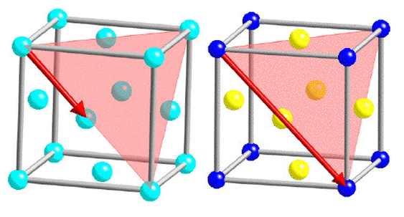
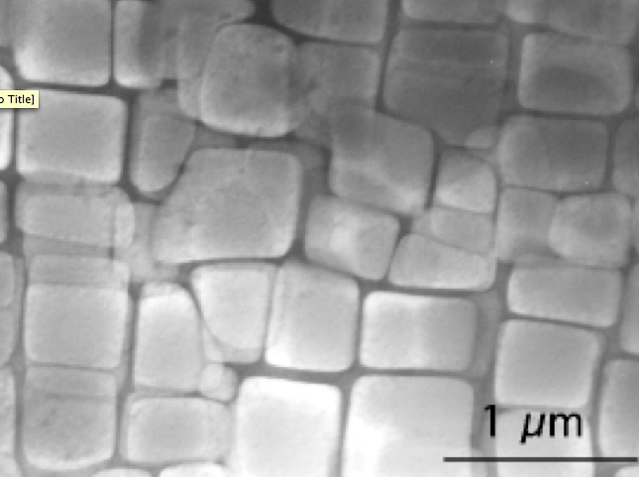
Assignment deadline Monday
Explain in a one page essay, how an iron alloy can be designed to emulate the nickel based superalloy, containing ordered precipitates which are coherent with the matrix.
For information on nickel based alloy see:
http://www.msm.cam.ac.uk/phase-trans/2003/Superalloys/superalloys.html

Slide 2


Interstices in Cubic-I, Cubic-F and HCP Structures
Crystallography
H. K. D. H. Bhadeshia

Slide 3
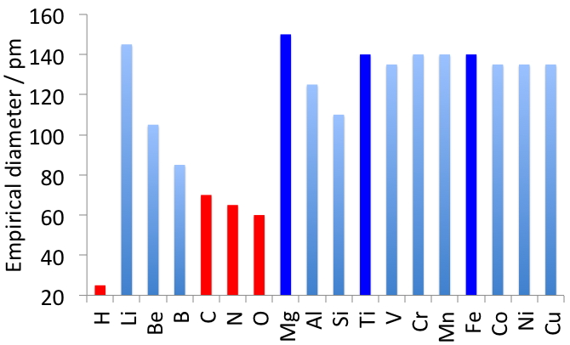

Slide 4
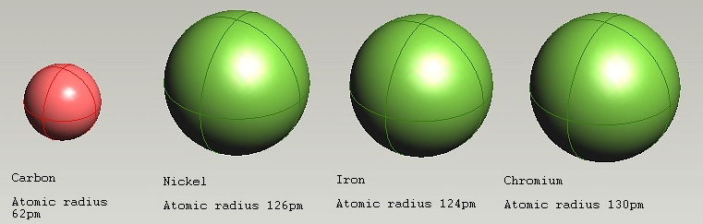
(Andrew Fairbank)
C 62 pm Ni 126 pm Fe 124 pm Cr 130 pm

Slide 5
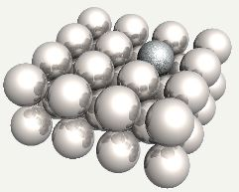
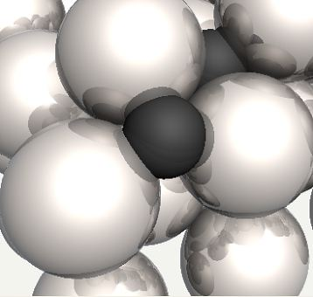
carbon in iron
silicon in iron

Slide 6
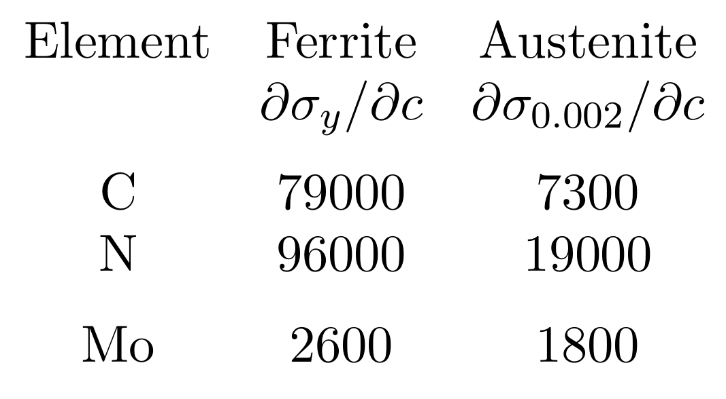

Insterstitial solid solution strengthening
(Ghosh & Olson)

Slide 7
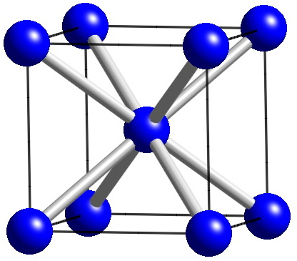
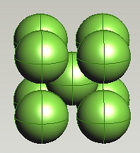

Cubic-I
Ferrite
Close-packed direction?
(Andrew Fairbank)

Slide 8
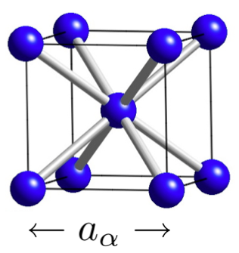

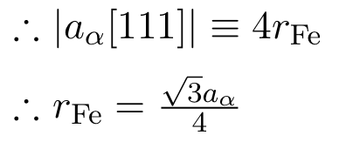
radius of iron atom in ferrite

Slide 9
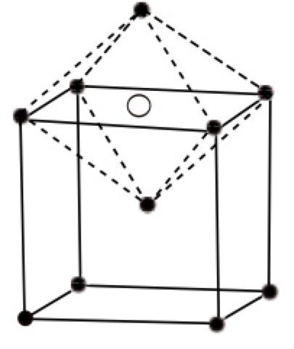
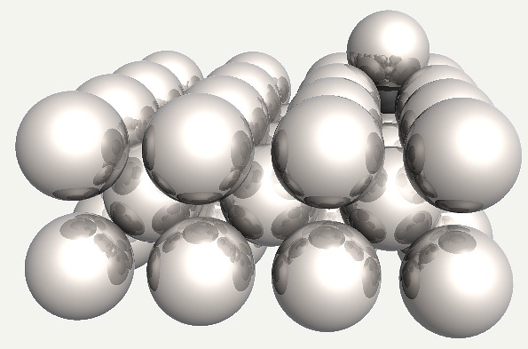

octahedral interstice in ferrite
point group symmetry?
Carbon does not fit. Therefore, placing in octahedral site reduces the tetragonality of the site.

Slide 10
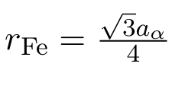

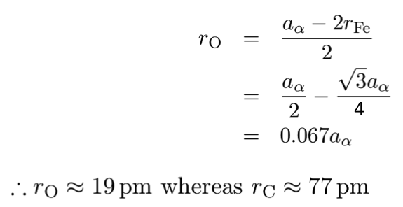
Largest atom that can fit in octahedral site

Slide 11
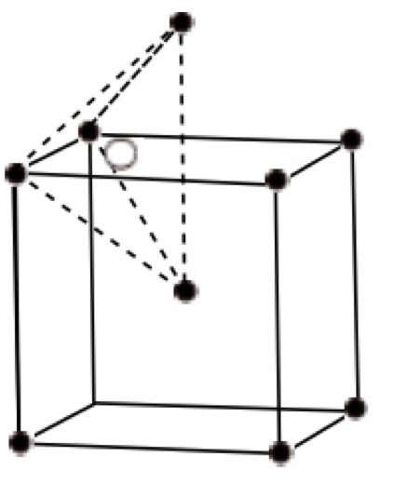
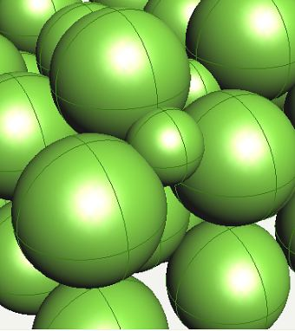
tertrahedral interstice in ferrite
Vector joining centres of iron and carbon?

Slide 12
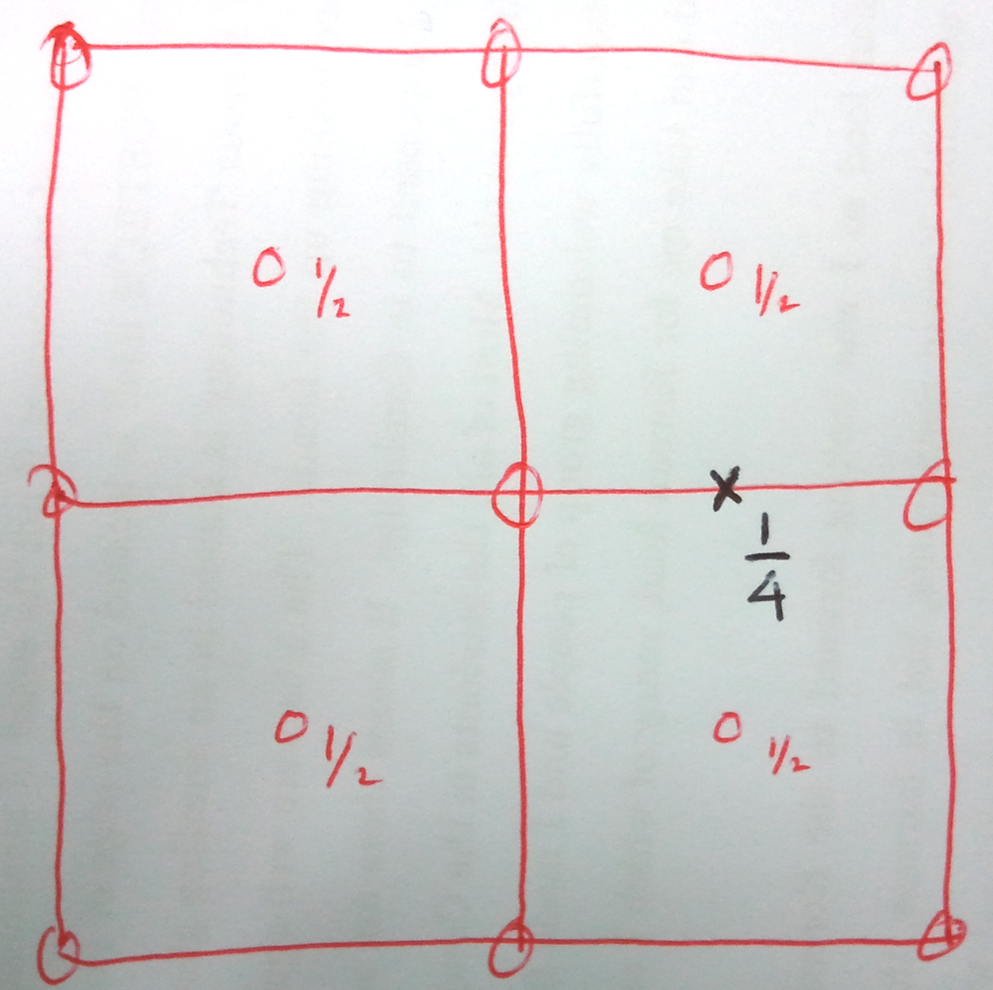

Structure projection of 4 unit cells of ferrite
What it the vector joining iron and carbon atom neighbours?
y
x

Slide 13

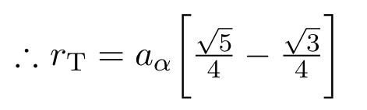
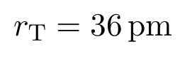

structure projection

Slide 14
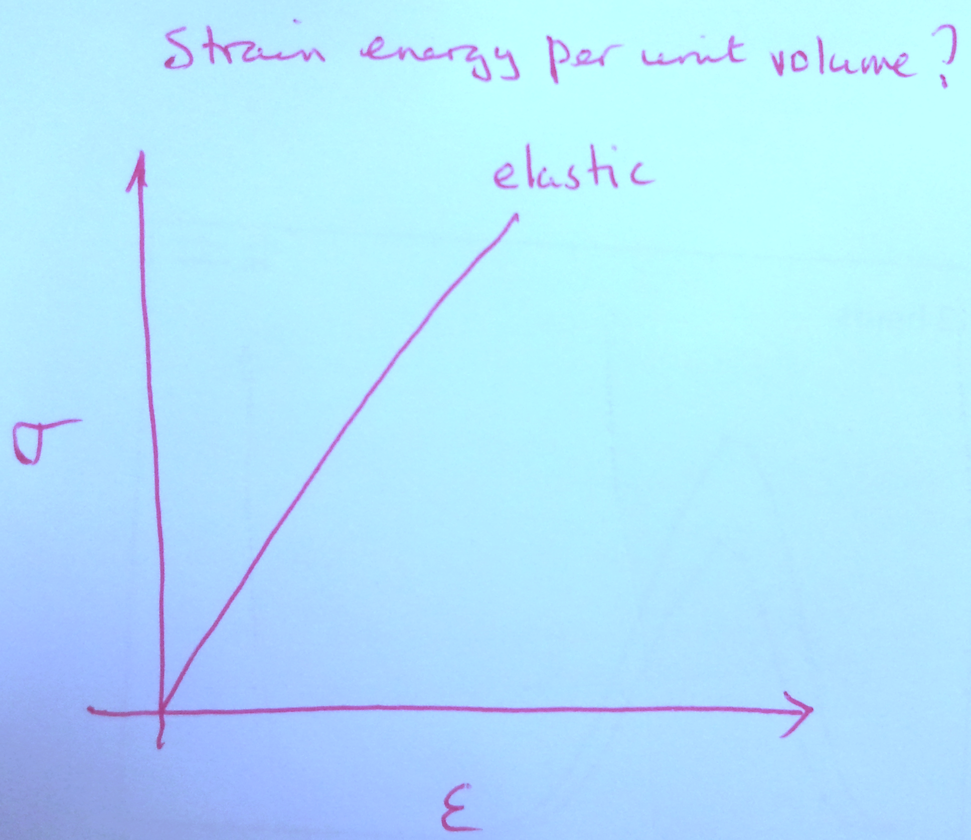
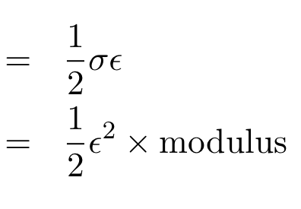
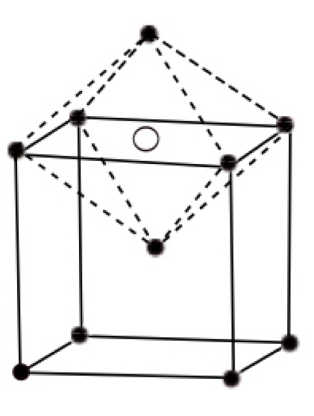
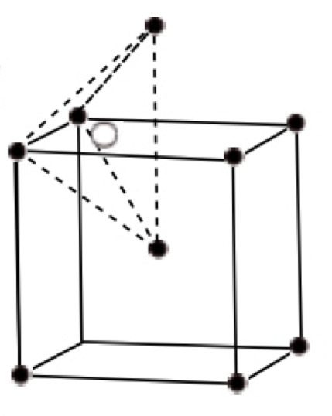
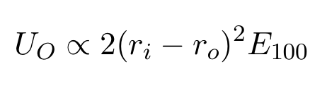
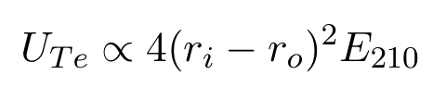

Slide 15
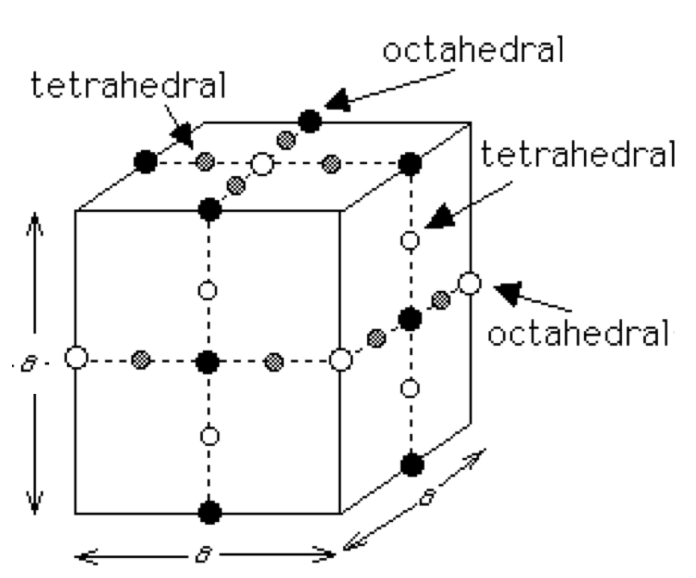
3 octahedral sites per Fe
6 tetrahedral sites per Fe

Slide 16
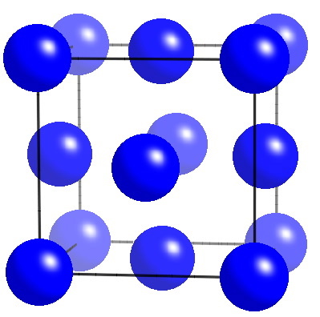
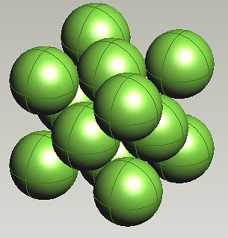
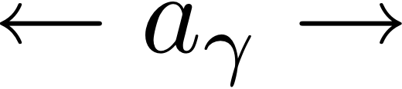
austenite
cubic-F

Slide 17

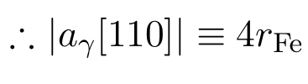
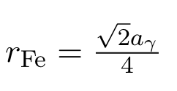

Slide 18
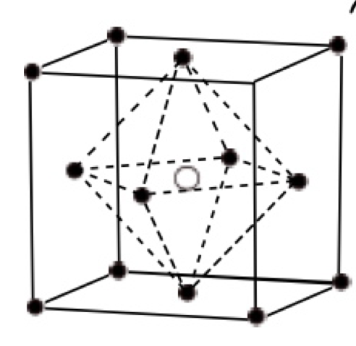
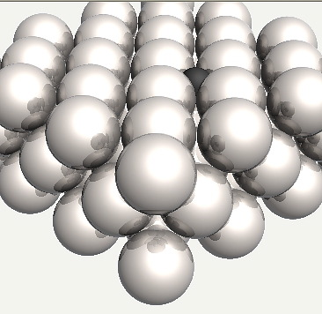

octahedral interstice in austenite
point group symmetry?
Carbon does not fit. It causes uniform expansion.

Slide 19
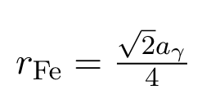

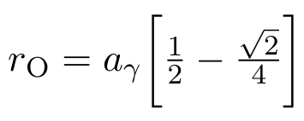
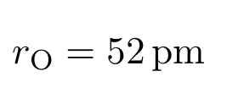
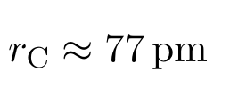
Largest atom that can fit in octahedral site

Slide 20
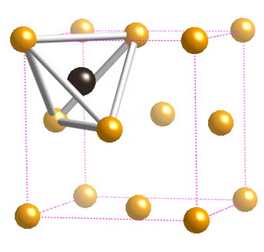
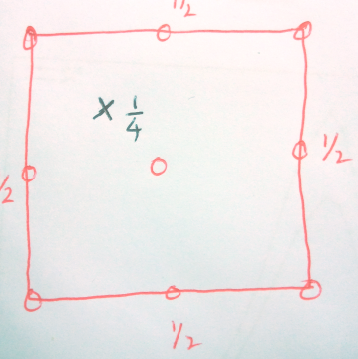
tertrahedral interstice in austenite
Vector joining centres of iron and carbon?

Slide 21
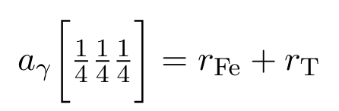
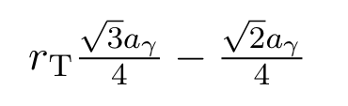
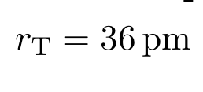
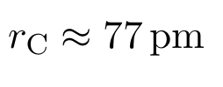

Slide 22
Insterstitial solid solution strengthening
(Ghosh & Olson)

Slide 23

ferrite
austenite

Slide 24
Ferrite
Carbon in “smaller” anisotropic octahedral interstices
Resulting strain is anisotropic
Strong interaction with deviatoric and dilatational strain fields of dislocations
Intense strengthening
3 octahedral and 6 tetrahedral holes per iron

Slide 25
Austenite
carbon in larger isotropic octahedral interstices
therefore, behaves like substitutional solute with weak interactions with dislocations
mild strengthening
1 octahedral and 2 tetrahedral holes per iron

Slide 26

a
b
3
3
a
2
b
1
b
2
a
1
(a)
(b)
BAIN
STRAIN
(c)
(d)
Body-centered
Body-centered
tetragonal
cubic martensite
austenite

Slide 27
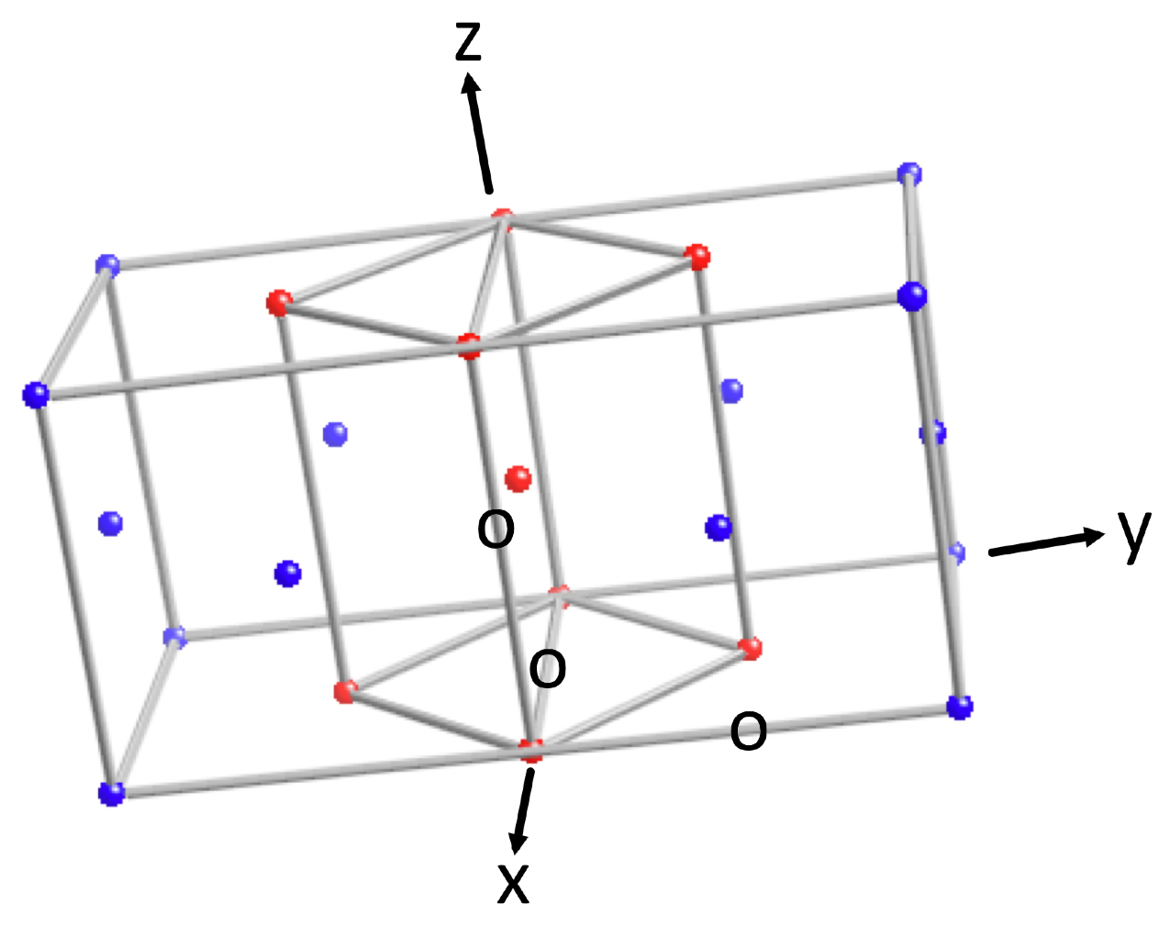
tetragonal martensite?

Slide 28
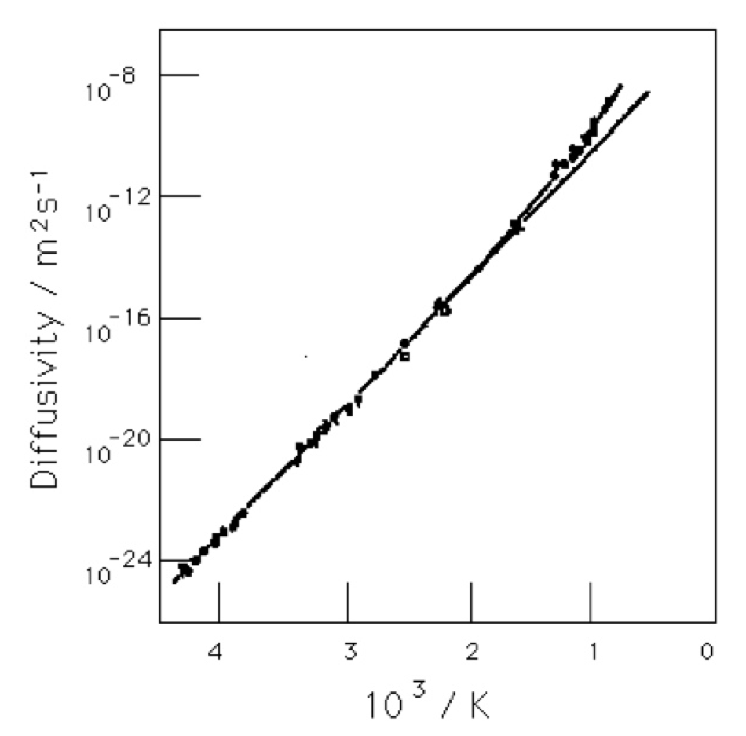
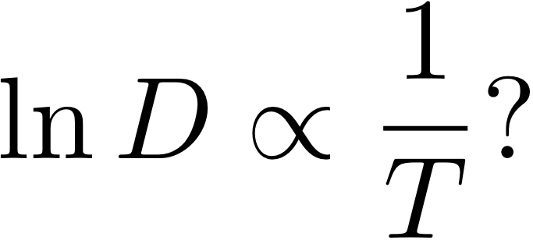

Slide 29
