Slide 1

“100 times stronger than steel”
www.msm.cam.ac.uk/phase-trans
Iron is the standard against which life and new materials are compared
Iron Man 3
Iron maiden
Iron Lady
Stalin
Steely personality
Tough as steel
Strong as steel
Iron will
Iron hand in a velvet glove

Slide 2

September 2001
Quote from BBC journalist, talking about England 5 and Germany 1
“Eriksson has married the midfield of Liverpool and Man. United into a unit that has class and creativity and silk and steel”
April 2000
Quote from Russian Space and Aviation Agency, Alexei Karsnov
“I’m optimistic (MIR space station) ….. There could be problems .. with the atmosphere support .. but the steel is OK”

Slide 3
Quote from a teacher to me, by email
“I have to teach about scientists at work. I am obviously going to talk about famous ones, but I will talk about you as well.”
Query by email
“Please save my life. We want to know the elastic modulus of bainite. It’s a microstructure in steels.”
1400 million tonnes of steel used per annum. Without song and dance.
So if there is something stronger than iron, should we take it seriously?

Slide 4
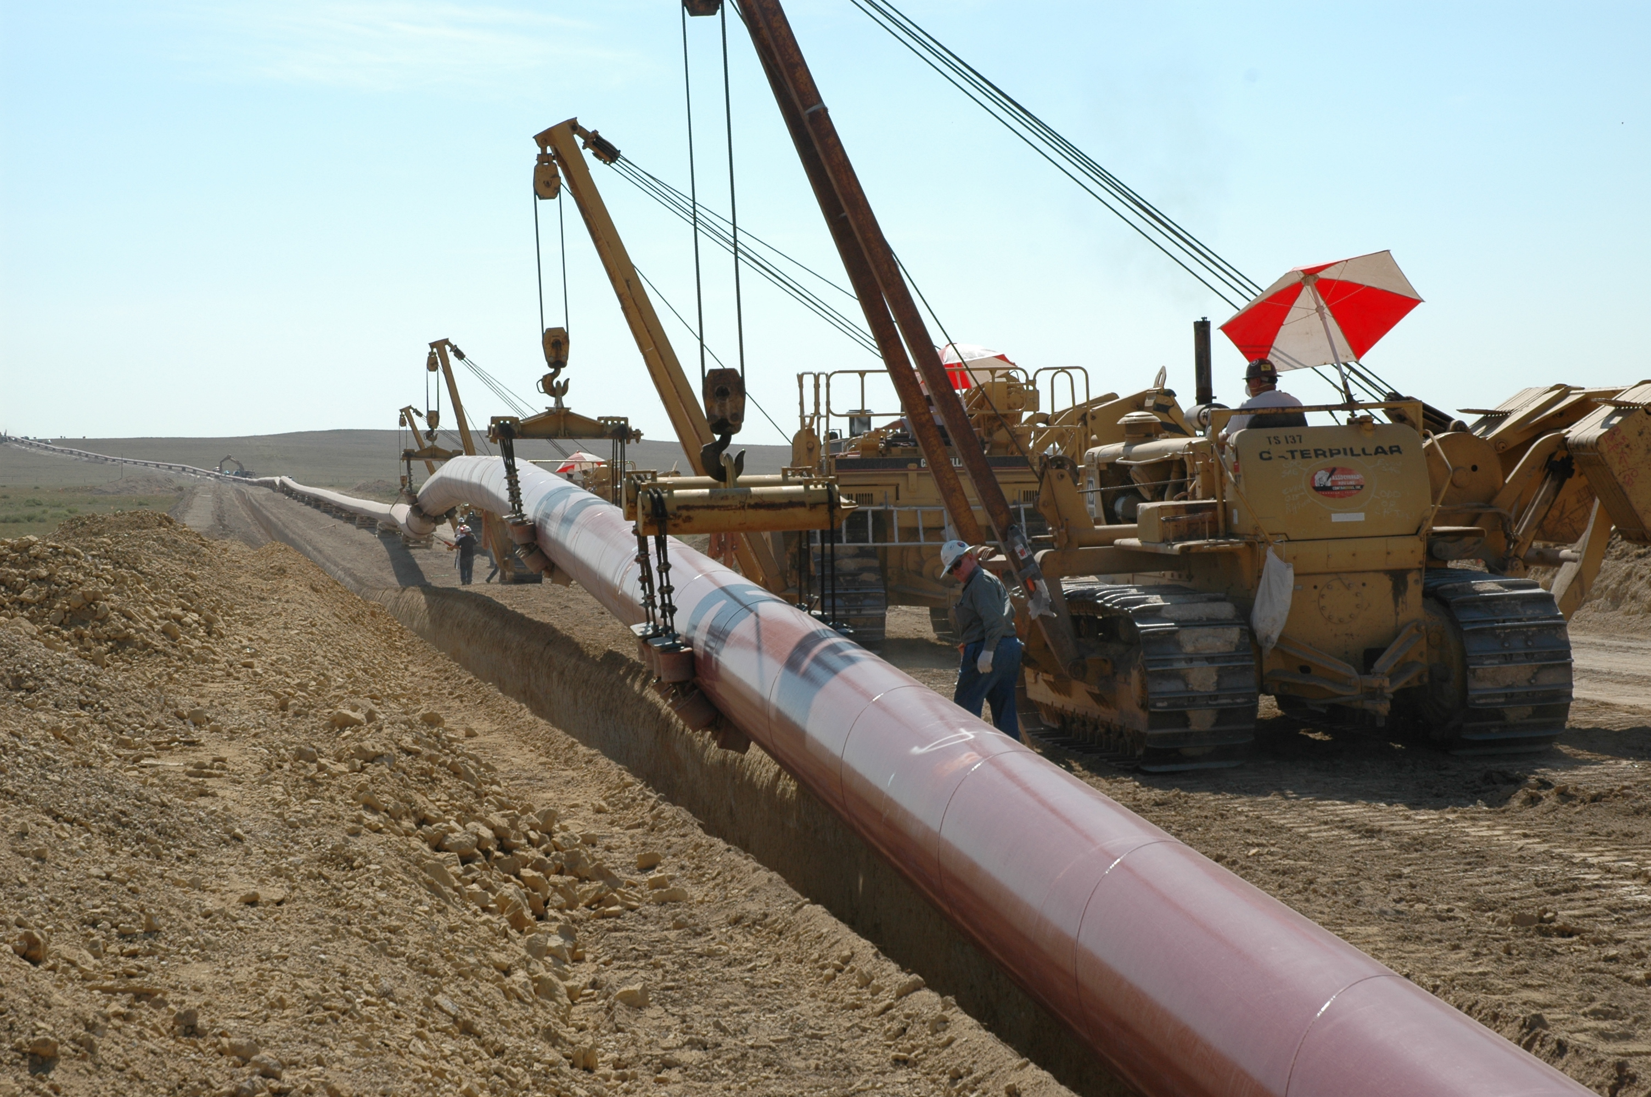
3000 MPa
1500 MPa
500 MPa

Slide 5
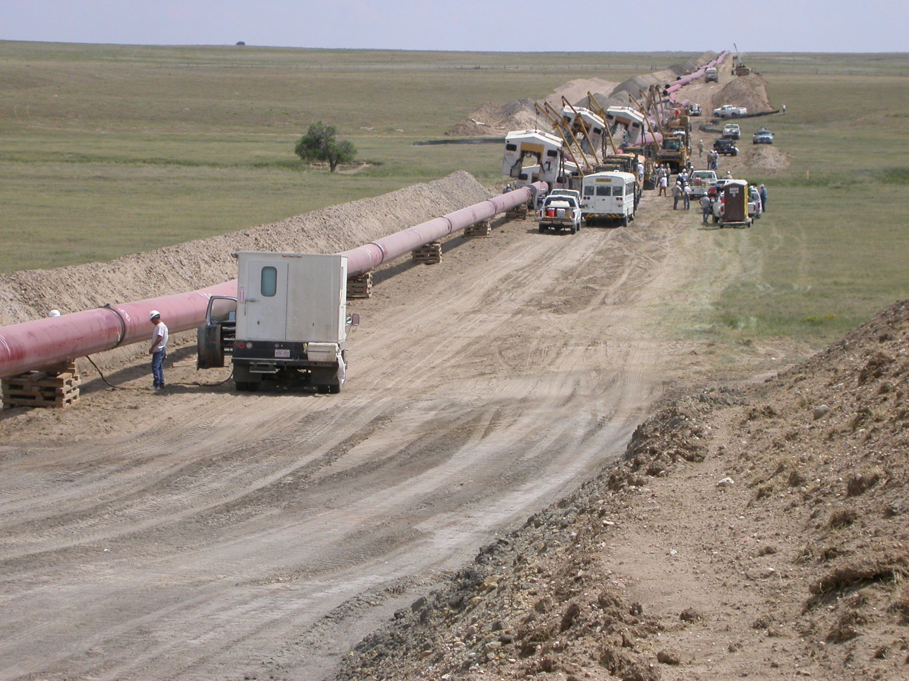
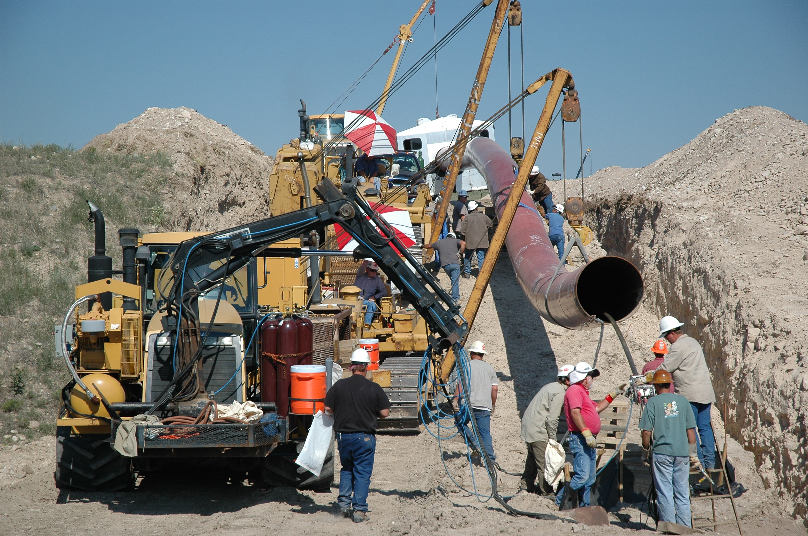

Slide 6
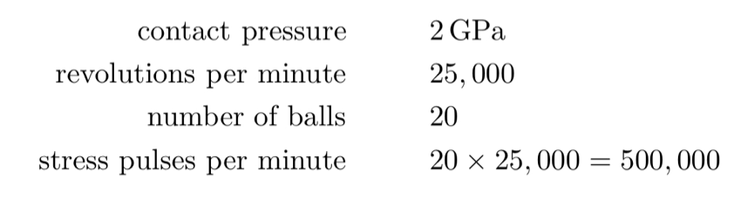
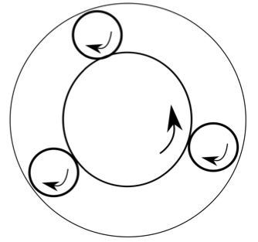


Slide 7
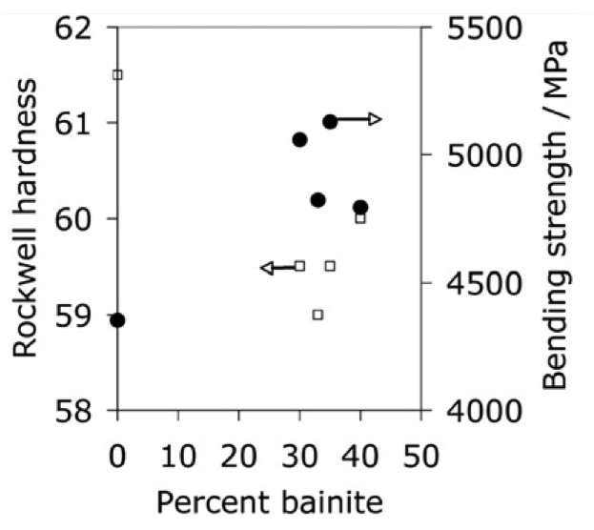
Li et al. 1993

Slide 8
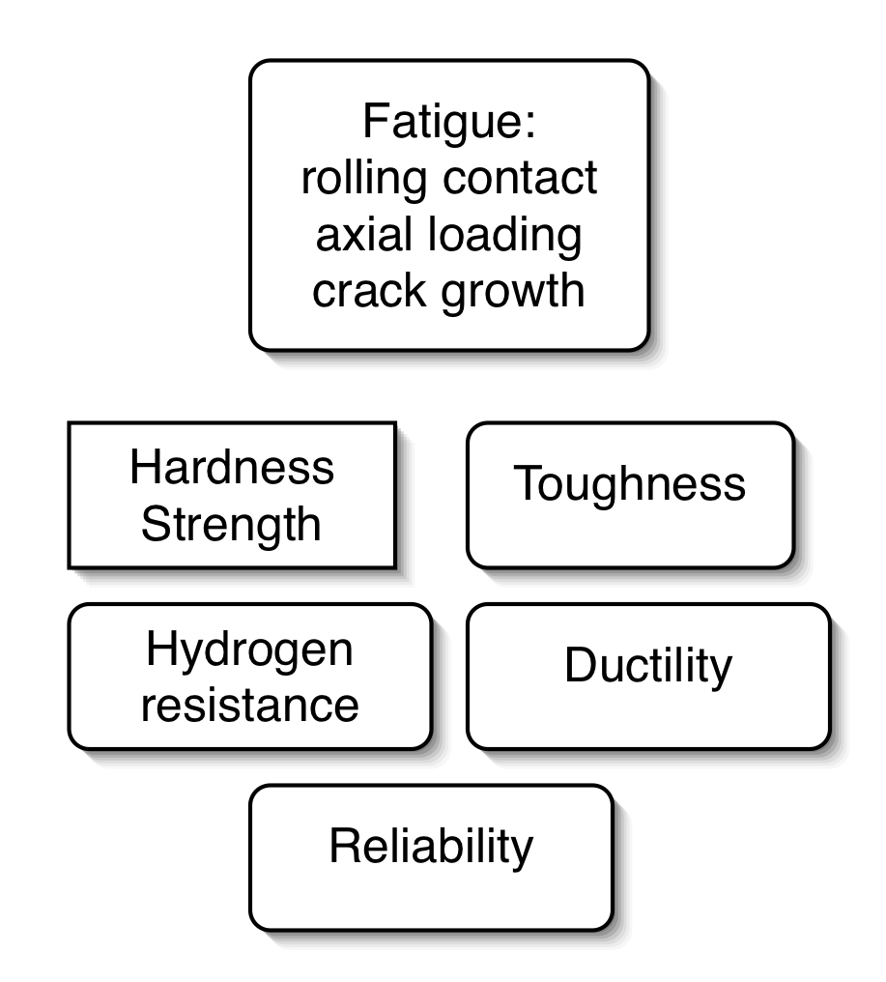
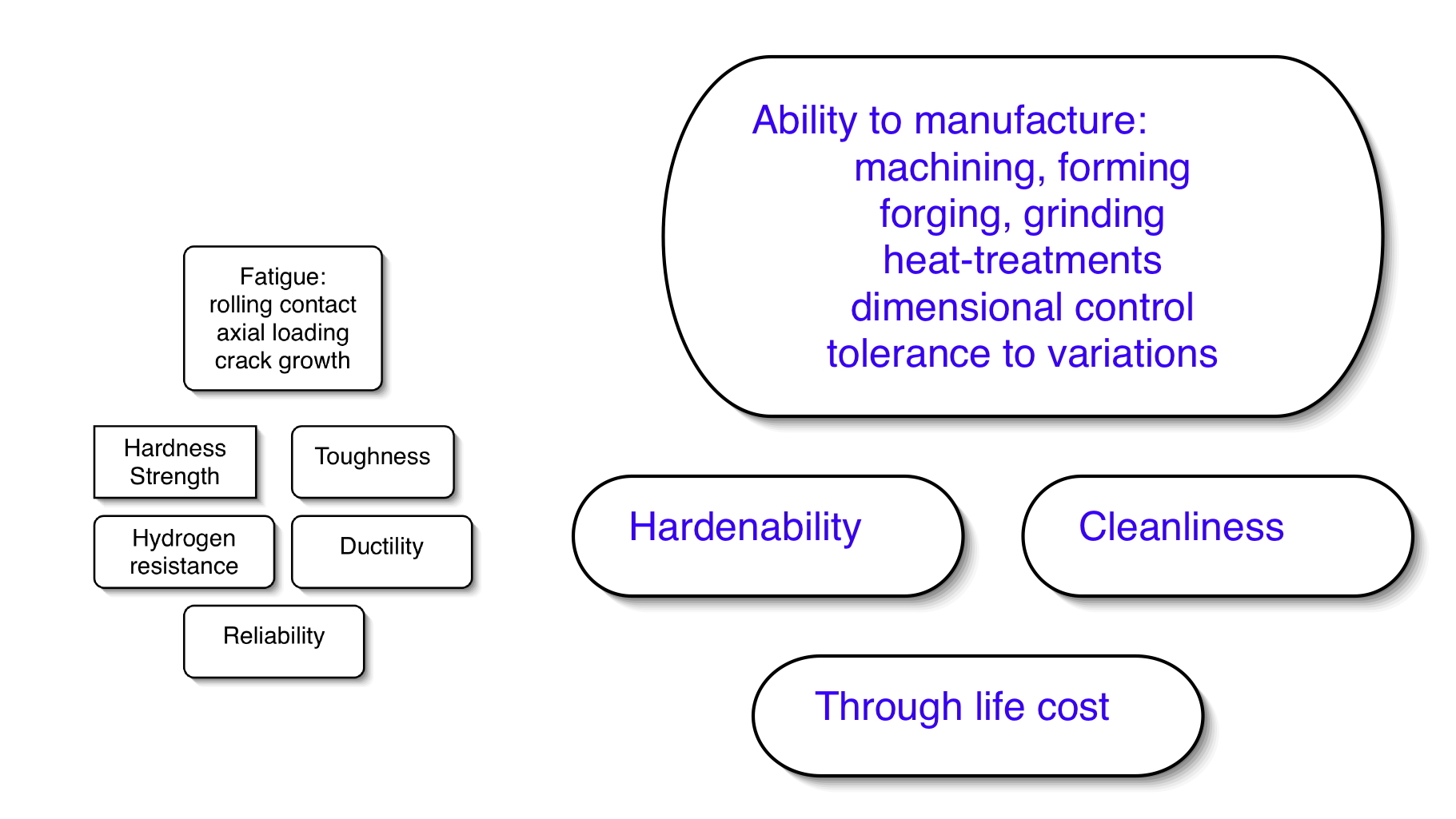
Design a new bearing steel

Slide 9
It is nonsense to talk about the invention of a new material on the basis of just one property.
“there is much work between measuring a single attractive property in a single alloy to demonstrating credibility for a particular application”
Dan Miracle, Materials Science and Technology (2015)

Slide 10
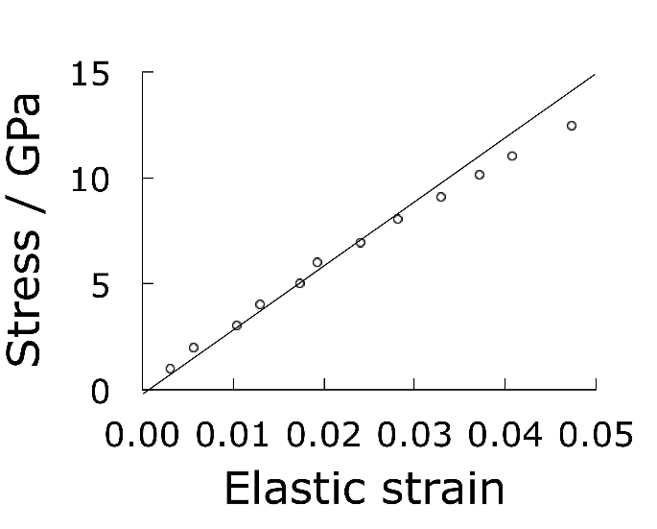
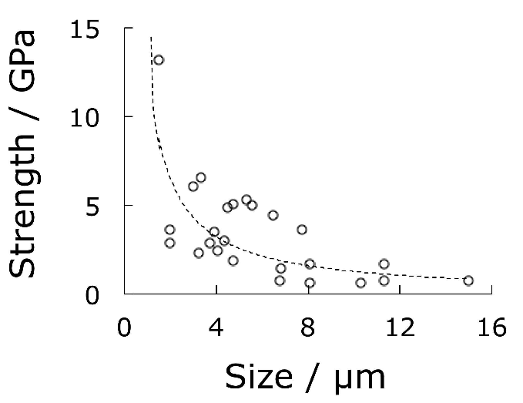
Single crystals of iron
Brenner:1956

Slide 11

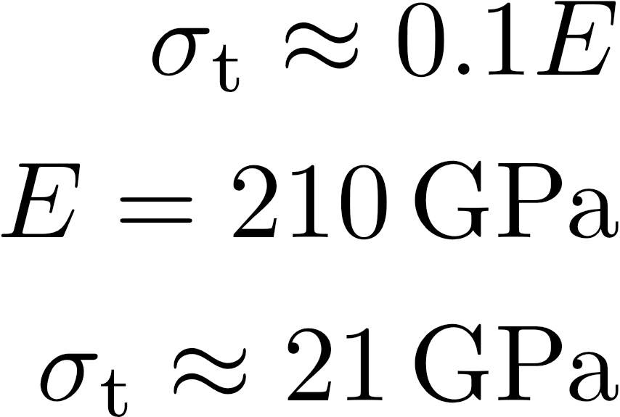
What is the maximum strength of iron?
remember this number

Slide 12
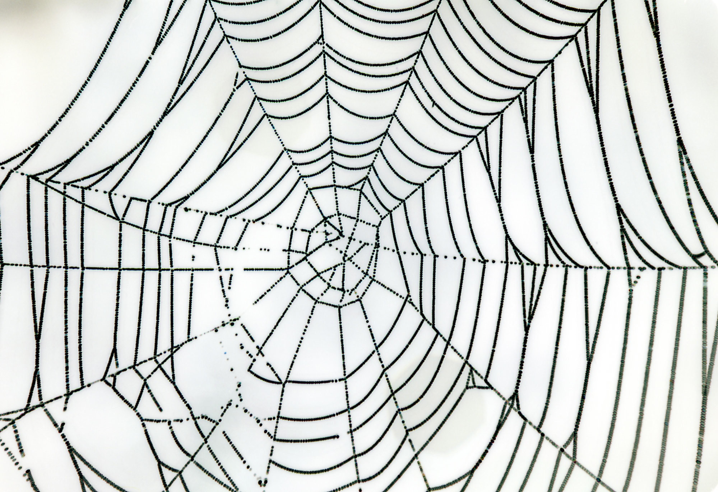
Spider’s silk

Slide 13
Spider’s silk
Tensile strength 700 MPa
Density 1.3 g cm⁻³
“Specific strength 6 times greater than steel of identical tensile strength”
Steel has a much greater specific strength than osmium at the same tensile strength (Os 22.6 g cm⁻³)

Slide 14
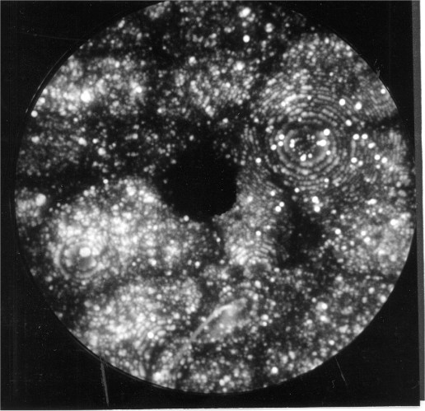
Commercial alloy made by Kobe Steel

Slide 15
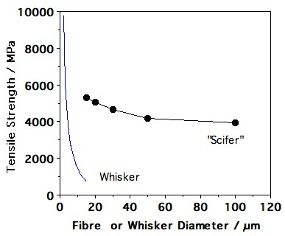

Slide 16
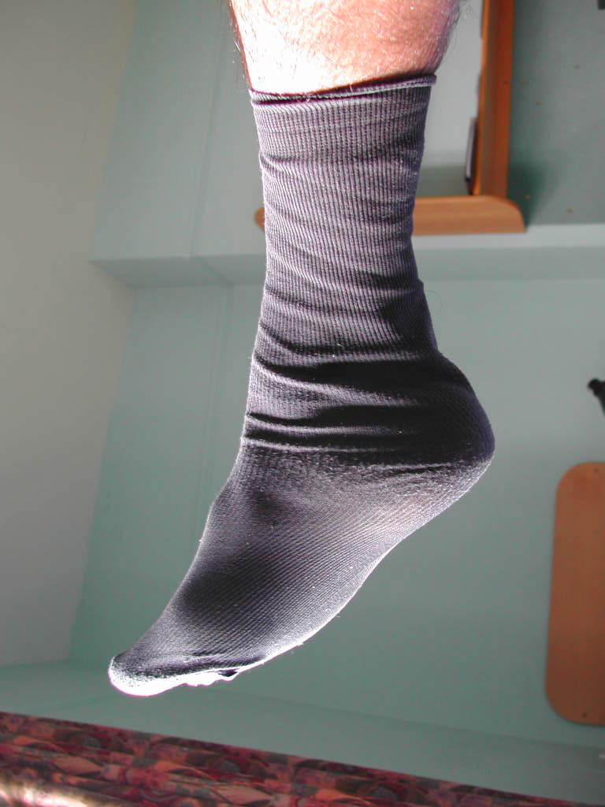
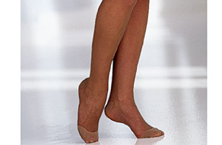
1 Denier: weight in grams, of 9 km of fibre
50-10 Denier
Scifer is 9 Denier

Slide 17
Spider’s silk
Tensile strength 700 MPa
Density 1.3 g cm⁻³
Specific strength 5.38 MPa g⁻¹ cm³
“Specific strength 6 times greater than steel of identical tensile strength”
Tensile strength of Scifer 5500 MPa
Density 7.8 g cm⁻³
Specific strength 7.05 MPa g⁻¹ cm³
Steel has a greater specific strength for same diameter as the silk

Slide 18
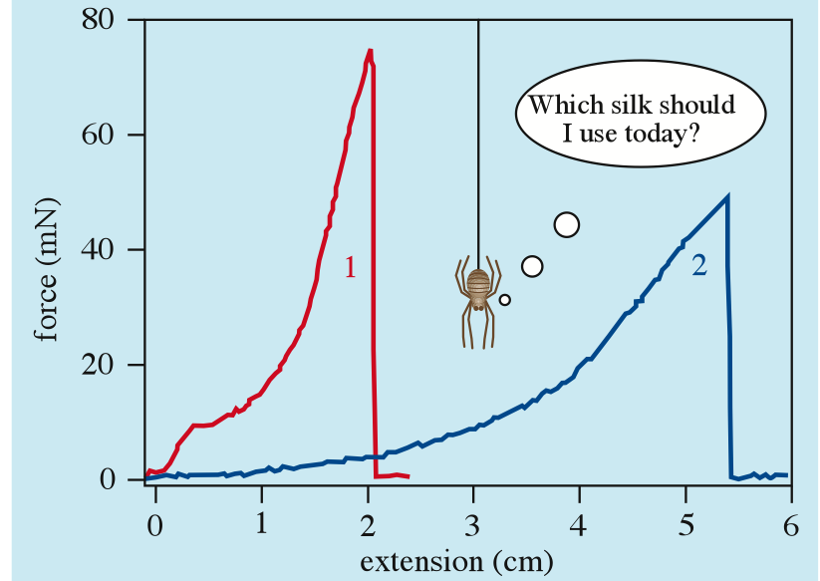
Spider’s silk
700 MPa, 30% elongation gives “toughness” of 105 MJ m⁻³
Spider’s silk is therefore “tougher than steel”
Physics Education
43 (2008) 57

Slide 19
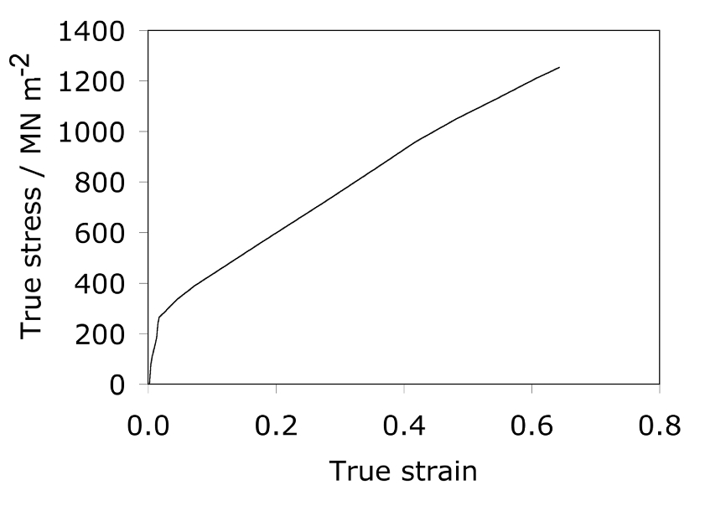
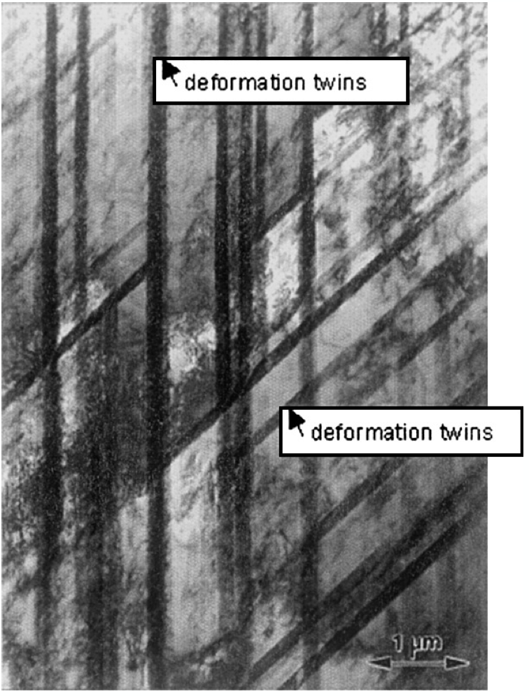
Twinning induced plasticity
TWIP steel on similar calculation has a toughness of 500 MJ m⁻³

Slide 20


Slide 21
Claimed strength of carbon nanotube is 130 GPa
Edwards, Acta Astronautica, 2000
Claimed modulus is 1.2 TPa
Terrones et al., Phil. Trans. Roy. Soc., 2004

Slide 22
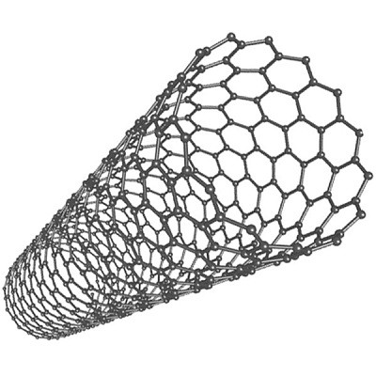
How is the strength of nanotube calculated?
By ignoring the empty space within the nanotube
But let us ignore this
Therefore strength of steel, which has 32% space unoccupied, is greater by 47% than reported since time zero

Slide 23

36000 km
tethered space elevator
Arthur C. Clark (1979)

Slide 24


geosynchronous orbit

Slide 25
strength 130 GPa
modulus 1.2 TPa
 | J g⁻¹ | m s⁻¹
Dynamite | 4650 | 6000
Nanotube | 5420 | 21500

Slide 26
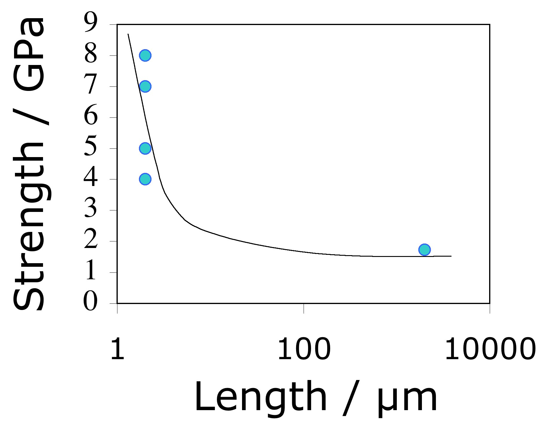
data from Pan et al. 1999, Yu et al. 2000

Slide 27
Entropy
P
P / 2

Slide 28



Binary solution

Slide 29
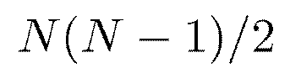
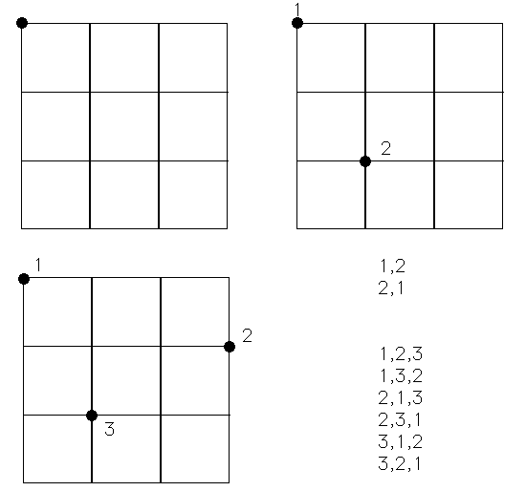


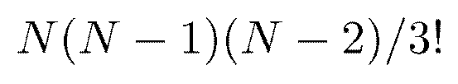

Slide 30
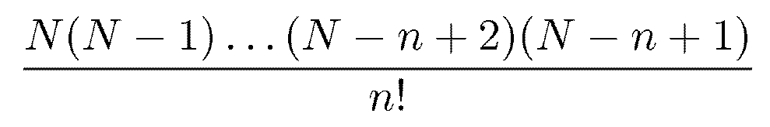
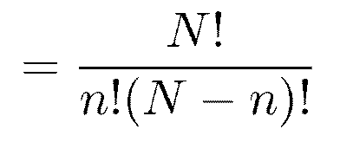
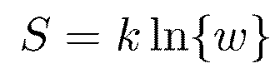

Slide 31
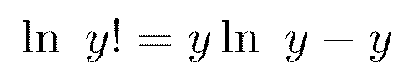
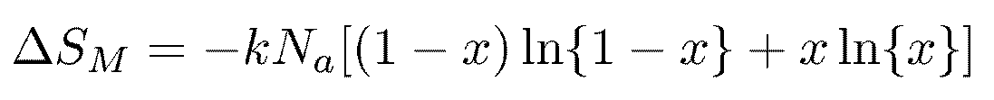

Slide 32
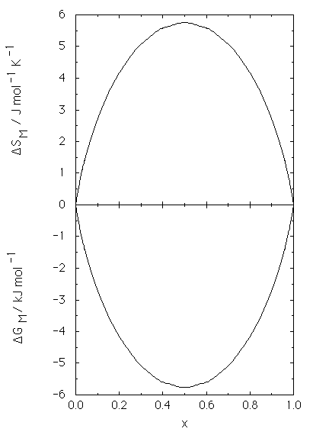

Slide 33
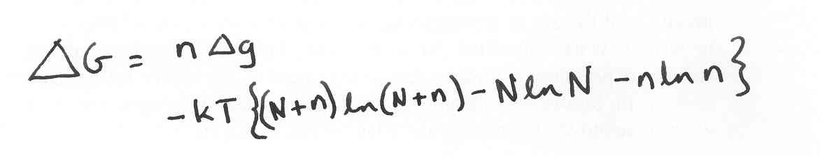
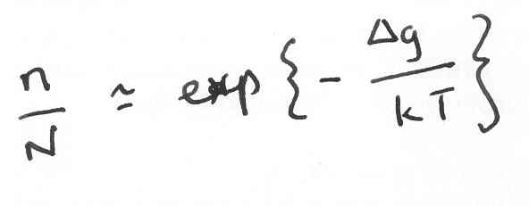
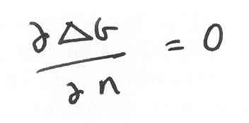
An equilibrium number of defects.
Strength of a nanotube rope 2 mm long is less than 2000 MPa

Slide 34
Summary
Strength produced by deformation limits shape: wires, sheets...
Strength in small particles relies on perfection. Doomed as size increases.

Slide 35
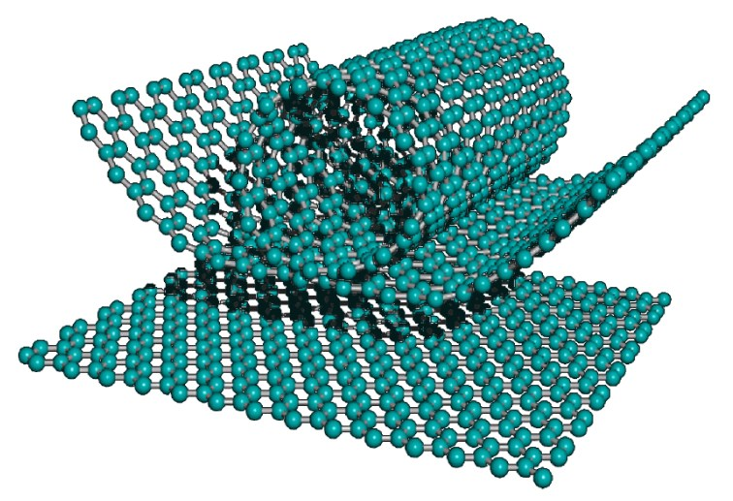
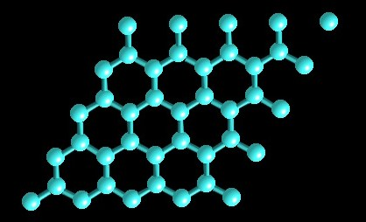
Morinobu Endo, 2004

Slide 36
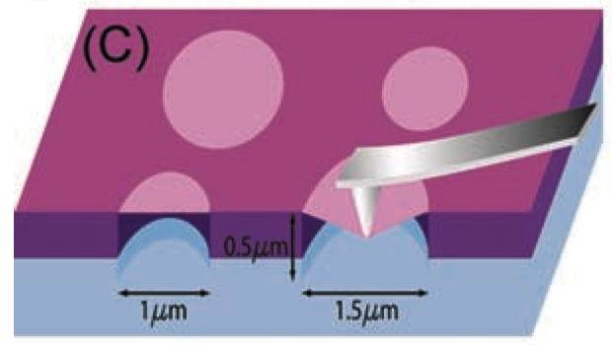
Lee et al. Science (2008)

Slide 37

Intrinsic strength of Graphene
(samples 2 µm²)

Slide 38
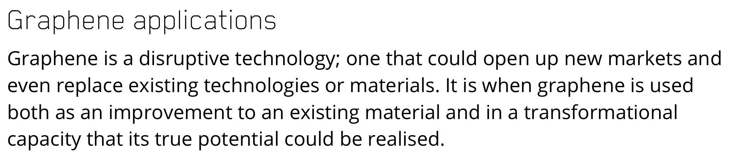
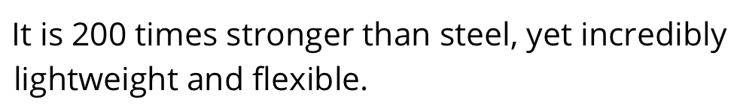
University of Manchester web site

Slide 39
April 2011: graphene 10 times stronger than steel (Univerisity of Techn. Sydney)
http://www.popsci.com/science/article/2011-04/new-graphene-material-paper-thin-and-ten-times-stronger-steel
April 2014: graphene about 100 times stronger than steel (Manchester University)
now claimed to be 200 times stronger
http://www.bbc.co.uk/news/science-environment-27113732
August 2015: graphene is 200 times stronger than structural steel (Columbia University)
http://news.bbc.co.uk/1/hi/programmes/click_online/9491789.stm

Slide 40
The researchers measured the intrinsic strength of the material — that is the maximum stress that a pristine (or defect-free) material can withstand just before all the atoms in a given cross-section are pulled apart at the same time. This was found to be 42 N m^{–1} and represents the intrinsic strength of a defect-free sheet.
The graphene monolayers used in the experiments are defect-free because they are so small, something that precludes the existence of flaws — a condition that cannot be satisfied in macroscopic materials.
July 2008, Physics World
http://physicsworld.com/cws/article/news/2008/jul/17/graphene-has-record-breaking-strength

Slide 41
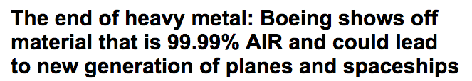
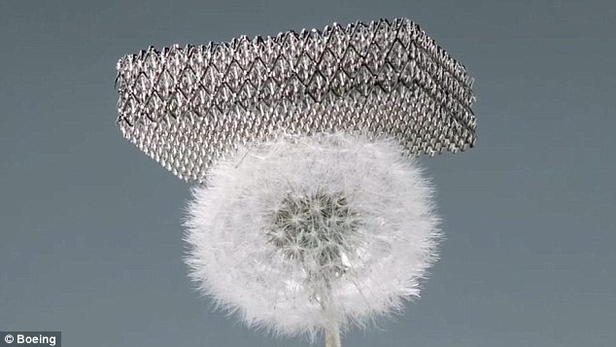
Daily Mail

Slide 42
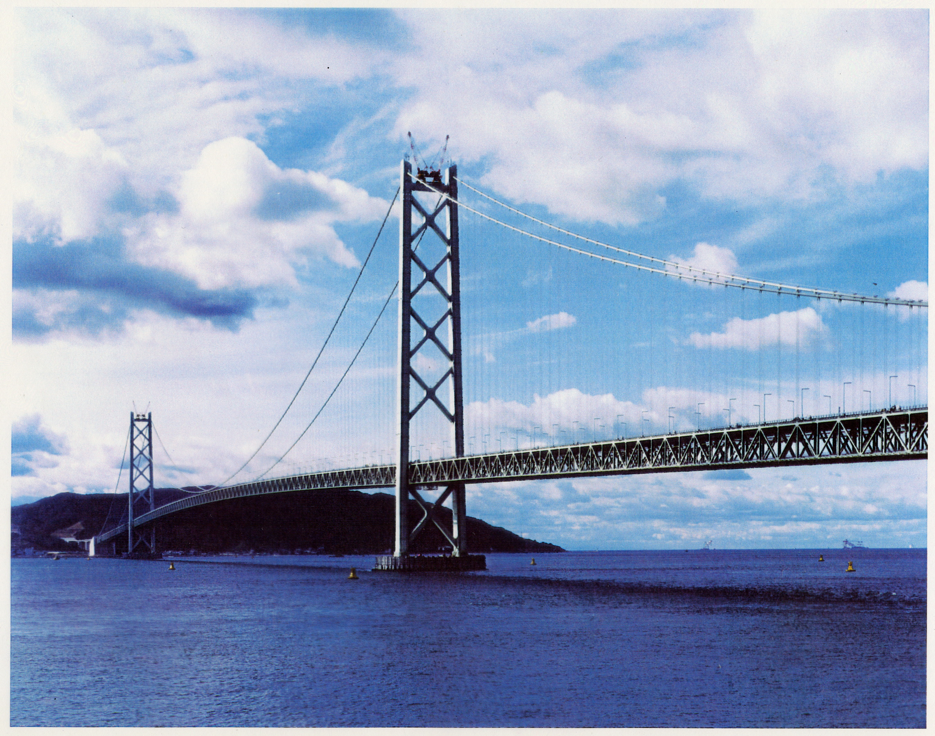

Slide 43
“100 times stronger than steel”
www.msm.cam.ac.uk/phase-trans
Really? or are we simply lacking scholars?
and fooling the public?

