Slide 1
Crystallography
H. K. D. H. Bhadeshia
Introduction and point groups
Stereographic projections
Low symmetry systems
Space groups
Deformation and texture
Interfaces, orientation relationships
Martensitic transformations

Slide 2
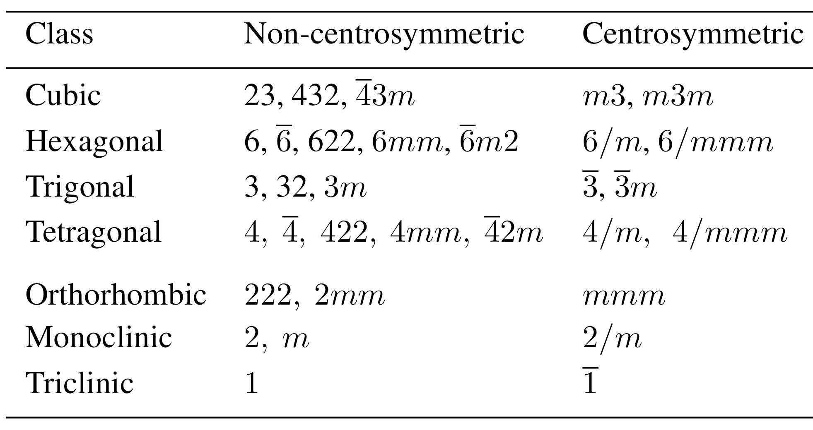

Slide 3
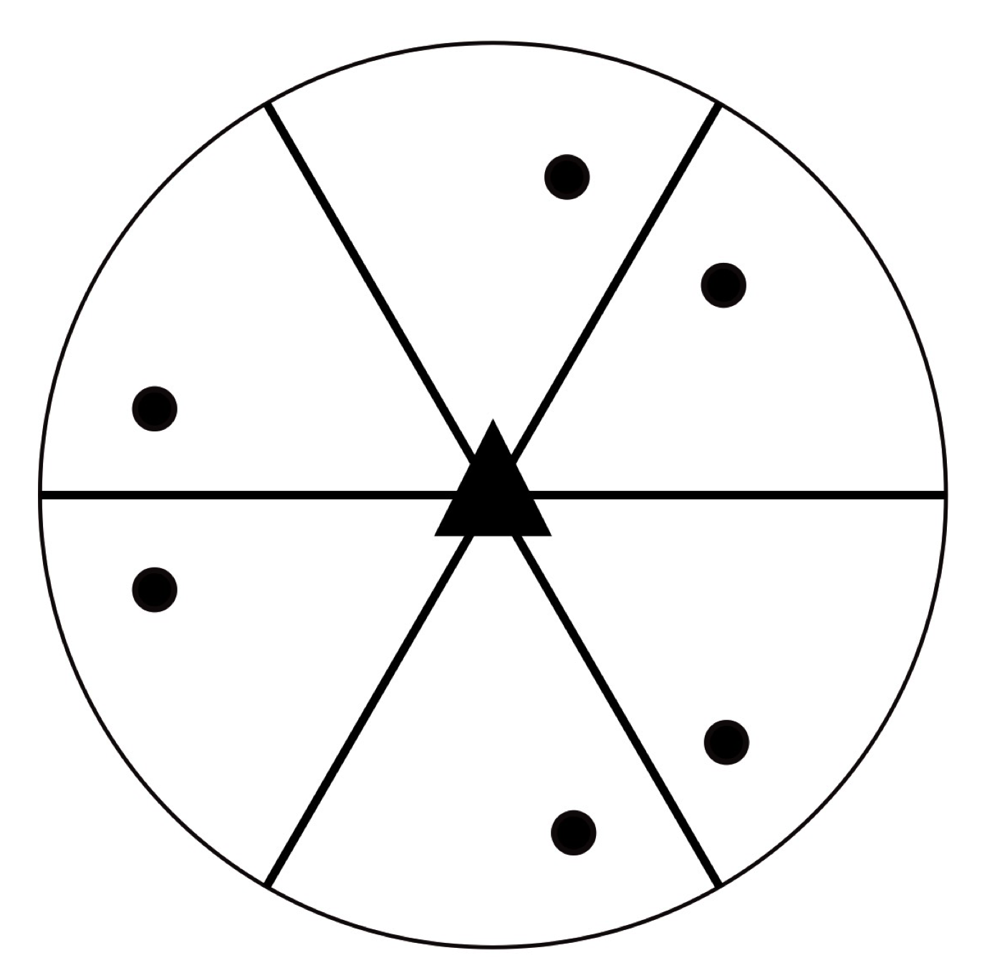
3m
polar group

Slide 4
6mm
polar group

Slide 5
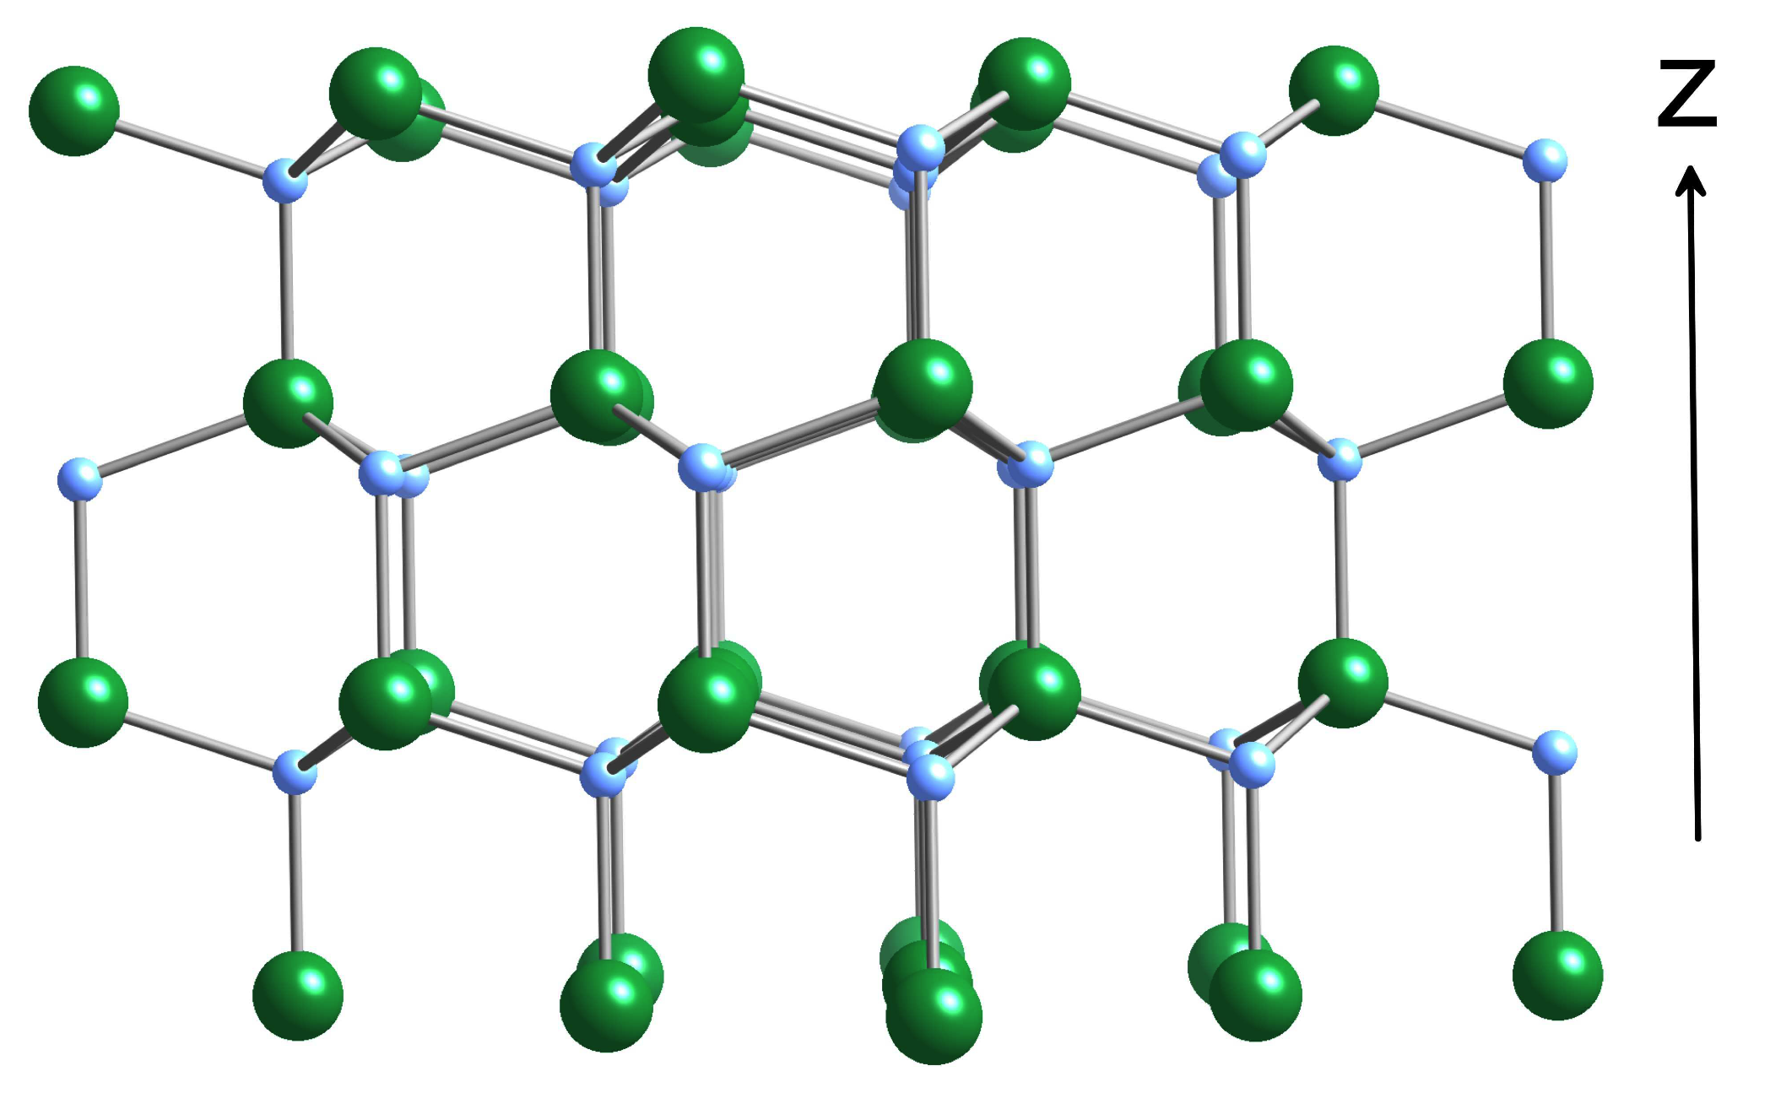
polar group 6mm GaN

Slide 6
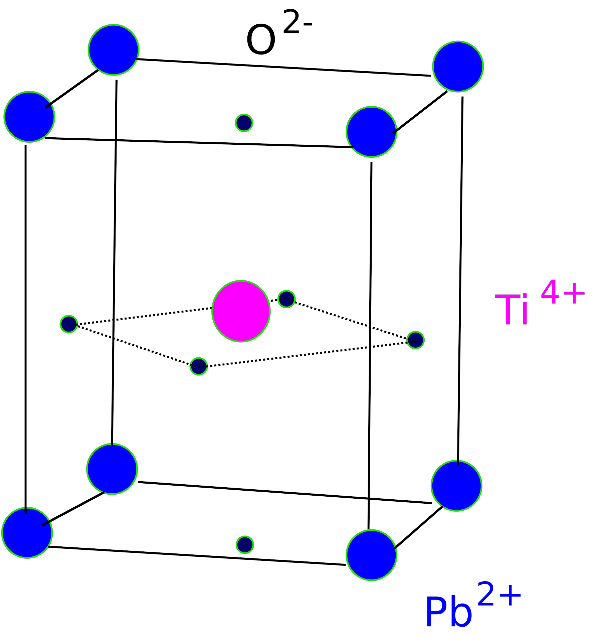
tetragonal
lattice type and point group?

Slide 7
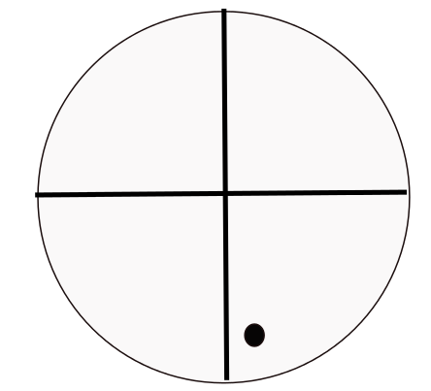
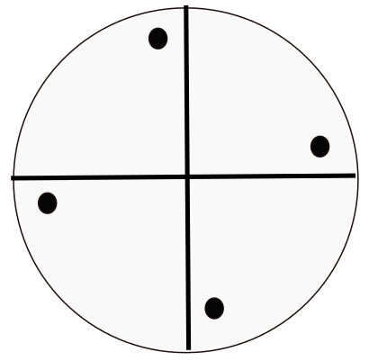
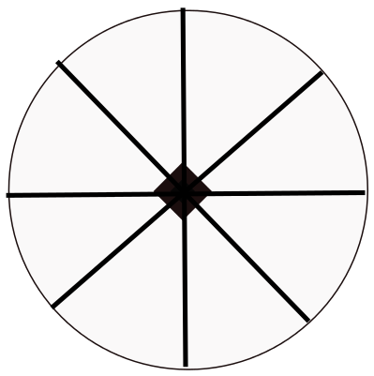
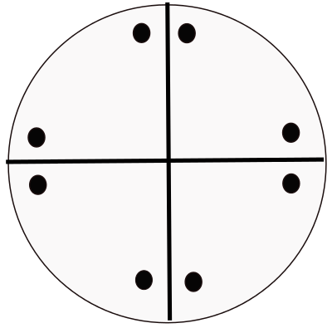
Point group 4mm, tetragonal
pole of general form
operate 4-fold axis
a general location x,y,z with a site symmetry 1
would require 8 such atoms in the cell
operate mirrors

Slide 8
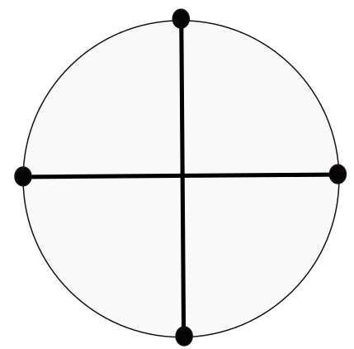
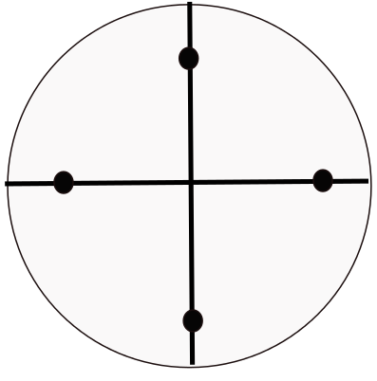
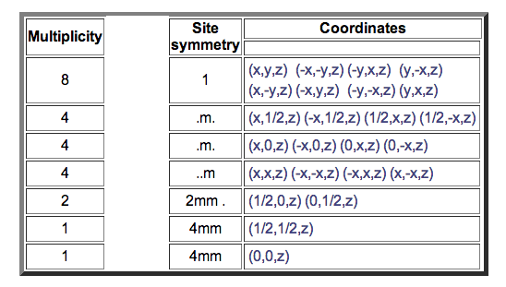
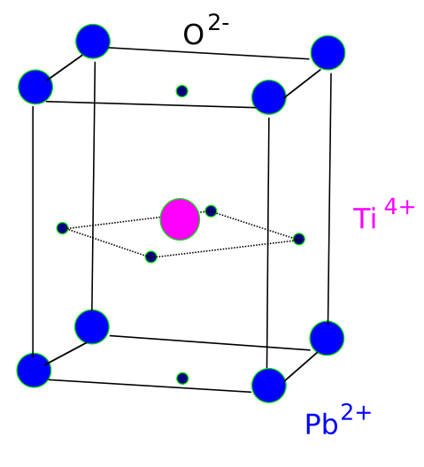
P4mm

Slide 9
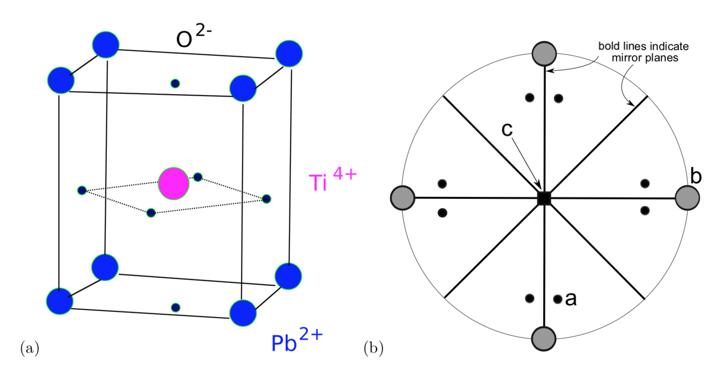

Slide 10
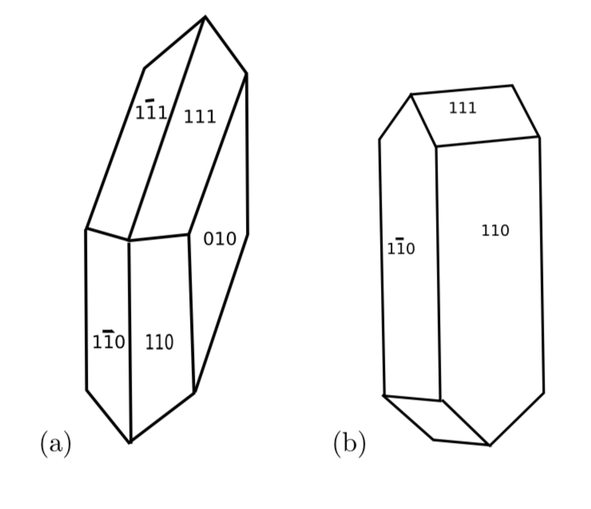

Slide 12
the titanate just discussed has no centre of symmetry,
piezoelectric.
free energy of heterogeneous solution

Slide 13
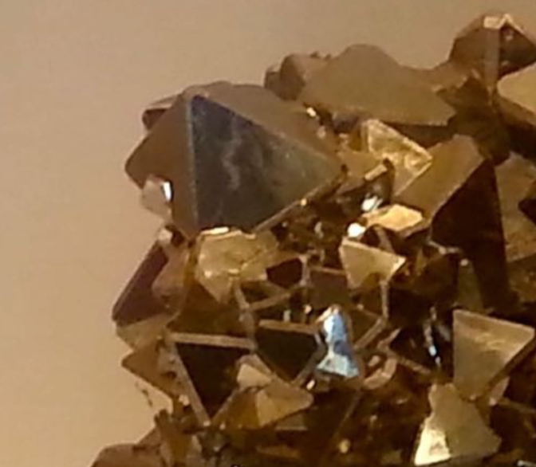
PYRITE
(MISIS, Moscow)

Slide 15
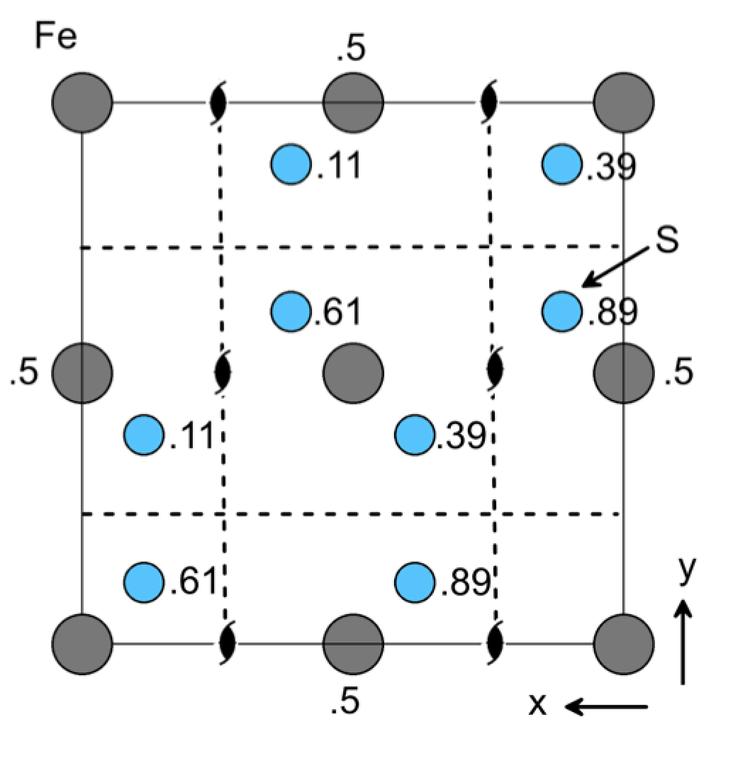
Pyrite m3

Slide 16
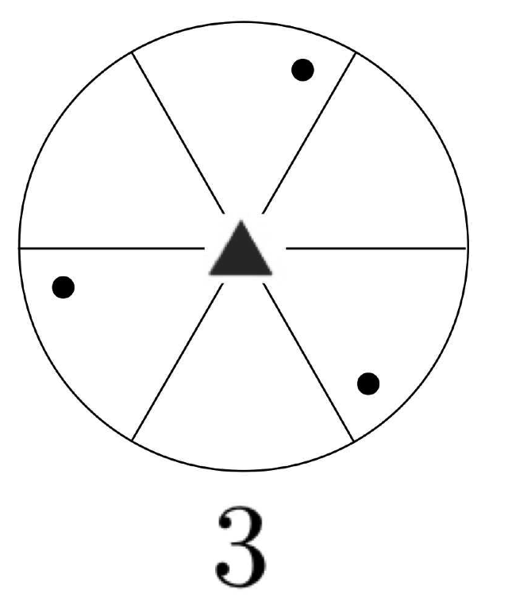
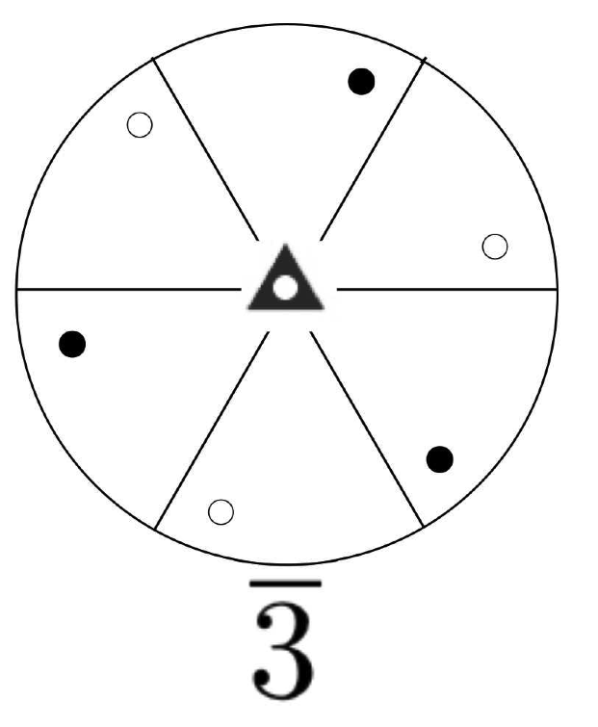

Slide 17
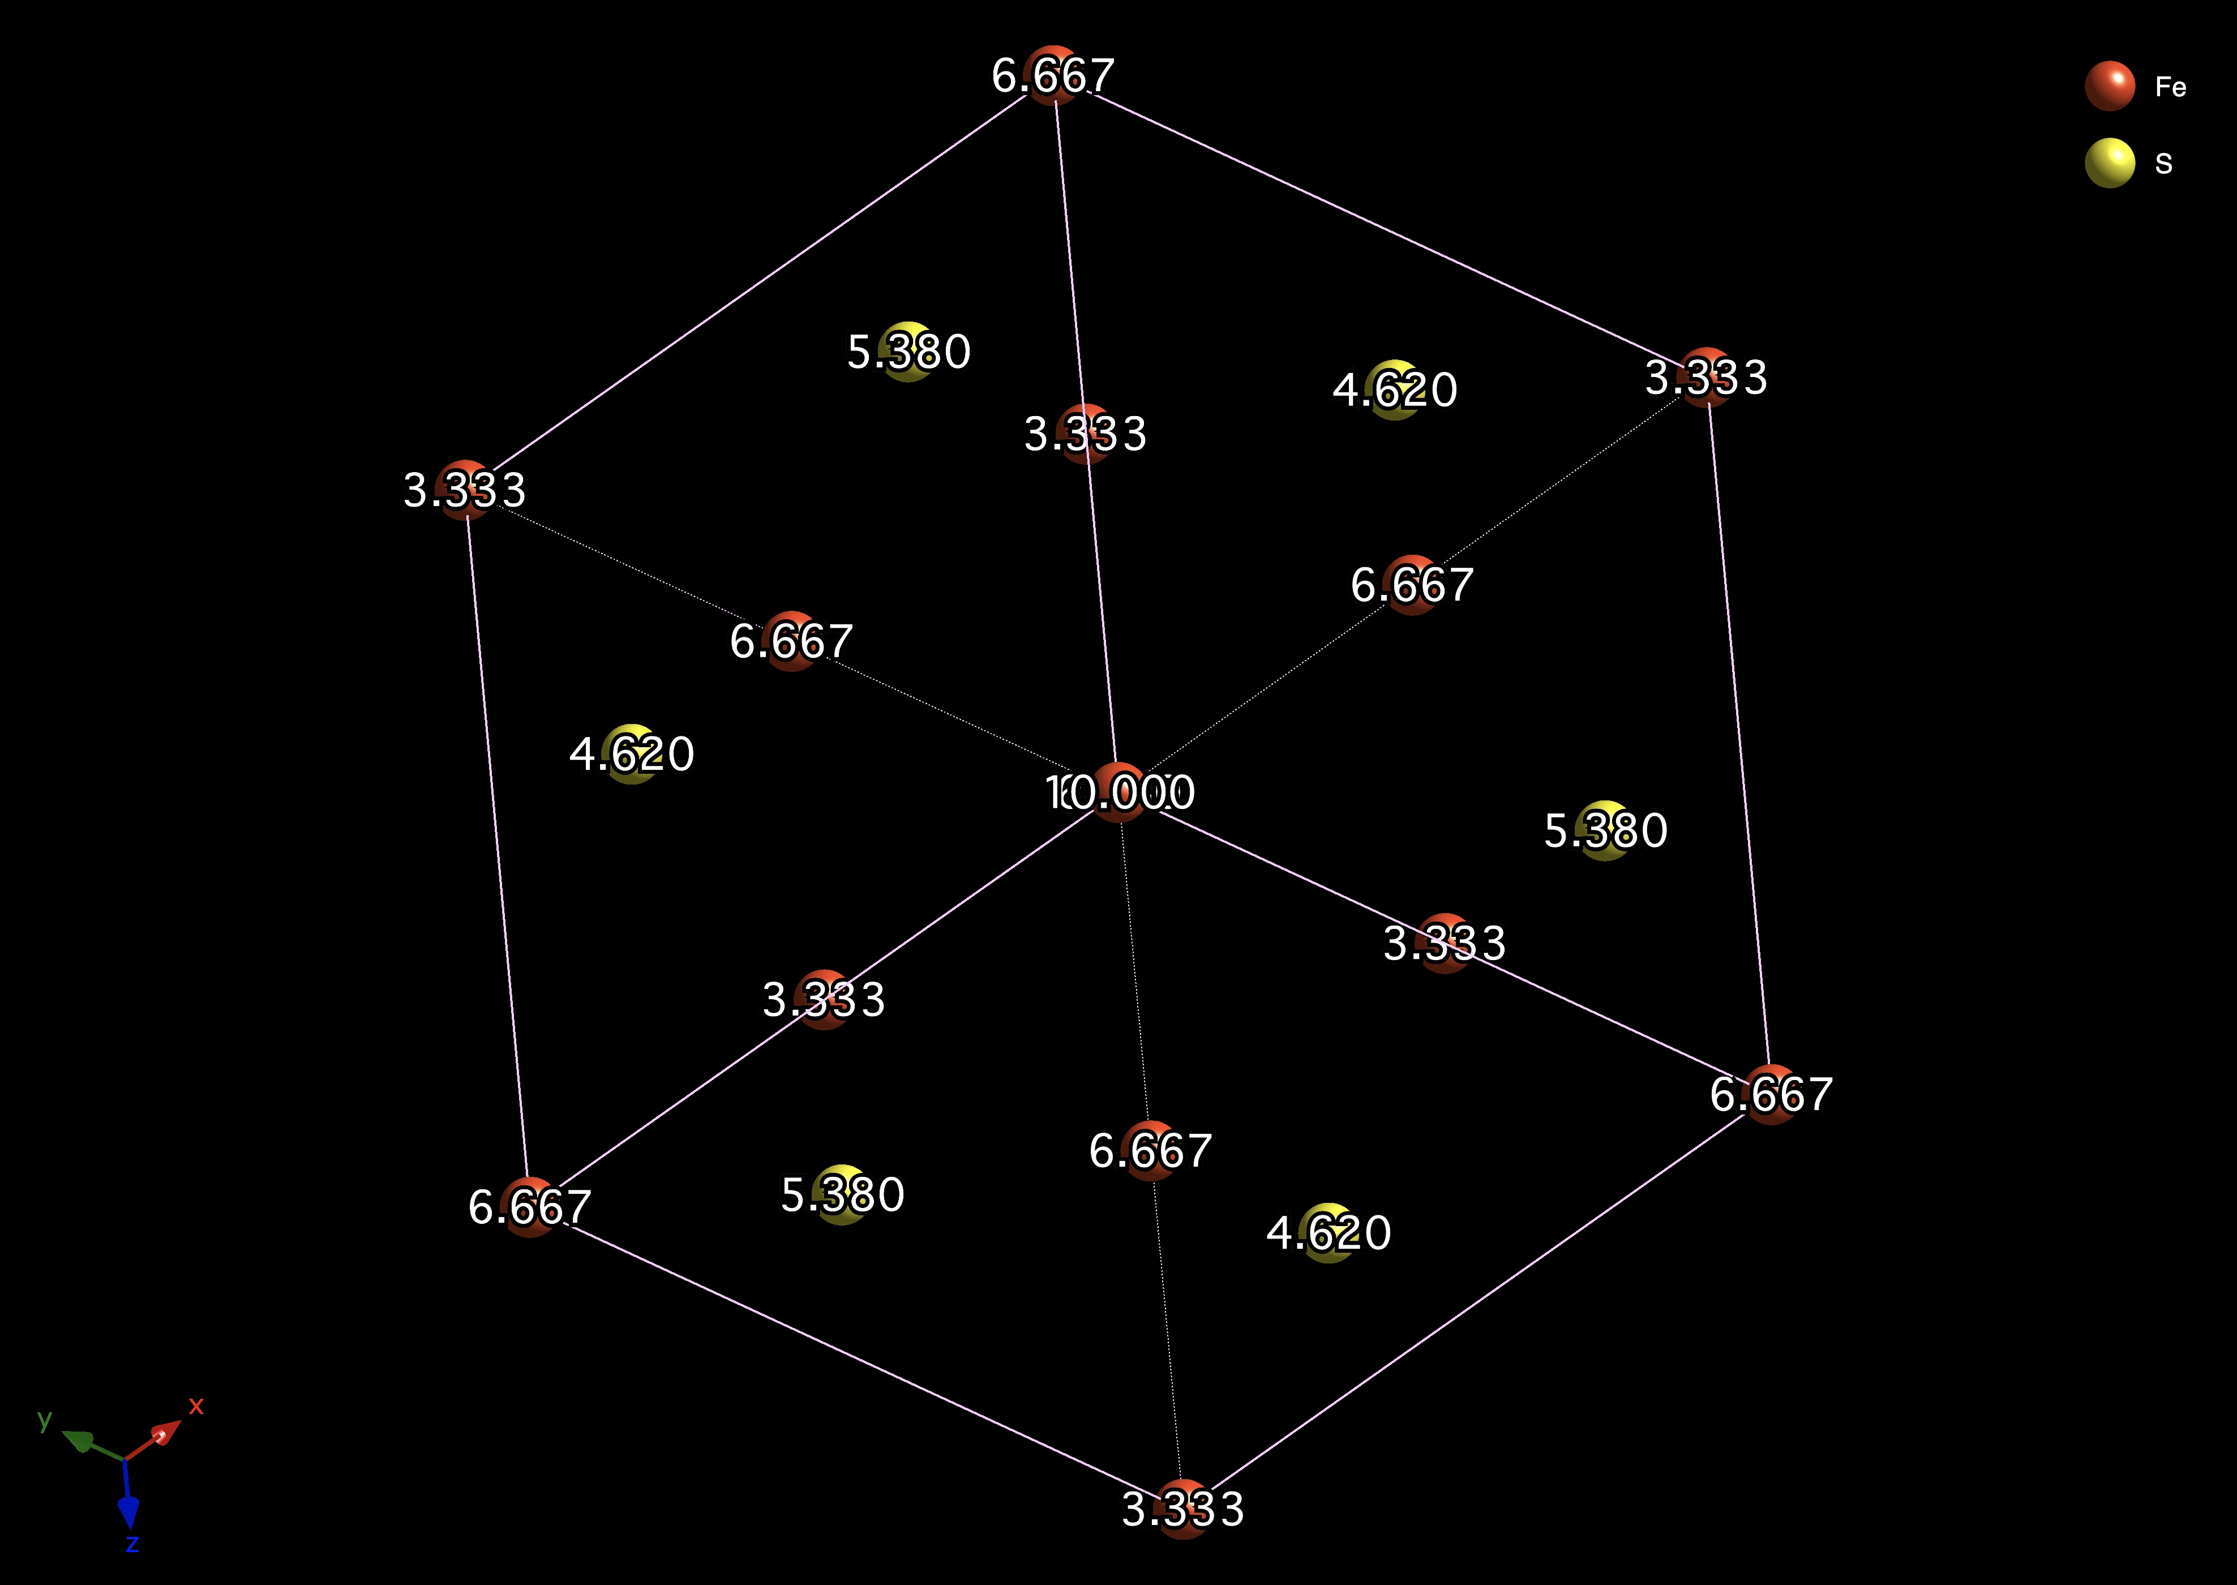

Slide 18
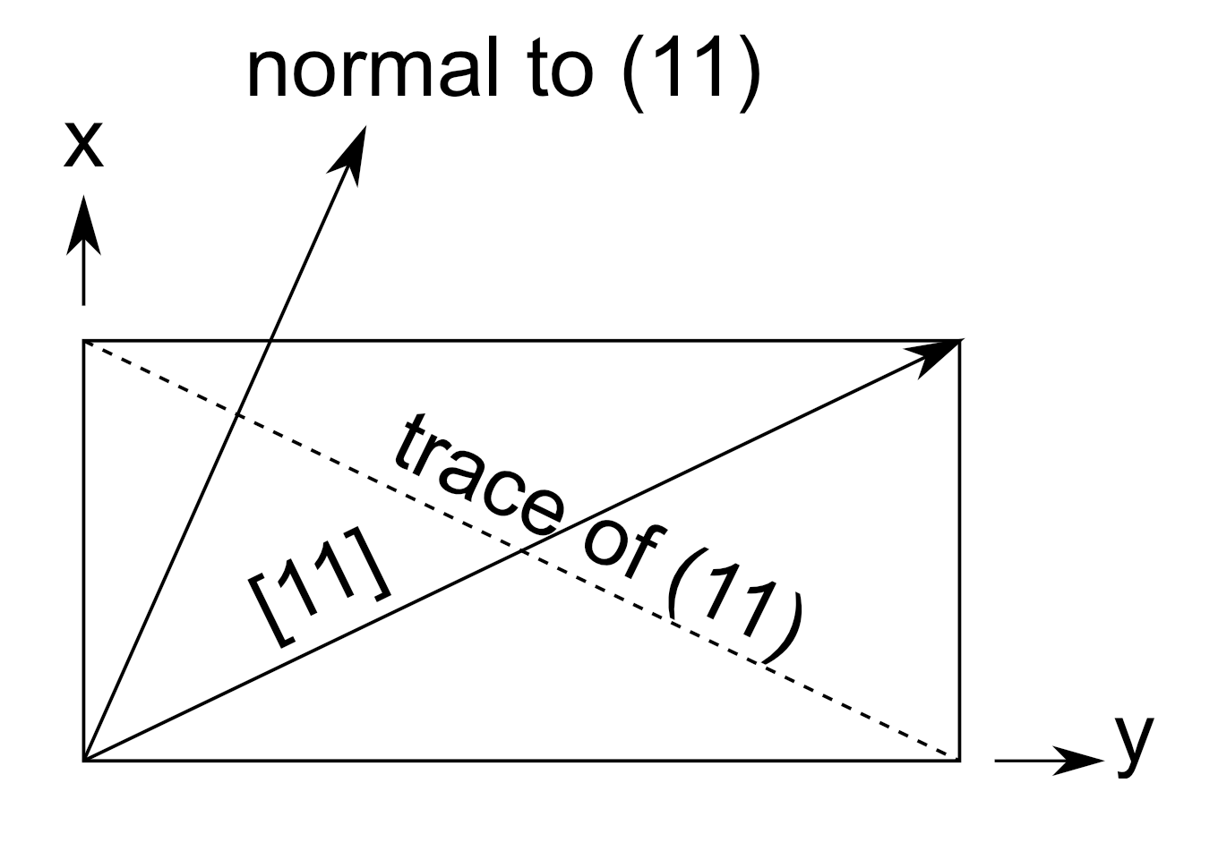
Stereograms for systems of low symmetry

Slide 19
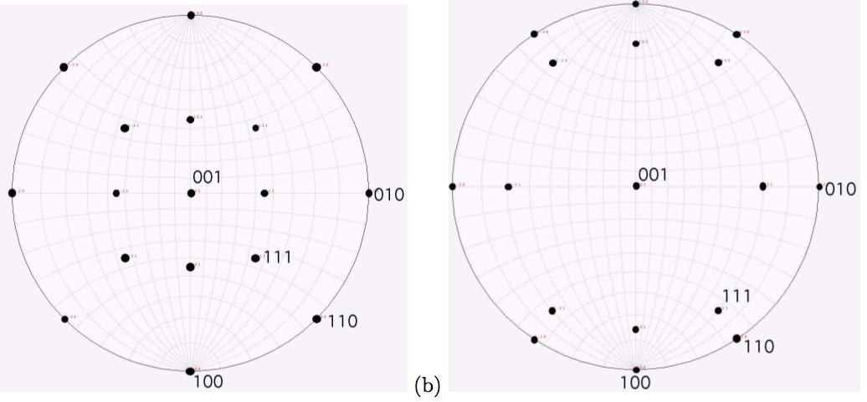
5
2,3,8

Slide 20
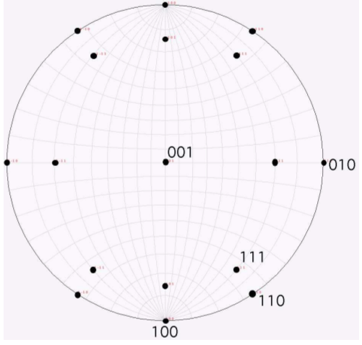
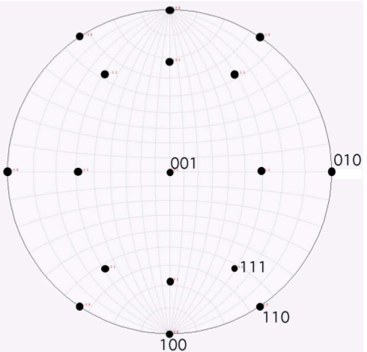
2,3,8 2,3,5

Slide 21
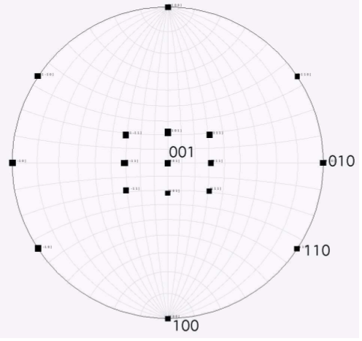
2,3,5
normals directions

Slide 22
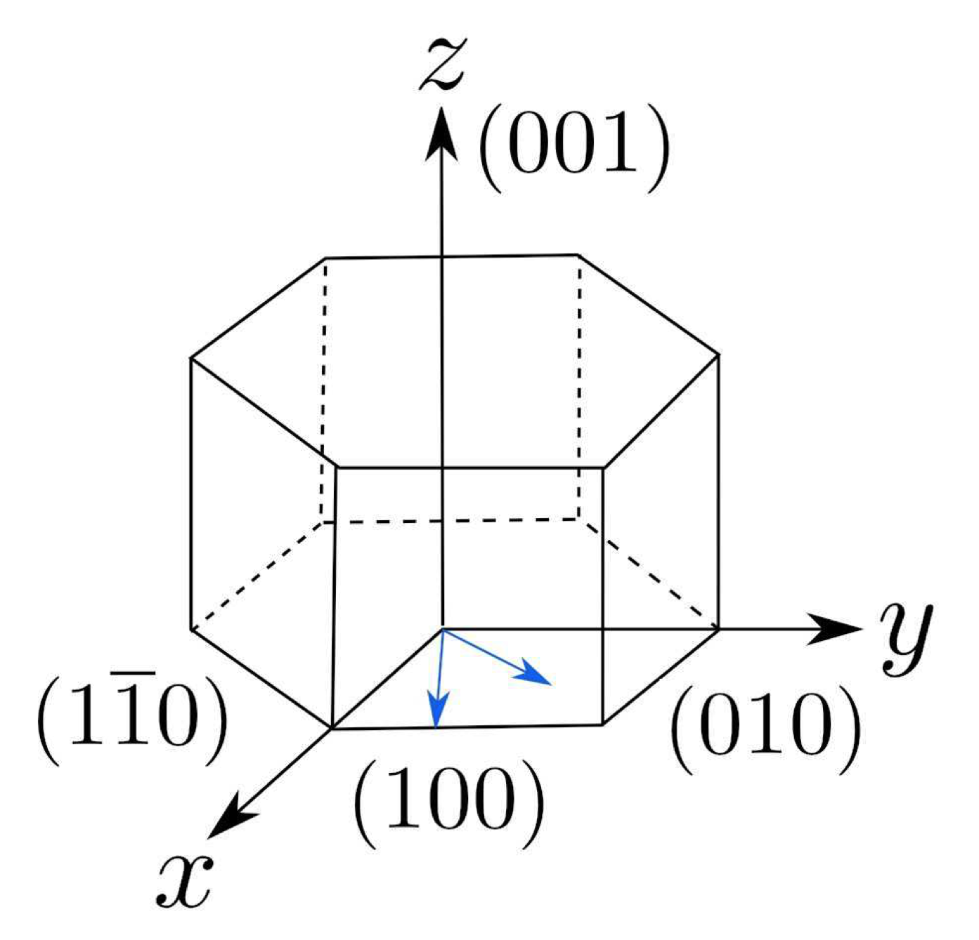
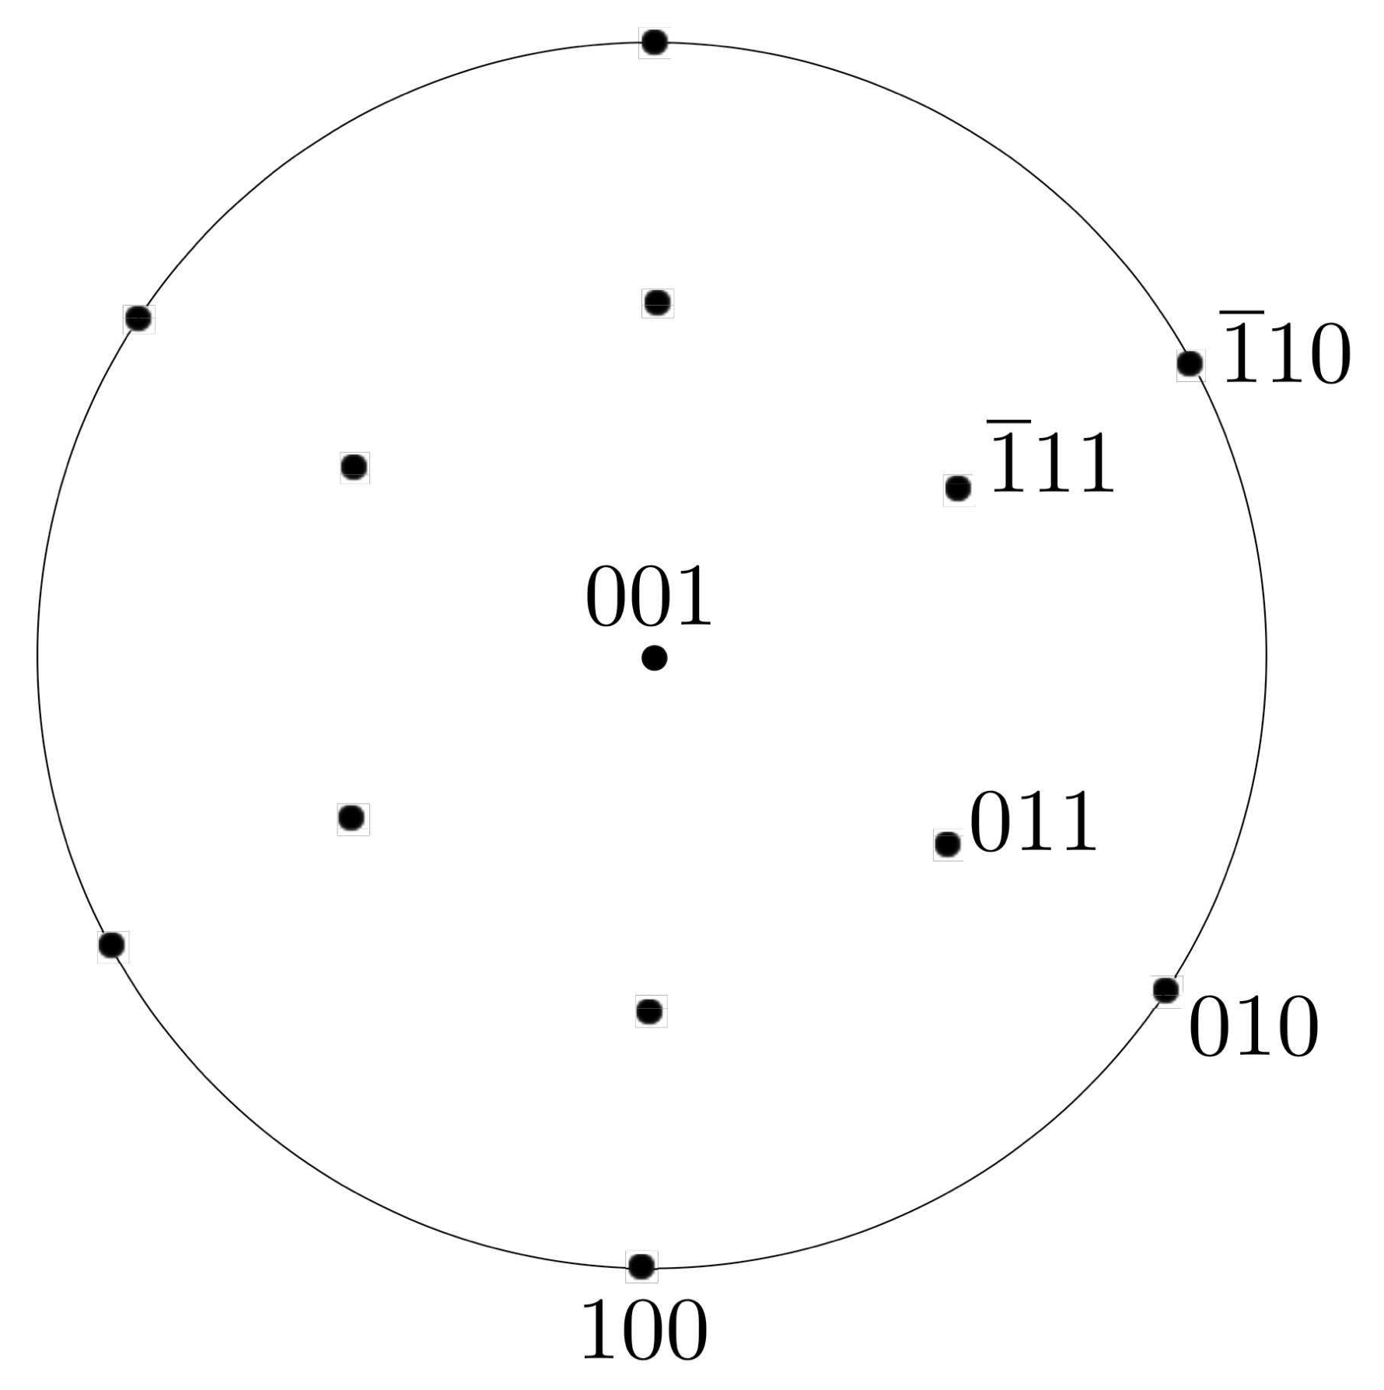

Slide 23
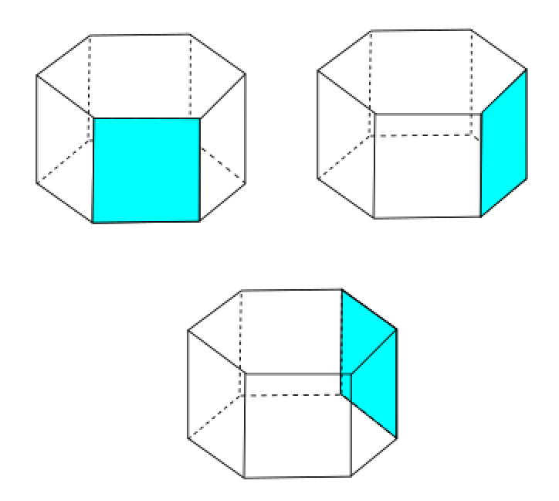

Slide 24
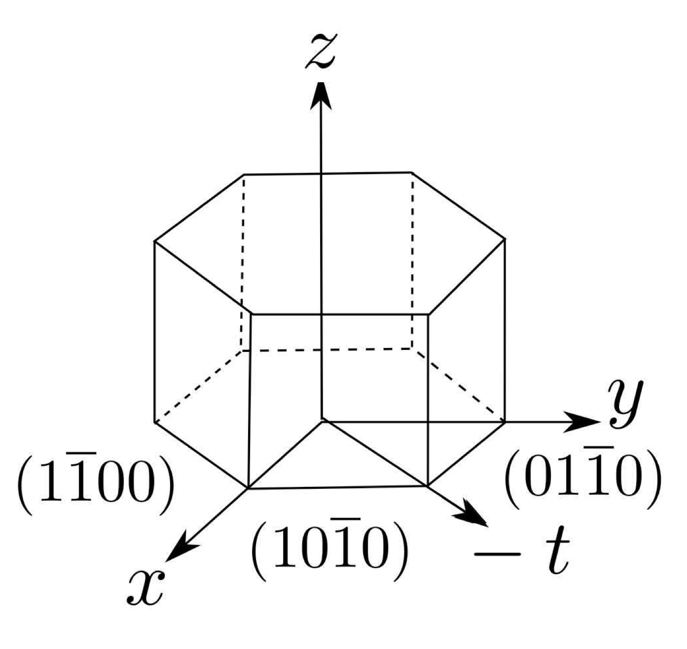

Slide 25
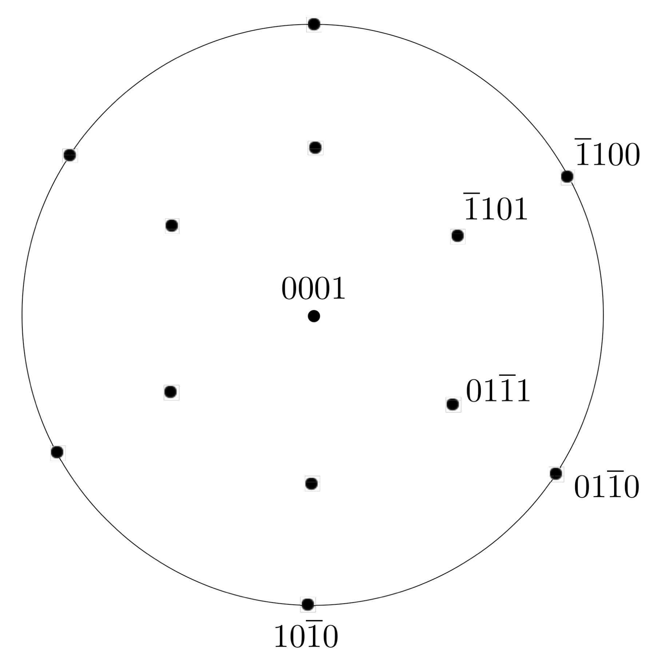

Slide 26
Weiss zone rule

Slide 29
