Slide 1

Crystallography
H. K. D. H. Bhadeshia
Introduction and point groups
Stereographic projections
Low symmetry systems
Space groups
Reciprocal Lattice & Diffraction
Deformation and texture
Interfaces, orientation relationships
Martensitic transformations

Slide 2
Diffusionless
can form at incredibly
low temperatures
can form very rapidly
no composition change

Slide 3
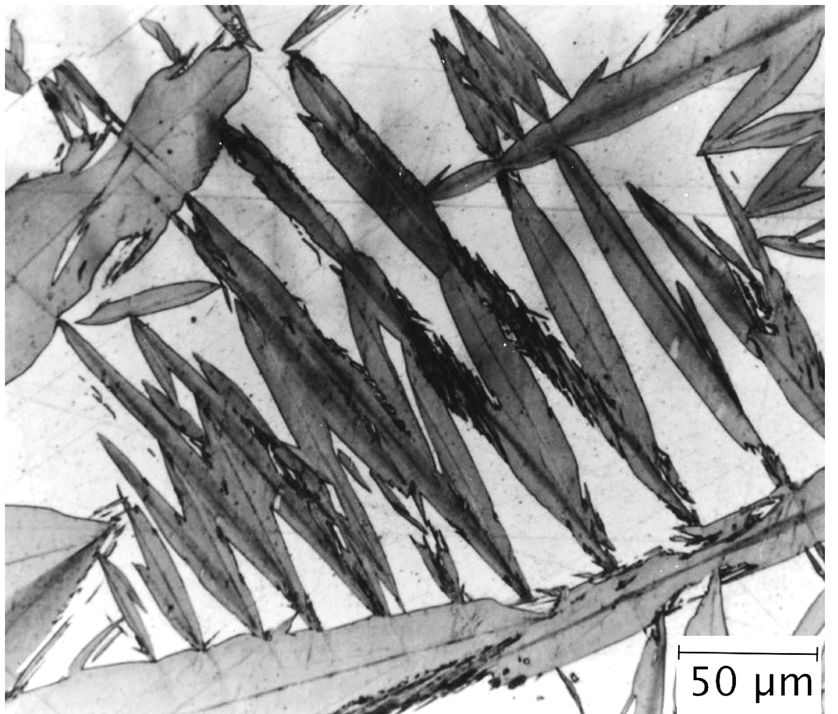
shape

Slide 4
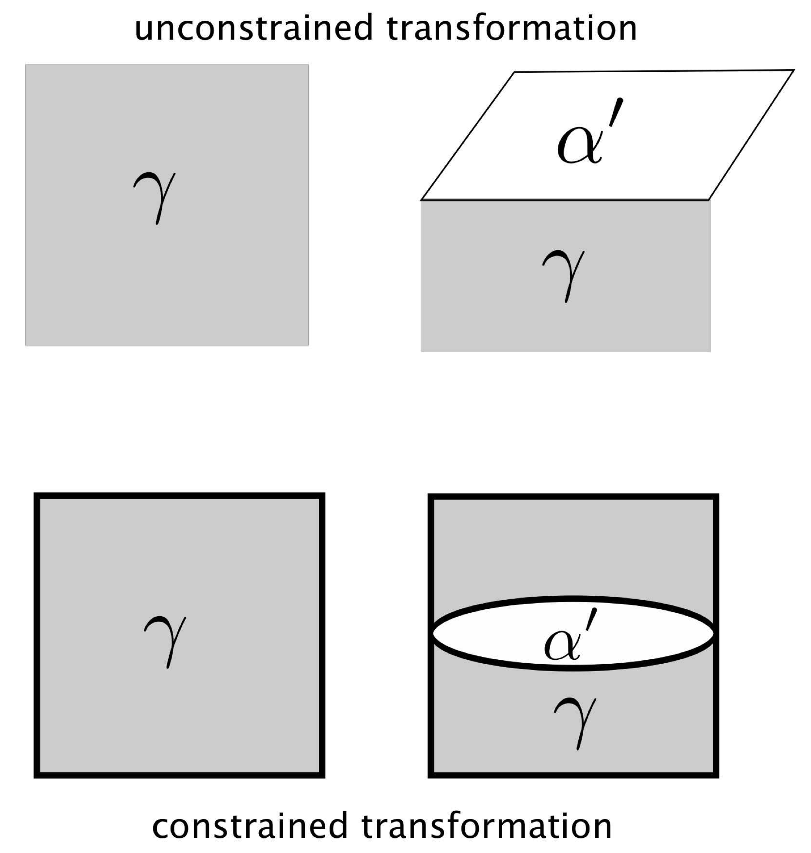

Slide 5
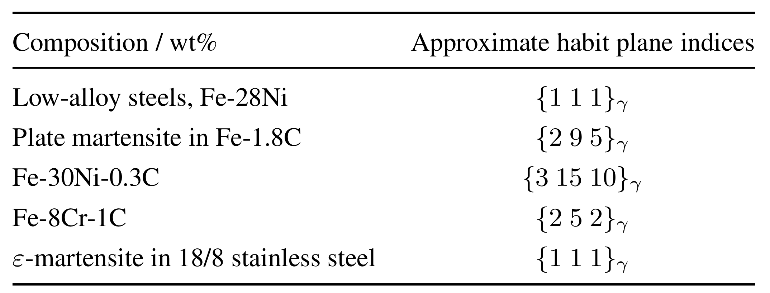
Irrational: why?

Slide 7
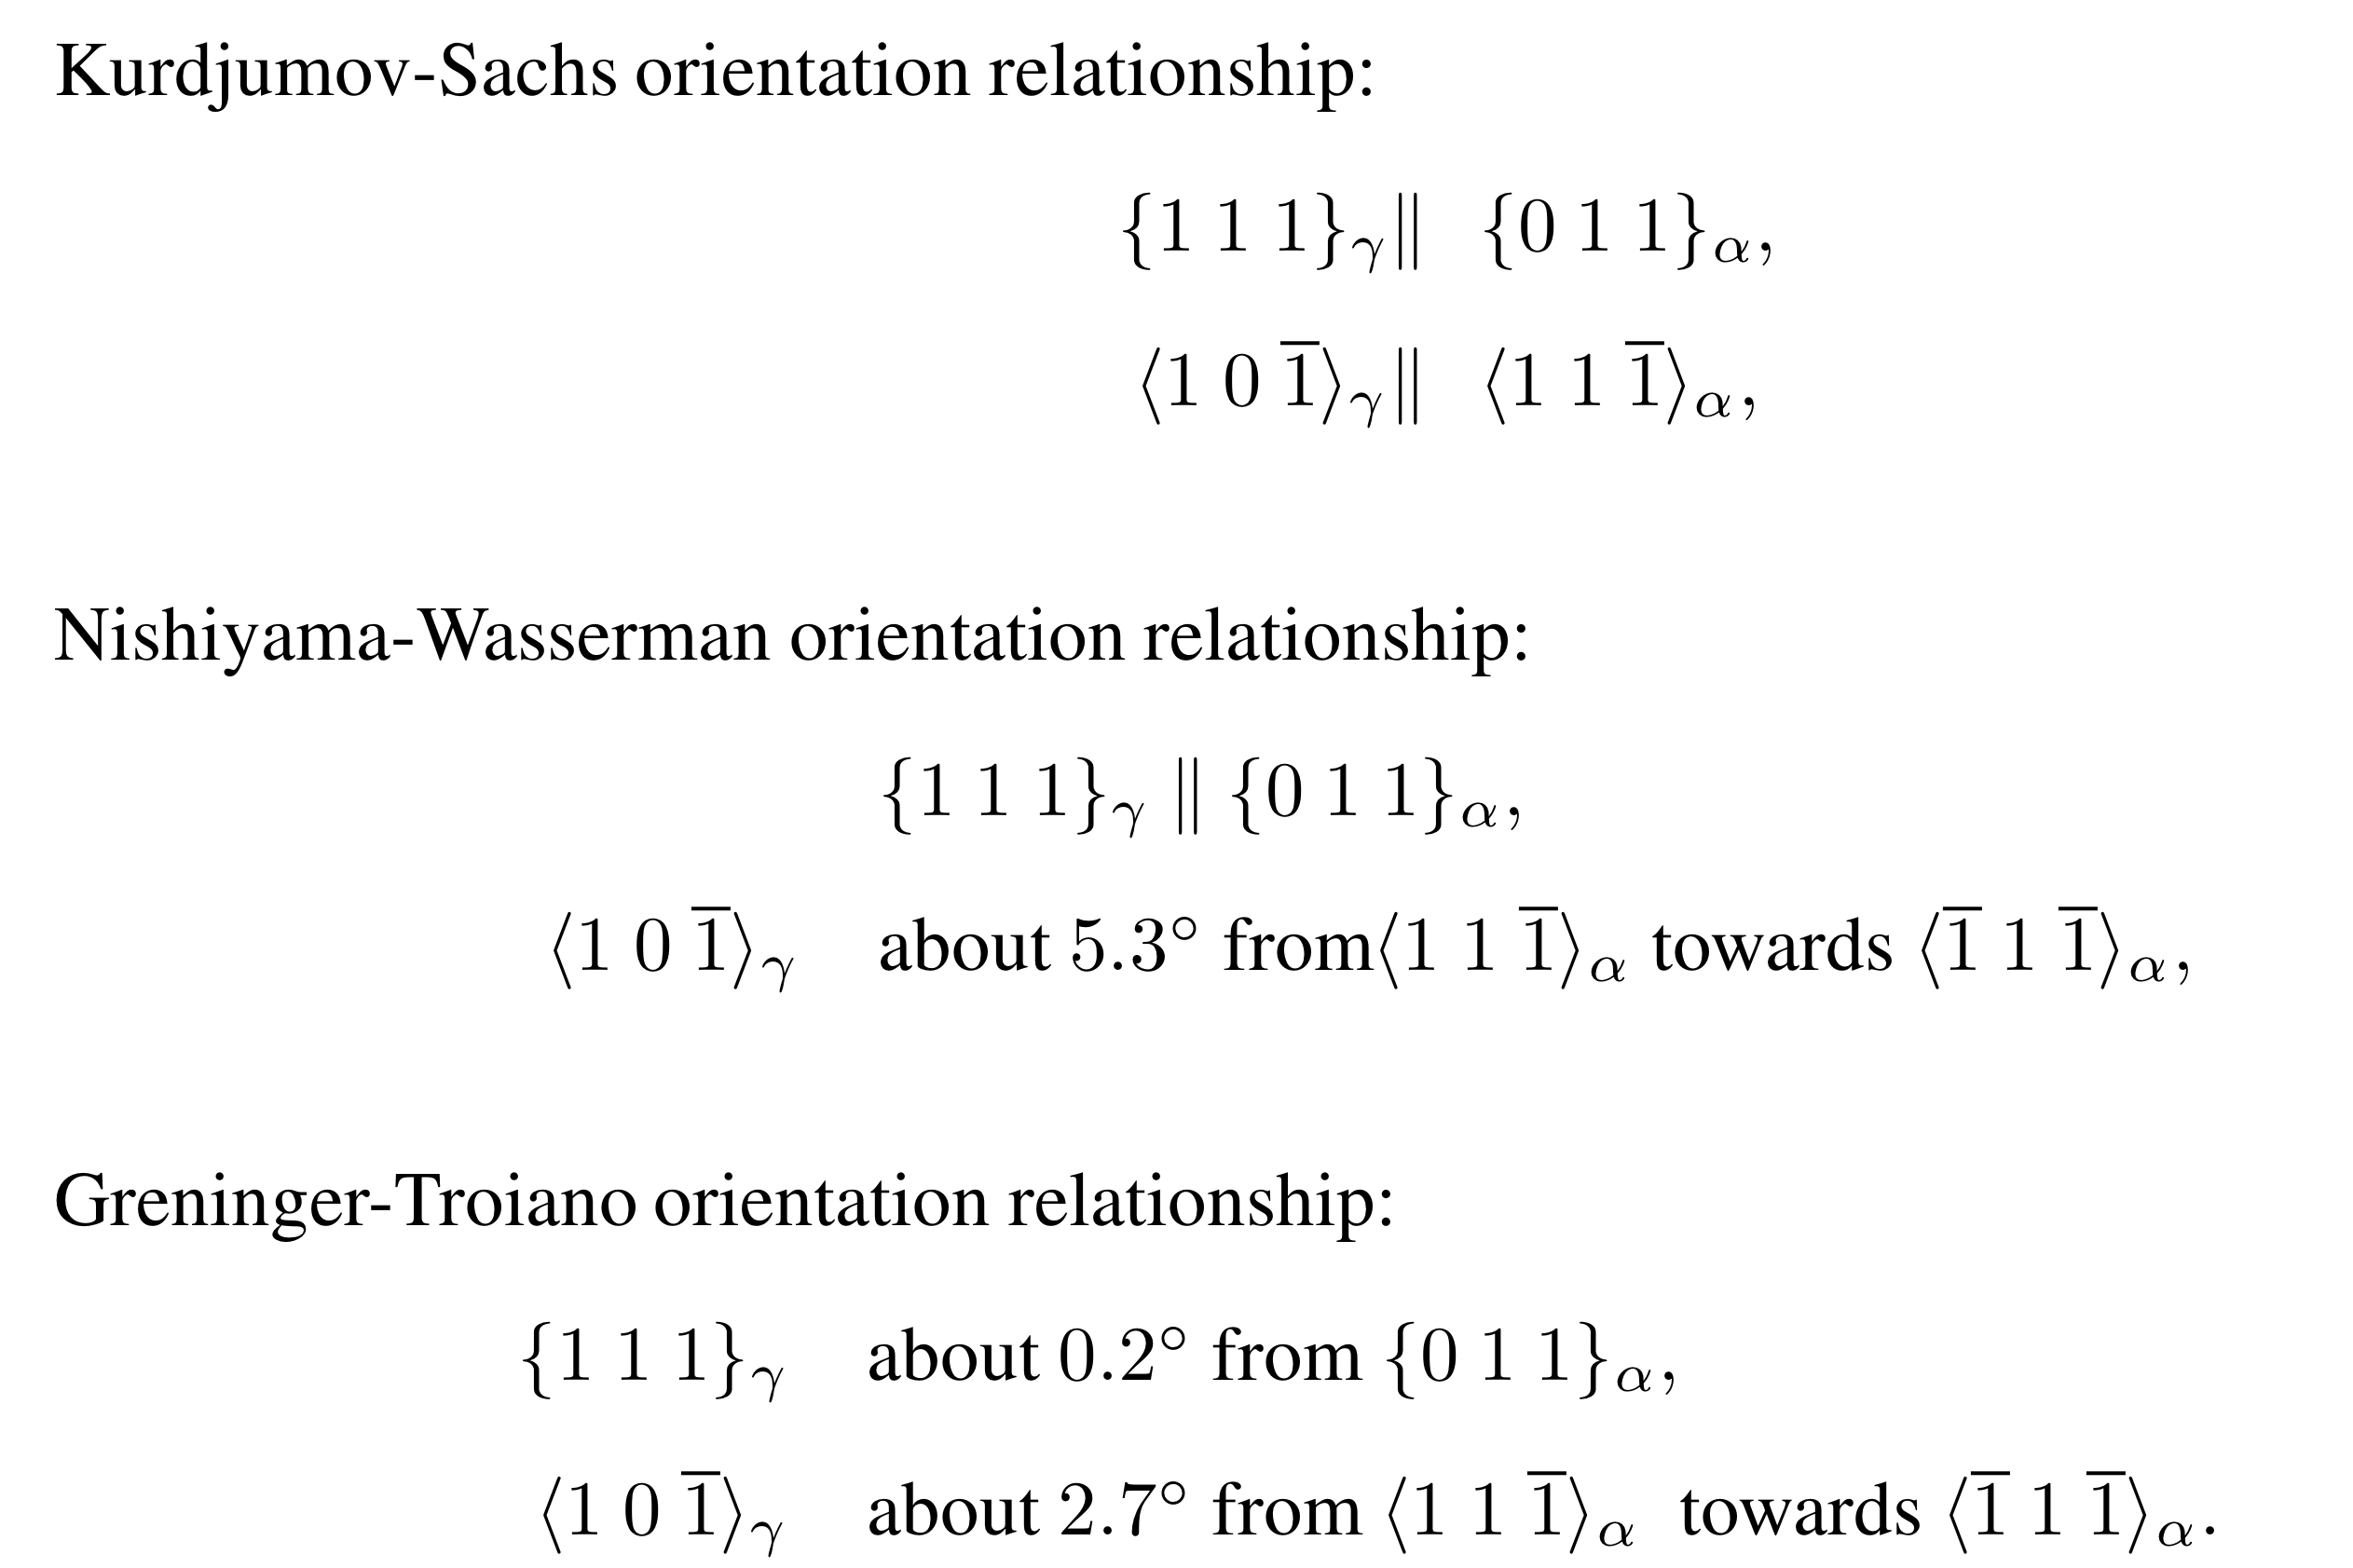
Orientation relationships: irrational

Slide 8
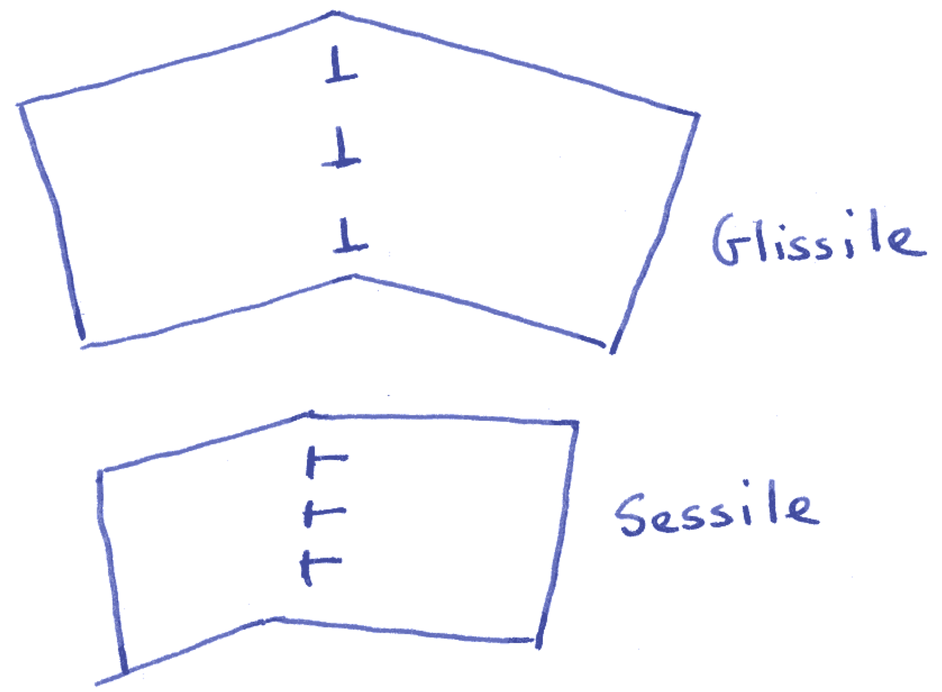

Slide 9
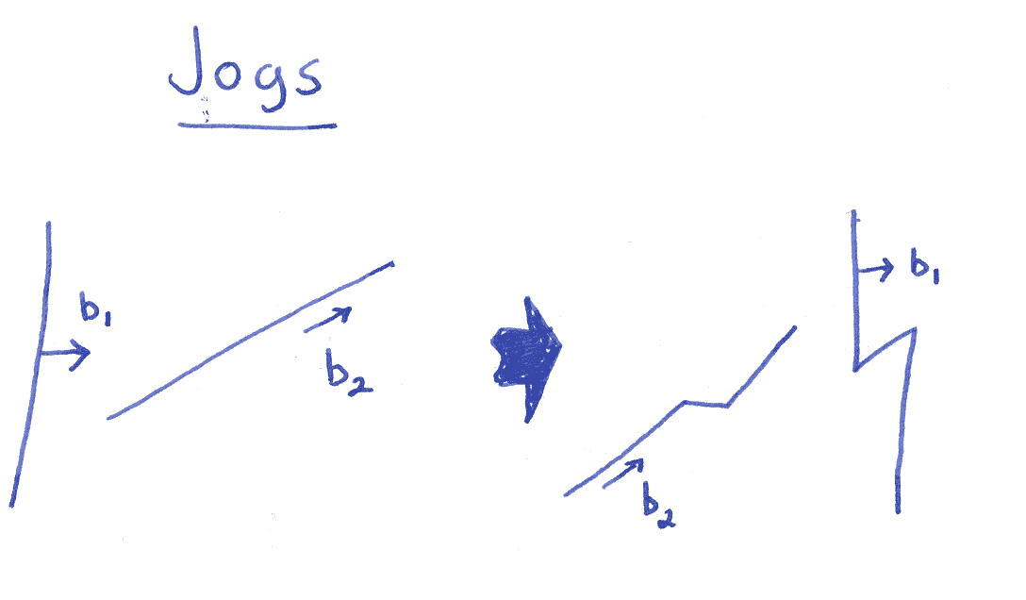

Slide 10
Glissile interface cannot contain more than one set of dislocations.
Martensitic transformation only possible if deformation which changes the parent into the product leaves one line undistorted and unrotated, i.e. an invariant-line.
Deformation is an invariant-line strain.

Slide 11
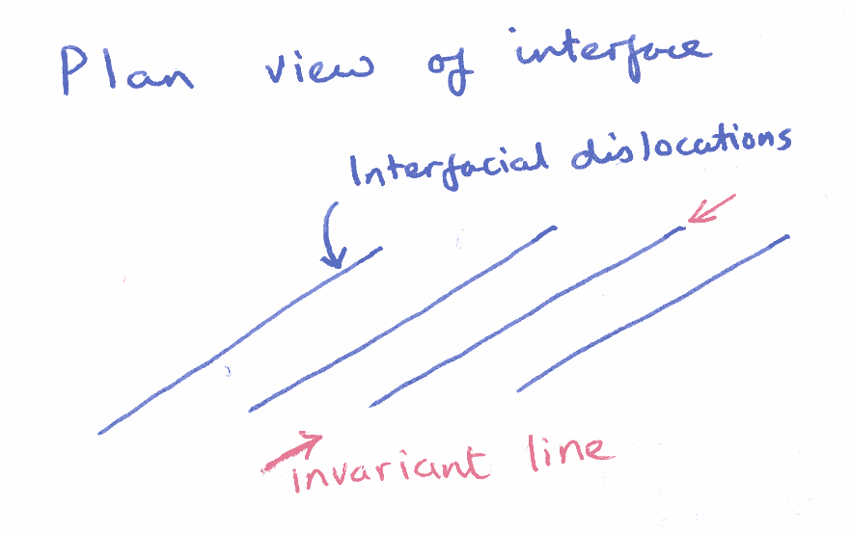

Slide 12
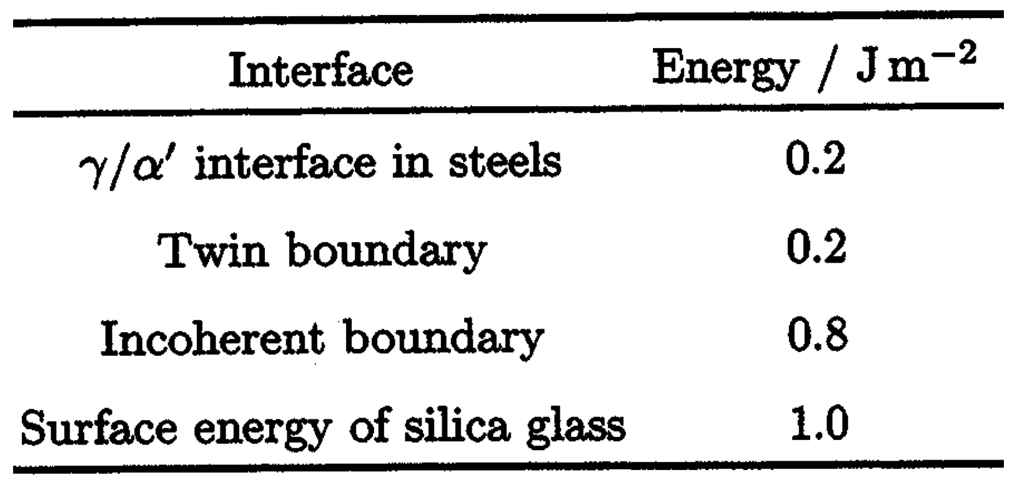

Slide 13
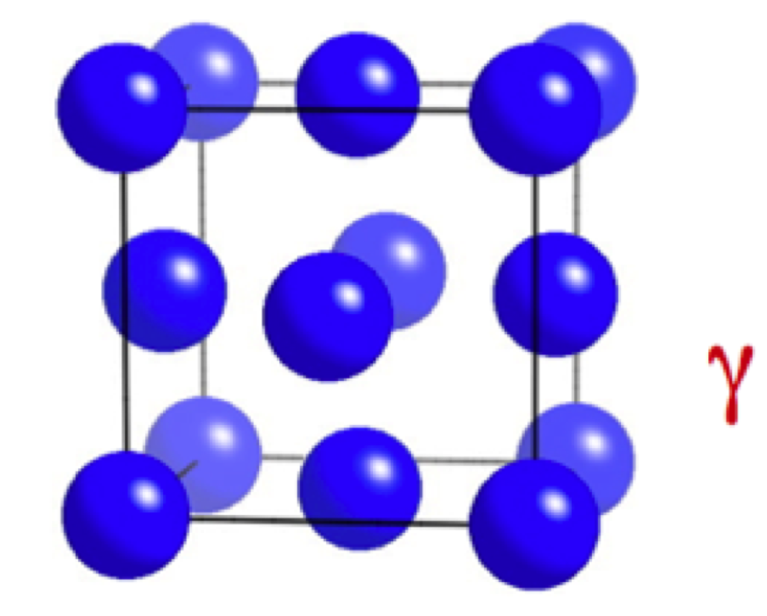
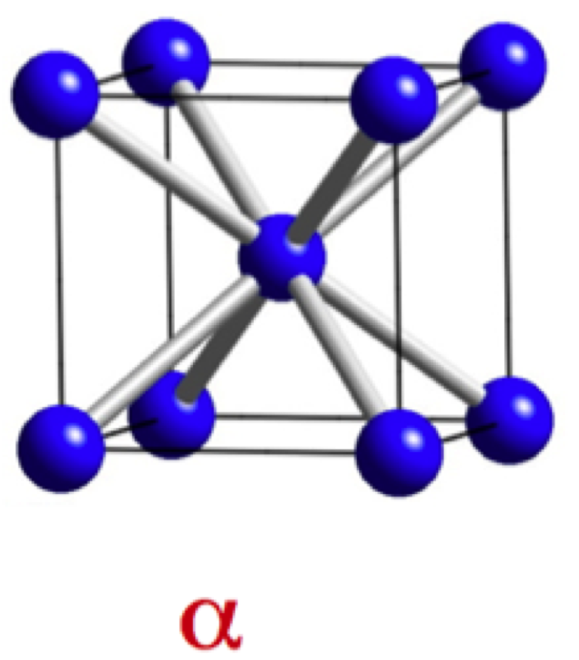

Slide 14
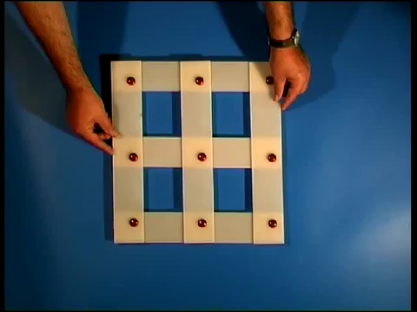

Slide 15
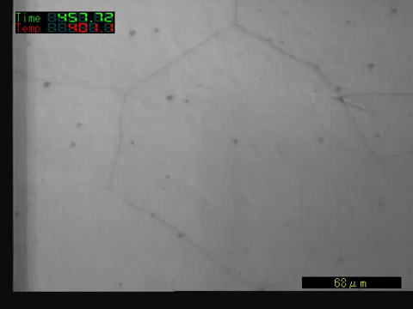

Slide 16
general invariant-plane strain
uniaxial dilatation
simple shear
s
s
δ
δ
1
1
1
s=0.26
δ=0.03

Slide 17
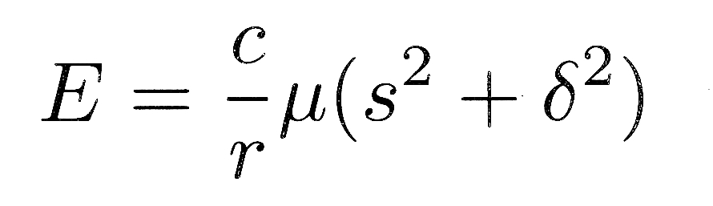
s
δ
c
r
1
Christian, 1957

Slide 18
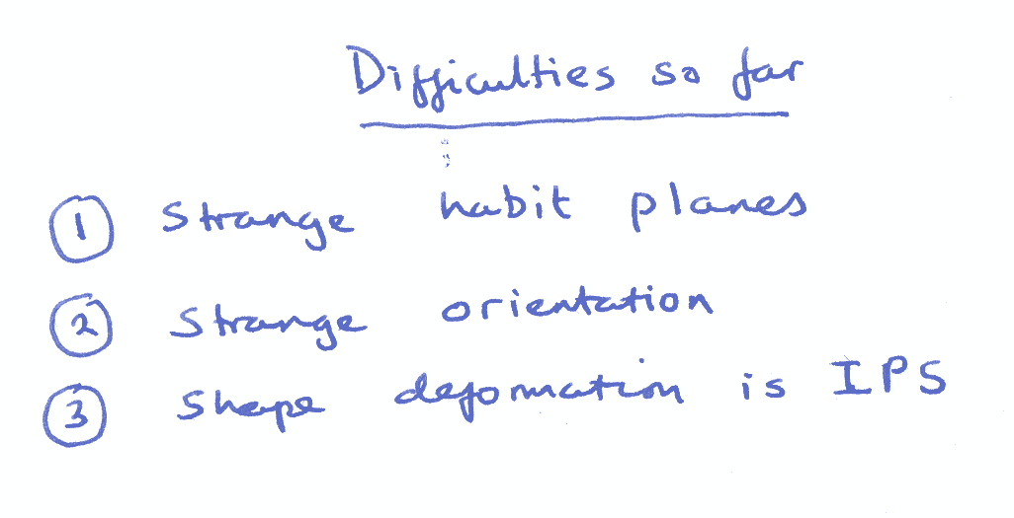

Slide 20
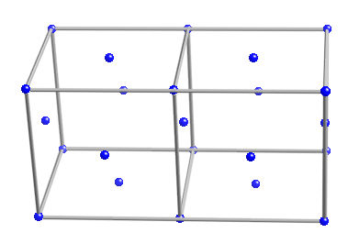
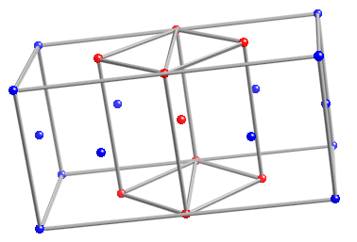
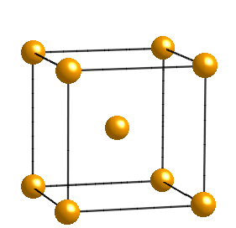

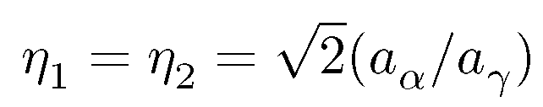
The Bain strain

Slide 21
[001]
b
b'
o
[100]
a'
a
b
(a)
o
b'
(b)
a,a'

Slide 22
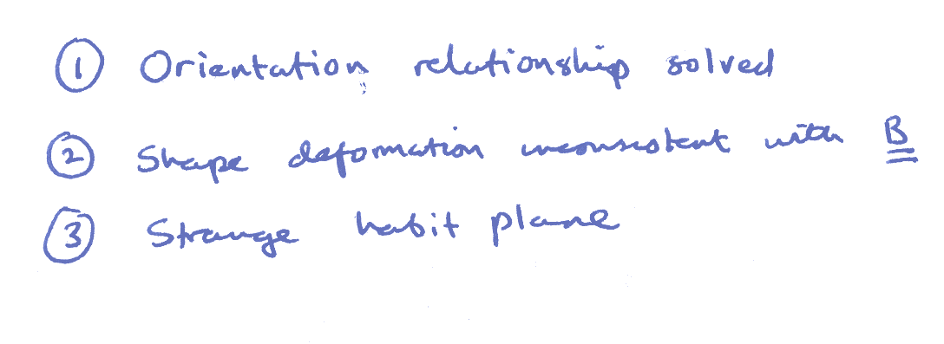

Slide 23
RB
z
w
w
z
w
z
P
Observed
P
Austenite
1
shape,
2
Martensite
wrong
(wrong
y
structure
shape)
x
x
y
x
y
(a)
(b)
(c)
LATTICE
-INVARIANT
DEFORMATION
Twin
w
z
w
z
Boundary
x
y
x
y
Twinned
Slipped
Martensite
Martensite
Correct macroscopic shape, correct structure

Slide 24
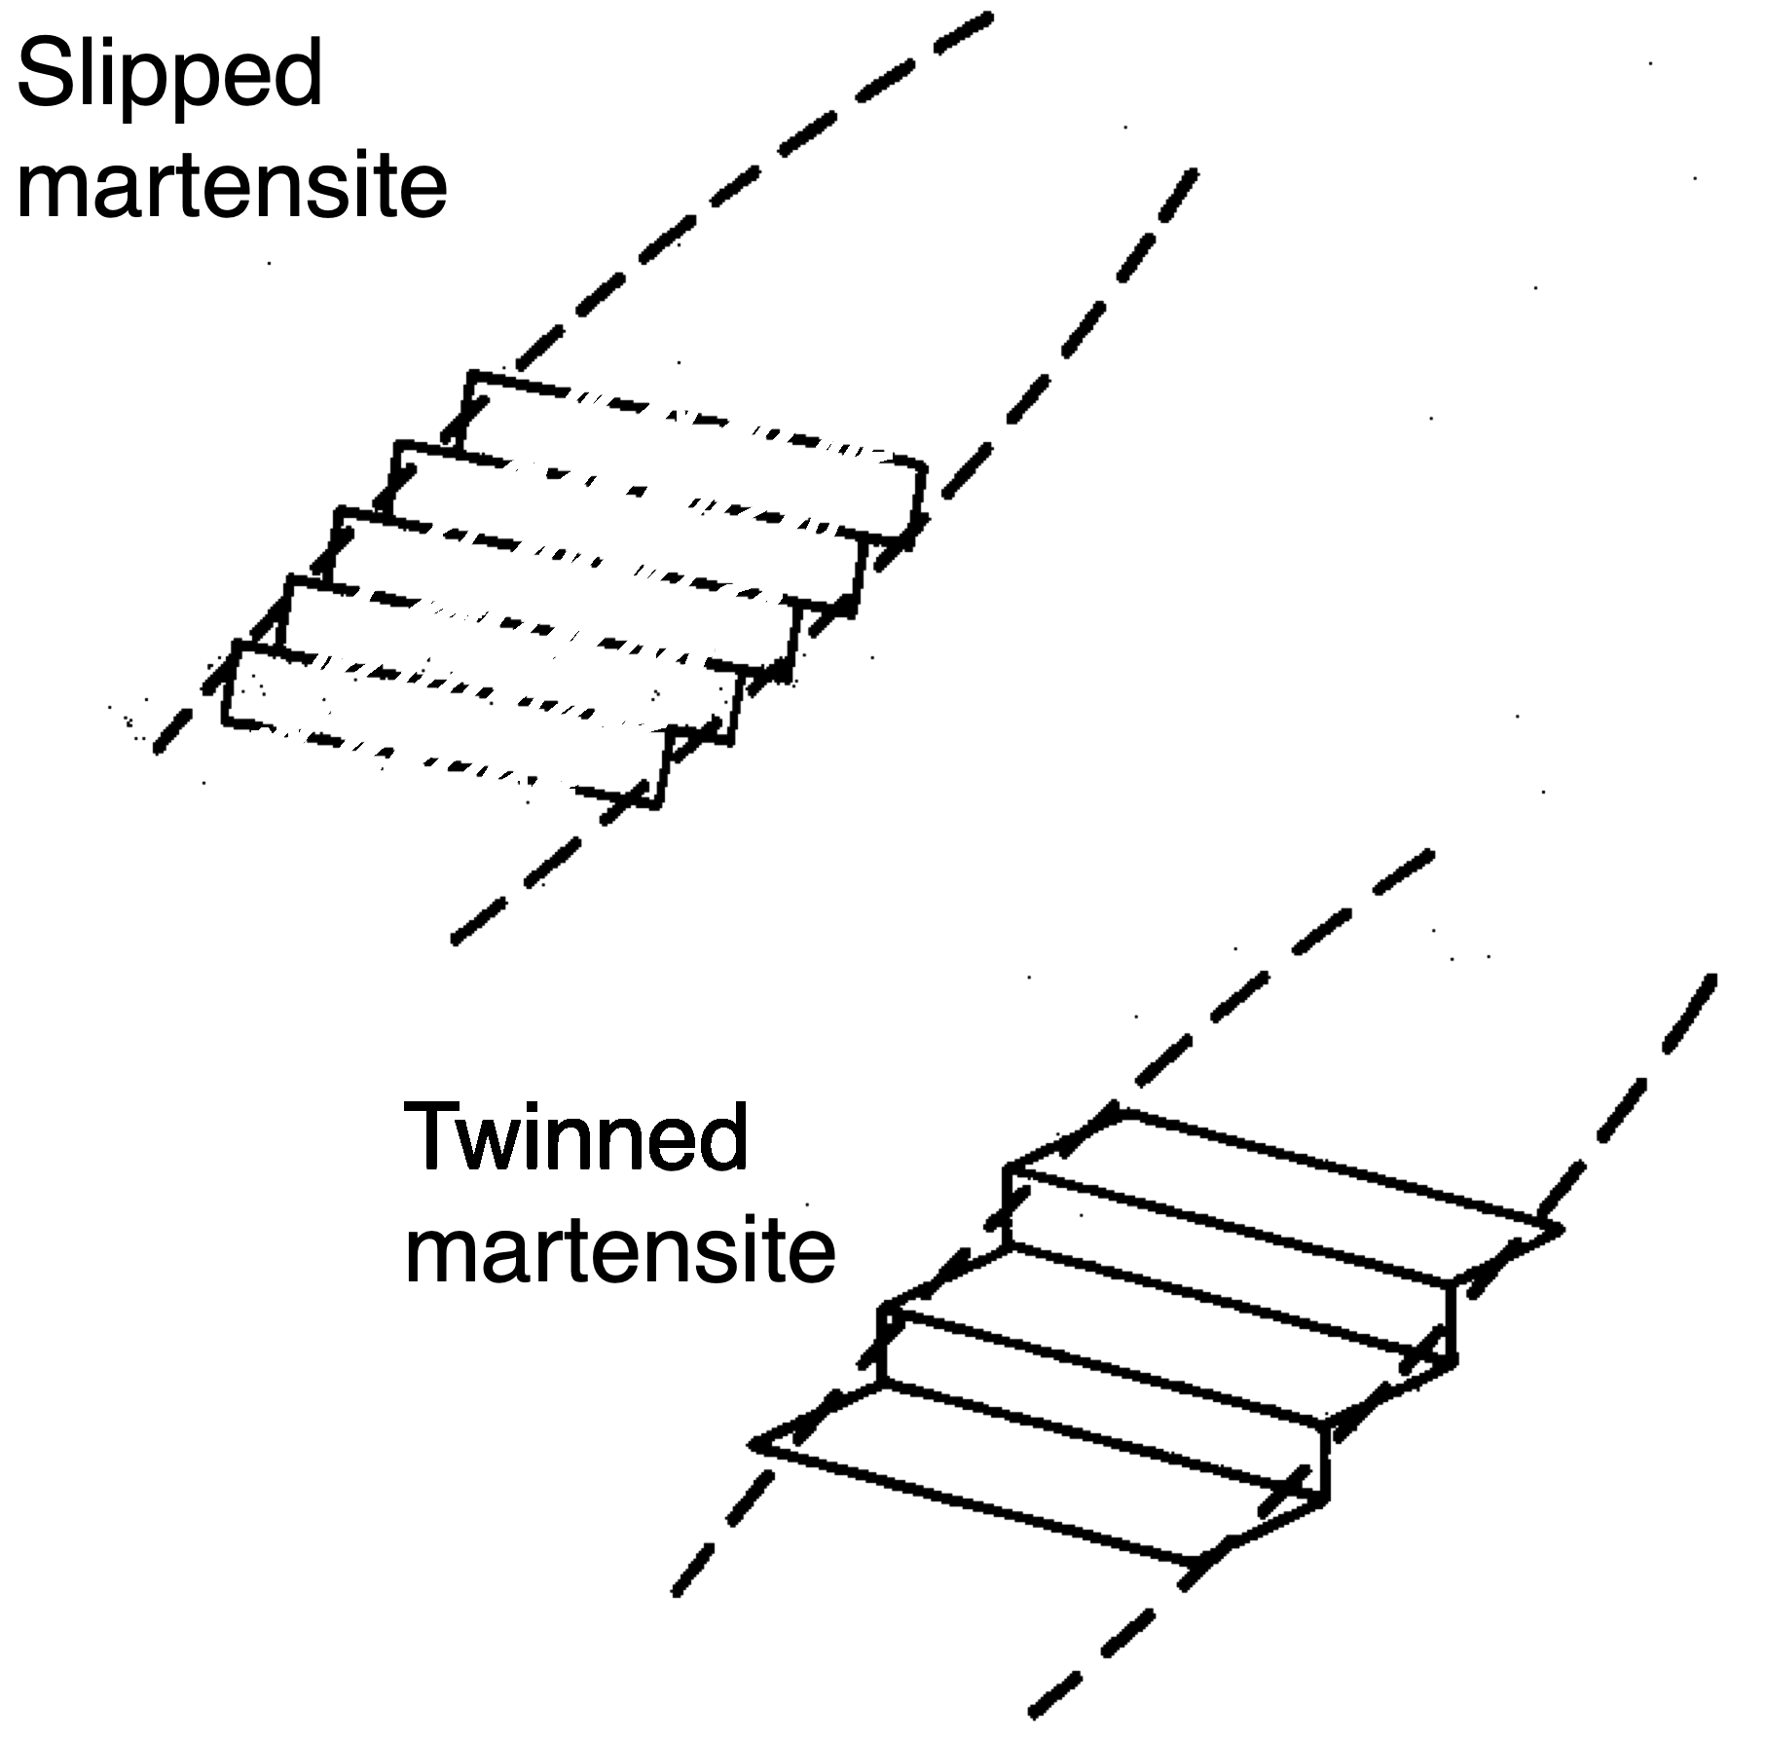

Slide 25
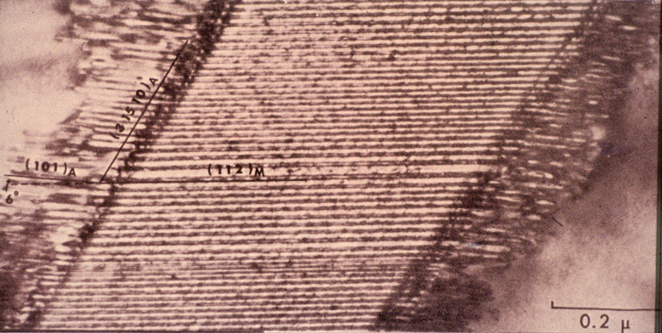
transformation twins (Wayman)

