Slide 1


Hydrogen in complex microstructures in steels
www.msm.cam.ac.uk/phase-trans

Slide 2
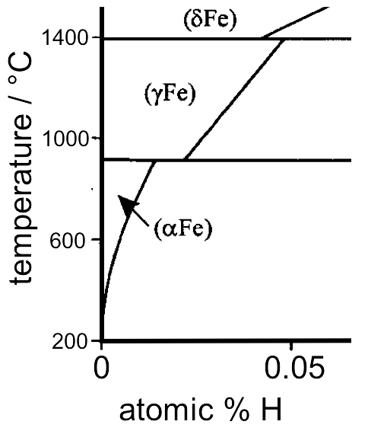
Facts
Hydrogen dissolves in ferrite, austenite
Okamoto:2004

Slide 3
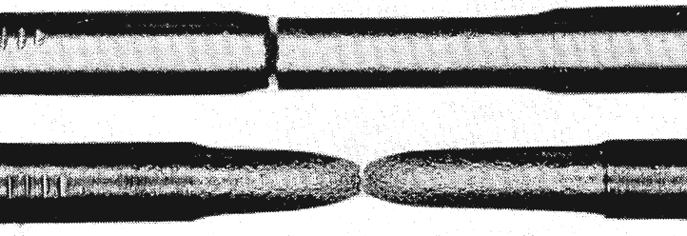
Facts
W. H. Johnson: ‘On some remarkable changes produced in iron and steel by the action of hydrogen and acids’, Proceedings of the Royal Society of London, 1875, 23, 168–179.
normal
pickled
Pfeil 1926
Hydrogen embrittles iron
both single and polycrystalline forms

Slide 4
Facts
W. H. Johnson: ‘On some remarkable changes produced in iron and steel by the action of hydrogen and acids’, Proceedings of the Royal Society of London, 1875, 23, 168–179.
It is diffusible hydrogen that embrittles
it is atomic hydrogen that embrittles
submerging H-containing steel causes frothing
stronger steel more susceptible

Slide 5
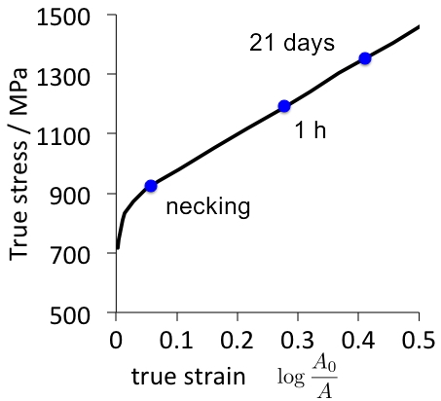
Facts
Hobson, 1951

Slide 6
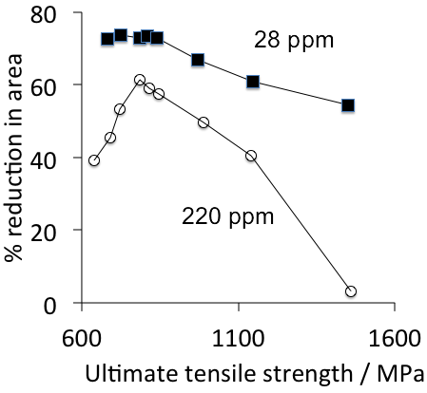
Facts
Hobson & Sykes, 1951
Tendency to embrittle scales with strength
or does it in fact scale with ductility in the absence of hydrogen?

Slide 7
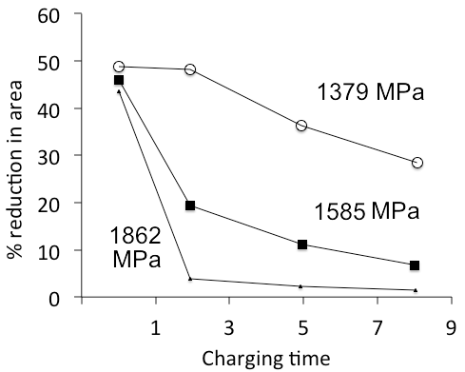
Facts
Frohmberg, 1954

Slide 8
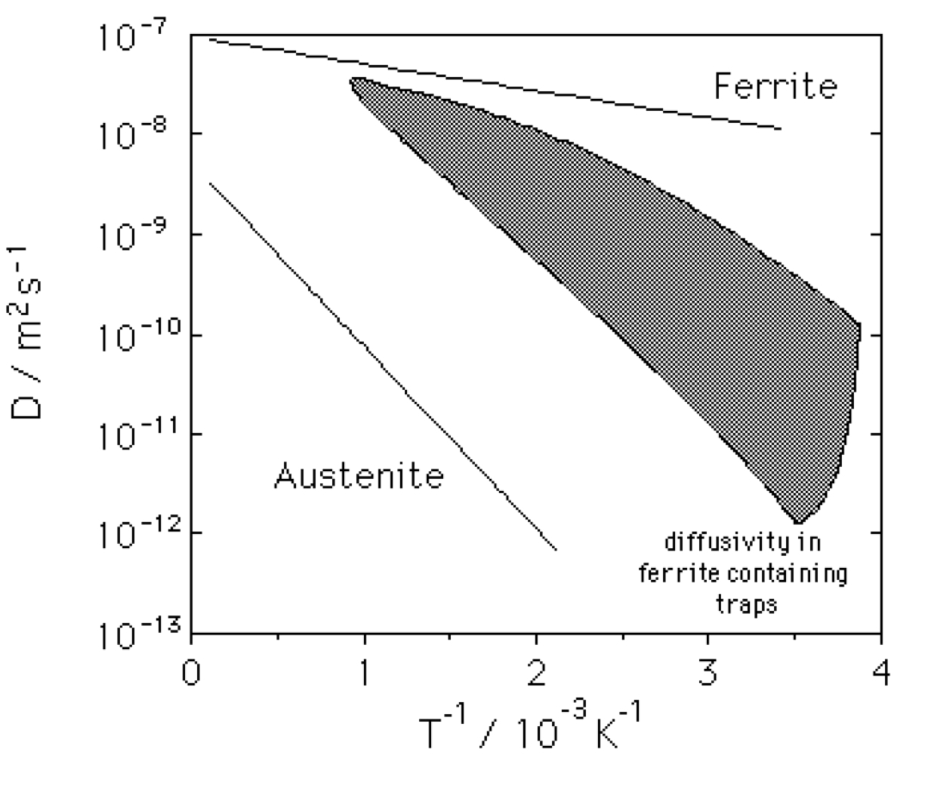
Facts
Coe, 1973
hydrogen diffuses faster in ferrite, but there are complications

Slide 9
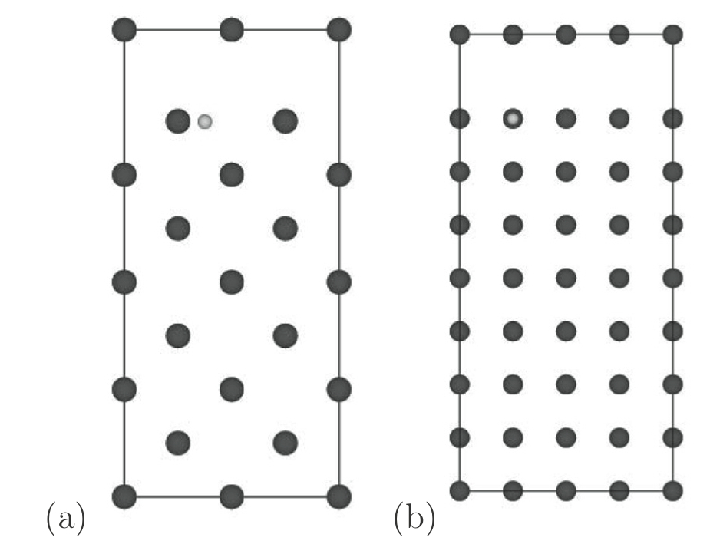
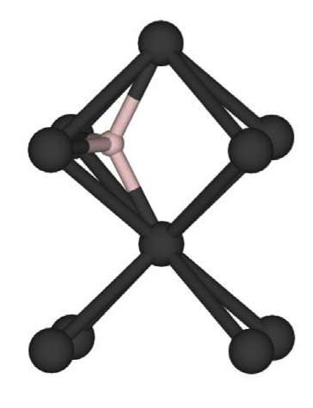
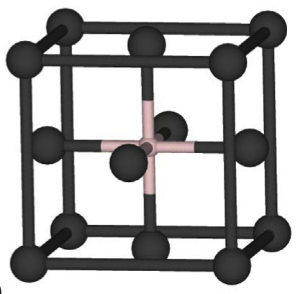
Mechanisms
Reduction in surface energy of iron, making it easier to cleave (Oriani, 1960)
Song, Bhadeshia, Suh 2013

Slide 10
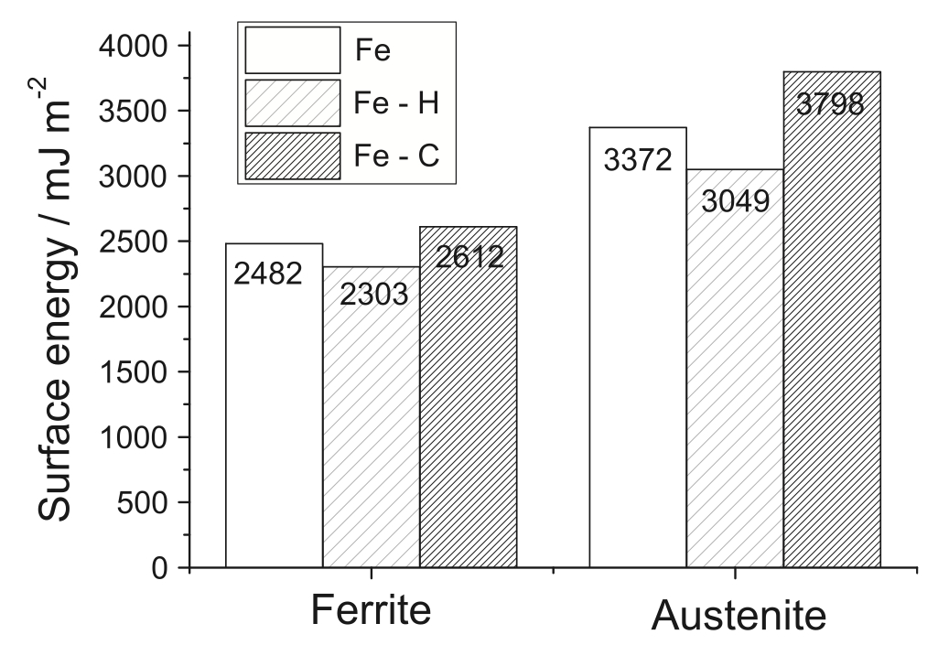
Song, Bhadeshia, Suh 2013

Slide 11
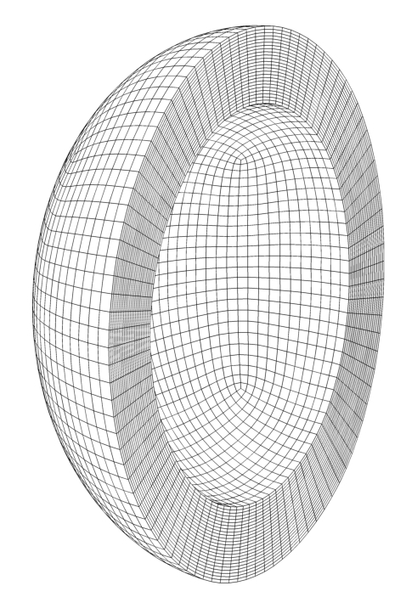
Mechanisms
Accumulation of internal stress due to diffusible hydrogen precipitating at defects (Zapffe, 1941)

Slide 12
Mechanisms
Hydrogen enhanced plastic instability
increased dislocation mobility due to H segregation
microscopically ductile fracture
requires a heterogeneous distribution of hydrogen

Slide 13
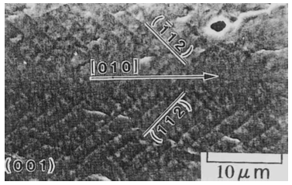
Mechanisms
Hydrogen enhances vacancy concentrations
vacancies agglomerate
enhances ductile nucleation and linking of cracks
Terasaki et al. 1998

Slide 14
Facts: summary
All evidence points to easily diffusible or
weakly trapped hydrogen embrittles
Trapped molecular hydrogen irrelevant
Strongly trapped hydrogen irrelevant

Slide 15
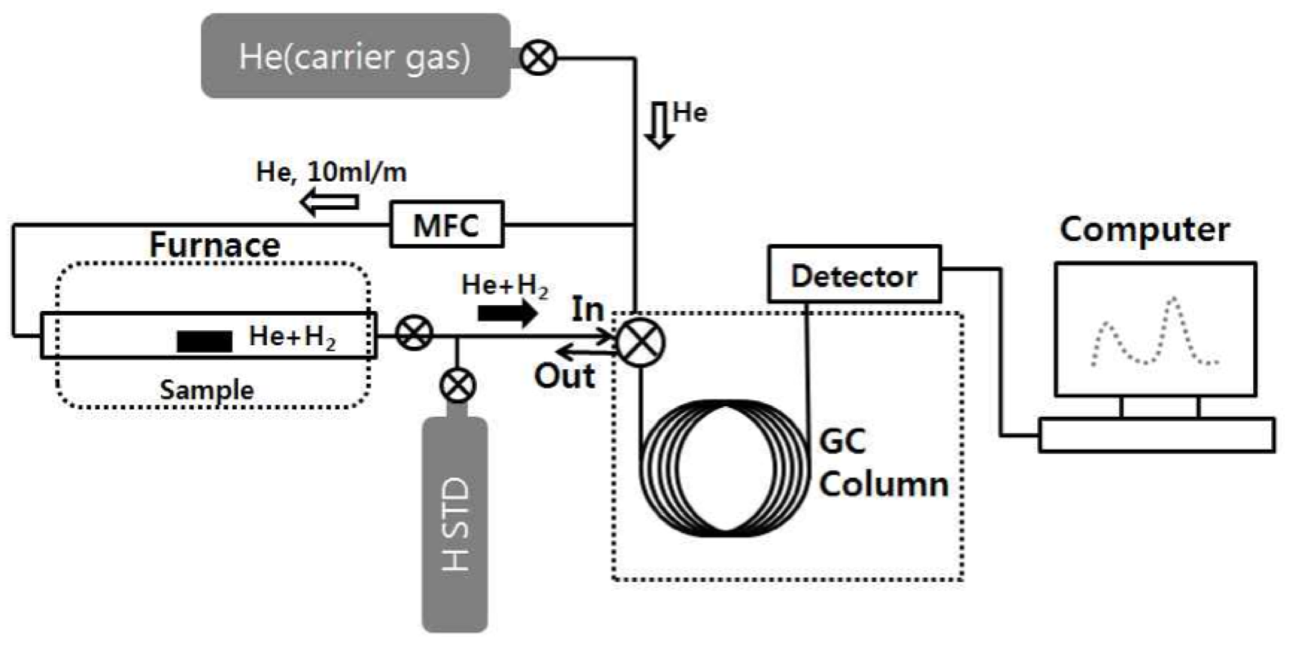

Slide 16
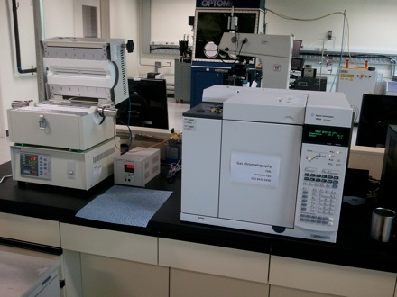

Slide 17
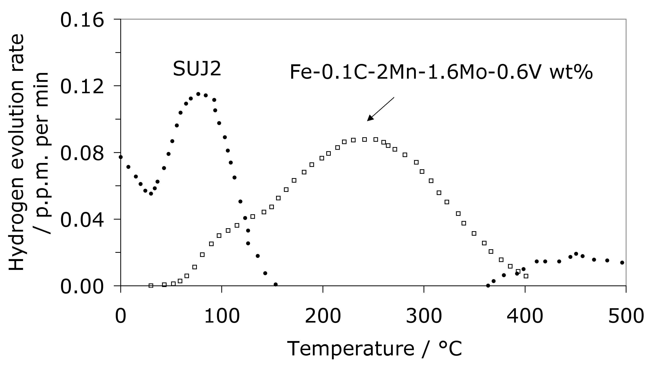
Hydrogen

Slide 18
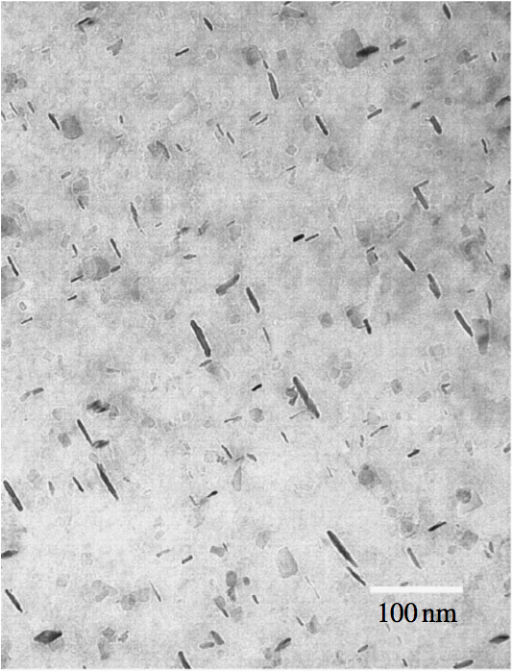
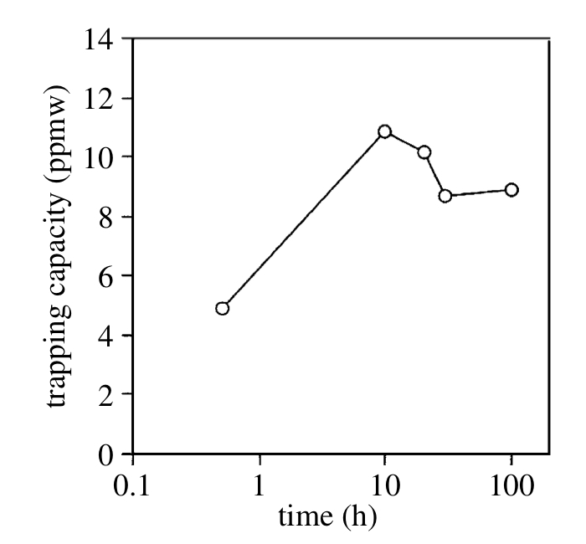
Yamasaki and Bhadeshia, 2006

Slide 19
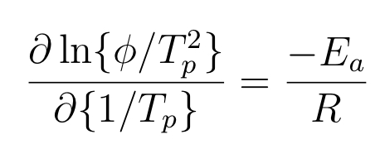
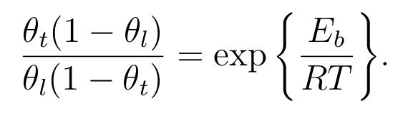

Slide 20
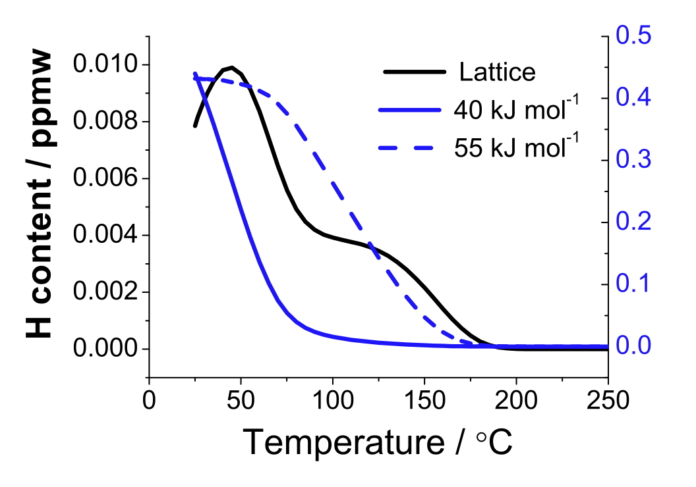
Song, Bhadeshia, Suh, 2013

Slide 21
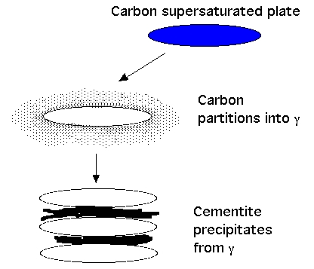
Composition following transformation

Slide 22
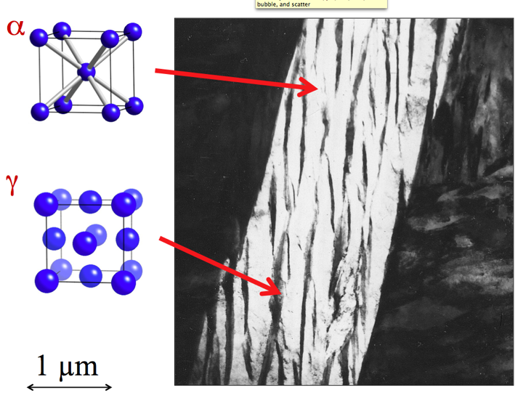

Slide 23
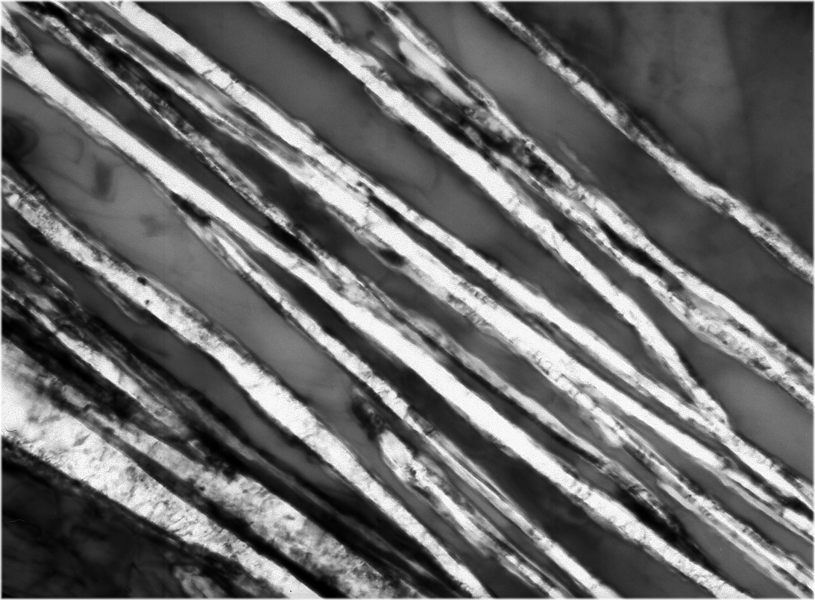
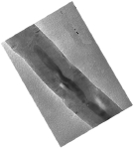
γ
γ
α
α
α
Caballero, Mateo, Bhadeshia
200 Å

Slide 24
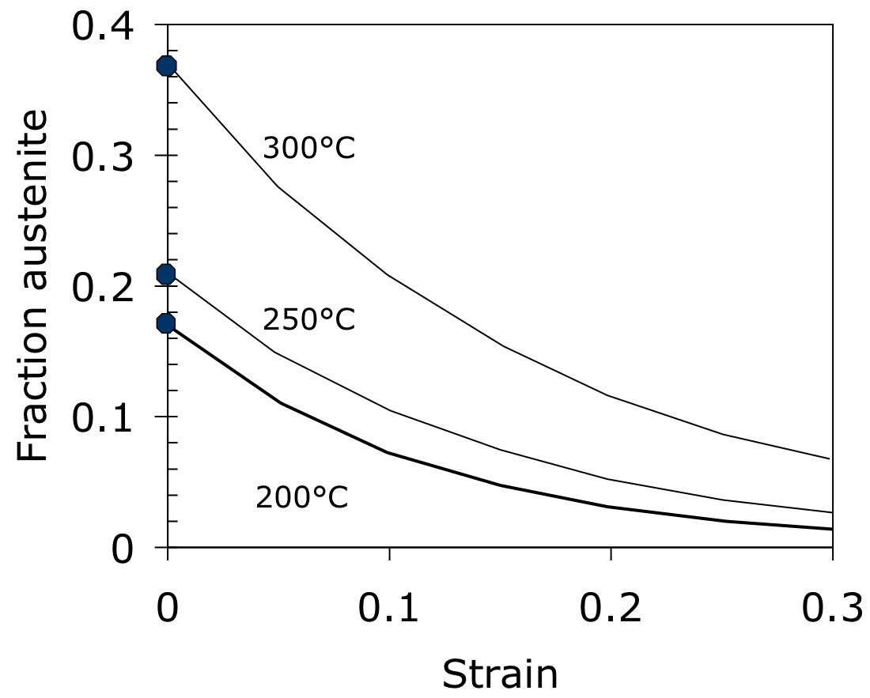

Slide 25
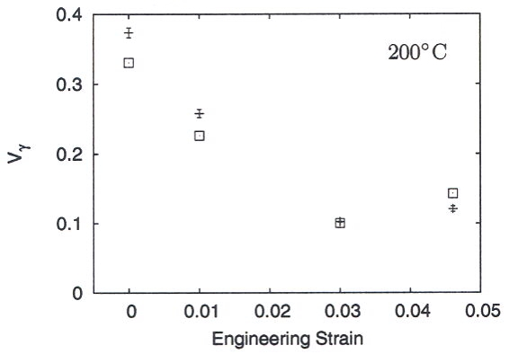
Sherif, 2005, Ph.D. thesis, Cambridge

Slide 26
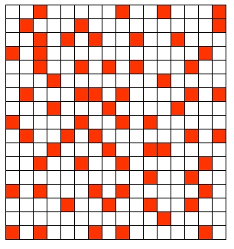
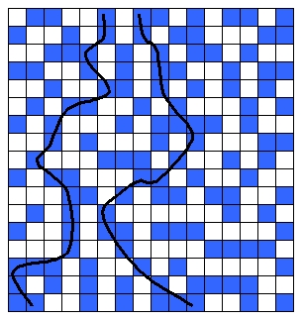
Above percolation threshold
Below percolation threshold

Slide 27
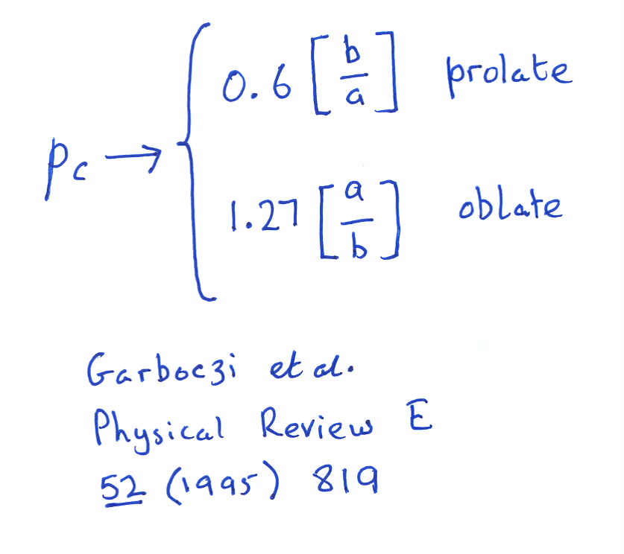
Geometrical percolation threshold of overlapping ellipsoids

Slide 28
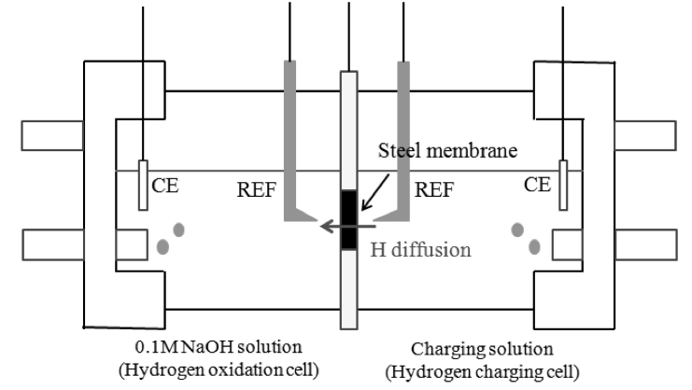

Slide 29
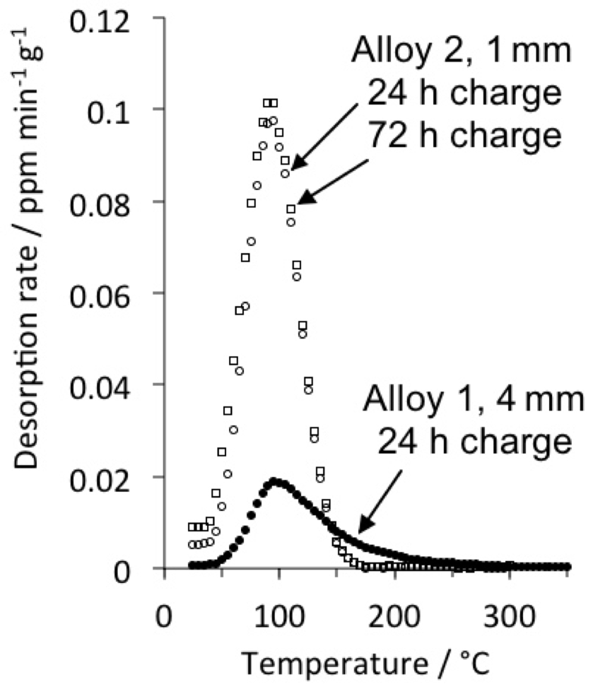
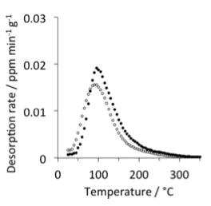
Fielding, Song, Han, Bhadeshia, Suh, unpublished

Slide 30
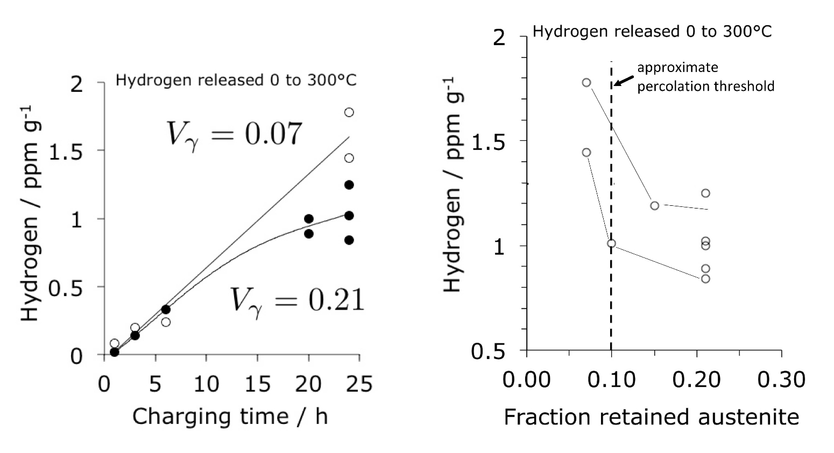
Fielding, Song, Bhadeshia, Suh, unpublished

Slide 31
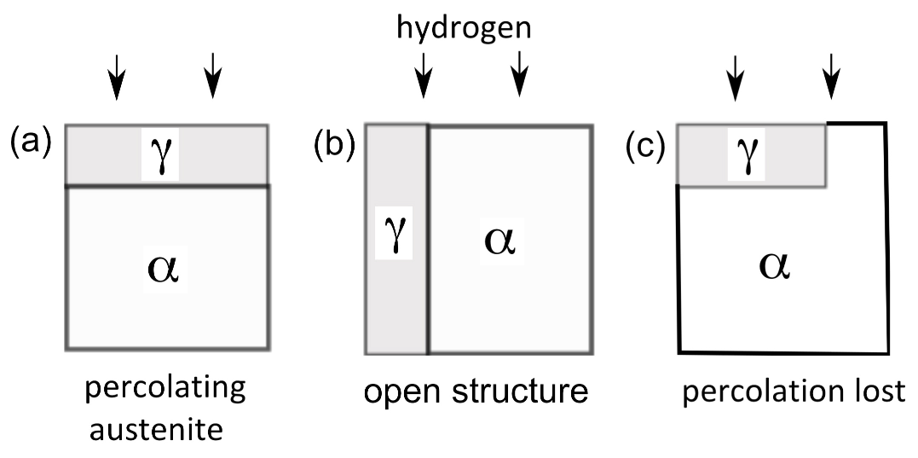
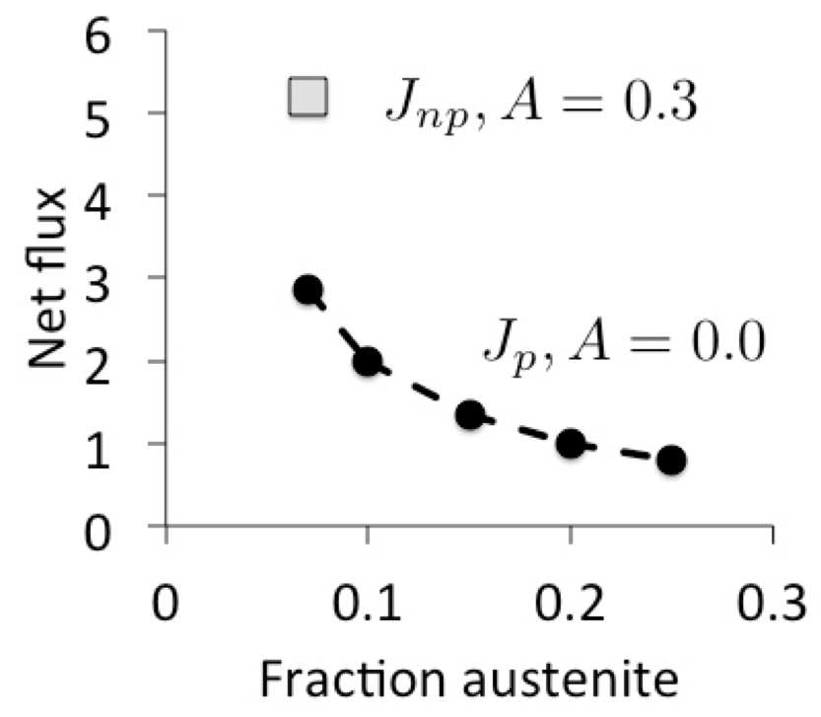

Slide 32
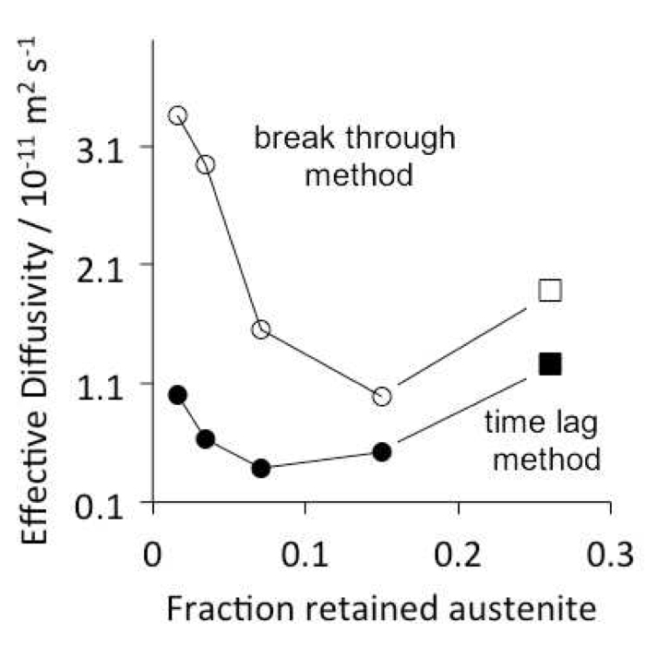
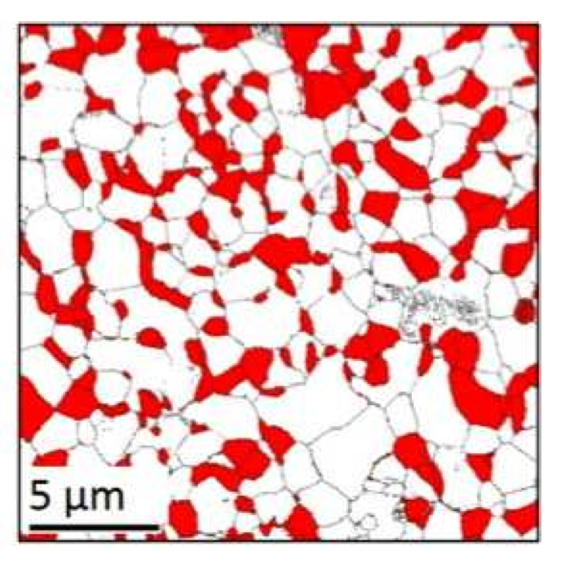

Slide 33
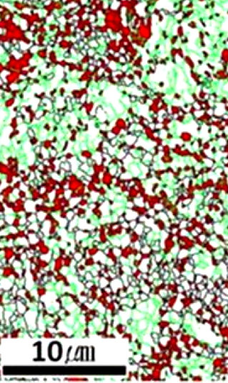
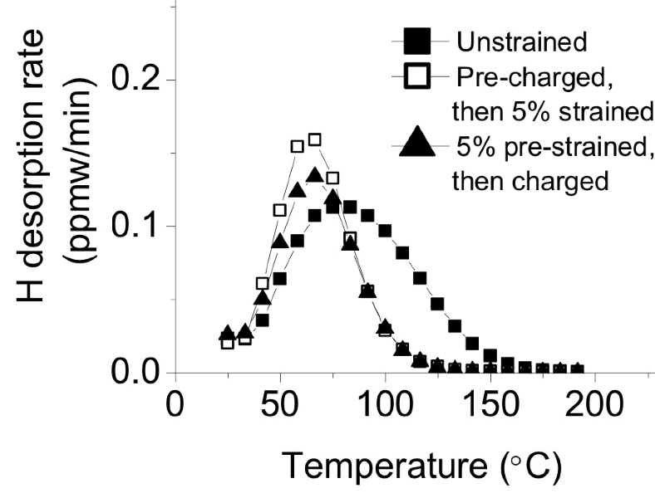
Ryu, Chun, Lee, Bhadeshia, Suh, 2012

Slide 34
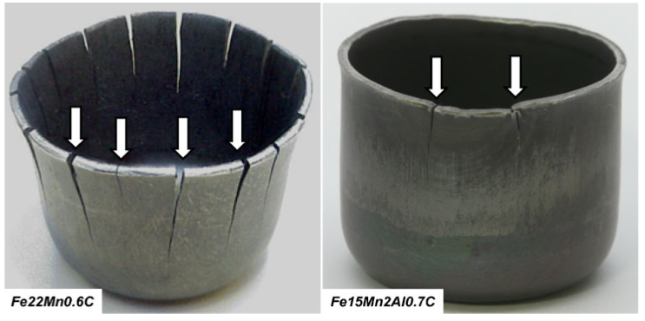
Hydrogen embrittlement of austenite
B. C. De Cooman, O. Kwon and K.-G. Chin,
Materials Science & Technology, 2012

Slide 35
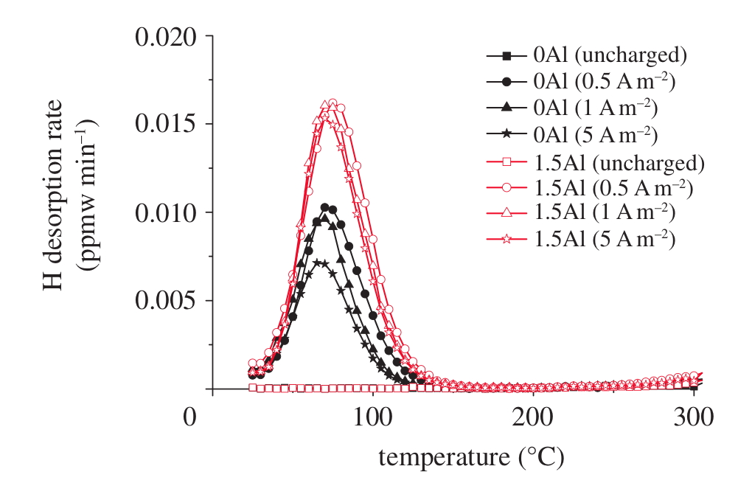
Hydrogen embrittlement of austenite

Slide 36
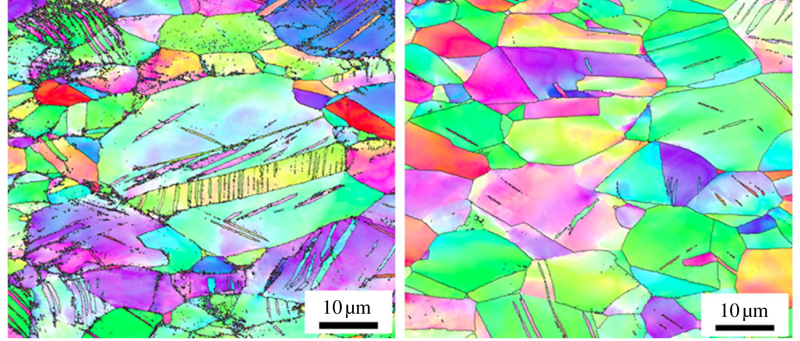
Hydrogen embrittlement of austenite
Fe-0.6C-18Mn wt% Fe-0.6C-18Mn-1.5Al
Ryu, Kim, Lee, Suh, Bhadeshia, 2012

Slide 37
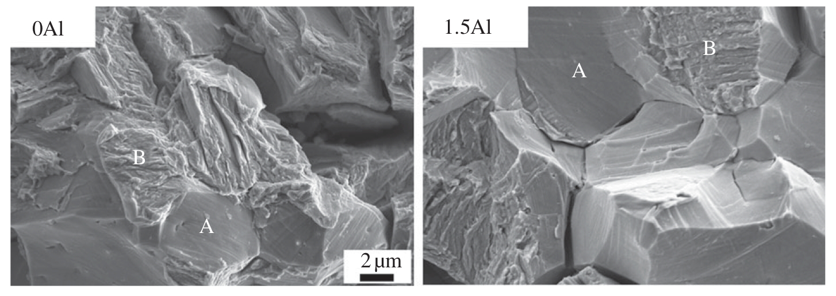
Hydrogen embrittlement of austenite
Combination of inter- and trans-granular fracture
Ryu, Kim, Lee, Suh, Bhadeshia, 2012

Slide 38
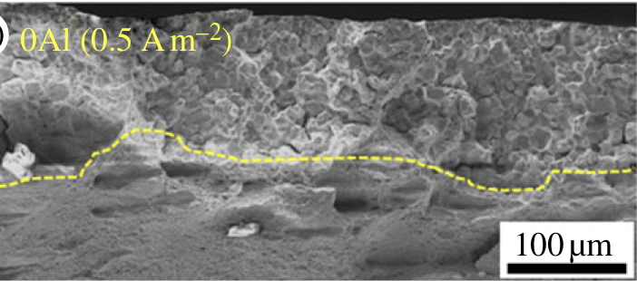
Hydrogen embrittlement of austenite
Ryu, Kim, Lee, Suh, Bhadeshia, 2012

Slide 39
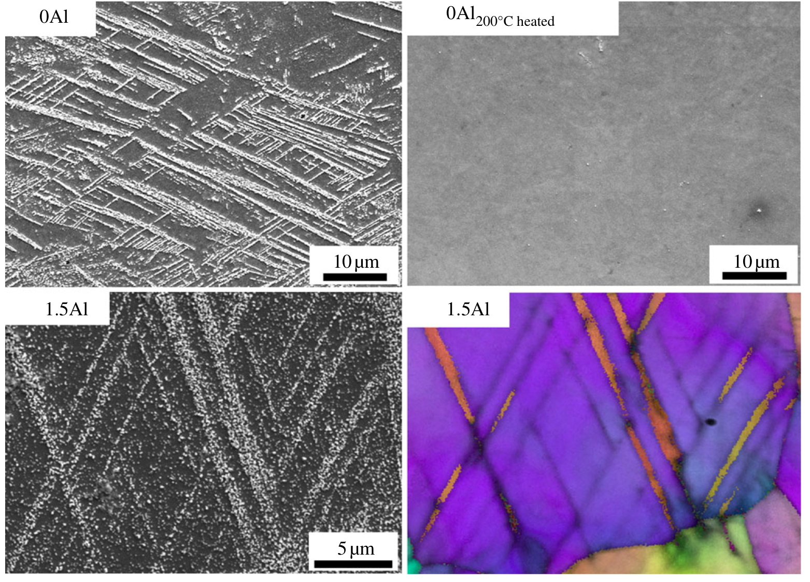
Hydrogen embrittlement of austenite

Slide 40
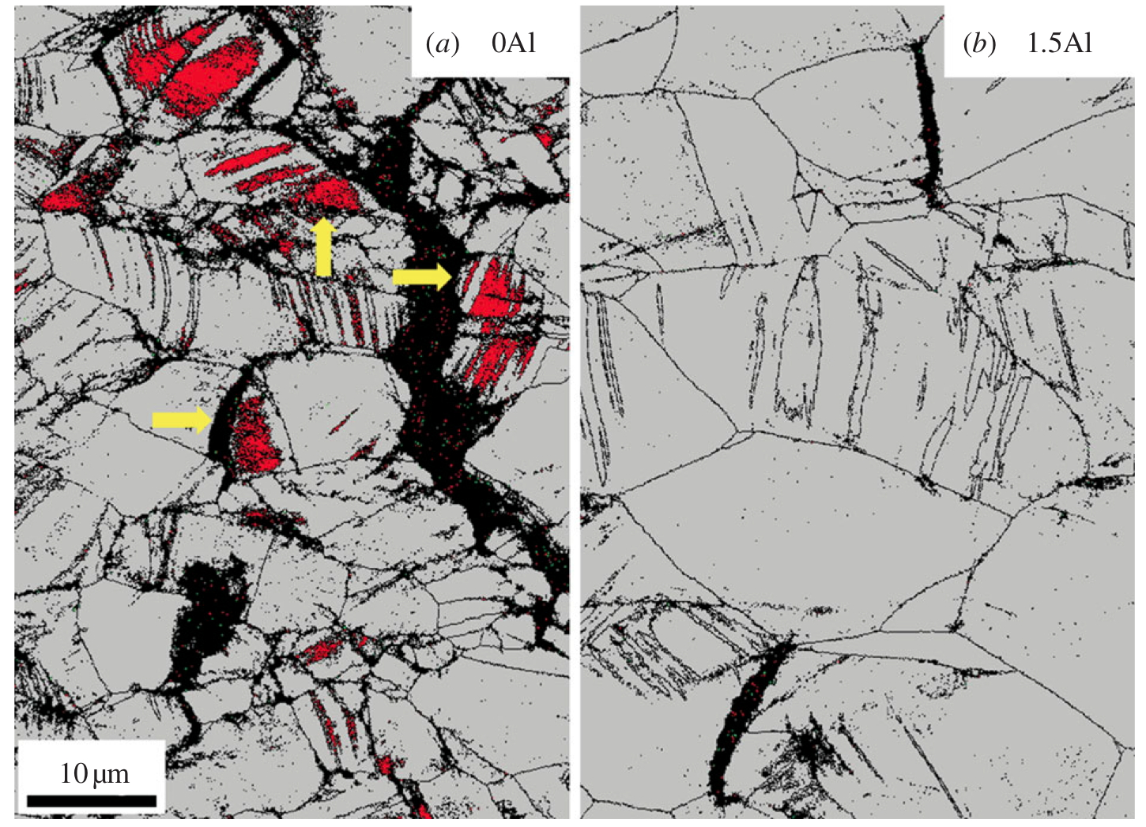

Slide 41
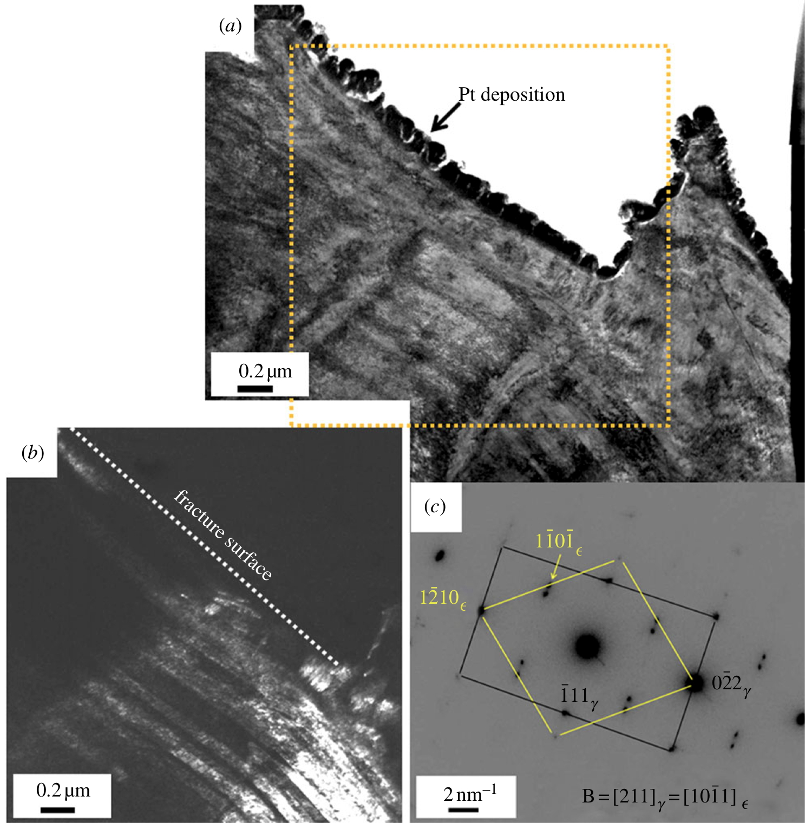

Slide 42
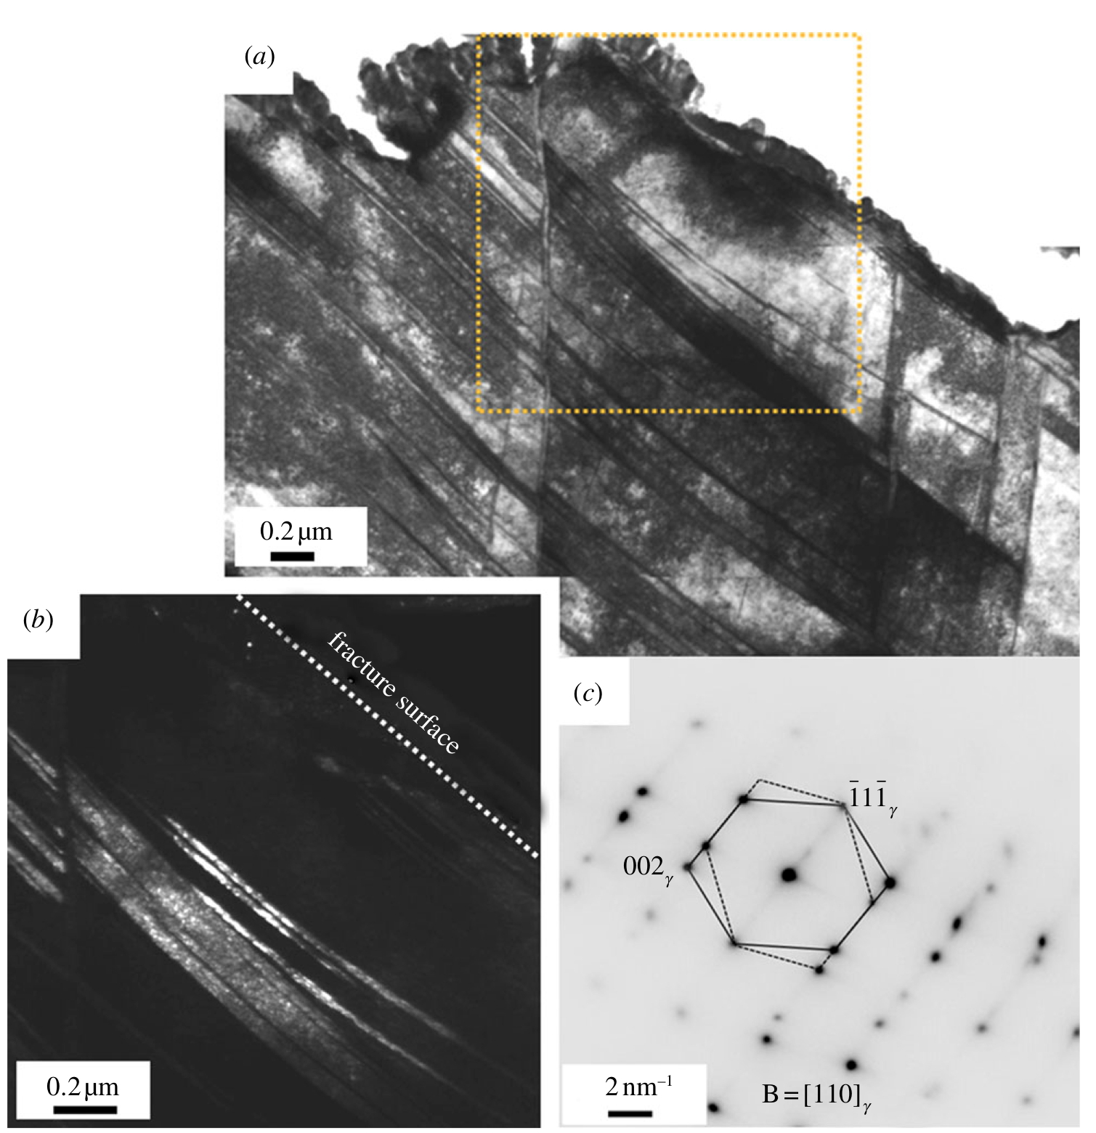

Slide 43

Methods for mitigating consequences of hydrogen
Ferritic
Provide traps for infused hydrogen
Retard the infusion of hydrogen
Austenitic
Control stacking fault energy
Control phase transformations
Must not compromise other properties

Slide 44
Open questions:
How much hydrogen will enter steel over service life?
Any long-term ex-service samples that we can test for hydrogen content?
Can void formation at stress concentrations be observed directly using “large facilities”?
How can we suppress enhanced vacancy generation due to H?

