Slide 1


Very short and very long heat treatments in the processing of steels
www.msm.cam.ac.uk/phase-trans

Slide 2
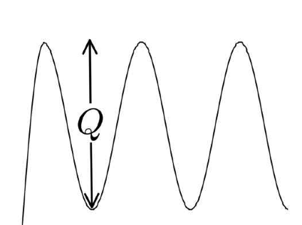
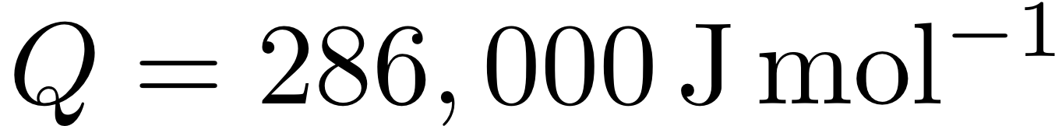
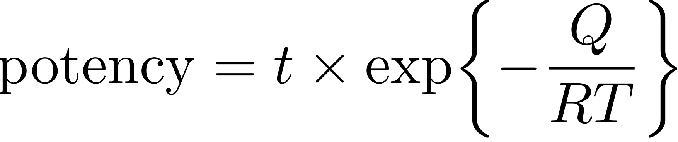
purpose of heat treatment is to move atoms

Slide 3
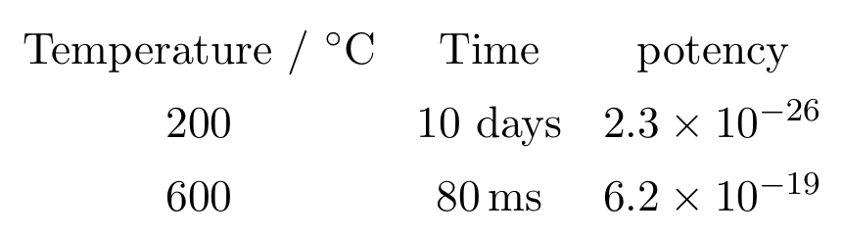

Slide 4
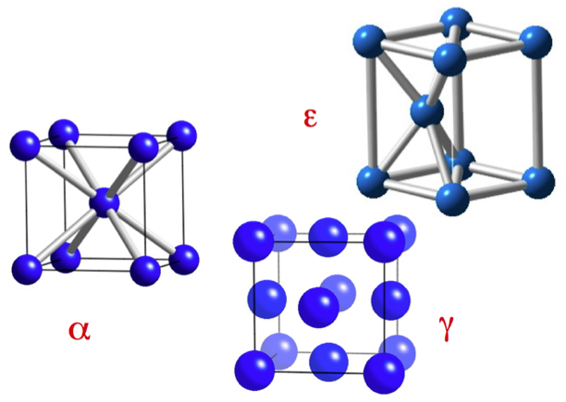

Slide 5
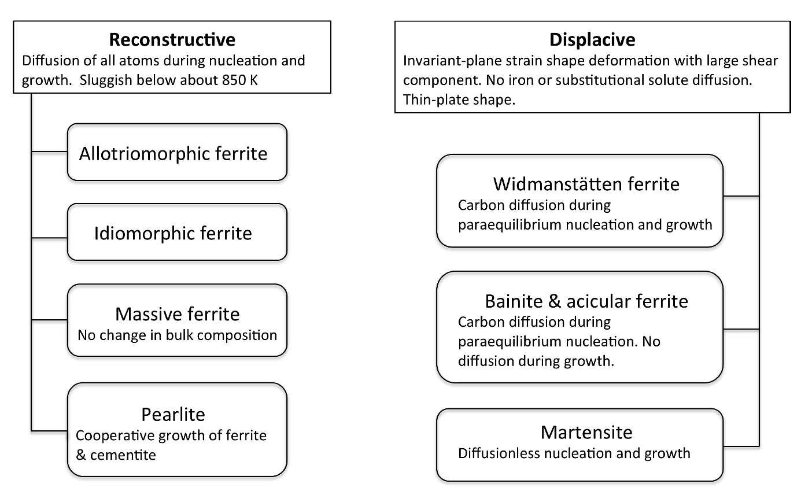

Slide 6
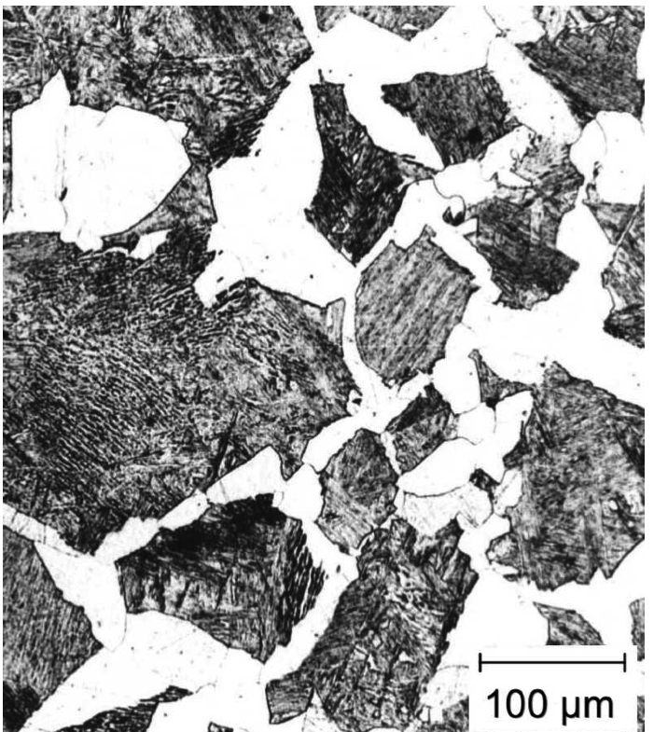
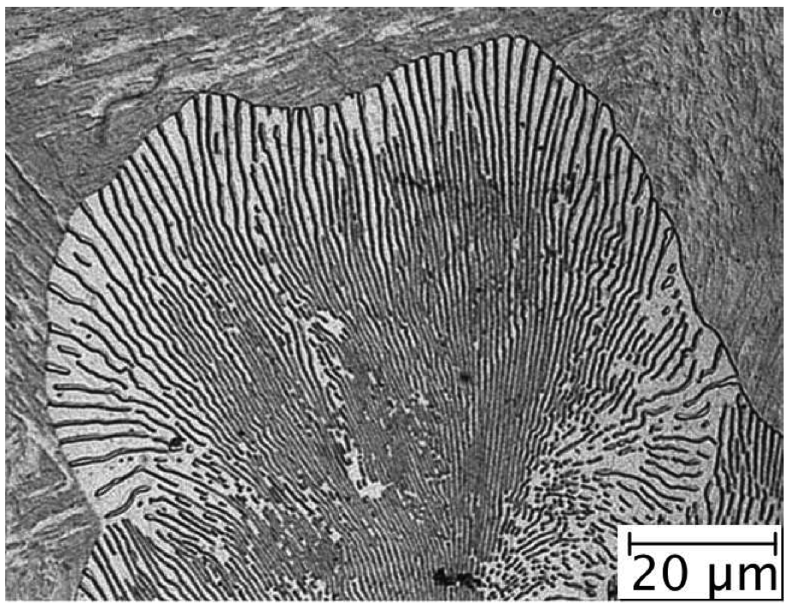
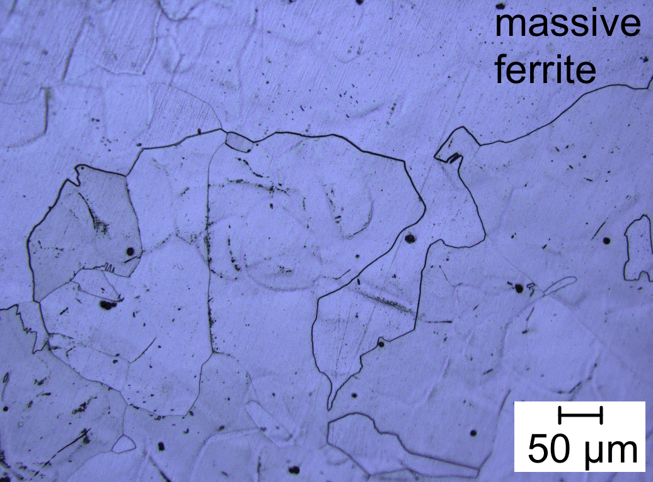
allotriomorphic
ferrite
pearlite
Reconstructive
transformations

Slide 7
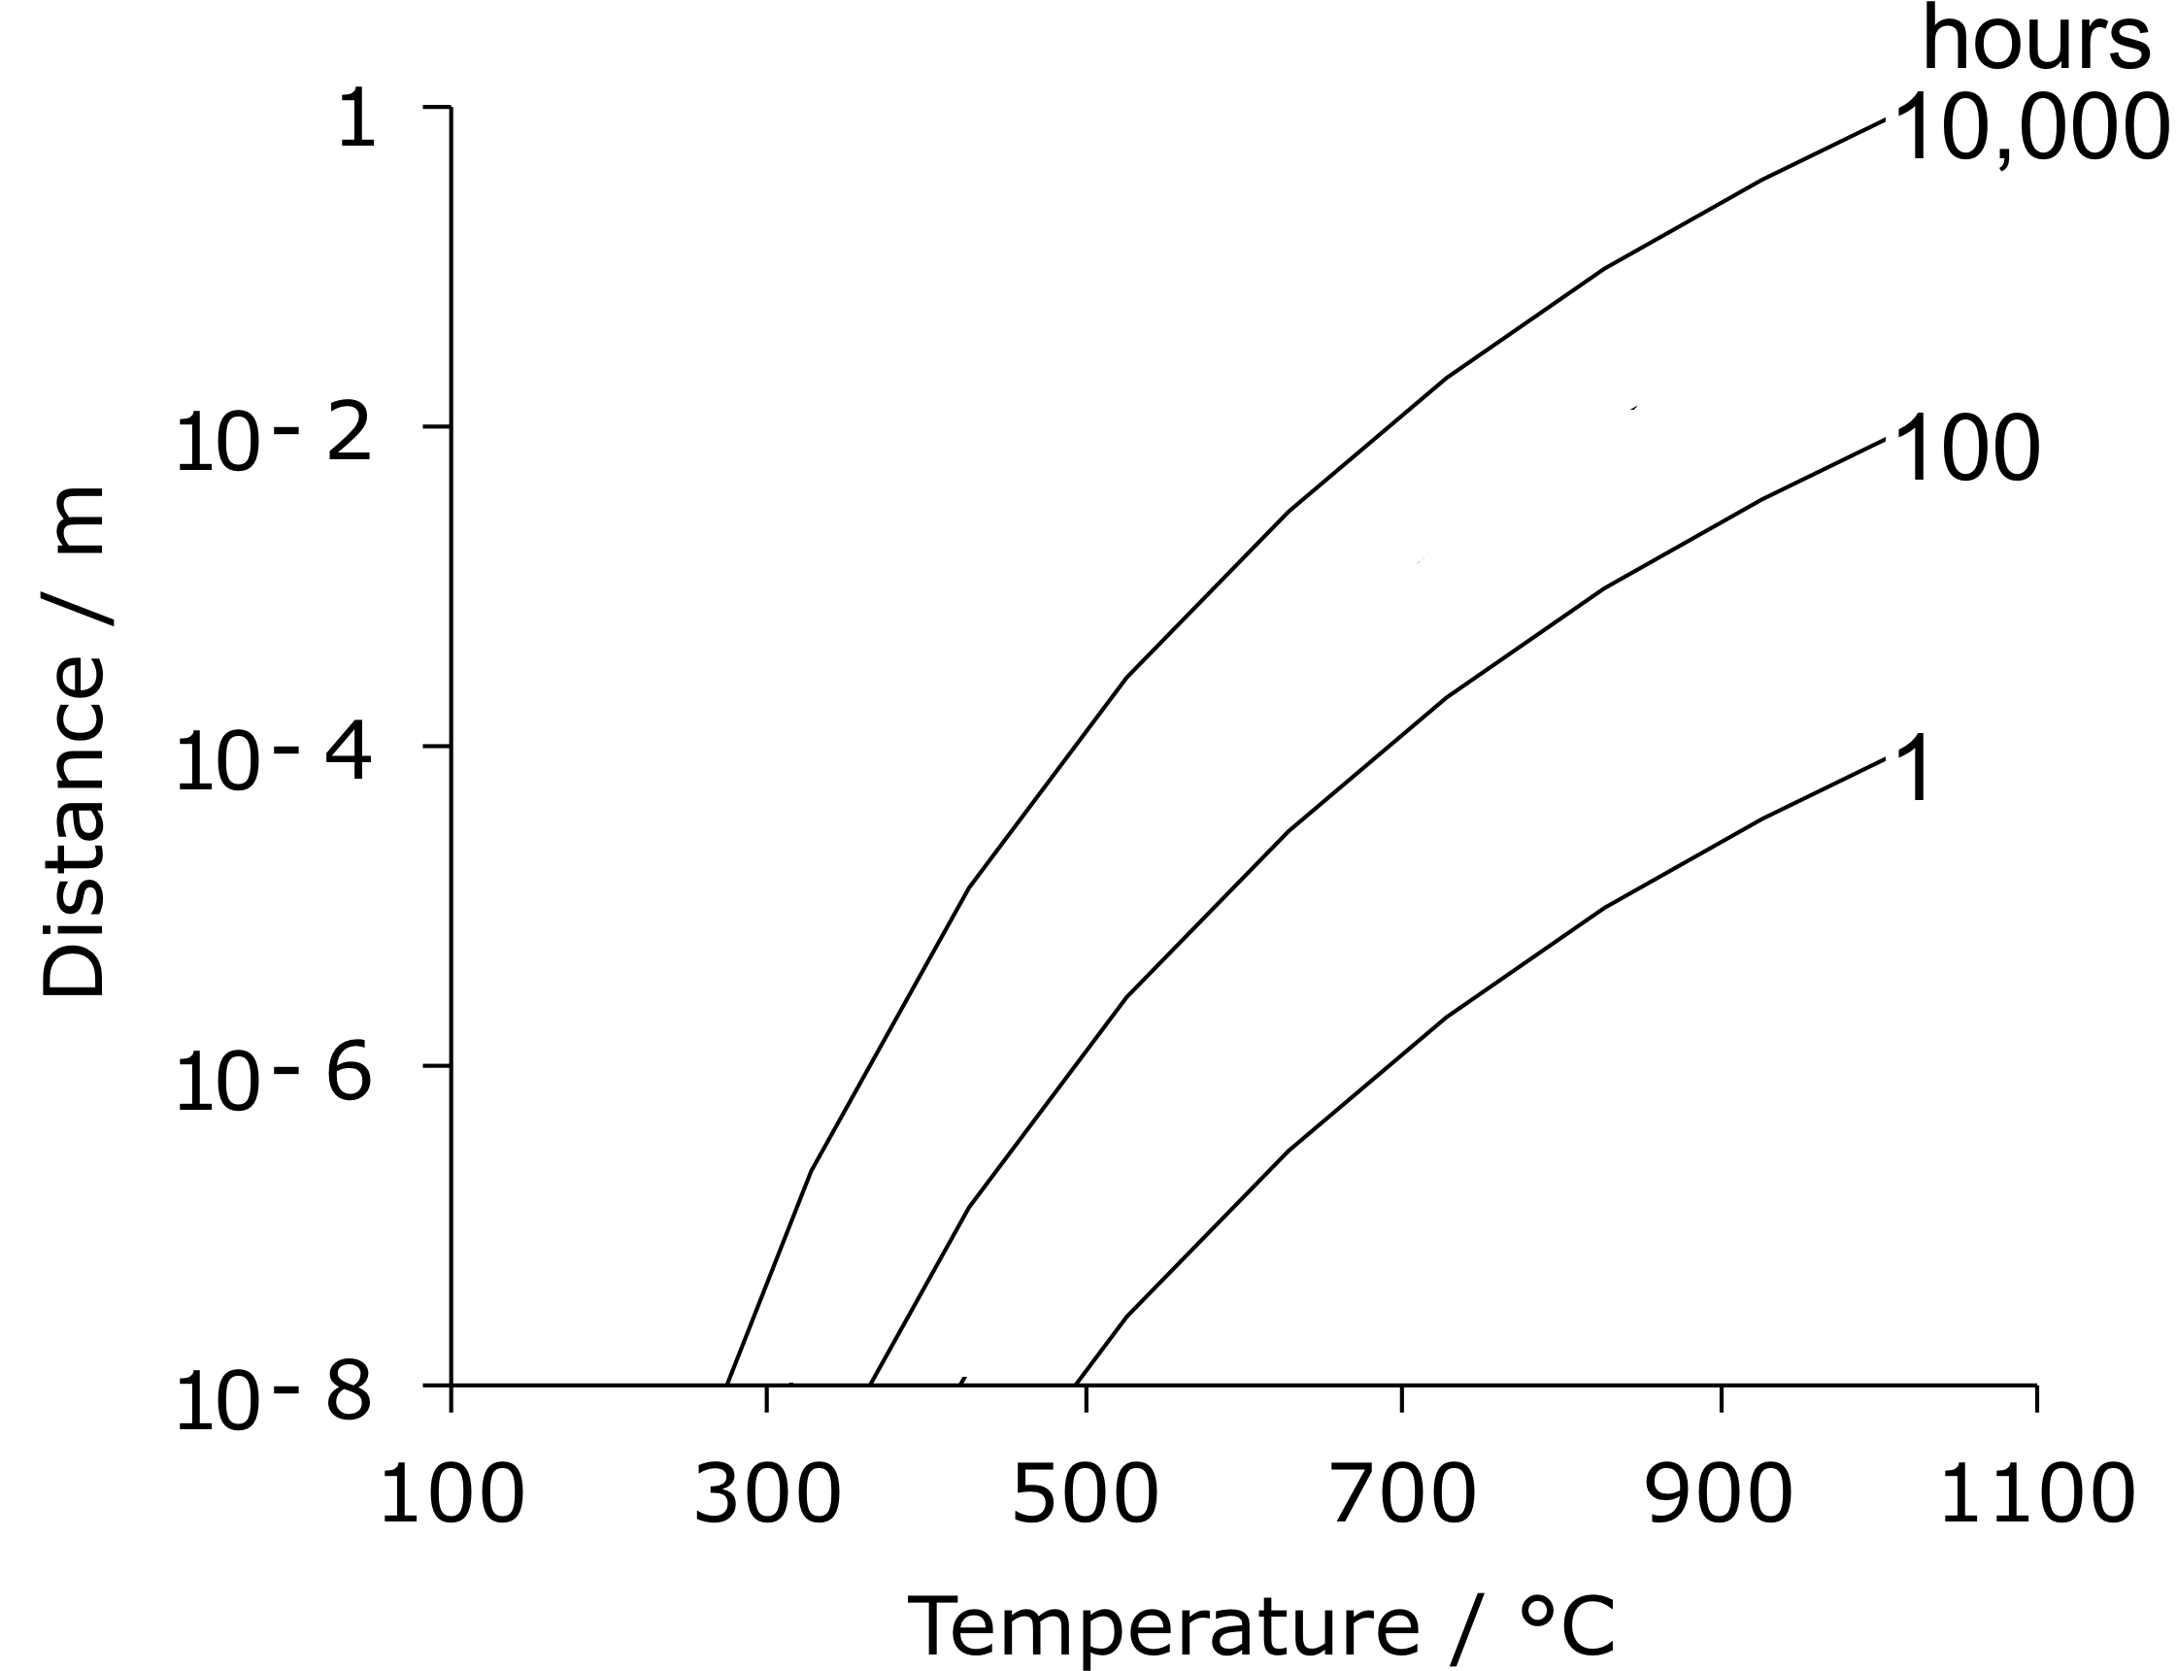
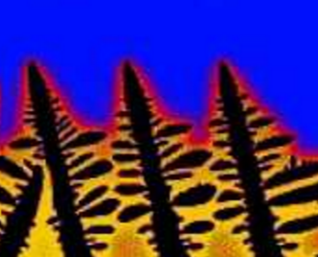
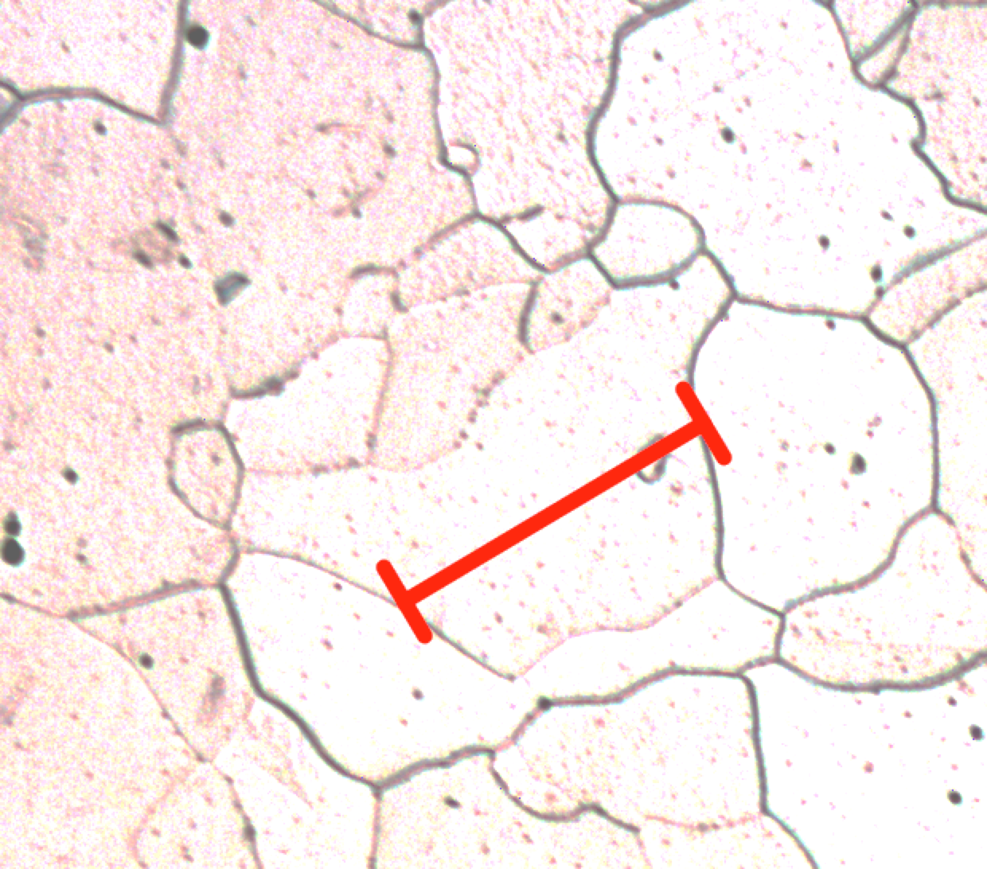
structural scale
homogenisation

Slide 8
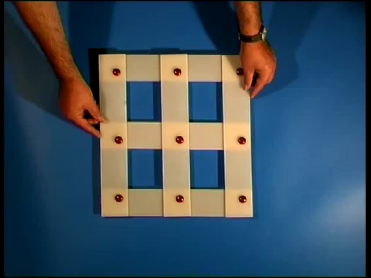

Slide 9
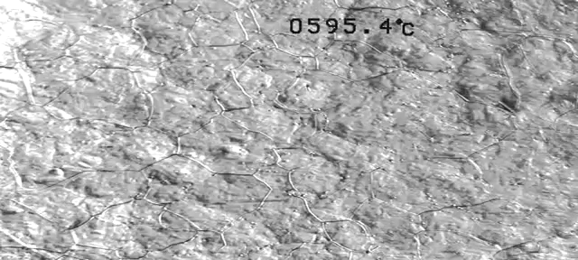

Slide 10
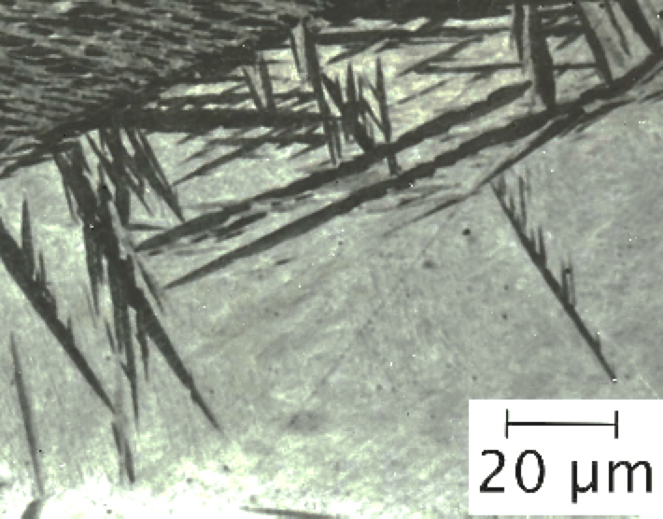
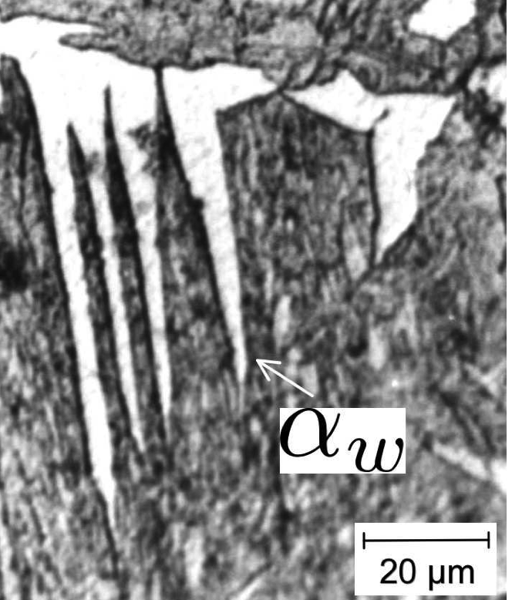
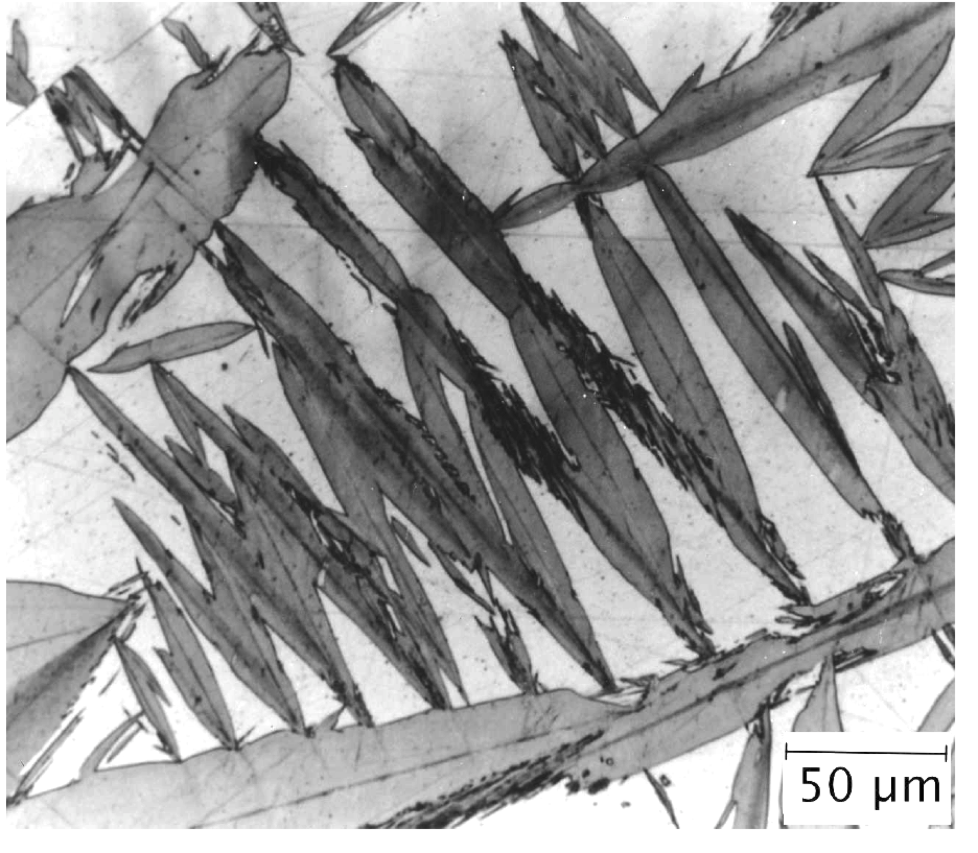
Widmanstaetten ferrite
bainite
Displacive
transformations
martensite

Slide 11
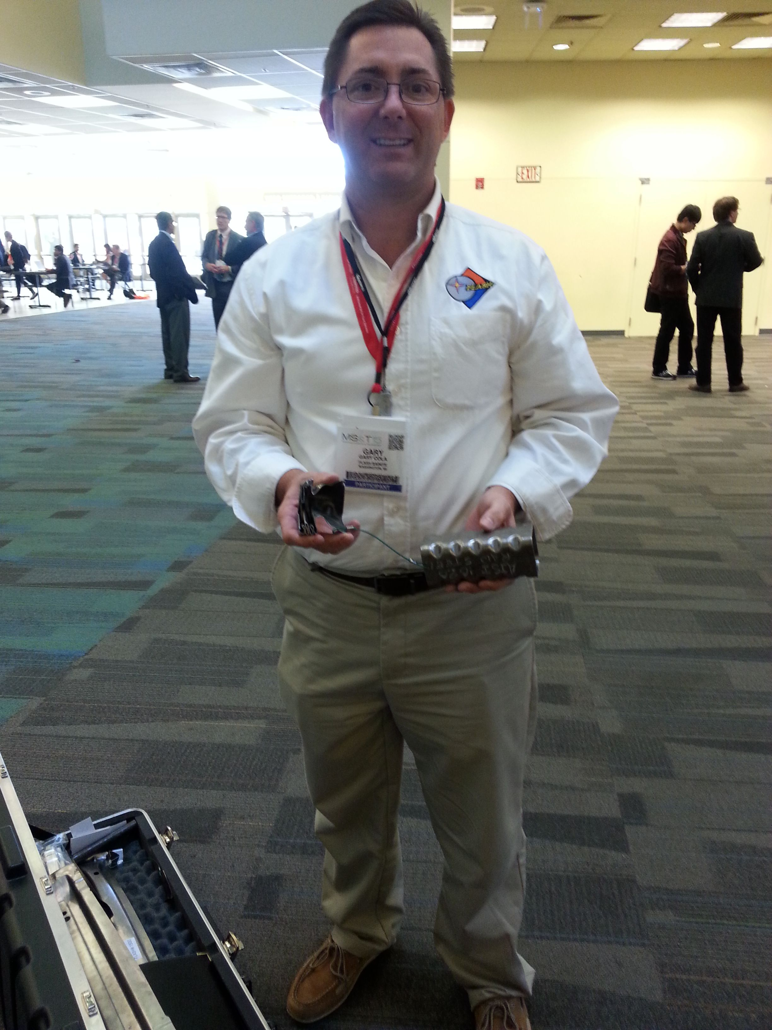
Gary Cola and the 80 ms heat treatment

Slide 12
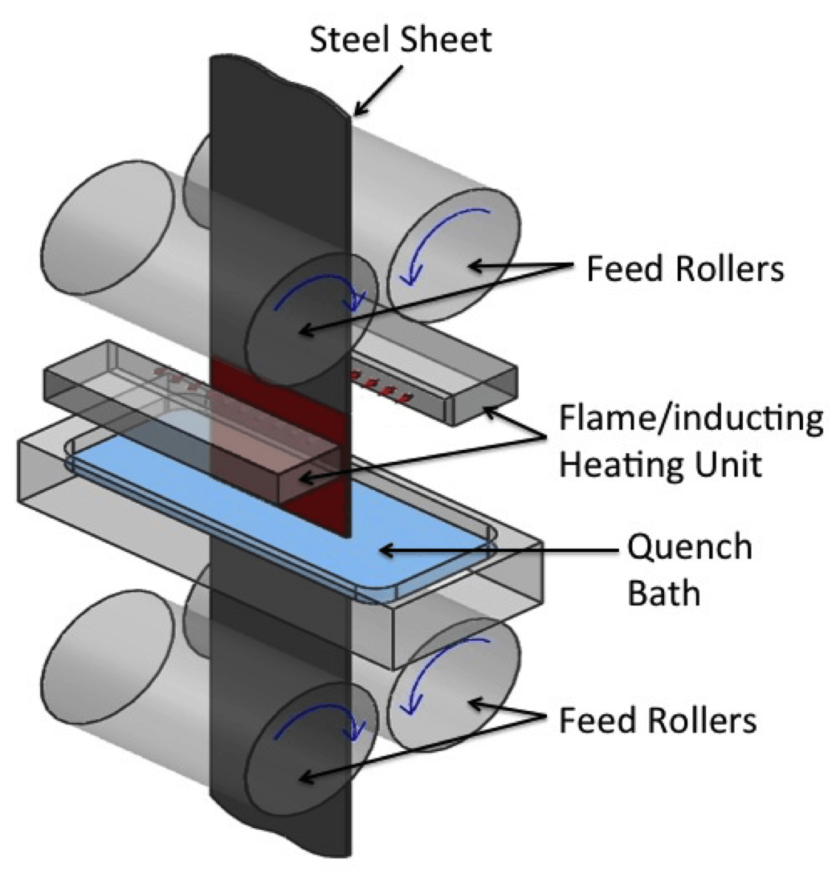
Image courtesy of Gary Cola

Slide 13
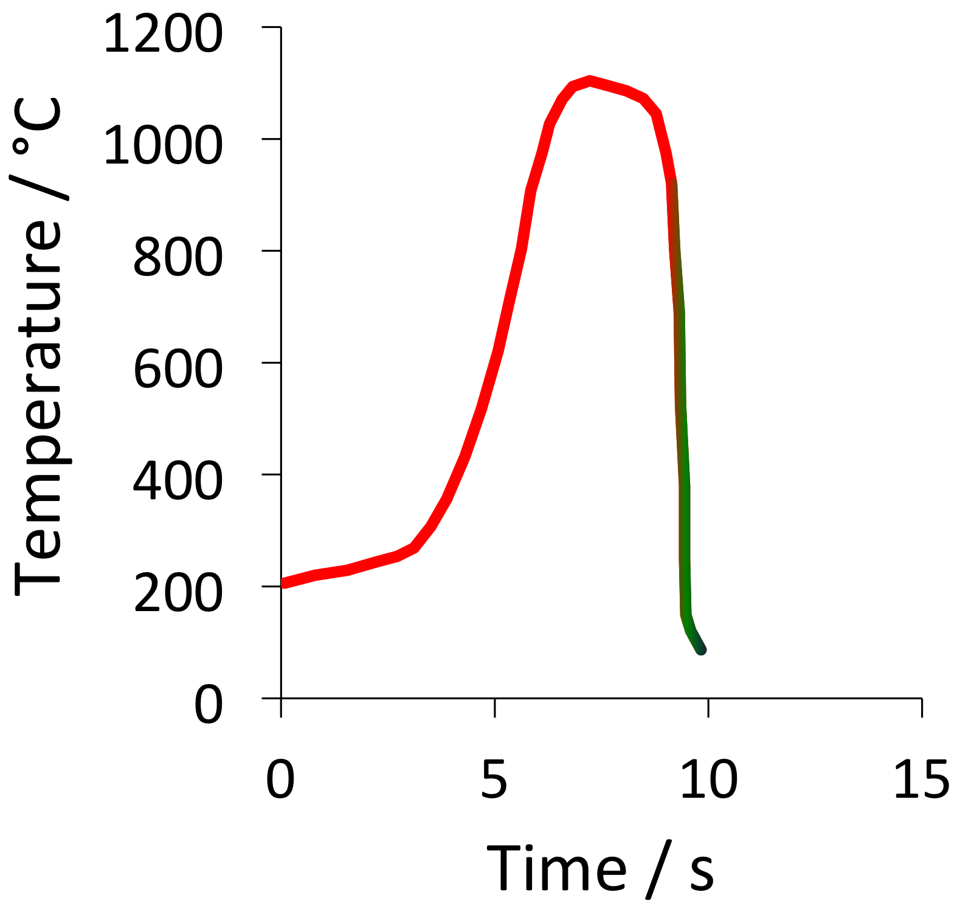
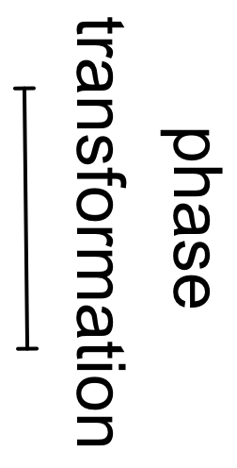
Lola et al. (2009)

Slide 14
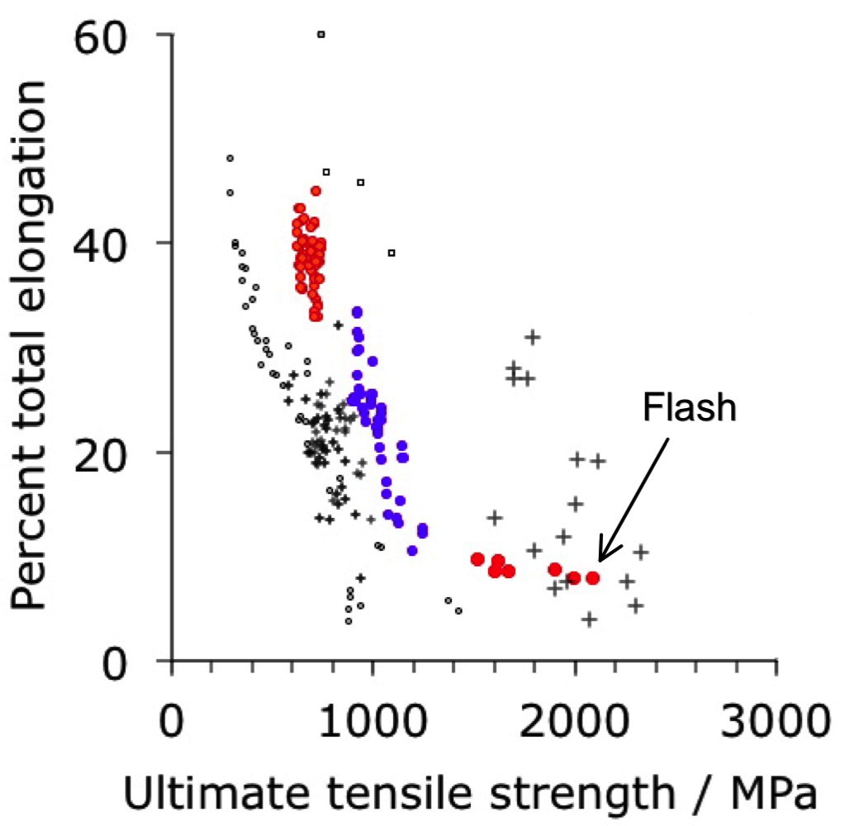

Slide 15
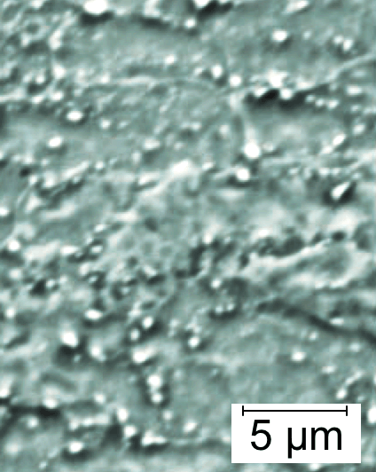
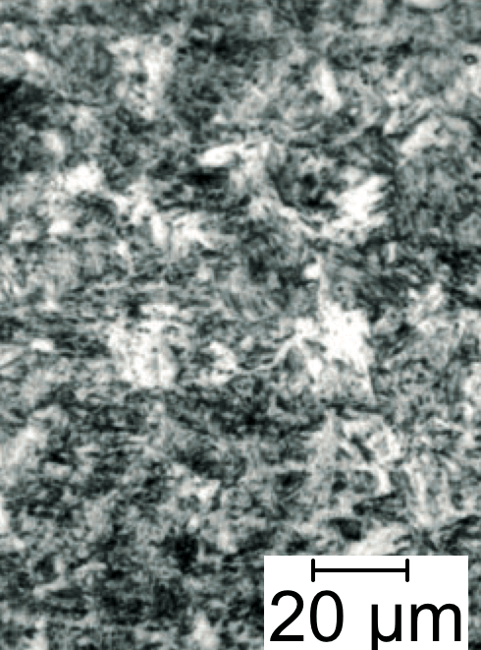
before
after
Lolla et al. (2009)

Slide 16
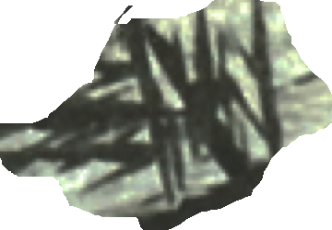
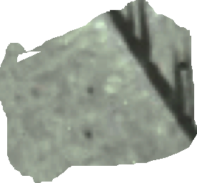
before
after

Slide 17
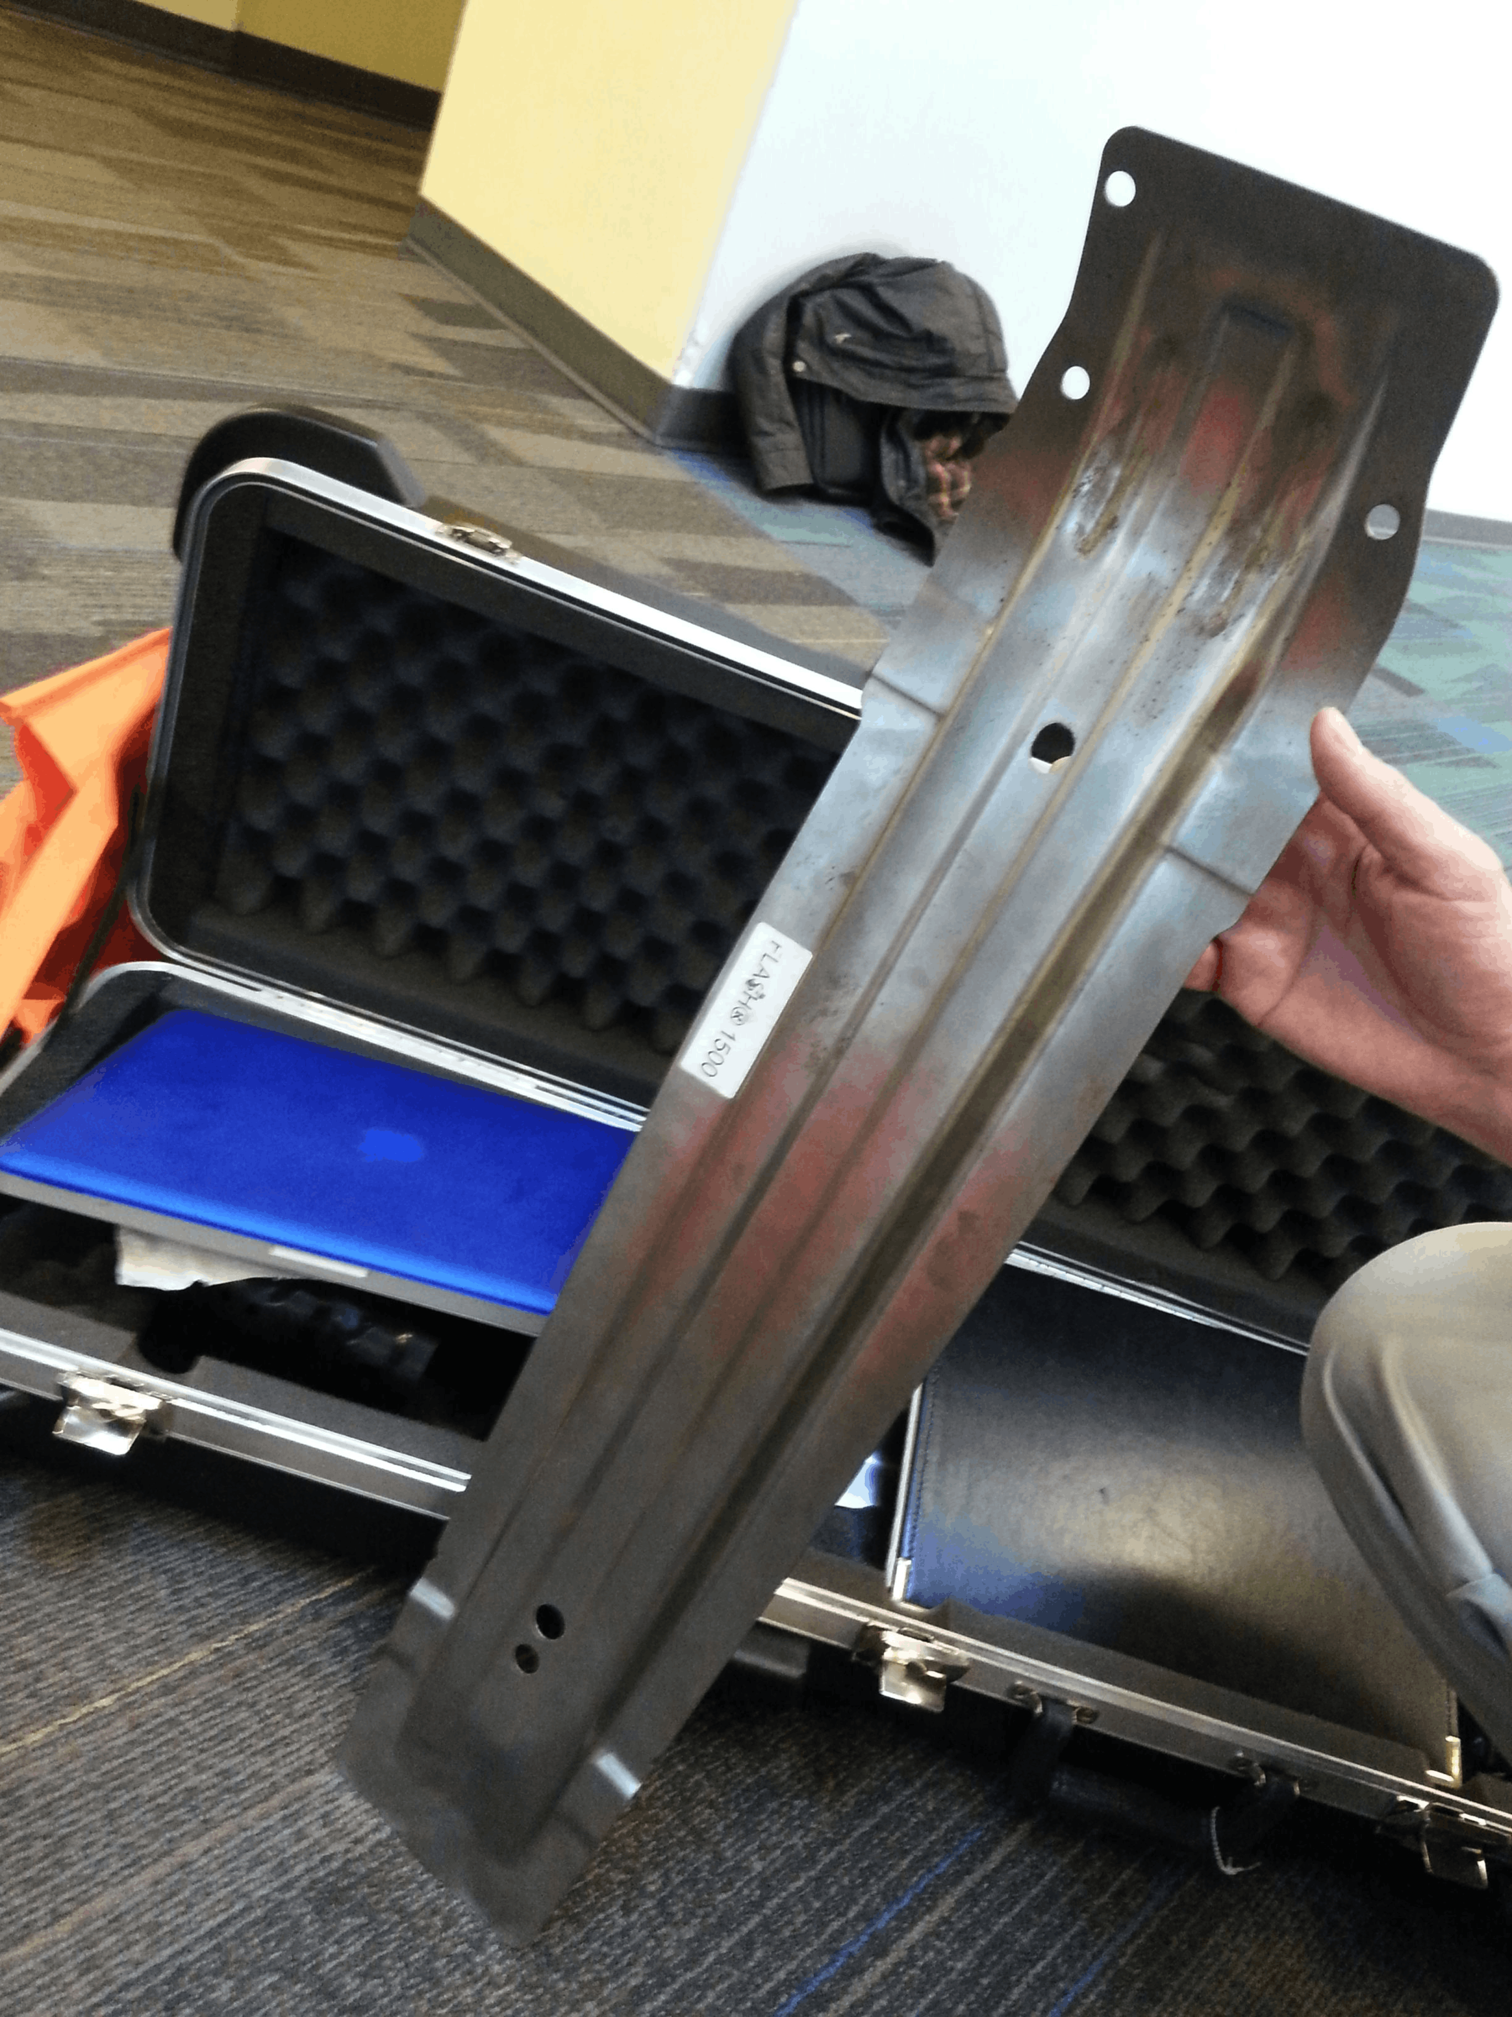
Key component of car safety

Slide 18
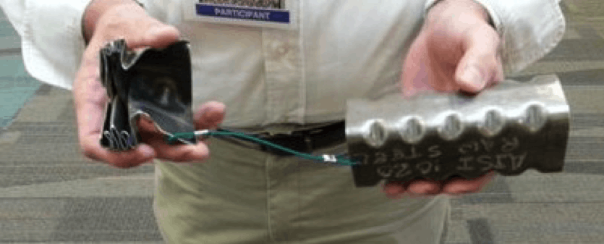
Key component of car safety

Slide 19
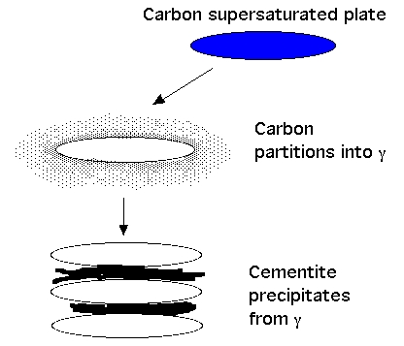

Slide 20
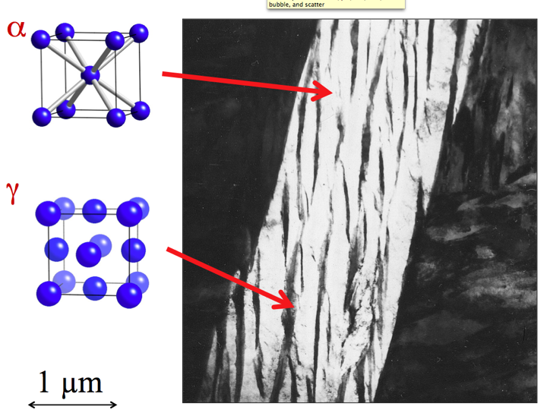
20

Slide 21
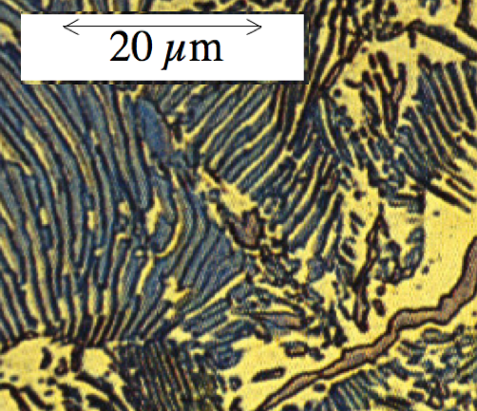
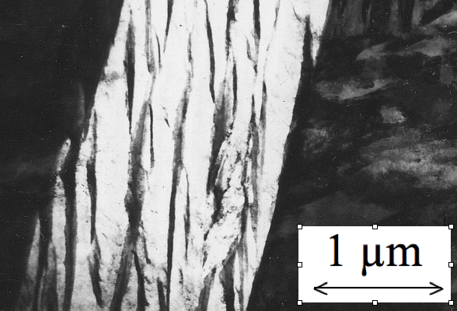
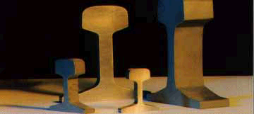
Notes:
21
21

Slide 22
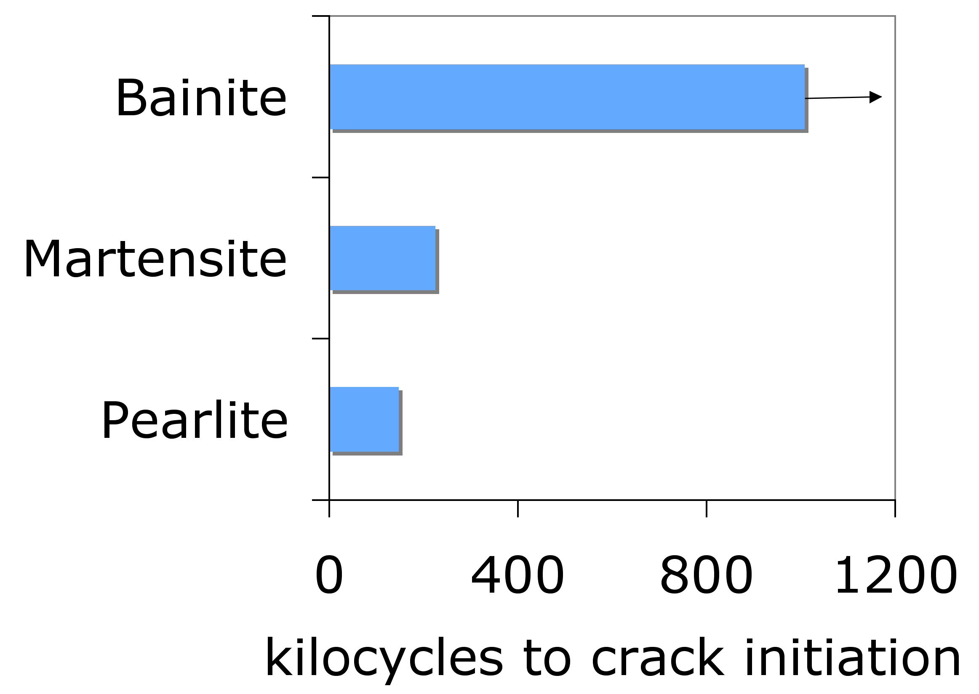
Yates, Jerath, Bhadeshia
Notes:
22
22

Slide 23
Yates, Jerath
Notes:
23
23

Slide 24
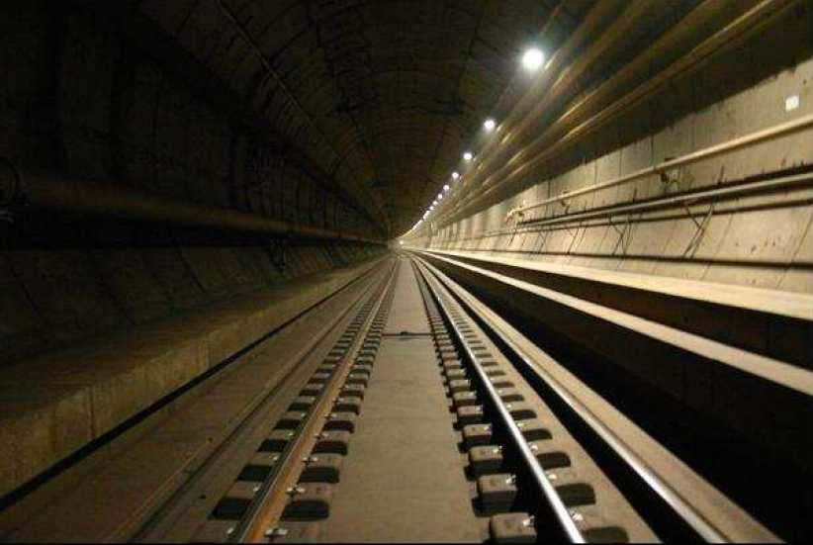
Carbide-free bainite in Eurotunnel
Photograph courtesy of V. Jerath
Notes:
24
24

Slide 25
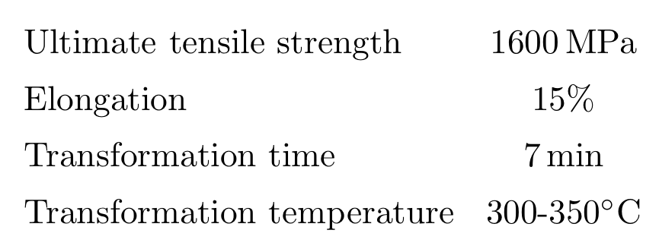
Custom design

Slide 26
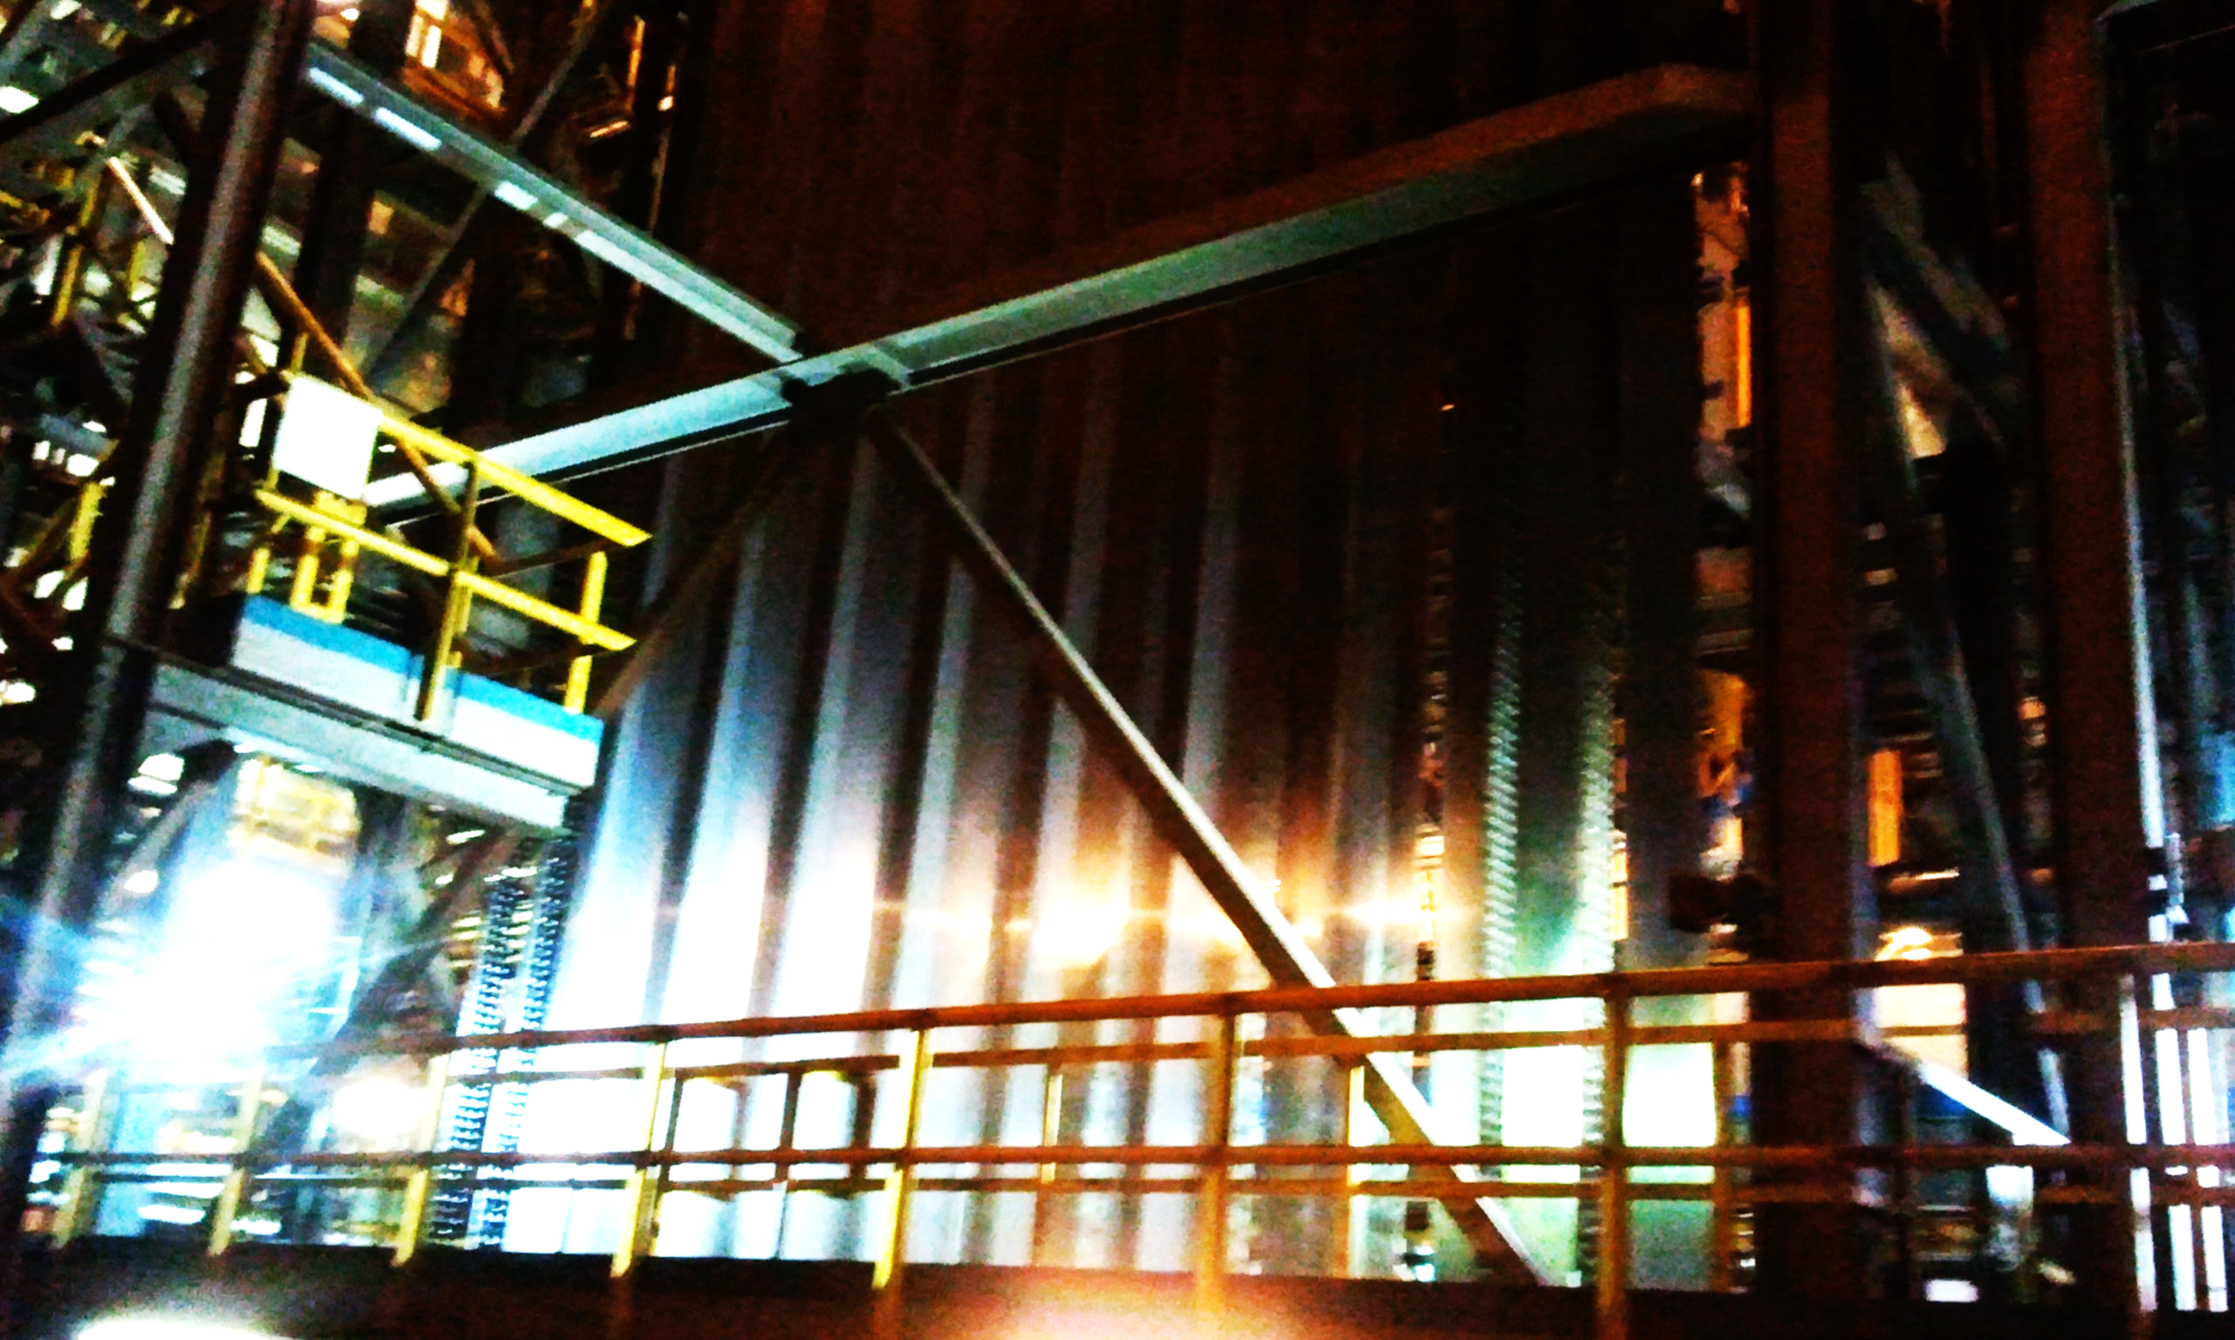
Continuous annealing strip production line

Slide 27
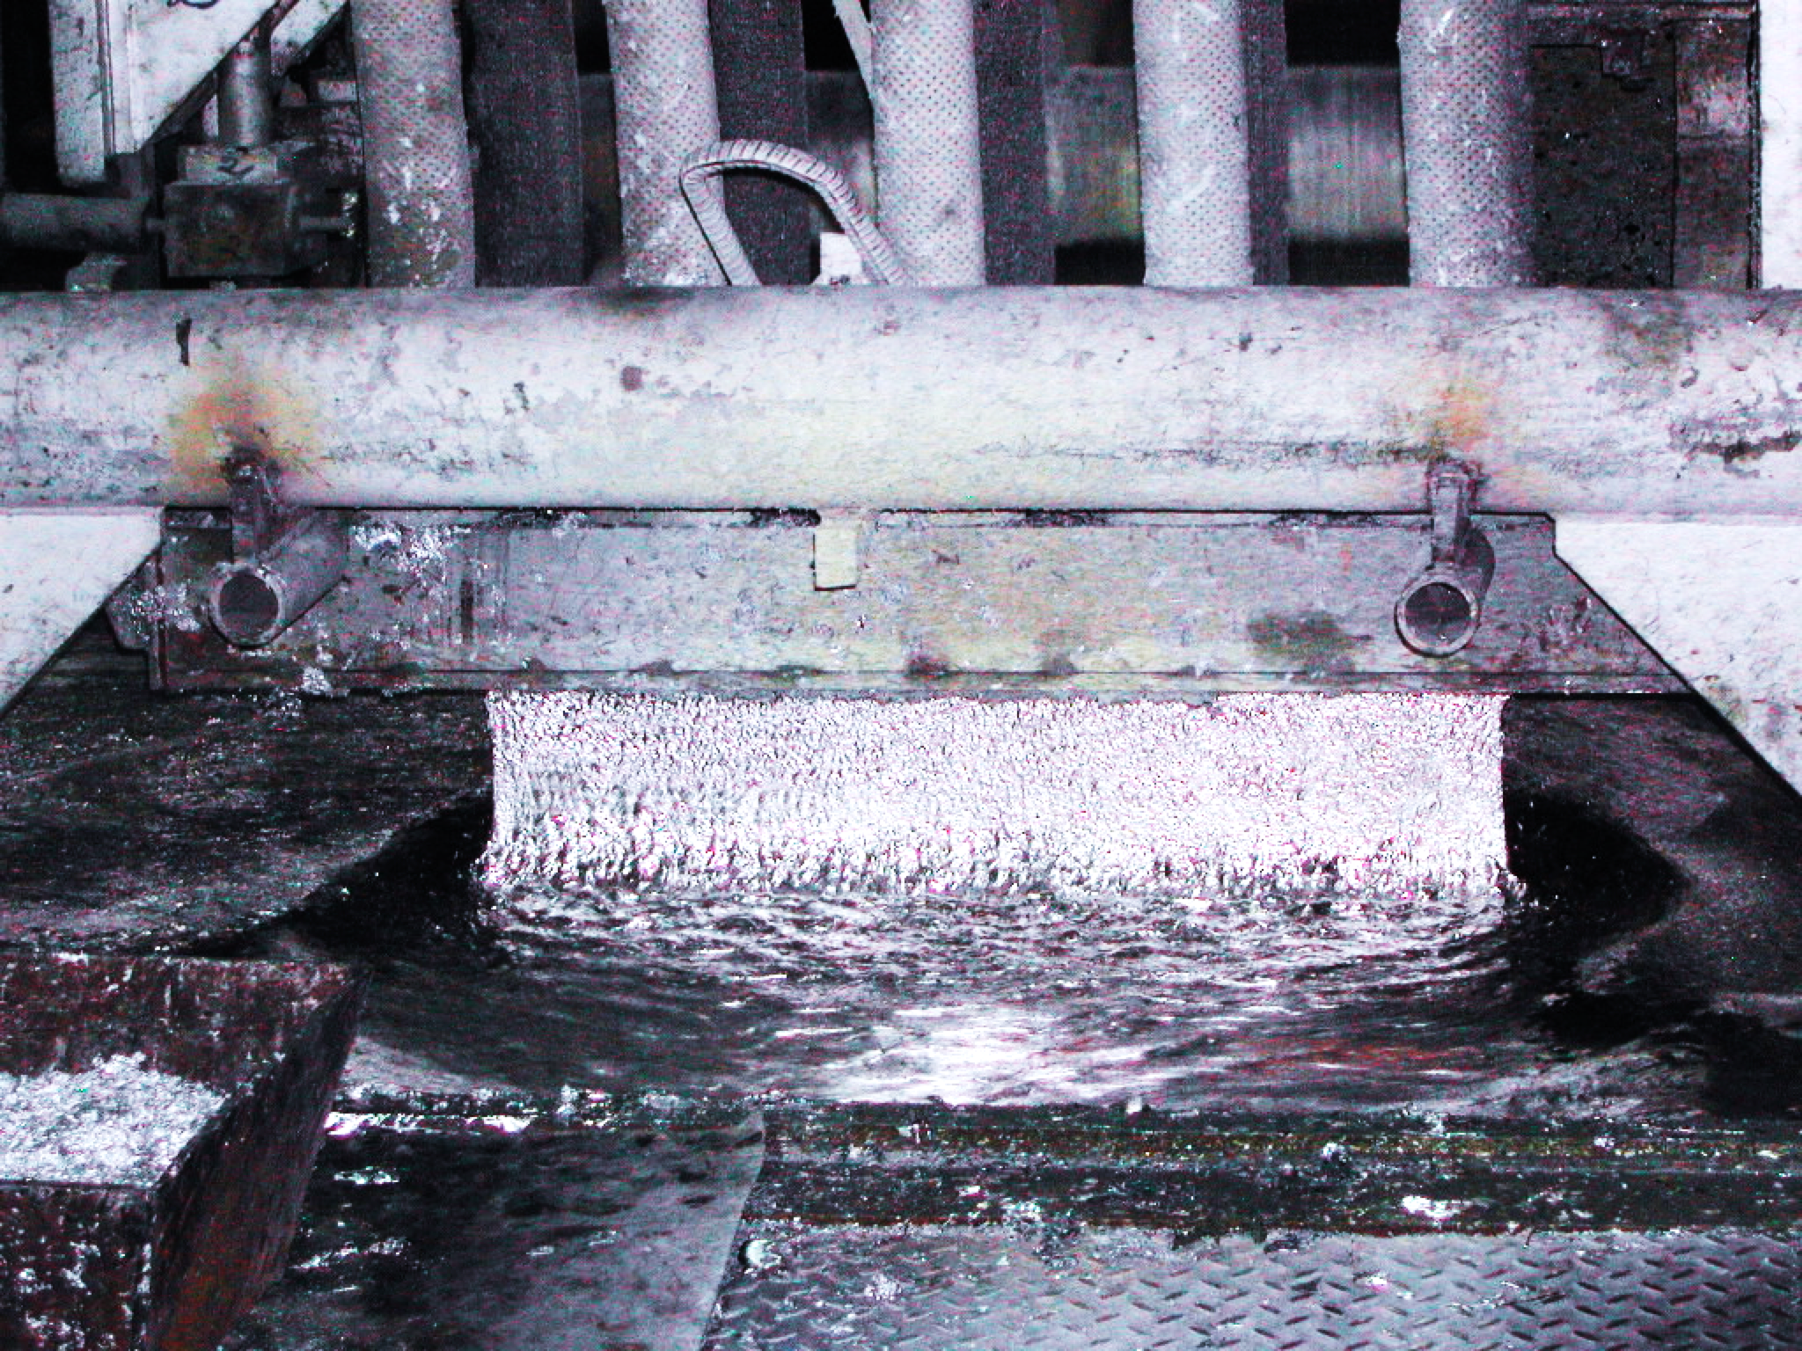
Galvanising bath

Slide 28
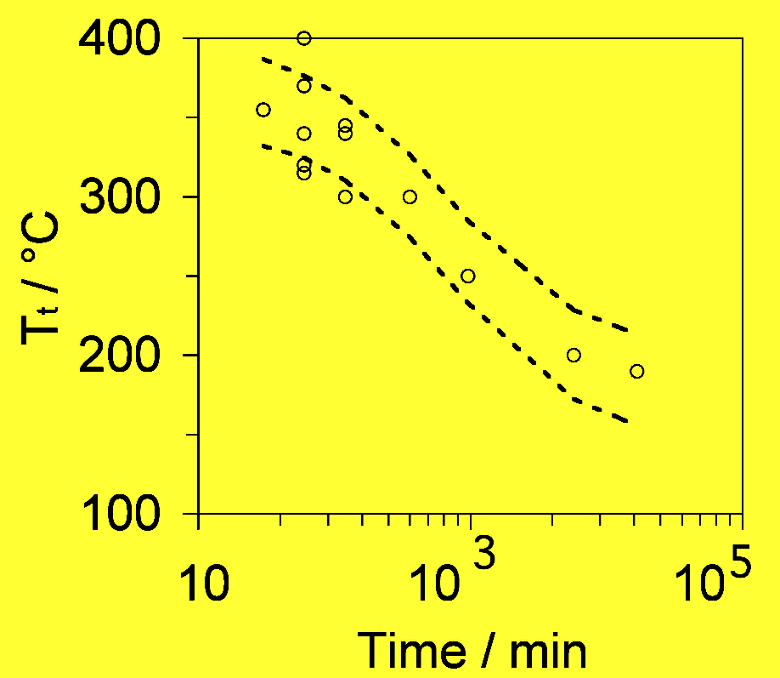
carbide-free bainitic steel

Slide 29
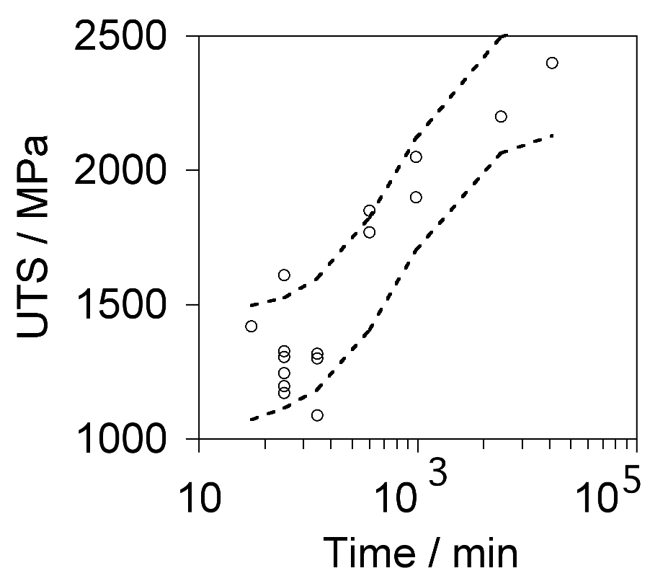
carbide-free bainitic steel

Slide 30
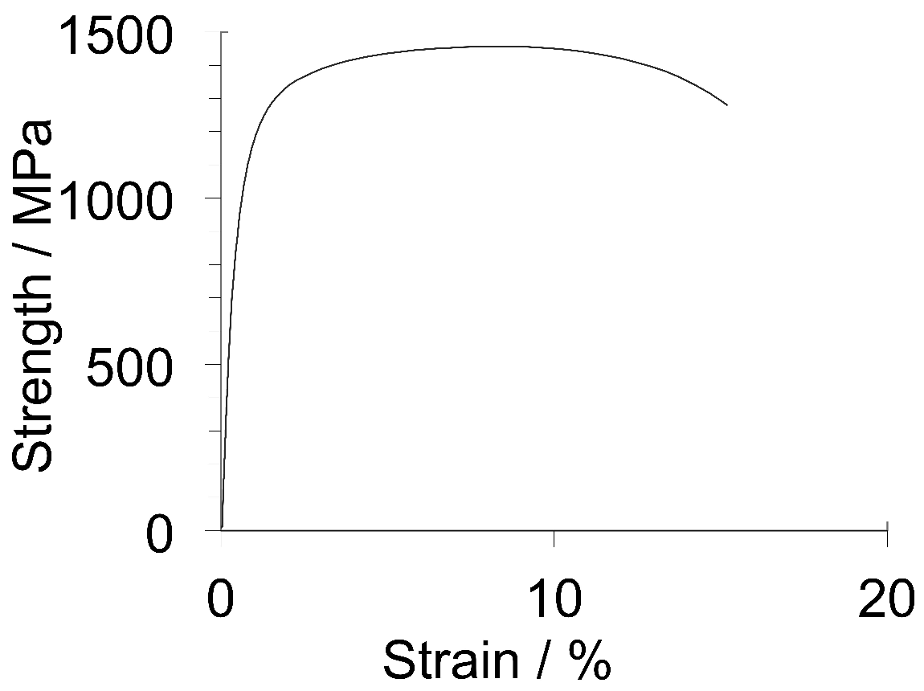
carbide-free bainitic steel

Slide 31
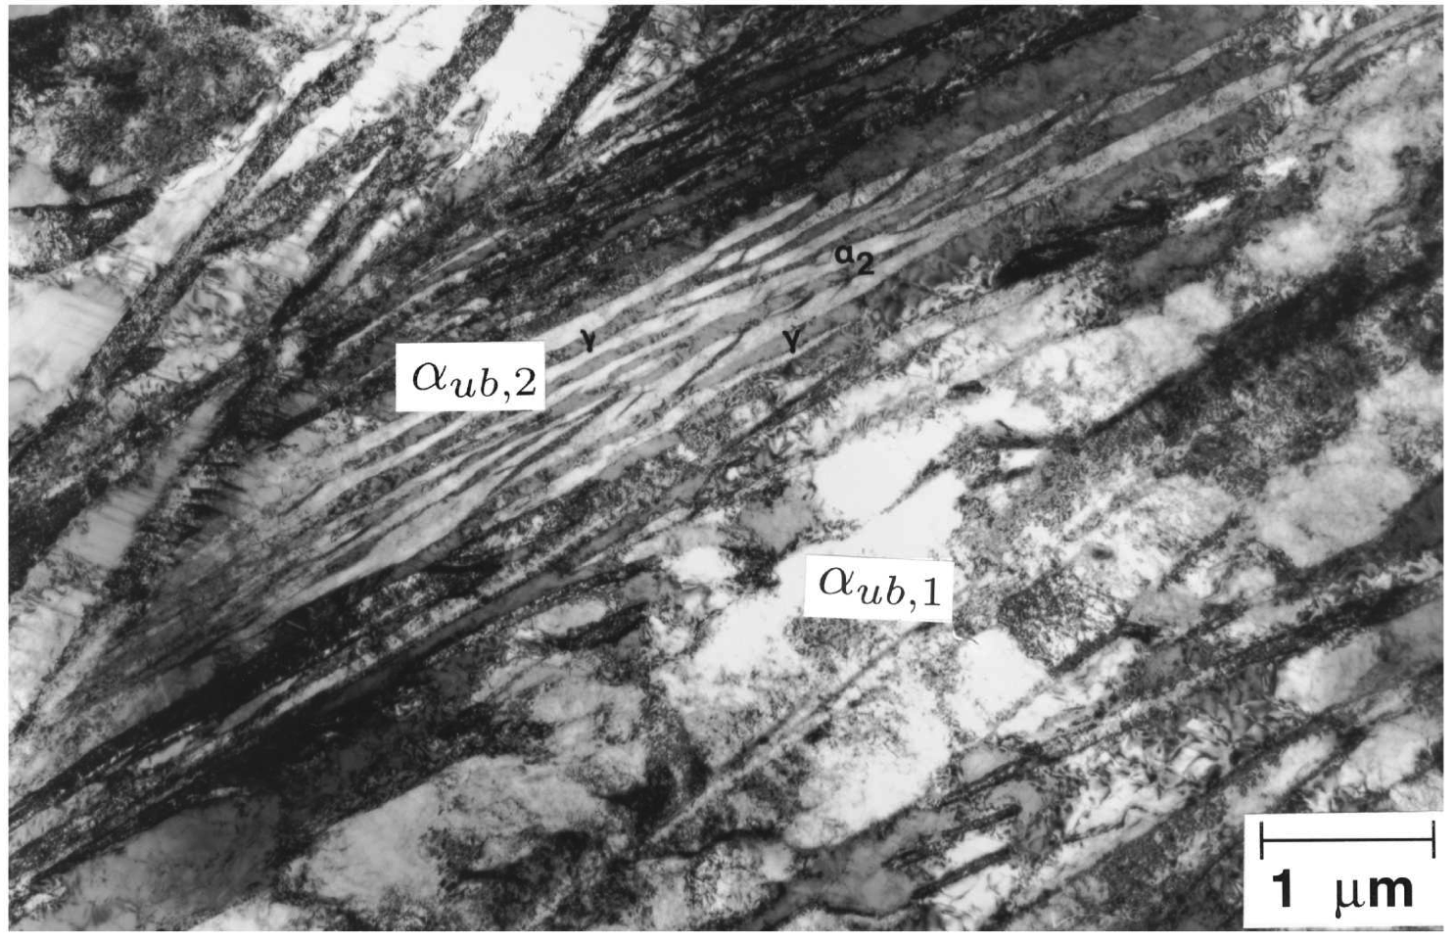
Papadimitriou and Fourlaris, 1997

Slide 32
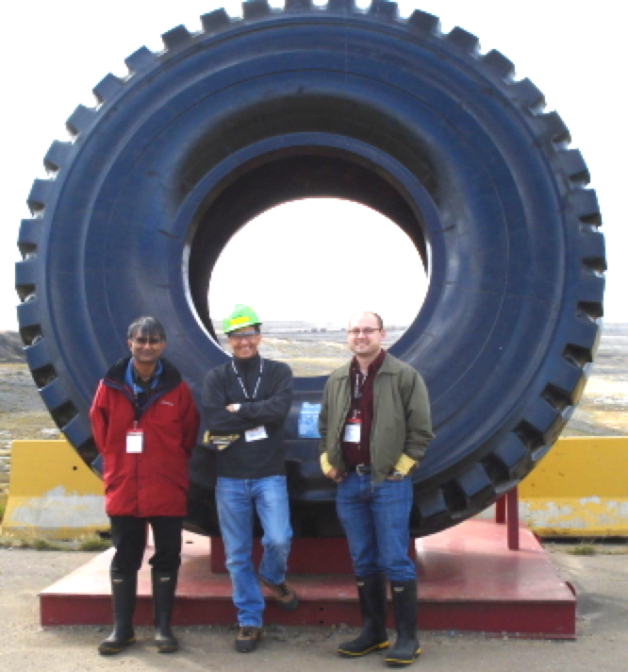
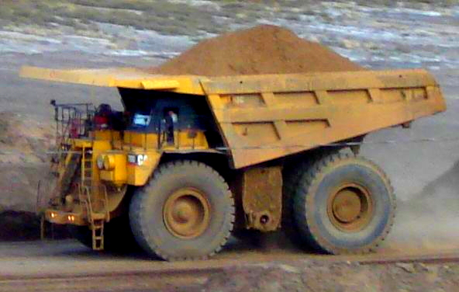
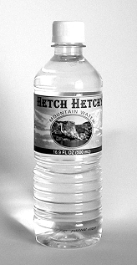
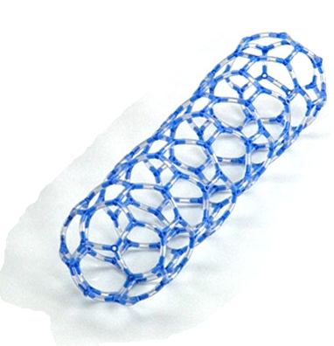
…. bulk nanocrystalline steel which is very strong, tough, cheap ….

Slide 33
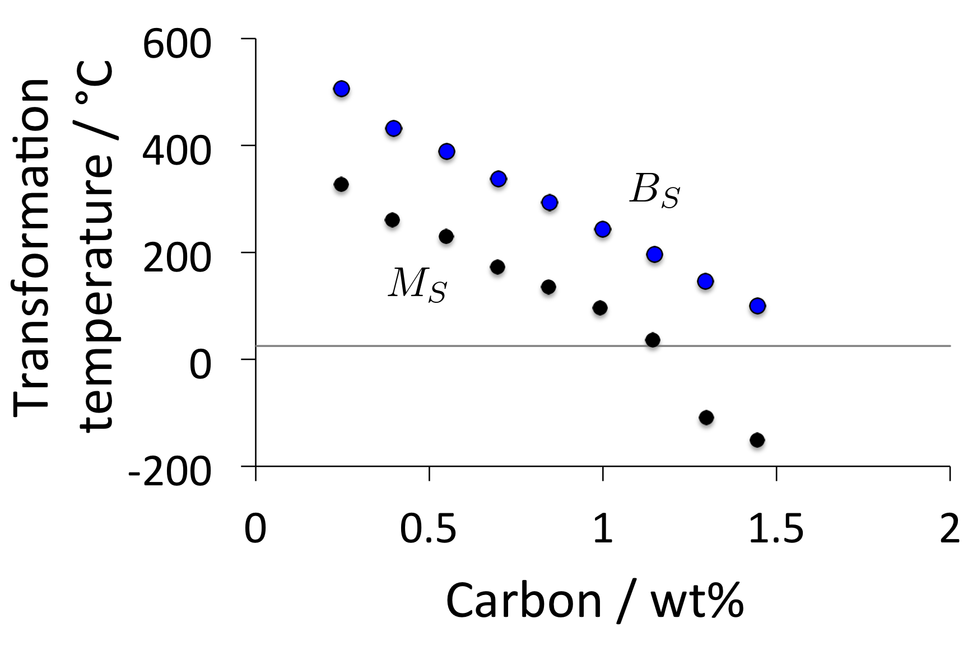
Calculated data Fe-2Si-3Mn-C wt%

Slide 34
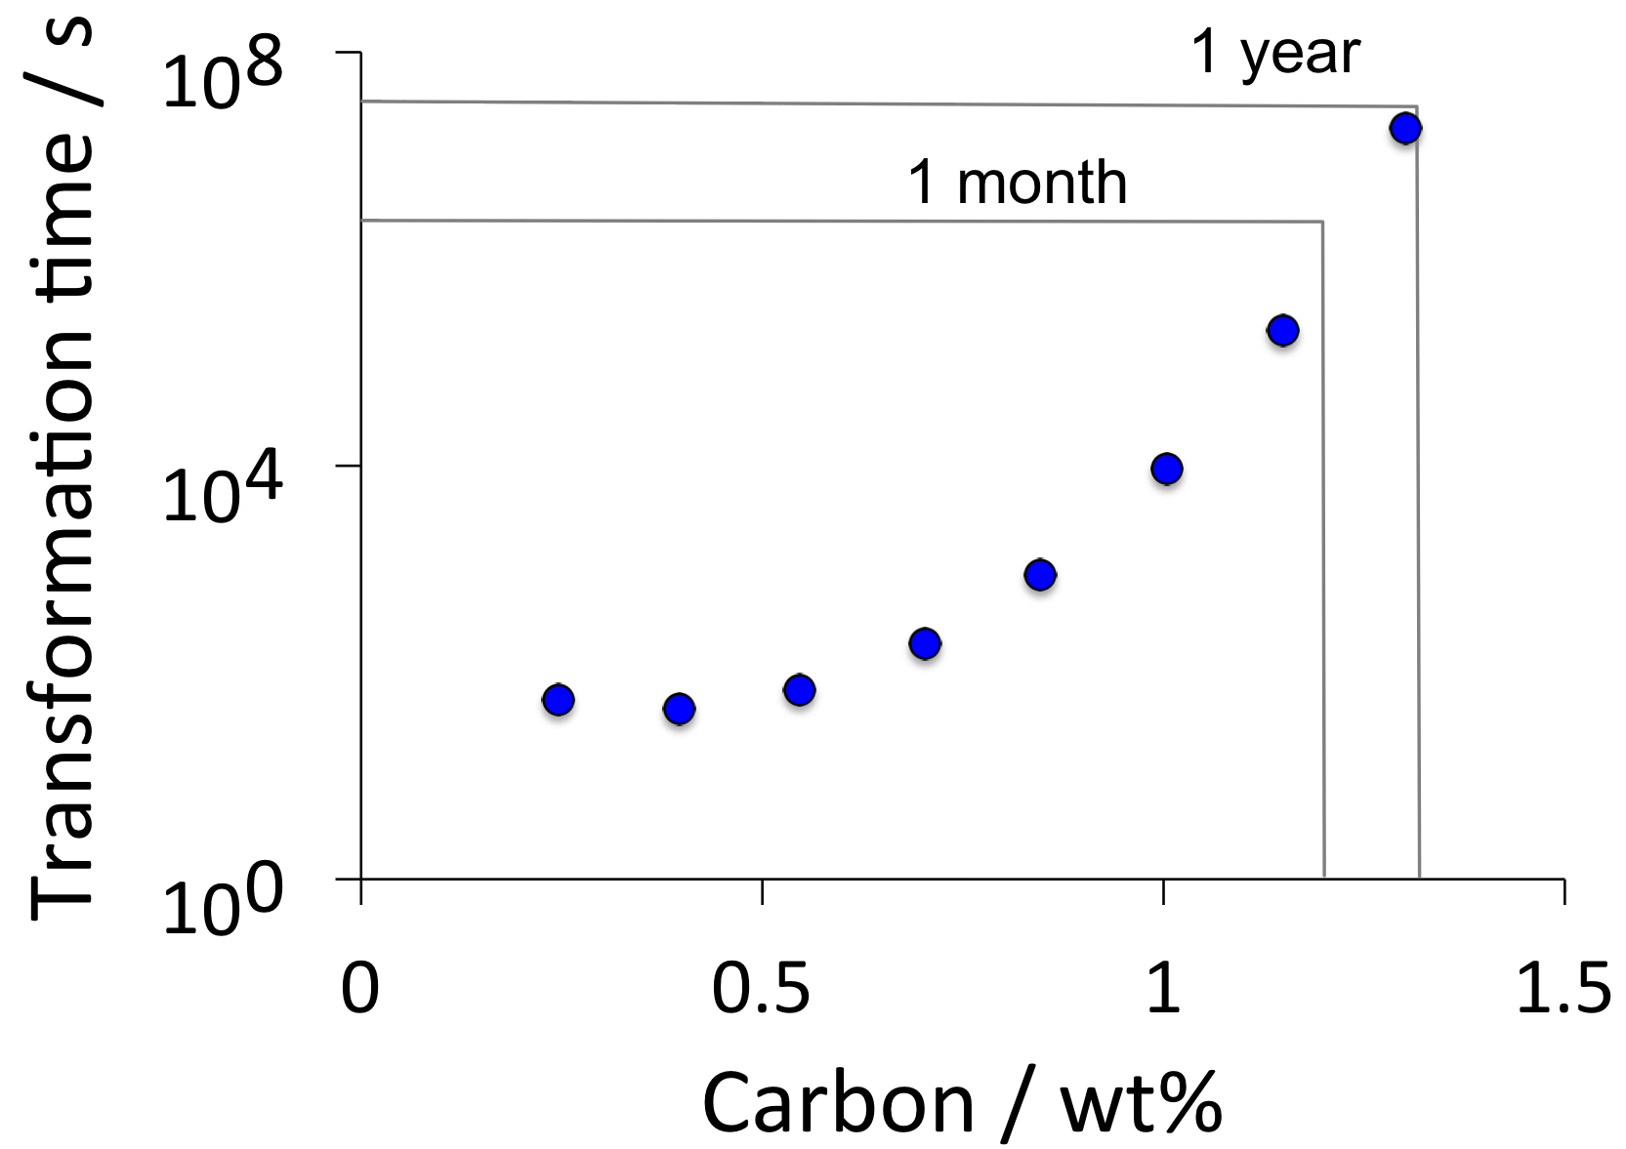
Calculated data Fe-2Si-3Mn-C wt%

Slide 35
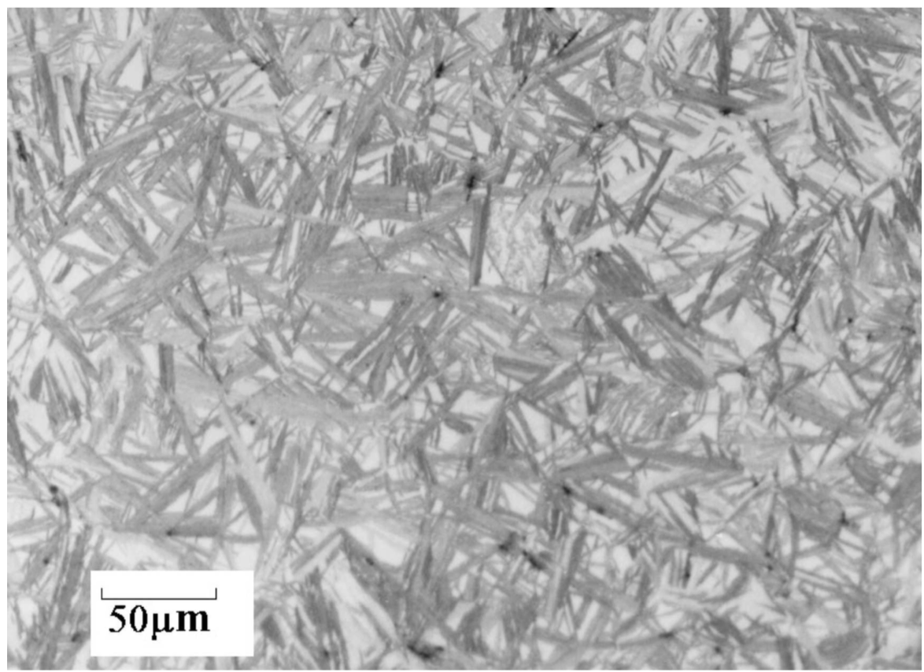

Slide 36
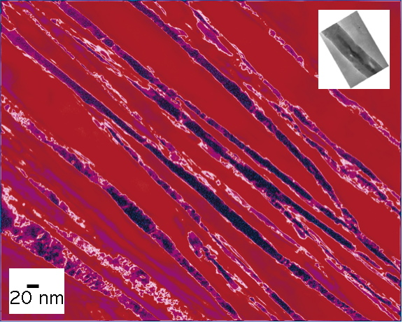

Slide 37



Slide 38


Slide 39


Slide 40

Paul Davies, Tata Steel
Notes:
40

Slide 41

“more serious battlefield threats”
Notes:
41

Slide 42


ballistic mass efficiency
consider unit area of armour
Notes:
42

Slide 43

Notes:
43

Slide 45

Cannot easily be welded
Fang, Yang, Liu, Song, Fang, Bhadeshia, Materials and Design, 50 (2013) 38

Slide 46
What next?
Steel with impossible combination of properties
>2 GPa
30% ductility at conventional strain rates
ductility at very high strain rate
toughness and Charpy impact at -40°C
weldable
cheap, large in all dimensions
mass production
high-temperature capability
www.msm.cam.ac.uk/phase-trans

Slide 47
Composition following transformation

Slide 48

Bhadeshia, Met. Sci. (1982)

Slide 49


Slide 50


Caballero, Miller, Mateo, Cornide. J. Alloys & Compounds, (2012)
Large carbon concentration in solution in ferrite
Ferrite
Dislocation
Austenite
Francisca Garcia Caballero

Slide 51

atom probe data for carbon in solid solution in ferrite in contact with austenite
Caballero, Miller, Mateo, Cornide
J. Alloys & Compounds, (2012)

Slide 52



A diffusionless transformation will necessarily lead to a body-centred tetragonal ferrite.

Slide 53


Huge increase in solubility; ferrite with tetragonal symmetry
Jang, Suh, Bhadeshia, Scr. Mat. 68 (2012) 195

Slide 54





C. N. Hulme-Smith, I. Lonardelli,
A. C. Dippel and H. K. D. H. Bhadeshia, Scr. Mat. 69 (2013) 409.

Slide 55

C. N. Hulme-Smith,
I. Lonardelli,
C. Dippel
H. K. D. H. Bhadeshia, Scr. Mat. 69 (2013) 409.

Slide 56


2104
Fe-1.75C-Si-Mn wt%
Chatterjee & Bhadeshia, 2004

