Slide 1

Quantitative Metallography
www.msm.cam.ac.uk/phase-trans

Slide 2
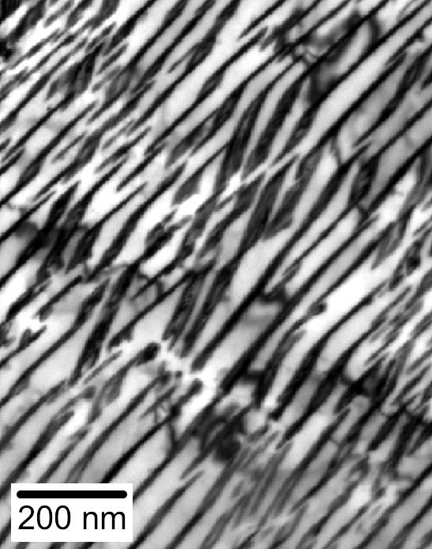
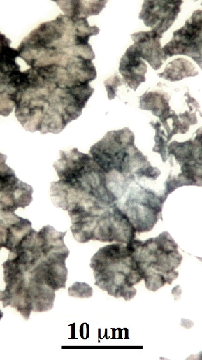
Stucture of pearlite?

Slide 3
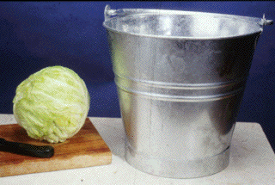

Slide 4
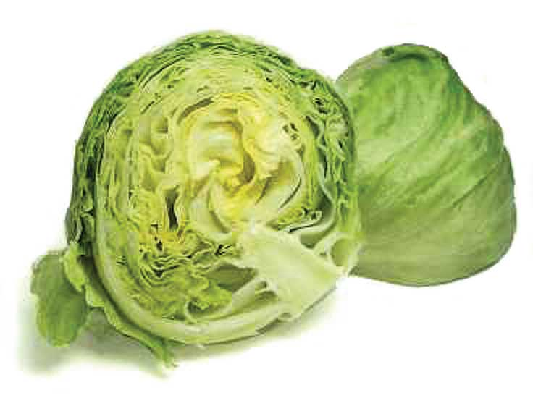

Slide 5
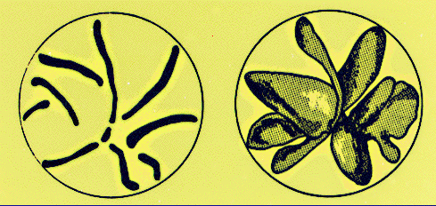
Three-dimensional shape of graphite (adapted from Underwood)

Slide 6
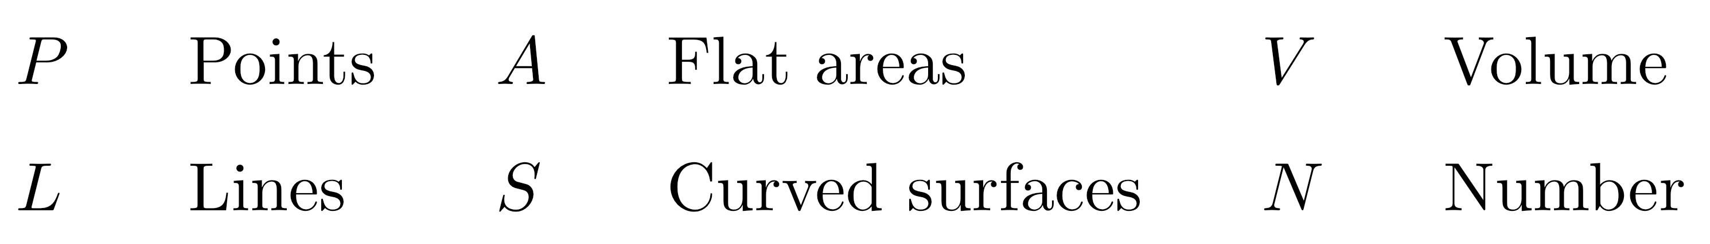
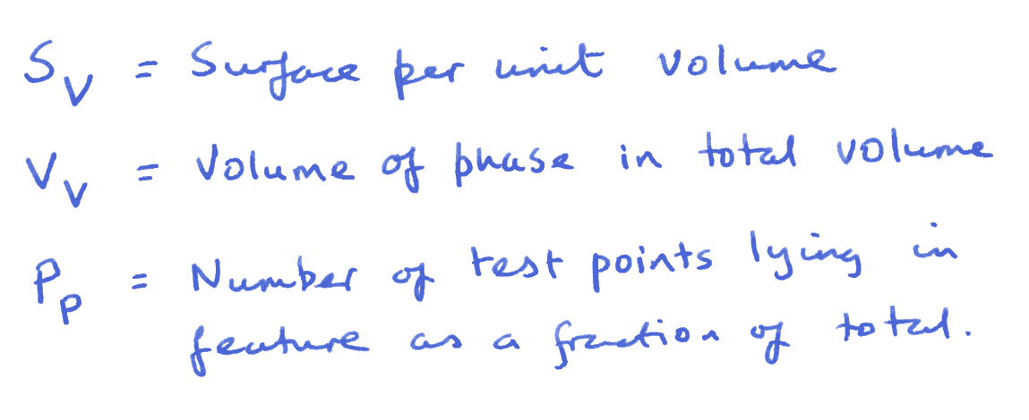
Stereological Terms

Slide 7
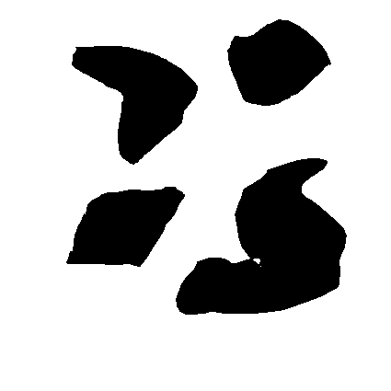
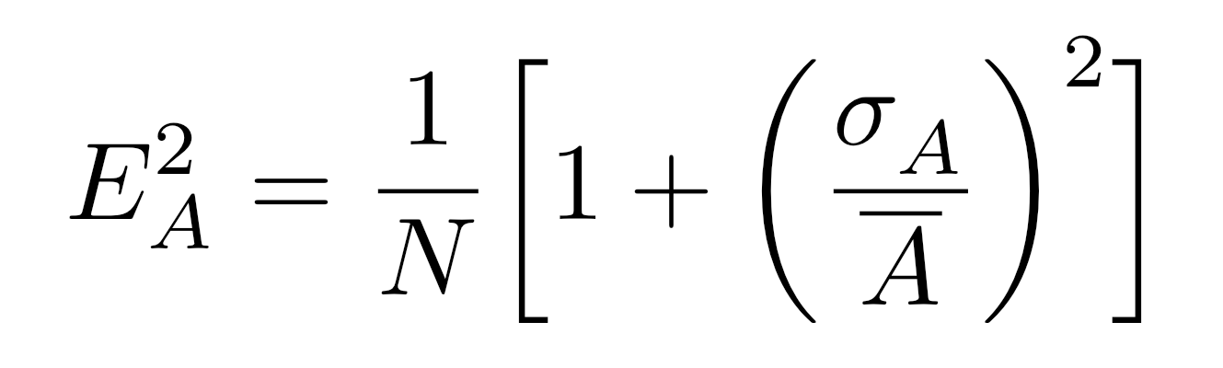
Volume fraction
Area fraction

Slide 8
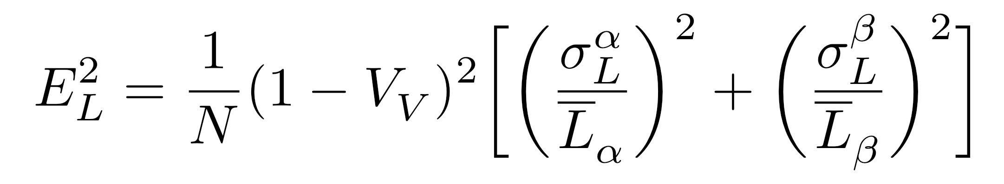
Line fraction

Slide 9
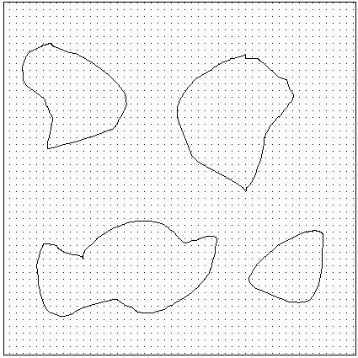
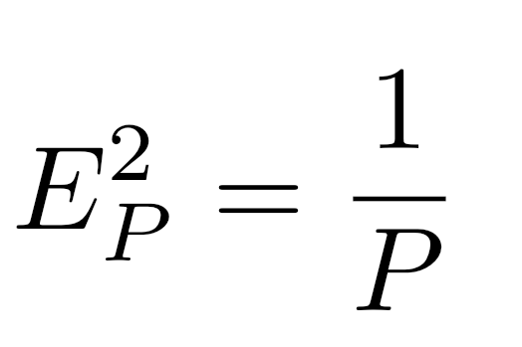
Point fraction

Slide 10
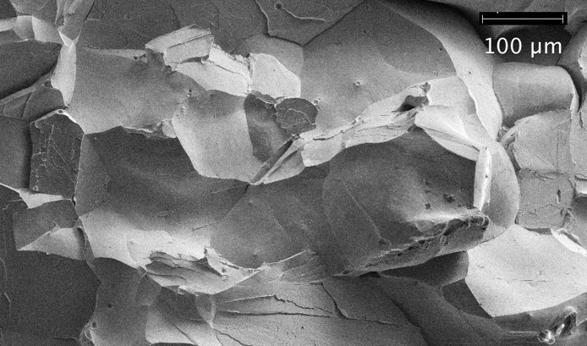
Three dimensional grain structure: Fe-P

Slide 11
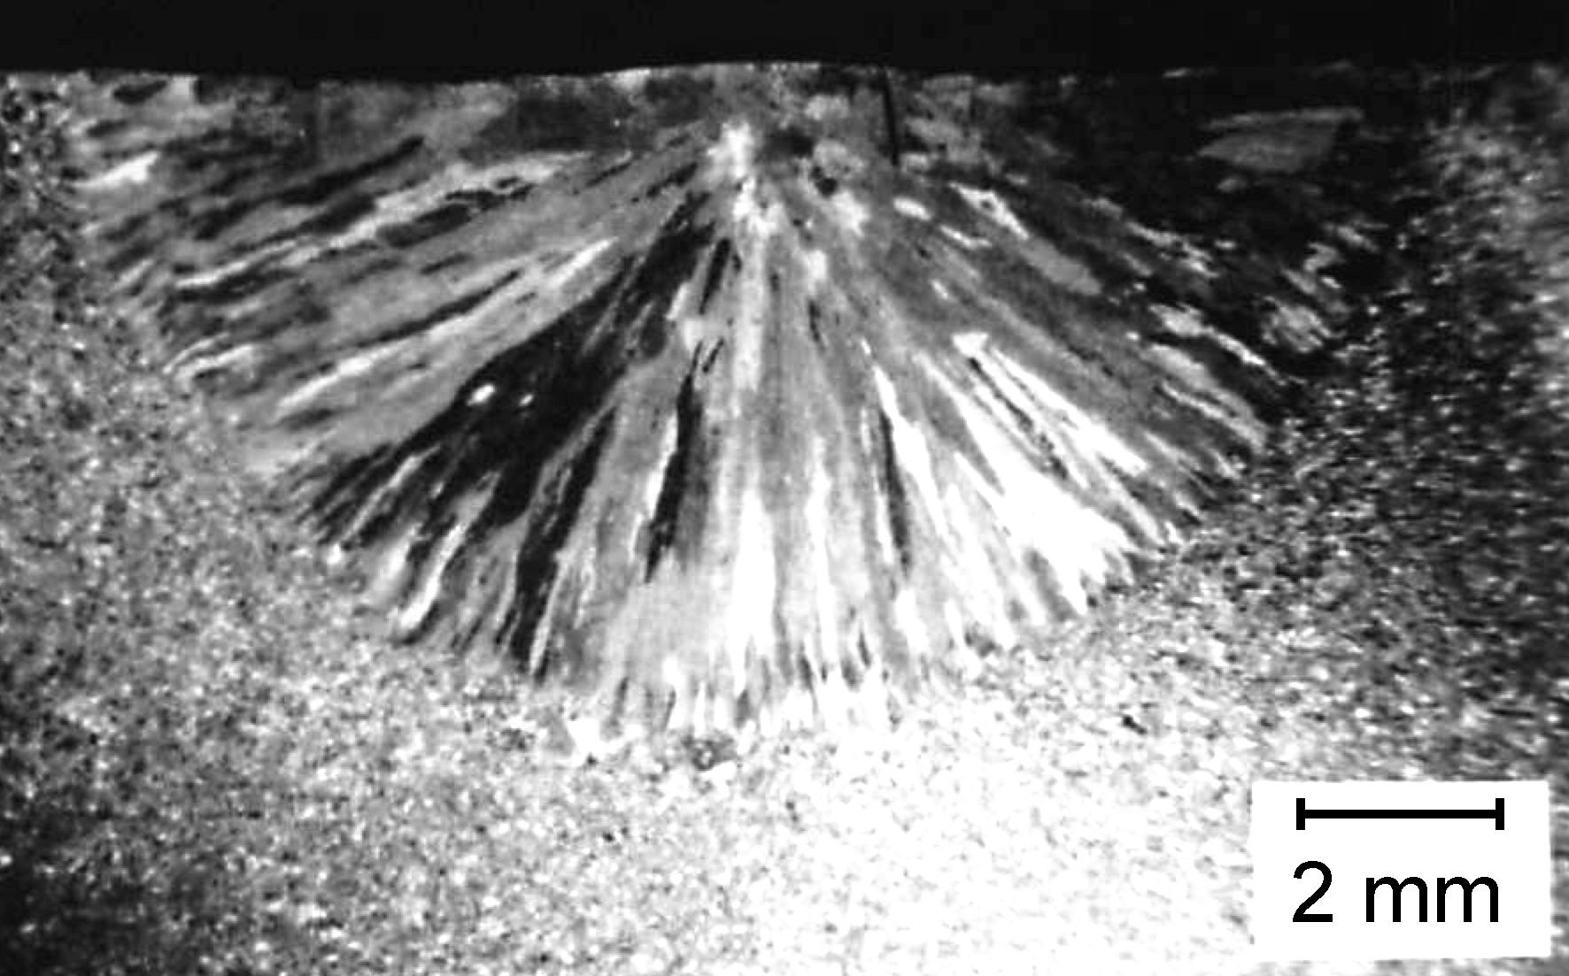
Anisotropic grain structures

Slide 12
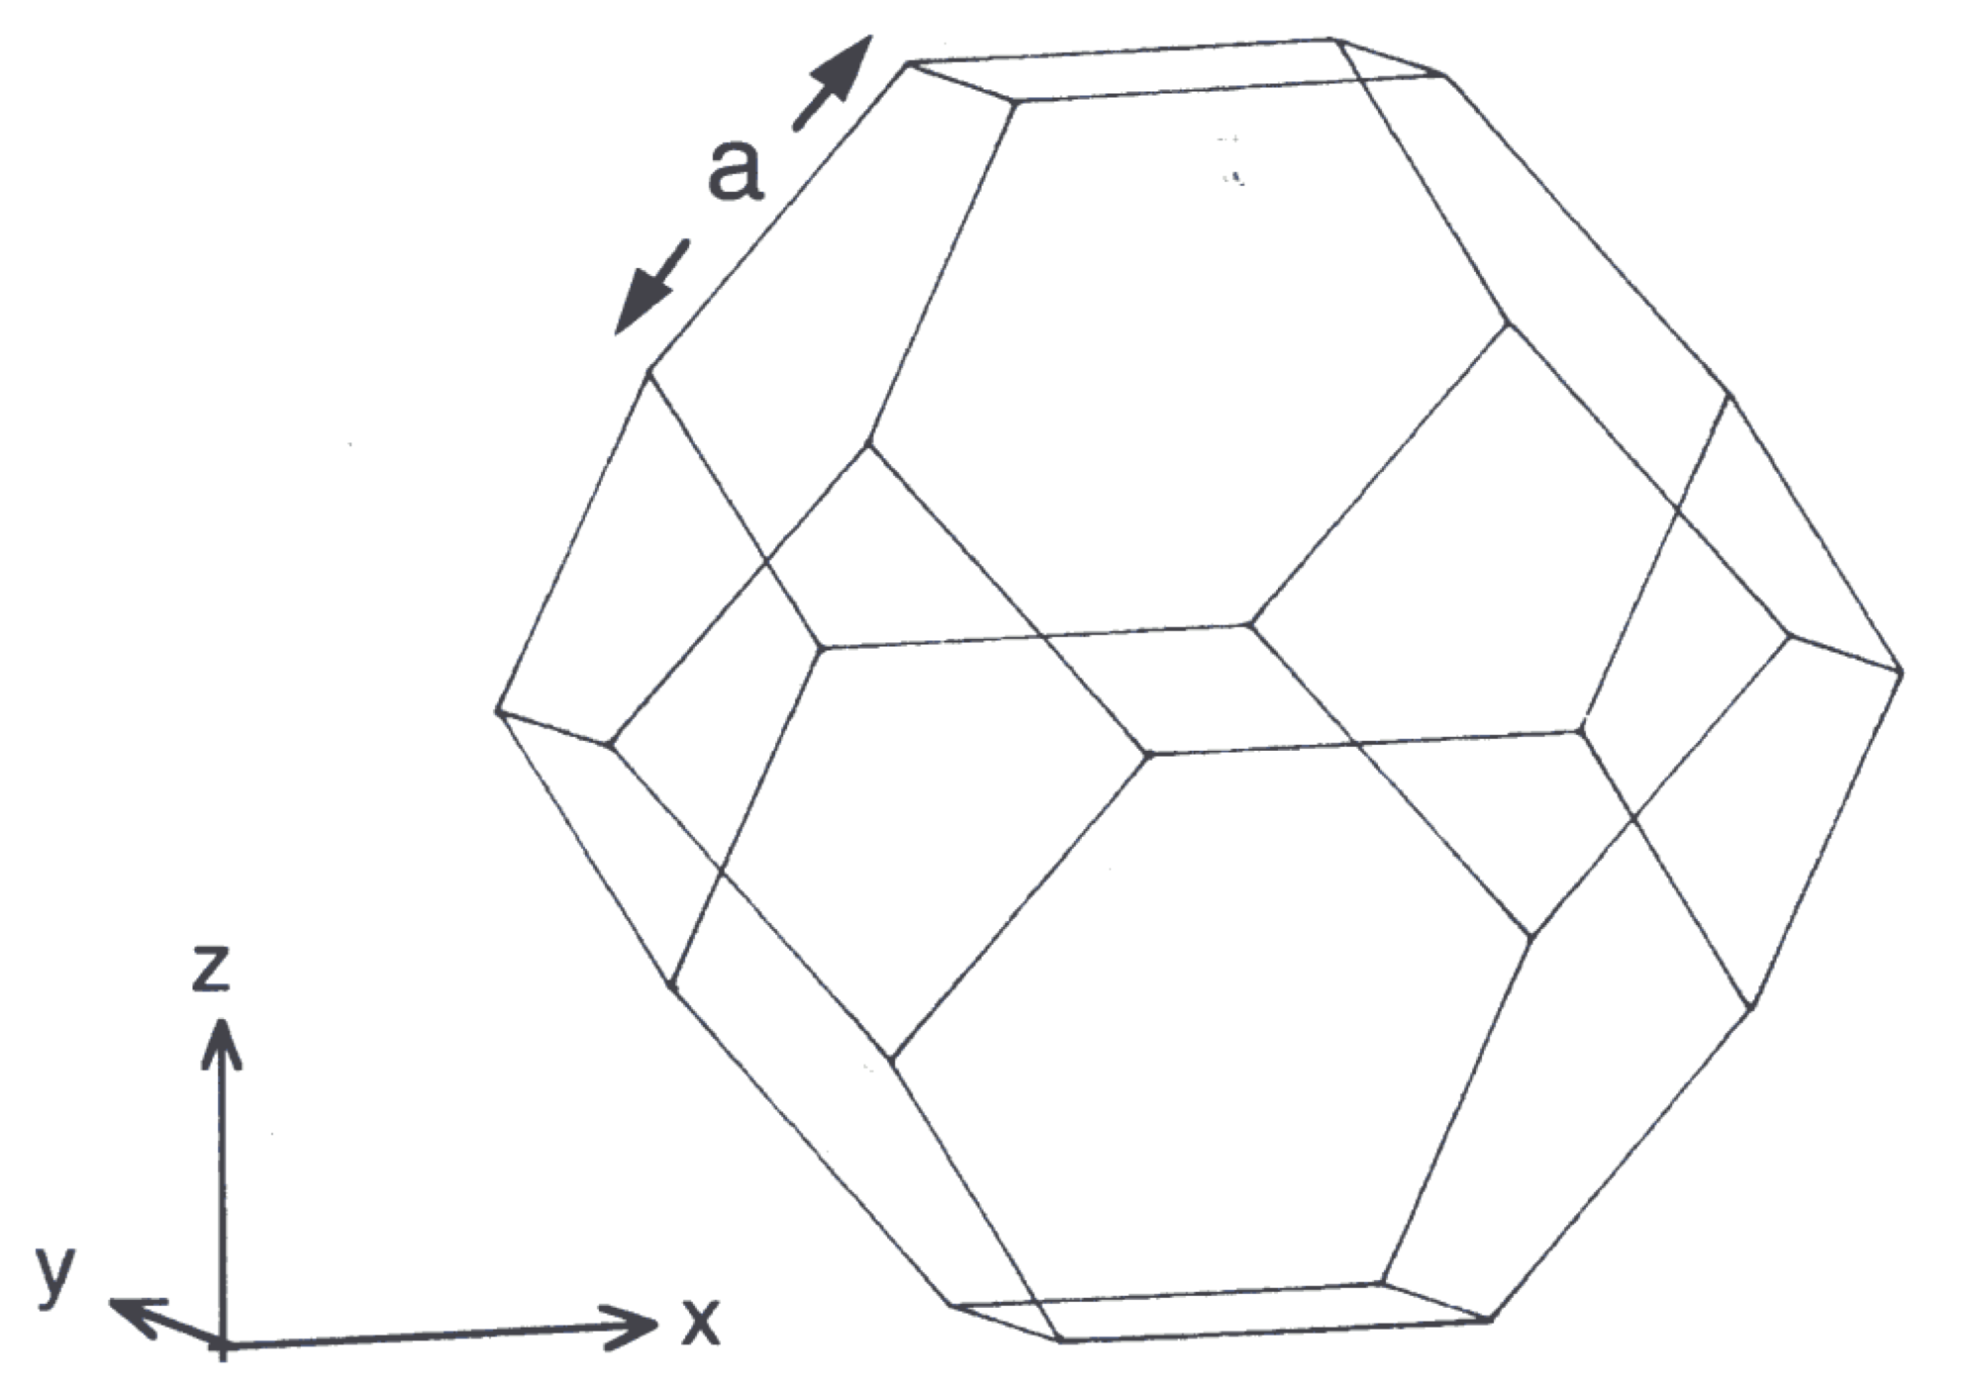
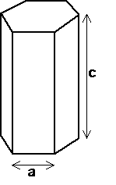

Slide 13
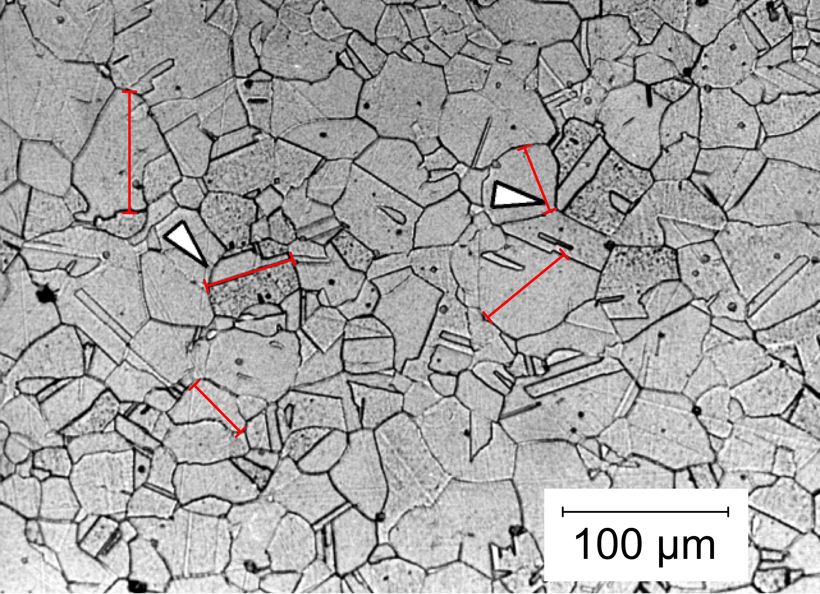
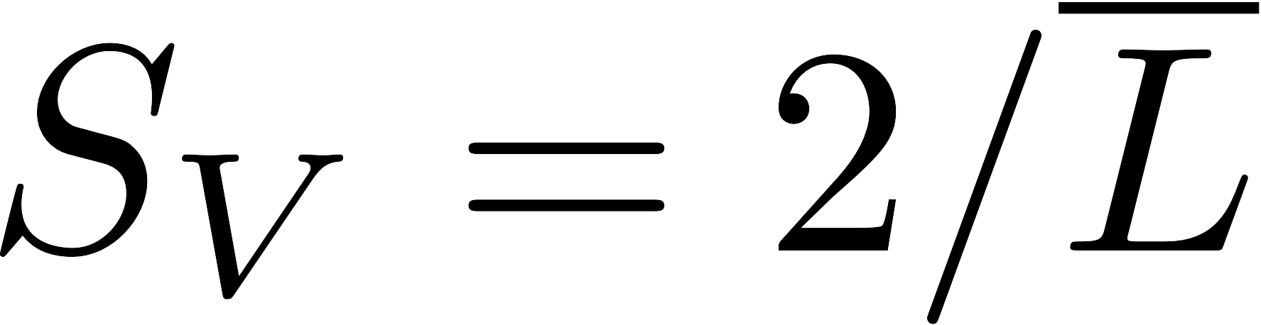

Slide 14
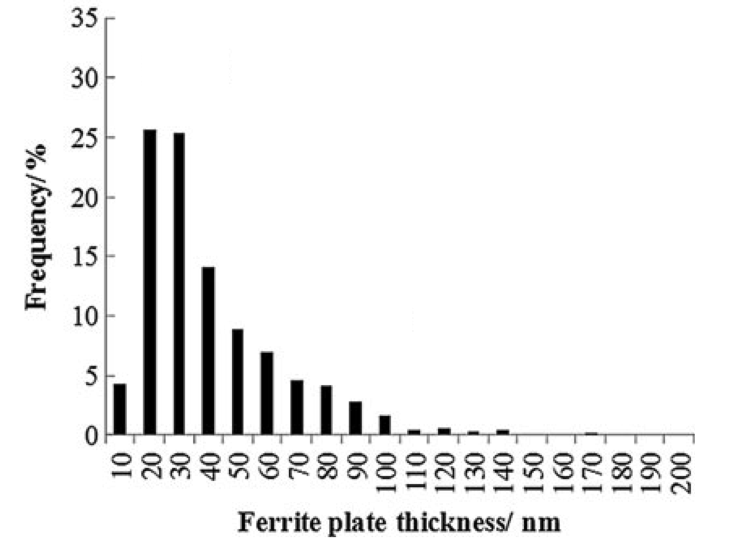
J. Mat. Sci. 48 (2013)

Slide 15
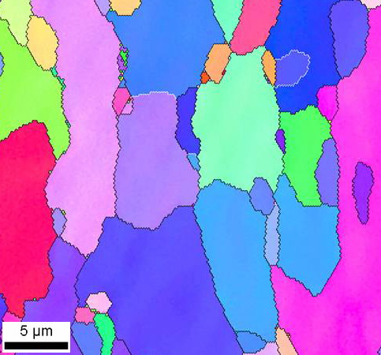

Slide 16
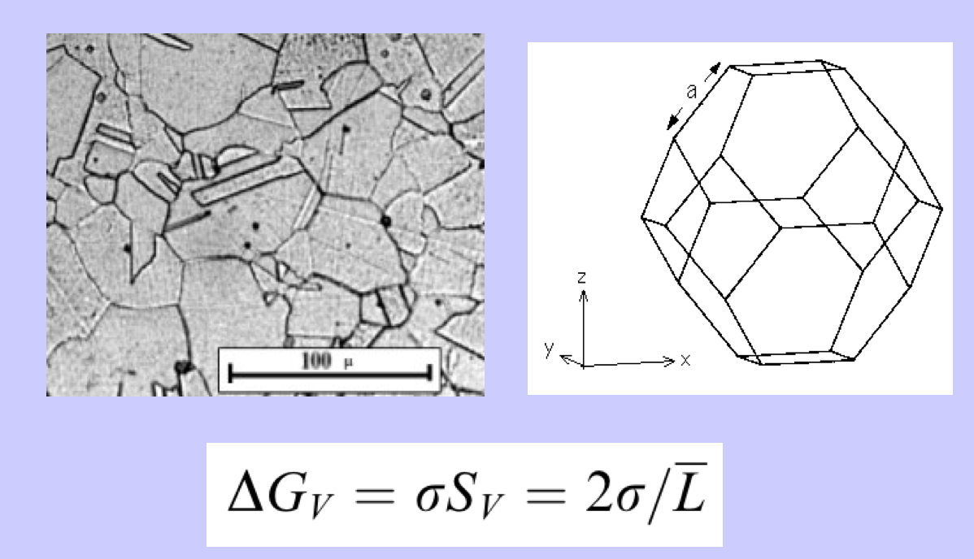
Smallest size that can be achieved in a polycrystalline substance?

Slide 17
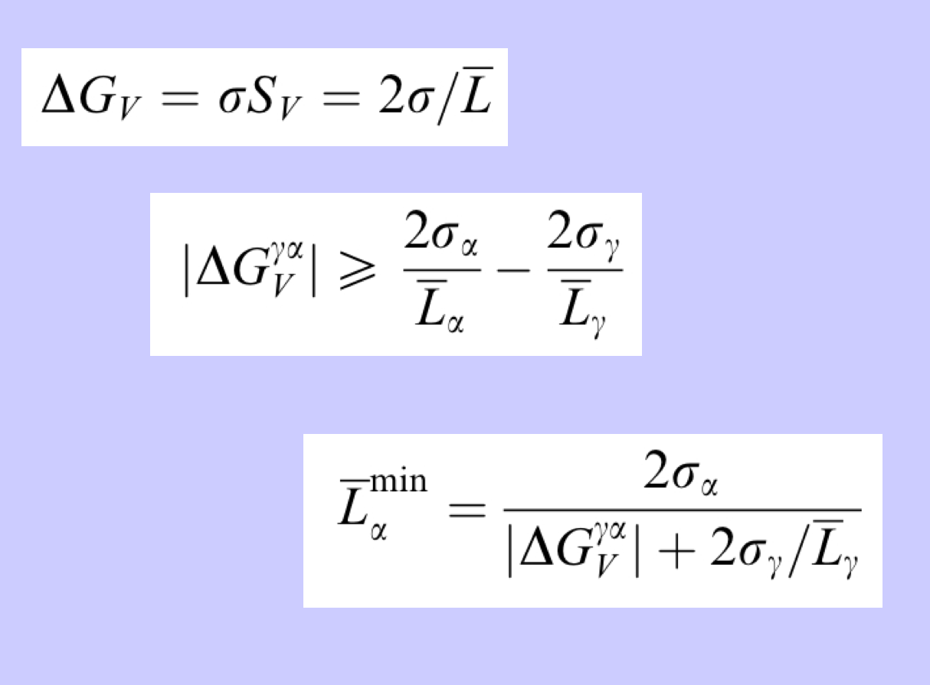

Slide 18
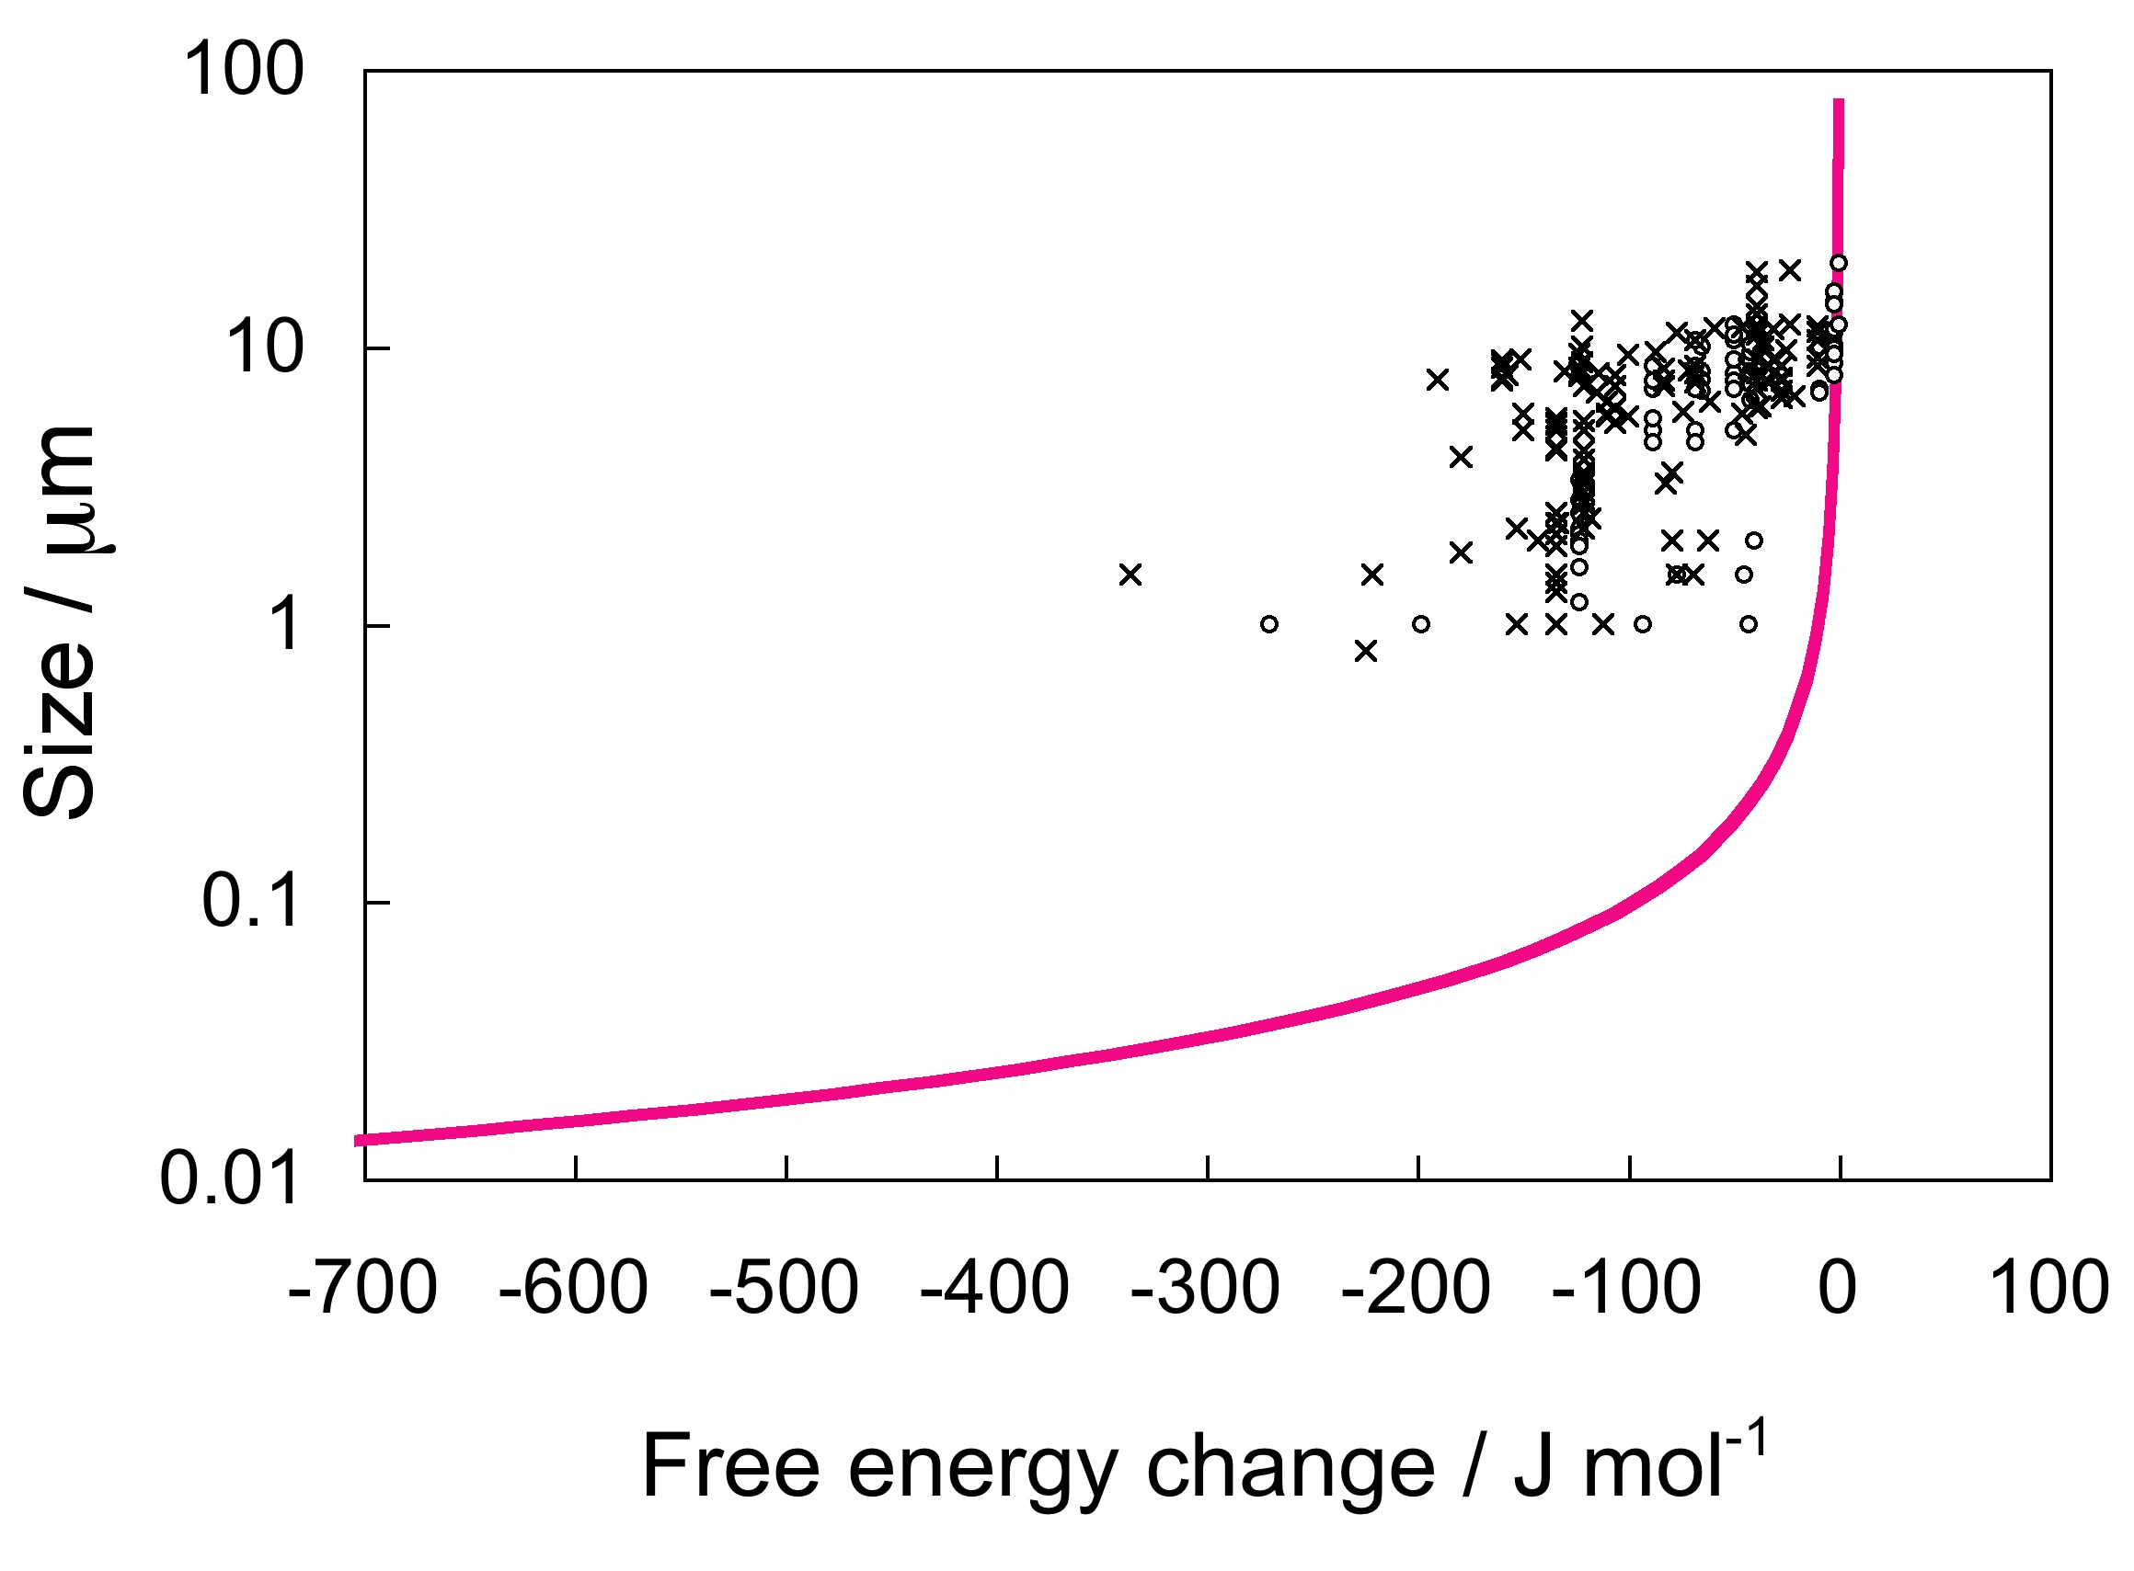
Yokota & Bhadeshia, 2004

Slide 19
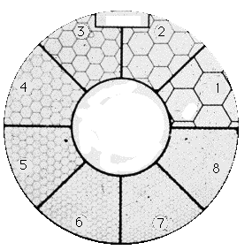

Slide 20
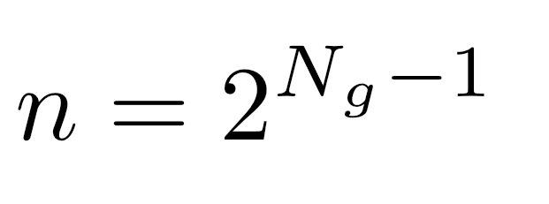
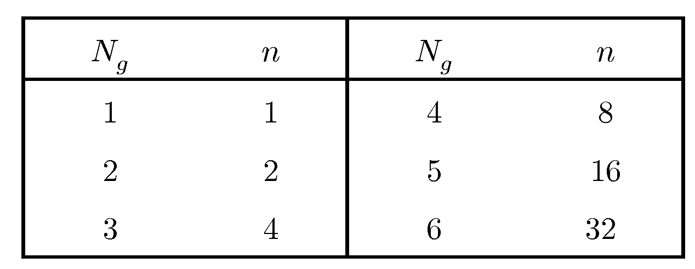
number of grains per square inch at x100
ASTM grain size number

Slide 21
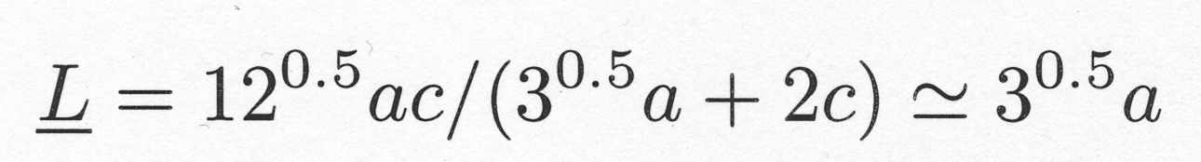
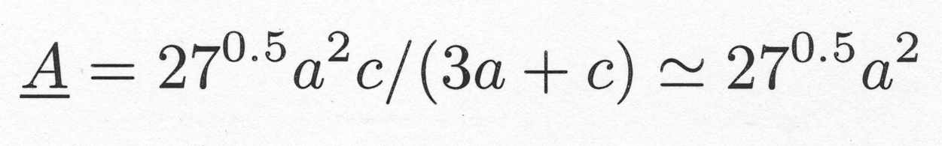
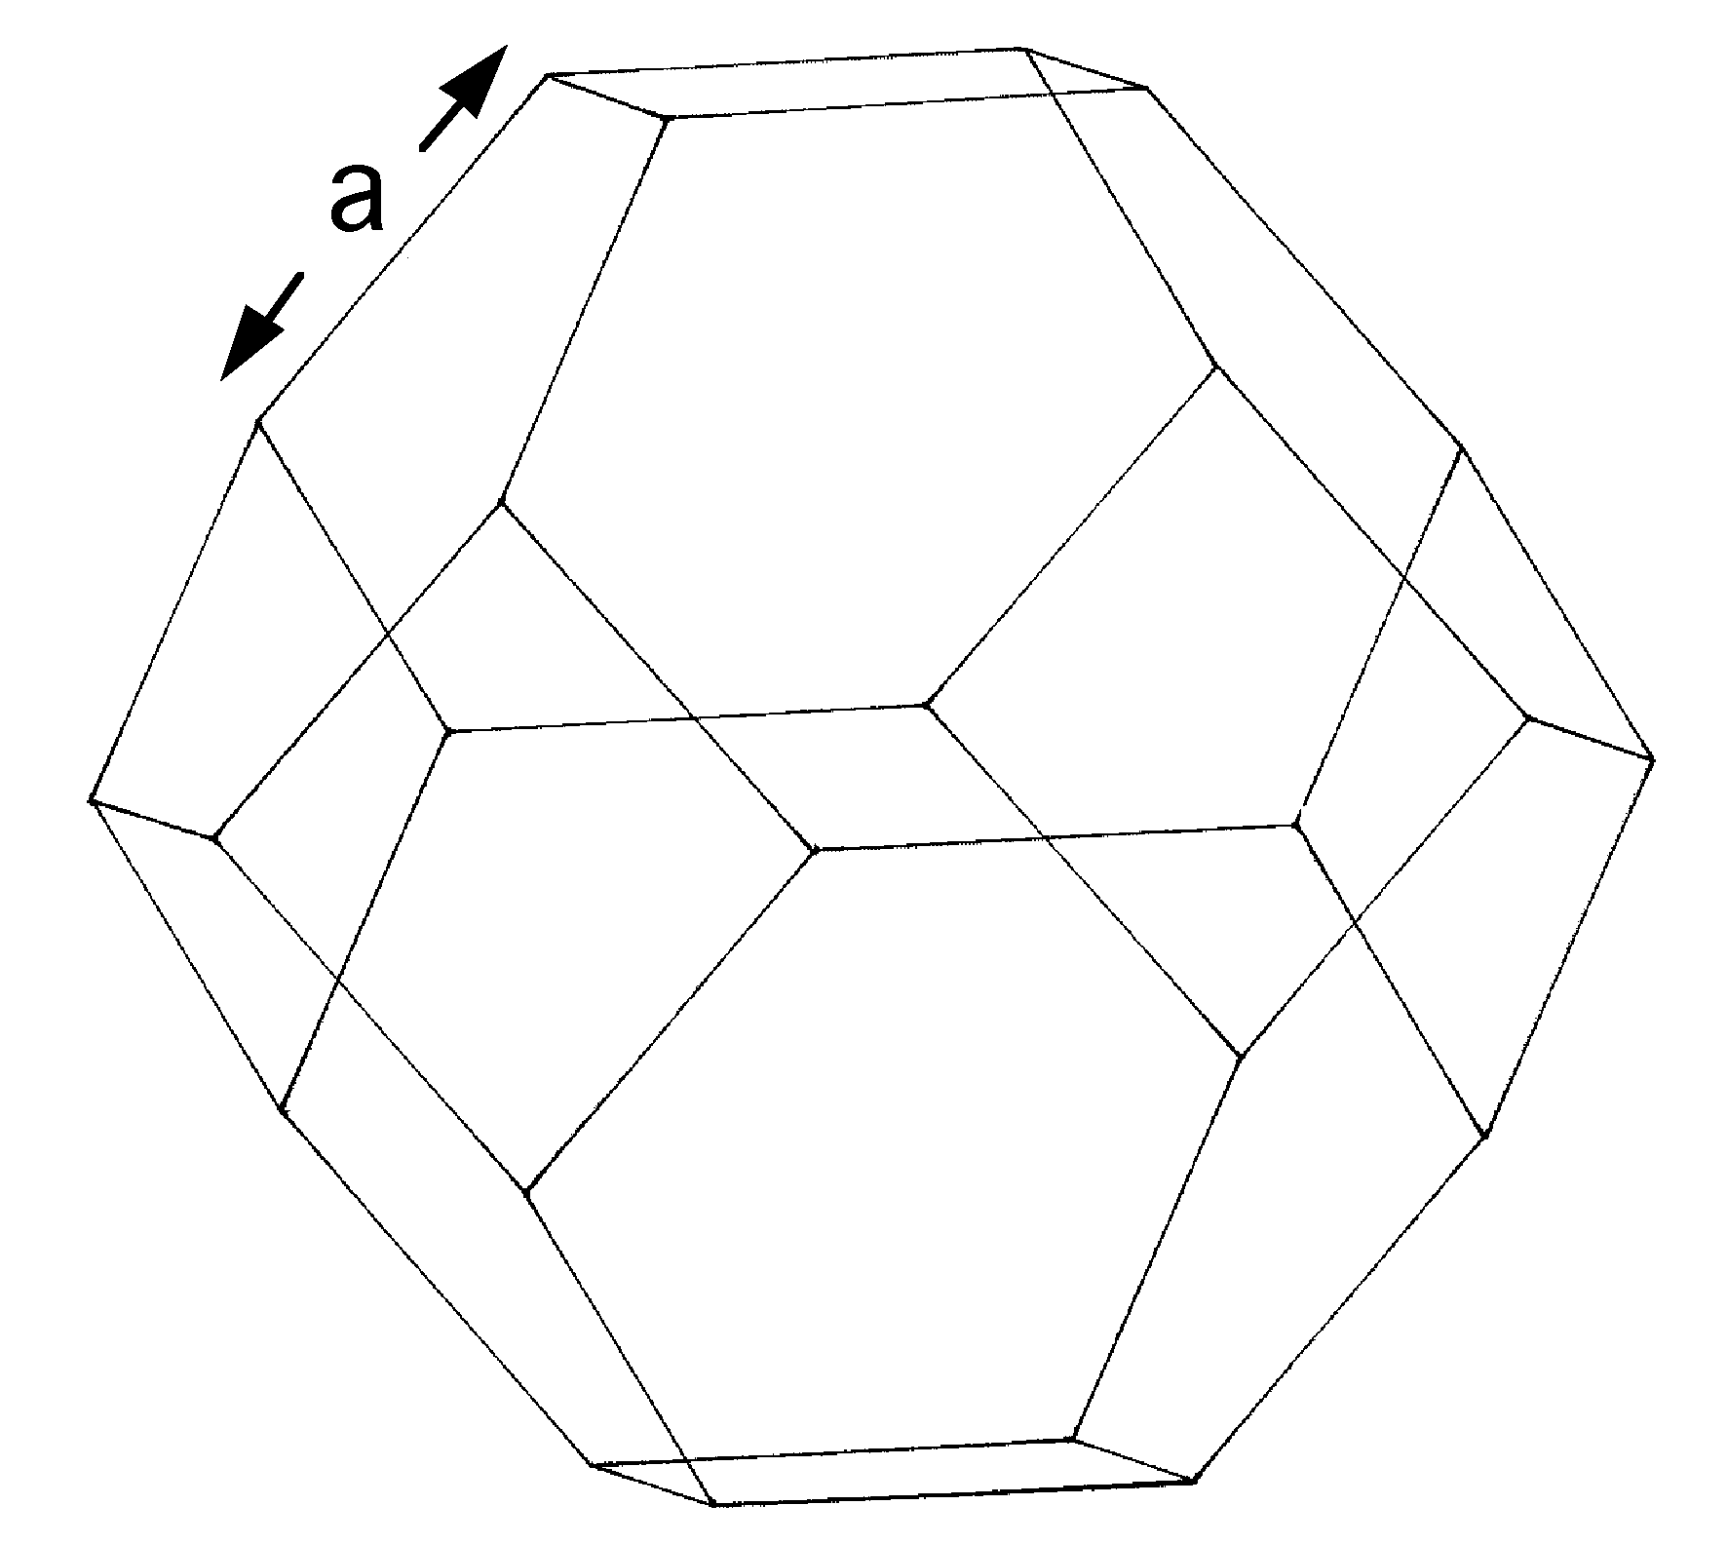

Slide 22
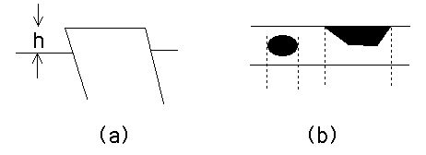
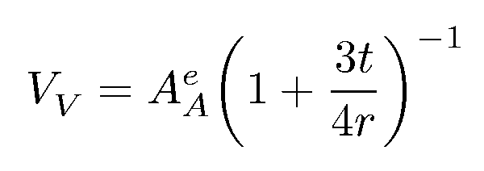
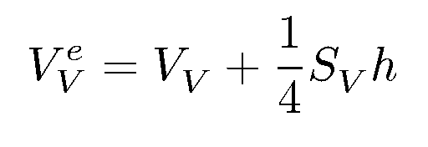
Systematic Errors

Slide 23
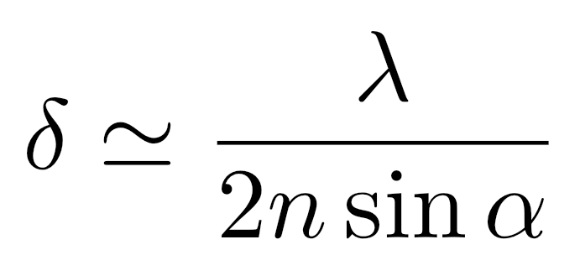

Systematic Errors

Slide 24
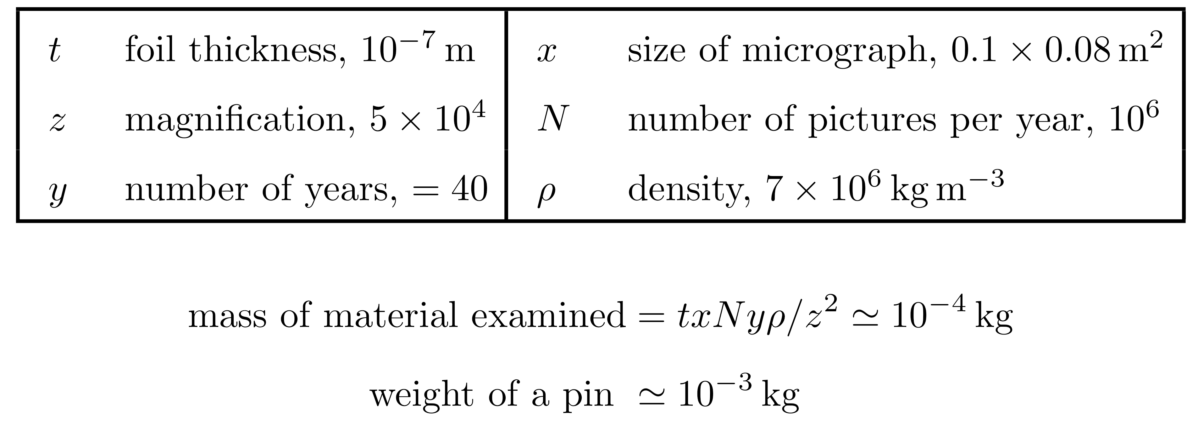
Systematic Errors

Slide 25
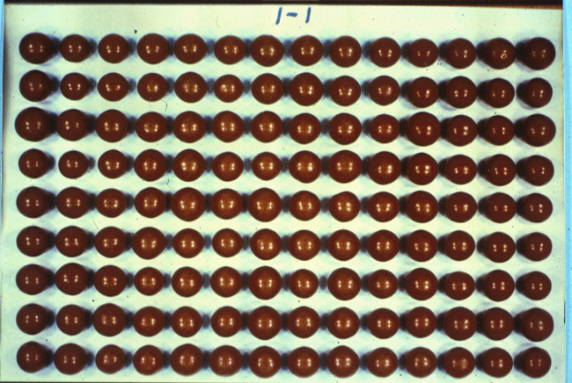
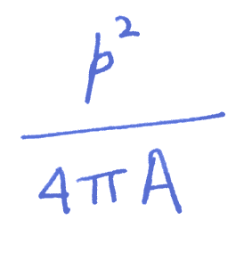
Shape parameters: roundness

Slide 26
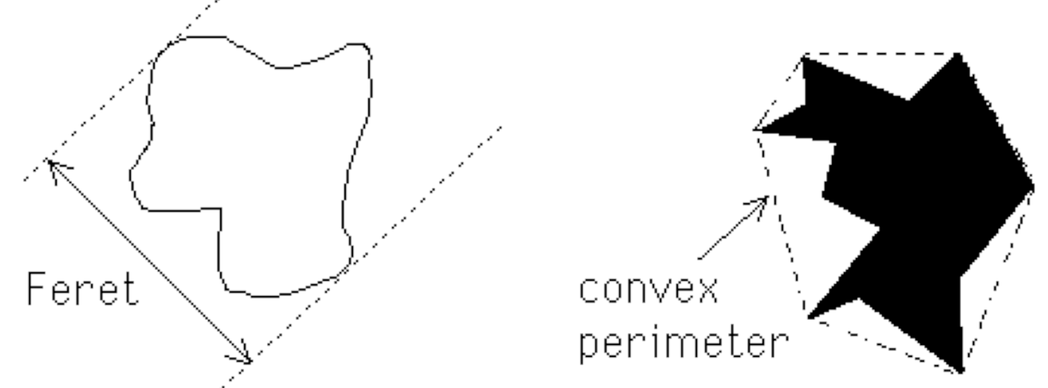

Slide 27
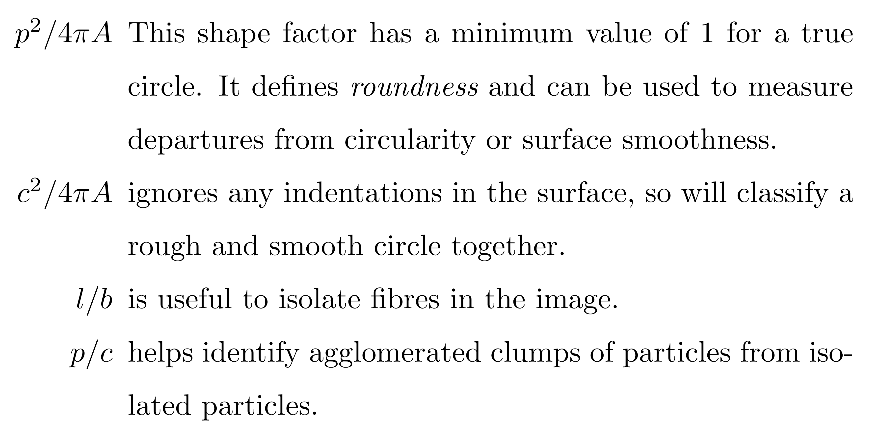

Slide 28
Percolation in the solid state
Important in describing, e.g., transport in
multiphase alloys
as a function of volume fraction, shape,
orientation
as a function of time as the
structure evolves
or as a function of external stimulation

Slide 29
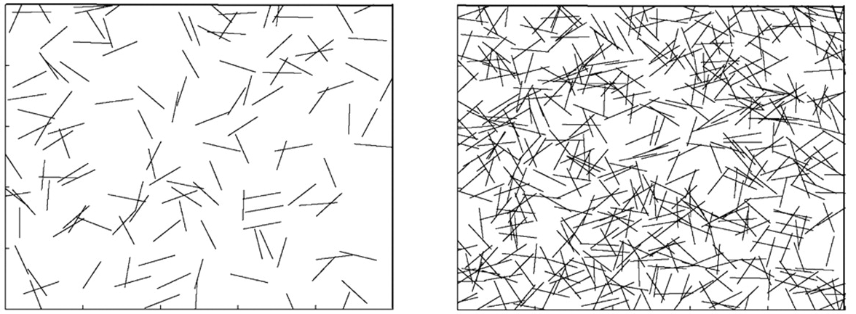
At what point do microscopic cracks percolate?

Slide 30
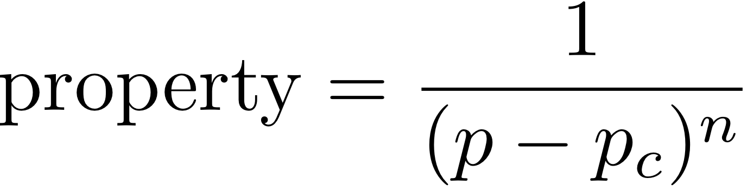
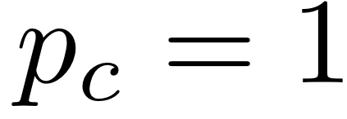
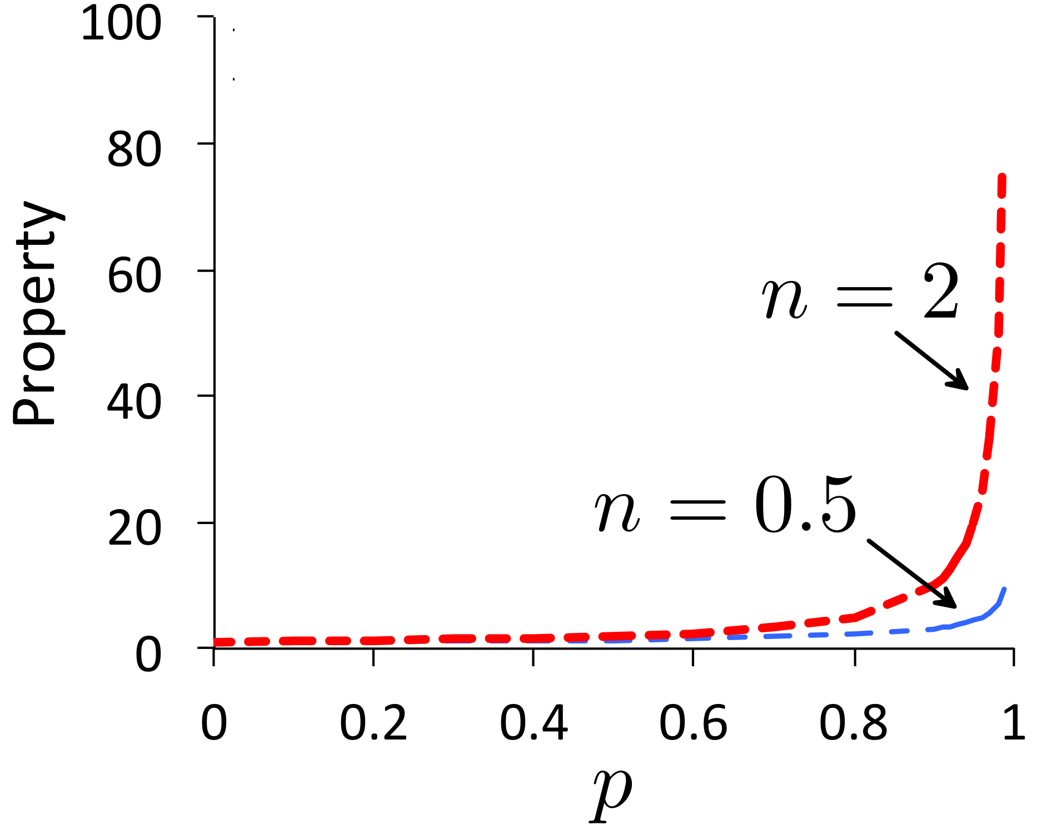

Slide 31
Expect large changes at percolation threshold only if difference in properties between phases is large.

Slide 32
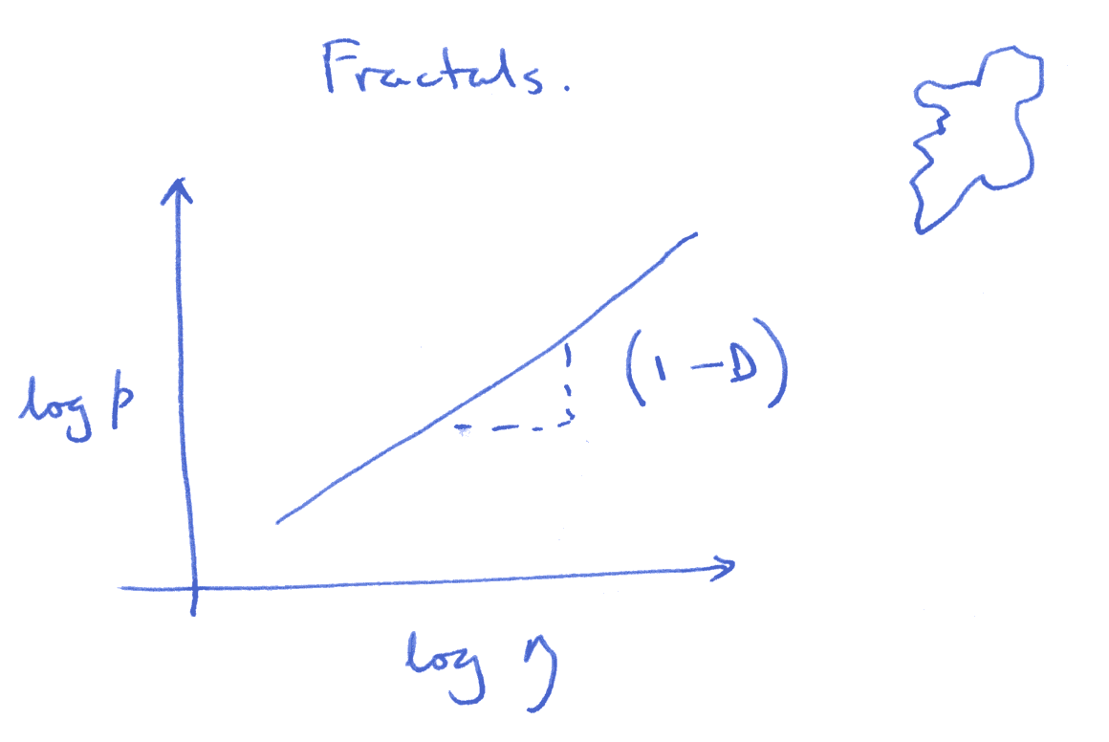
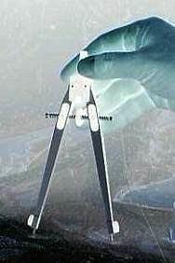

Slide 33
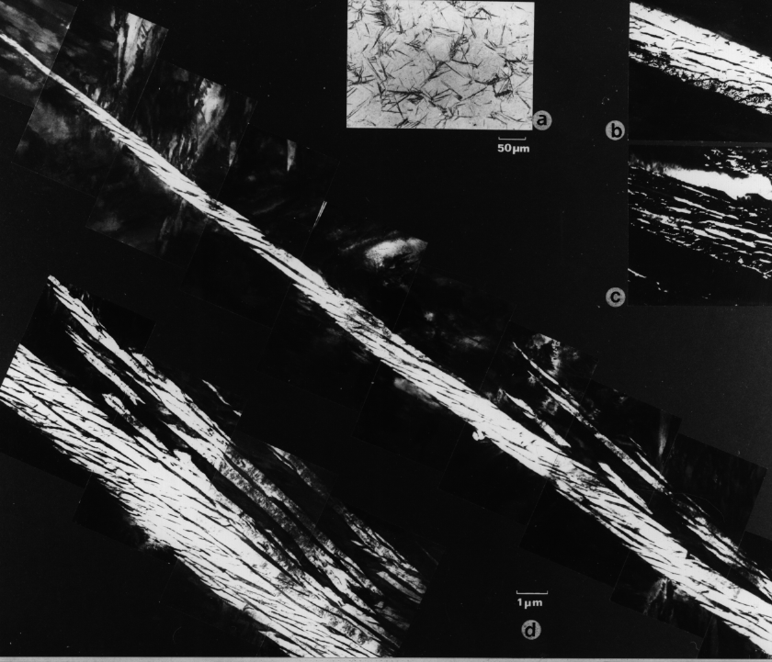
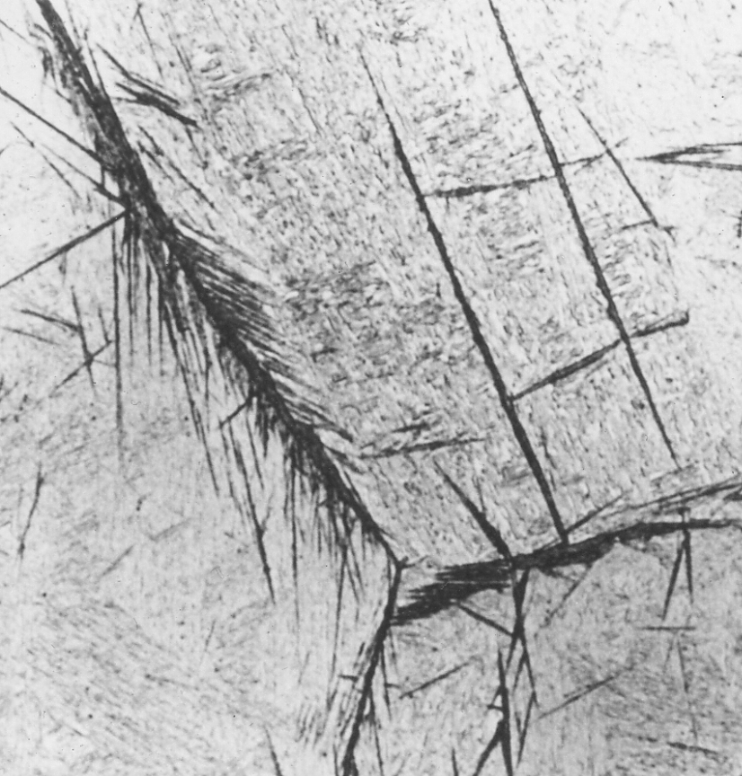
50 µm

Slide 34
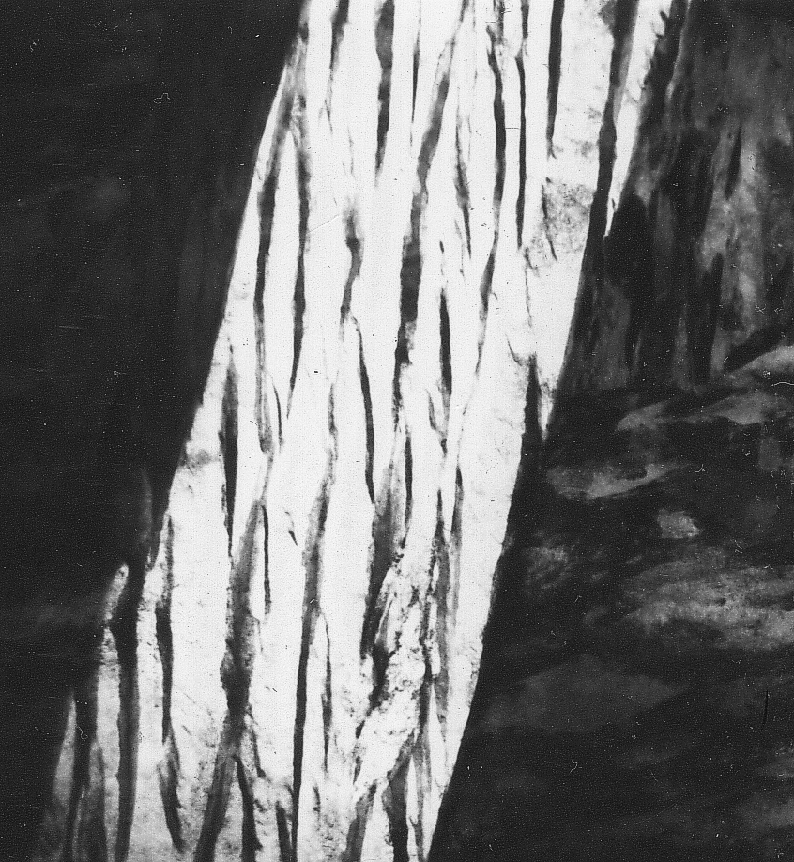
upper bainite
1 µm

Slide 35
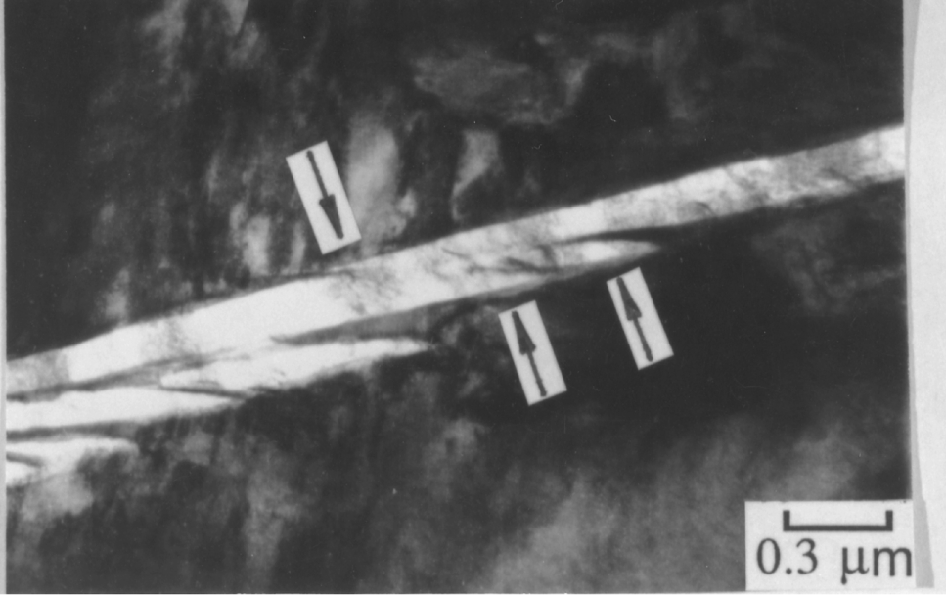

Slide 36
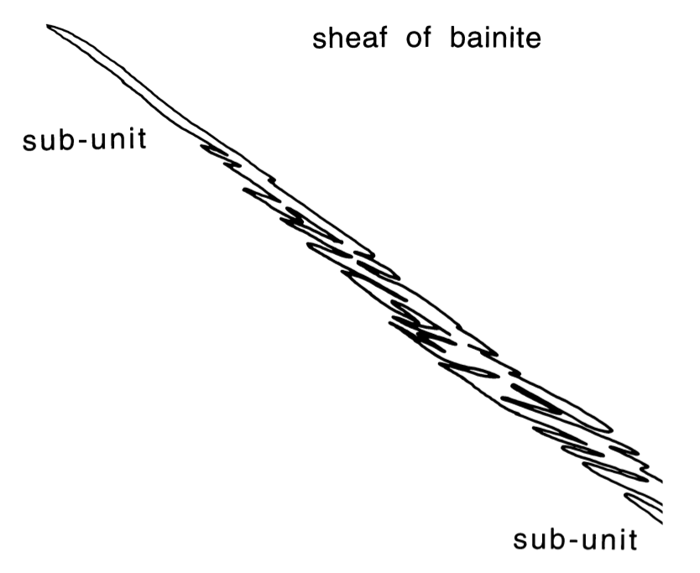
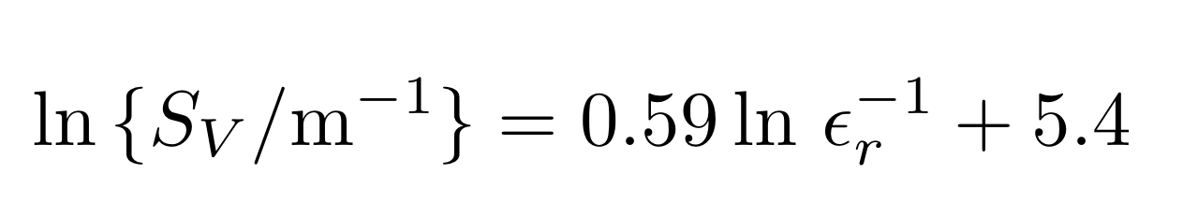

Sheaf is a rough object

Slide 37


γ
γ
α
α
α
Caballero, Mateo, Bhadeshia
200 Å

Slide 38


Slide 39

Sherif, 2005, Ph.D. thesis, Cambridge

Slide 40


Above percolation threshold
Below percolation threshold

Slide 41

Geometrical percolation threshold of overlapping ellipsoids

Slide 42

Hydrogen diffusion
Fielding, Song, Han, Bhadeshia, Suh, Proc. Roy. Soc. A, 2014
Kazum et al. DOI: 10.1007/s11661-016-3677-2

Slide 43
Robert T. DeHoff, Frederick Nims Rhines, University of Florida
McGraw-Hill, 1968 - 422 pages
The Quantitative Description of the Microstructure of Materials
by Krzysztof Jan Kurzydlowski, Brian Ralph, CRC Press, 1995,
95 pages

