Slide 1
^{On-line tools,}
^{quality control}
^{automated assessment}
^{- an amateur approach}
www.msm.cam.ac.uk/phase-trans/teaching.html

Slide 2
factual stories
book reviews,
reviews
Resource Library for
Metals and Alloys
calculations
stills
worked examples
Q & A

Slide 3
Metals and alloys (2nd year)
Crystallography (3rd year)
Metals and alloys
Metallography
Steels (4th year)
Thermodynamics, phase diagrams
Mesoscale, multiscale modelling
Kinetics, microstructure modelling
Finite element analysis
Information theory, patterns, neural networks
Process modelling
Mathematical crystallography
Laboratory classes, seminars
+ related topics I do not teach but am interested in.

Slide 4
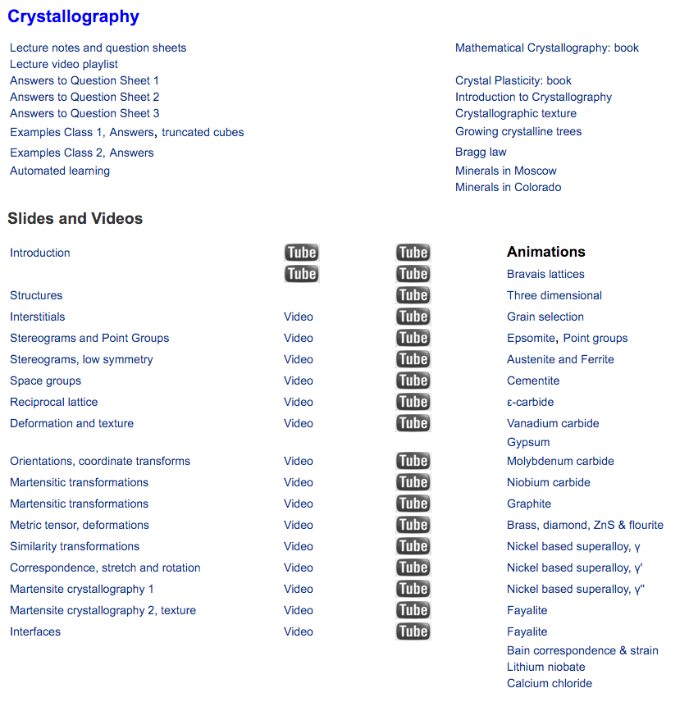

Slide 5
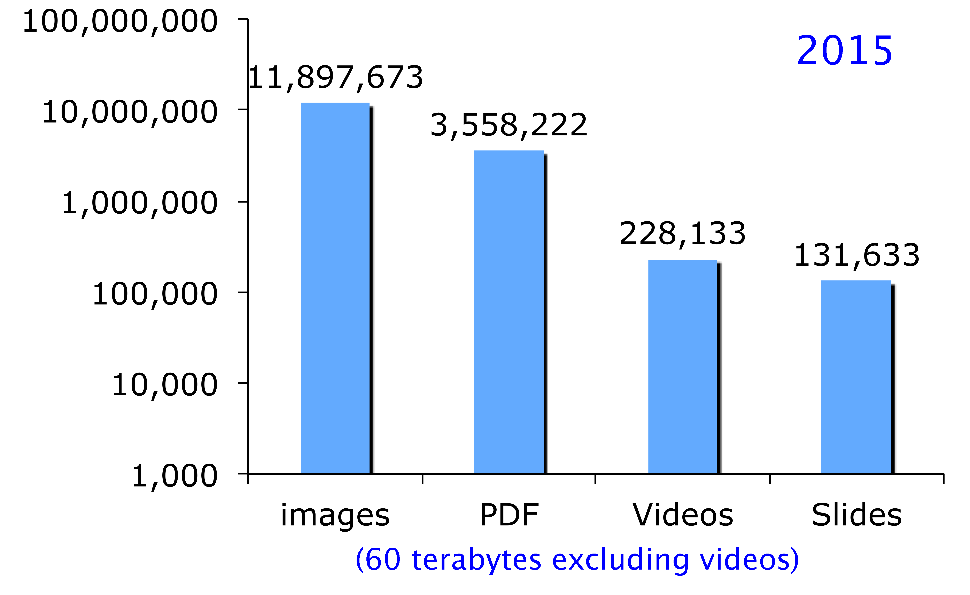

Slide 7
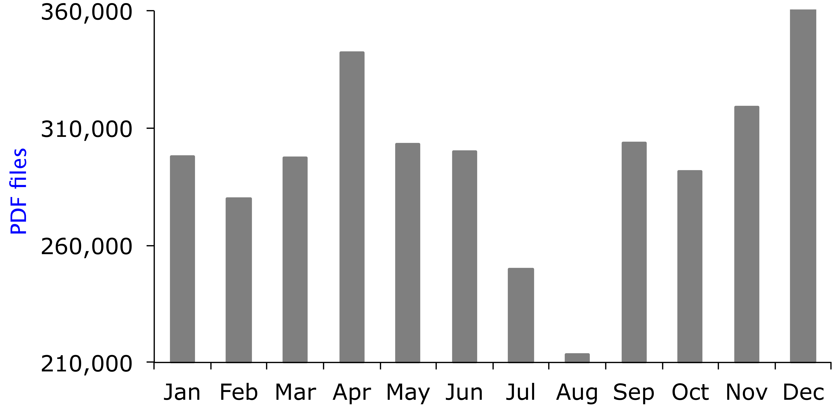
2015

Slide 8
Quality
cost effective
transformative
copyright issues
fitness for purpose
Notes:
cost effective (in terms of my time, and monetary cost)
my purpose goes beyond this University
Change student perceptions about difficulty, and the University culture

Slide 9
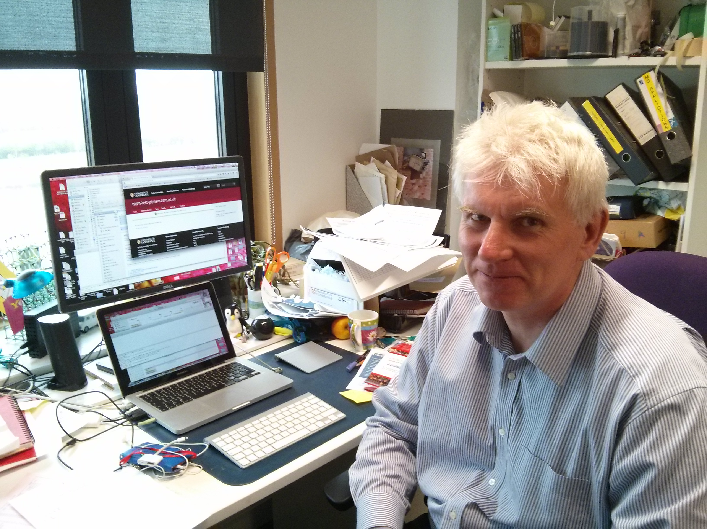
Quality: cost effective?
cost effective
Zero cost other than network traffic
money
latent costs
time
network traffic 60 Tb per annum
total cost per annum £1000
Zero cost?
Notes:
cost effective (in terms of my time, and monetary cost)
my purpose goes beyond this University
Change student perceptions about difficulty, and the University culture

Slide 10
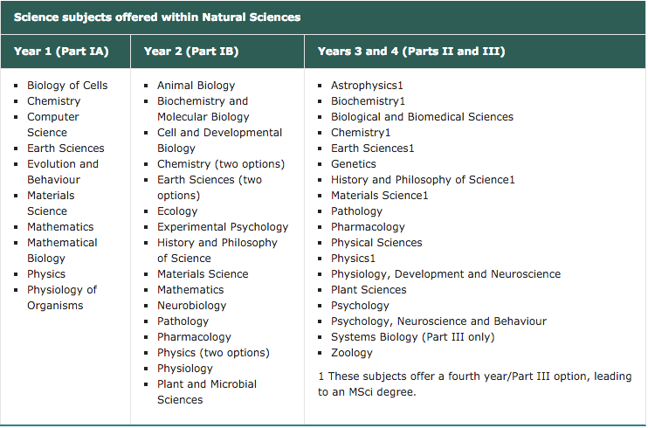
2700 applications, 525 accepted

Slide 11
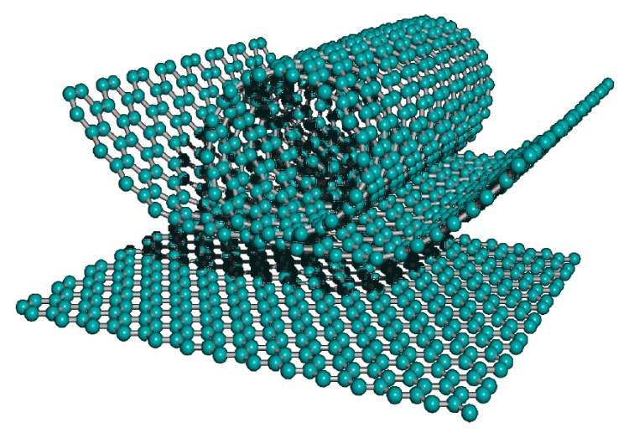
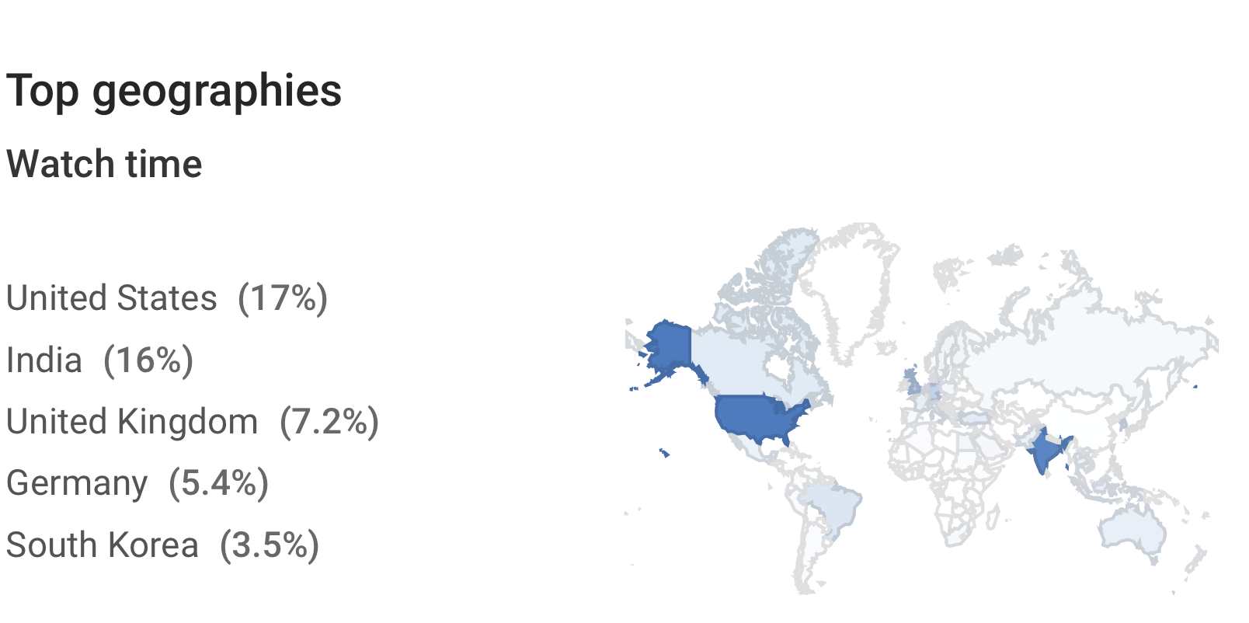
Quality: transformative
change perceptions
challenge
reach further than ever

Slide 12
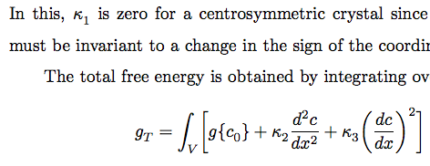
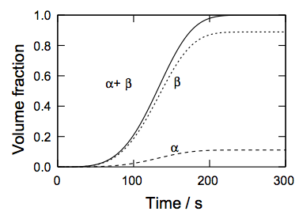
….... Quality: transformative
immortality

Slide 13
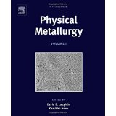
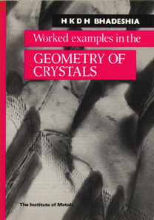
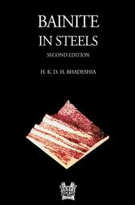
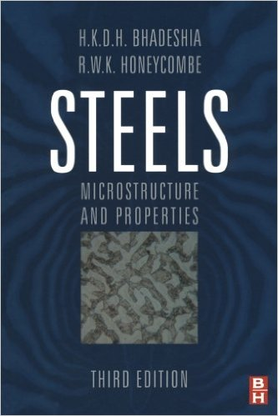
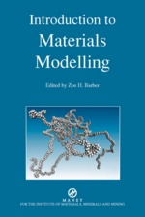
Quality: copyright
huge advantage in creating well-presented, copyright-free materials from time zero

Slide 14
Quality: fitness for purpose
mistakes and thermodynamics
learning and assessment

Slide 15
Assessment of small numbers (45) and very large numbers of students (>100,000)
MOOCs* open-source software
(Harvard, MIT)
Fully automated assessment, which goes far far beyond multiple choice.
*Massive open online courses

Slide 16
University of Cambridge does not participate (quotes from letter to Harry from Academic Division, on behalf of pro-vice chancellor for education)
little enthusiasm in the University
lack of clear business models
implications for the Cambridge `brand’
variable quality …... [amongst] MOOC consortia

Slide 17
…. but in the good traditions of Cambridge academic freedom, the letter continued ....
no problem whatsoever if individuals who own the relevant IP wish individually to engage
….... provided that there is no implication that their offerings come with formal University approval or imply any Cambridge accreditation.

Slide 19
How I use MOOCs in Cambridge
students asked to complete exercise after each lecture given to live audience
therefore understand what is not understood
supervisions or ad hoc questions
quantitative feedback on MOOC performance in supervision reports
MOOC used in revision before examinations

Slide 20
How I use MOOCs in Leuven and POSTECH
Leuven: voluntary examination, with a letter explaining performance on my headed notepaper
POSTECH: MOOCs form the final examination for the course, consistent with POSTECH quality requirements

Slide 21
My MOOCs
Not yet on the main edX platform
Videos are of amateur nature but too expensive to match the other edX content
Currently useful only in live teaching internationally.
Therefore, strictly, OOCs

Slide 22
Conclusions about amateur approach
very cheap
greatly enhances learning
does not require professional help
does not require approval by any authority
a great deal of fun

