Slide 1


Strength of strong materials: graphene, spider’s silk and steel
www.msm.cam.ac.uk/phase-trans

Slide 2
Purpose
Focus on structural materials and how to assess them.
Study two incredibly successful materials
Study one new material

Slide 3
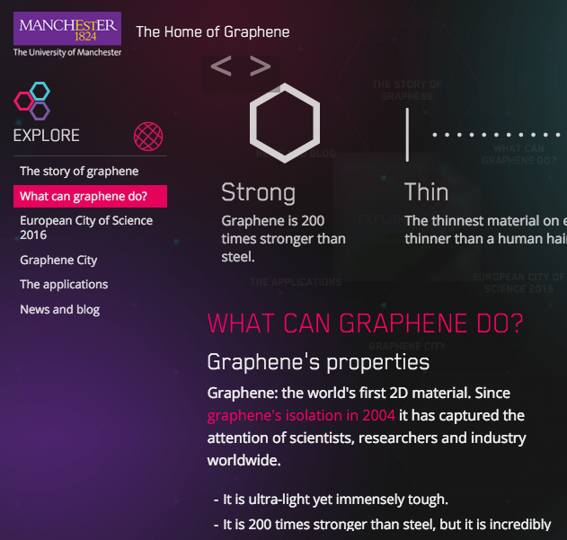
Graphene
200 times
stronger than
steel
immensely
tough

Slide 4
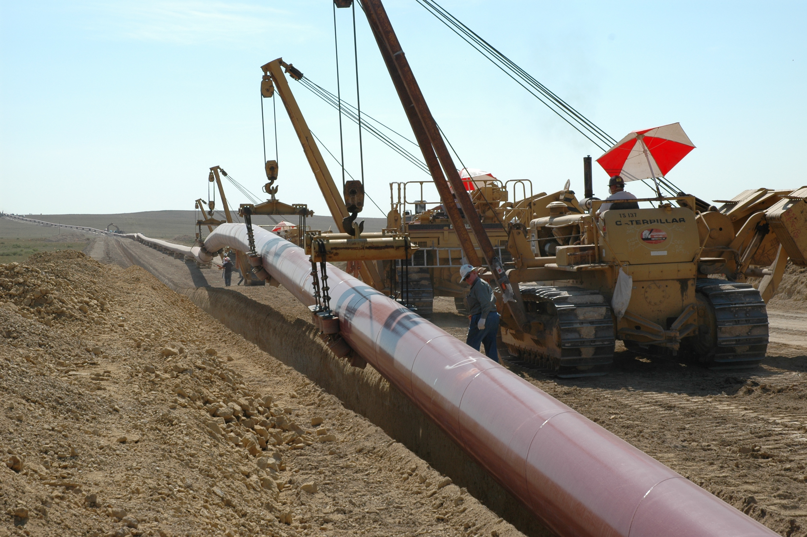
3000 MPa
1500 MPa
500 MPa

Slide 5
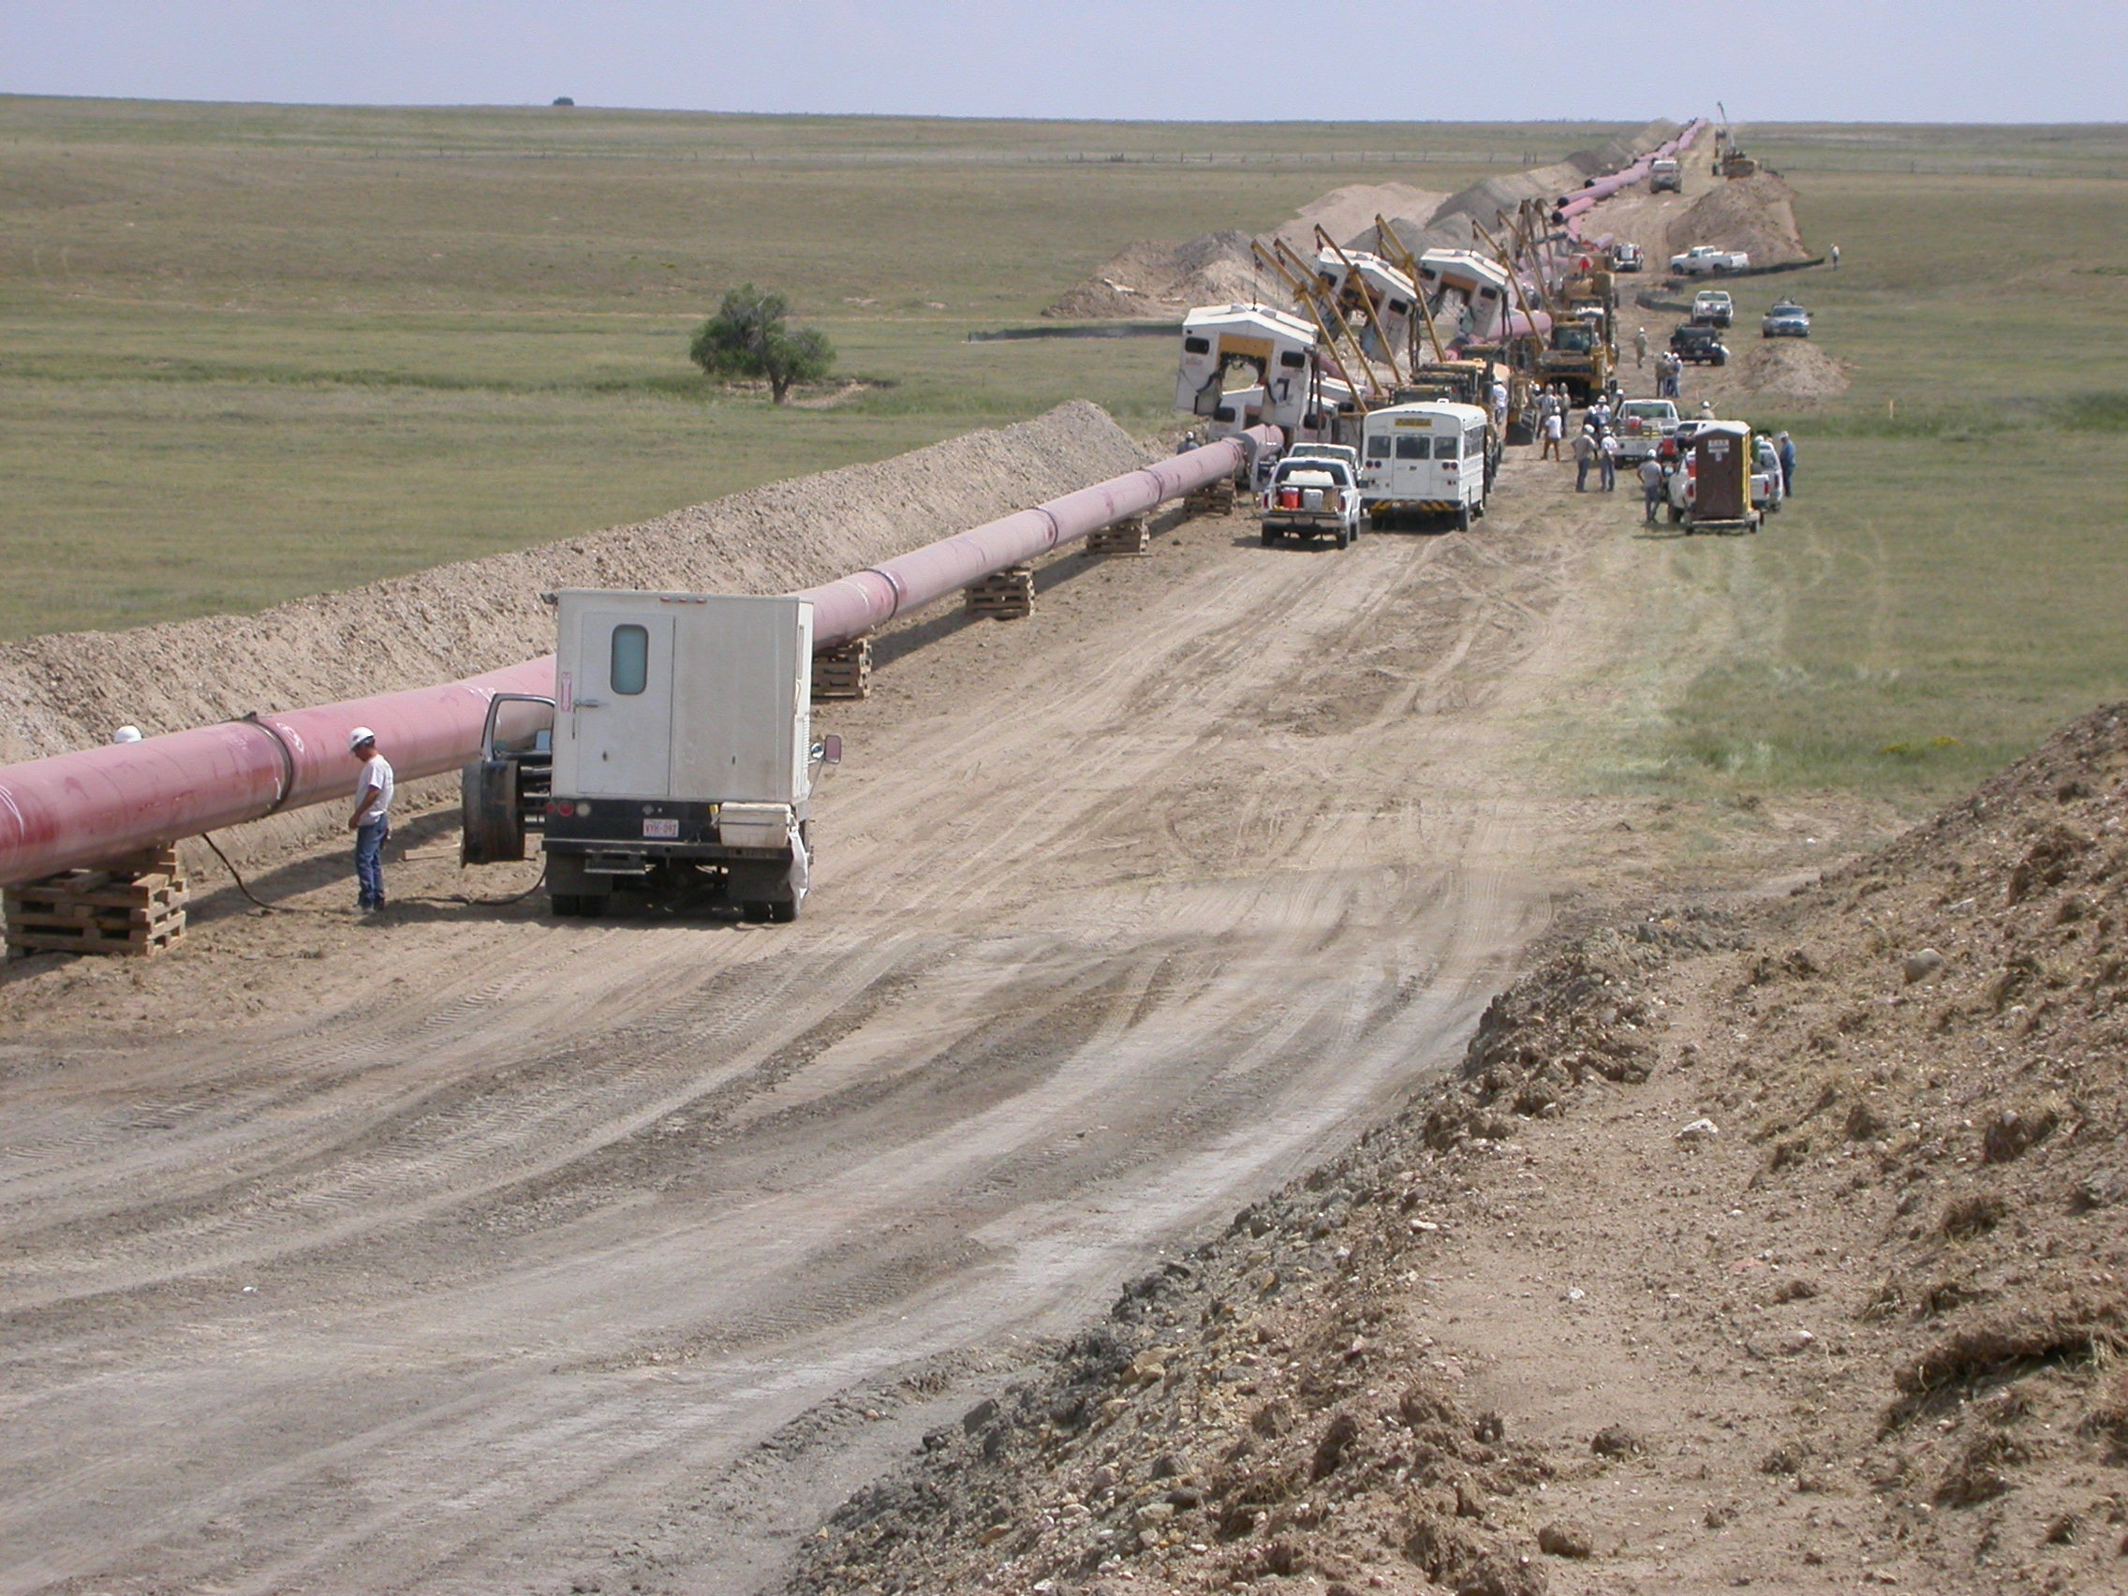
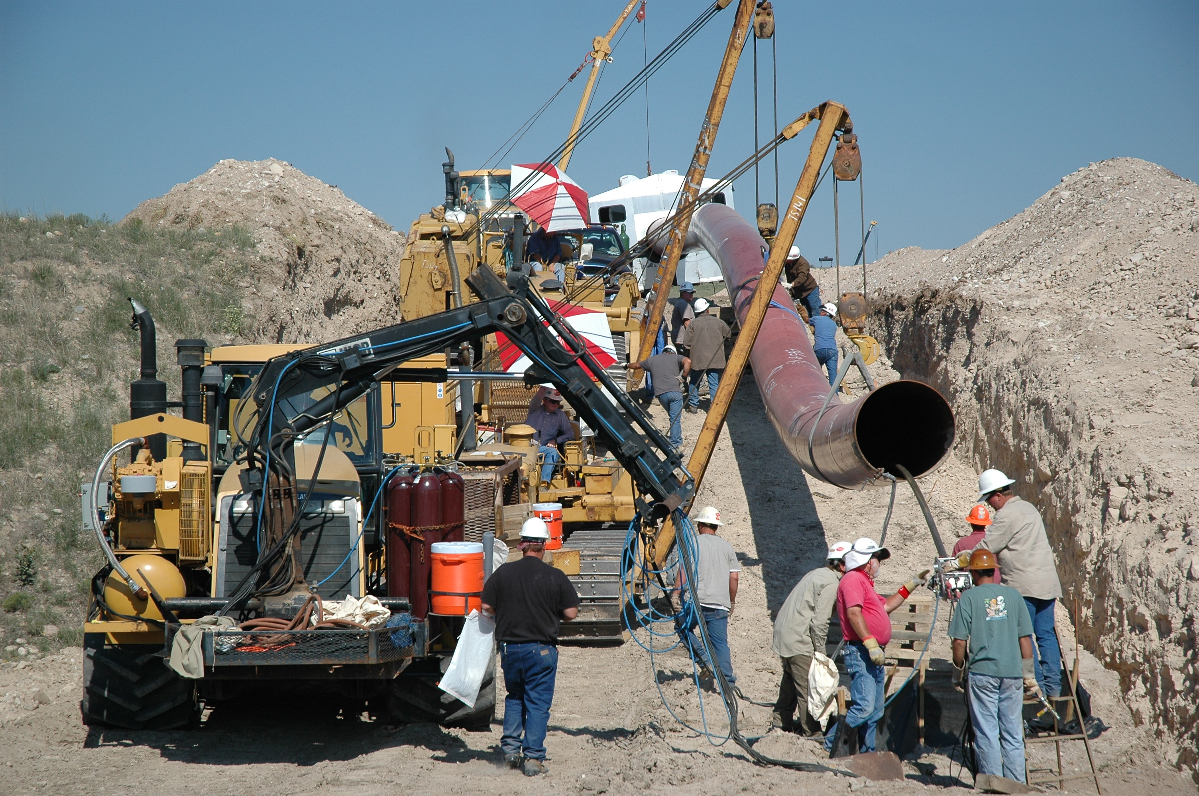

Slide 6
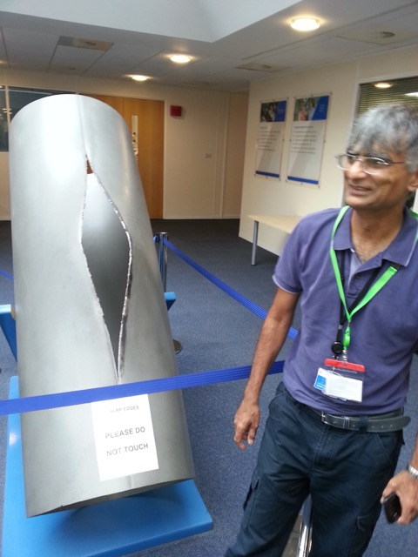

Slide 7
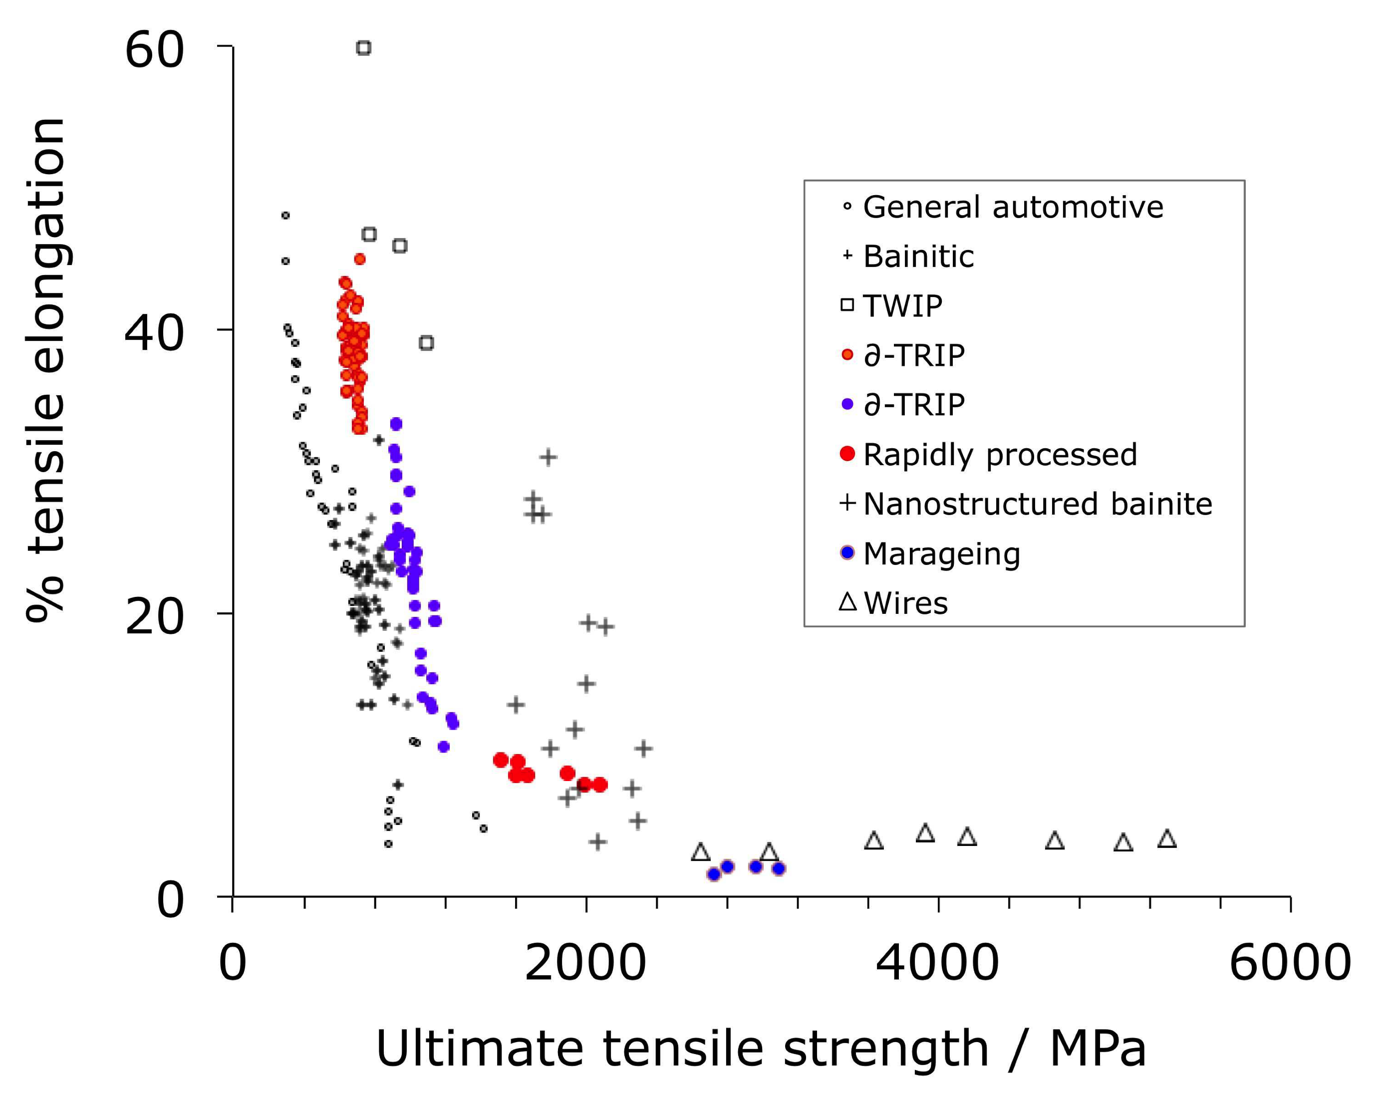
Total: 1.4 billion tonnes per annum

Slide 8
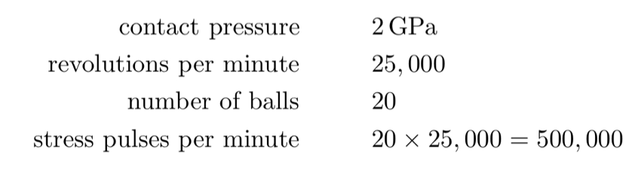
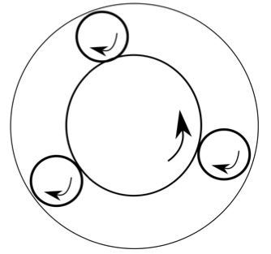


Slide 9
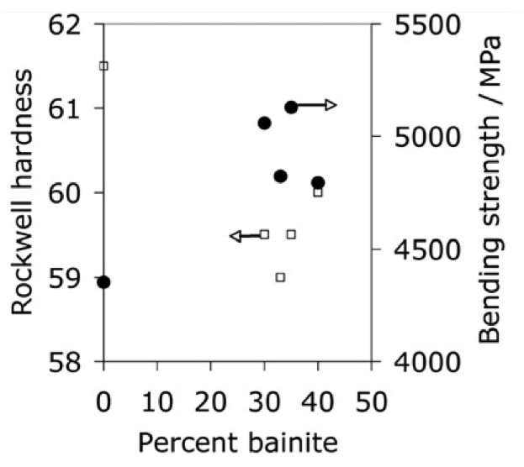
Li et al. 1993

Slide 10
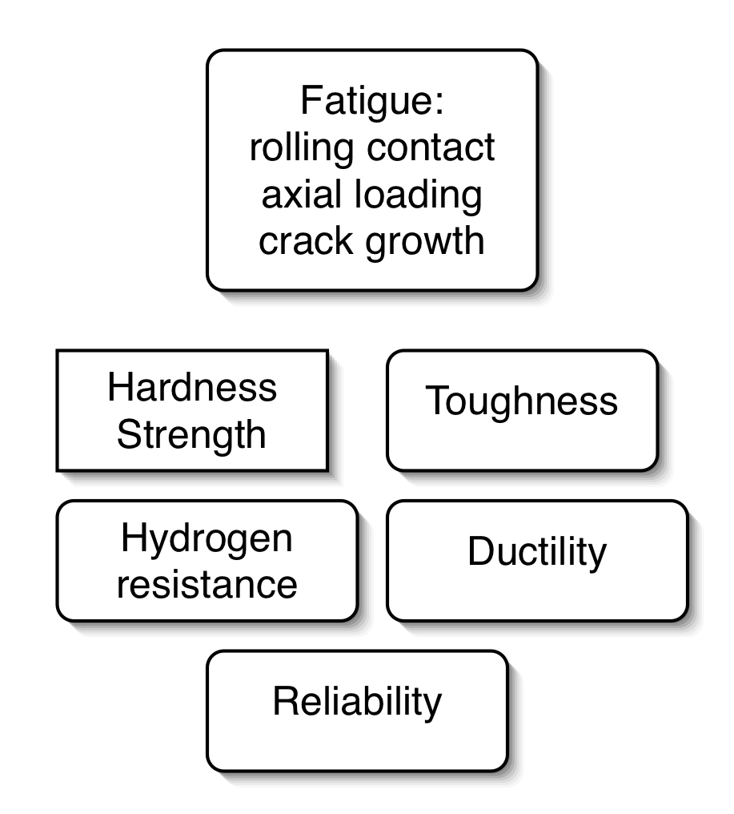
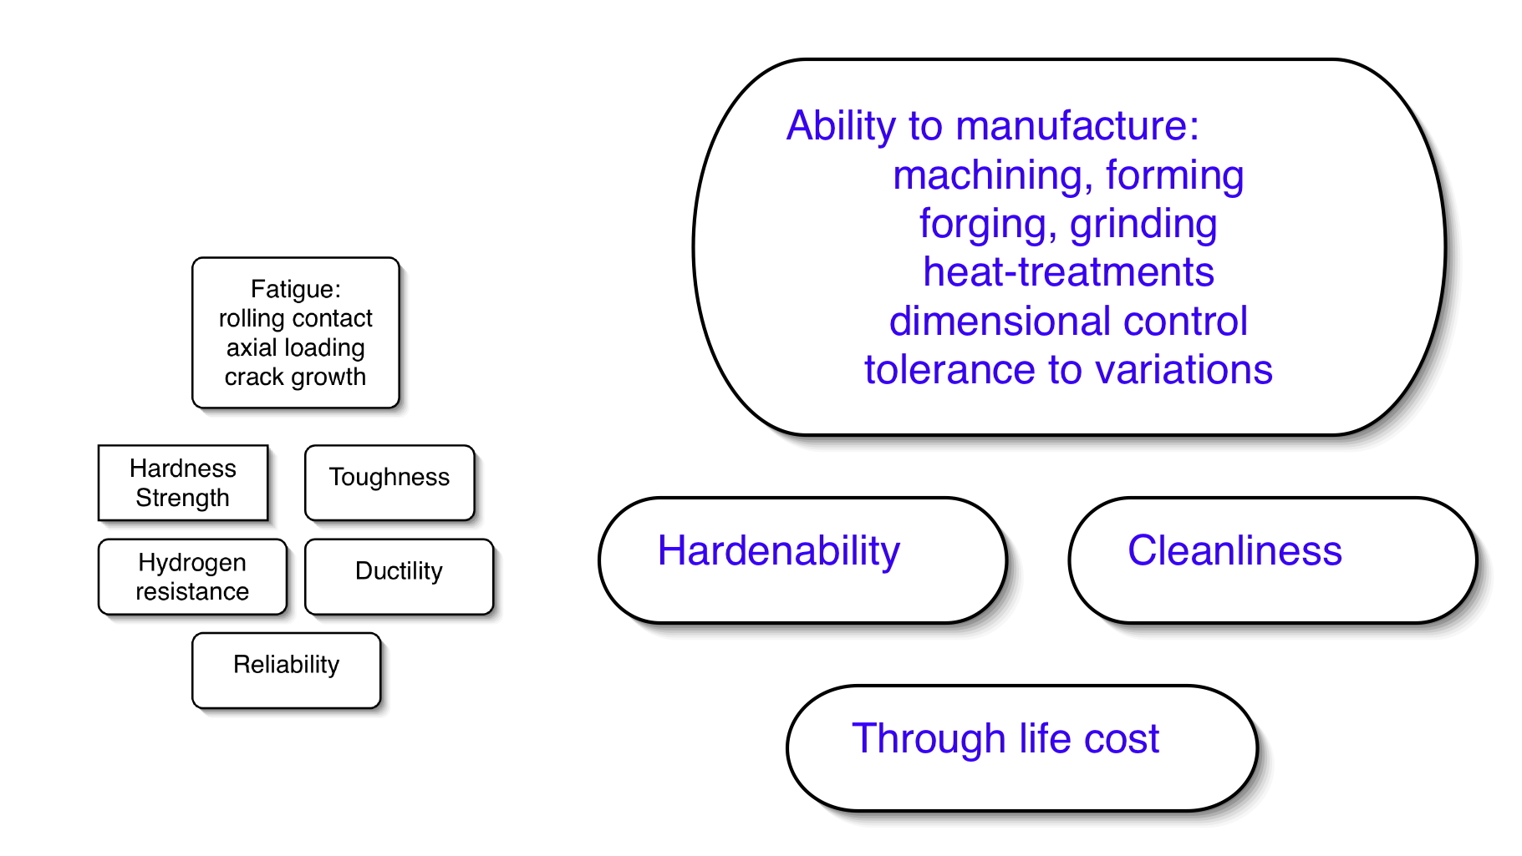
Design a new bearing steel

Slide 11
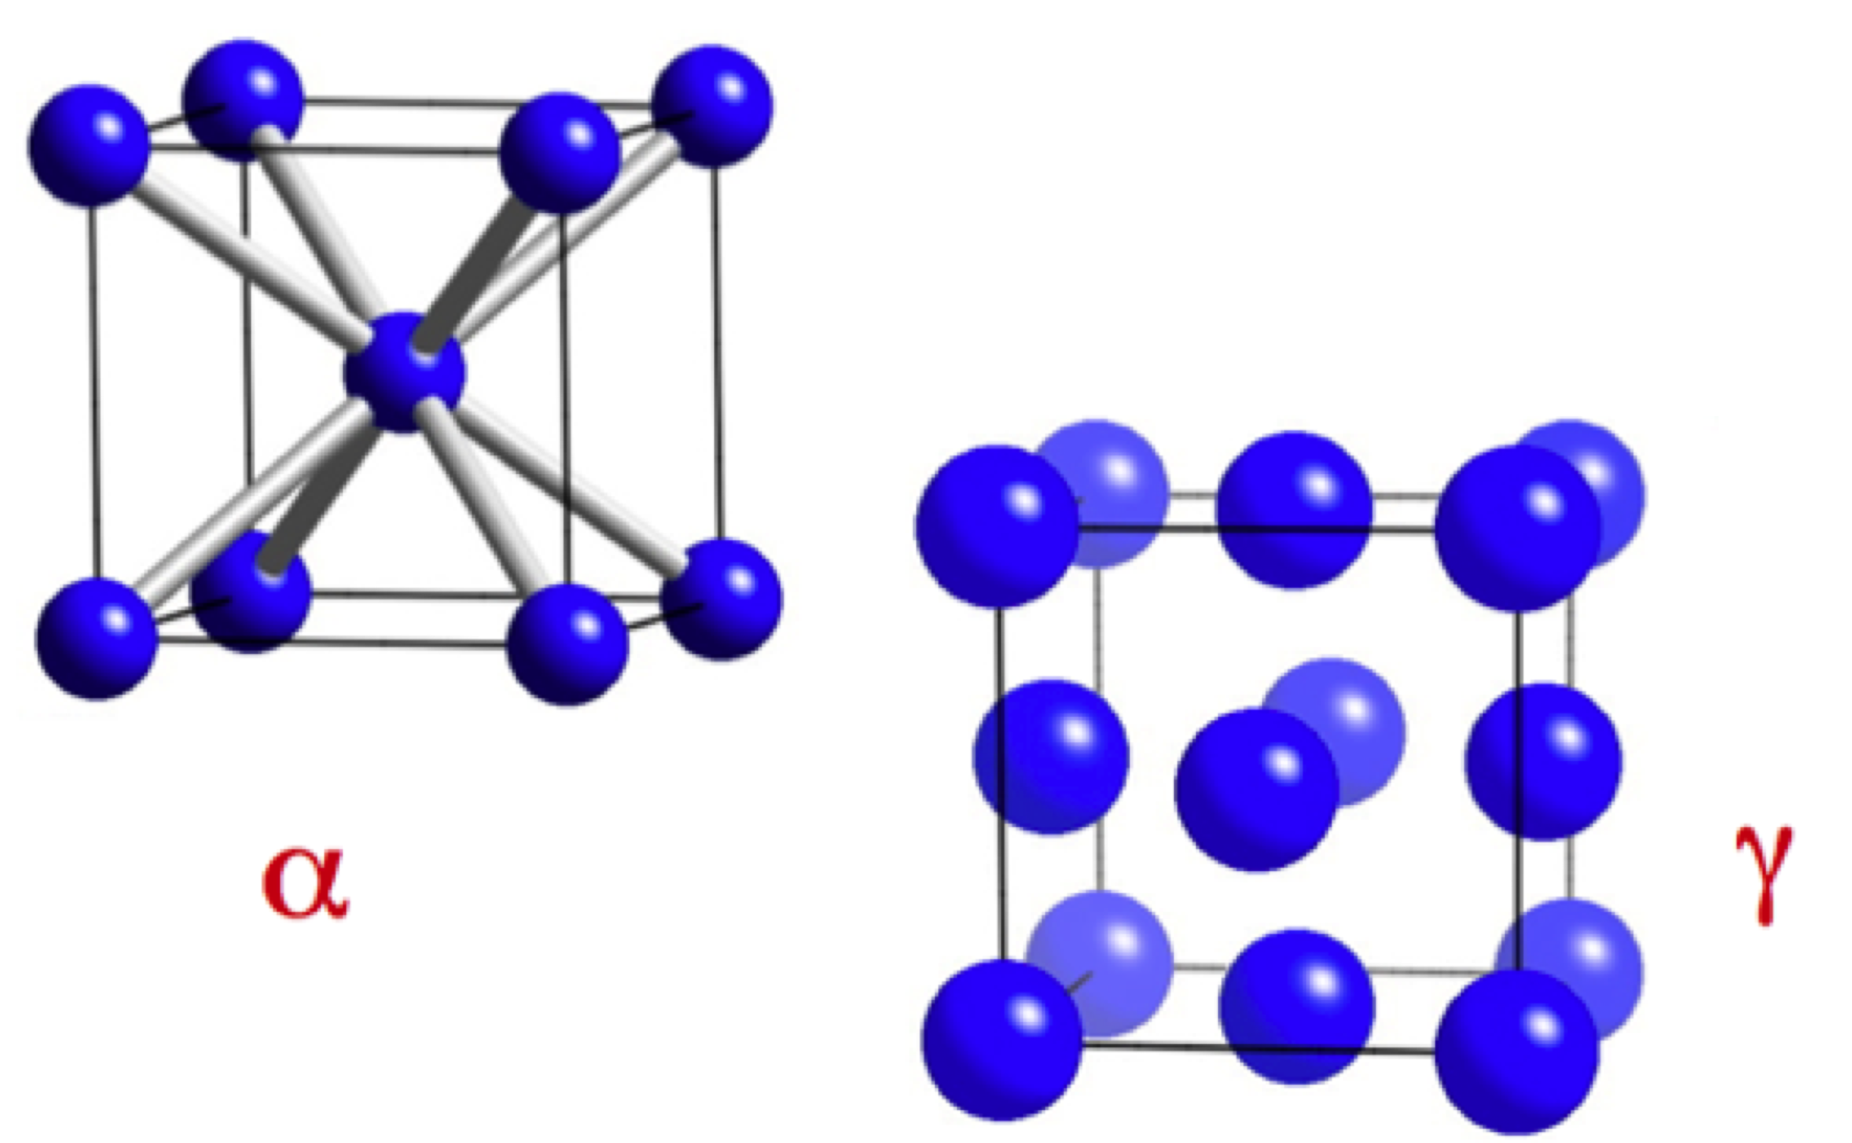
ideal strength?

Slide 12
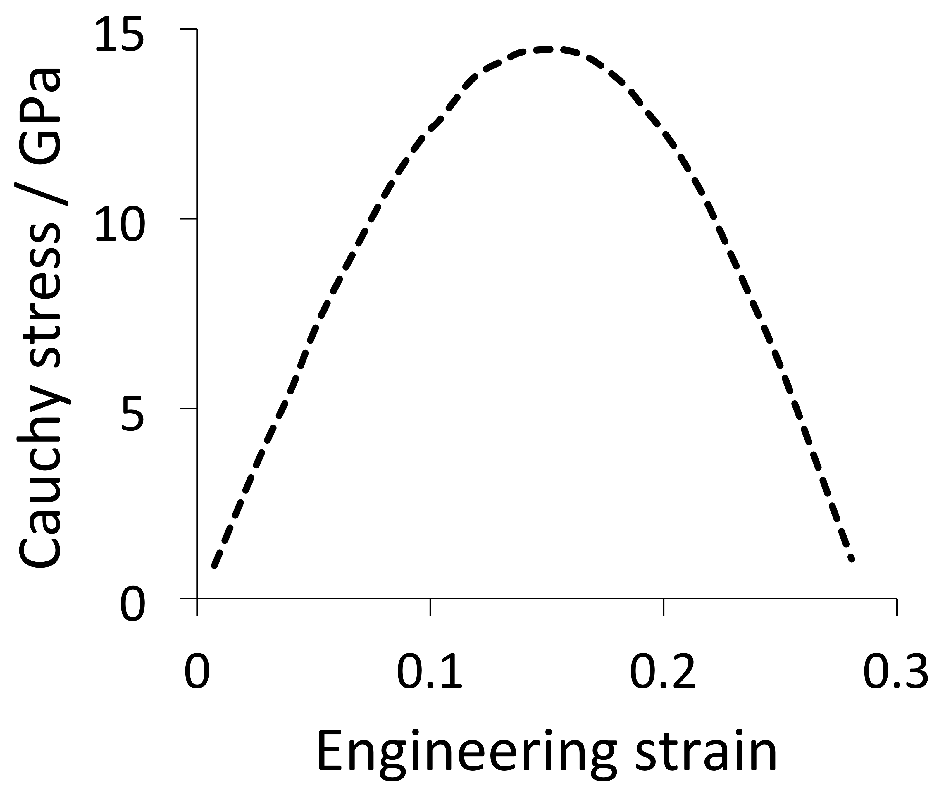
BCC iron weakest along <100>
Clatterbuck et al.
Phil. Mag. Lett.
2002

Slide 13
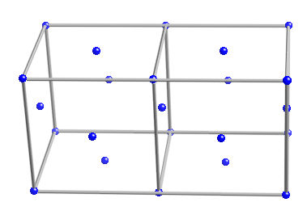
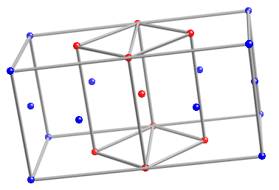
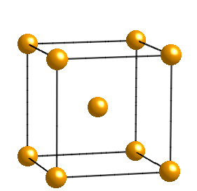

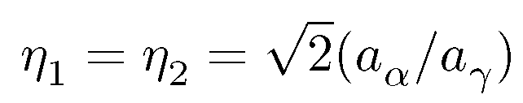
The Bain strain

Slide 14
What is the maximum strength of iron when pulled along its weakest direction?
14.5 GPa
remember this number

Slide 15
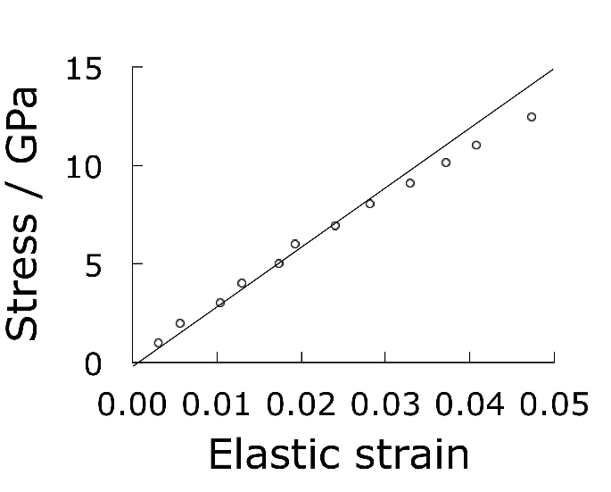
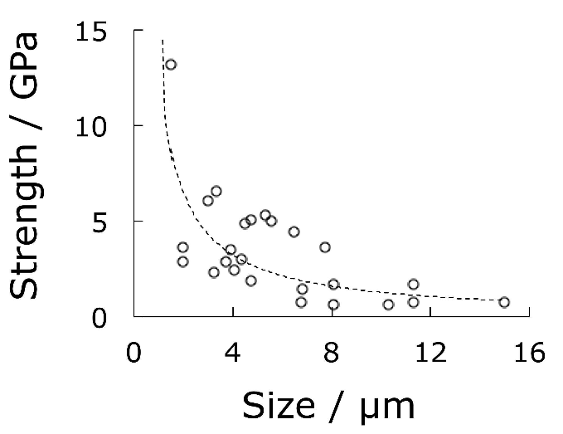
Single crystals of iron
Brenner:1956

Slide 16
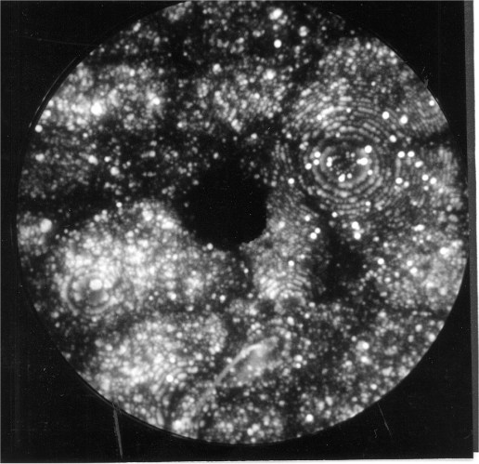
Commercial alloy made by Kobe Steel

Slide 17
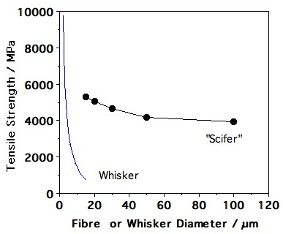

Slide 18
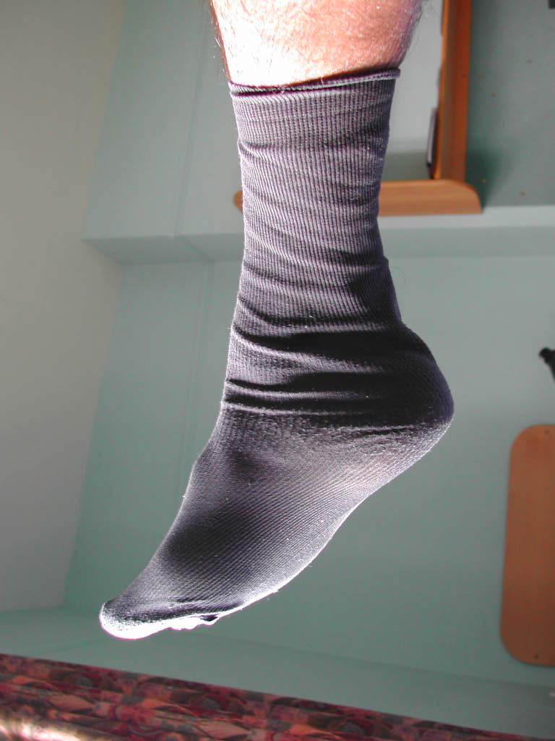
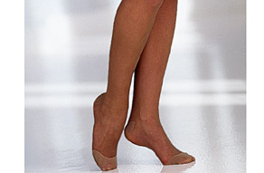
1 Denier: weight in grams, of 9 km of fibre
50-10 Denier
Scifer is 9 Denier

Slide 19
Claimed strength of carbon nanotube is 130 GPa
Edwards, Acta Astronautica, 2000
Claimed modulus is 1.2 TPa
Terrones et al., Phil. Trans. Roy. Soc., 2004

Slide 20
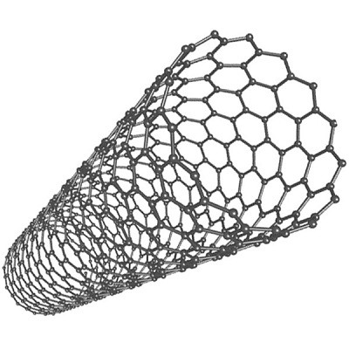
How is the strength of nanotube calculated?
By ignoring the empty space within the nanotube
But let us ignore this
Therefore strength of steel, which has 32% space unoccupied, is greater by 47% than reported since time zero

Slide 21

36000 km
tethered space elevator

Slide 22
strength 130 GPa
modulus 1.2 TPa
 | J g⁻¹ | m s⁻¹
Dynamite | 4650 | 6000
Nanotube | 5420 | 21500

Slide 23
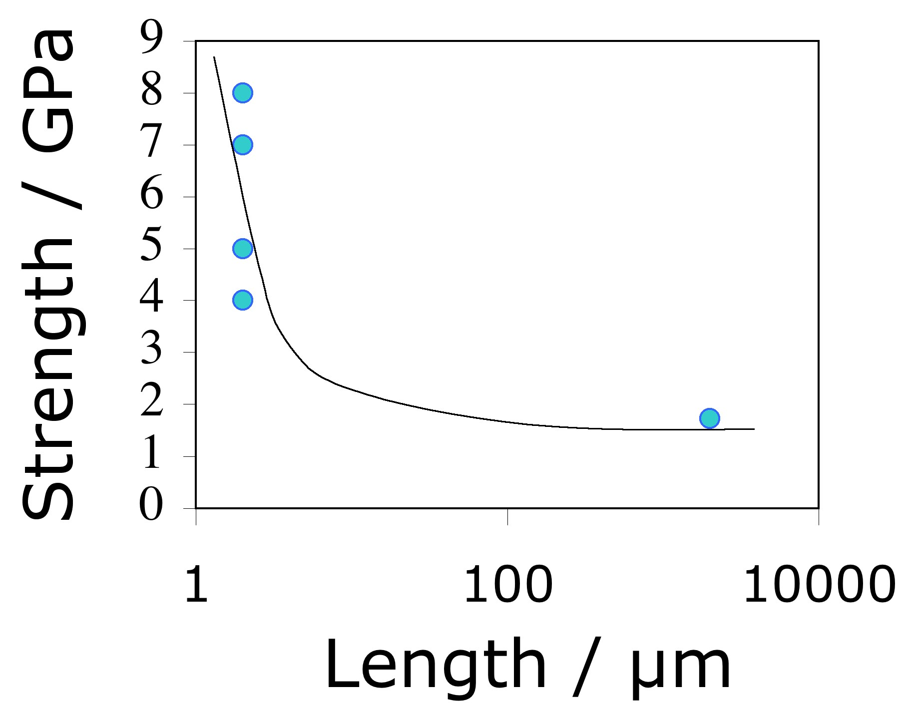
data from Pan et al. 1999, Yu et al. 2000

Slide 24
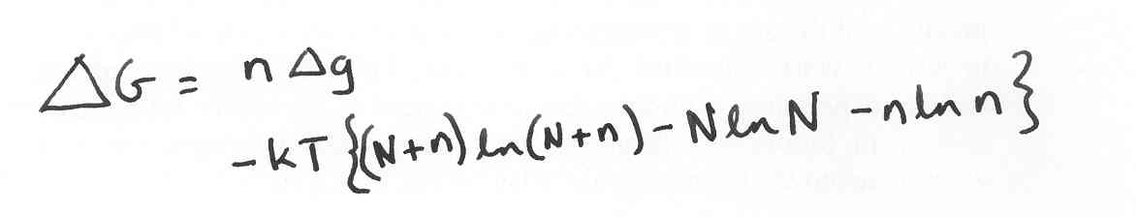
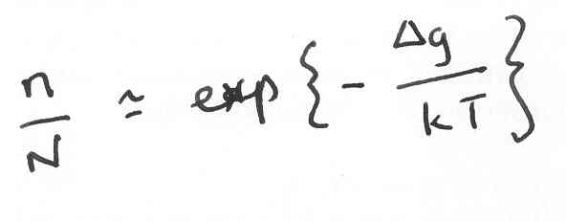
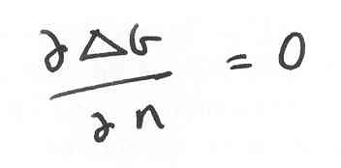
An equilibrium number of defects.
Strength of a nanotube rope 2 mm long is less than 2000 MPa

Slide 25
Summary
Strength produced by deformation limits shape: wires, sheets...
Strength in small particles relies on perfection. Doomed as size increases.

Slide 26
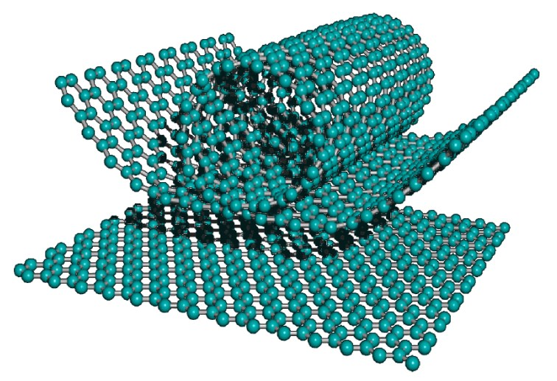
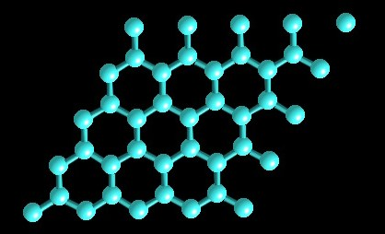
Morinobu Endo, 2004

Slide 27
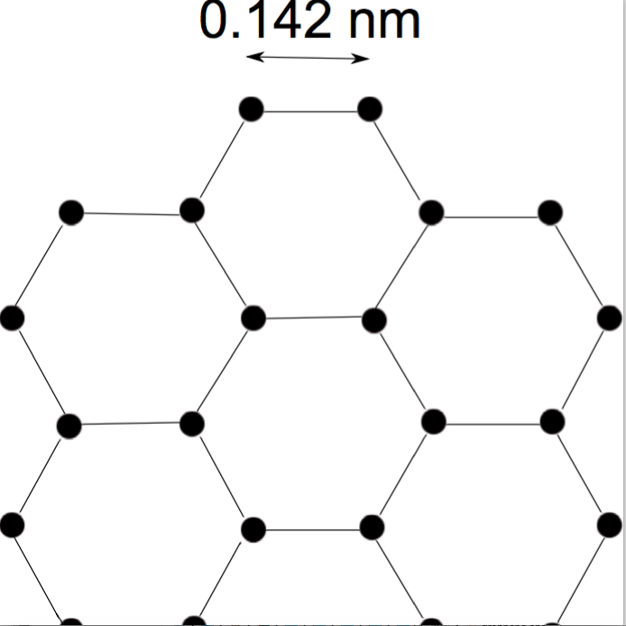
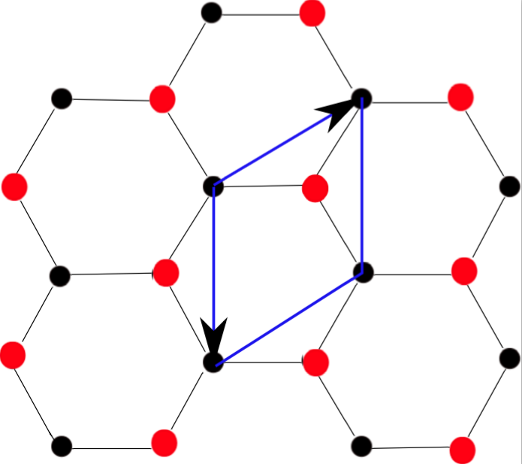
What is graphene?
single-atom thick sheet (Carbon 65 [2013] 1-6)

Slide 28
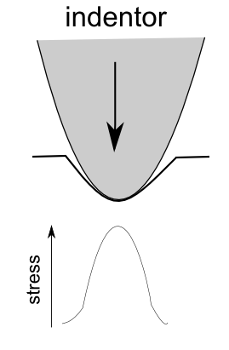
Lee et al. Science (2008)
reported breaking strength
of 130 GPa for sample
about 2 µm square of
pristine graphene

Slide 29
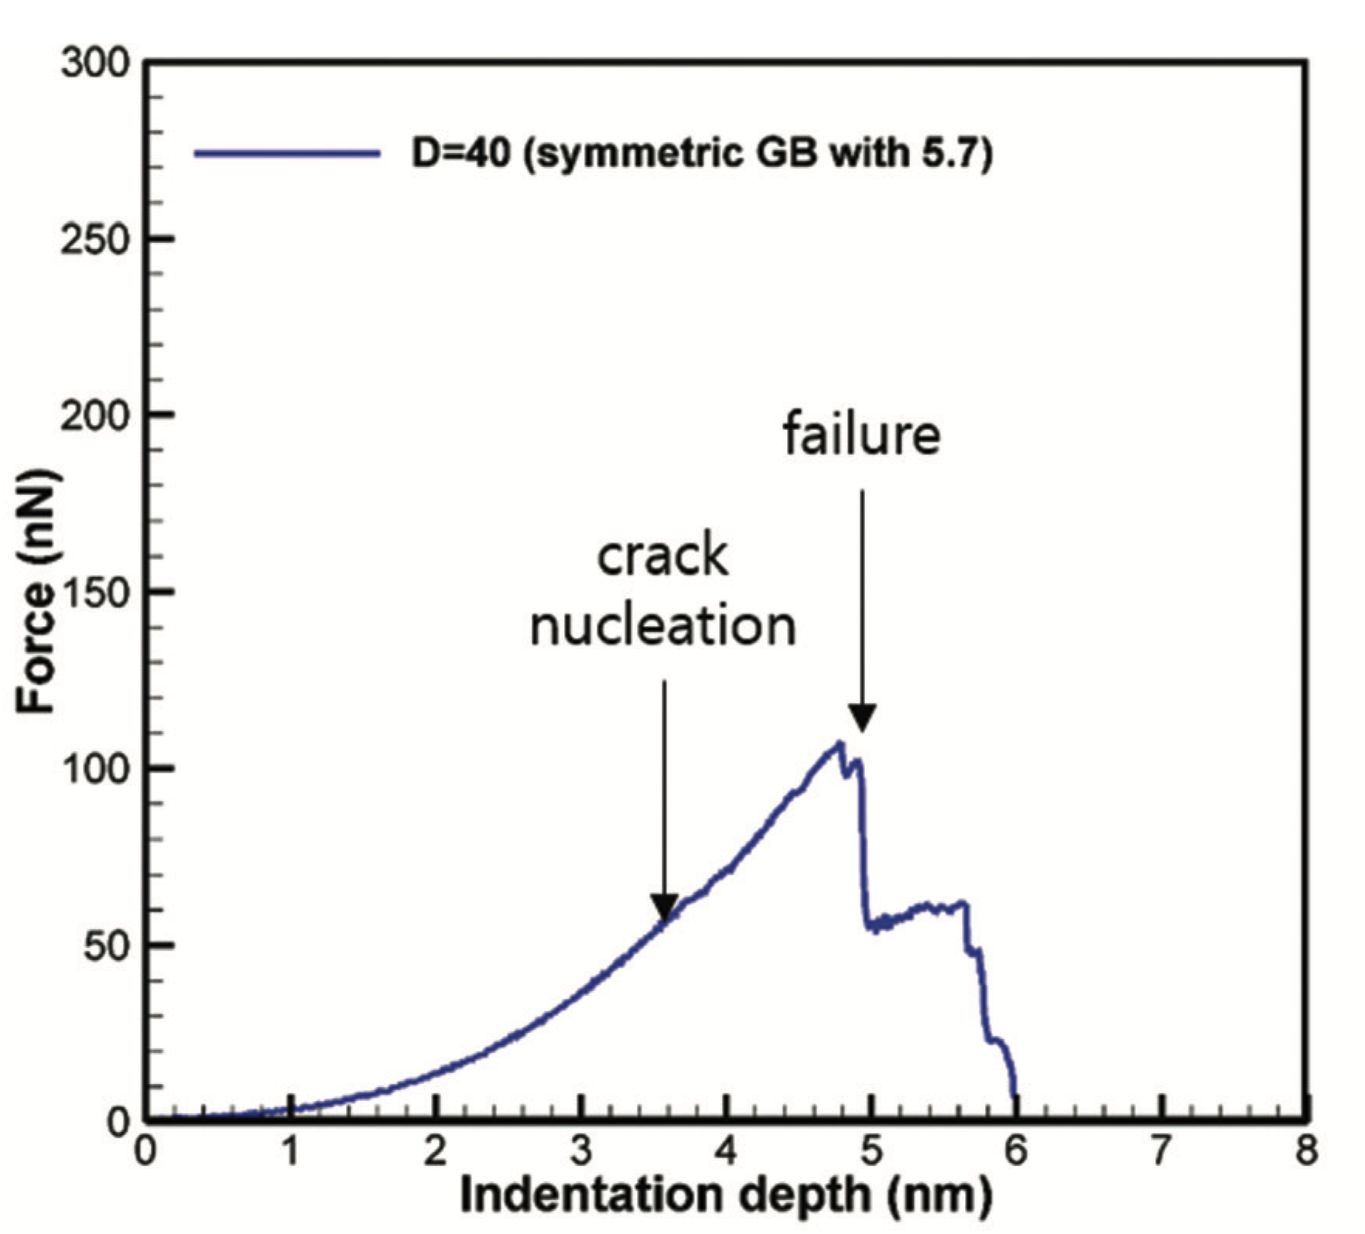
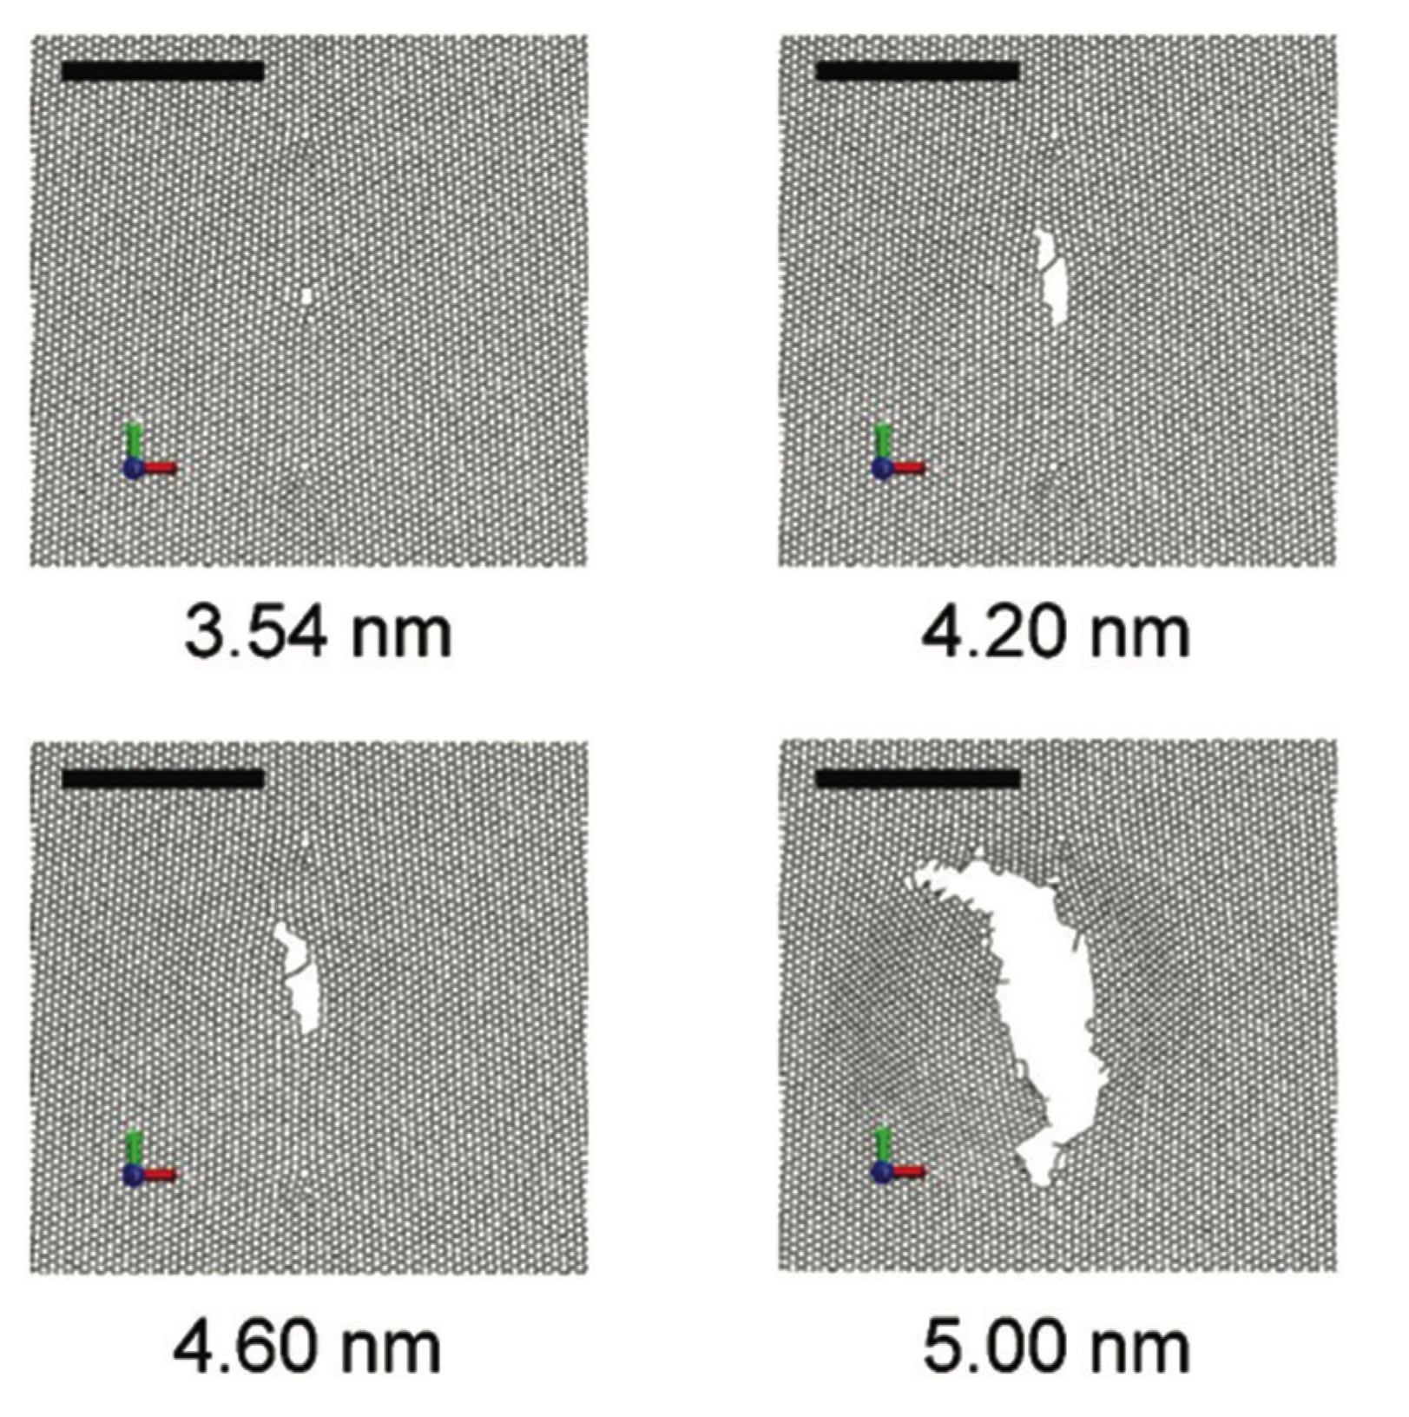
Han et al.
Nanoscale
7 (2015) 15672

Slide 30
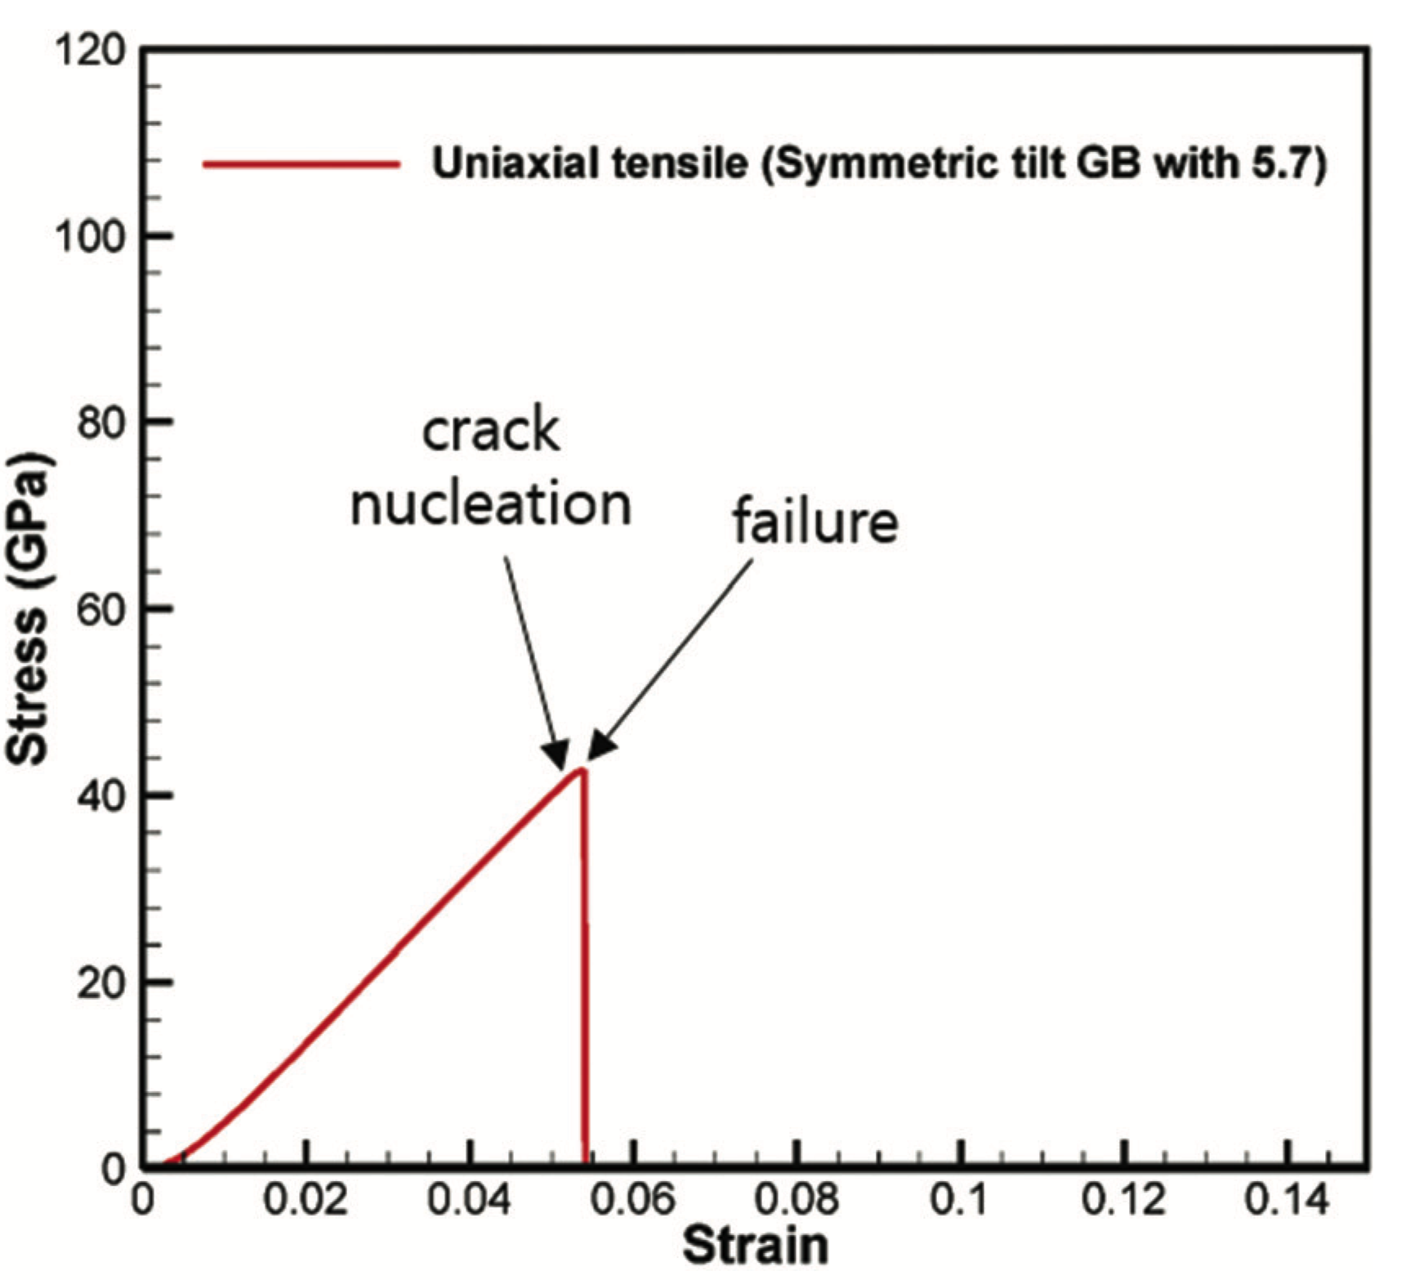
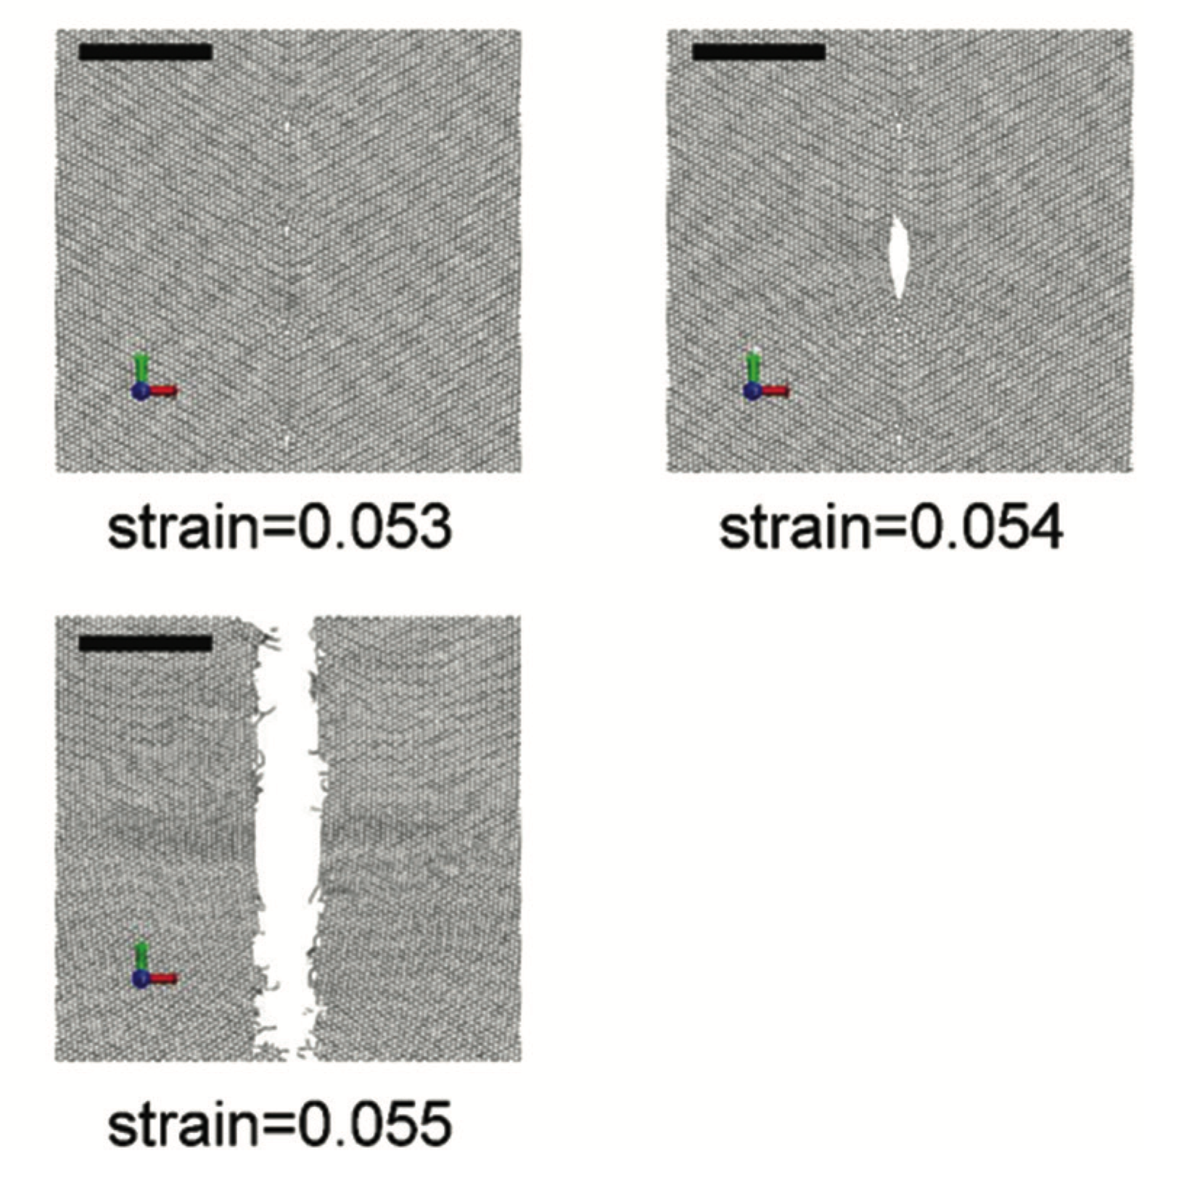
Polycrystalline graphene is brittle under homogeneous tensile stress
Han et al.
Nanoscale
7 (2015) 15672

Slide 31
immensely
tough

Slide 32

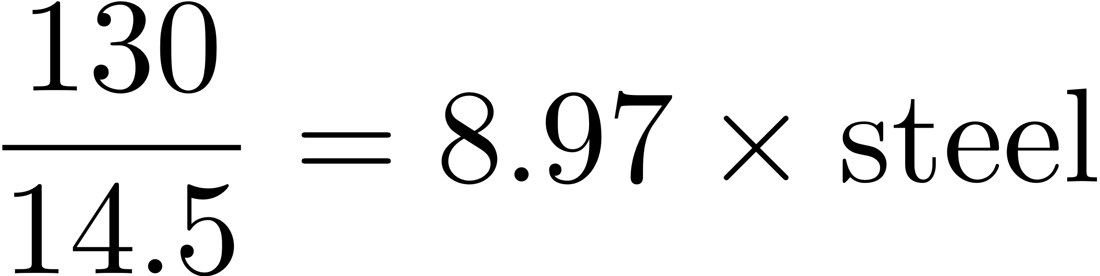
Intrinsic strength of Graphene
(samples 2 µm²)

Slide 33
Graphene
200 times
stronger than
steel

Slide 34
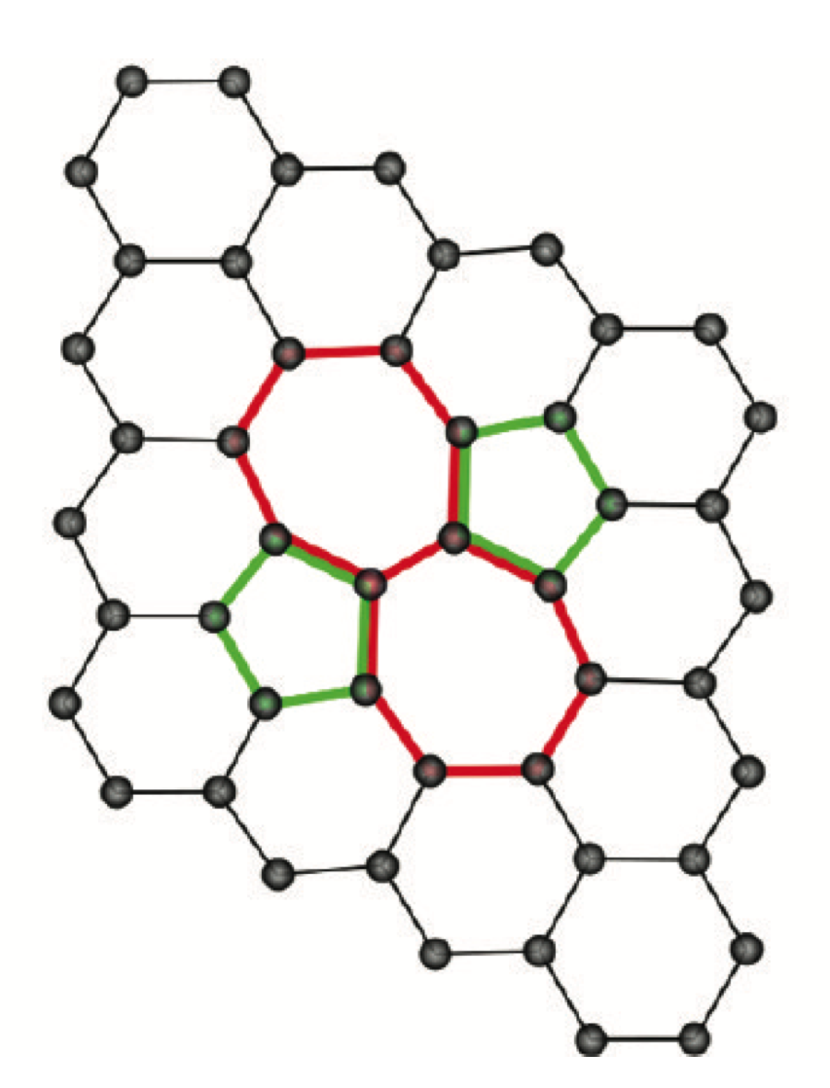
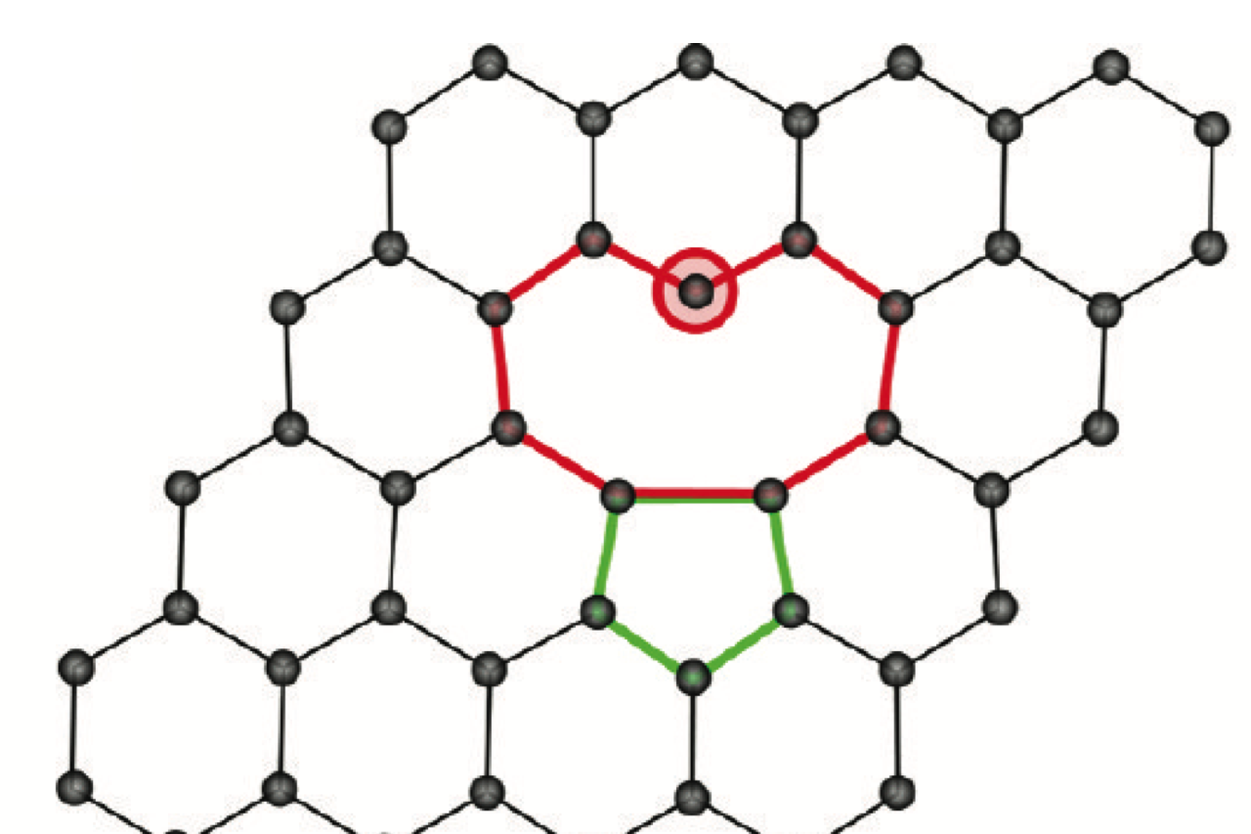
Stone-Wales defects
Vacancy

Slide 35
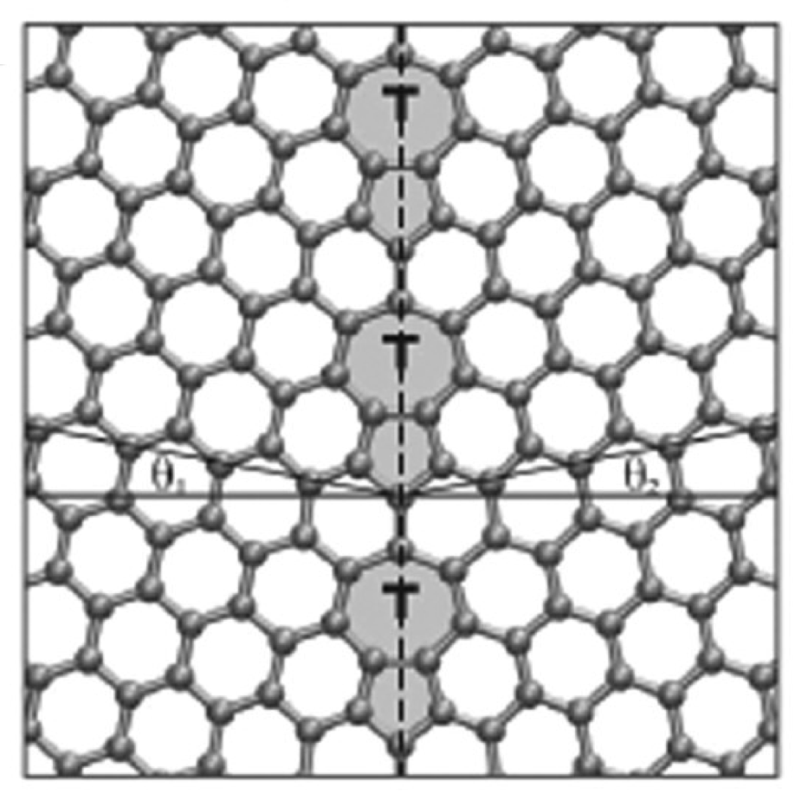
Yazyev et al. Phys. Rev. B 81 (2010) 195420

Slide 36
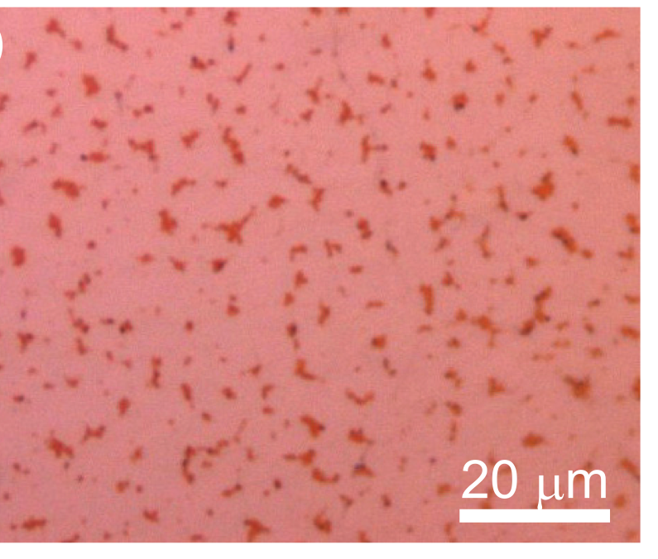
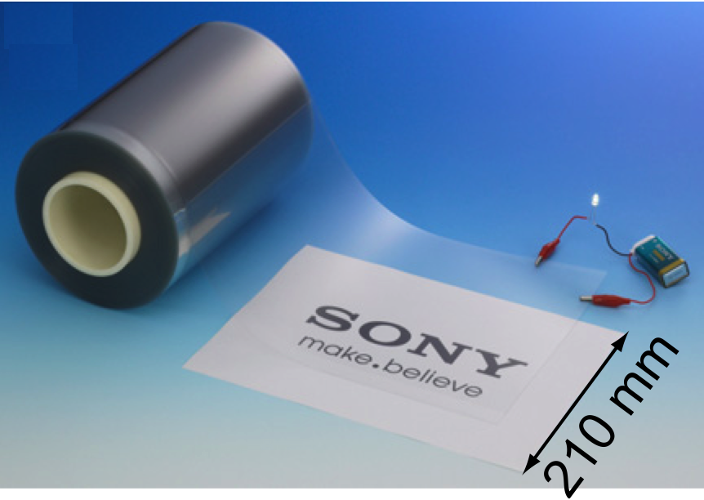
Kobayashi et al.
APL 102 (2014)
023112

Slide 37
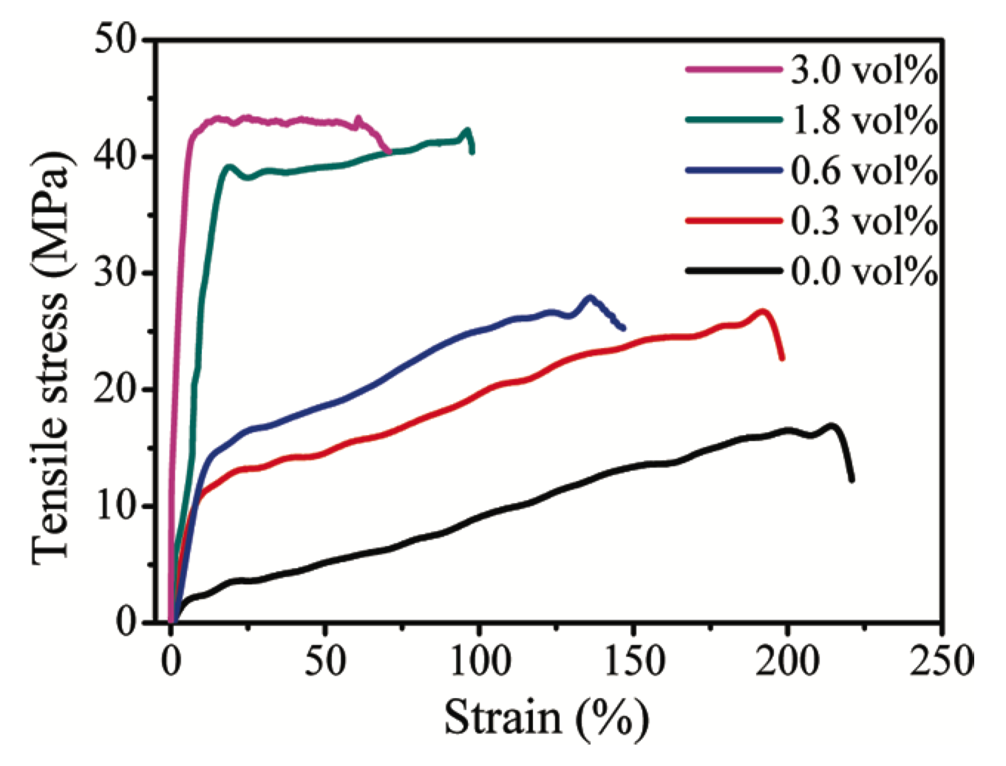
Graphene in composites
Zhao et al.
Macromolecules
43 (2010) 2357

Slide 38
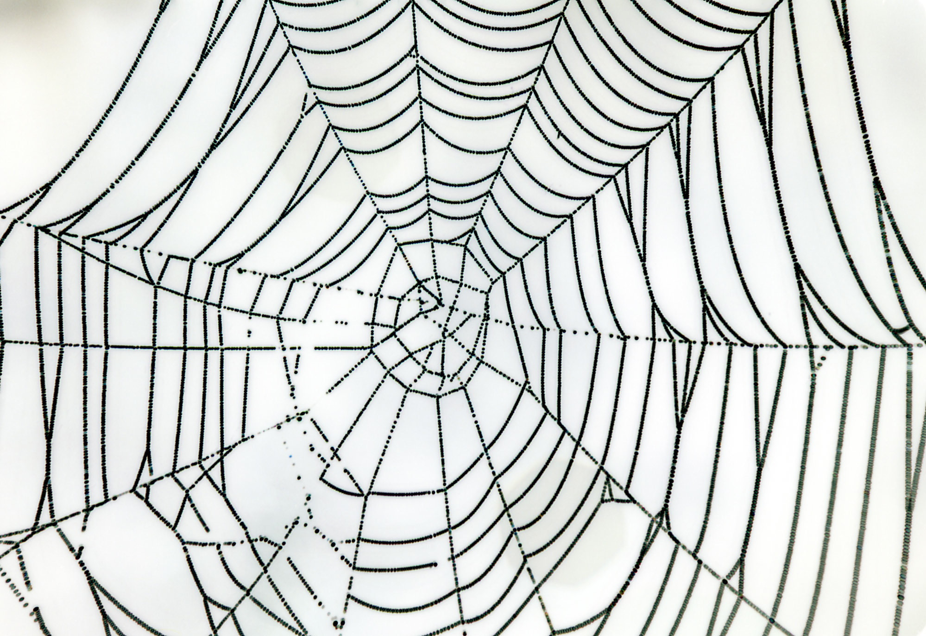
Spider’s silk

Slide 39
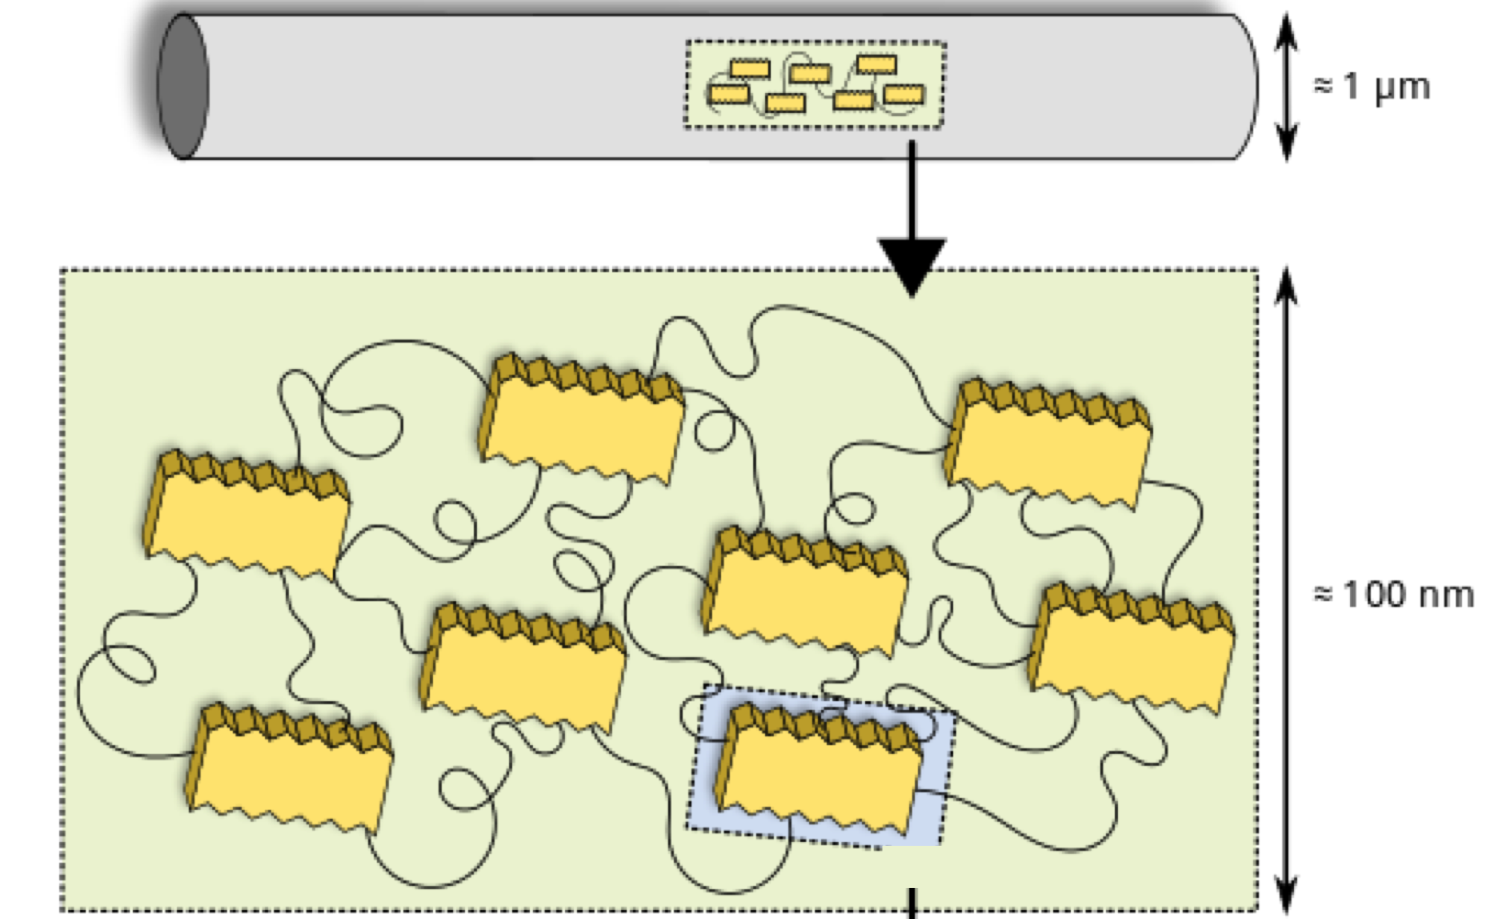
http://creativecommons.org/licenses/by-sa/3.0

Slide 40
Spider’s silk
Tensile strength 700 MPa
Density 1.3 g cm⁻³
“Specific strength 6 times greater than steel of identical tensile strength”

Slide 41
Spider’s silk
Tensile strength 700 MPa
Density 1.3 g cm⁻³
Specific strength 5.38 MPa g⁻¹ cm³
“Specific strength 6 times greater than steel of identical tensile strength”
Tensile strength of Scifer 5500 MPa
Density 7.8 g cm⁻³
Specific strength 7.05 MPa g⁻¹ cm³
Steel has a greater specific strength for same diameter as the silk

Slide 42
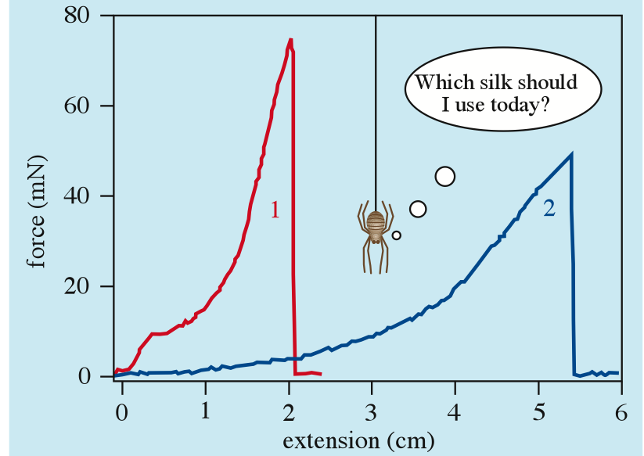
Spider’s silk
700 MPa, 30% elongation gives “toughness” of 105 MJ m⁻³
Spider’s silk is therefore “tougher than steel”
Physics Education
43 (2008) 57

Slide 43
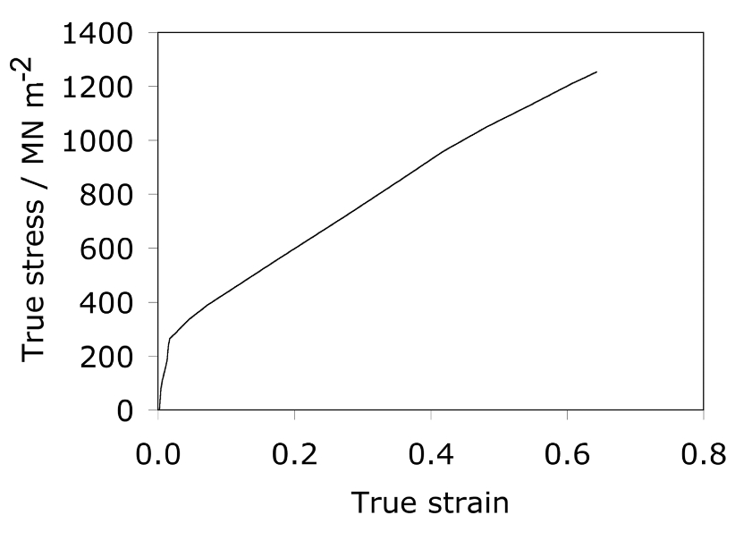
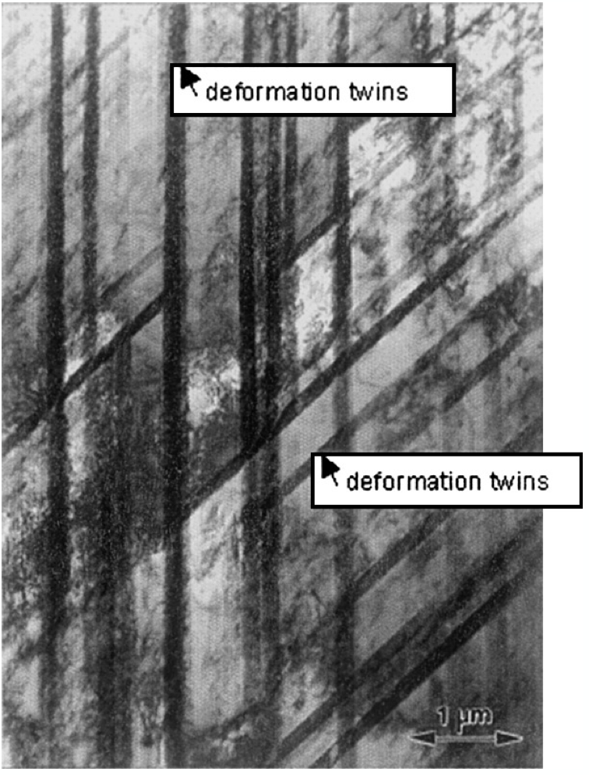
Twinning induced plasticity
TWIP steel on similar calculation has a toughness of 500 MJ m⁻³

Slide 44
Conclusions
Graphene is at best ten times stronger than steel at the micrometre level
No evidence that the strength of graphene is sustained as the size is increased
Graphene is a brittle material

Slide 45
With metallic bonding, the cohesion between atoms is maintained even when atoms
are translated along long distances.
Therefore, plasticity, energy absorption, safe design.
Covalent C-C bonds once broken remain broken.
Therefore, plastic deformation is absent when covalent bonds are stretched.
Therefore, limited energy absorption. Brittle.
Not safe in engineering design.

Slide 46


Slide 47
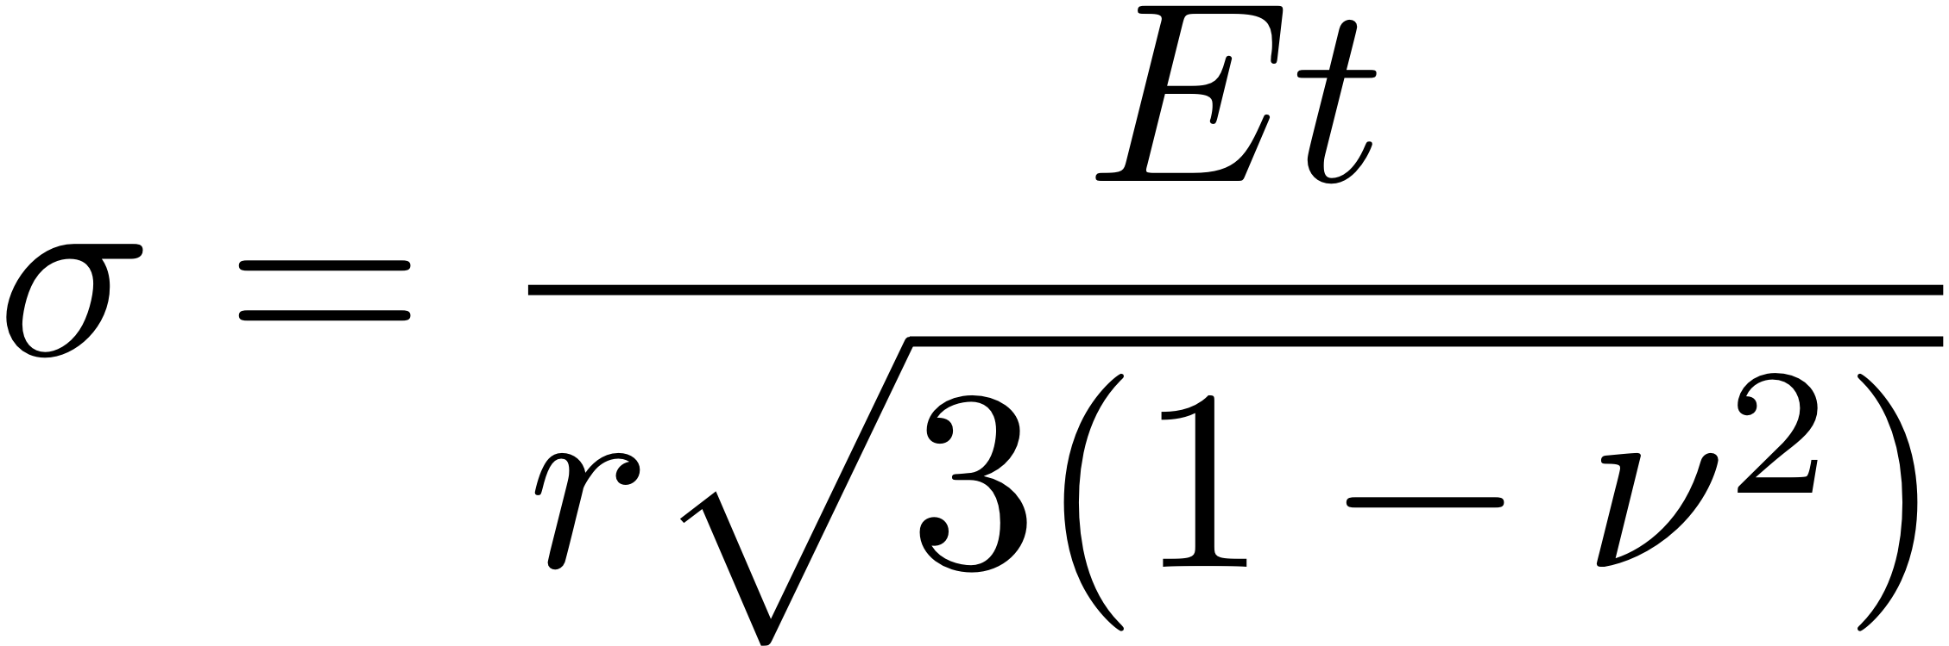
Graphene is a two-dimensional material
about 3500 Pa
Cannot make bicycle frame from graphene

Slide 48
Conclusions
Spider’s silk is excellent for webs
Spider’s silk is not stronger than steel when considering specific strength or absolute strength
Spider’s silk is not tougher than steel
Low density steels

Slide 49

Low-density steels
lattice expansion
lower atomic mass of
substitutional atom
(M. Shiga et al. J. Phy. Soc. J.)
● Specific weight of
Fe-Al alloy
■ Specific weight of
Fe-14~28Mn-Al-C [Frommeyer]
Al : 26.98 g/mol
Fe: 55.85 g/mol

Slide 50
Total: 1.4 billion tonnes per annum

Slide 51

Fe-10Al-15Mn-5Ni-0.8C wt%
strengthened by fine FeAl precipitates
Density 17% lower than iron
Nature 518 (2015) 77-79, by S.-H. Kim, H. Kim and N. J. Kim,

Slide 52


Xiong et al. Mat. Sci. Techn. (2016)

Slide 53
An invention of a new material should not rely on just one property.
Avoid deliberate attempts to mislead the general audience.
“there is much work between measuring a single attractive property in a single alloy to demonstrating credibility for a particular application”
Dan Miracle, Materials Science and Technology (2015)

