Slide 1
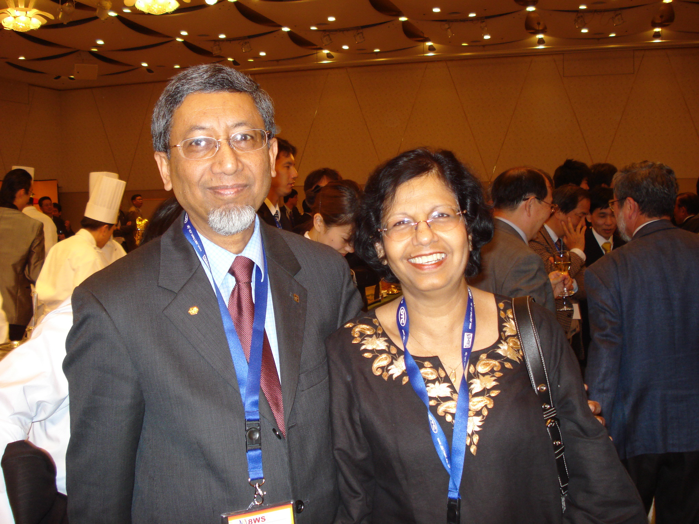
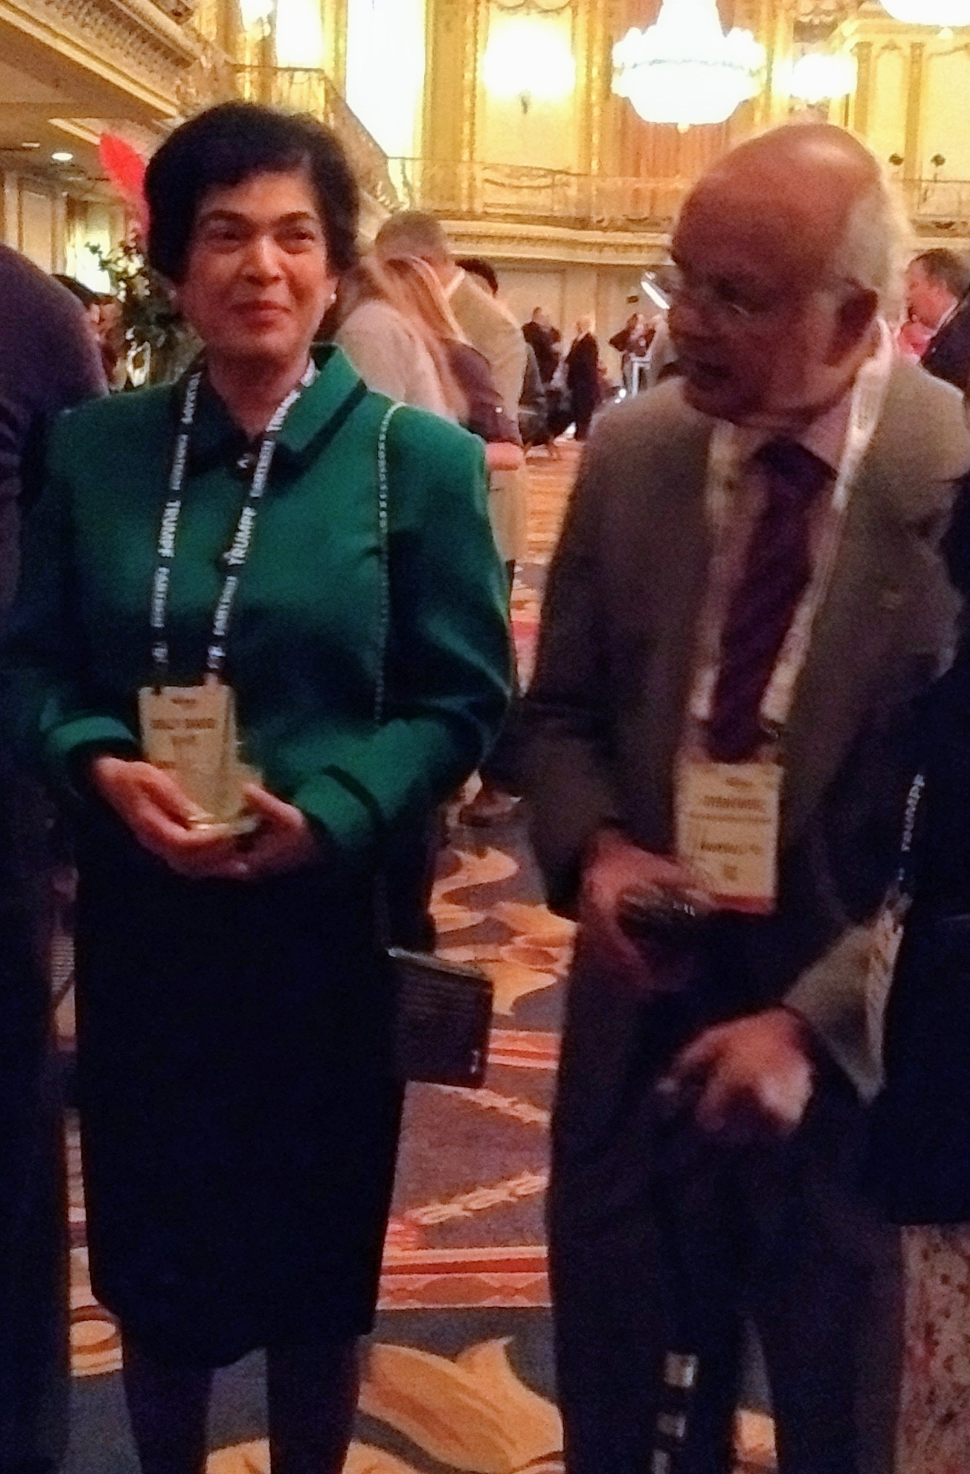
Tarashankar DebRoy
Stanislaus David

Slide 2
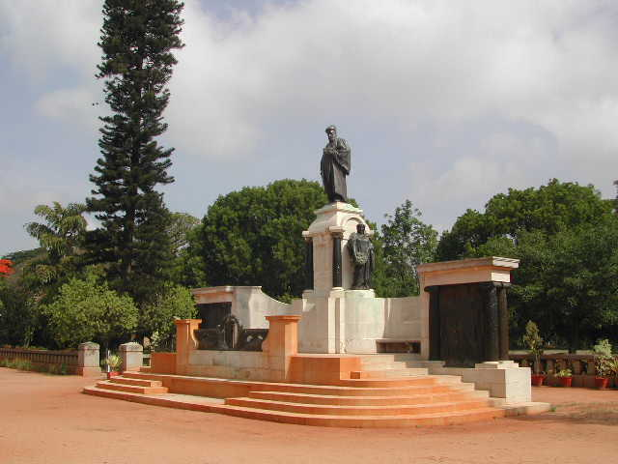

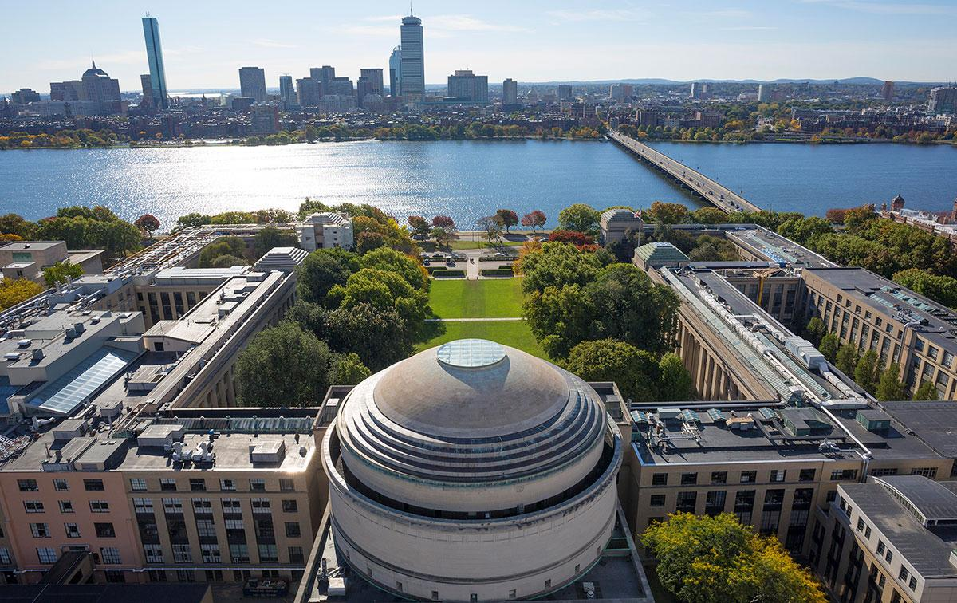

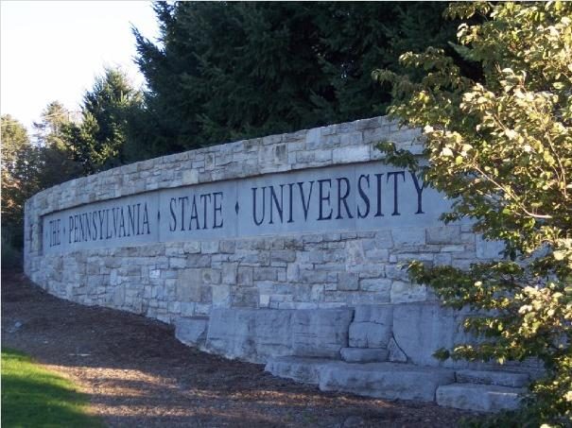


Slide 3

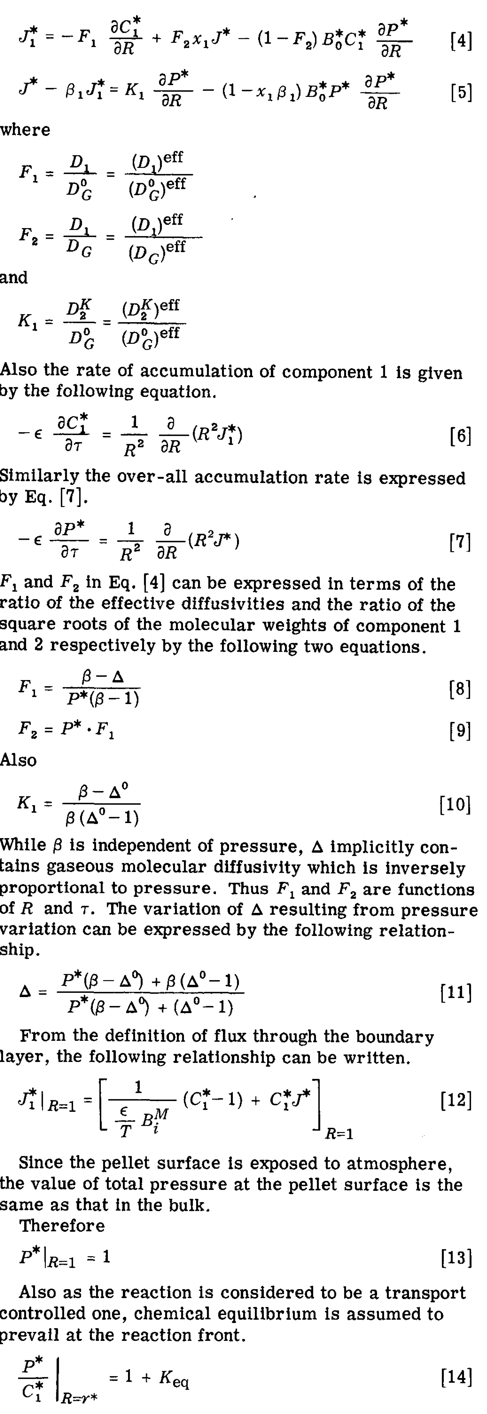
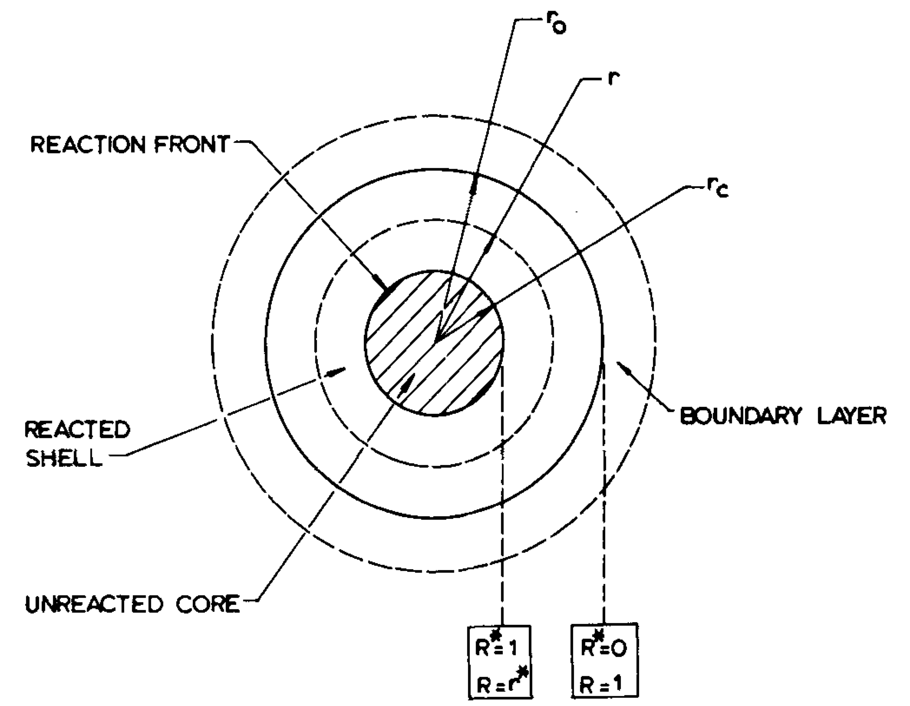
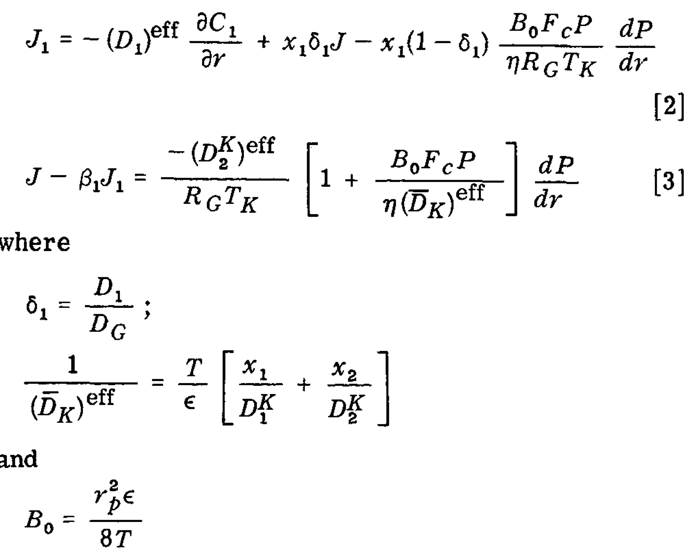
Deb Roy T, Abraham KP. Metallurgical and Materials Transactions B. 1974 5:349-54.

Slide 4
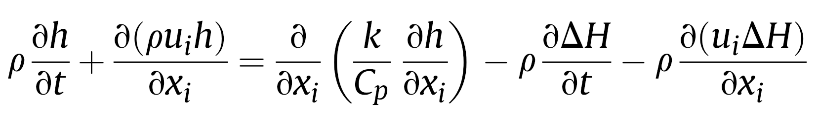
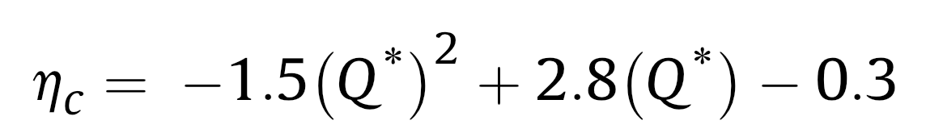
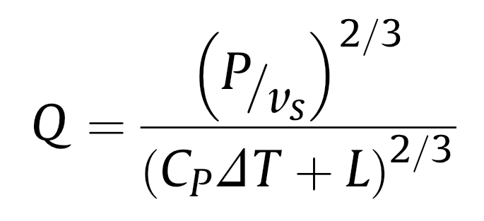
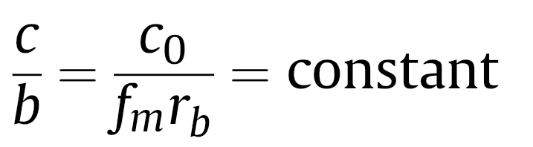
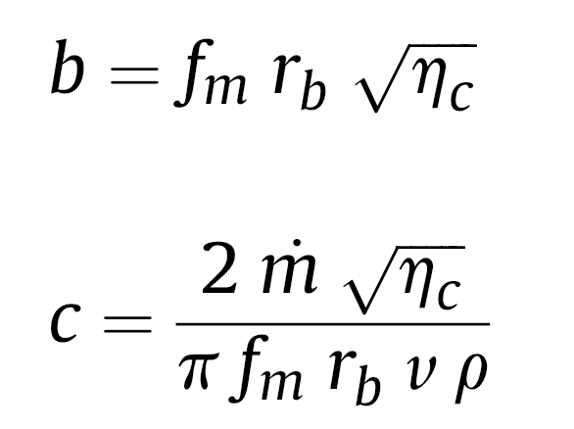
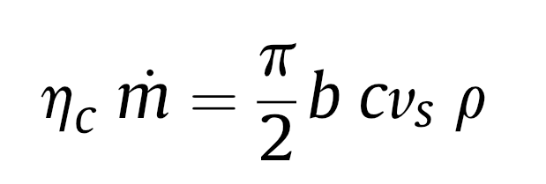
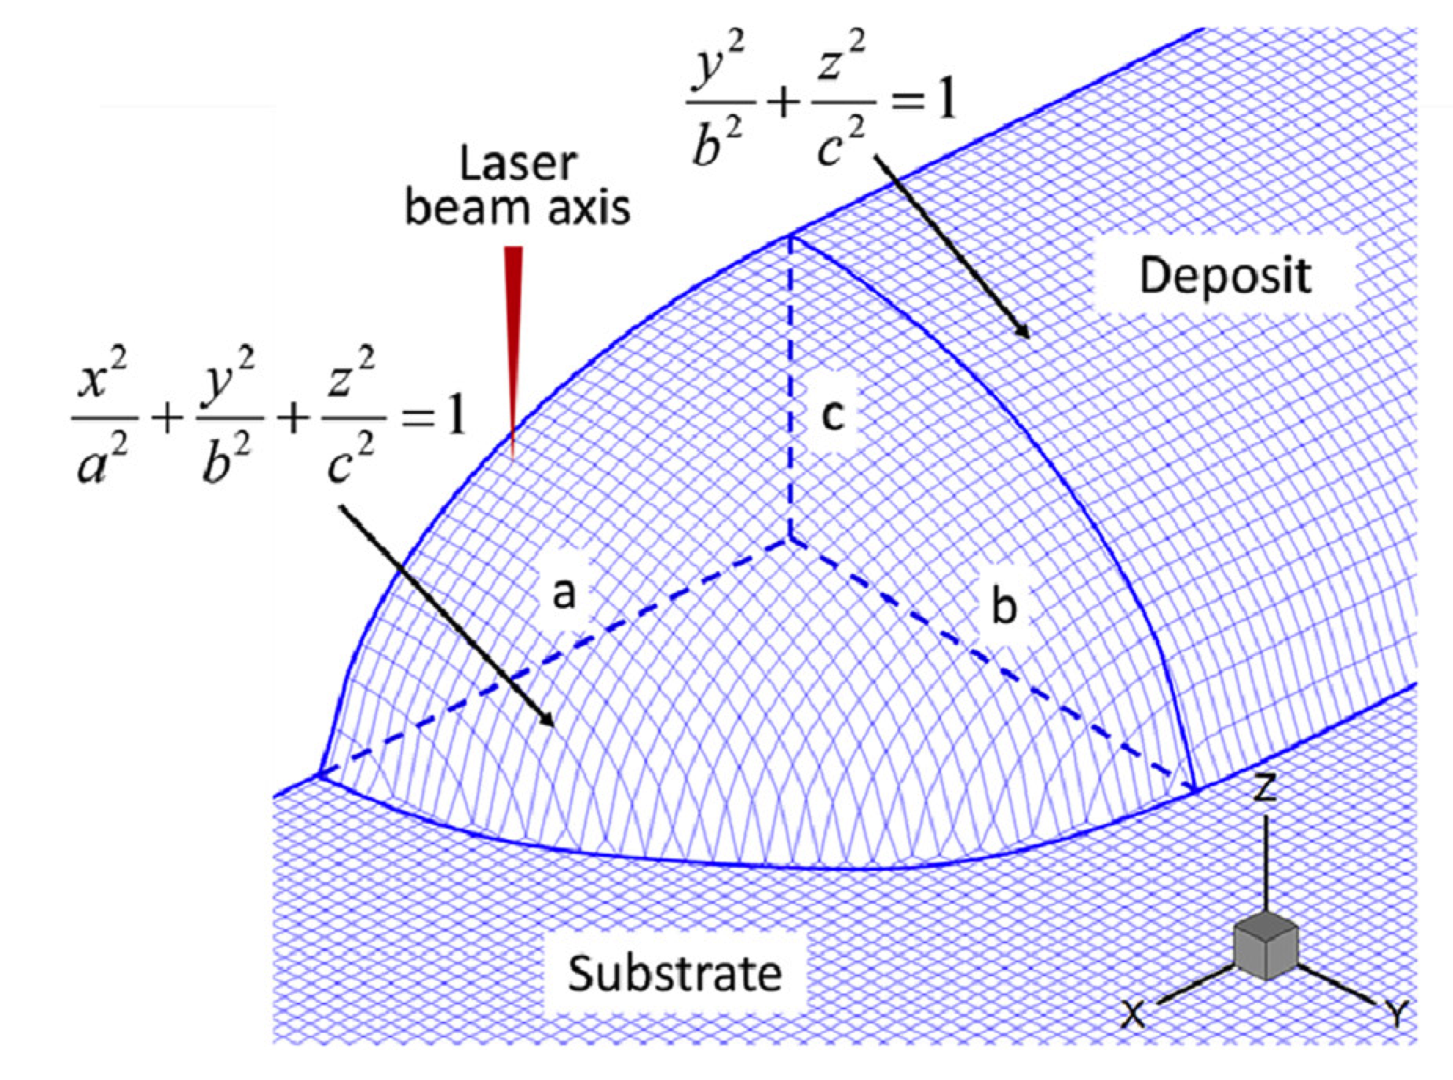
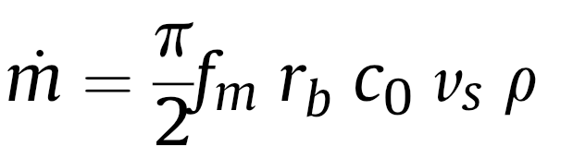
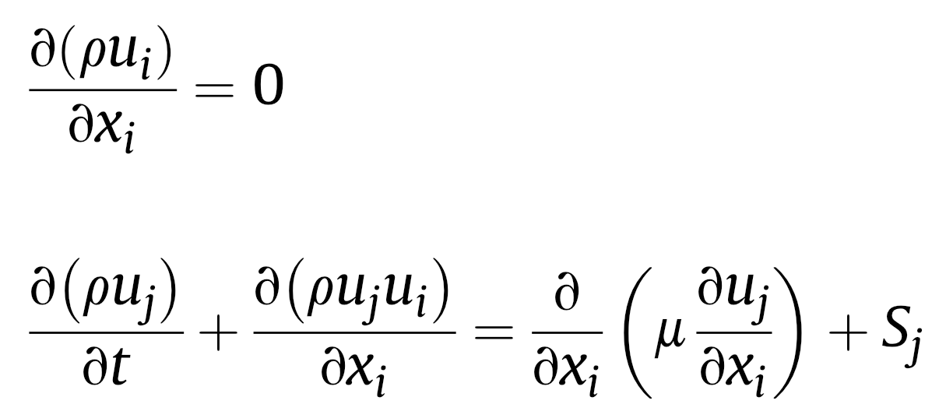
Knapp GL, Mukherjee T, Zuback JS, Wei HL, Palmer TA, De A, DebRoy T. Acta Materialia. 2017;135:390-9.

Slide 5

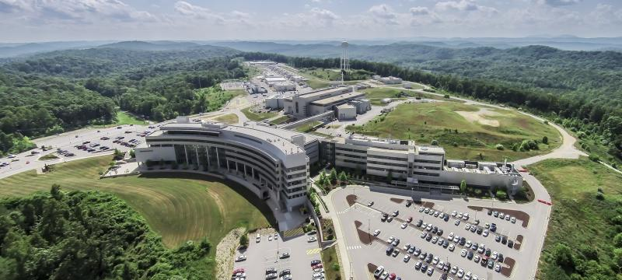
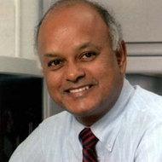
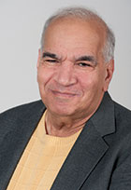
Steel
Aluminium
Nickel
Composites
Intermetallics
Ceramics
Iridium
Vanadium
Titanium
High-entropy
Niobium/NbC
ODS
Indium …….

Slide 6


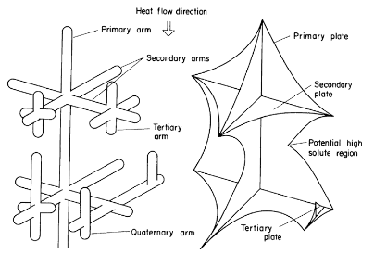


Brody HD, David SA. Application of Solidification Theory to Titanium Alloys.

Slide 7
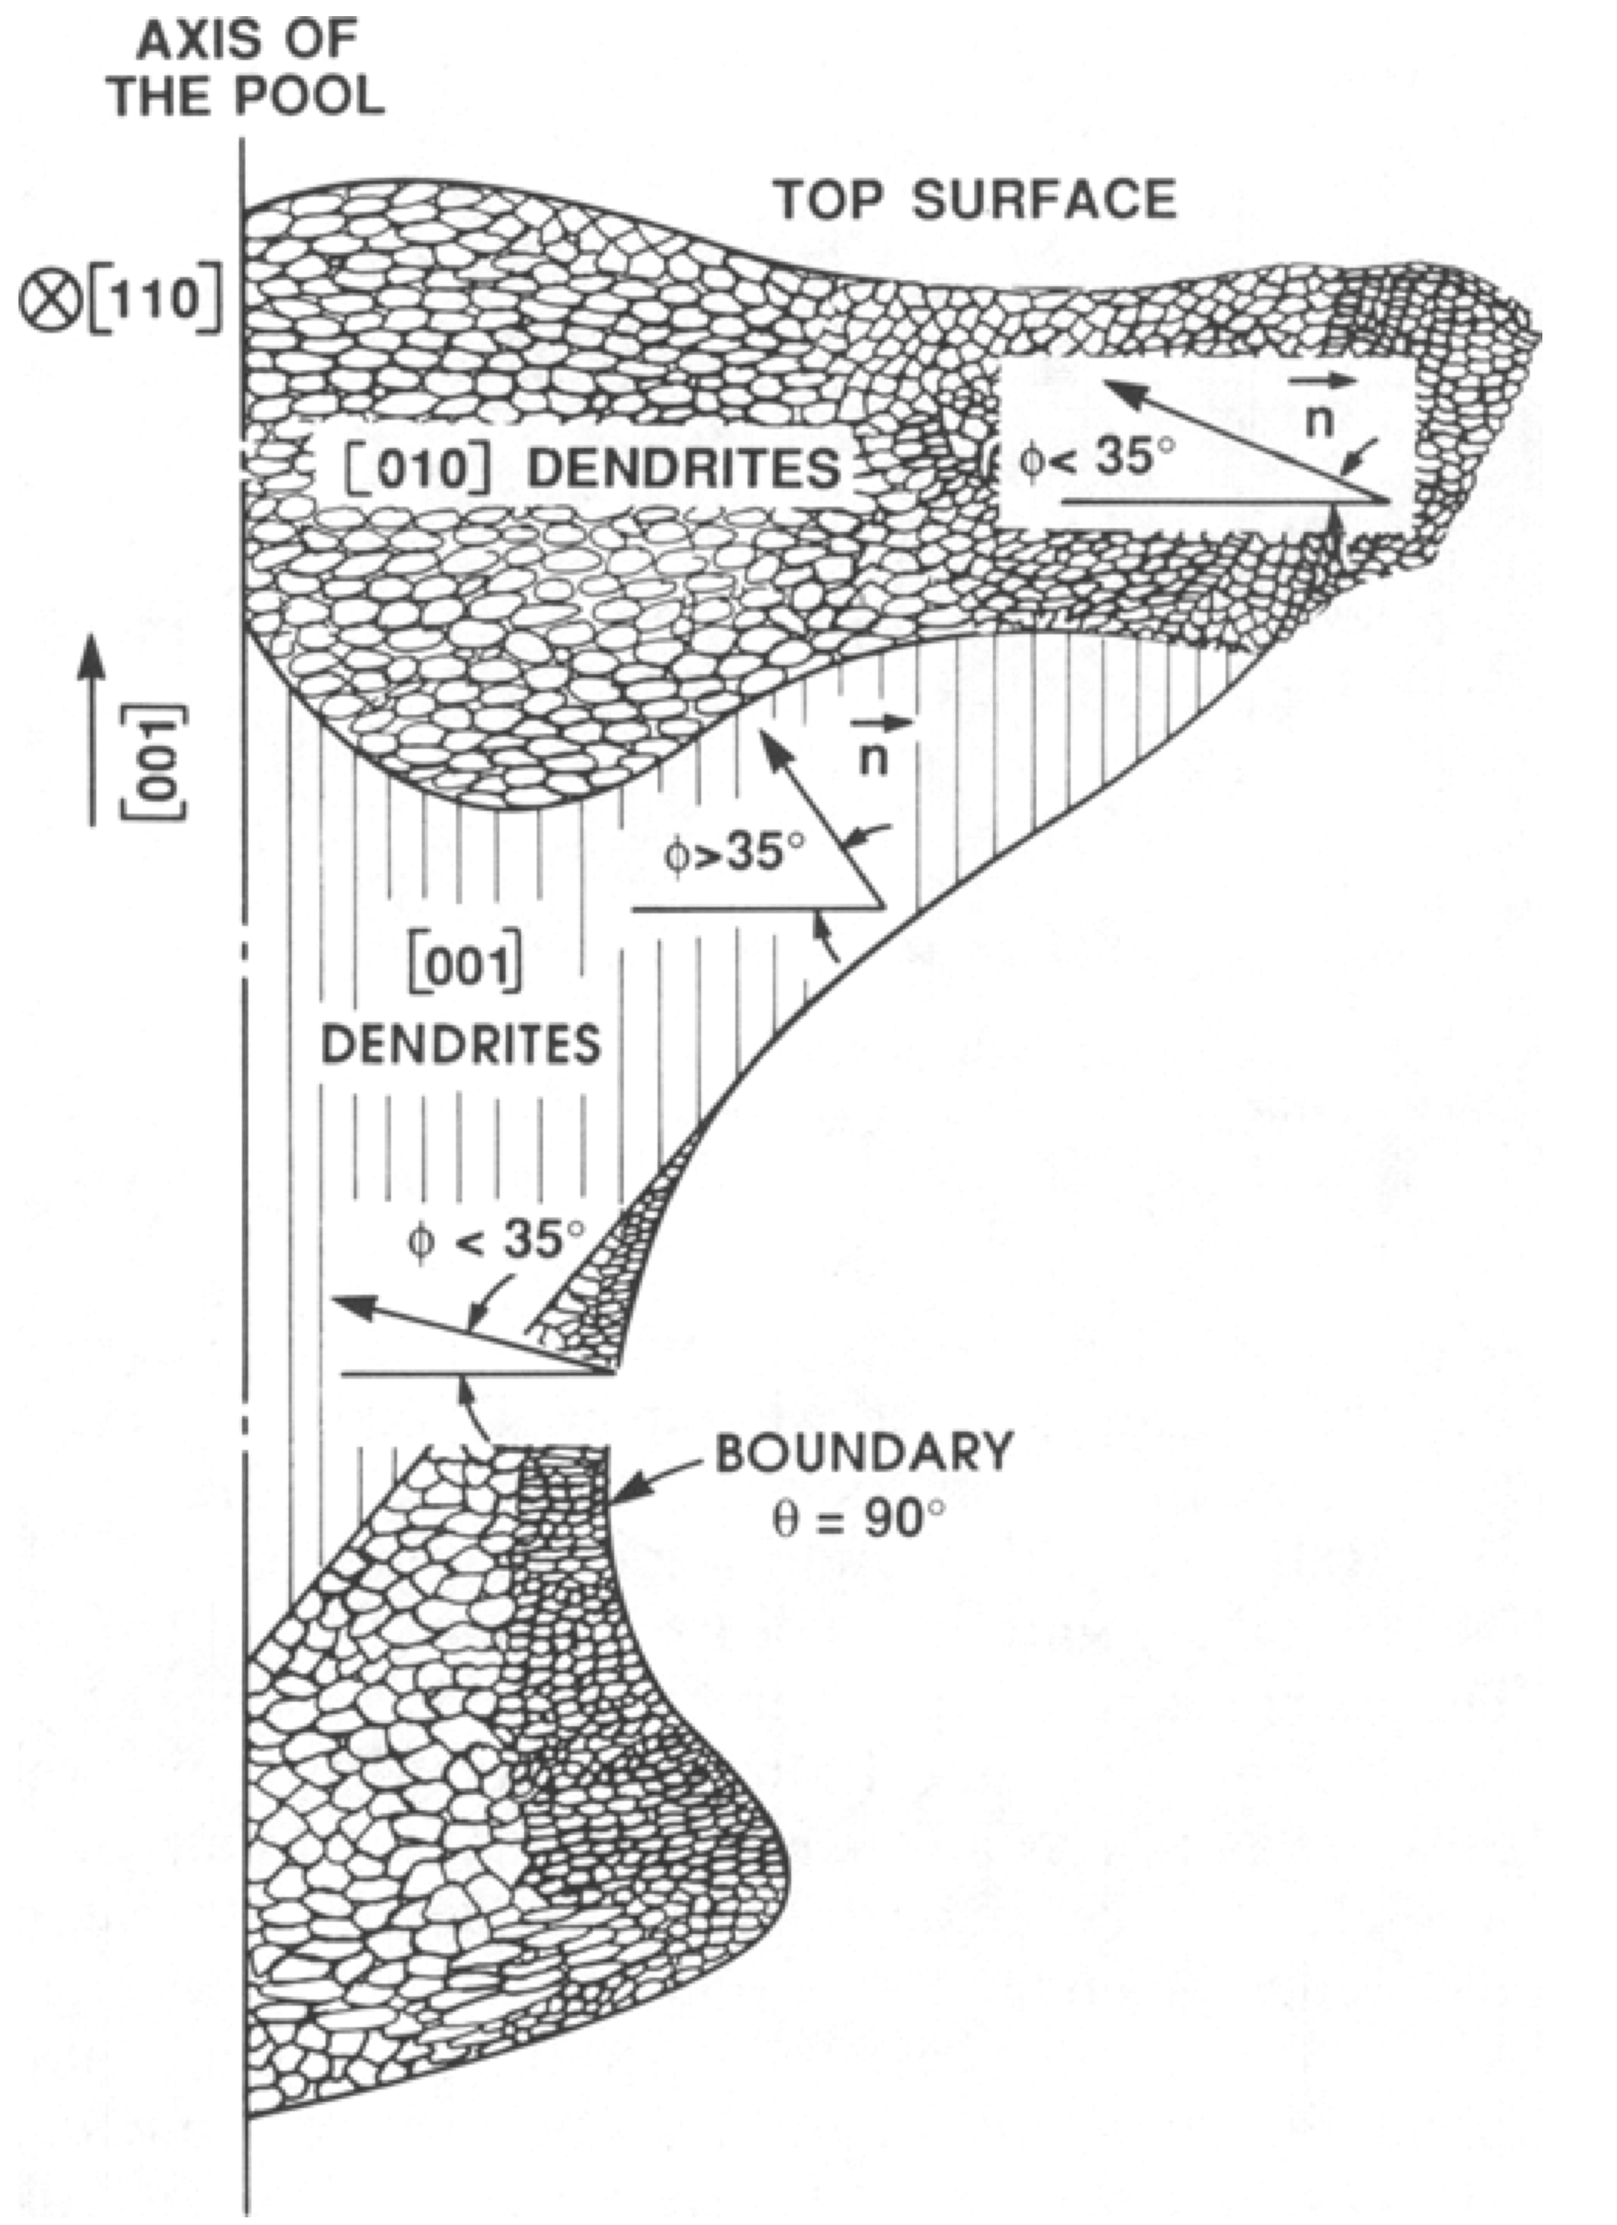
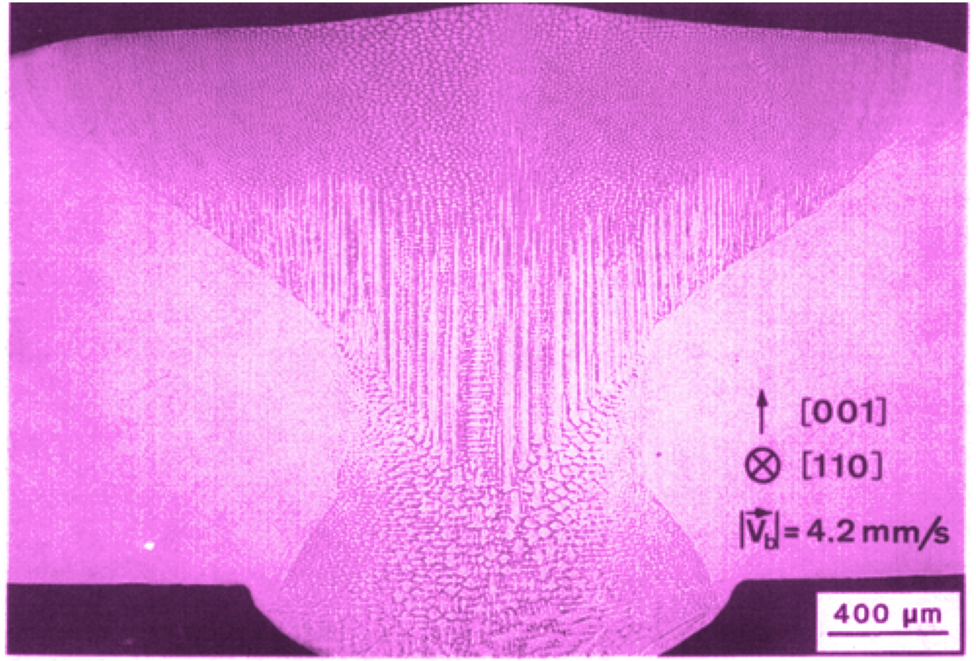
Evaluation of electron-beam welds of single-crystal alloy
Vitek, Rappaz, David, Boatner, JOM 40 (1988) 48

Slide 8
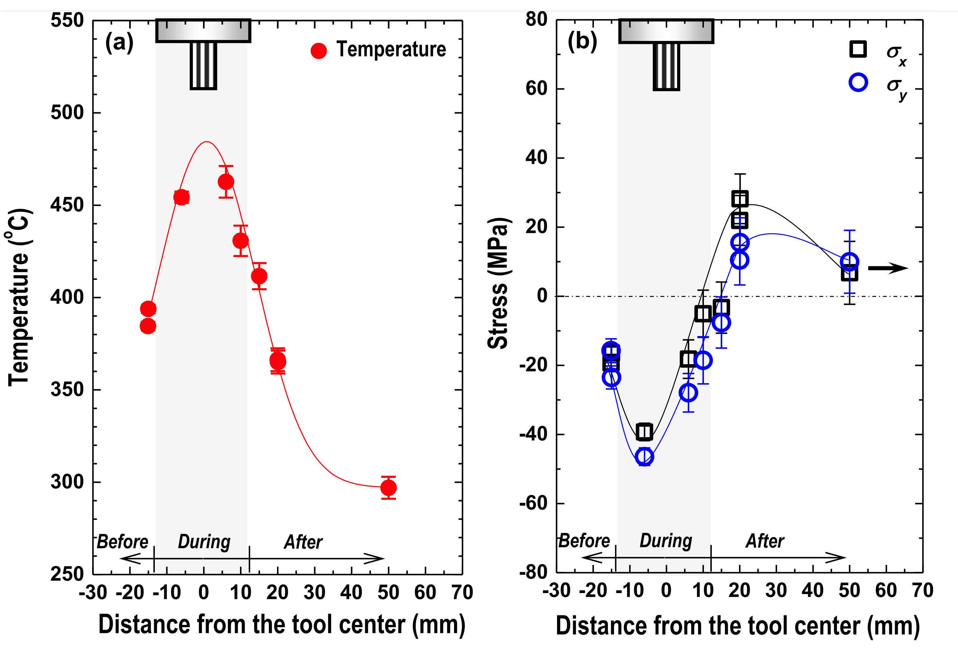
Woo W, Feng Z, Clausen B, David SA. Materials Letters. 2017;196:284-7.

Slide 9
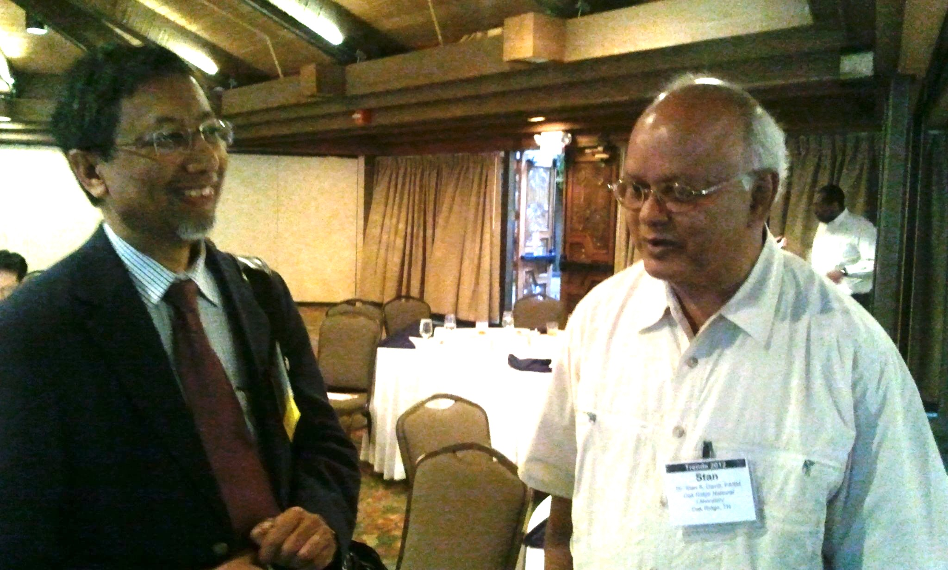
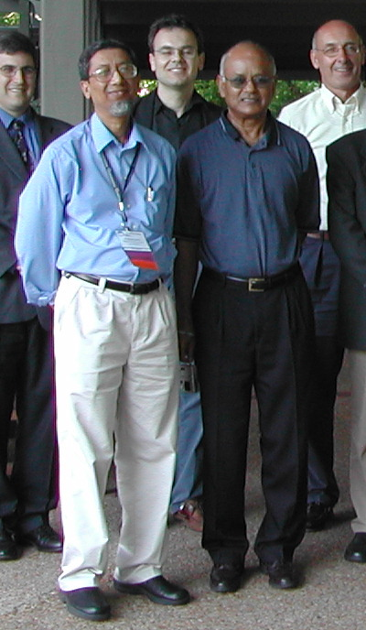
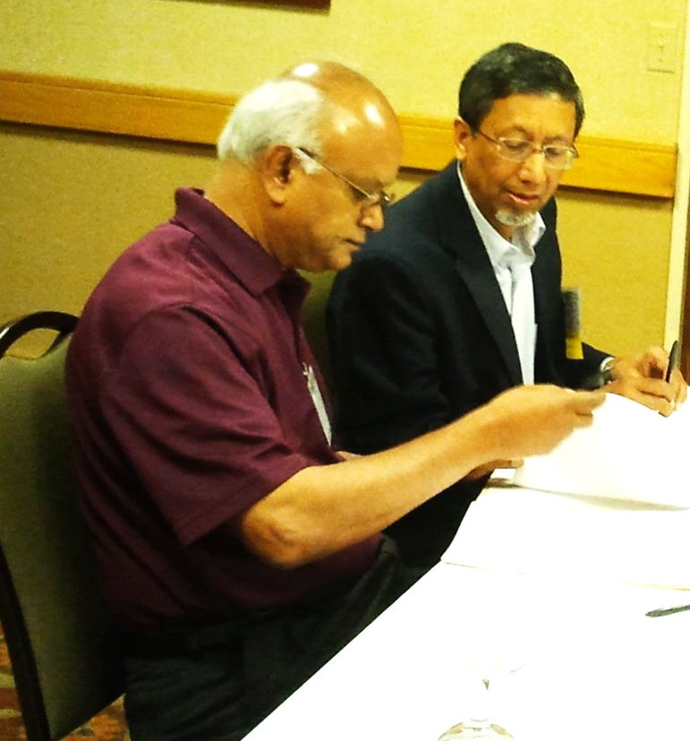

Slide 10
Laser beam welding of high-manganese stainless steels—alloying element loss and microstructural changes
Khan PA, DebRoy T, David SA. Welding Journal. 1988;67:1s-7s.
Around 1984, I studied a paper in which DebRoy used a disarmingly simple method to collect vapour from weld plasma to establish the thermodynamic state of the plasma.
I remember feeling elated at the elegance of the work.
And in the field of welding!

Slide 11
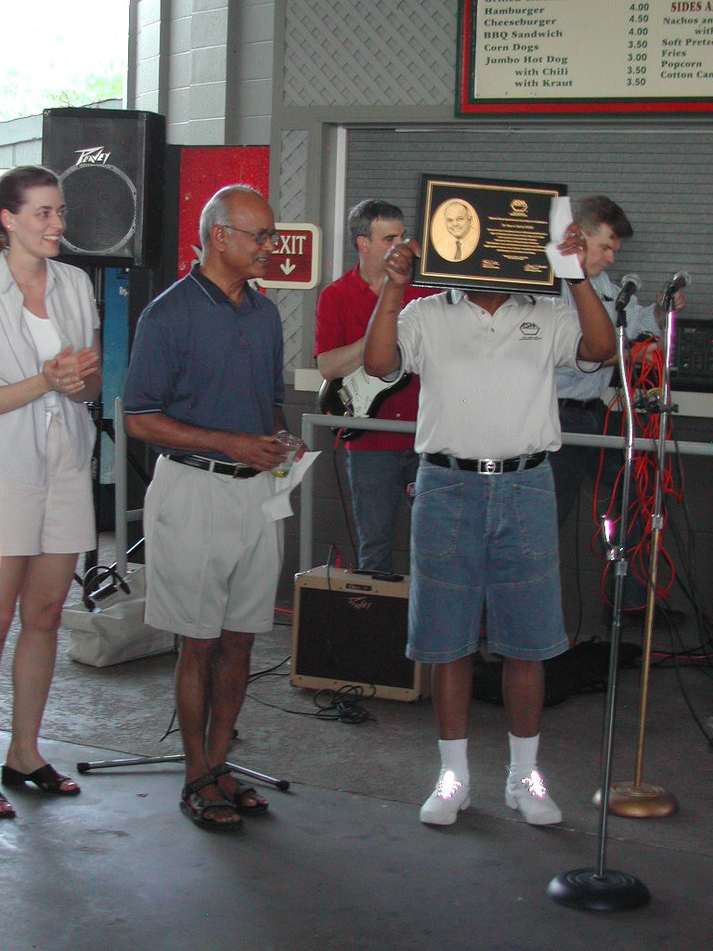
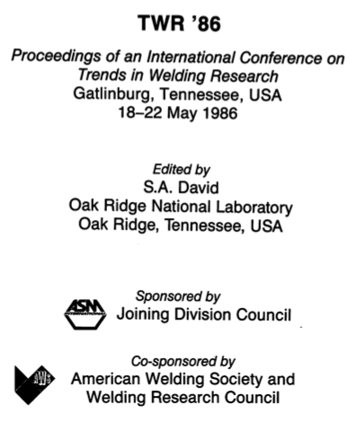
Stan, the trend setter…

Slide 12
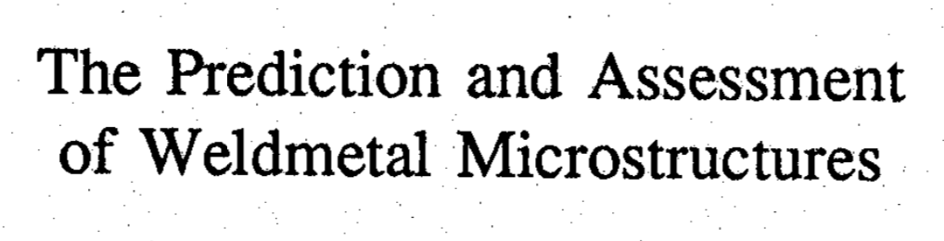
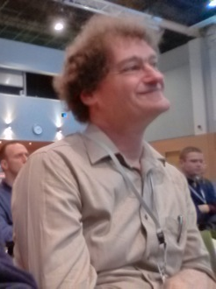
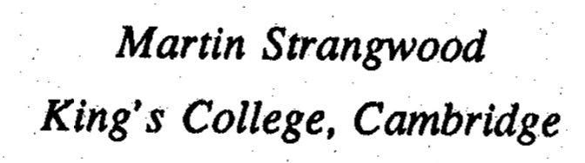
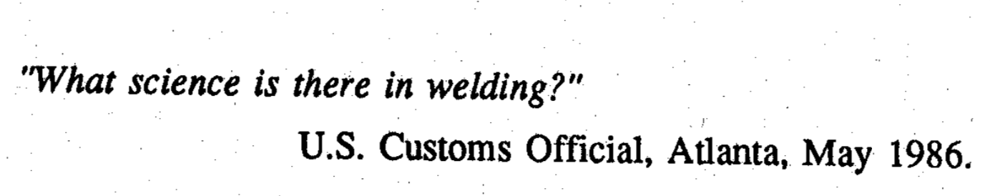

Slide 13
David SA, DebRoy T.
Current issues & problems in welding science.
Science.
1992, 257:497-502.
DebRoy T, David SA.
Physical processes in fusion welding.
Reviews of modern physics.
1995;67:85.

Slide 14
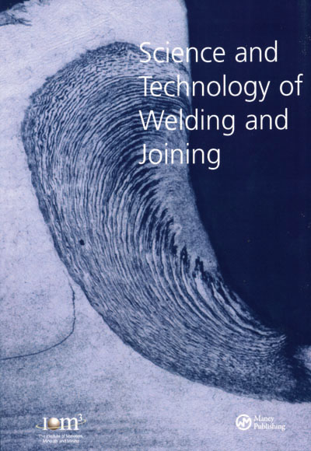
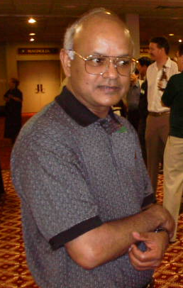
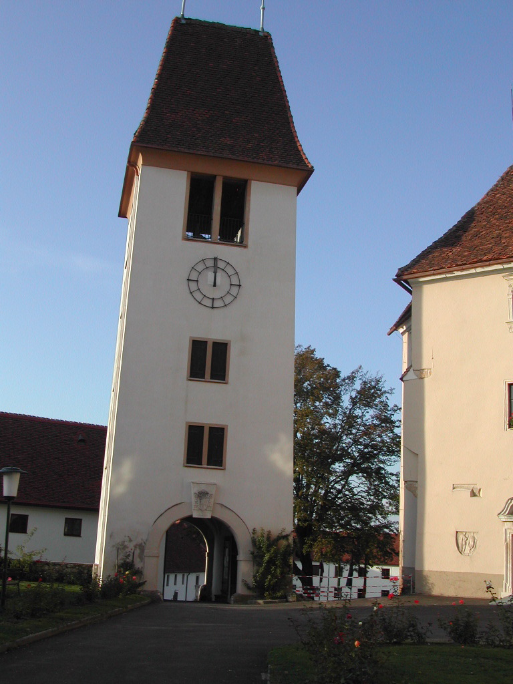
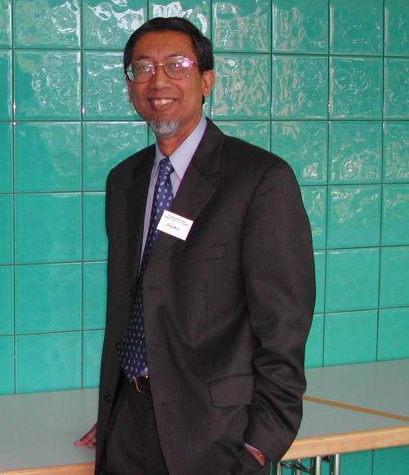
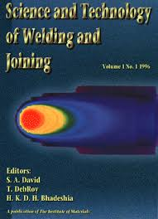
22 Volumes published
since 1996
1694 gems

Slide 15
STWJ

Slide 16
Citations per paper (3 years)
STWJ
Welding in the World
Welding Journal
Transactions of China Welding
2.32
1.26
0.62
0.37

Slide 17
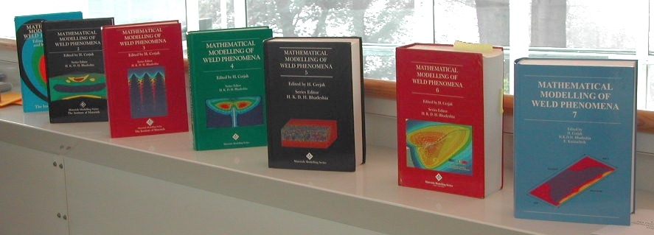
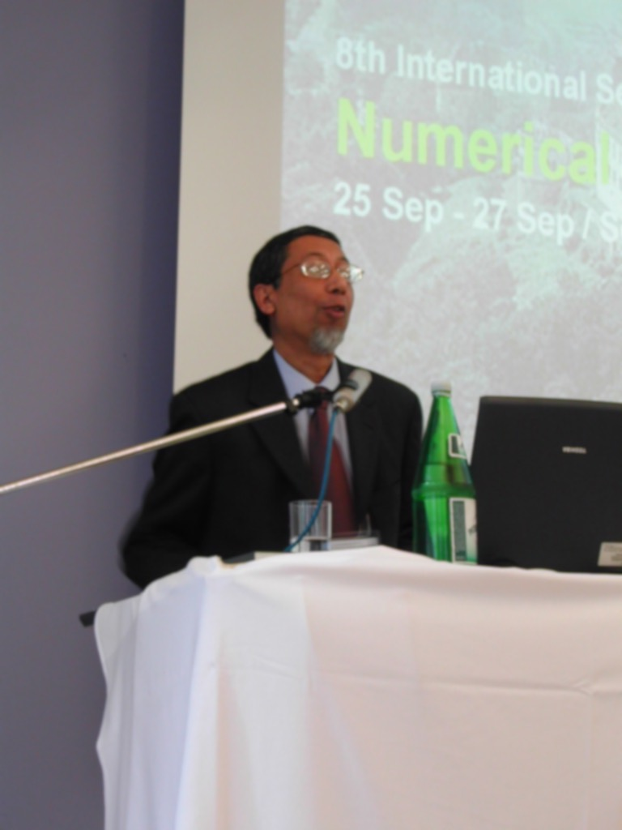
DebRoy is a prolific author
Ken Easterling Award

Slide 18
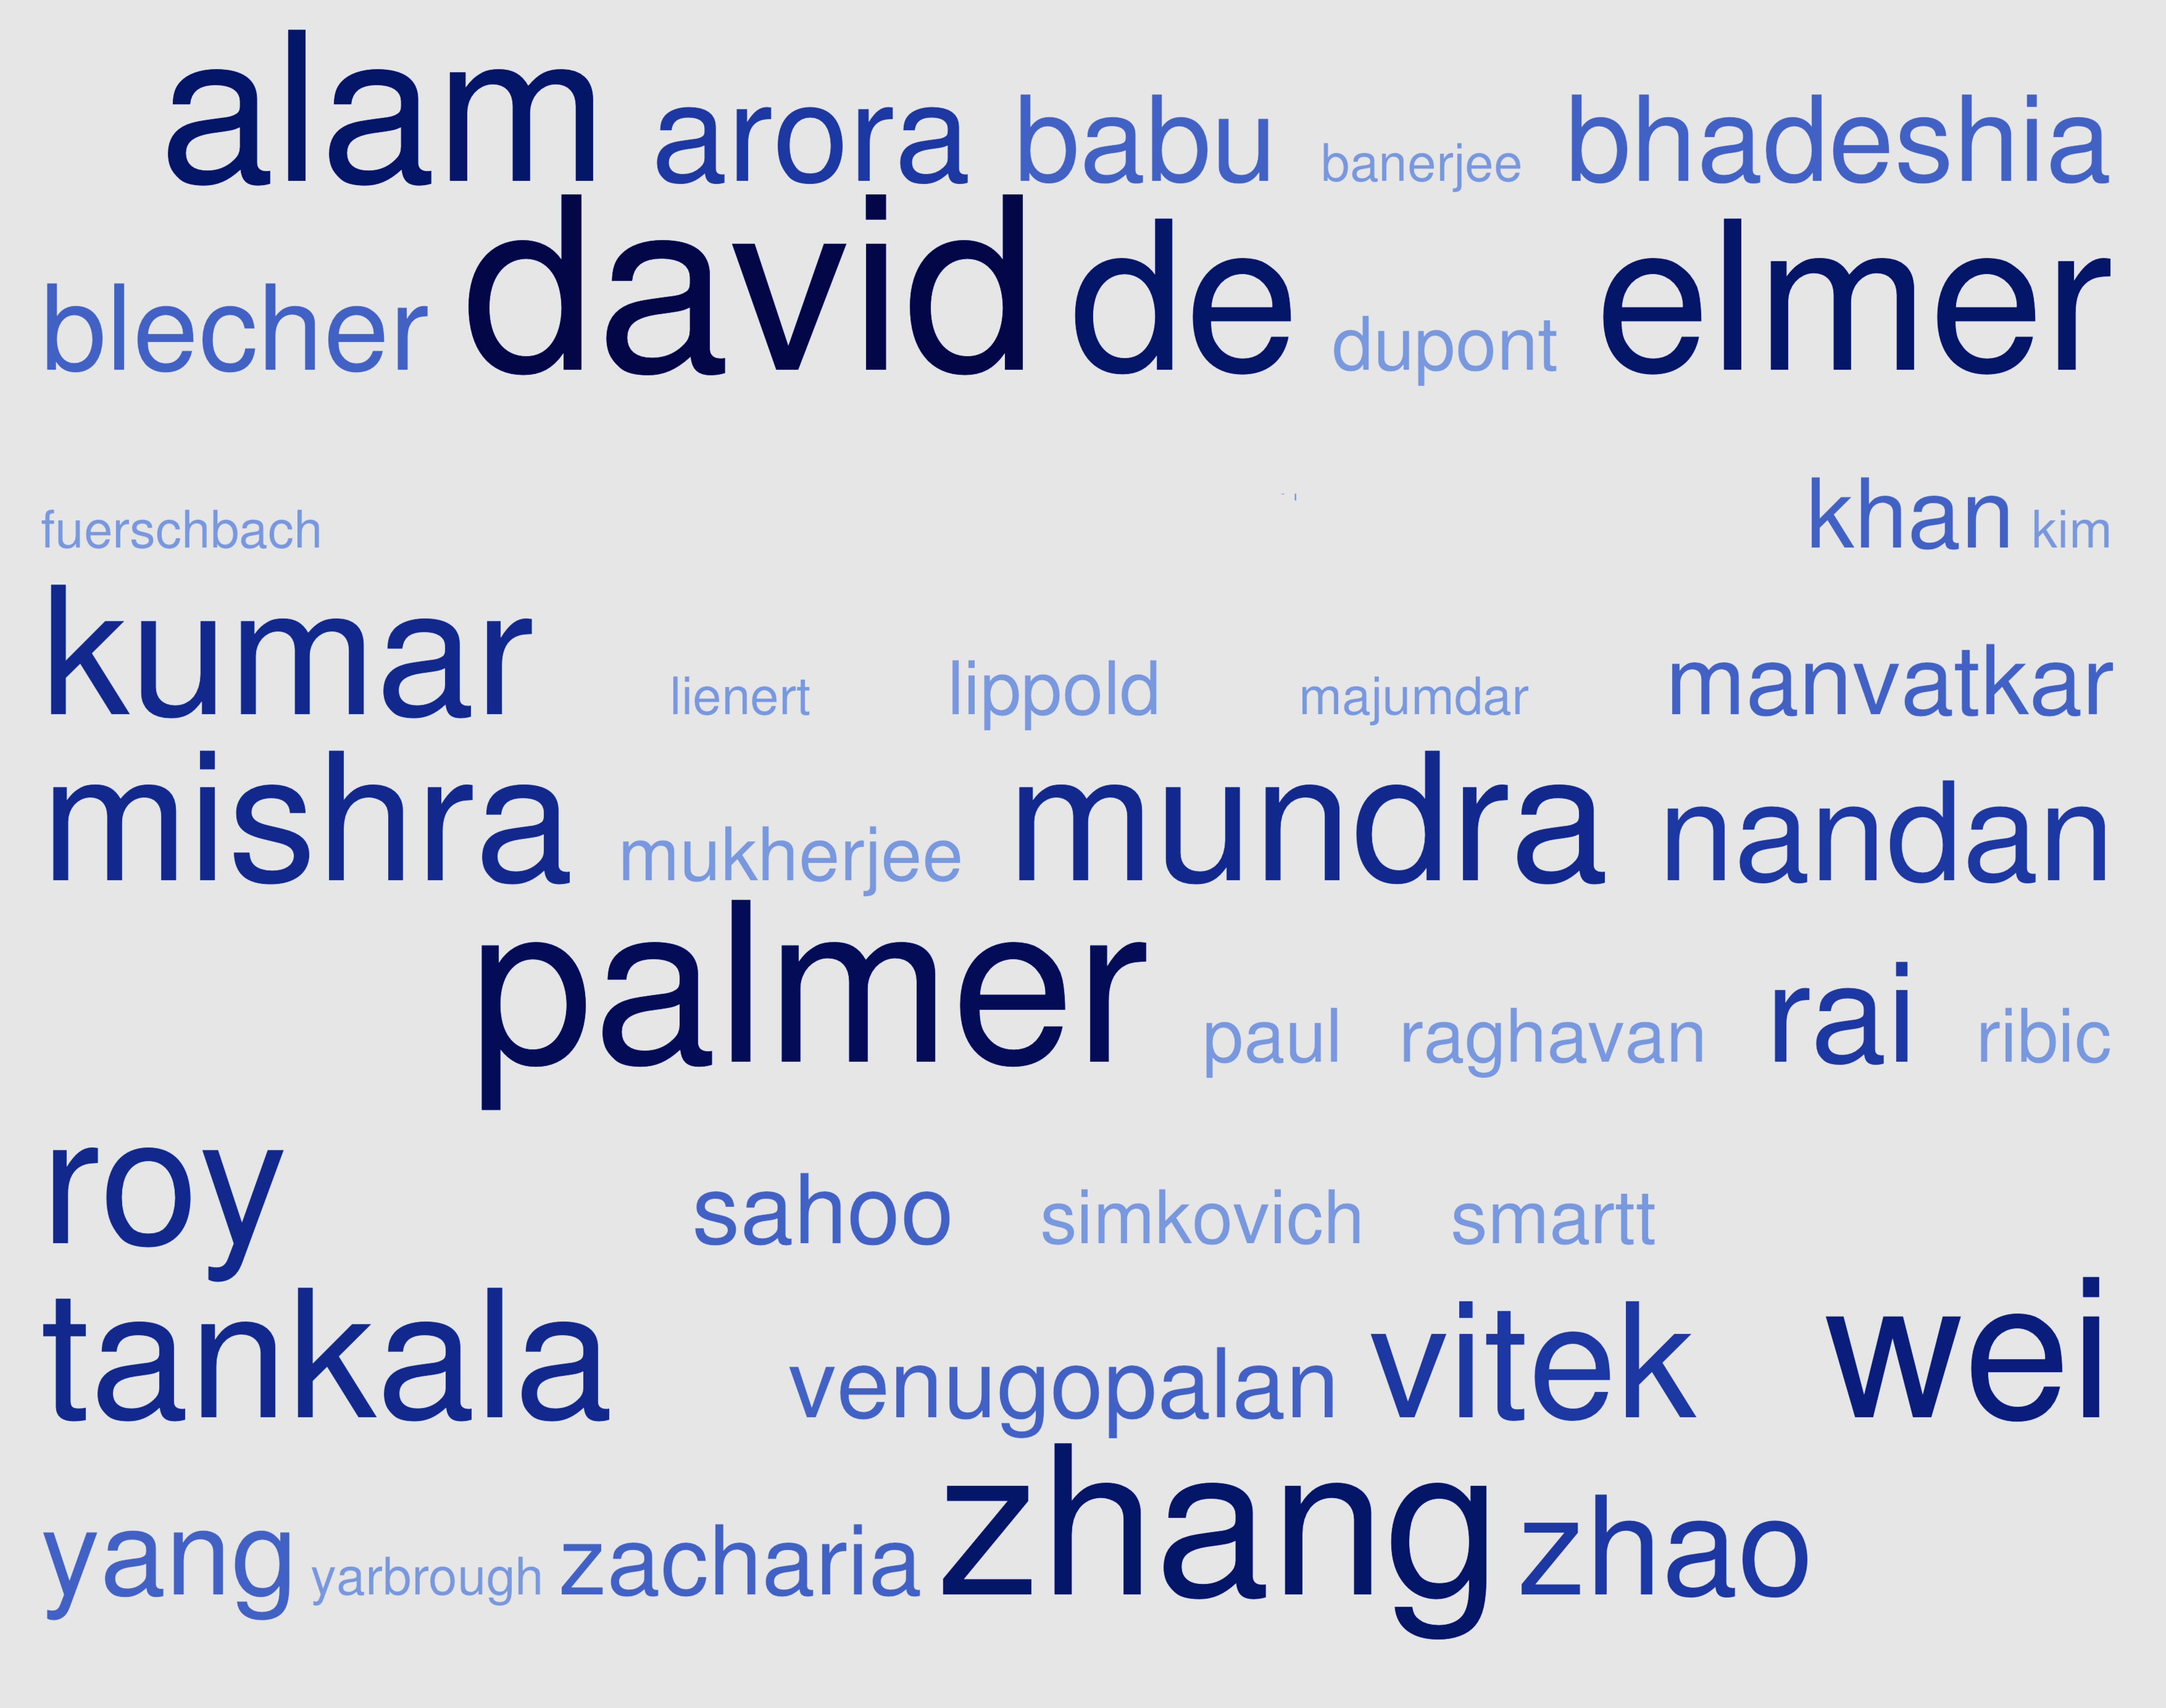

Slide 19
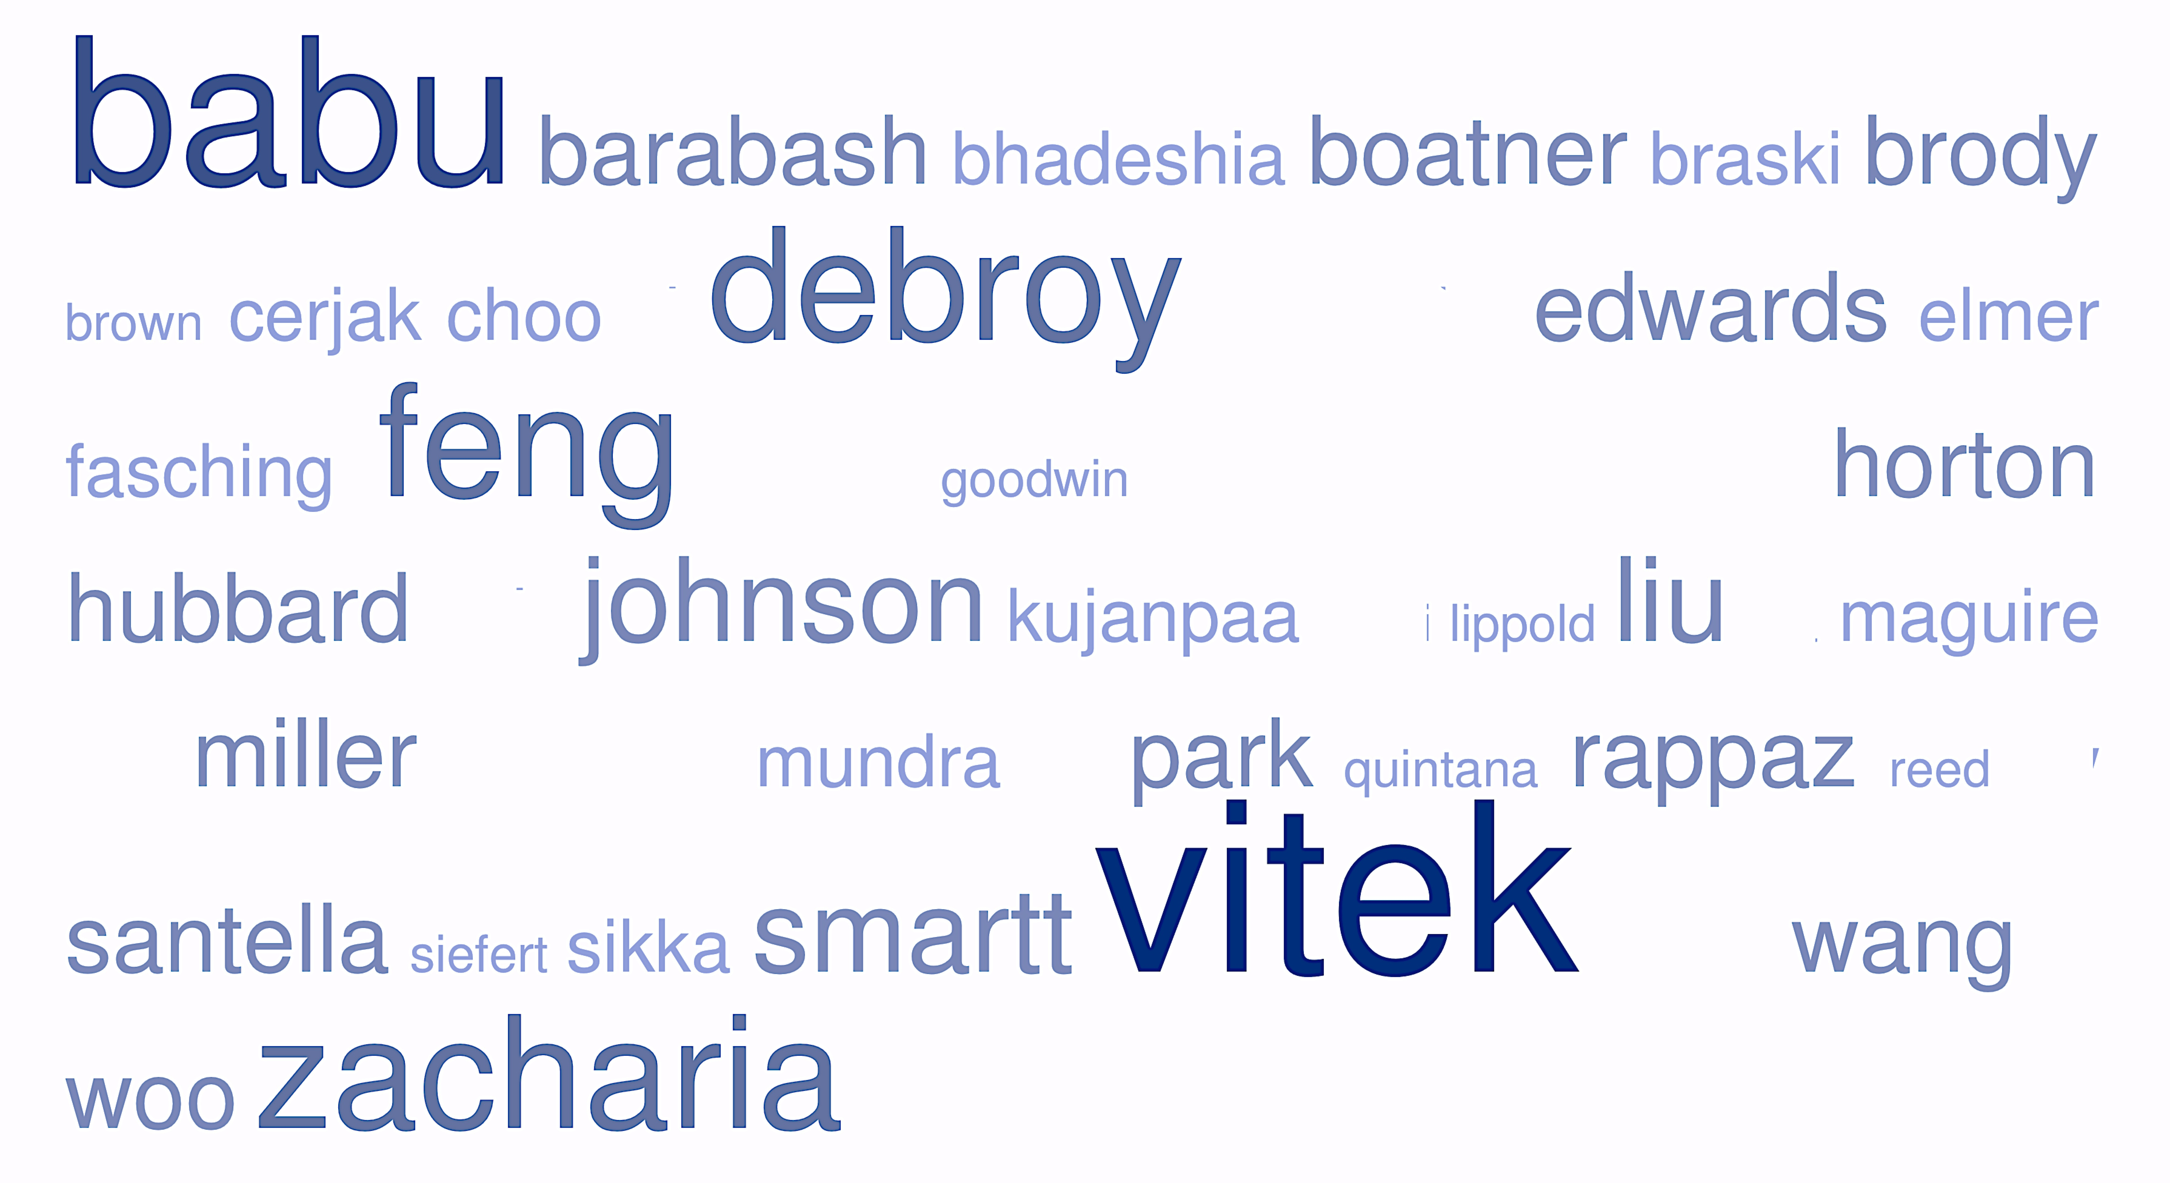

Slide 20
Scholars and gentlemen

