Slide 1
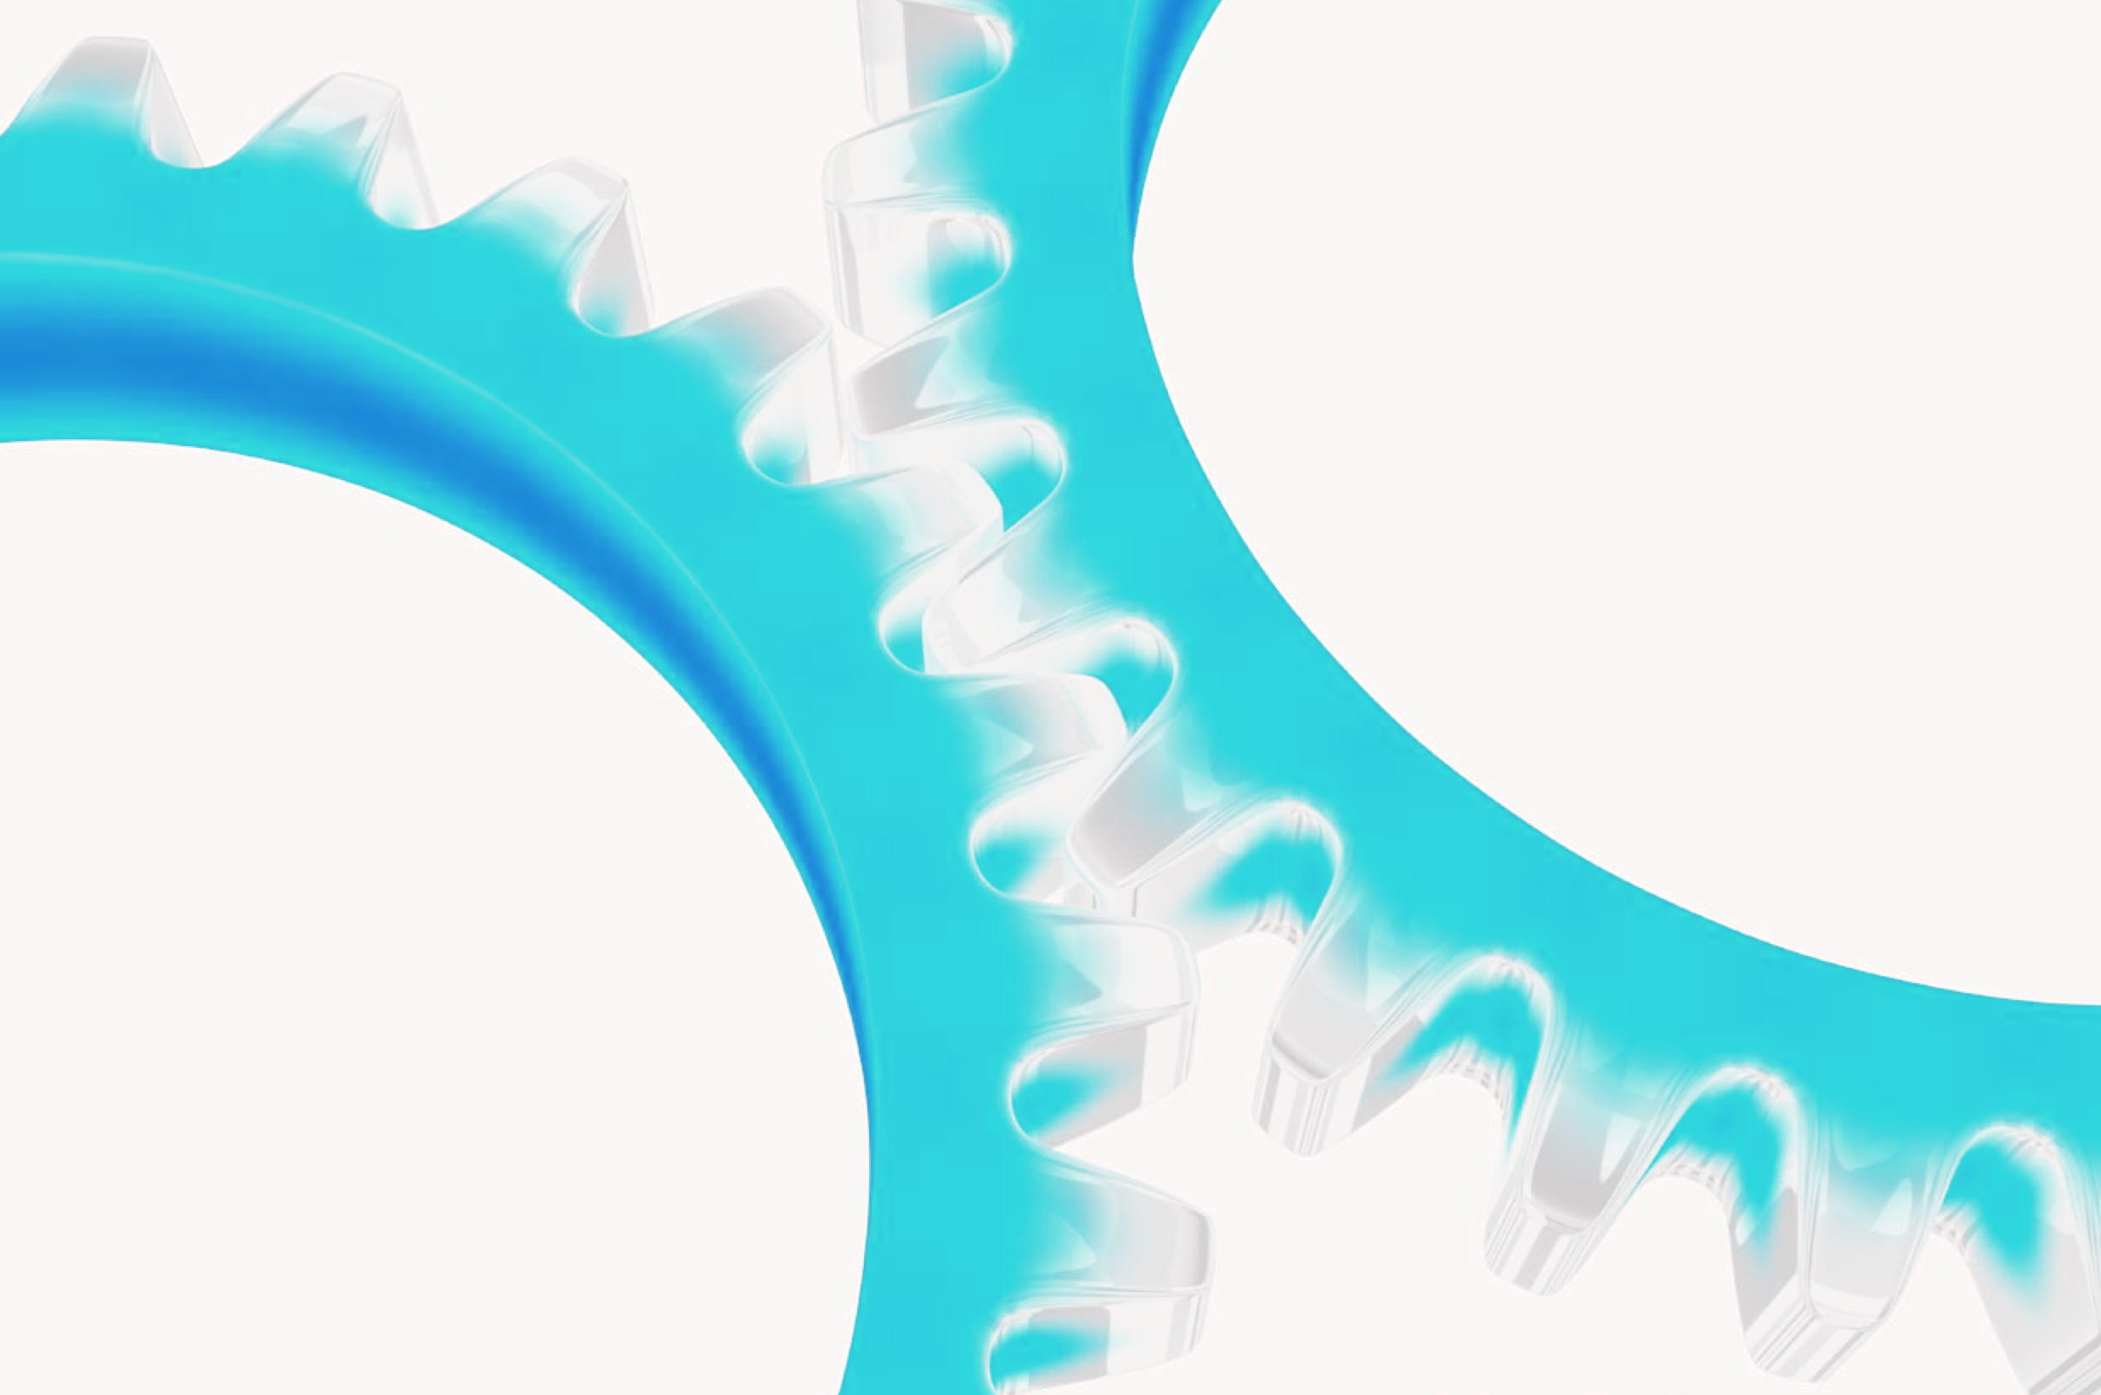
Design of advanced steels
www.msm.cam.ac.uk/phase-trans

Slide 2
electron theory
molecular dynamics
thermodynamics
irreversible thermodynamics
kinetics
finite elements
structure-properties
uncertainties

Slide 4
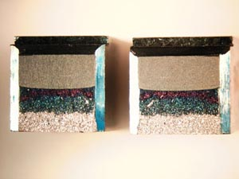
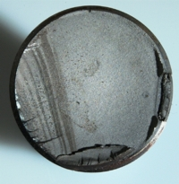
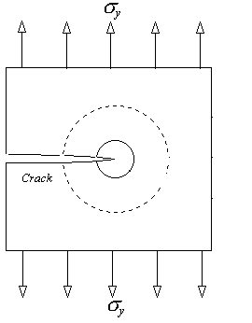
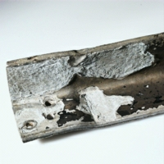
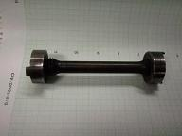
Charpy
fatigue
tensile
critical stress intensity
corrosion

Slide 5
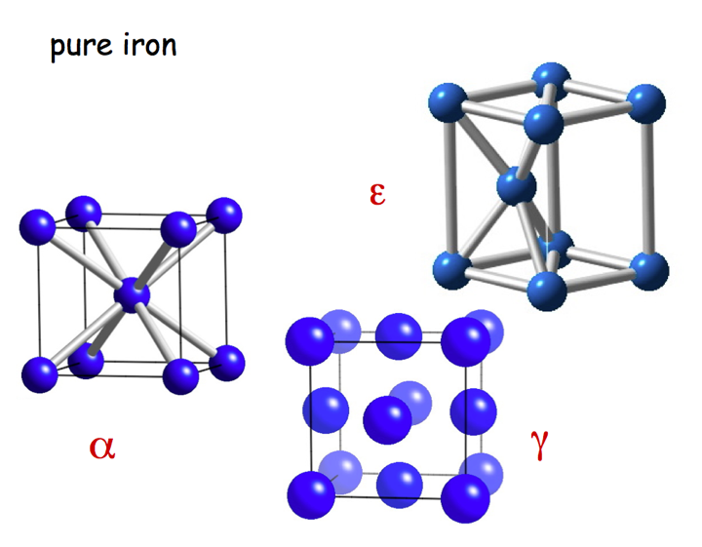

Slide 6
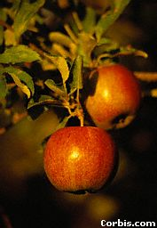
an apple weighs
1 Newton
= 1 Pa
1 m

Slide 7
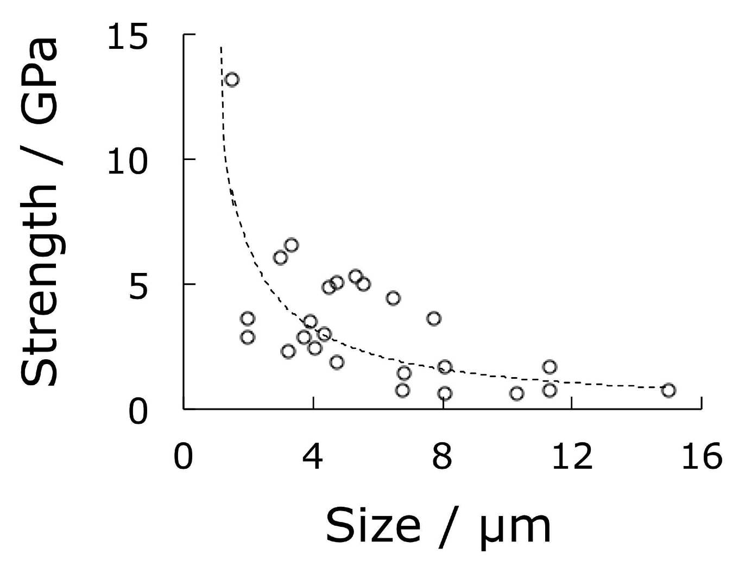
Pure iron, Brenner (1956)

Slide 8
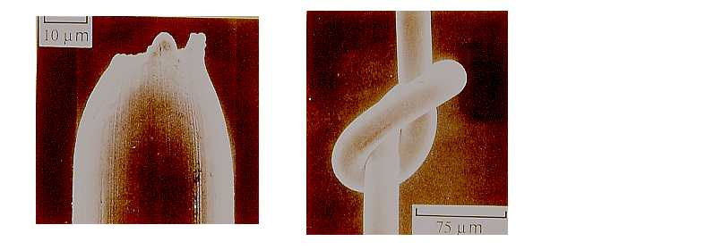
Scifer, 5.5 GPa and ductile
Kobe Steel

Slide 9
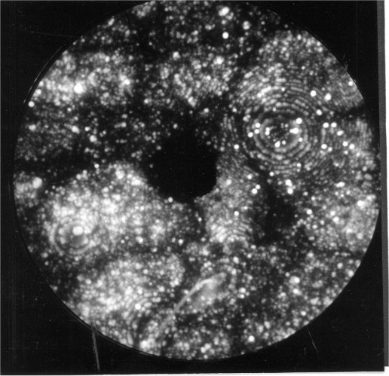

Slide 10
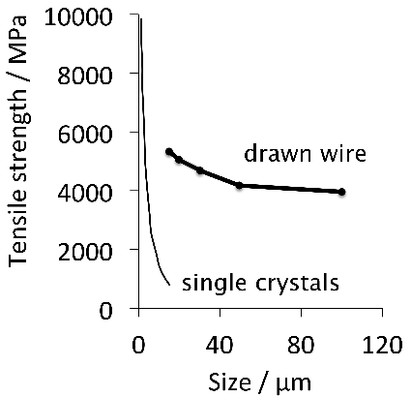

Slide 11
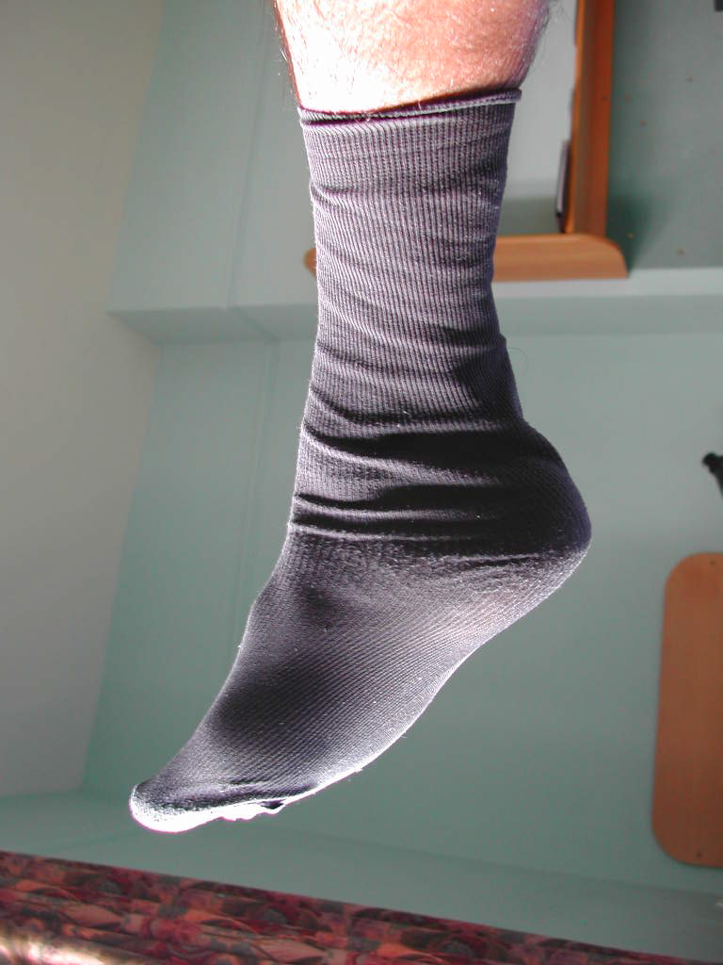
1 Denier: weight in grams, of 9 km of fibre
50-10 Denier
Scifer is 9 Denier

Slide 12
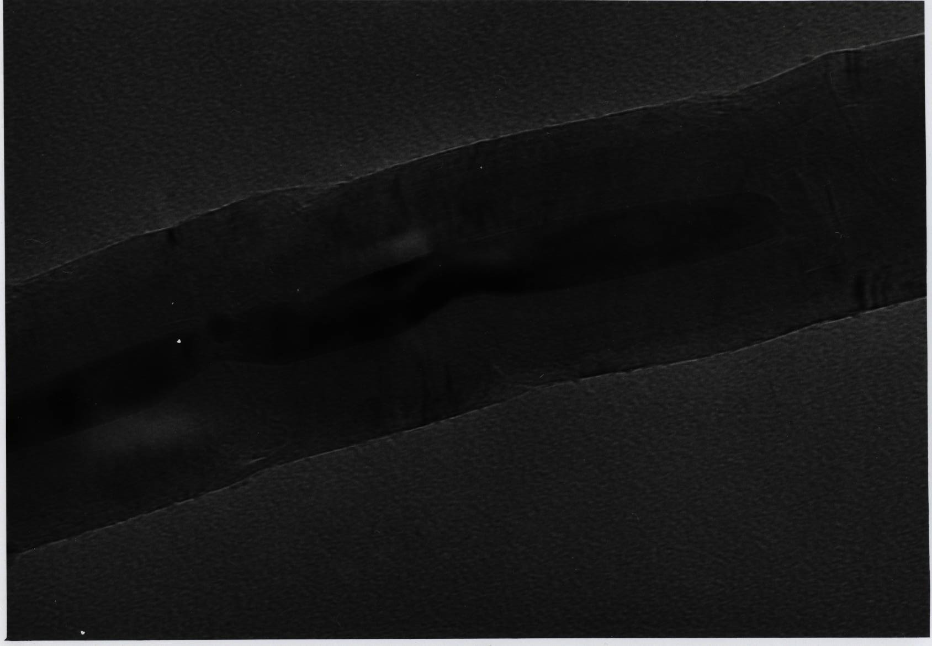
Claimed strength of carbon nanotube is 130 GPa
Edwards, Acta Astronautica, 2000
Claimed modulus is 1.2 TPa
Terrones et al., Phil. Trans. Roy. Soc., 2004

Slide 13
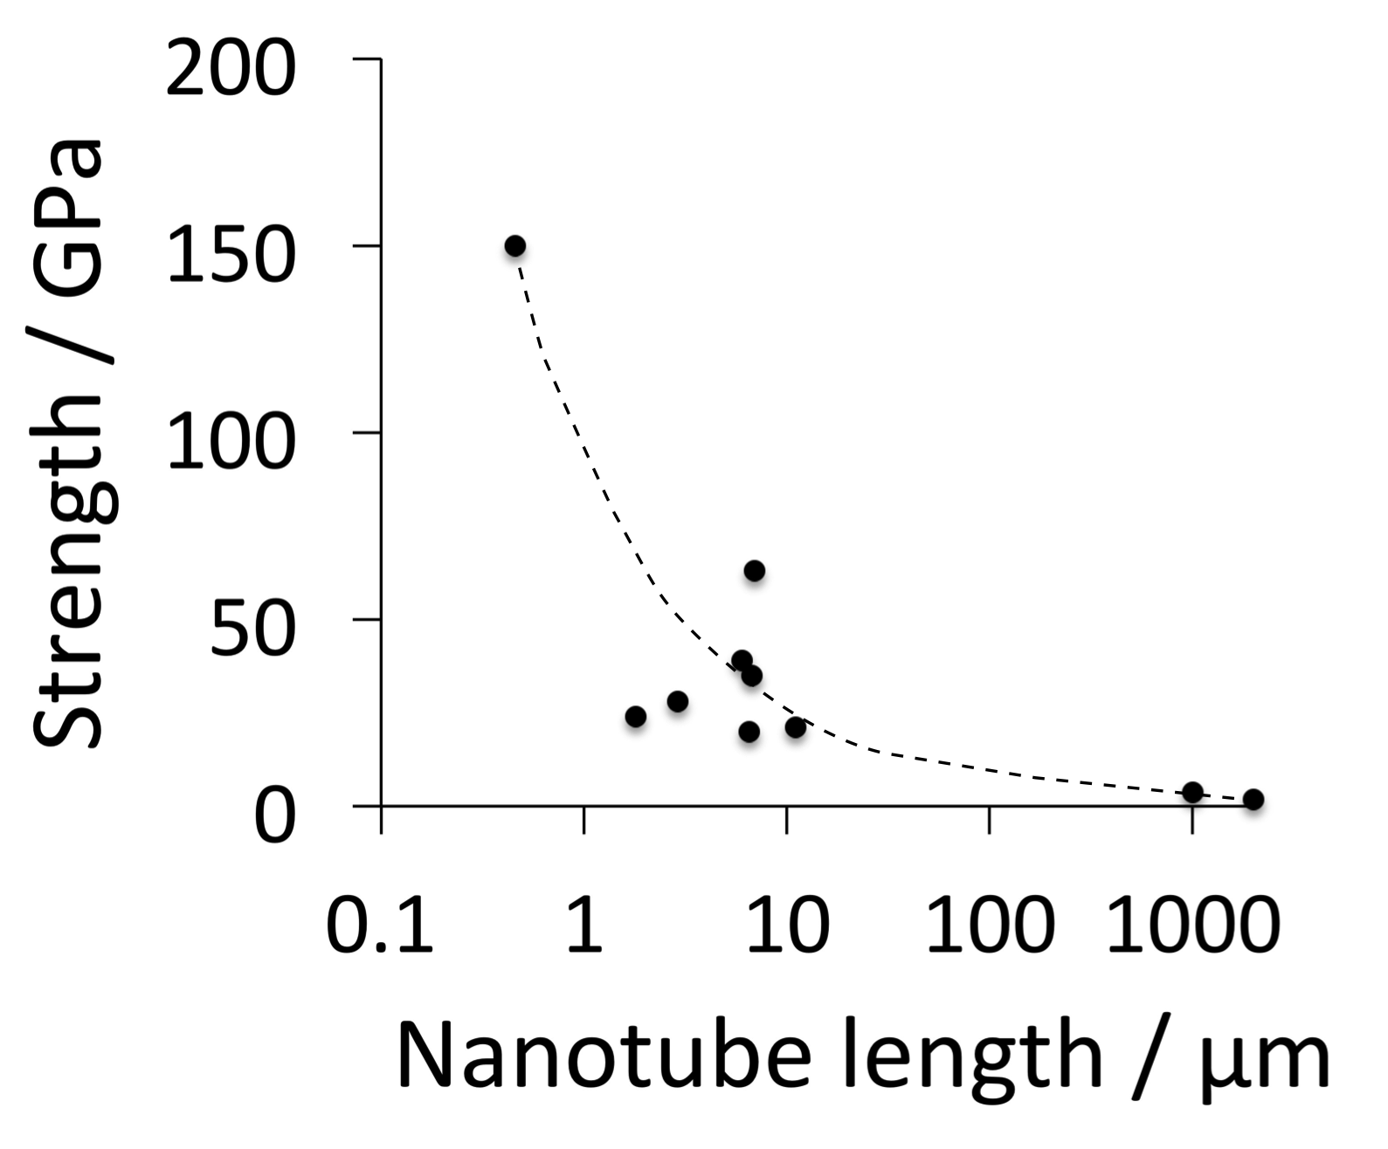
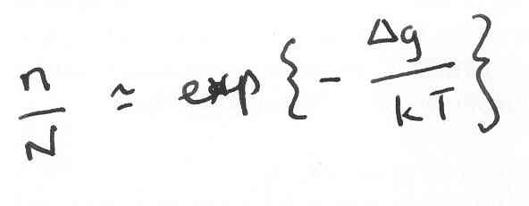
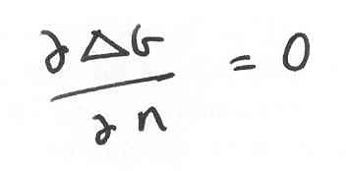
carbon nanotubes and graphene fundmentally
unsuitable for structural applications

Slide 14
strength 130 GPa
modulus 1.2 TPa
 | J g⁻¹ | m s⁻¹
Dynamite | 4650 | 6000
Nanotube | 5420 | 21500

Slide 15
Summary
Strength produced by deformation limits shape: wires, sheets...
Strength in small particles relies on perfection. Doomed as size increases.

Slide 16
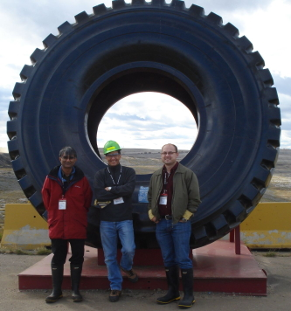
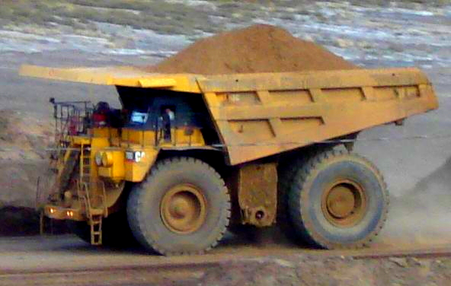
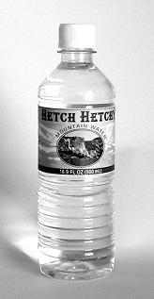
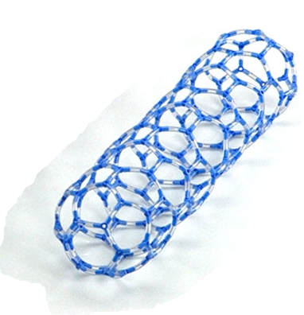
…. bulk nanocrystalline steel which is very strong, tough, cheap ….

Slide 17
Fine crystals by transformation
Introduce work-hardening capacity
Need to store the heat of transformation
Reduce rate of transformation
Transform at low temperature

Slide 20
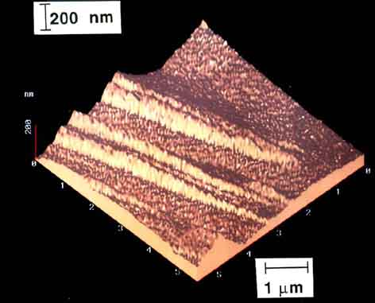
Swallow and Bhadeshia, 1996

Slide 21
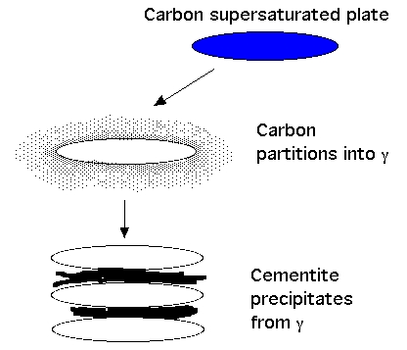

Slide 22
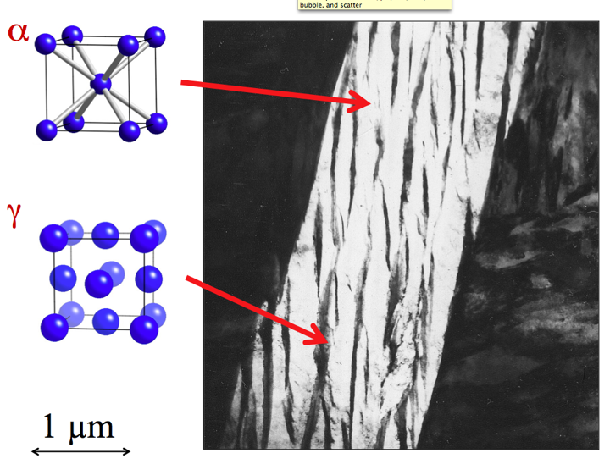
22

Slide 23
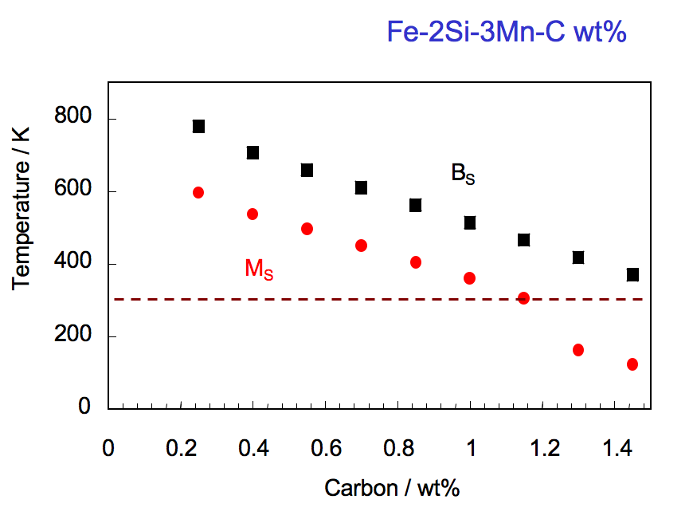

Slide 24
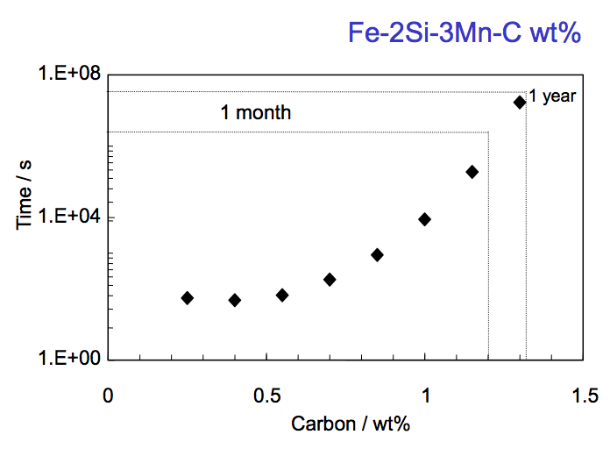

Slide 25
Low transformation temperature
Bainitic hardenability
Reasonable transformation time
Elimination of cementite
Austenite grain size control
Avoidance of temper embrittlement
wt%

Slide 26
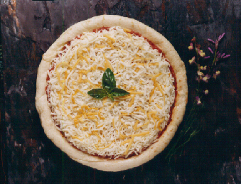
Cooking temperature?
180 to 220 °C

Slide 27
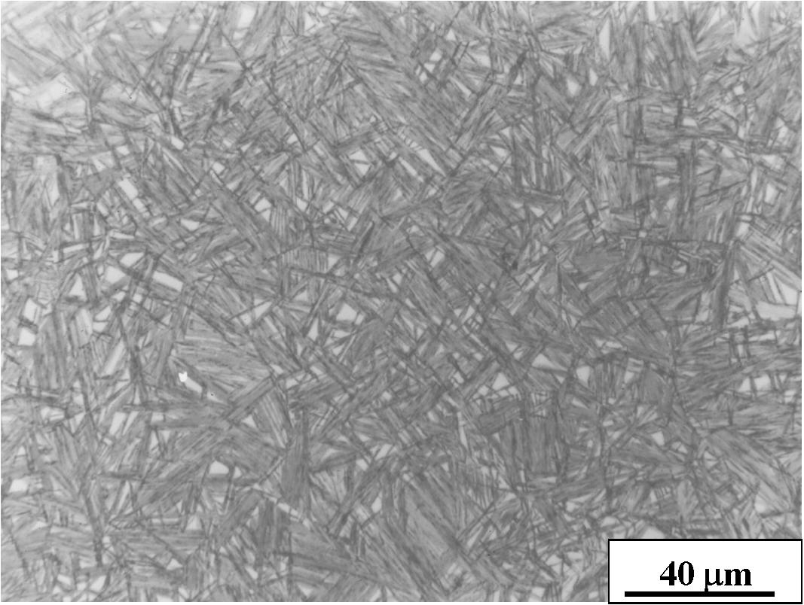

Slide 28
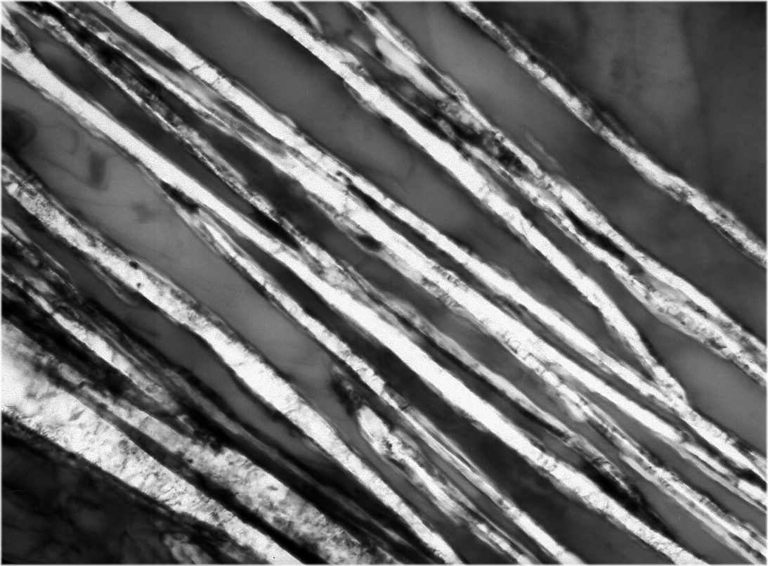
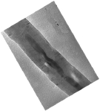
Very strong
Huge uniform ductility
γ
γ
α
No deformation
No rapid cooling
No residual stresses
α
Cheap
Uniform in very large sections
α
200 Å

Slide 29
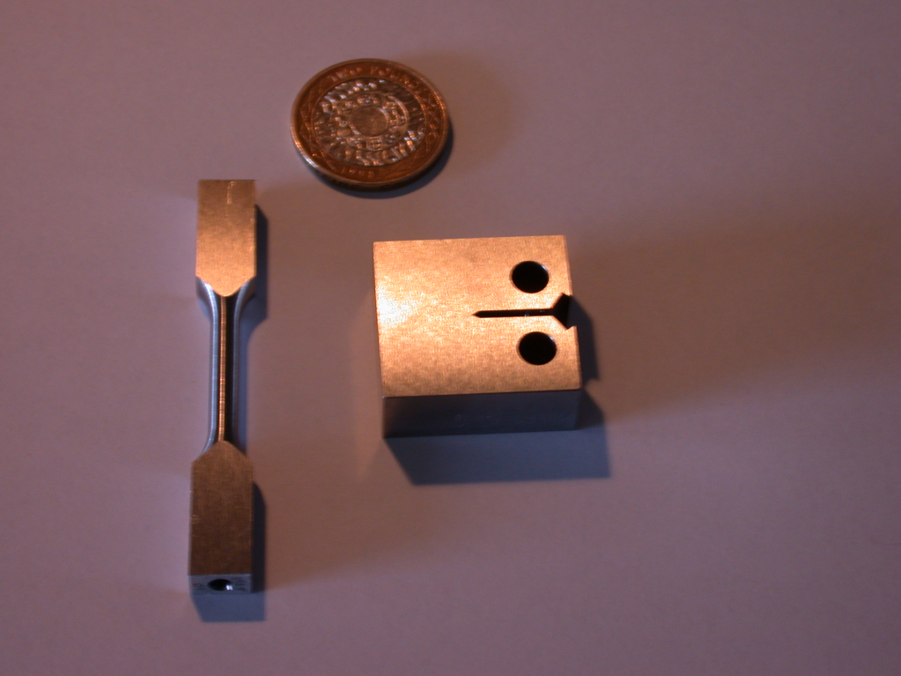
2300-2500 MPa, up to 27% uniform elongation, about 40 MPa m^{1/2}

Slide 30
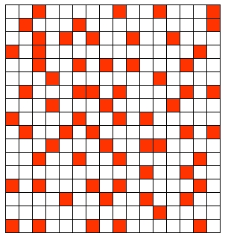
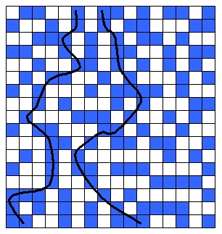
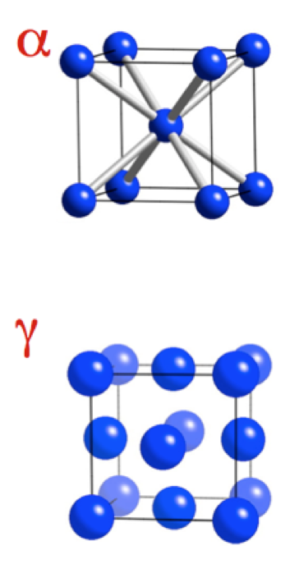
Above percolation threshold
Below percolation threshold

Slide 31
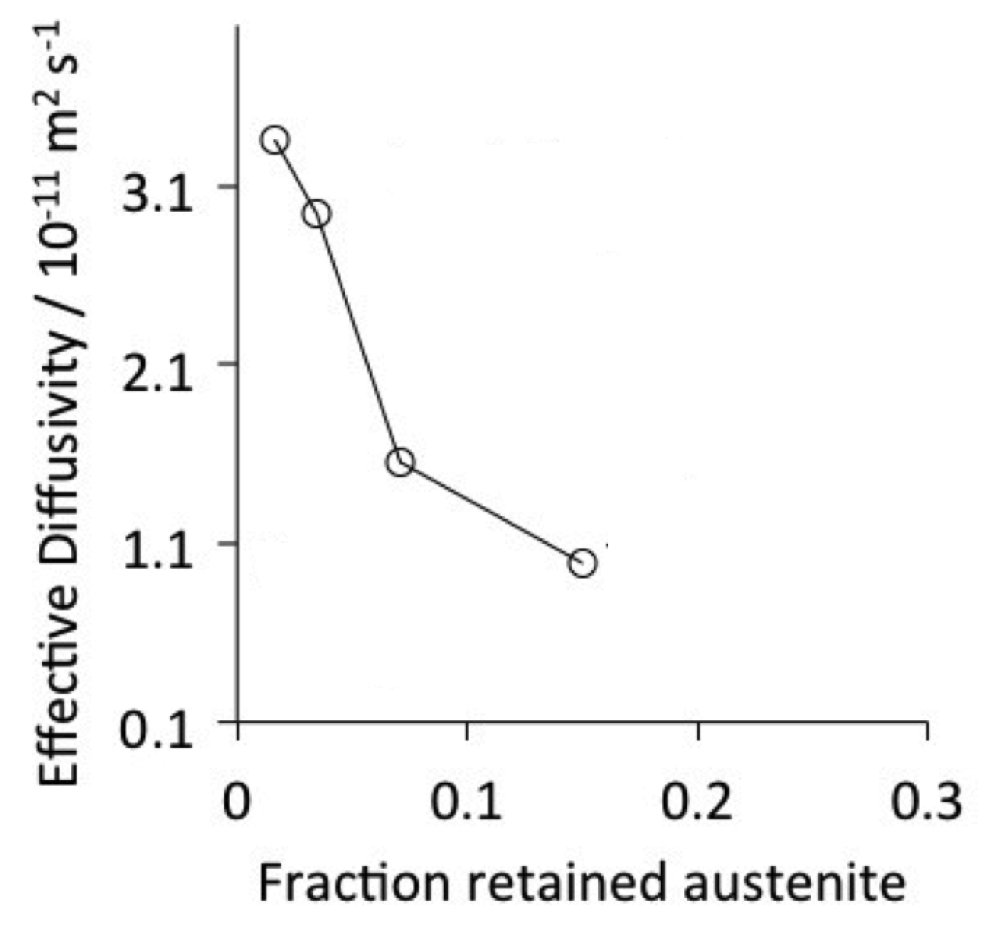
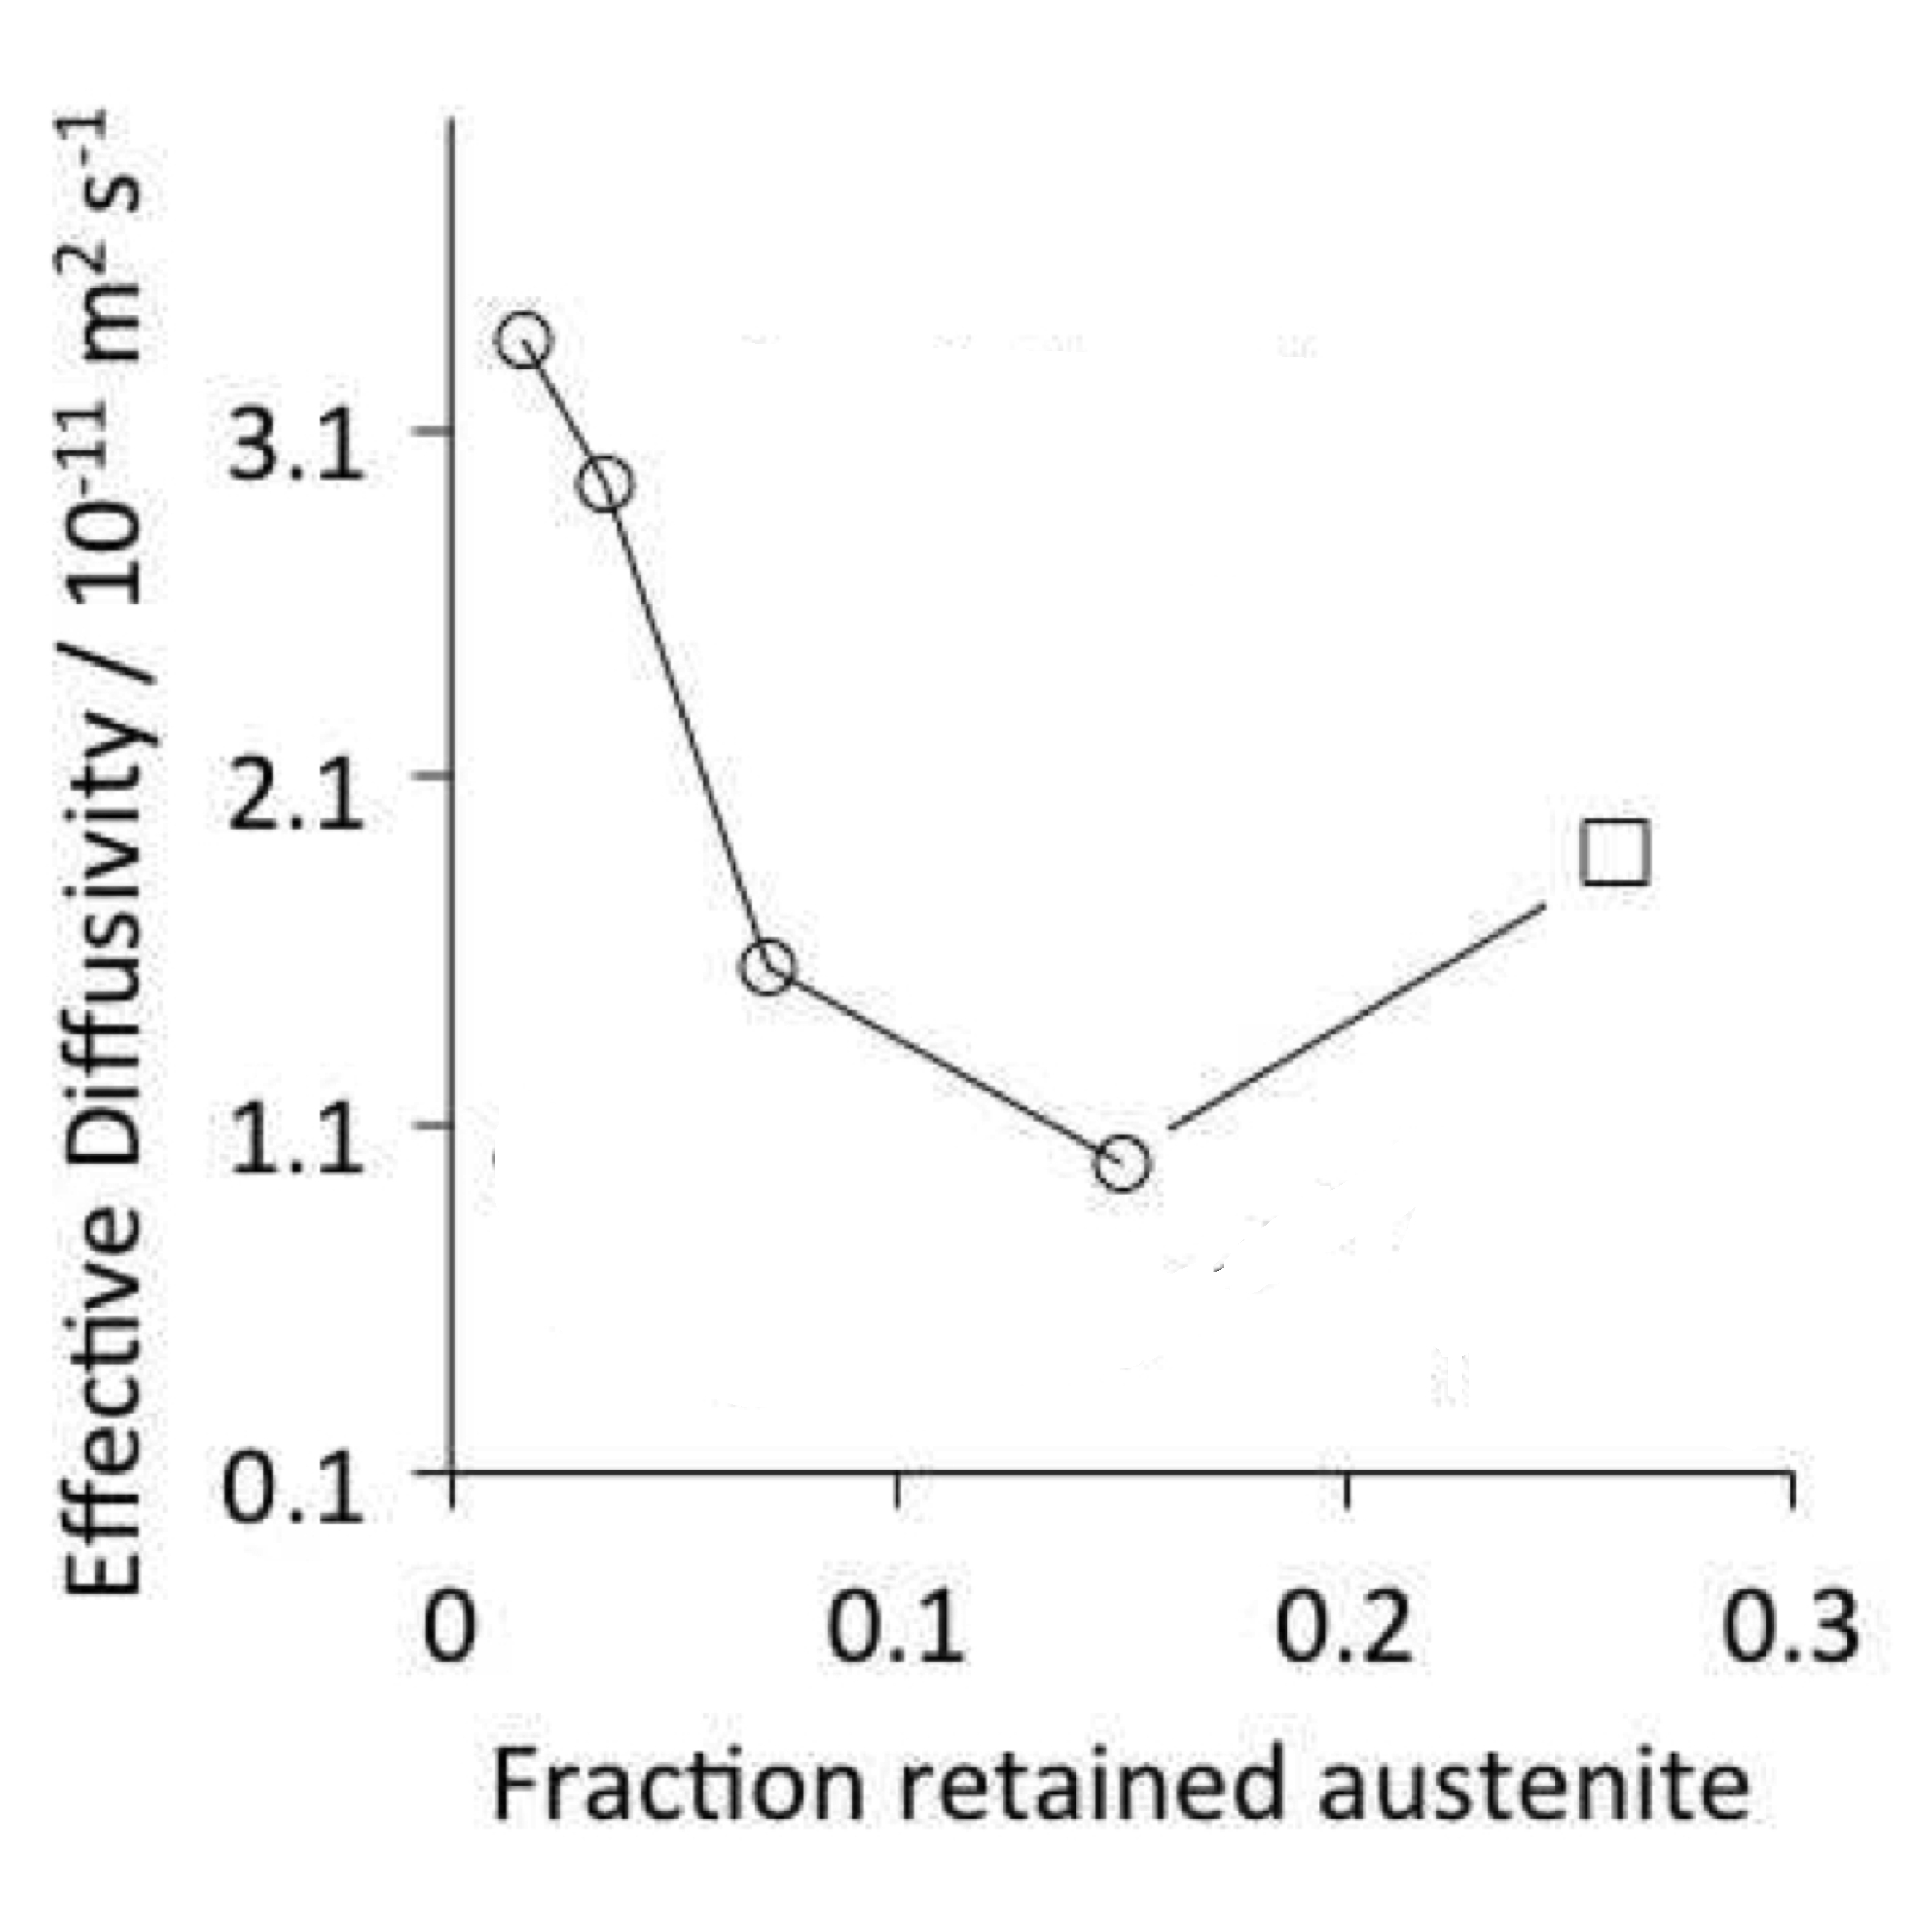
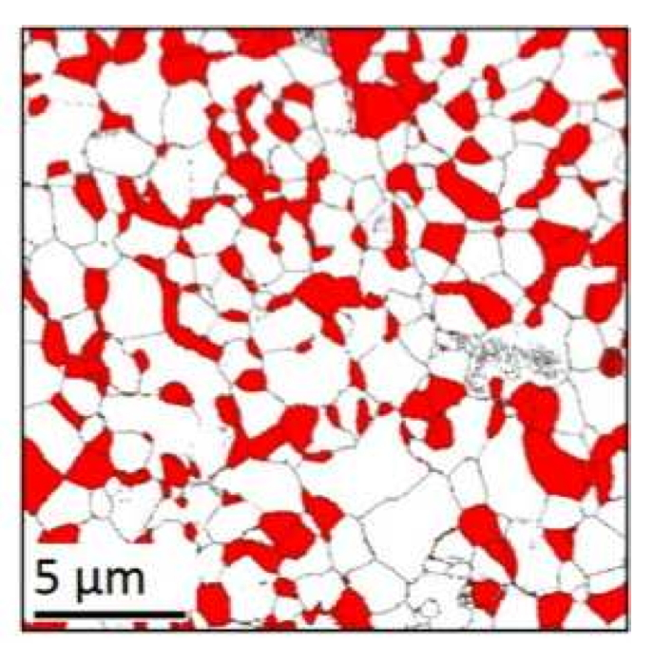
Fielding, Song, Han, Bhadeshia, Suh, Proc. Roy. Soc. A, 2014

Slide 32
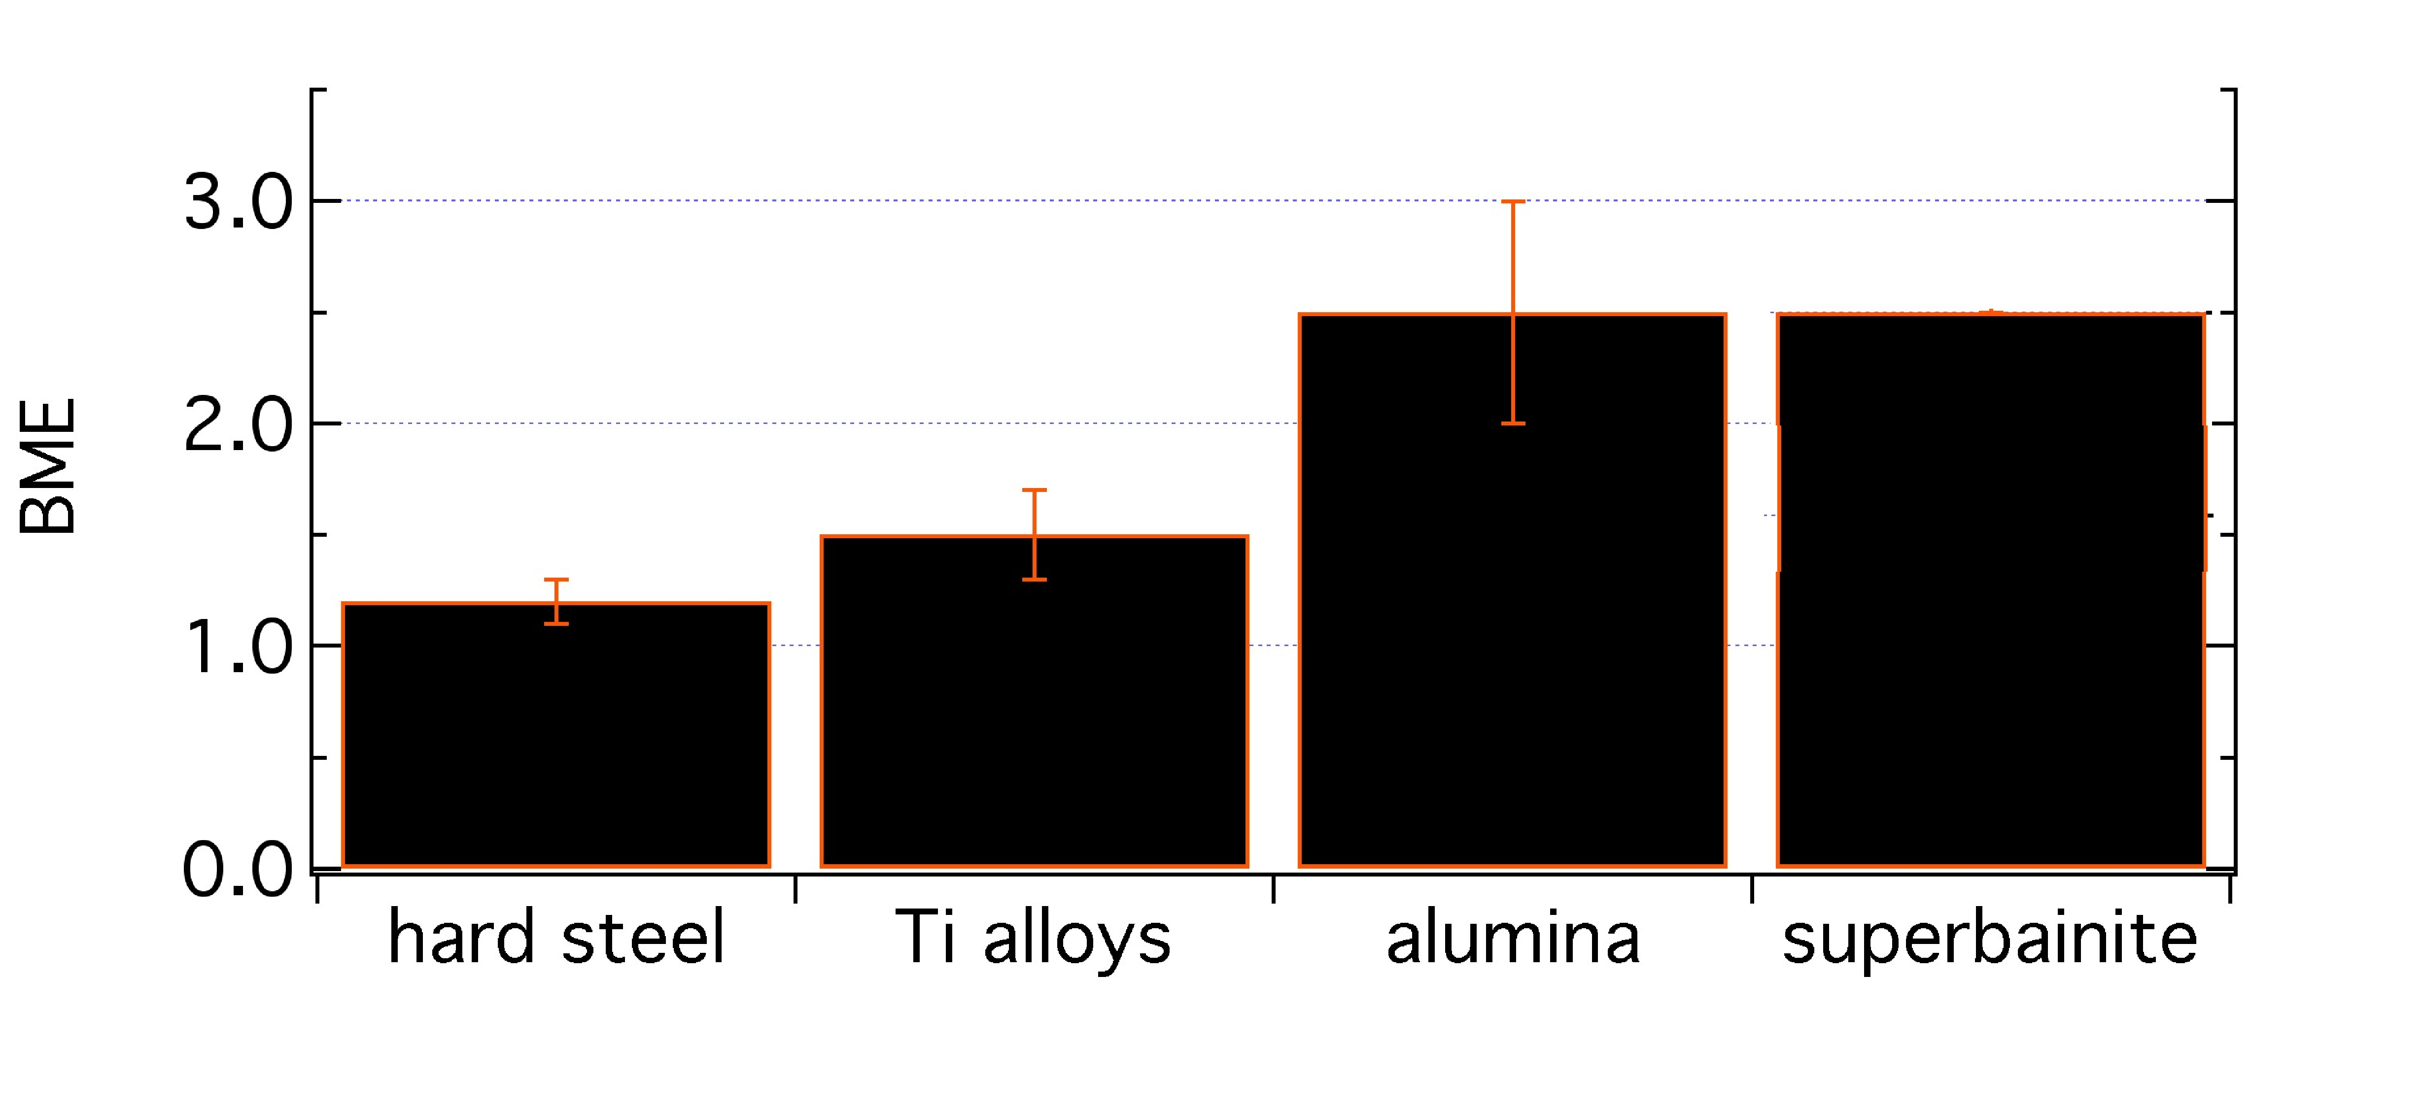
ballistic mass efficiency
consider unit area of armour

Slide 33
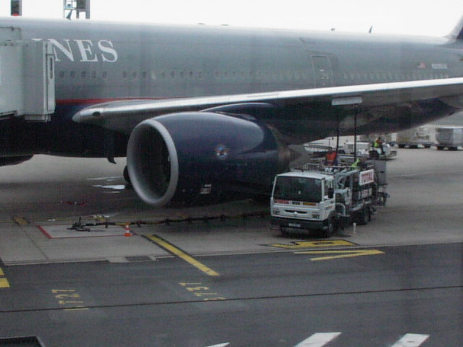

Slide 34
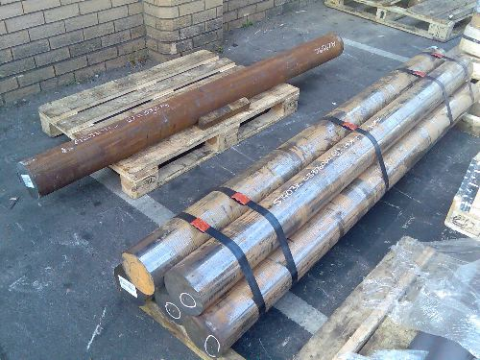

Slide 35
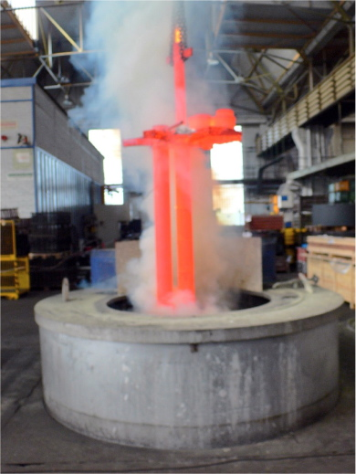

Slide 36
36

Slide 38
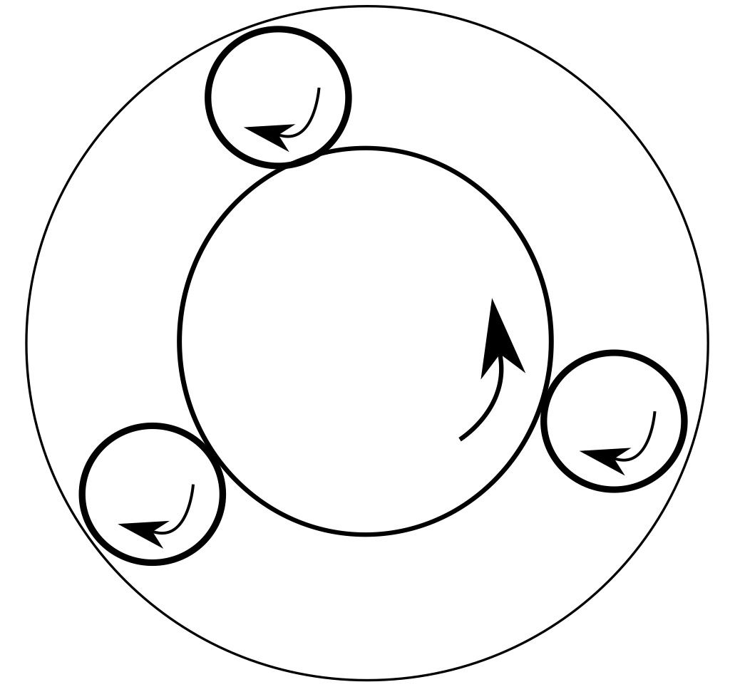
Exceptional alloys of iron

Slide 39
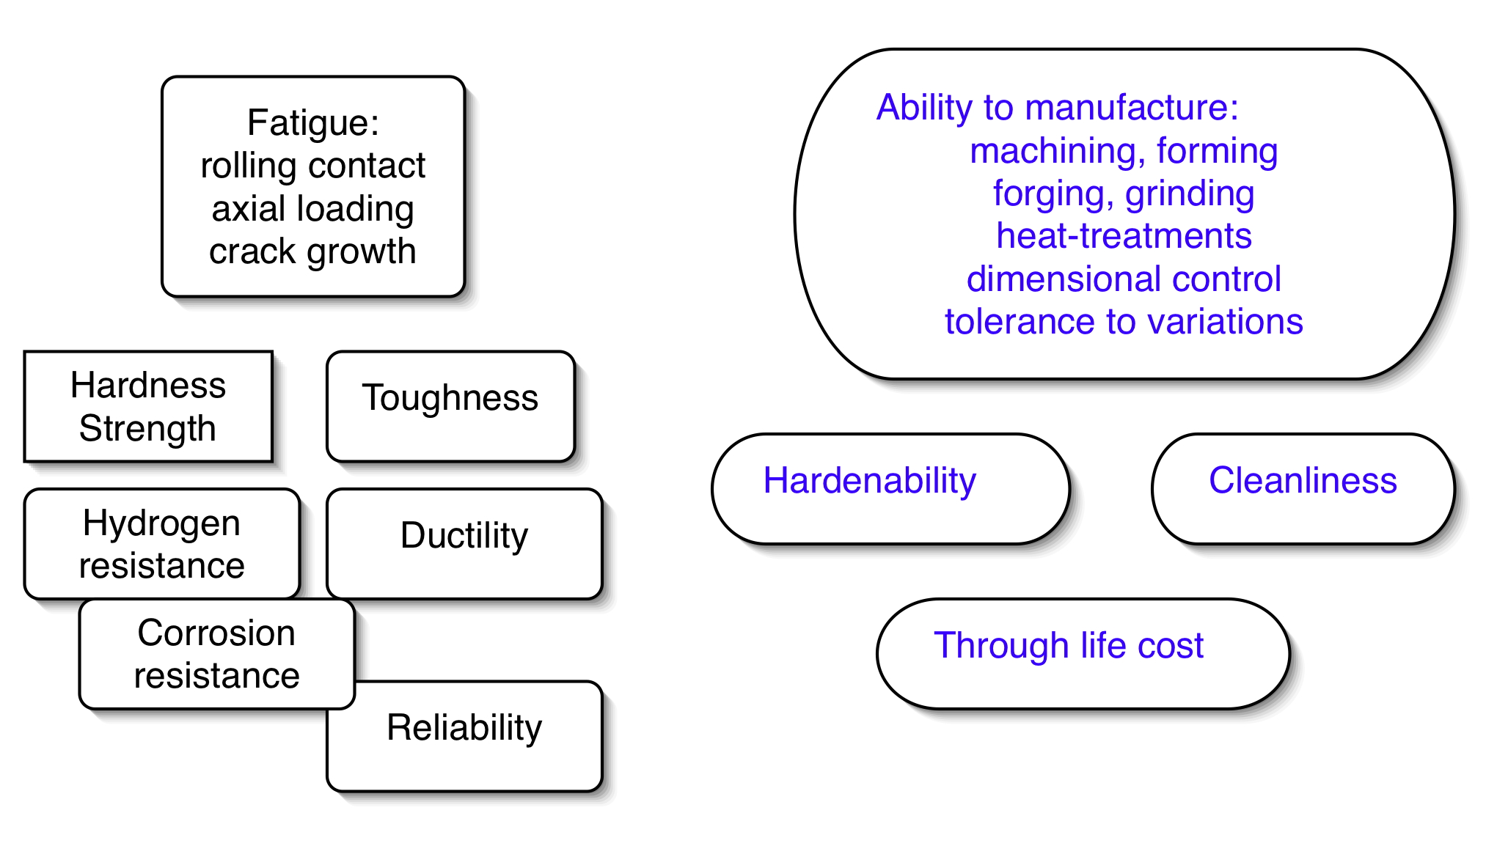
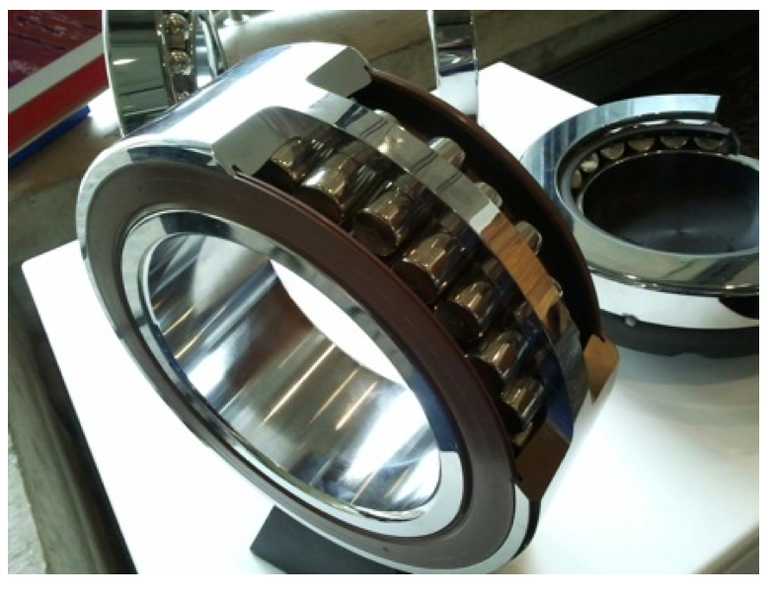
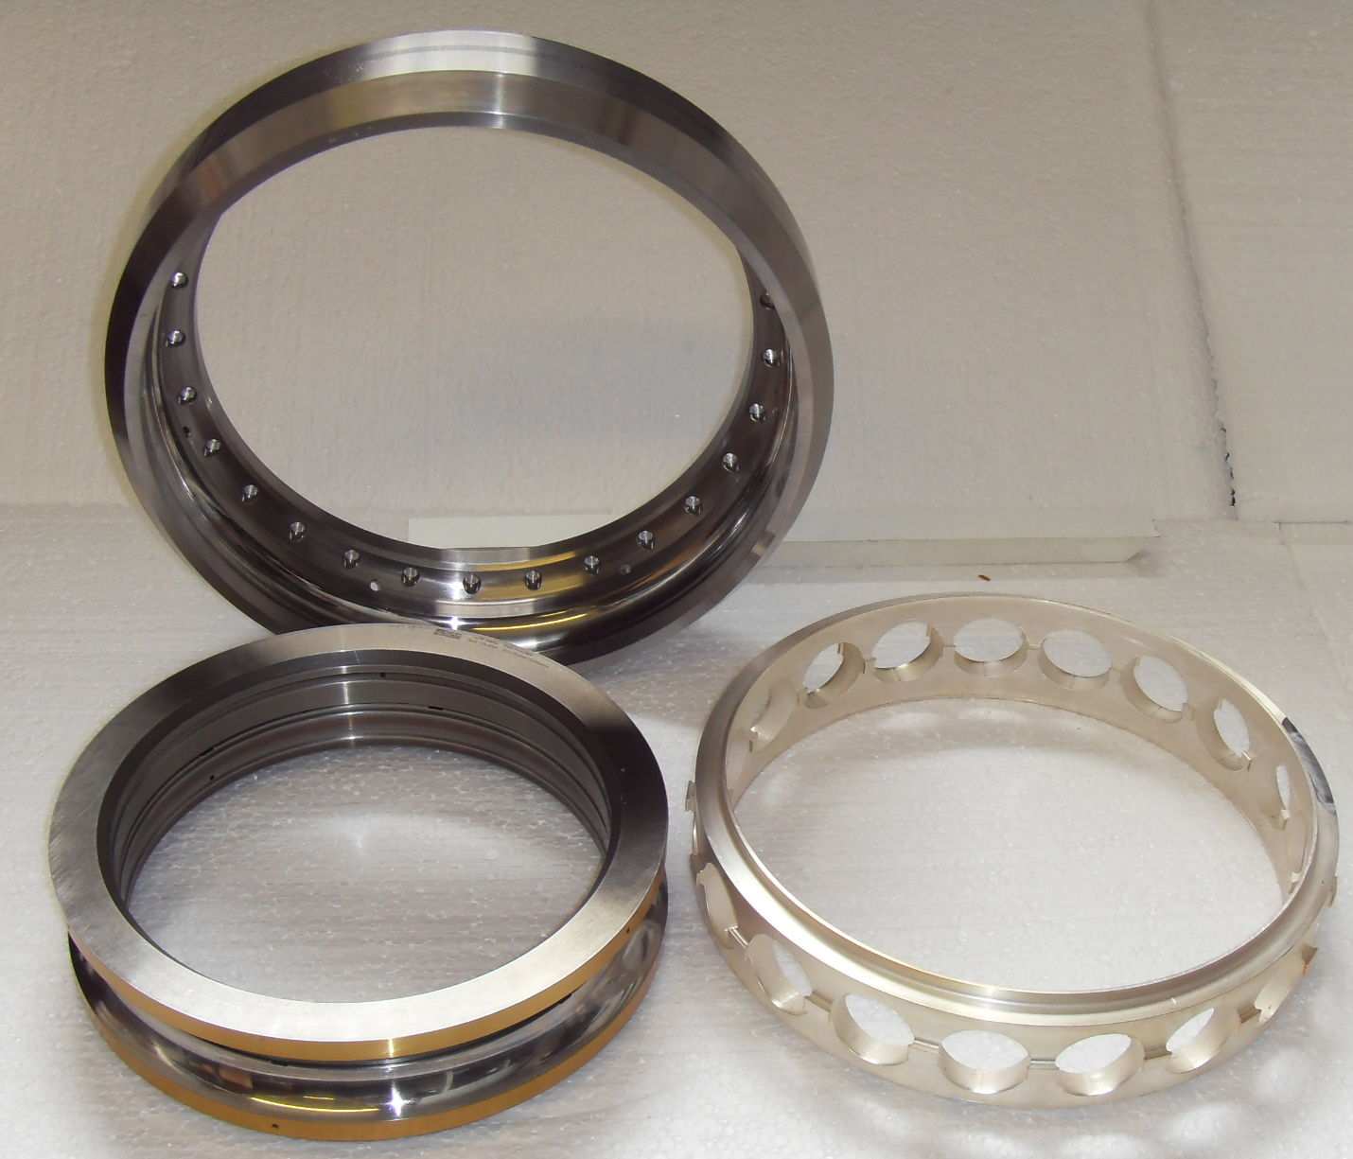
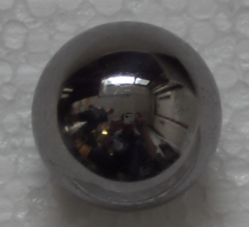
Notes:
39

Slide 40
Composition following transformation

Slide 41
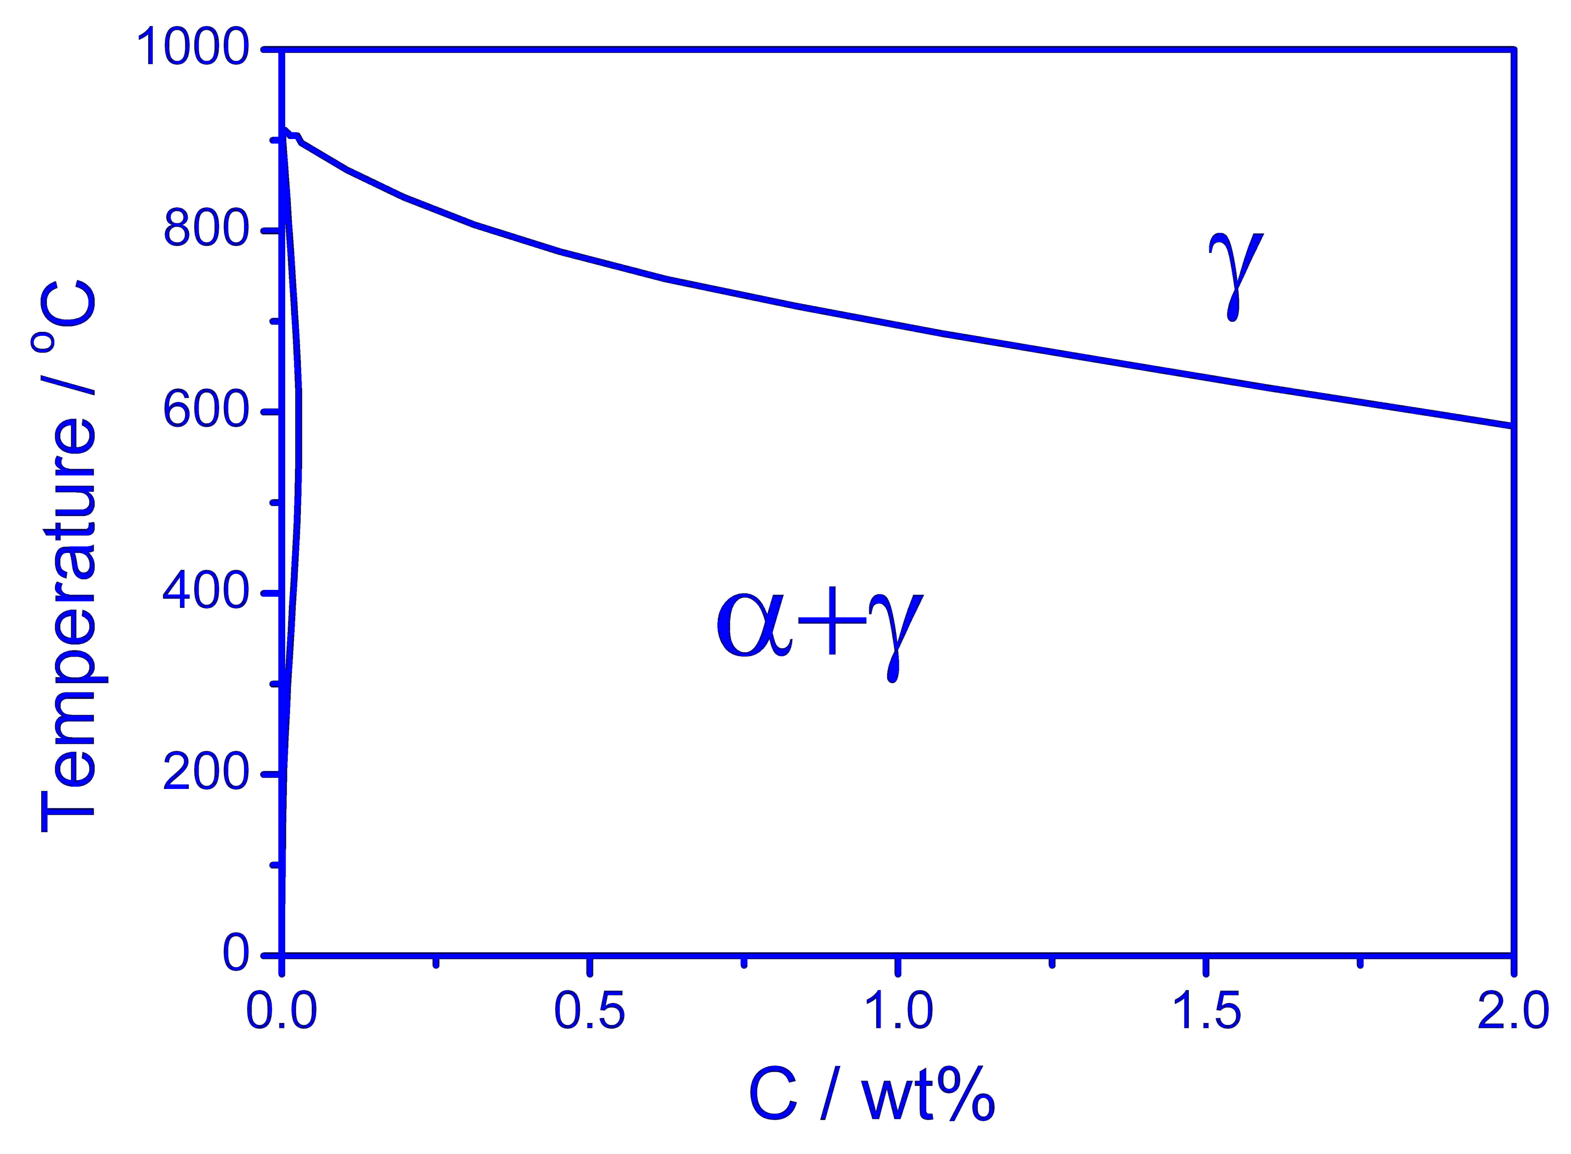
Bhadeshia, Met. Sci. (1982)

Slide 43
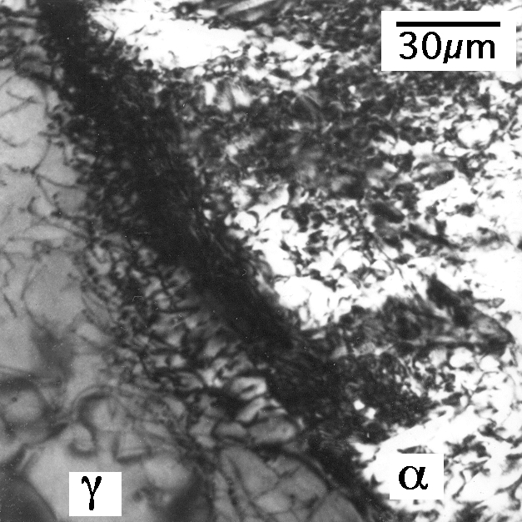
It was assumed therefore, that these carbon atoms are trapped at dislocations, since the original paper published in 1981.
Bhadeshia, Edmonds
Metall. Trans. (1979)

Slide 44
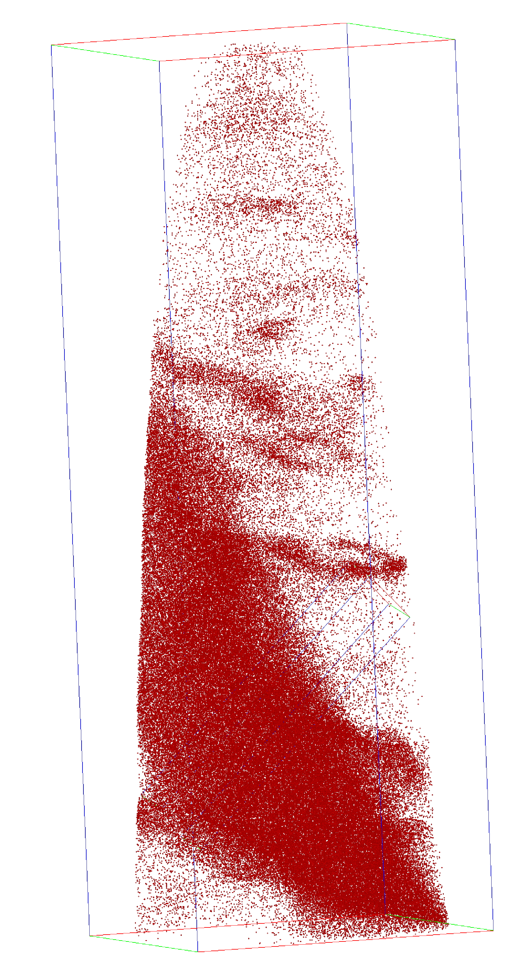
Caballero, Miller, Mateo, Cornide. J. Alloys & Compounds, (2012)
Large carbon concentration in solution in ferrite
Ferrite
Dislocation
Austenite
Francisca Garcia Caballero

Slide 45
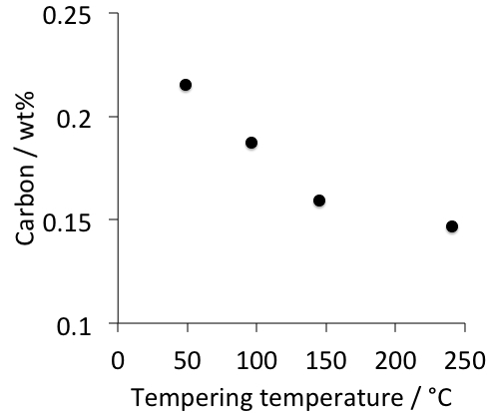
atom probe data for carbon in solid solution in ferrite in contact with austenite
Caballero, Miller, Mateo, Cornide
J. Alloys & Compounds, (2012)

Slide 46
A diffusionless transformation will necessarily lead to a body-centred tetragonal ferrite.

Slide 47
Huge increase in solubility; ferrite with tetragonal symmetry
Jang, Suh, Bhadeshia, Scr. Mat. 68 (2012) 195

Slide 48
C. N. Hulme-Smith, I. Lonardelli,
A. C. Dippel and H. K. D. H. Bhadeshia, Scr. Mat. 69 (2013) 409.

Slide 50
Cannot easily be welded
Fang, Yang, Liu, Song, Fang, Bhadeshia, Materials and Design, 50 (2013) 38

Slide 51
What next?
Steel with impossible combination of properties
>2 GPa
30% ductility at conventional strain rates
ductility at very high strain rate
toughness and Charpy impact at -40°C
weldable
cheap, large in all dimensions
mass production
high-temperature capability
Mathew Peet

Slide 54
Kelvin tetrakaidecahedron
Pous et al. (2014)

Slide 59
Two pass
Single pass
12 mm

Slide 60
High speed video
Survival
V₀ = 445 m s⁻¹
Vickram Deshpande, Mathew Peet

Slide 61
61

Slide 62
2104
Fe-1.75C-Si-Mn wt%
Chatterjee & Bhadeshia, 2004

