Slide 1
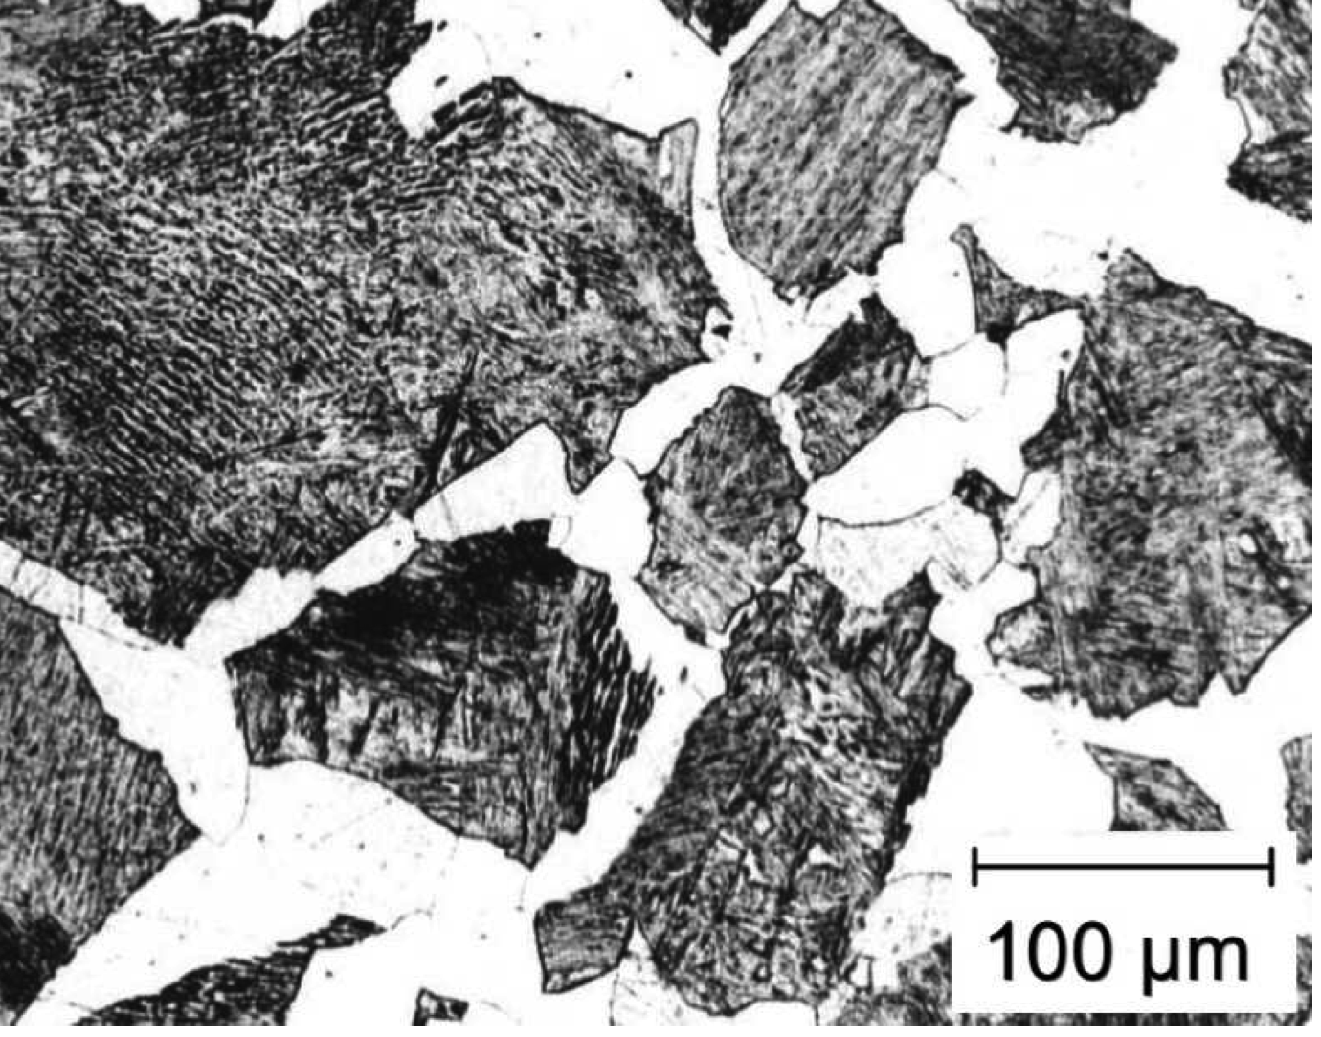
Unresolved issues:
Difficulties in theory of ferrite growth
steep concentration gradients
www.phase-trans.msm.cam.ac.uk

Slide 2
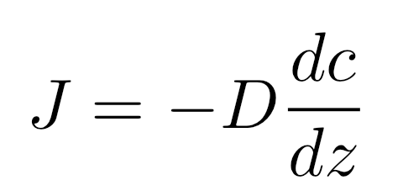
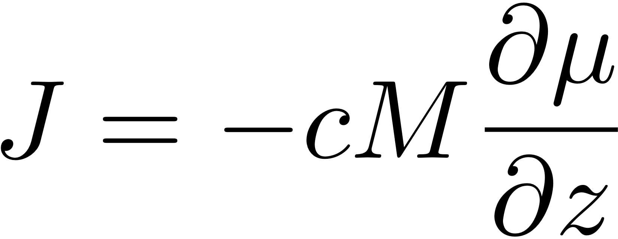
(1855)
Flux is proportional to the gradient

Slide 3
μ
o
B
μ
o
Gibbs free energy per mole
A
μ
A
G{x}
μ
B
A
B
x
Composition

Slide 4
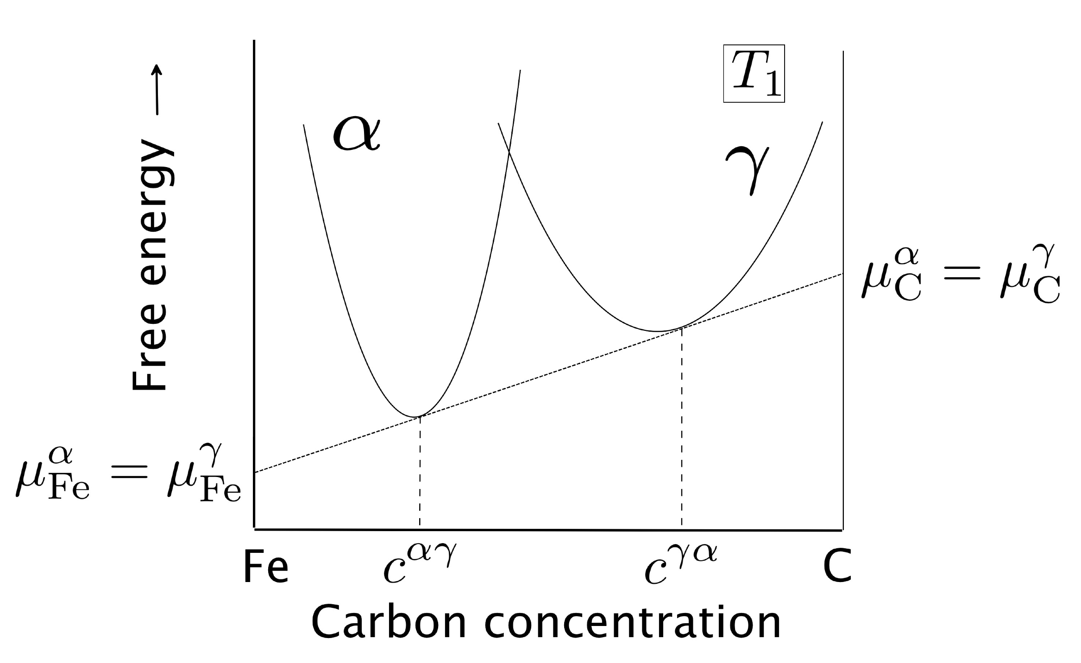

Slide 5
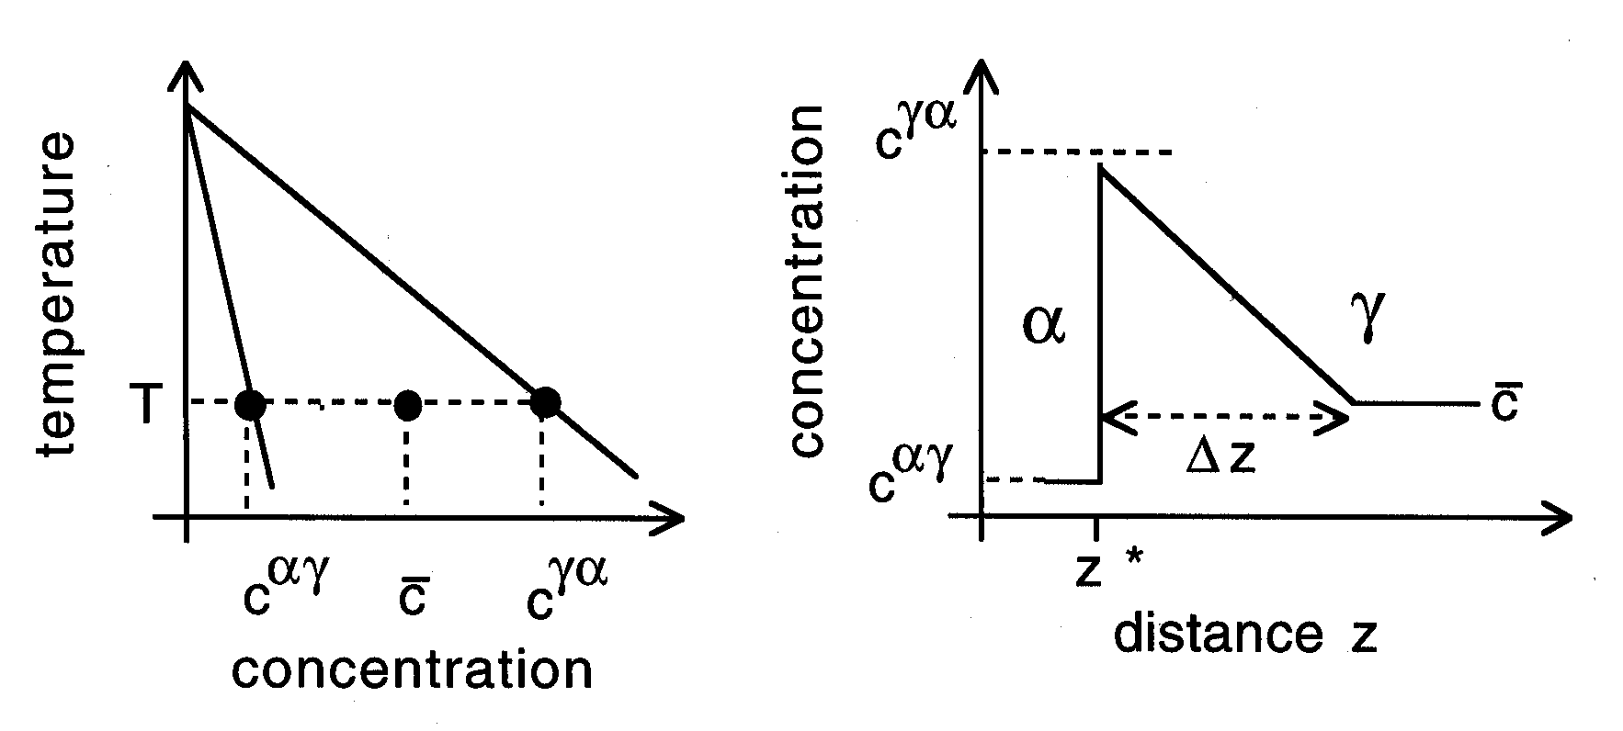

Slide 6
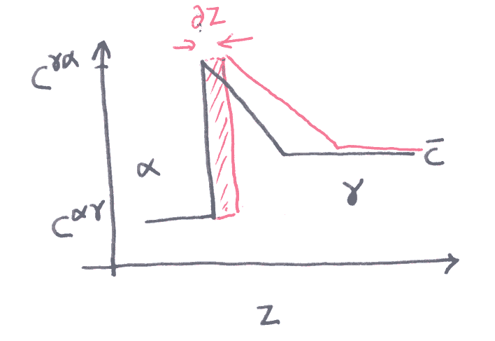
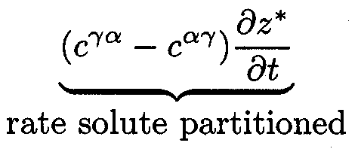

Slide 7
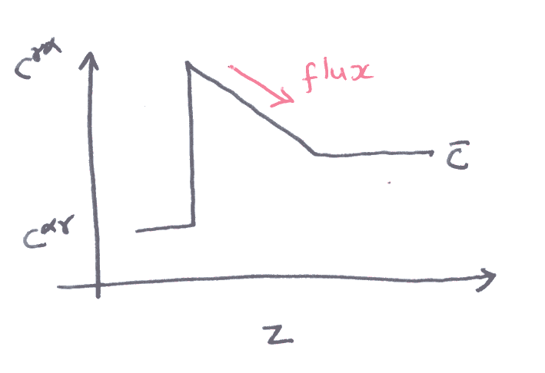
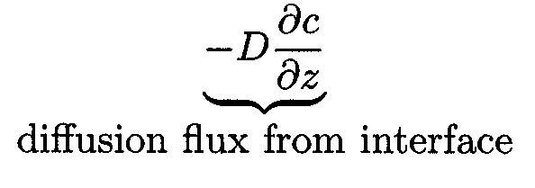

Slide 8
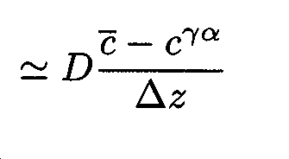
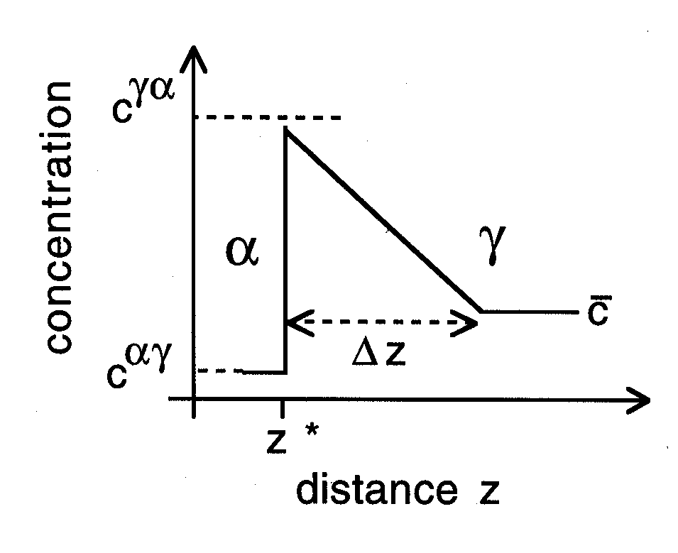

Slide 9
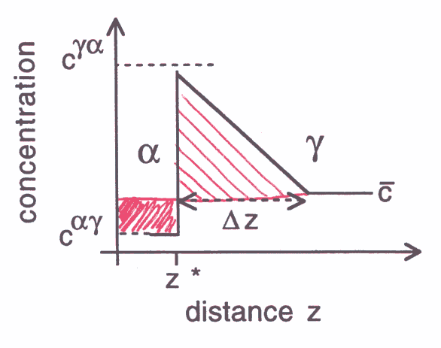

Slide 10
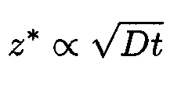
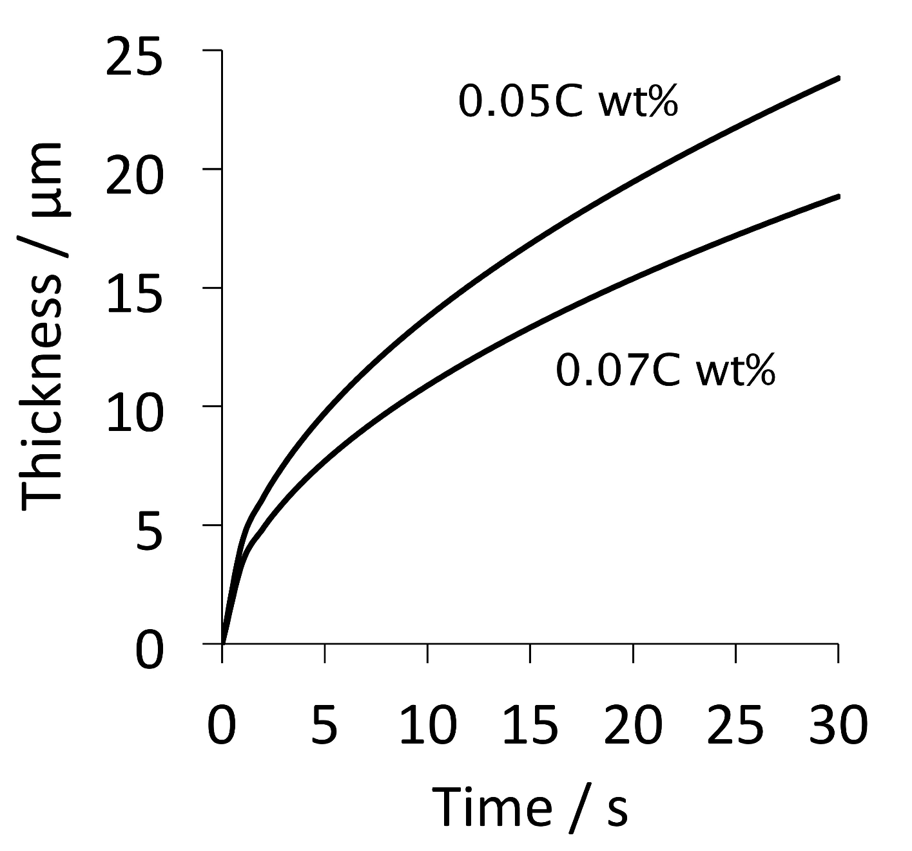

Slide 11
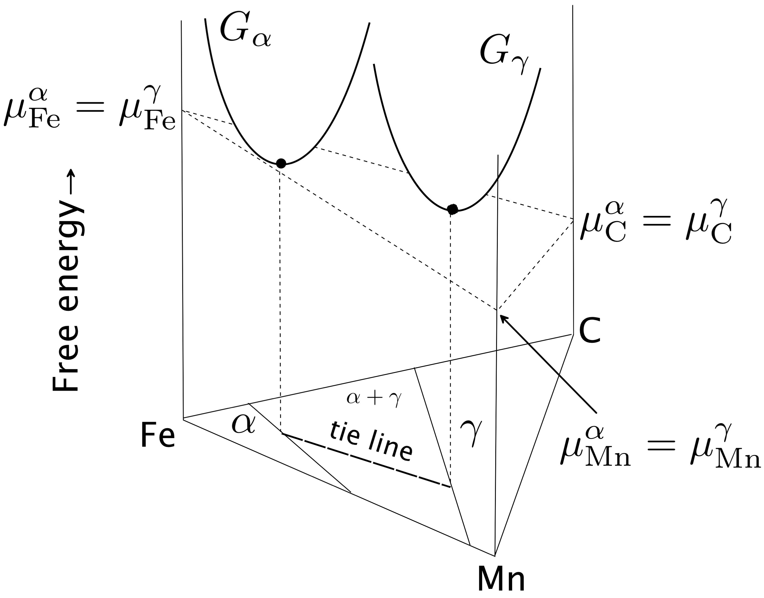

Slide 12
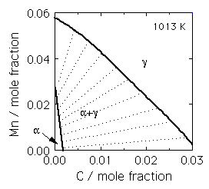

Slide 13
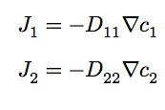

Slide 14
γ
High supersaturation
NP-LE mode
Manganese
α
α
γ
α+γ
Carbon
α
γ

Slide 15
Metall. Mater. Trans. A 43 (2012) 833
diffusion distance 0.03 nm
Metall. Mater. Trans. A 46 (2015) 2347
diffusion distance 0.002-0.04 nm
how do we proceed?

Slide 16
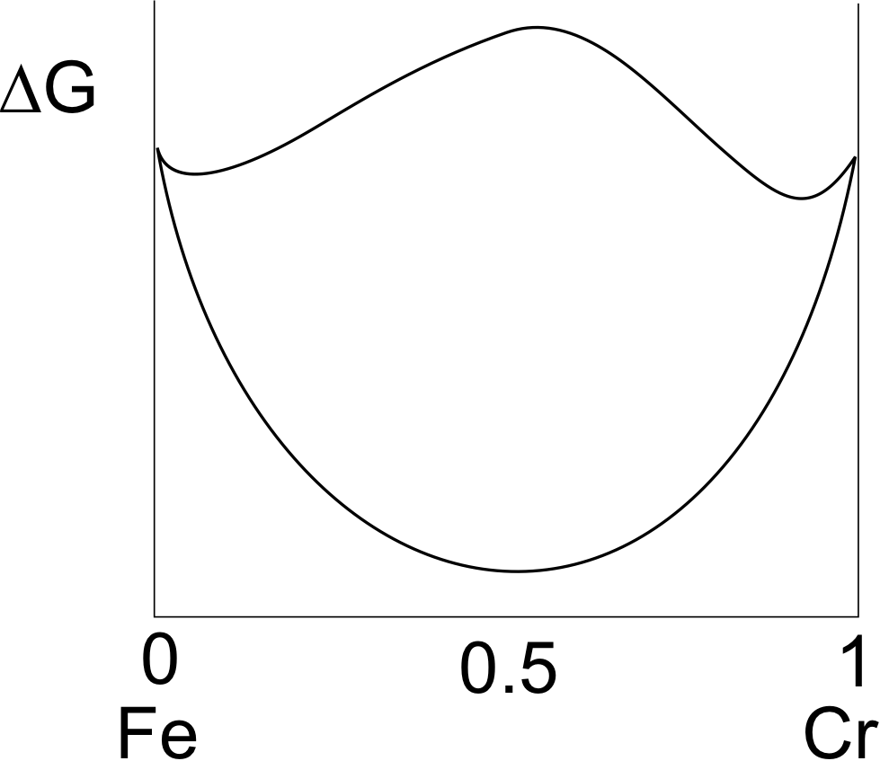

Slide 17
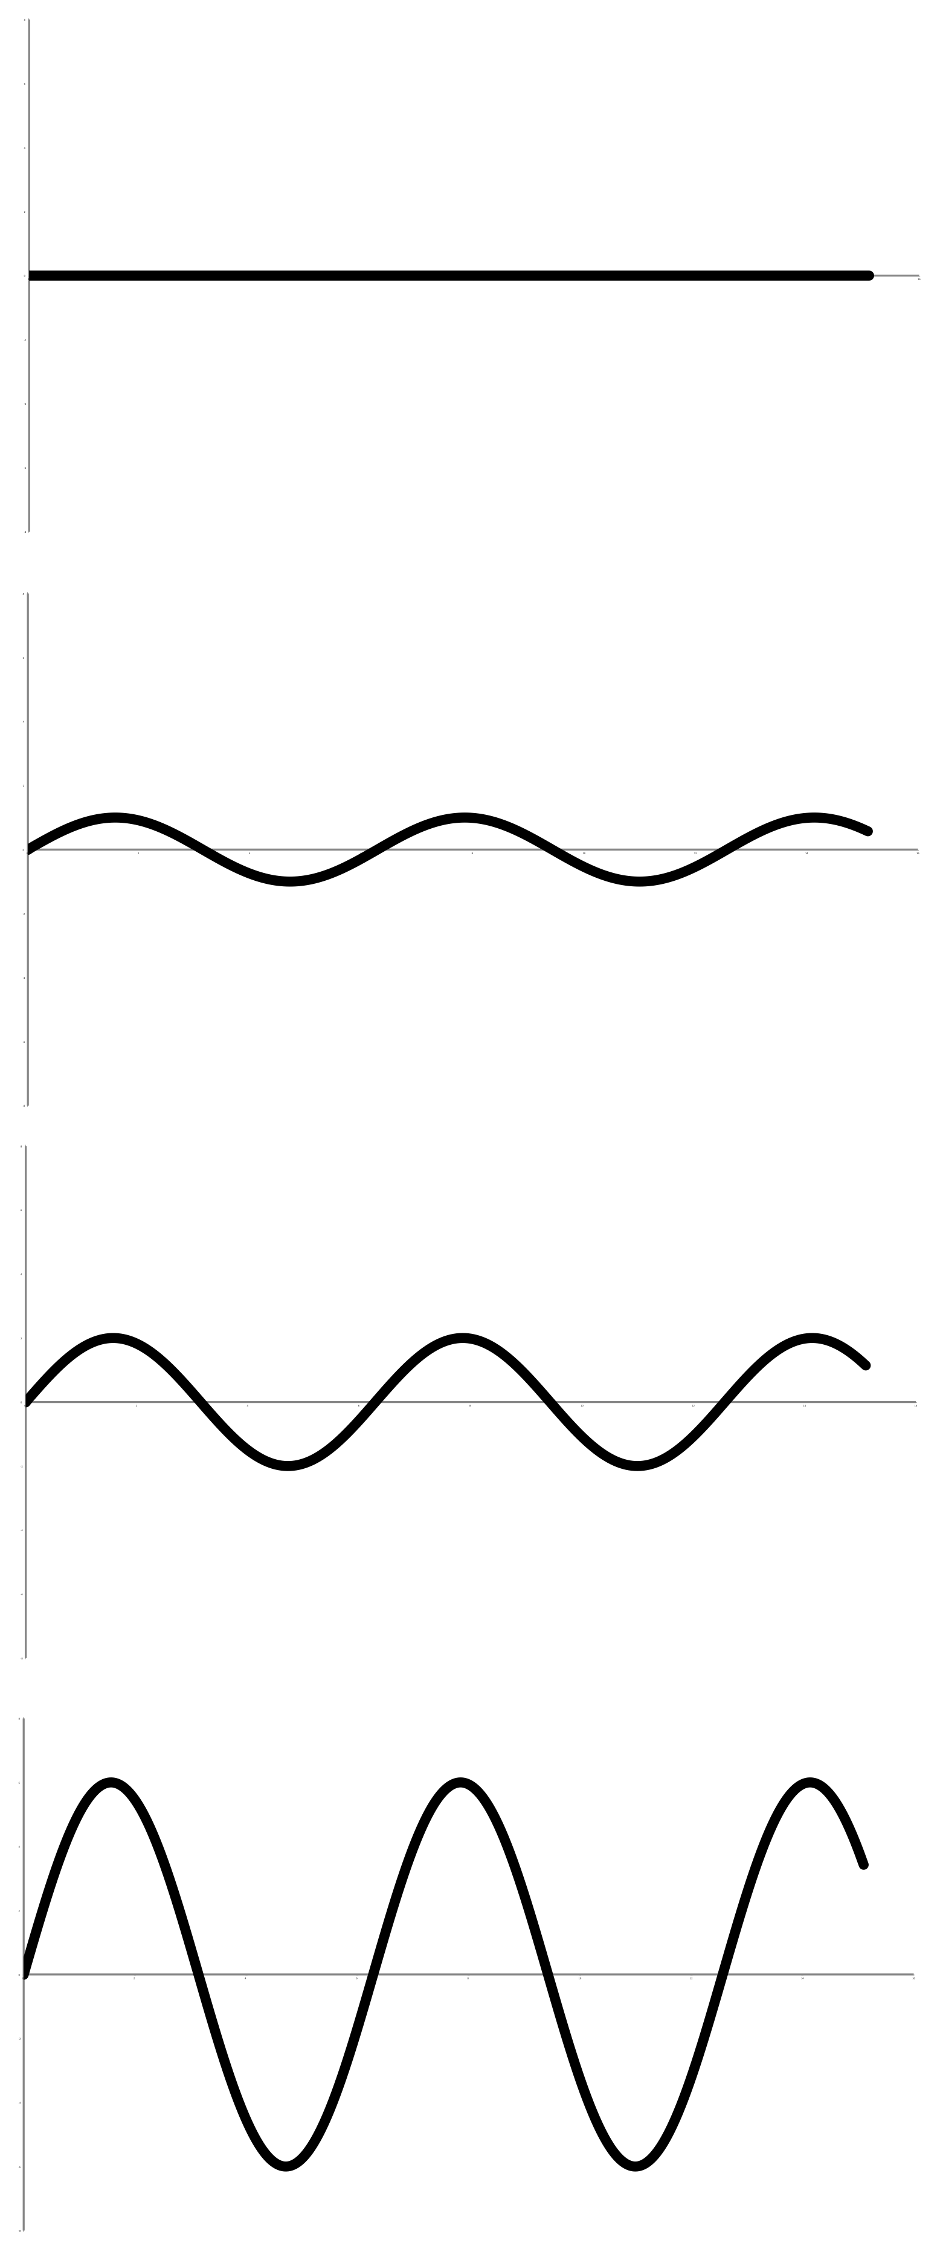
Yoshiyuki Saito
Cr
time
Carlos Martins
distance

Slide 18
Most rapidly growing Fourier components have infinitely small wavelength
chemical interfacial energy
larger with steeper gradients
STEEP GRADIENTS RETARD DIFFUSION

Slide 19
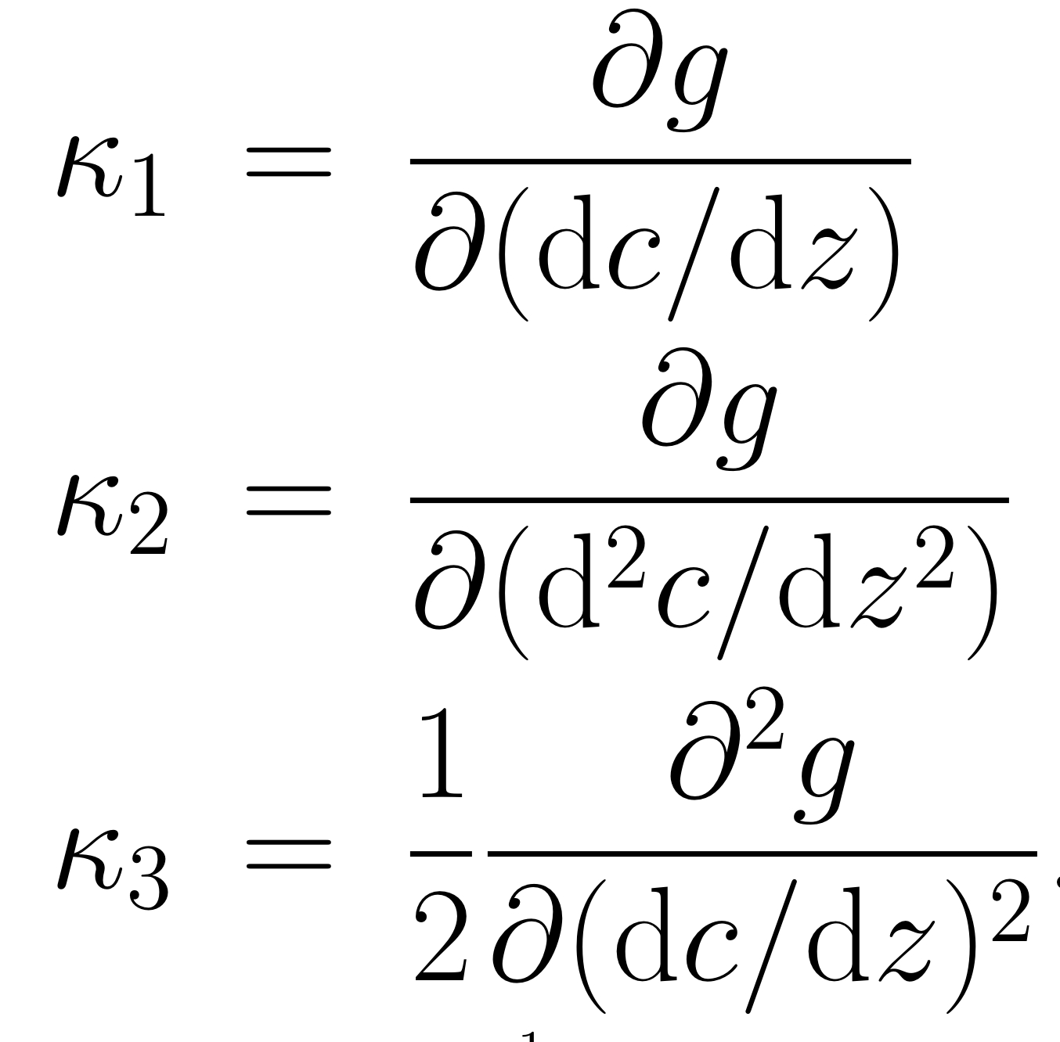

Slide 21
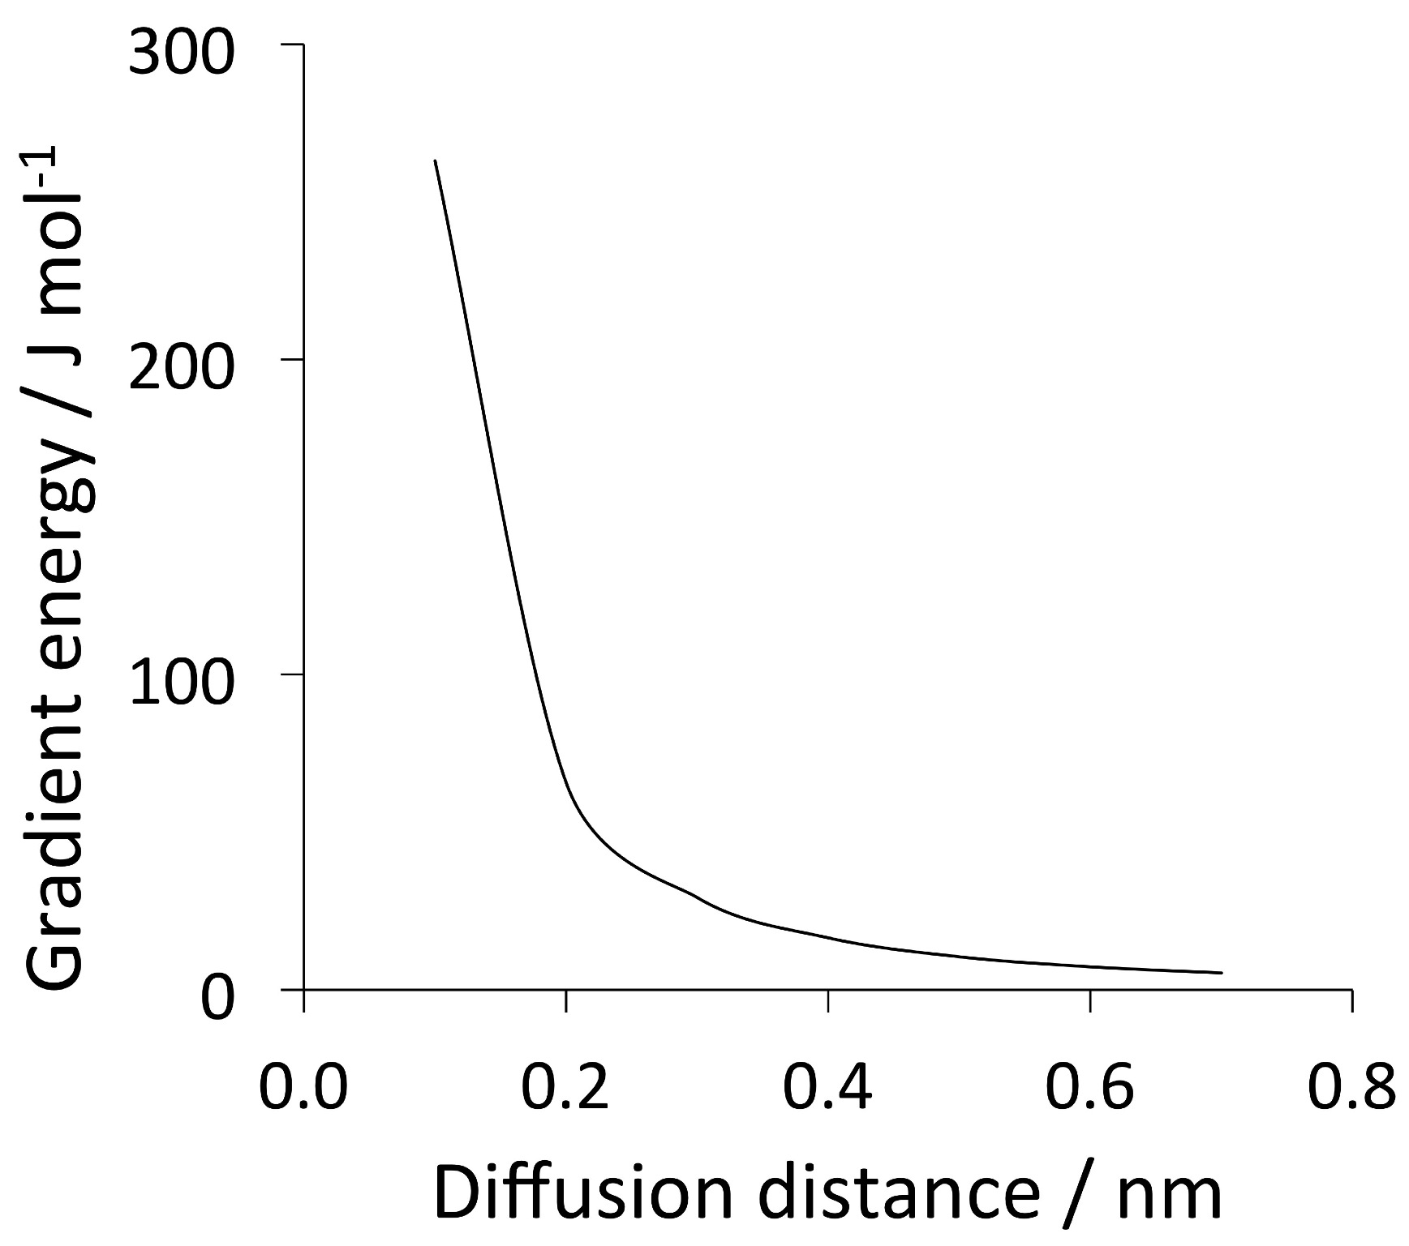
Impossible to avoid partitioning substitutional solutes if local equilibrium is demanded.

Slide 22
Conclusion: NPLE mode does not exist
Current Opinion in Solid State and Materials Science,
20 (2016) 396-400
Physica Status Solidi (a)
69 (1982) 745-750
www.phase-trans.msm.cam.ac.uk

