Slide 1


Complete theory for displacive transformations
www.phase-trans.msm.cam.ac.uk

Slide 2
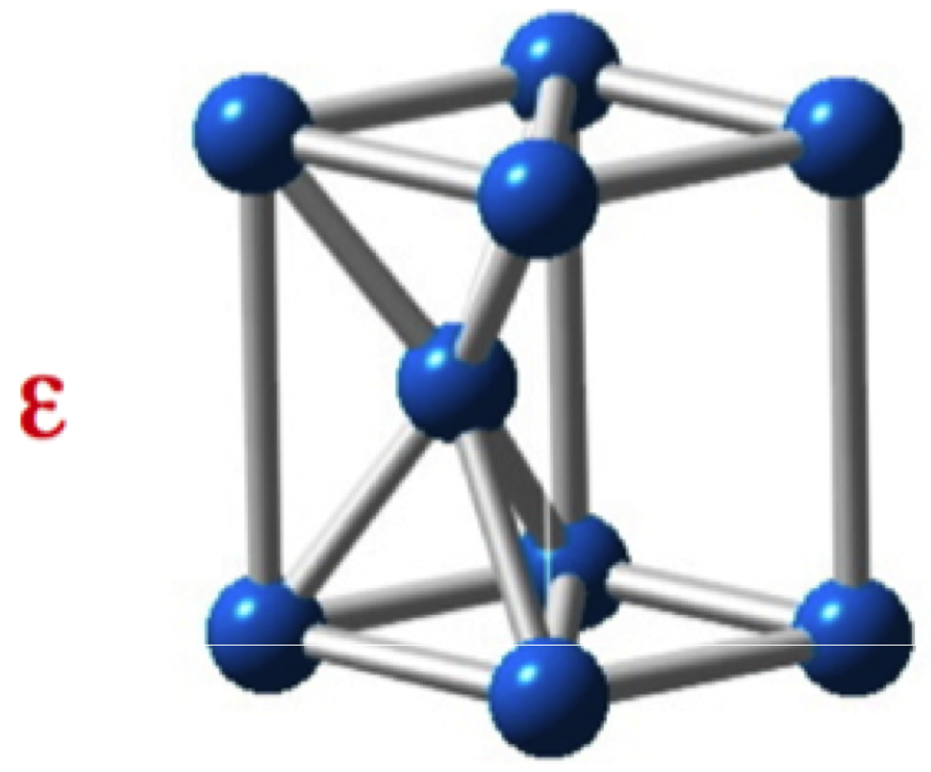
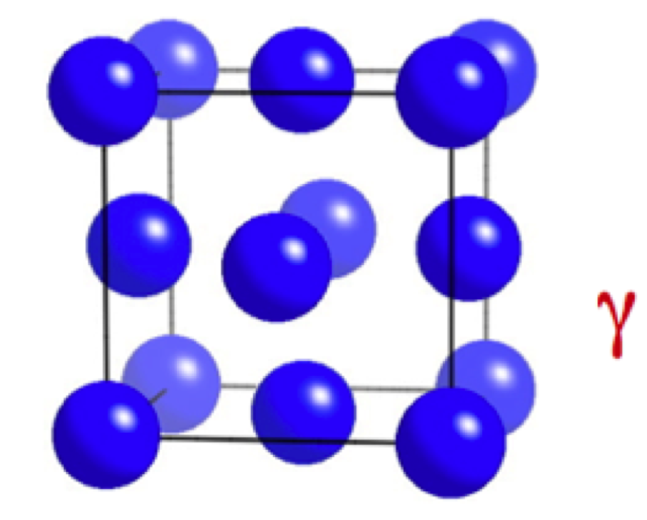
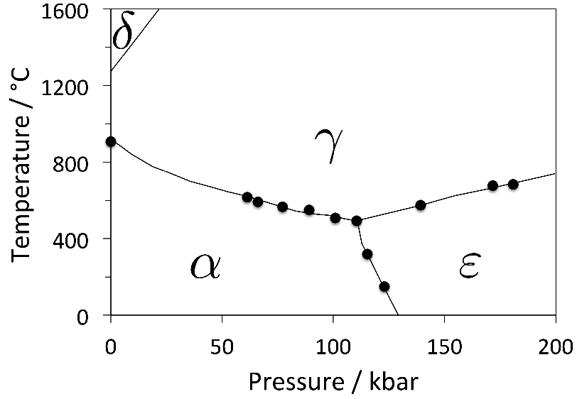
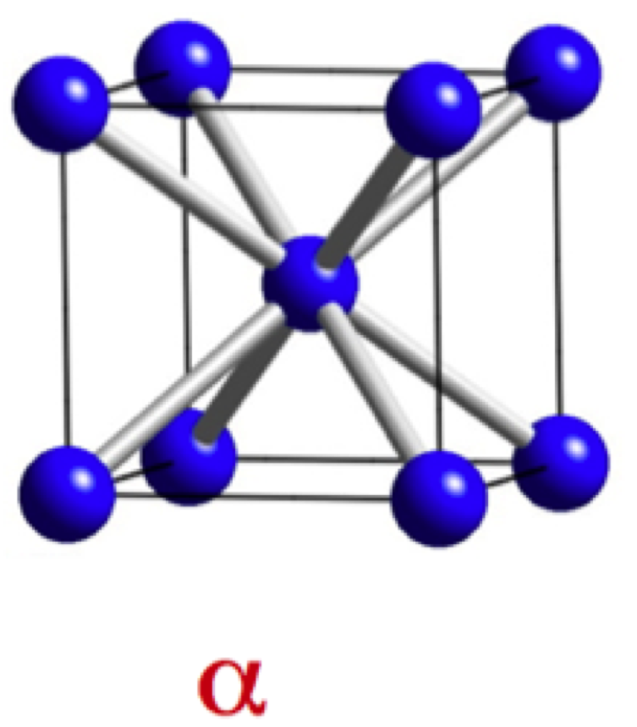

Slide 3
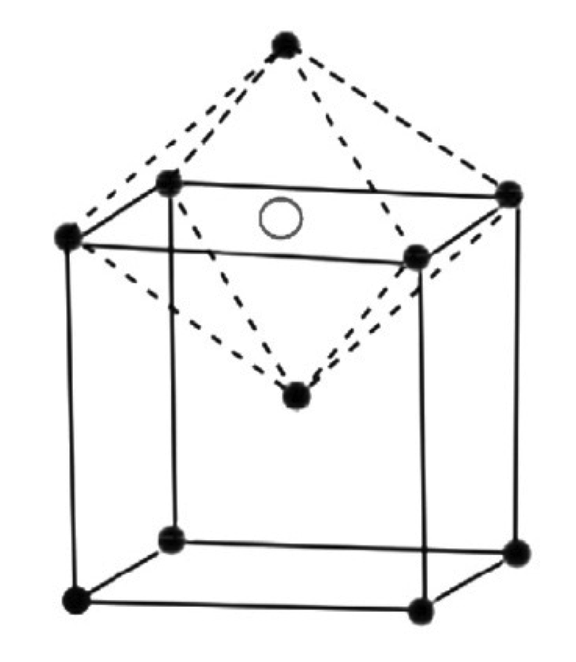
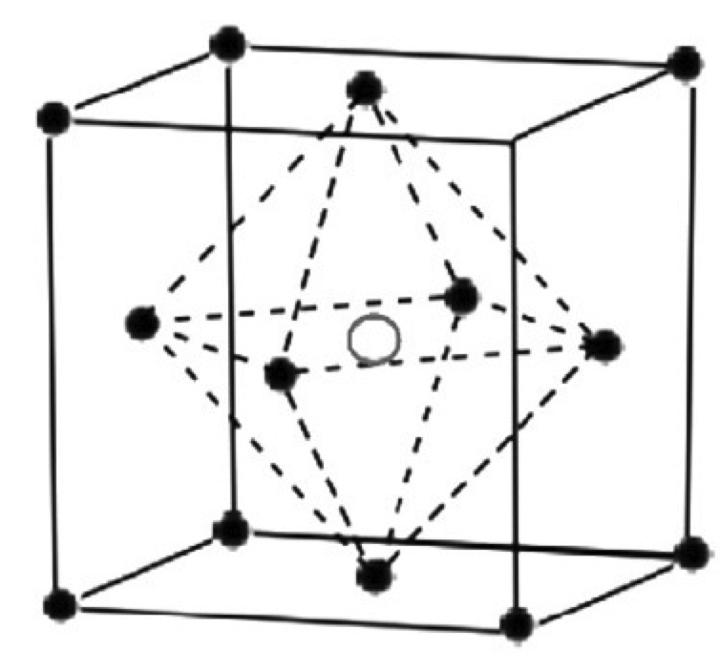

Slide 4
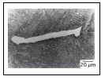
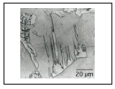

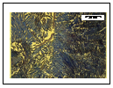
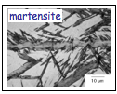

Slide 5
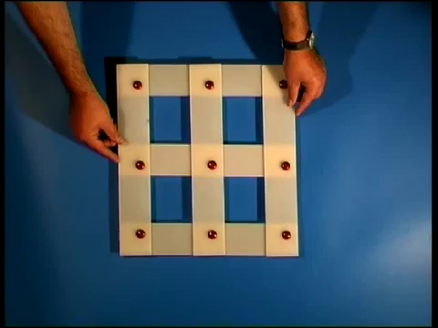

Slide 6
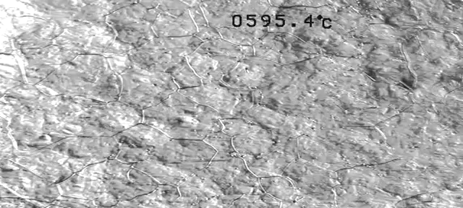

Slide 7
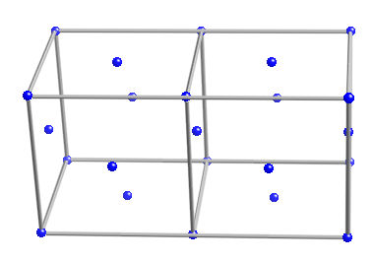
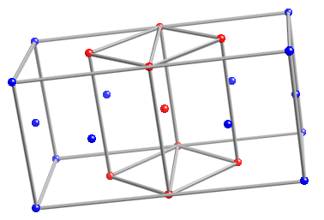
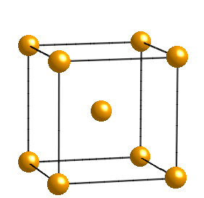
The Bain strain

Slide 8
general invariant-plane strain
uniaxial dilatation
simple shear
s
s
δ
δ
1
1
1
s=0.26
δ=0.03

Slide 9
[001]
b
b'
o
[100]
a'
a
b
(a)
o
b'
(b)
a,a'

Slide 10
RB
z
w
w
z
w
z
P
Observed
P
Austenite
1
shape,
2
Martensite
wrong
(wrong
y
structure
shape)
x
x
y
x
y
(a)
(b)
(c)
LATTICE
-INVARIANT
DEFORMATION
Twin
w
z
w
z
Boundary
x
y
x
y
Twinned
Slipped
Martensite
Martensite
Correct macroscopic shape, correct structure

Slide 11
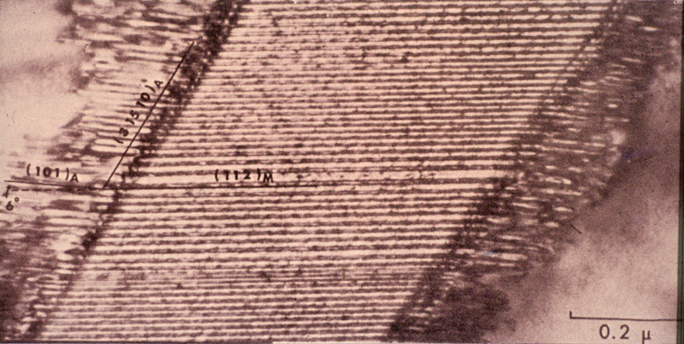
transformation twins (Wayman)

Slide 12

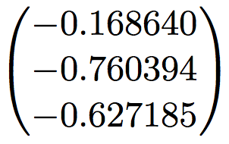

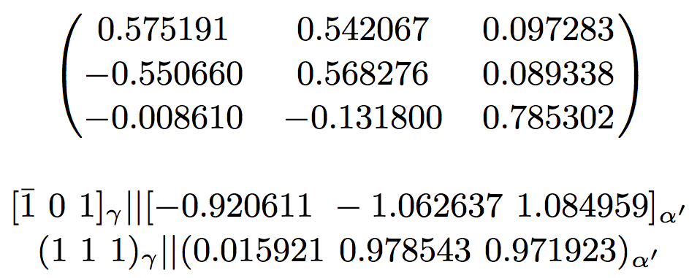
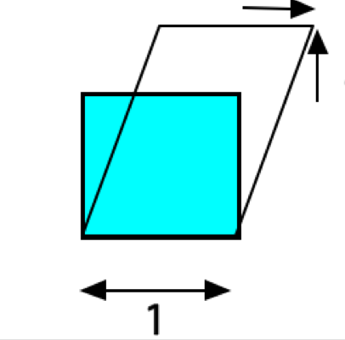

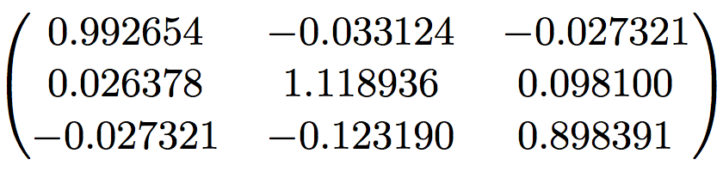

Slide 13
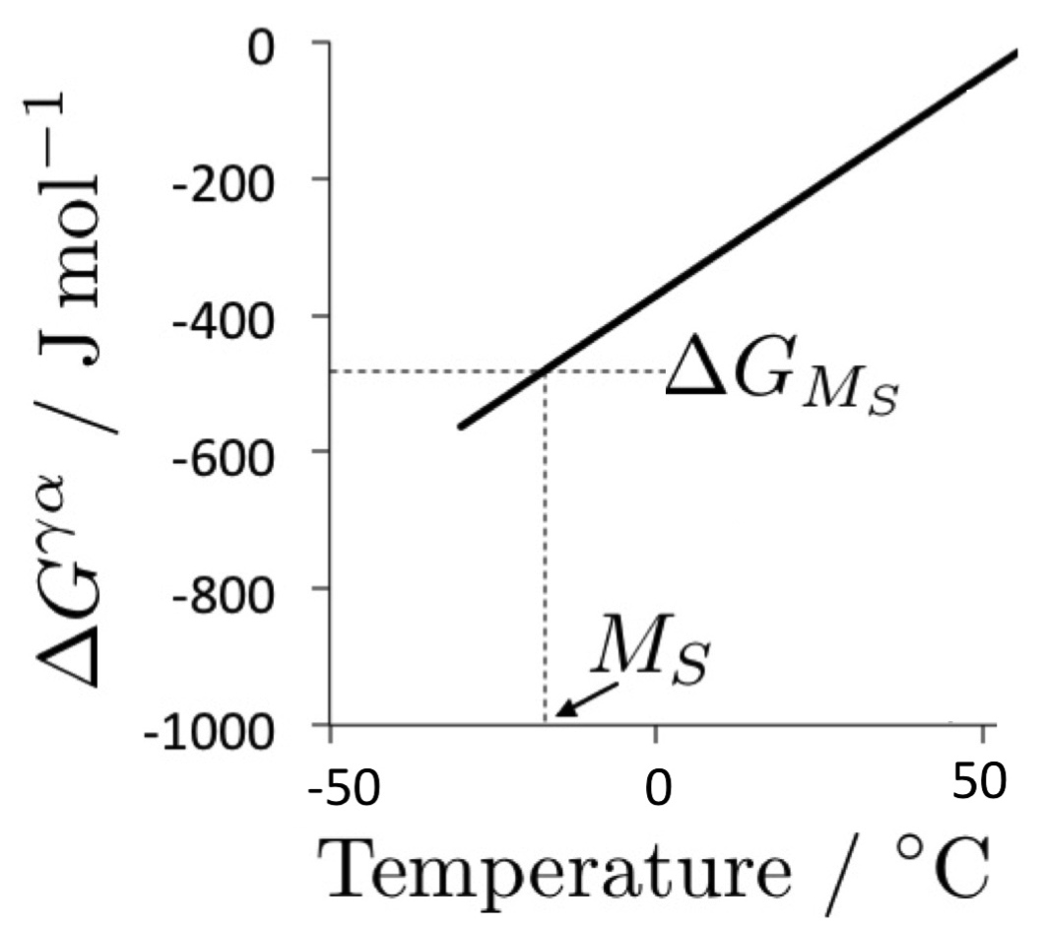
Martensite start temperature
Notes:
13

Slide 14
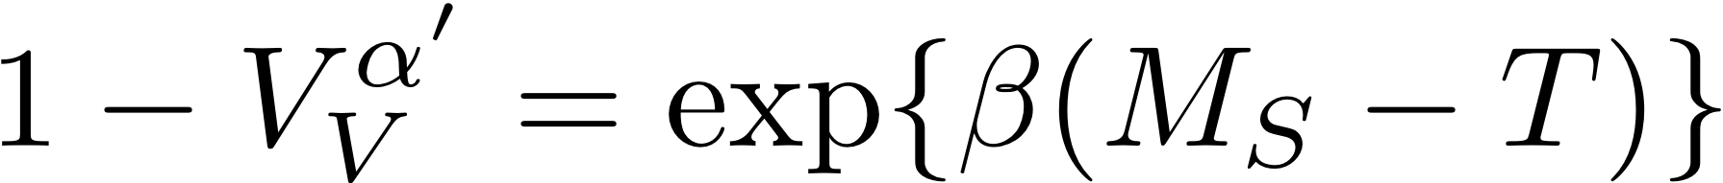
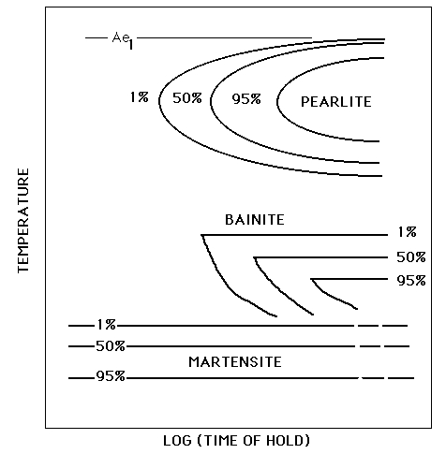
athermal transformation

Slide 15
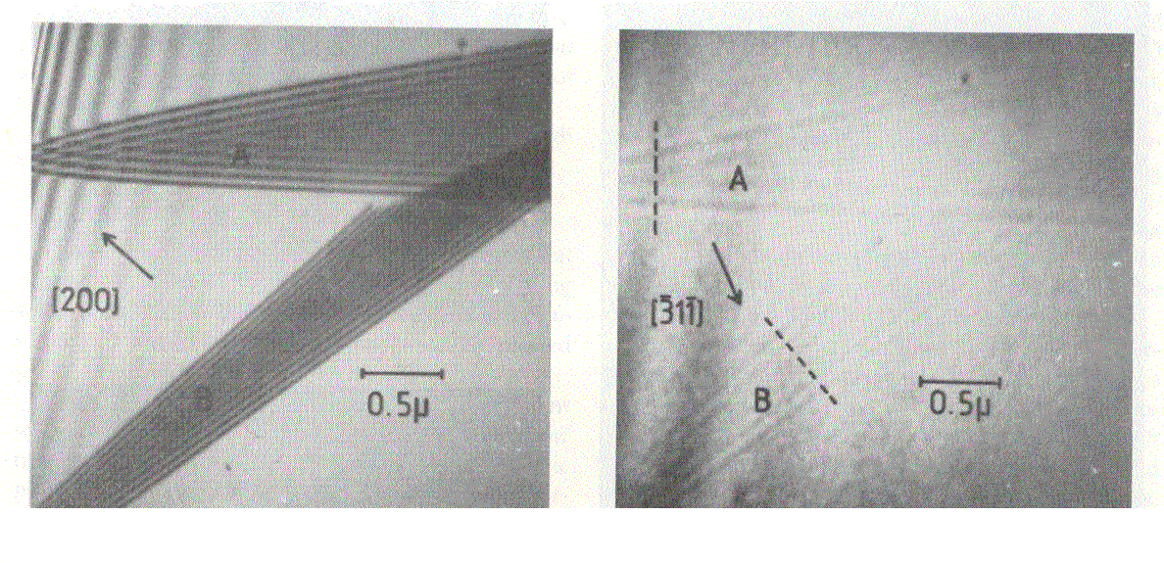
Brooks, Loretto and Smallman, 1979

Slide 16
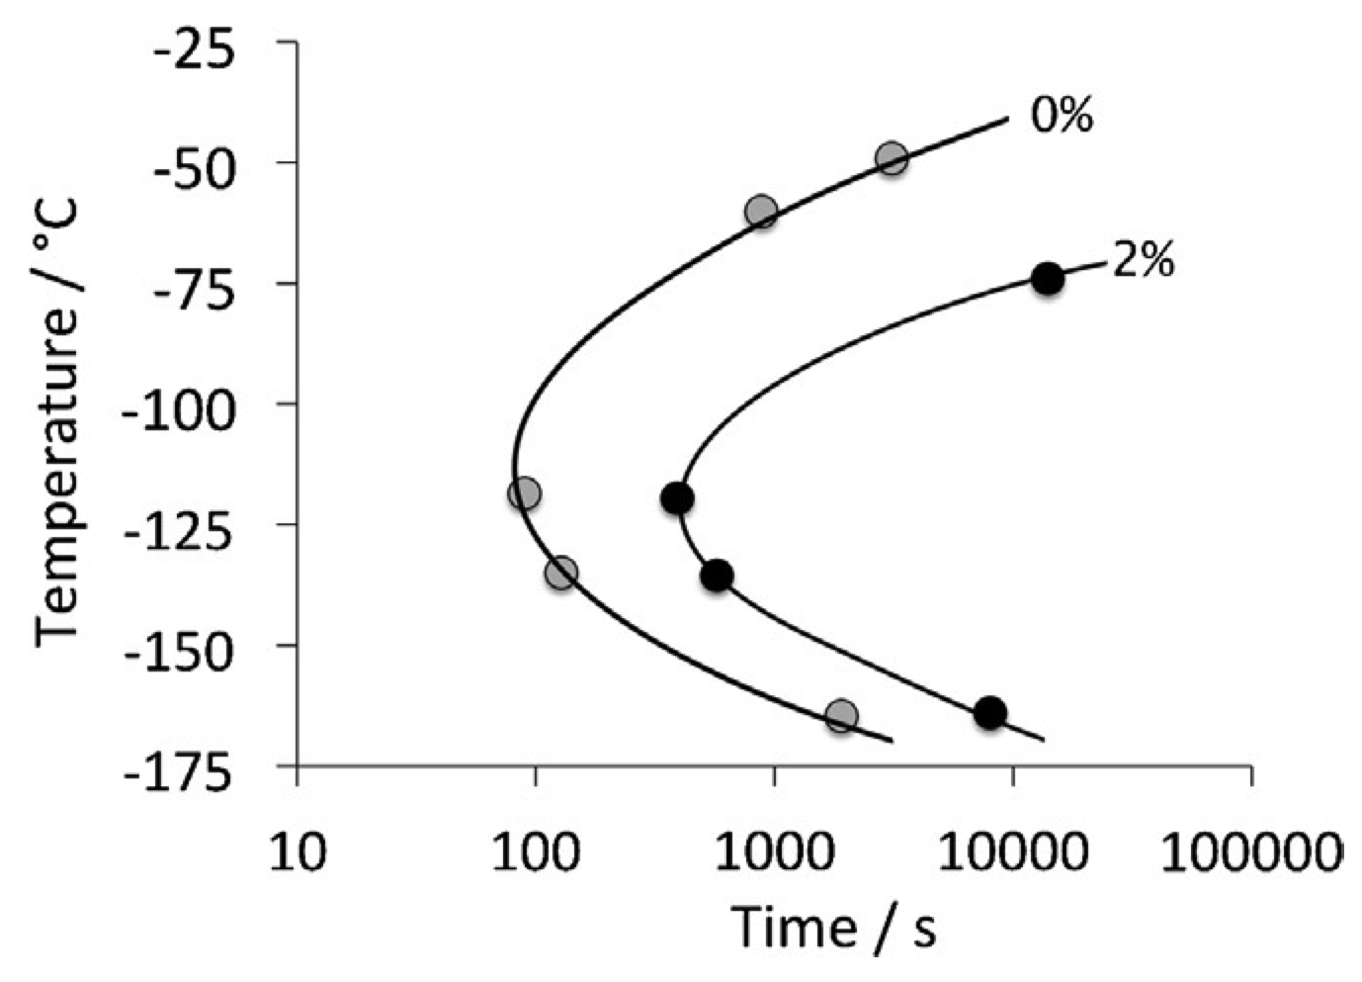
However, martensitic transformation can be suppressed by rapid cooling
Kurdjumov
Maximova

Slide 17
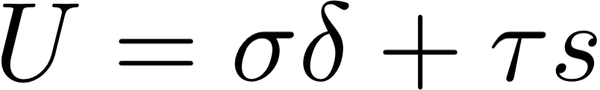
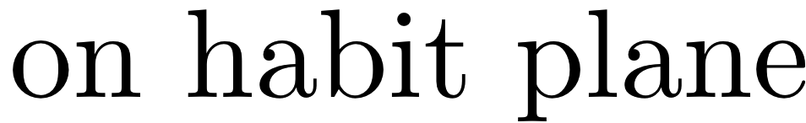
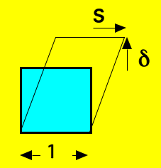

Slide 18
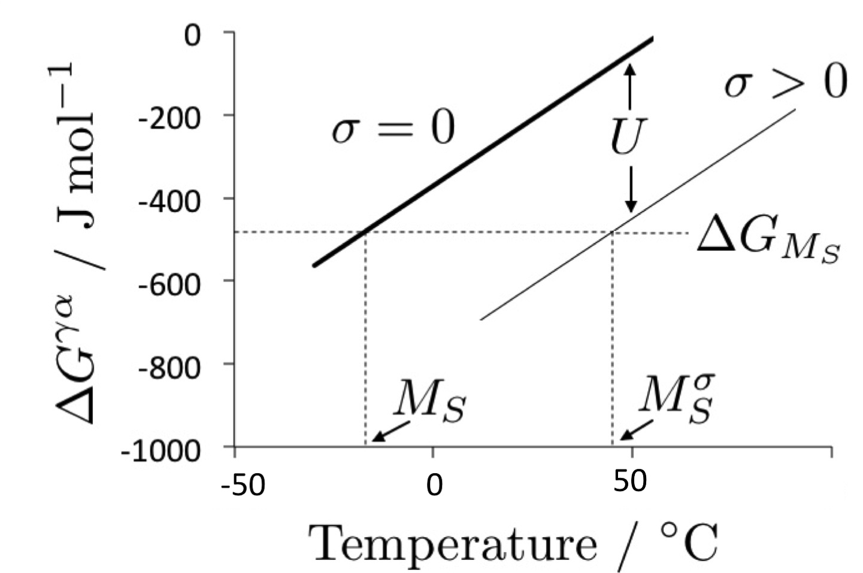

Slide 19
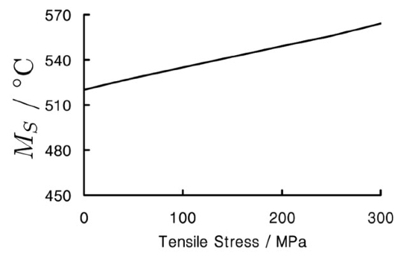
Fe-0.1C wt%
Influence of tensile stress

Slide 20
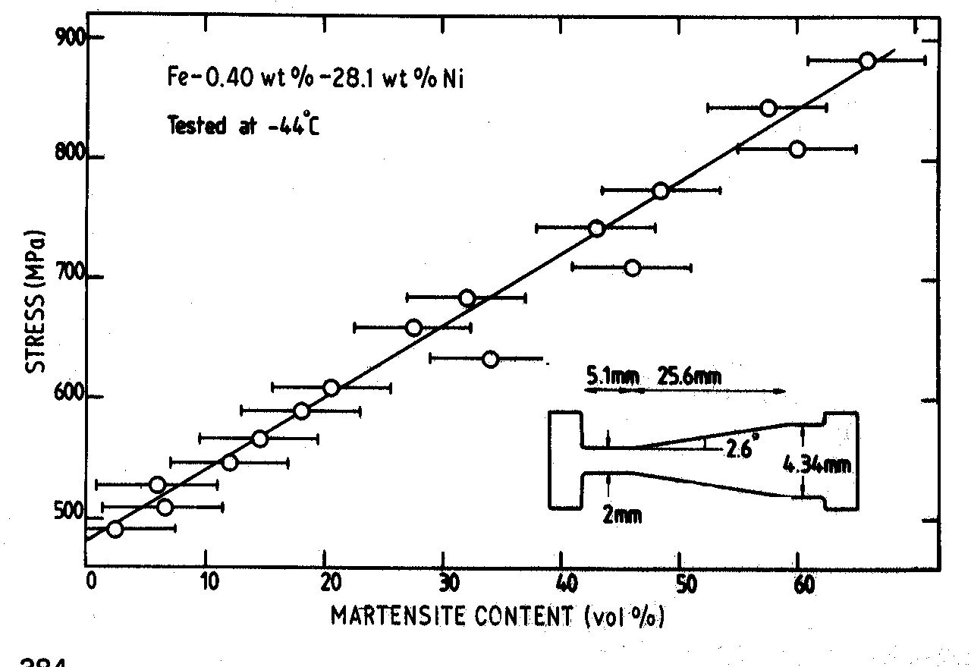
Bhadeshia, 1982

Slide 21
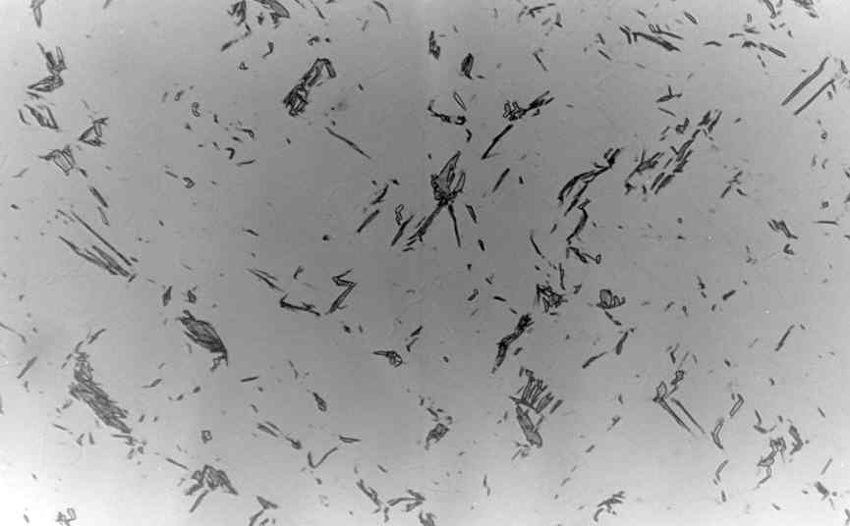
polycrystalline austenite
σ
50 μm
Bhadeshia, 1982

Slide 22
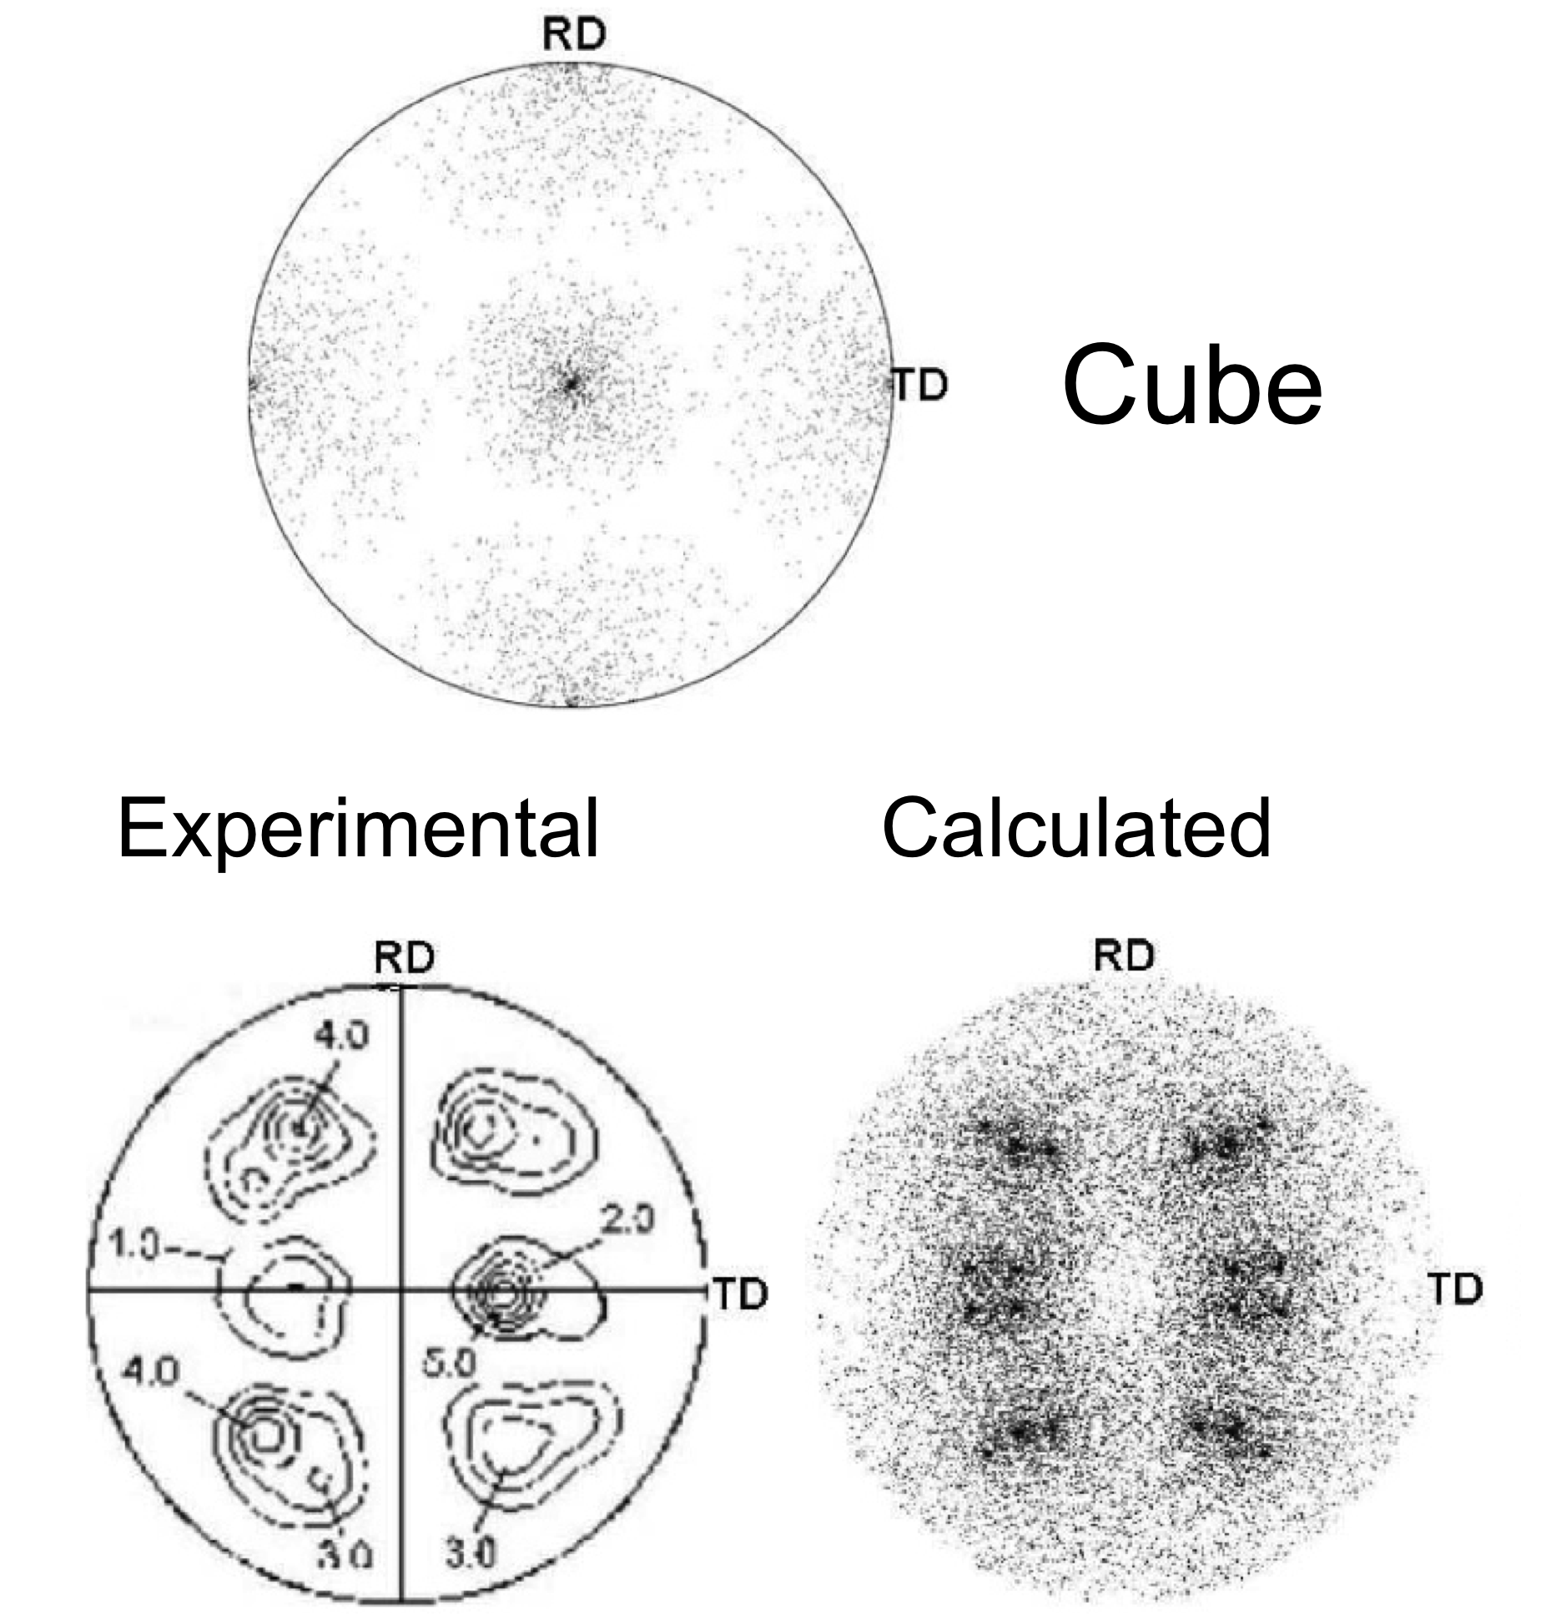
Texture prediction

Slide 23
Most methods calculate only POSITIONS of poles, not intensities

Slide 24
TRIP steels that are fully austenitic are expensive
How do we produce cheap austenite?

Slide 25
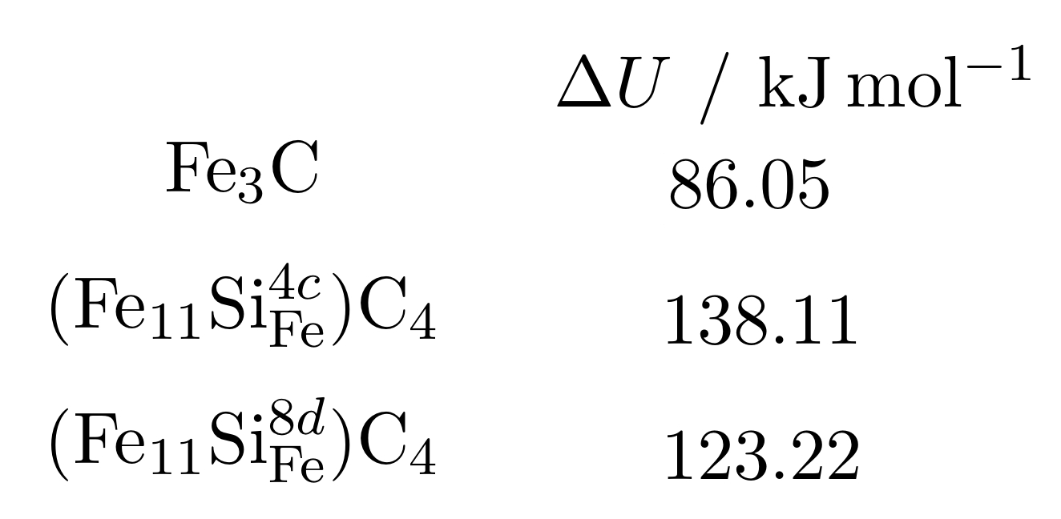
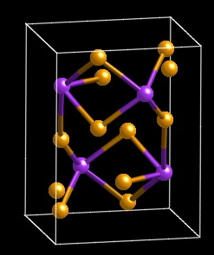
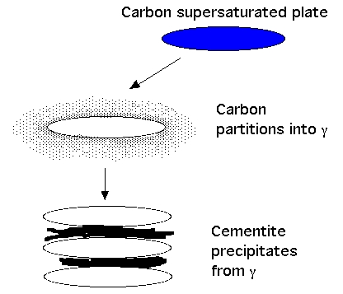
TRIP-Assisted Steels
austenite is expensive
carbon can be cheap
too much carbon is bad
Jae Hoon Jang, In Gee Kim
Notes:
25

Slide 26
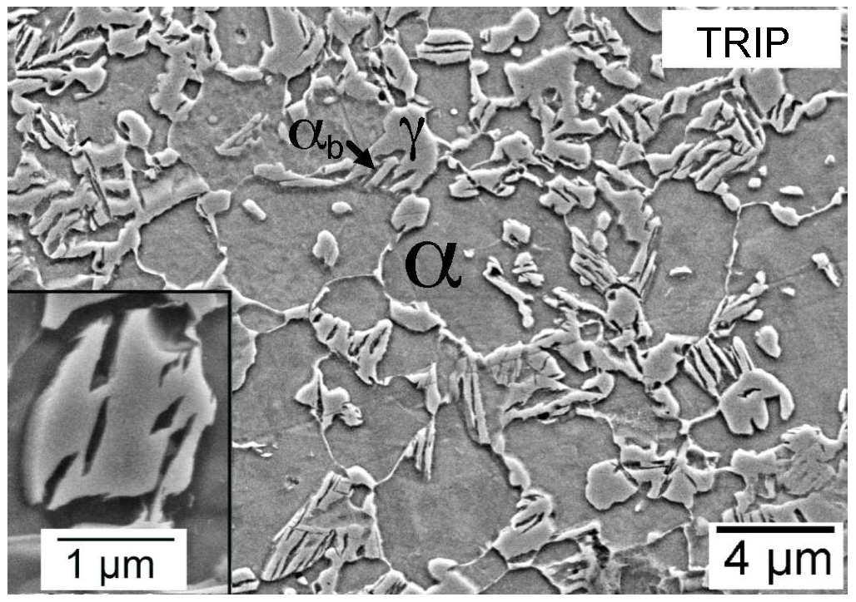
Typical composition Fe-0.15C-1.5Si-1.5Mn wt%

Slide 27
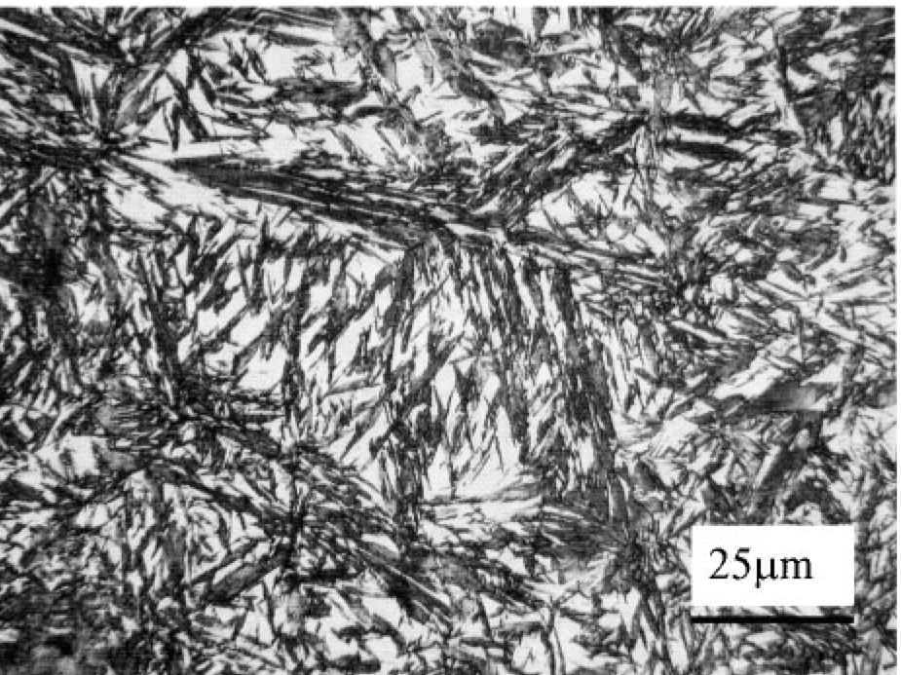
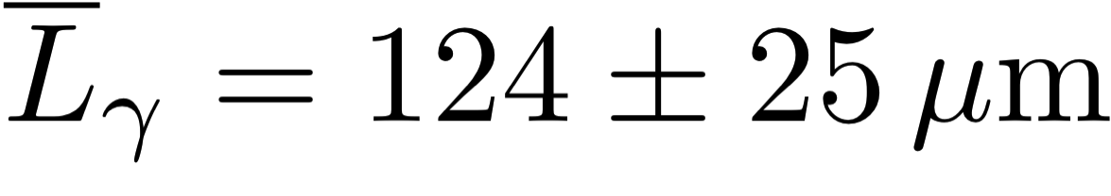
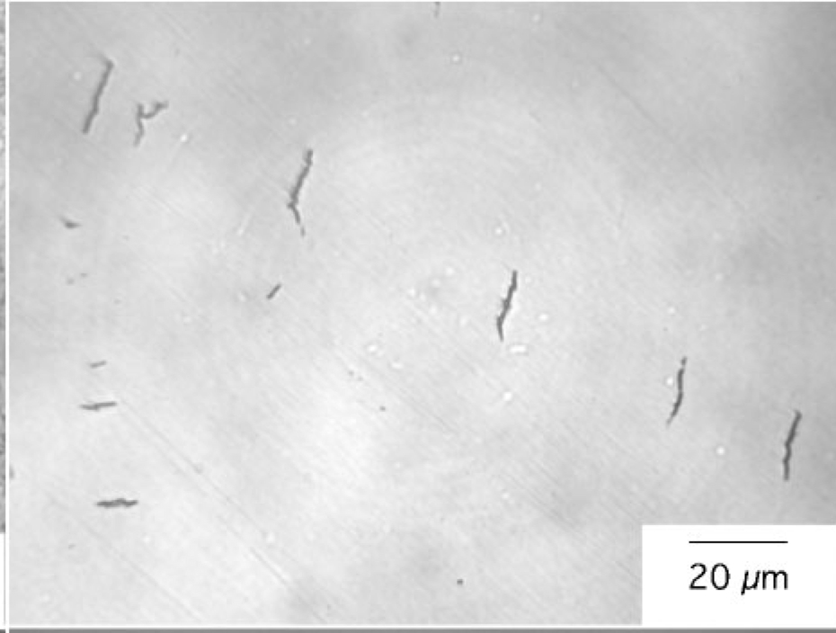
Chatterjee & Bhadeshia, 2006

Slide 28
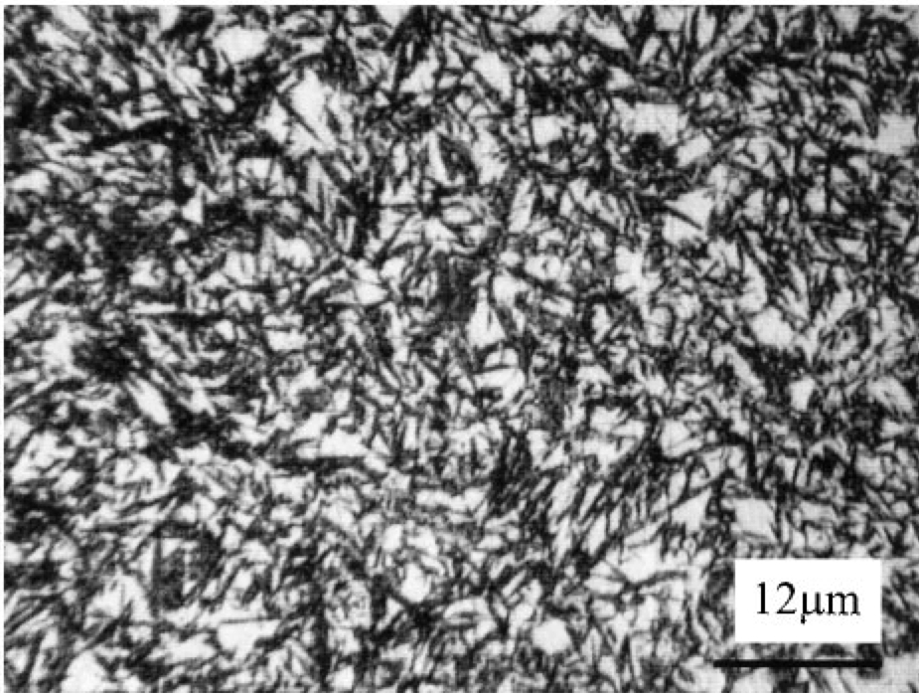
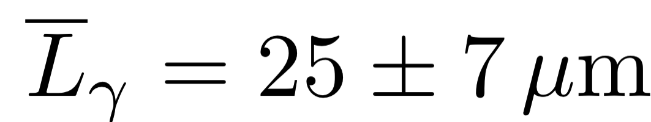
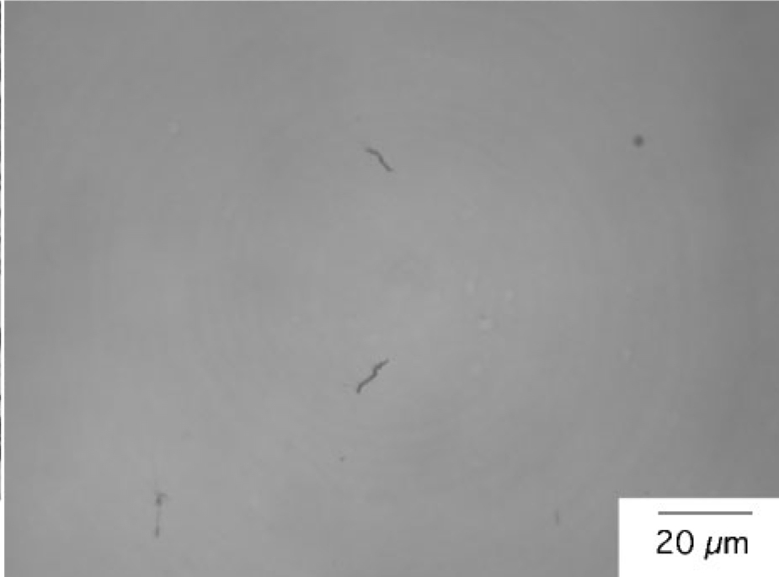
plates become finer than stress-transfer length, and hence do not crack

Slide 29
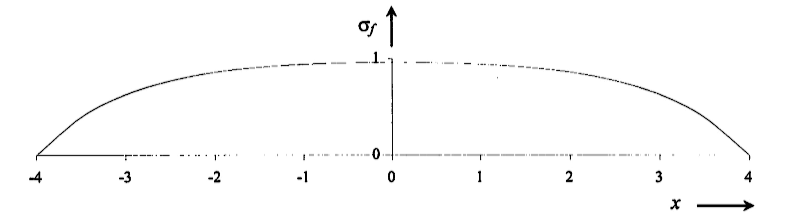
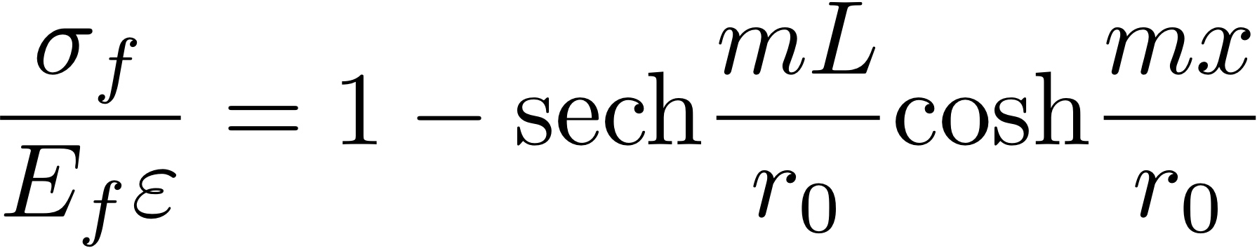
Cracking of brittle martensite
tensile stress in fibre enclosed by matrix

Slide 30
Austenite grain size effects
plates stopped by austenite grain boundary
total volume transformed reduced when grain size small
detection limit leads to reduction in start temperature

Slide 31
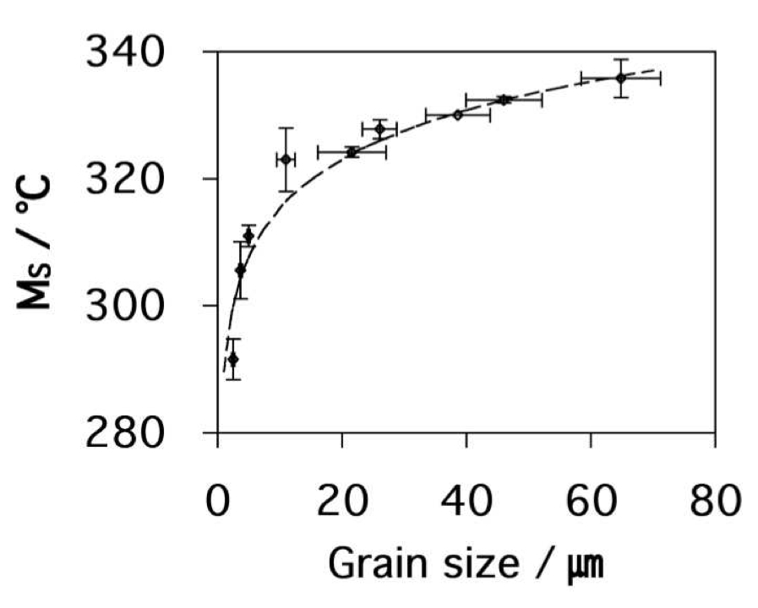
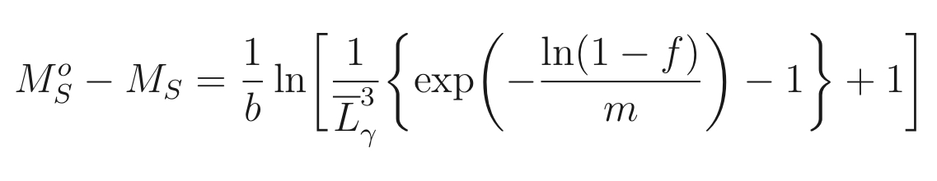
Yang & Bhadeshia, 2009

Slide 32
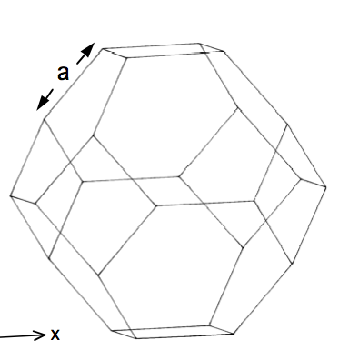
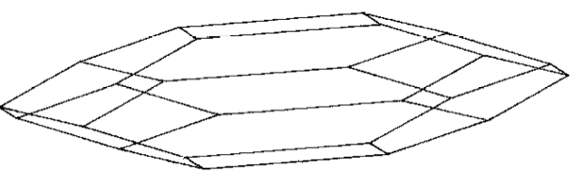
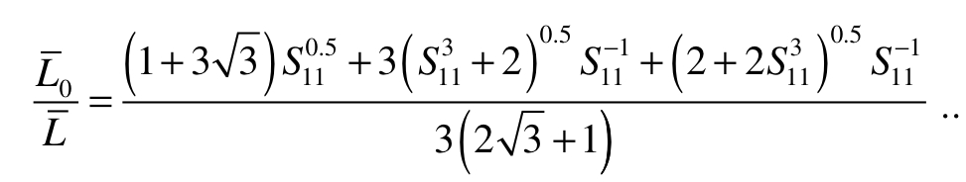
Plastic strain: grain shape

Slide 33

Plastic strain: stabilisation
Shipway & Bhadeshia 1995

Slide 34


Plastic strain: stabilisation
Chatterjee & Bhadeshia

Slide 35

Classic TRIP-assisted steel stress or strain-induced?

Slide 36

Classic TRIP-assisted steel calculations of austenite stability

Slide 37
Crystallography
Interfacial structure
Atomic structure
Chemical composition
Texture
Thermodynamics
Magnetic
Stress
Kinetics
Plastic strain
Critical mechanical properties

Slide 38
Steel with impossible combination of properties
>2 GPa
30% ductility at conventional strain rates
ductility at very high strain rate
toughness and Charpy impact at -40°C
weldable
cheap, large in all dimensions
mass production

Slide 39


Slide 40


Slide 41


Kelvin tetrakaidecahedron
Pous et al. (2014)

Slide 42


Slide 43



Slide 44



Slide 45


Slide 46


Two pass
Single pass
12 mm

Slide 47


Slide 49
Temperature
Ae3'
T'
o
x
Carbon in austenite

Slide 50

1 μm

Slide 51
Fine structure
Retained austenite:
TRIP effect
no ductile-brittle transition
barrier to hydrogen
No cementite
Small concentration of C in ferrite

Slide 52
Very poor toughness!

Slide 53

50 µm

Slide 54


Slide 55
Carbide-free alloys
Fe-0.4C-3Mn-2Si
Fe-0.2C-3Mn-2Si
Fe-0.4C-4Ni-2Si wt%
Notes:
55

Slide 56


Slide 57

50 μm

Slide 58

0.5 μm

Slide 59


Slide 60


Slide 61

Yates, Jerath, Bhadeshia
Notes:
61

Slide 62

Kevin Sawley: 90 million gross tonnes of traffic on curve

Slide 63

Notes:
63

Slide 64

Notes:
64

Slide 65



Slide 66


Standard thermodynamic databases fail for epsilon martensite

Slide 67


analysis limited to cases where

Slide 68




Pure iron
CALPHAD
First principles
Fe-5Mn-2-Si-2Cr
First principles

Slide 69


Slide 70


…………
empirical
method

Slide 71

non-linear: neural networks

