Slide 1
Evolution of solutions
www.phase-trans.msm.cam.ac.uk

Slide 2

mechanical alloying

Slide 3
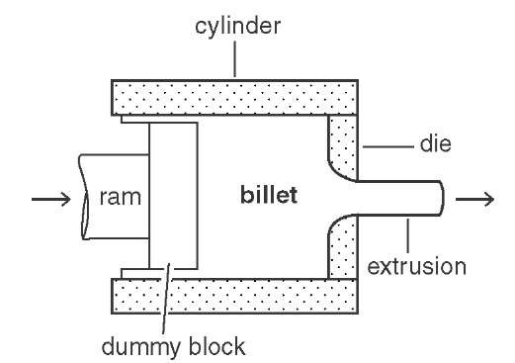
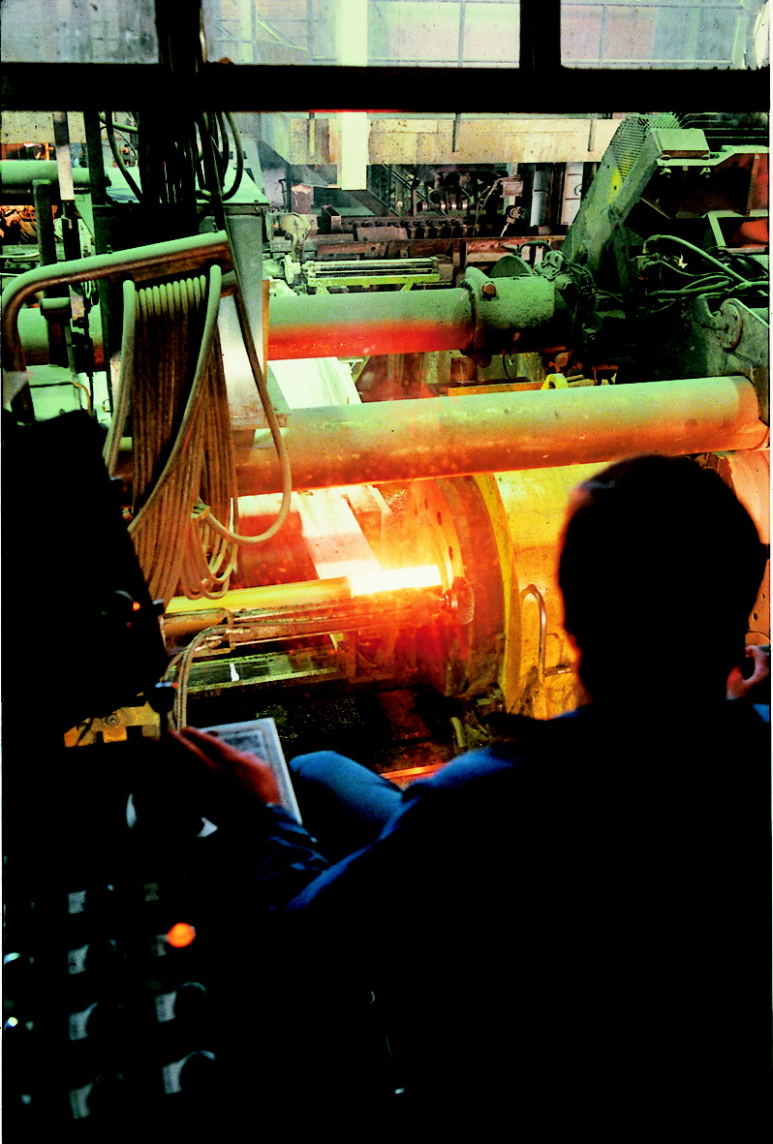
extrusion of canned powder

Slide 4
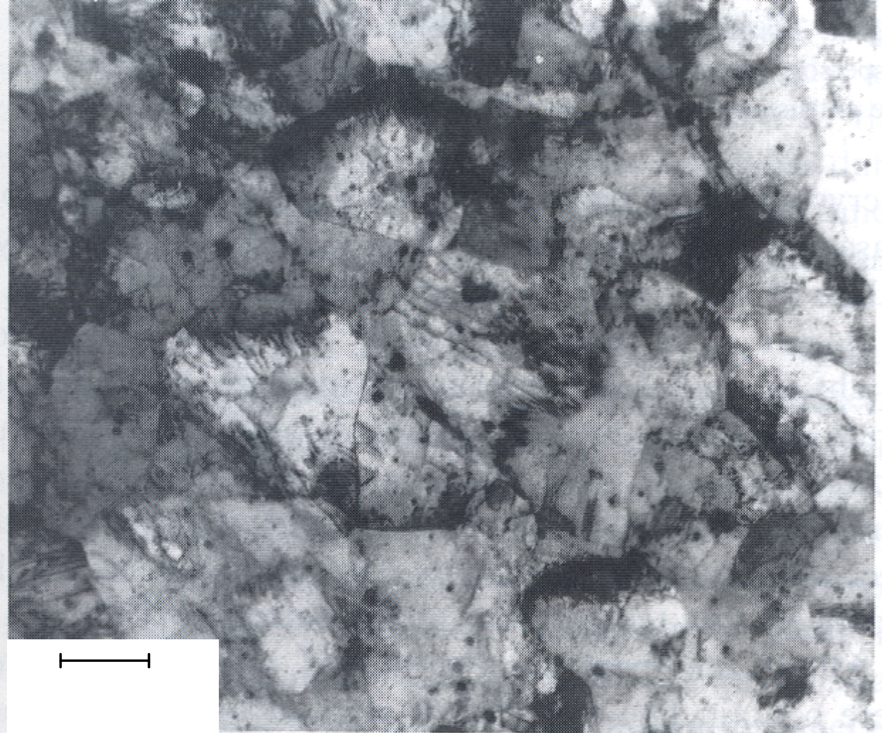
“MA956” Fe-20Cr-4.5Al-0.5Ti-0.5 yttria wt%
200 nm

Slide 5
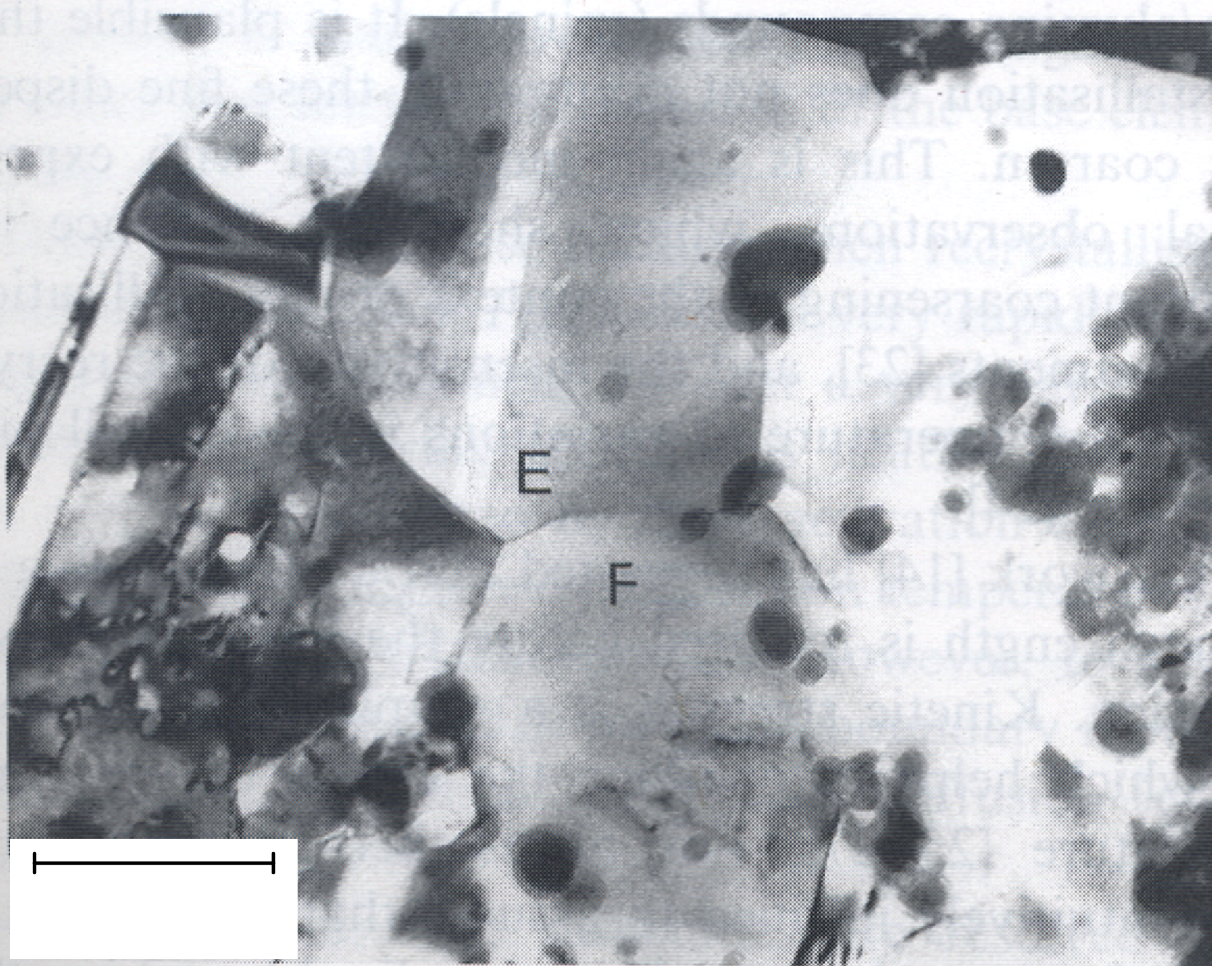
“MA6000”
Ni-15Cr-4.5Al-2.3Ti-4W-1.1 yttria wt%
200 nm

Slide 6
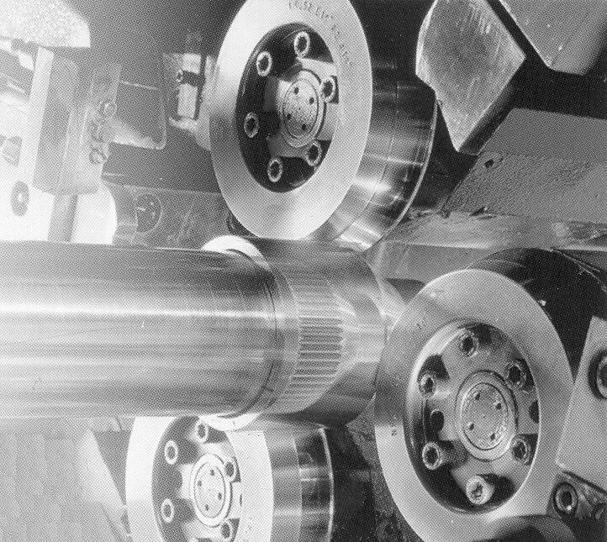

Slide 7
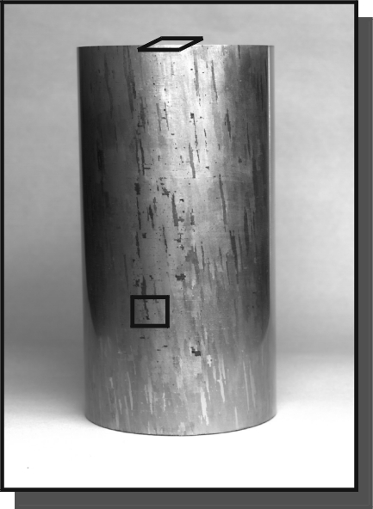
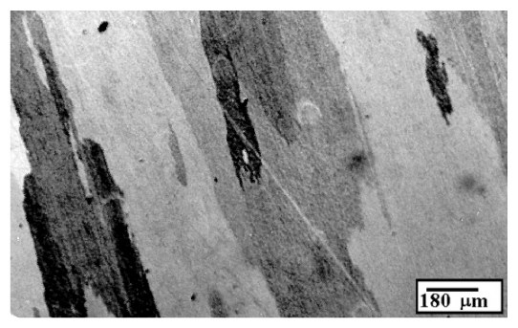
Helical grains

Slide 8
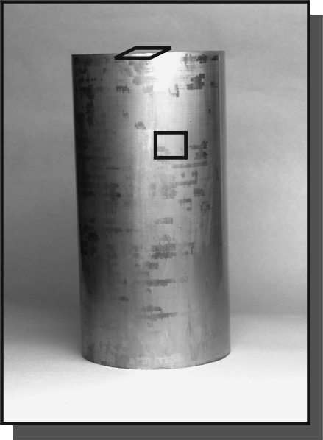
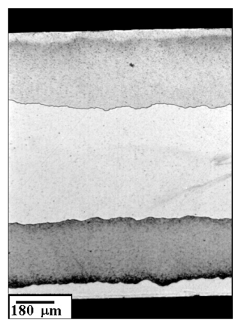

Slide 9
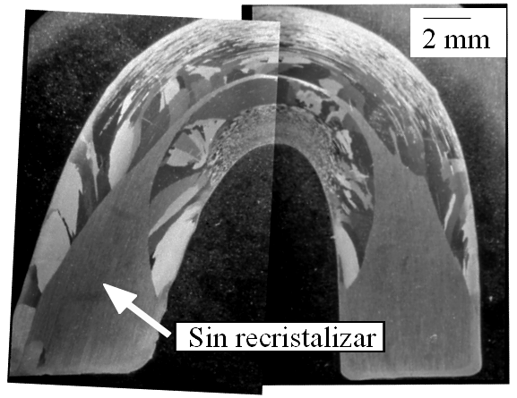
not recrystallised

Slide 10
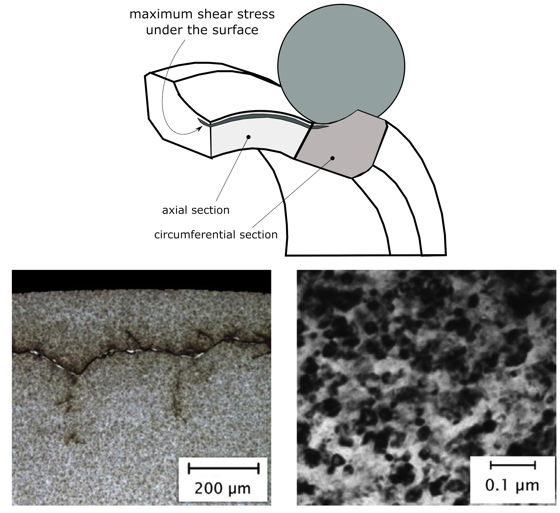
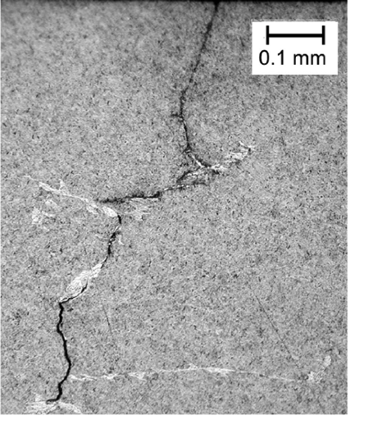

Slide 11
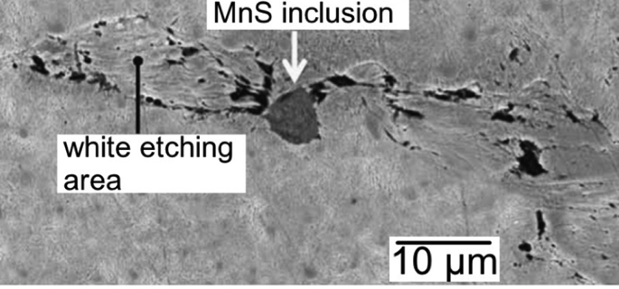

Slide 12
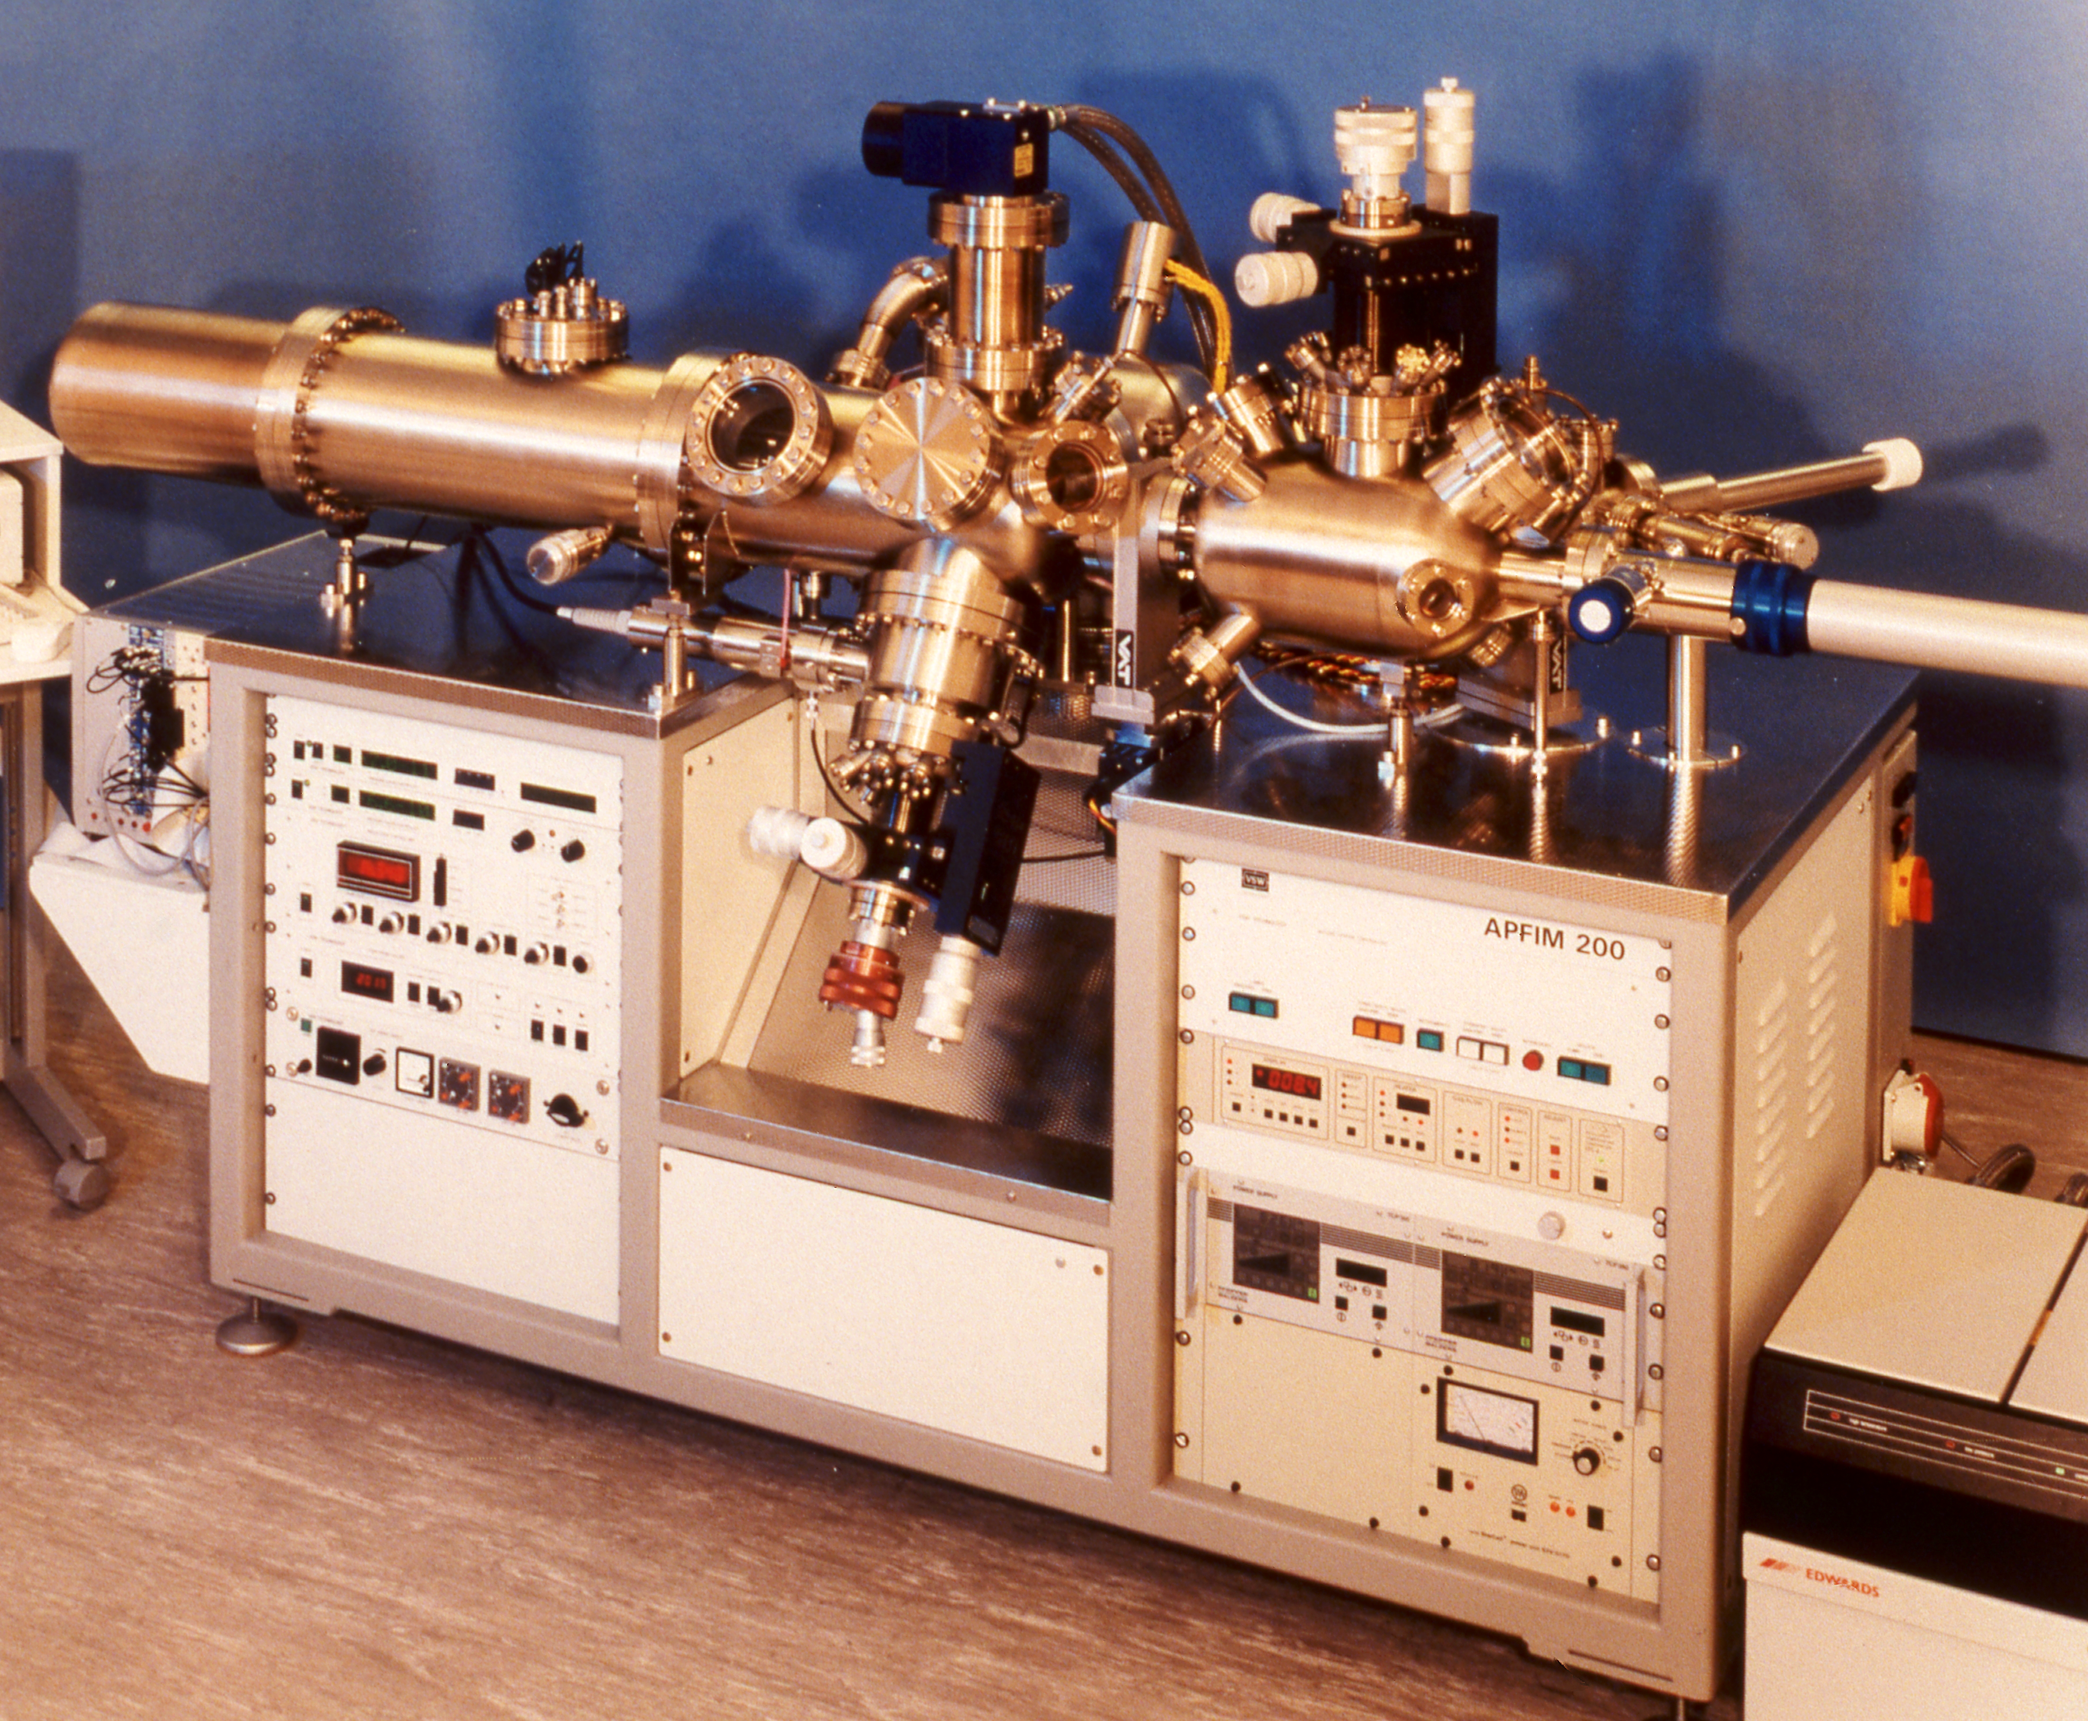
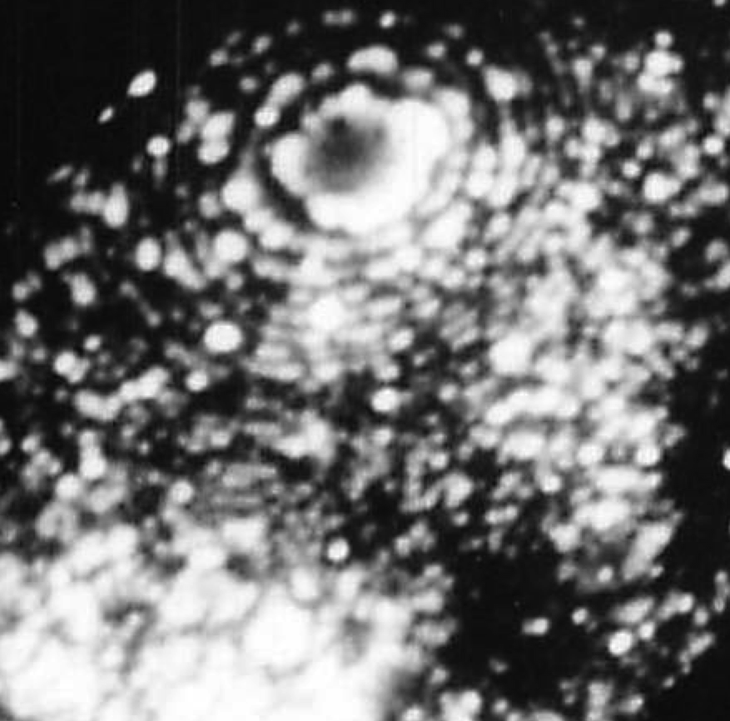
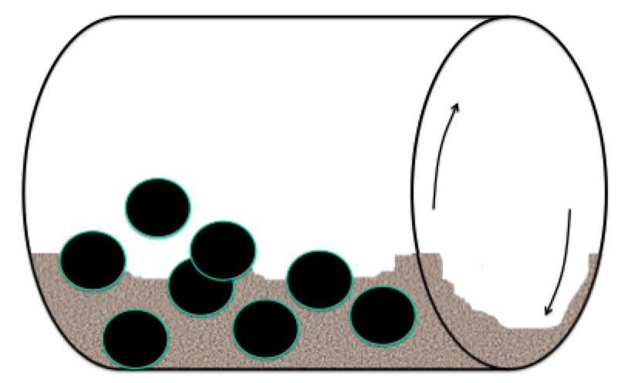
MA956

Slide 15
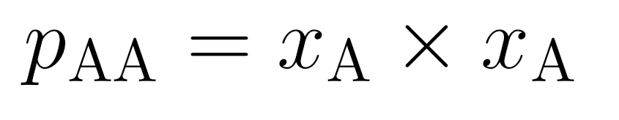
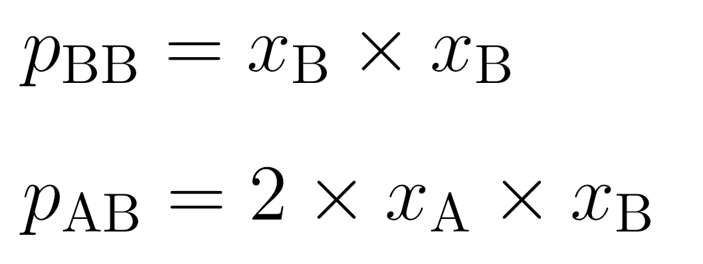
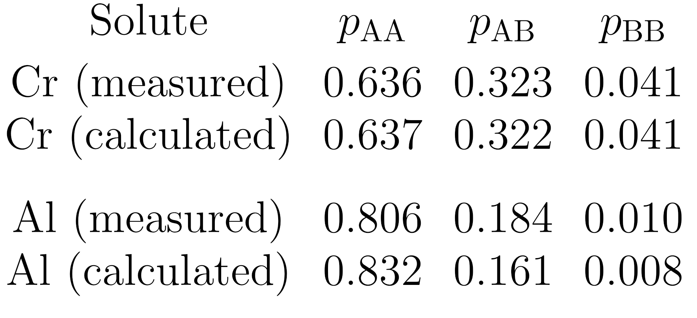
Probability of pairwise bonds in random solution

Slide 16
Mechanical Mixture
free energy of
mechanical
μ
o
mixture
B
G*
μ
o
Gibbs free energy per mole
A
x
1-x
A
B
Concentration x of B

Slide 17
free energy of
mechanical
μ
o
mixture
B
G*
Gibbs free energy per mole
μ
o
A
∆G
M
G{x}
free energy
of solution
A
B
x
Composition

Slide 18
Entropy
P
P / 2

Slide 19
+
=

Slide 20
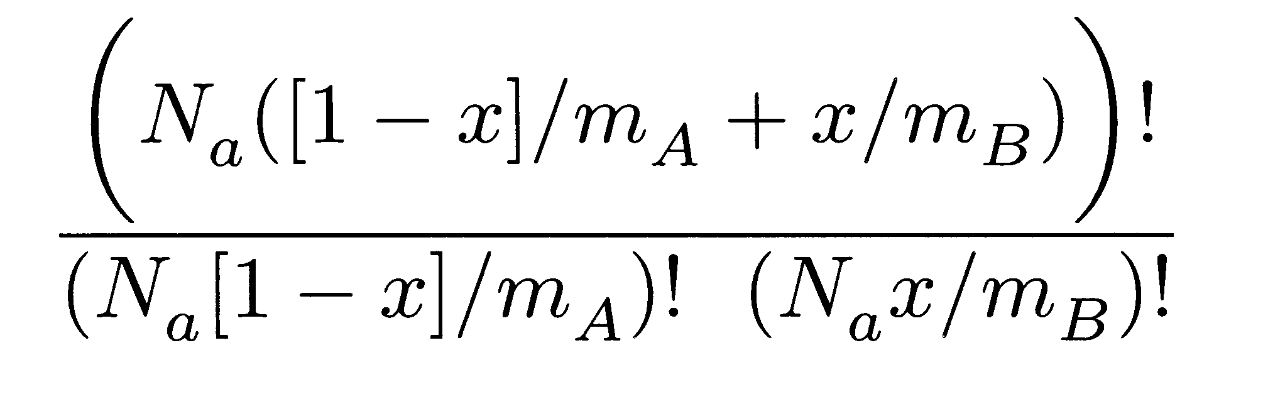
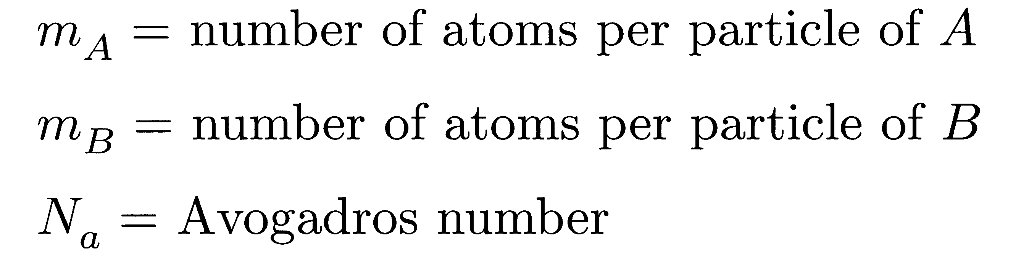
For a random mixture, number of configurations given by:

Slide 21
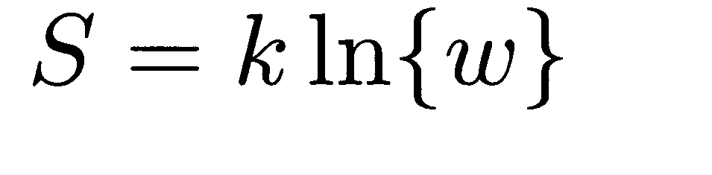
Boltzmann

Slide 22
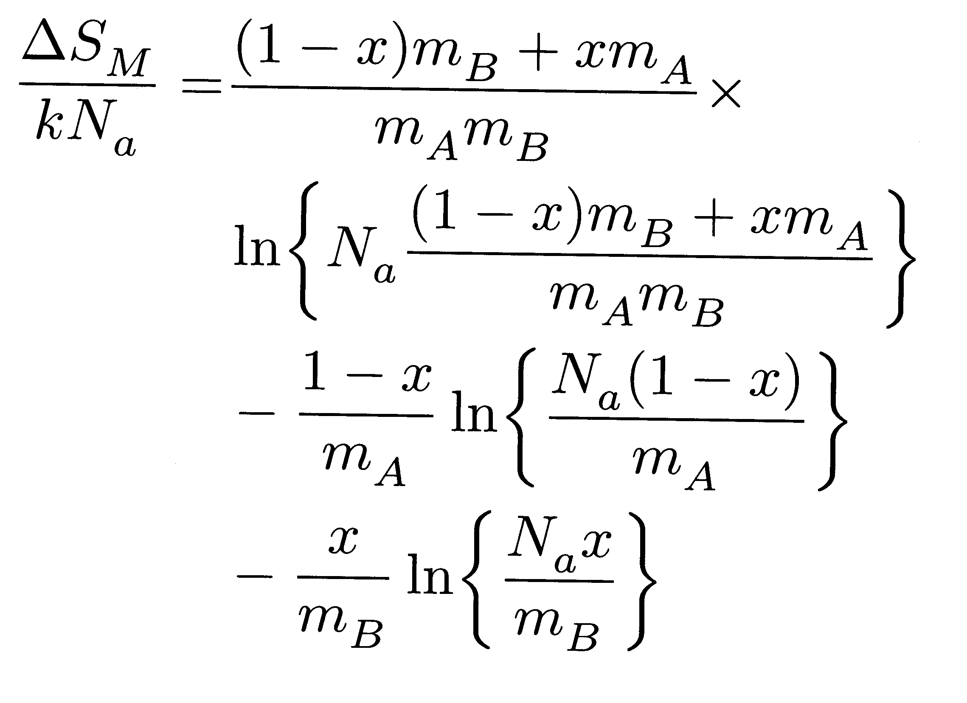

Slide 23
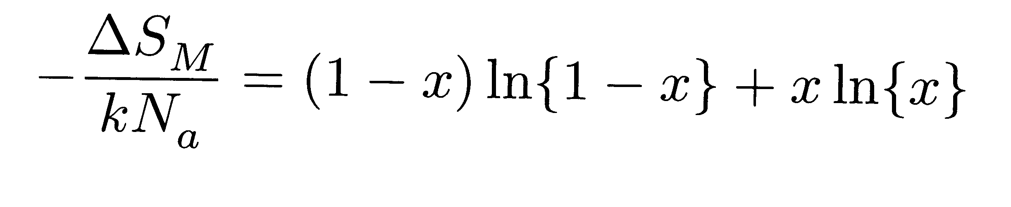
Classical theory for entropy of mixing

Slide 24
Solution-like behaviour when particles about 1000 atoms in size
Free energy of mixing due to configurational entropy alone

Slide 25
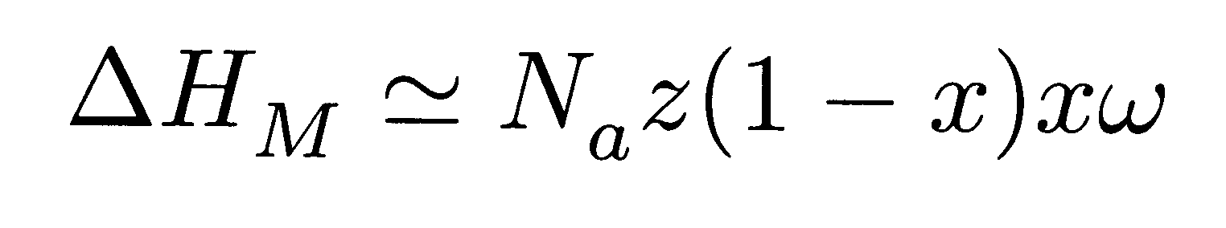
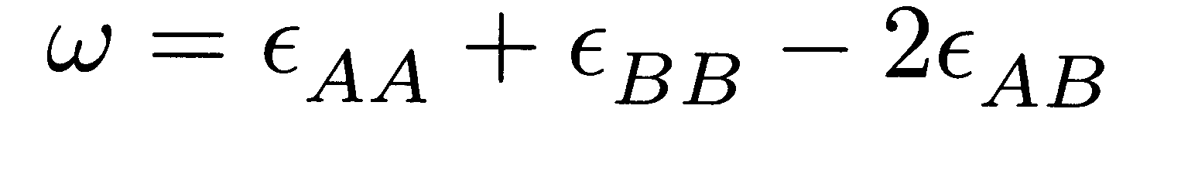
Enthalpy

Slide 26


Slide 27
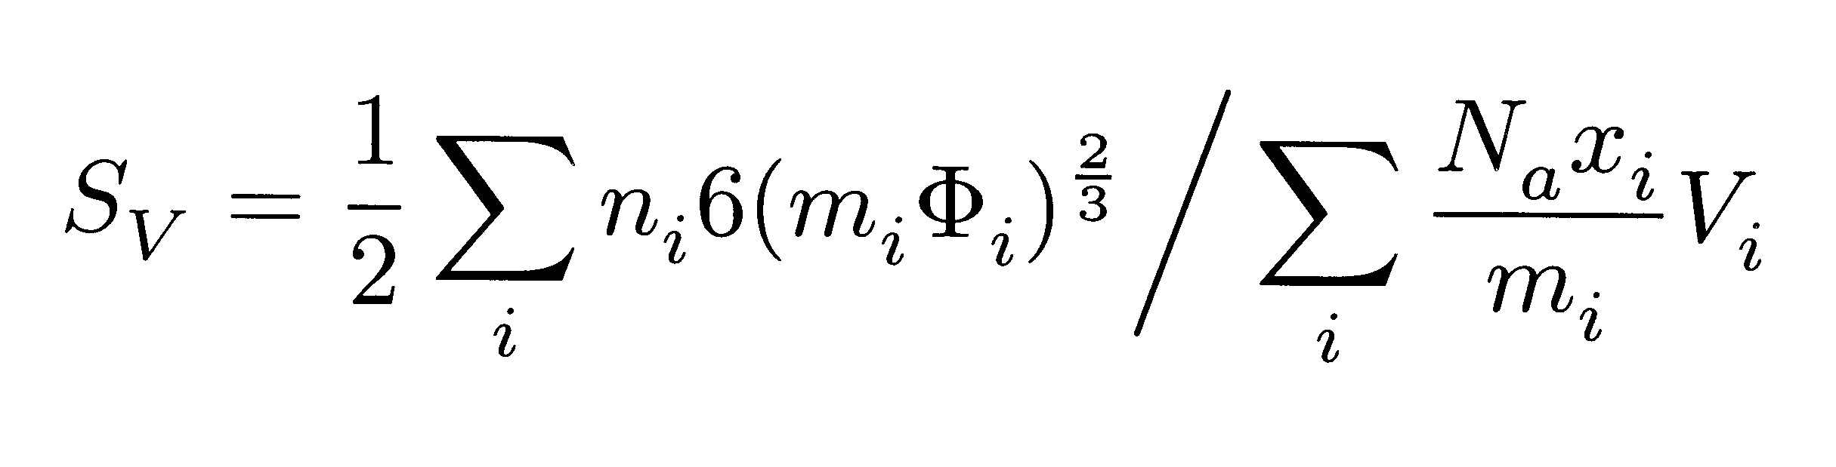
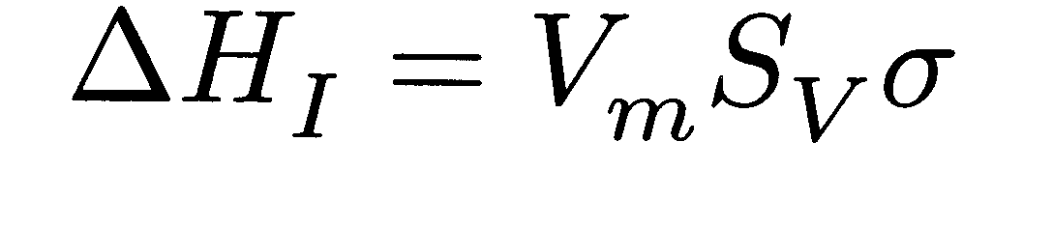
Surface per unit volume
S_{v}
Solution formation impossible!
Particle size

Slide 28
coherent
coherent
incoherent

Slide 29
Single barrier to solution formation when components attract

Slide 30
Double barrier to solution formation when components immiscible

Slide 31
μ
o
B
μ
o
A
Gibbs free energy per mole
Paradox at concentration extremities vanishes in the discrete model of concentration
A
B
Concentration x of B

