Slide 1
Andre Geim (2016):
….would like a graphene age, like the … iron ages.

Slide 2
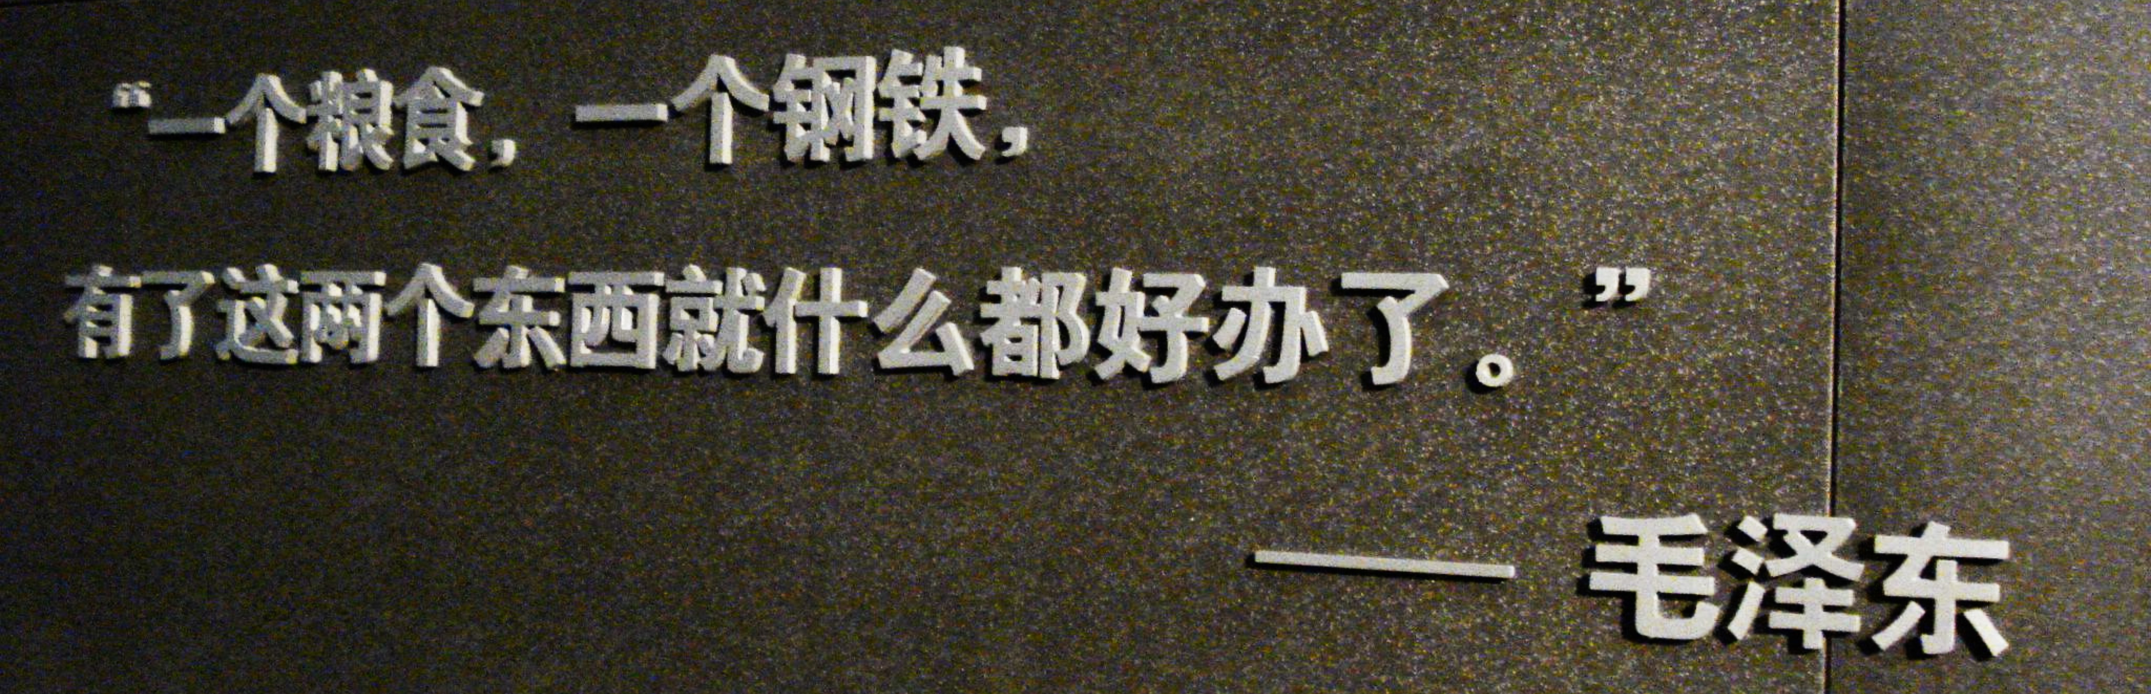
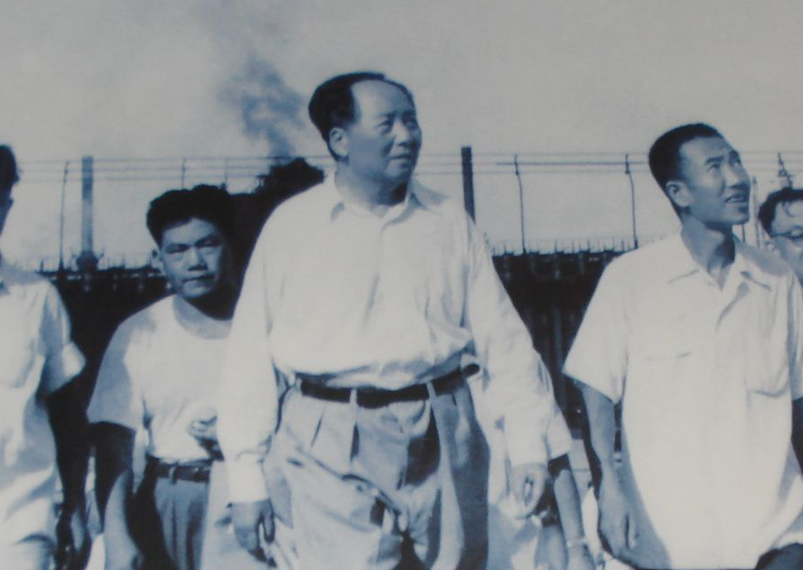


Slide 3

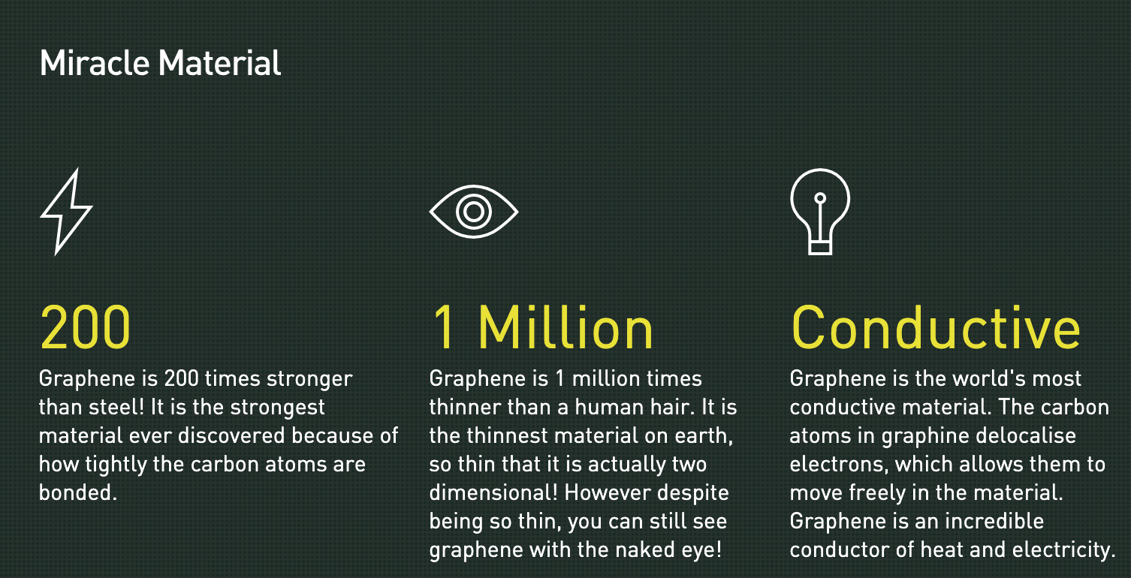

Slide 4
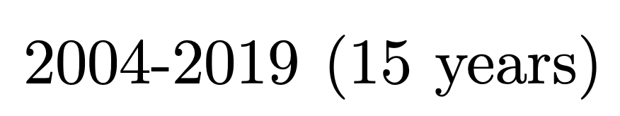
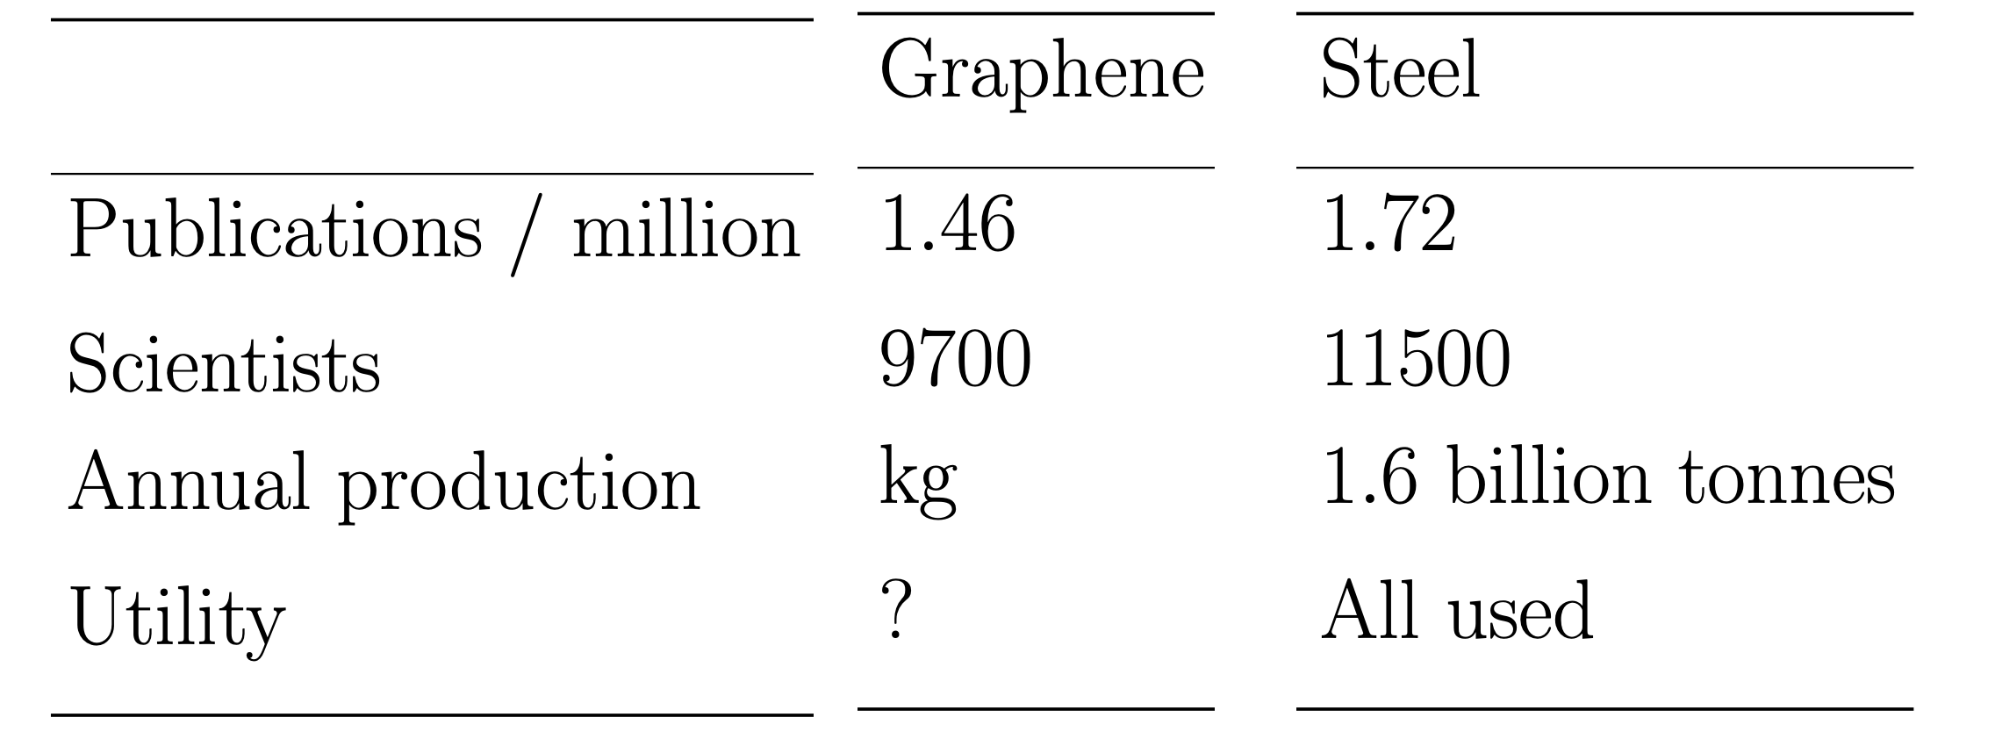


Slide 5

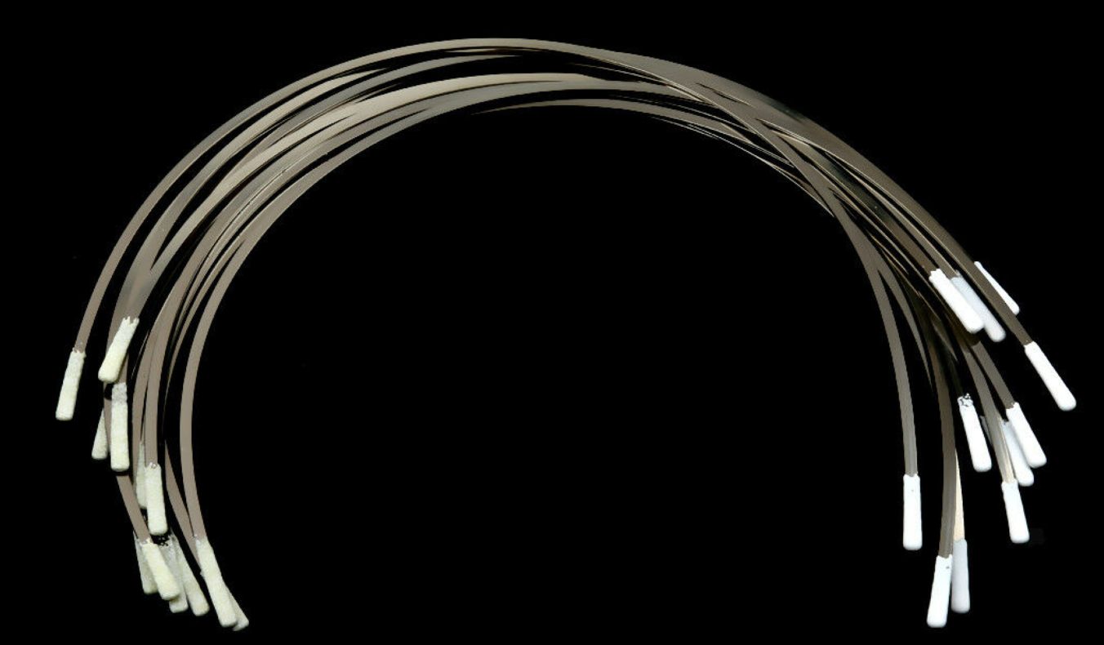
Stainless steel underwires for bra, 12 for £3.81, ebay

Slide 6


“Every year, tonnes of graphene are applied to Vittoria tires….
…. increase all performance metrics”

Slide 7


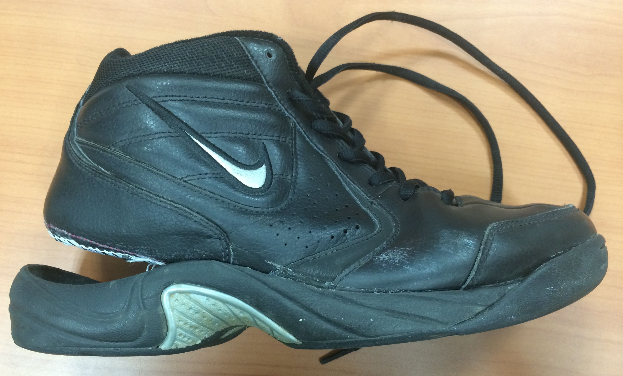
World’s toughest grip
Utilising the world’s strongest material,
graphene-enhanced rubber …
50% stronger
50% more elastic
50% harder wearing

Slide 8
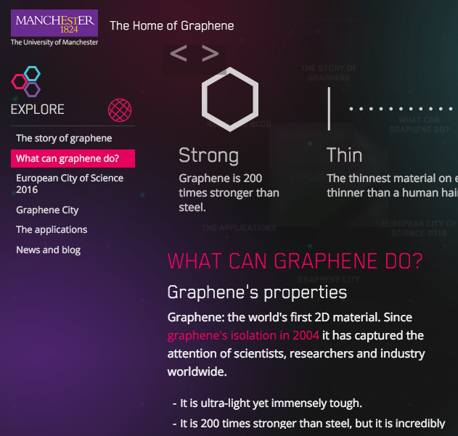
Graphene
200 times
stronger than
steel
immensely
tough

Slide 9
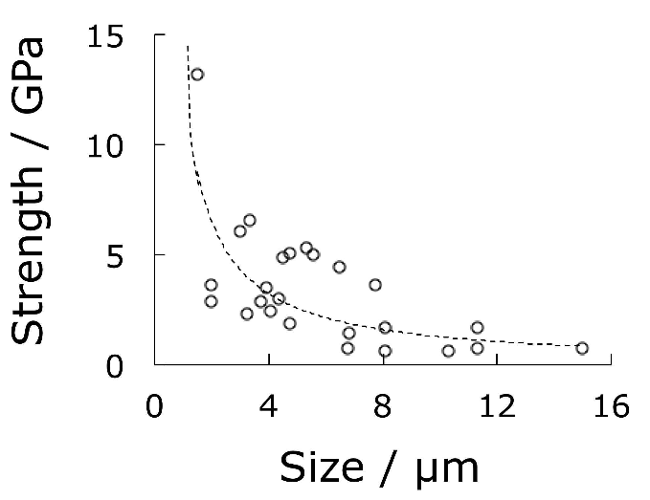
Single crystals of iron
Strength and size go together
Brenner:1956

Slide 10
What is the maximum strength of iron when pulled along its weakest direction?
14.5 GPa
remember this number

Slide 11

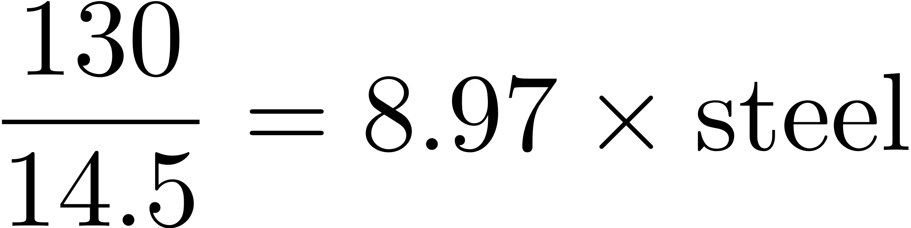
Strength of perfect graphene samples approximately (2 µm)²

Slide 12
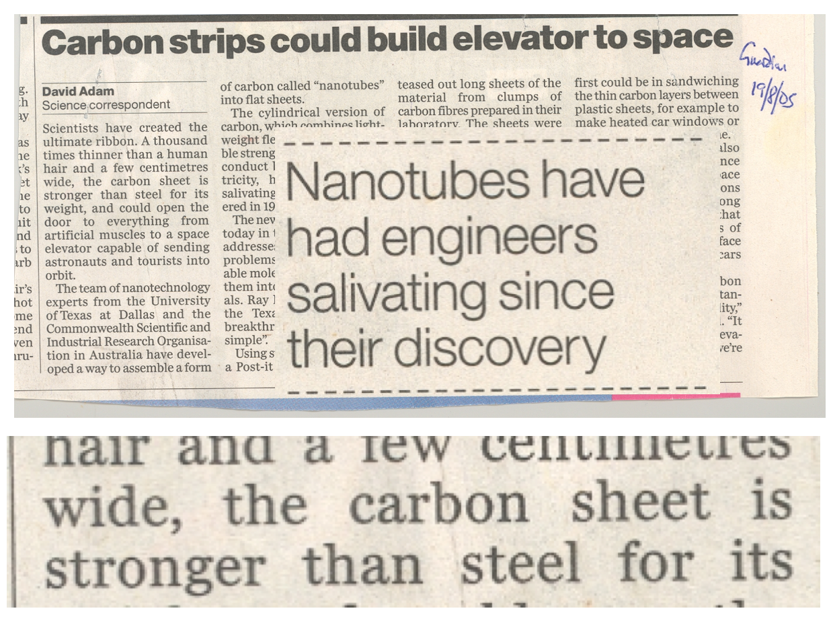

Slide 13
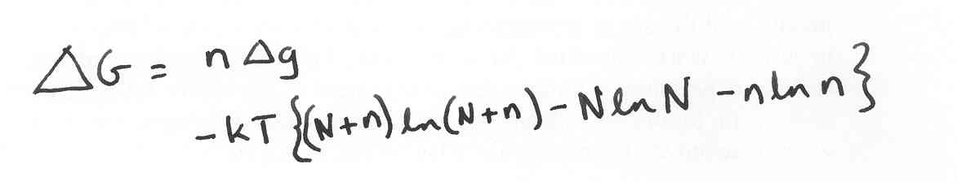
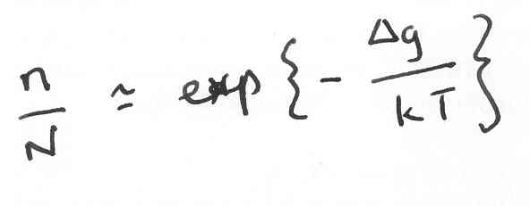
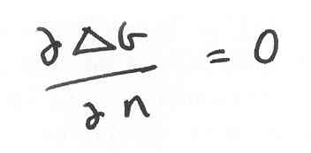
An equilibrium number of defects.
Strength of a nanotube rope 2 mm long is less than 2000 MPa

Slide 14
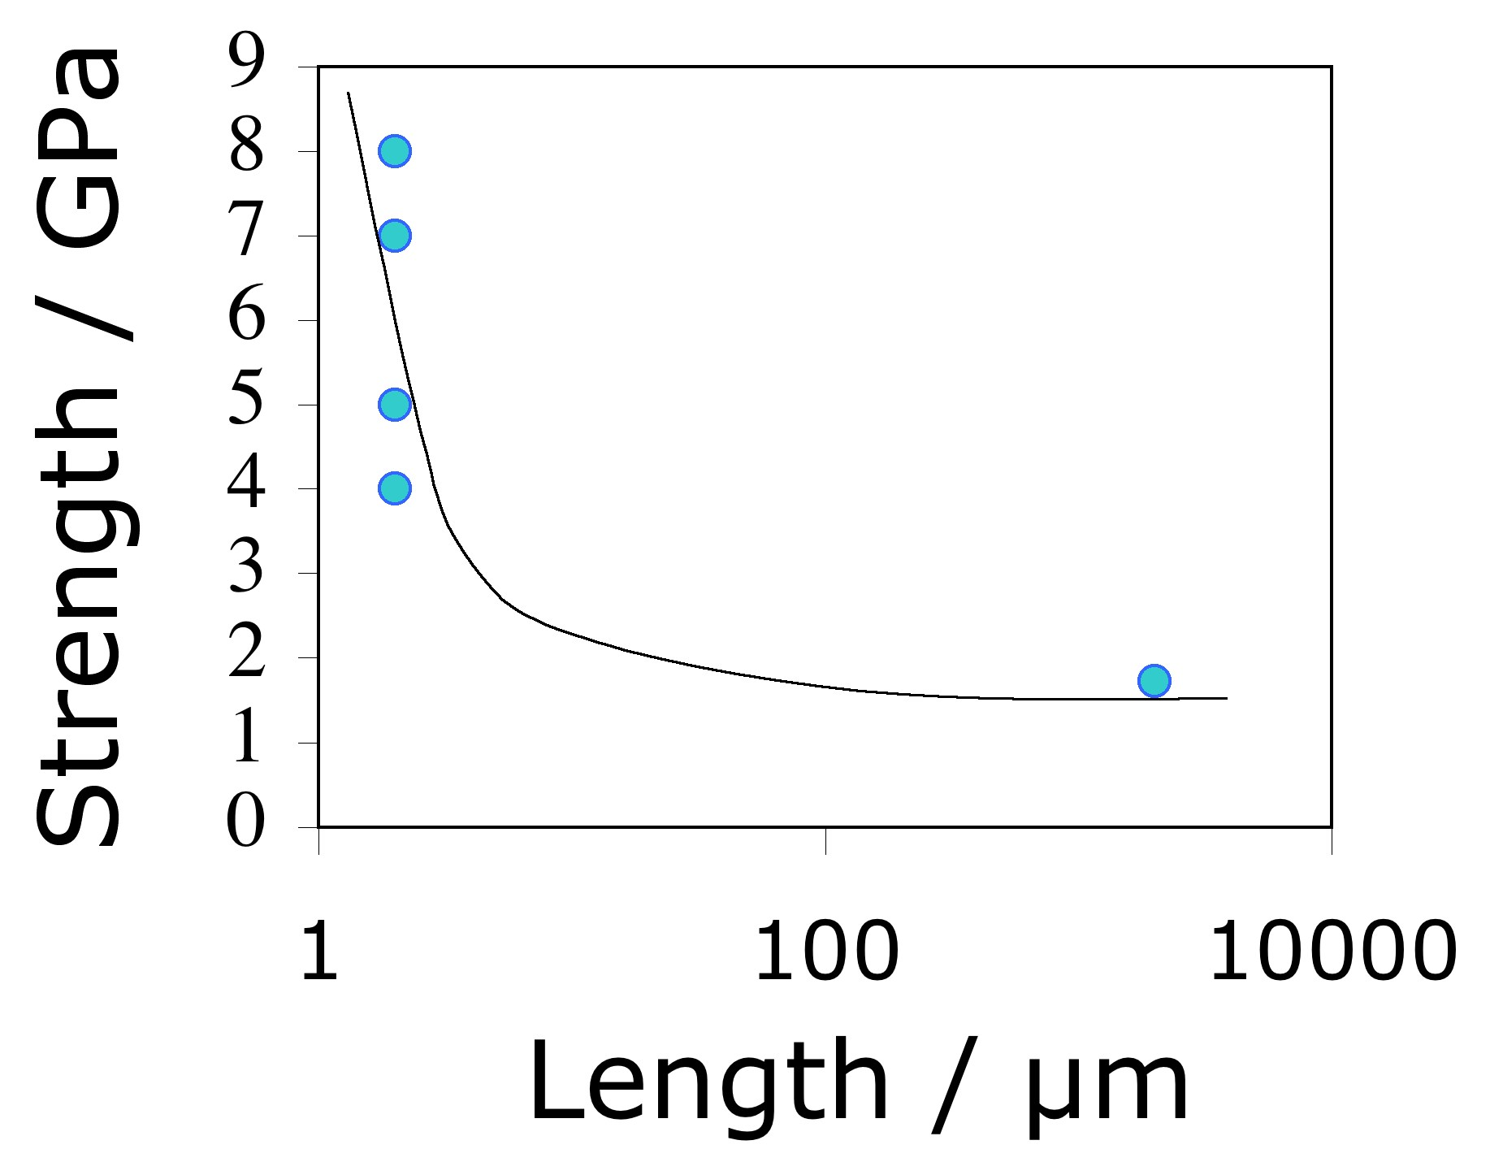
data from Pan et al. 1999, Yu et al. 2000

Slide 15
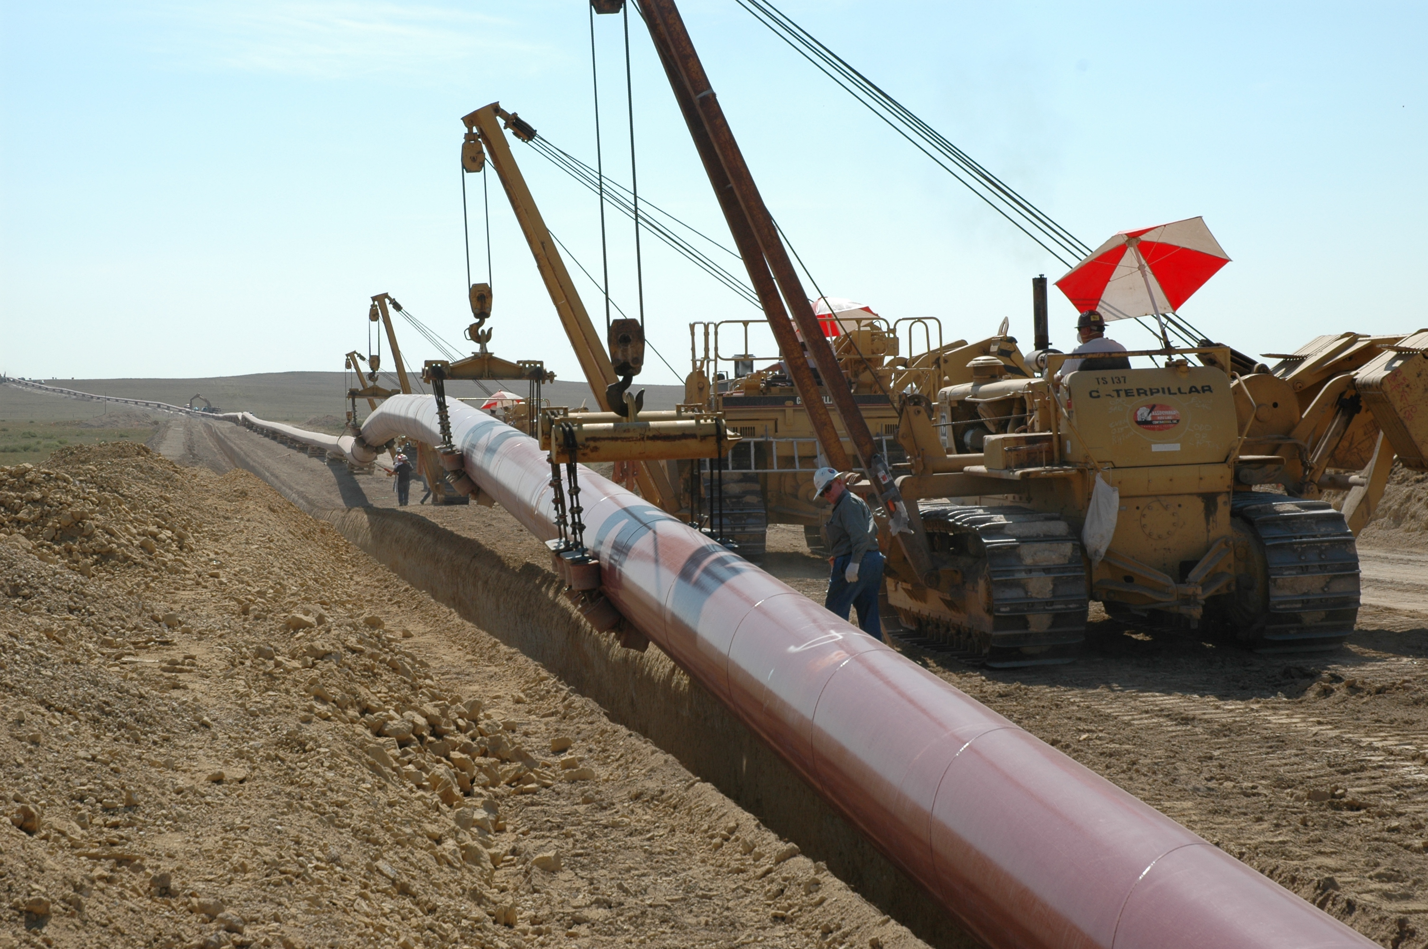
3000 MPa
1500 MPa
500 MPa

Slide 16
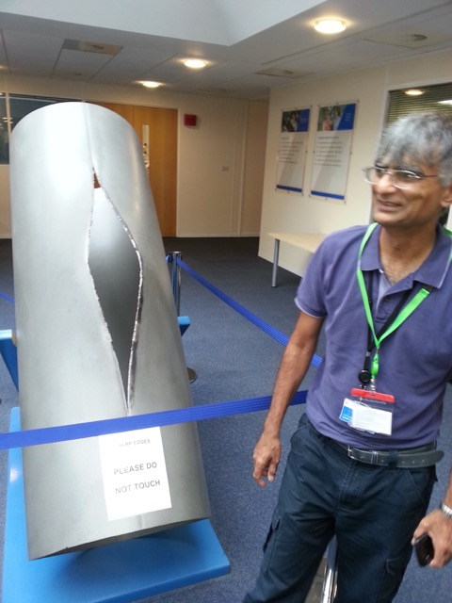

Slide 17
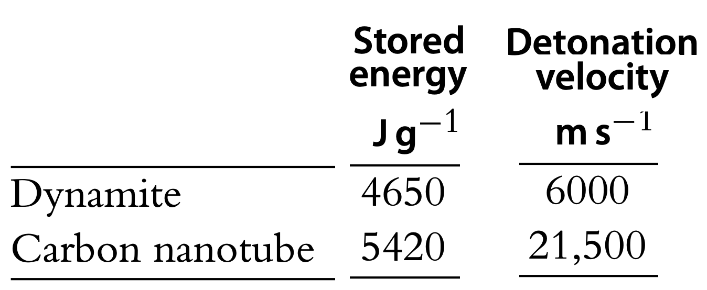
strength 130 GPa
modulus 1.2 TPa

Slide 18
First dress made with graphene unveiled in Manchester
….. little black dress uses `wonder material’
…… looks set to storm the catwalks of Paris,
New York and Milan
….. graphene, which is 200 times stronger than steel
Guardian, 25th Jan 2017

Slide 19
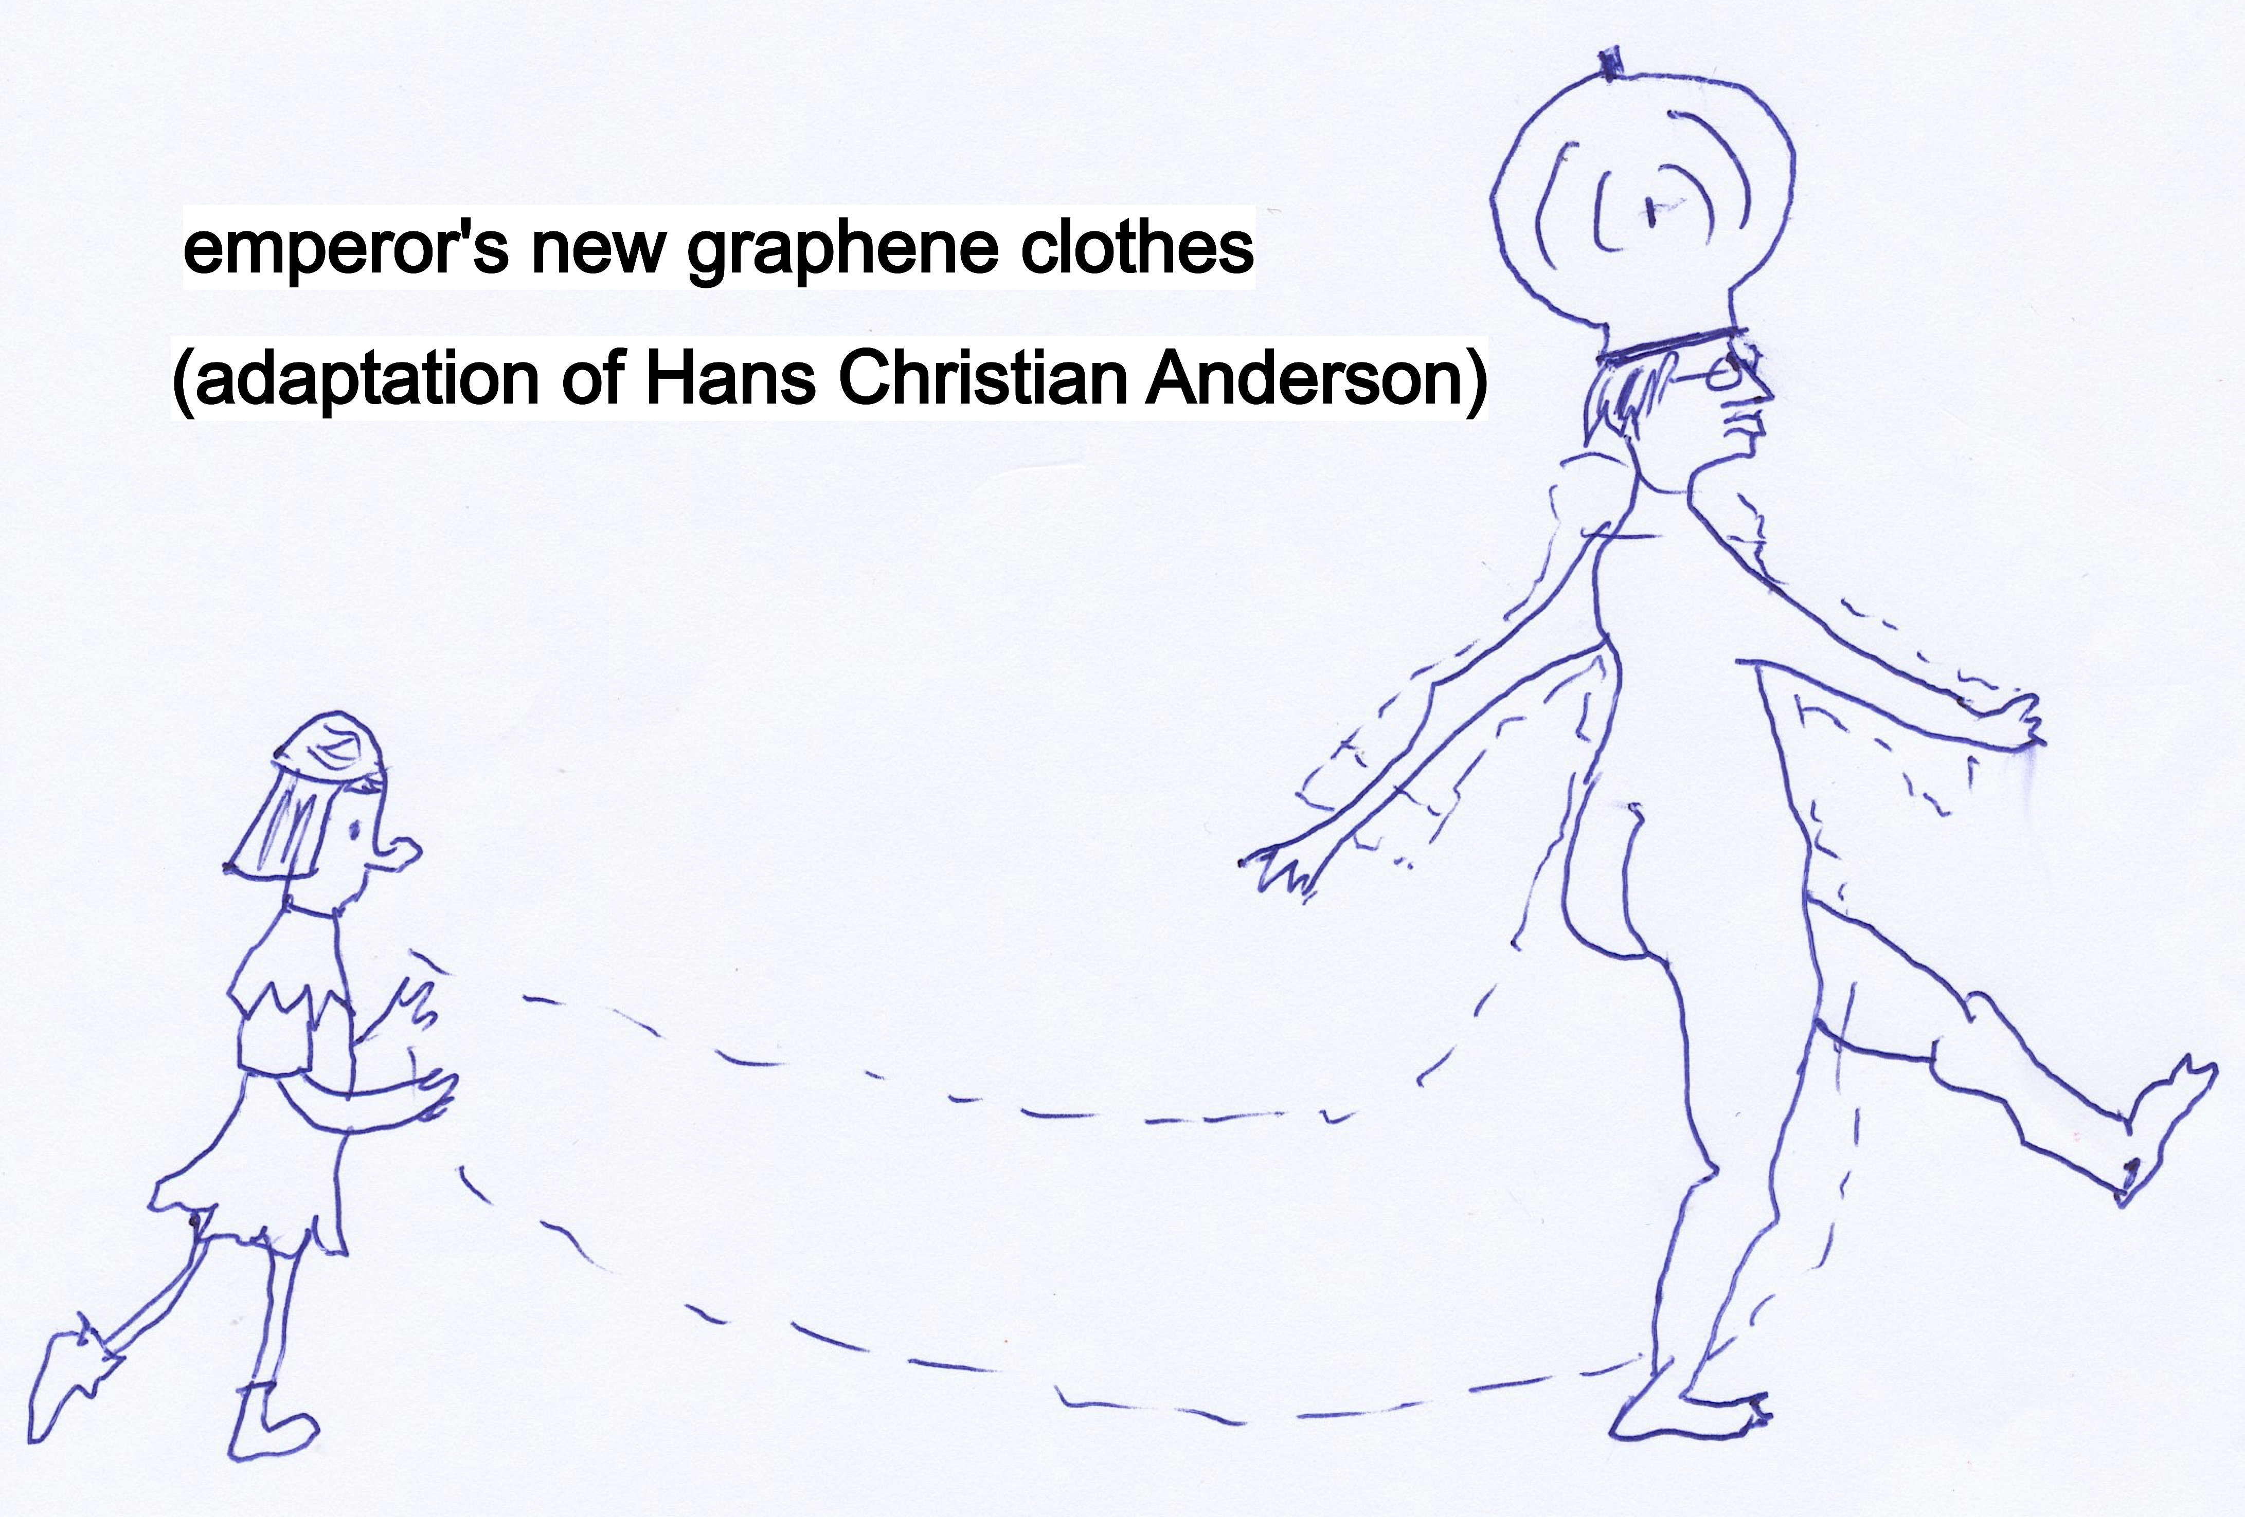

Slide 20
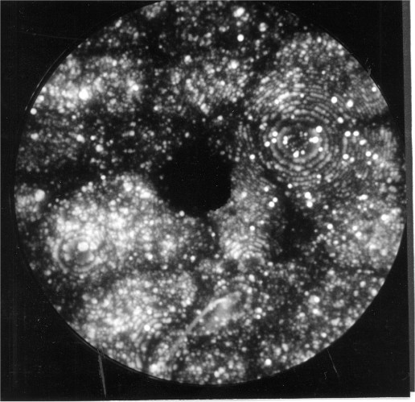
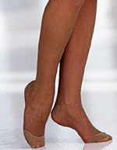
Scifer: 5.5 GPa steel wire
1 Denier is weight in grams of 9 km of fibre
Scifer is 9 Denier
Stockings: 10 Denier

Slide 21
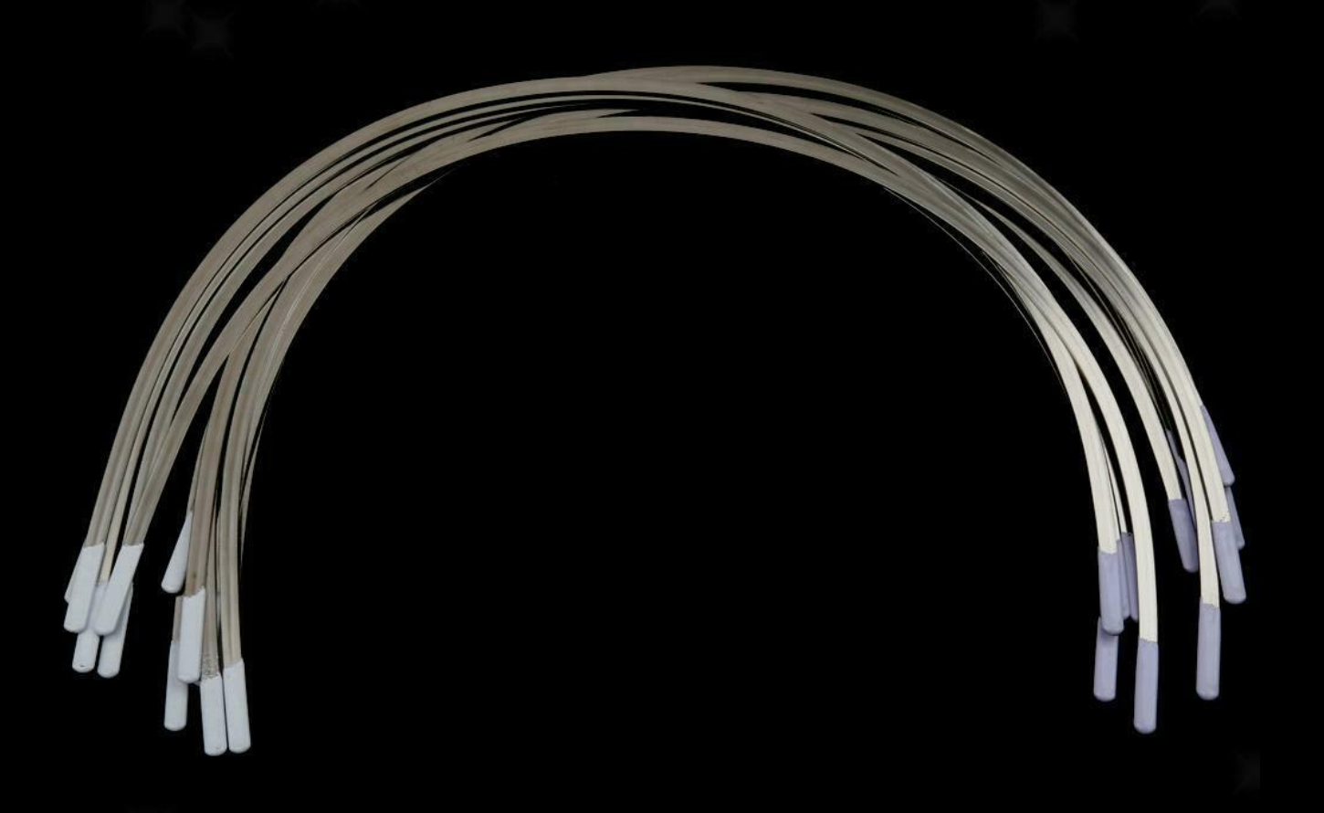
Steel “underwires” in 70% of bras

Slide 22
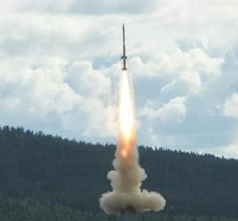
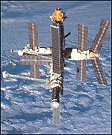
Graphene goes into space
… printing ink …
Russian Space Agency
“There could be problems .. with the atmosphere support .. but the steel is OK”
… gyroscopes…

Slide 23


IRONMAN 1, 2, 3, 4
MAN of Steel

Slide 24
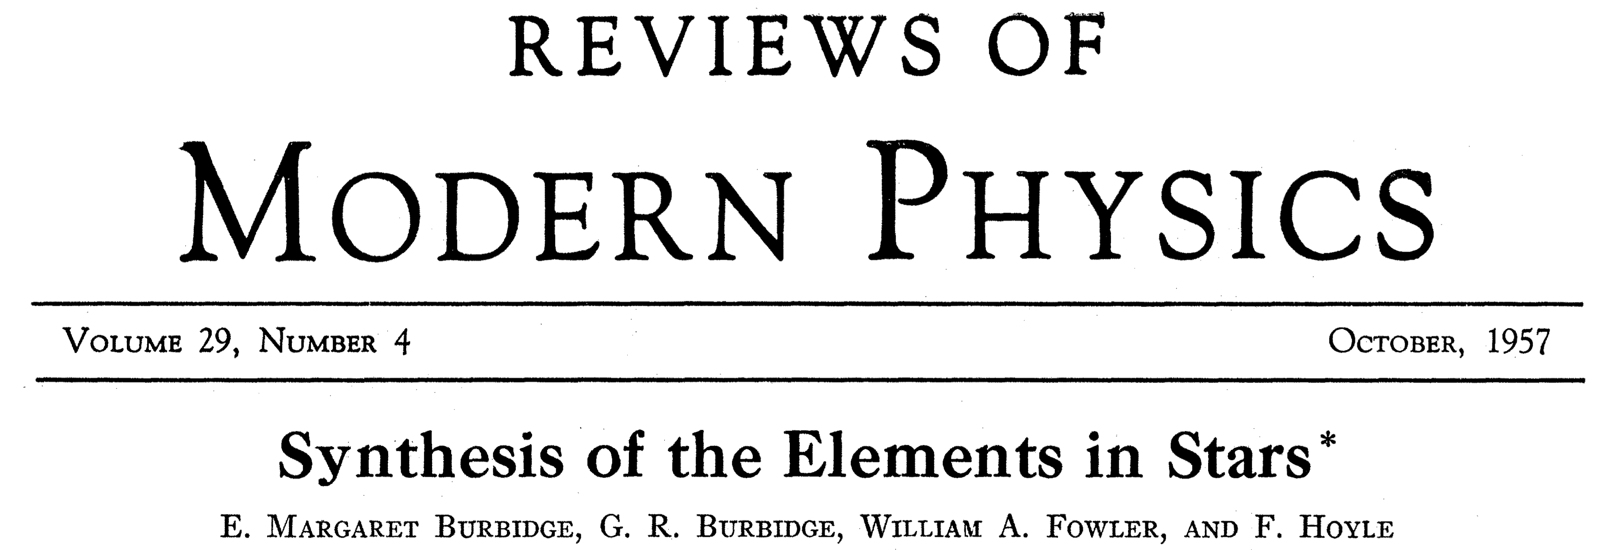
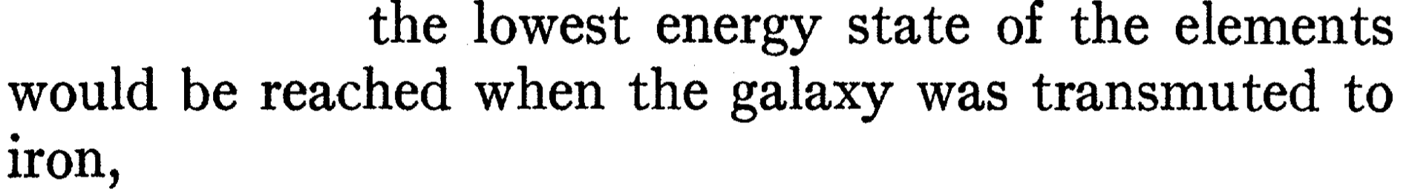
Wonder material – iron or graphene?

