Slide 1

Machine learning in materials science
www.phase-trans.msm.cam.ac.uk
What is intelligence?
episodic memory
planning the future

Slide 2
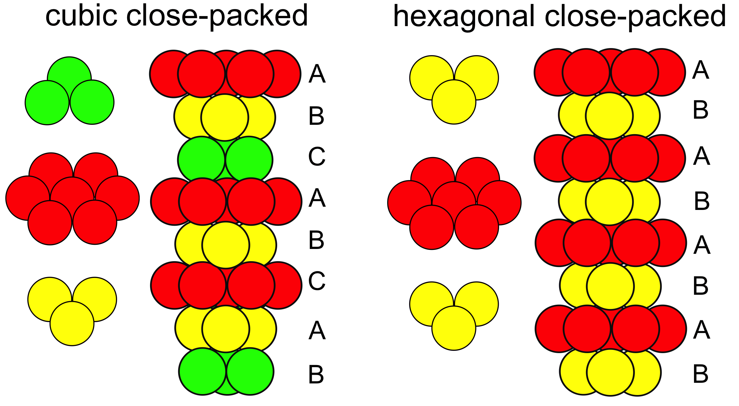

Slide 3
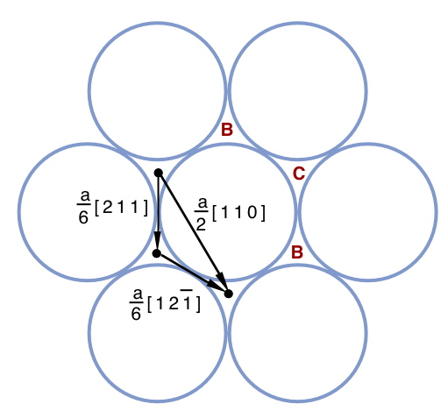


Slide 4
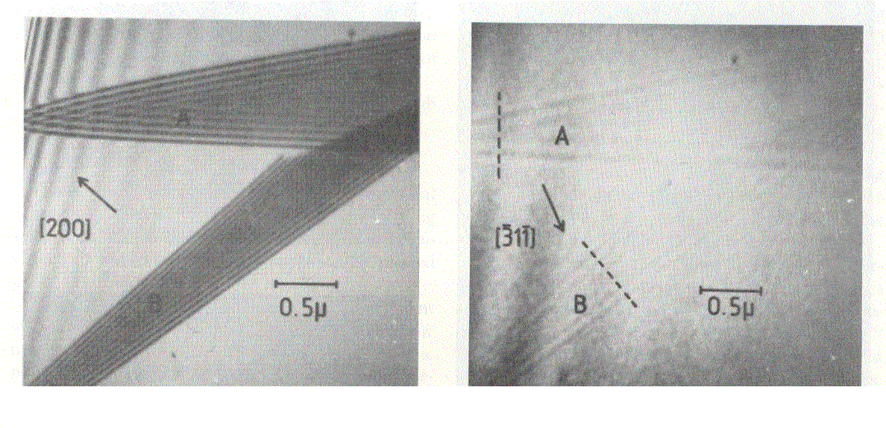
Brooks, Loretto and Smallman, 1979

Slide 5
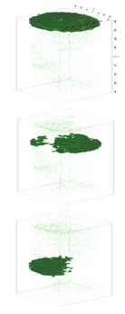
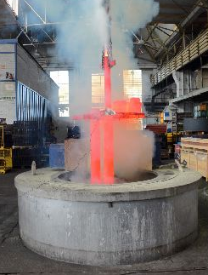
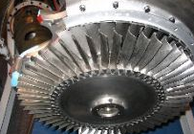
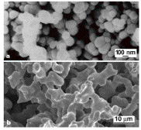
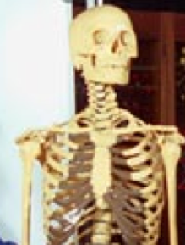
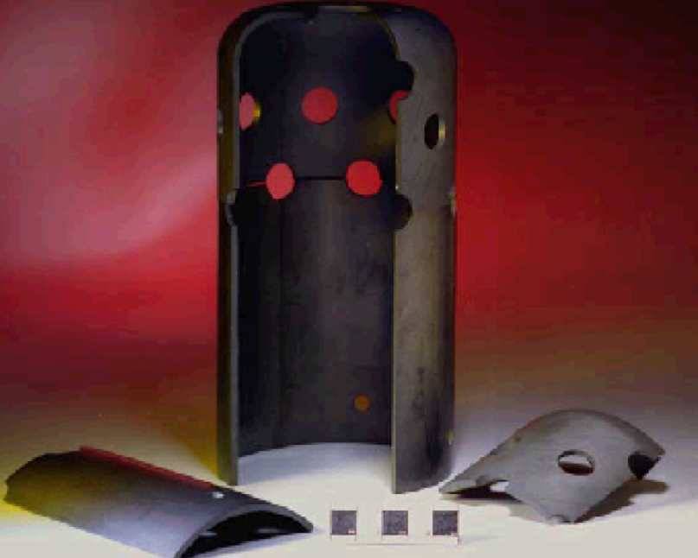
device materials
physical metallurgy
materials chemistry
characterisation
mathematical modelling
polymers ceramics composites
biomaterials

Slide 6
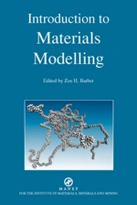
electron theory
molecular dynamics
thermodynamics
irreversible thermodynamics
kinetics
finite elements
structure-properties
uncertainties

Slide 7


Slide 8
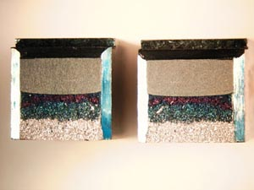
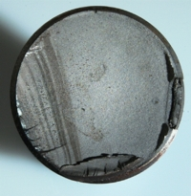
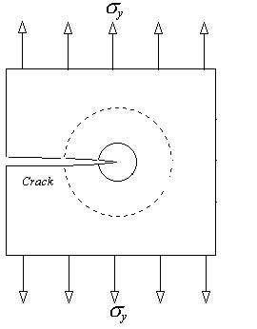
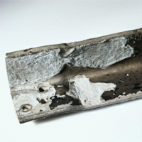
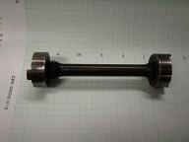
Charpy
fatigue
tensile
critical stress intensity
corrosion

Slide 9
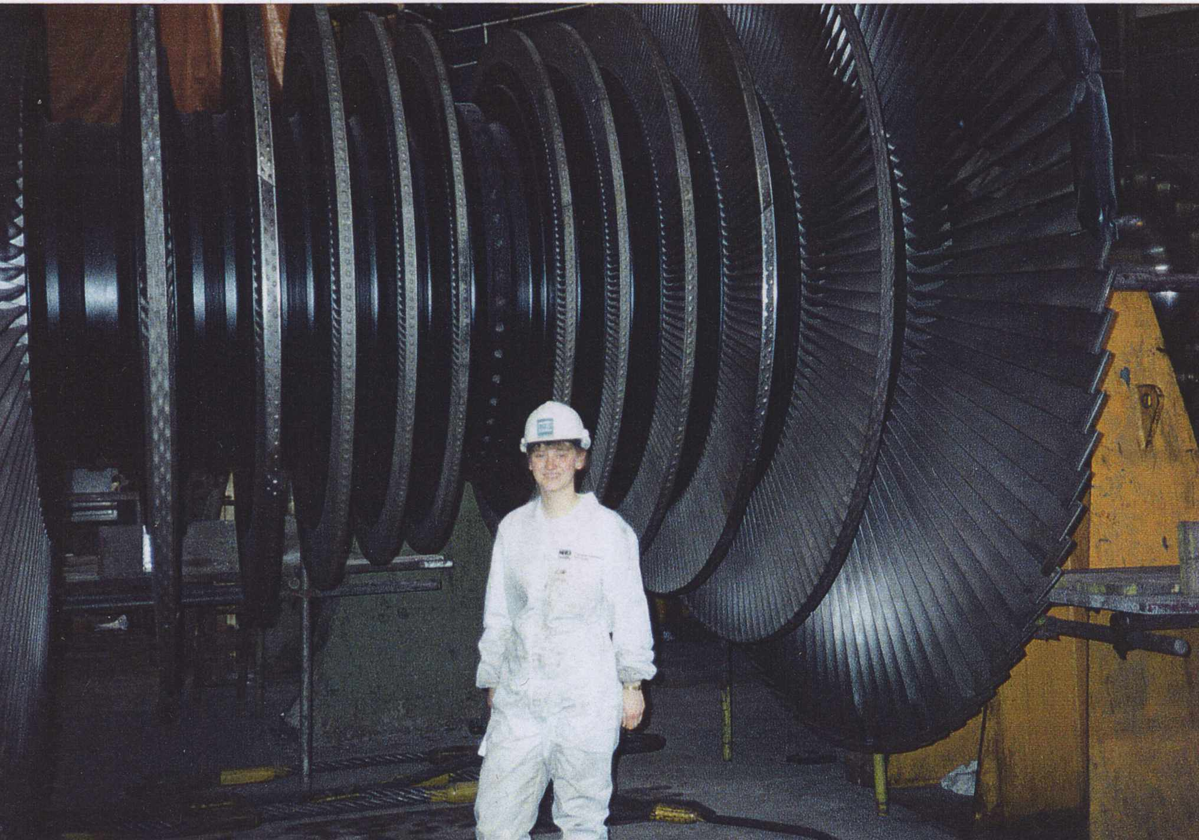

Slide 10
Variables
C, Mn, Si, Ni, Cr, Mo, V, Co, B, N, O…..
Thermomechanical processing of steel
Welding consumable
Welding parameters
Subsequent heat treatment

Slide 11

y
x
Michael McIntyre

Slide 12
Solution
non-linear functions
large numbers of variables
uncertainties
exploit large knowledge base
Notes:
Dogma - statement of belief

Slide 13
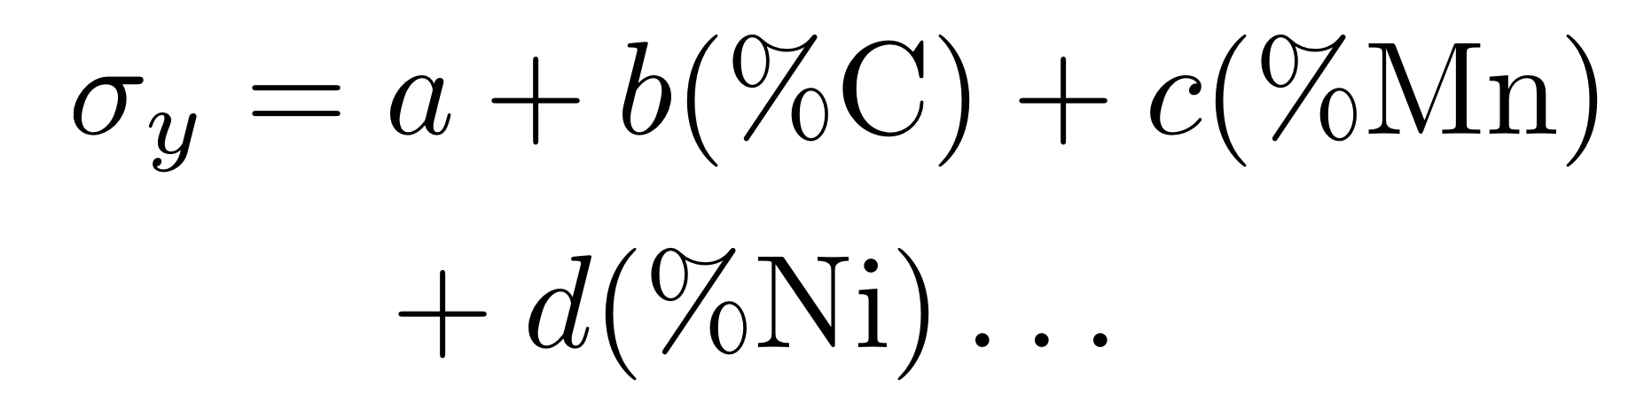
Empirical Equations

Slide 14
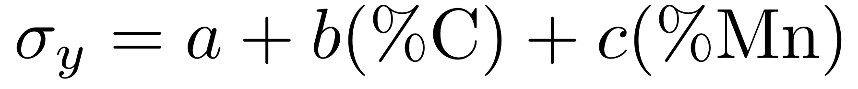
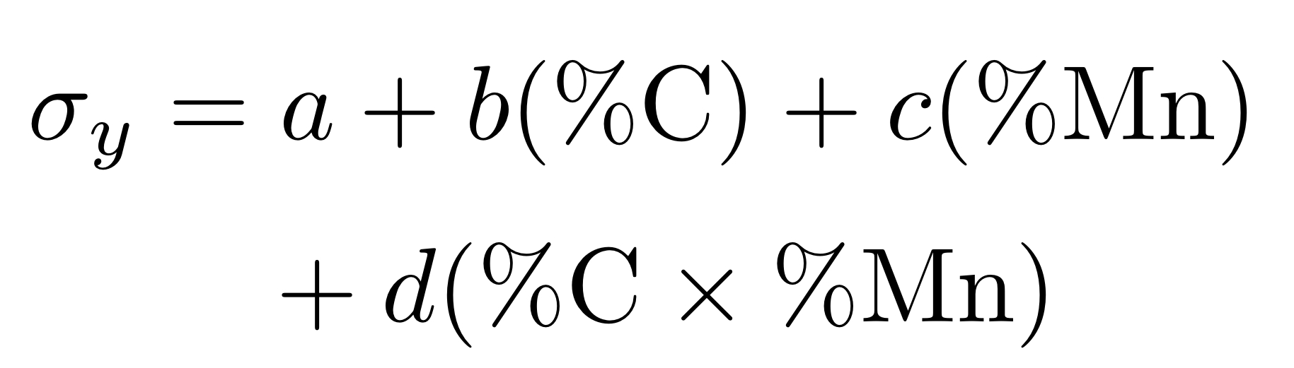

Slide 15
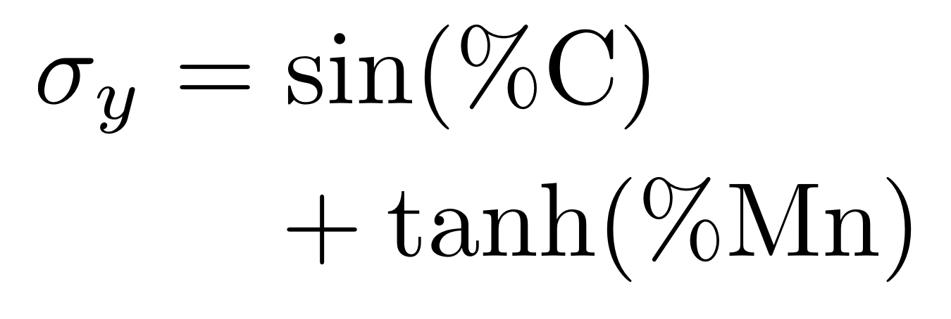

Slide 16
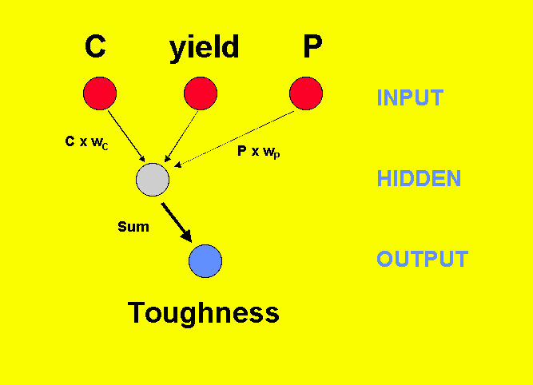

Slide 17
Hyperbolic Tangents

Slide 18
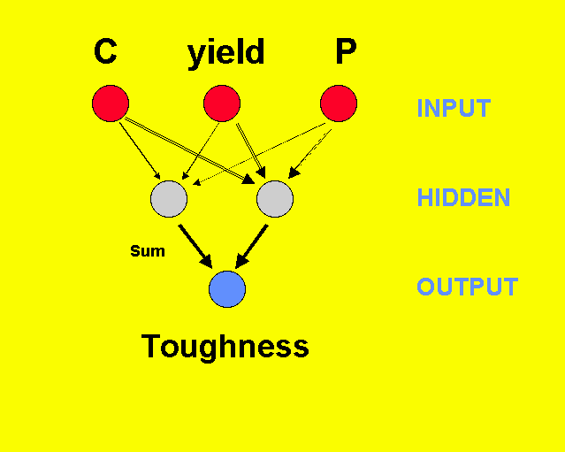

Slide 19
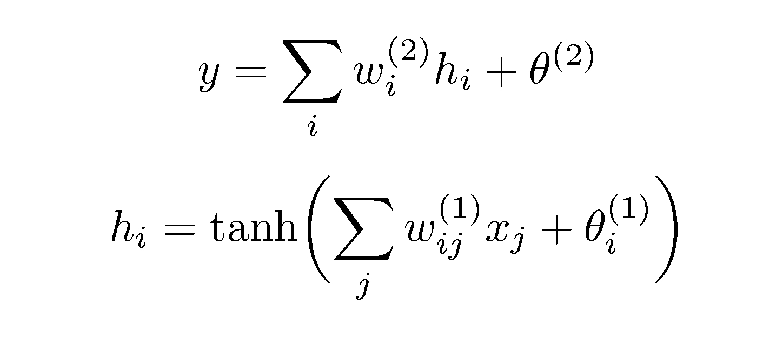

Slide 20
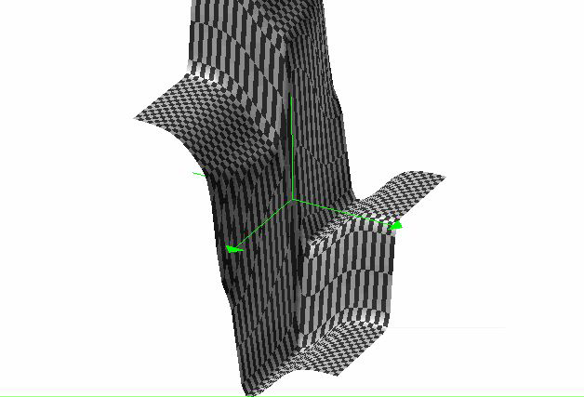
non-linear
functions

Slide 23
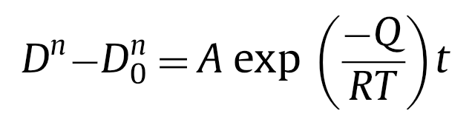
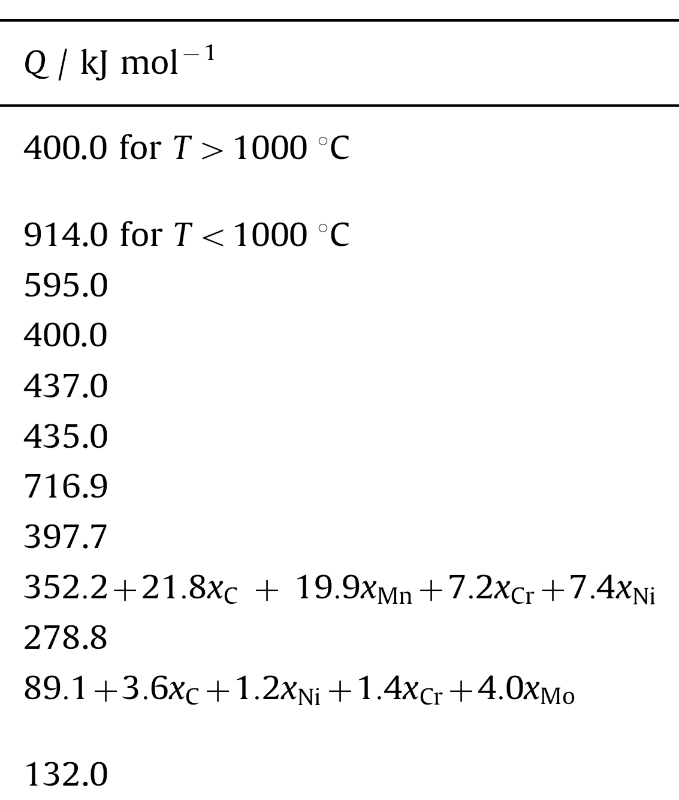
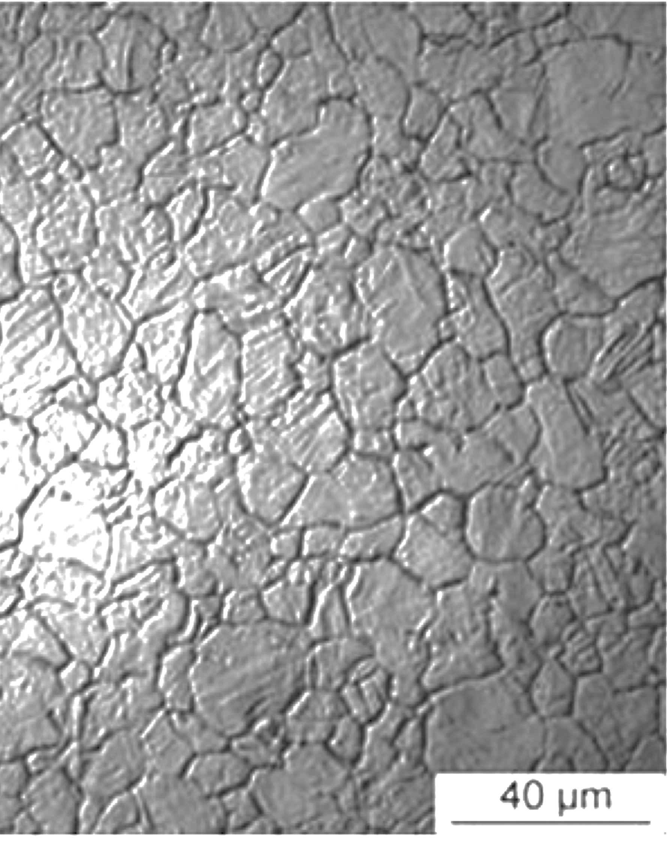

Slide 24
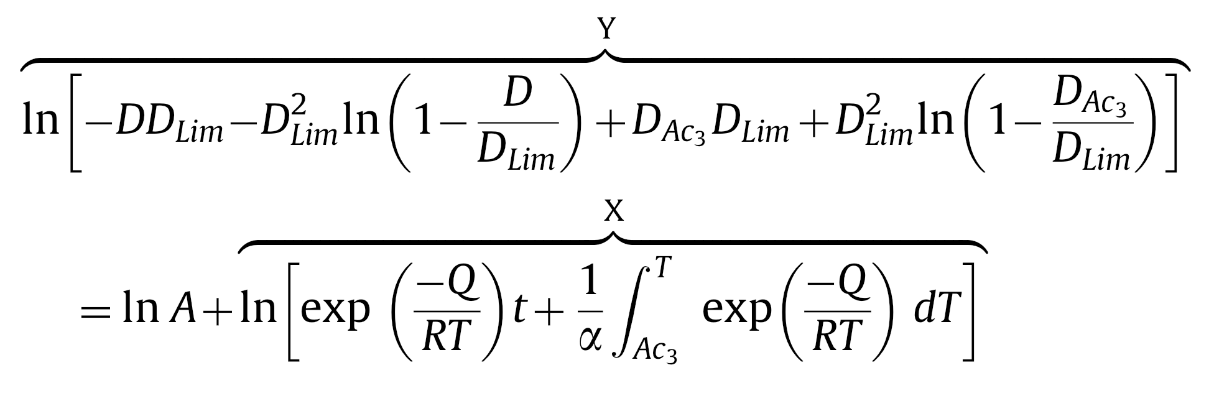
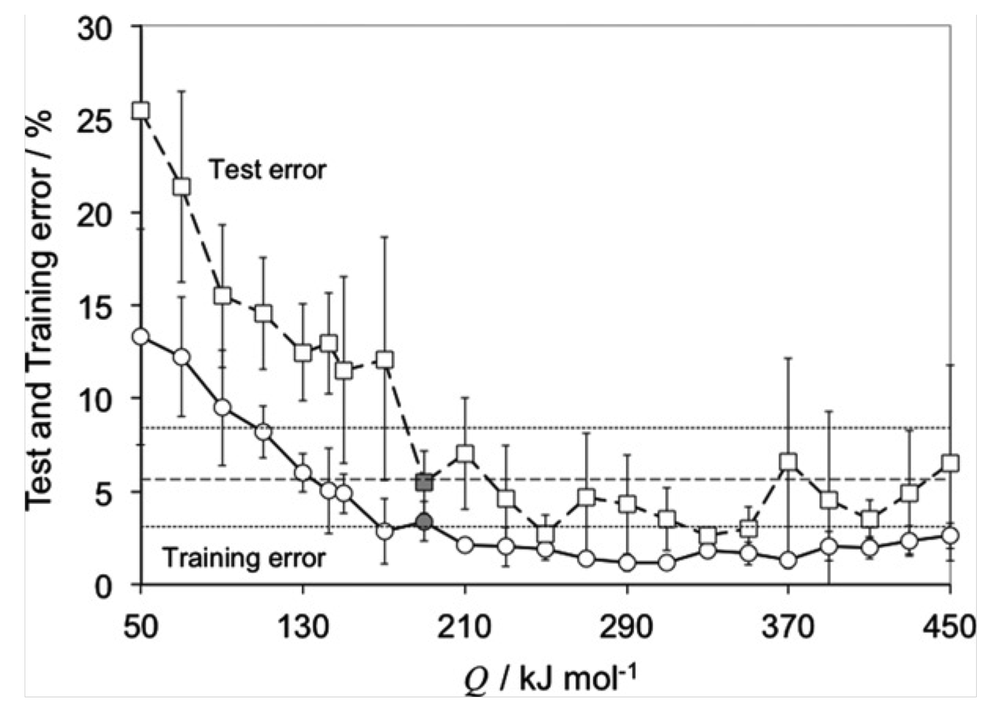
Pous, Lonardeli, Cogswell, Bhadeshia
Mat. Sci. Eng. A 567 (2013) 72

Slide 25
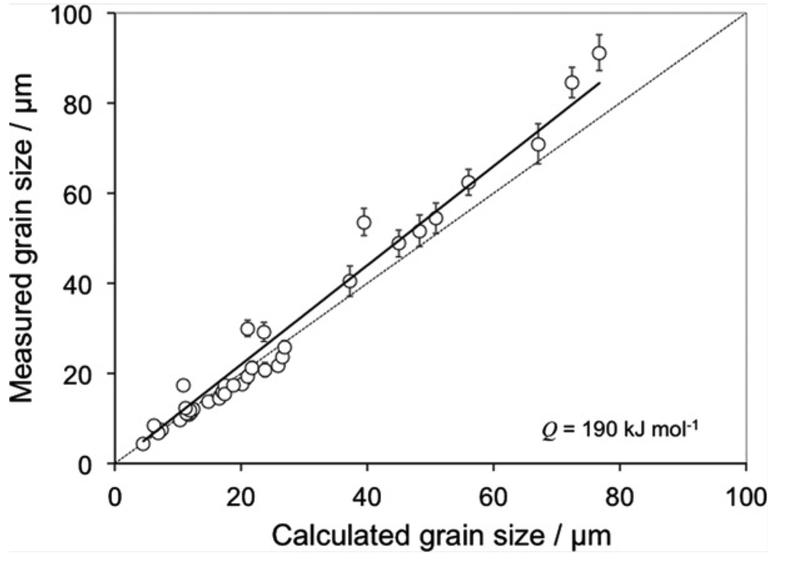

Slide 26



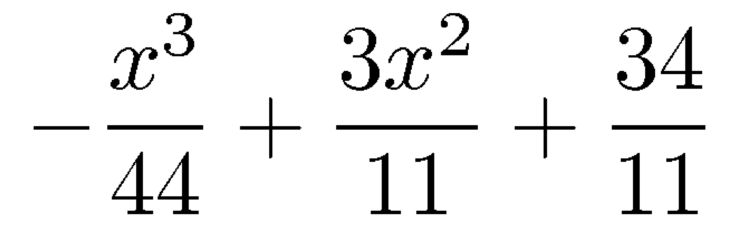

Slide 27
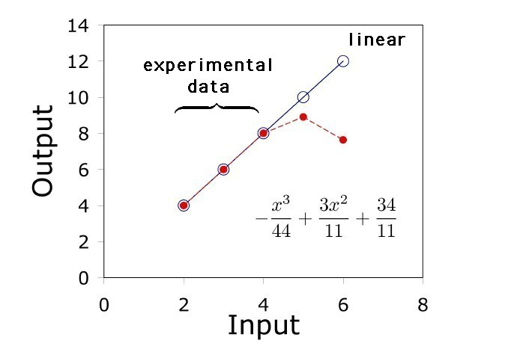

Slide 28
y
A
B
x

Slide 29
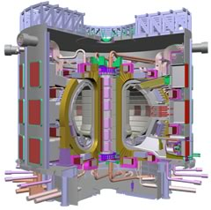
International Fusion Reactor
Reduced activation steels

Slide 30
Modelling irradiation hardening
No current strongly predictive model
Data collected by Yamamoto et al. and from European RAFM database
~1800 data up to 90 dpa
  36 input variables
  No heat treatment information included

Slide 31
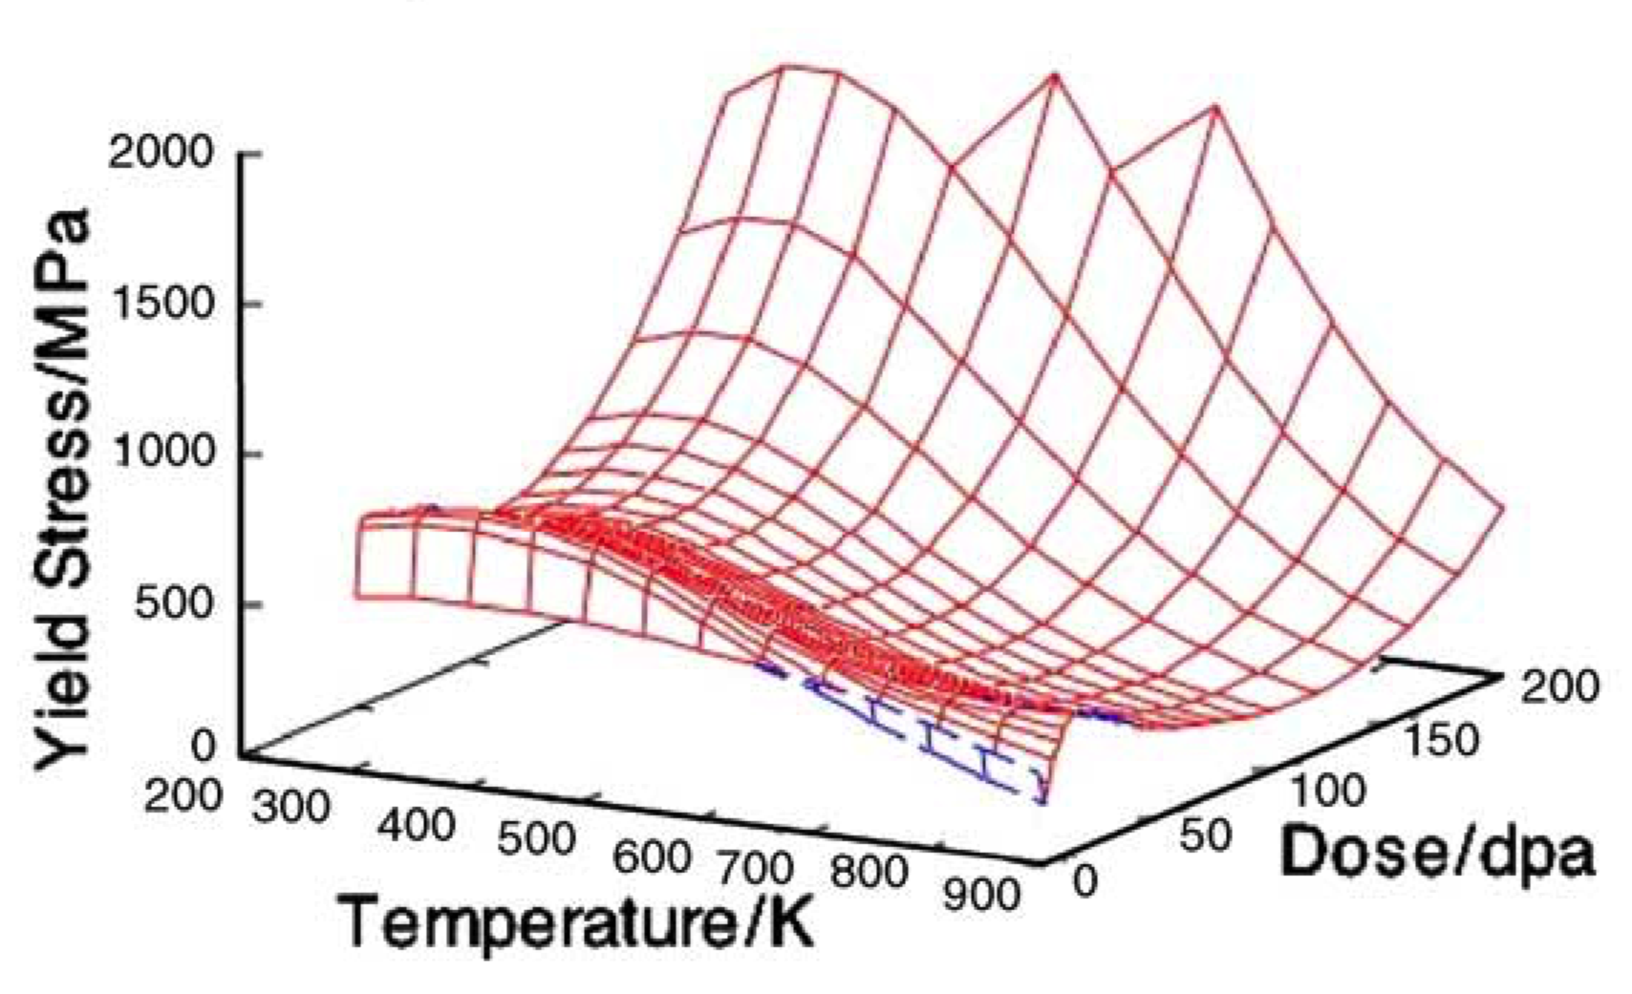
Fusion reactor steels
Kemp, Cottrell & Bhadeshia, 2006

Slide 32
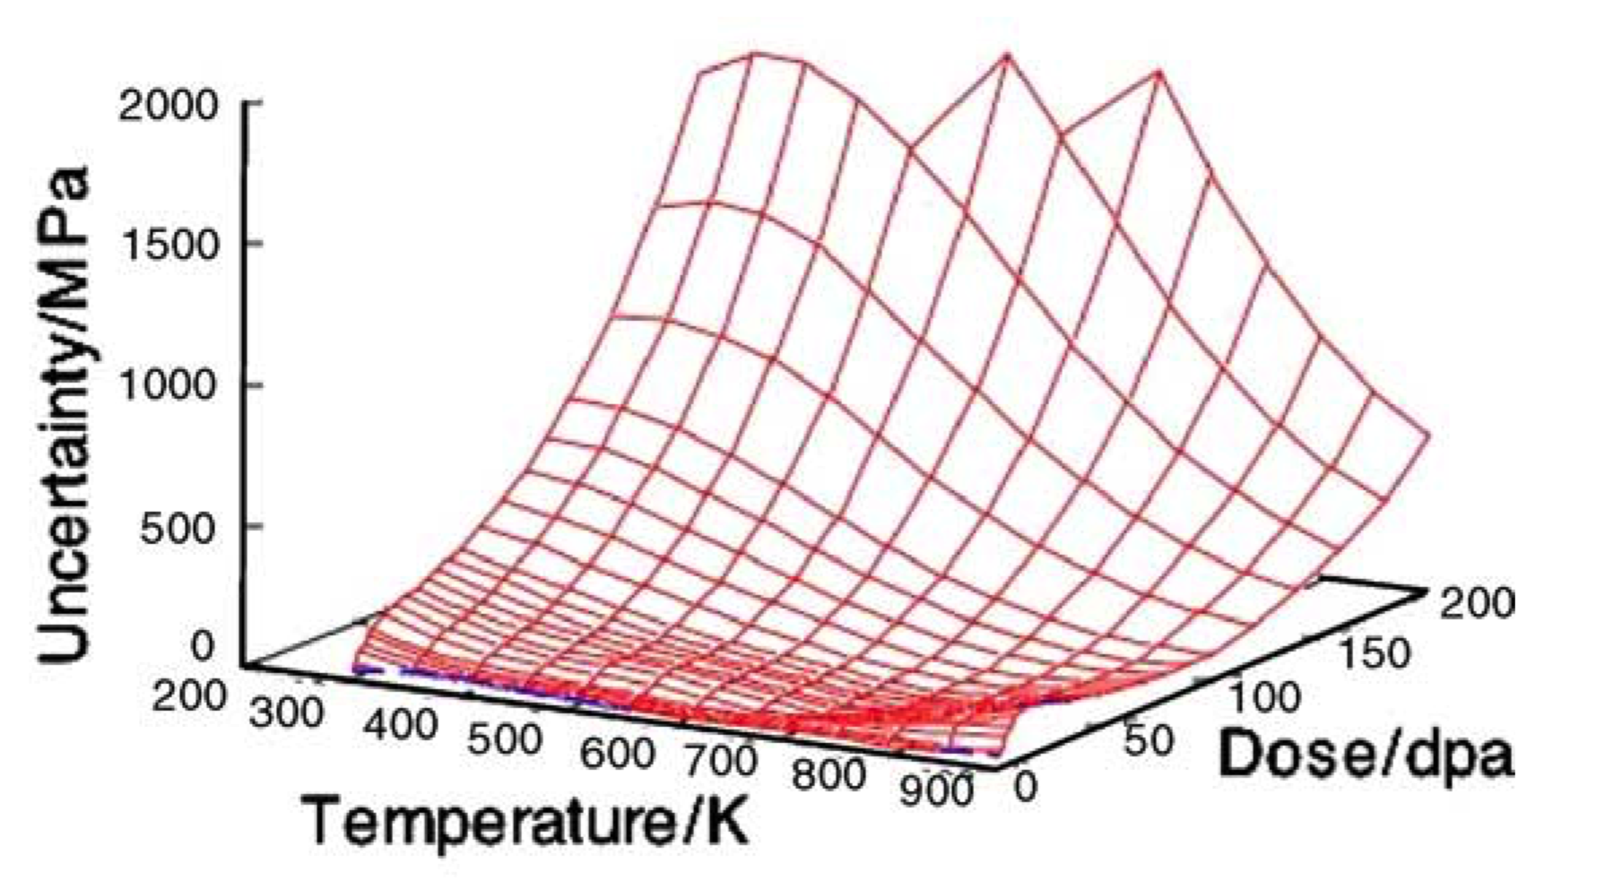

Slide 33
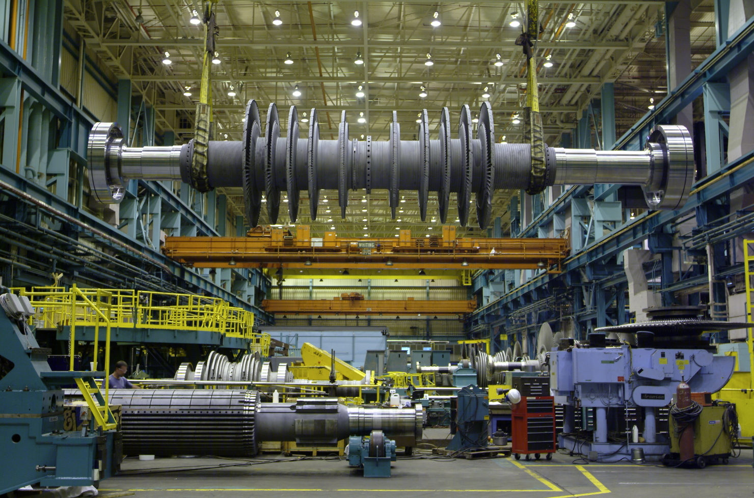

Slide 35
Cole & Bhadeshia, 1999

Slide 36
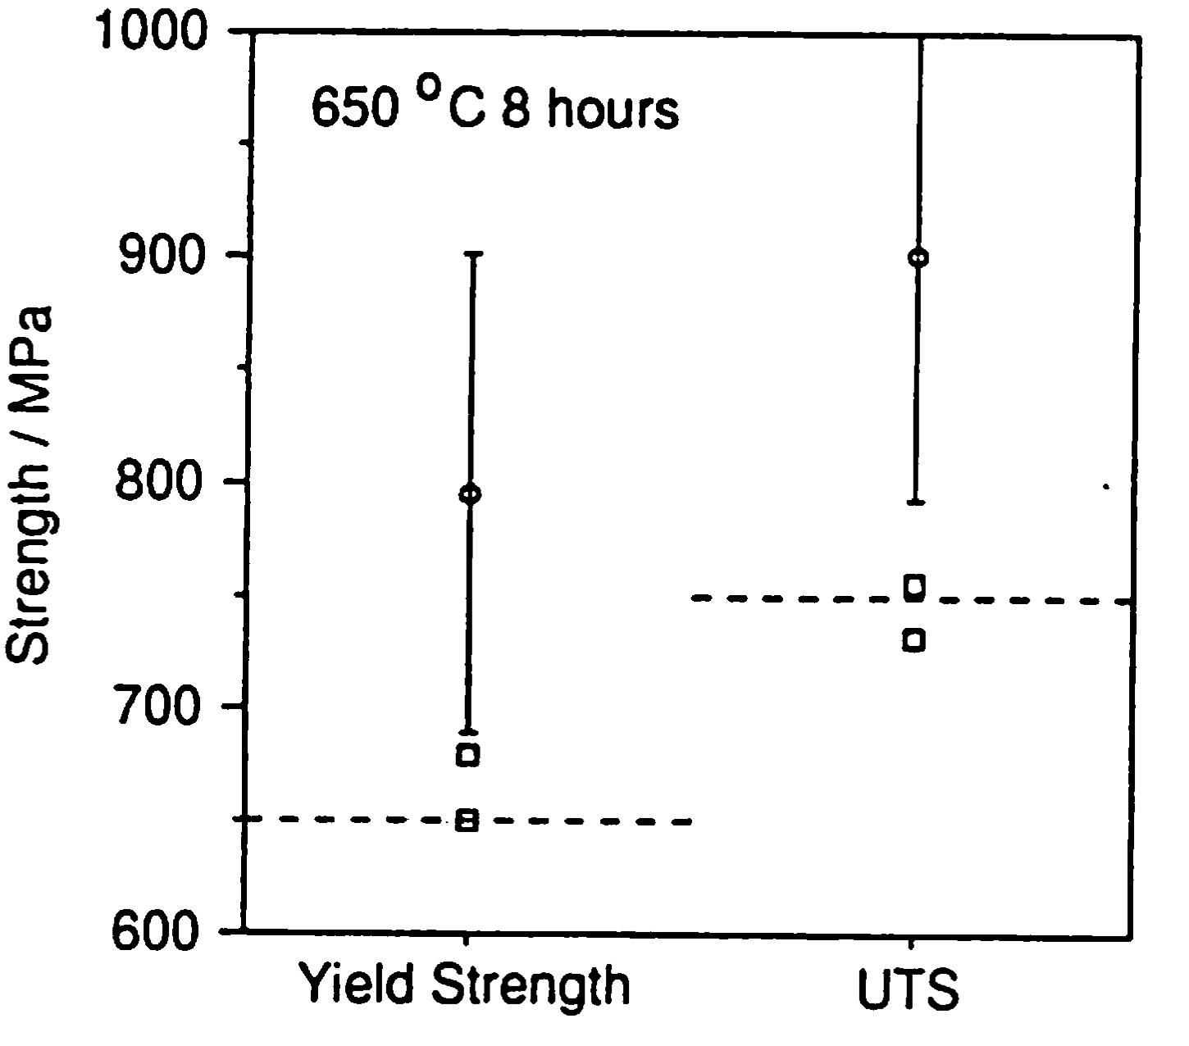
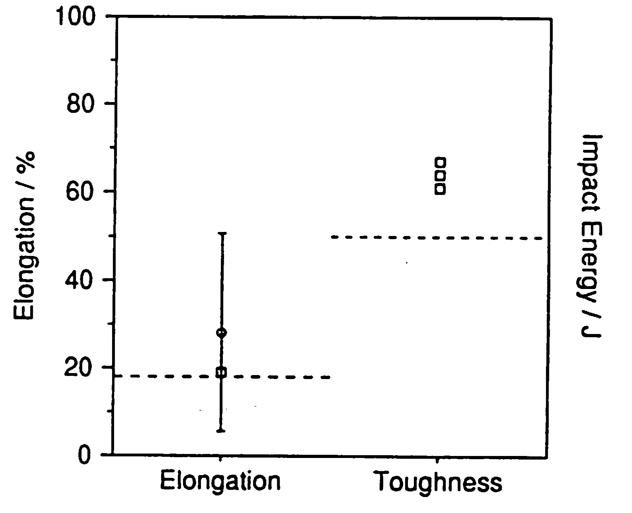
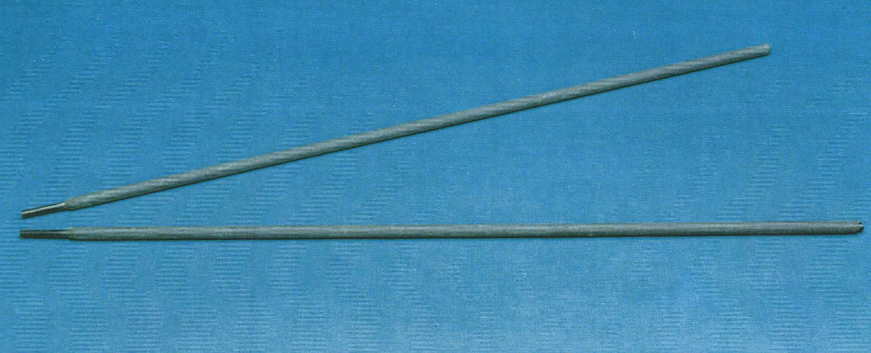

Slide 37
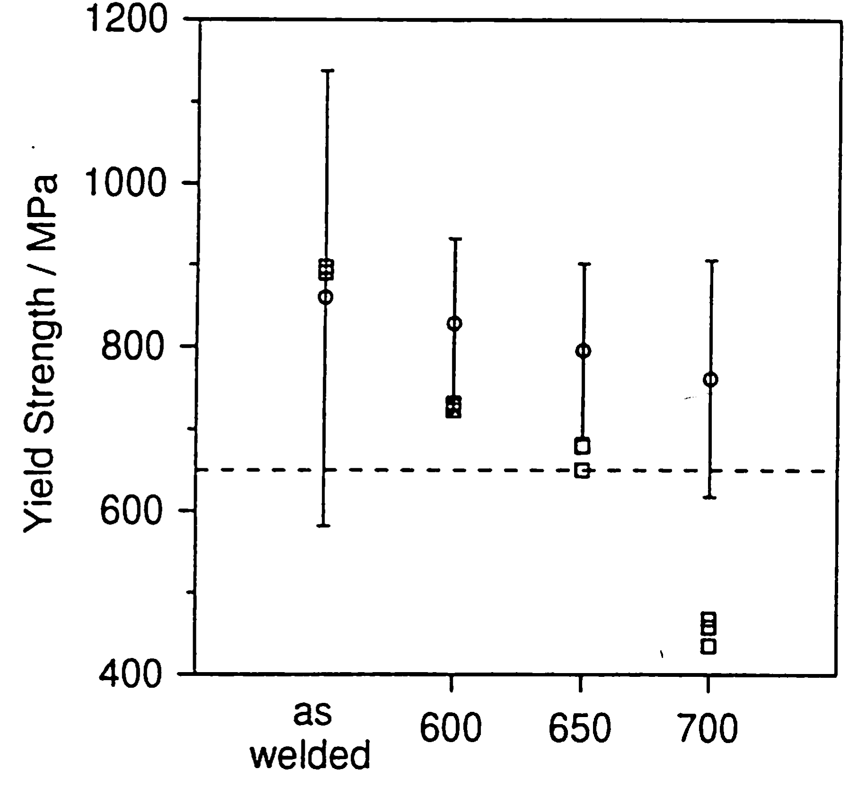

Slide 38
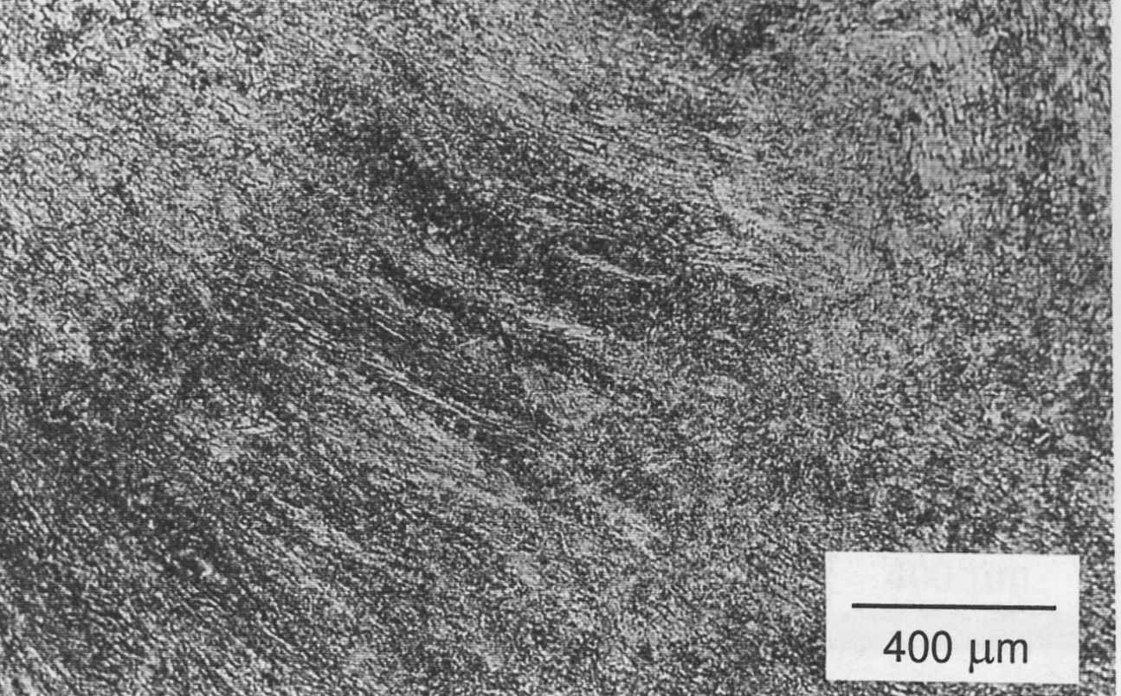
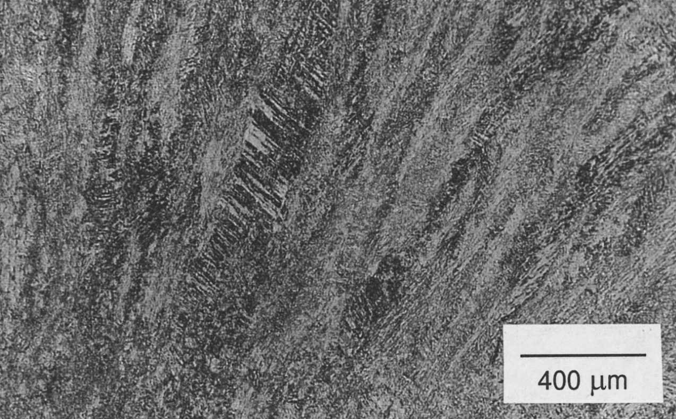
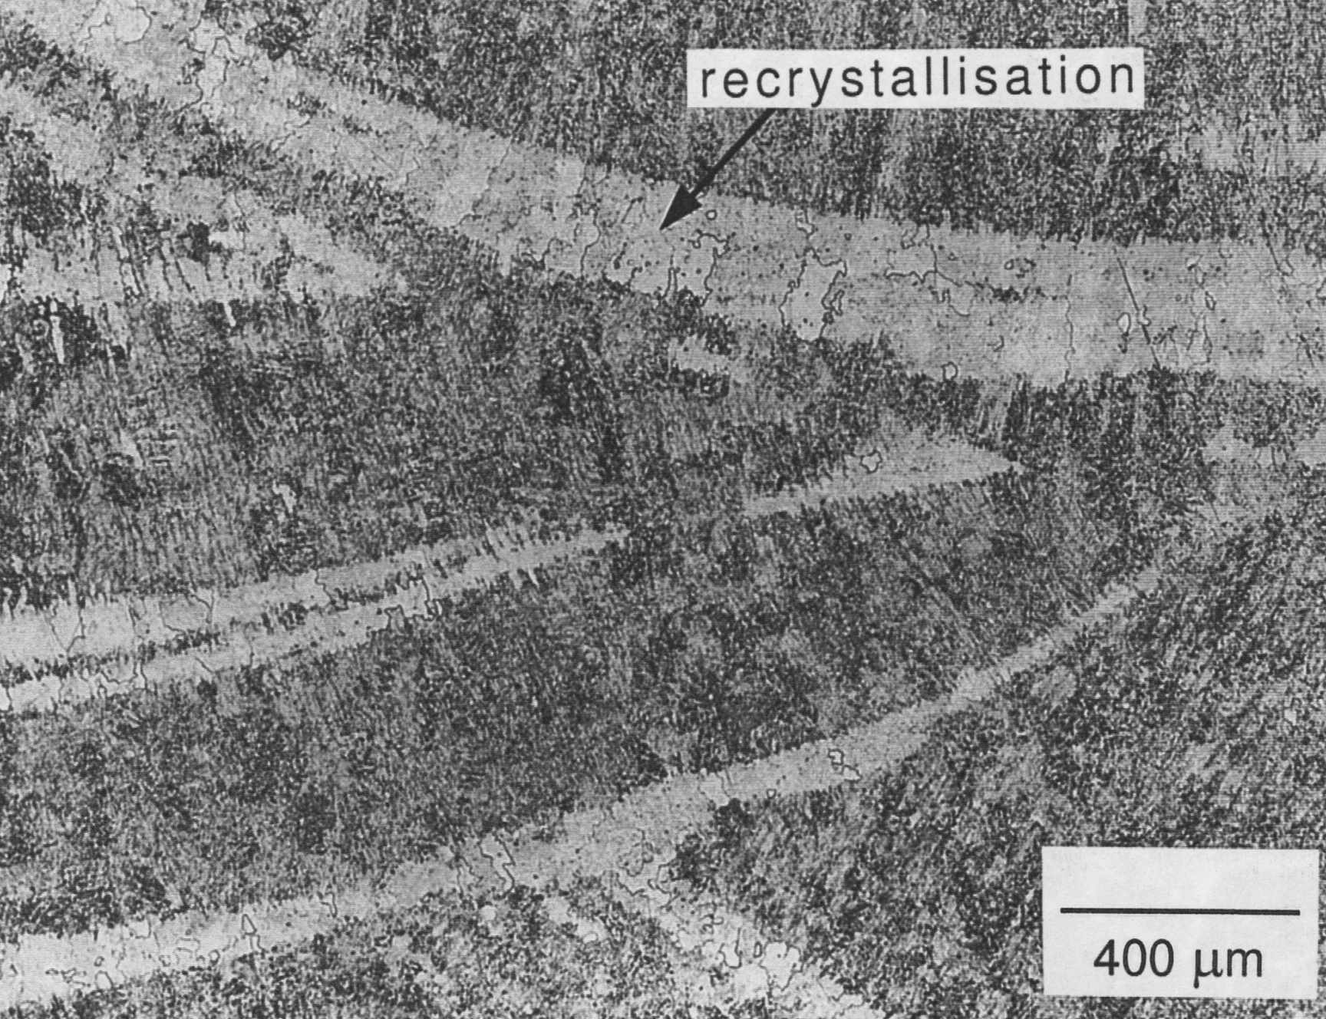
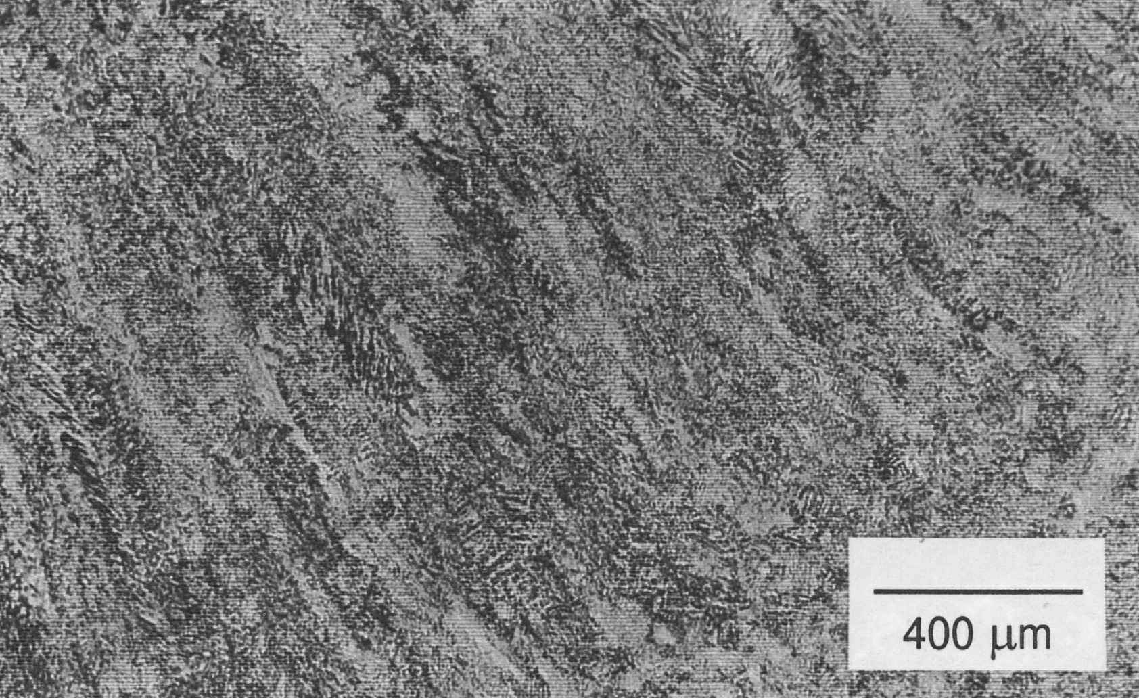
As-welded
600 °C
700 °C
650 °C
Cool, 1996

Slide 39
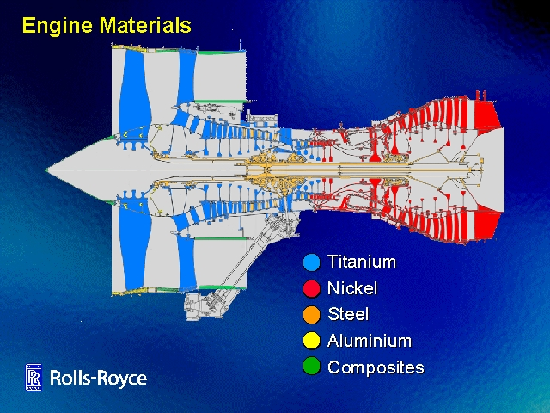
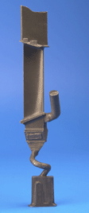
Suppose we fail to achieve 650°C ferritic creep-resistant steel

Slide 40
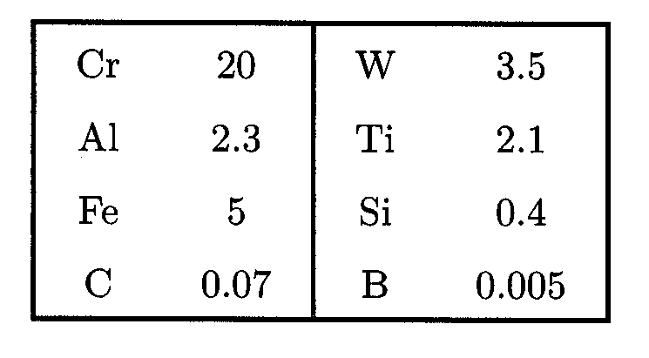
Nickel base alloy FT750dc
wt%

Slide 41
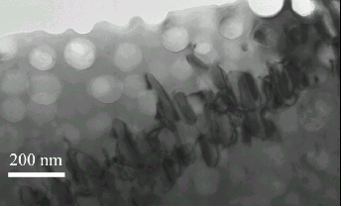

Slide 42
Tancret & Bhadeshia, 2002
1000
800
600
Yield stress / MPa
400
200
0
0
200
400
600
800
1000
1200
Temperature / °C

Slide 43
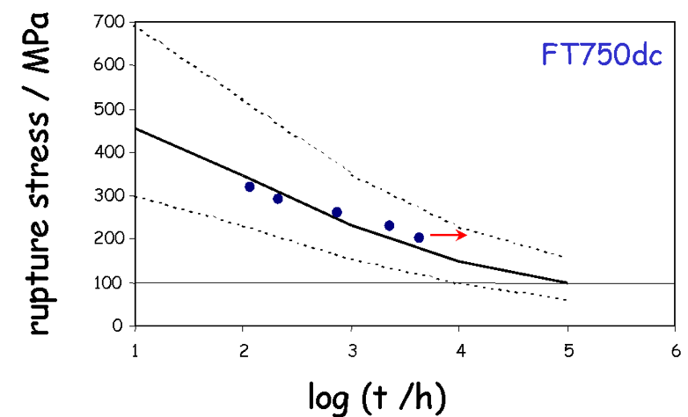

Slide 44
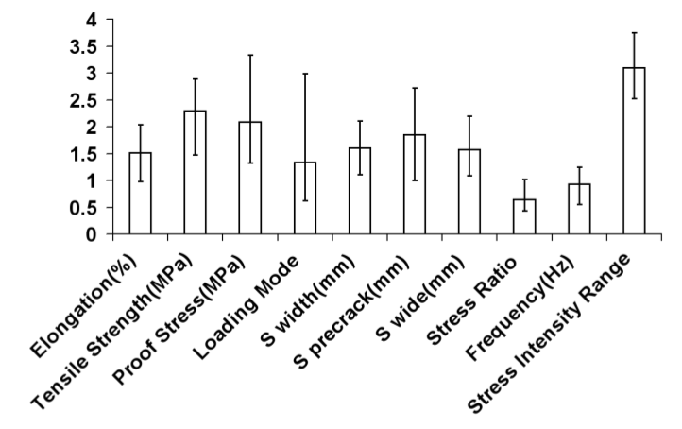
General Fatigue Model

Slide 45

Steel

Slide 46

Nickel Alloys

Slide 47

Titanium and Aluminium alloys

Slide 48
Numerous other examples:
Neural networks in materials science
ISIJ International 39 (1999) 966-979
www.phase-trans.msm.cam.ac.uk

Slide 49
Machine learning in materials science
www.phase-trans.msm.cam.ac.uk
What is intelligence?
episodic memory
planning the future

