Slide 1

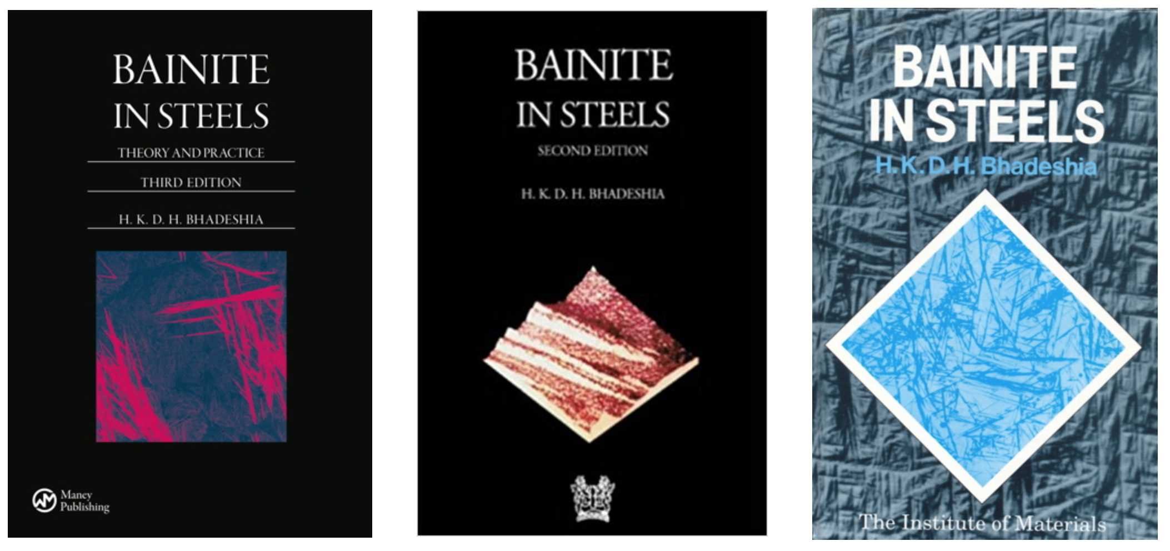
Atomic mechanism of the bainite transformation
www.phase-trans.msm.cam.ac.uk

Slide 2
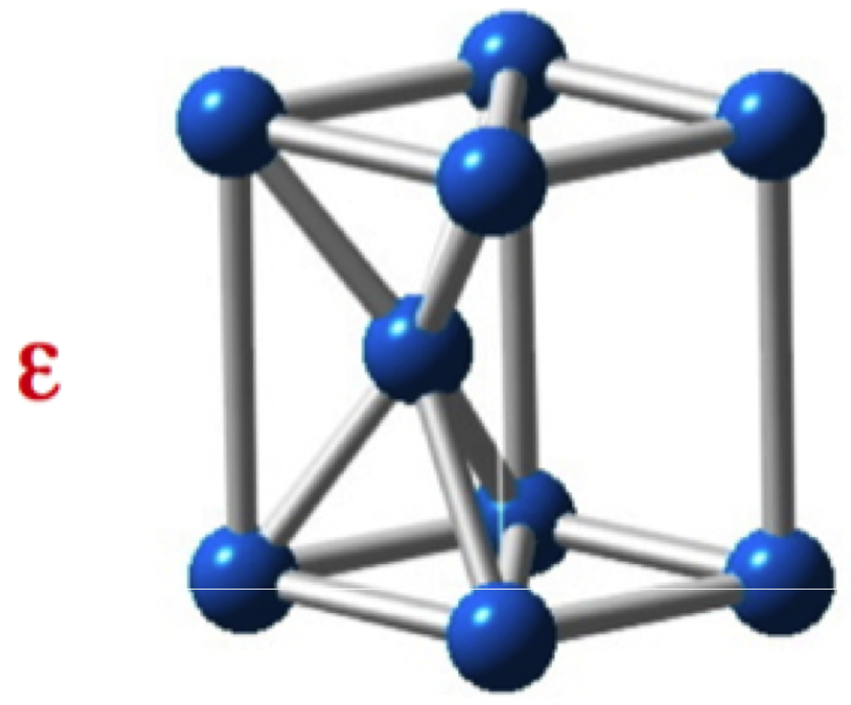
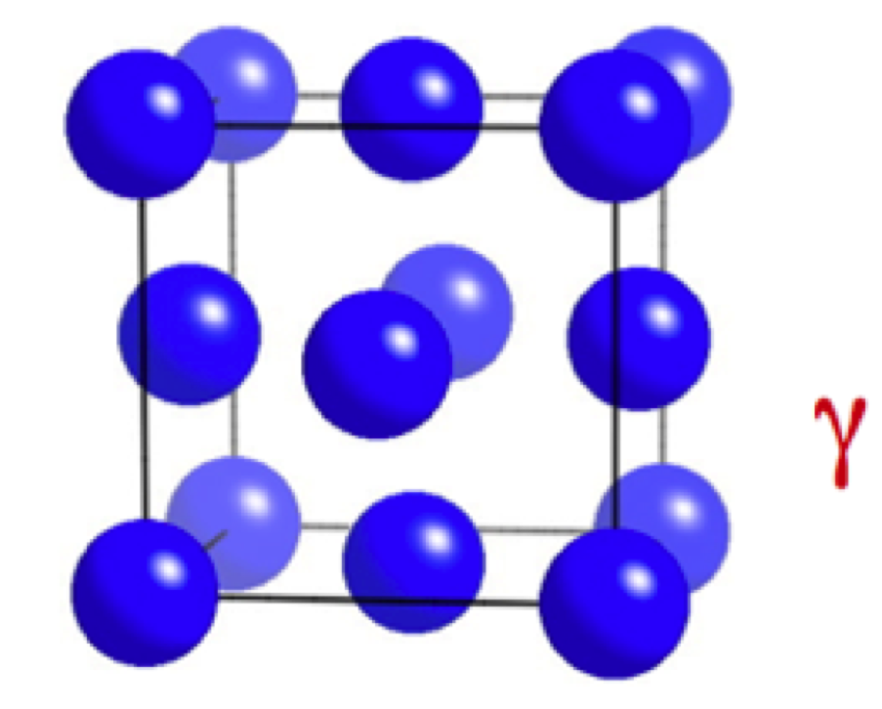
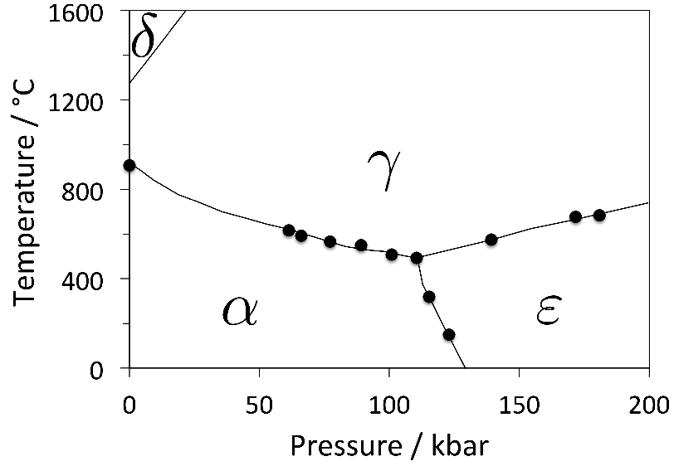
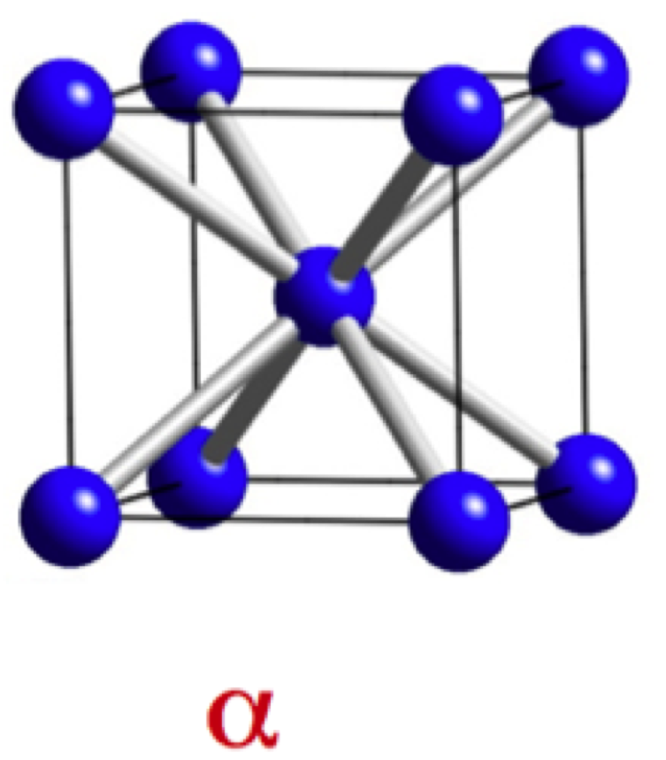

Slide 3
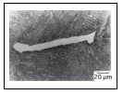
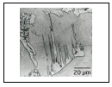

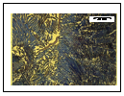
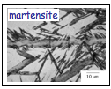

Slide 4


Slide 5
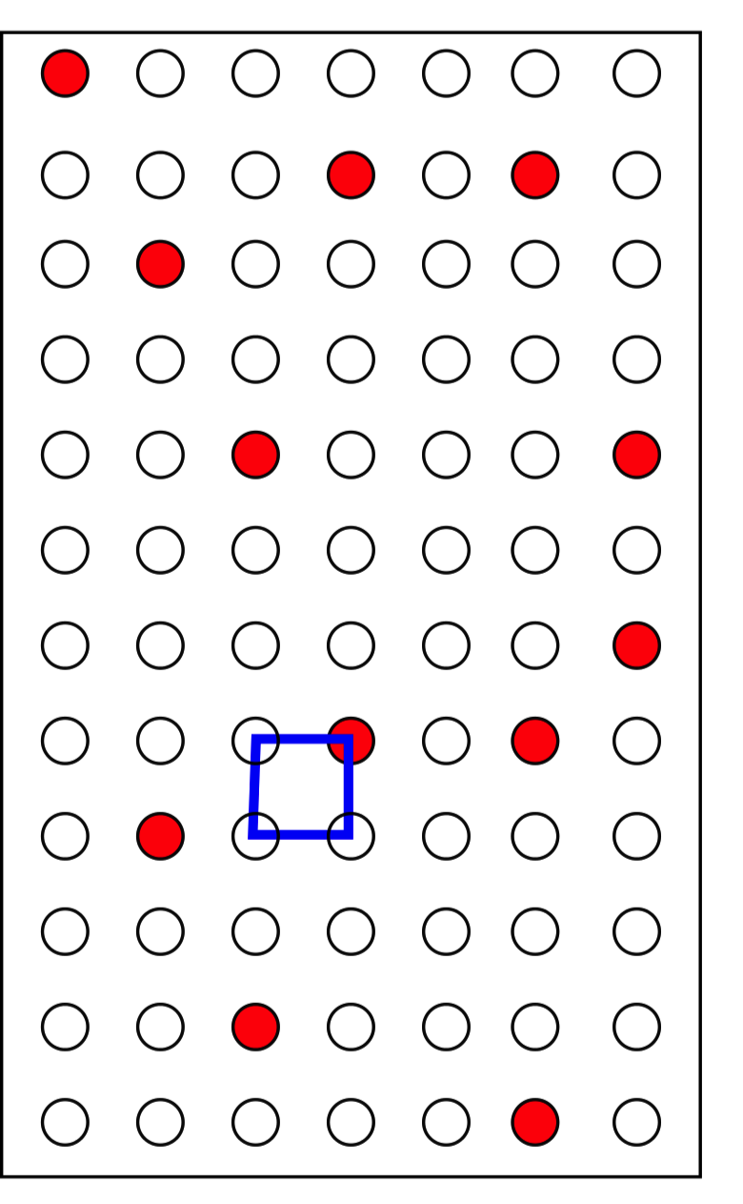
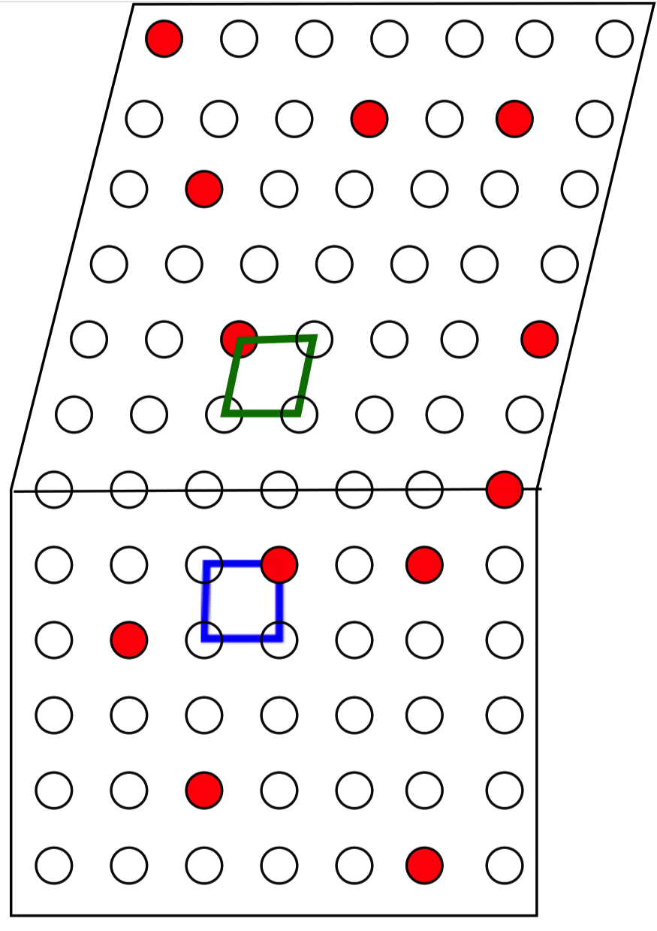
Displace atomic arrangement into new pattern

Slide 6
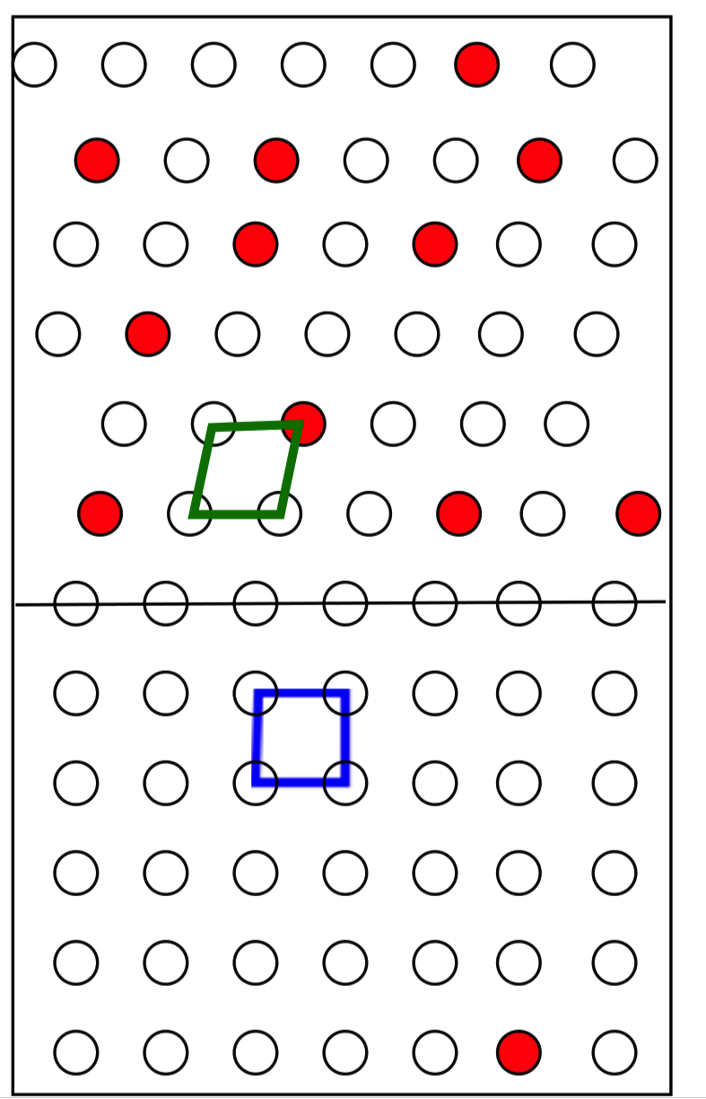
Reconstruct atomic arrangement into new pattern

Slide 7
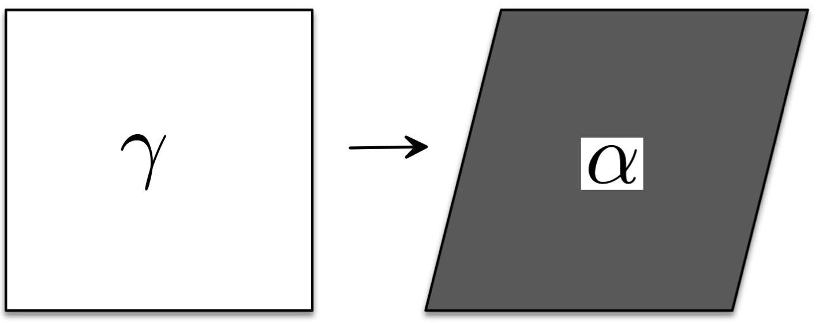
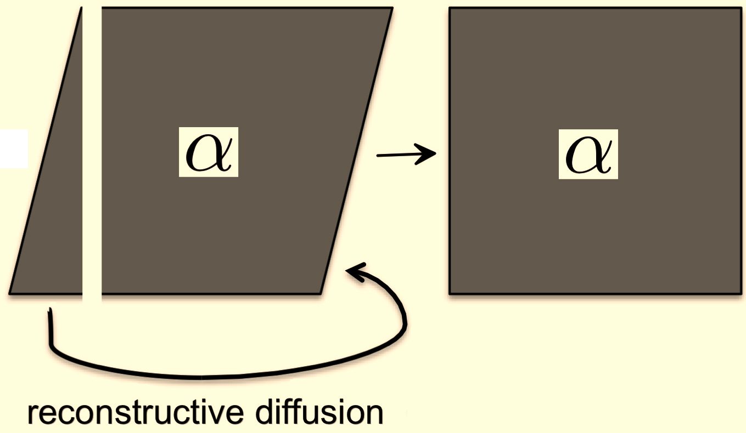
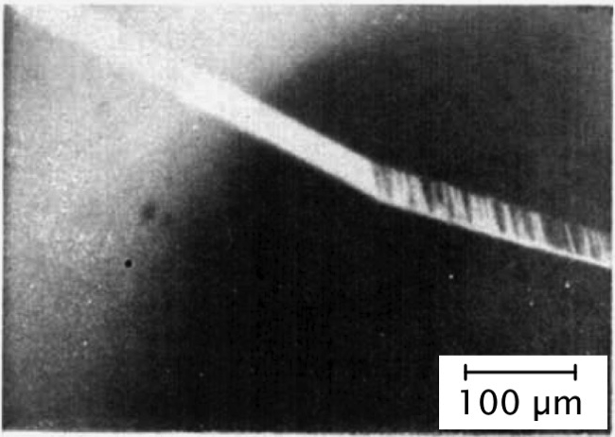
Martensitic transformation in pure iron
Zerwech & Wayman
Acta Metallurgica 13 (1965) 99

Slide 8
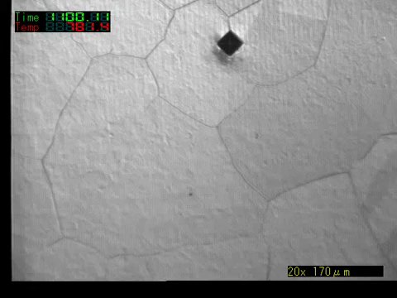
Toshihiko Koseki, University of Tokyo

Slide 9
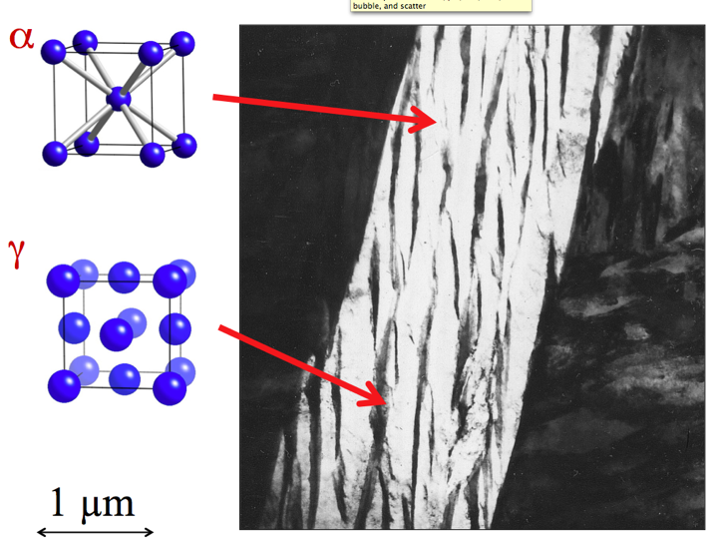
9

Slide 10
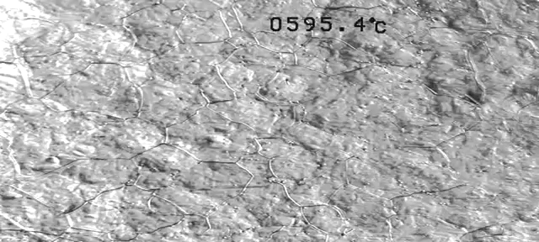
Displacive transformations (Widmanstaetten ferrite, bainite, martensite) cause deformation.
Reconstructive transformations (pearlite, ferrite) do not.

Slide 11
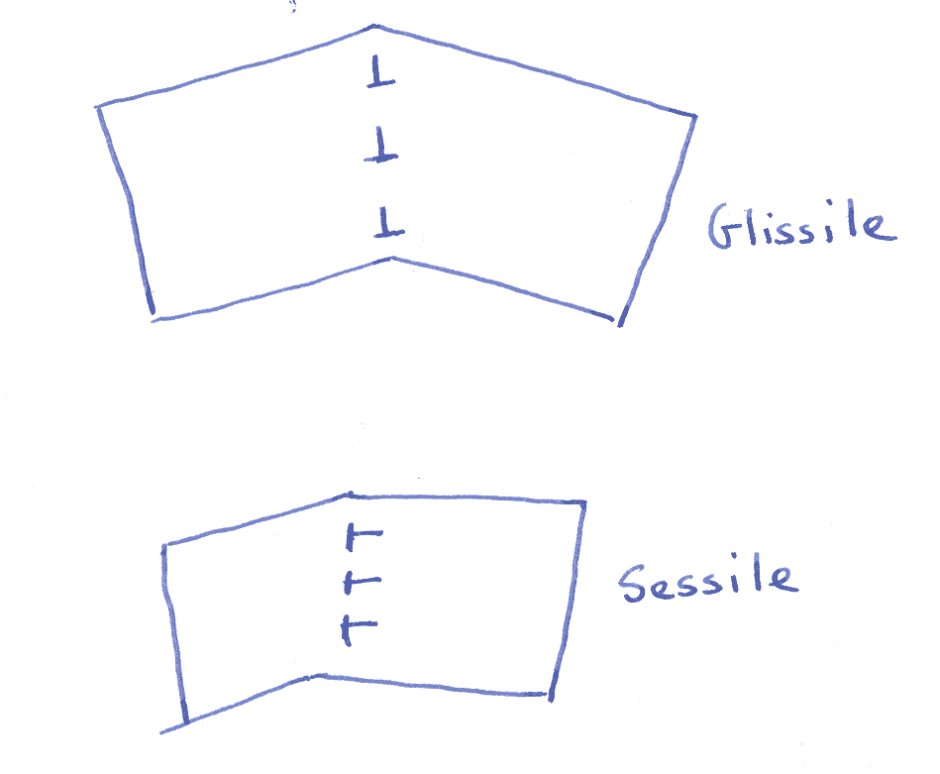
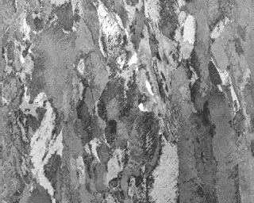

Slide 12
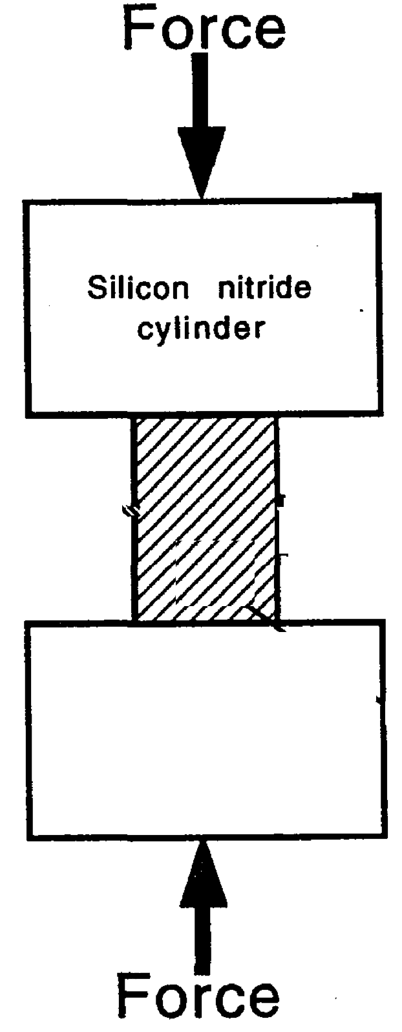
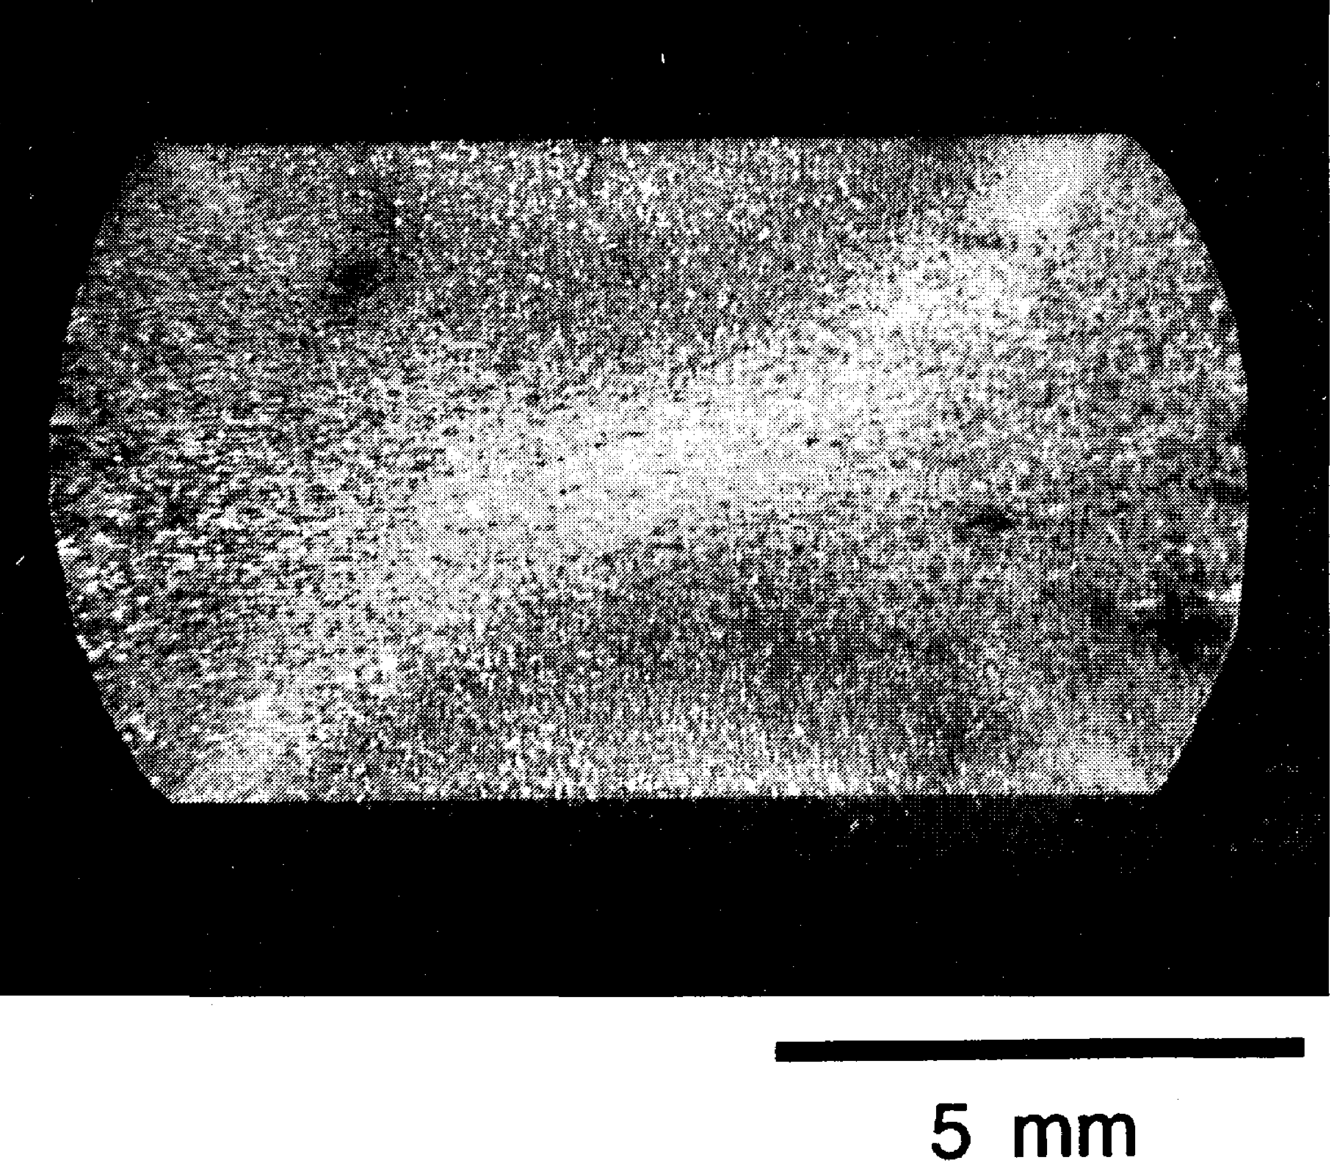
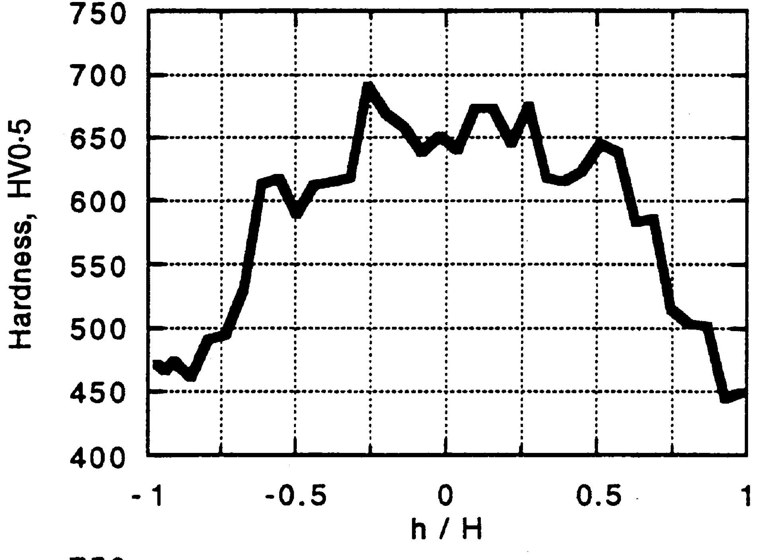
Shipway & Bhadeshia 1995

Slide 13
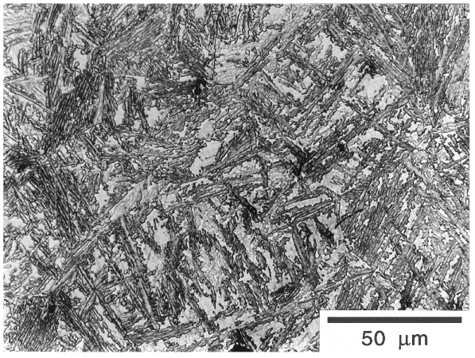
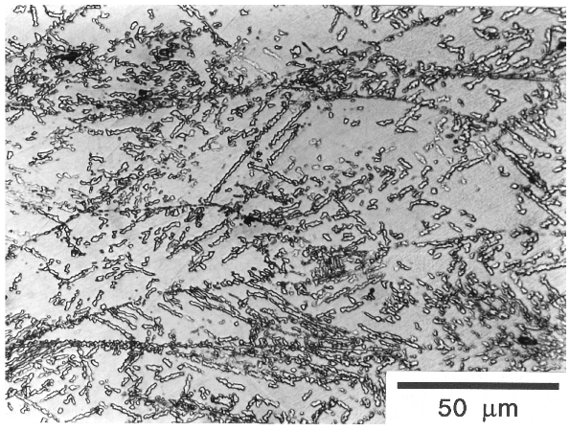
Plastic strain: stabilisation

Slide 14
Plastic deformation cannot retard reconstructive transformation
Only displacive transformation can be mechanically stabilised.

Slide 15
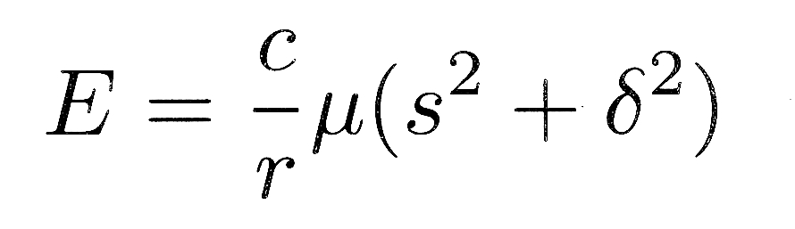
s
δ
c
r
1
Christian, 1957

Slide 16
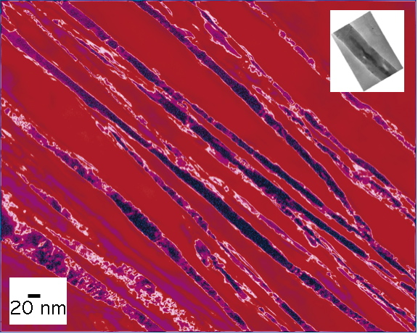
Caballero, Mateo & Bhadeshia

Slide 17
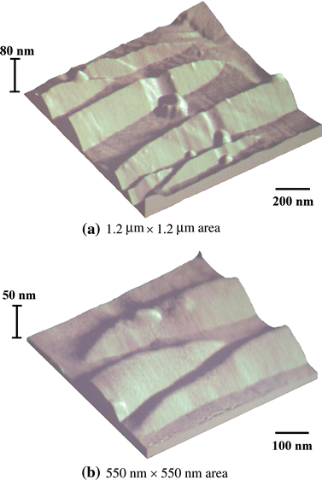
Peet & Bhadeshia 2011
Giant shear strain of 0.46

Slide 18
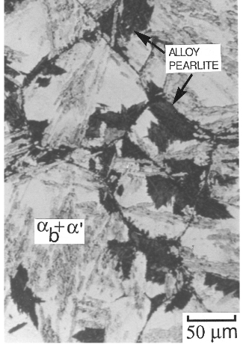
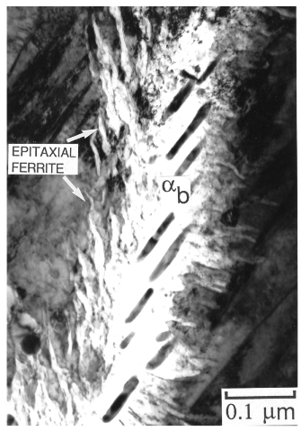
478°C for 43 days – bainite completed in seconds. Bhadeshia (1981)

Slide 19
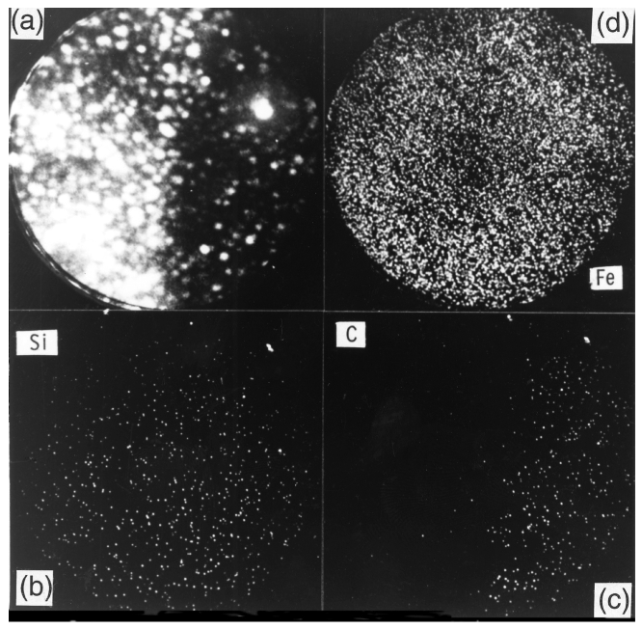
Substitutionalsolutes
frozen
Bhadeshia, Waugh, 1981

Slide 20
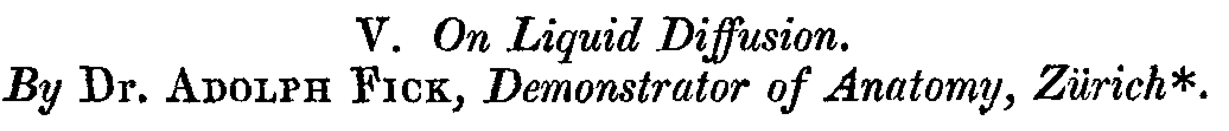
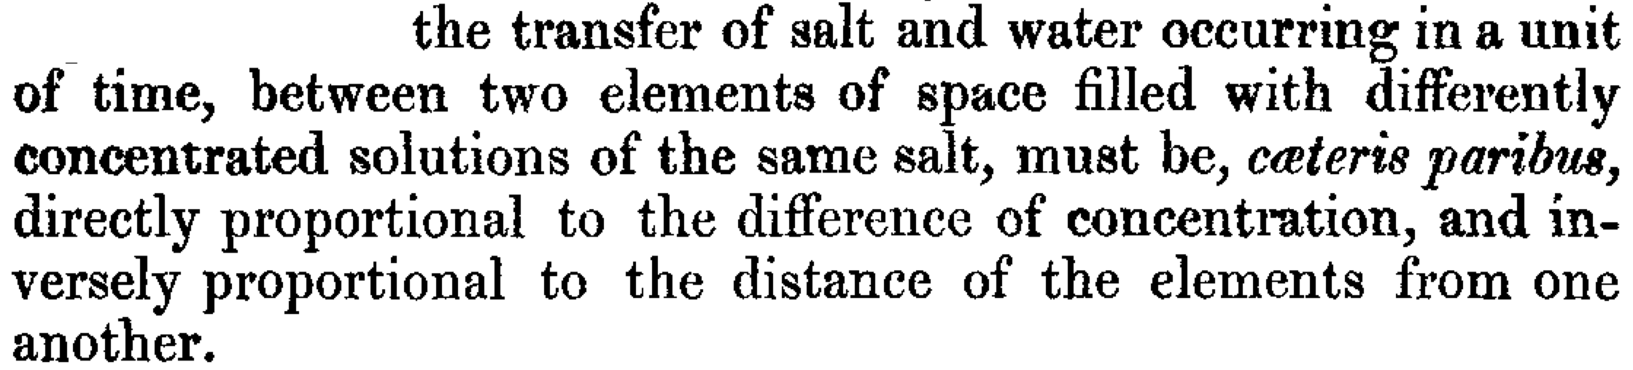
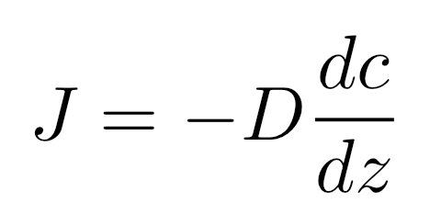
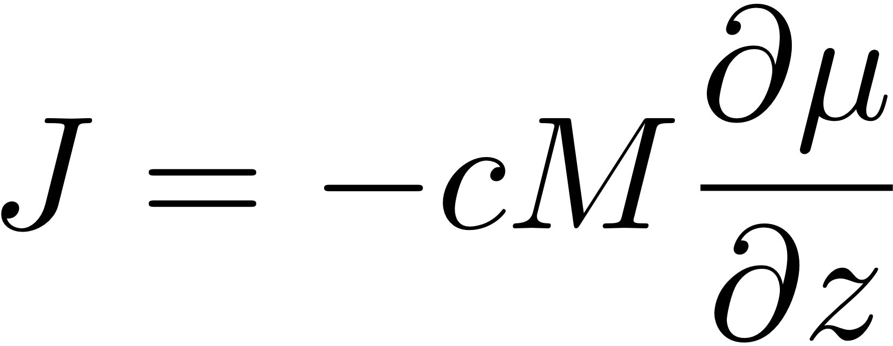
(1855)
Flux is proportional to the gradient

Slide 21
μ
o
B
μ
o
Gibbs free energy per mole
A
μ
A
G{x}
μ
B
A
B
x
Composition

Slide 22
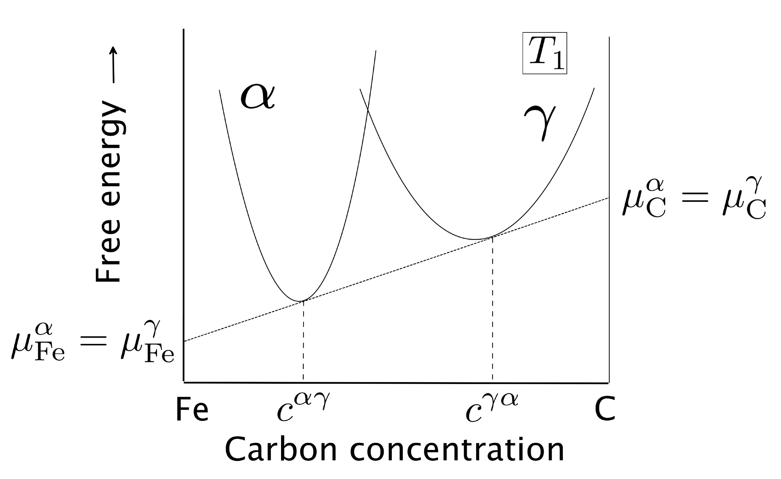

Slide 23
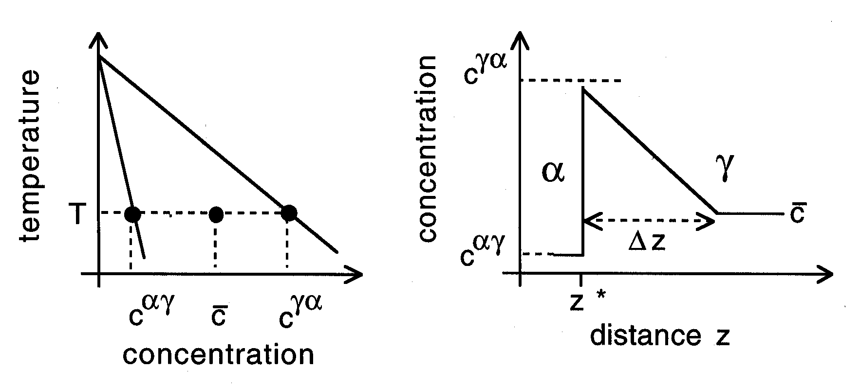

Slide 24
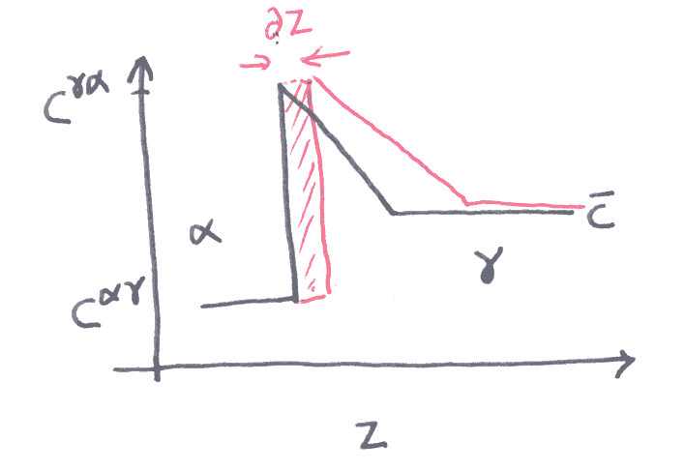
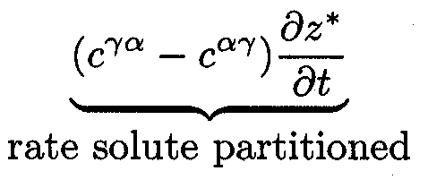

Slide 25
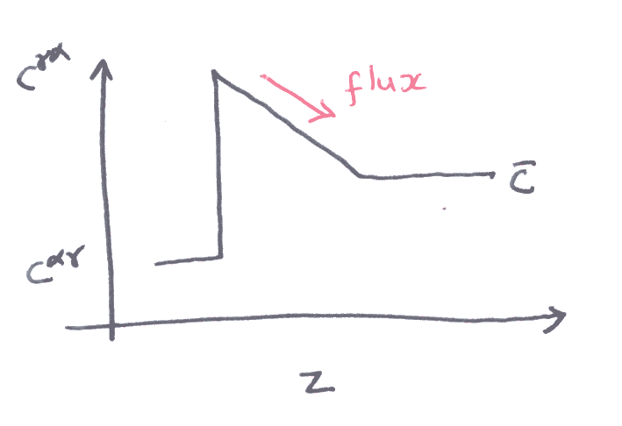
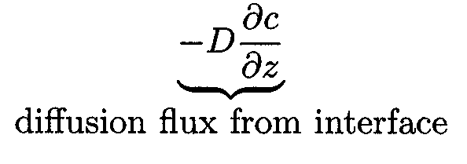

Slide 26
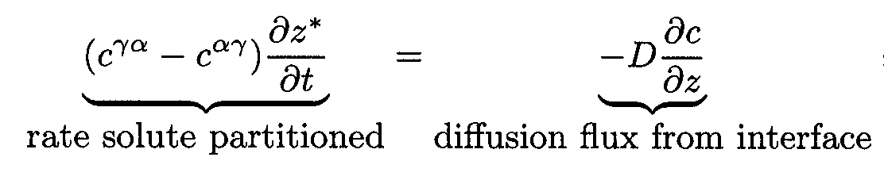
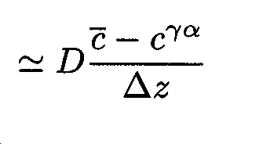
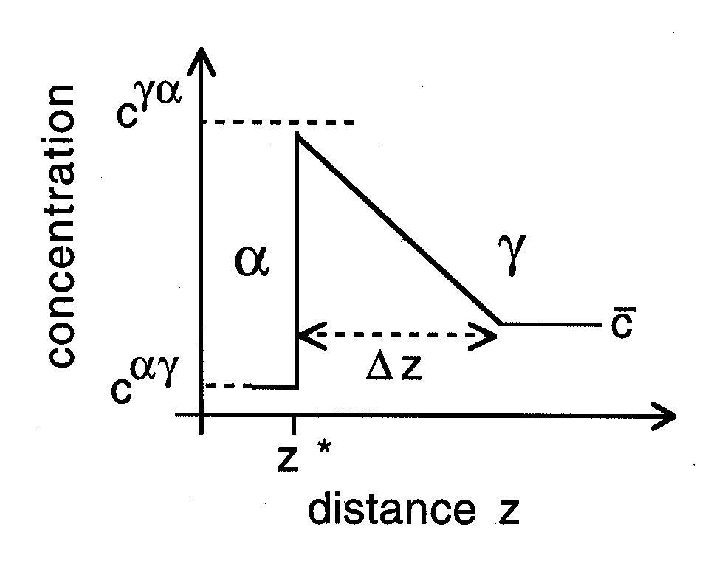

Slide 27
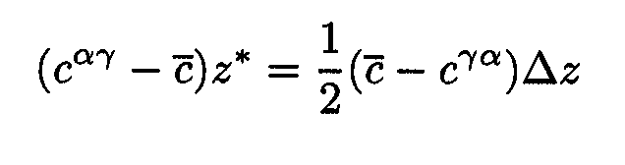
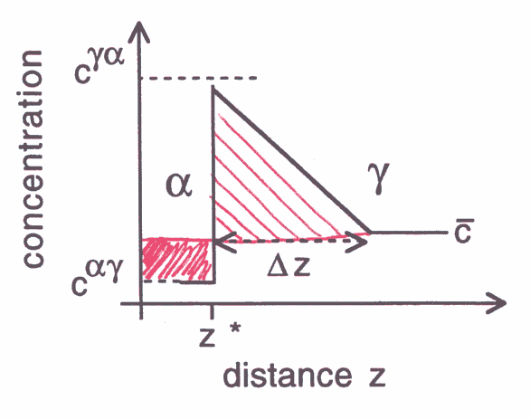

Slide 28
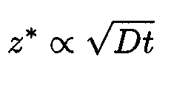
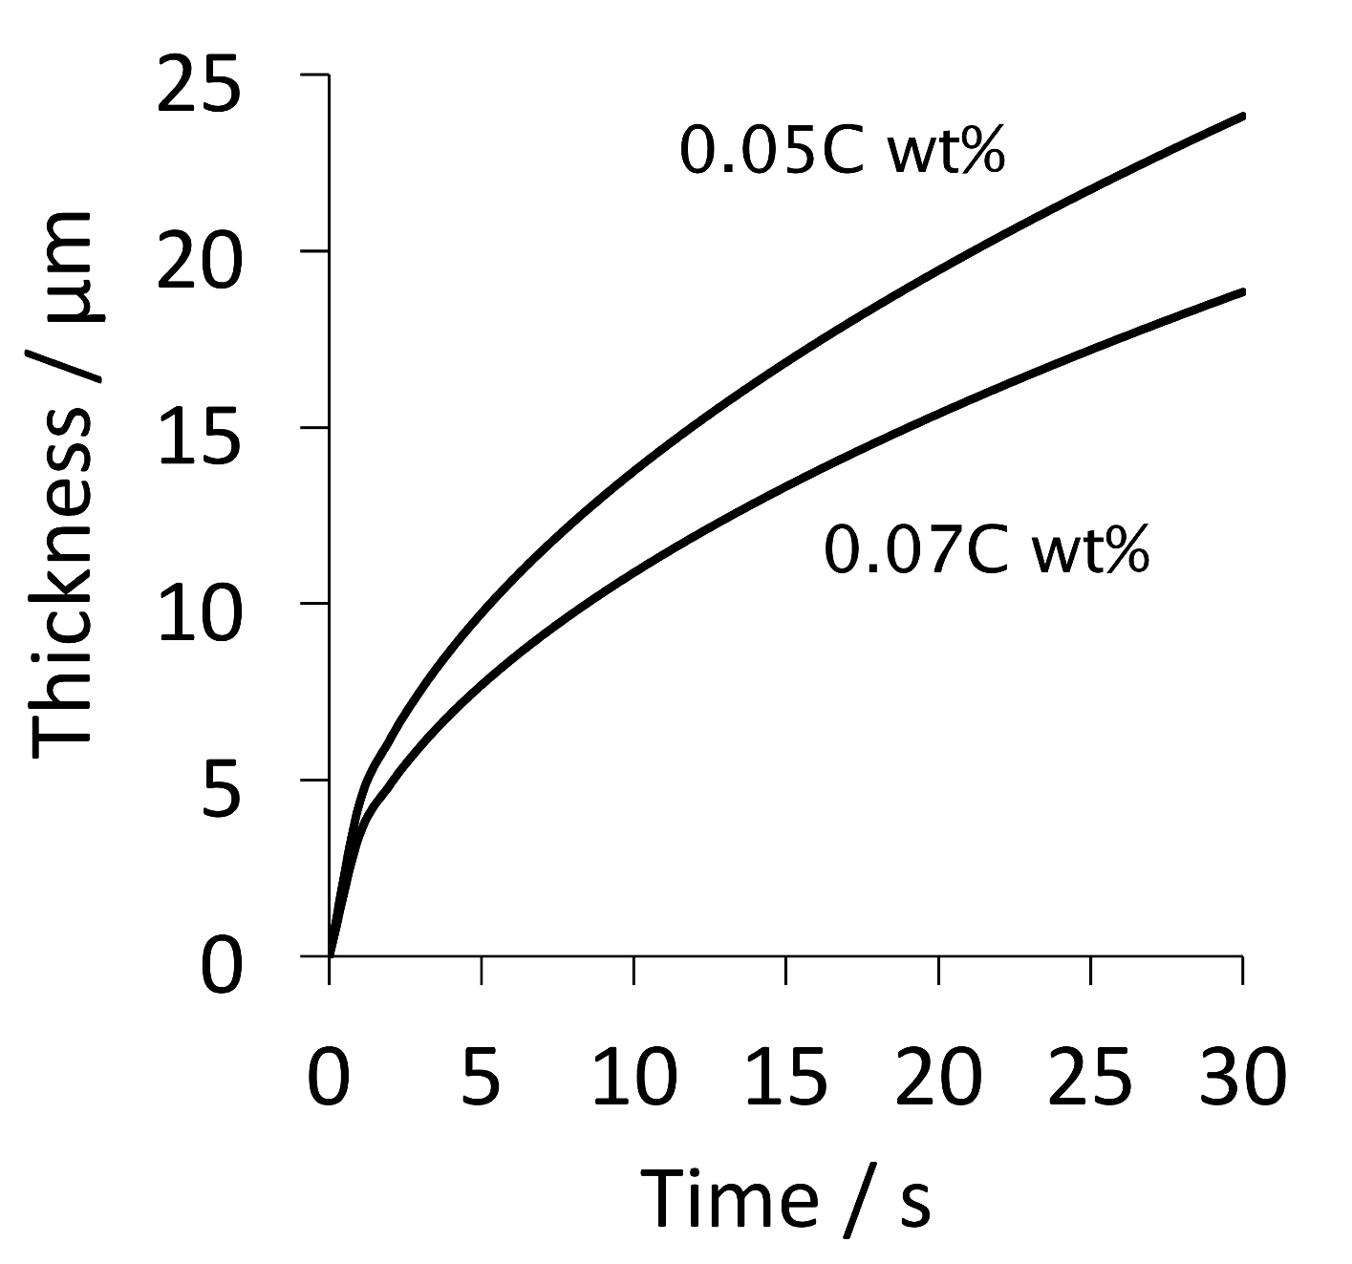

Slide 29
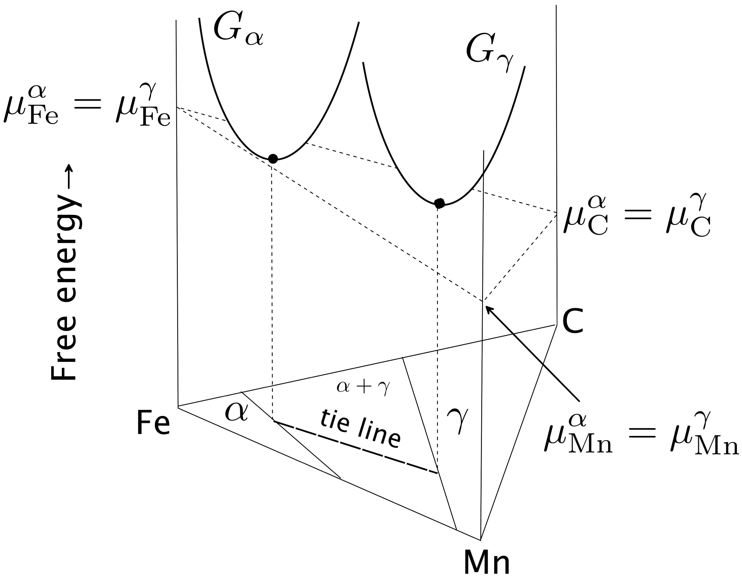

Slide 30
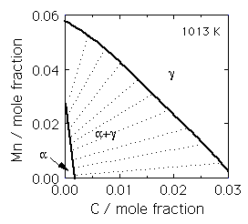

Slide 31


Slide 32
γ
High supersaturation
NP-LE mode
Manganese
α
α
γ
α+γ
Carbon
α
γ

Slide 33
Metall. Mater. Trans. A 43 (2012) 833
diffusion distance 0.03 nm
Metall. Mater. Trans. A 46 (2015) 2347
diffusion distance 0.002-0.04 nm
how do we proceed?

Slide 34


Slide 35



Yoshiyuki Saito
Cr
time
Carlos Martins
distance

Slide 36
Most rapidly growing Fourier components have infinitely small wavelength
chemical interfacial energy
larger with steeper gradients
STEEP GRADIENTS RETARD DIFFUSION

Slide 37





Slide 38




Slide 39

Impossible to avoid partitioning substitutional solutes if local equilibrium is demanded.

Slide 40
Conclusion: NPLE mode does not exist
Current Opinion in Solid State and Materials Science,
20 (2016) 396-400
Physica Status Solidi (a)
69 (1982) 745-750
www.phase-trans.msm.cam.ac.uk

Slide 41
Substitutionalsolutes
frozen
Bhadeshia, Waugh, 1981

Slide 42

Notes:
42

Slide 43



Slide 45


Slide 46


Slide 47



Slide 48


Slide 49


Impact energy / J
Temperature / °C

Slide 50


Slide 51


Slide 52

20 µm

Slide 53


Slide 54

Kevin Sawley: 90 million gross tonnes of traffic on curve

Slide 55


Slide 56


Displacive atomic mechanism:
more susceptible to impurity embrittlement
Prior austenite grain
boundary embrittlement

Slide 57

Bainite forms by the same mechanism as martensite, it is diffusionless, but tempers during the course of transformation.
This is the basis of the modern design of steels.
www.phase-trans.msm.cam.ac.uk
Adolf Martens

Slide 58

Composition following transformation

Slide 59

Bhadeshia, Met. Sci. (1982)

Slide 60


Slide 61

It was assumed therefore, that these carbon atoms are trapped at dislocations, since the original paper published in 1981.
Bhadeshia, Edmonds
Metall. Trans. (1979)

Slide 62


Caballero, Miller, Mateo, Cornide. J. Alloys & Compounds, (2012)
Large carbon concentration in solution in ferrite
Ferrite
Dislocation
Austenite
Francisca Garcia Caballero

Slide 63

atom probe data for carbon in solid solution in ferrite in contact with austenite
Caballero, Miller, Mateo, Cornide
J. Alloys & Compounds, (2012)

Slide 64



A diffusionless transformation will necessarily lead to a body-centred tetragonal ferrite.

Slide 65


Huge increase in solubility; ferrite with tetragonal symmetry
Jang, Suh, Bhadeshia, Scr. Mat. 68 (2012) 195

Slide 66





C. N. Hulme-Smith, I. Lonardelli,
A. C. Dippel and H. K. D. H. Bhadeshia, Scr. Mat. 69 (2013) 409.

Slide 67


Slide 68


