Slide 1
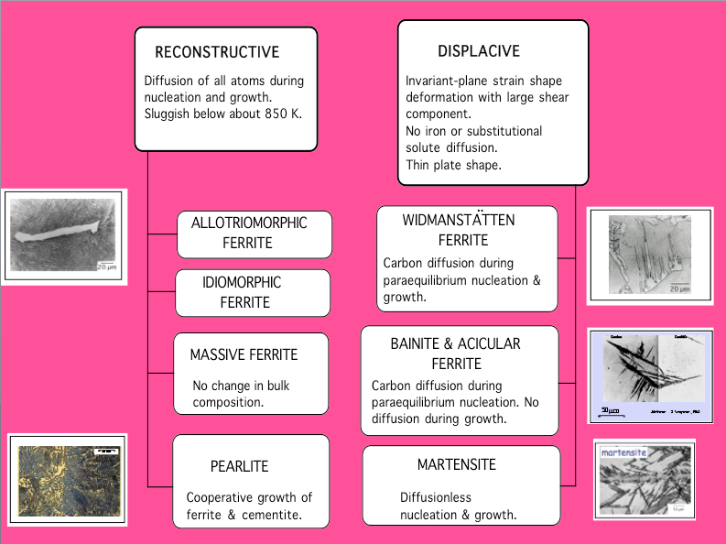

Slide 2
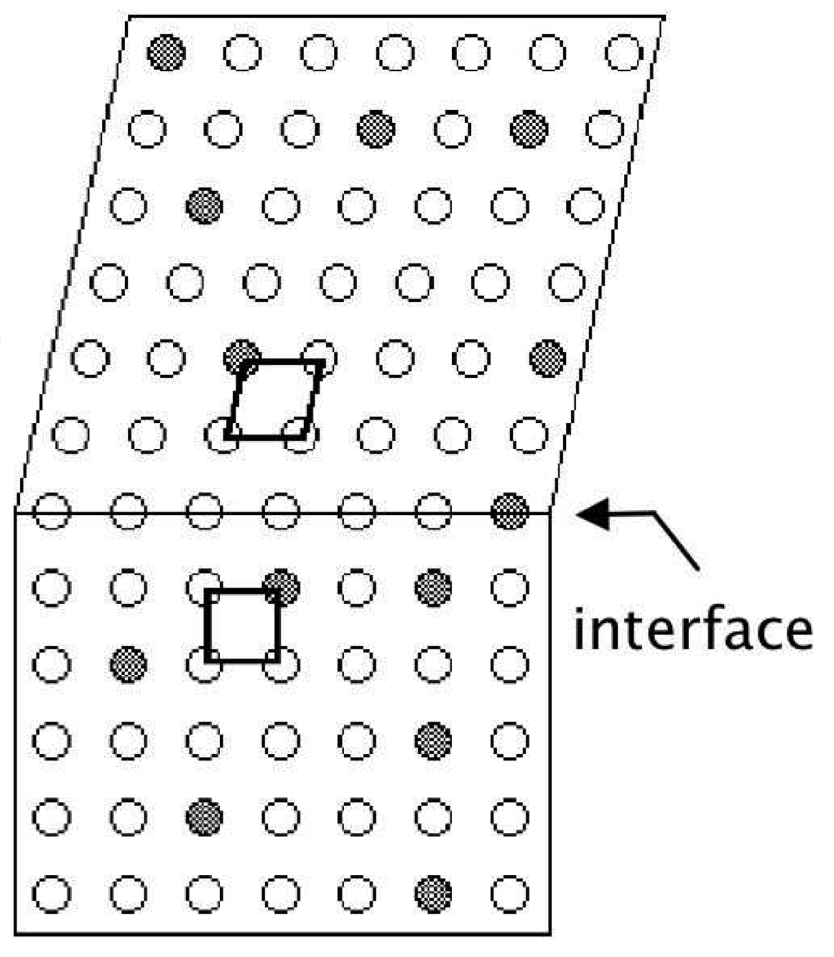
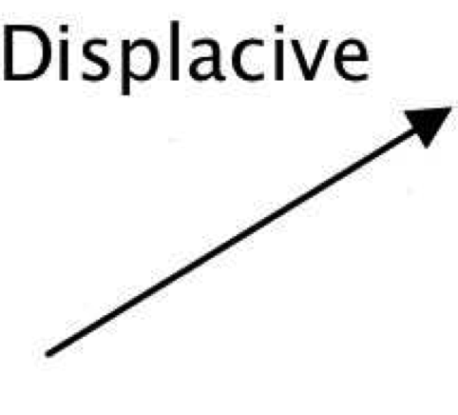
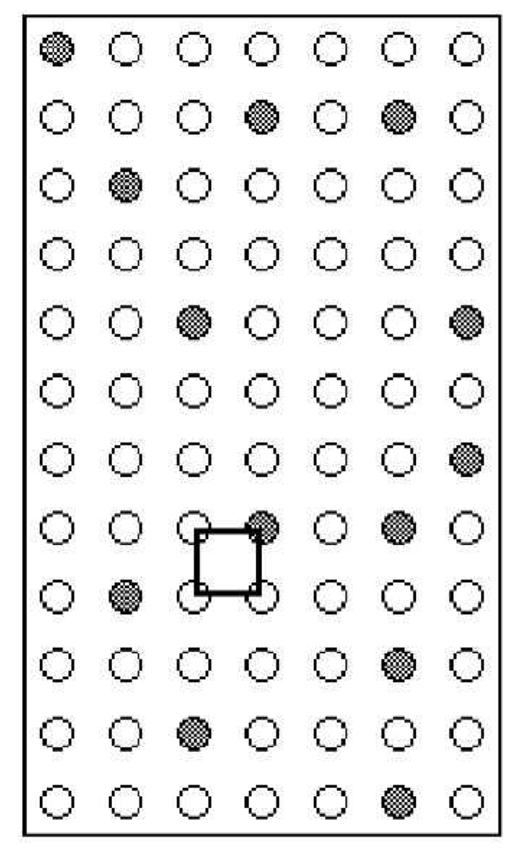
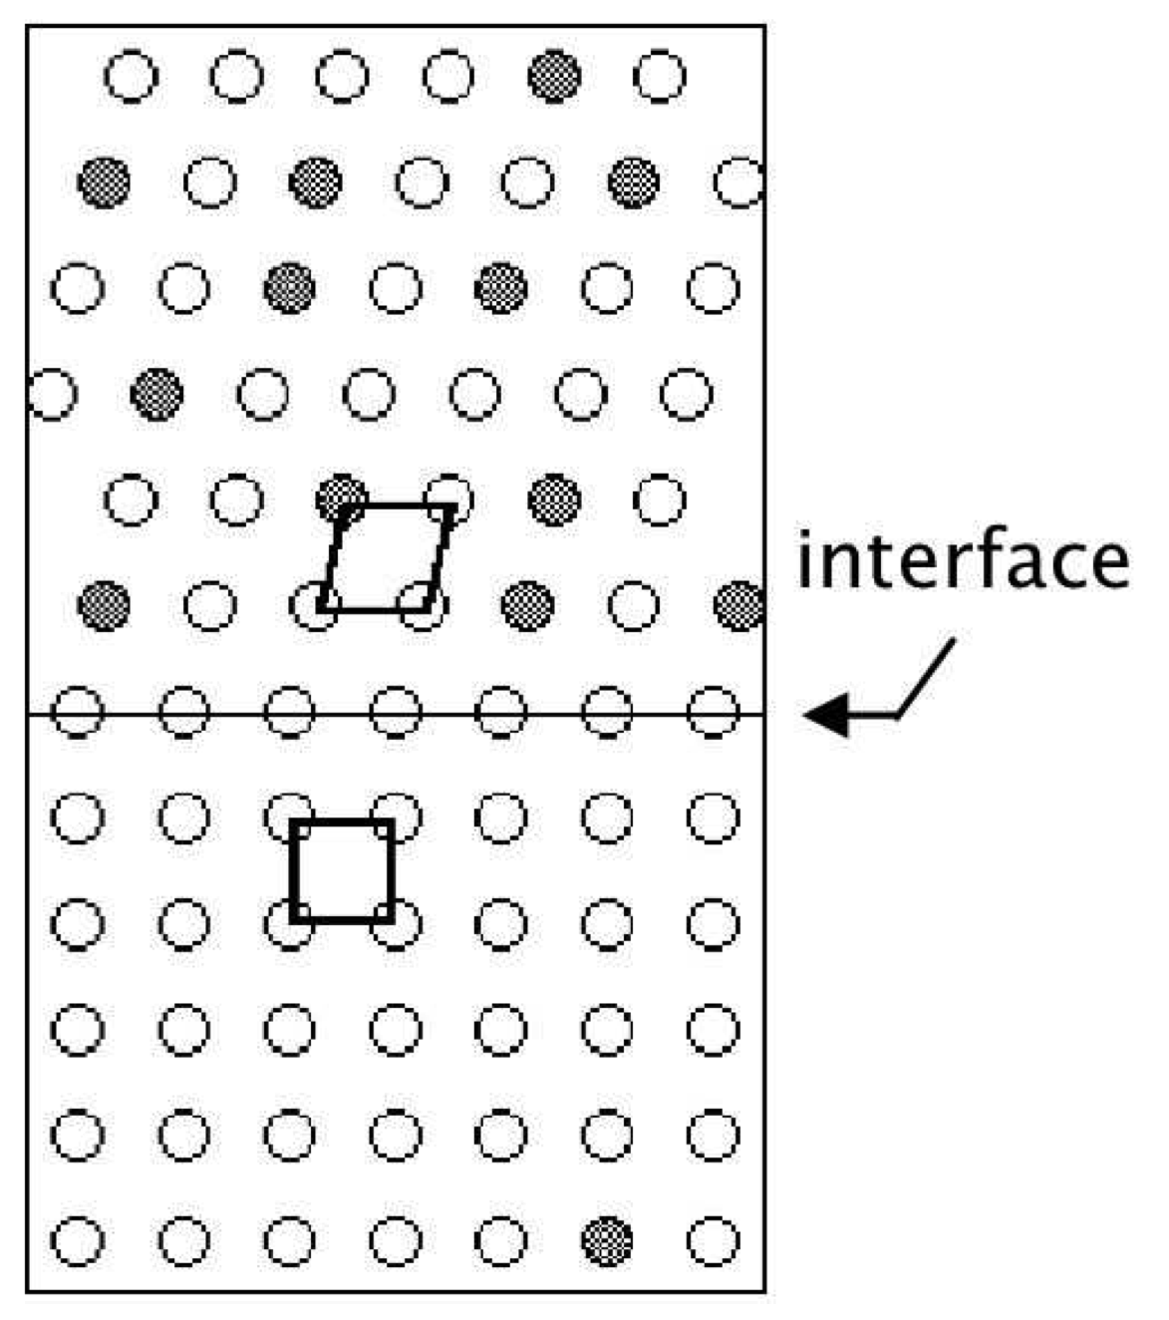
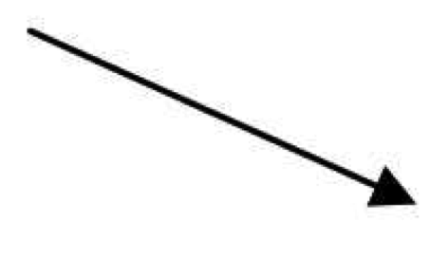


Slide 3
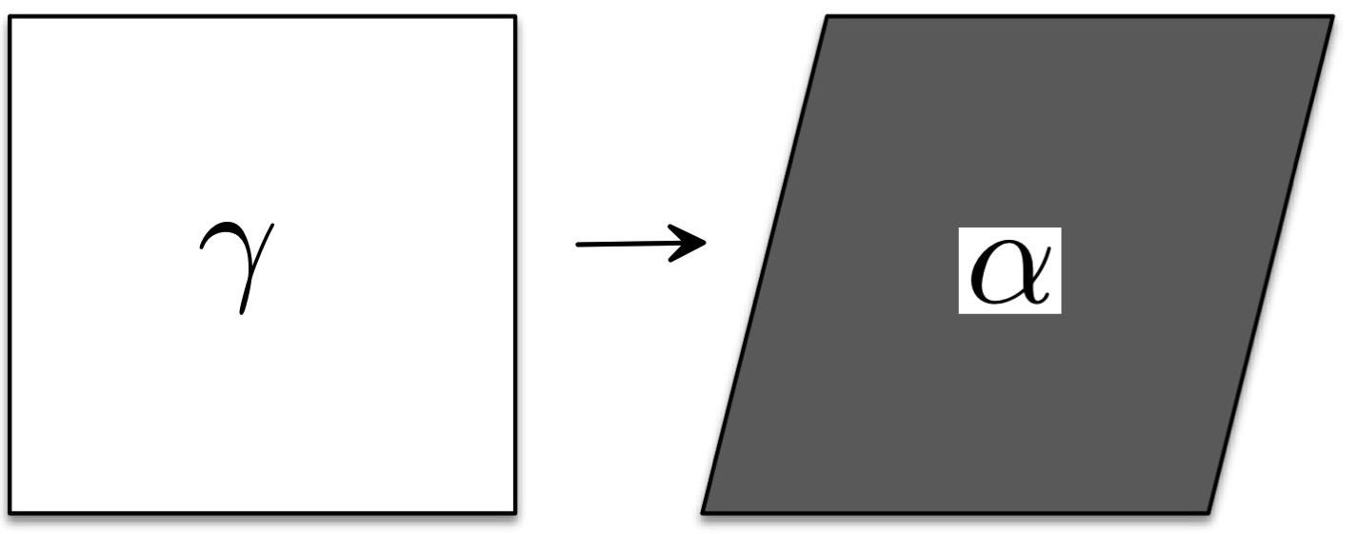
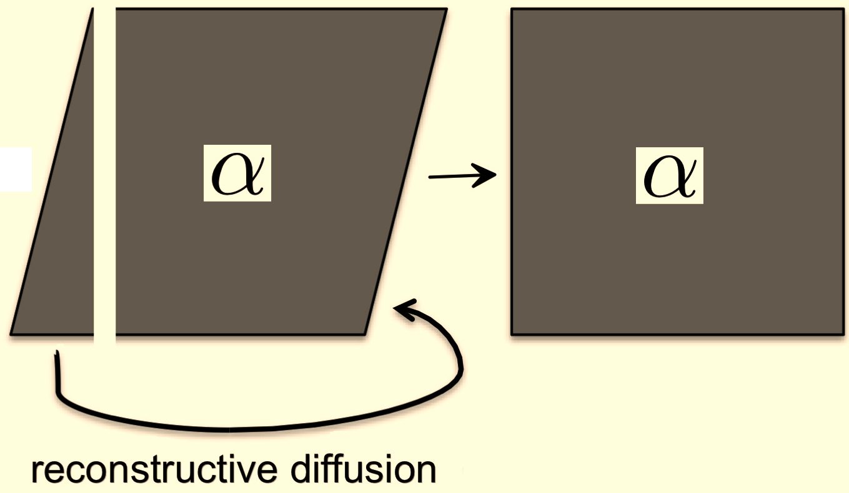
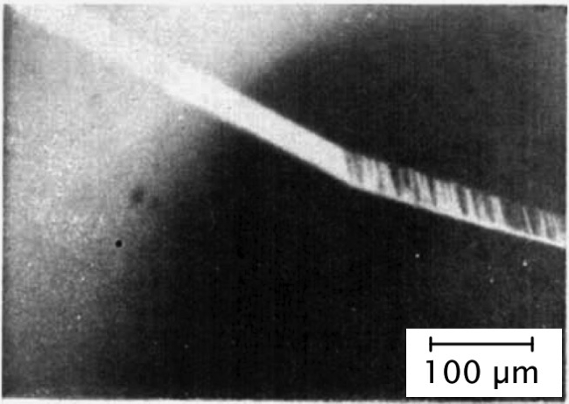
Martensitic transformation in pure iron
Zerwech & Wayman
Acta Metallurgica 13 (1965) 99

Slide 4
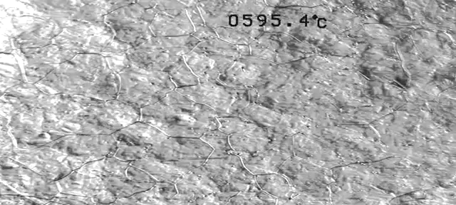
Displacive transformations (Widmanstaetten ferrite, bainite, martensite) cause deformation.
Reconstructive transformations (pearlite, ferrite) do not.

Slide 5
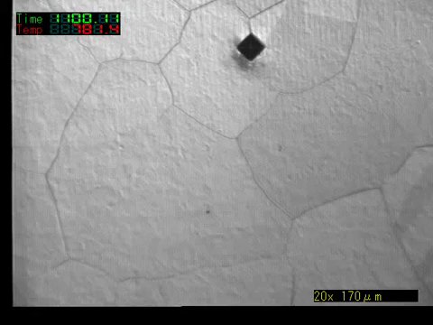
Toshihiko Koseki, University of Tokyo

Slide 6

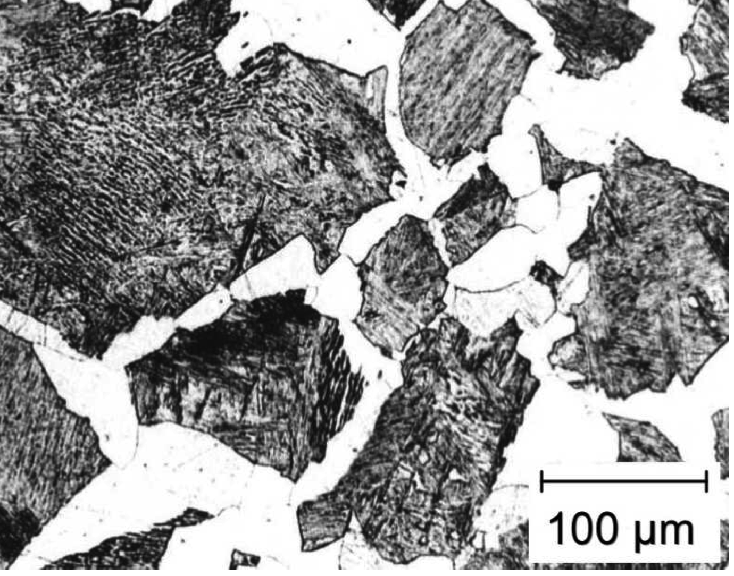
Unresolved issues:
Difficulties in theory of ferrite growth
steep concentration gradients
www.phase-trans.msm.cam.ac.uk

Slide 7
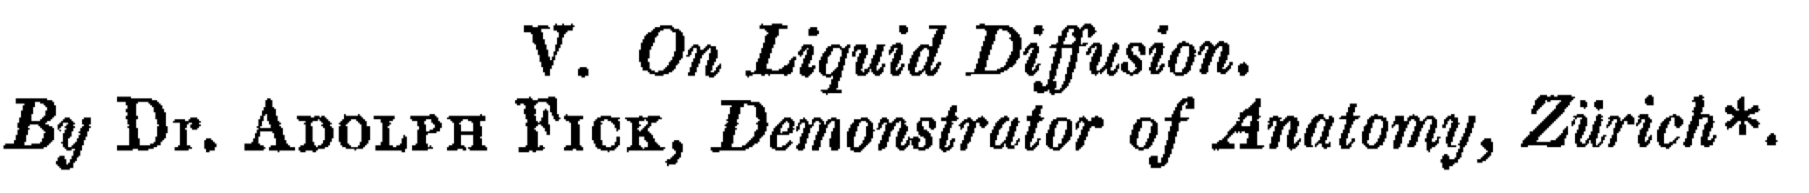
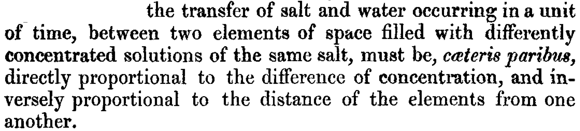
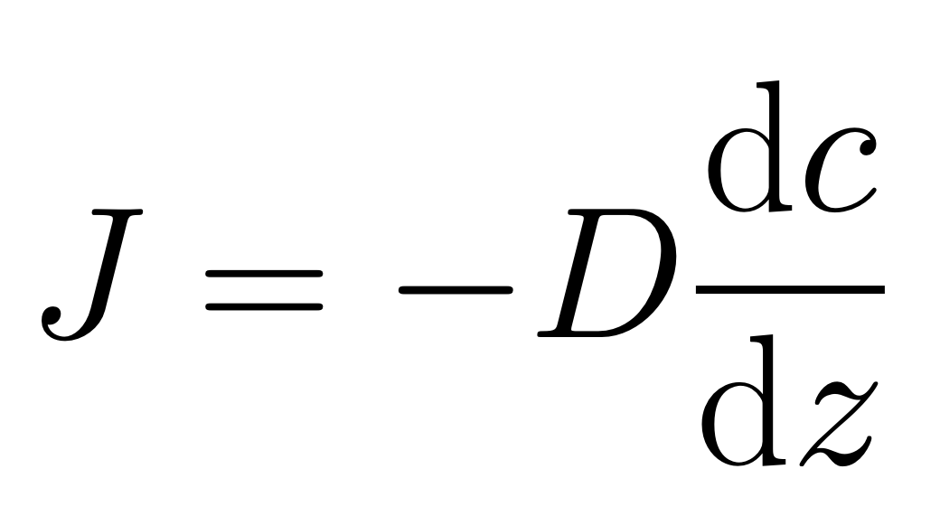
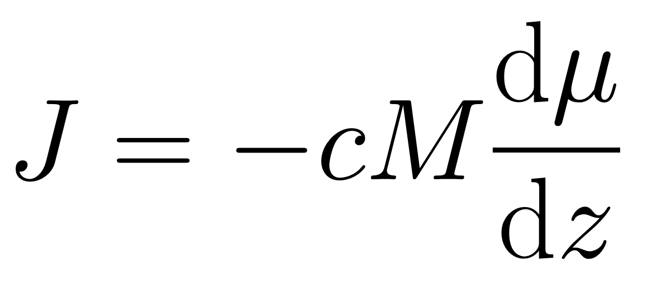
(1855)
Flux is proportional to the gradient

Slide 8
μ
o
B
μ
o
Gibbs free energy per mole
A
μ
A
G{x}
μ
B
A
B
x
Composition

Slide 9
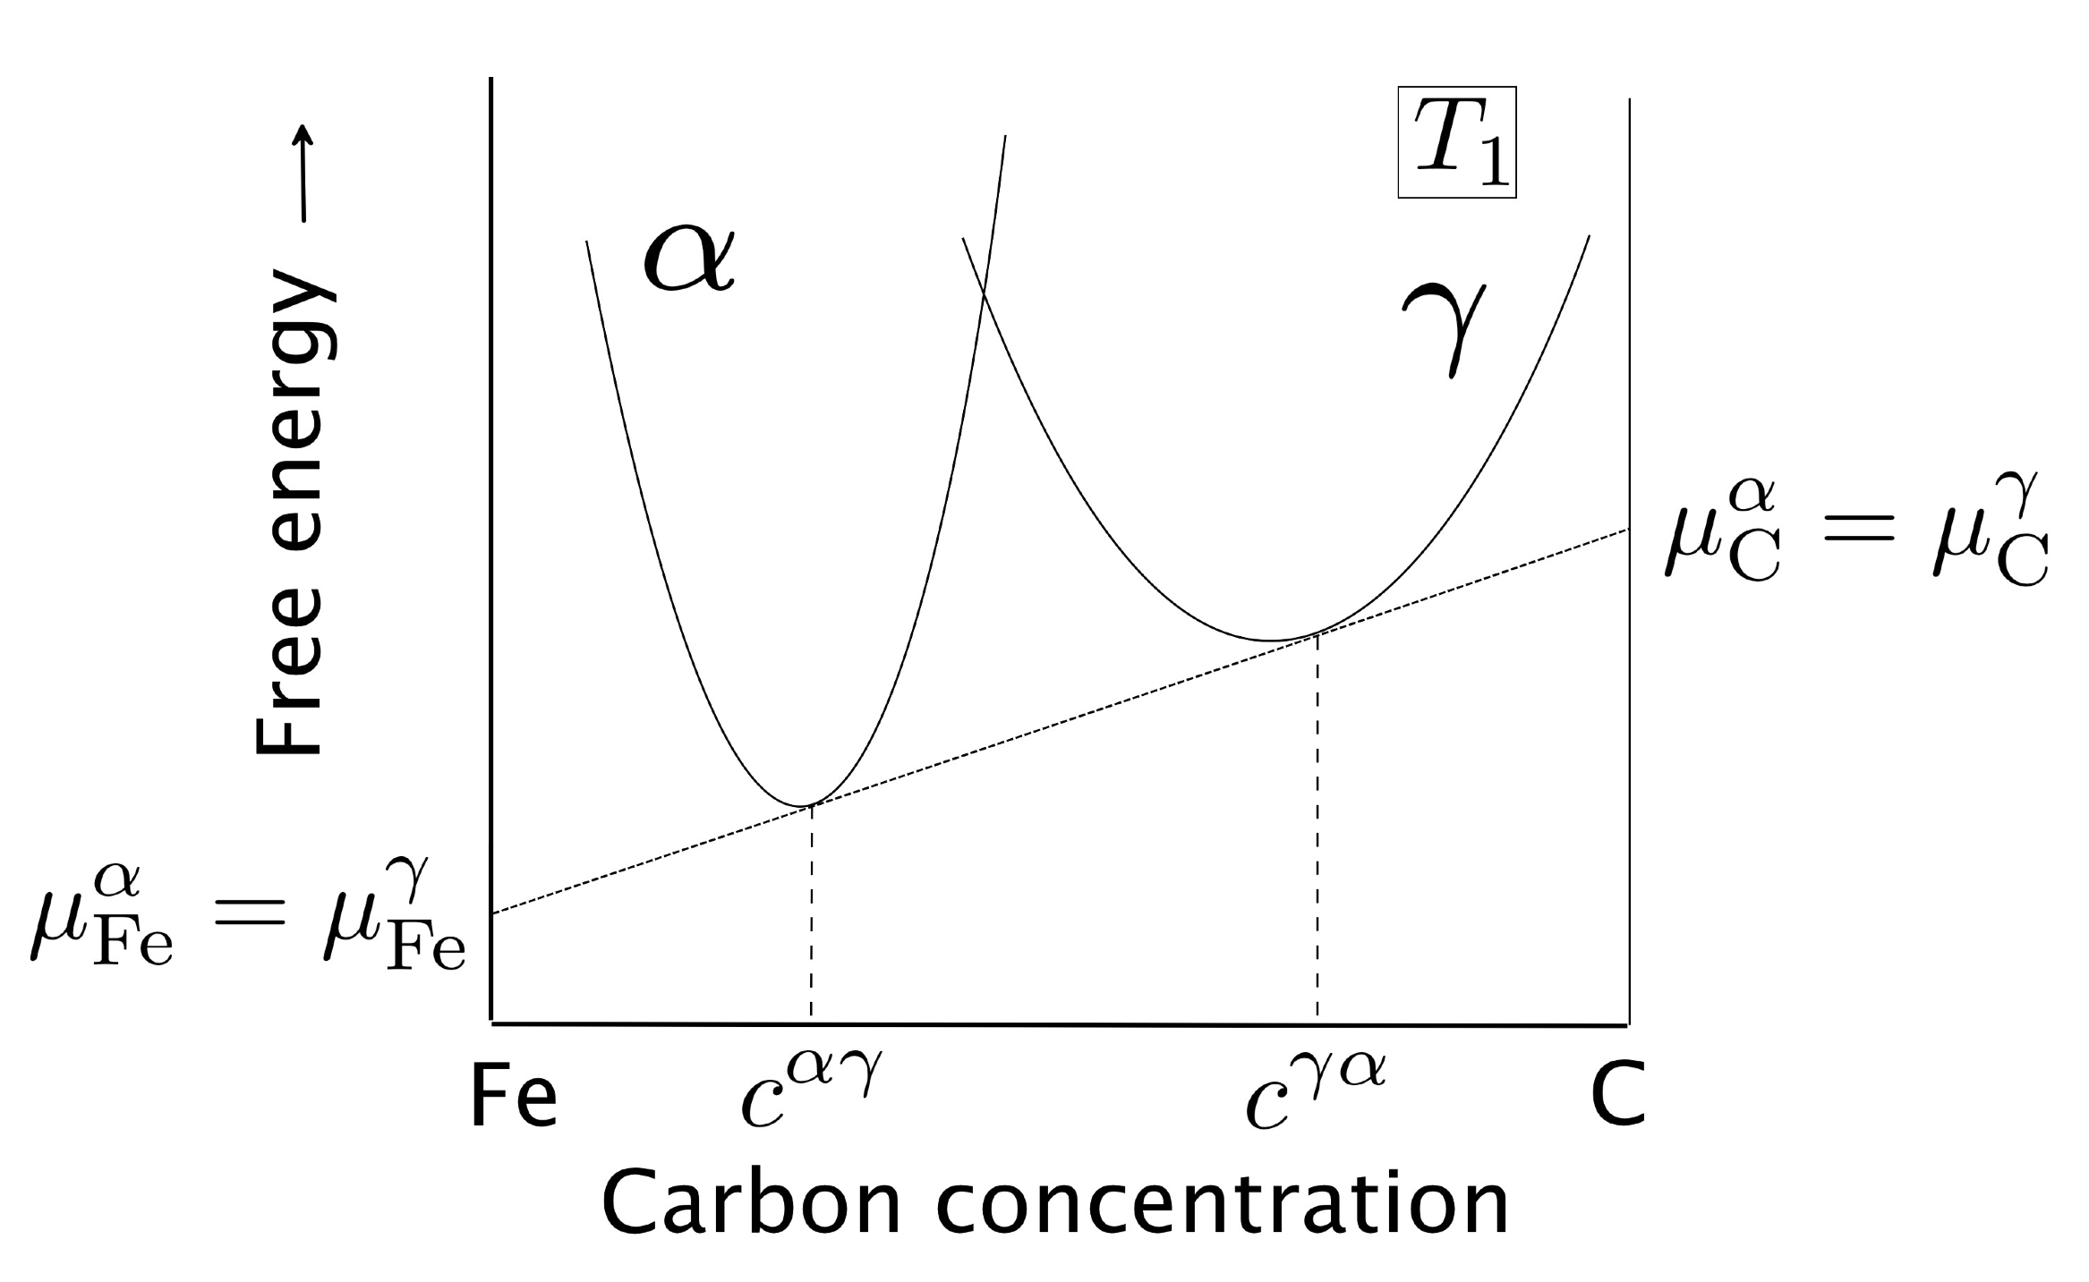

Slide 10
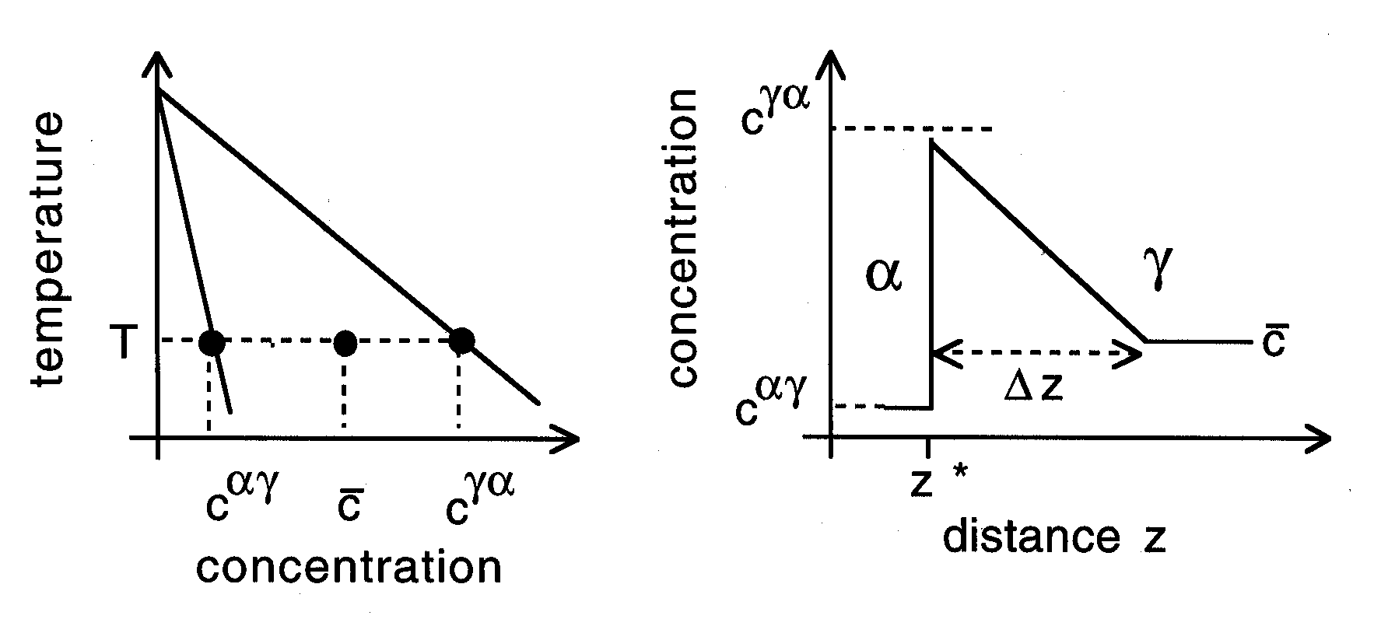

Slide 11
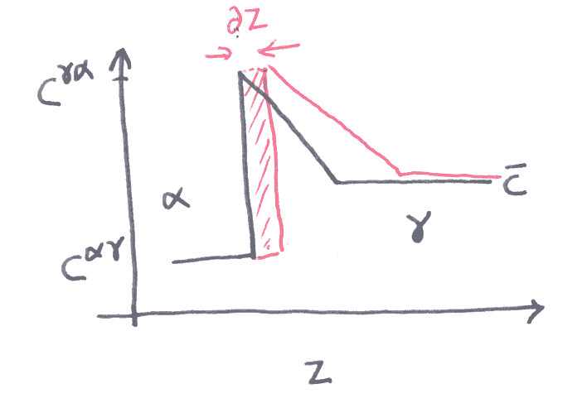
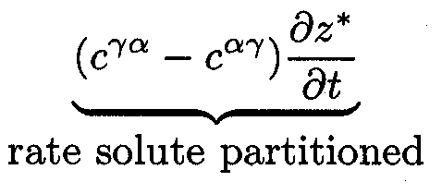

Slide 12
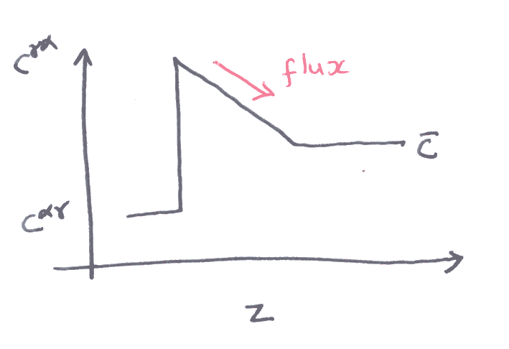
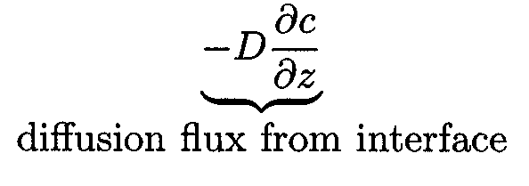

Slide 13
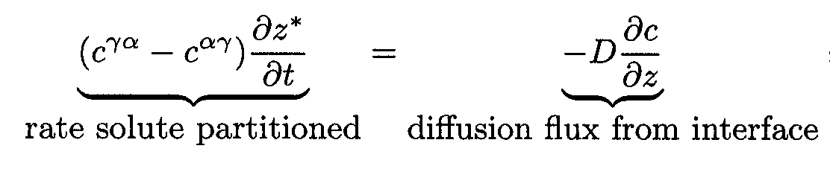
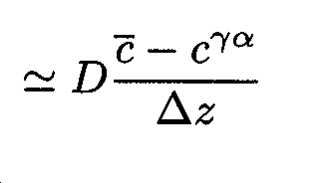
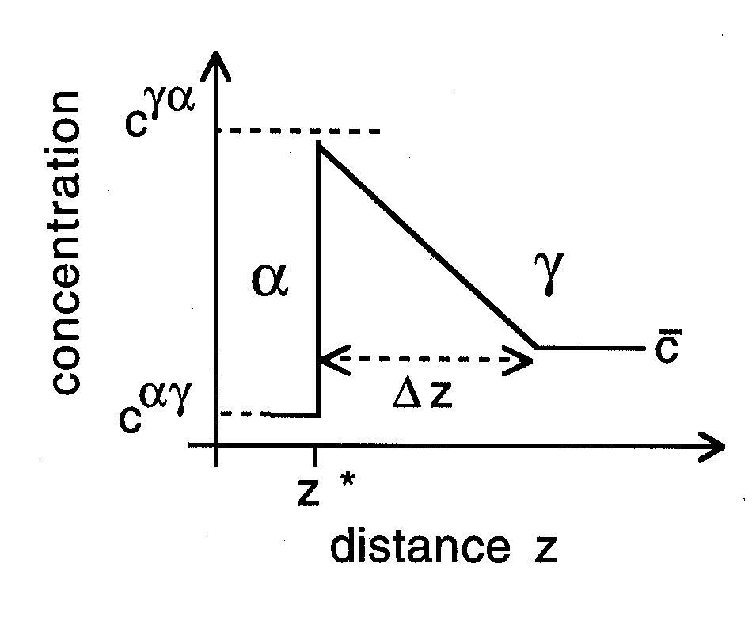

Slide 14
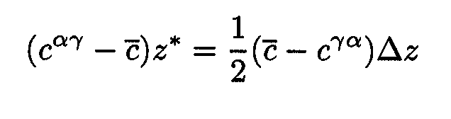
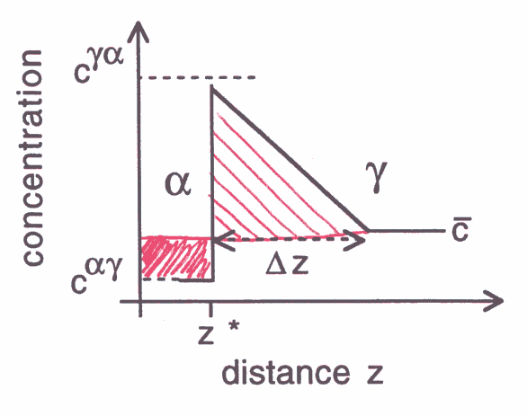

Slide 15
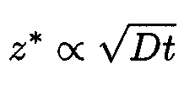
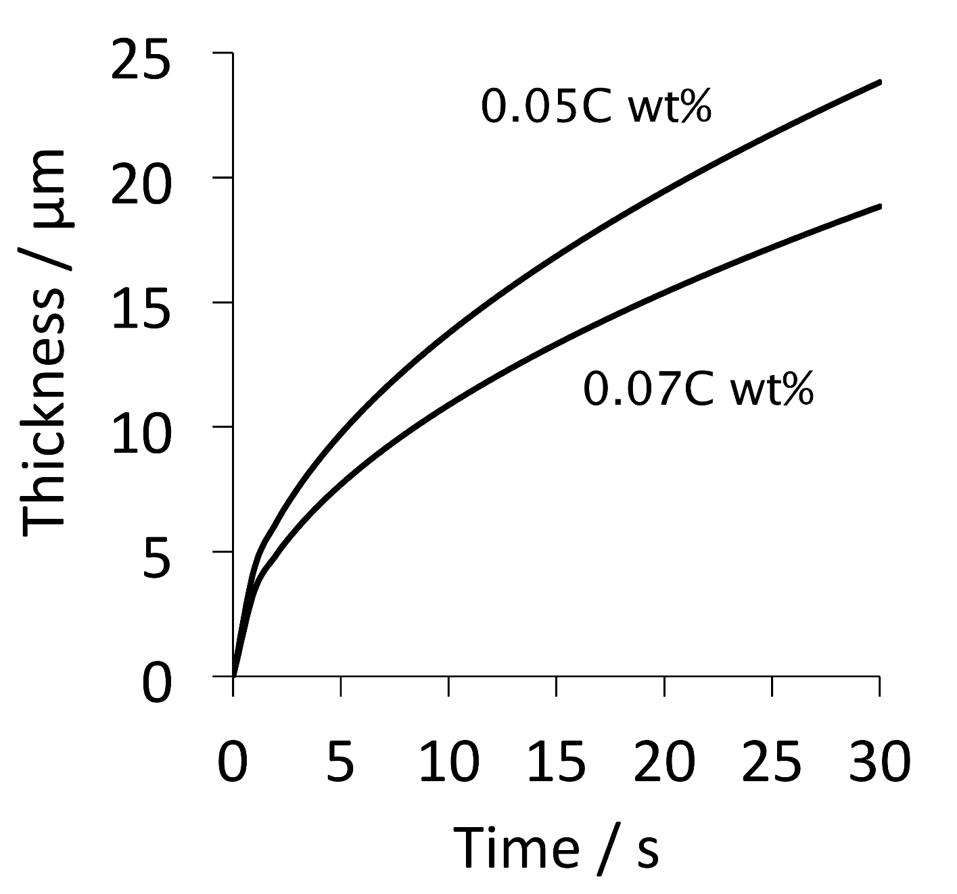

Slide 16
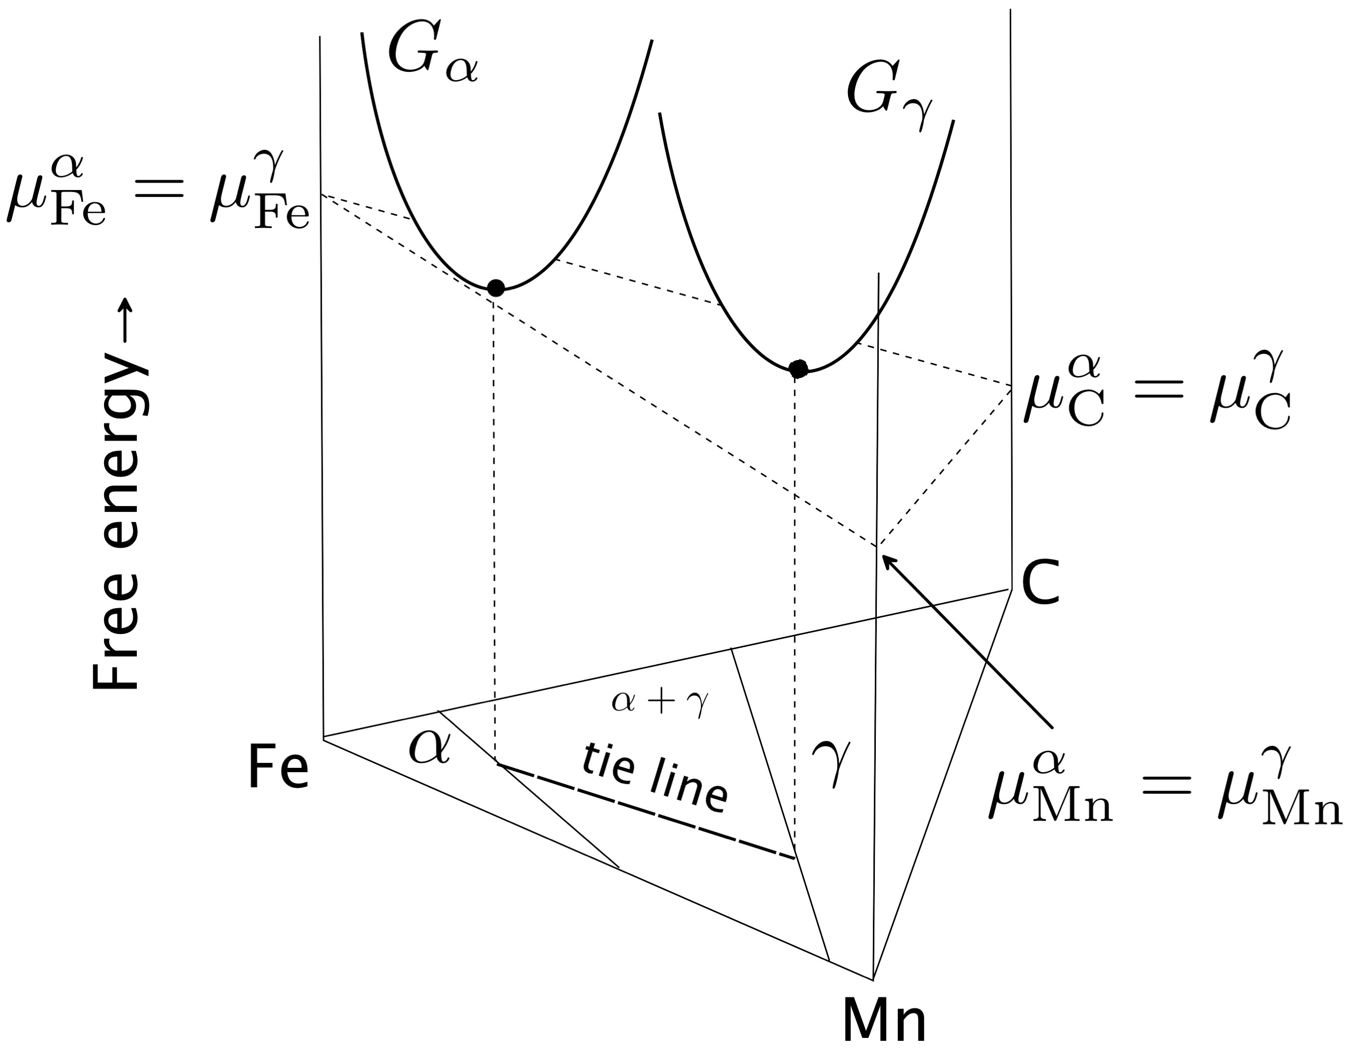

Slide 17
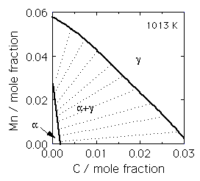

Slide 18
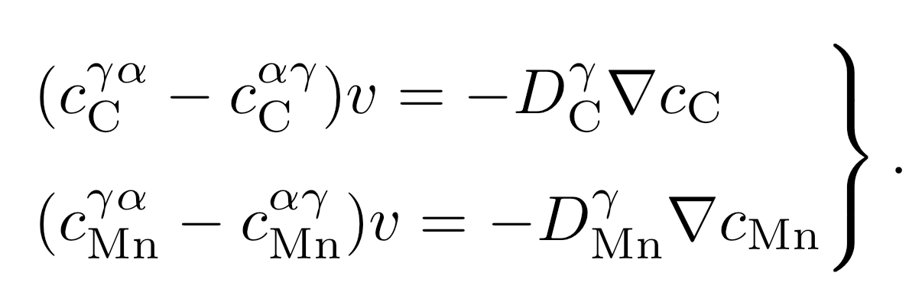

Slide 19
γ
High supersaturation
NP-LE mode
Manganese
α
α
γ
α+γ
Carbon
α
γ

Slide 20
Metall. Mater. Trans. A 43 (2012) 833
diffusion distance 0.03 nm
Metall. Mater. Trans. A 46 (2015) 2347
diffusion distance 0.002-0.04 nm
how do we proceed?

Slide 21
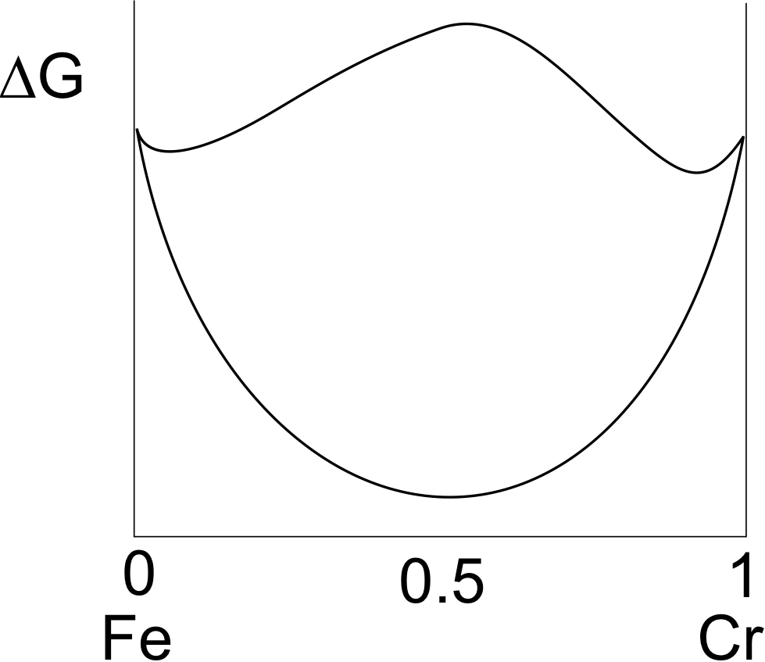

Slide 22
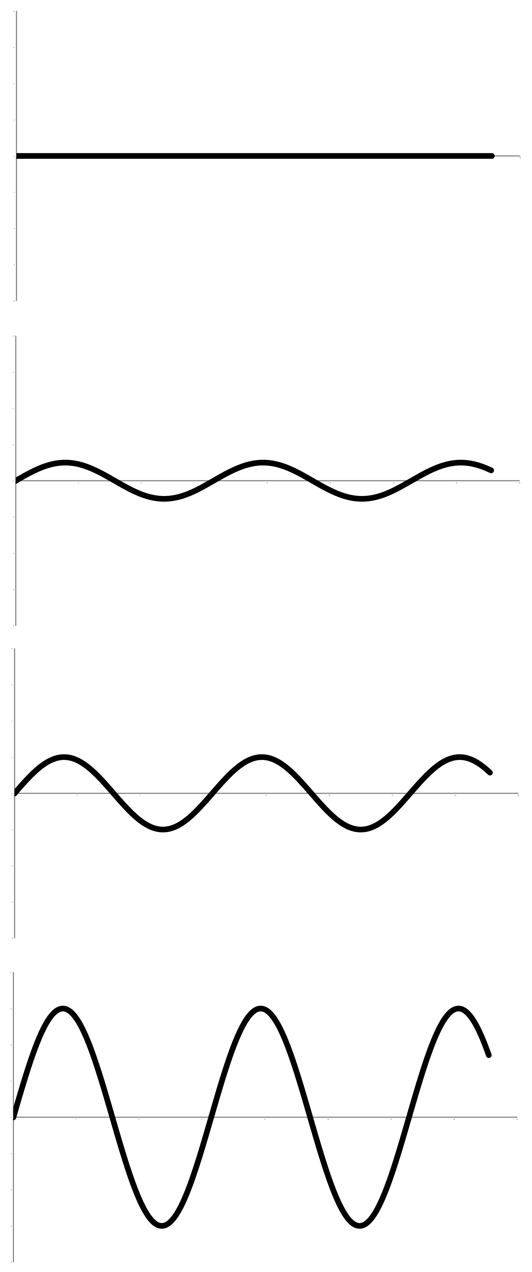
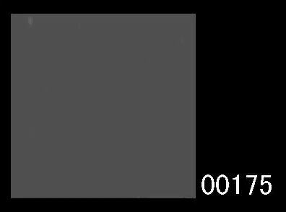

Yoshiyuki Saito
Cr
time
Carlos Martins
distance

Slide 23
Most rapidly growing Fourier components have infinitely small wavelength
chemical interfacial energy
larger with steeper gradients
STEEP GRADIENTS RETARD DIFFUSION

Slide 24
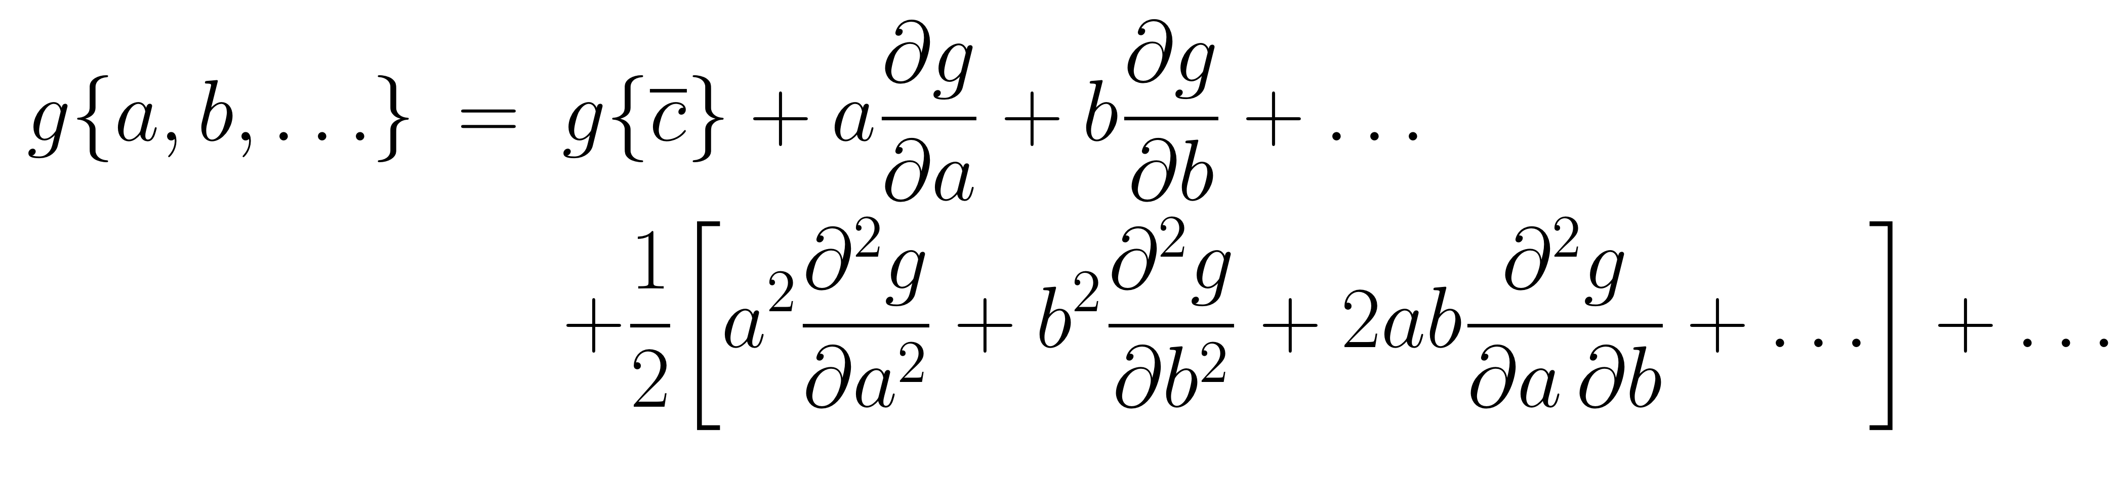
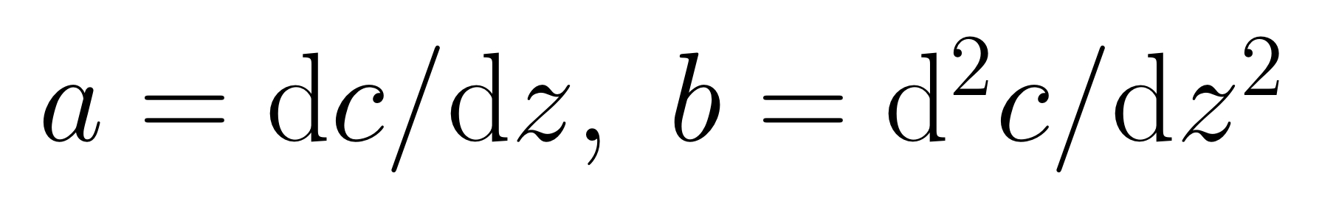
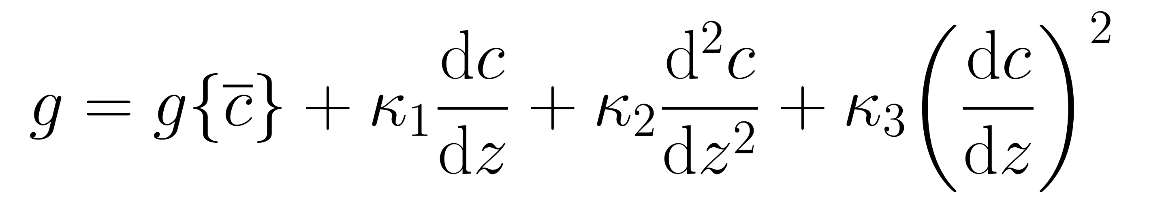
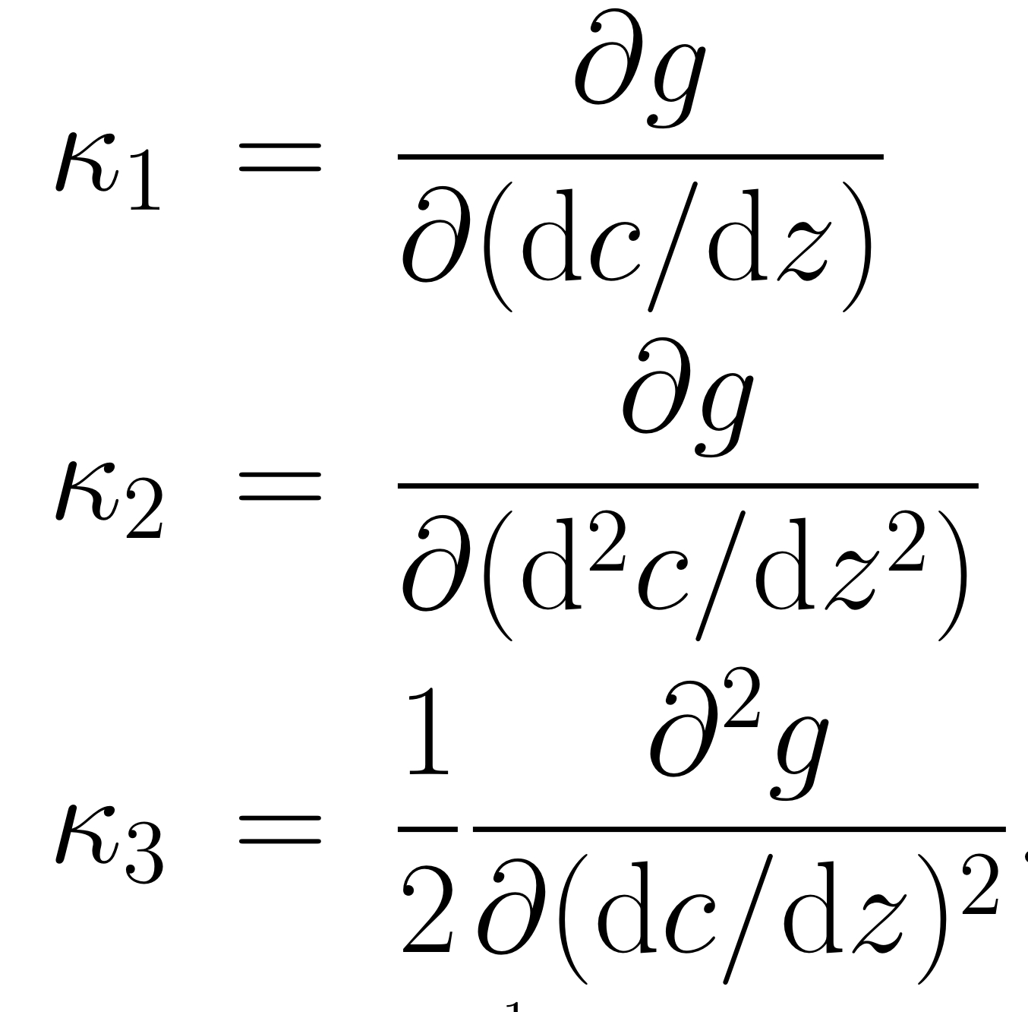

Slide 25
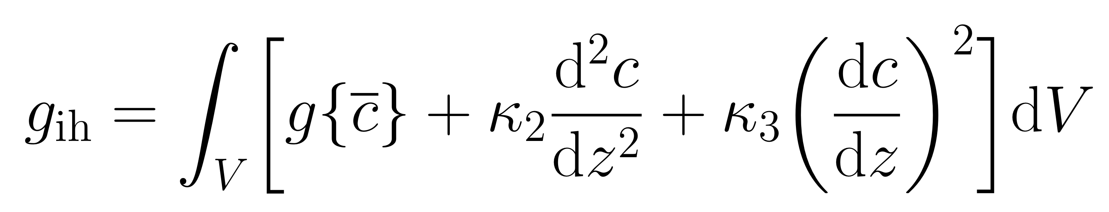
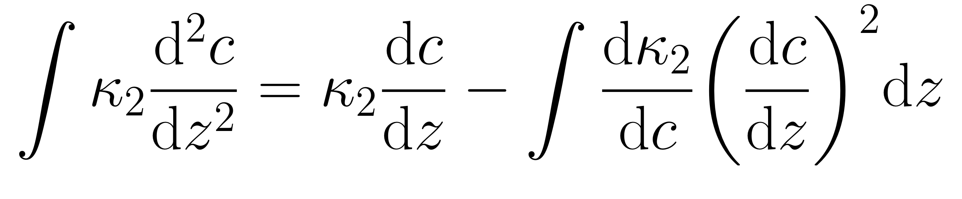
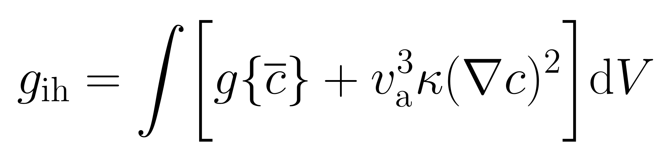

Slide 26
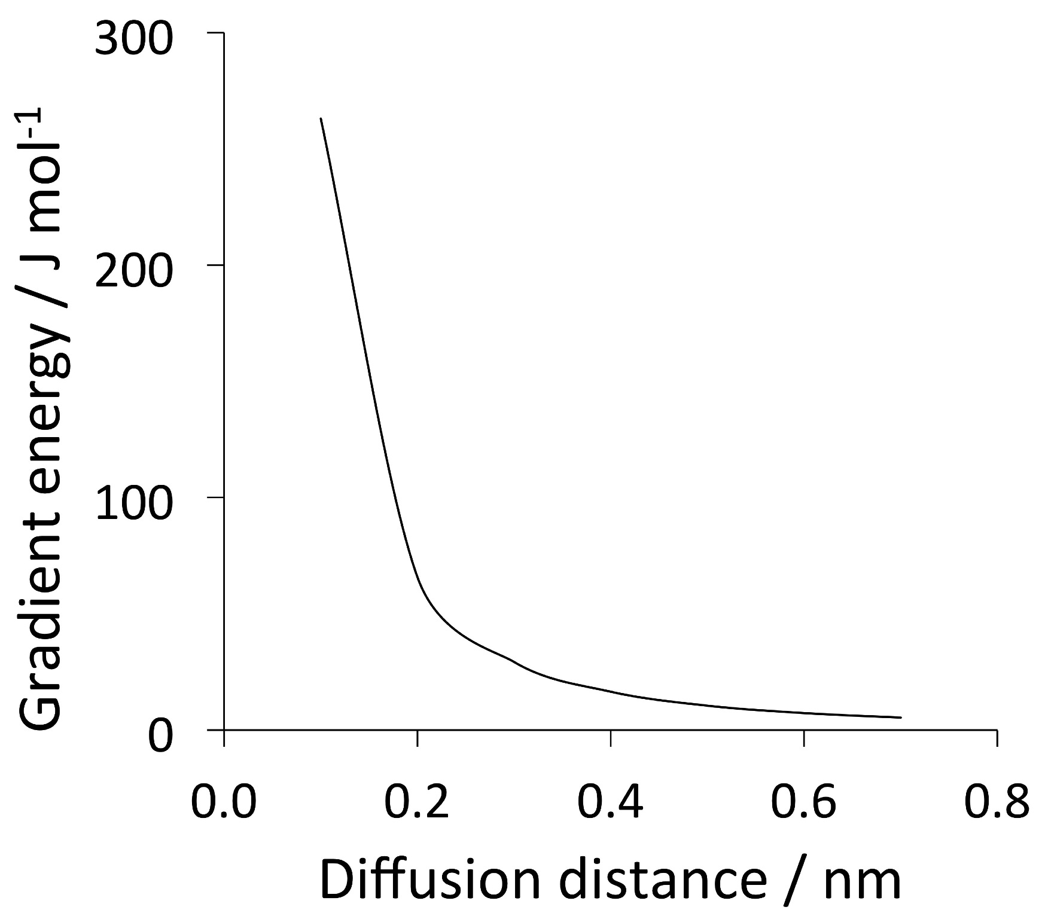
Impossible to avoid partitioning substitutional solutes if local equilibrium is demanded.
α
γ

Slide 27
Conclusion 1: NPLE mode does not exist
Current Opinion in Solid State and Materials Science,
20 (2016) 396-400
Physica Status Solidi (a)
69 (1982) 745-750

Slide 29
Temperature
Ae3'
T'
o
x
Carbon in austenite

Slide 30
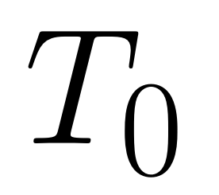
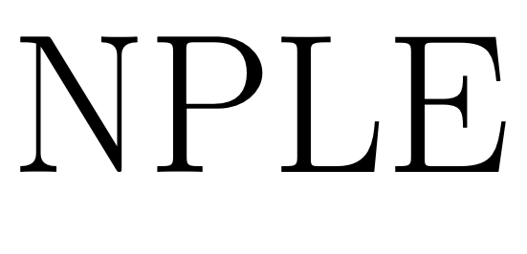
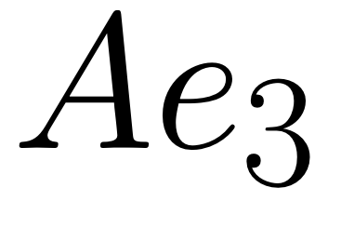
The NPLE curve on a phase diagram does NOT represent a locus where a reaction stops.
Temperature
Carbon

Slide 31
γ
High supersaturation
NP-LE mode
Manganese
α
α
γ
α+γ
Carbon
α
γ

Slide 32
Conclusion 2:
NPLE cannot represent incomplete reaction
… because it does not define the
termination of a reaction.

Slide 33
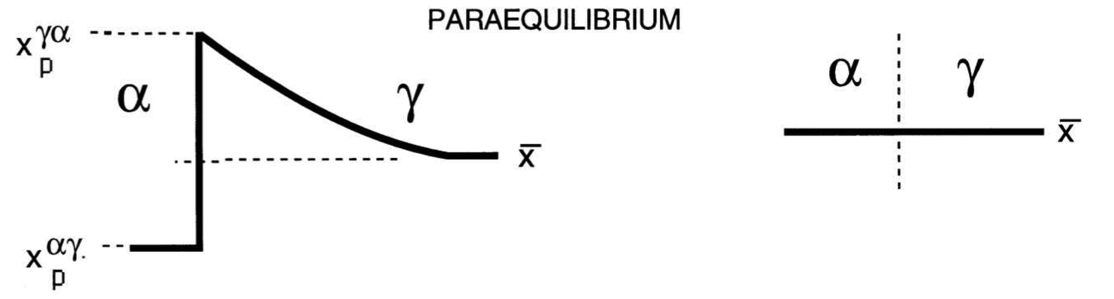
Is paraequilibrium possibile for diffusional transformations?
Carbon
Manganese

Slide 34
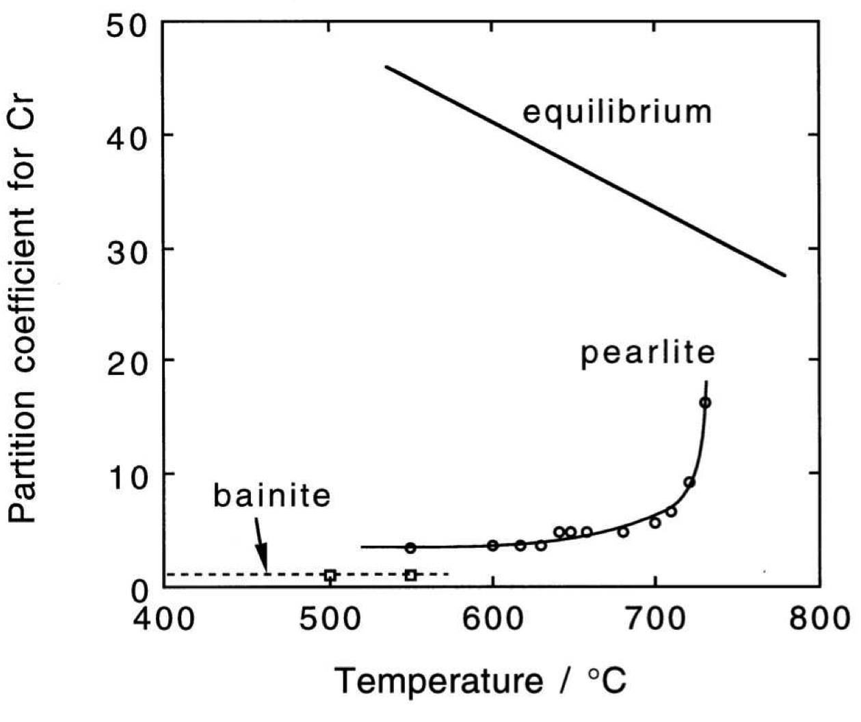
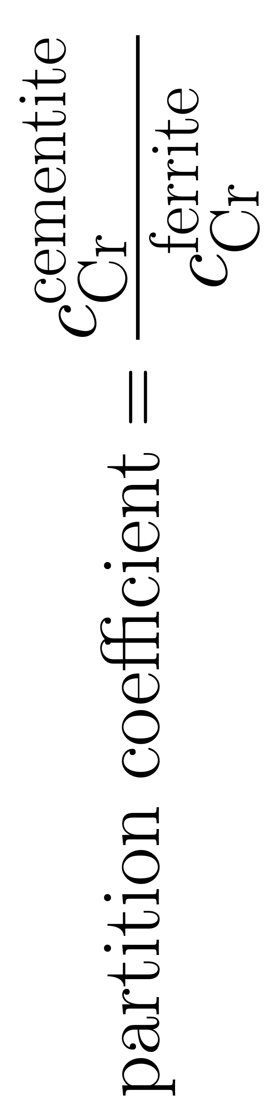
Chance & Ridley (1981)

Slide 35
Conclusion 3:
paraequilibrium applies only to
displacive transformations
Comment:
there is no evidence for
paraequilibrium diffusional-transformation

Slide 36
Diffusional transformations must occur without equilibrium when atomic mobility is limited.
The theory for this exists.
www.phase-trans.msm.cam.ac.uk

