Slide 1
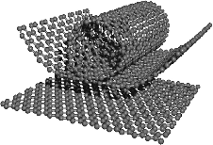

Is graphene stronger than steel?
Morinobu Endo, 2004
www.phase-trans.msm.cam.ac.uk

Slide 2
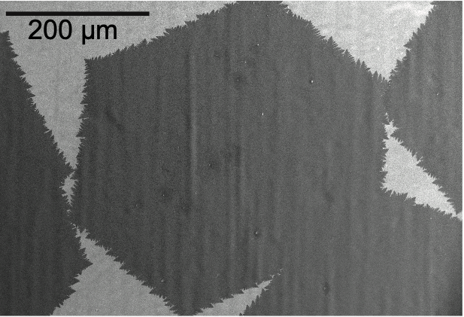
Naydenova, Peet, Russo; PNAS 116 (2019) 11718

Slide 3
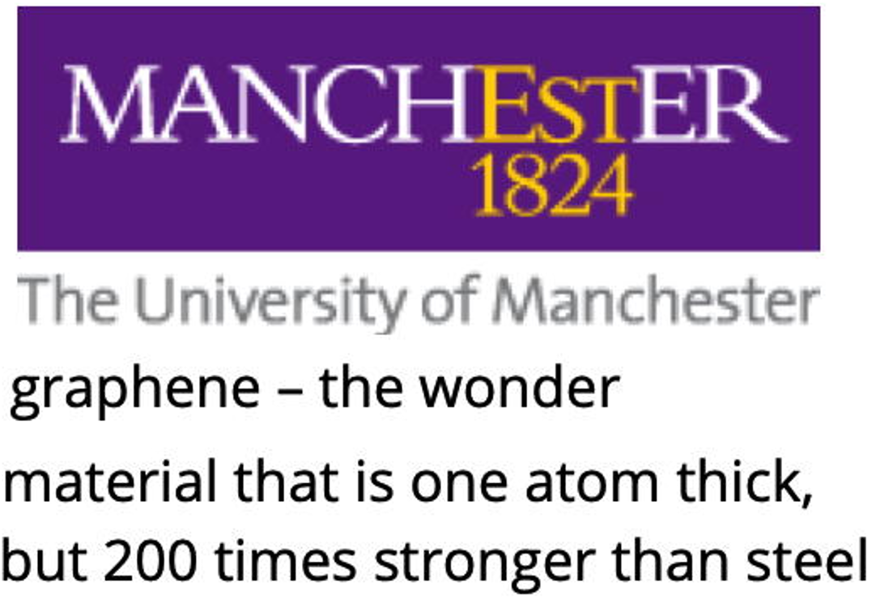
July 2020: student recruitment information

Slide 4
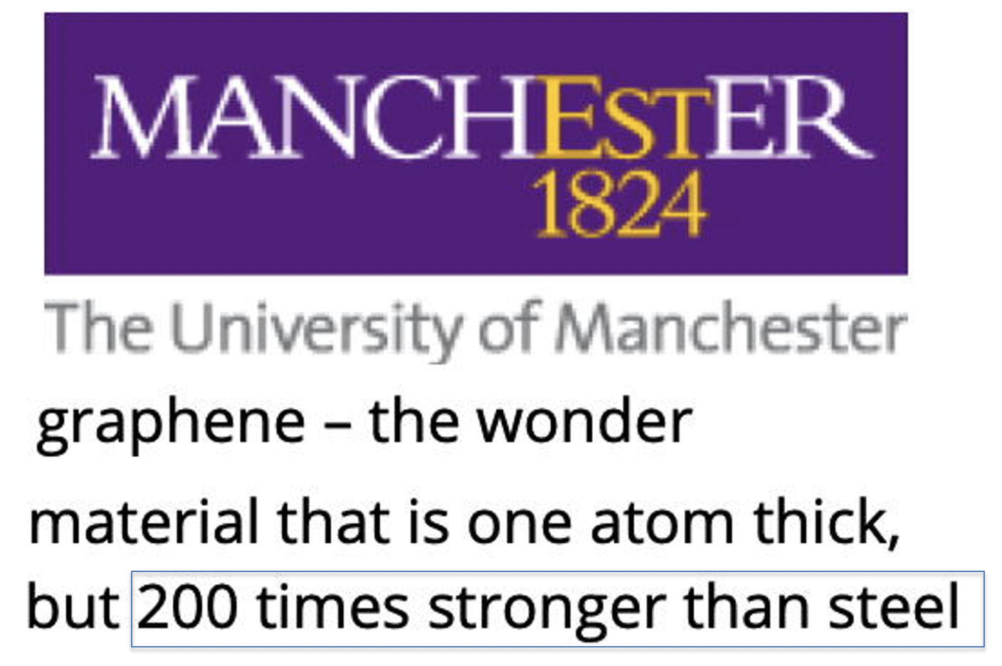
Has graphene delivered a strong material?
Is there a scaling law for strength?

Slide 5
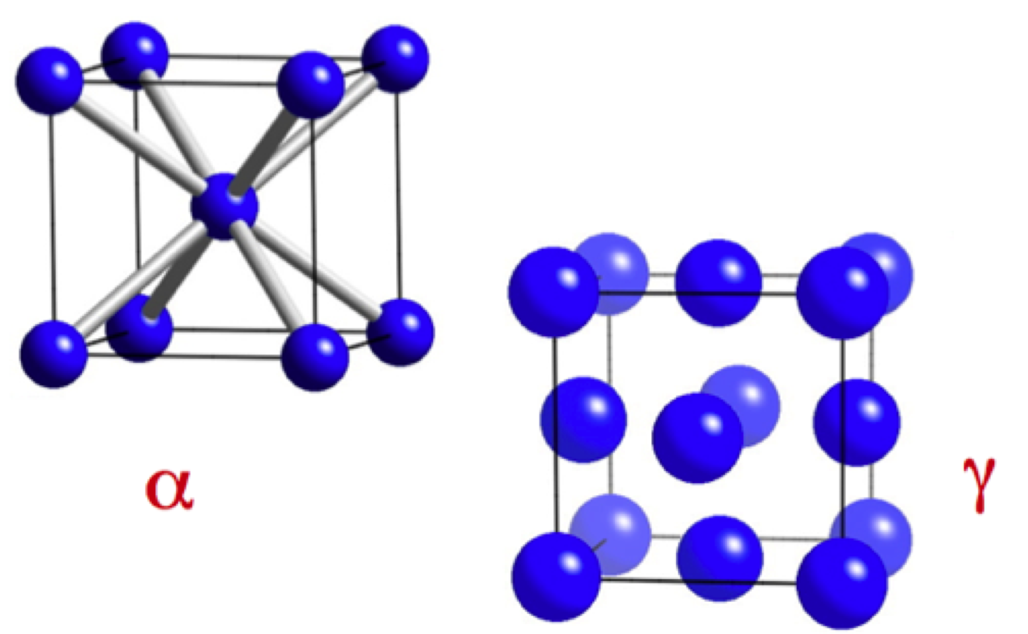
ideal strength?

Slide 6
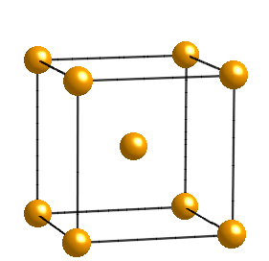
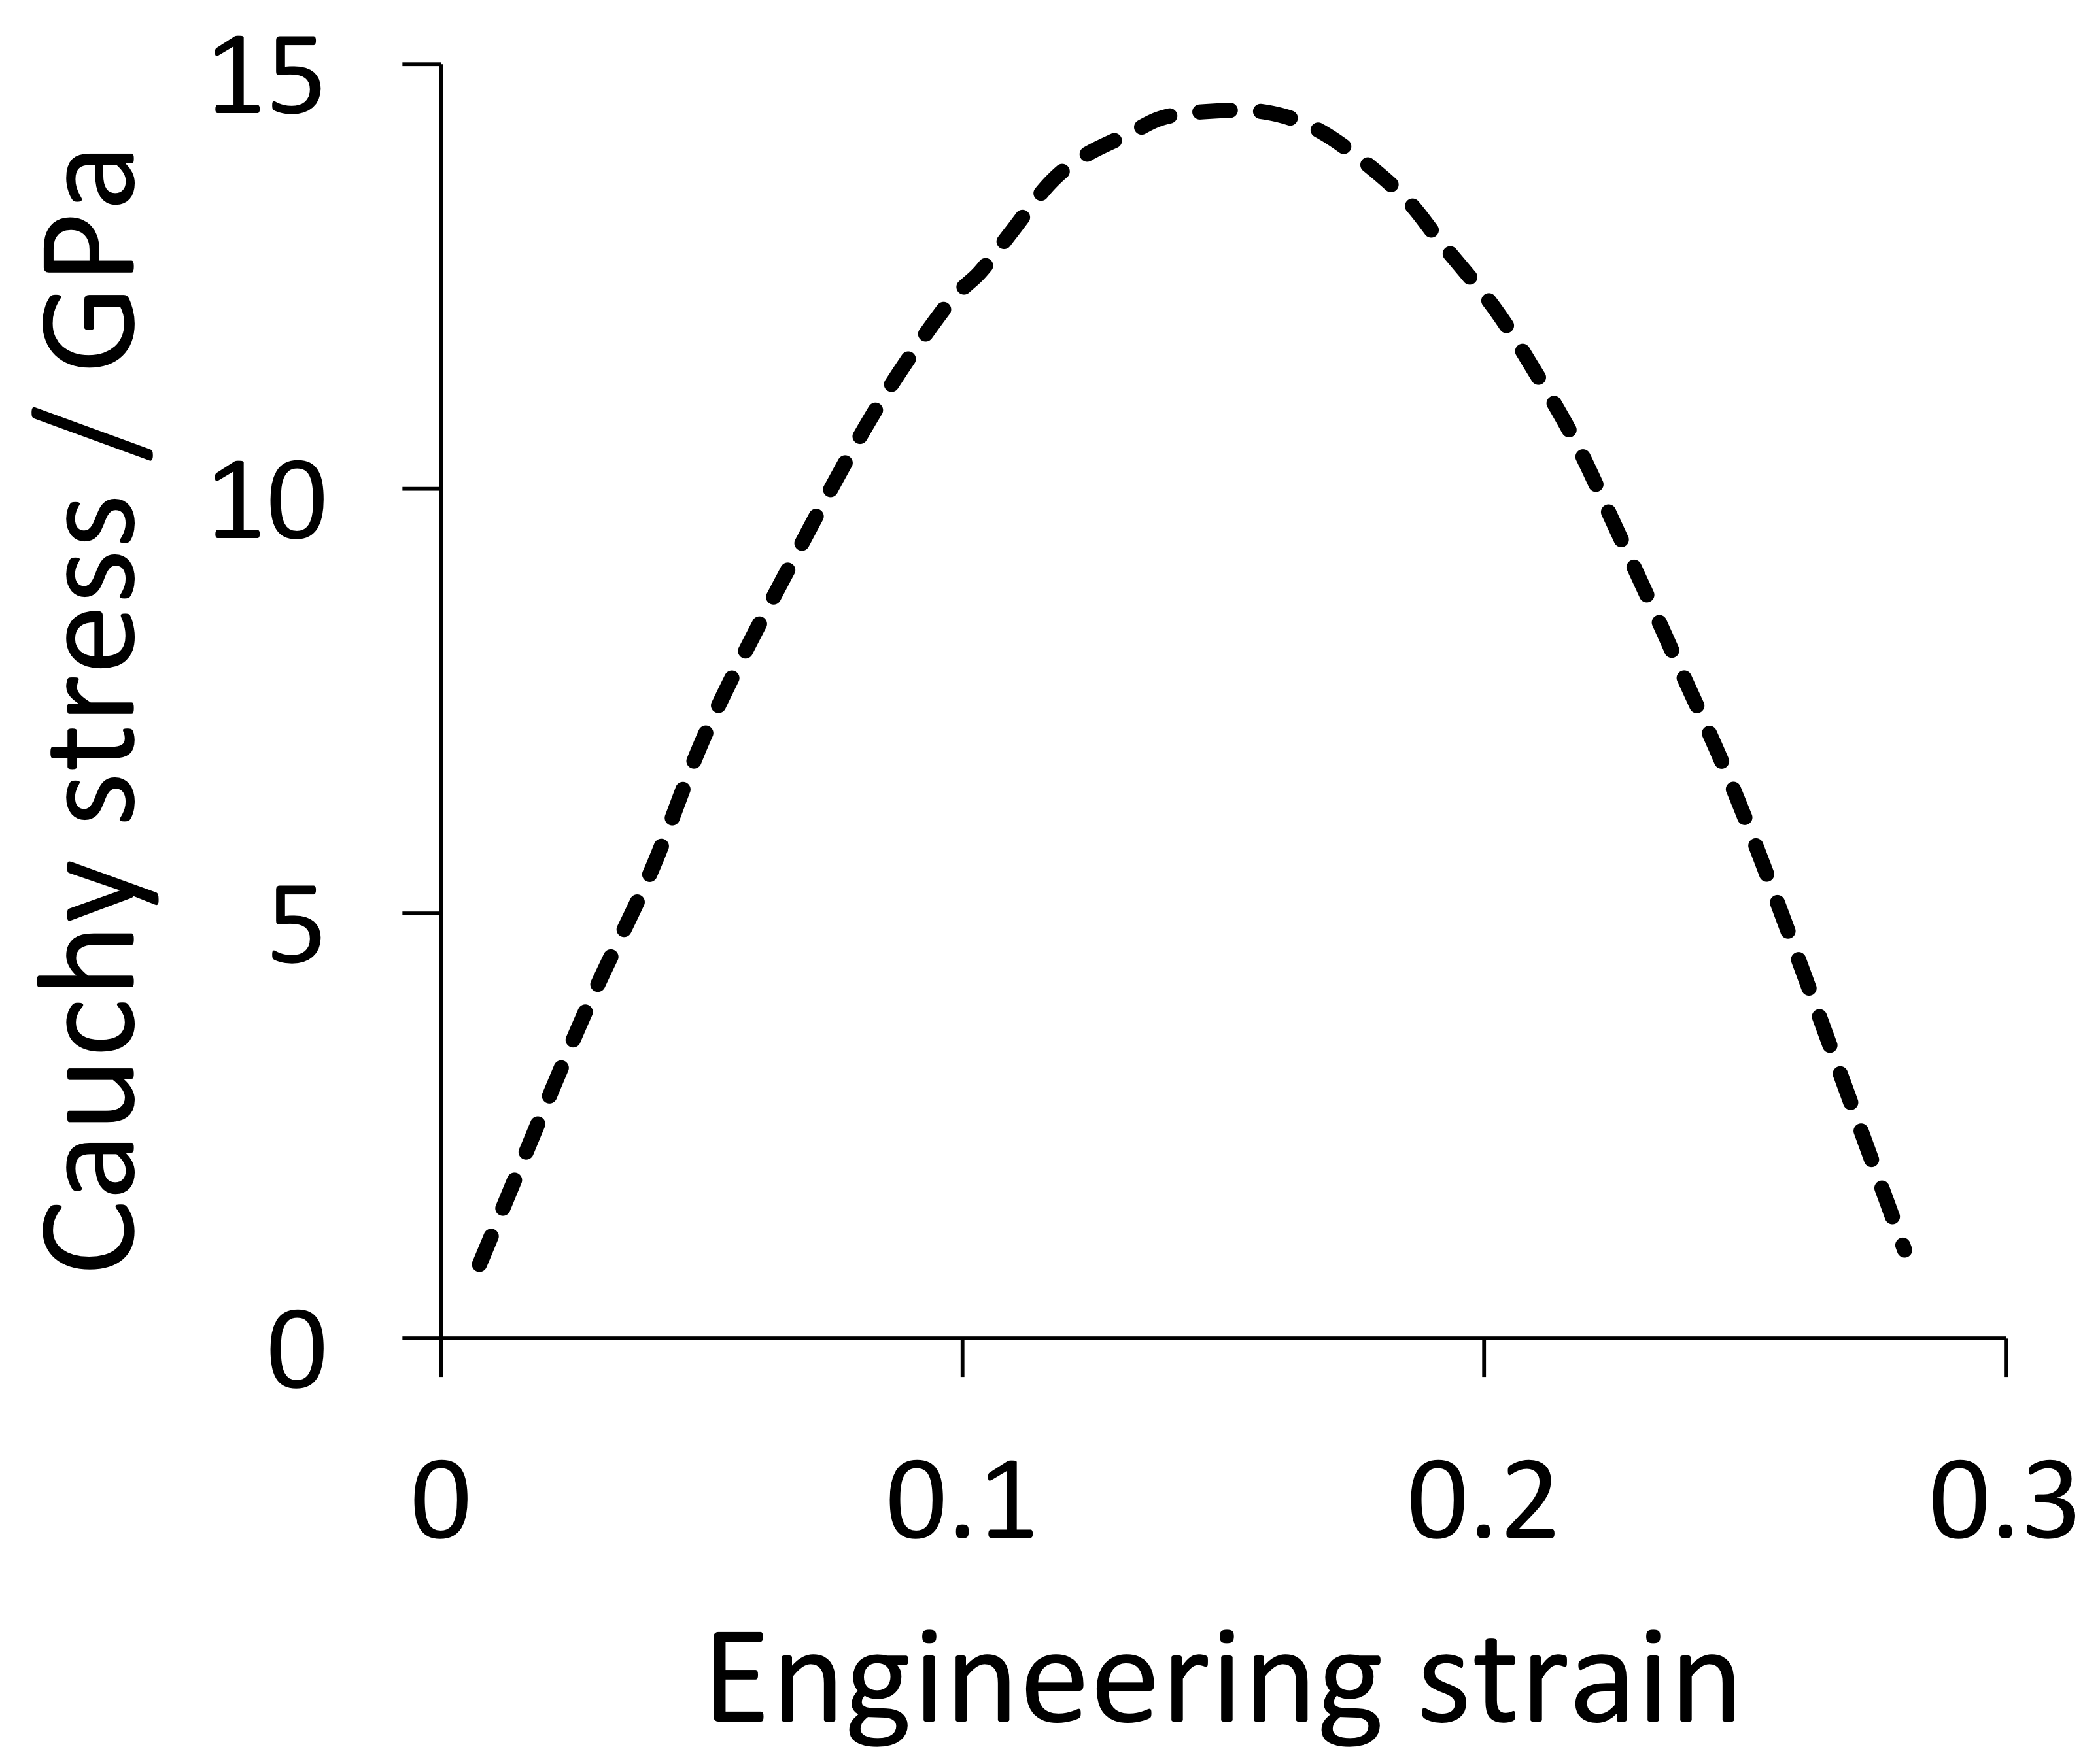
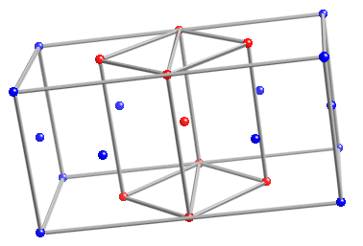
Clatterbuck et al.
Phil. Mag. Lett.
2002

Slide 7
Maximum strength of iron when pulled along its weakest direction?
14.5 GPa

Slide 8
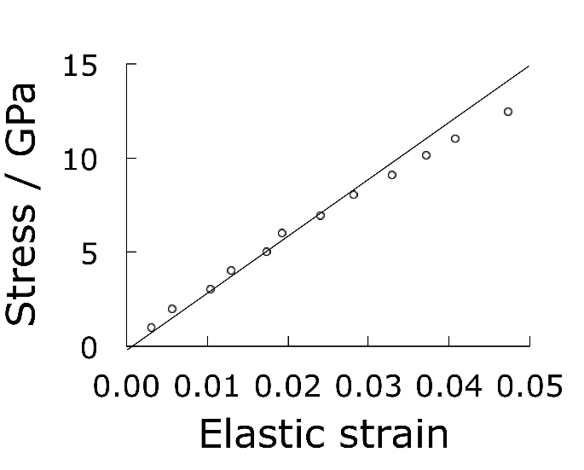
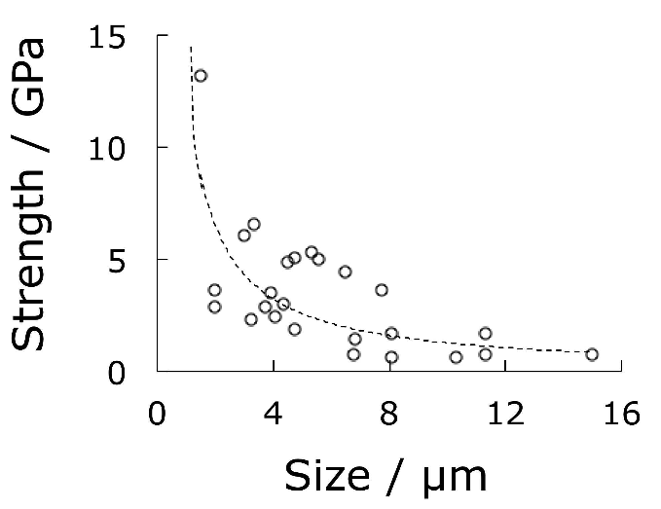
Single crystals of iron
Brenner:1956

Slide 9
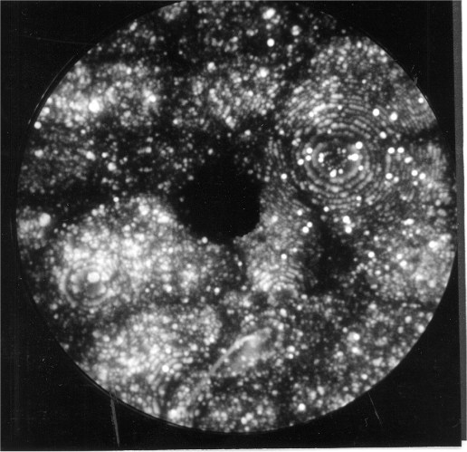
Commercial alloy made by Kobe Steel

Slide 10
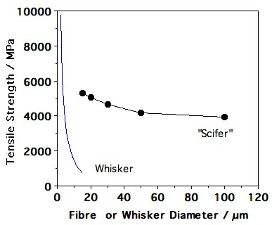

Slide 11
Claimed strength of carbon nanotube is 130 GPa
Edwards, Acta Astronautica, 2000
Claimed modulus is 1.2 TPa
Terrones et al., Phil. Trans. Roy. Soc., 2004

Slide 12
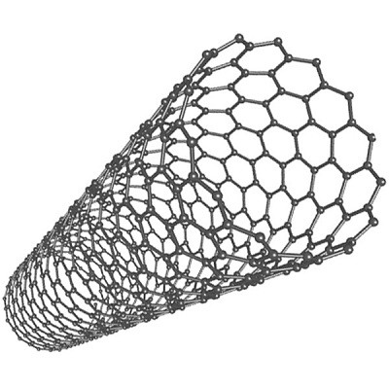
How is the strength of nanotube calculated?
By ignoring the empty space within the nanotube
Therefore strength of steel, which has 32% space unoccupied, is greater by 47% than reported since time zero

Slide 13
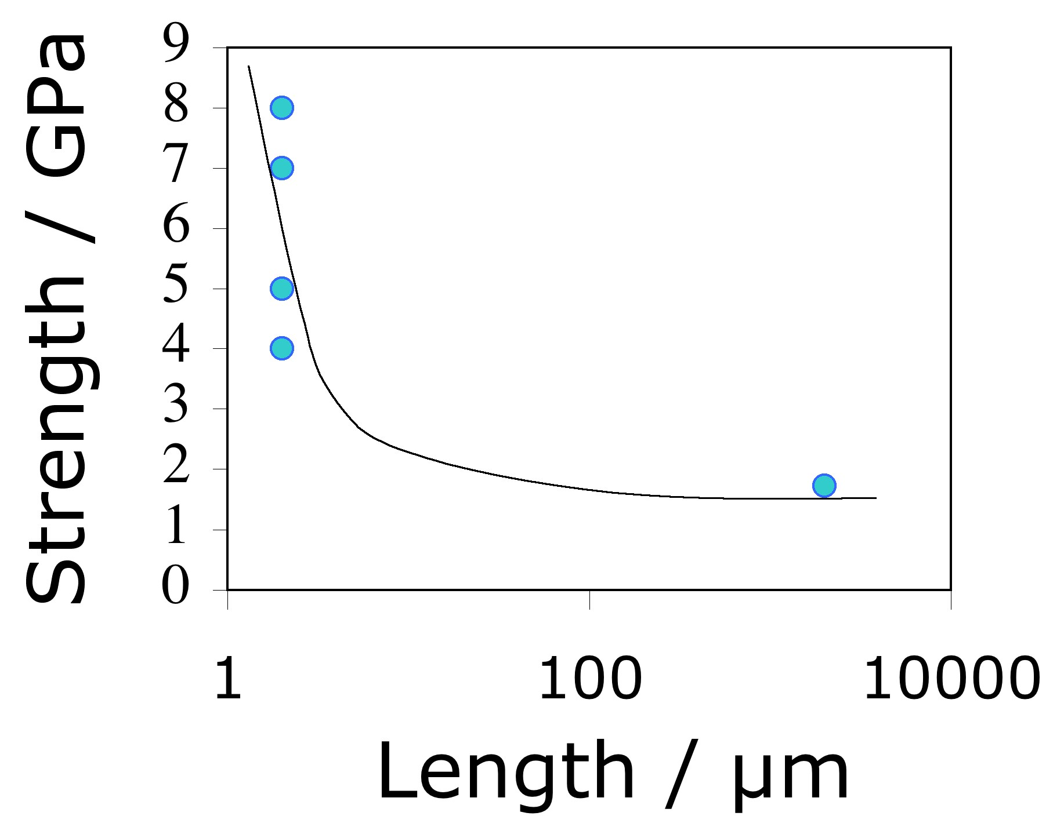
data from Pan et al. 1999, Yu et al. 2000

Slide 14
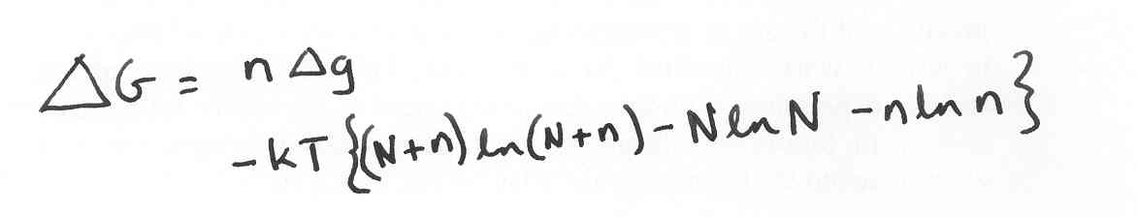
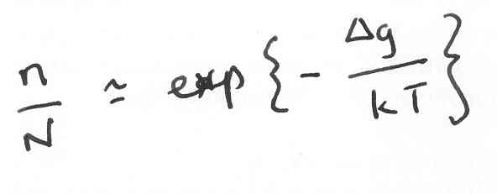
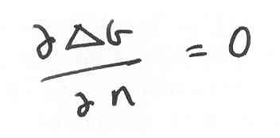
An equilibrium number of defects.
Strength of a nanotube rope 2 mm long is less than 2000 MPa

Slide 15
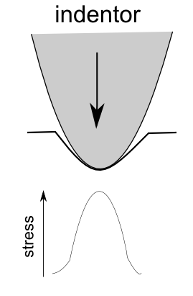
Lee et al. Science (2008)
reported breaking strength
of 130 GPa for sample
about 2 µm square of
pristine graphene

Slide 16

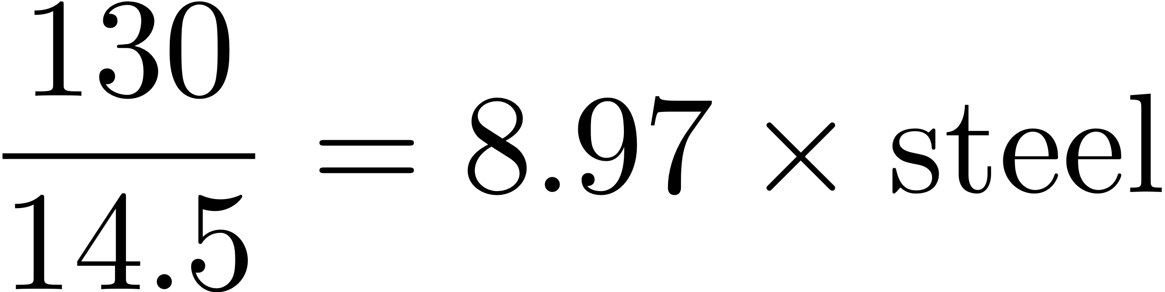
Intrinsic strength of Graphene
(samples 2 µm²)

Slide 17
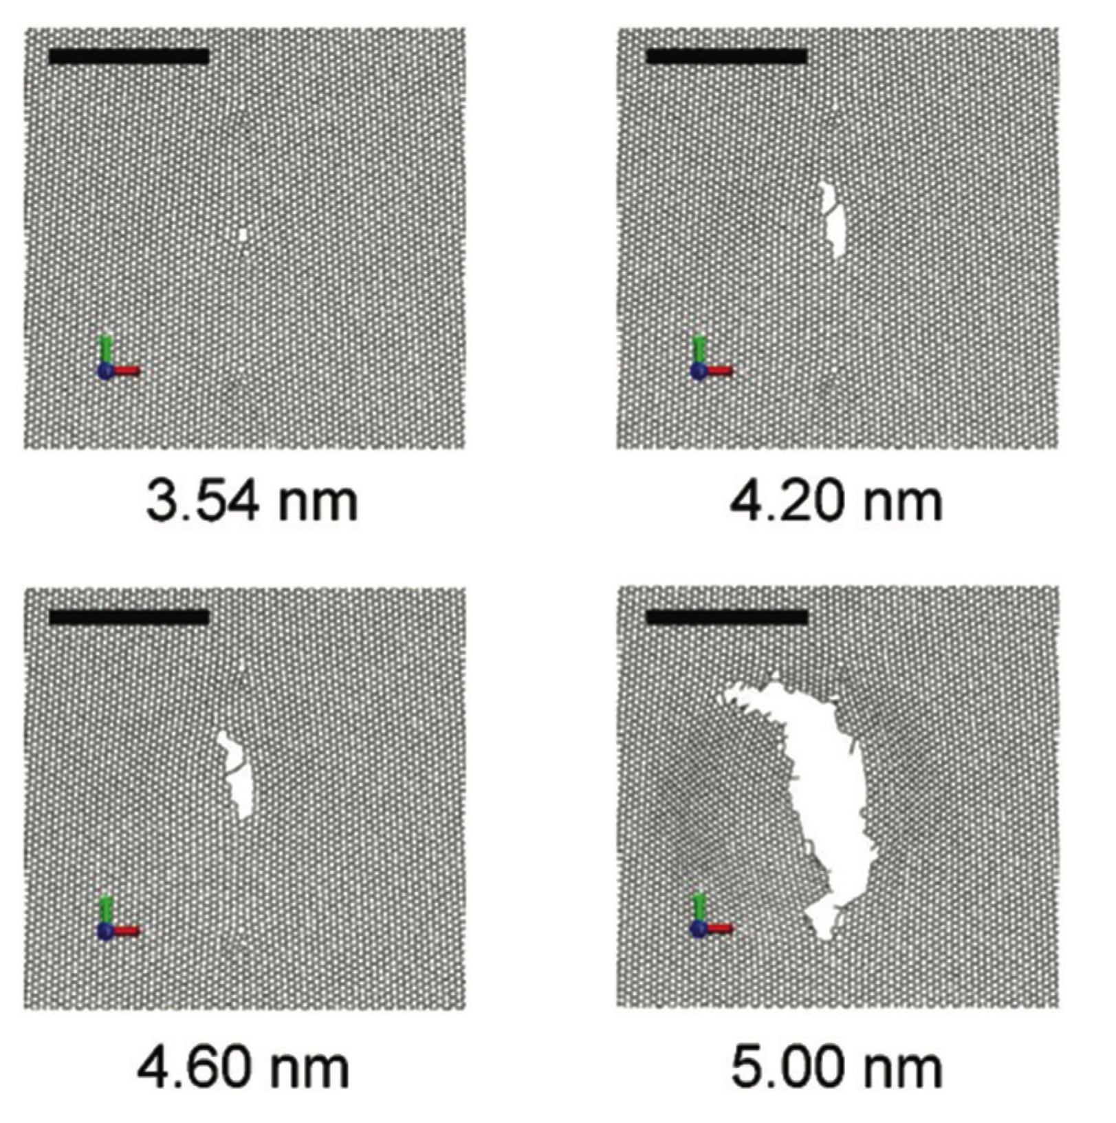
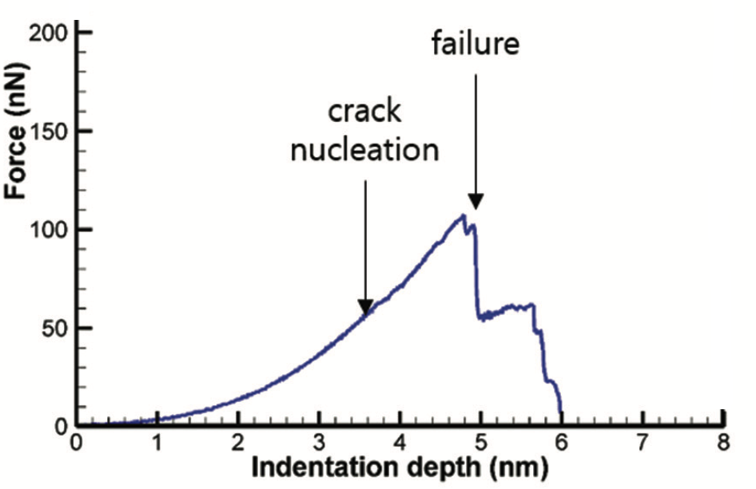
Han et al., Nanoscale, 7 (2015) 15672

Slide 18
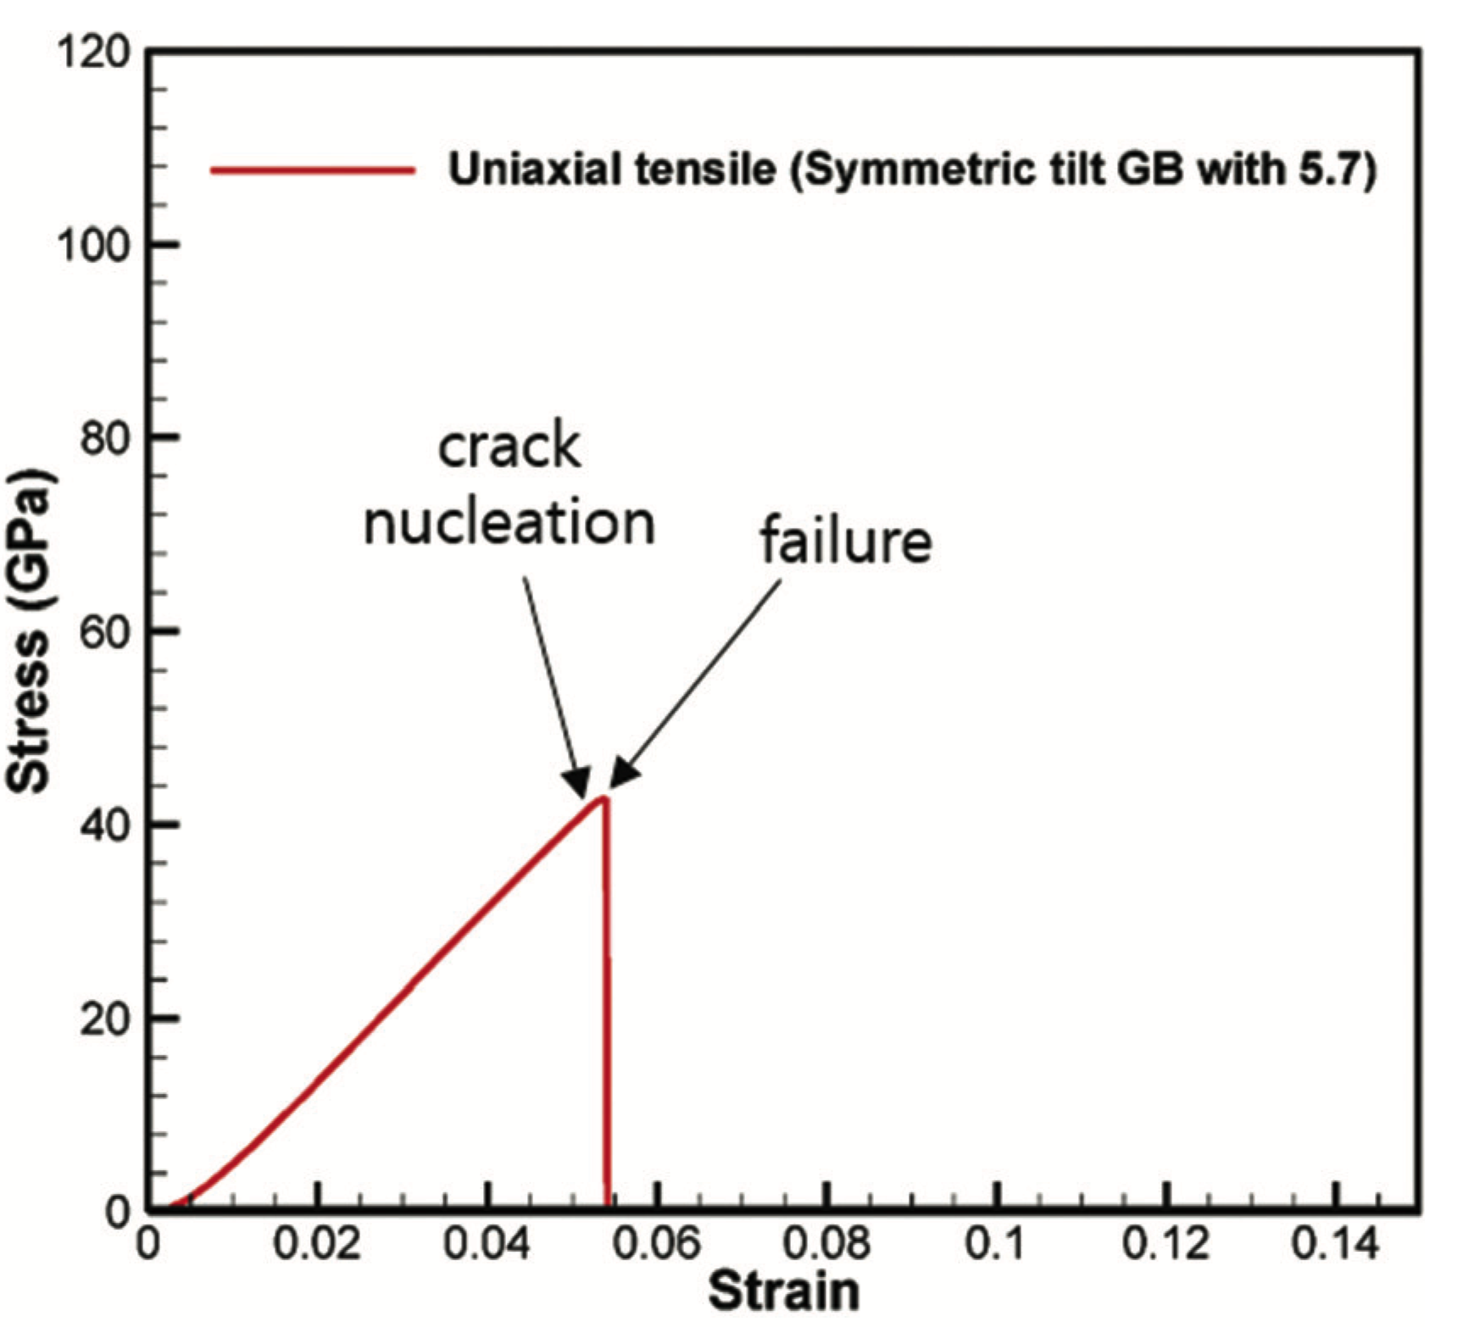
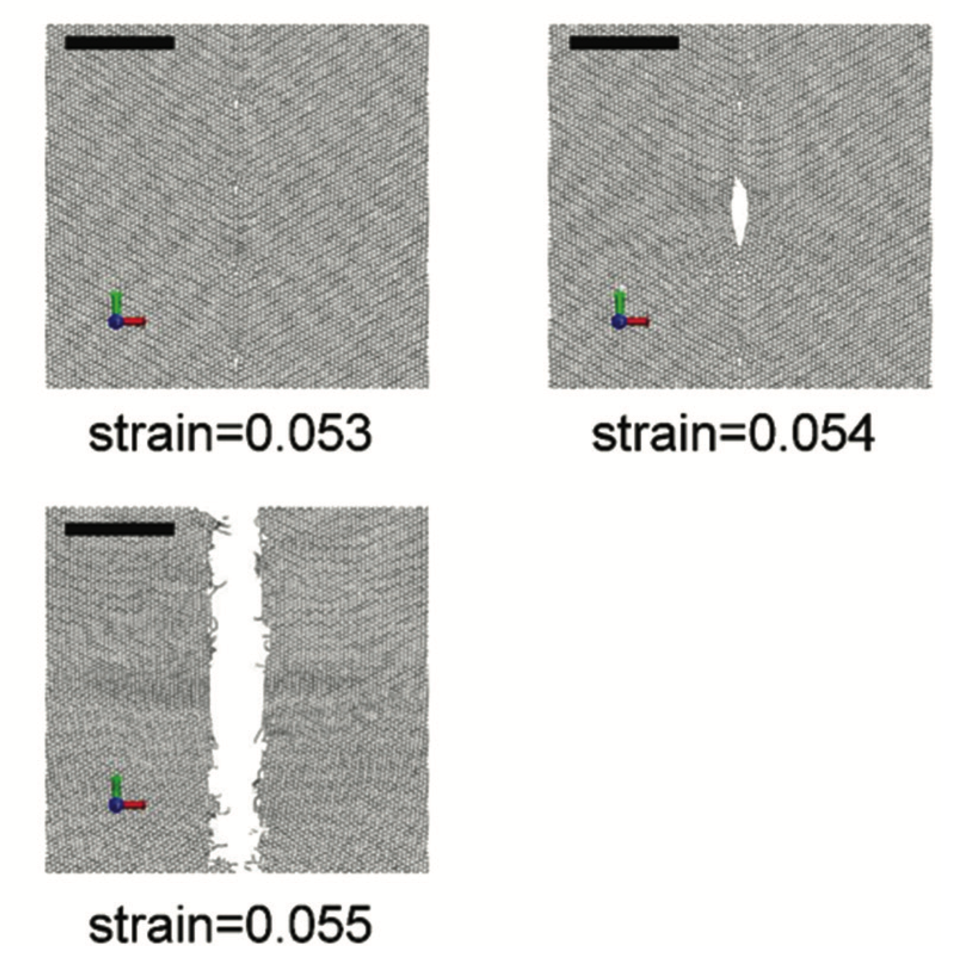
Polycrystalline graphene is brittle under homogeneous tensile stress
Han et al.
Nanoscale
7 (2015) 15672

Slide 19
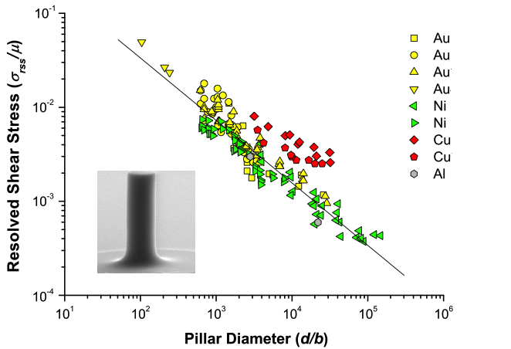
Micropillar tests: Dou, Derby, Scripta Mat. 61 (2009) 524

Slide 21
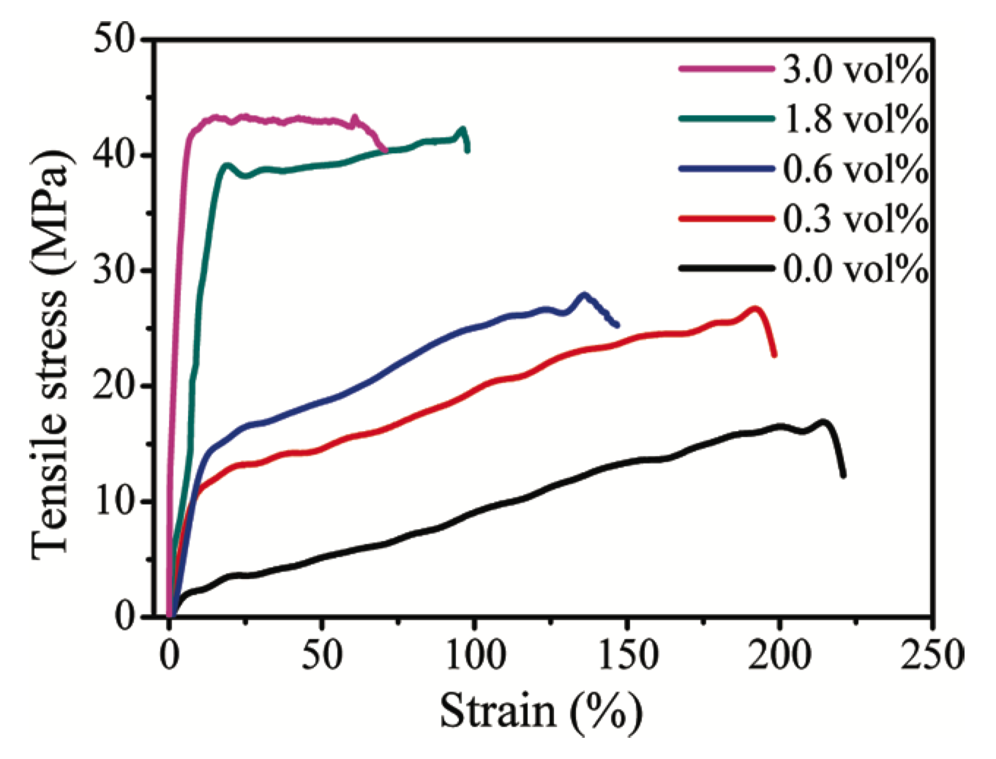
Graphene in composites
Zhao et al.
Macromolecules
43 (2010) 2357

Slide 22
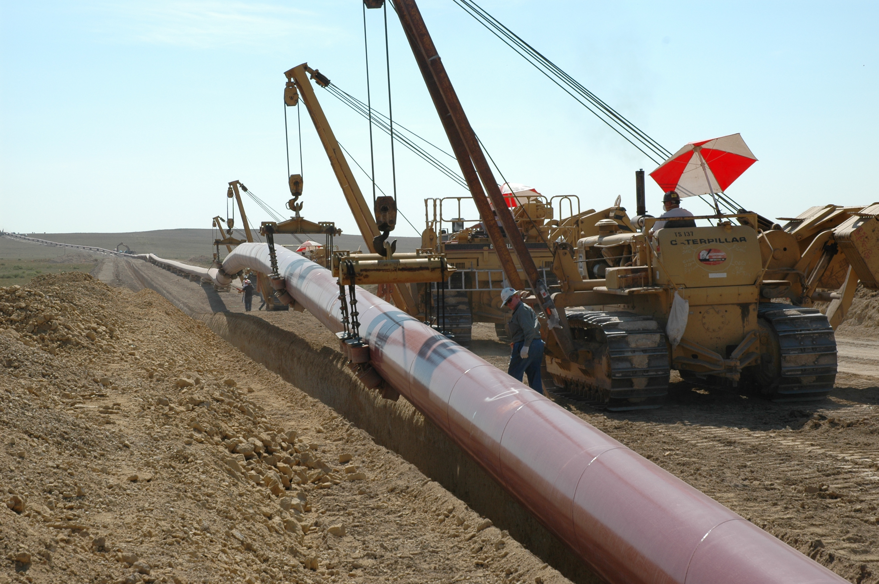
2000 MPa
1200 MPa
500 MPa

Slide 23
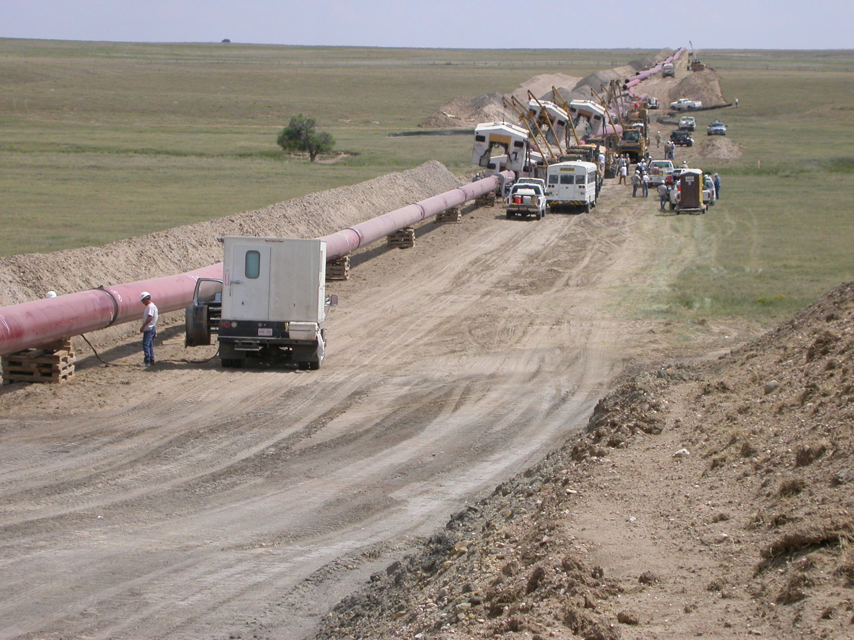
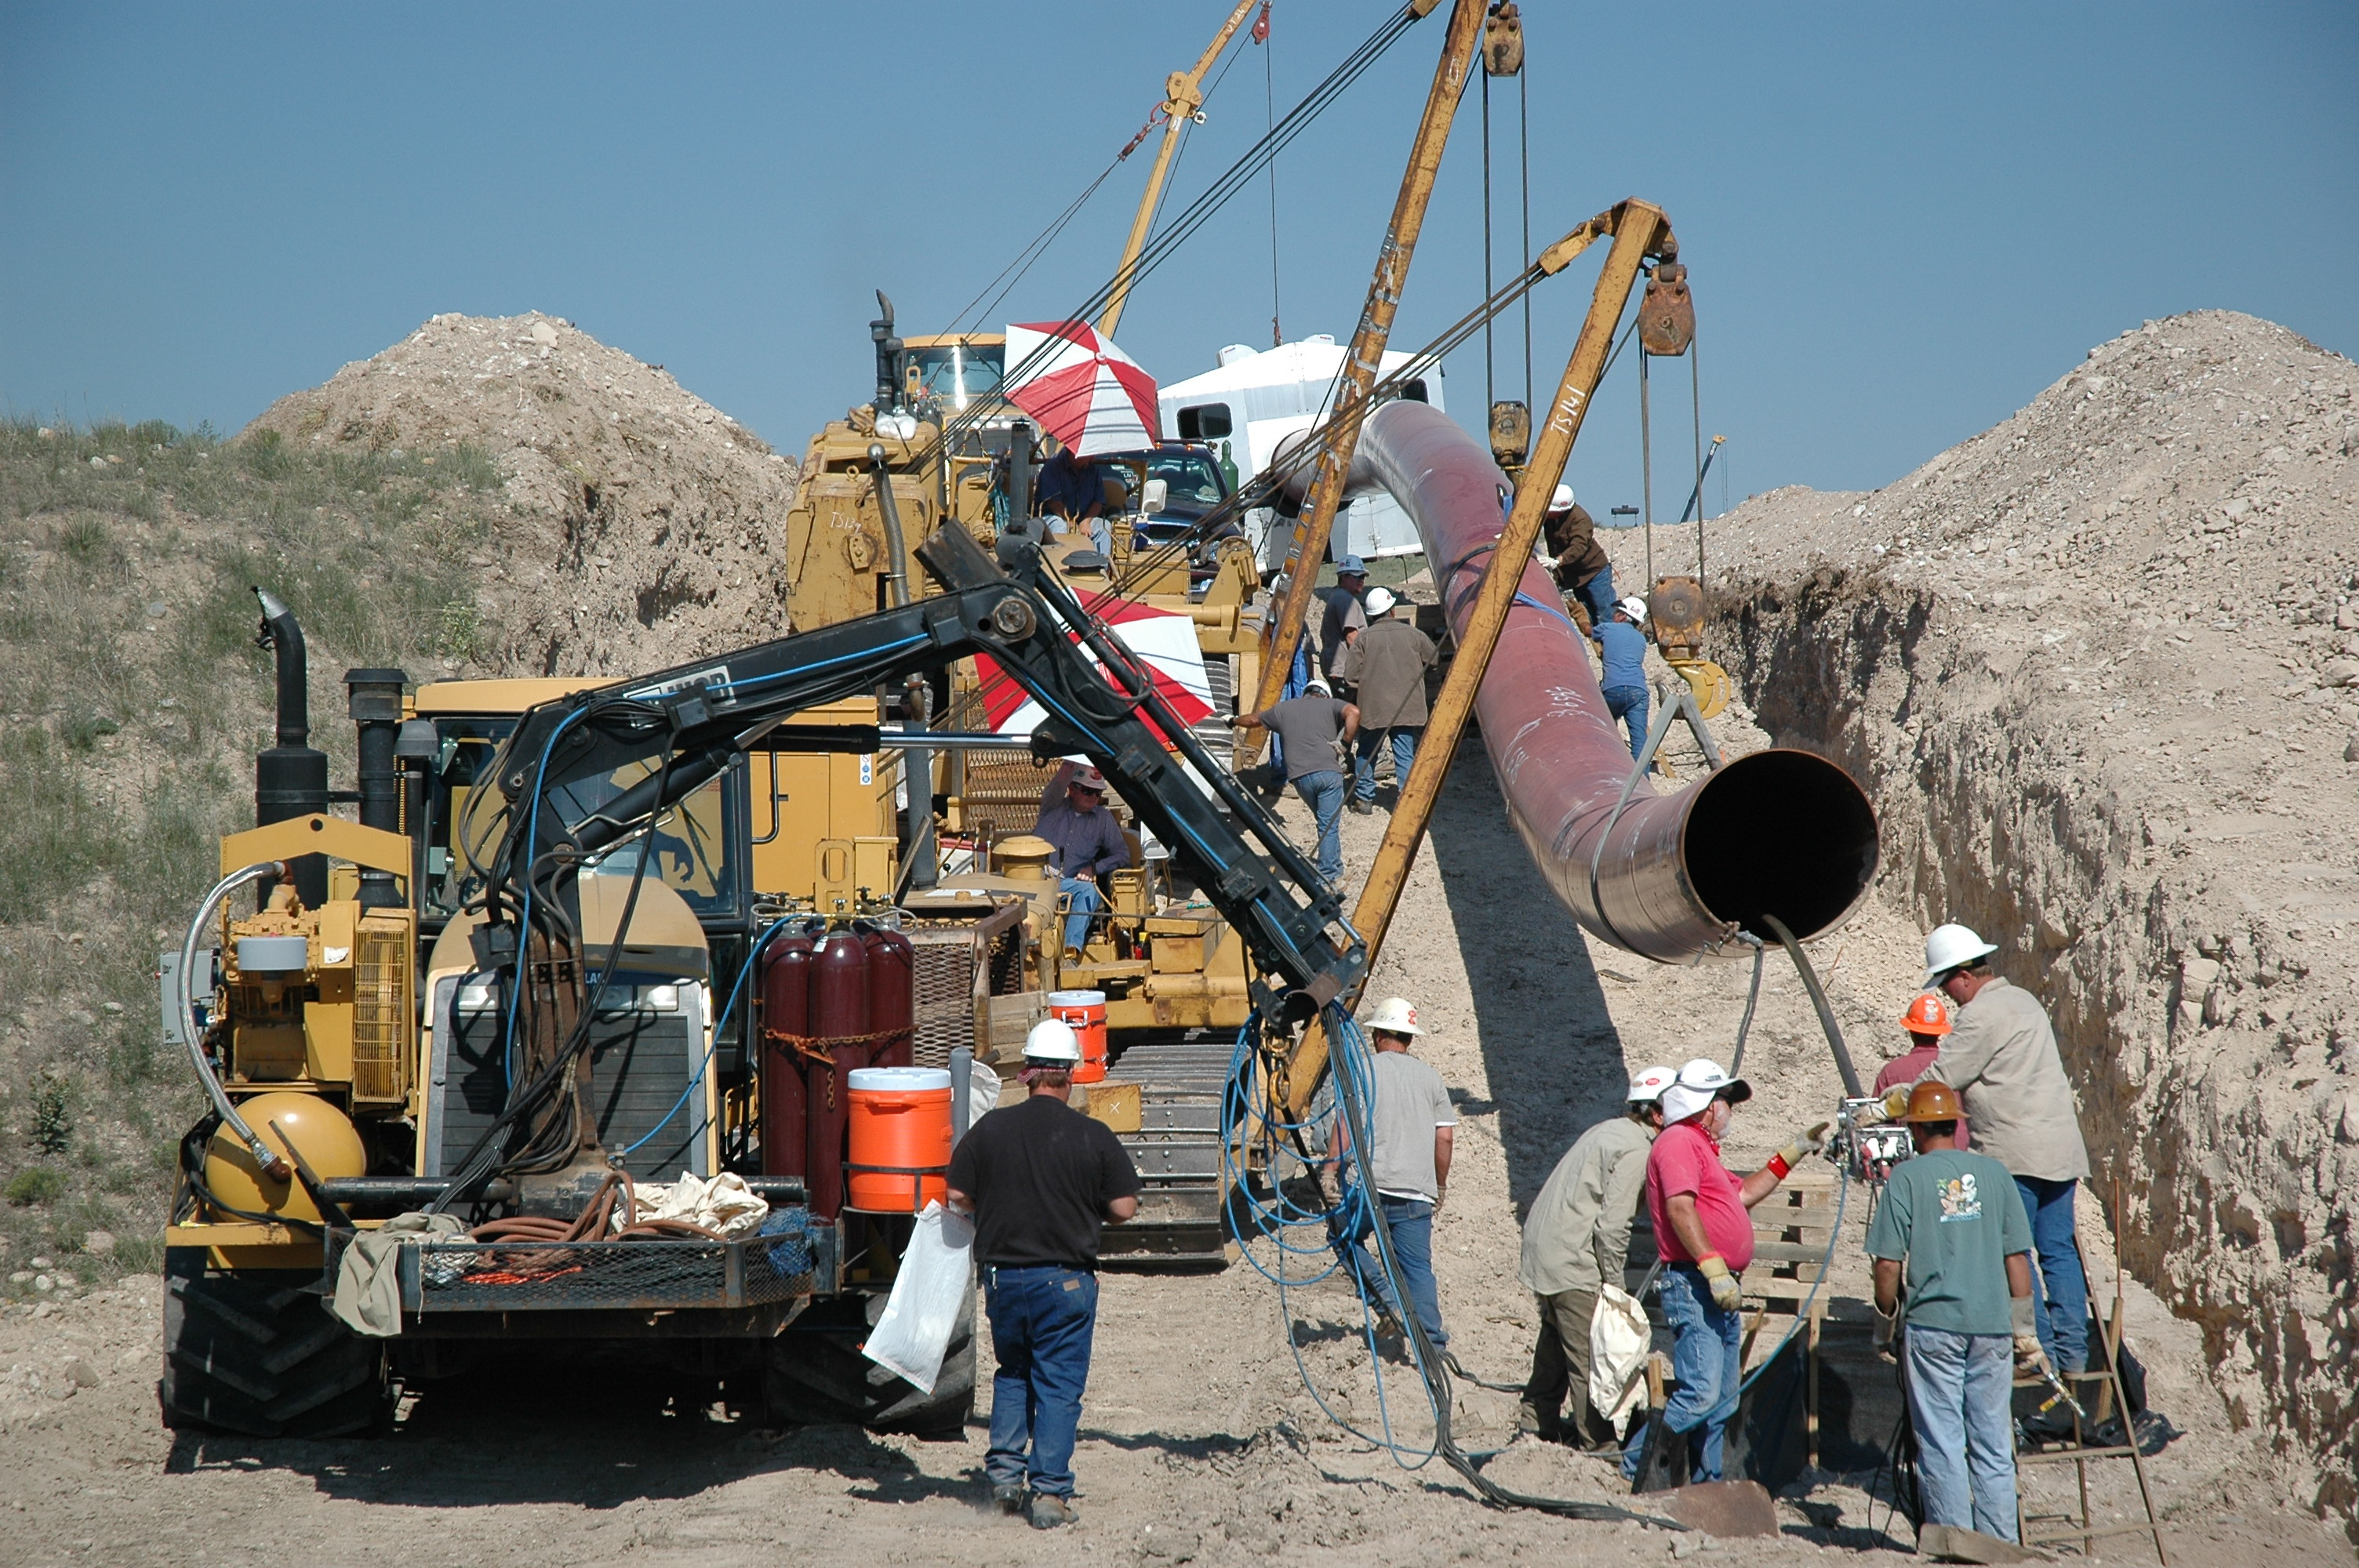

Slide 24
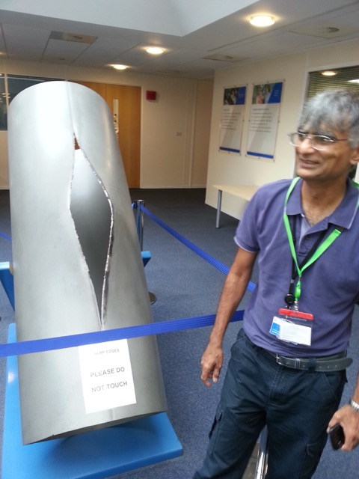

Slide 25
strength 130 GPa
modulus 1.2 TPa
 | J g⁻¹ | m s⁻¹
Dynamite | 4650 | 6000
Nanotube | 5420 | 21500

Slide 26
Conclusions
Graphene is at best ten times stronger than steel but at the micrometre level
No evidence that the strength of graphene is sustained as the size is increased.
Graphene is, a brittle material, can only be stressed elastically.

Slide 27
