Slide 1
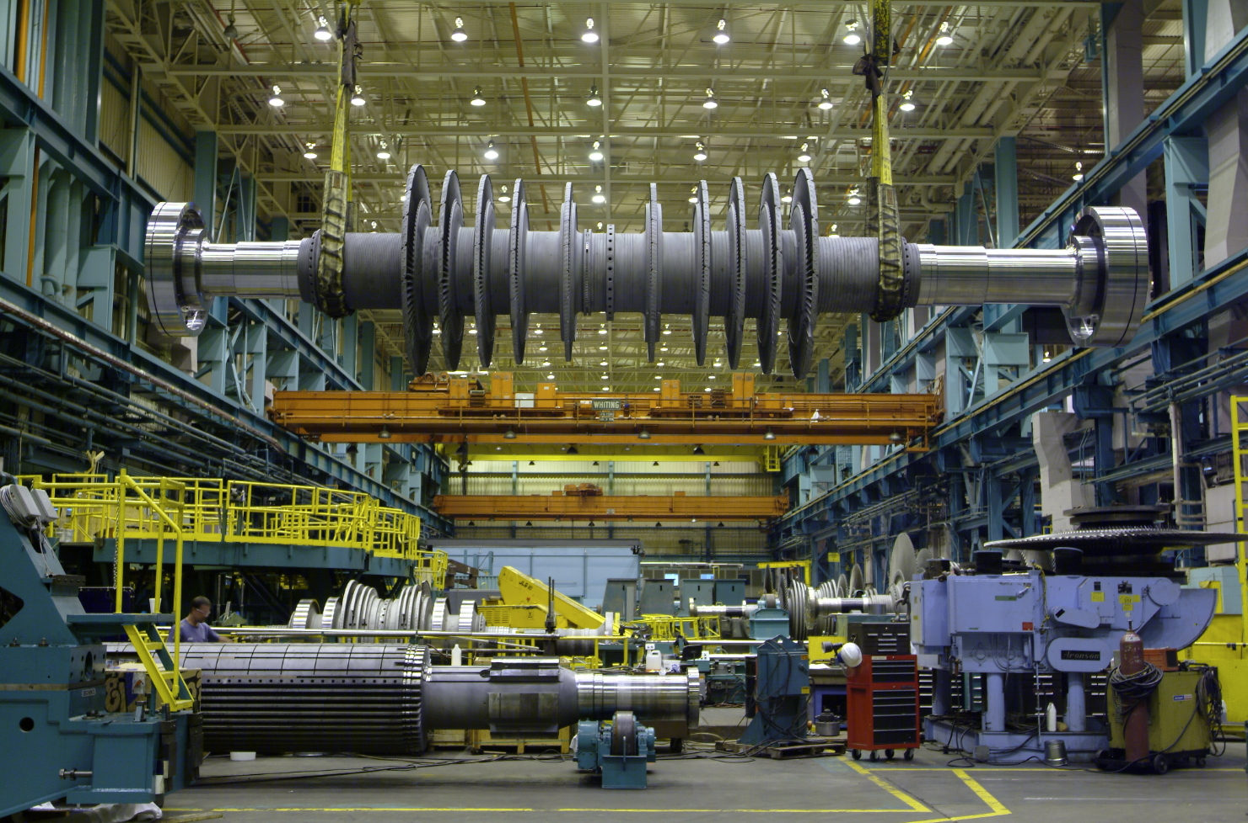
Data-centric engineering
… in metallurgy
www.phase-trans.msm.cam.ac.uk

Slide 2


David MacKay
1967-2016

Slide 3
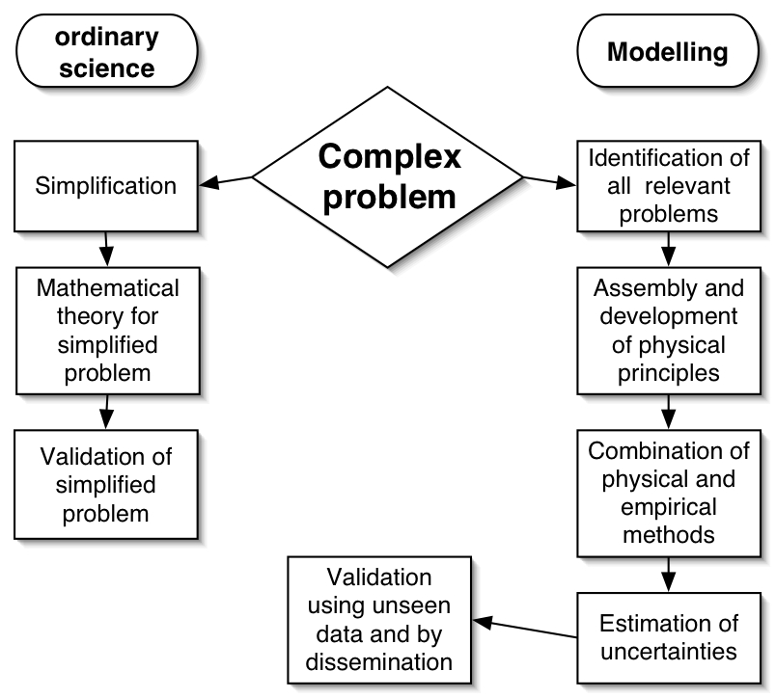

Slide 4


Slide 5
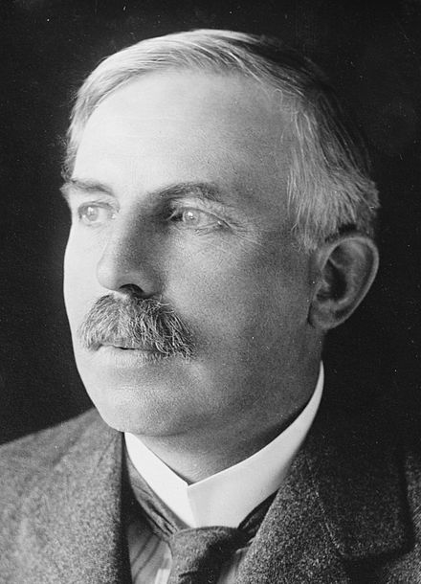
Physics is the only real science.
The rest are just stamp collecting.

Slide 6
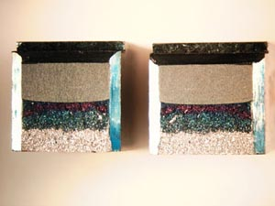
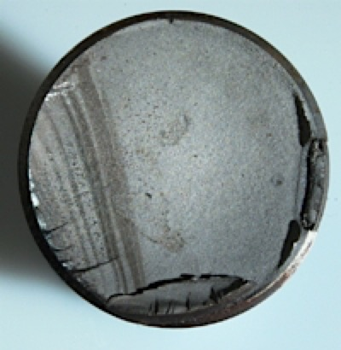
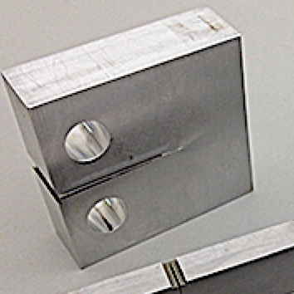
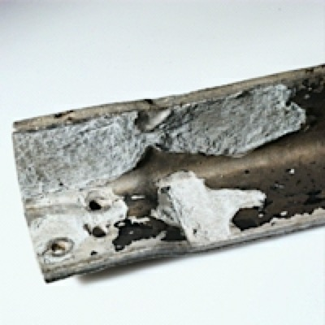
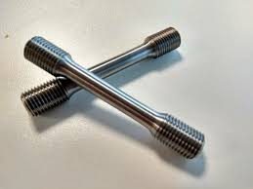
Charpy
fatigue
critical stress intensity
corrosion
tensile

Slide 7

y
x
Michael McIntyre

Slide 8
Solution
non-linear functions
Many, many variables
uncertainties
large knowledge base
Notes:
Dogma - statement of belief

Slide 9
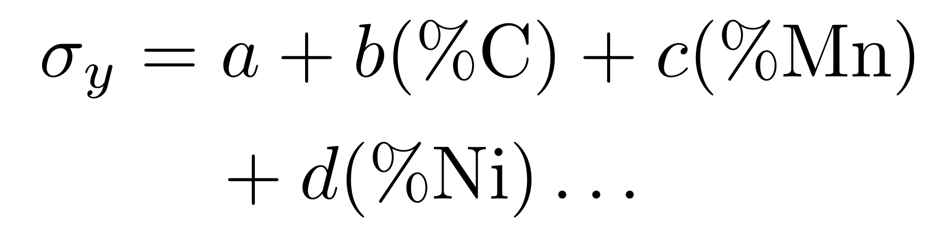
Empirical Equations

Slide 10
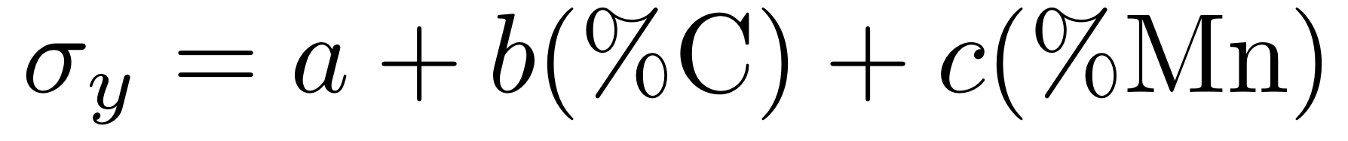
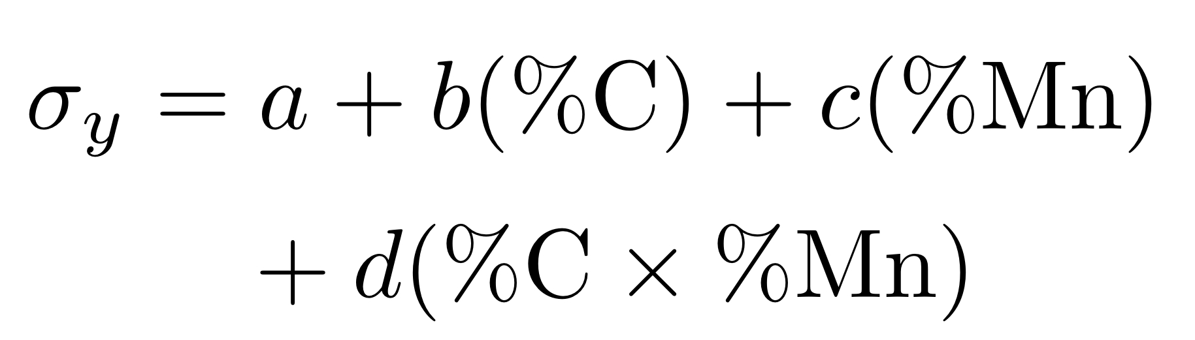

Slide 11
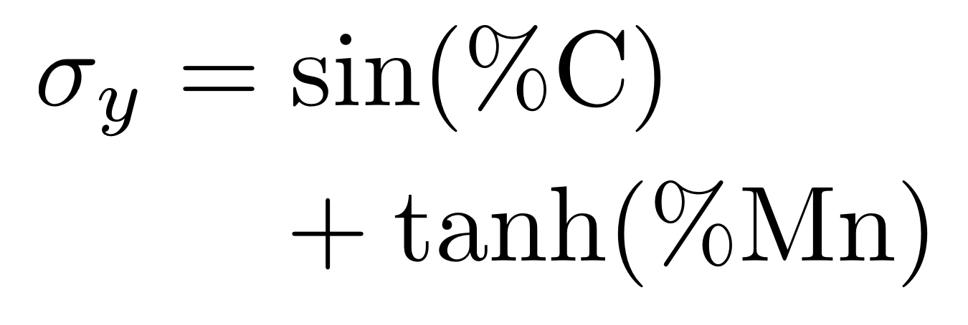

Slide 12
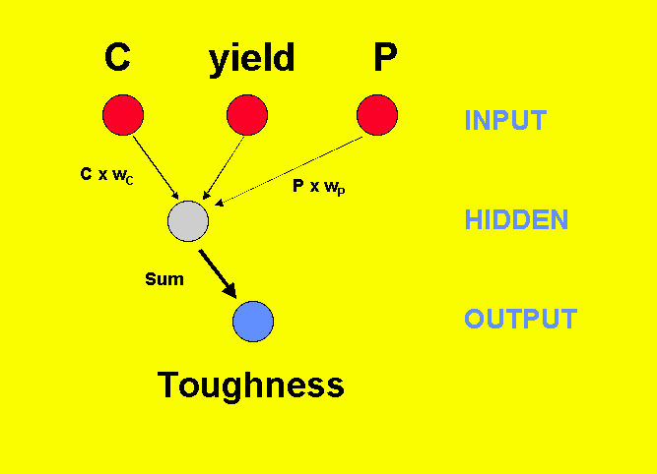

Slide 13
Hyperbolic Tangents

Slide 14
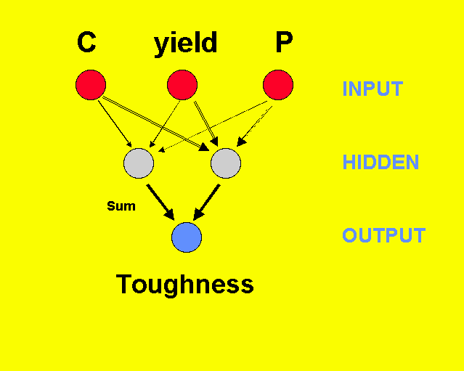

Slide 15
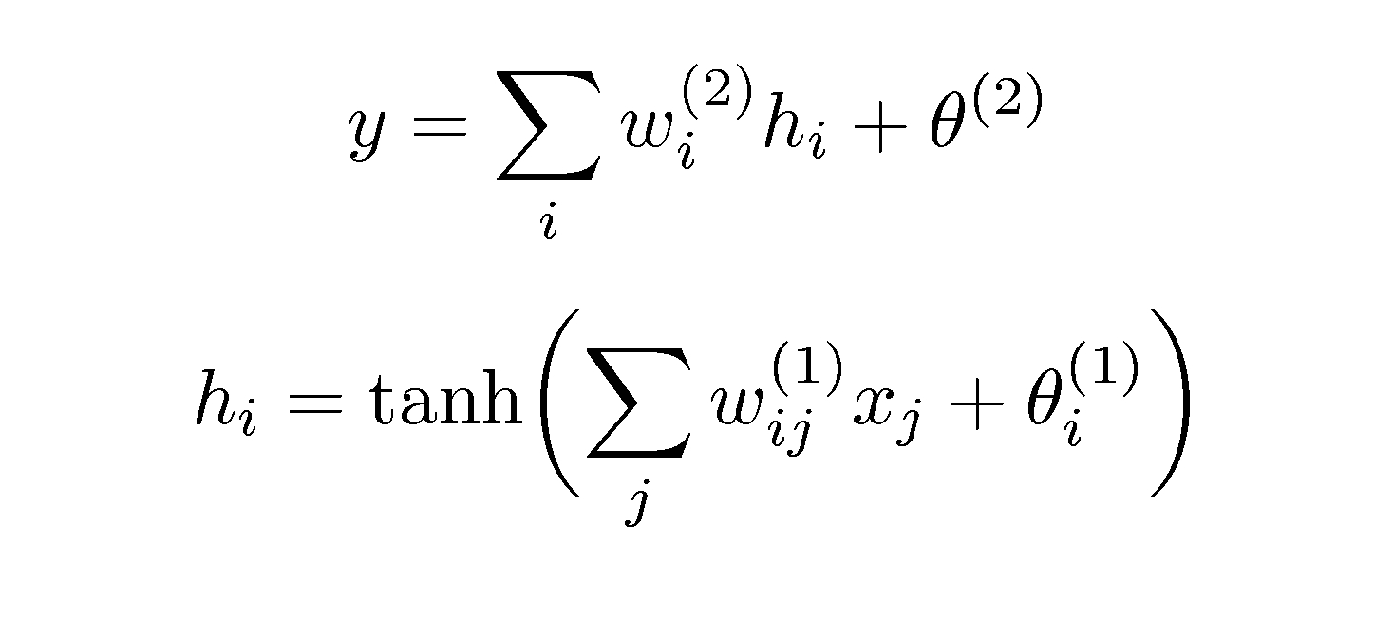

Slide 16
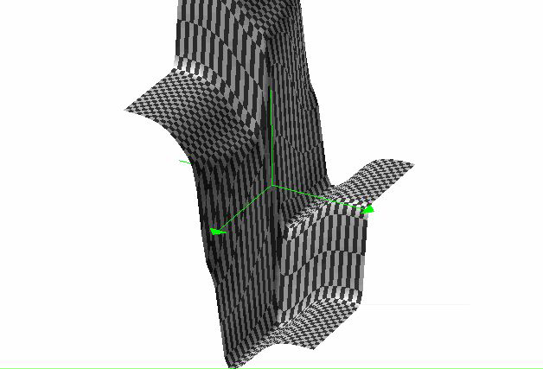
non-linear
functions

Slide 19
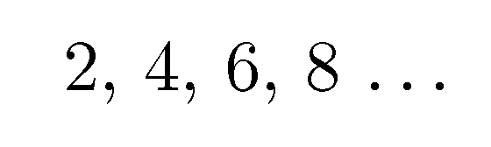


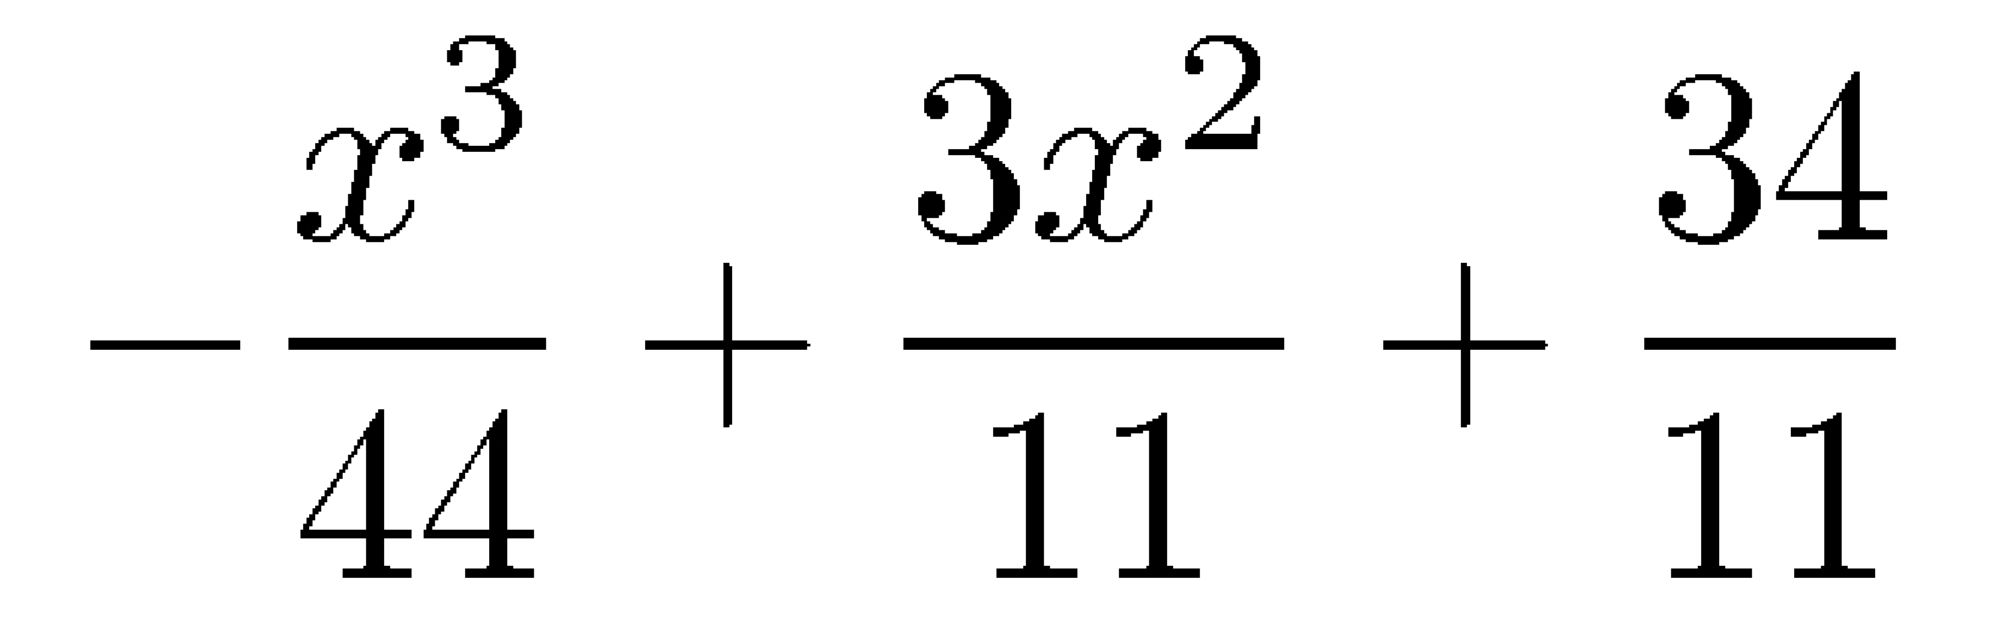

Slide 20
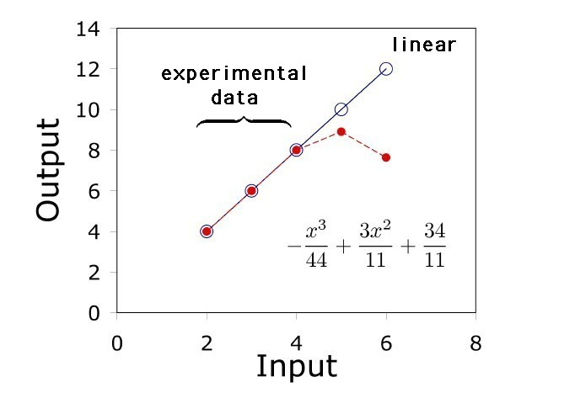

Slide 21
y
A
B
x

Slide 22
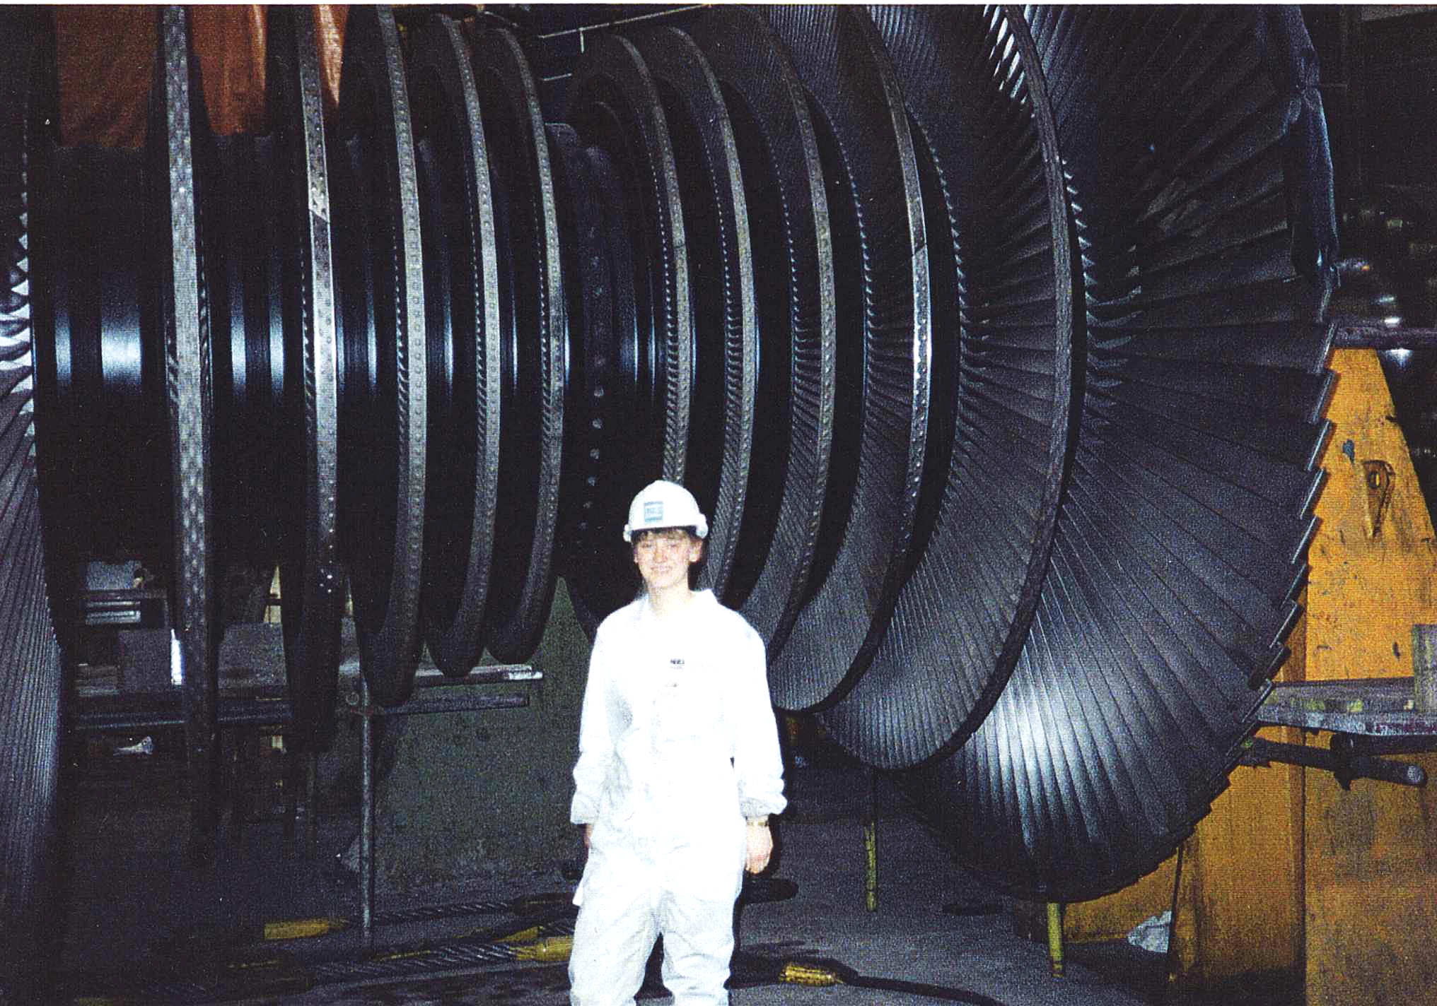

Slide 23
Variables
C, Mn, Si, Ni, Cr, Mo, V, Co, B, N, O…..
Thermomechanical processing of steel
Welding consumable
Welding parameters
Complex series of heat treatments

Slide 24
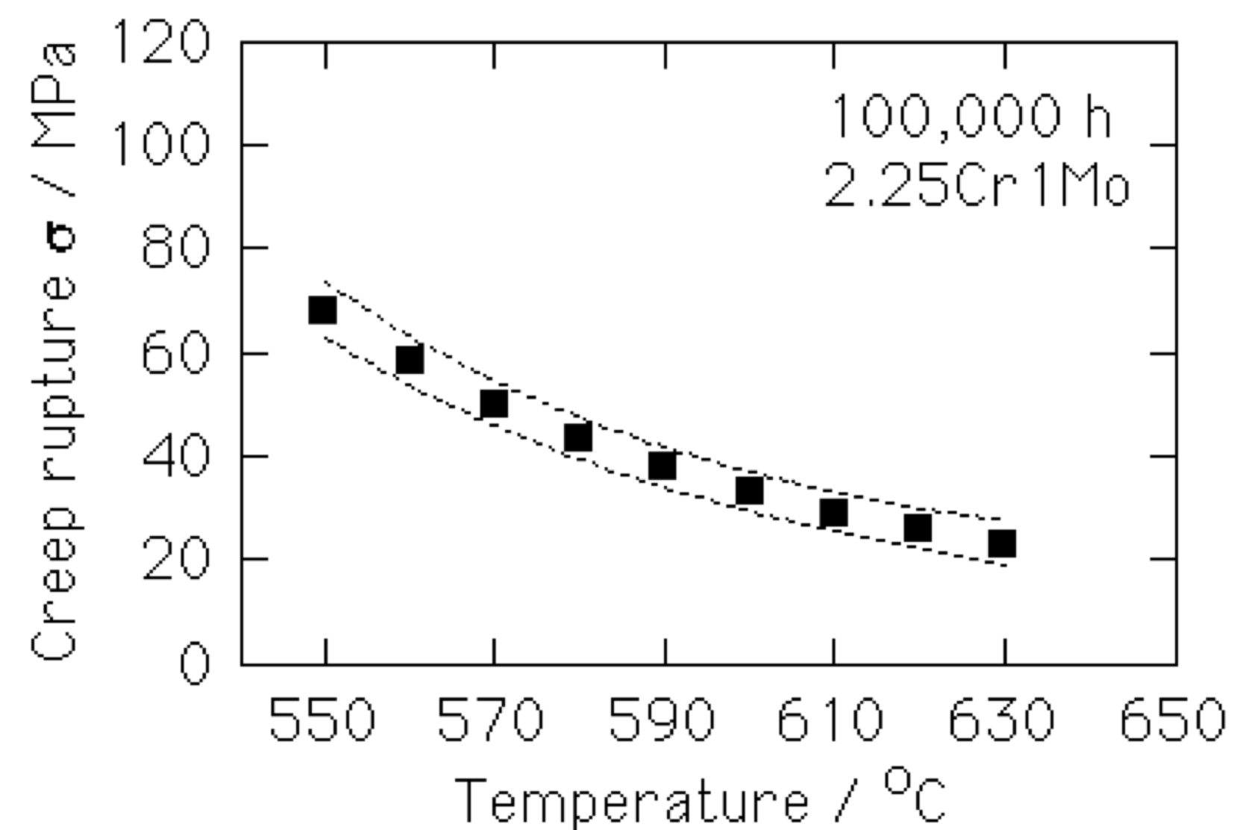
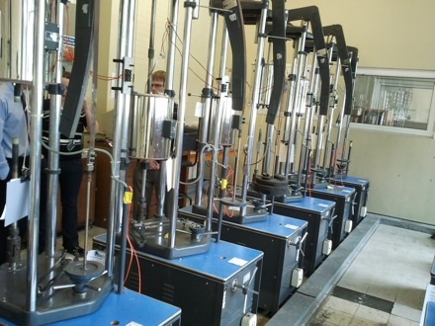
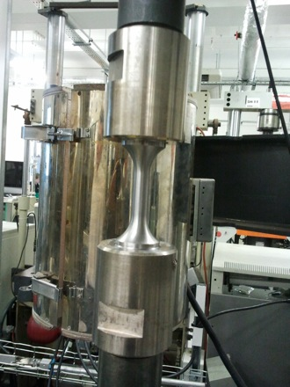
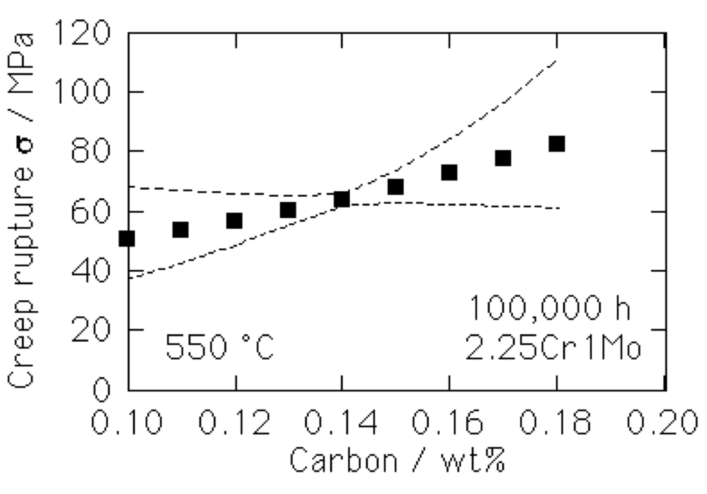

Slide 25
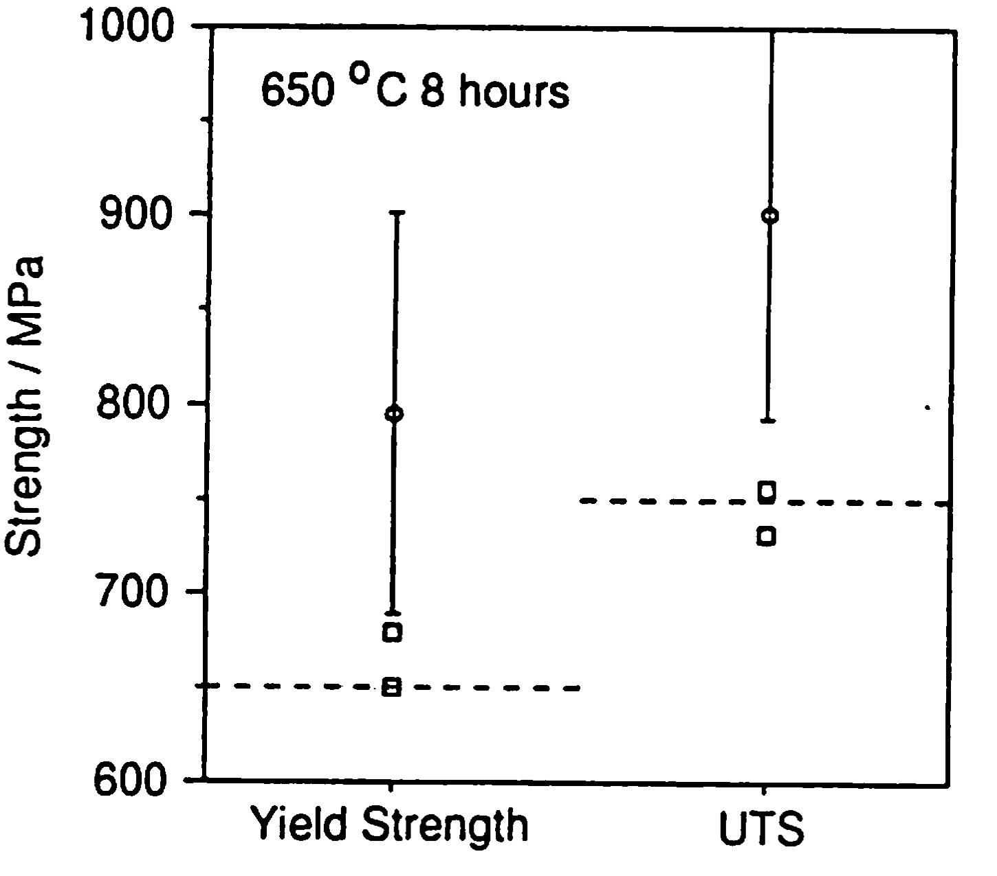
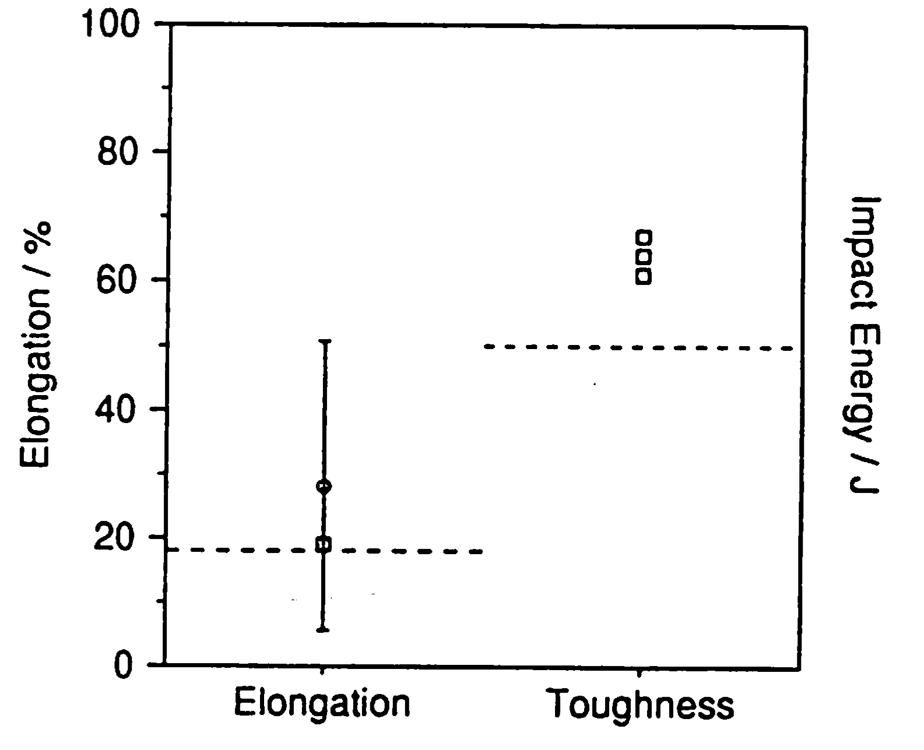
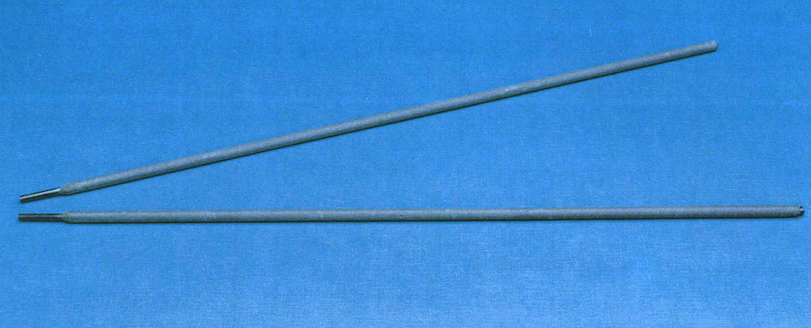

Slide 26
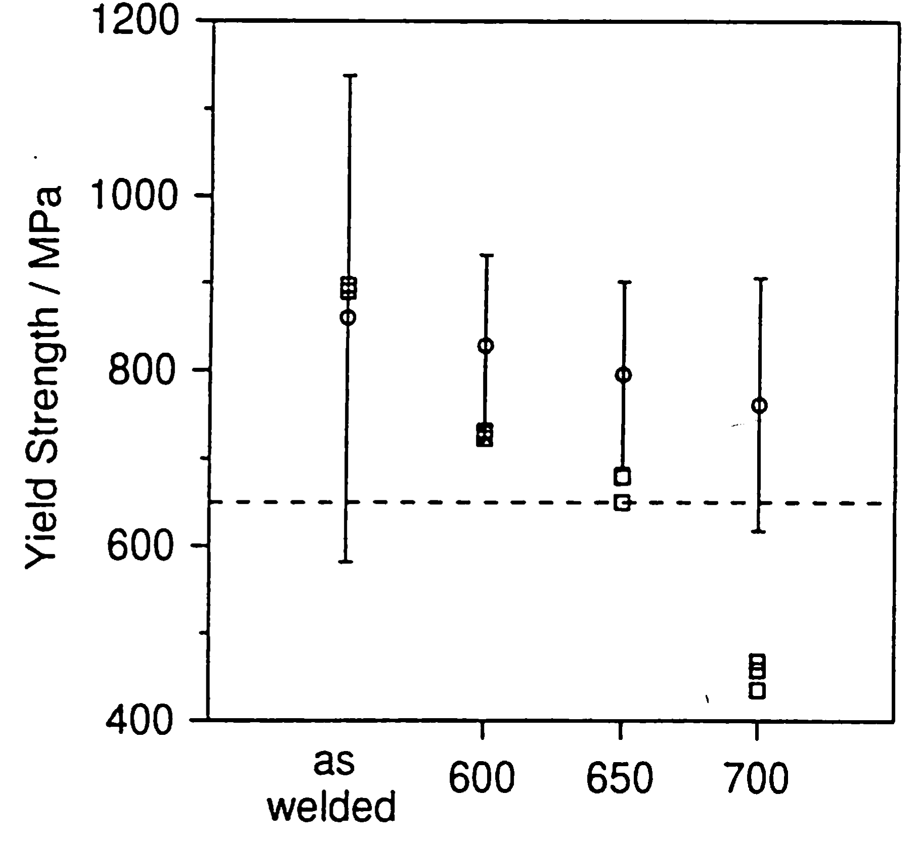

Slide 27
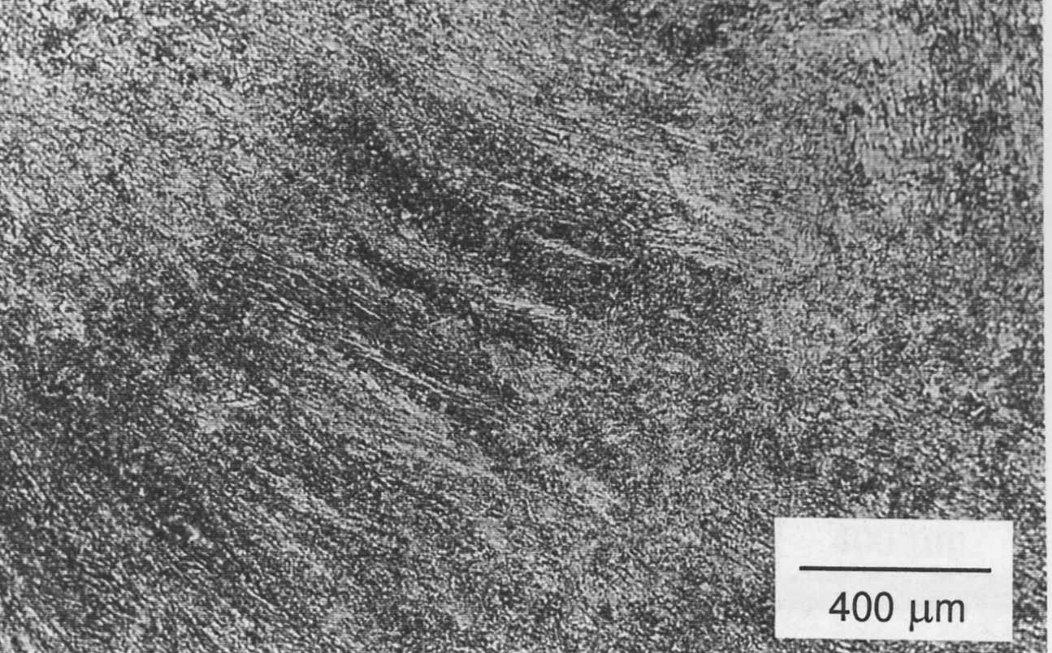
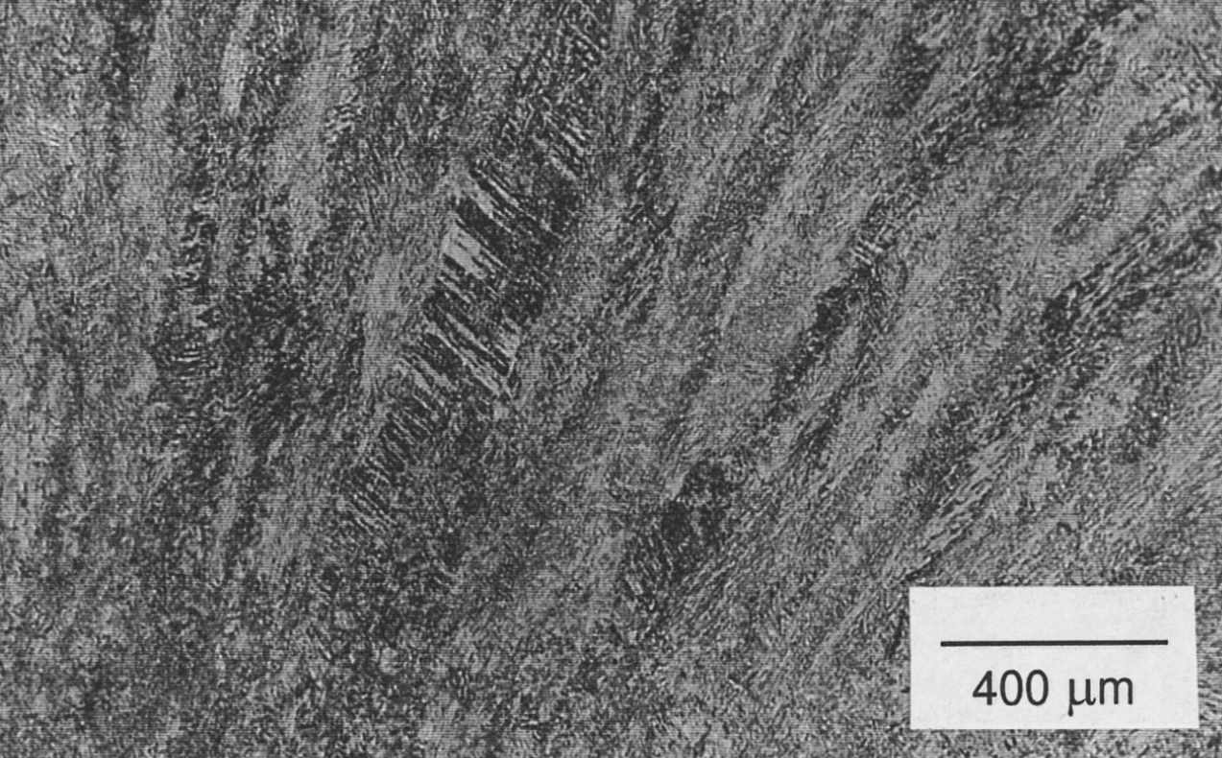
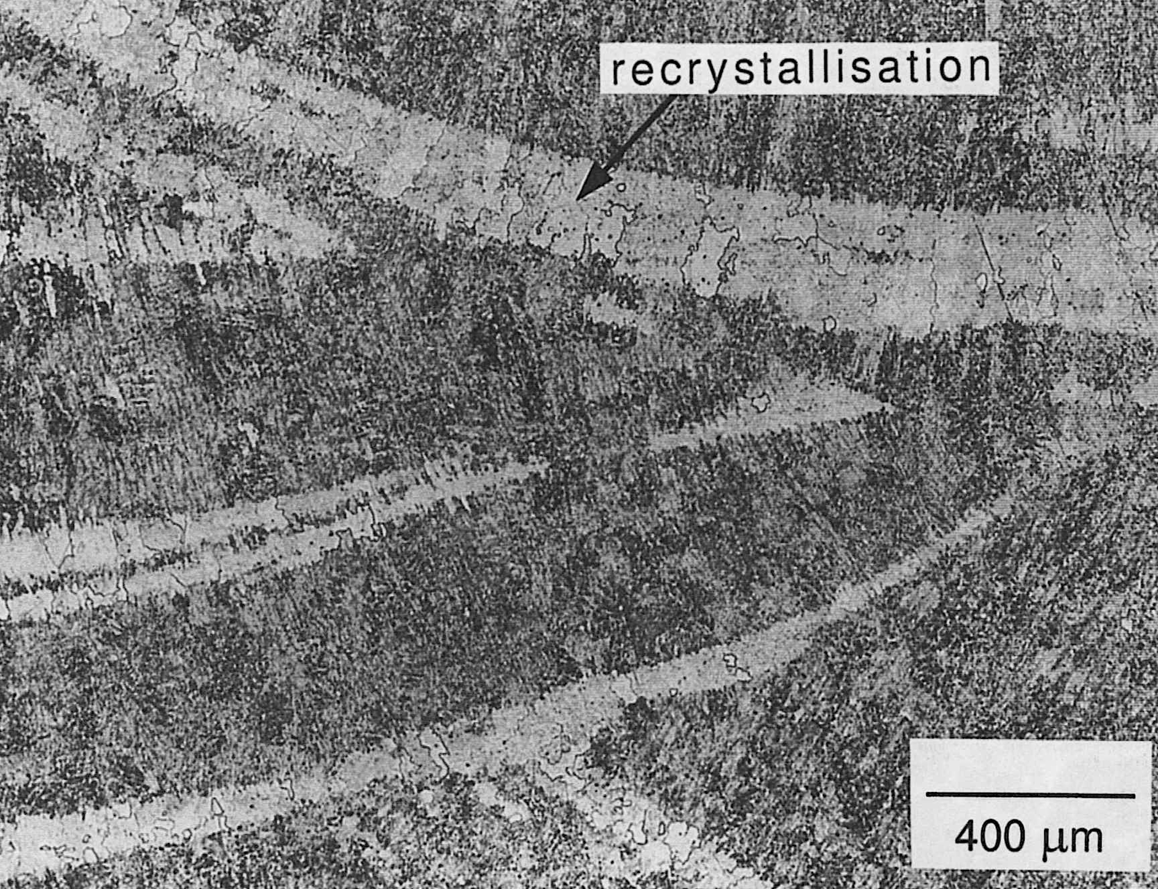
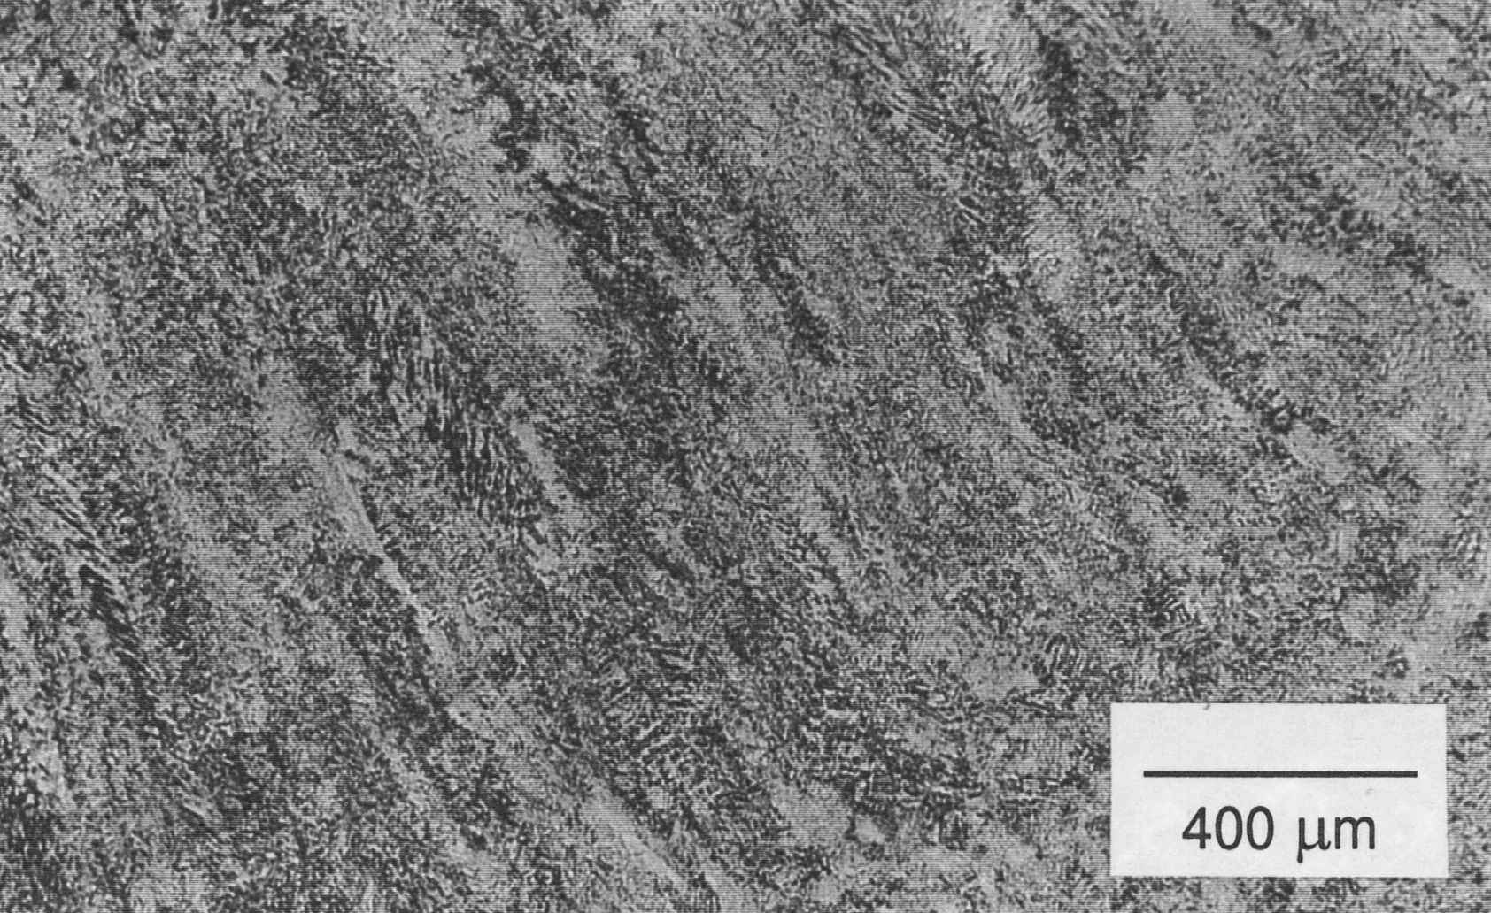
As-welded
600 °C
700 °C
650 °C
Cool, 1996

Slide 28
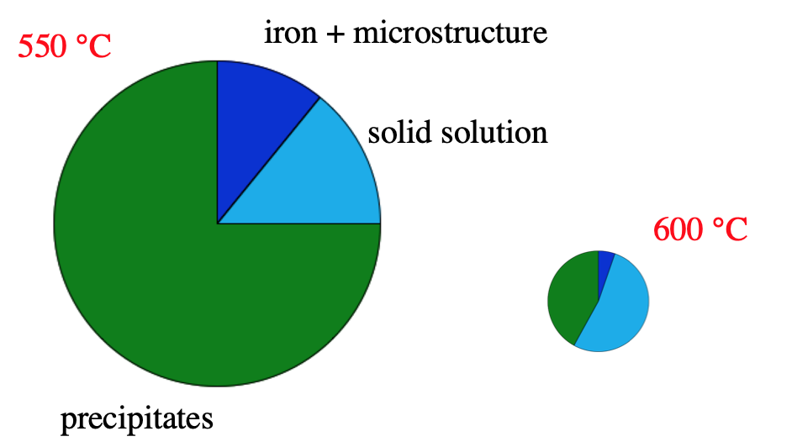

Slide 29
Cole & Bhadeshia, 1999

Slide 30
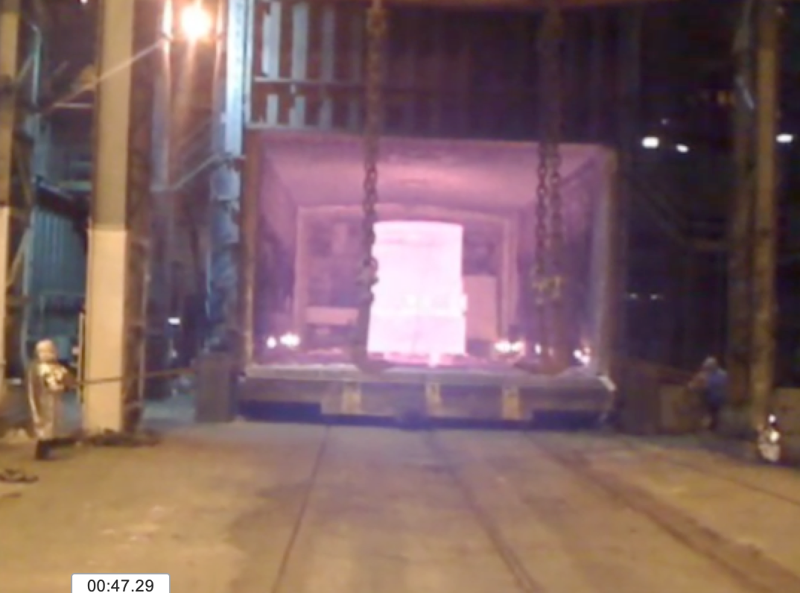

Slide 31
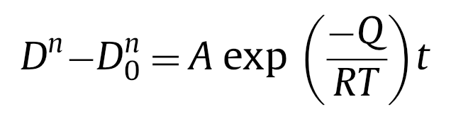
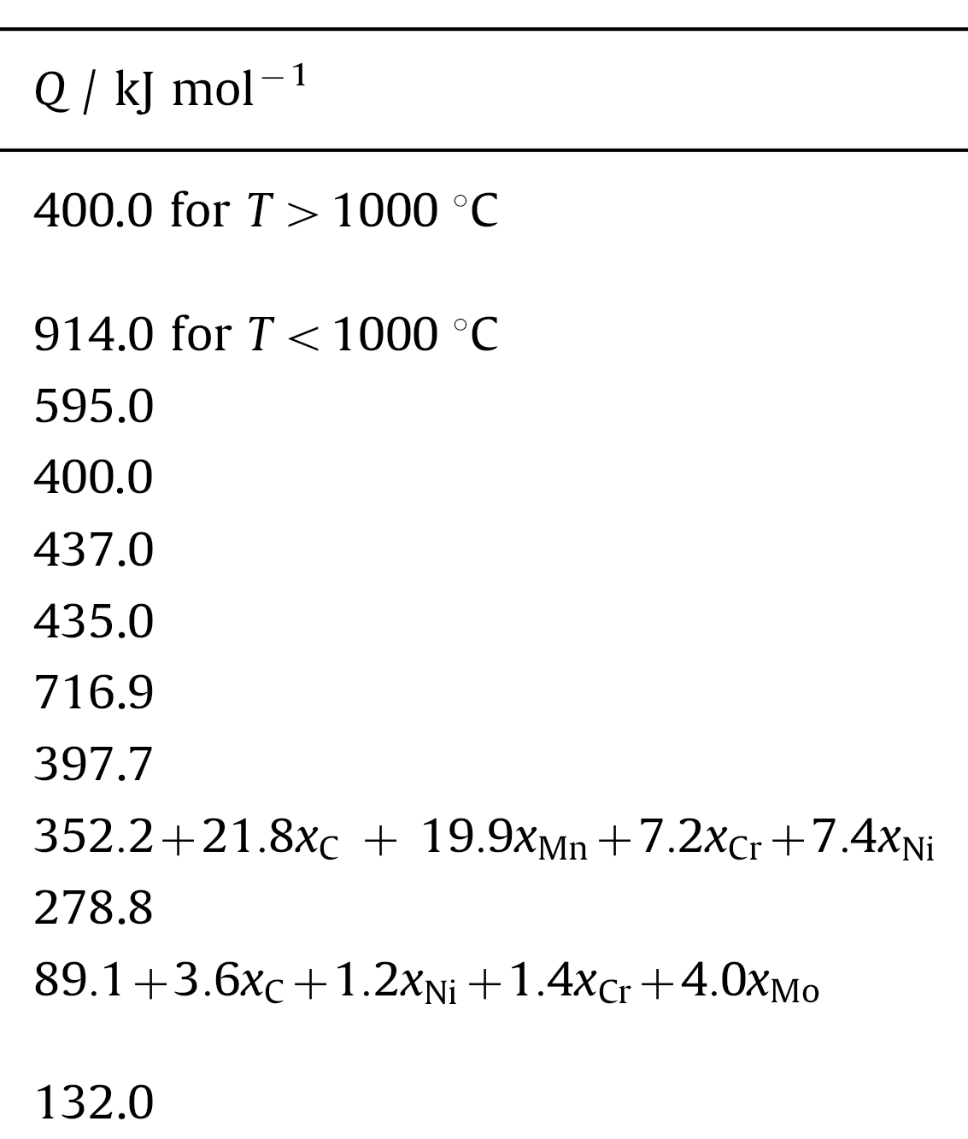
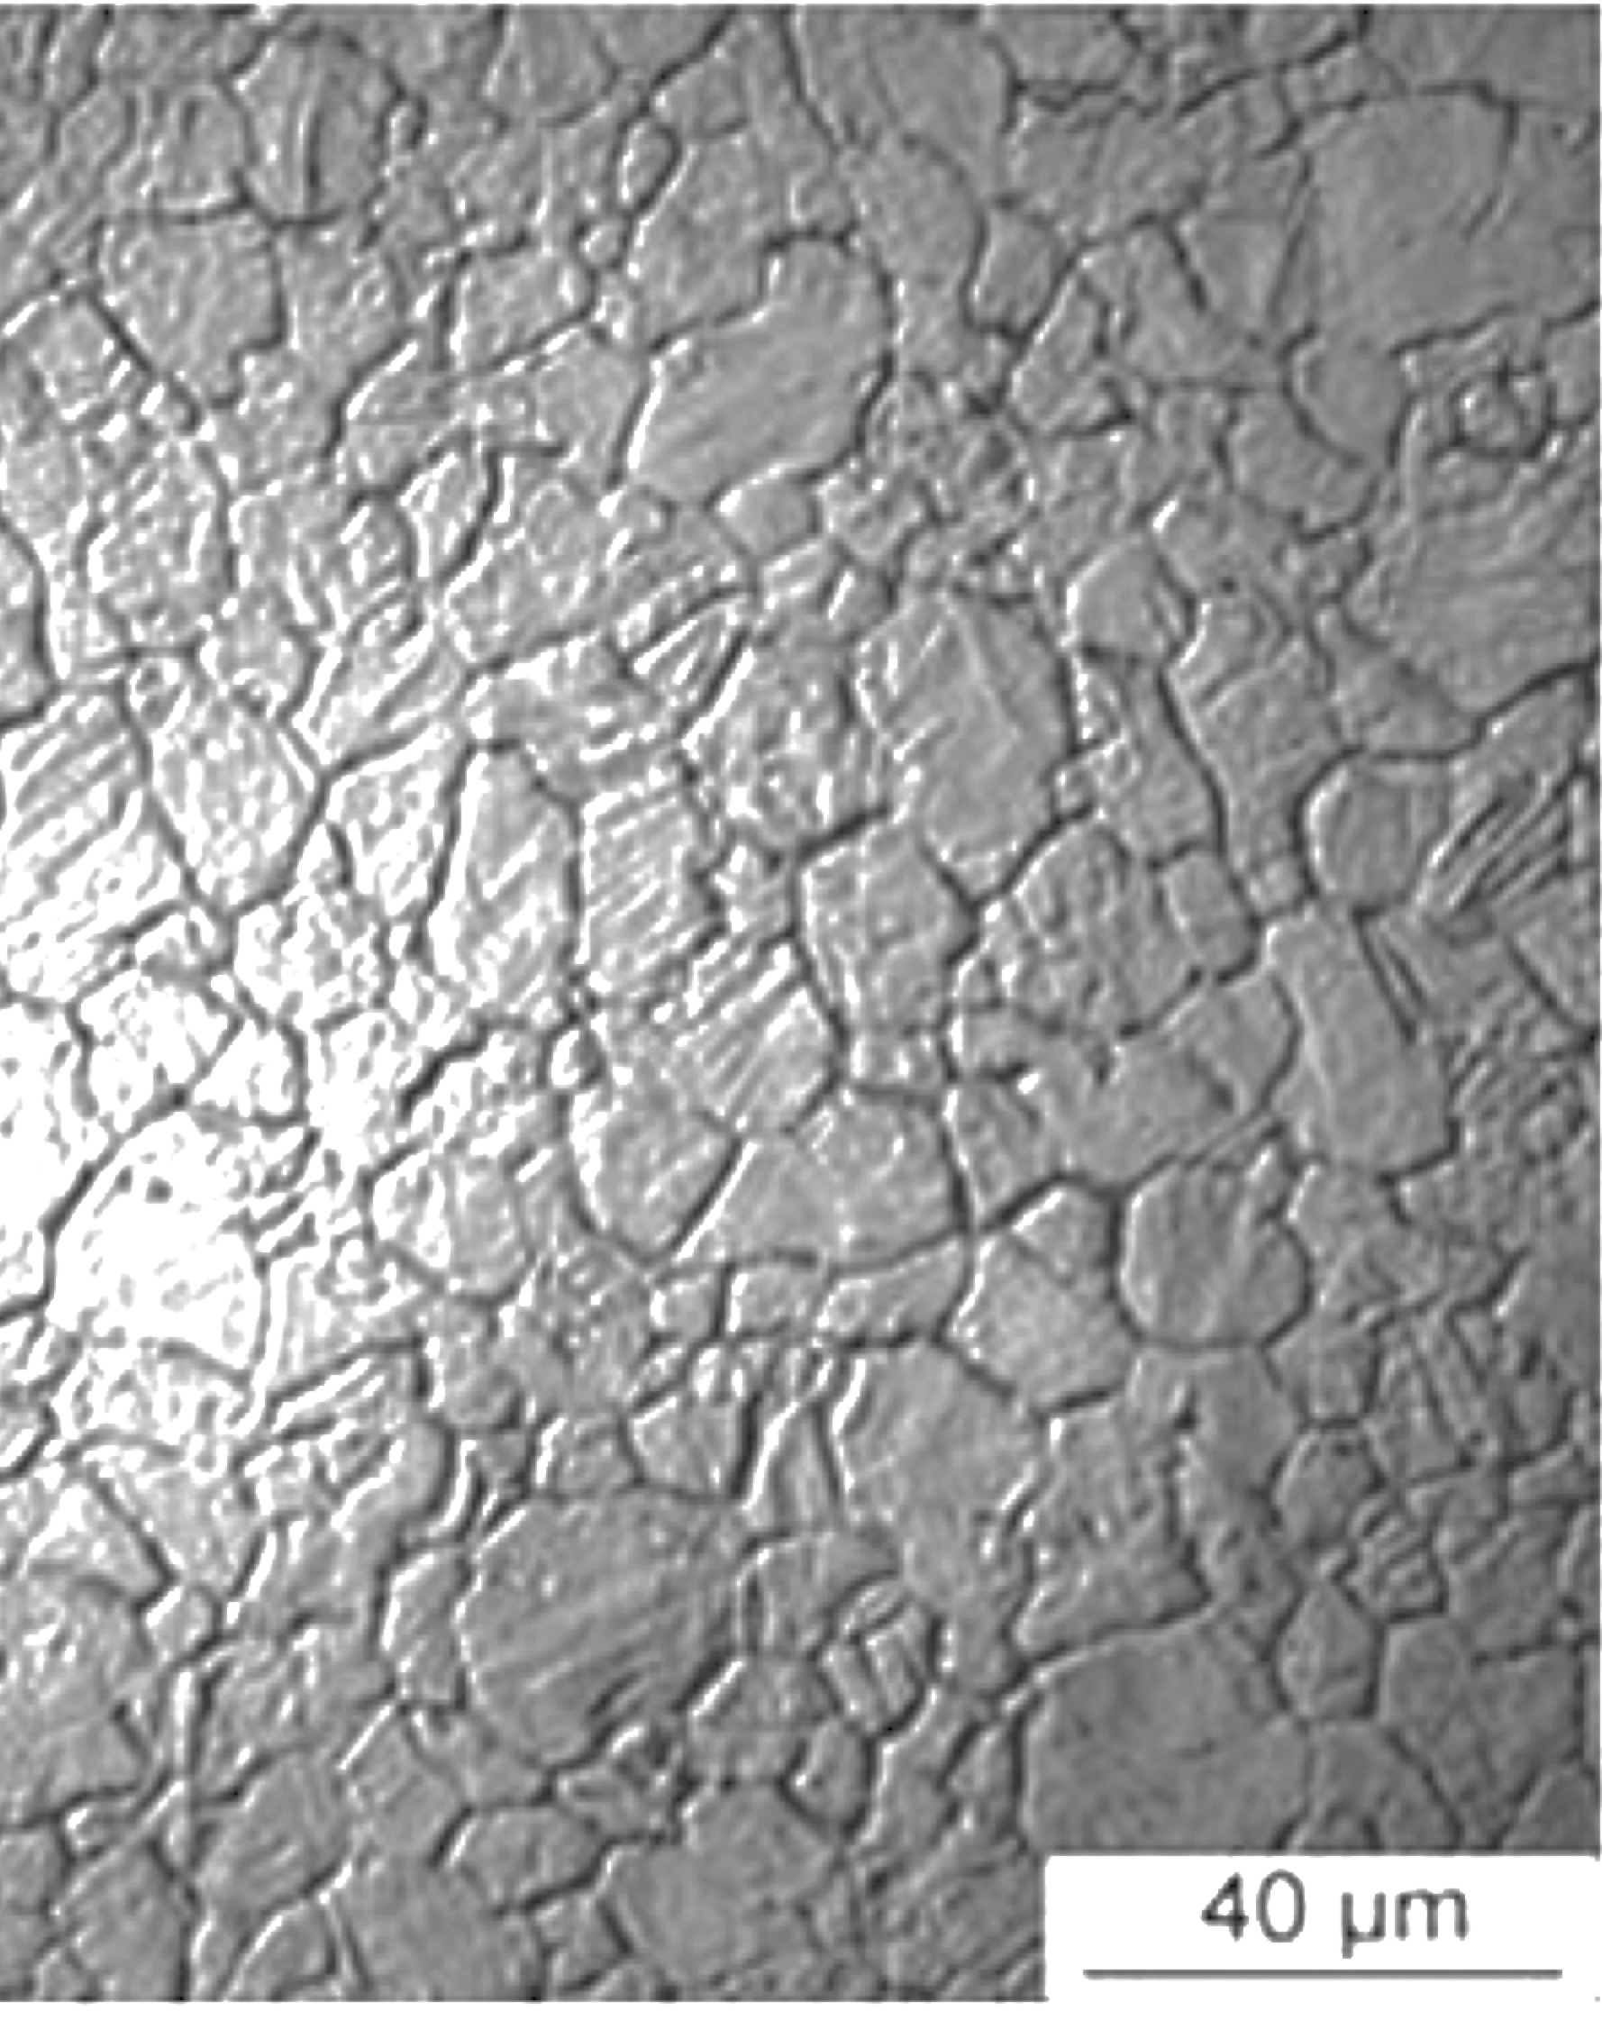

Slide 32
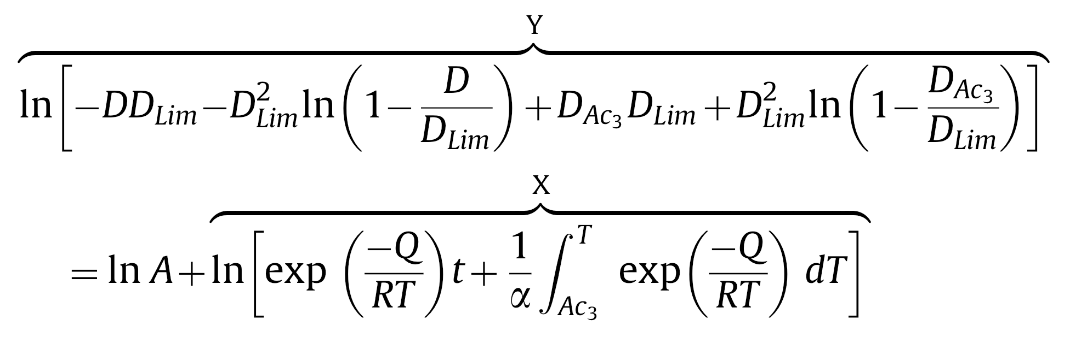
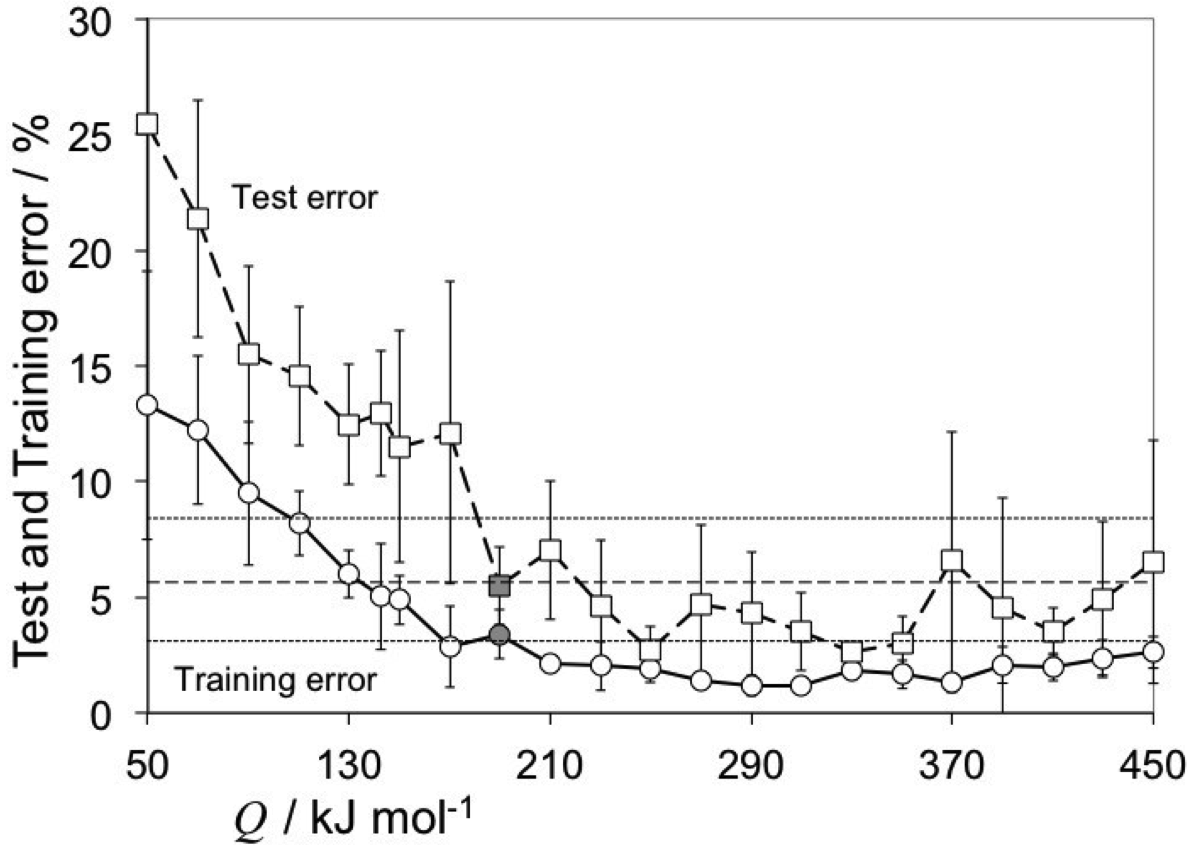
Pous, Lonardeli, Cogswell, Bhadeshia
Mat. Sci. Eng. A 567 (2013) 72

Slide 33
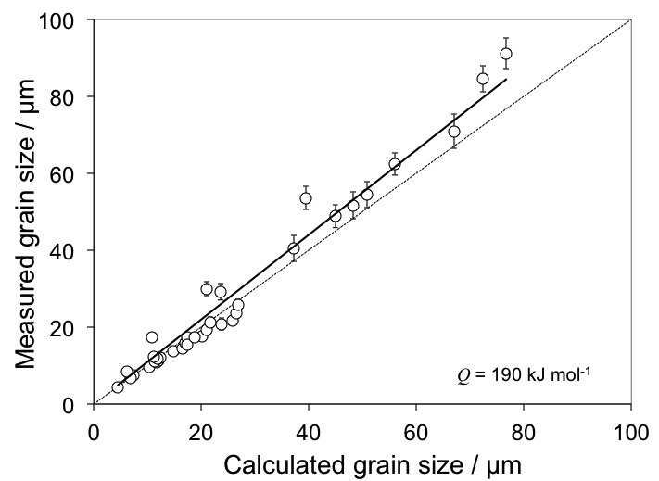

Slide 34
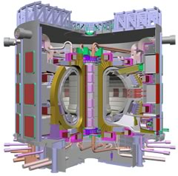
International Fusion Reactor
Reduced activation steels:
design of experiments

Slide 35
Modelling irradiation hardening
No strongly predictive model
Data by Yamamoto et al. and European RAFM database
~1800 data up to 90 dpa
  36 input variables
  No heat treatment information included

Slide 36
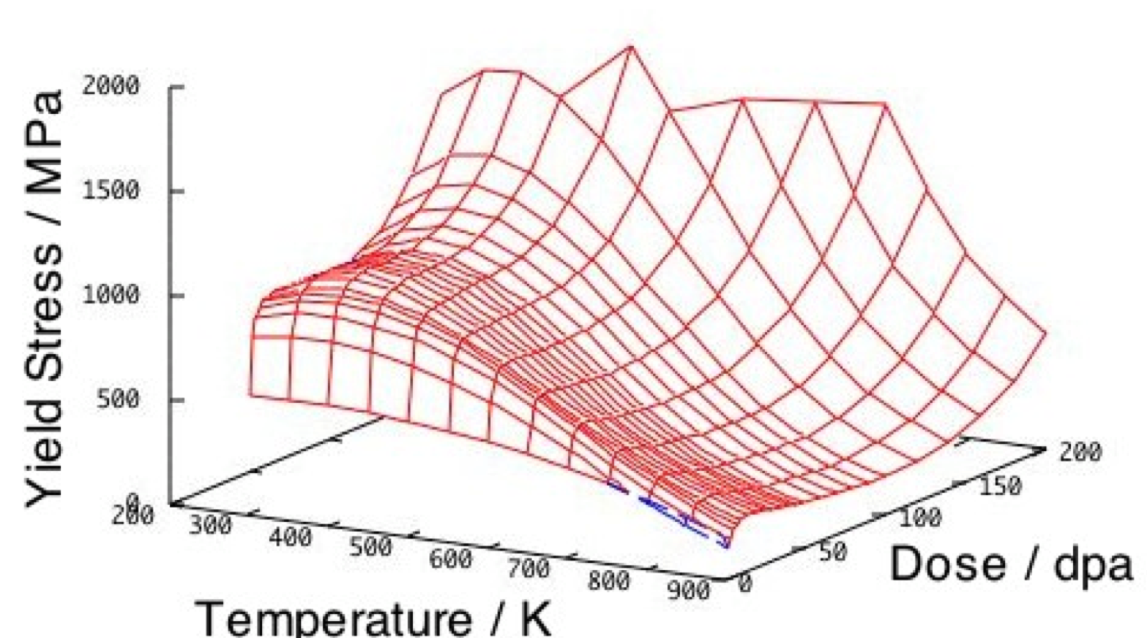
Fusion reactor steels
Kemp, Cottrell & Bhadeshia, 2006

Slide 37
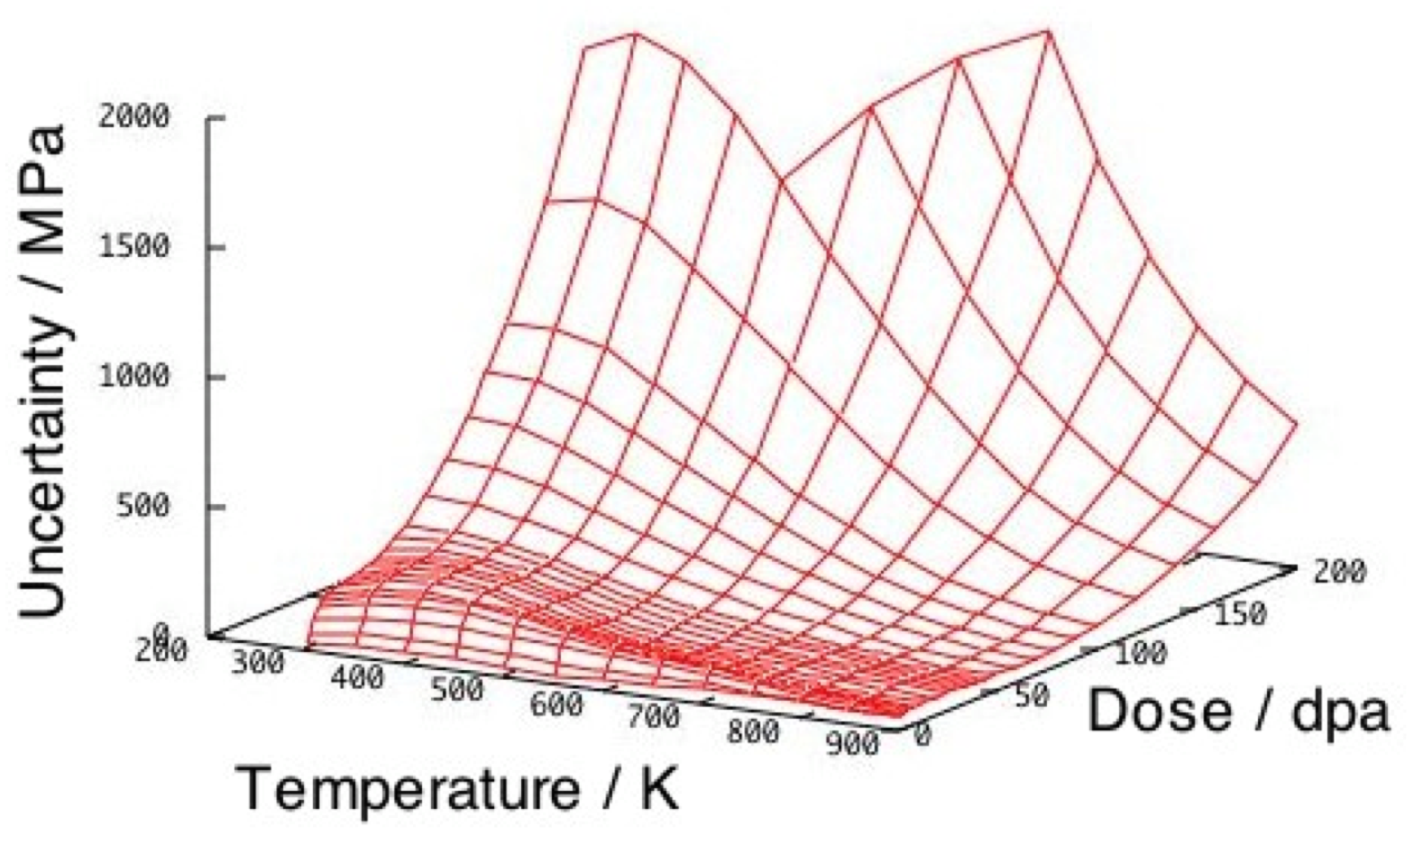

Slide 38
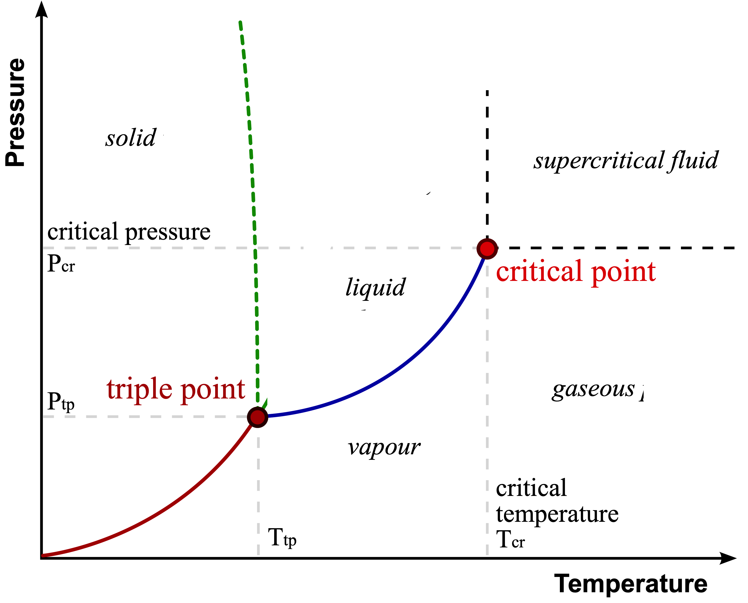

Slide 39
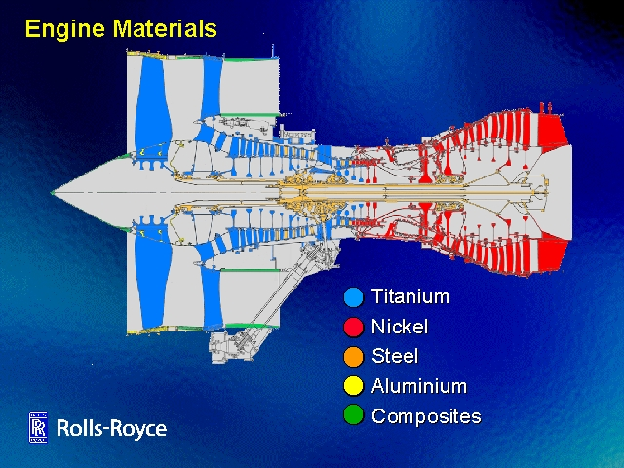
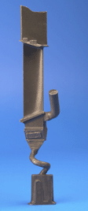
Suppose we fail to achieve 650°C ferritic creep-resistant steel

Slide 40
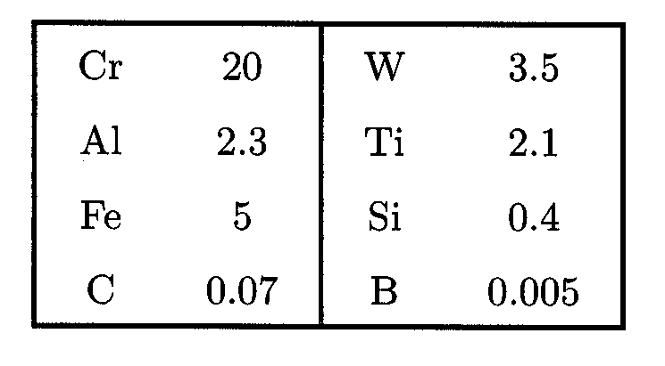
Nickel base alloy FT750dc
wt%

Slide 41
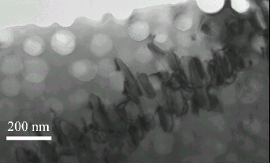

Slide 42
Tancret & Bhadeshia, 2002
1000
800
600
Yield stress / MPa
400
200
0
0
200
400
600
800
1000
1200
Temperature / °C

Slide 43
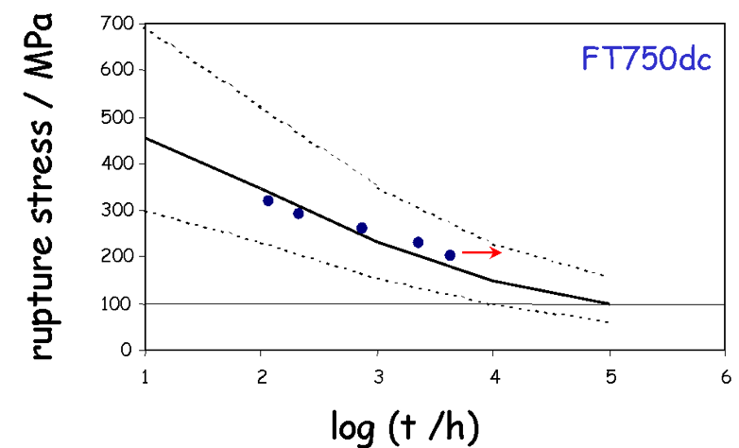

Slide 44
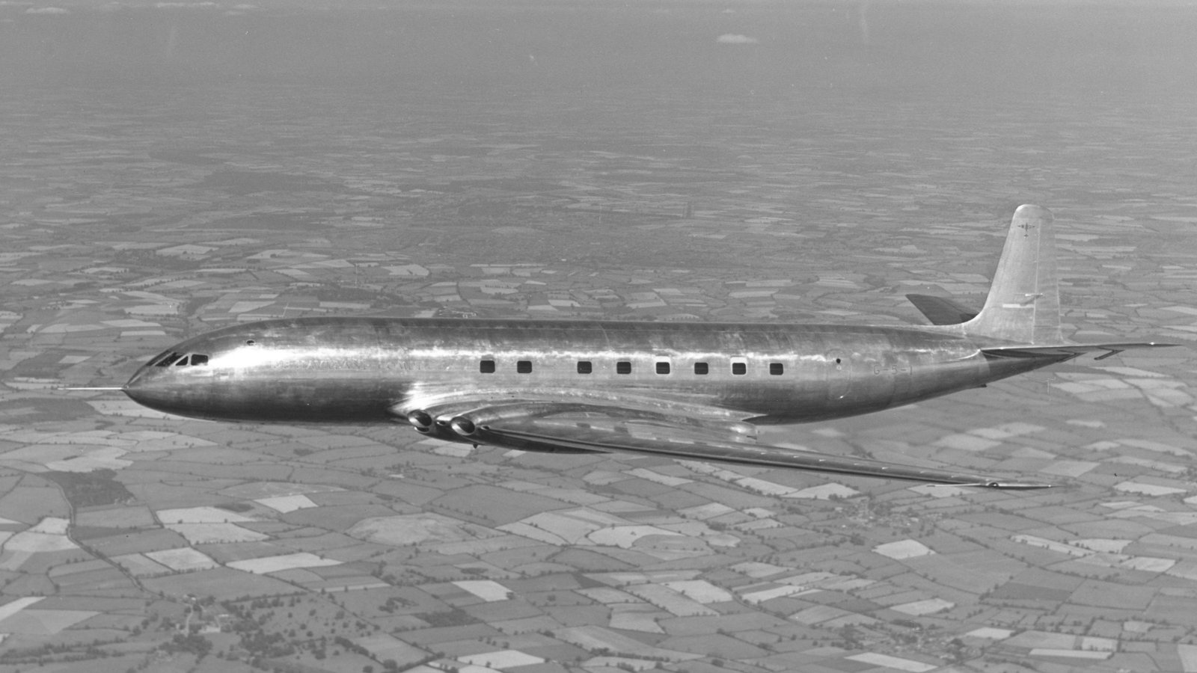


Slide 45

Generic fatigue model

Slide 46

Steel

Slide 47

Nickel Alloys

Slide 48

Titanium and Aluminium alloys

Slide 49

Dissemination
Source code
Compiled model
Data

Slide 50



Slide 51
Dissemination
Source code
Compiled model
Data
Neural networks in materials science
ISIJ International 39 (1999) 966-979
www.phase-trans.msm.cam.ac.uk

Slide 52






device materials
physical metallurgy
materials chemistry
characterisation
mathematical modelling
polymers ceramics composites
biomaterials

Slide 53

electron theory
molecular dynamics
thermodynamics
irreversible thermodynamics
kinetics
finite elements
structure-properties
uncertainties

