Slide 1
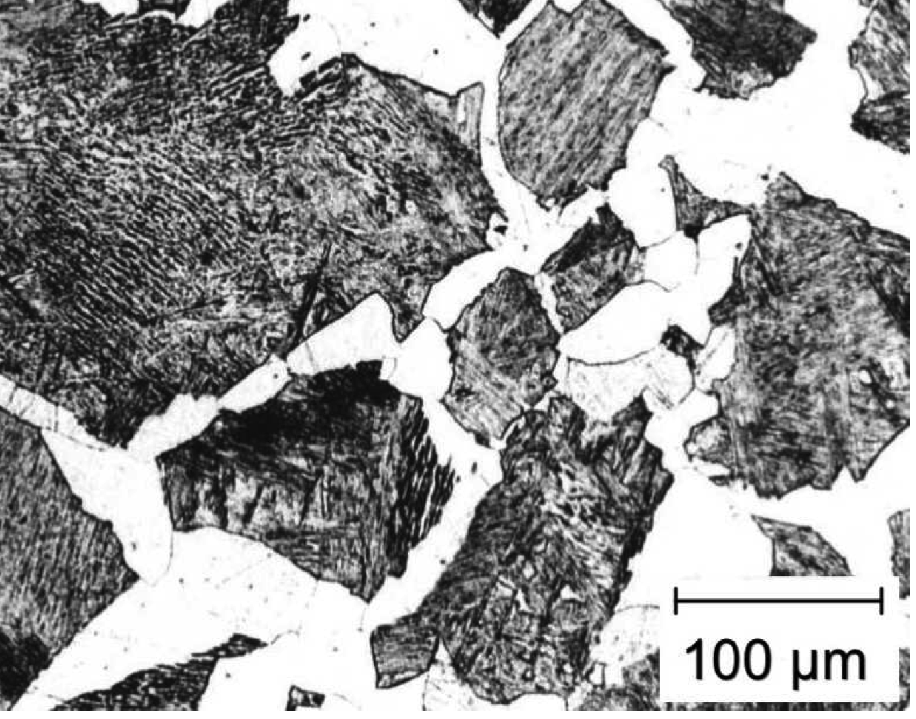
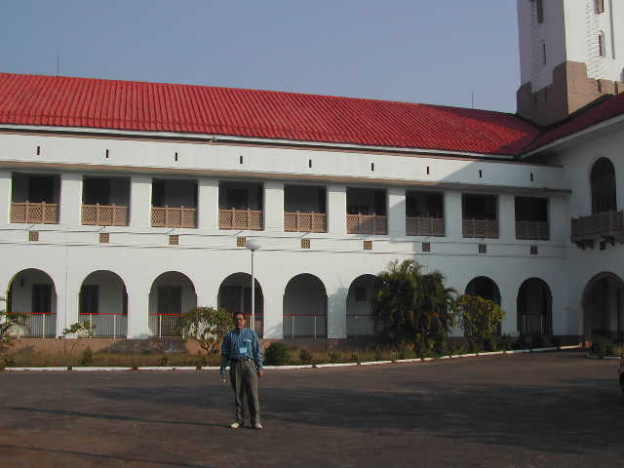
Diffusion in steep concentration gradients:
Difficulties in theory of ferrite growth
steep concentration gradients
www.phase-trans.msm.cam.ac.uk
IIT Kharagpur
2002

Slide 2
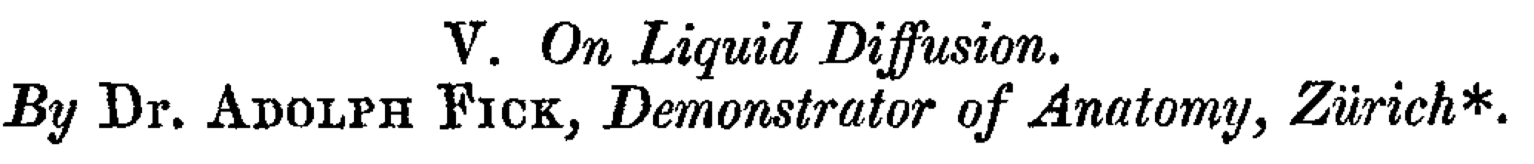
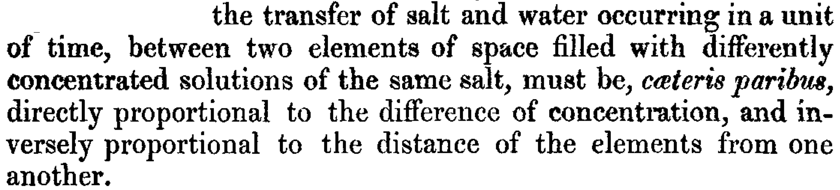
(1855)
}
concentration
gradient
flux
diffusion
coefficient

Slide 3
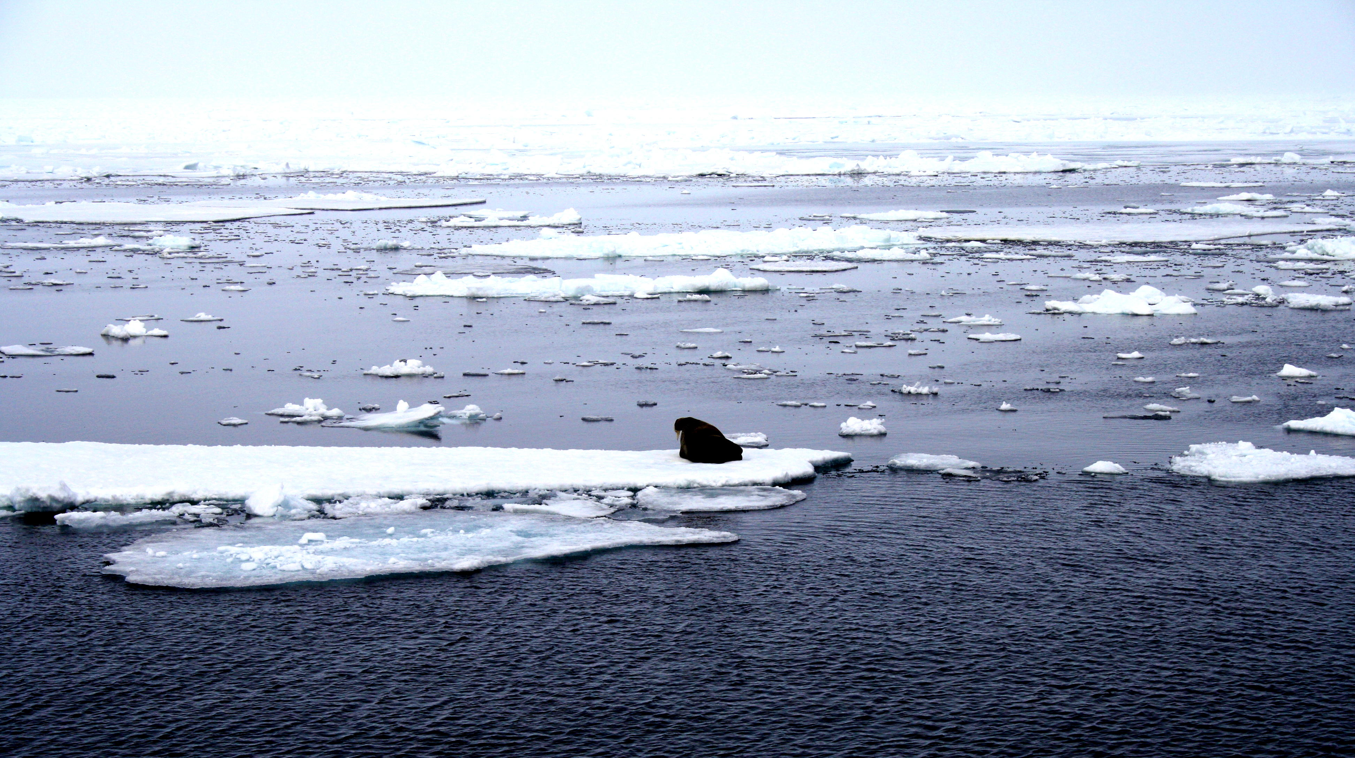
Why no diffusion of salt from sea-water into ice?
ice: pure
ocean: salty water
photograph courtesy of Sunita Hansraj from her Antarctica expedition

Slide 4
μ
o
B
μ
o
Gibbs free energy per mole
A
μ
A
G{x}
μ
B
A
B
x
Composition

Slide 5
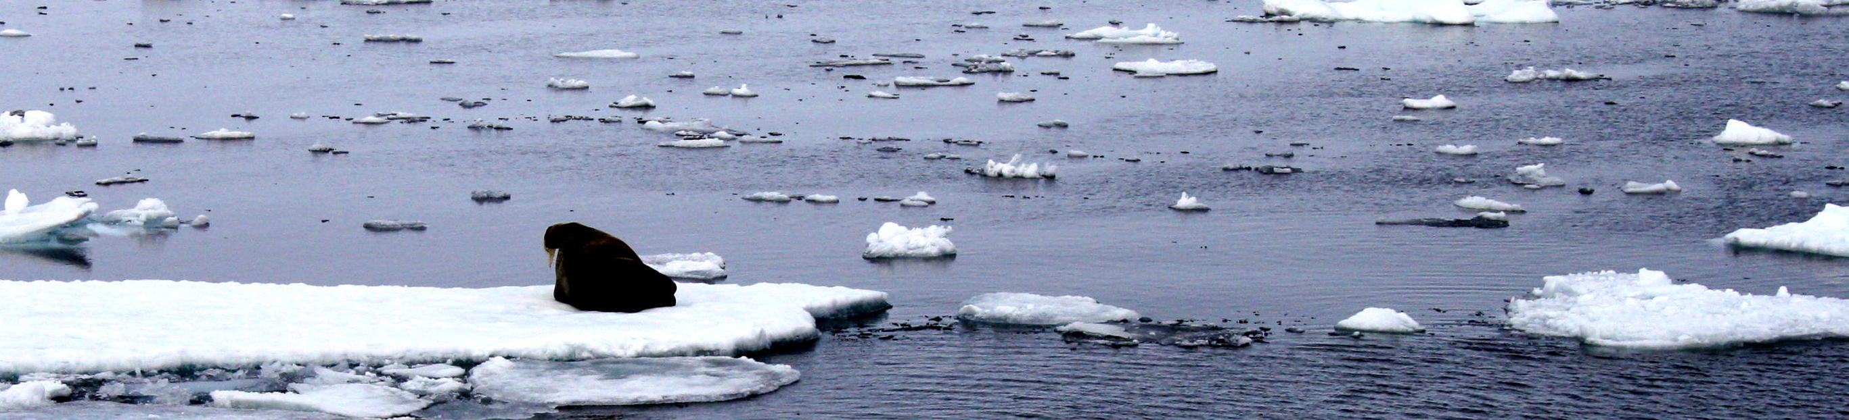

Slide 7
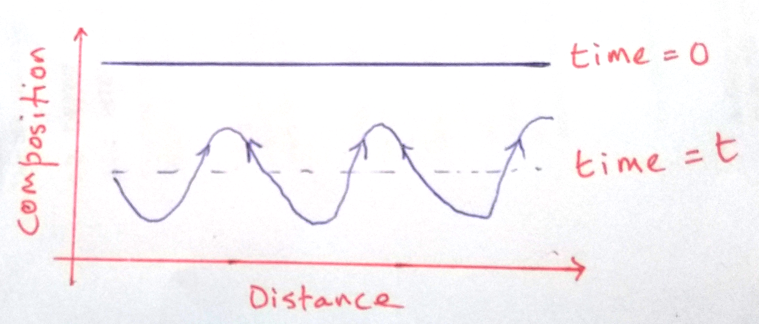

Slide 8
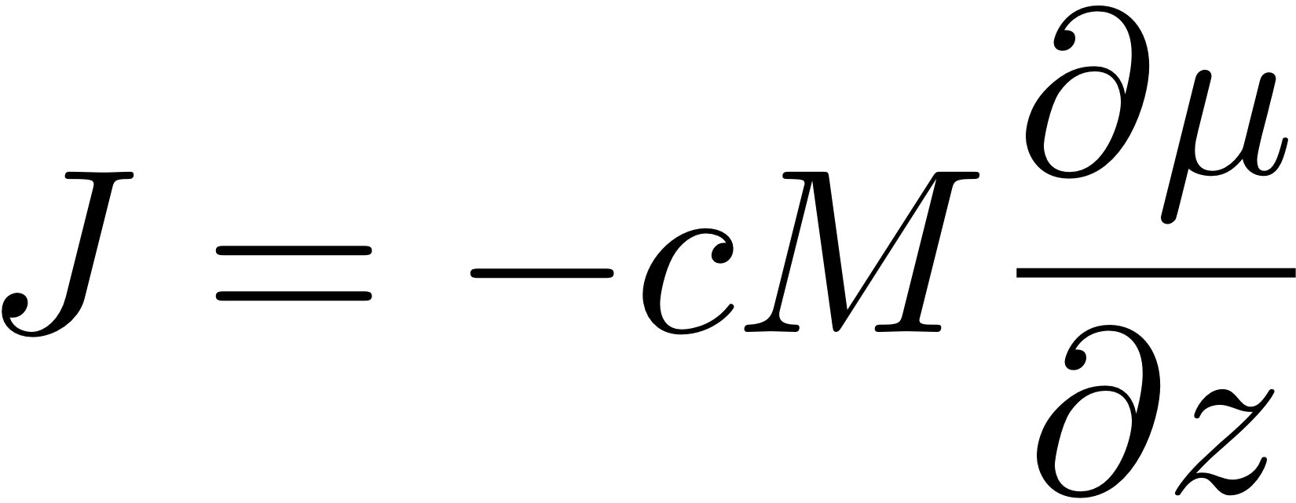

Slide 9
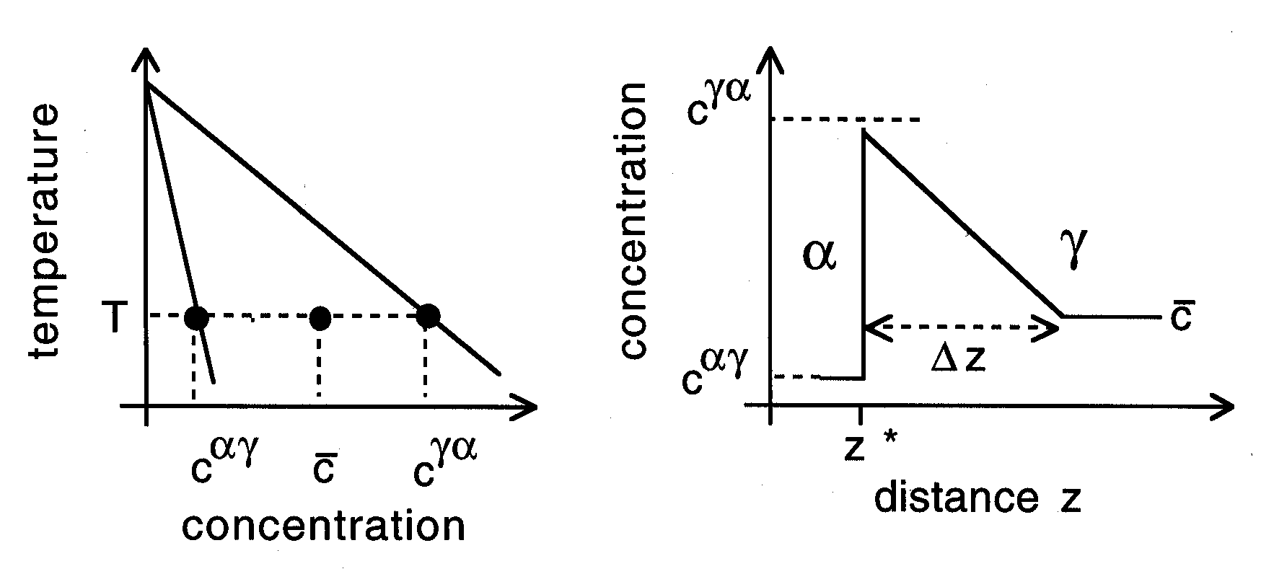
Kinetics of ferrite growth

Slide 10
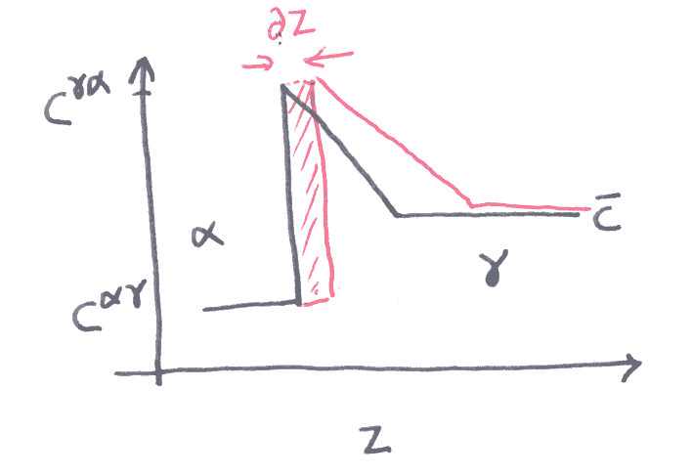

Slide 11
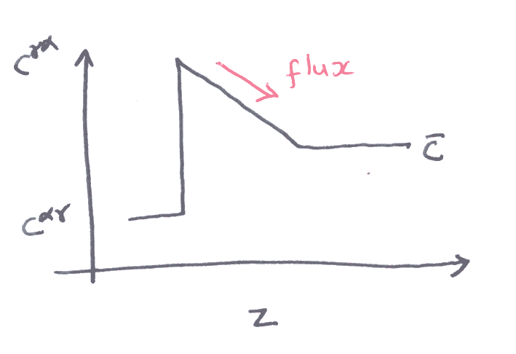

Slide 12
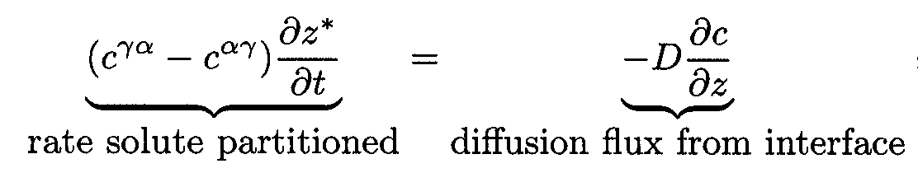
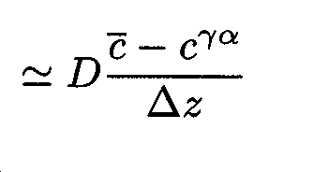
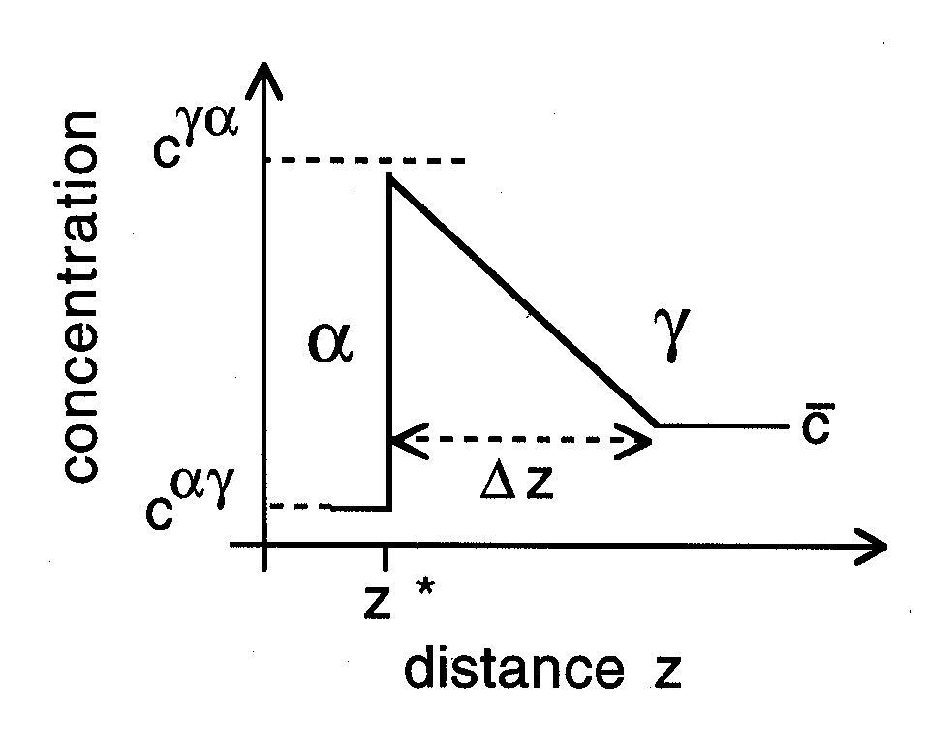
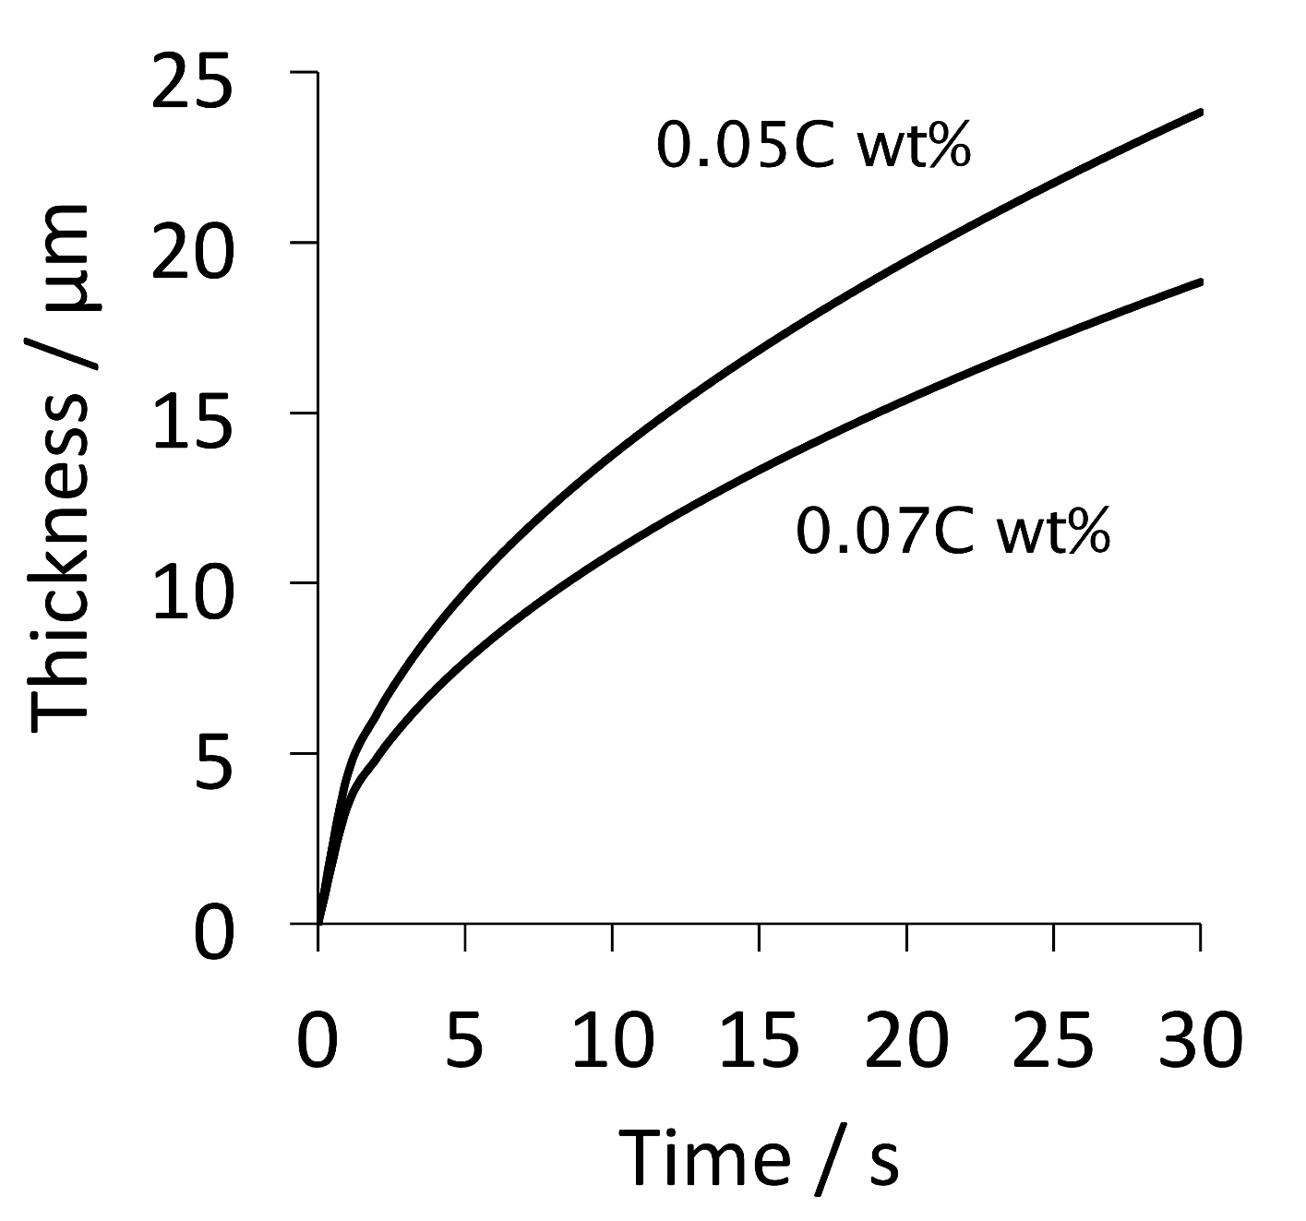

Slide 13
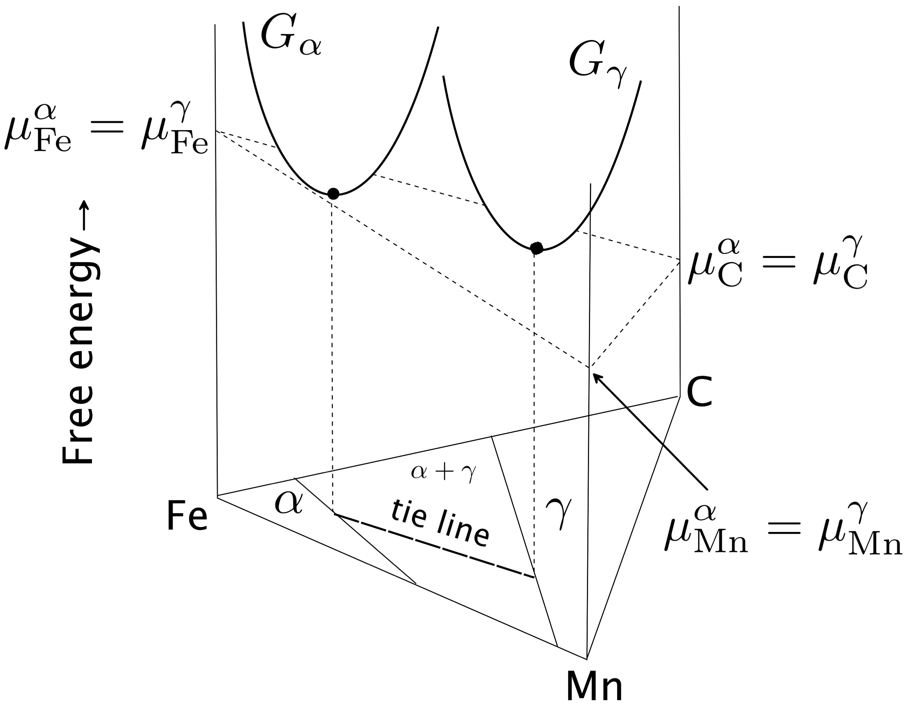

Slide 14
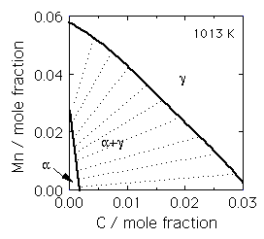

Slide 16
γ
High supersaturation
NP-LE mode
Manganese
α
α
γ
α+γ
Carbon
α
γ

Slide 17
Metall. Mater. Trans. A 43 (2012) 833
diffusion distance 0.03 nm
Metall. Mater. Trans. A 46 (2015) 2347
diffusion distance 0.002-0.04 nm
how do we proceed?

Slide 18
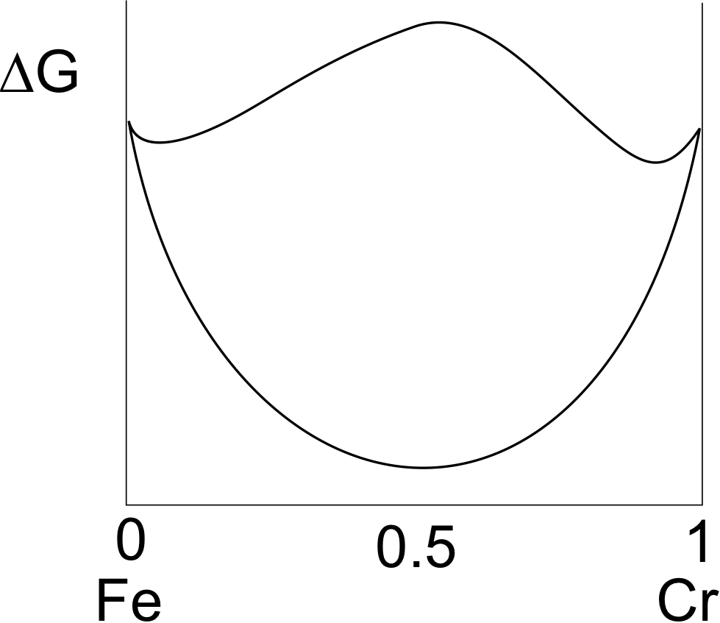

Slide 19
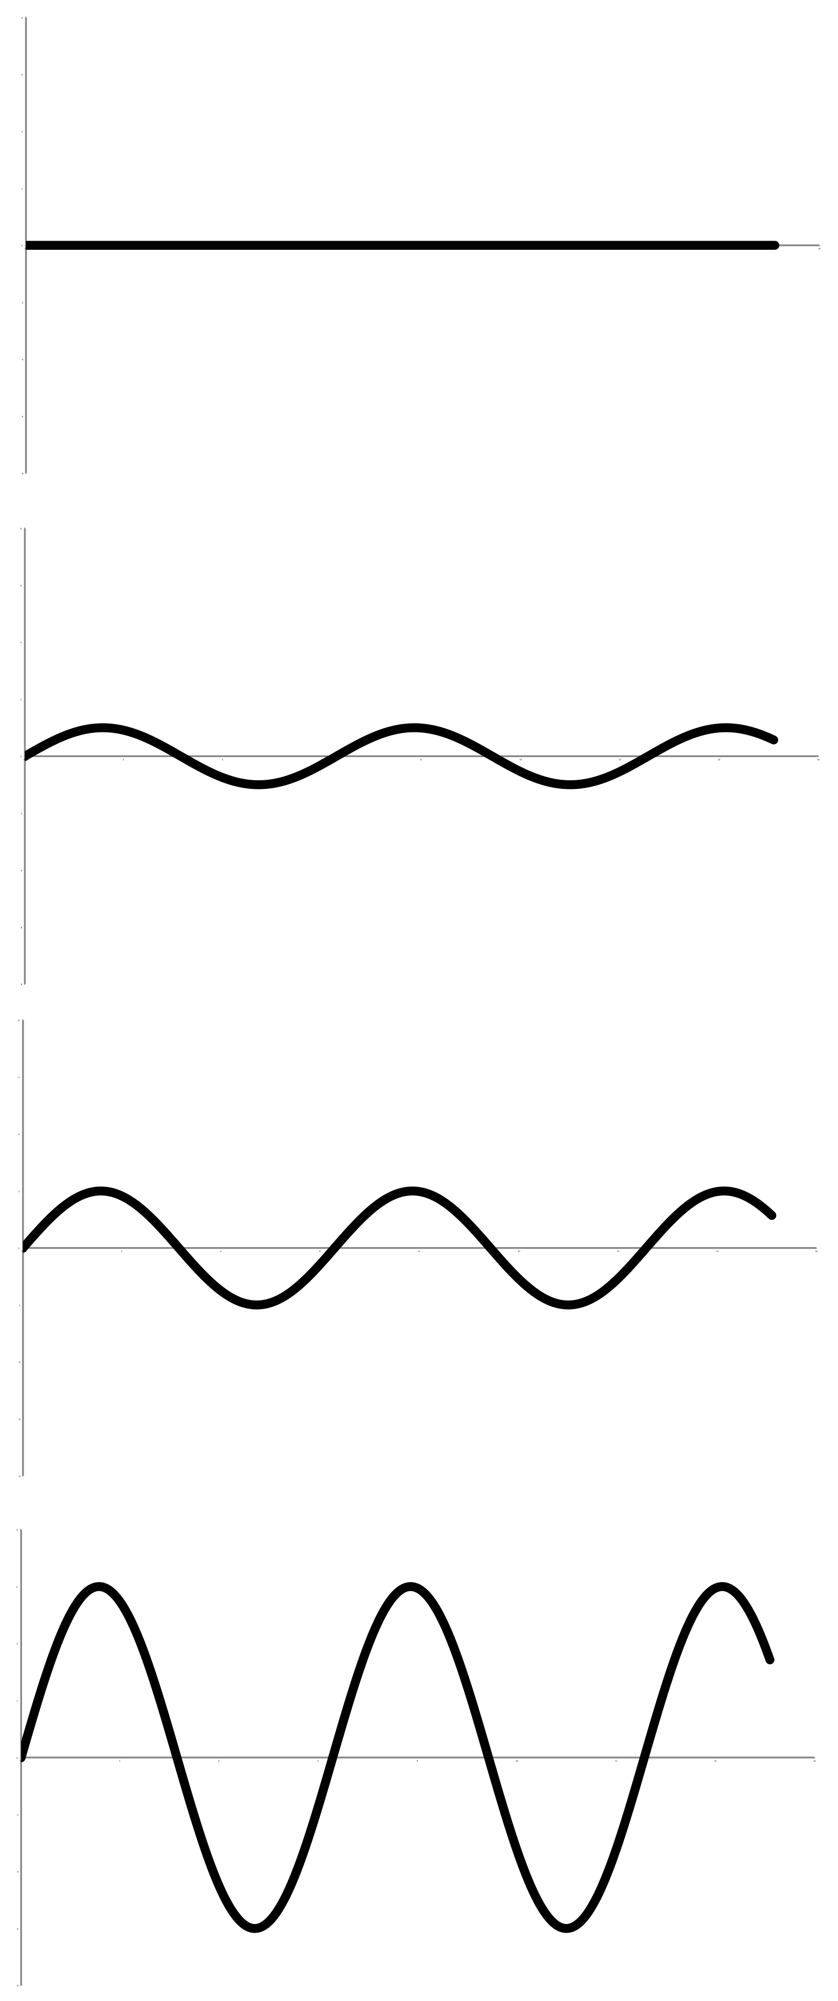
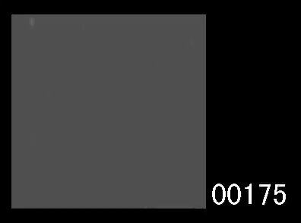

Yoshiyuki Saito
Cr
time
Carlos Martins
distance

Slide 20
Most rapidly growing Fourier components have infinitely small wavelength
chemical interfacial energy
larger with steeper gradients
STEEP GRADIENTS RETARD DIFFUSION

Slide 21
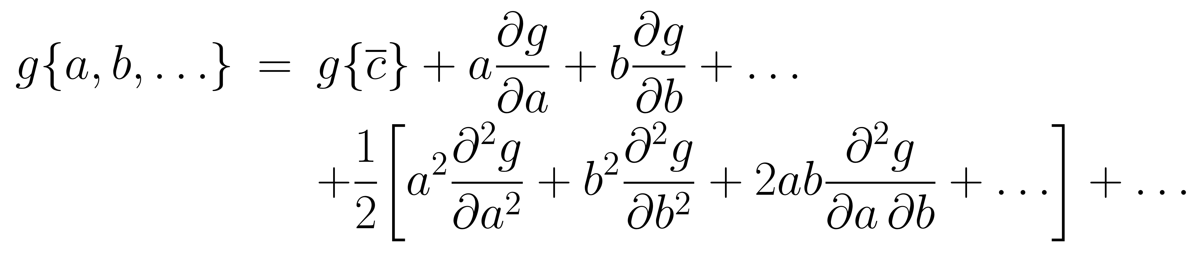
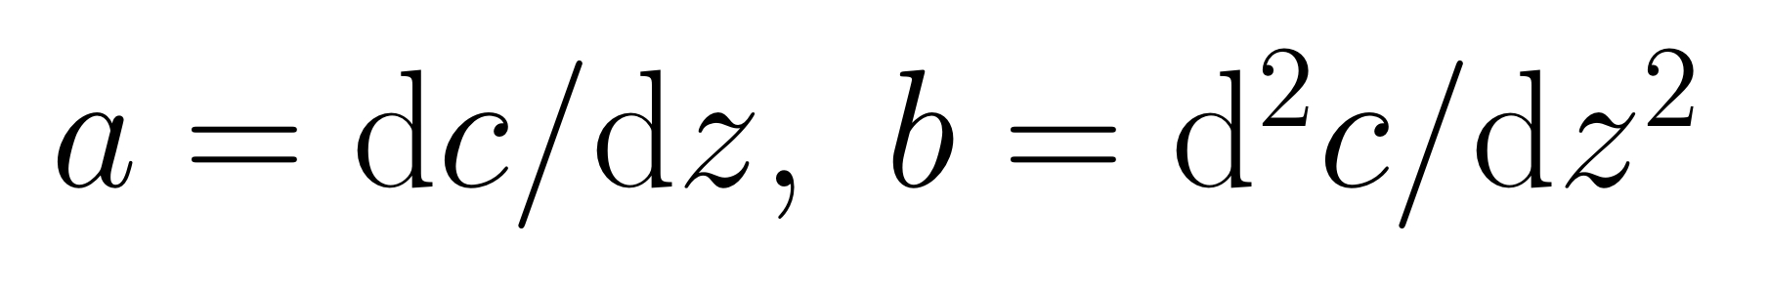
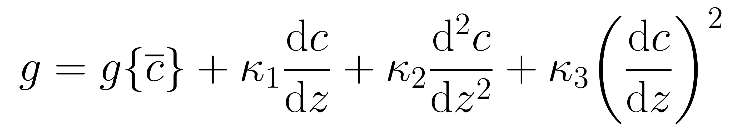
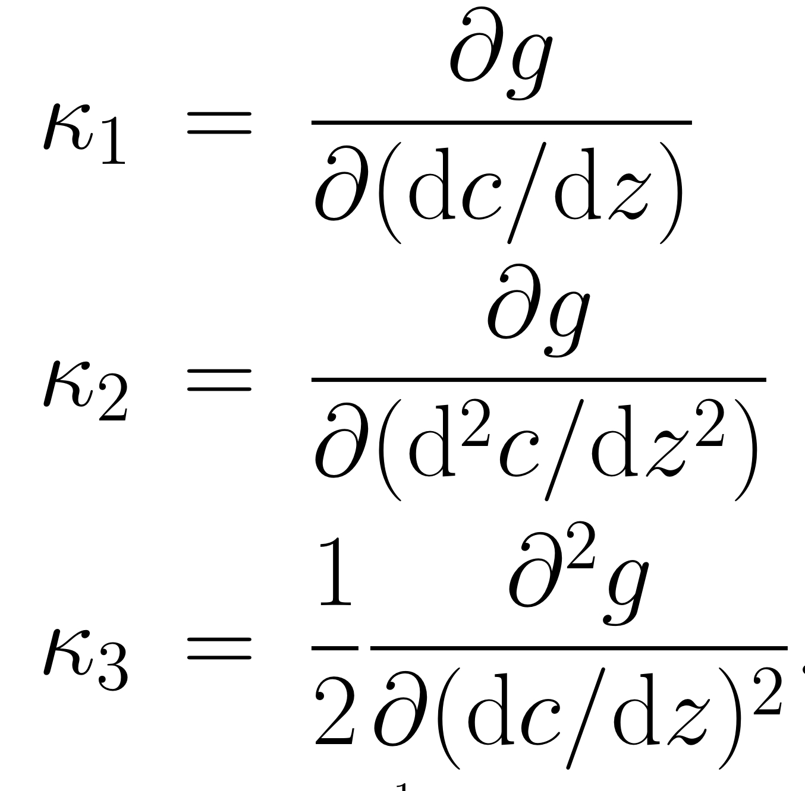

Slide 22
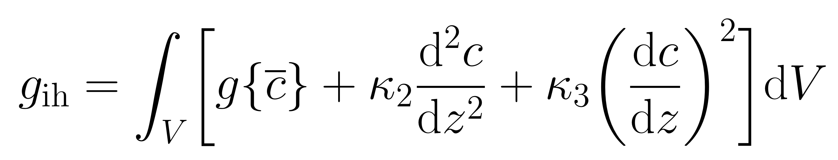
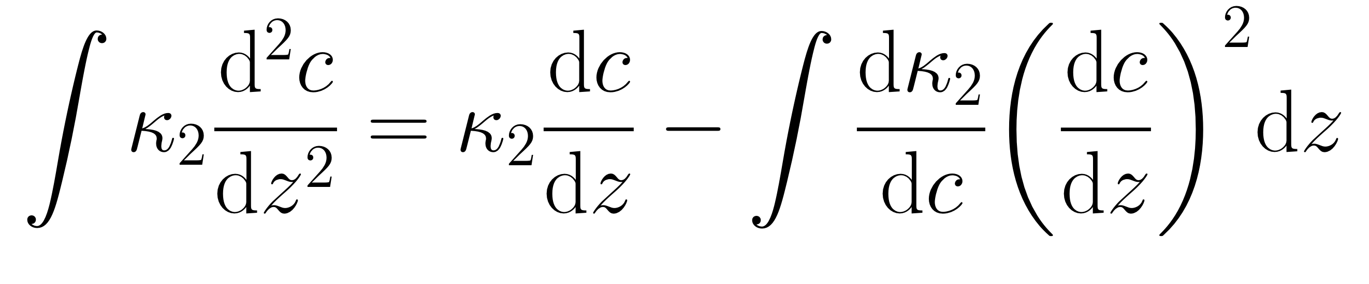
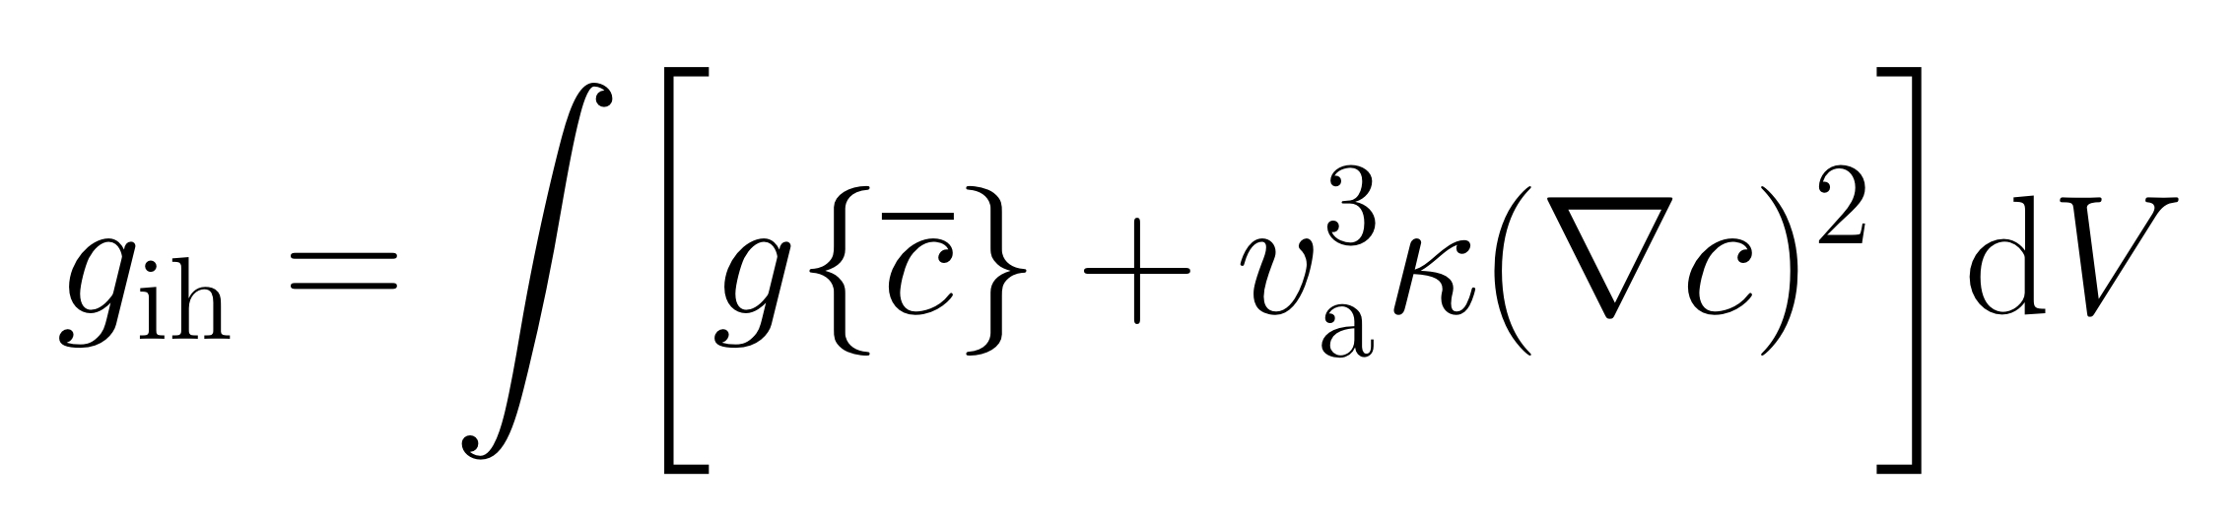

Slide 23
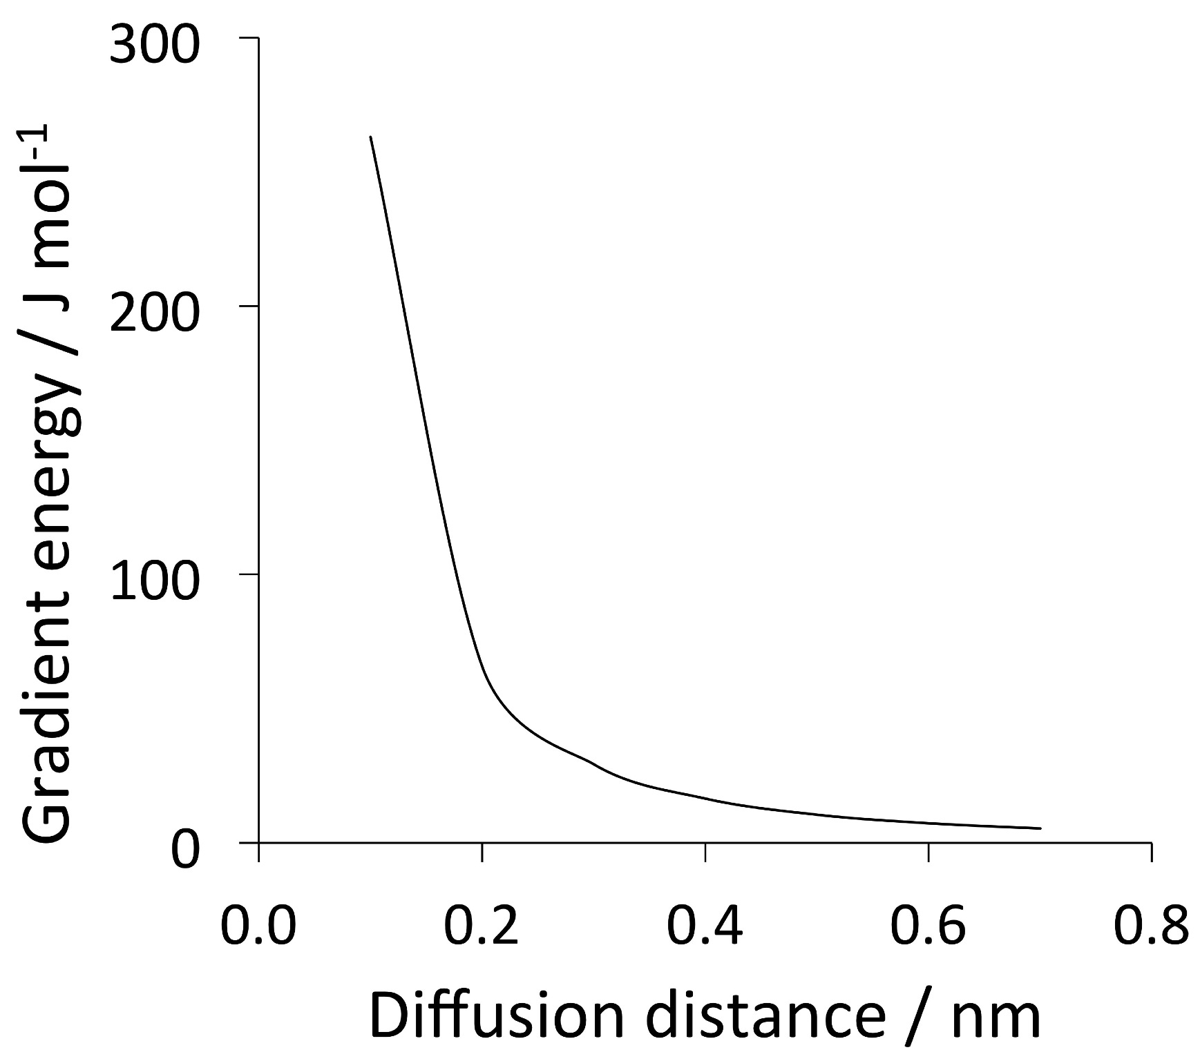
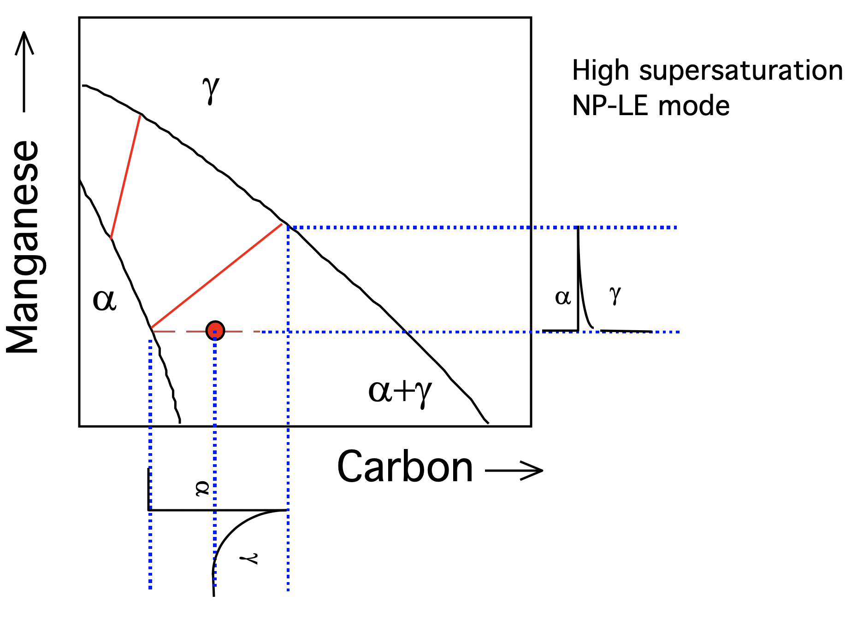
Impossible to avoid partitioning substitutional solutes if local equilibrium is demanded.

Slide 24
Conclusion: NPLE mode does not exist
Current Opinion in Solid State and Materials Science,
20 (2016) 396-400
Physica Status Solidi (a)
69 (1982) 745-750
www.phase-trans.msm.cam.ac.uk

Slide 25
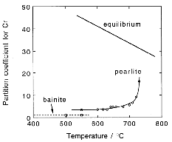
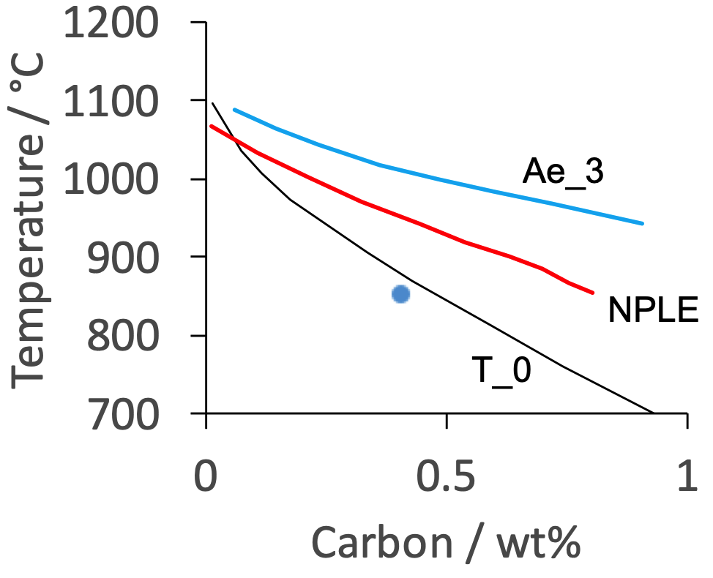
Corollary: NP-LE has never been observed experimentally although widely implemented in software
Measurements are crude, do not account for ledge mechanism.
No measurements of concentration profiles for NP-LE, even though we have atom probes.
Pearlite always shows partitioning.
NP-LE should never be used as a limiting composition.
Furuhara et al.
Chance, Ridley

Slide 26
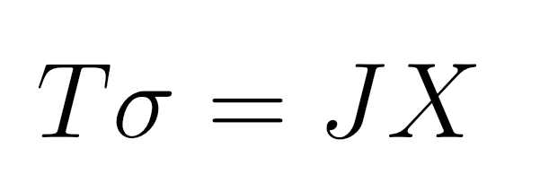
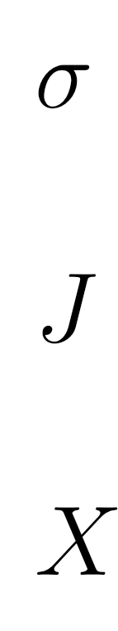
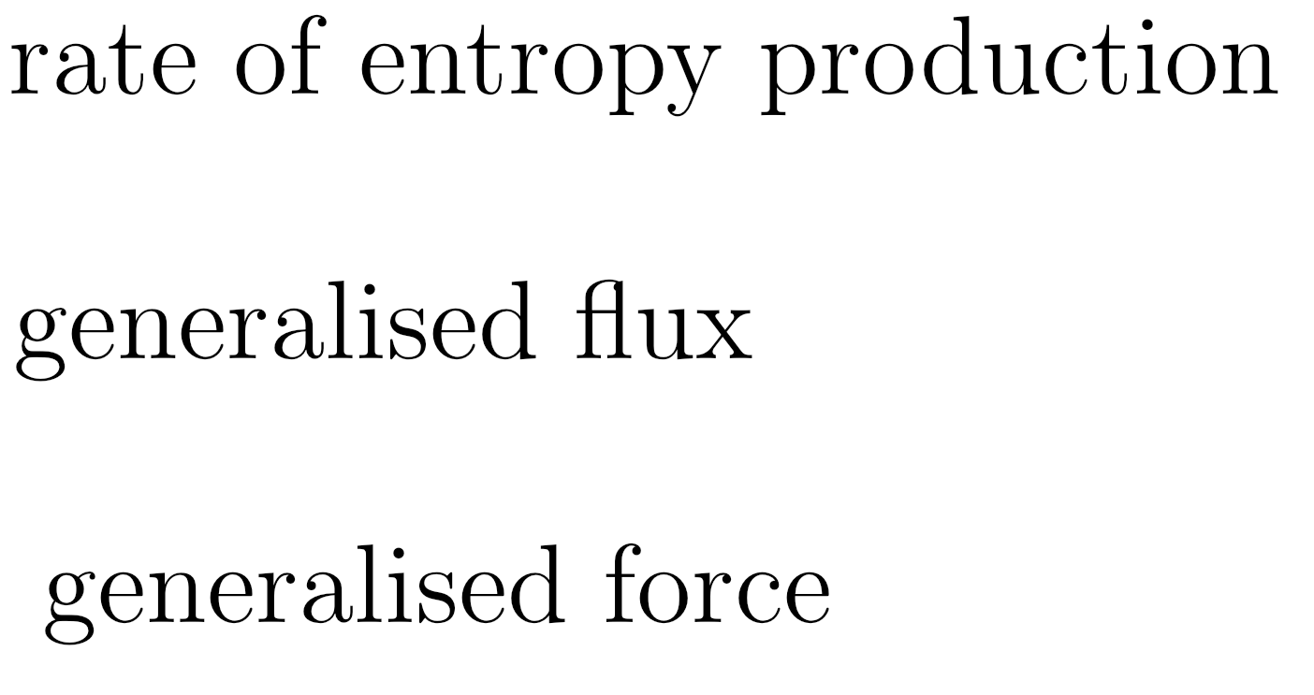
Corollary: thermodynamics of irreversible processes

Slide 27

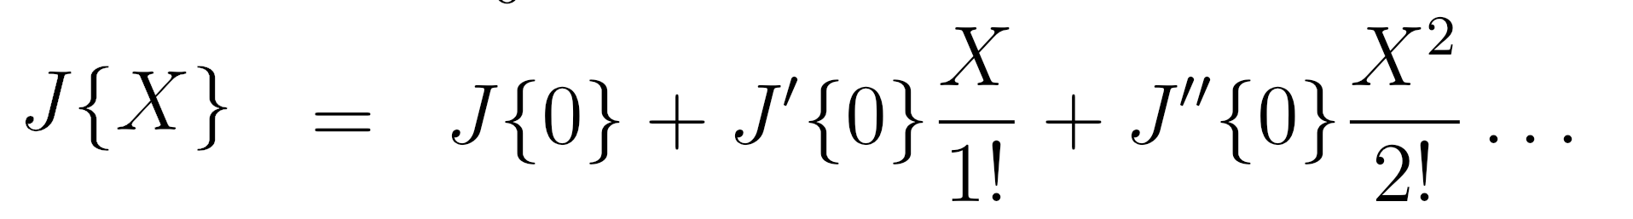
polynomial expansion of flux
as a function of force

Slide 28
General law of irreversible thermodynamics:
In diffusion, flux becomes proportional to the free energy gradient:

Slide 29
(1855)
}
concentration
gradient
flux
diffusion
coefficient

Slide 30
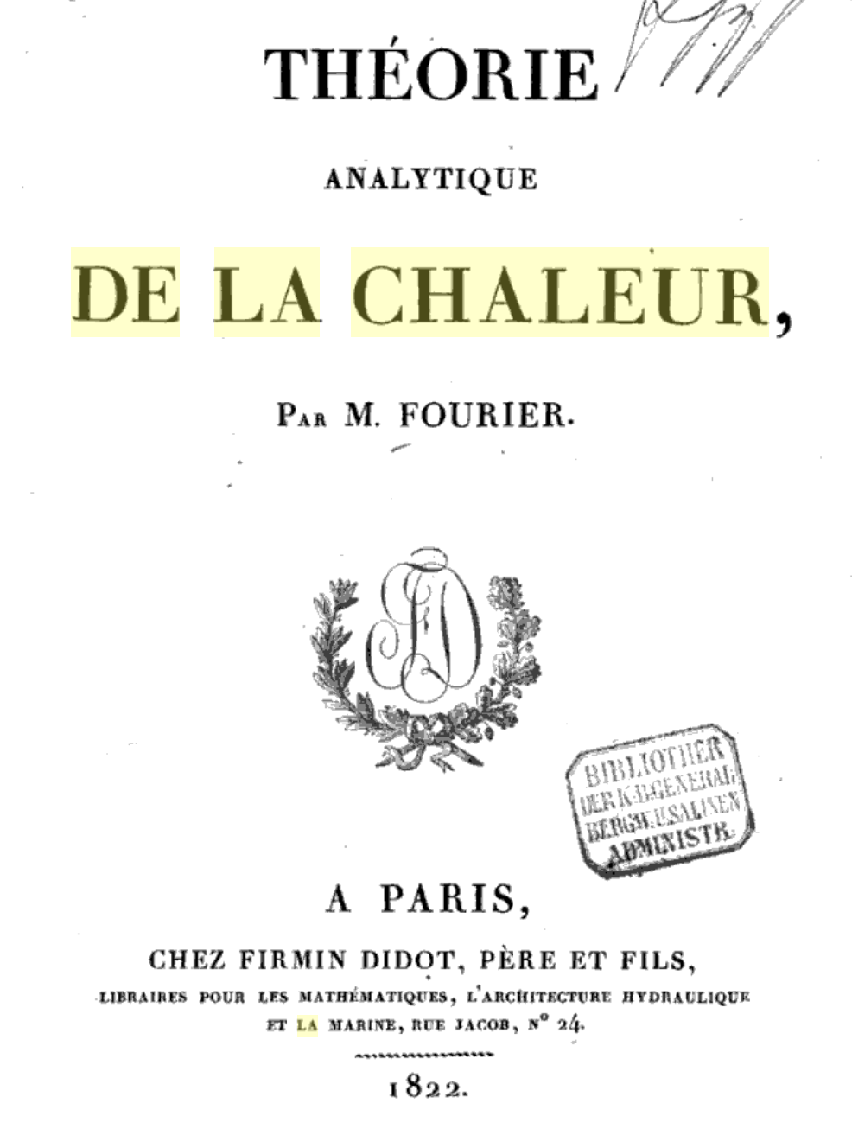

Slide 31
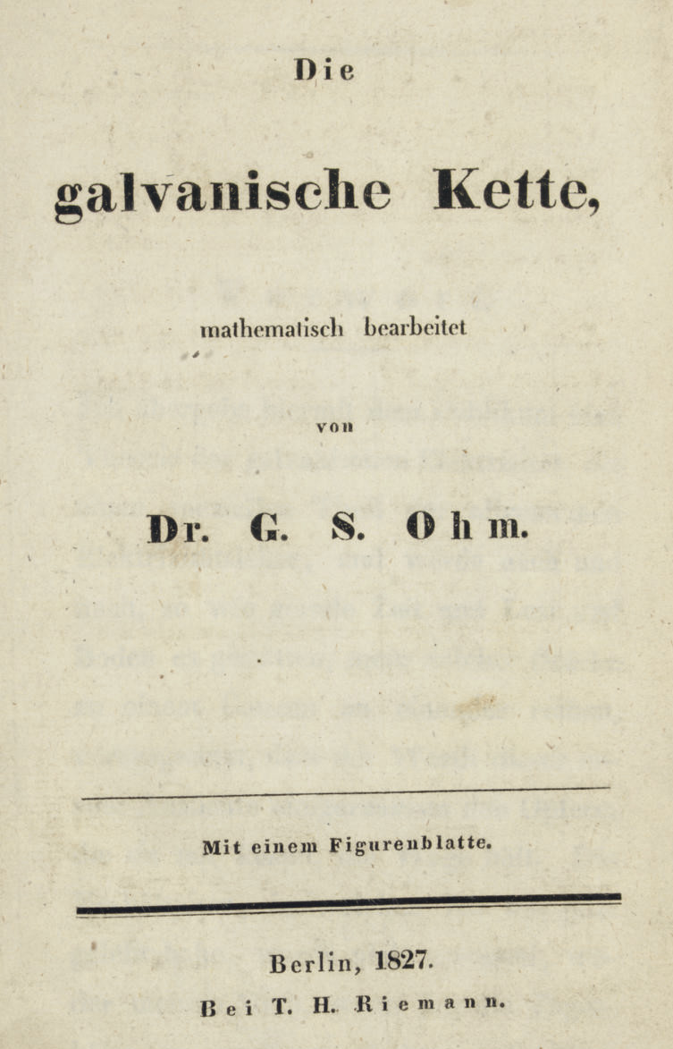

Slide 32
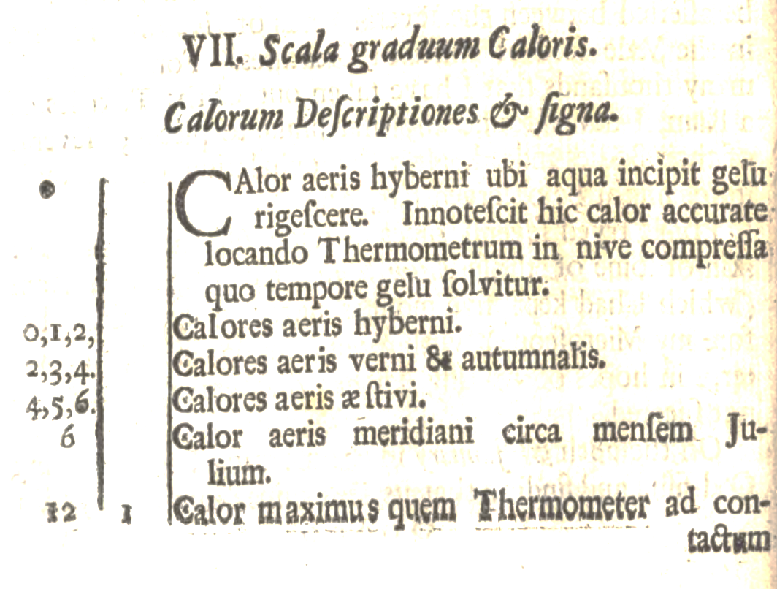
Newton’s cooling law
Phil. Trans. Roy. Soc. 1701

Slide 33
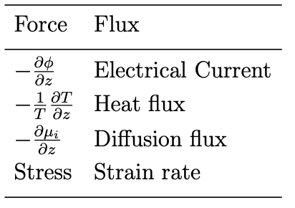
All of these processes driven by free energy gradients.
www.phase-trans.msm.cam.ac.uk

