Slide 1



Intragranular nucleation during transformations in steels
www.phase-trans.msm.cam.ac.uk

Slide 2
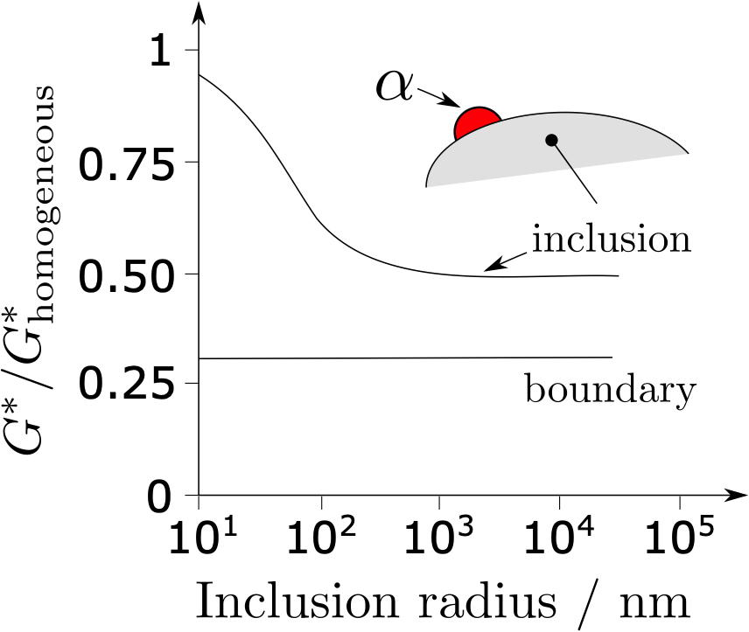
Ricks, Barritte, Howell
Solid-Solid Phase Transformations
1981, 463-468

Slide 3
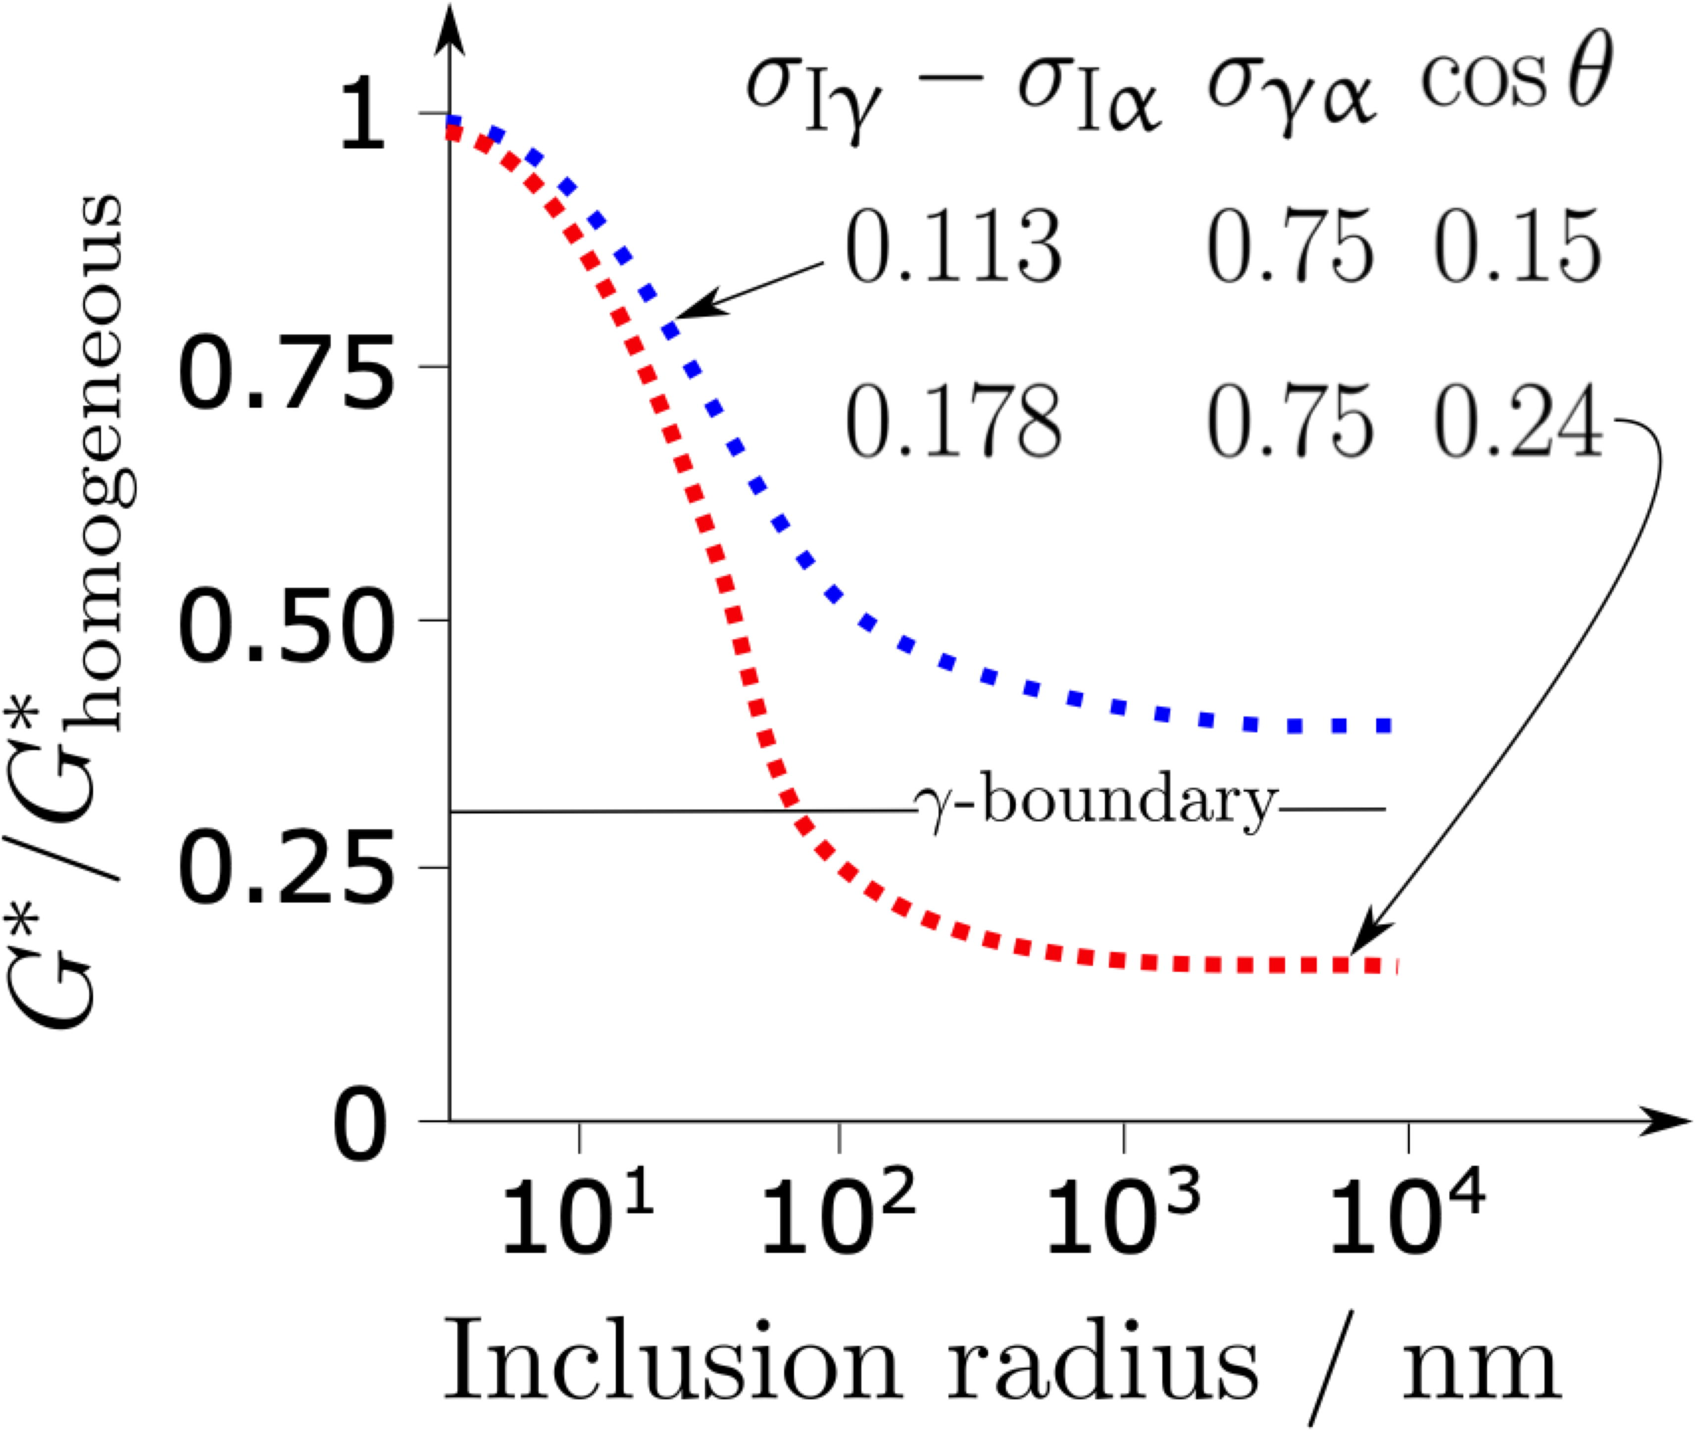
Mu, Jönsson, Nakajima
J. Materials Science
51 (2016) 2168-2180

Slide 4
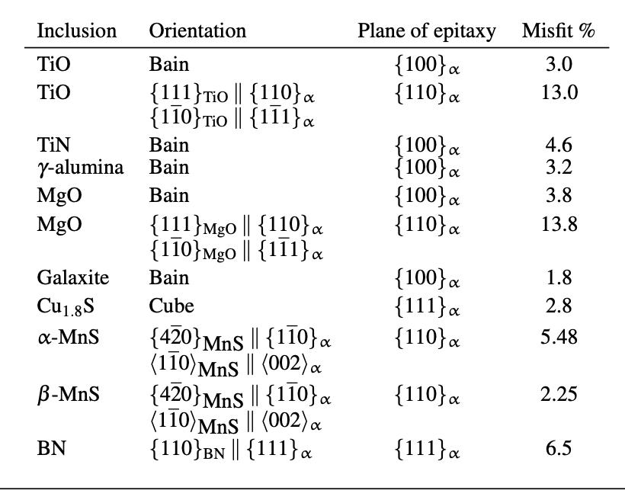
logical difficulties

Slide 5
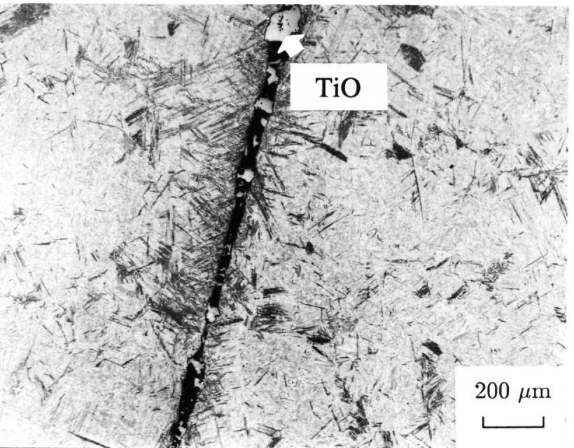
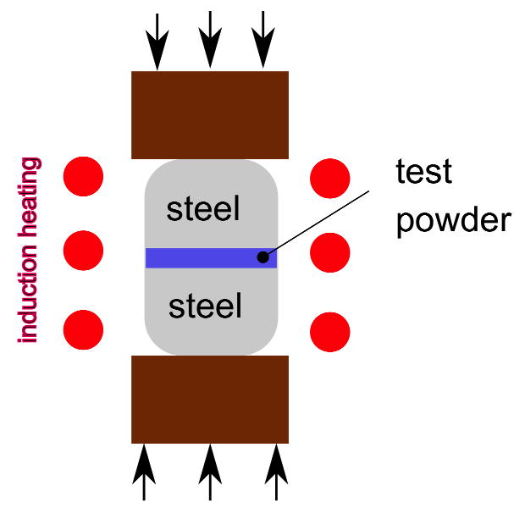
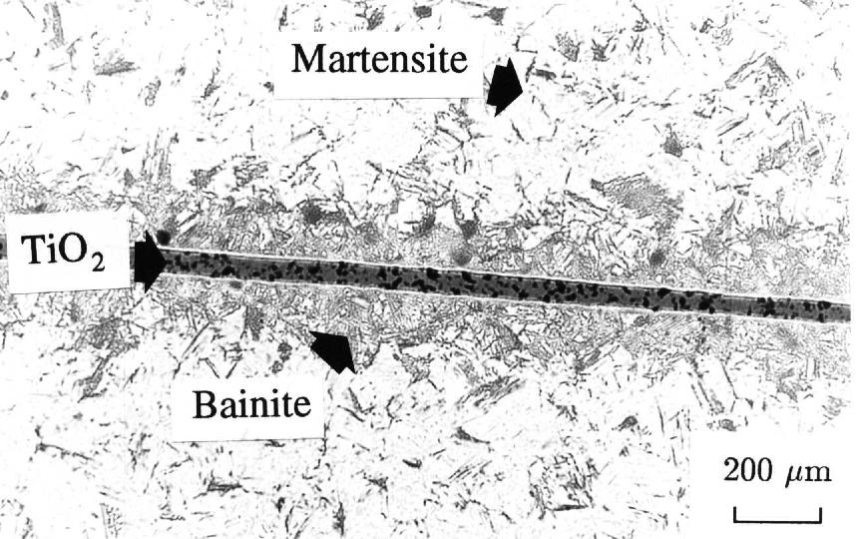
Testing minerals: the method

Slide 6
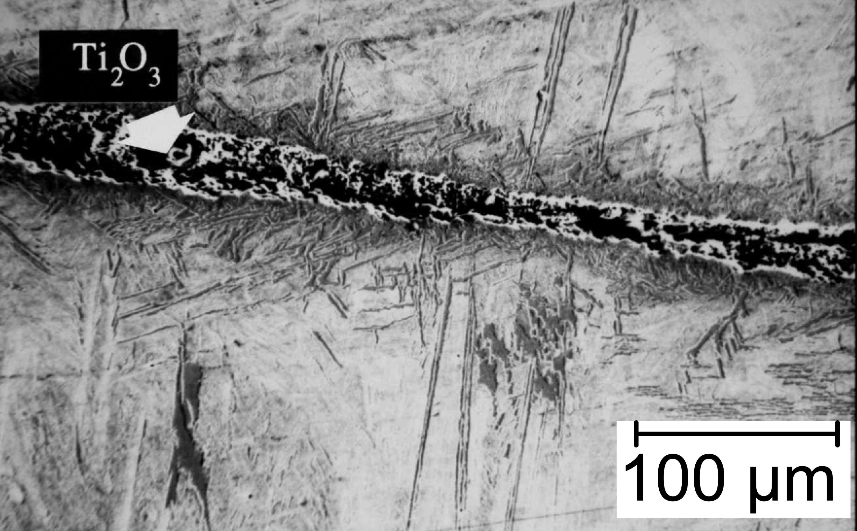
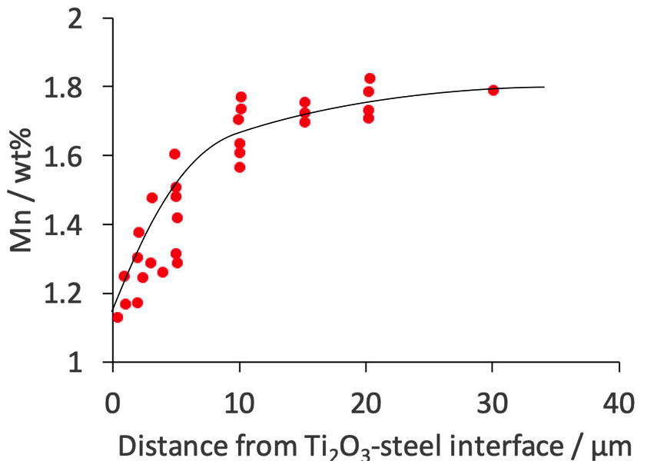

Slide 7
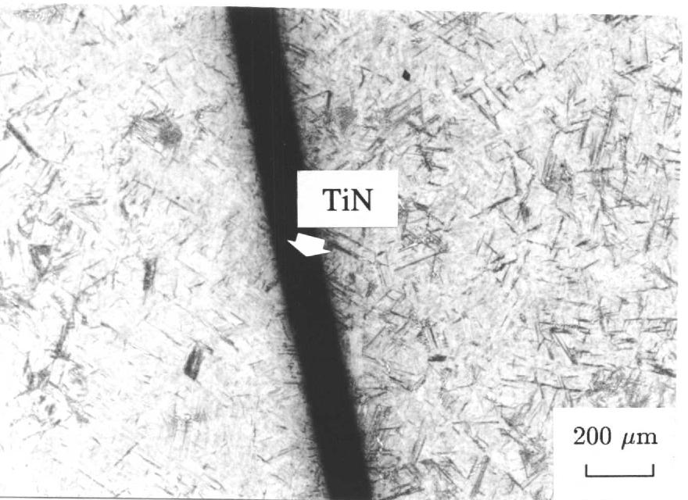

Slide 8
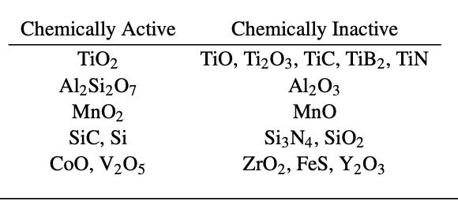

Slide 9
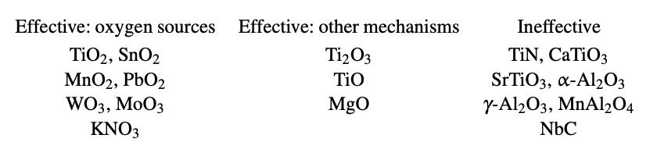

Slide 10
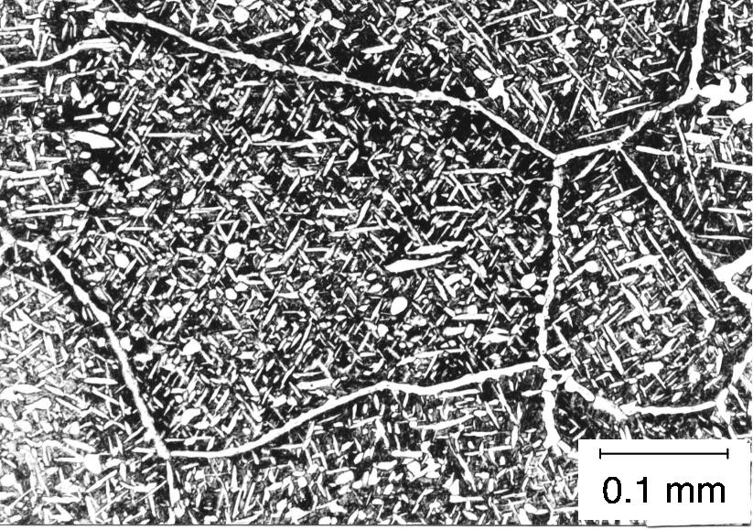
Ali, Bhadeshia
Materials Science & Techn.
6 (1990) 781-784

Slide 11

To calculate a TTT diagram, need:
nucleation theory
growth theory
hard impingement
soft impingement
concentration
distance

Slide 12
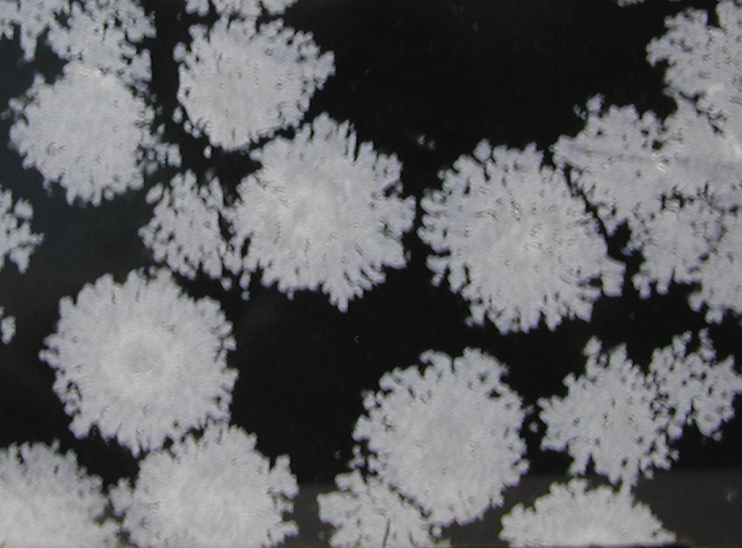
Overall Transformation Kinetics

Slide 13
α
time = t
time = t+∆t

Slide 14
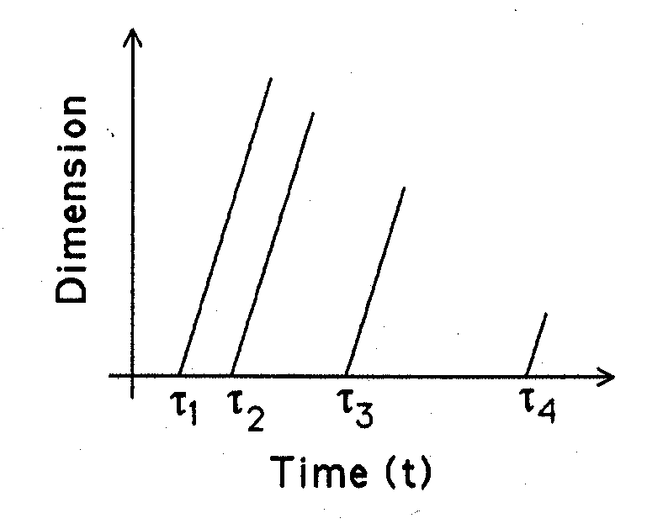
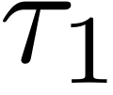
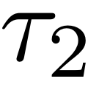
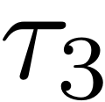

Slide 16
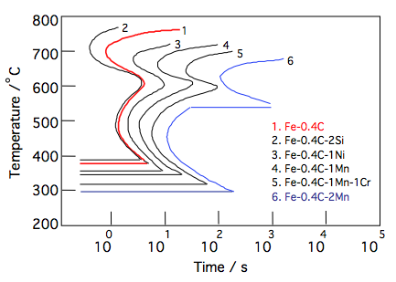

Slide 17
Ali, Bhadeshia
Materials Science & Techn.
6 (1990) 781-784

Slide 18
β
α
time = t
time = t+∆t

Slide 19
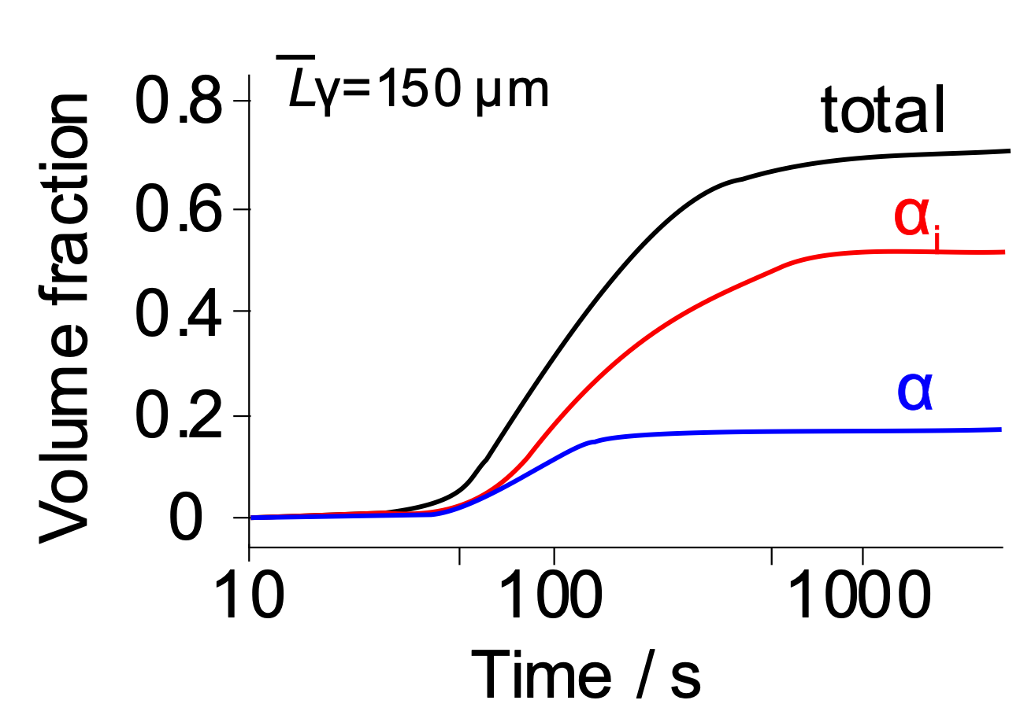
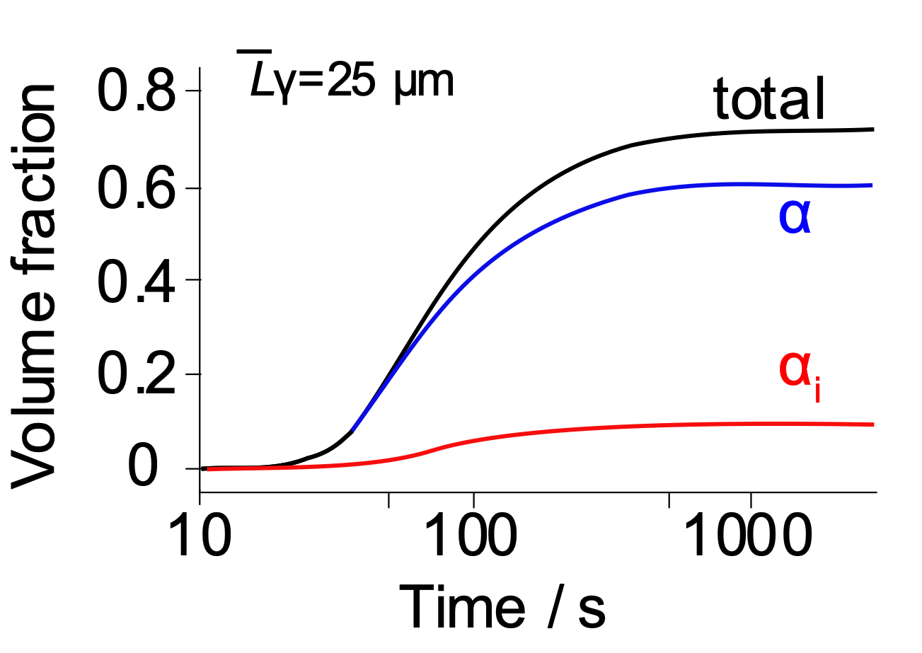
Jones, Bhadeshia
Metall. Mater. Trans. A
28 (1997) 2005-2103

Slide 20
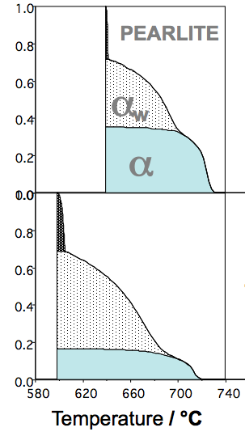
100 µm austenite grain size
11 °C min⁻¹
Volume fraction
101 °C min⁻¹
Jones & Bhadeshia

Slide 21
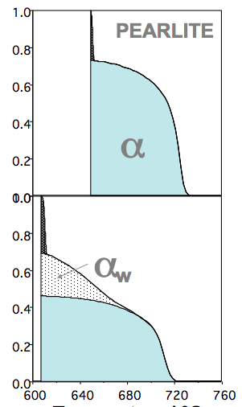
30 µm austenite grain size
11 °C min⁻¹
Volume fraction
101 °C min⁻¹
Jones & Bhadeshia
Temperature / °C

Slide 22
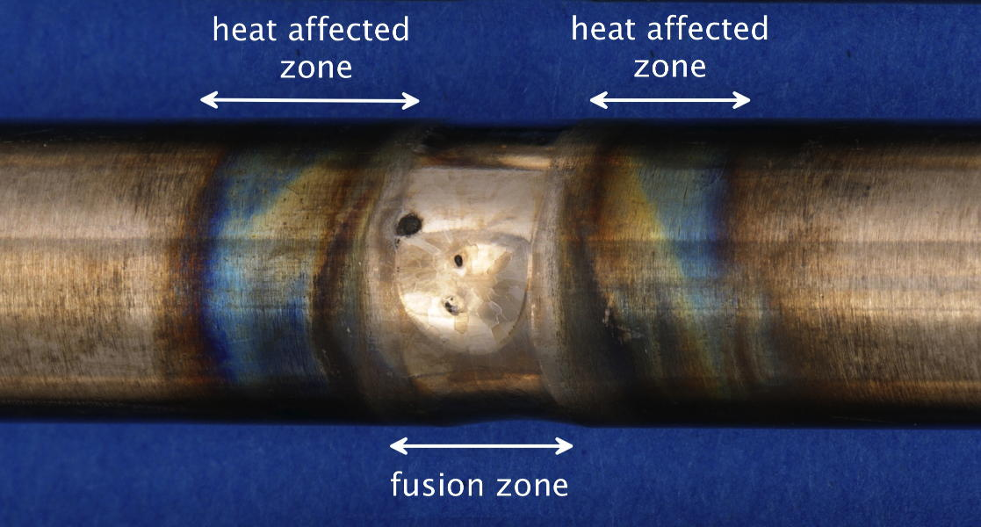
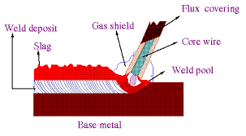
Weld metal
always low carbon concentration
always continuous cooling
variety of transformation products

Slide 23
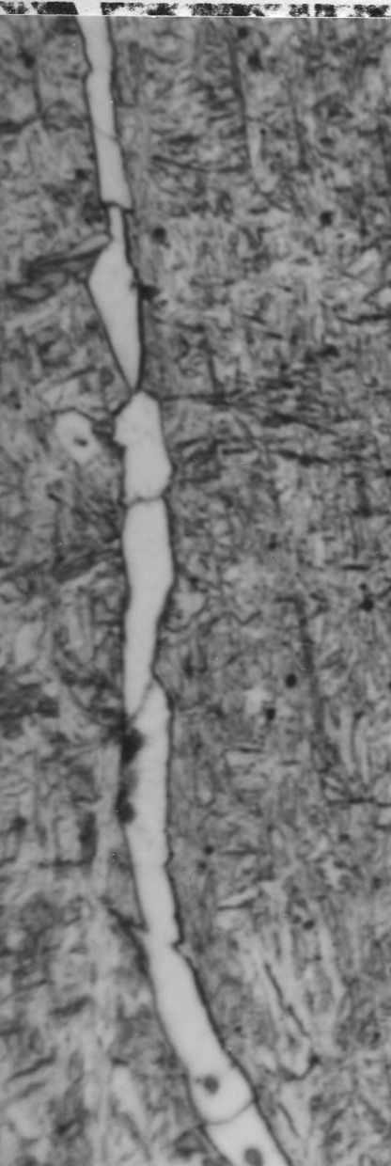
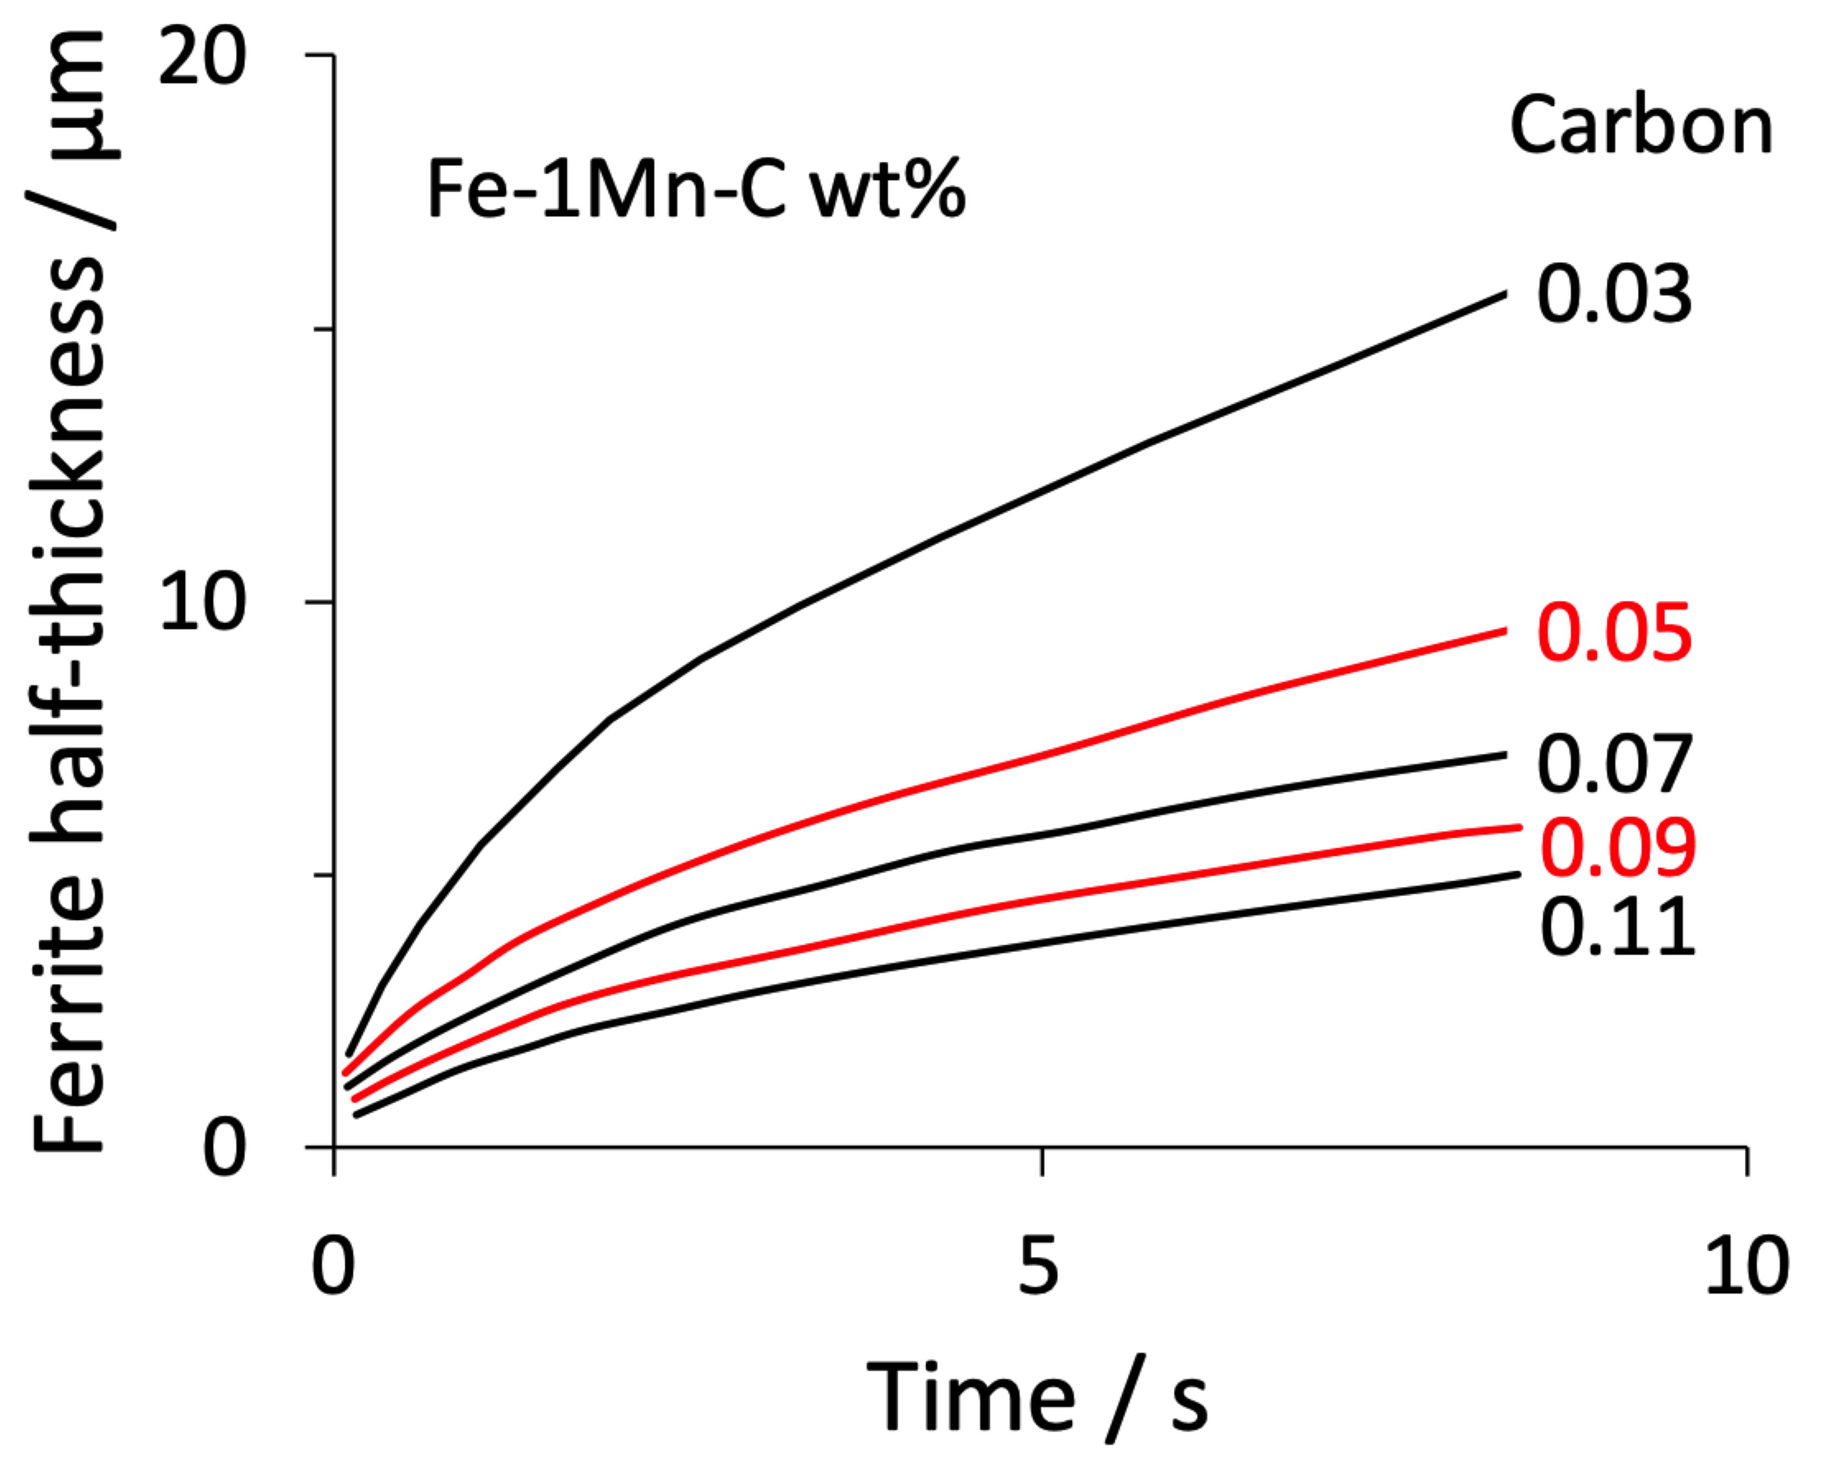
20 µm
Barritte (1982)

Slide 24
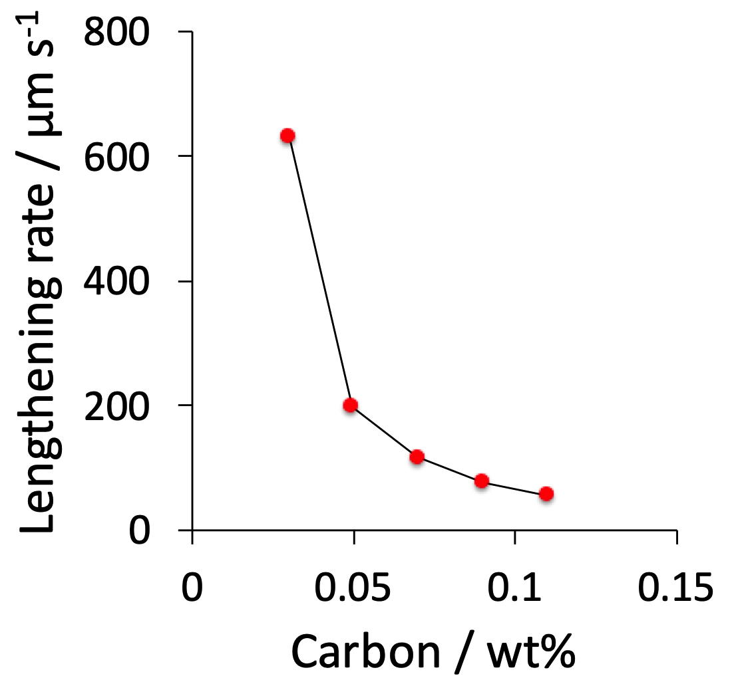
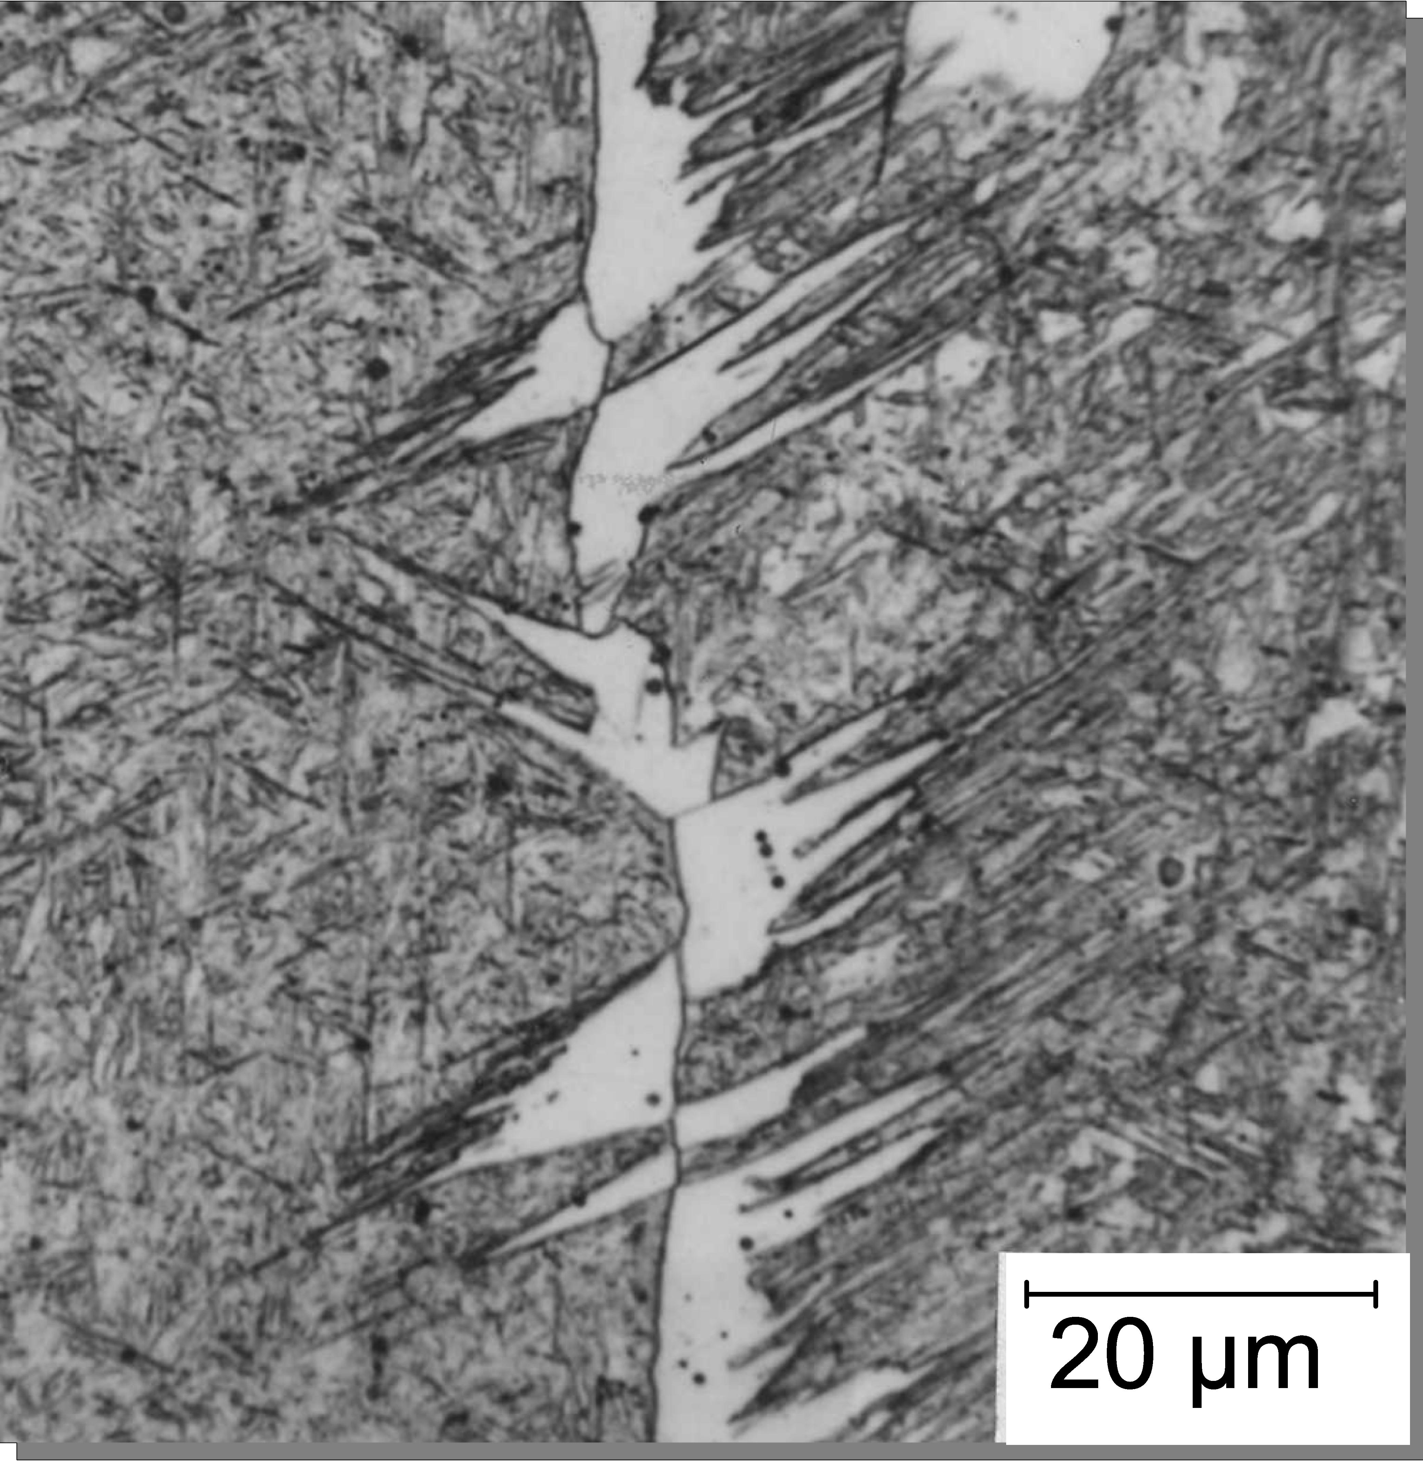
Barritte (1982)

Slide 25
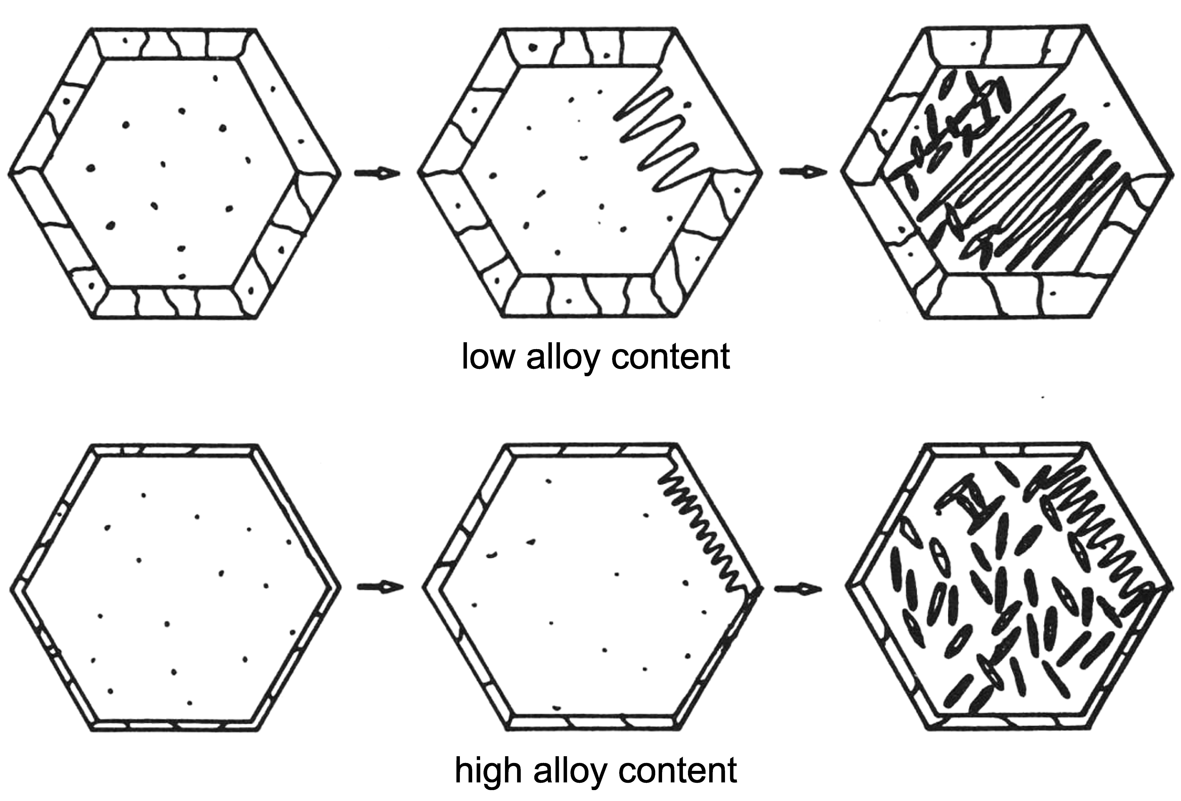

Slide 26
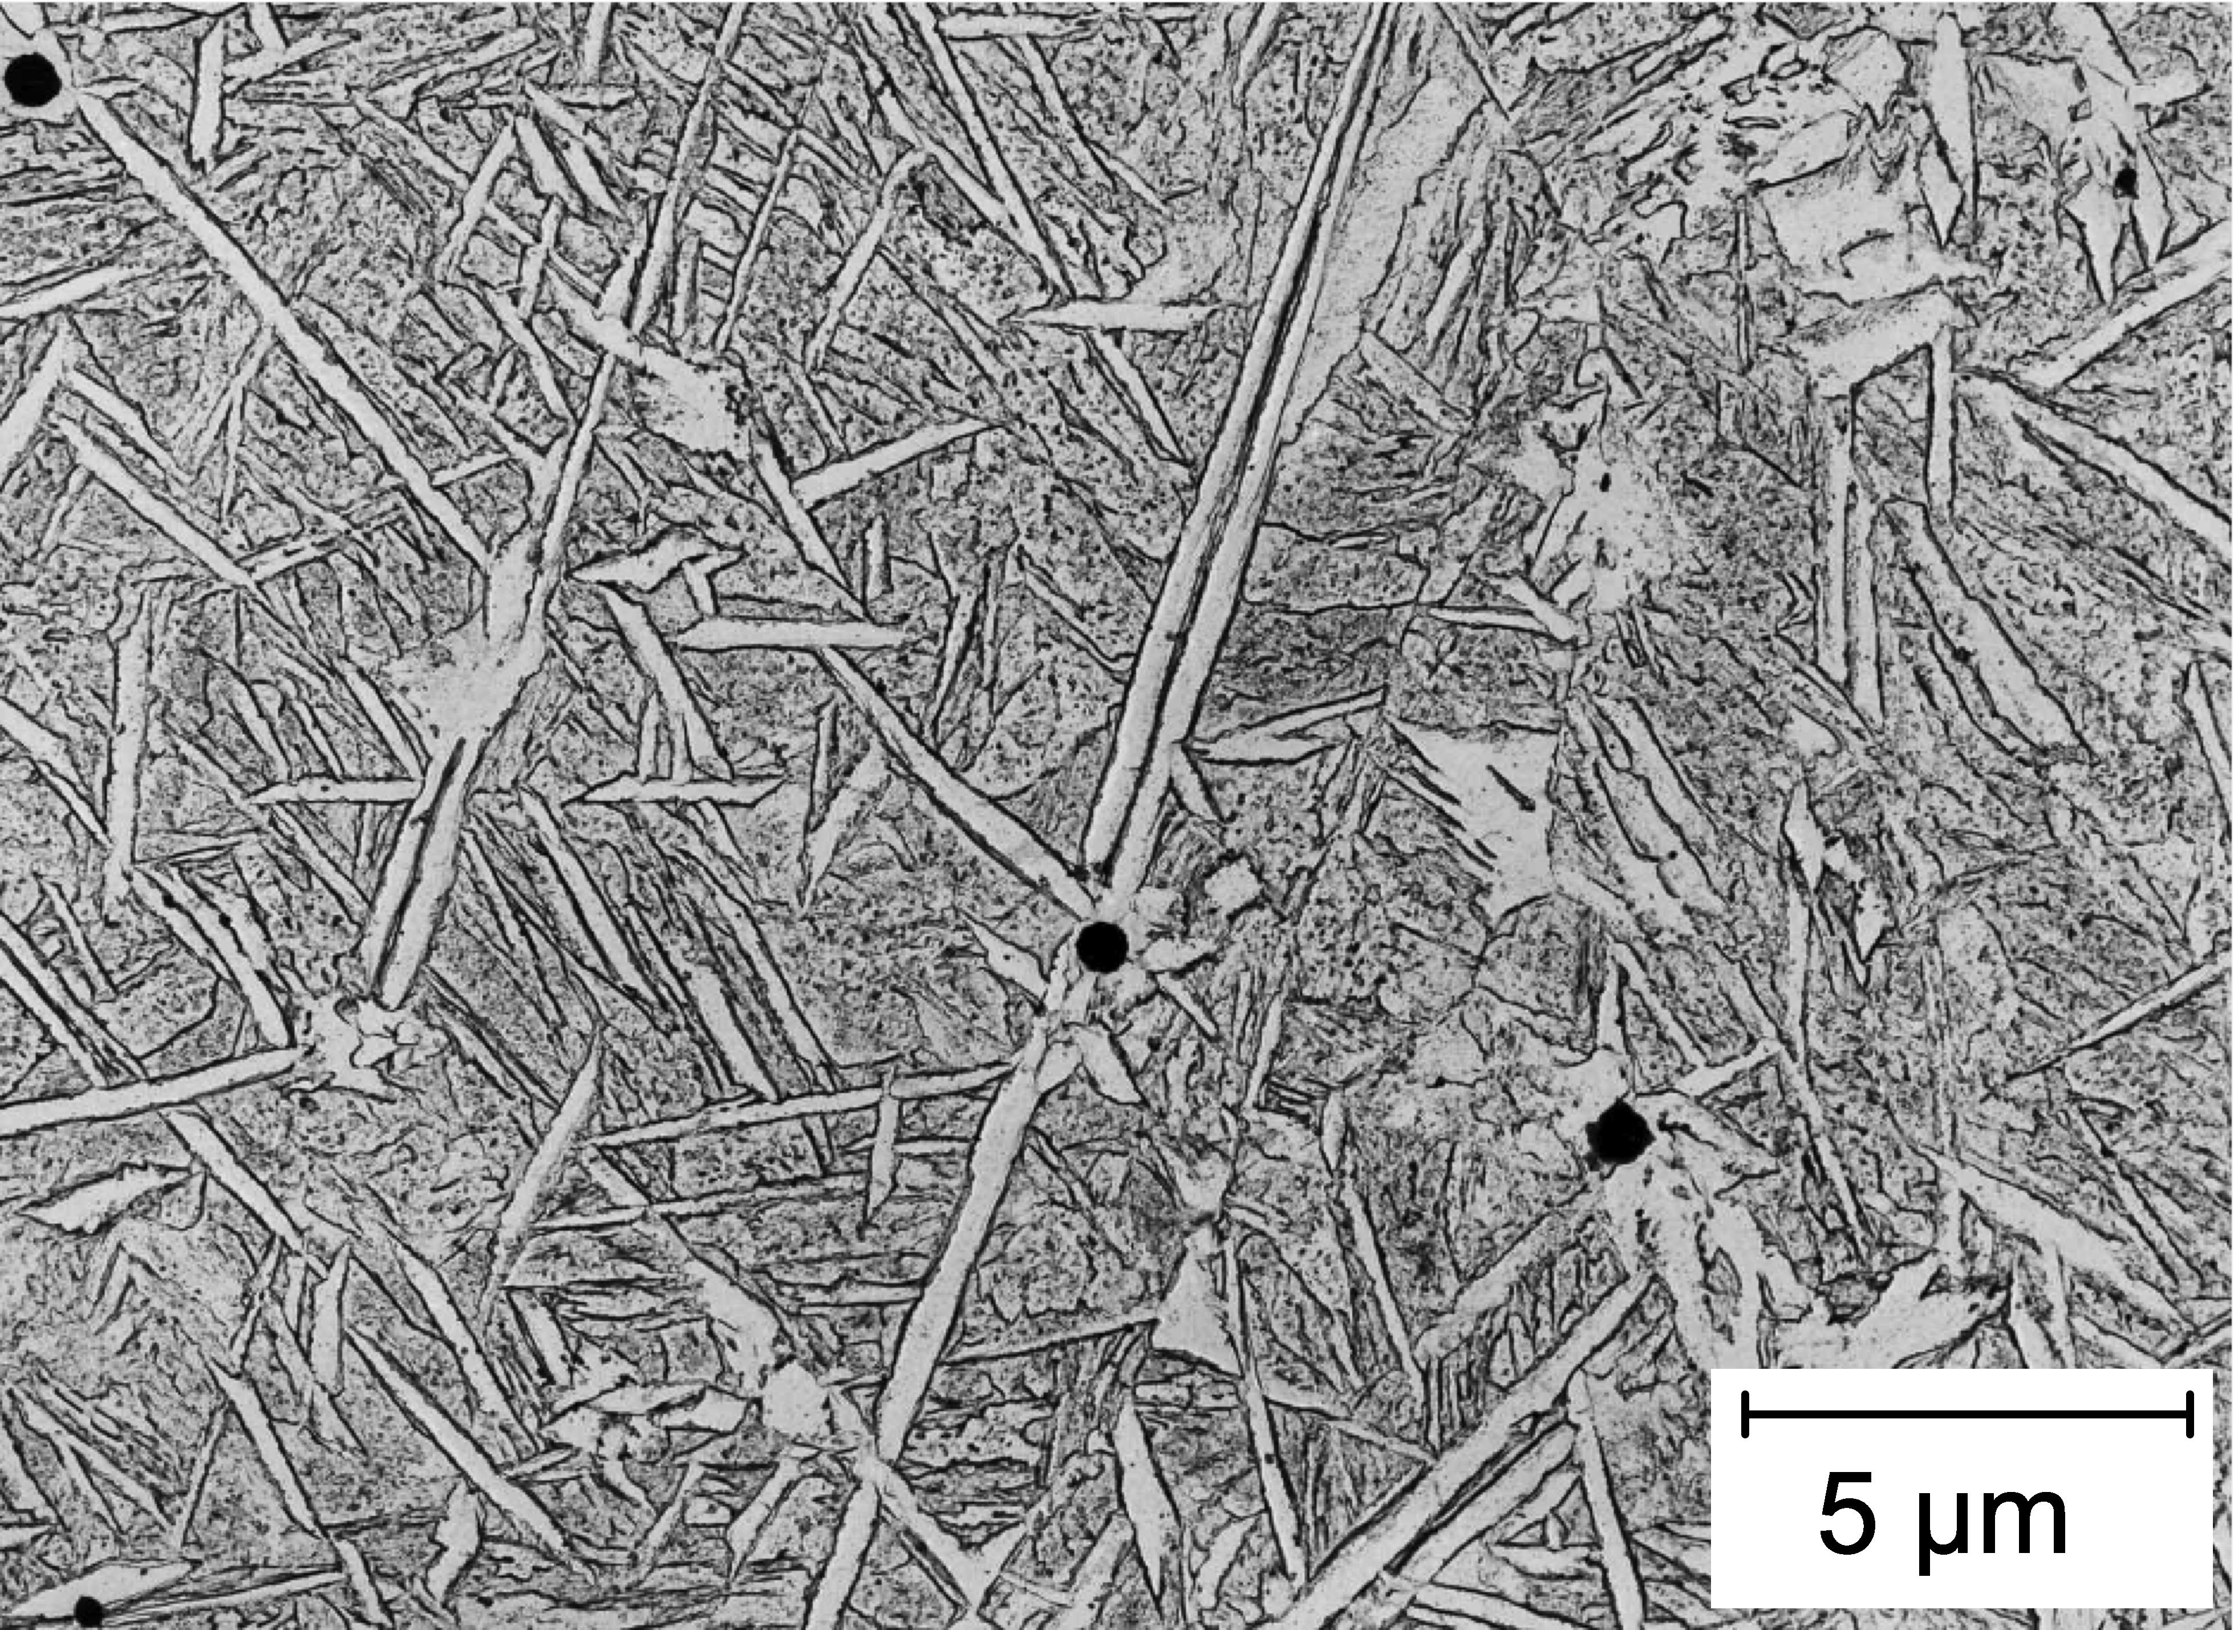
Barritte (1982)

Slide 27
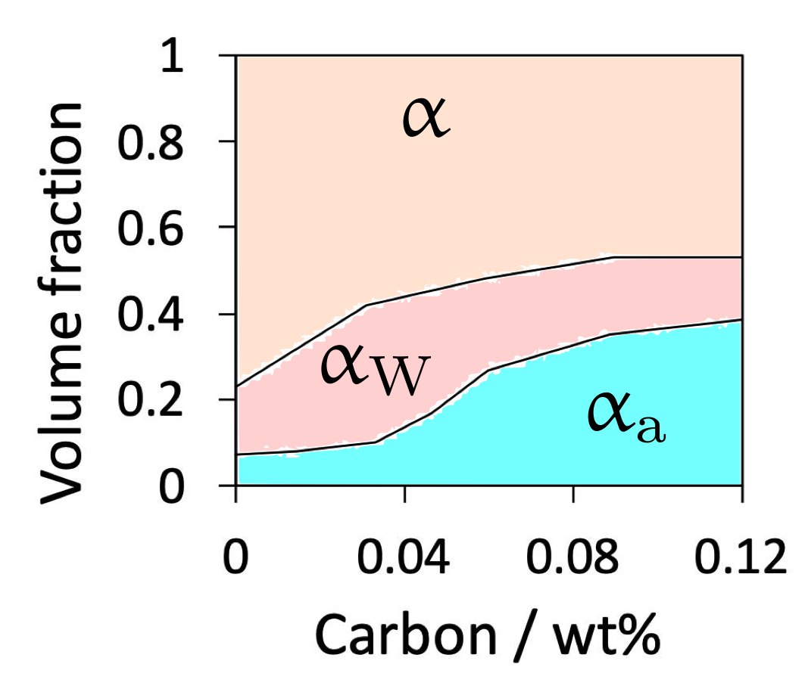
Fe-1Mn-C
Demonstration
toughness ⇧
strength ⇧

Slide 28
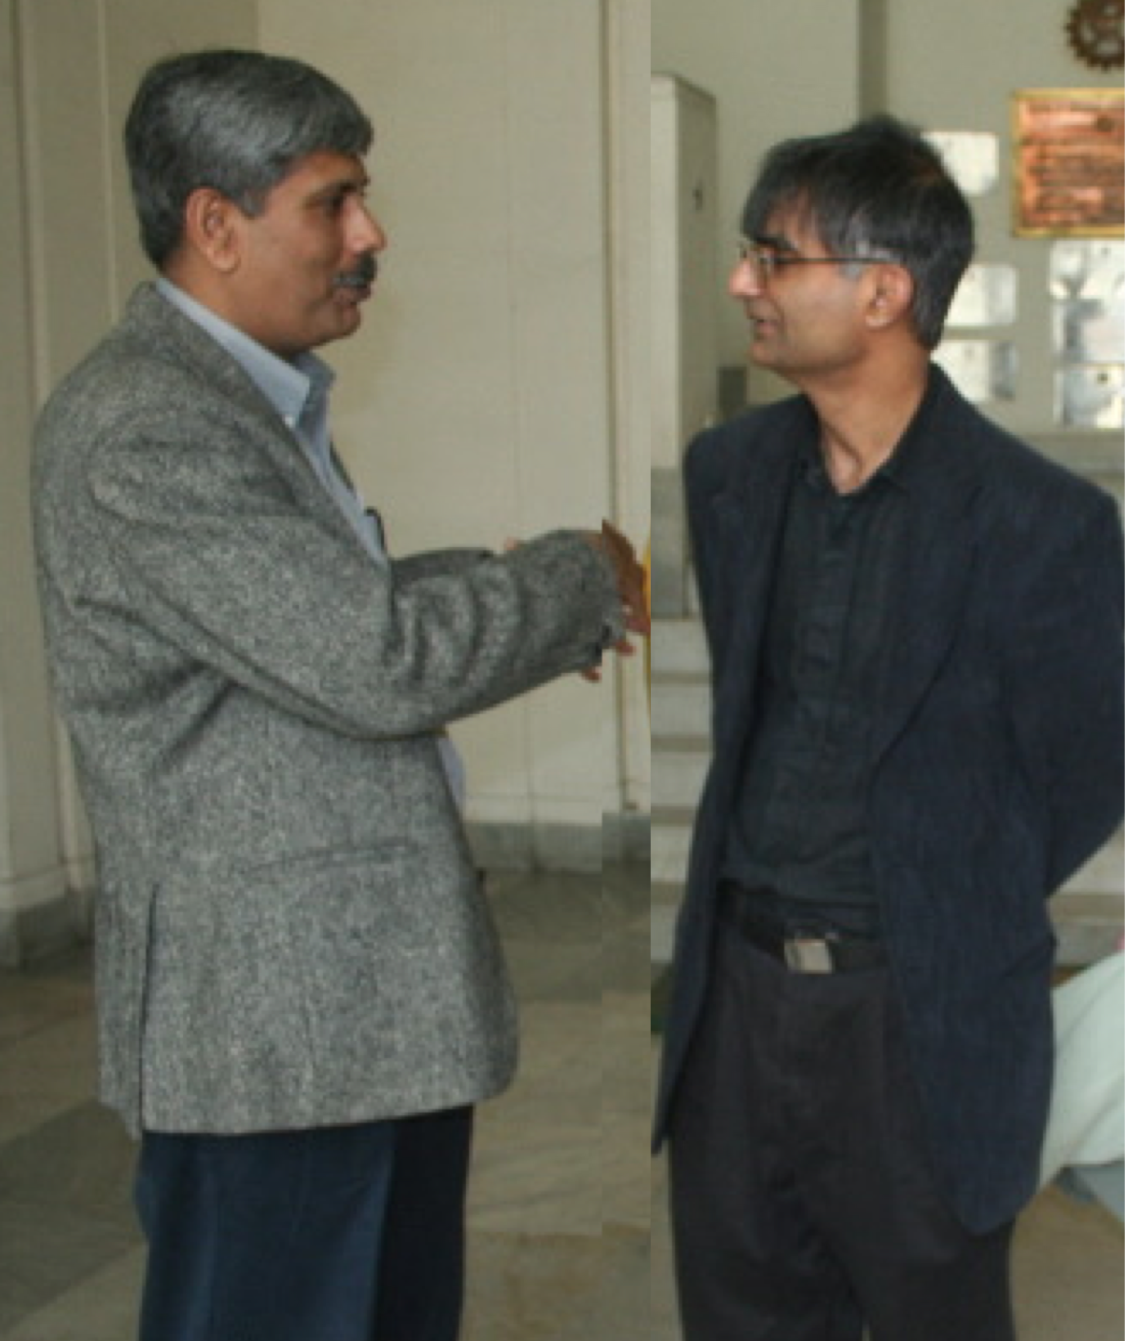





Slide 29

100 years of books
www.phase-trans.msm.cam.ac.uk

