Slide 1
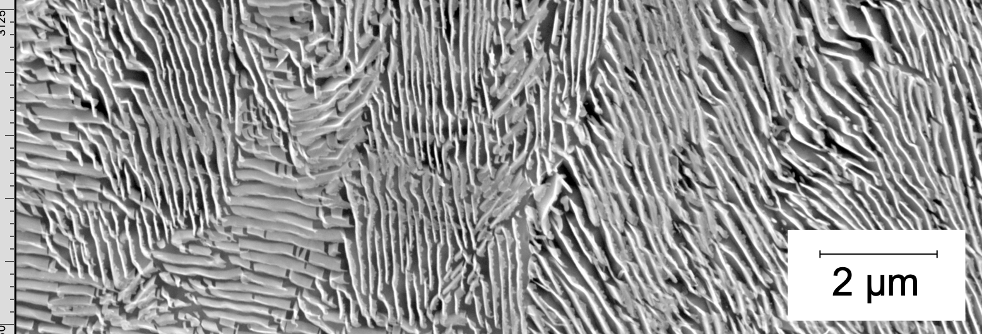
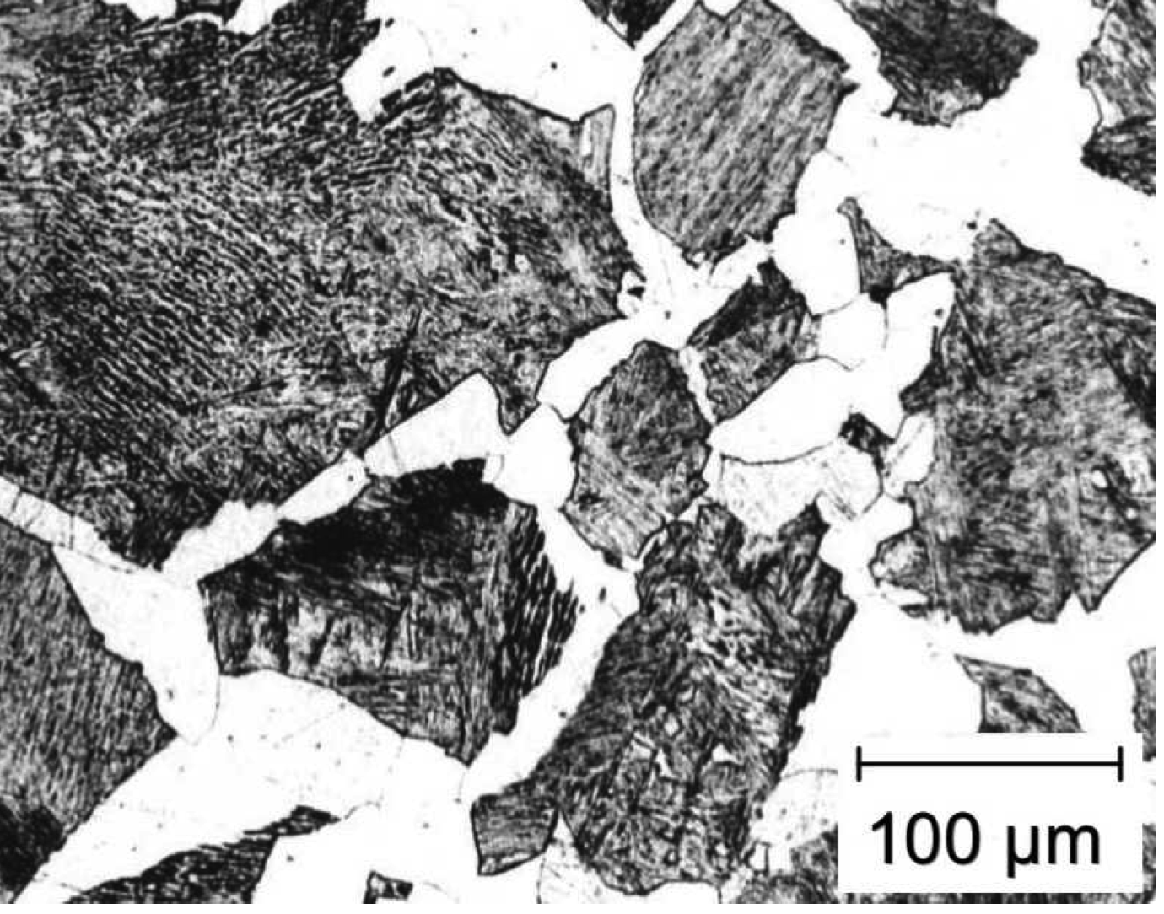
Diffusion-controlled growth in multicomponent steels
Difficulties in theory of ferrite growth
steep concentration gradients
(Apparao Chintha)
www.phase-trans.msm.cam.ac.uk

Slide 2
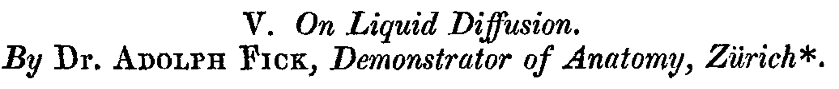
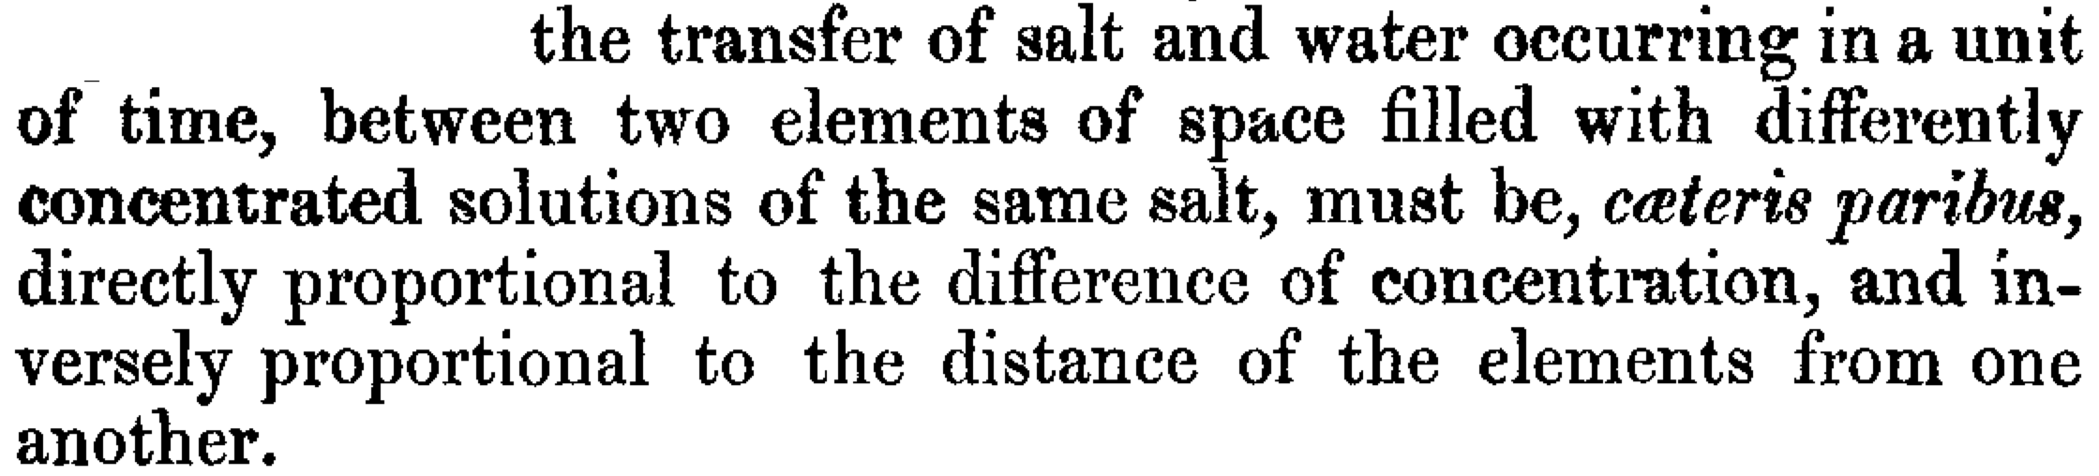
(1855)
}
concentration
gradient
flux
diffusion
coefficient

Slide 3
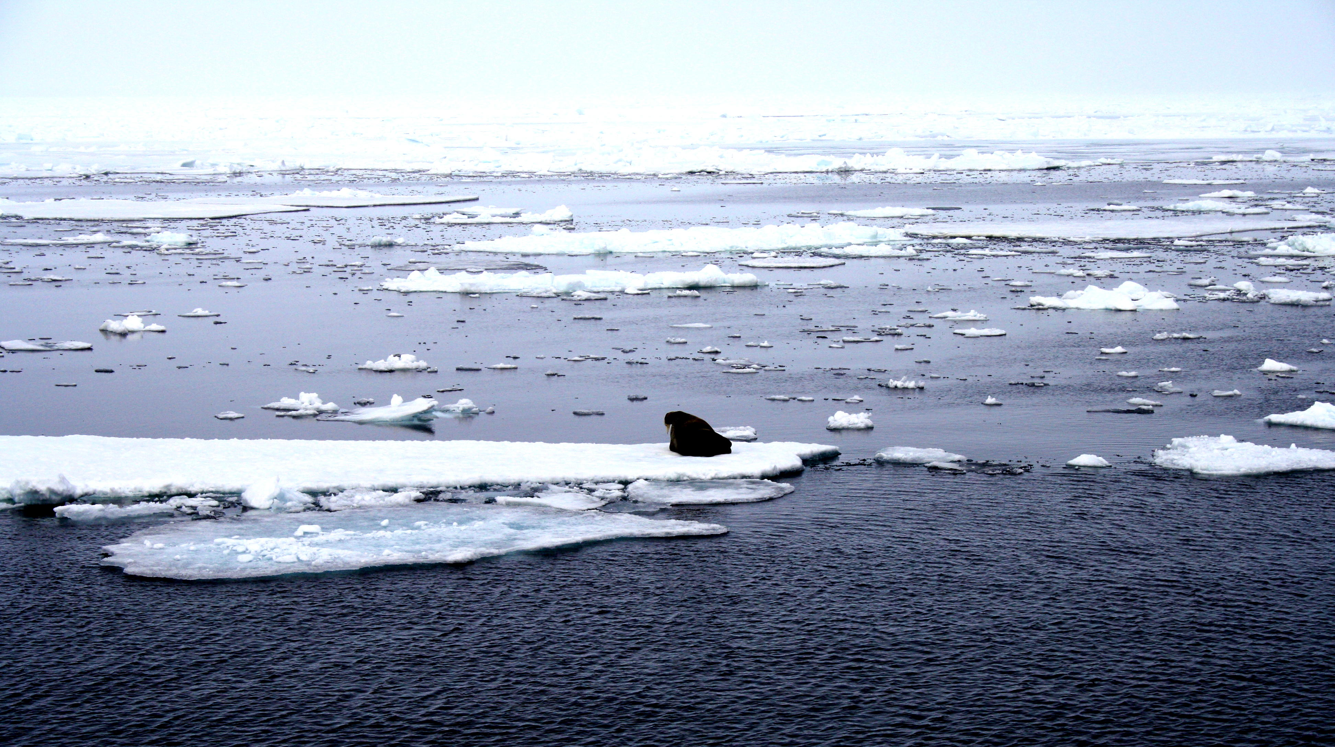
Why no diffusion of salt from sea-water into ice?
ice: pure
ocean: salty water
photograph courtesy of Sunita Hansraj from her Antarctica expedition

Slide 4
μ
o
B
μ
o
Gibbs free energy per mole
A
μ
A
G{x}
μ
B
A
B
x
Composition

Slide 5


Slide 7
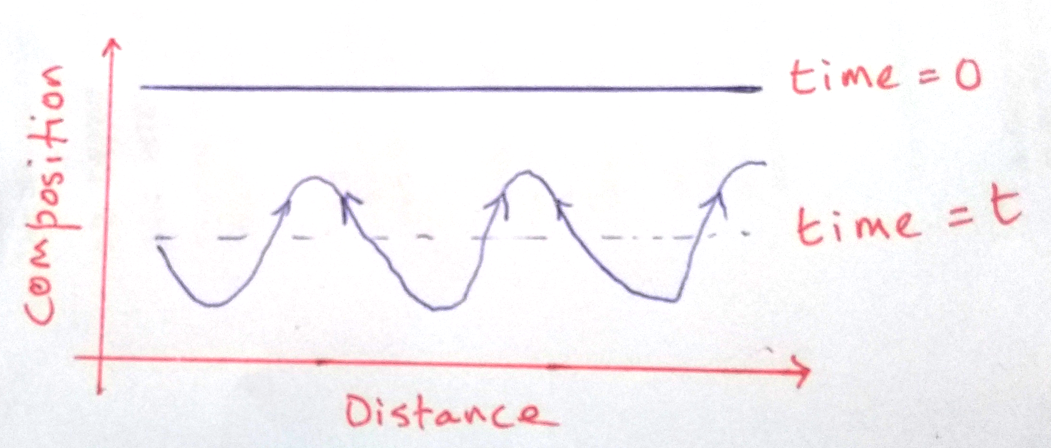

Slide 8
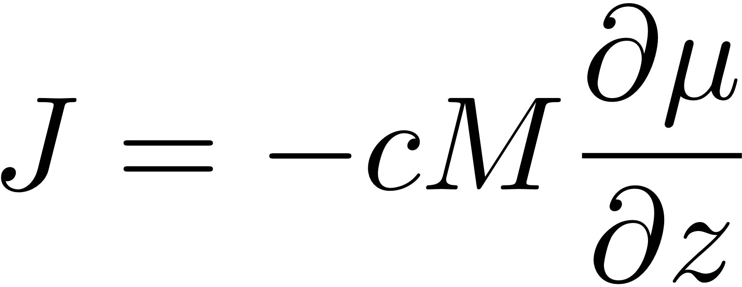

Slide 9
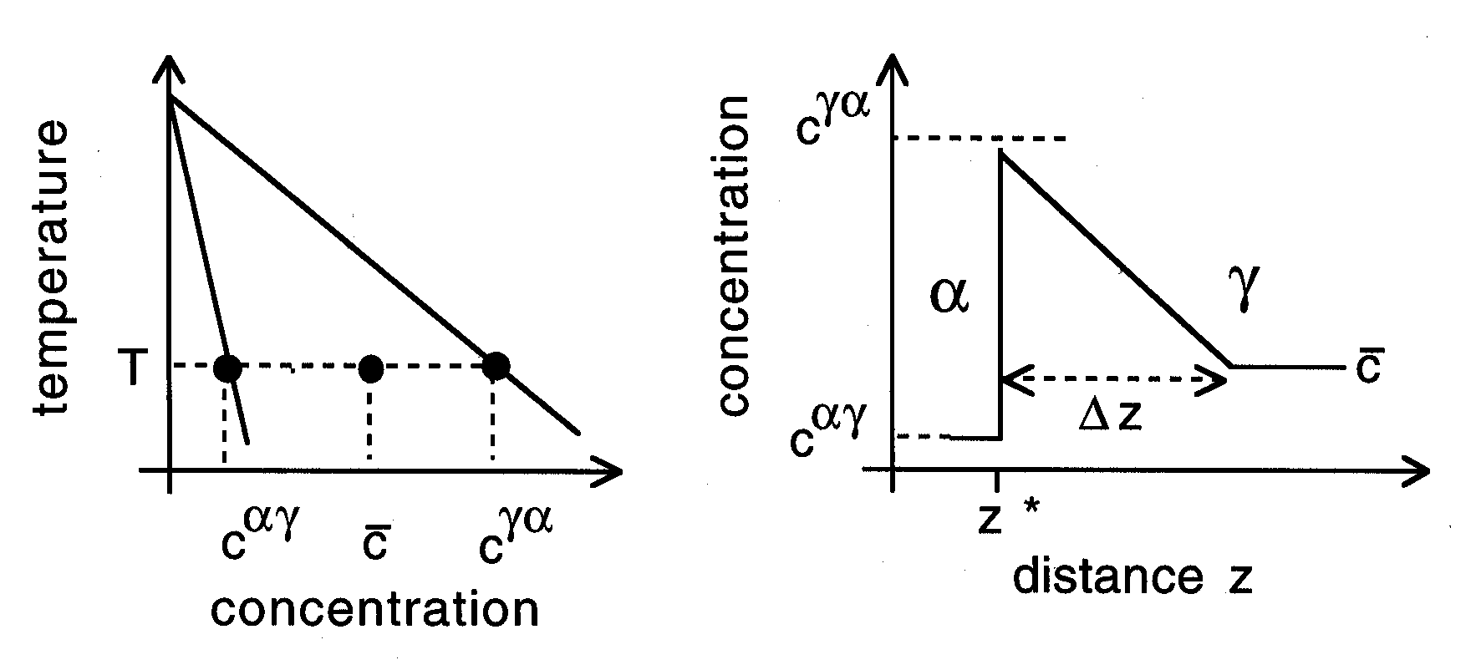
Kinetics of ferrite growth

Slide 10
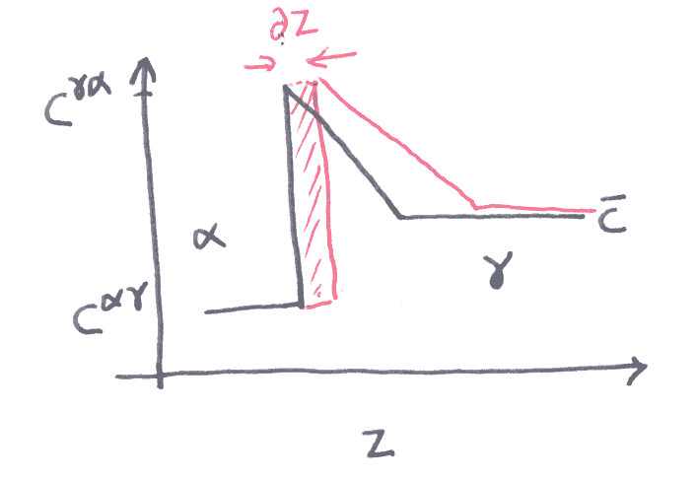

Slide 11
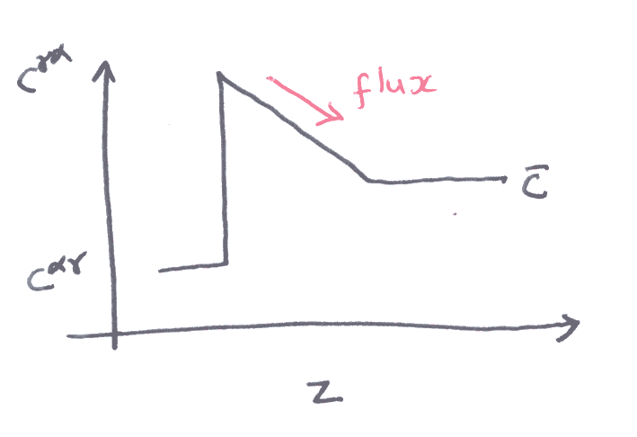

Slide 12
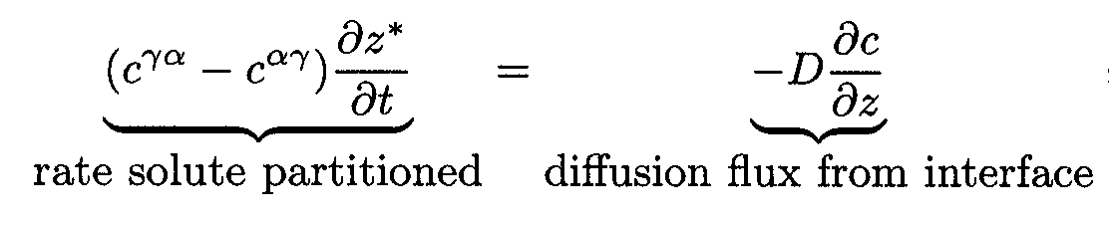
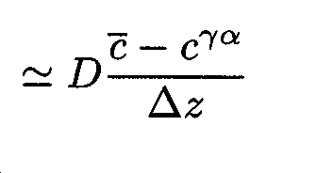
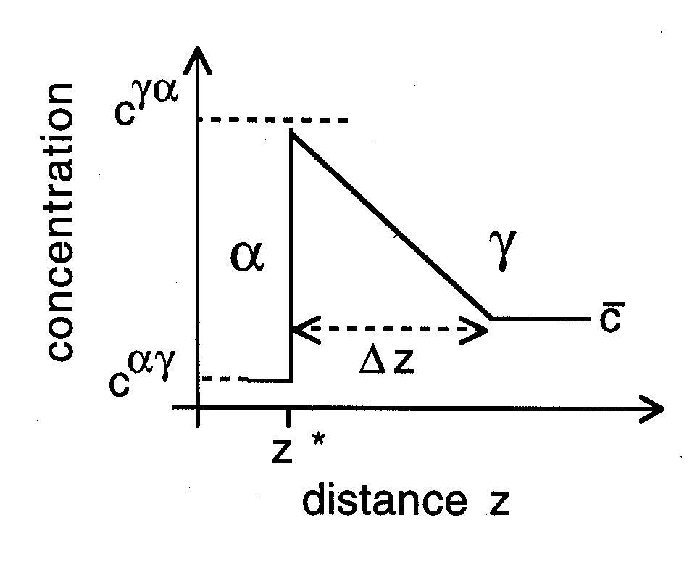
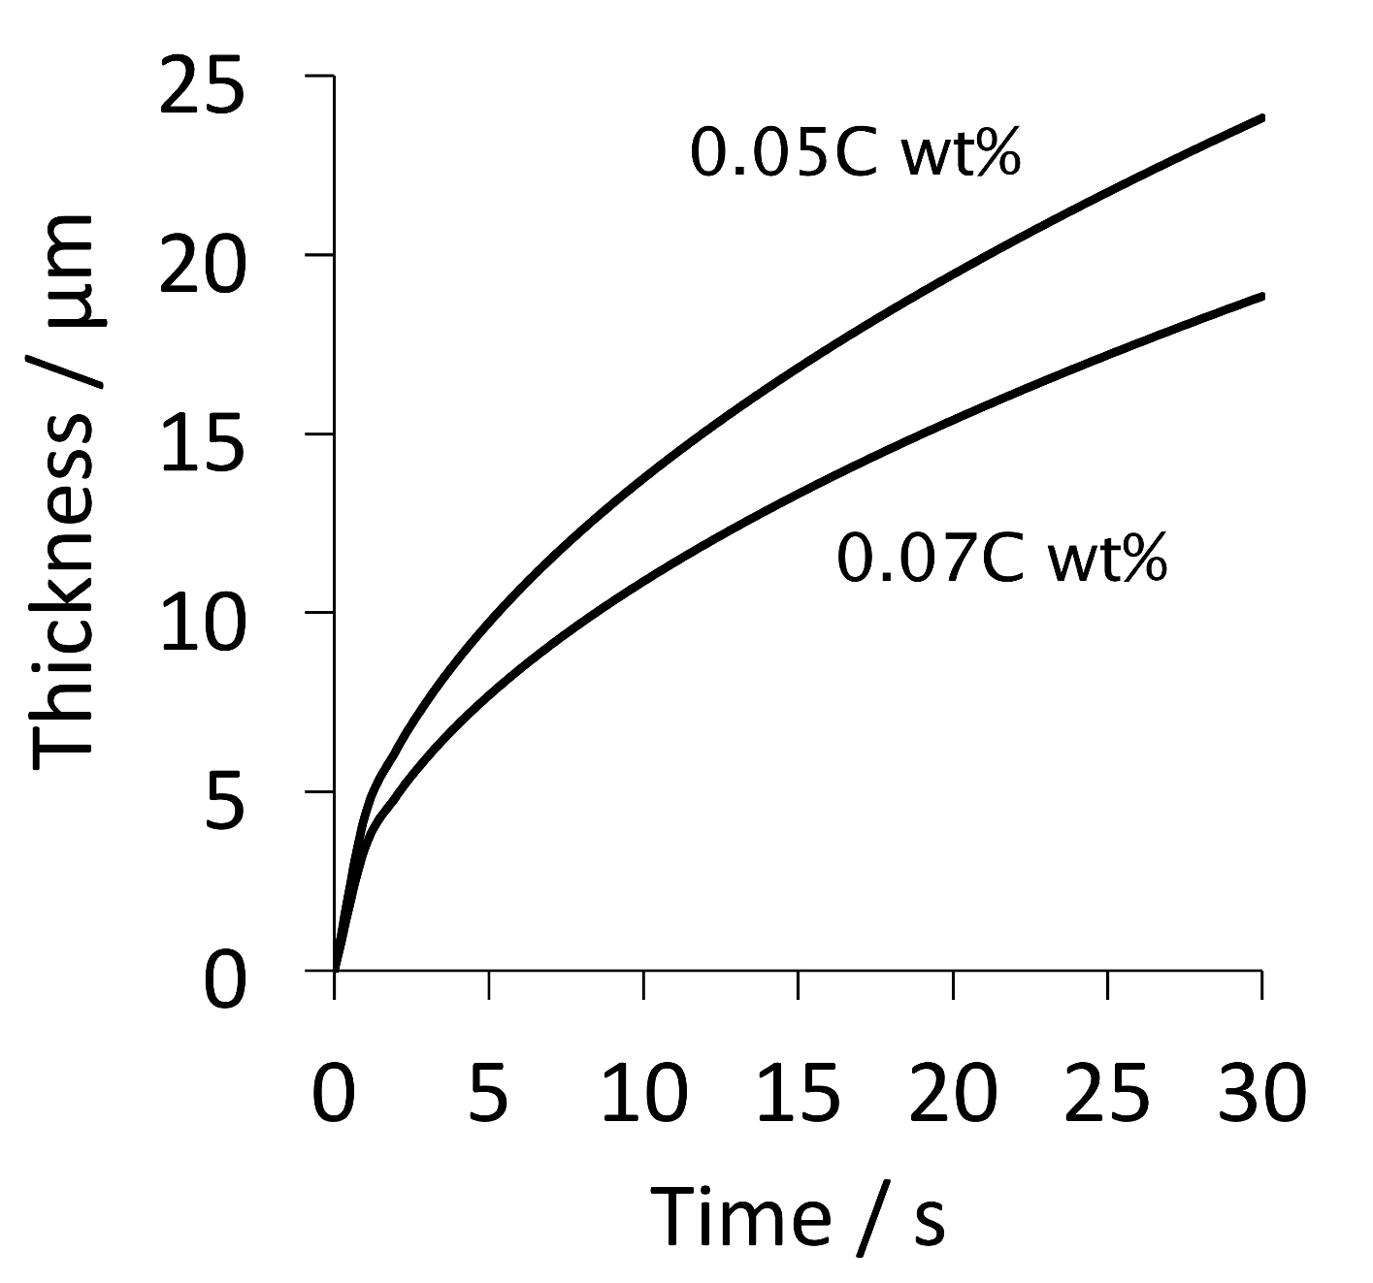

Slide 13
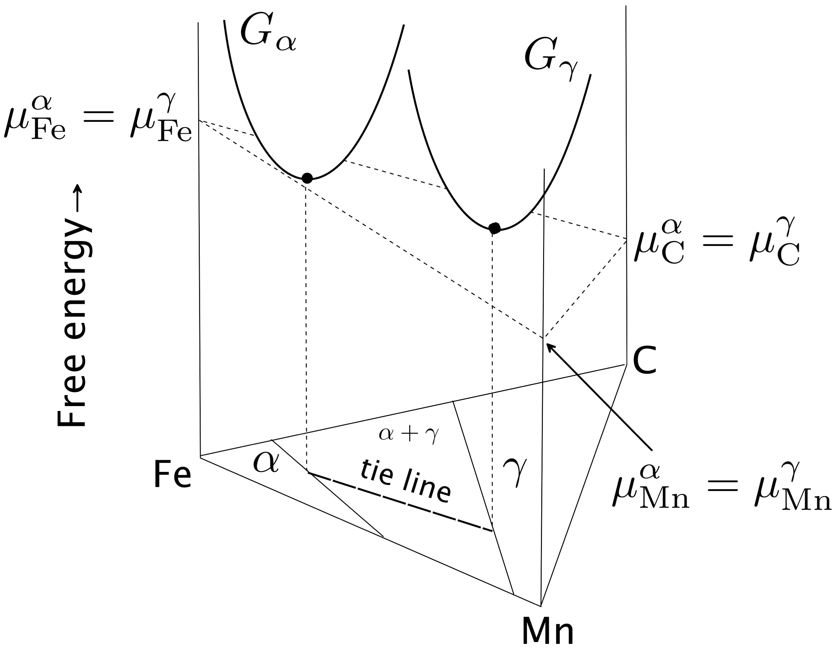

Slide 14
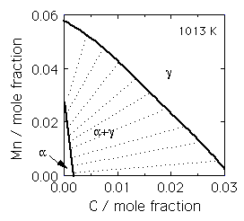

Slide 16
γ
High supersaturation
NP-LE mode
Manganese
α
α
γ
α+γ
Carbon
α
γ

Slide 17
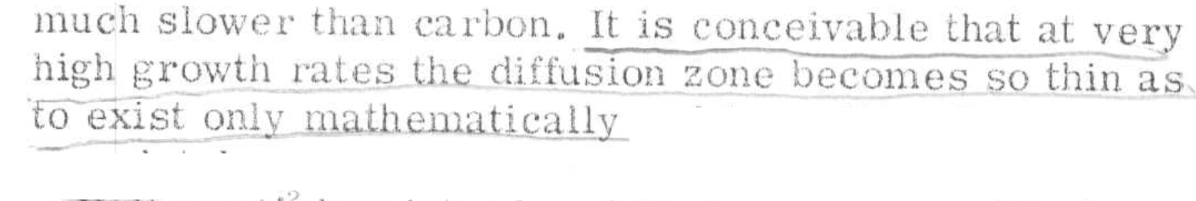
Metall. Mater. Trans. A 43 (2012) 833
diffusion distance 0.03 nm
Metall. Mater. Trans. A 46 (2015) 2347
diffusion distance 0.002-0.04 nm
how do we proceed?

Slide 18
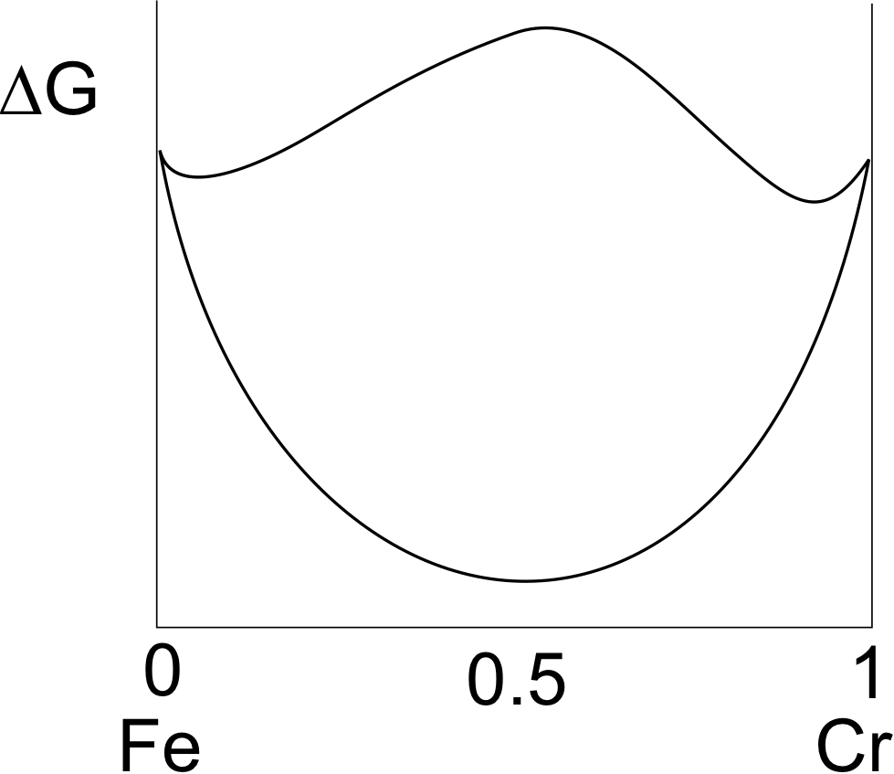

Slide 19
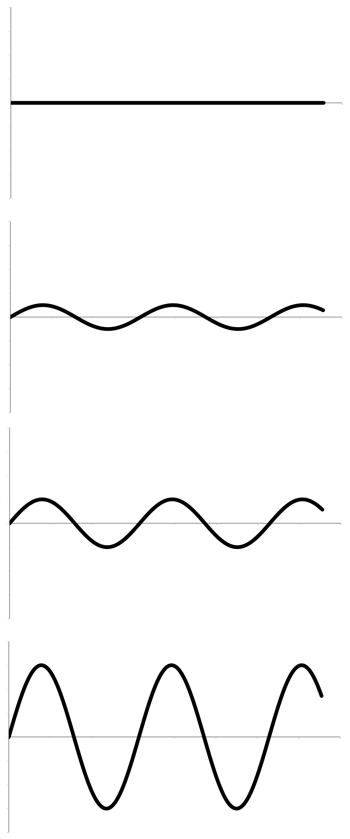


Yoshiyuki Saito
Cr
time
Carlos Martins
distance

Slide 20
Most rapidly growing Fourier components have infinitely small wavelength
However, diffusion coefficient
is actually a function of the concentration gradient. Large gradients retard diffusion. i.e. free energy is a function of gradient of concentration.

Slide 21
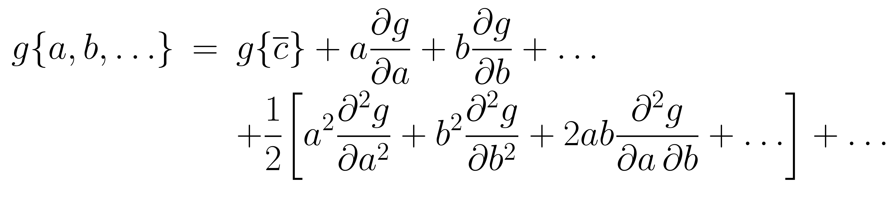
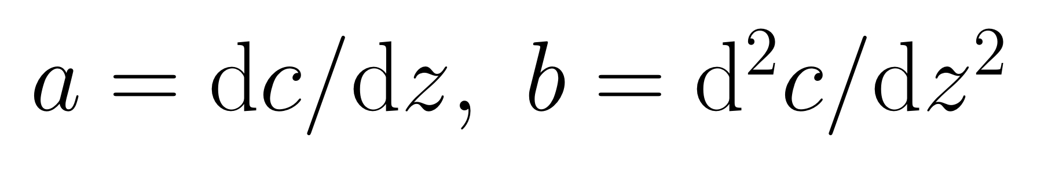
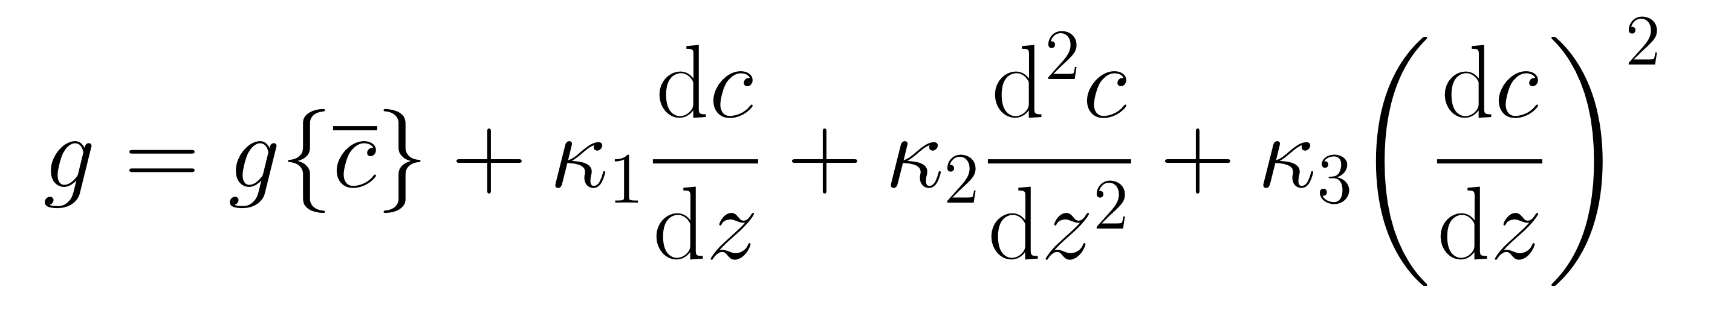
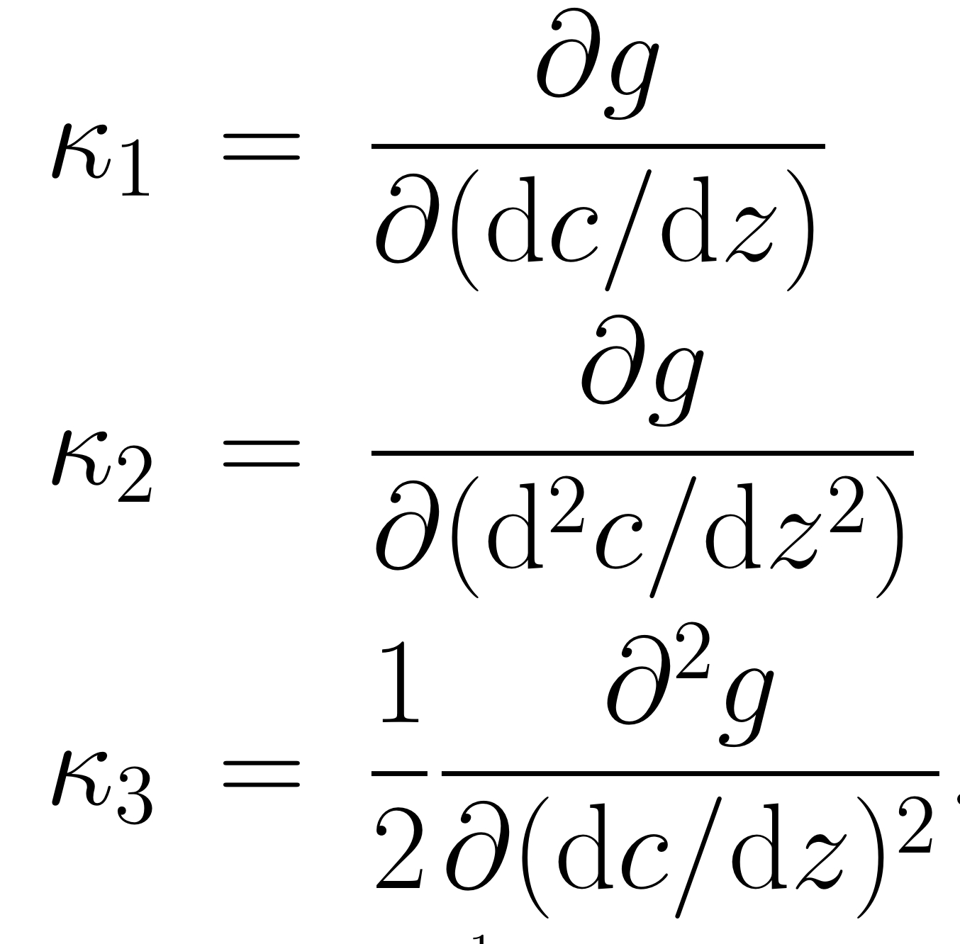

Slide 22
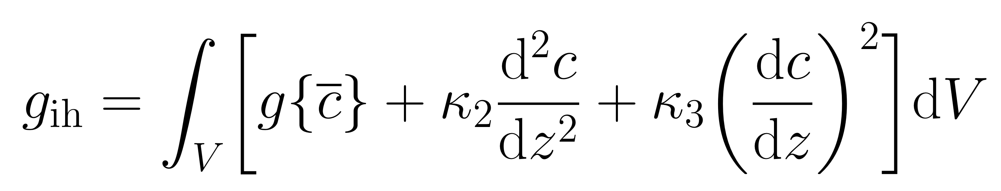
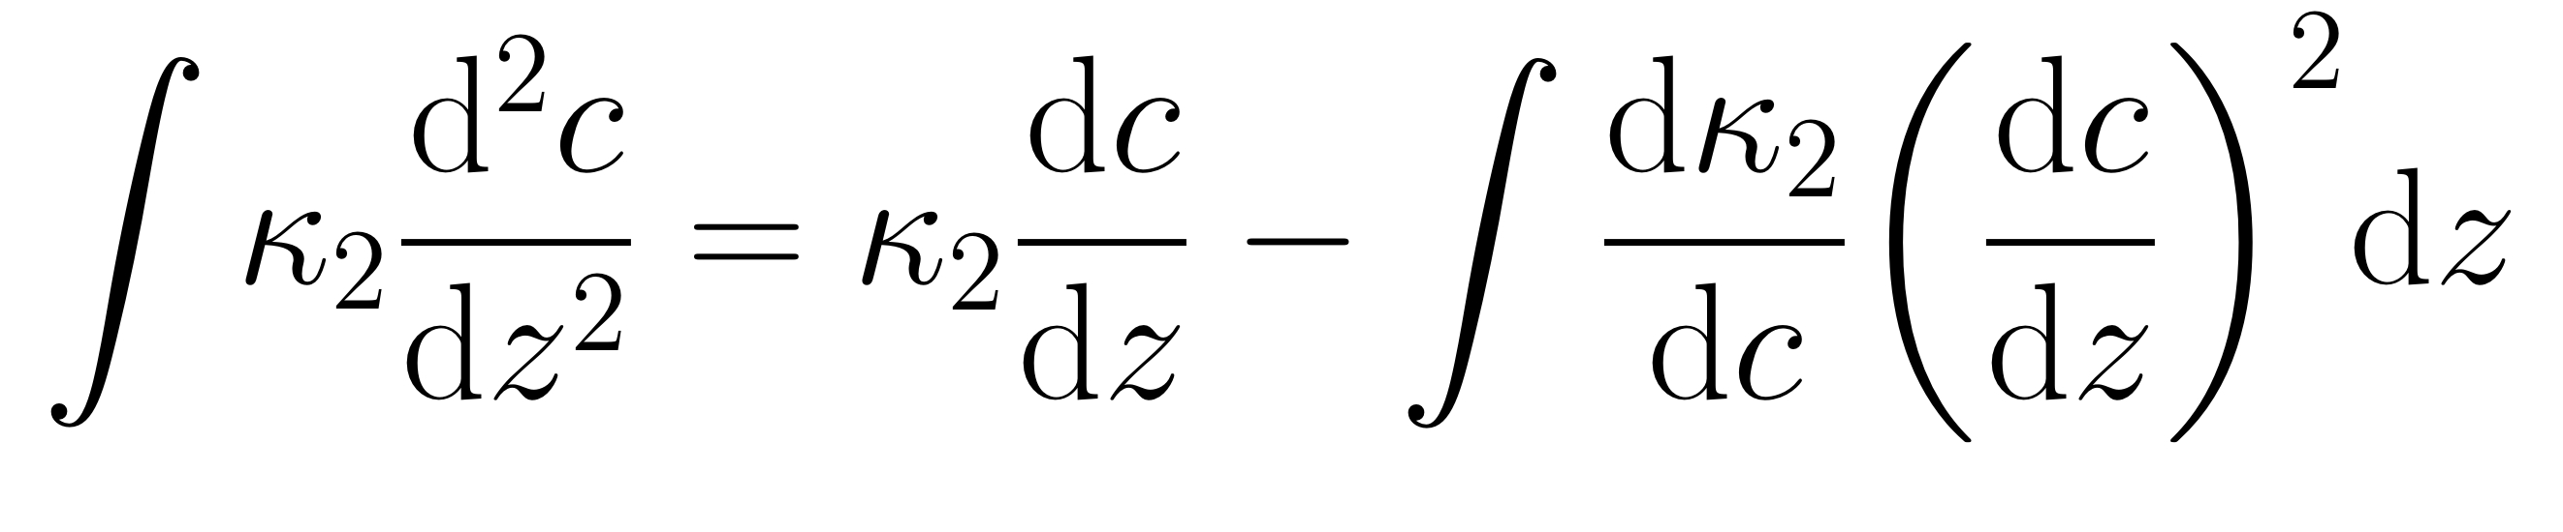
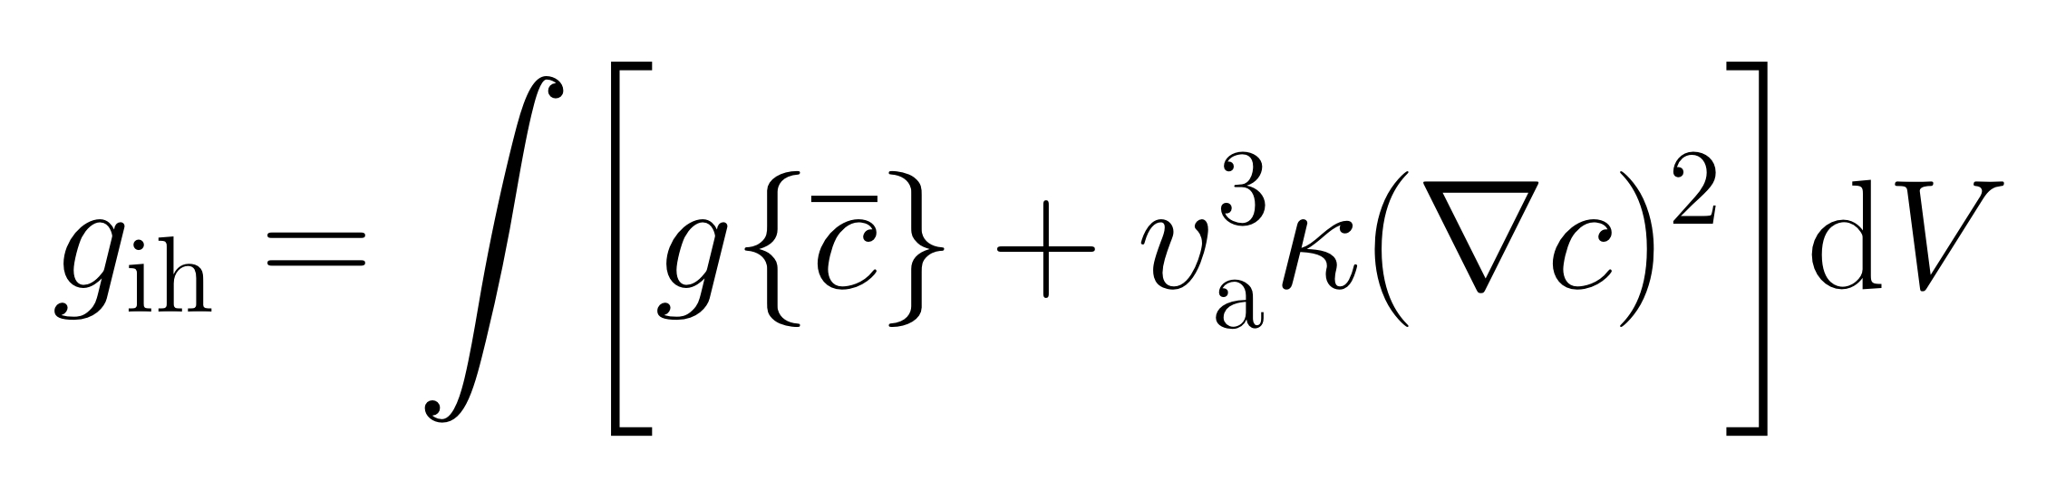

Slide 23
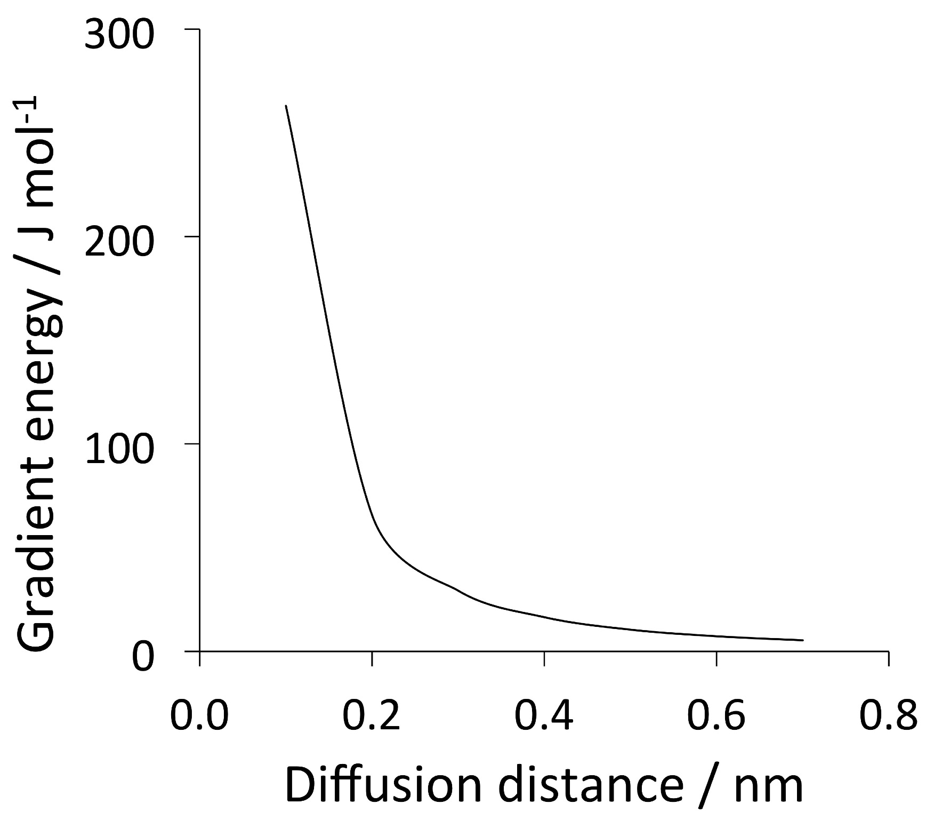
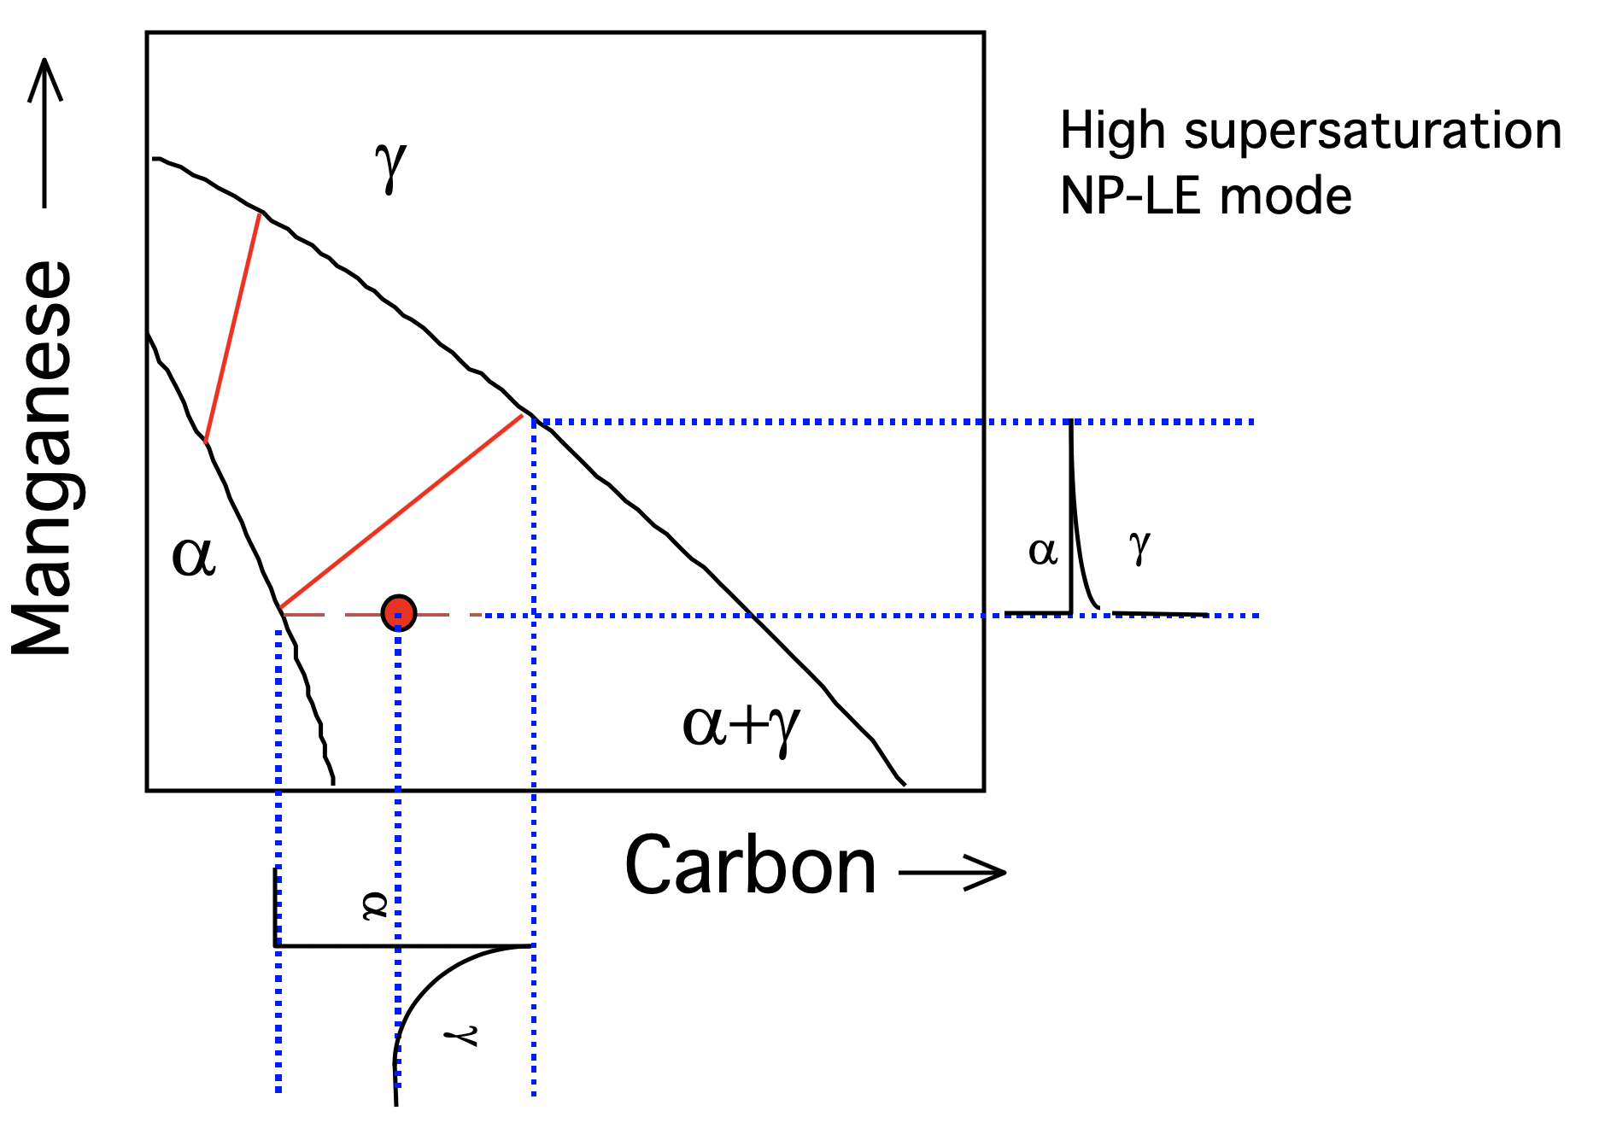
Impossible to avoid partitioning substitutional solutes if local equilibrium is demanded.

Slide 24
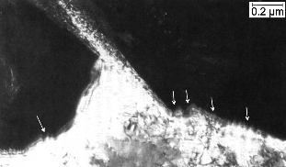
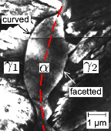
NP-LE has never been observed experimentally: kinetic data
Babu, Bhadeshia,1981

Slide 25
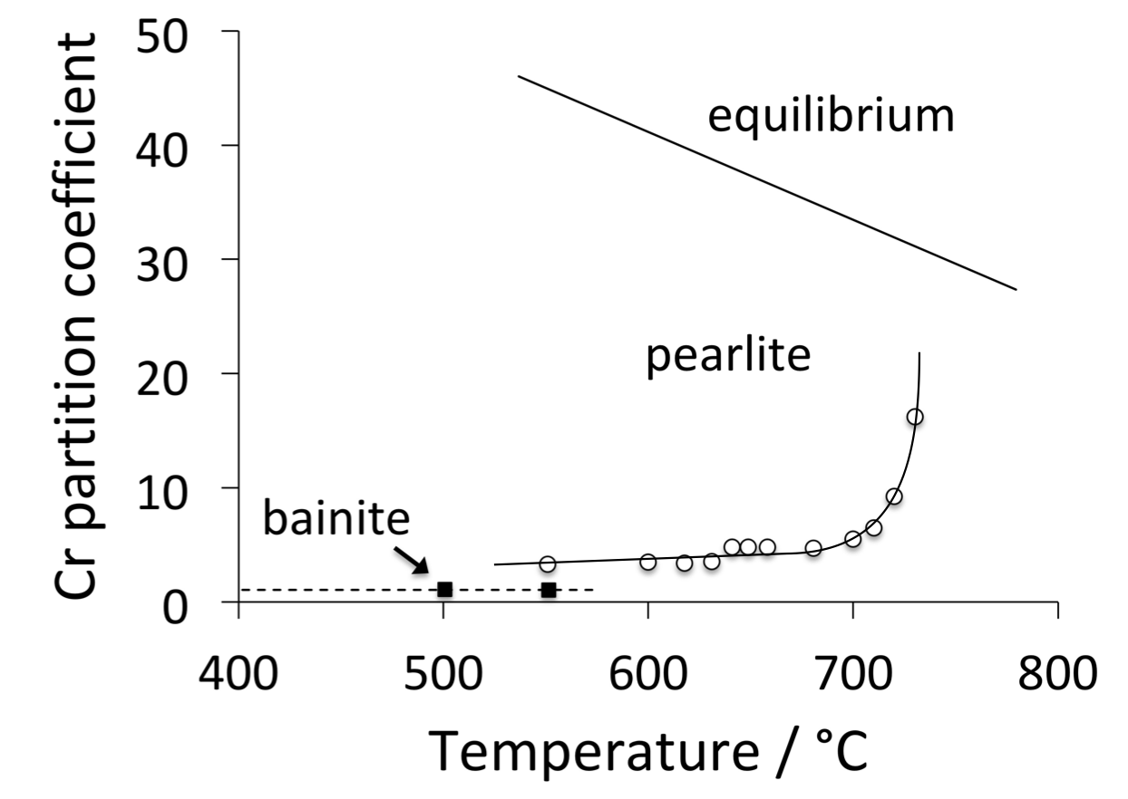
NP-LE has never been observed experimentally although widely implemented in software
Pearlite always shows partitioning.
Chance, Ridley

Slide 26
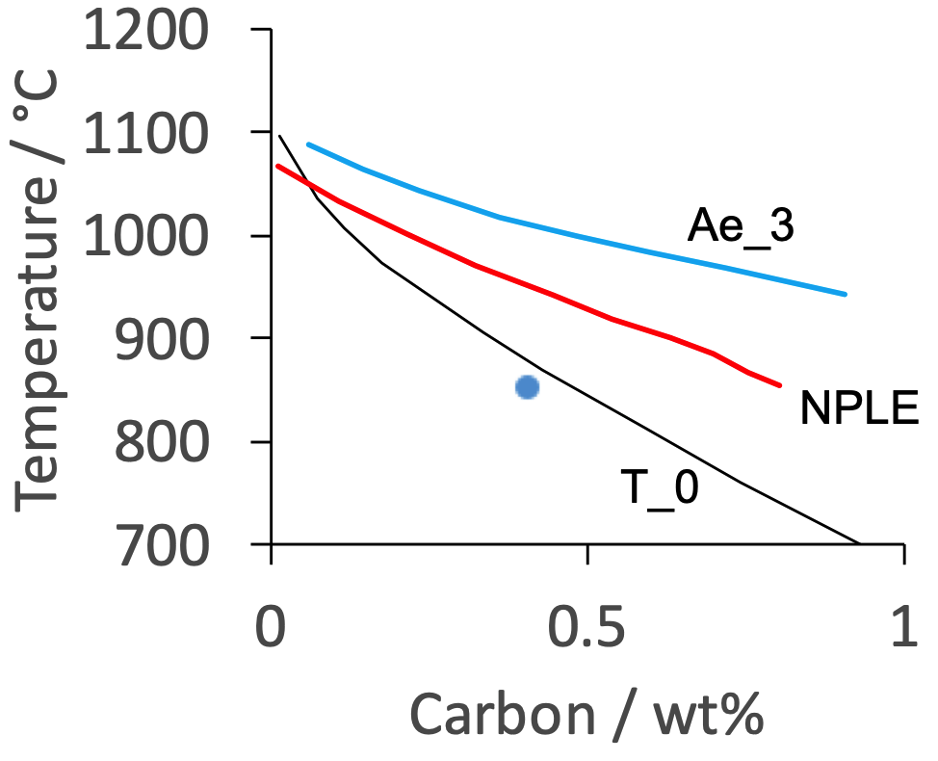
NP-LE has never been observed experimentally although widely implemented in software
NP-LE should never be used as a limiting composition.
Furuhara et al.

Slide 27
NP-LE has never been observed experimentally although widely implemented in software
Plenty of warnings in the theory of irreversible thermodynamics that for the concept of local equilibrium to be valid, the situation must not be too far removed from equilibrium.
e.g. J. W. Christian, Theory of Transformations in Metals and Alloys, Pergamon Press, Oxford, 2nd edition, p.98

Slide 28
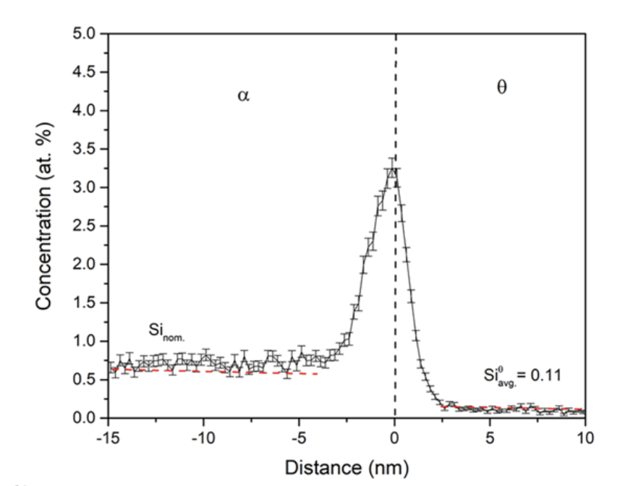
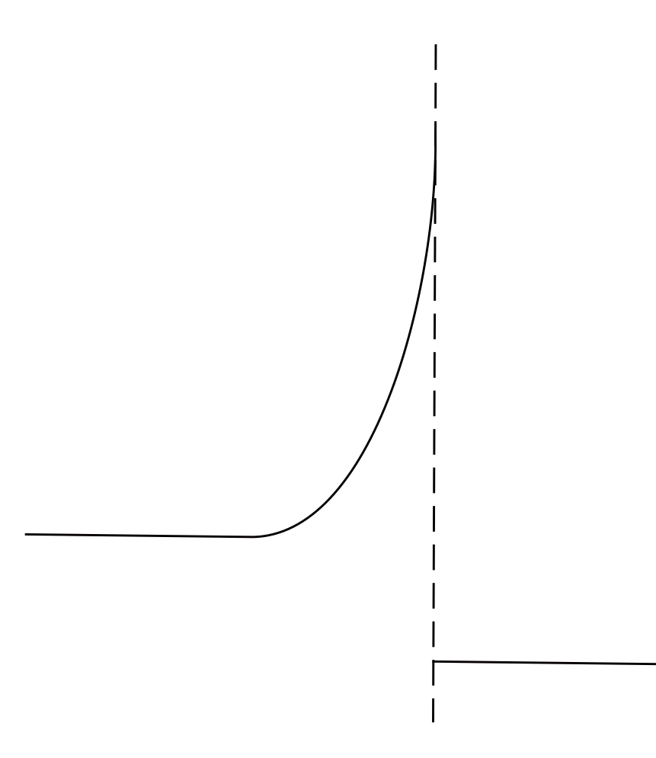
Kannan R, Wang Y, Poplawsky J, Babu SS, Li L. Cascading phase transformations in high carbon steel resulting in the formation of inverse bainite: An atomic scale investigation. Scientific reports. 2019 Apr 3;9(1):1-5.

Slide 29
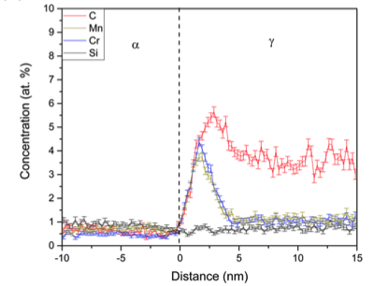
Kannan R, Wang Y, Poplawsky J, Babu SS, Li L. Cascading phase transformations in high carbon steel resulting in the formation of inverse bainite: An atomic scale investigation. Scientific reports. 2019 Apr 3;9(1):1-5.

Slide 30
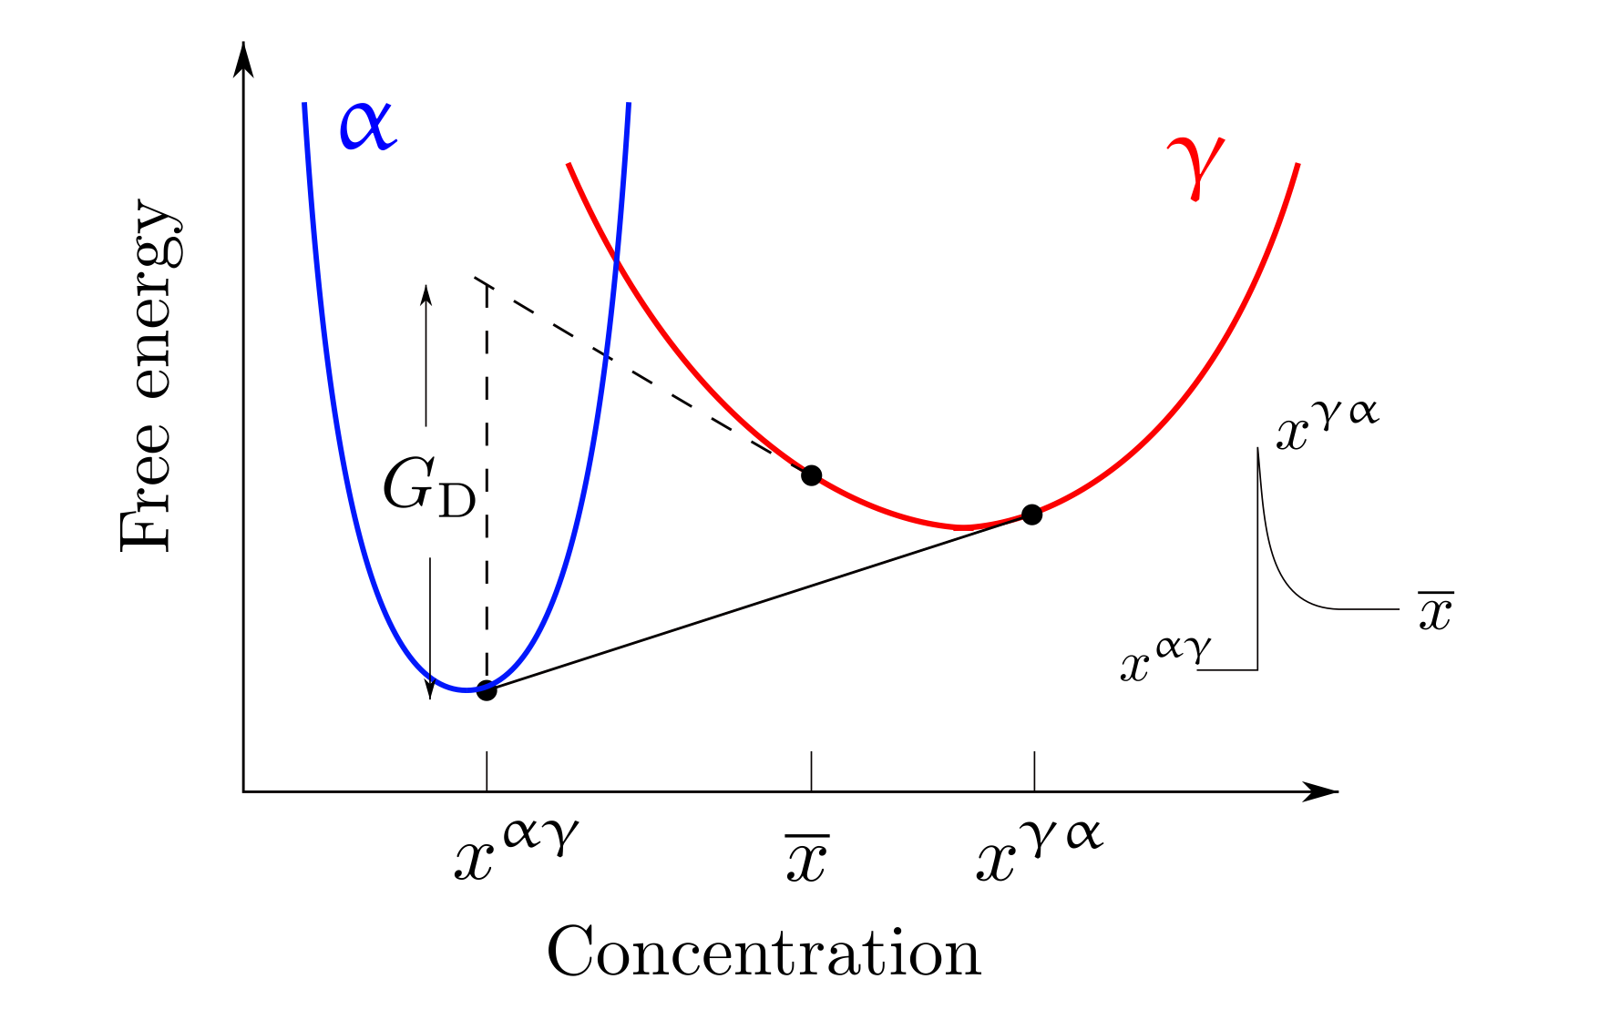

Slide 31
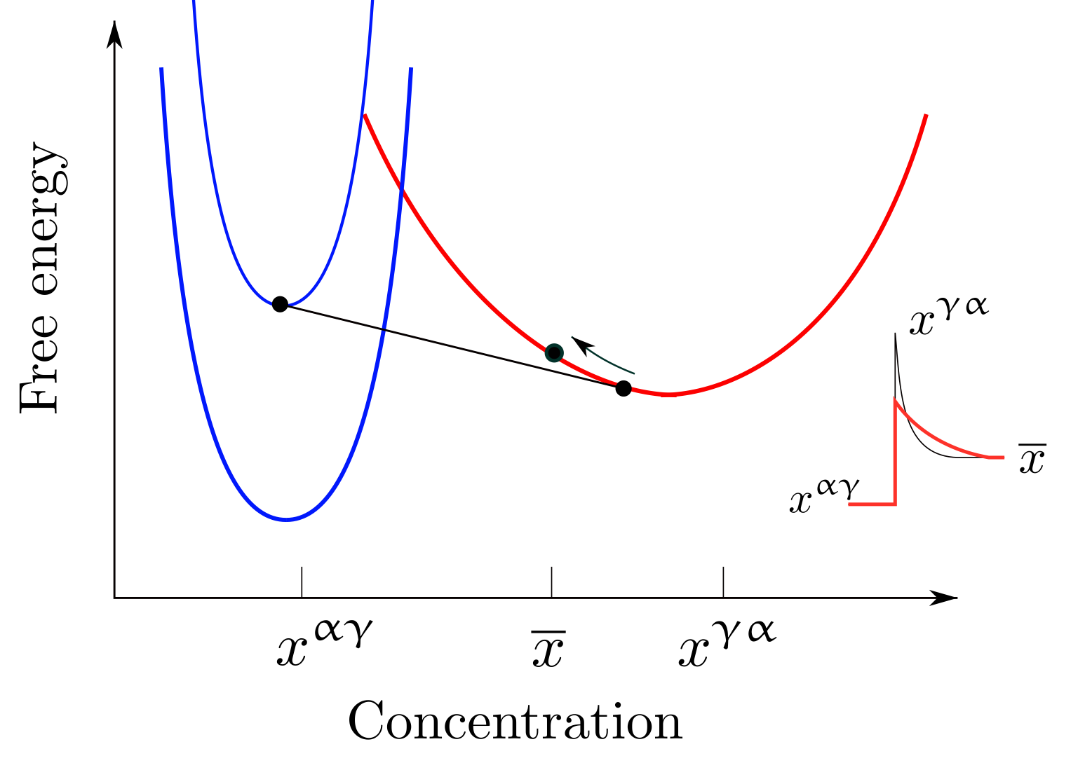

Slide 32
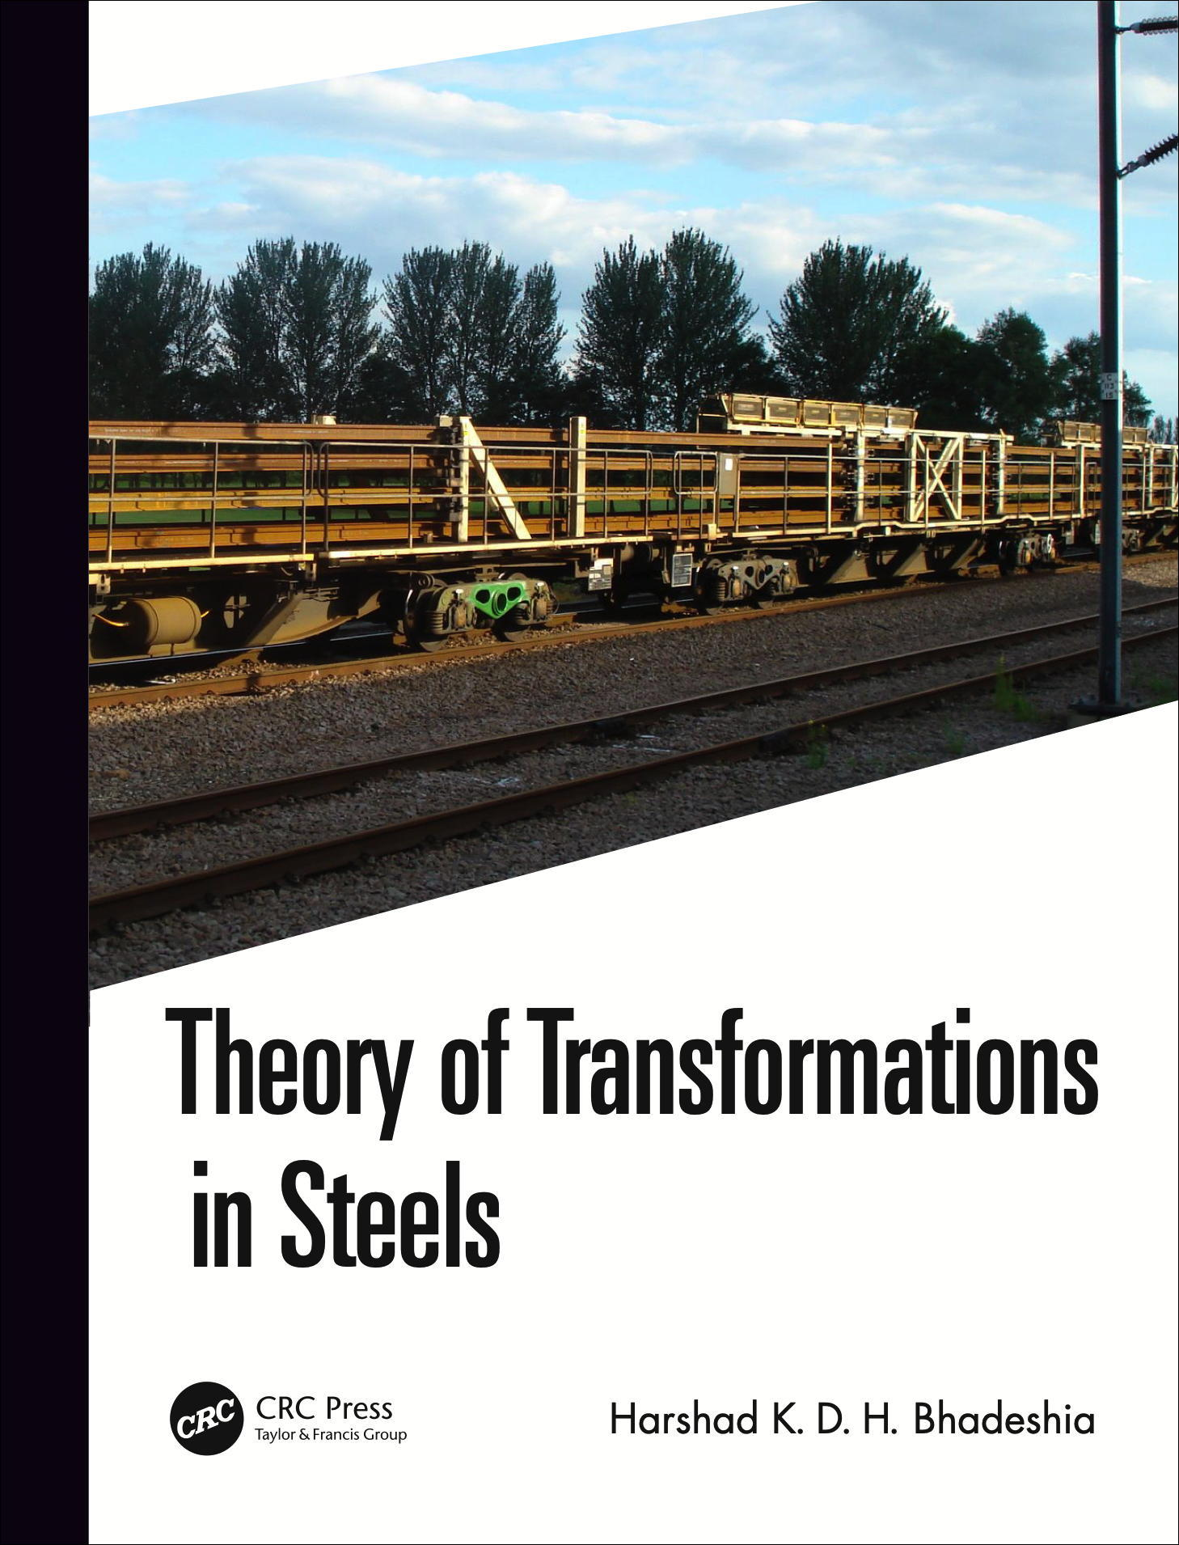
NPLE mode cannot exist
Current Opinion in Solid State and Materials Science,
20 (2016) 396-400
Physica Status Solidi (a)
69 (1982) 745-750
www.phase-trans.msm.cam.ac.uk

Slide 33
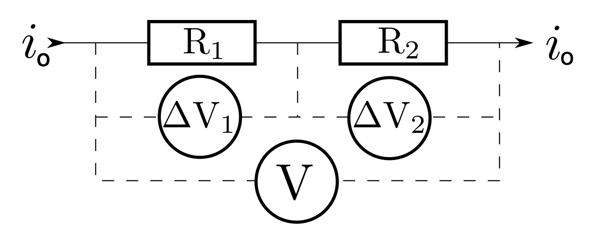
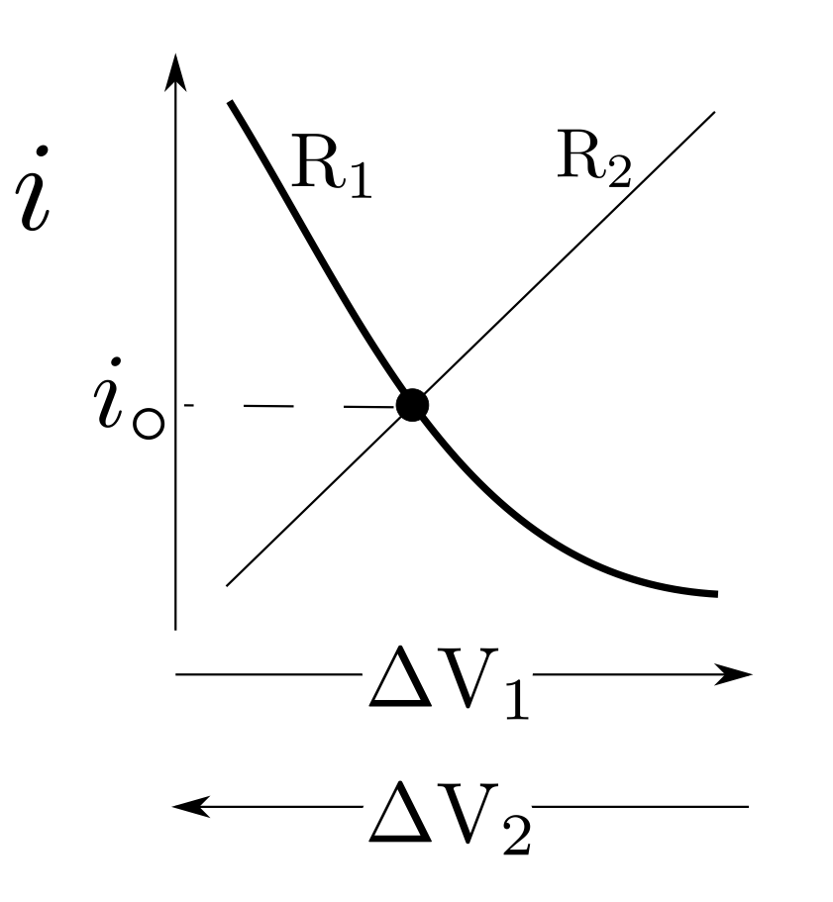

Slide 34
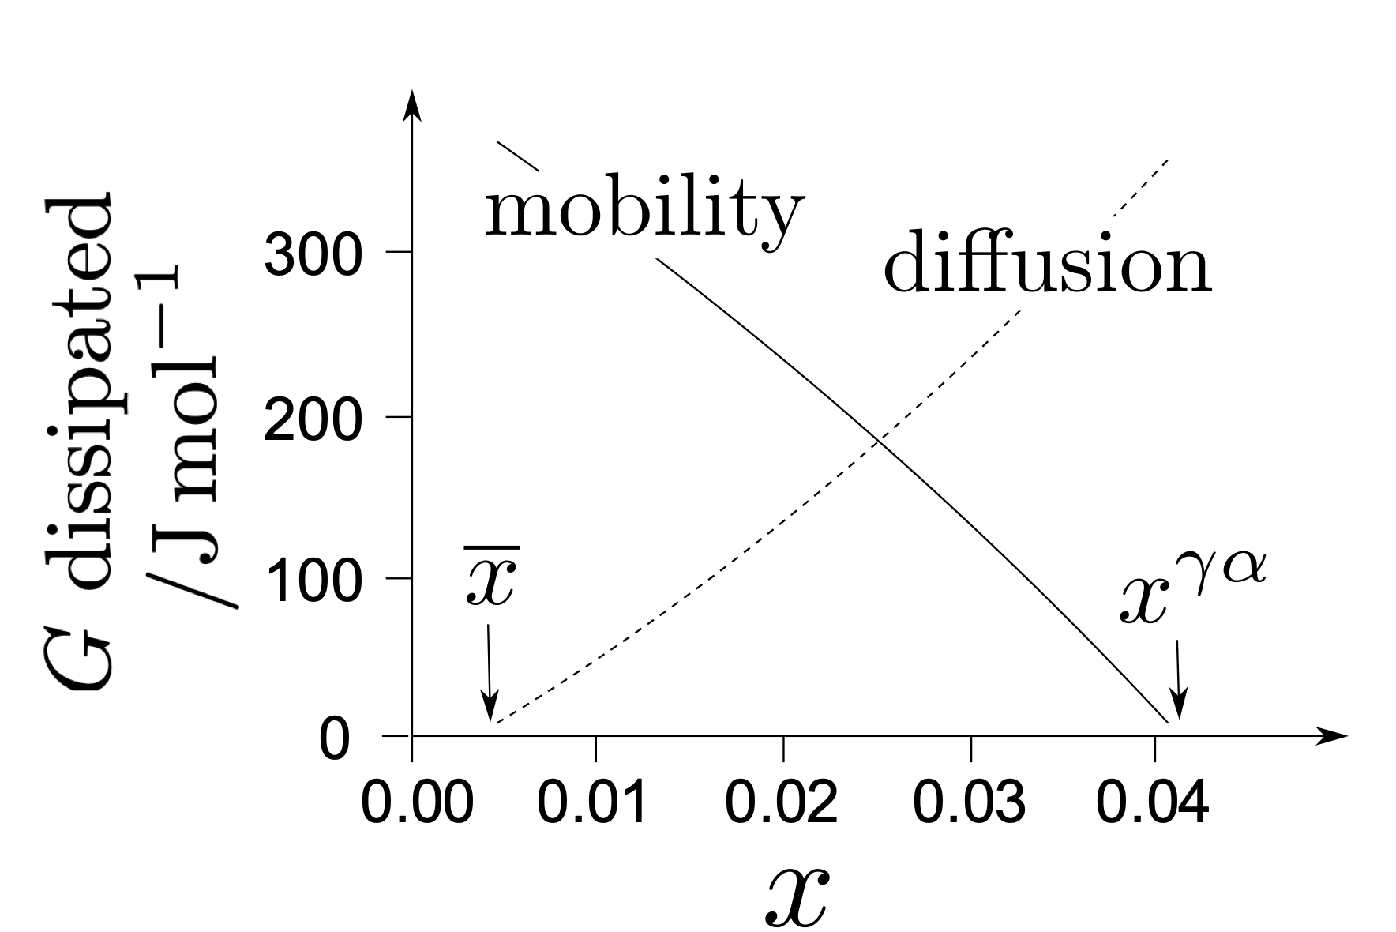

Slide 35
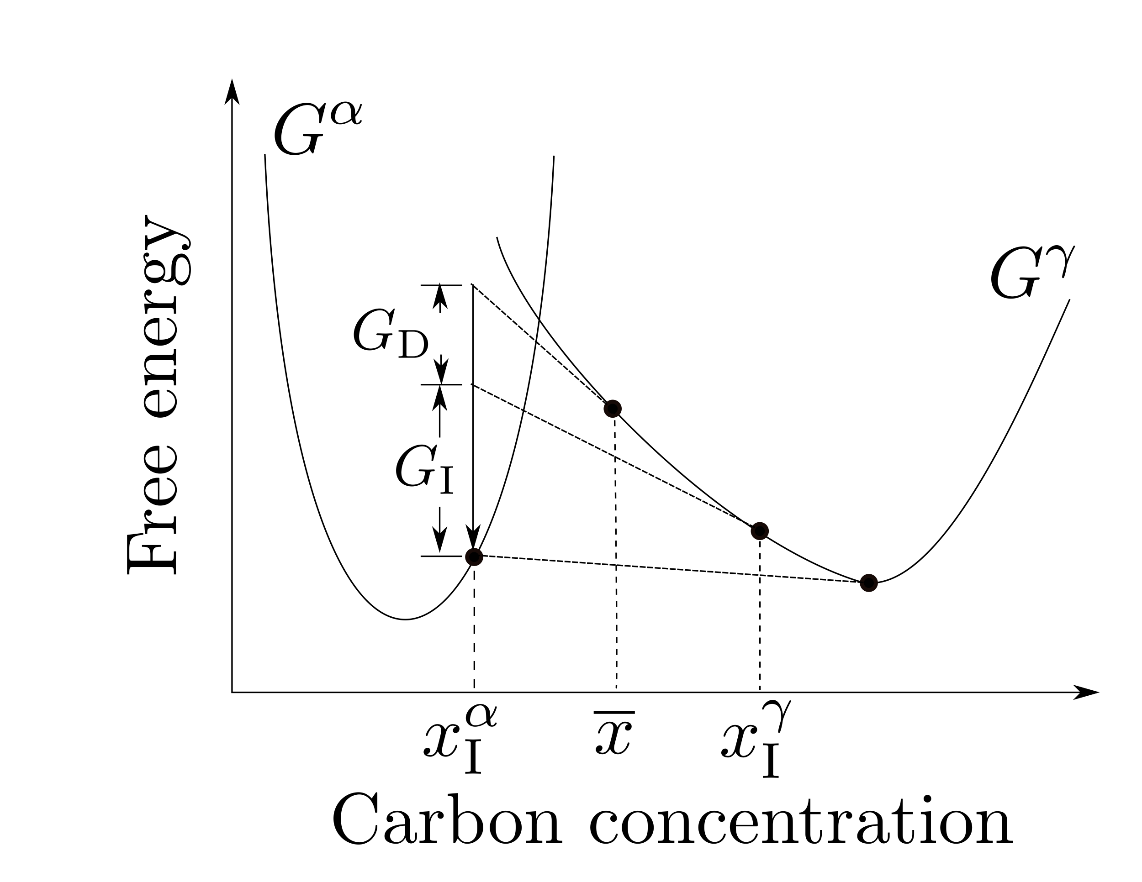
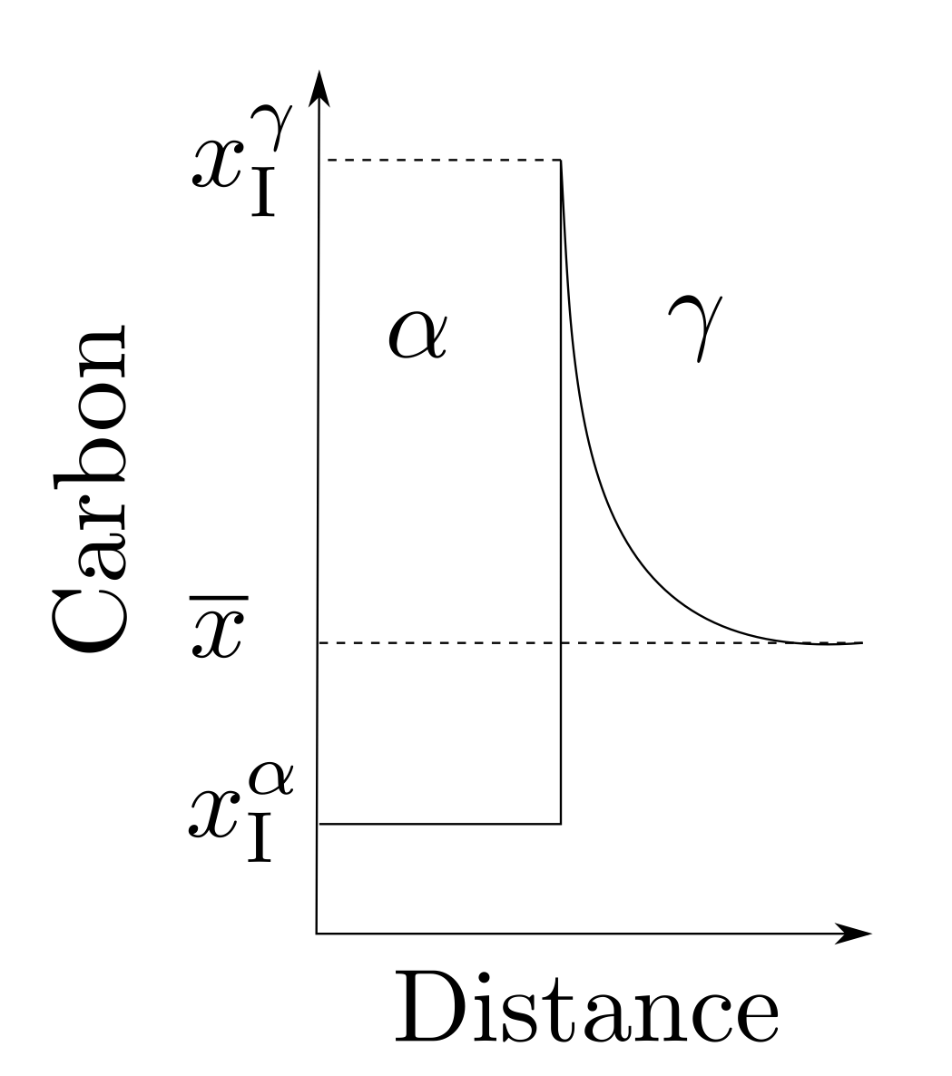

Slide 36
