Slide 1
Hydrogen and steel
www.phase-trans.msm.cam.ac.uk

Slide 2
The first ever paper: William H. Johnson, 1875, Proceedings of the Royal Society, 23 (1875) 168-179
Nascent hydrogen
Diffusible hydrogen
Reversible

Slide 3
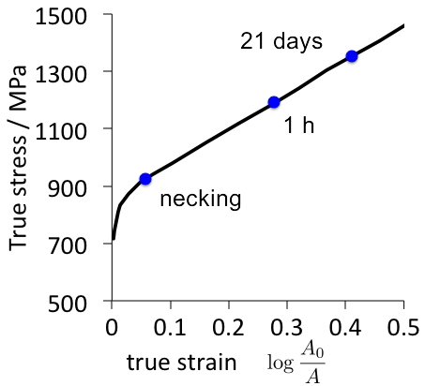
Hobson, 1951

Slide 4
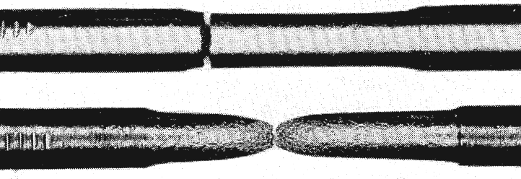
L. B. Pfeil, Proceedings of the Royal Society, 1926
normal
pickled
Hydrogen embrittles iron
both single and polycrystalline forms
Perspectives in hydrogen embrittlement in metals (1986) 647
Materials Science and Engineering 77 (1986) 75

Slide 5
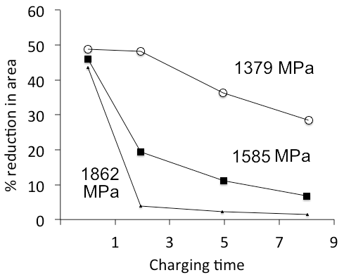
R. P. Frohmberg, Wright-Patterson Air Force Base report, 1954

Slide 6
Increased from 38,400 to 56,100
since 2016 to 2021

Slide 7
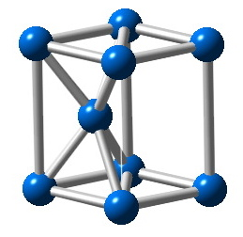
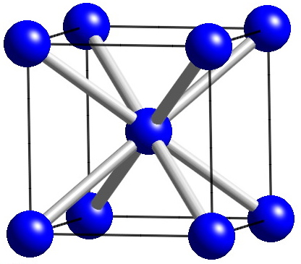
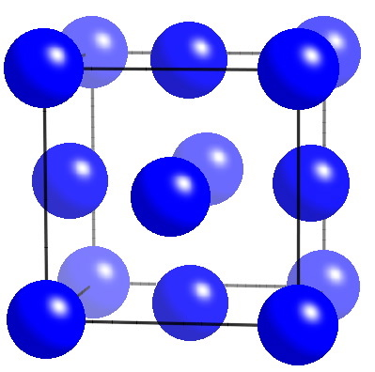
Iron
ε
γ
α

Slide 8
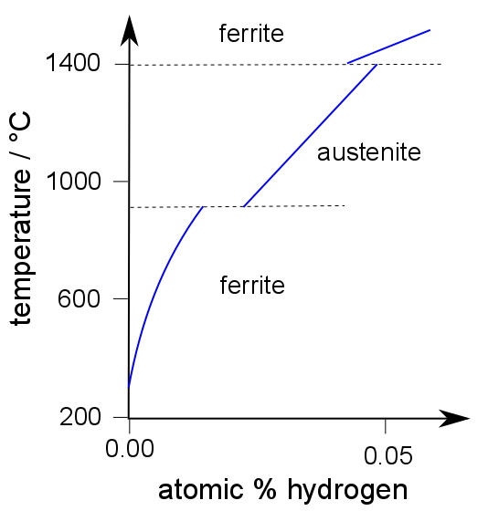
Fe-H phase diagram
Hydrogen dissolves less in ferrite than in austenite
data from Okamoto:2004

Slide 9
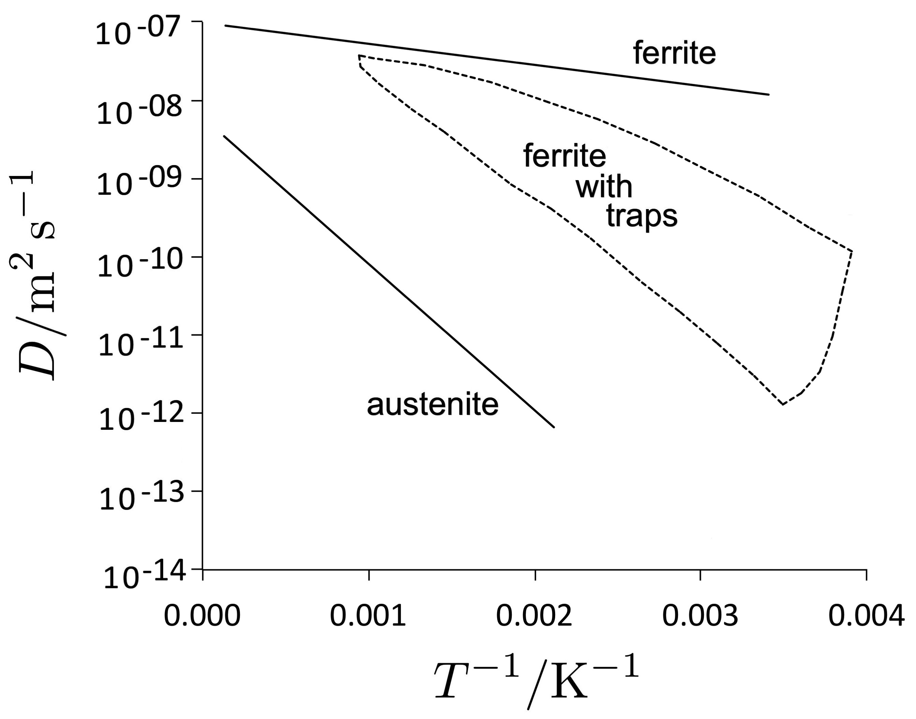
hydrogen diffuses faster in ferrite, but there are complications

Slide 10
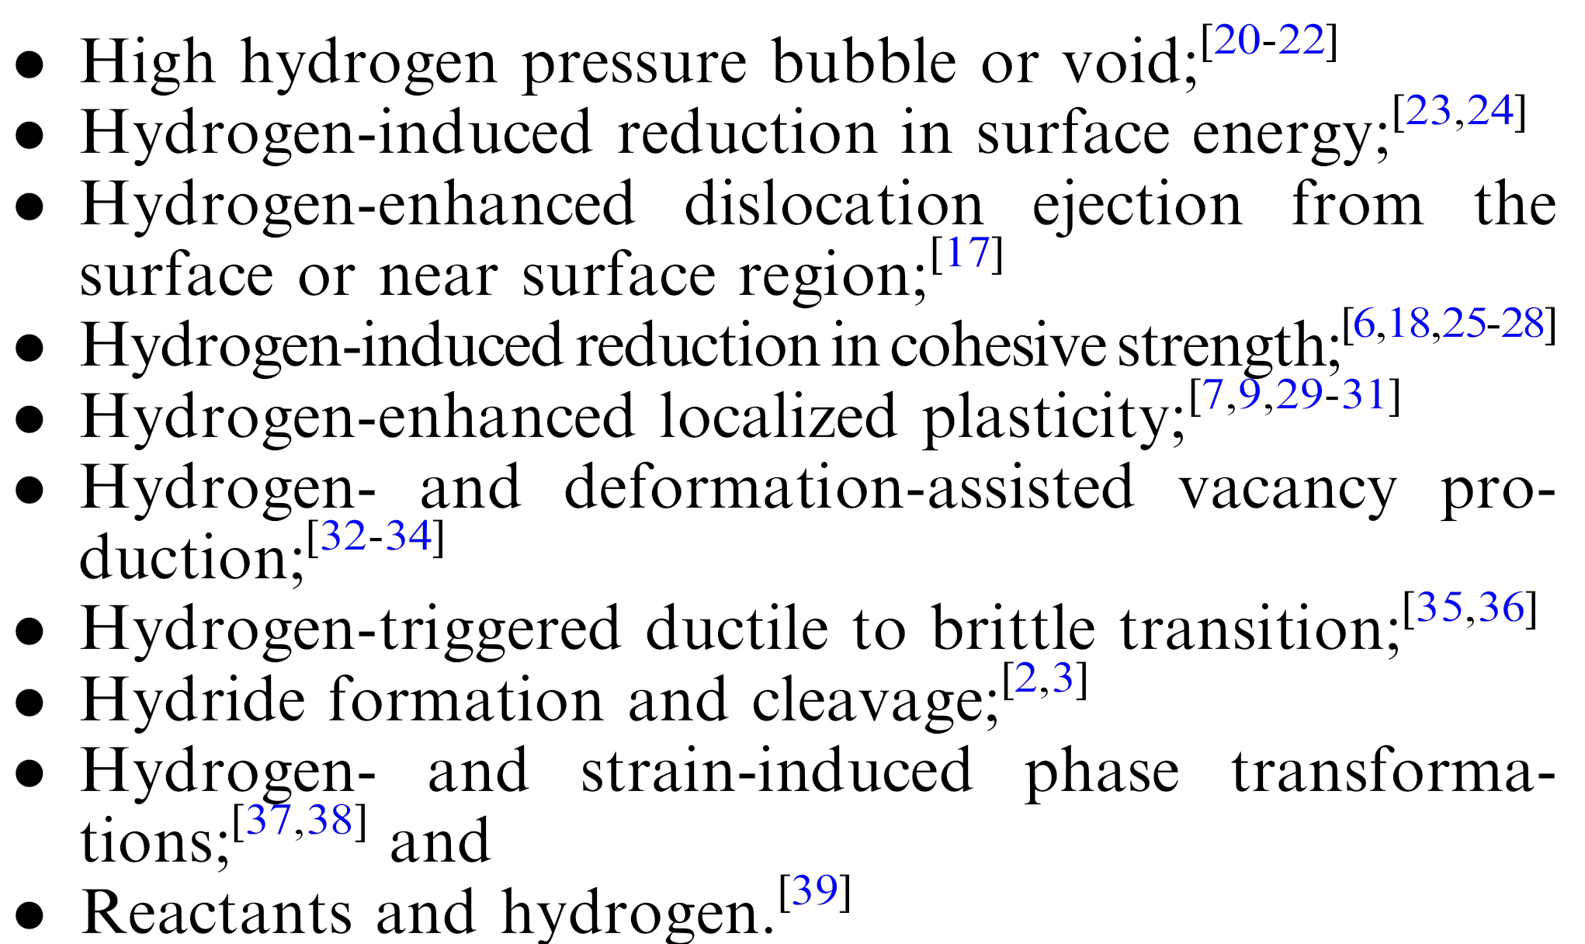
Metall. Mat. Trans. A 46 (2015) 2323

Slide 11
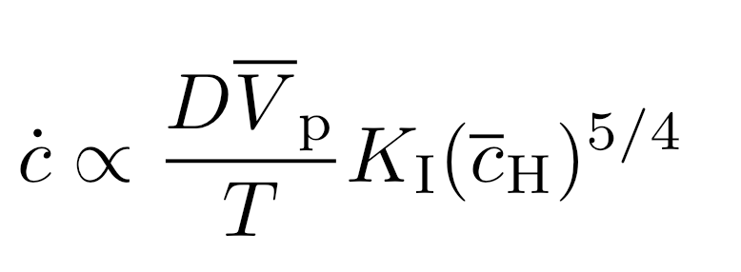
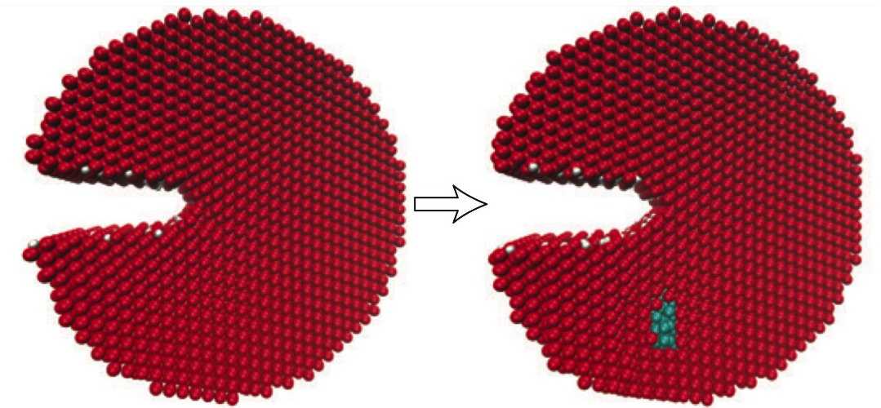
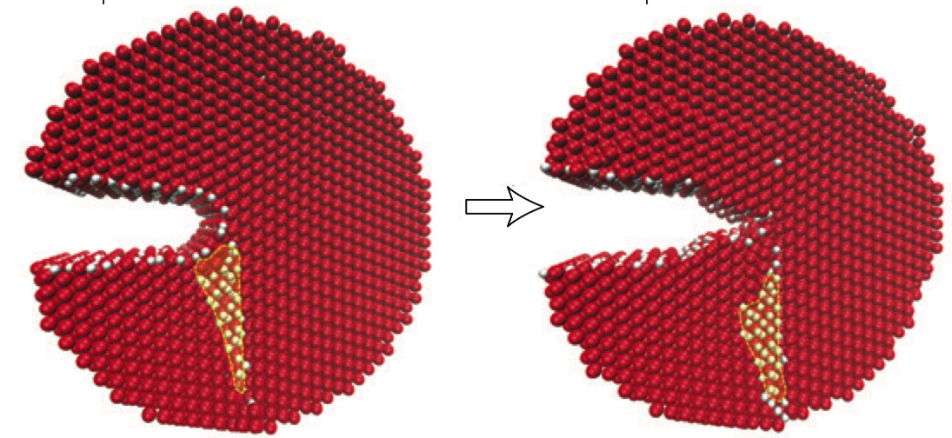
Song and Curtin
Nature Materials
12 (2013) 145-151

Slide 12
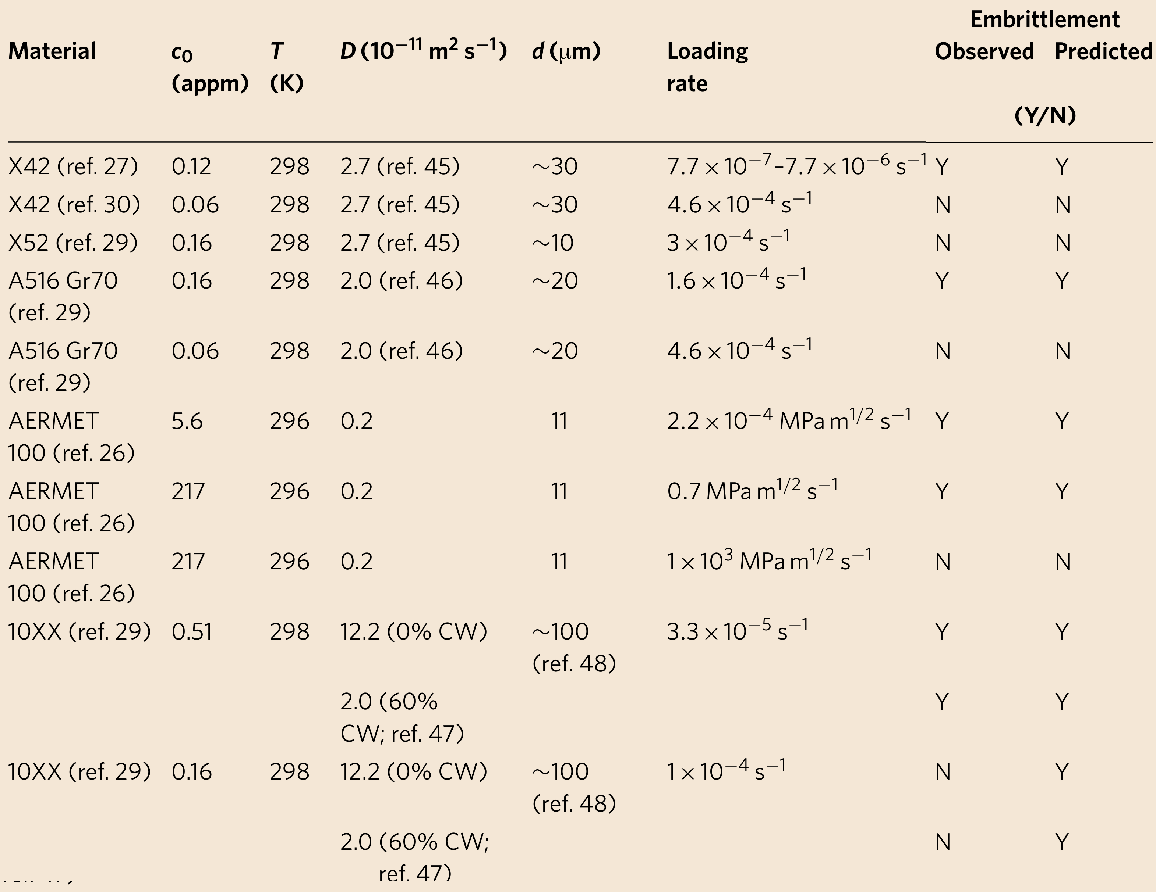

Slide 13
Summary
All evidence points to easily diffusible or
weakly trapped hydrogen embrittles
Trapped molecular hydrogen irrelevant.
Strongly trapped hydrogen irrelevant.

Slide 14
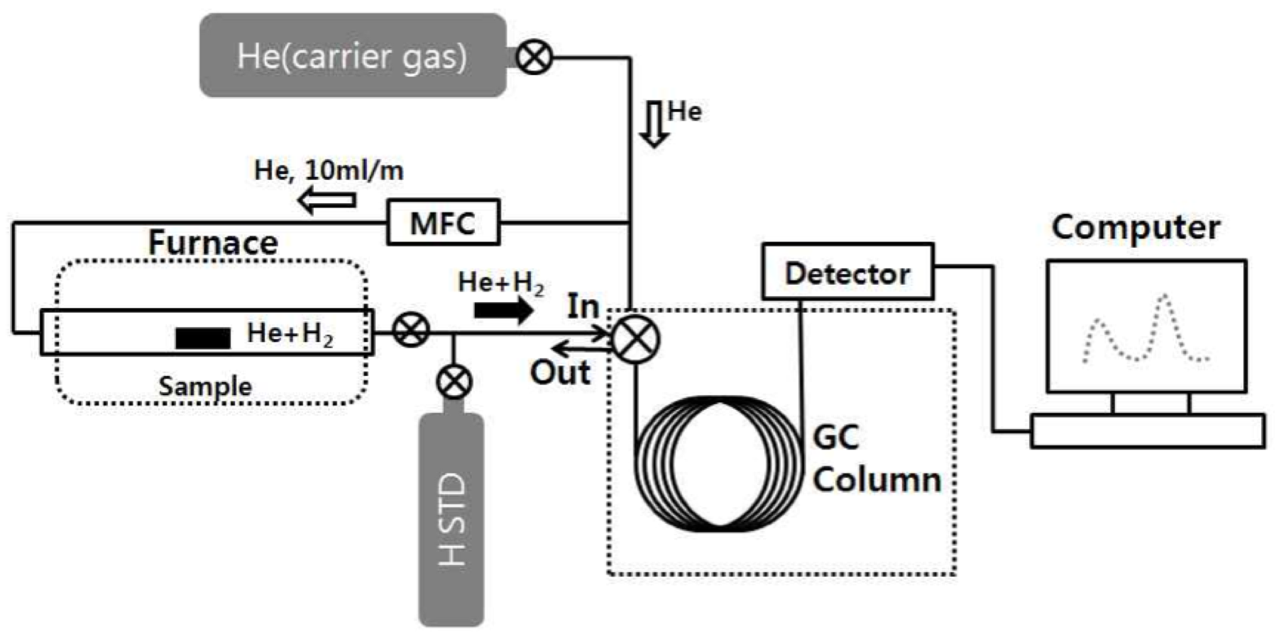
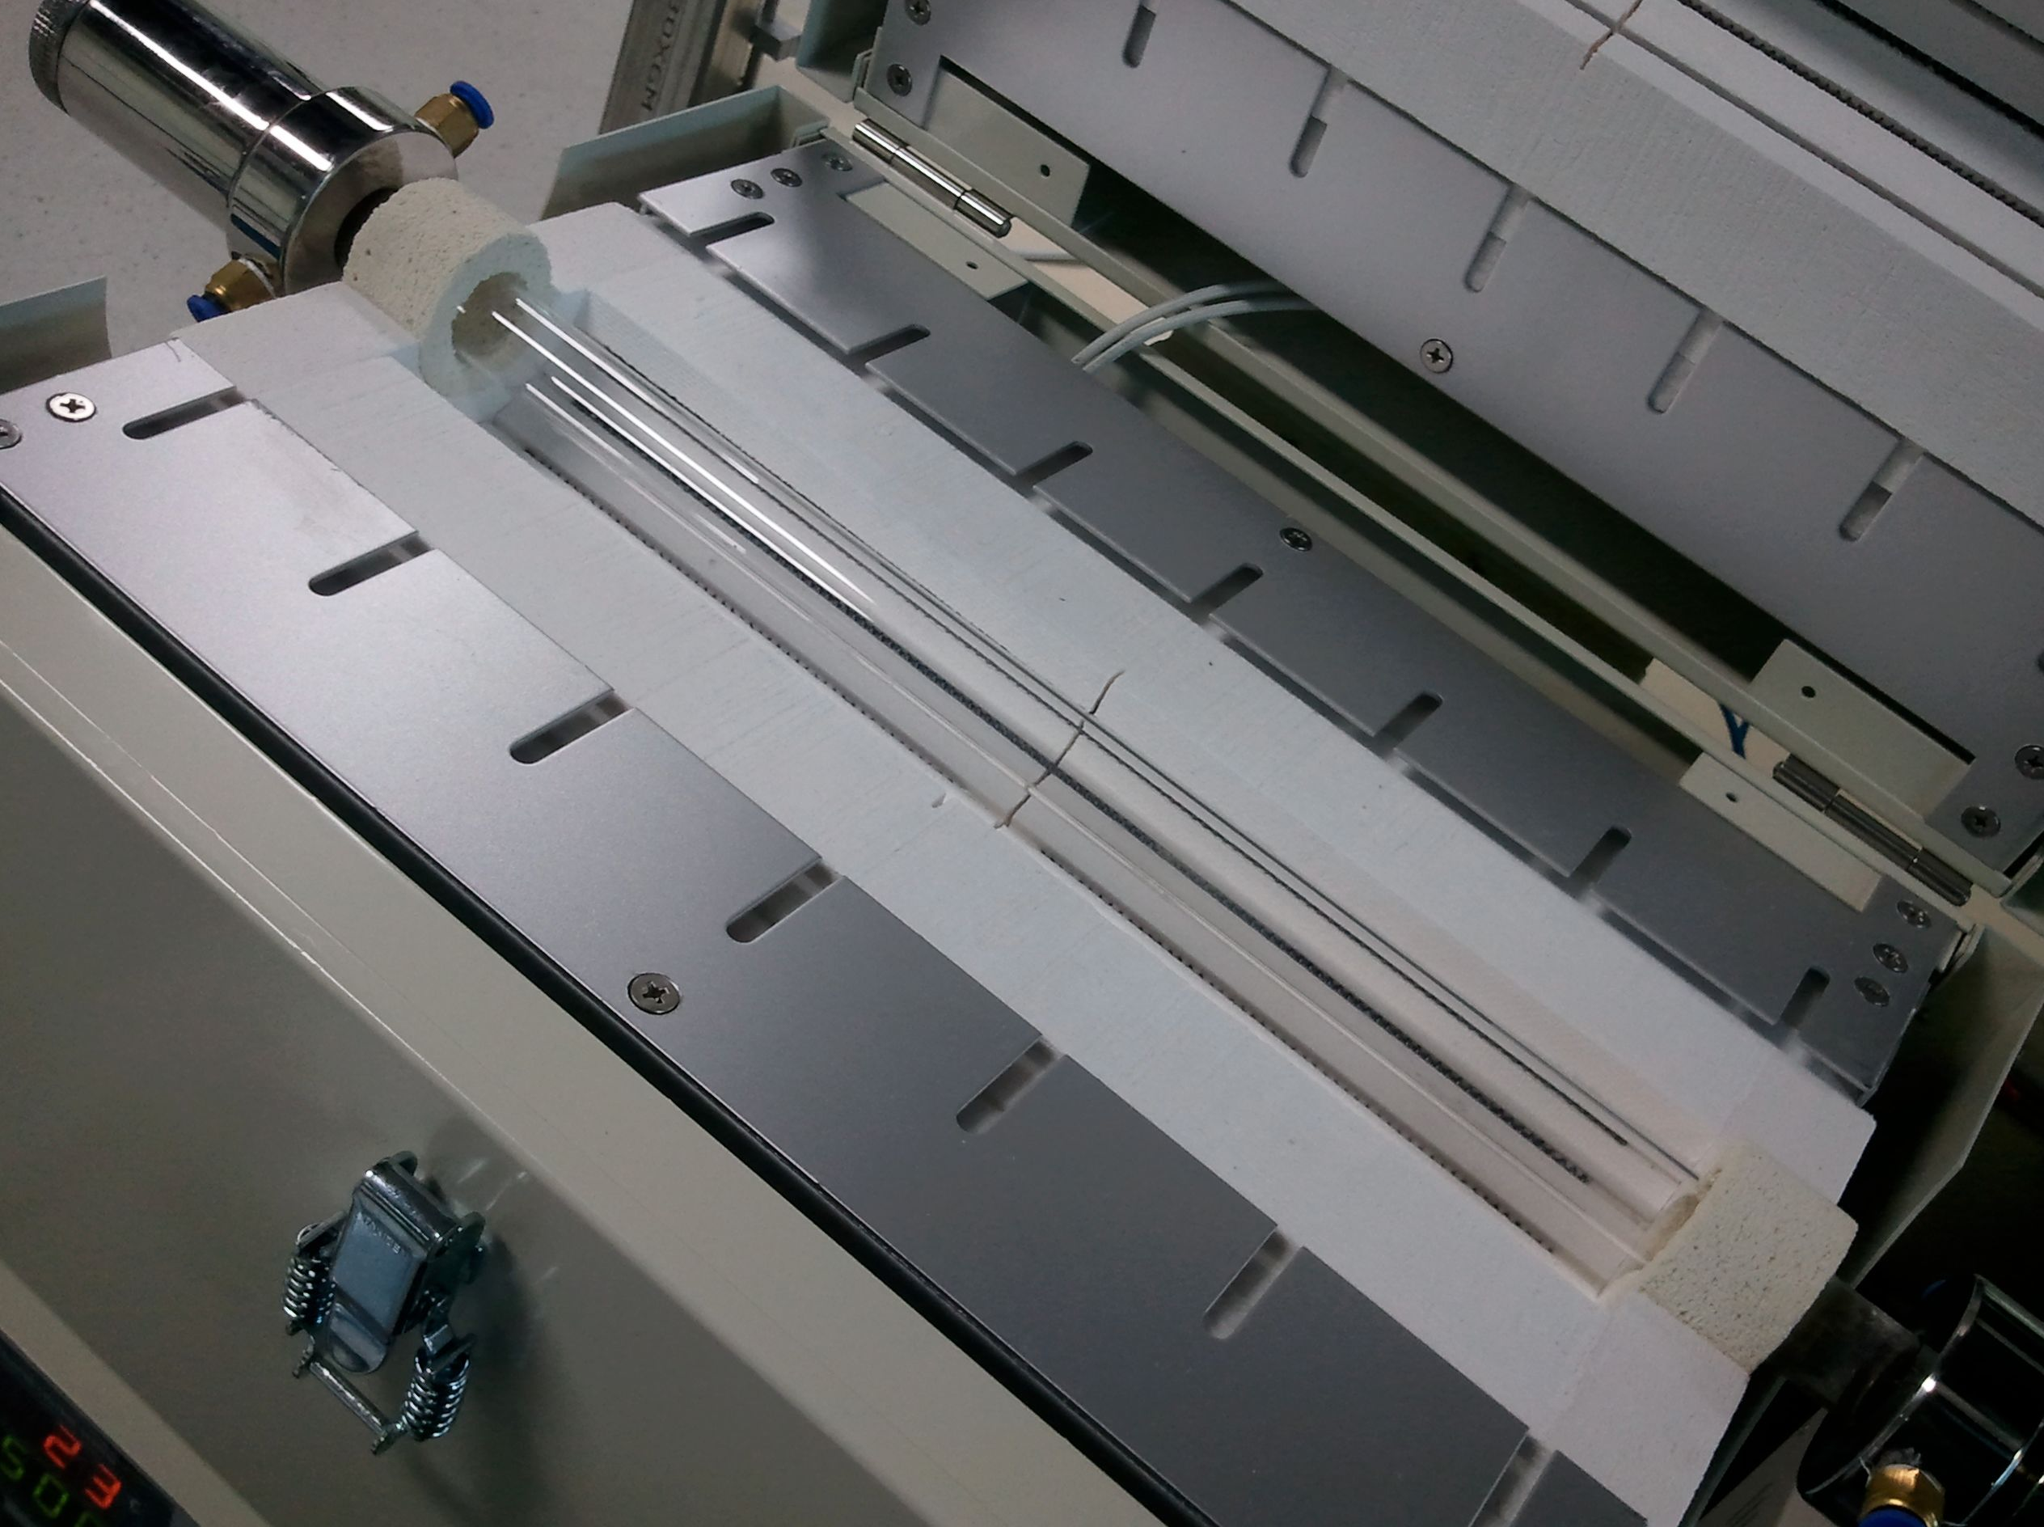
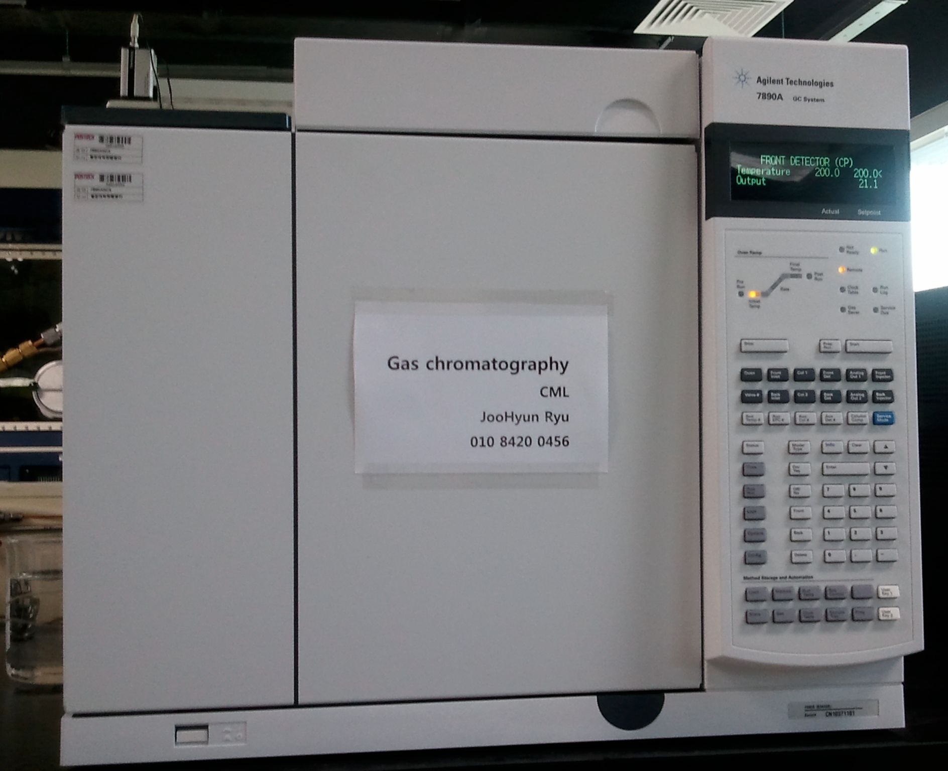

Slide 15
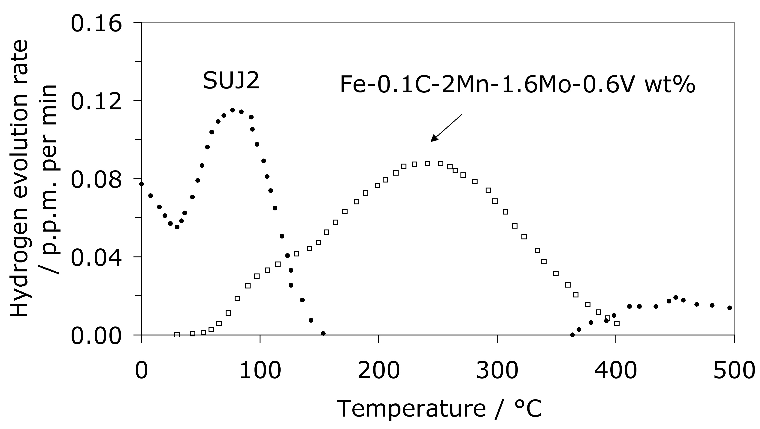

Slide 16
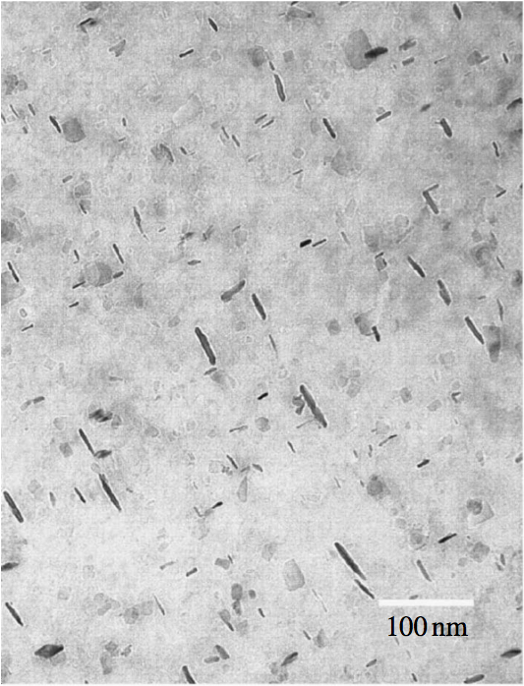
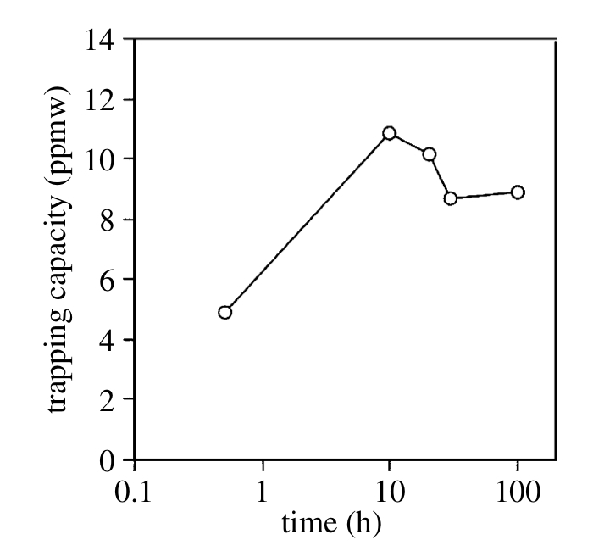
Yamasaki and Bhadeshia, 2006

Slide 17
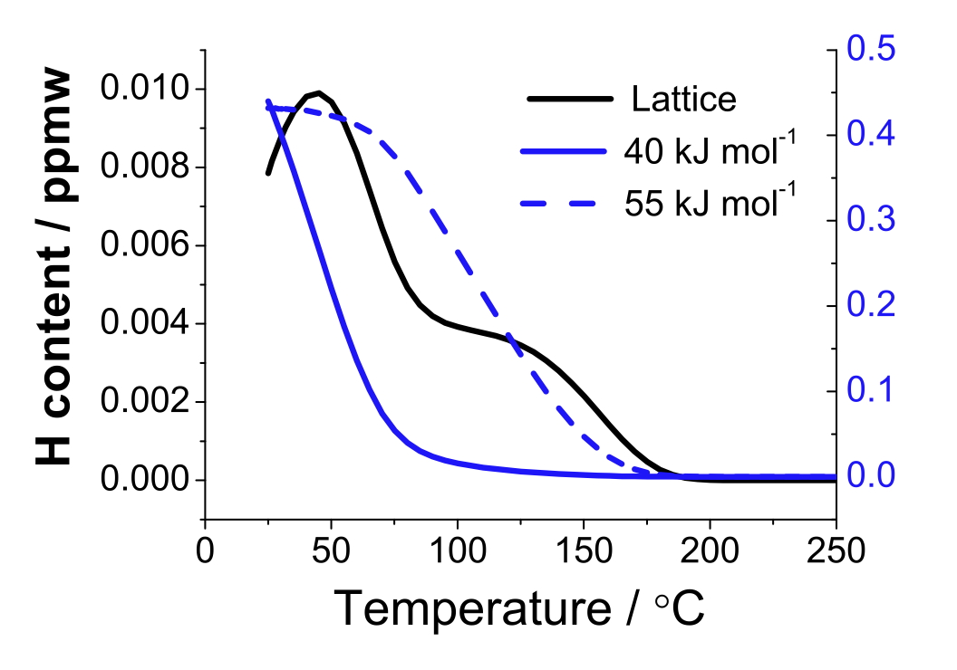
Song, Bhadeshia, Suh, 2013

Slide 20
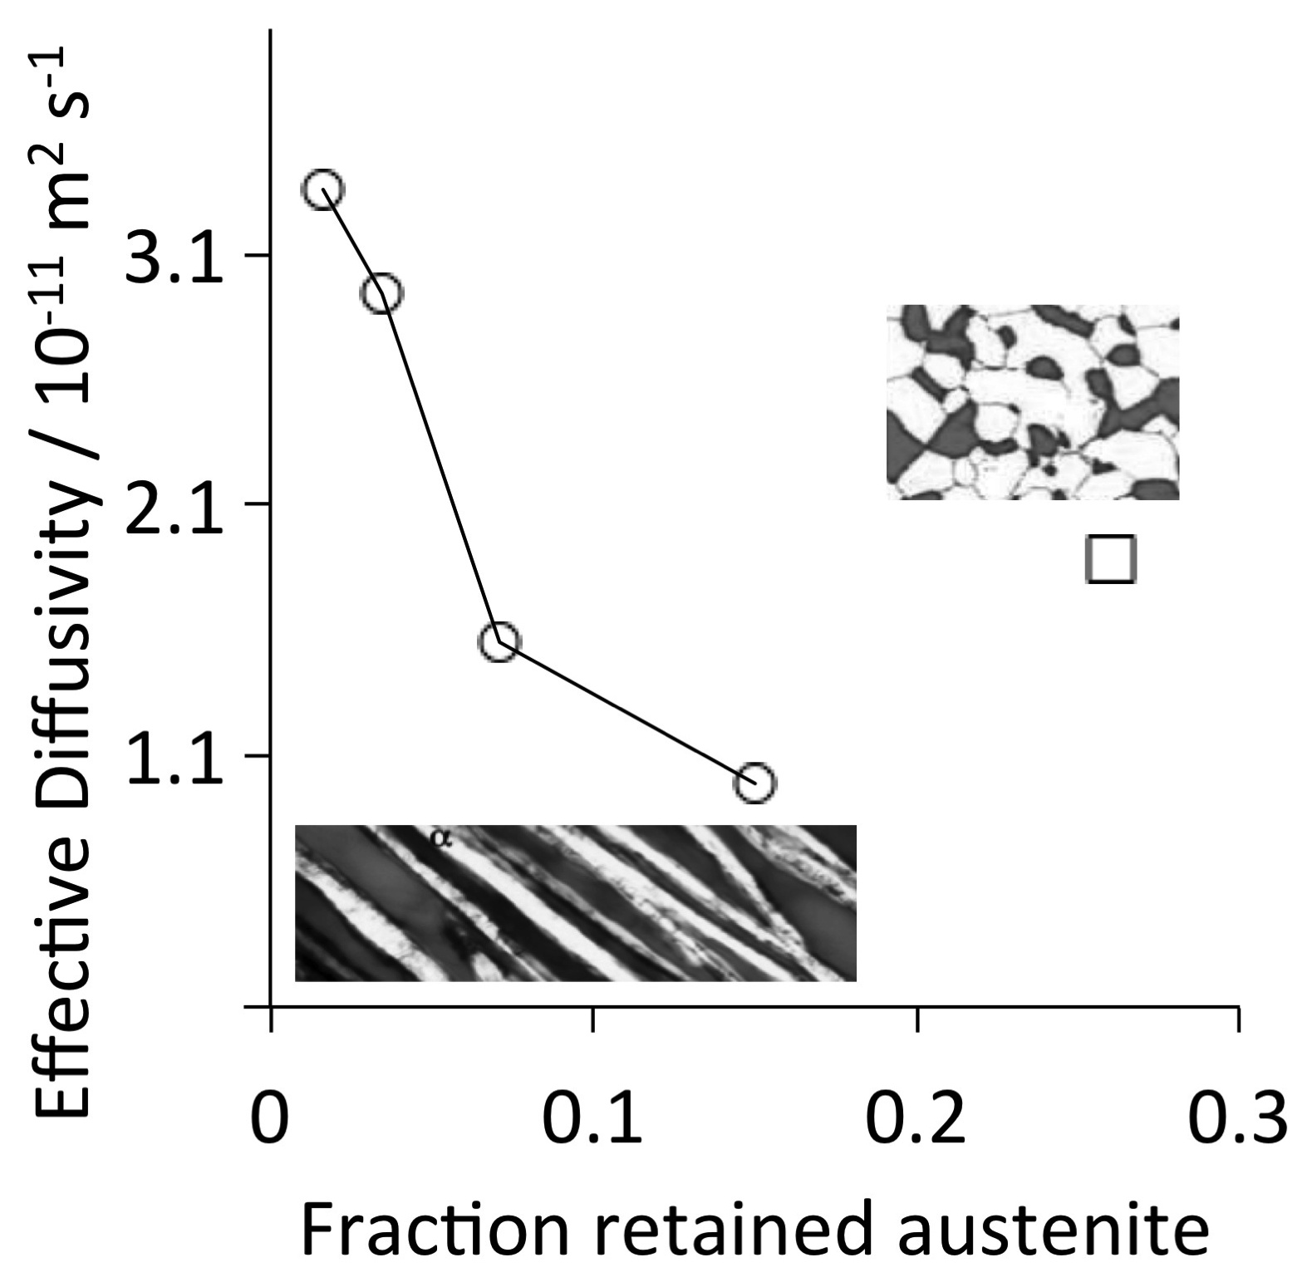
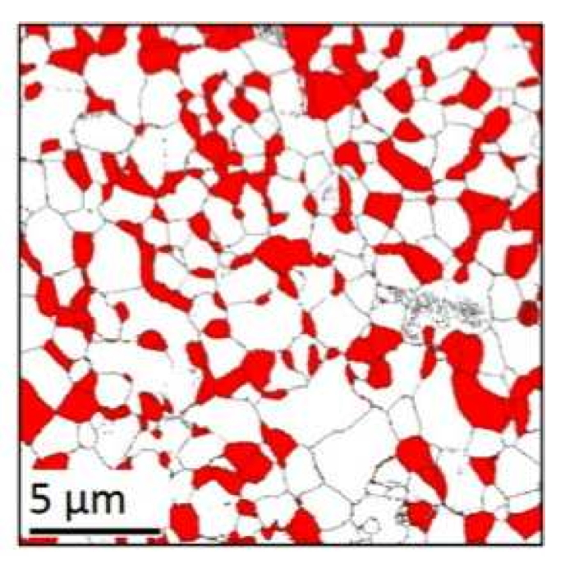
non-percolating
austenite
percolating austenite
Fielding et al. (2014)

Slide 21
Mitigating consequences of hydrogen
Provide traps for infused hydrogen
Retard the infusion of hydrogen
Any alloy modifications must not compromise other properties

Slide 23
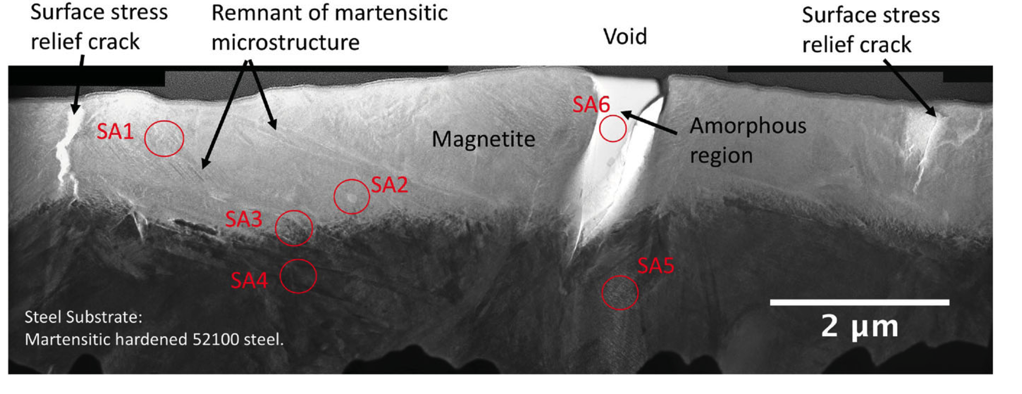
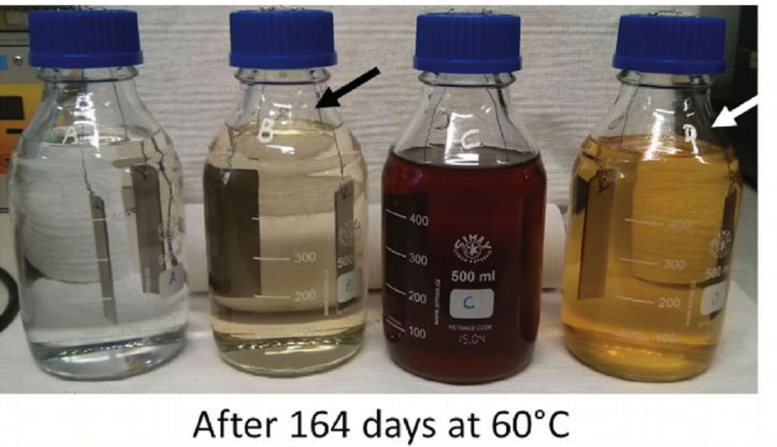
Ooi SW, Black oxide coating and its effectiveness on prevention of hydrogen uptake. Materials Science and Technology. 2019, 35:12-25.

Slide 24
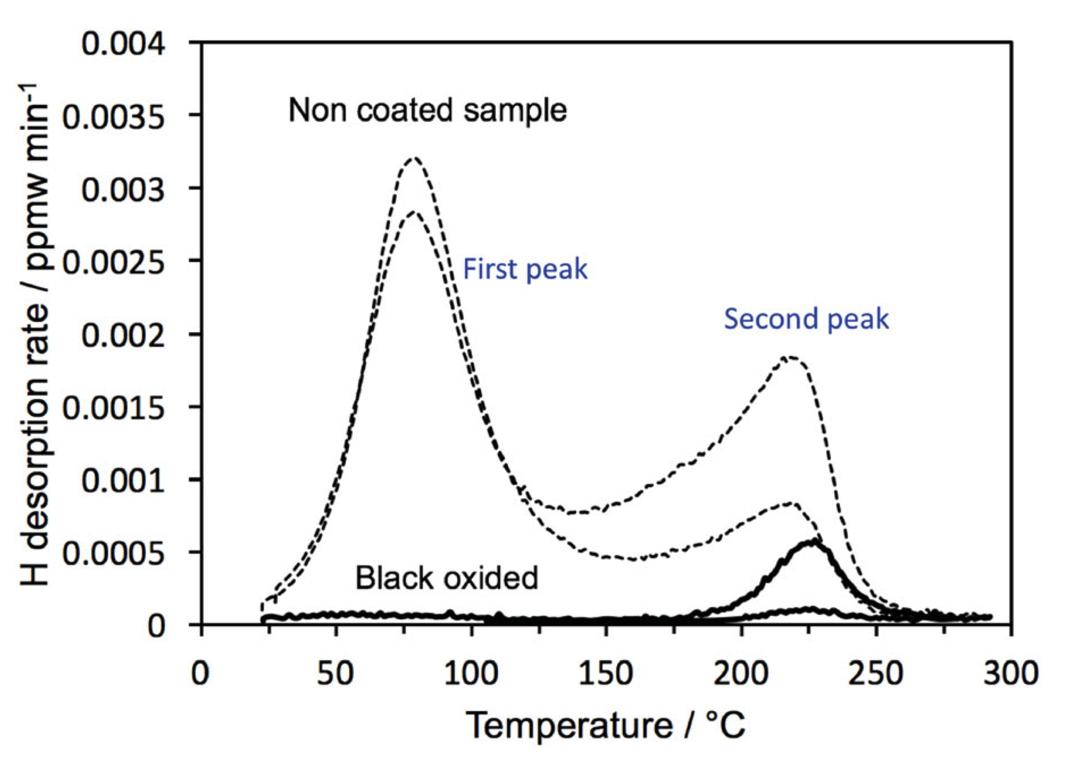

Slide 25
High-pressure, high-temperature hydrogen attack
(13.7 MPa, 600°C)
Reaction of hydrogen with carbides to form methane bubbles.

Slide 26
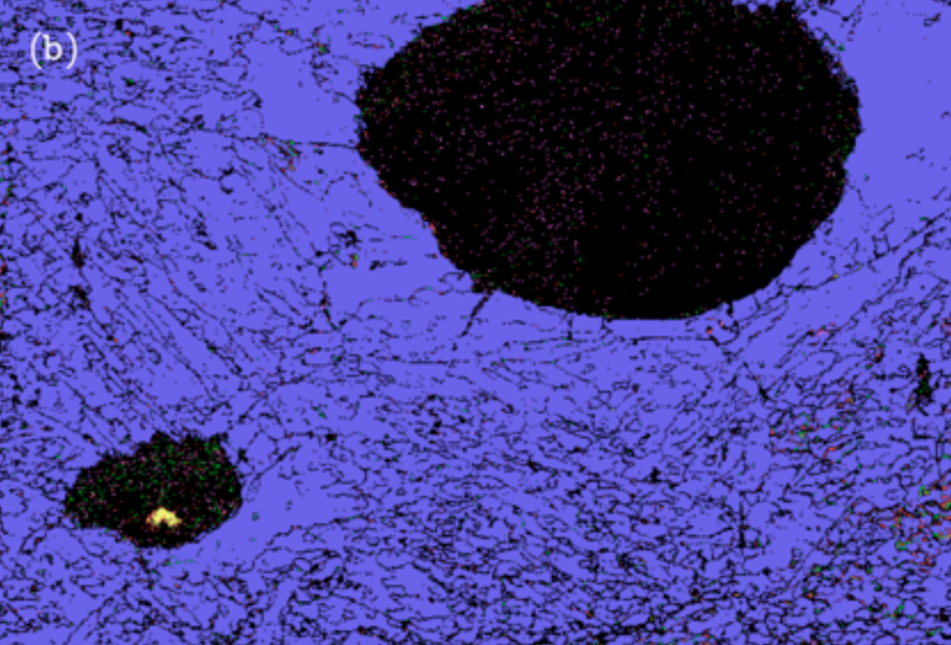
1 µm
Mohamed
Alshafrani

