Slide 1
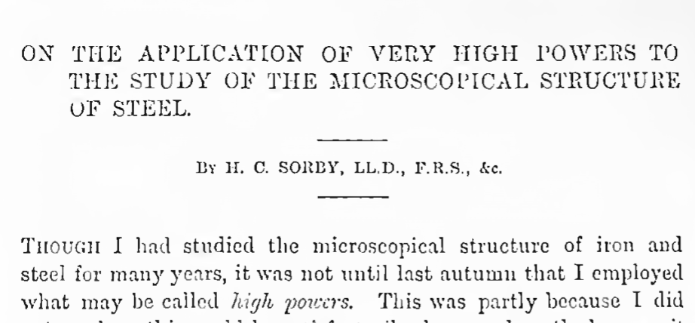
“pearly” structure
Journal of the Iron and Steel Institute 1 (1886) 140

Slide 2
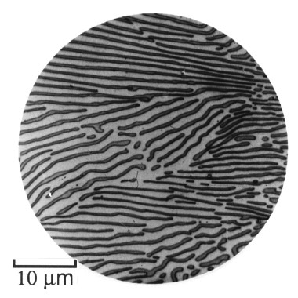
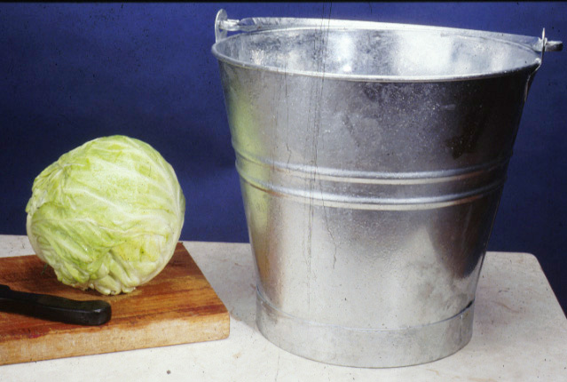
Strength of undeformed pearlite
E. C. Bain
www.phase-trans.msm.cam.ac.uk

Slide 3
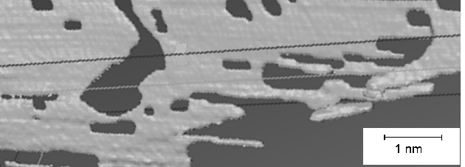
Three-dimensional, image of lamella of cementite in pearlite. Image generated using serial sectioning.
Courtesy of Yoshitaka Adachi.

Slide 4
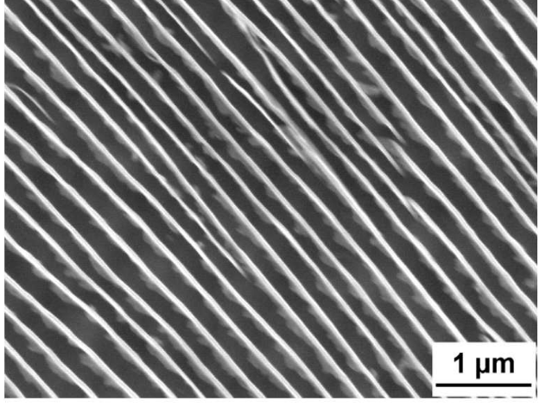
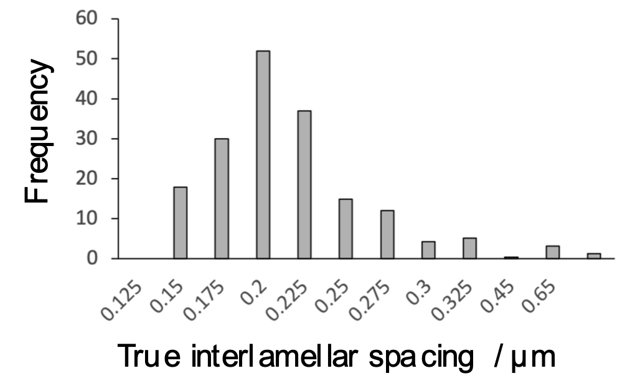
Kaiming Wu
Wuhan University of Science and Technology
Zhang, Enomoto, ISIJ International, 49 (2009) 921

Slide 5
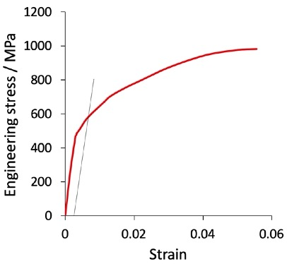
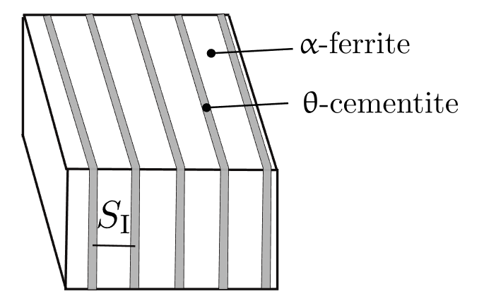
Cementite 1000 HV
Ferrite 250 HV

Slide 6
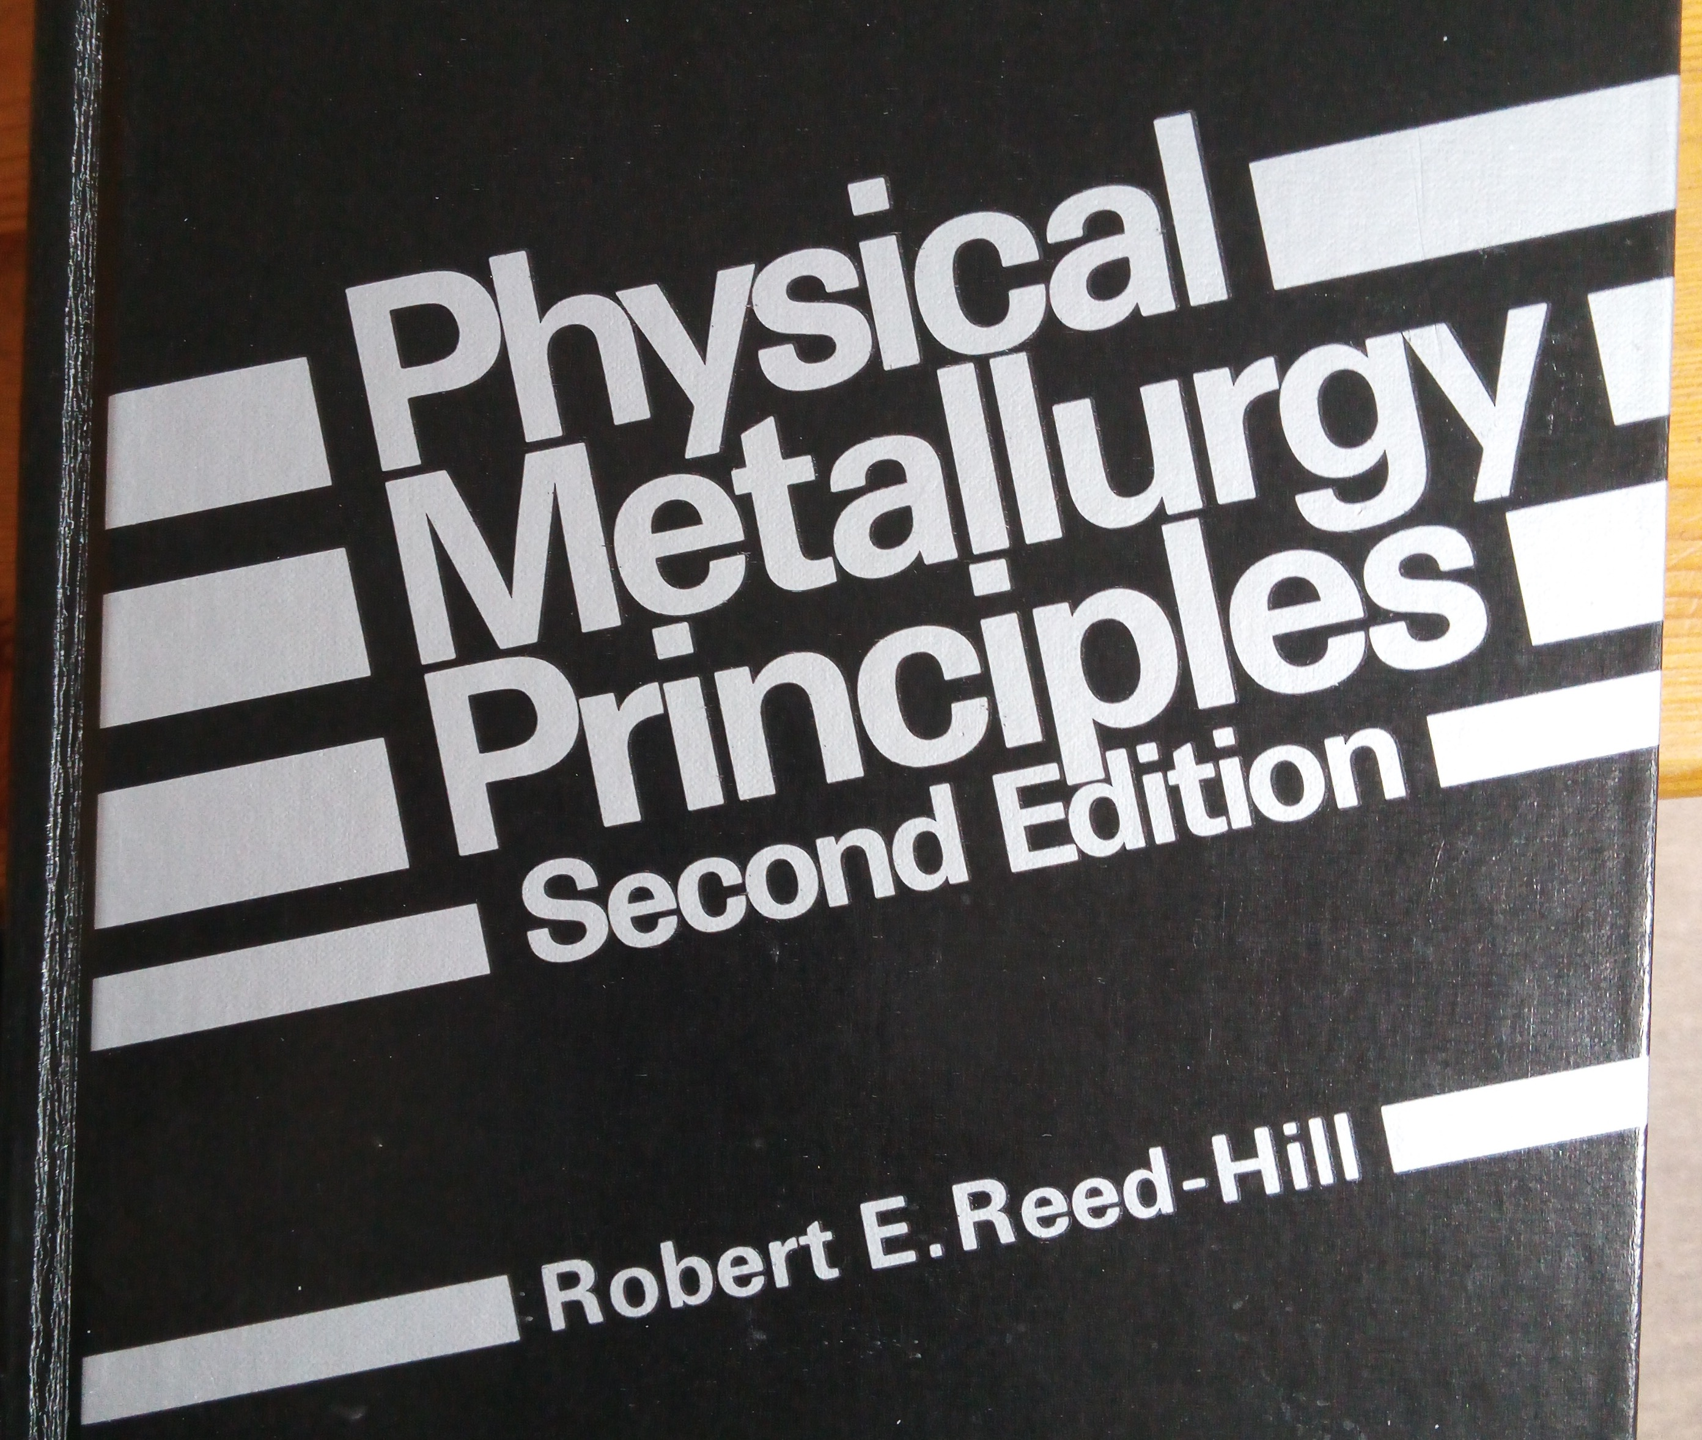
Stress to initiate plasticity sensitive to interlamellar spacing
“Hall-Petch relation …. by no means completely verified”
“equally good”
Page 230

Slide 7
Other problems
Dollar, Bernstein, Thompson
Acta Metallurgica
36 (1988) 311

Slide 8
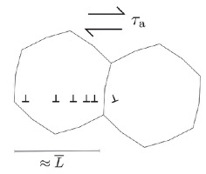
Theories: Hall-Petch

Slide 9
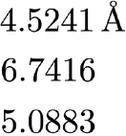
Cementite: primitive crystal structure

Slide 10
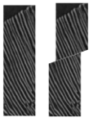
Theories: Langford
Dislocations pass through and shear cementite

Slide 11
Dislocation bowing between rigid cementite

Slide 12
Semiconductors: relaxation of epitaxial layer deposited on a substrate

Slide 14
Thin film theory
Order of magnitude smaller than expected from theory

Slide 15
Hall-Petch

Slide 16
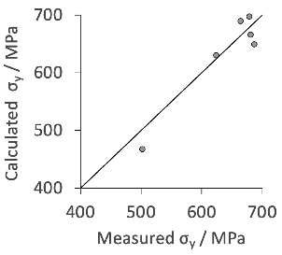
Solid solution effects
Data due to Fu, Furuhara

Slide 17
Comparison of nanostructure ferrite with pearlite
Data points: Tsuji et al.
Scr Mat 46 (2002) 893

Slide 18
Bayesian analysis

Slide 19
Why controversy about Hall-Petch?
… friction stress in ferrite negative intercept

Slide 20
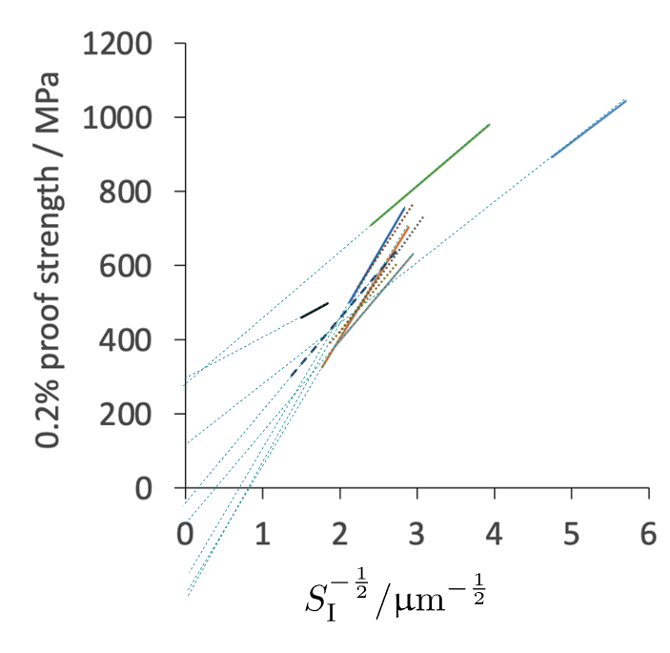
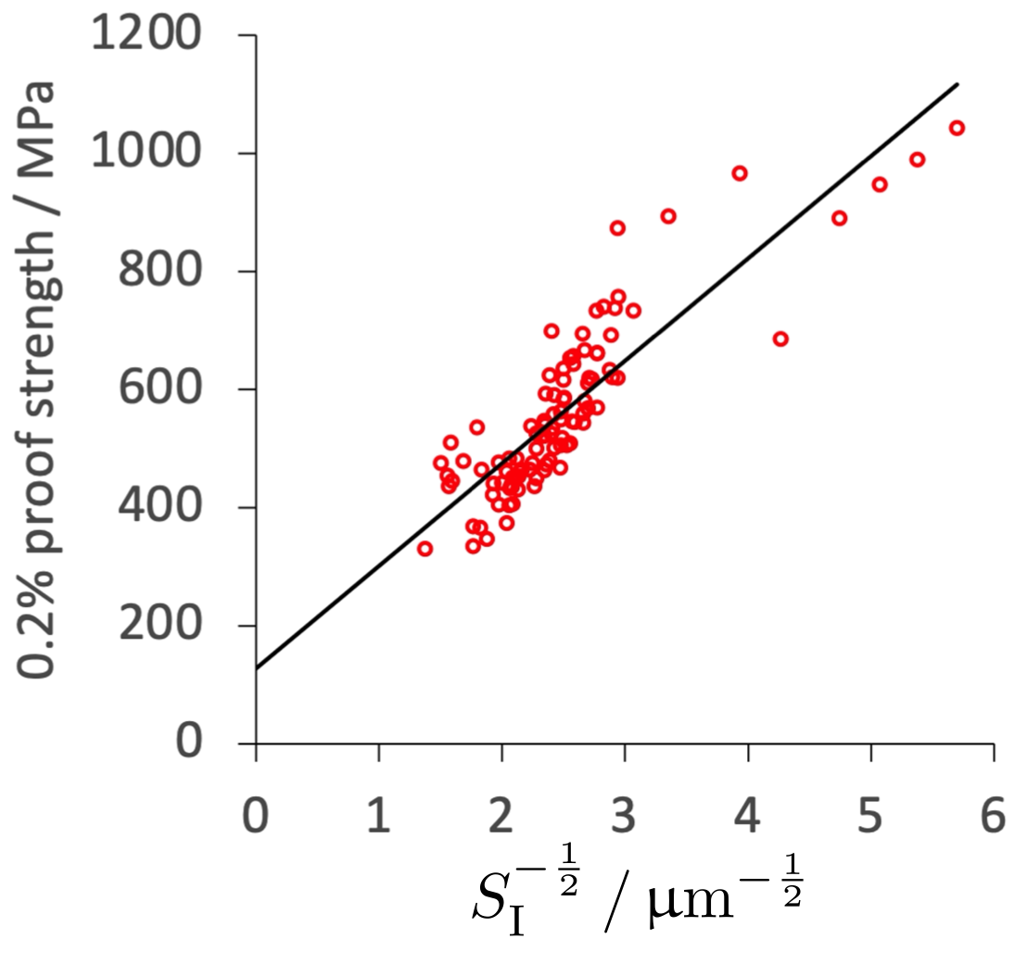
Overfitting of noisy data

Slide 21
Data can be downloaded from
www.phase-trans.msm.cam.ac.uk/2022/HP.xlsx
Critical assessment: the strength of undeformed pearlite
Materials Science and Technology, 2022
DOI: 10.1080/02670836.2022.2079295

