Slide 1
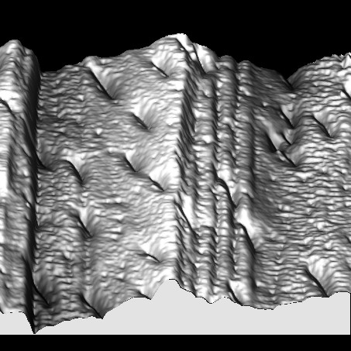

Choreography of atoms during the bainite transformation
Henry Clifton Sorby Award
Notes:
1050-1150 a.m.

Slide 2
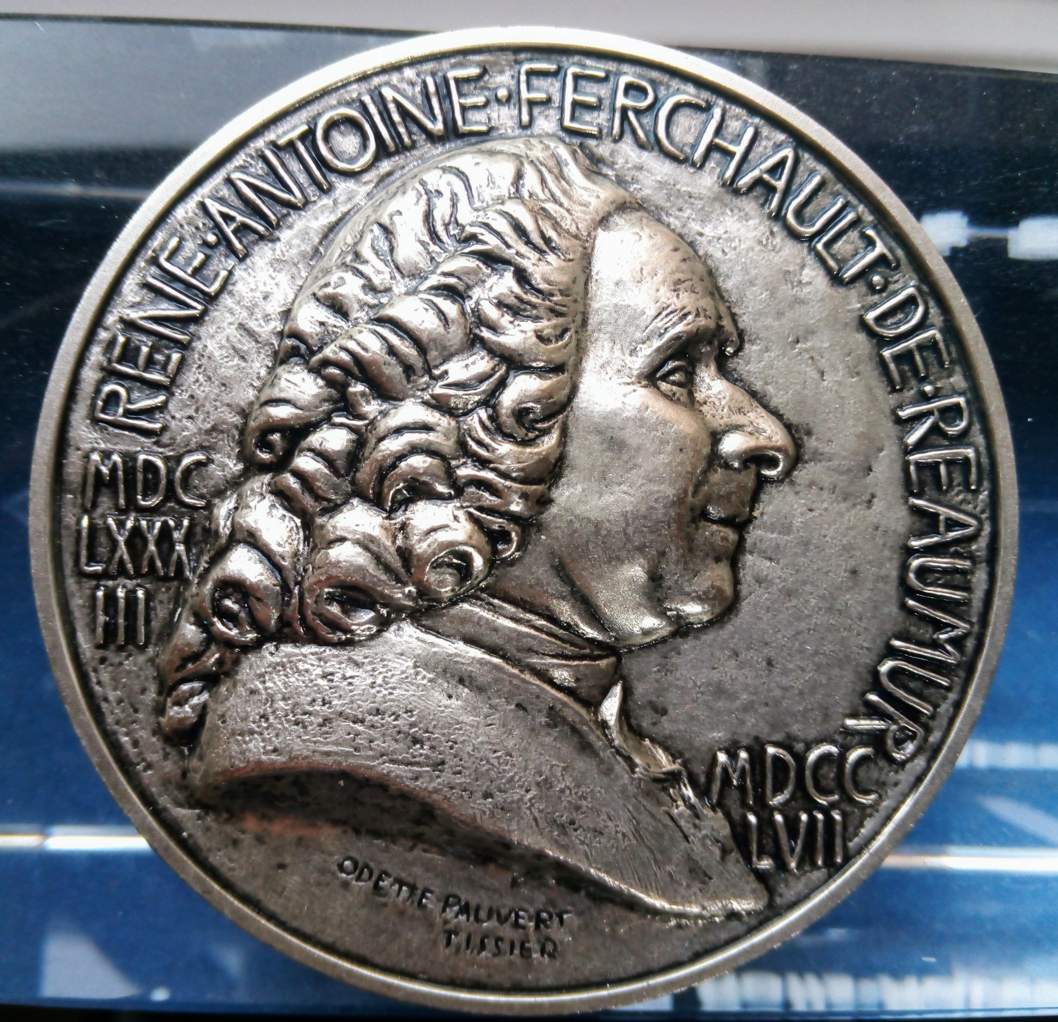
Réamur, “model of a modern materials scientist”.
MDCLXXXIII = 1683
MDCCLVII = 1757
Scientists of the time did not know that real materials had crystals.

Slide 3
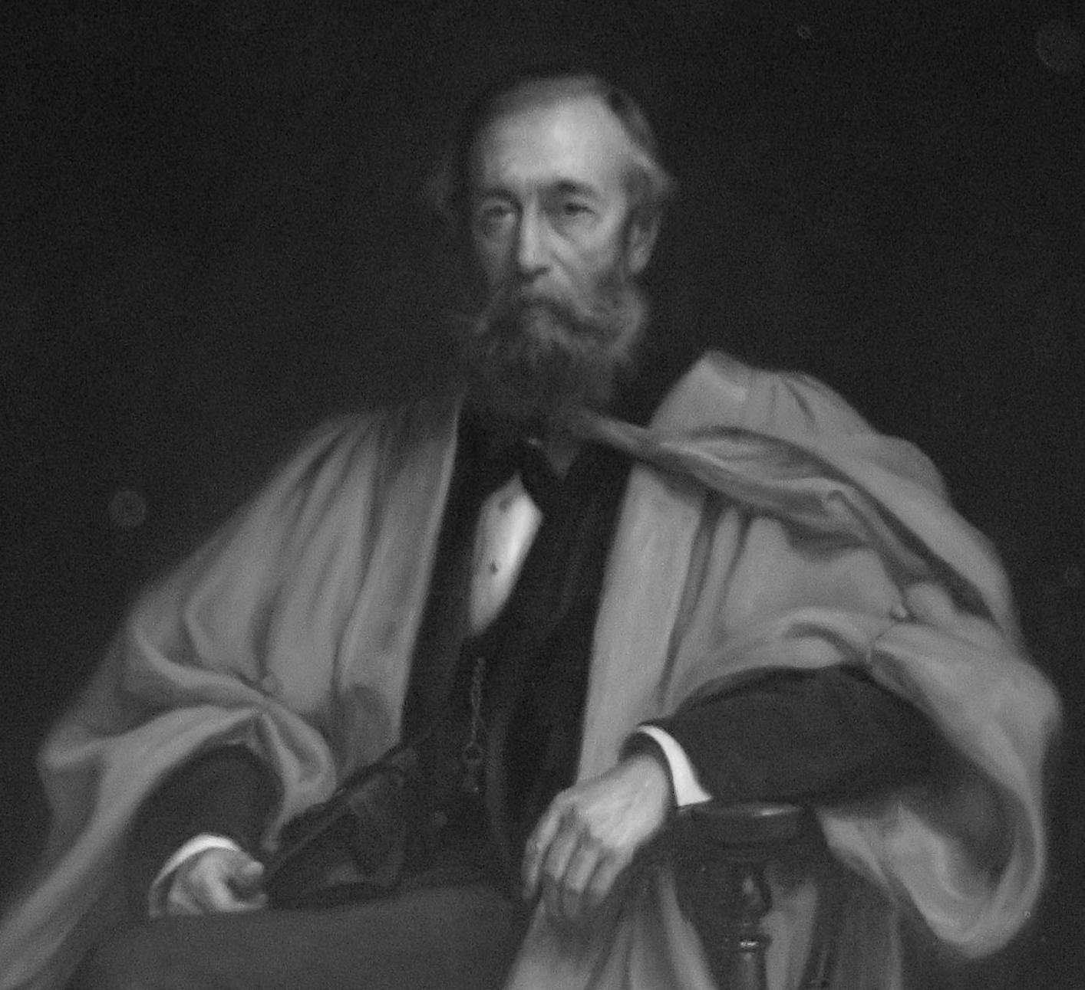
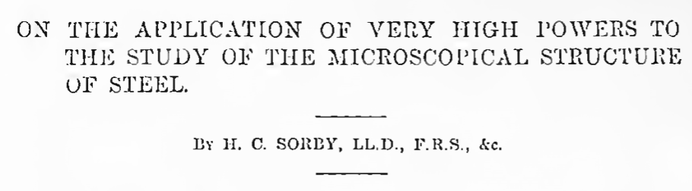
19th century: Sorby, applied microscope to steel and discovered its crystalline structure (1863).
“pearly” (1886)

Slide 4
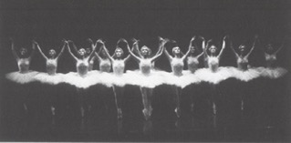
Birmingham Royal Ballet Company: ordered and symmetrical motion that leads to a predictable change in shape

Slide 5
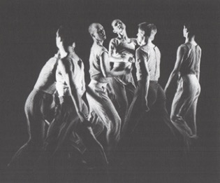
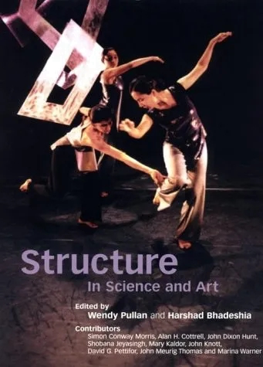
Siobhan Davies’ Dance Company: disordered equilibrium

Slide 6
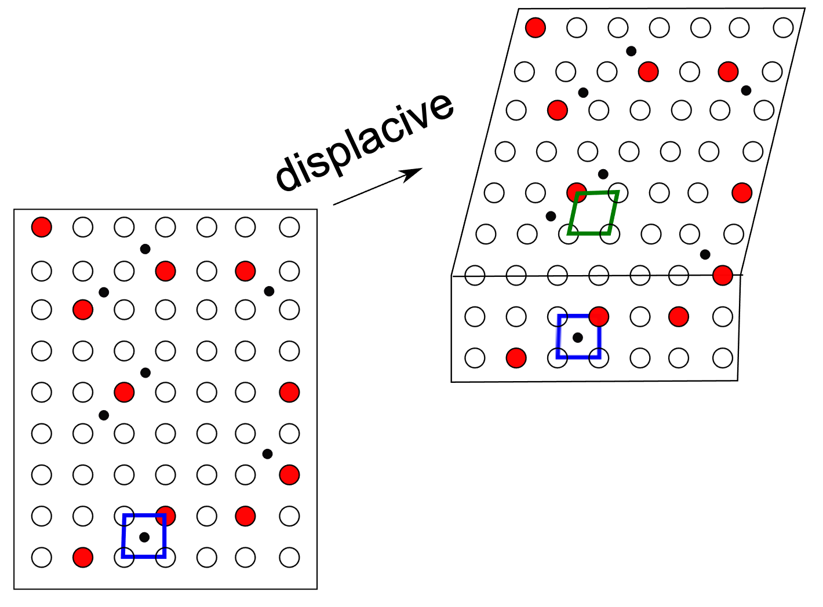

Low atomic mobility:
all atoms
High atomic mobility:
small atoms

Slide 7
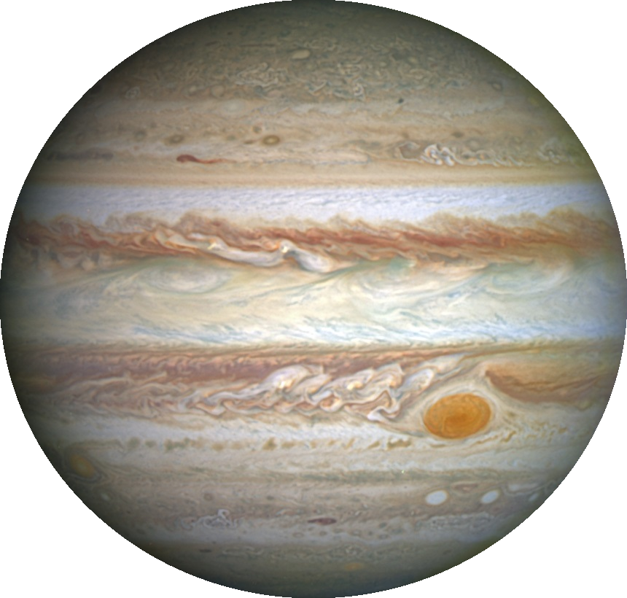
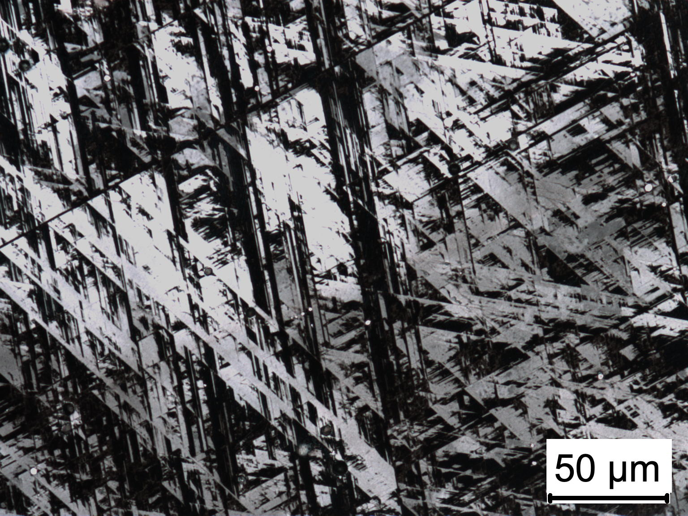
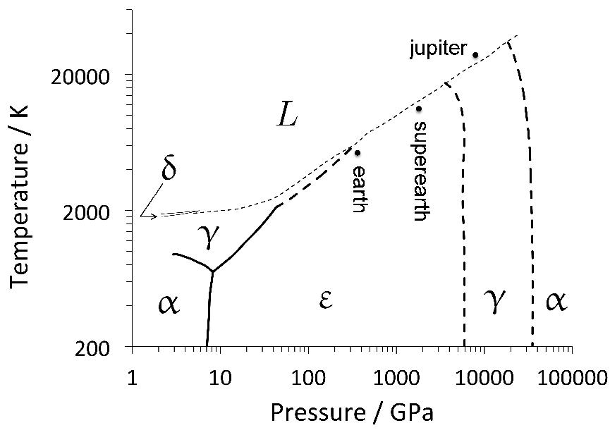

Structure of Fe to terapascal pressures and 40000 K (Stixrude, 2012)
Fe-25Mn-5.2Si wt%

Slide 8
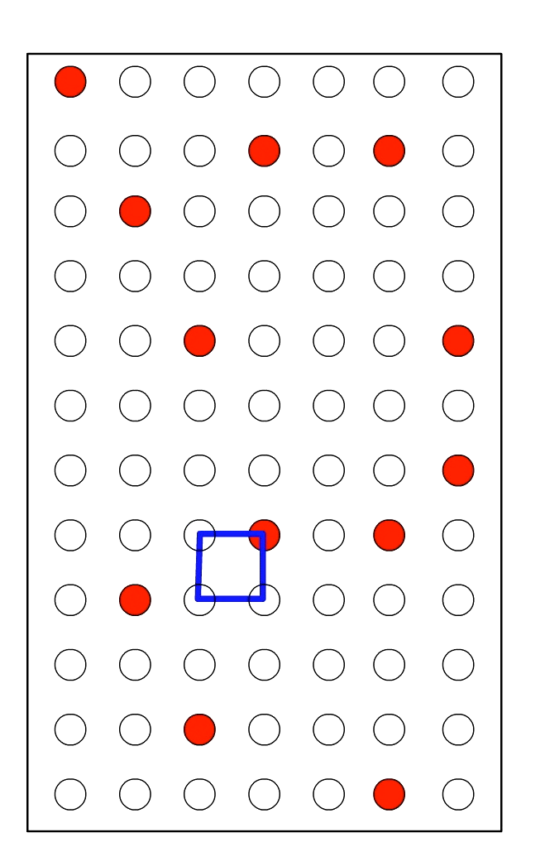
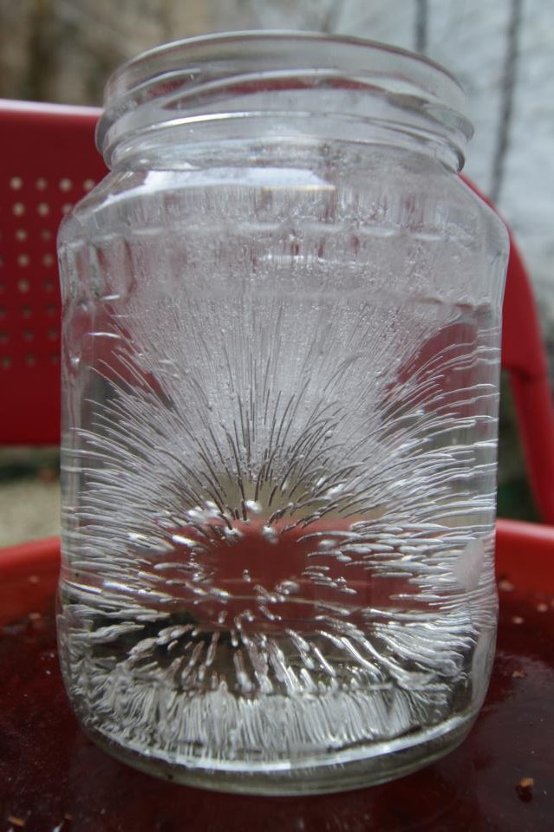
Reconstructive
transformation
Sufficient atomic mobility

Slide 9
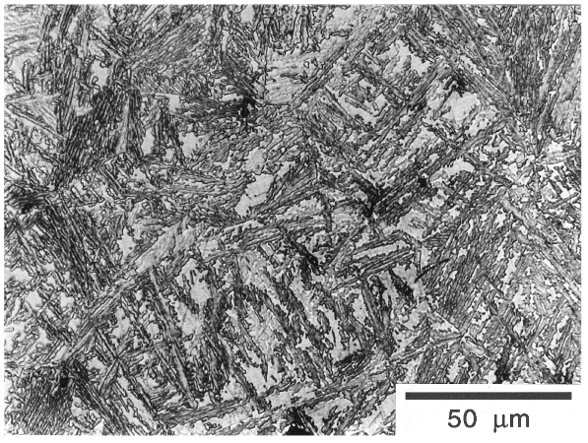
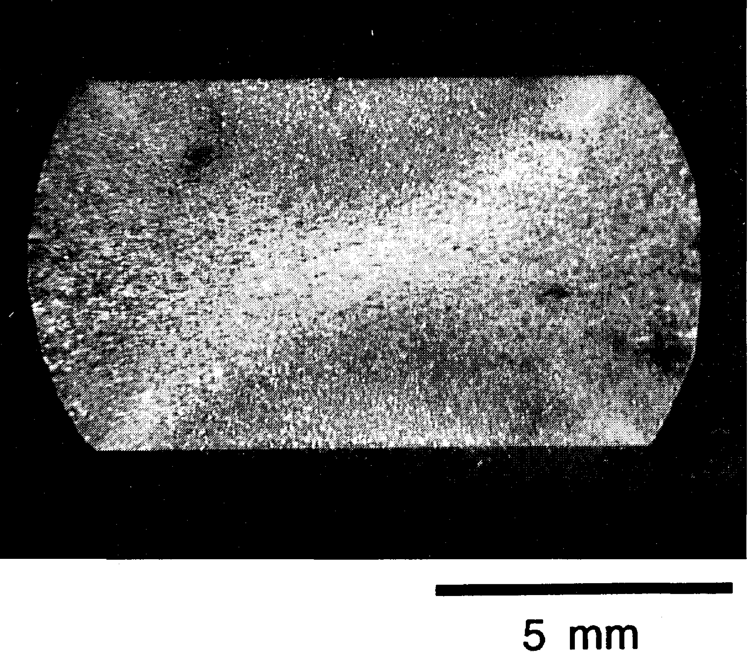
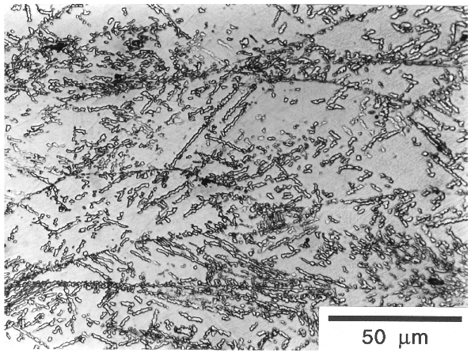
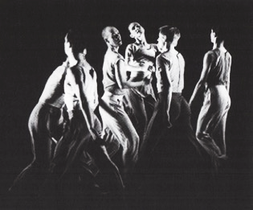
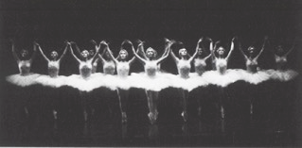
Any obstacles retard coordinated motion

Slide 10
Condition for diffusionless growth

Slide 11
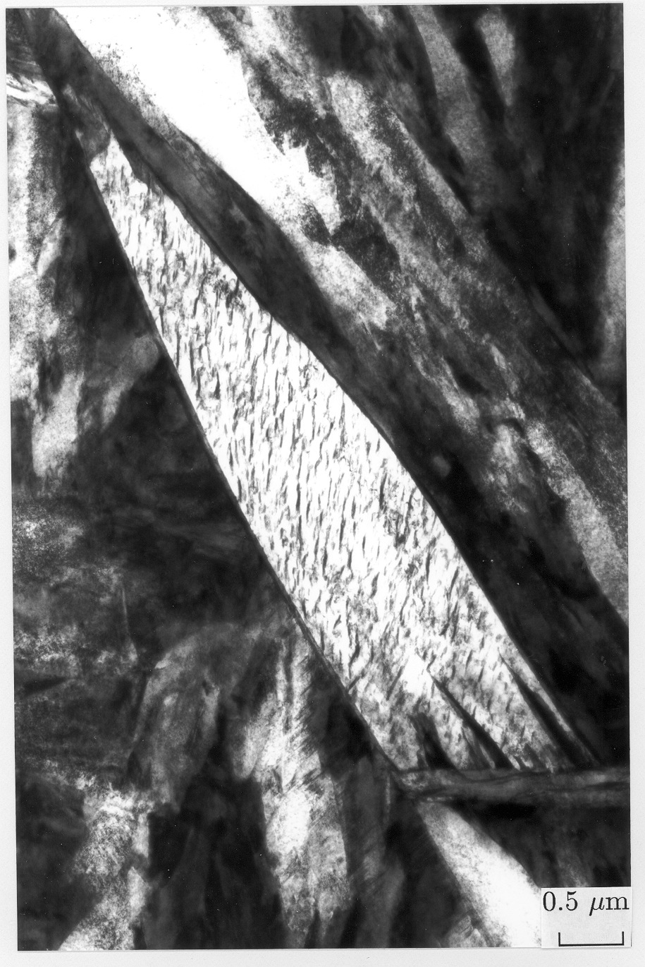
Conditions for diffusionless transformation:
.... slow diffusion
.... large driving force
.... crystallographic criteria
far from equilibrium
... huge strain energy
... solute trapping

Slide 12
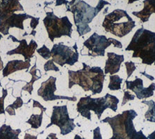
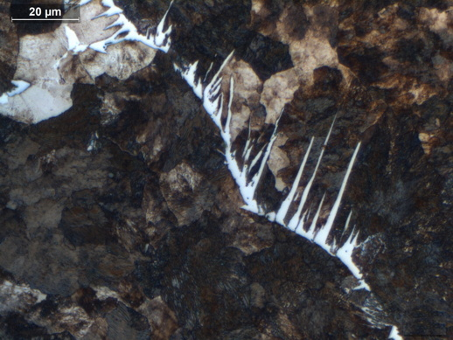
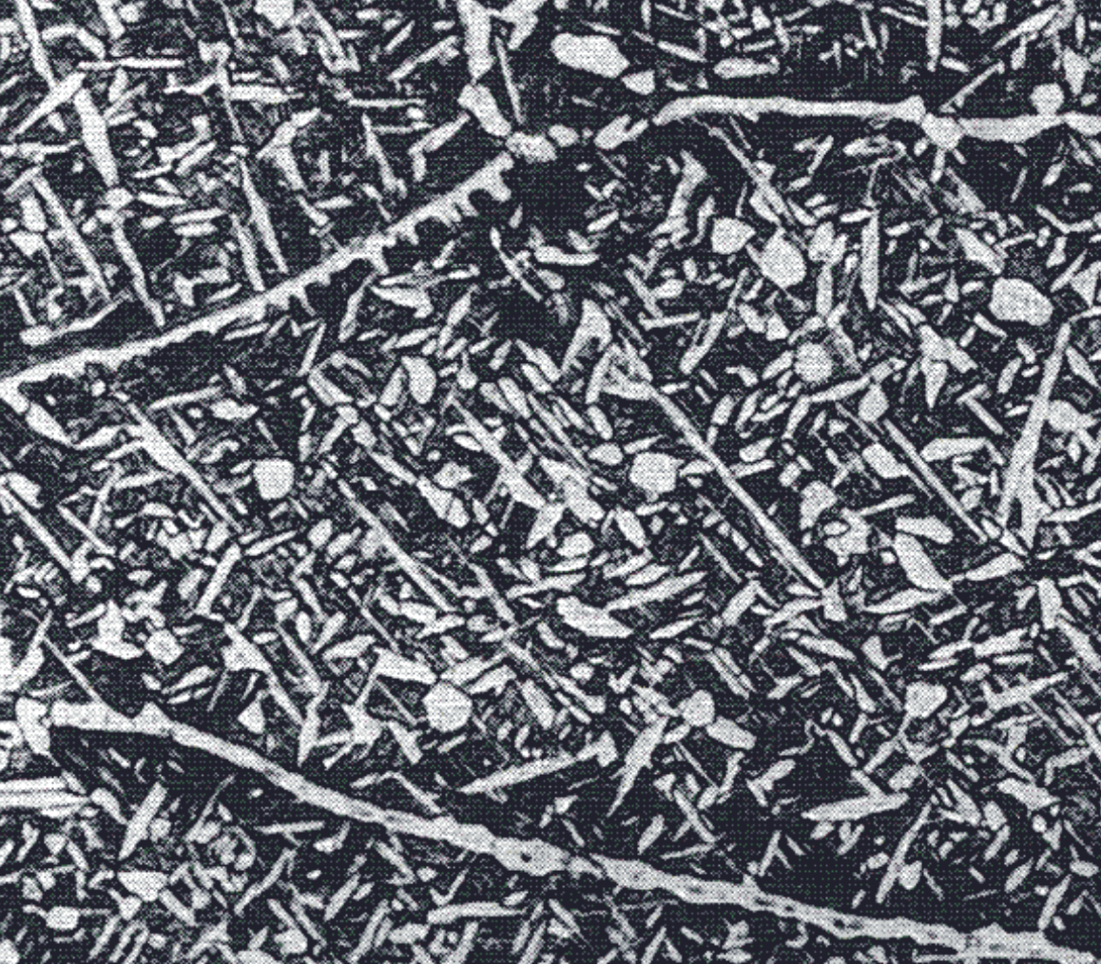
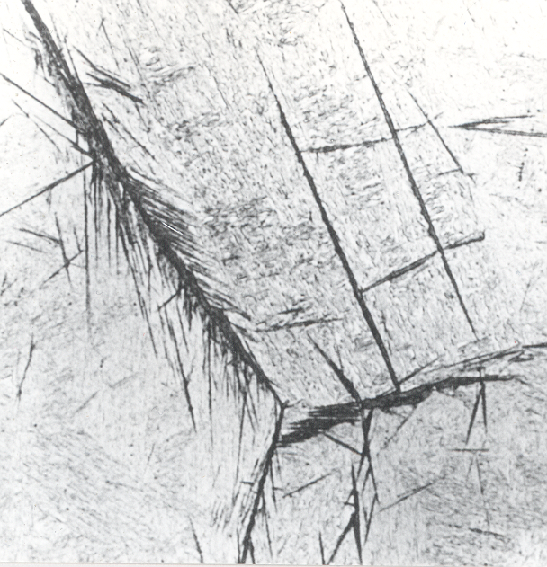
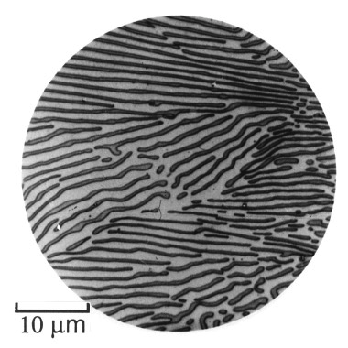
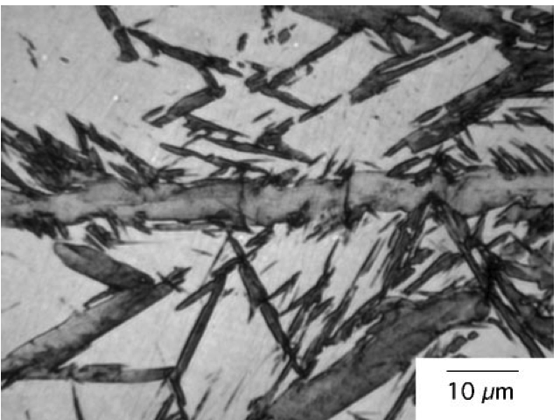

Slide 13
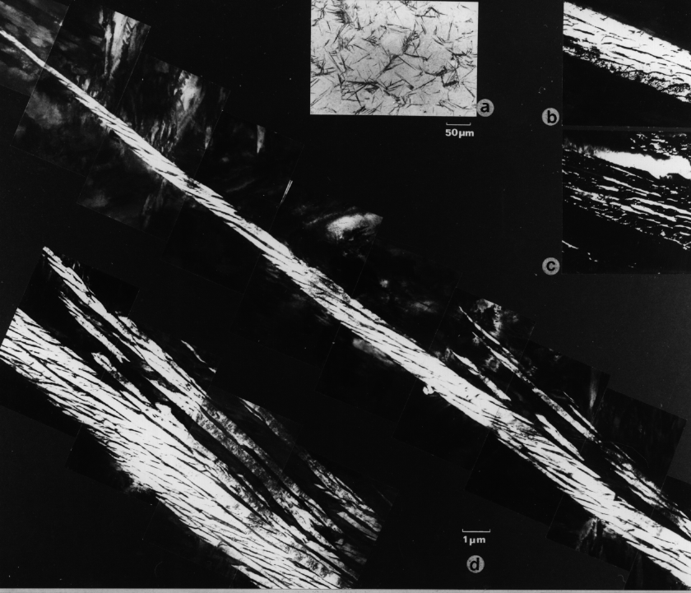
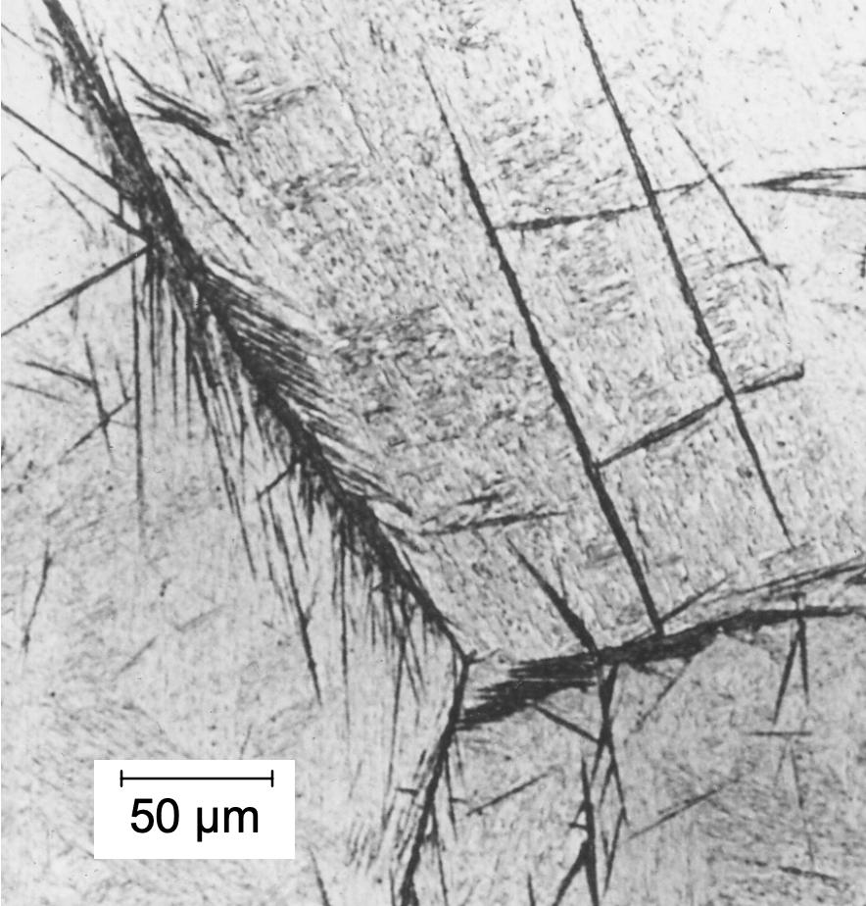

Slide 14
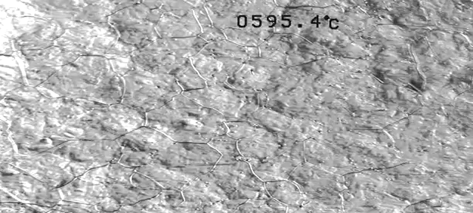
Real time
|
|
50 µm
J. H. Pak, D. W. Suh, H. K. D. H. Bhadeshia
Metall. & Mater. Trans A 43 (2012) 4520

Slide 15
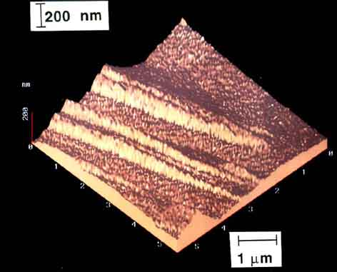
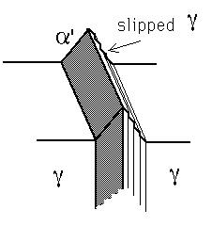
Swallow E, Bhadeshia HKDH. High resolution observations of displacements caused by bainitic transformation. Materials Science and Technology. 1996;12:121

Slide 16
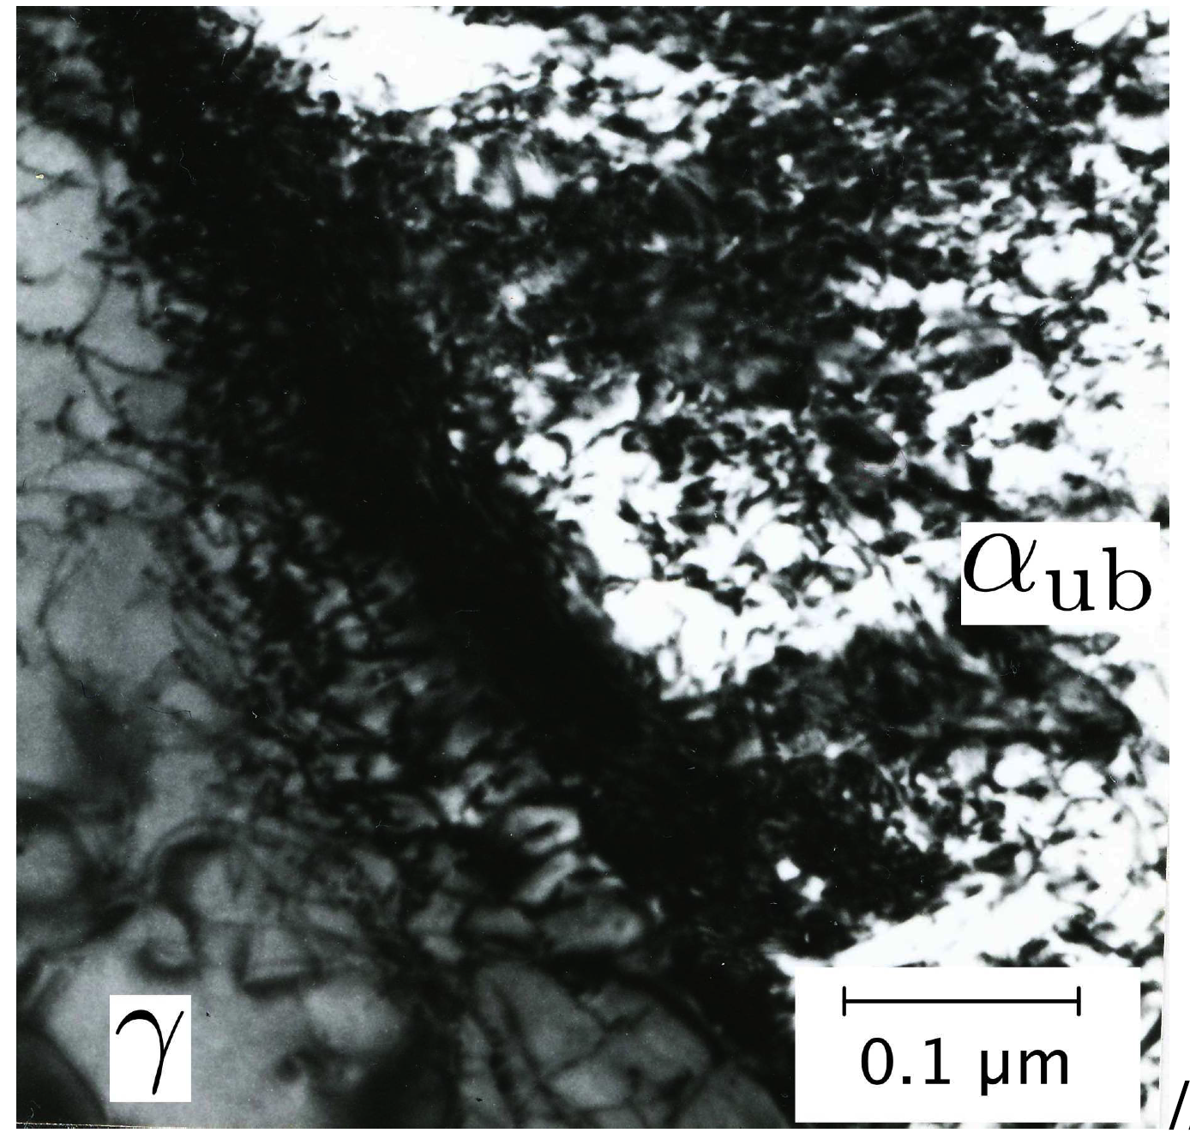
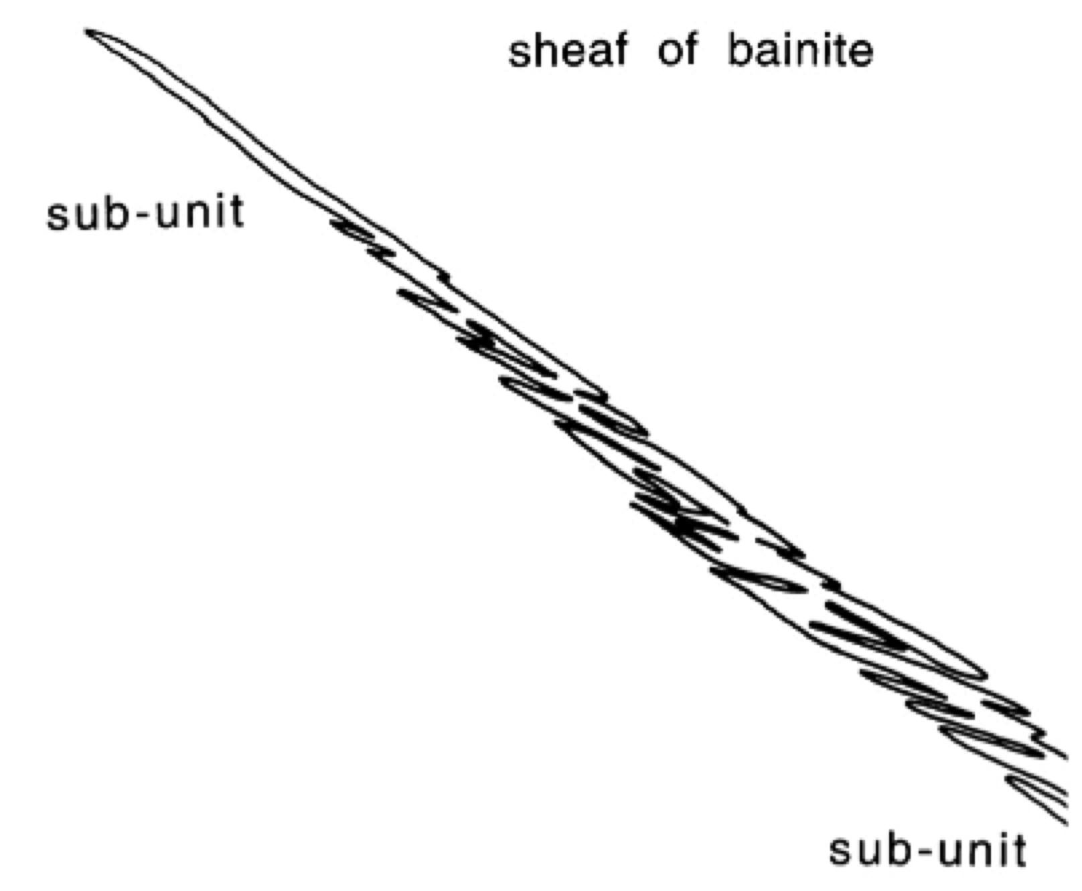

Slide 17
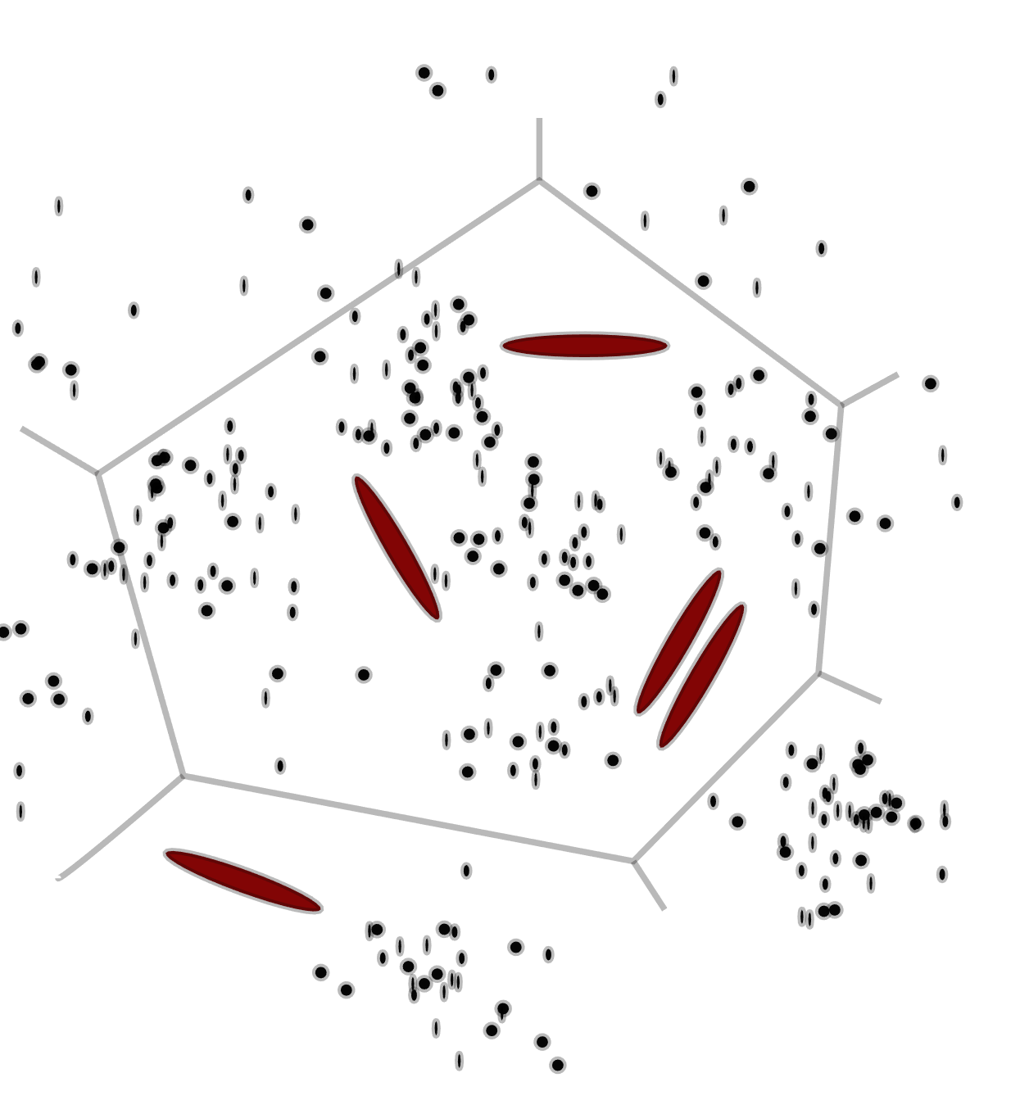
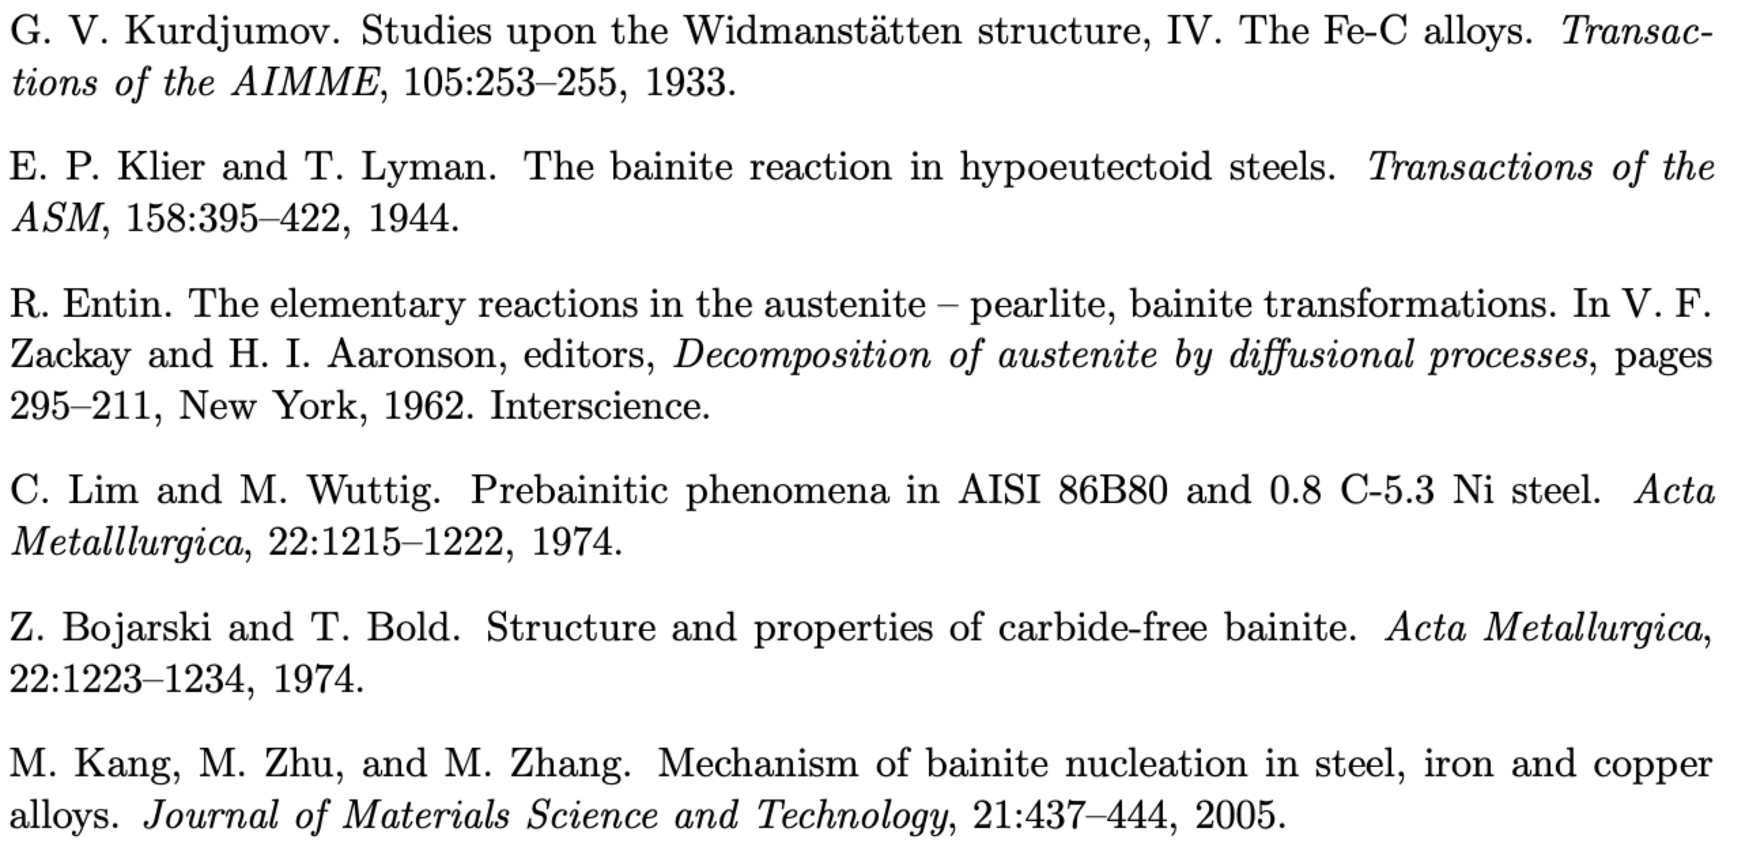
Bainite forms at low driving forces
.....austenite separates into carbon-rich and carbon-depleted regions ...
.... depleted regions → ferrite

Slide 18
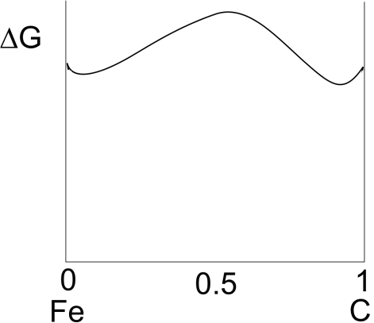
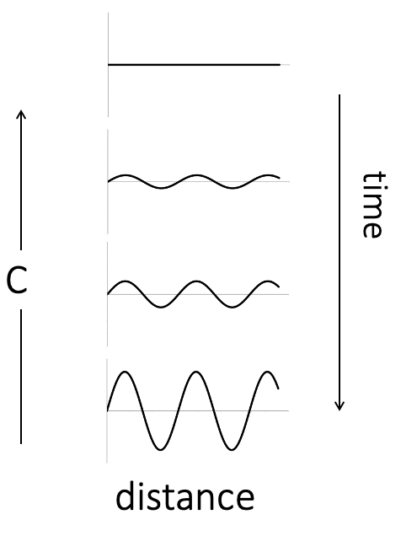
Aaronson, Domian, Pound, Thermodynamics of the austenite to proeutectoid ferrite transformation I
TMS-AIME 236 (1966) 753-767

Slide 19
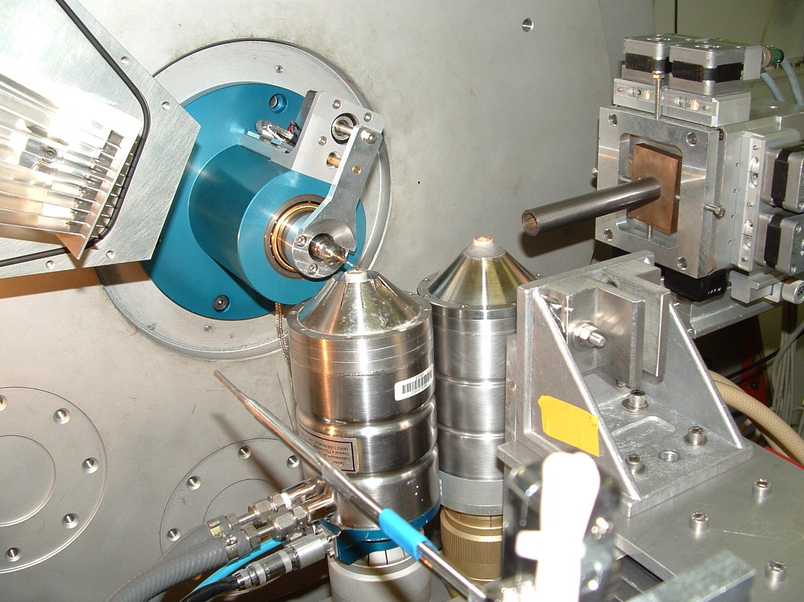
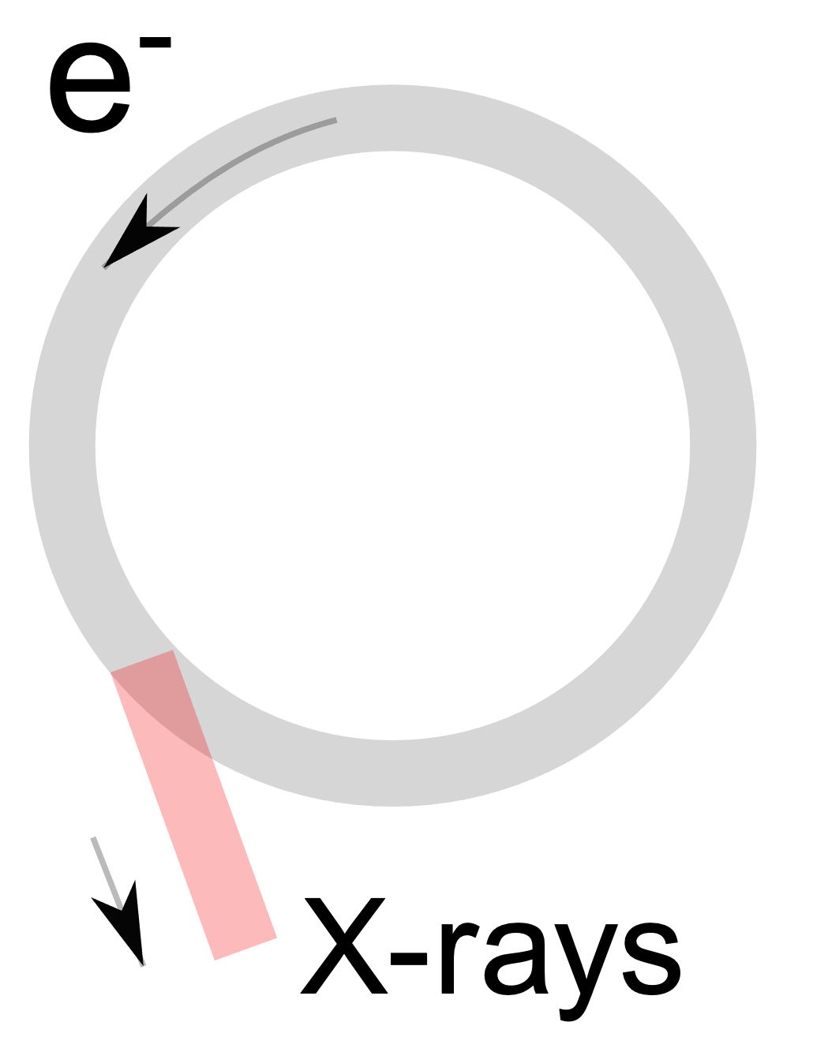
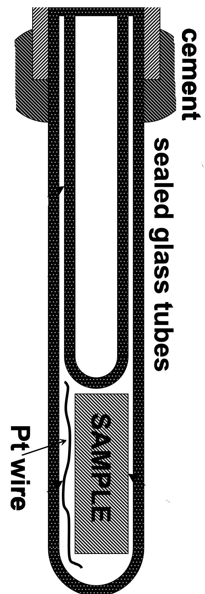
Accelerate electrons around magnetised ring.
Electrons bend around this ring, lose some energy as X-rays.
X-rays funnelled down
beamlines for experiments.

Slide 20
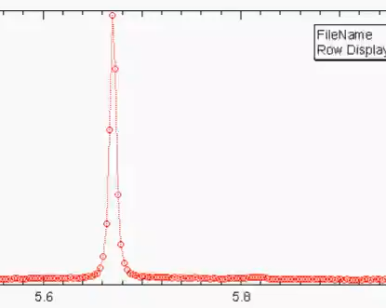
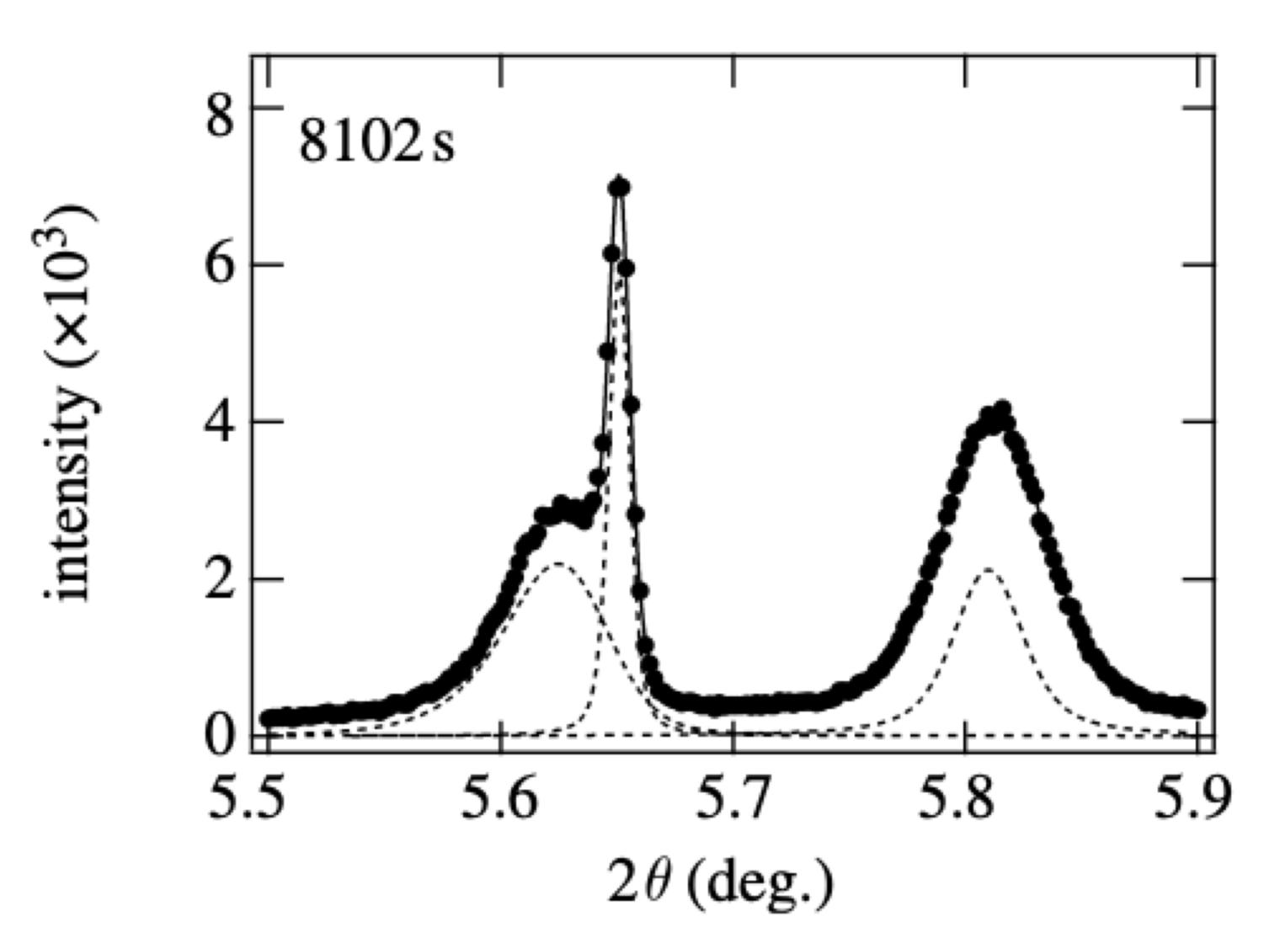
Time sequence
Intensity
Diffraction angle 2θ
H. J. Stone, M. J. Peet, H. K. D. H. Bhadeshia, P. J. Withers, S. S. Babu, E. D. Specht
Proc. of the Royal Society A, 464 (2008) 1009-1027

Slide 21
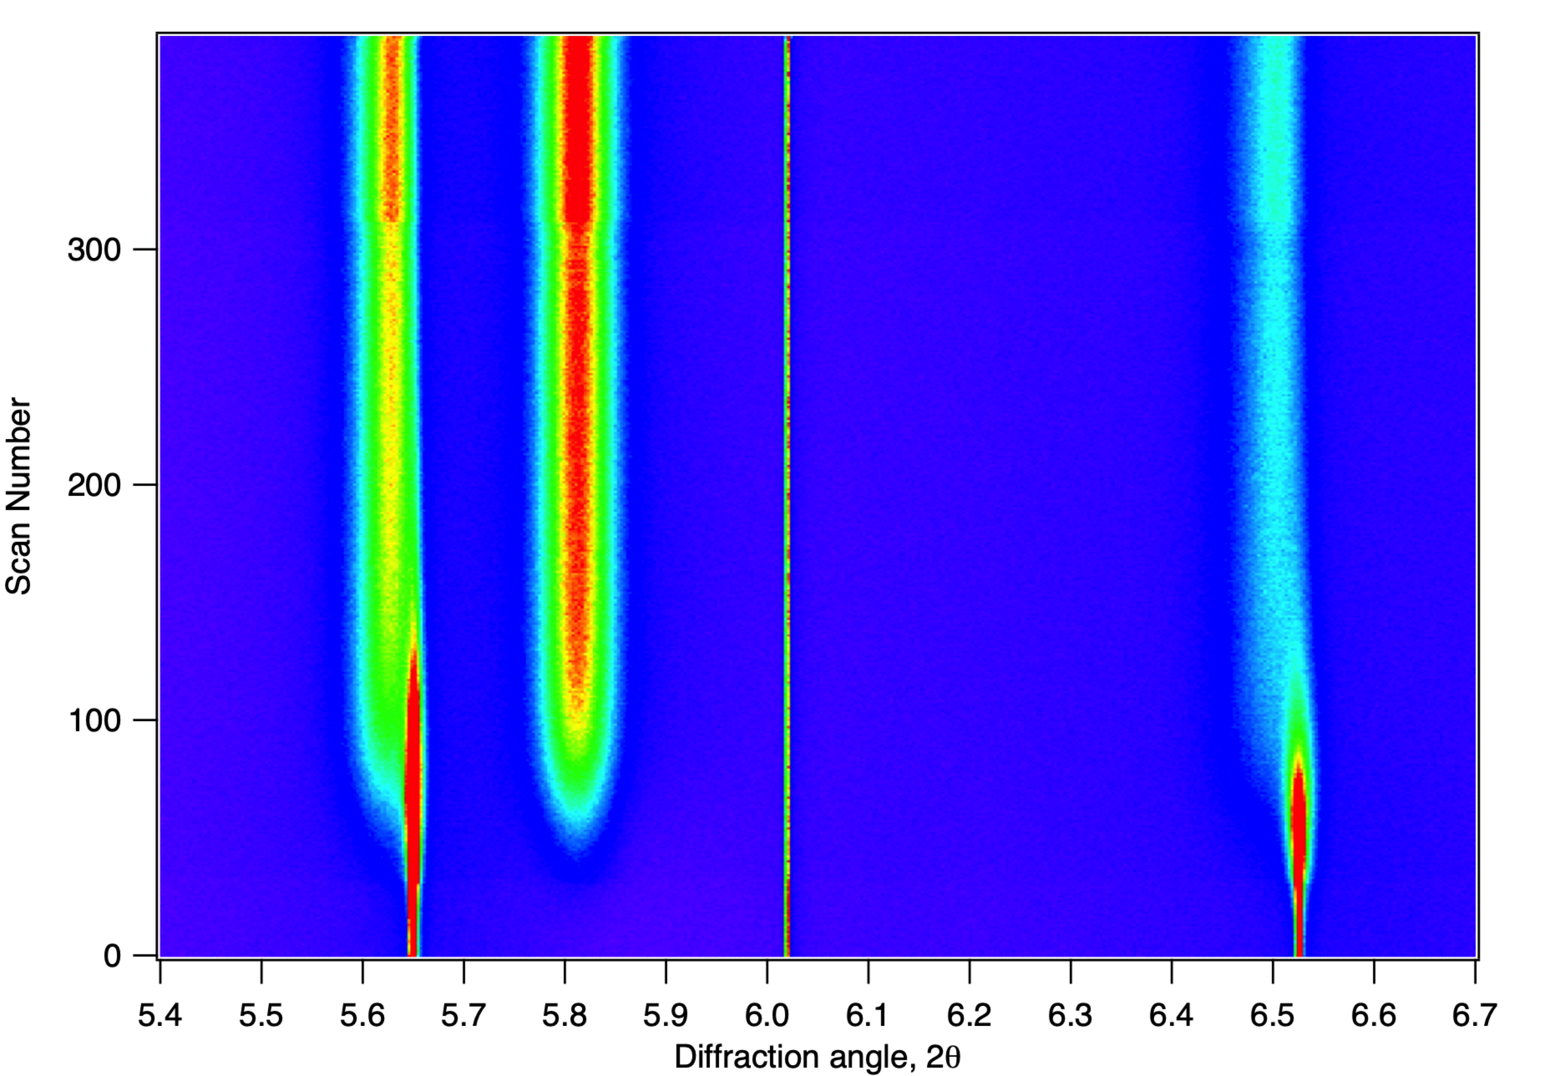
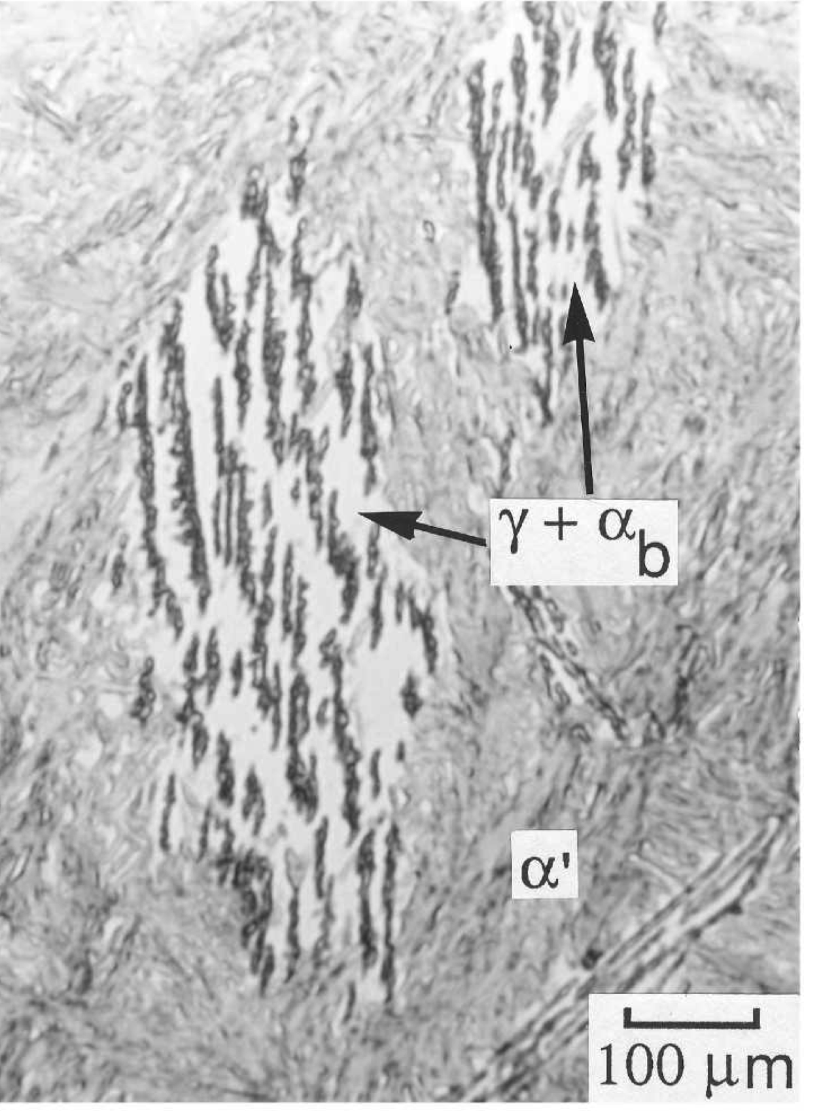
isothermal transformation at 300 °C
011 ferrite
002 Pt
002 austenite
H. J. Stone, M. J. Peet, H. K. D. H. Bhadeshia, P. J. Withers, S. S. Babu, E. D. Specht
Proc. of the Royal Society A, 464 (2008) 1009-1027
Time
111 austenite

Slide 22
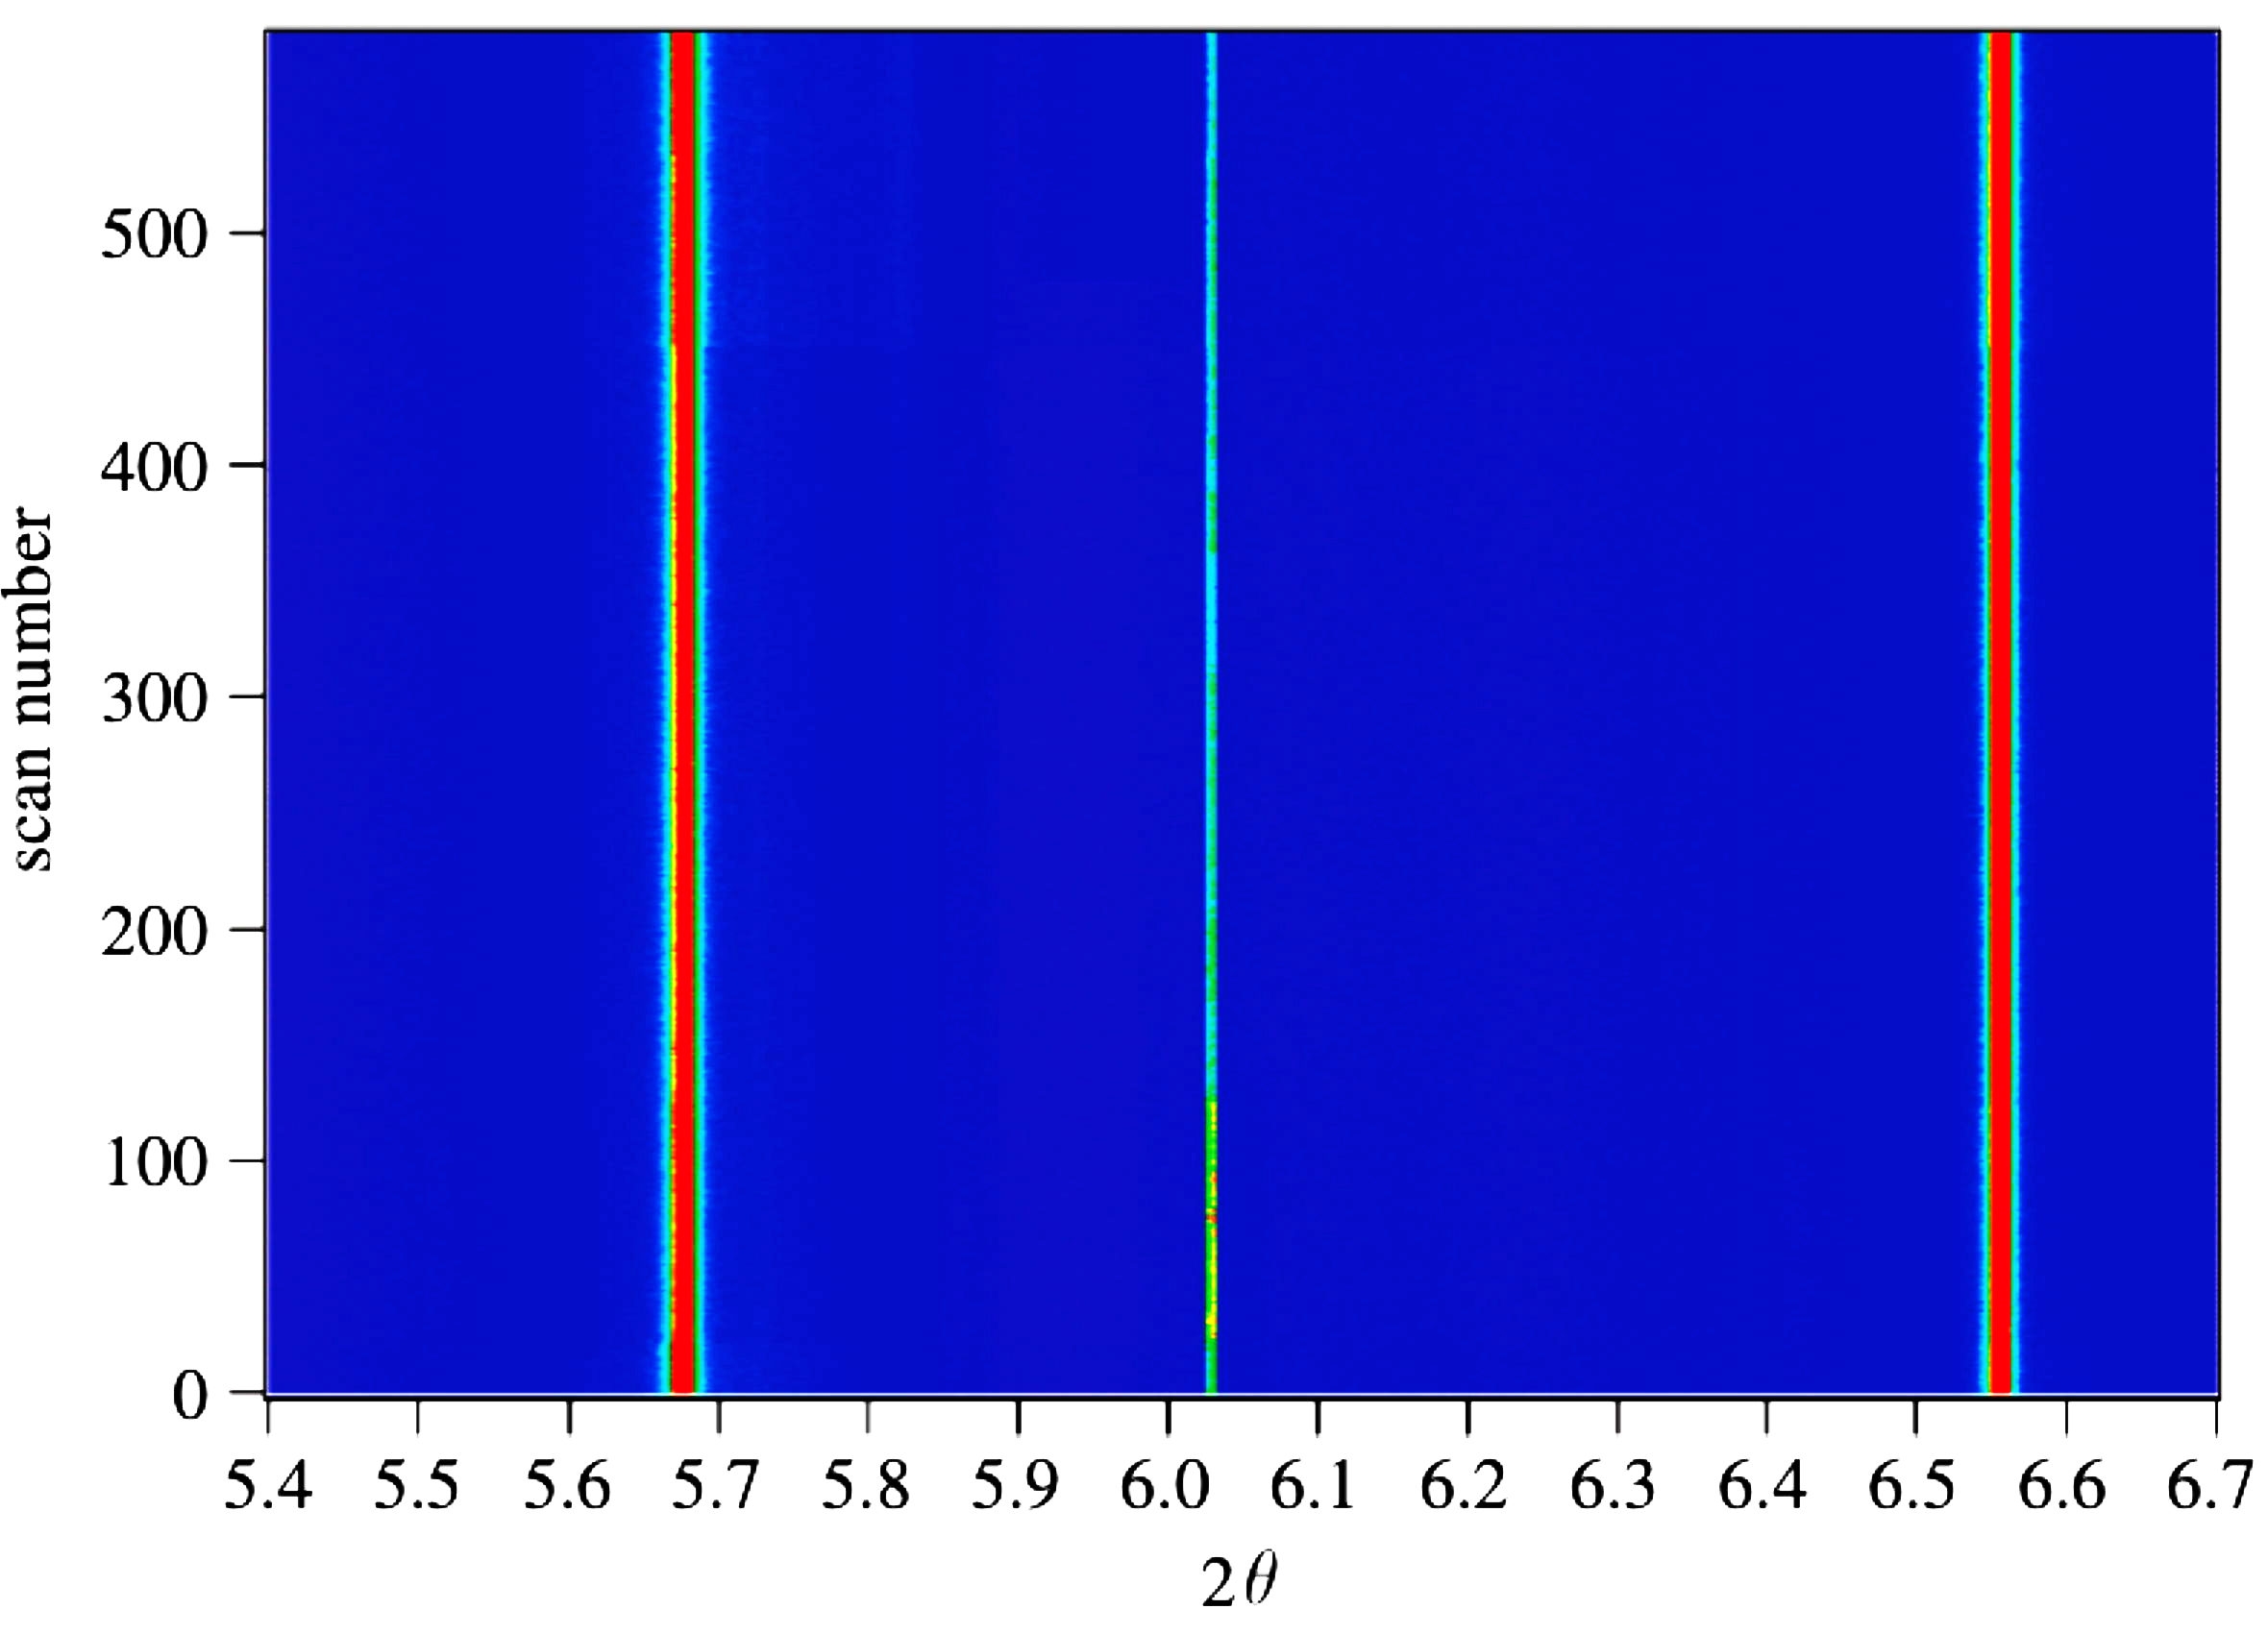

isothermal transformation at 200 °C
002 Pt
111 austenite
002 austenite
H. J. Stone, M. J. Peet, H. K. D. H. Bhadeshia, P. J. Withers, S. S. Babu, E. D. Specht
Proc. of the Royal Society A, 464 (2008) 1009-1027
Time (10 h total)

Slide 23
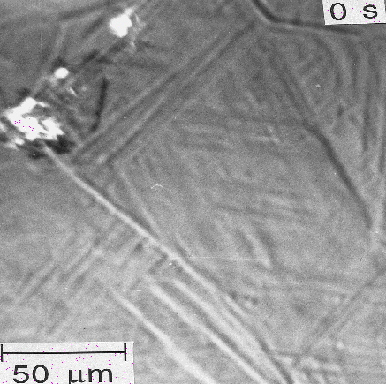
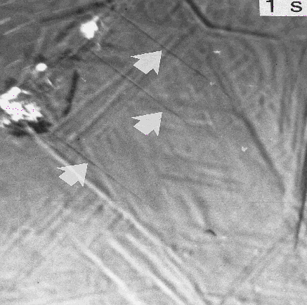
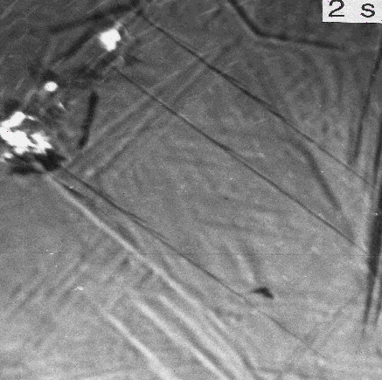
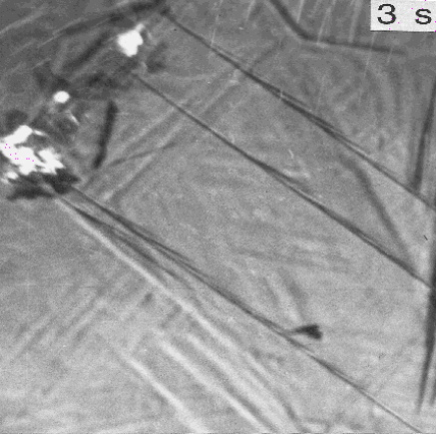
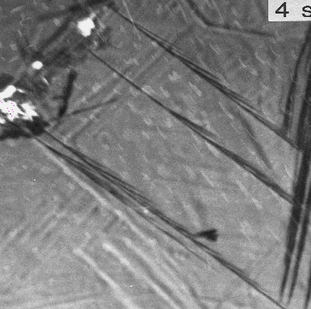
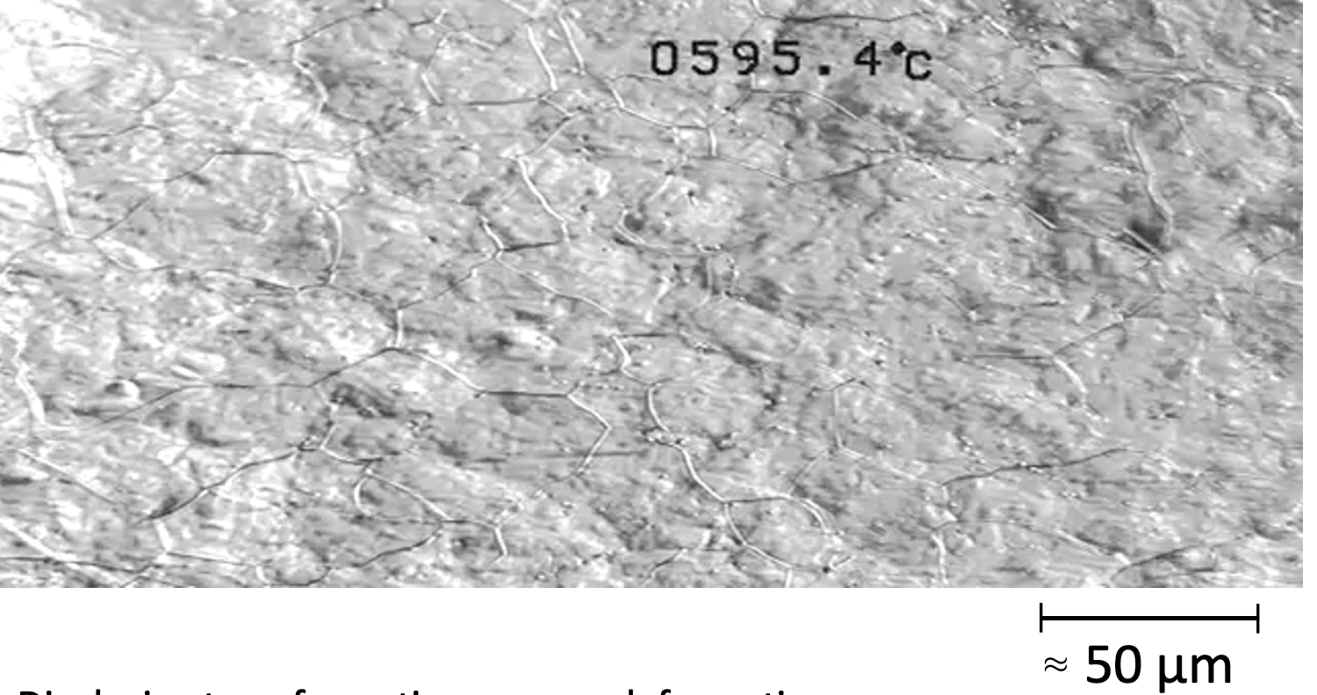
growth rate?
3 orders of magnitude faster than carbon diffusion-control
Photoemission electron microscopy

Slide 24

Acoustic emissions ....
... from bainite
Courtesy of Francisca Garcia Caballero

Slide 25

Bhadeshia HKDH, Waugh AR. Bainite: An atom-probe study of the incomplete reaction phenomenon. Acta Metallurgica. 1982;30:775-84.

Slide 26



Bhadeshia HKDH. Theoretical analysis of changes in cementite composition during tempering of bainite. Materials Science and Technology. 1989;5:131-7.

Slide 27


Slide 28

Growth is diffusionless
but plate decarburised shortly afterwards

Slide 29

T₀
Ae₃'
T₀'
Lin S, Borgenstam A, Stark A, Hedström P. Effect of Si on bainitic transformation kinetics in steels explained by carbon partitioning, carbide formation, dislocation densities, and thermodynamic conditions. Materials Characterization. 2022:111774
Notes:
Talk about the Swedish W_SB_s concept

Slide 30



Slide 31



Notes:
31

Slide 32


Very poor toughness!

Slide 33


Slide 34
Carbide-free alloys
Fe-0.4C-3Mn-2Si
Fe-0.2C-3Mn-2Si
Fe-0.4C-4Ni-2Si wt%
Notes:
34

Slide 35


Slide 36

0.5 μm

Slide 37

0.4C-2Si-4Mn
0.2C-2Si-3Mn
0.4C-2Si-4Ni

Slide 38


Slide 39


Yates, Jerath, Bhadeshia
Notes:
39

Slide 40

carbide-free bainitic rail
Carbide-free bainite has no hard particles,
Just bainitic ferrite and retained austenite
Kevin Sawley: 90 million gross tonnes of traffic on curve

Slide 41

November 2019: 1 billion gross tonnes of traffic achieved, without need for grinding
Pascal Secordel (Francerail), Jay Jaiswal (Arrail)
April 2020
Notes:
41

Slide 42

“Bainitic low fatigue” (BLF) is mandated for all new French TGV high-speed moveable points.
Daniel Callejas Sevilla
CC BY-SA 3.0 Unported

Slide 43


180
160
140
120
18 wt% Ni
maraging steel
Ascometal
Fracture toughness / MPa √m
100
80
60
40
QT
20
1000
1500
2000
2500
Ultimate tensile strength / MPa

Slide 44



Slide 45


Low transformation temperature
Bainitic hardenability
Reasonable transformation time
Elimination of cementite
Austenite grain size control
Avoidance of temper embrittlement

Slide 46





Slide 47



Real images of nanostructured bainite

Slide 48


Zhang & Yang, 2019
wind turbines +rolling mill, vibration machinery

Slide 49


Slide 50

It was assumed therefore, that these carbon atoms are trapped at dislocations, since the original paper published in 1981.
Bhadeshia, Edmonds
Metall. Trans. (1979)

Slide 51


Large carbon concentration in solution in ferrite
Ferrite
Dislocation
Austenite
Caballero, Miller, Mateo, Cornide, J. Alloys & Compounds, (2012)

Slide 52


C. N. Hulme-Smith, I. Lonardelli,
A. C. Dippel and H. K. D. H. Bhadeshia, Scr. Mat. 69 (2013) 409.

Slide 53


Huge increase in solubility; ferrite with
tetragonal symmetry
Jang, Suh, Bhadeshia, Scr. Mat. 68 (2012) 195

Slide 54





