Slide 1
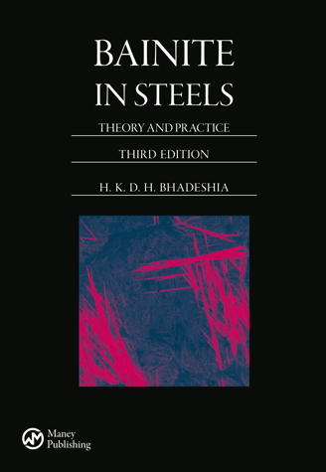
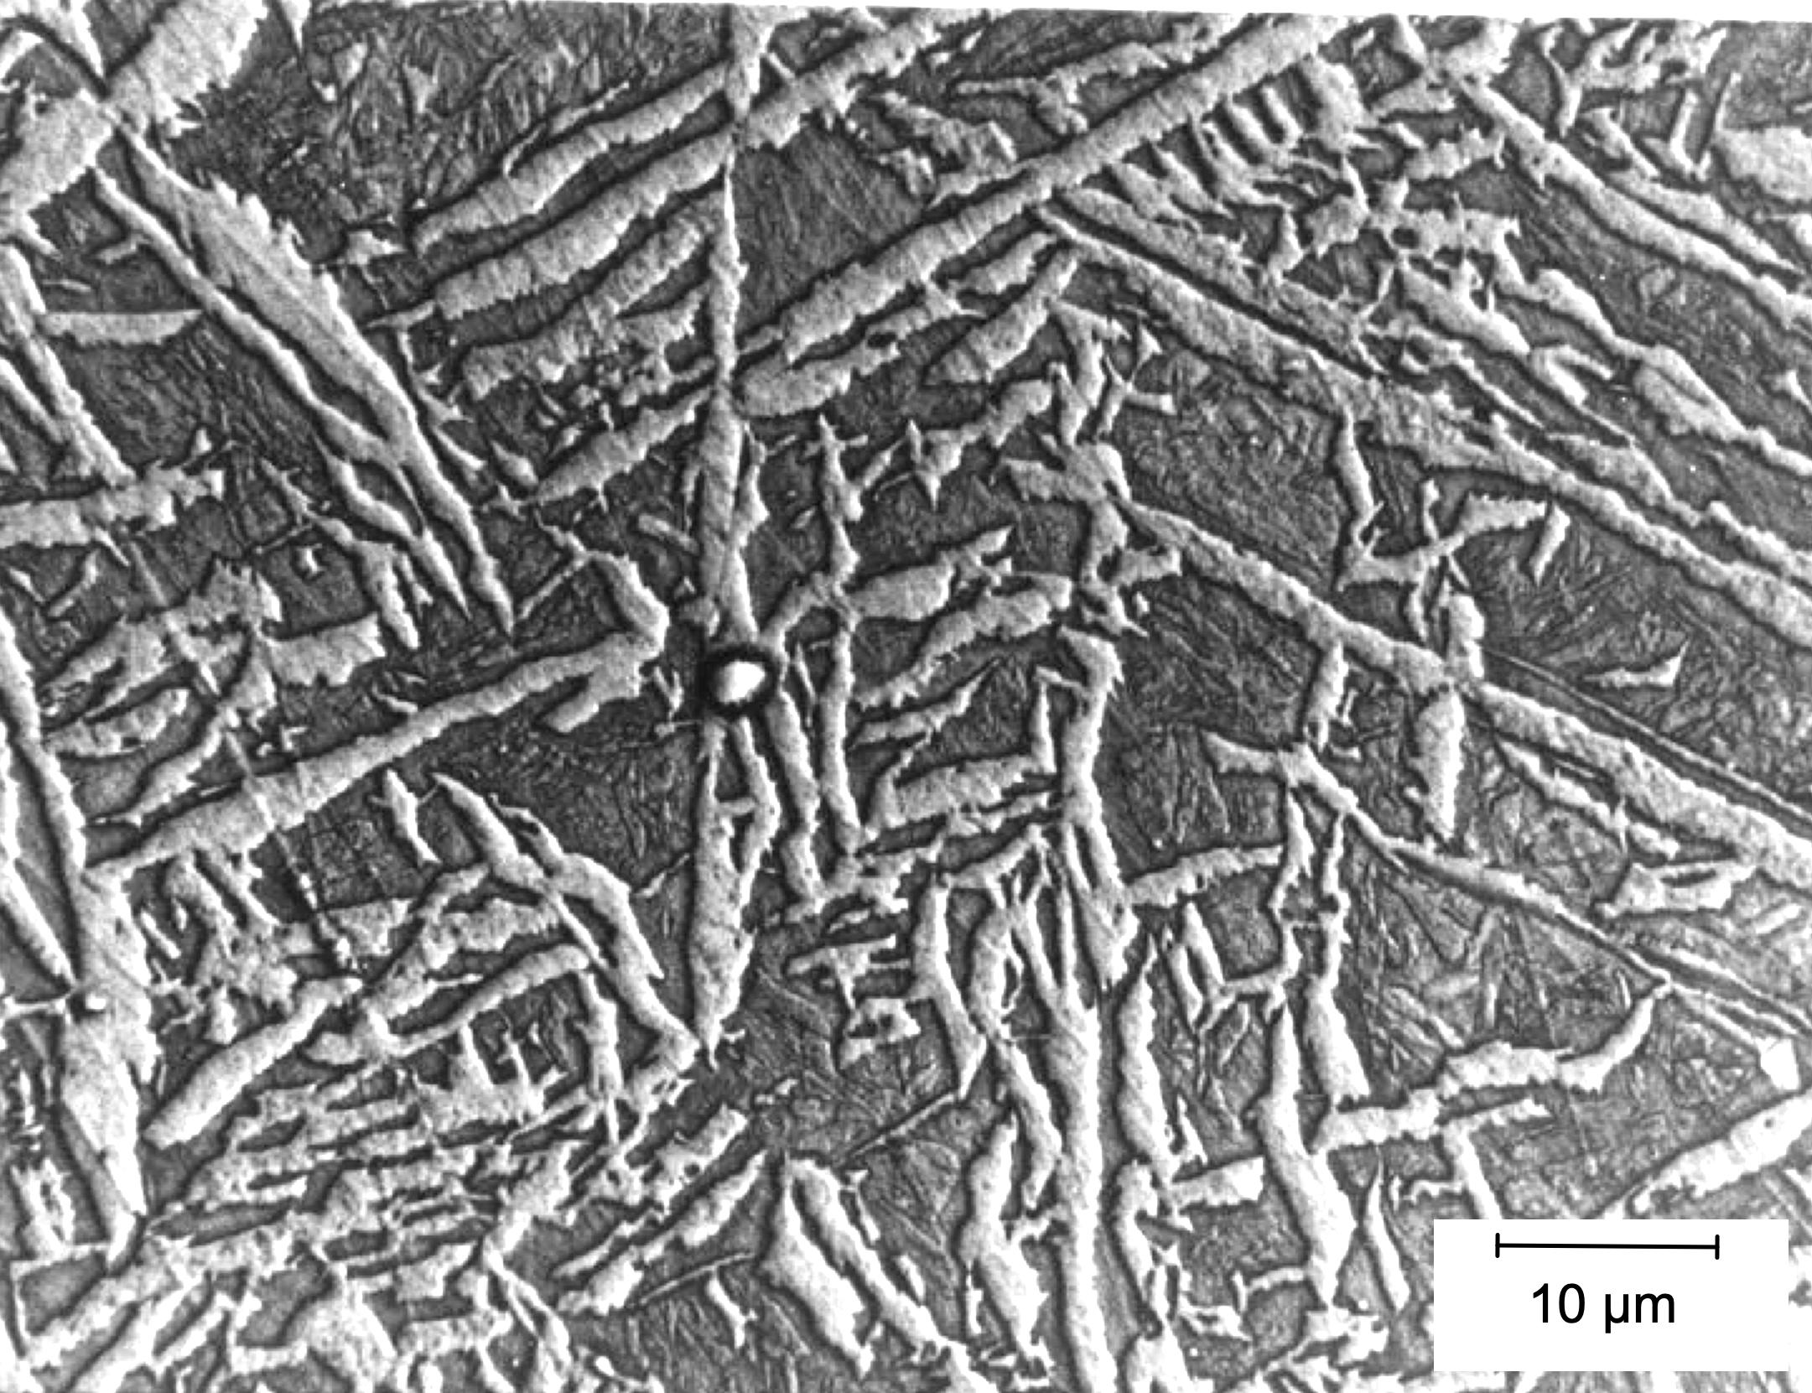




Atomic mechanism of the acicular ferrite transformation
www.phase-trans.msm.cam.ac.uk

Slide 2
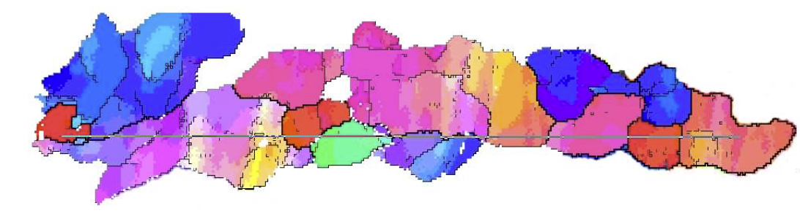
Crystallographic grain size
cleavage facet corresponds to the distance between large-misorientation boundaries that force crack deflection
Pickering FB: Proc. Symp. ‘Transformation and hardenability in steels’.
Ann Harbor, MI, February 1967, Climax Molybdenum Co. and The University of Michigan, 109–129.
cleavage facet corresponds to crystallographic grain size
Gourgues A.-F., Flower HM, Lindley TC. Electron backscattering diffraction study of acicular ferrite, bainite, and martensite steel microstructures. Materials Science and Technology. 2000;16:26-40.

Slide 3
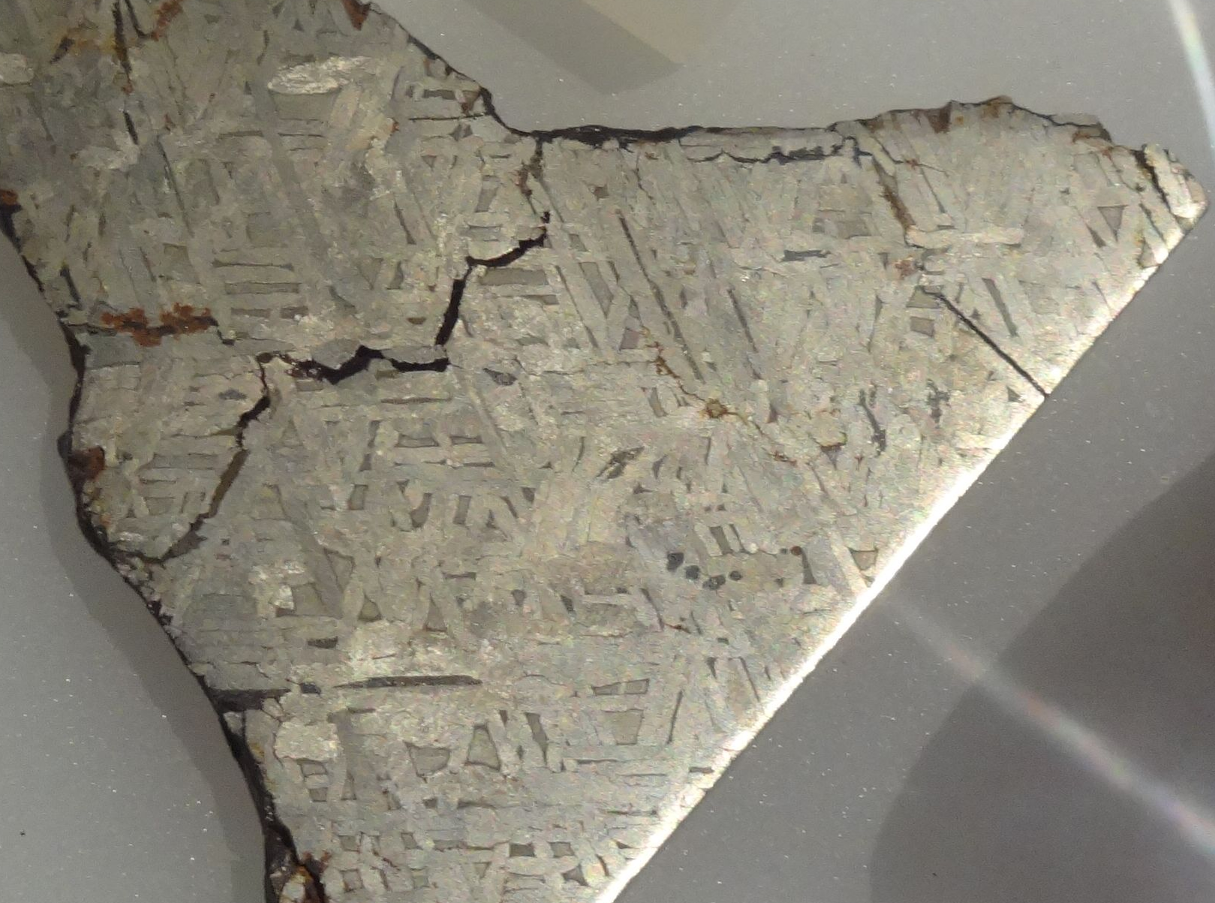
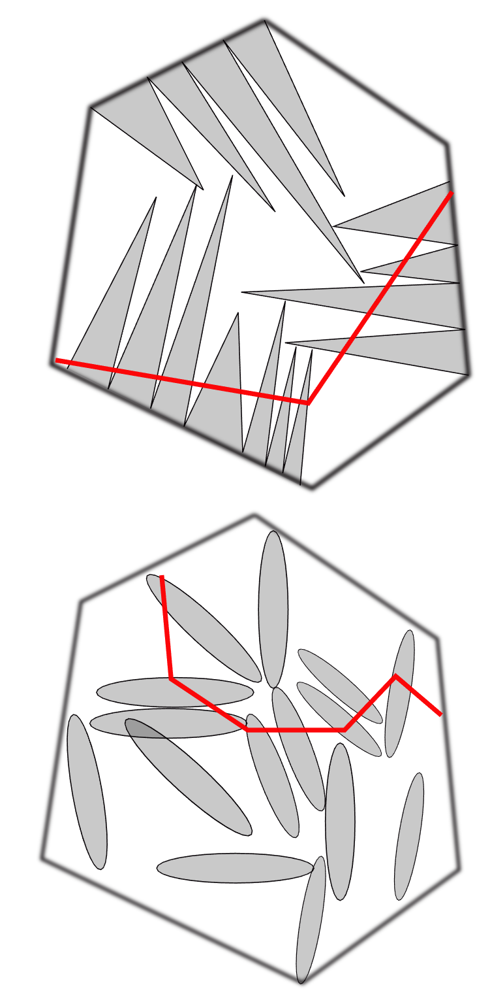
Crystallographic grain size

Slide 4
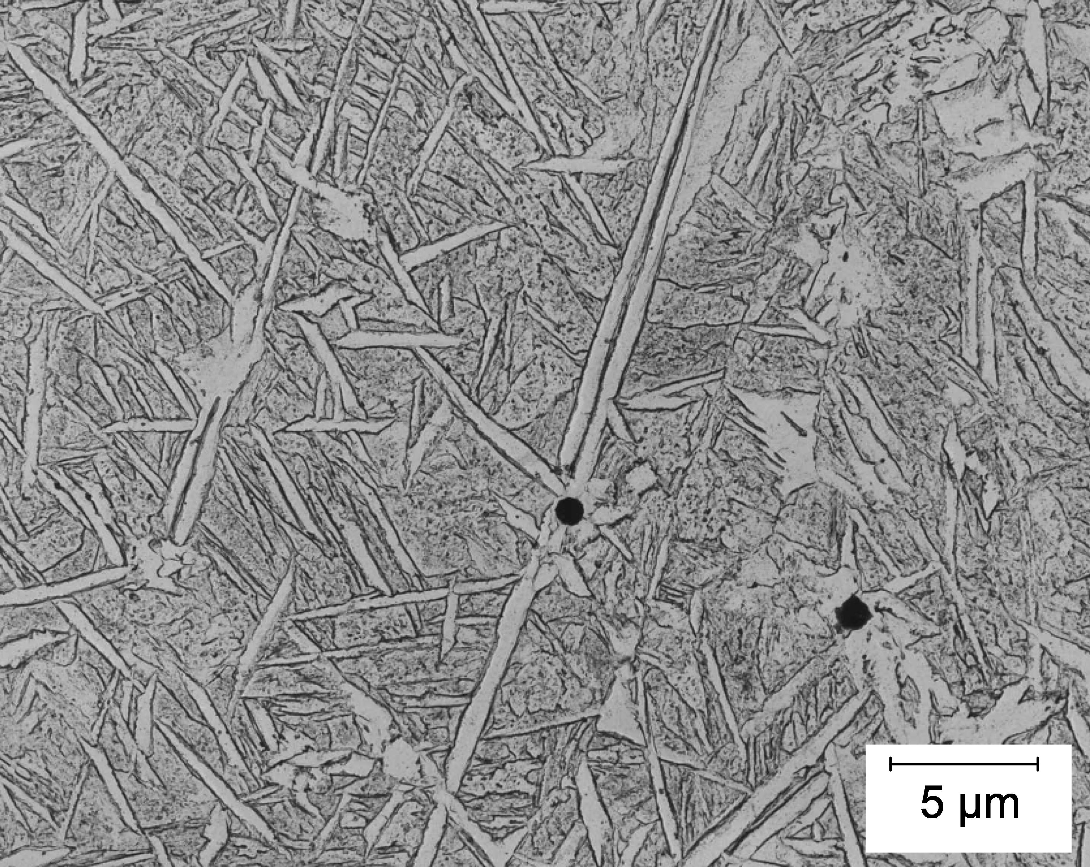
Image courtesy of Graeme Barritte

Slide 5
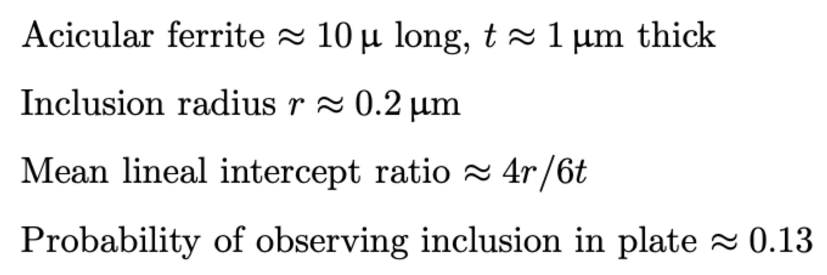
Bhadeshia, Bainite in Steels 3rd edition, p. 271

Slide 6
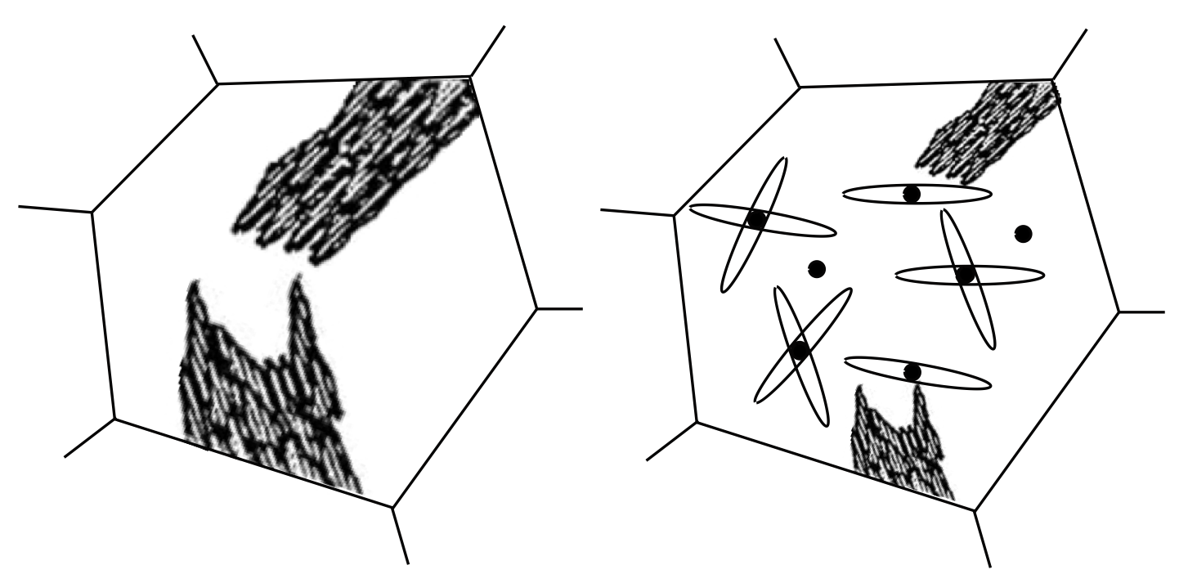
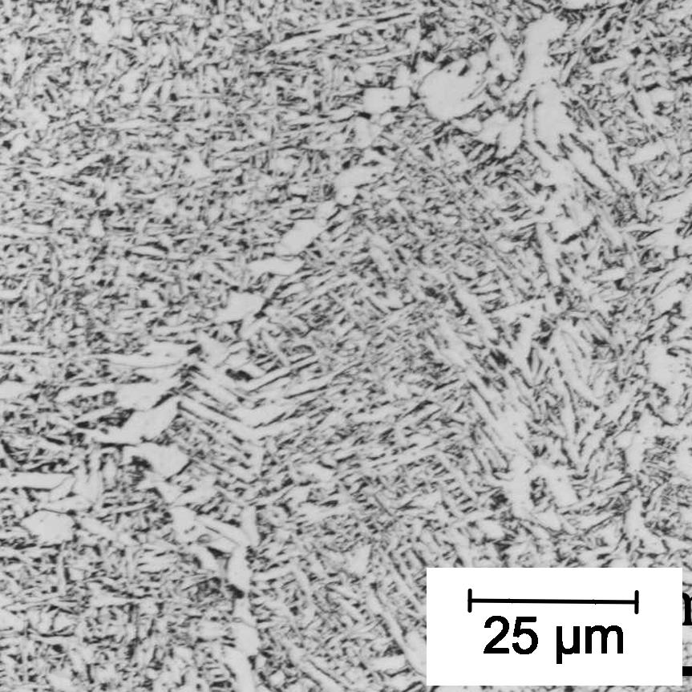
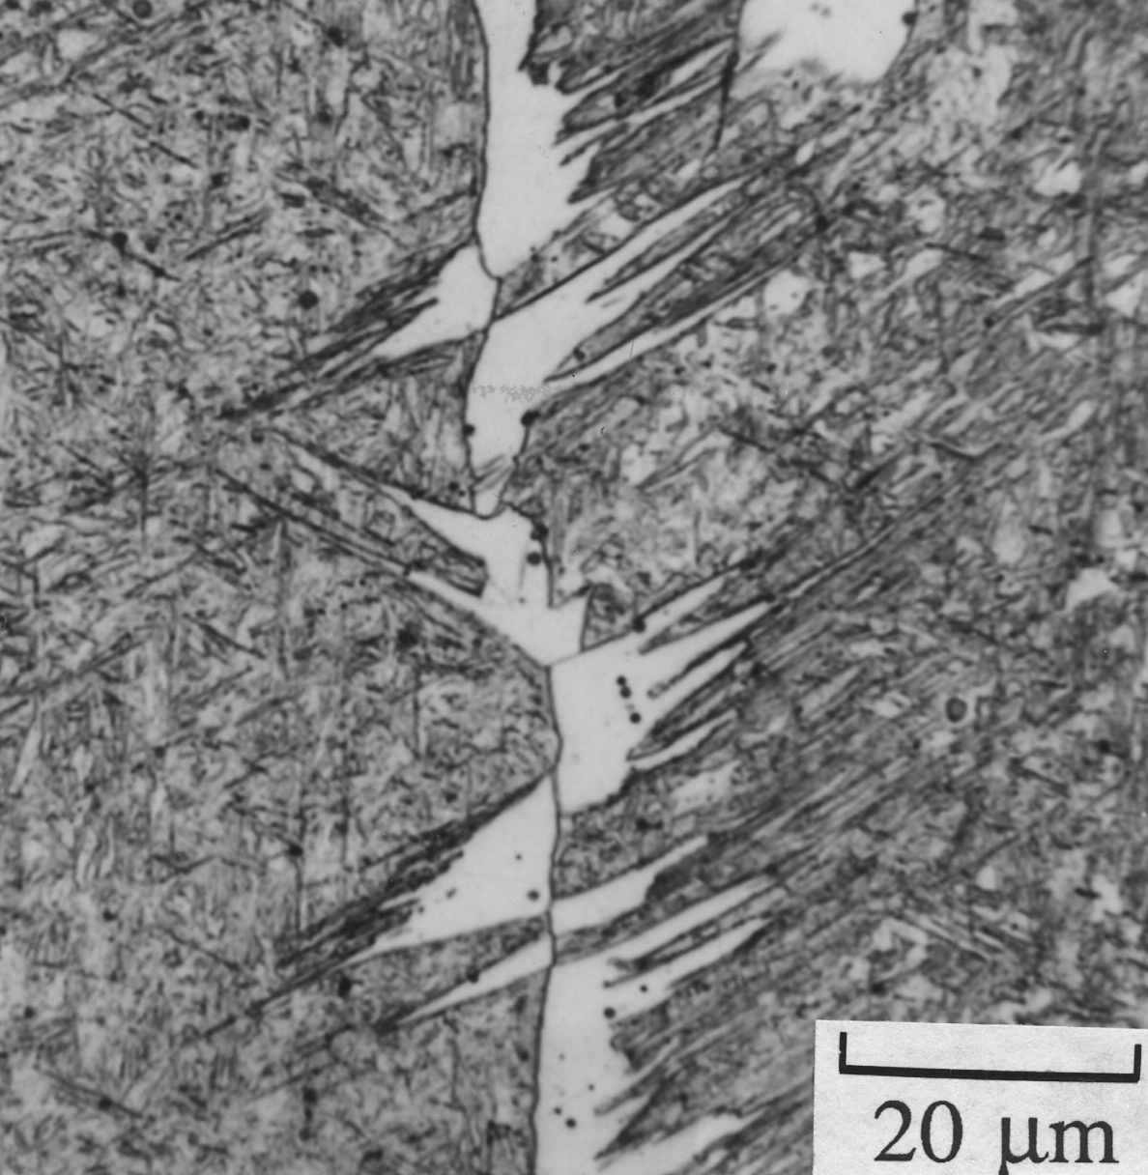
role of inclusions

Slide 7
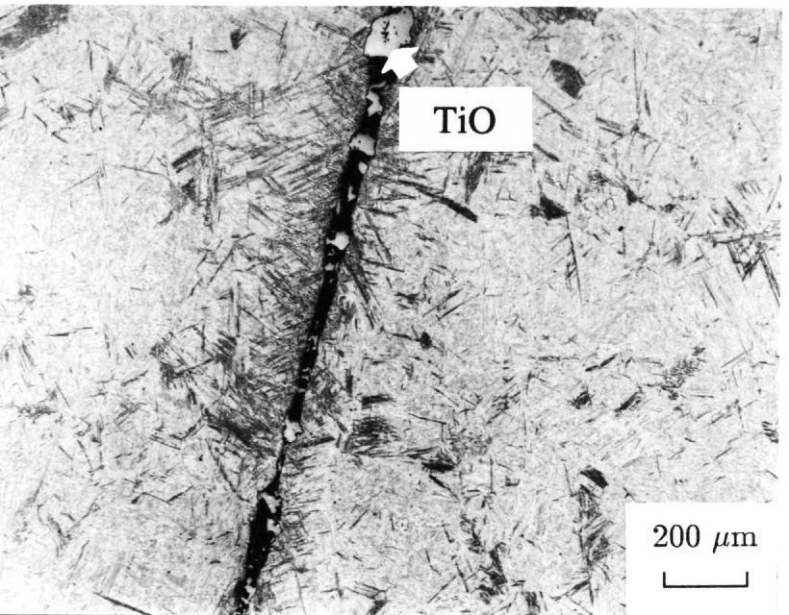
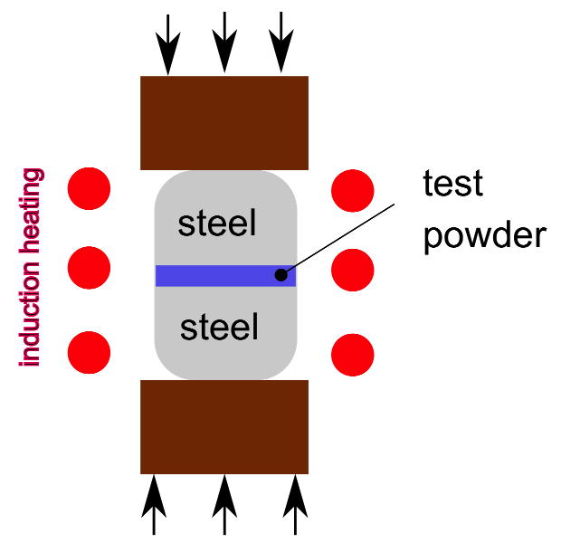
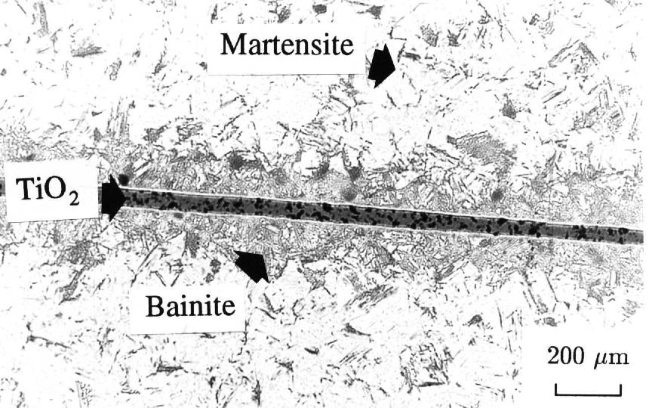
Testing minerals: the method
Gregg JM, Bhadeshia HKDH. Bainite nucleation from mineral surfaces. Acta metallurgica et materialia. 1994 42:3321-30.

Slide 8
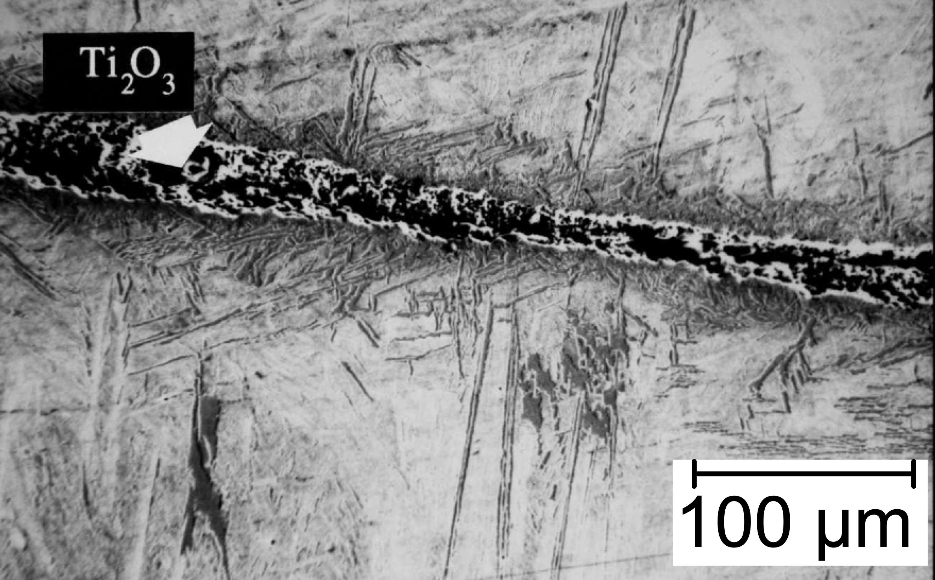
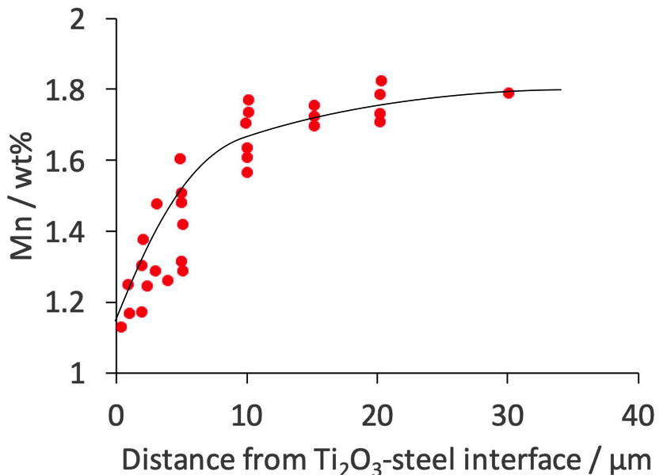

Slide 9
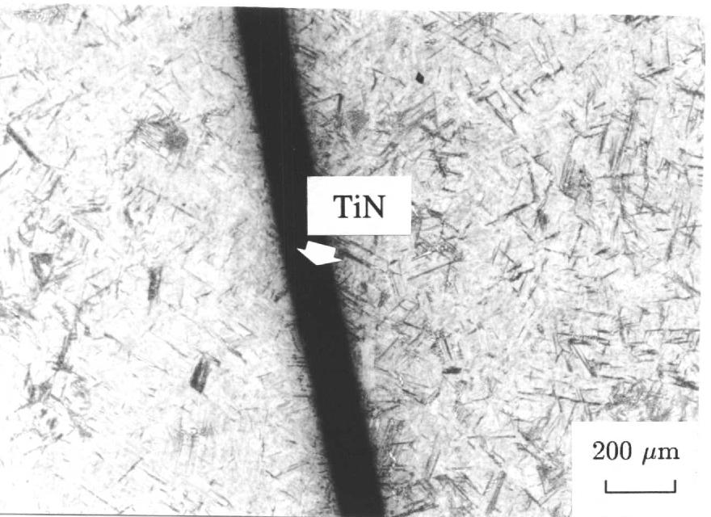

Slide 10
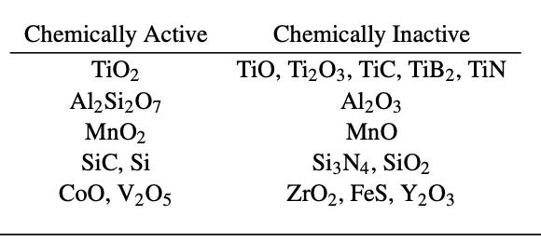

Slide 11
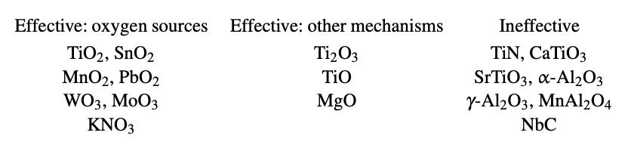

Slide 12
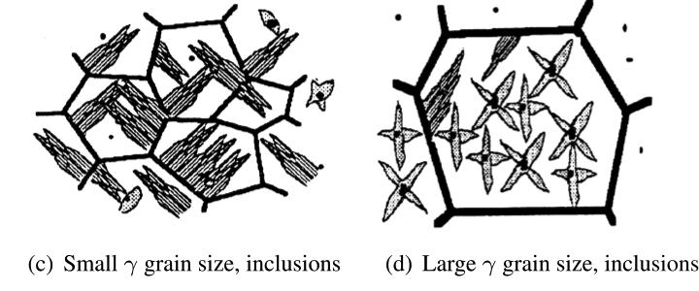
Competition between grain surface and inclusion nucleation
Sketches courtesy of Suresh S. Babu

Slide 13
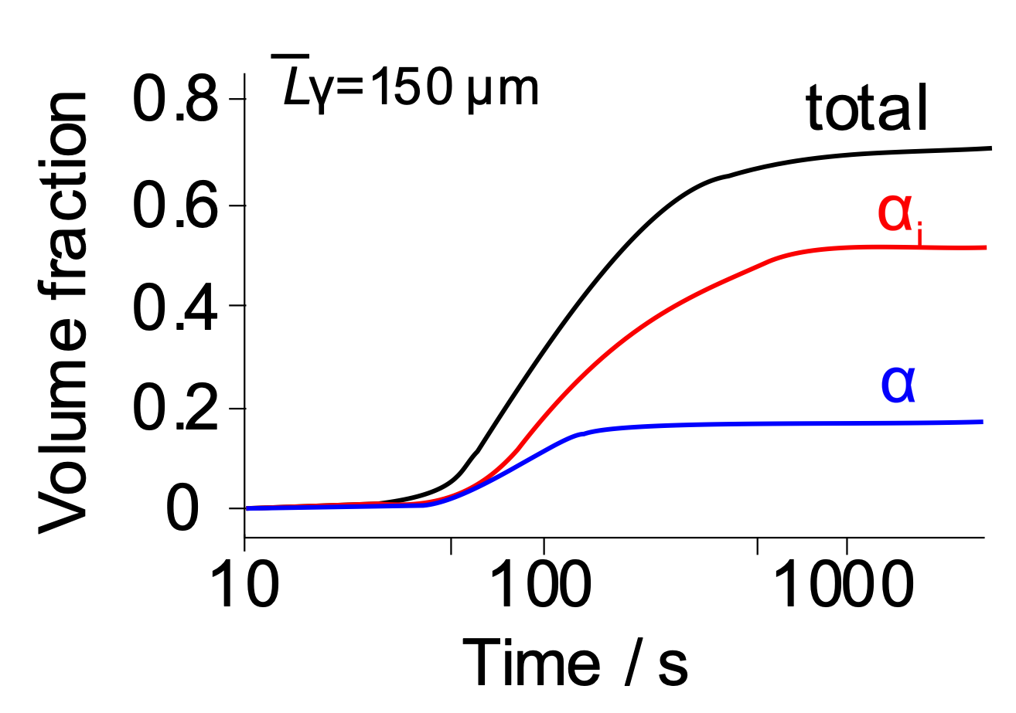
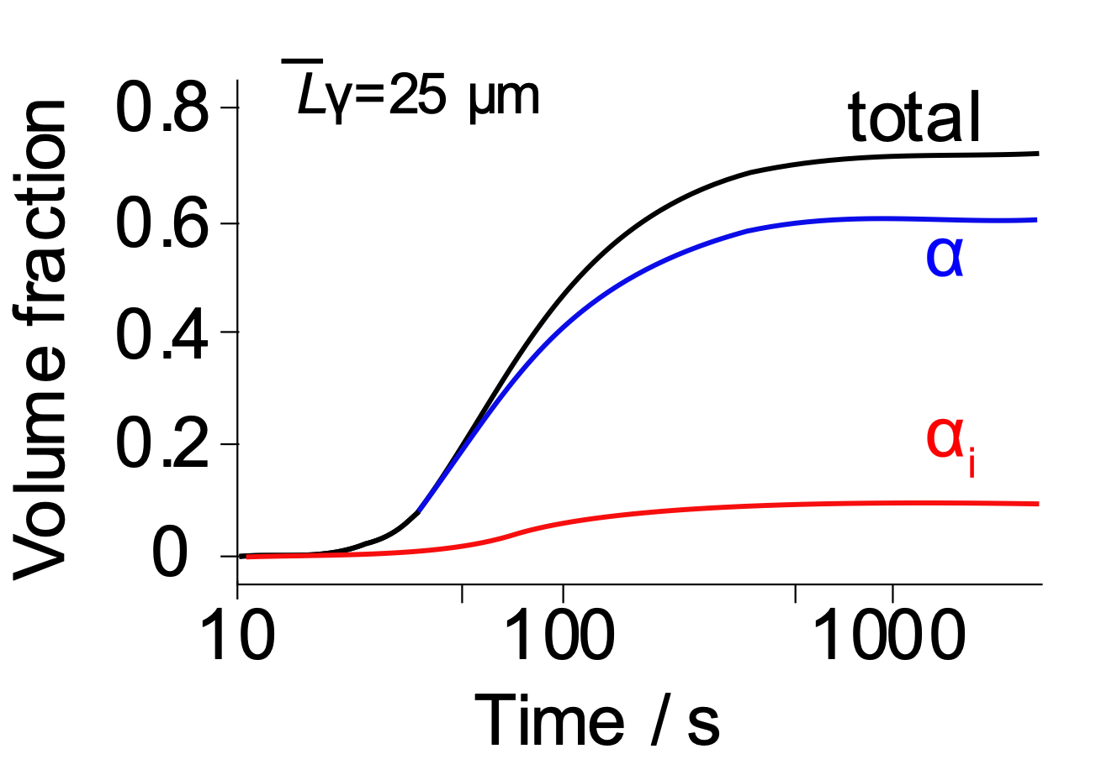
Jones, Bhadeshia
Metall. Mater. Trans. A
28 (1997) 2005-2103

Slide 14
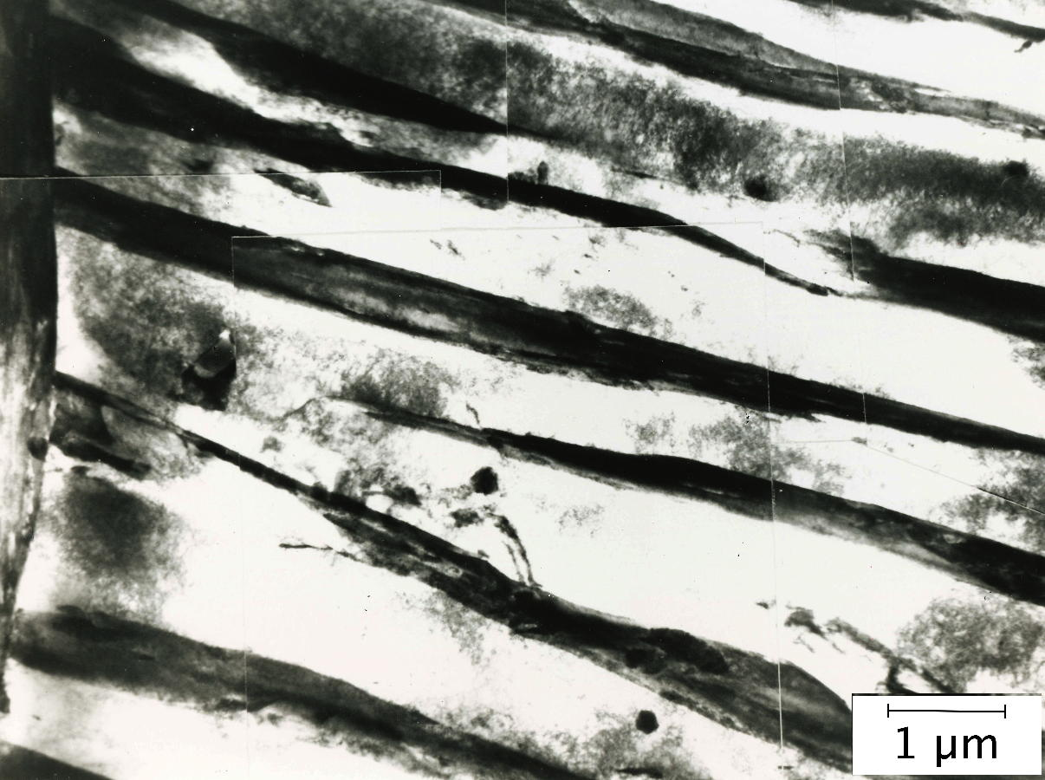
Austenitised at 950°C for 10 min, transformed isothermally at 460°C for 30 min.
Yang JR, Bhadeshia HKDH. Acicular ferrite transformation in alloy-steel weld metals. Journal of materials science. 1991 Feb;26(3):839-45.
Fe-0.06C-0.27Si-1.84Mn-2.48Ni-0.2Mo wt% + 399 ppmw of oxygen

Slide 15
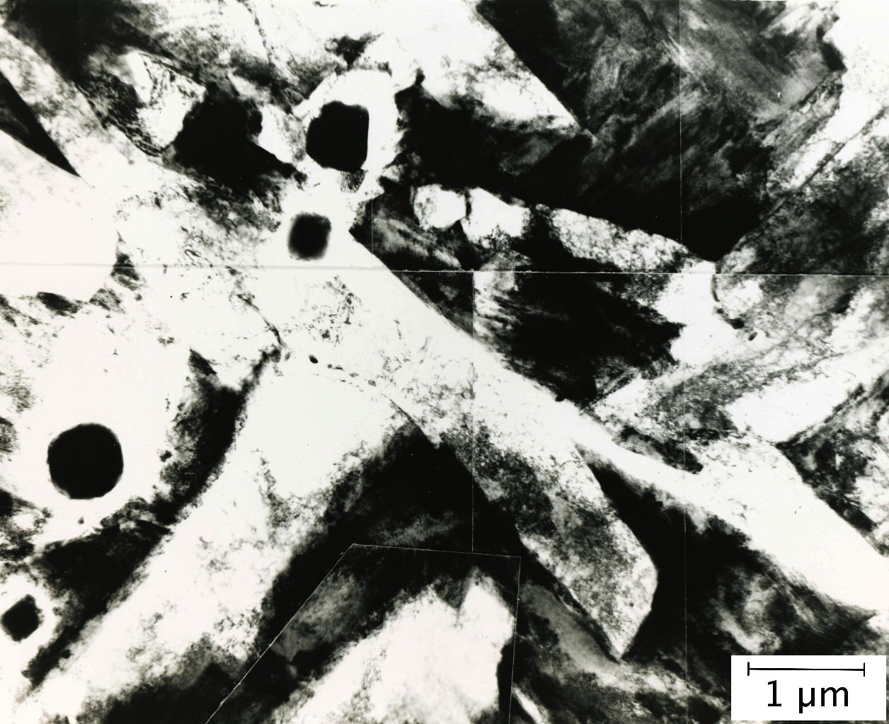
Austenitised at 1200°C for 10 min, transformed isothermally at 460°C for 30 min.
Yang JR, Bhadeshia HKDH. Acicular ferrite transformation in alloy-steel weld metals. Journal of materials science. 1991 Feb;26(3):839-45.
Fe-0.06C-0.27Si-1.84Mn-2.48Ni-0.2Mo wt% + 399 ppmw of oxygen

Slide 16
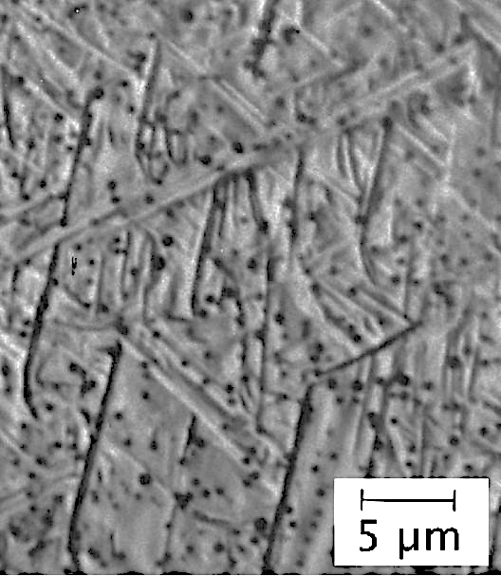
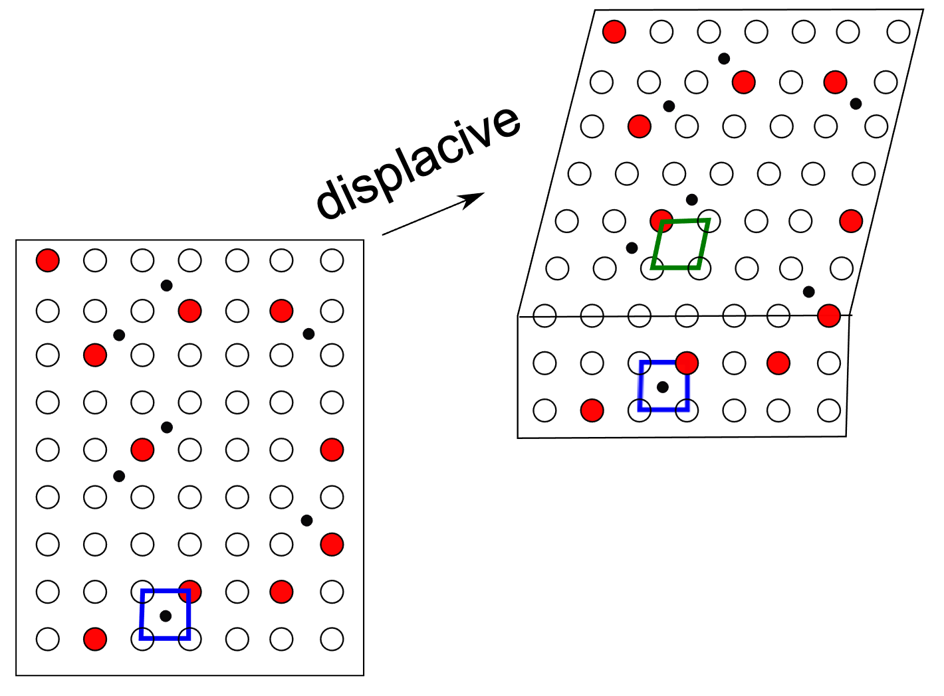
Micrograph courtesy of
Martin Strangwood

Slide 17
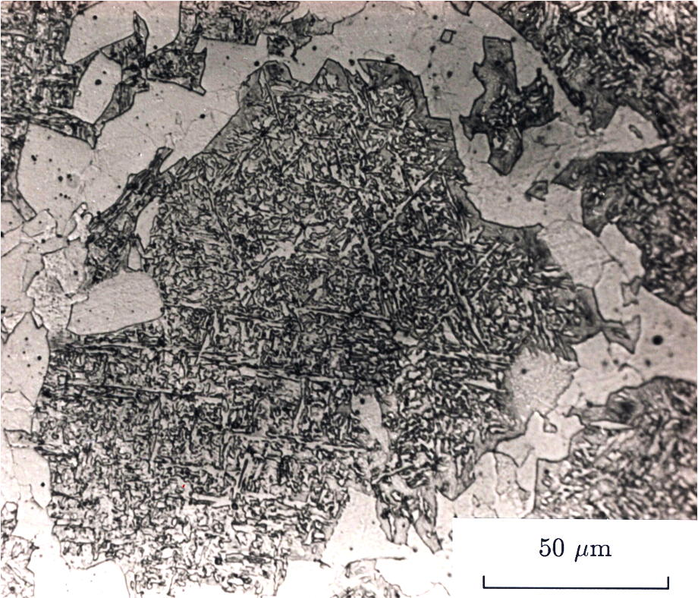
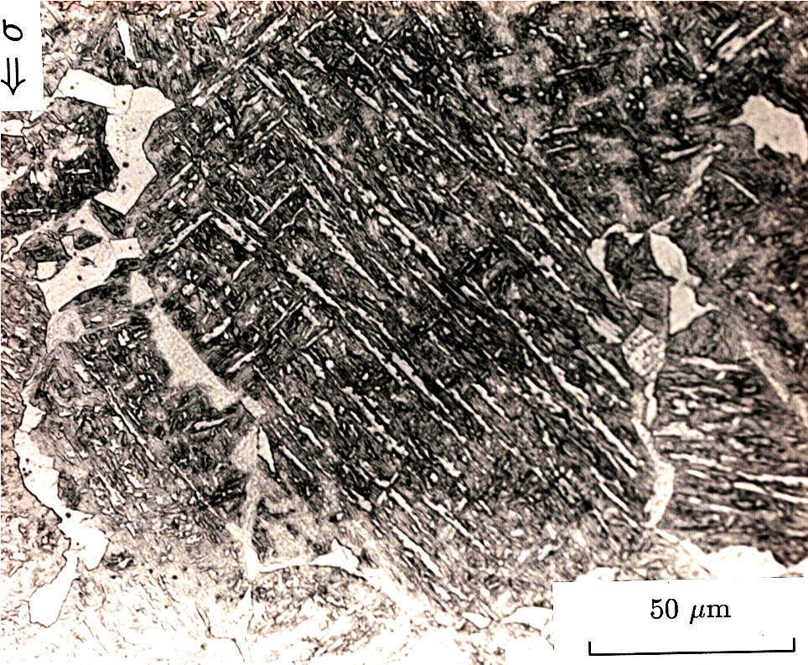
Stress affected transformation
Babu SS, Bhadeshia HKDH. Stress and the acicular ferrite transformation. Mat. Sci. and Engineering: A. 1992 156:1-9.

Slide 18
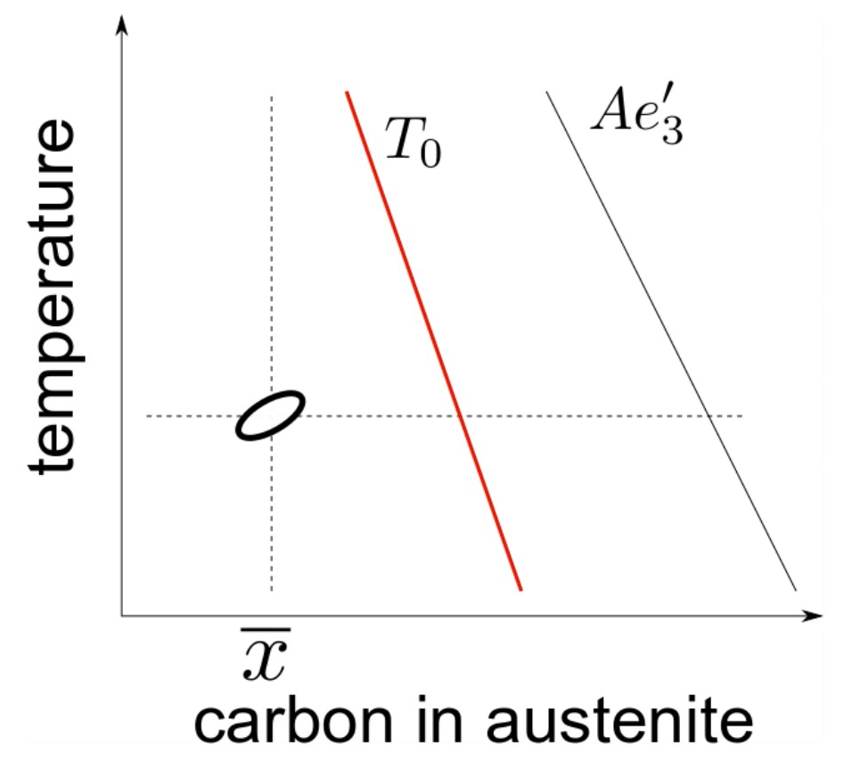

Slide 19
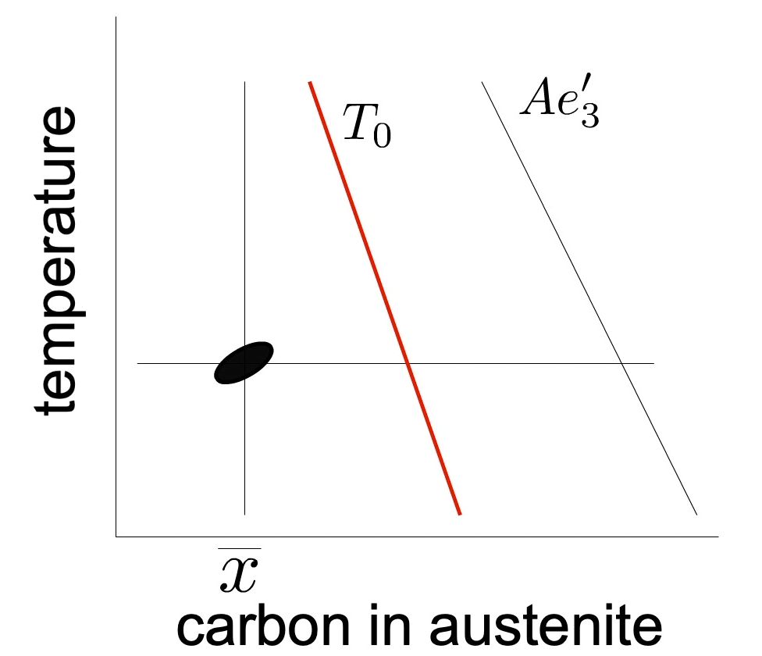
Growth is diffusionless
but plate decarburised shortly afterwards

Slide 20
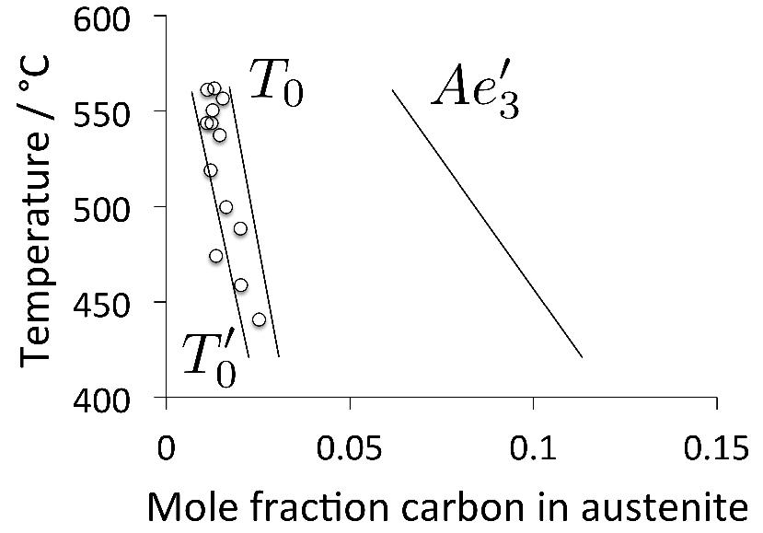
Strangwood M, Bhadeshia HK. The mechanism of acicular ferrite formation in steel weld deposits. ASM INTERNATIONAL,. 1986:209-13.

Slide 21
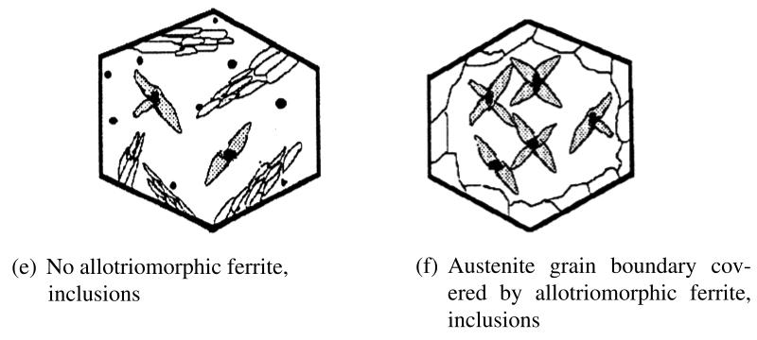
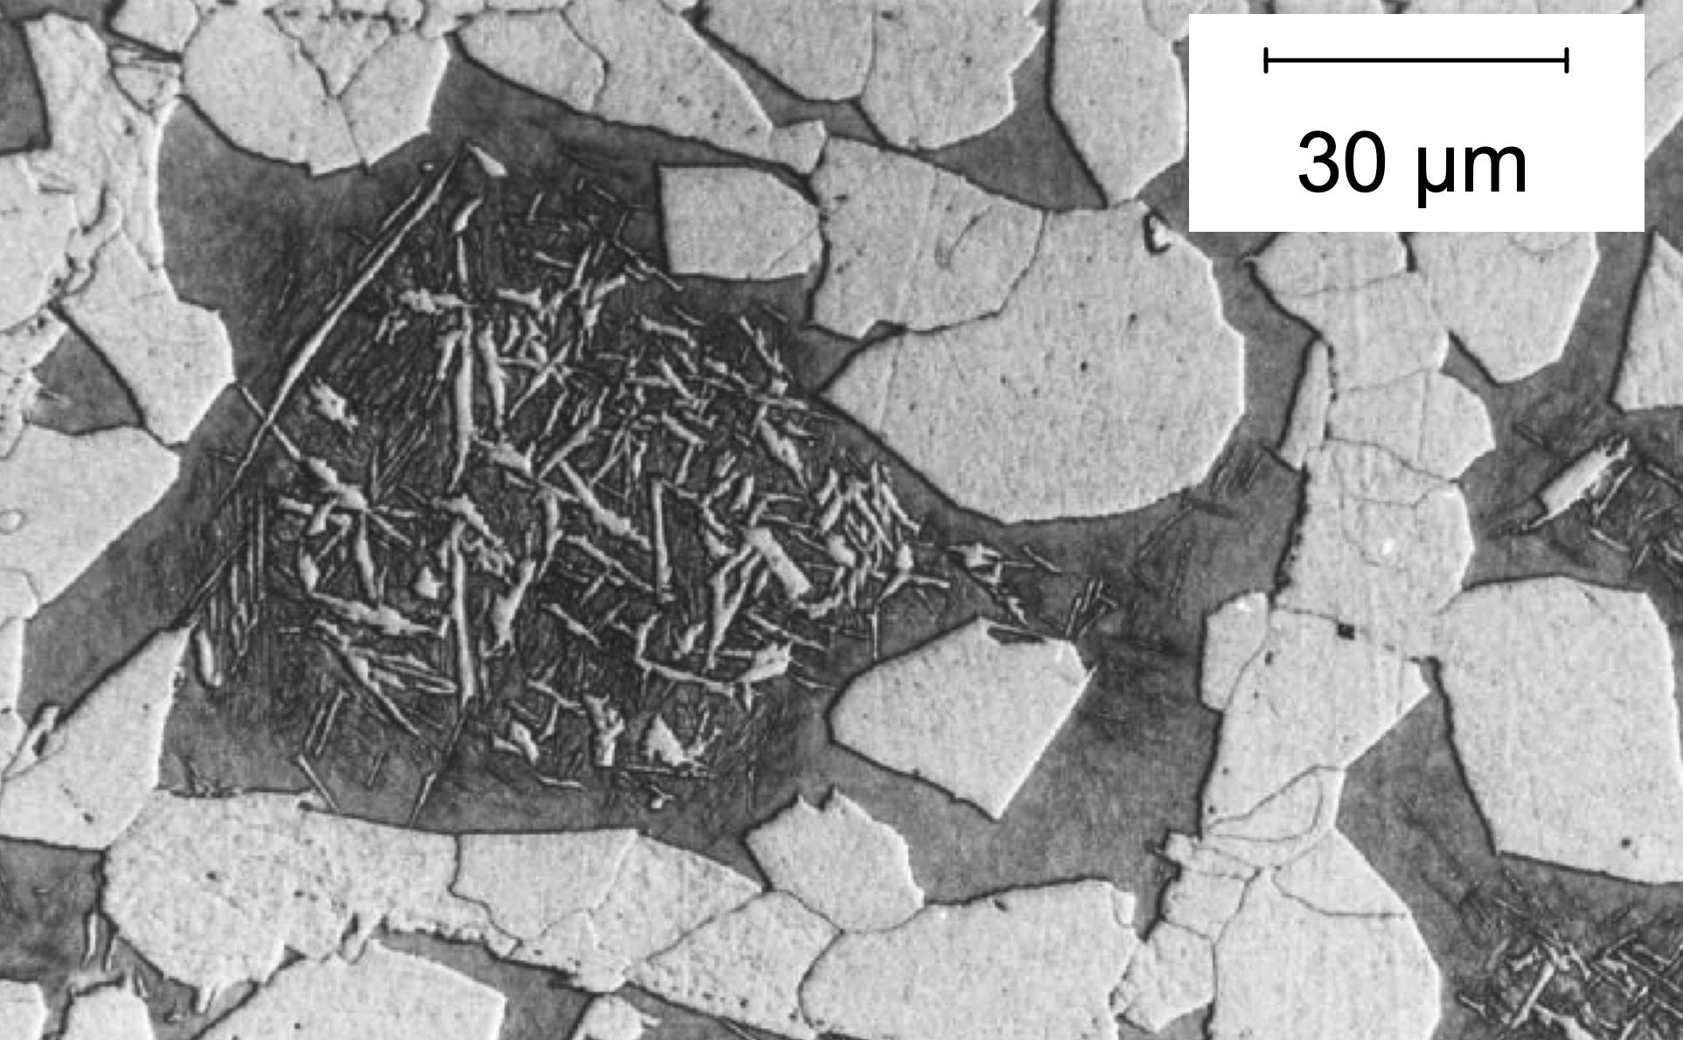

Slide 22
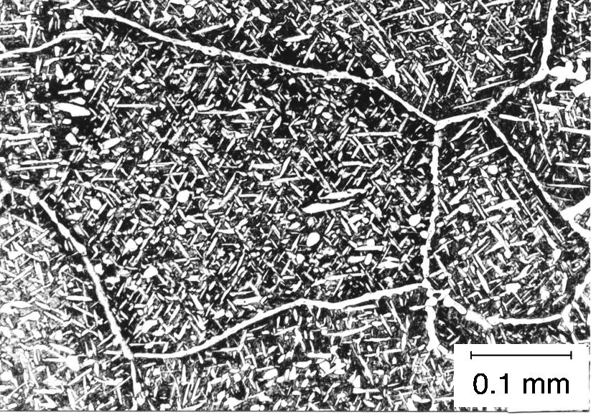
Ali, Bhadeshia
Materials Science & Techn.
6 (1990) 781-784

Slide 23
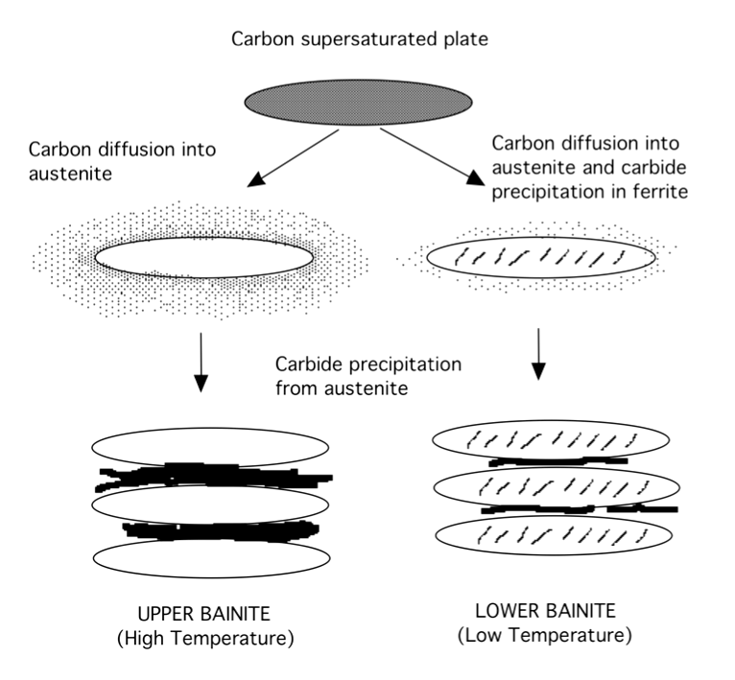
quantitative theory for the transition
from upper to lower bainite

Slide 24
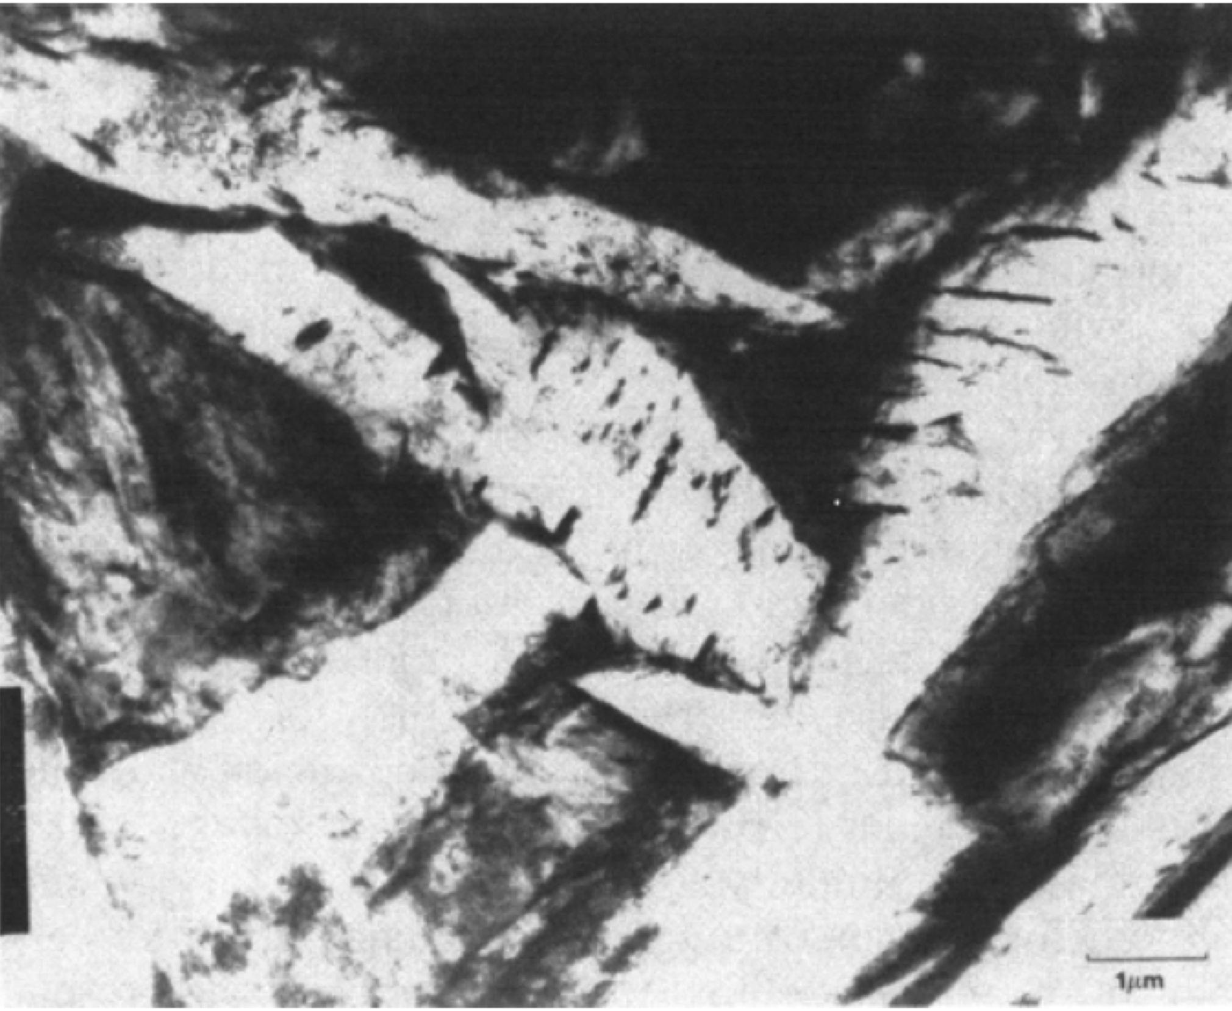
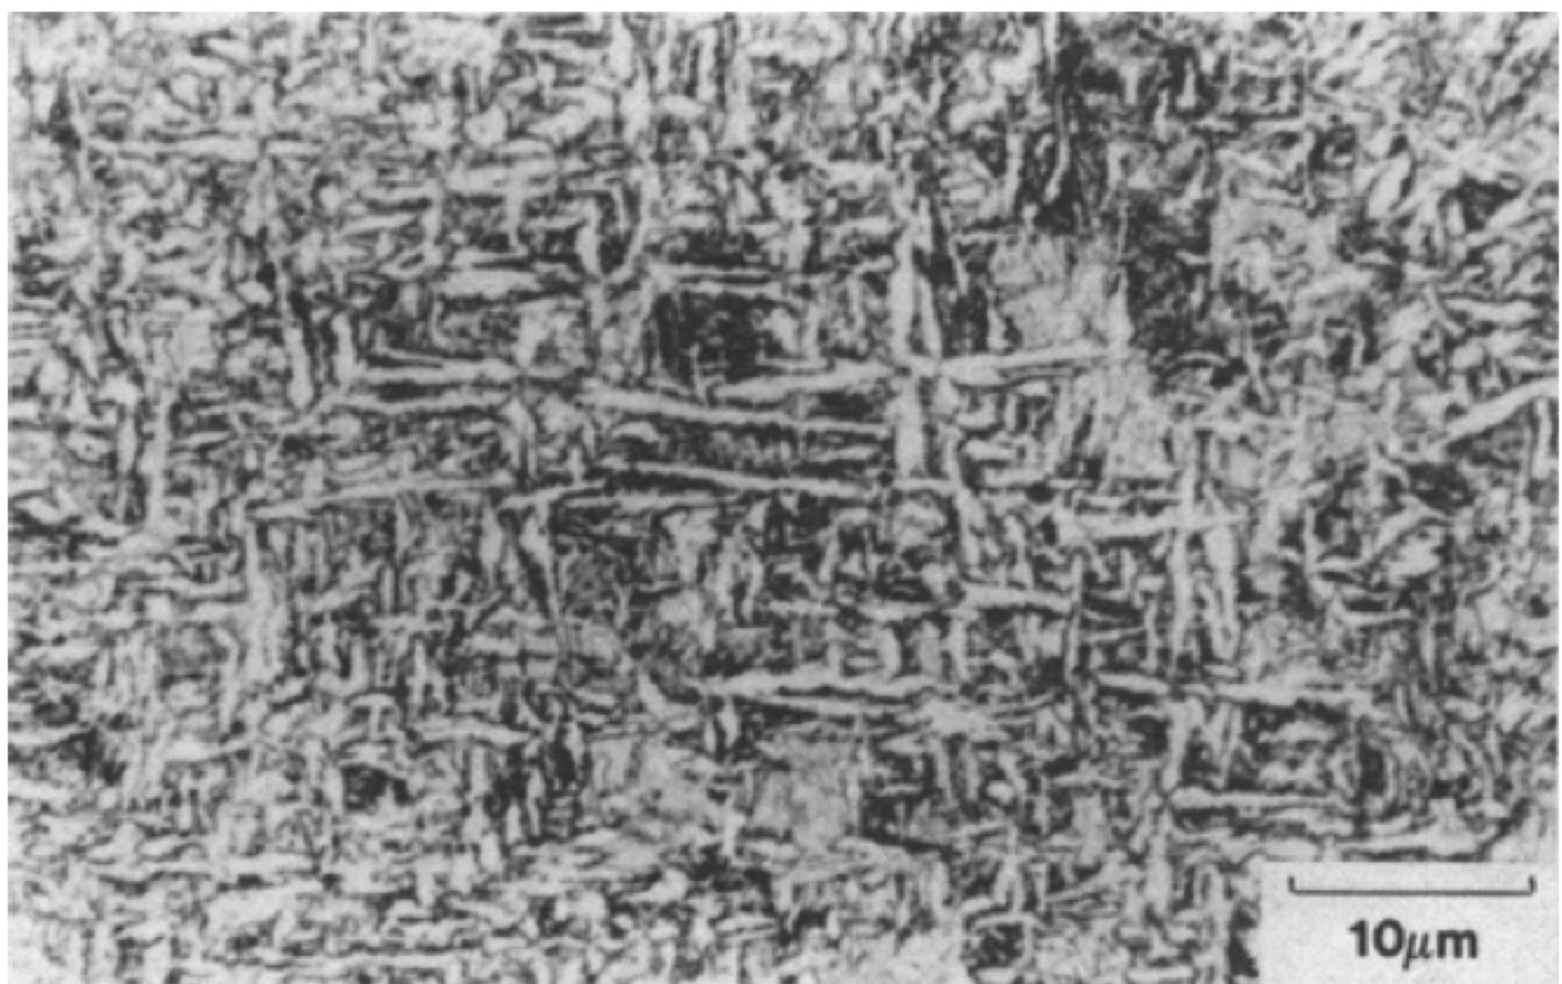
Lower acicular ferrite
Sugden AA, Bhadeshia HKDH. Lower acicular ferrite. Metallurgical Transactions A. 1989 20:1811-8.

Slide 25
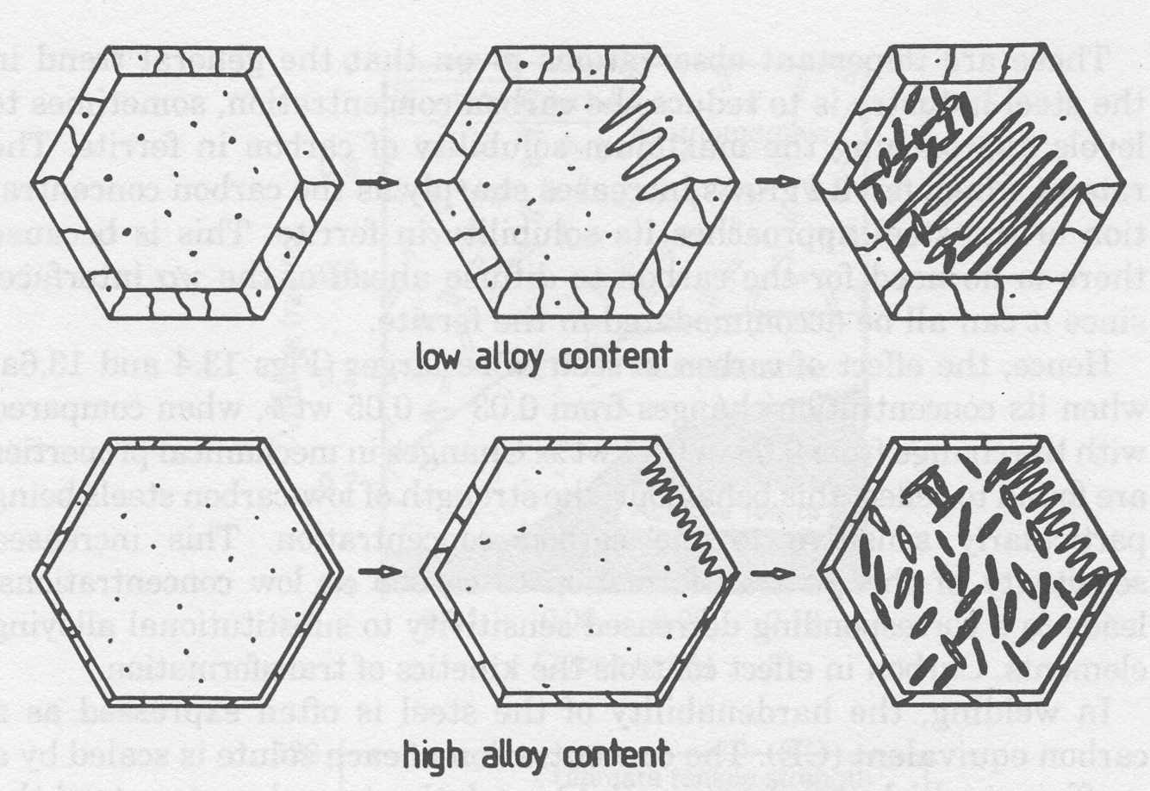

Slide 26
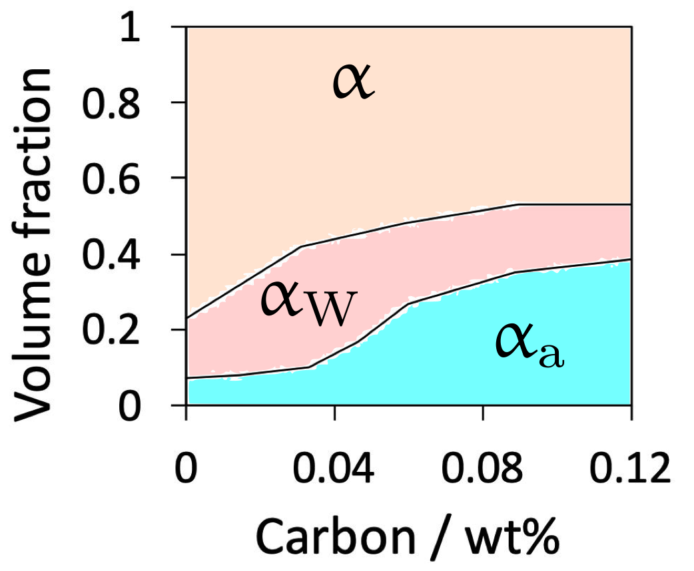
Acta Metallurgica, Vol. 33, 1985, pp. 1271-1283
H.K.D.H. Bhadeshia, L.-E. Svensson and B. Gretoft

