Slide 1



Steels: martensite
Lecture 1
Fabio Miani
Harry Bhadeshia
Professor of Metallurgy
Queen Mary University of London
Emeritus Tata Steel Professor of Metallurgy
University of Cambridge
2022

Slide 2
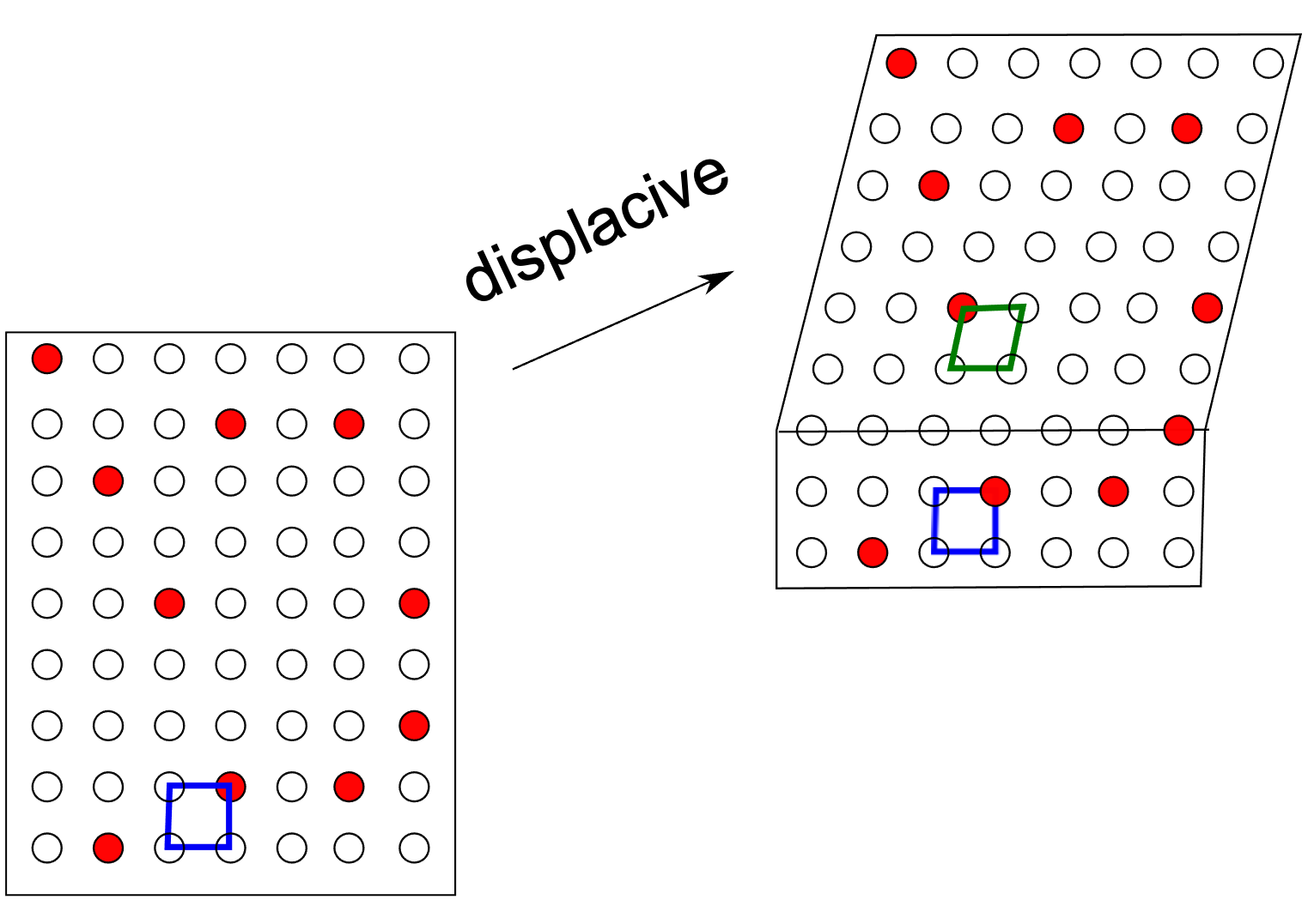
Low atomic mobilities

Slide 3
Low atomic mobilities: diffusionless growth

Slide 4
Two reasons for diffusionless
transformation:
.... small diffusion coefficient
.... large driving force
but far from equilibrium
... huge strain energy
... solute trapping

Slide 5
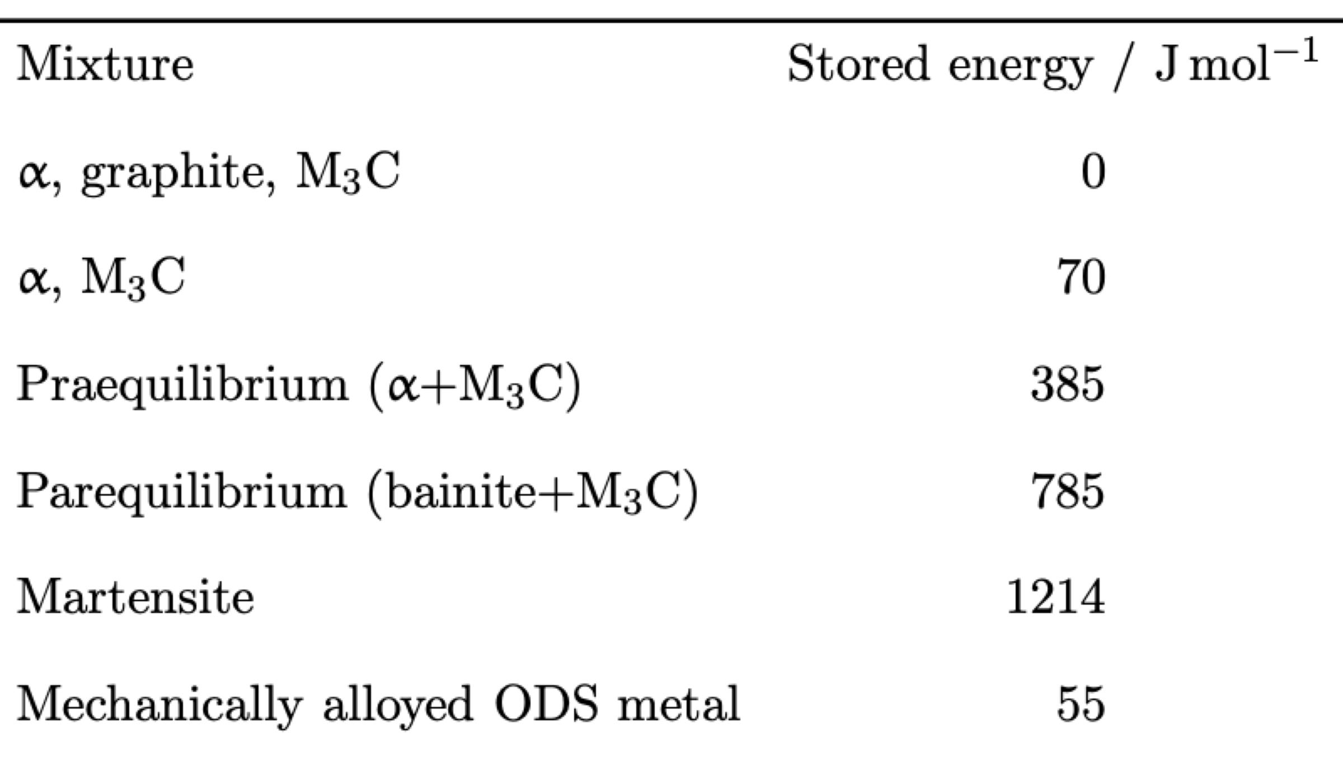
Fe-0.2C-1.5Mn wt%, 300 K
Bhadeshia HKDH, Alternatives to the ferrite-pearlite microstructures
Materials Science Forum 284 (1998) 39-50.

Slide 6
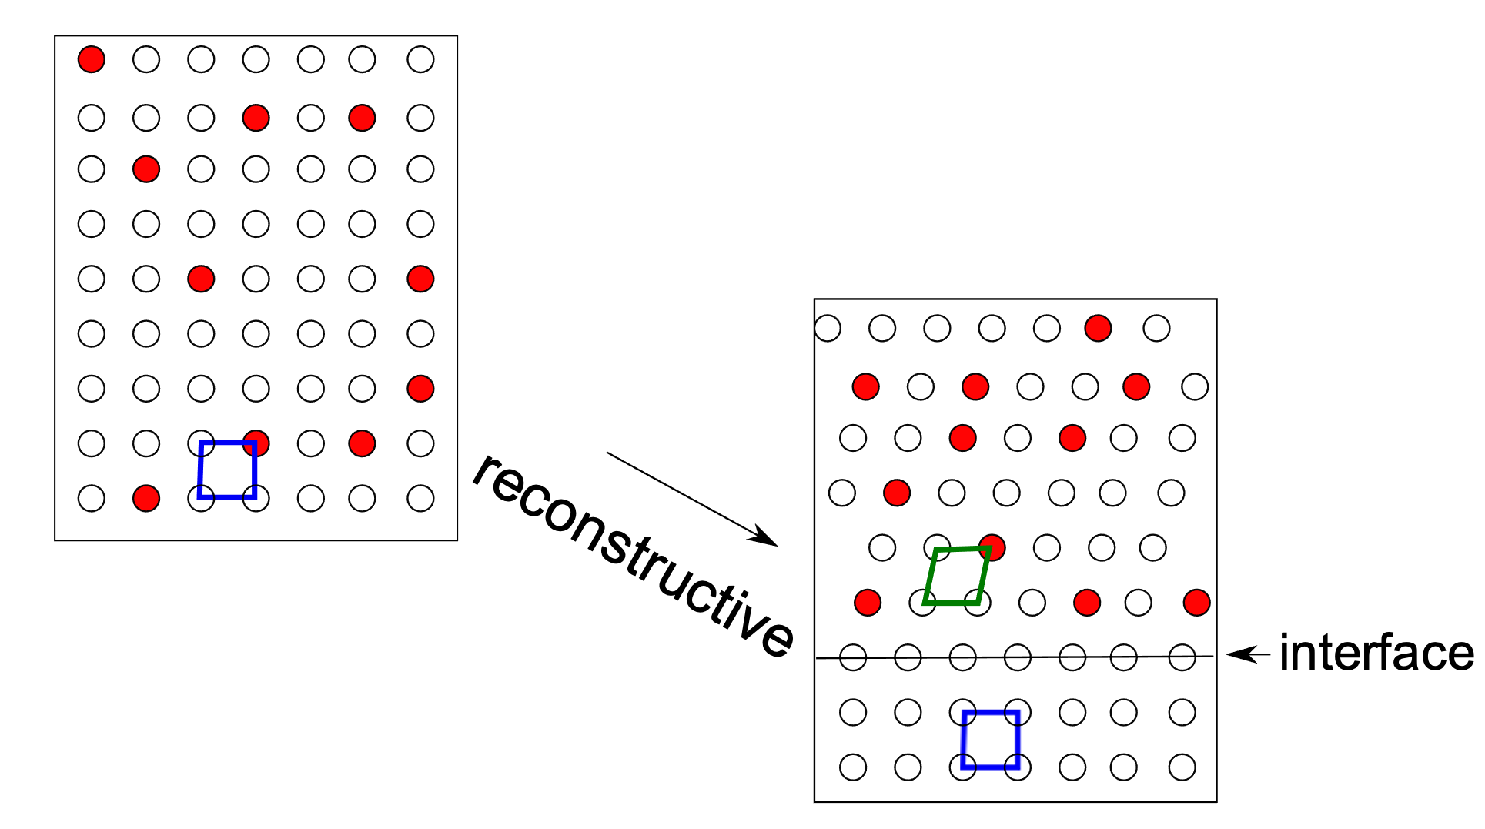
Diffusion over length
scale of product

Slide 7
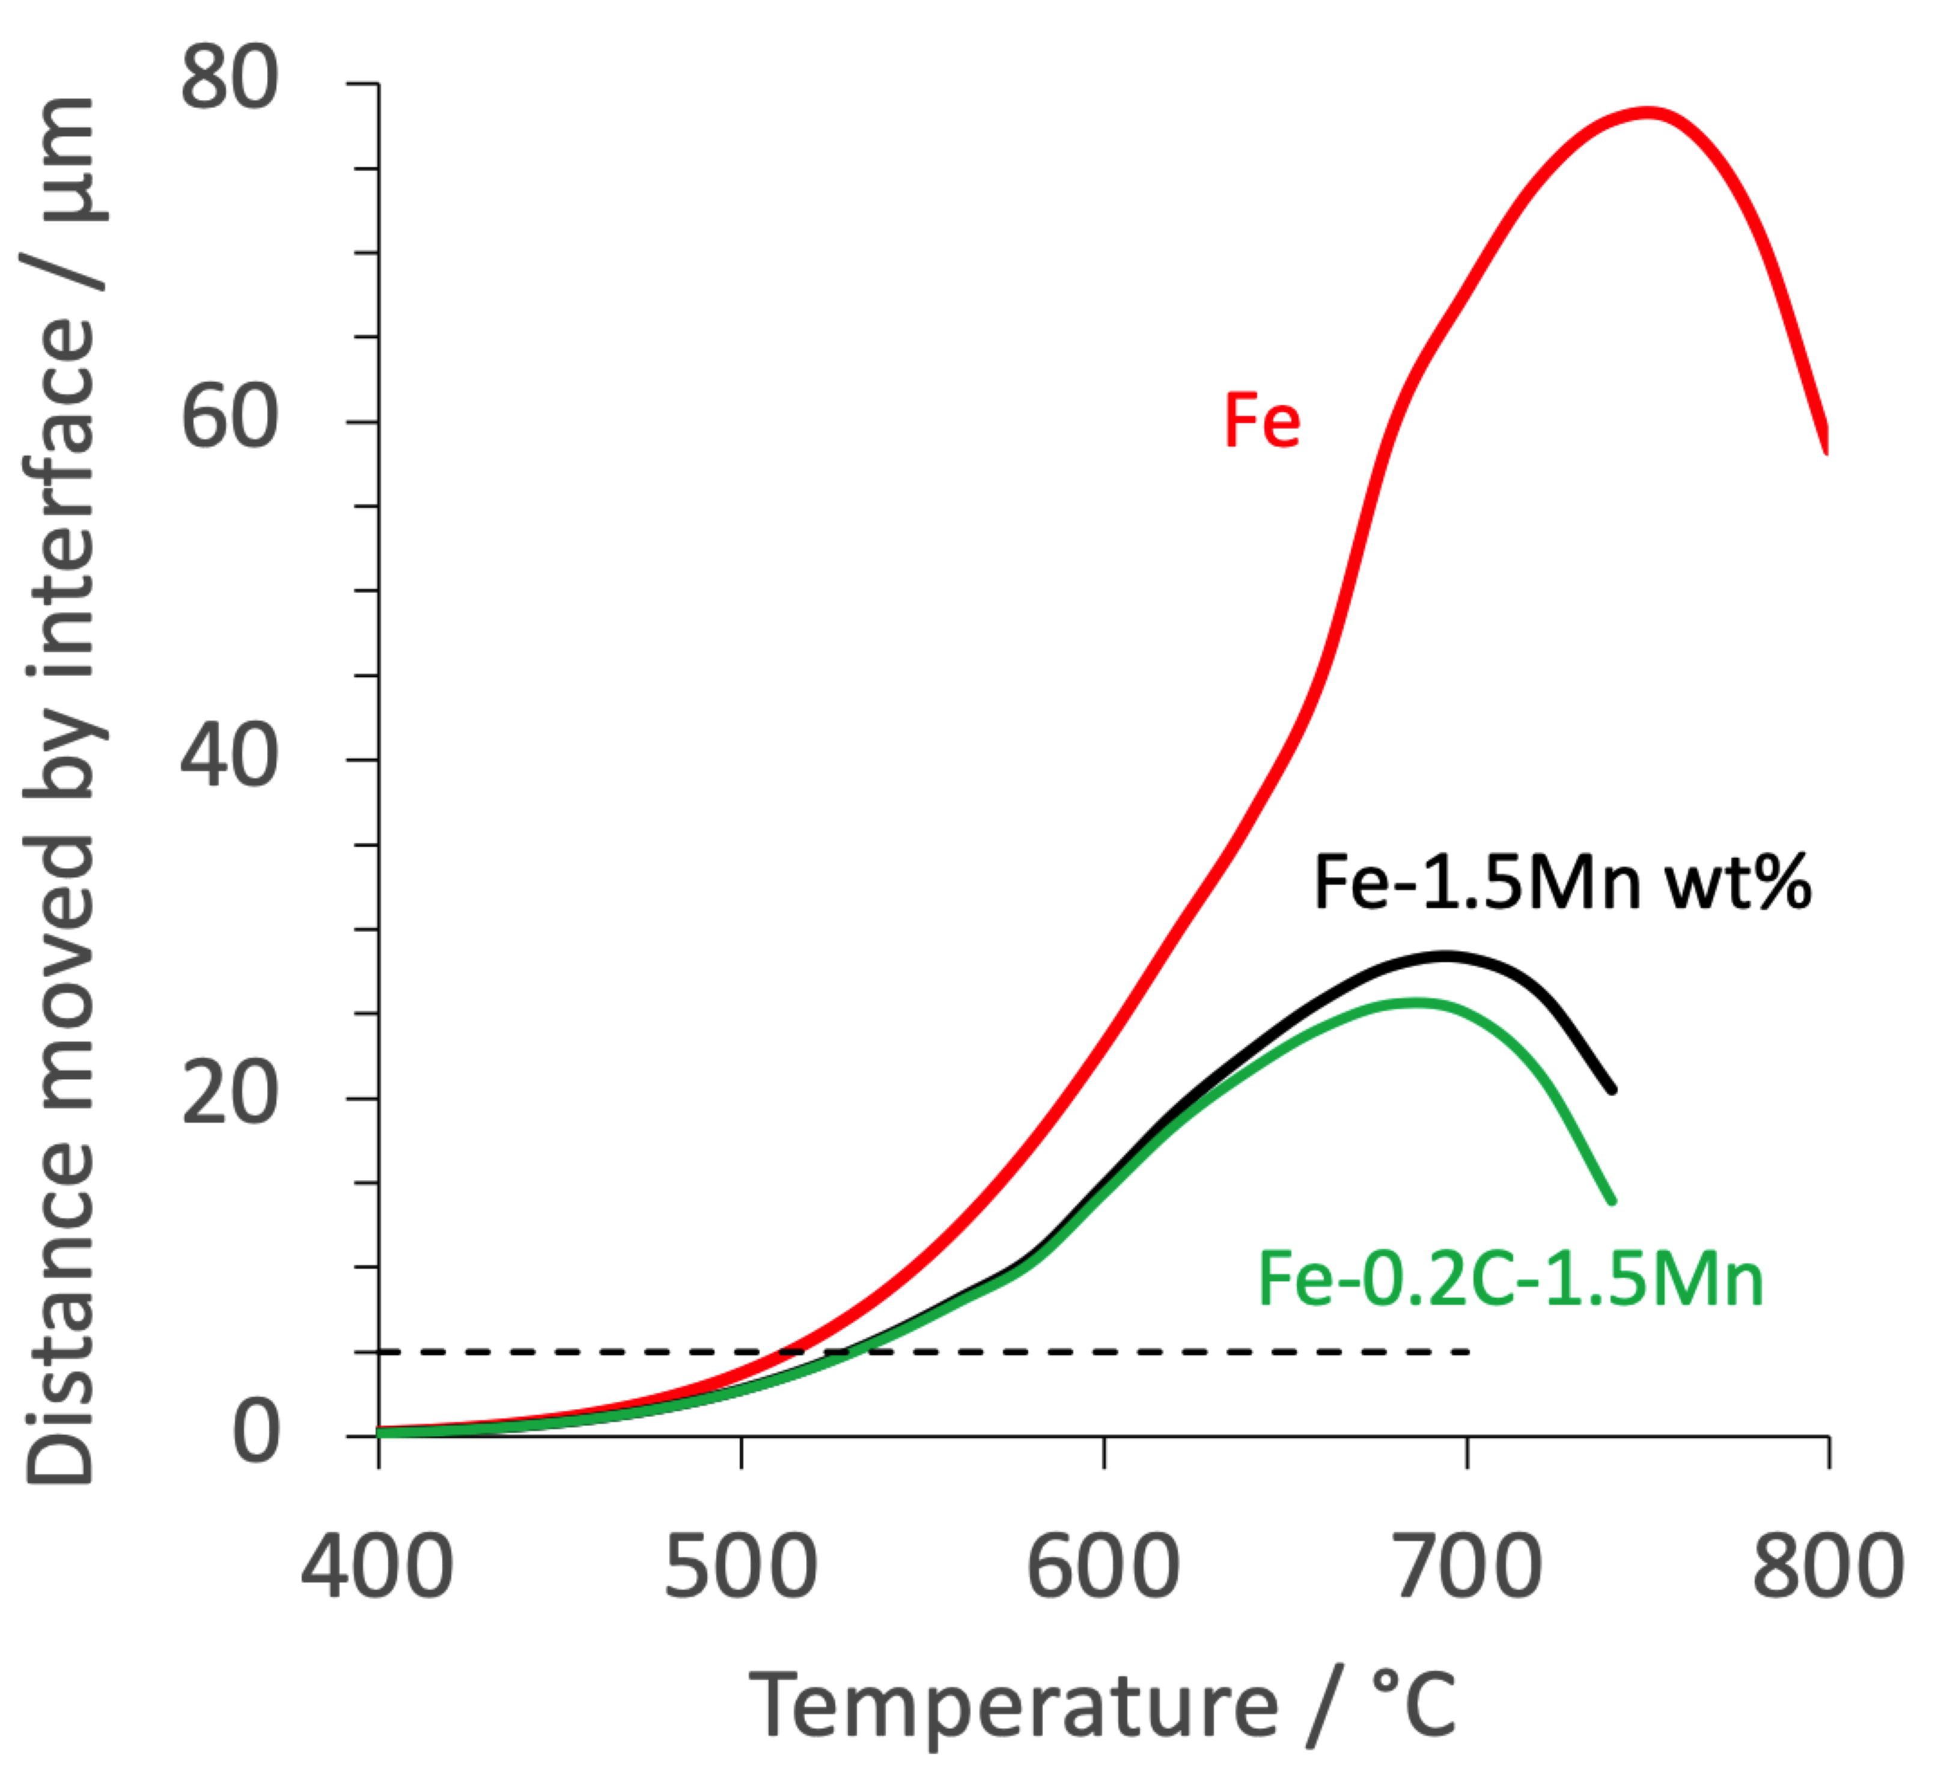

Slide 8
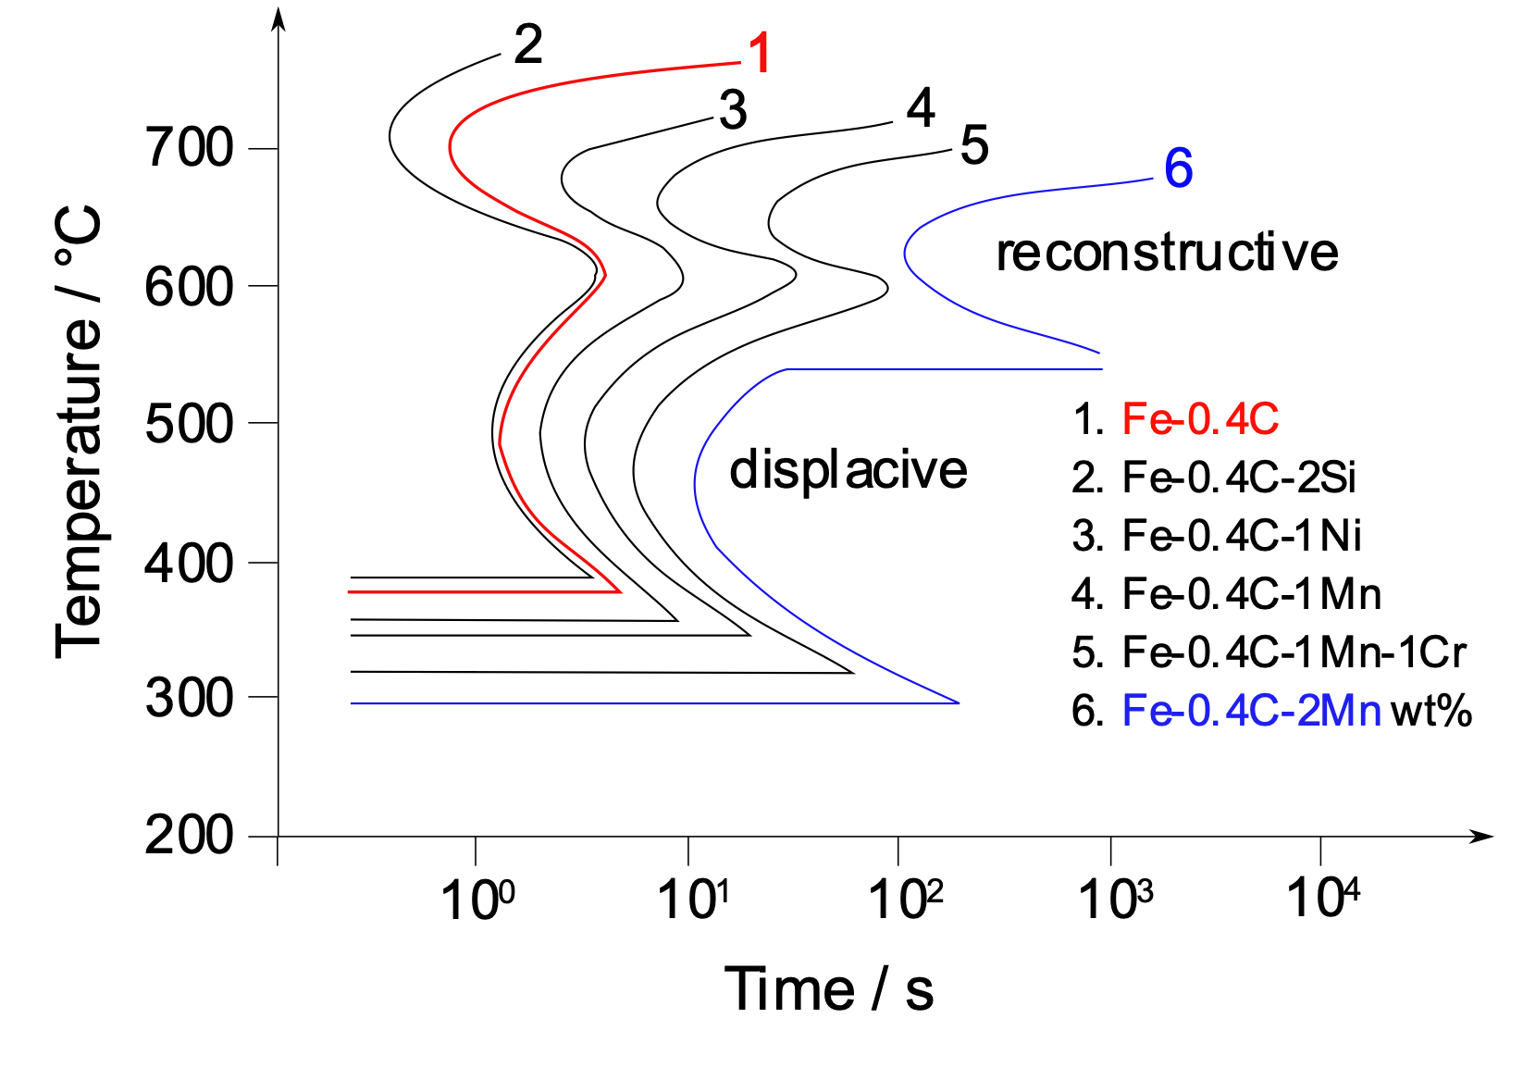
Time-temperature-transformation diagrams

Slide 9
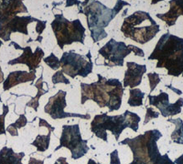
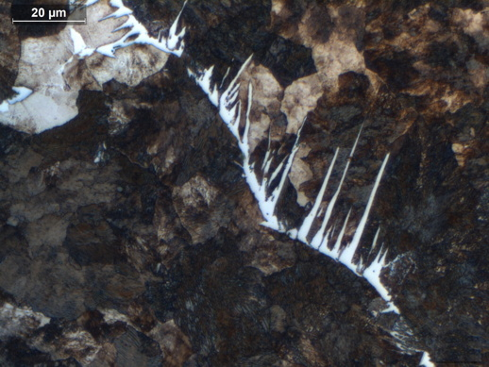
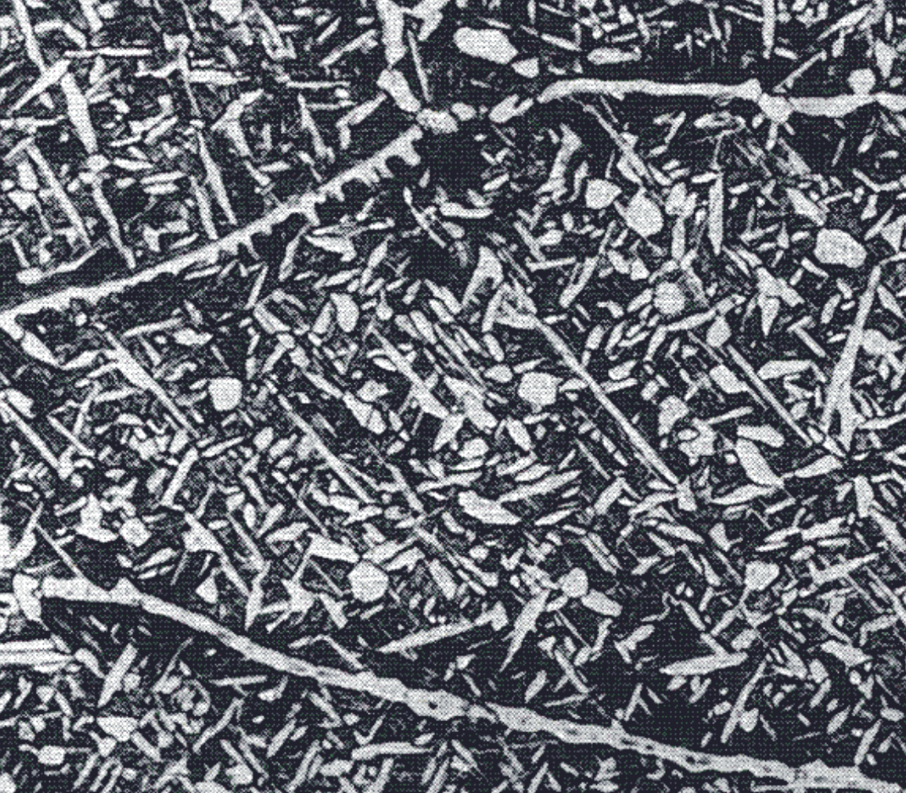
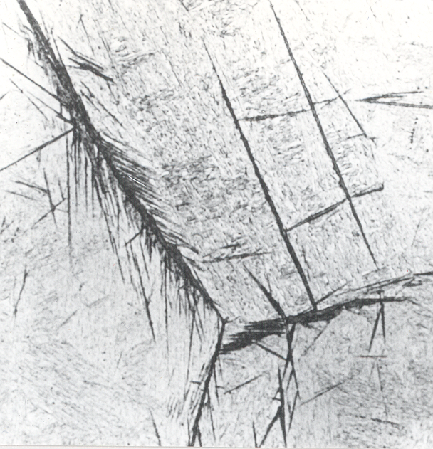
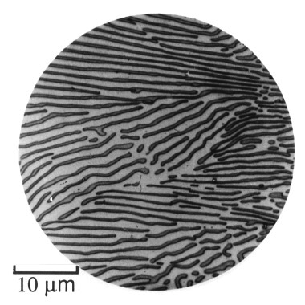
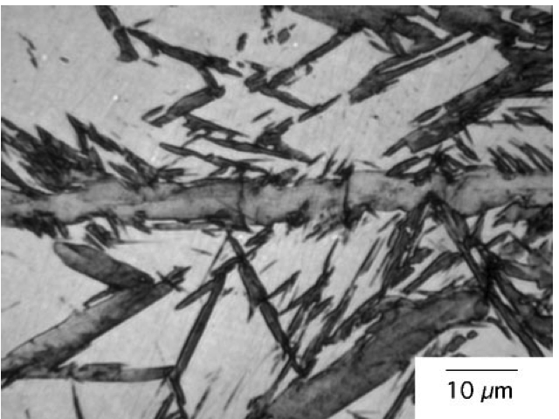

Slide 10
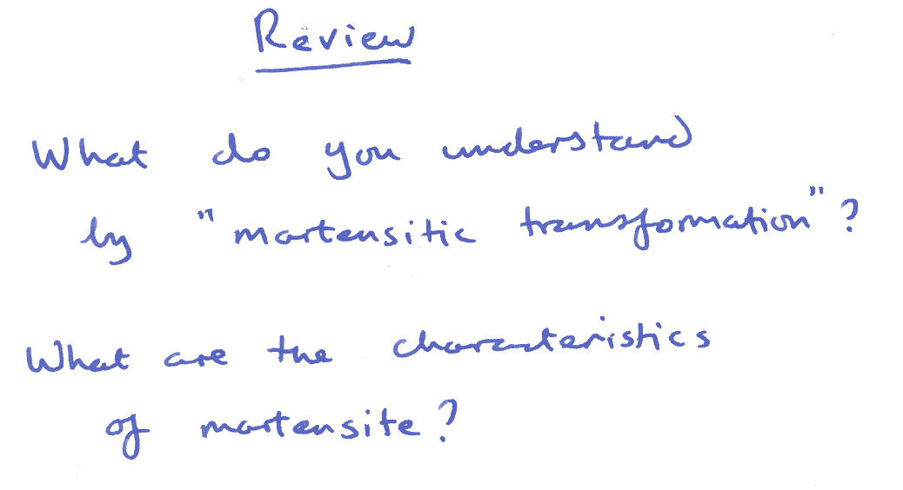
displacive
metastable
diffusionless
volume change
body-centred tetragonal
quenched
hard
plates or laths
brittle

Slide 11
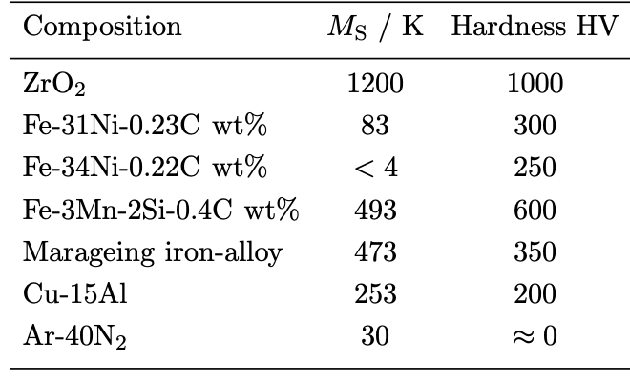
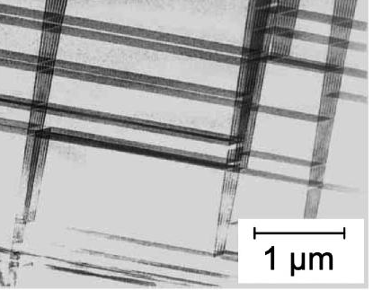
Materials, transformation temperatures & strength
F. R. Chien and R. J. Clifton and S. R. Nutt
Journal of the American Ceramics Society
78 (1995) 1537

Slide 12
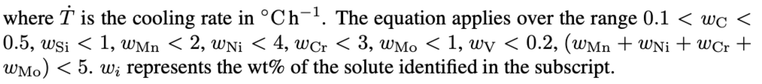
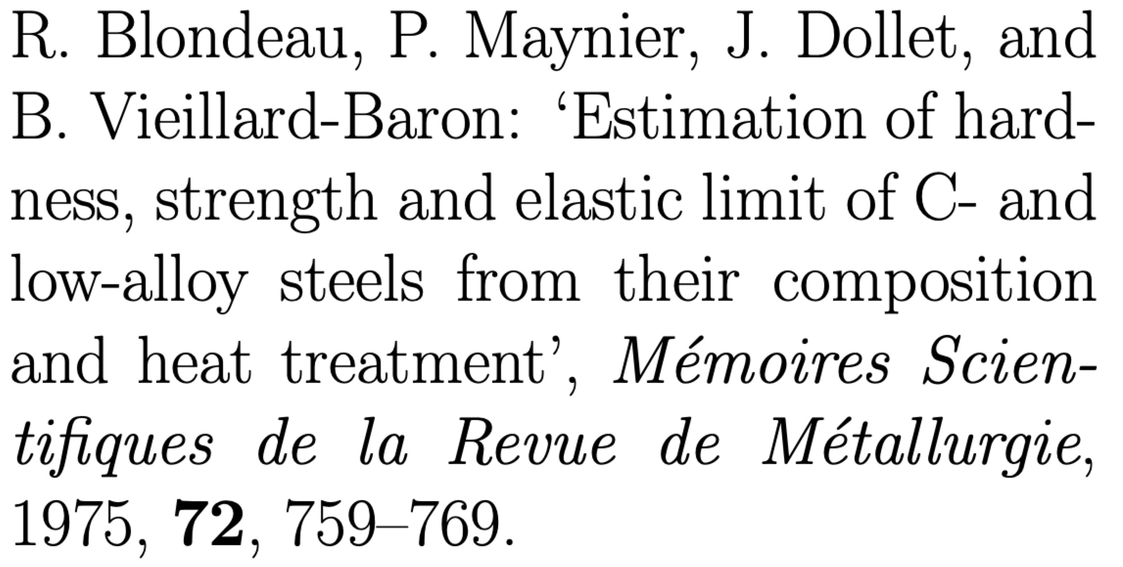

Slide 13
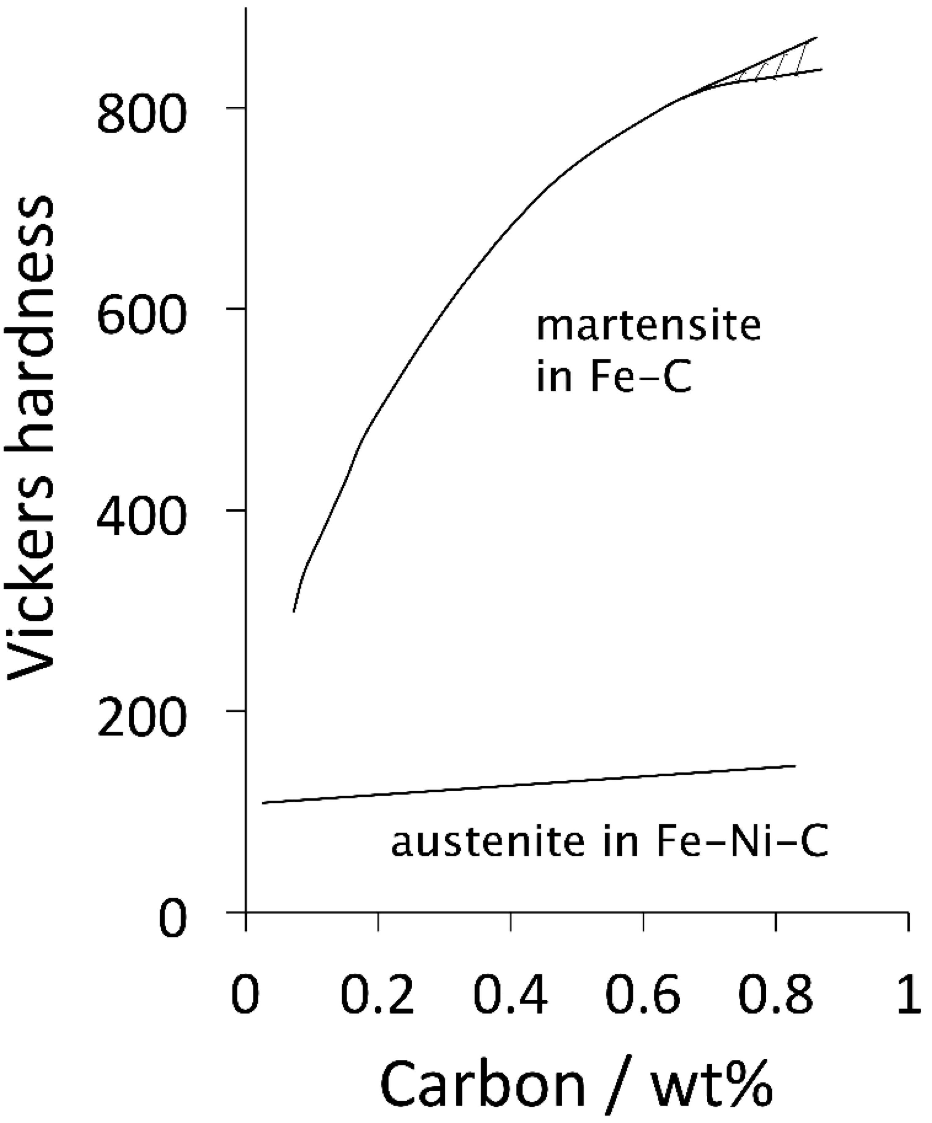
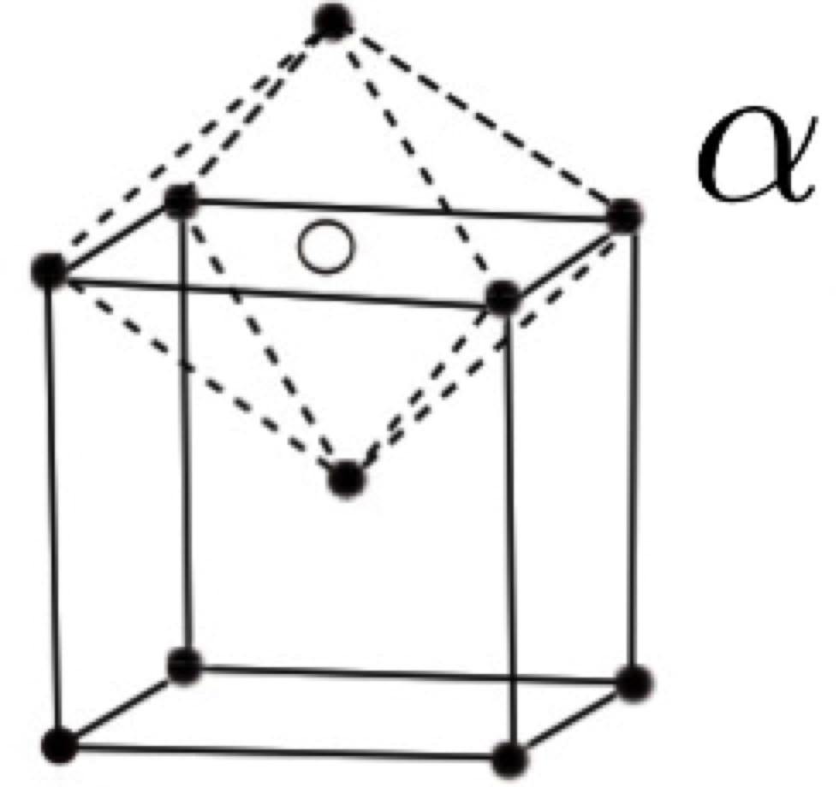
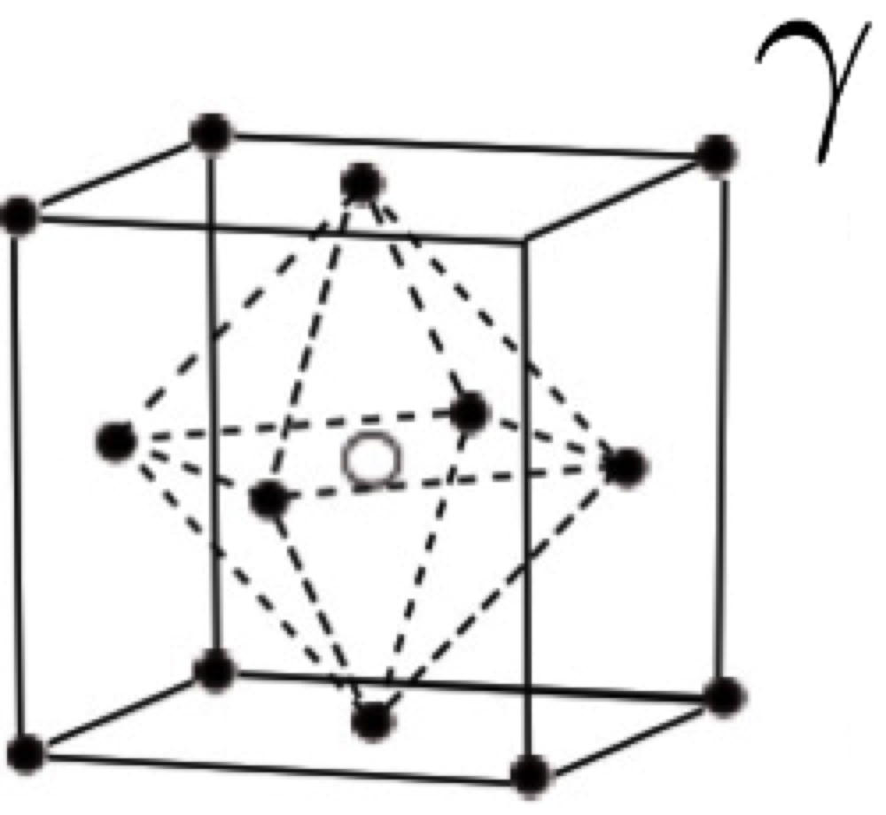
Data from: P. G. Winchell and M. Cohen, Effect of carbon on the hardness of martensite and austenite, Trans. Metall. Soc. AIME 224 (1962) 638.

Slide 14
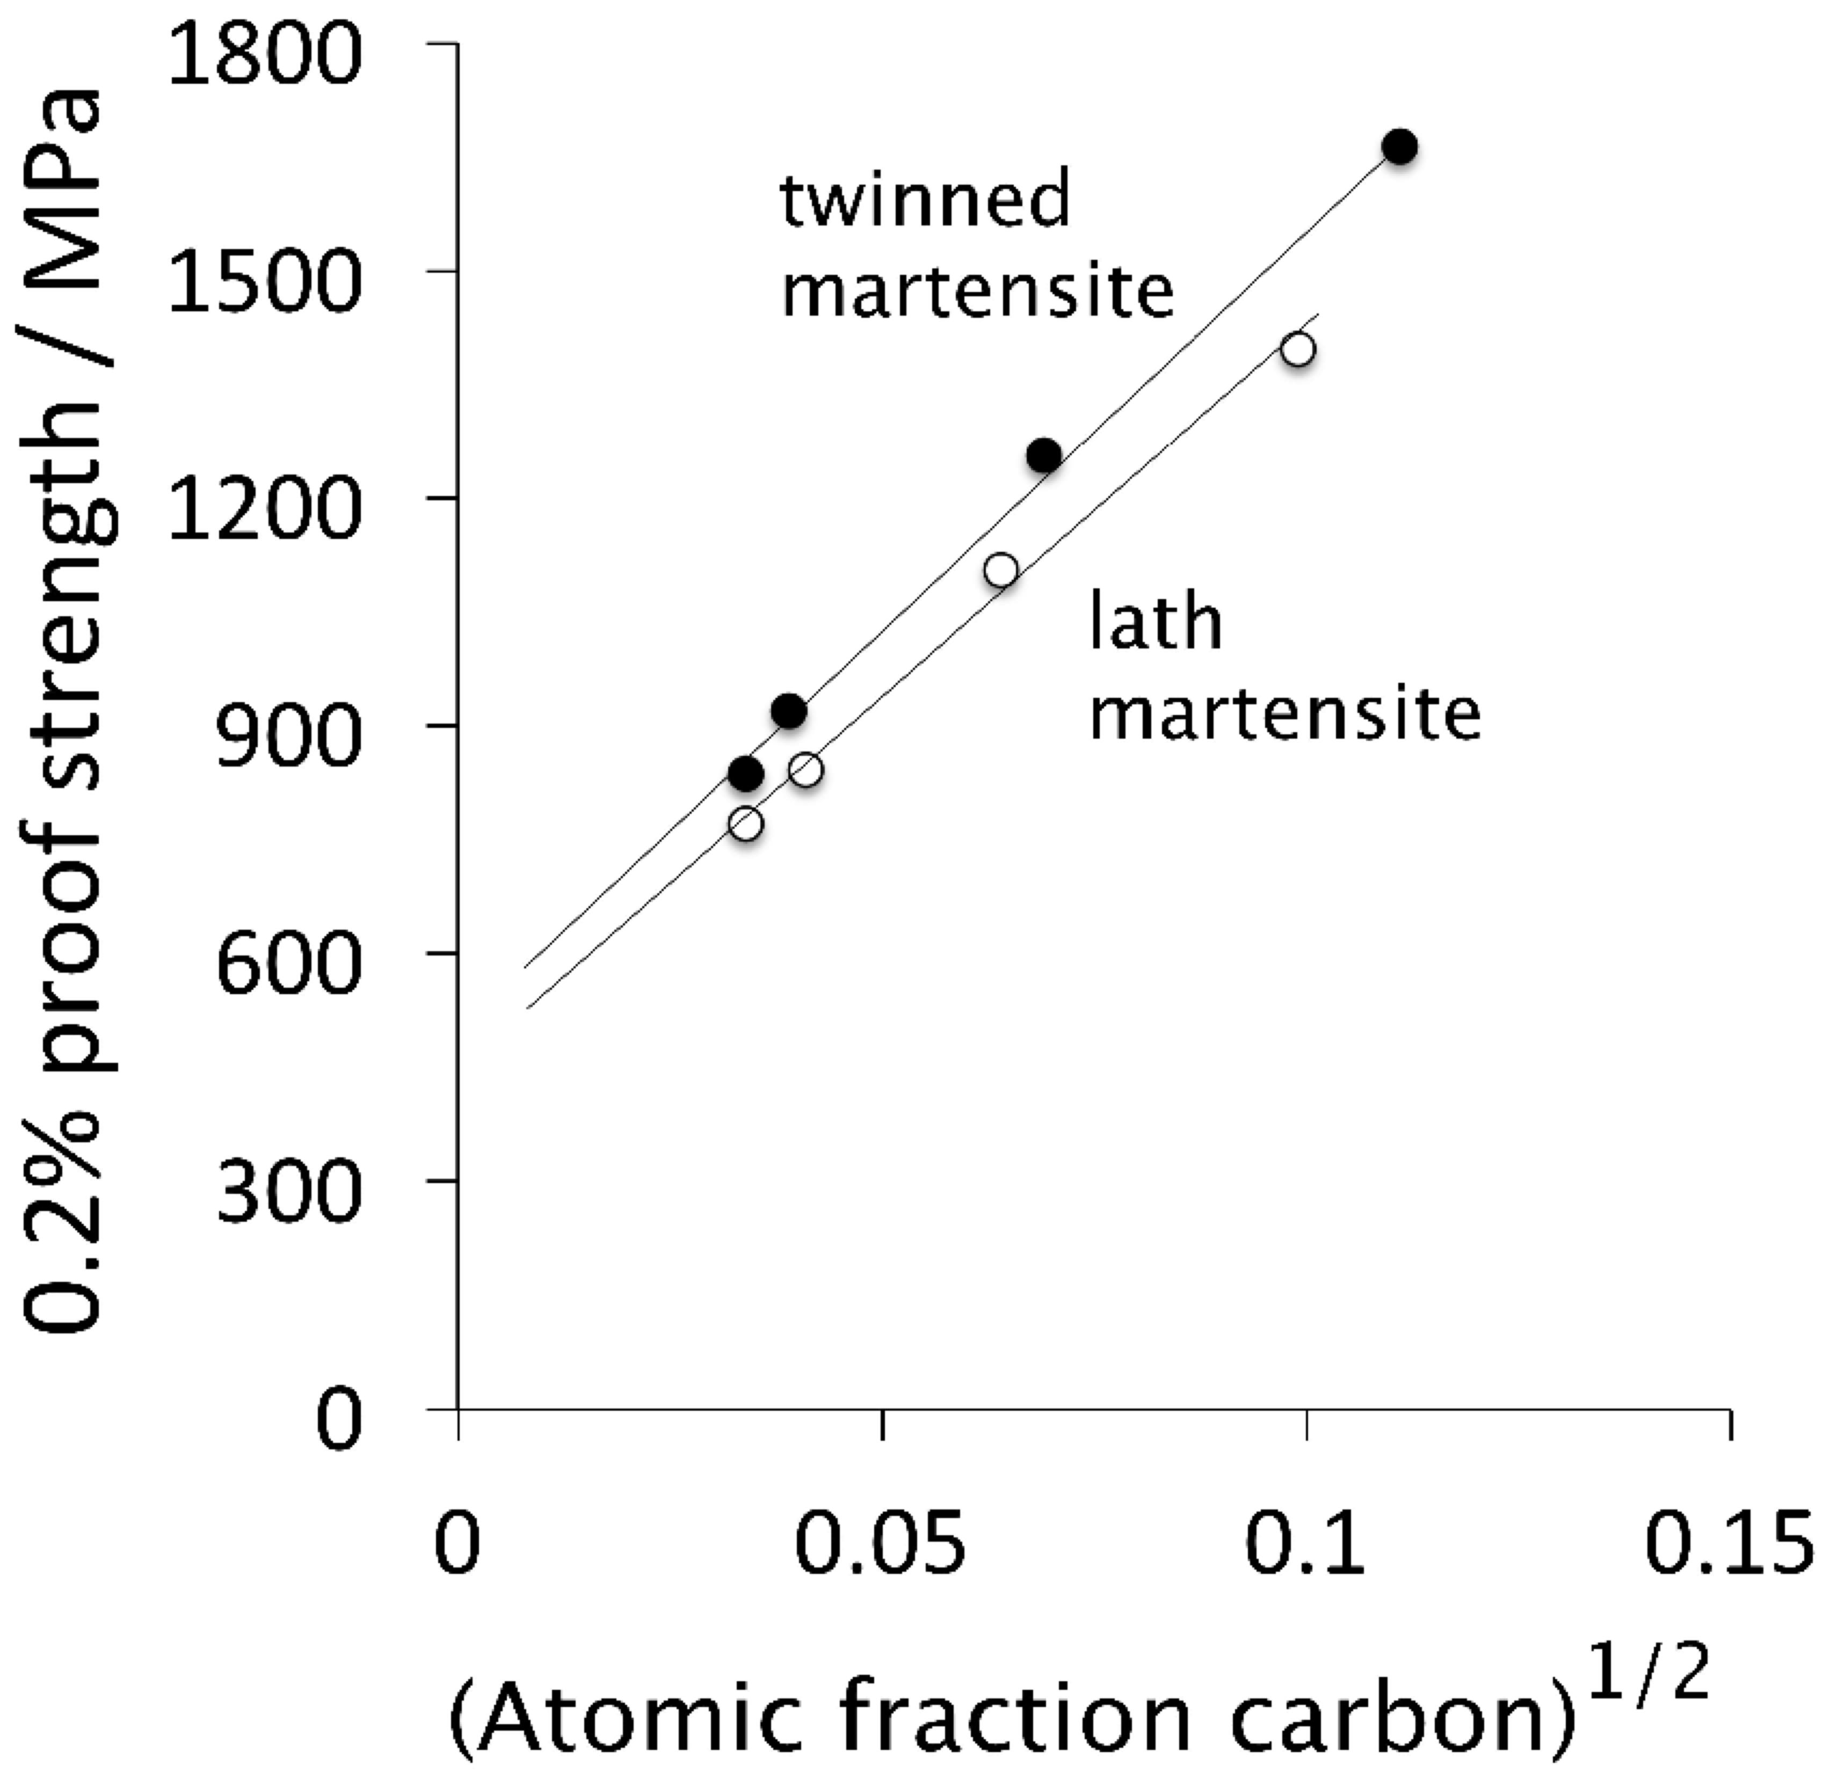
Data from: J. M. Chilton and P. M. Kelly, Strength of ferrous martensite, Acta Metallurgica 16 (1968) 637

Slide 15
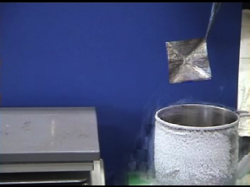
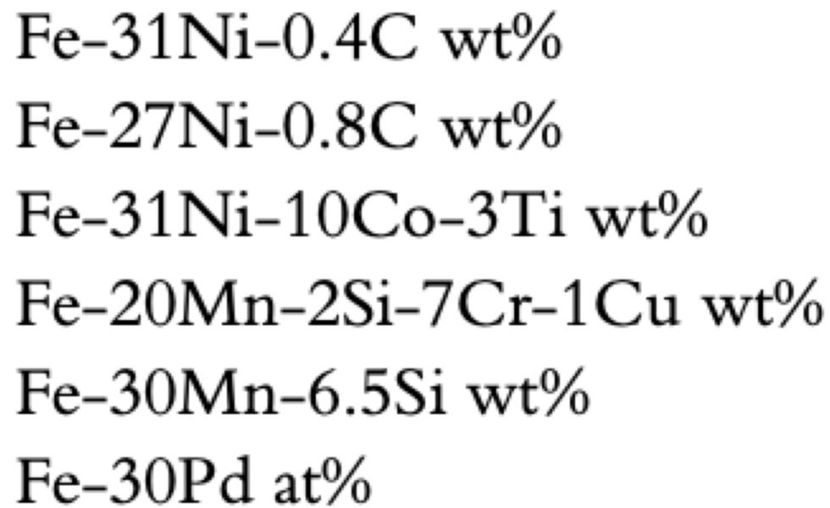
Courtesy of Professor Koichi Tsuchiya, Toyohashi University of Technology

Slide 16
Diffusionless
can form at incredibly low temperatures
can form very rapidly
no composition change

Slide 17
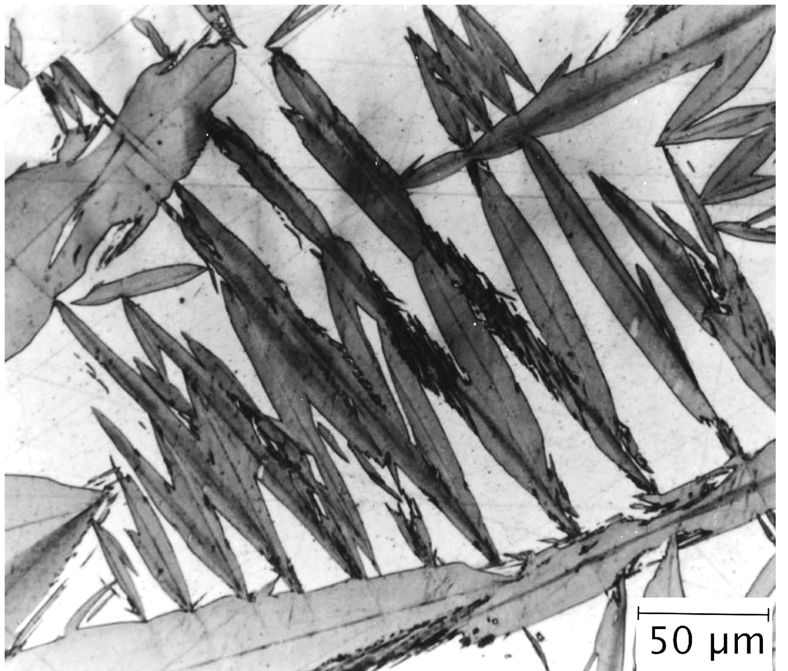
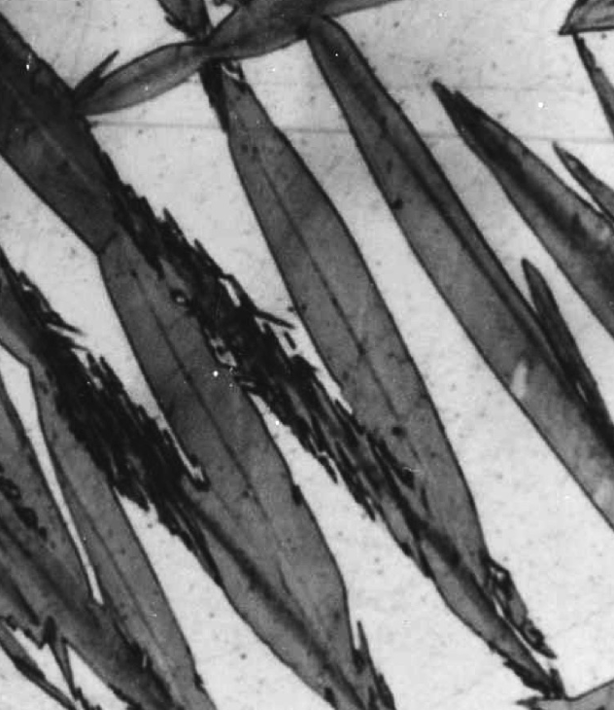
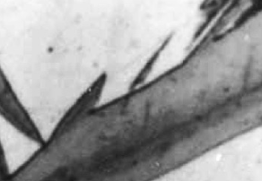
Plate shape

Slide 18
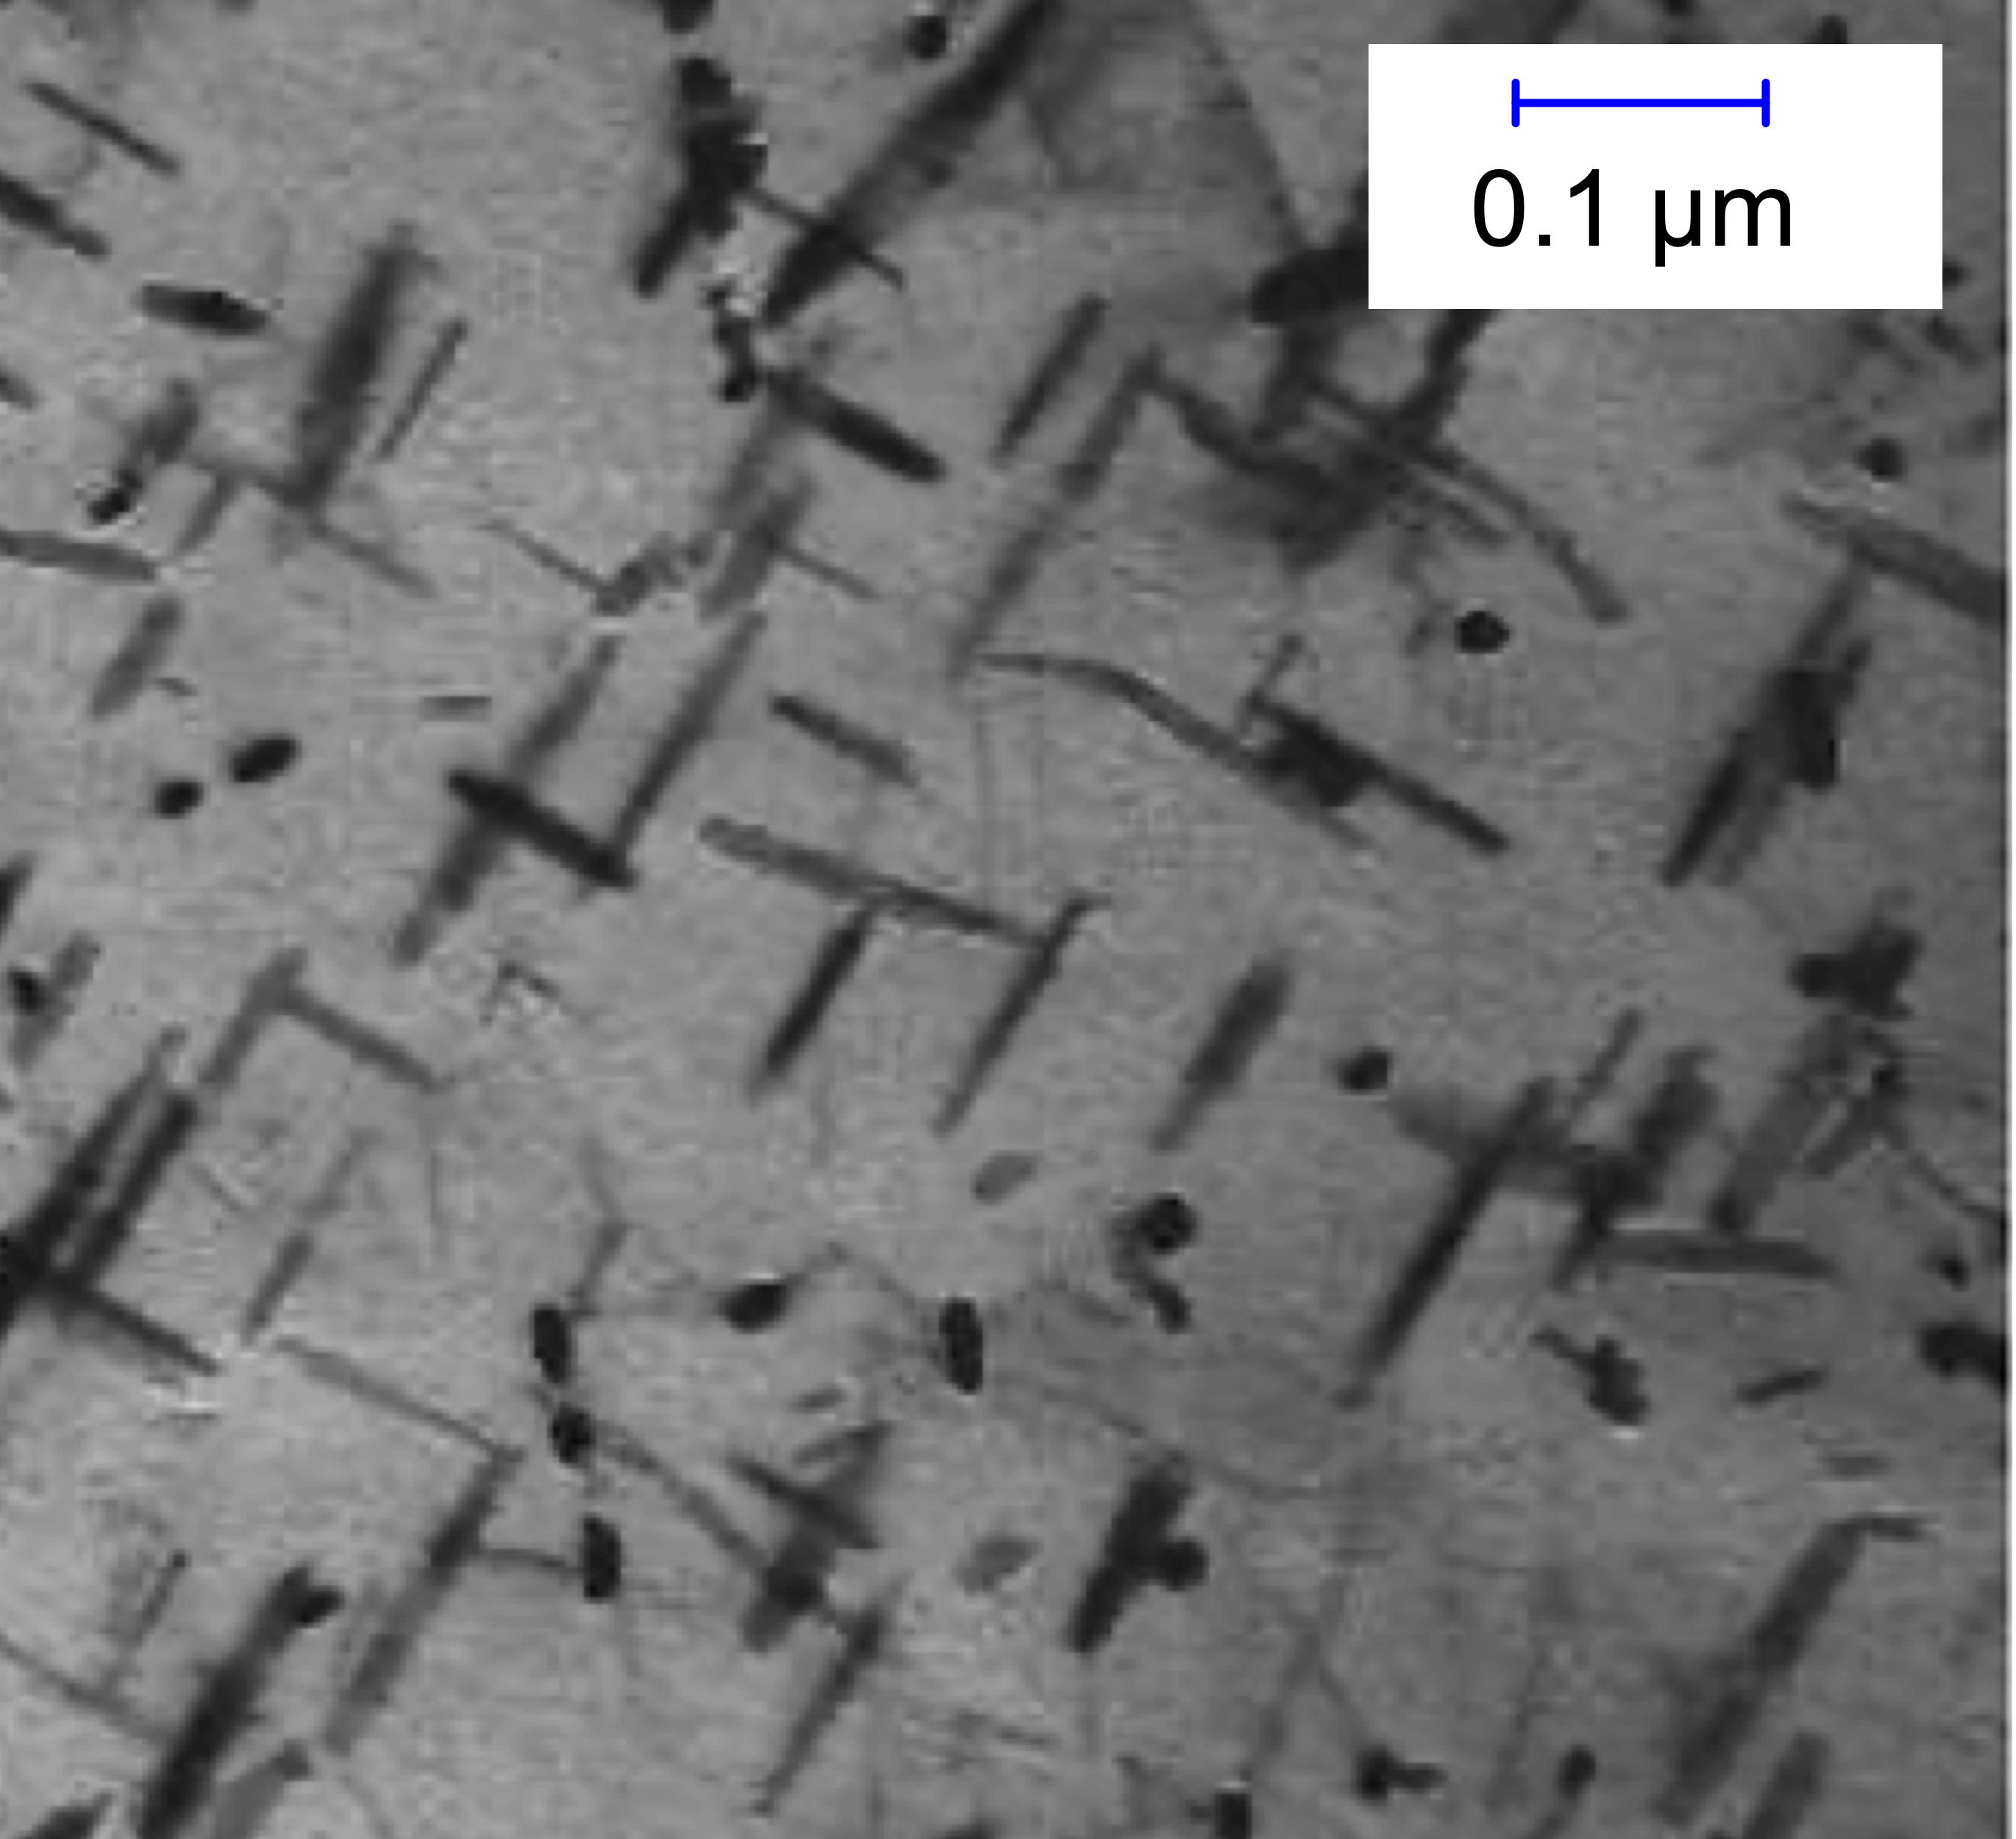
Needles of molybdenum carbide
Yamasaki S, Bhadeshia HK. Modelling and characterisation of Mo2C precipitation and cementite dissolution during tempering of Fe–C–Mo martensitic steel. Materials Science and Technology. 19 (2003)723-731.

Slide 19
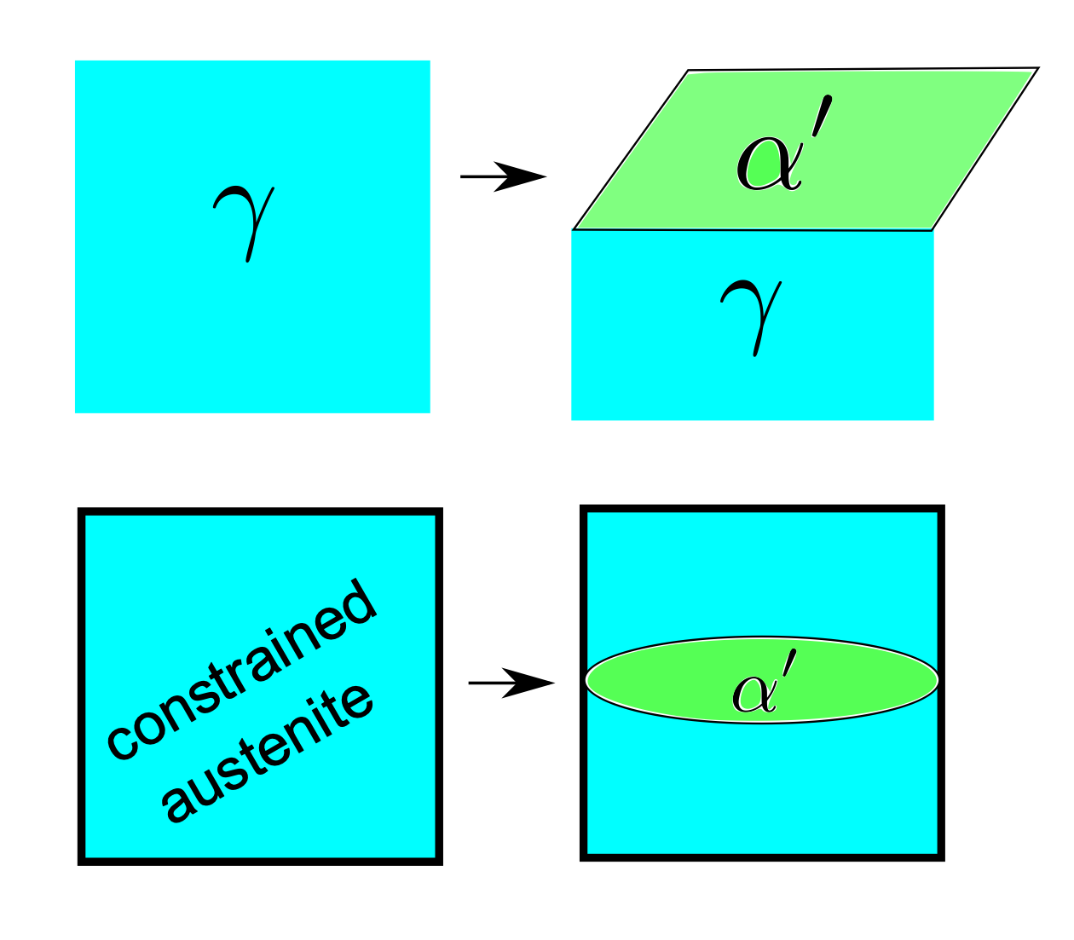

Slide 20
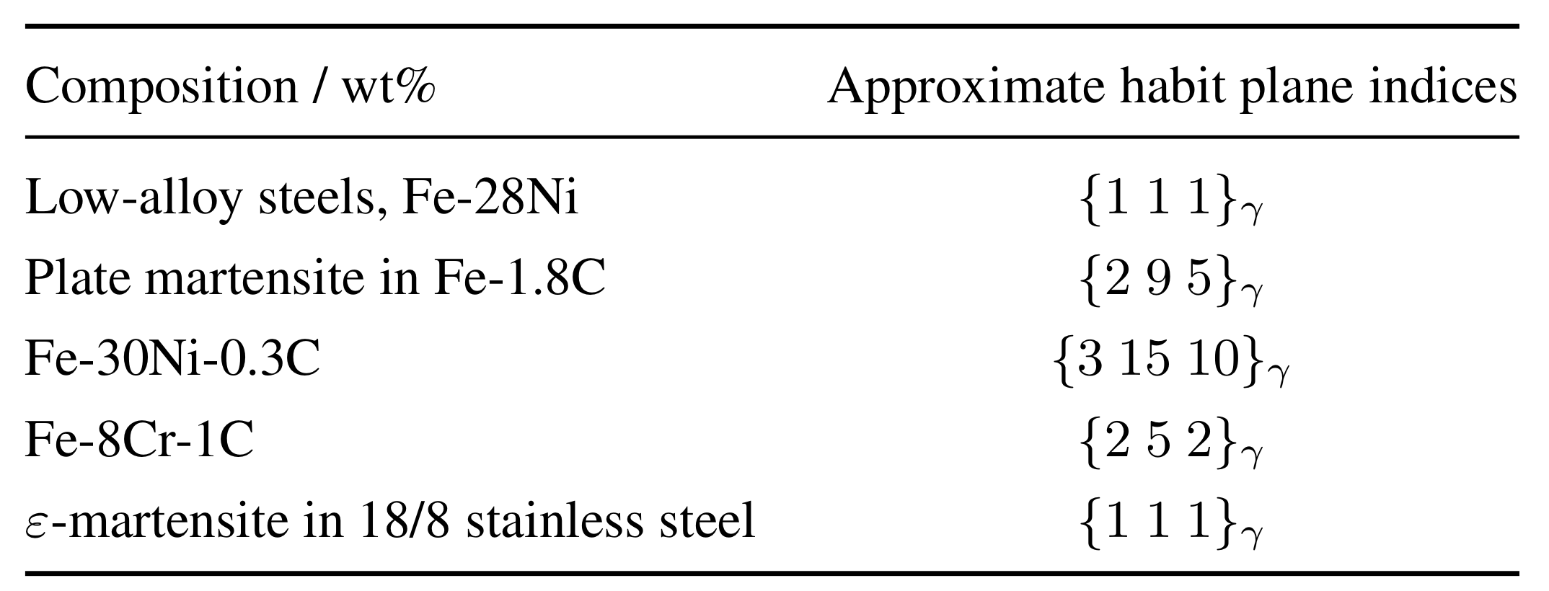
Irrational: why?

Slide 21
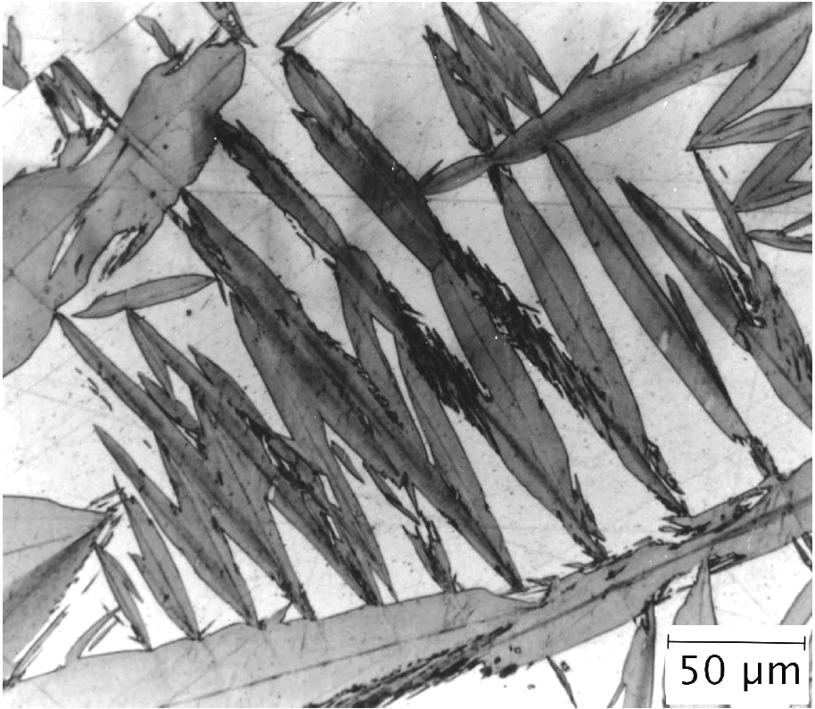
Shape of martensite ?

Slide 22
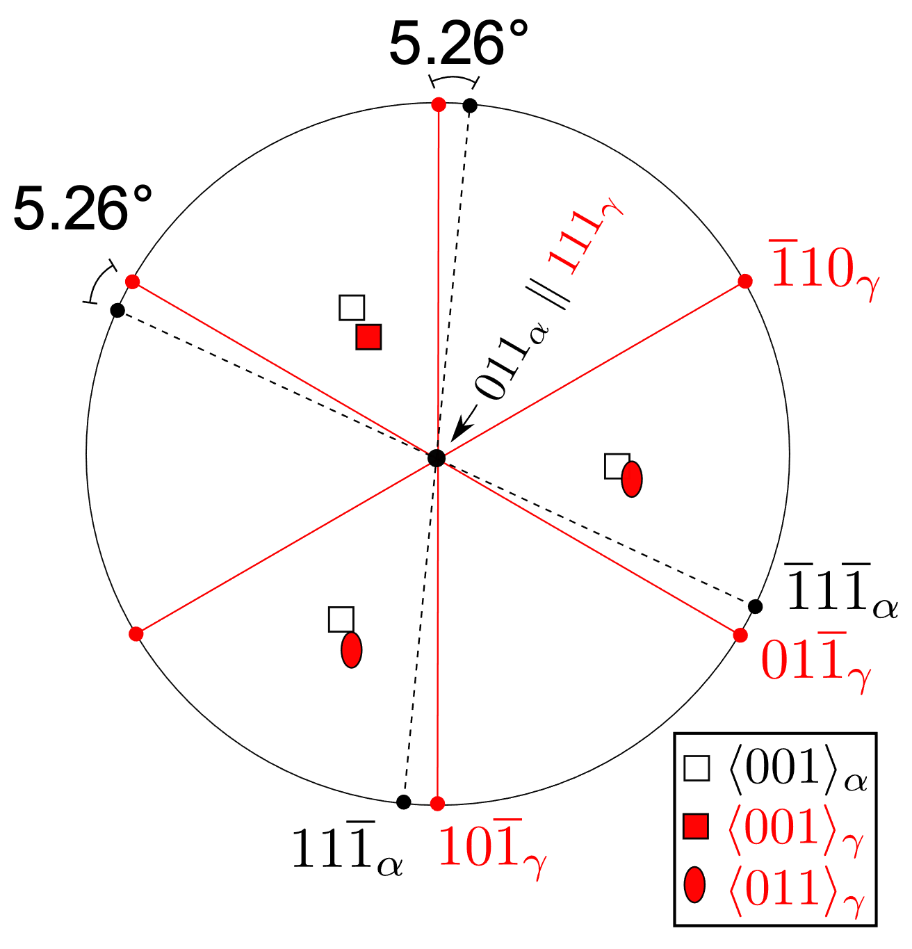
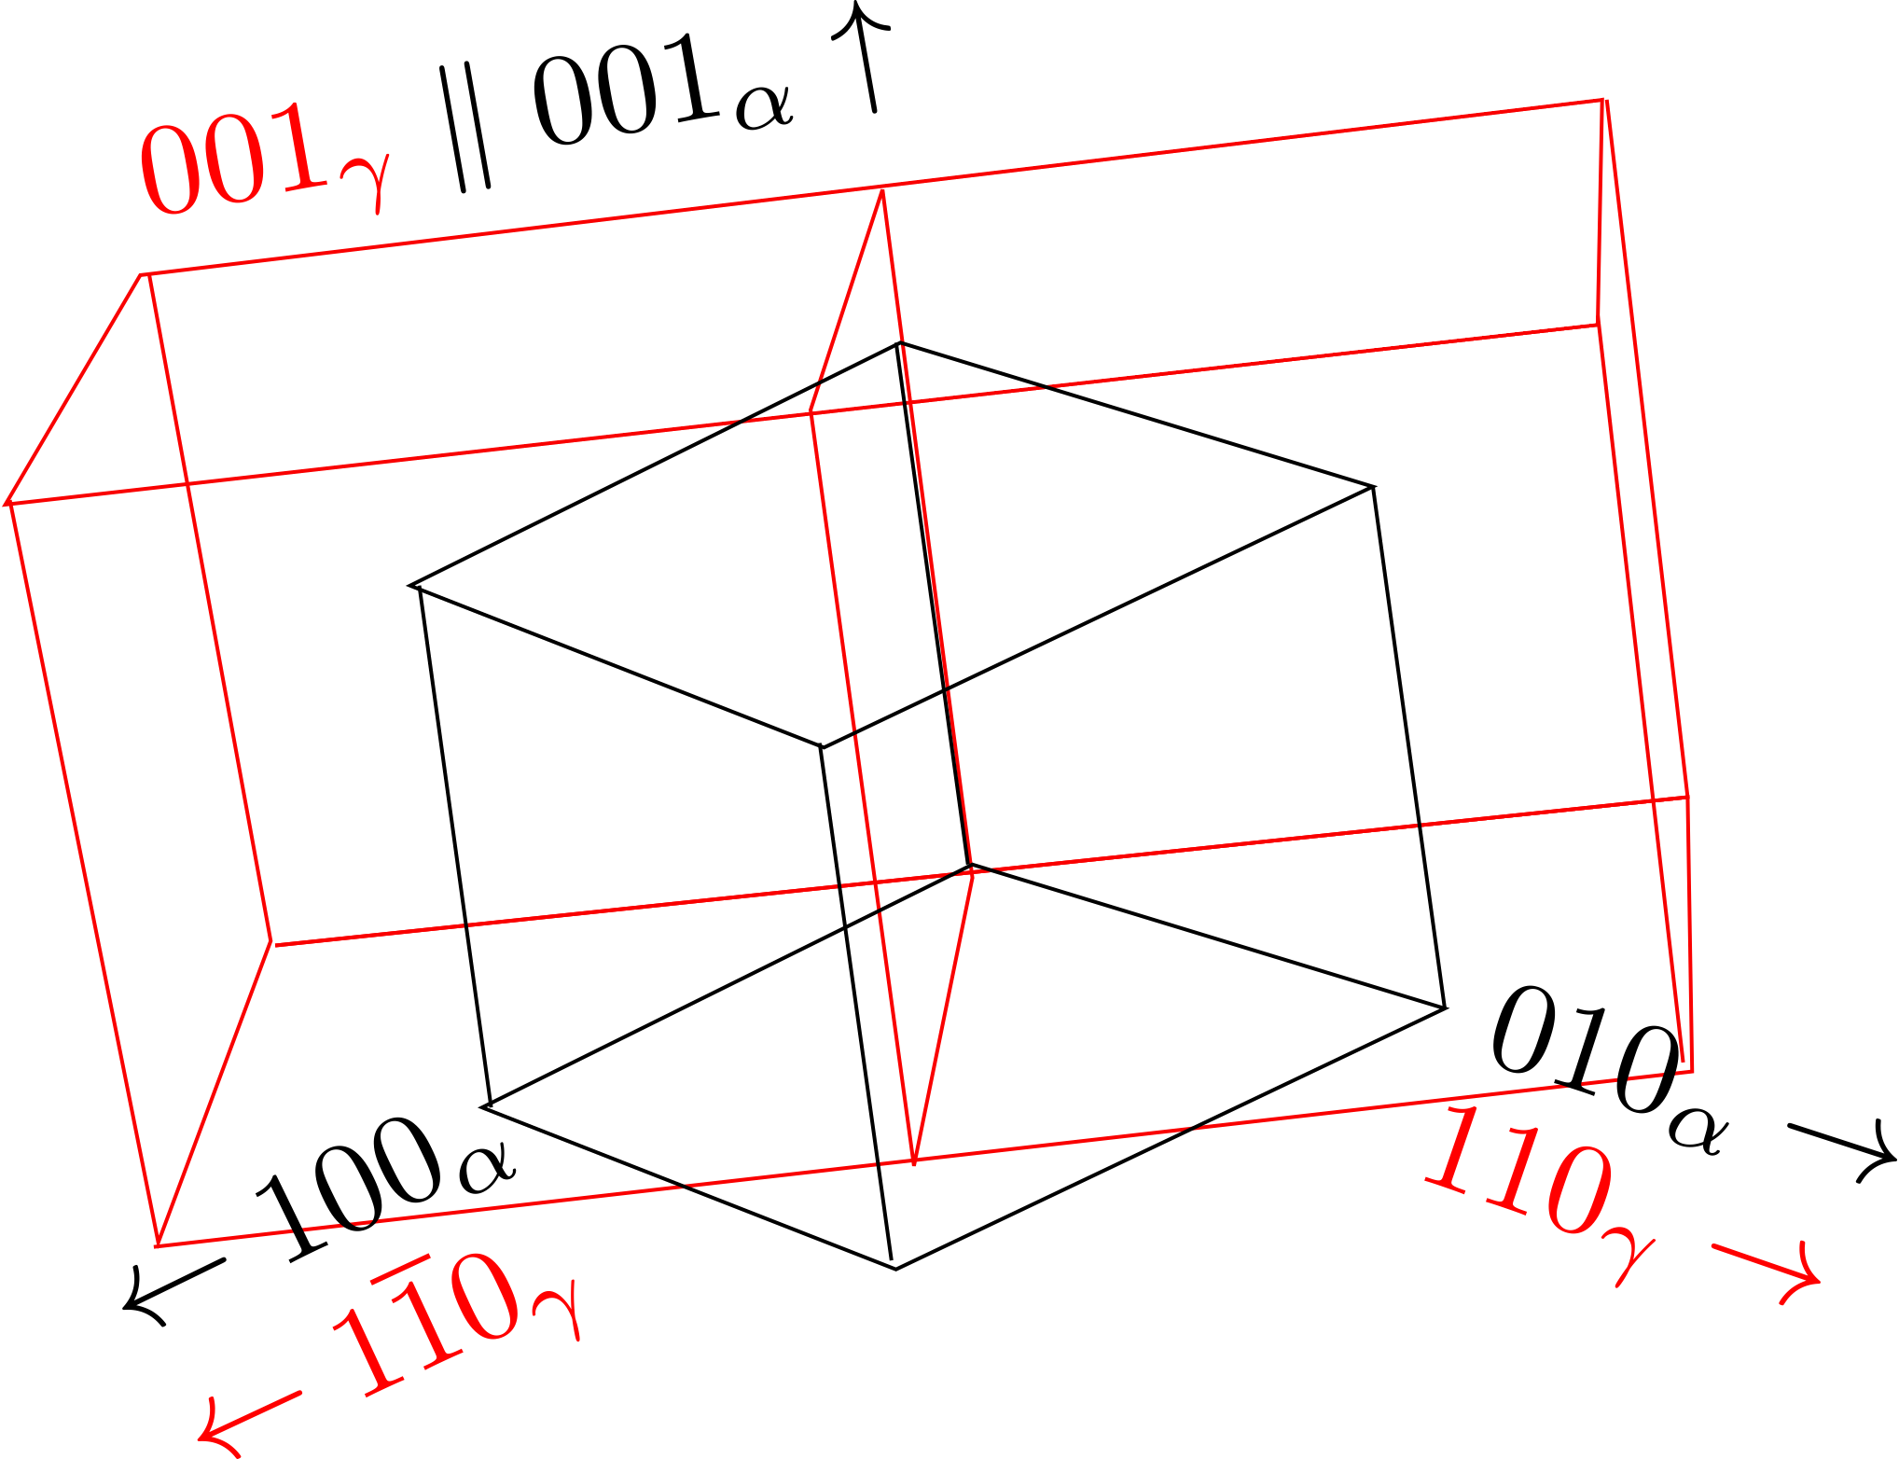
Nishiyama-Wasserman

Slide 23
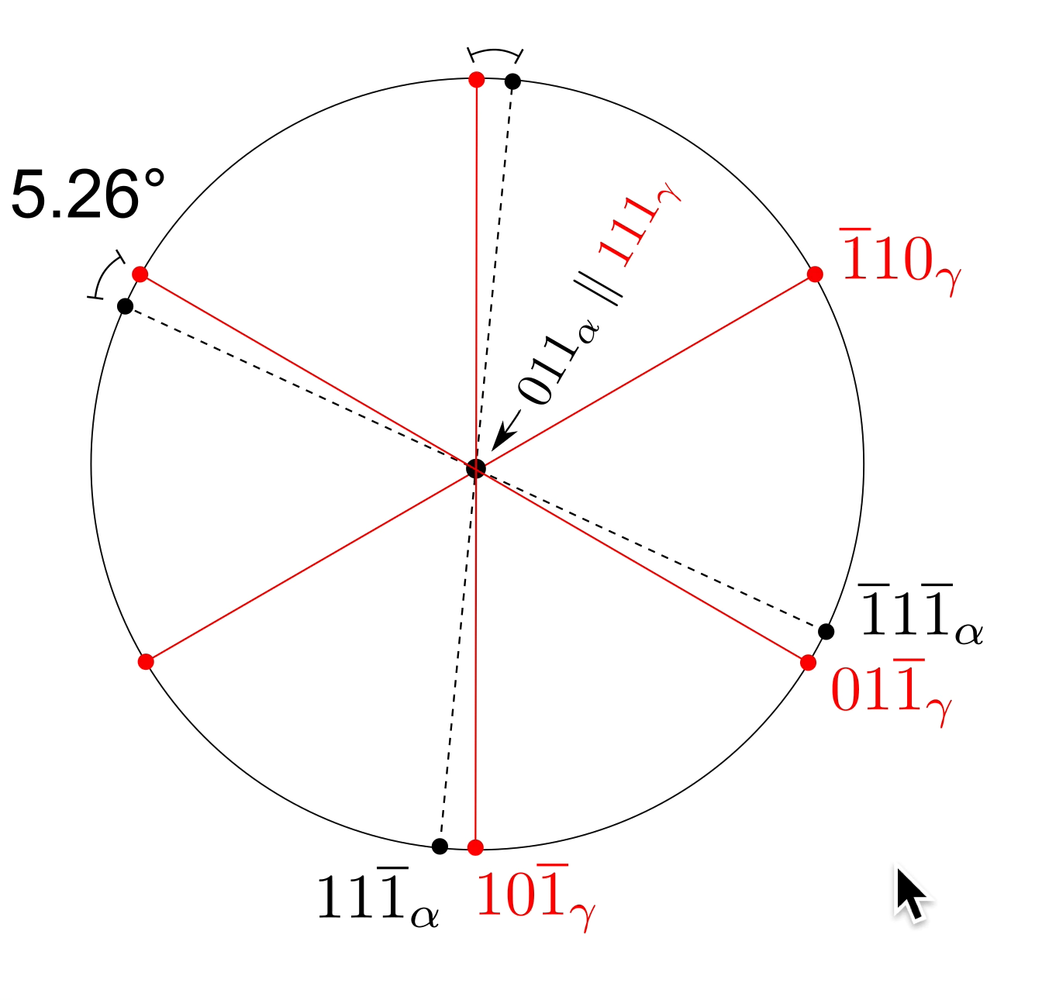
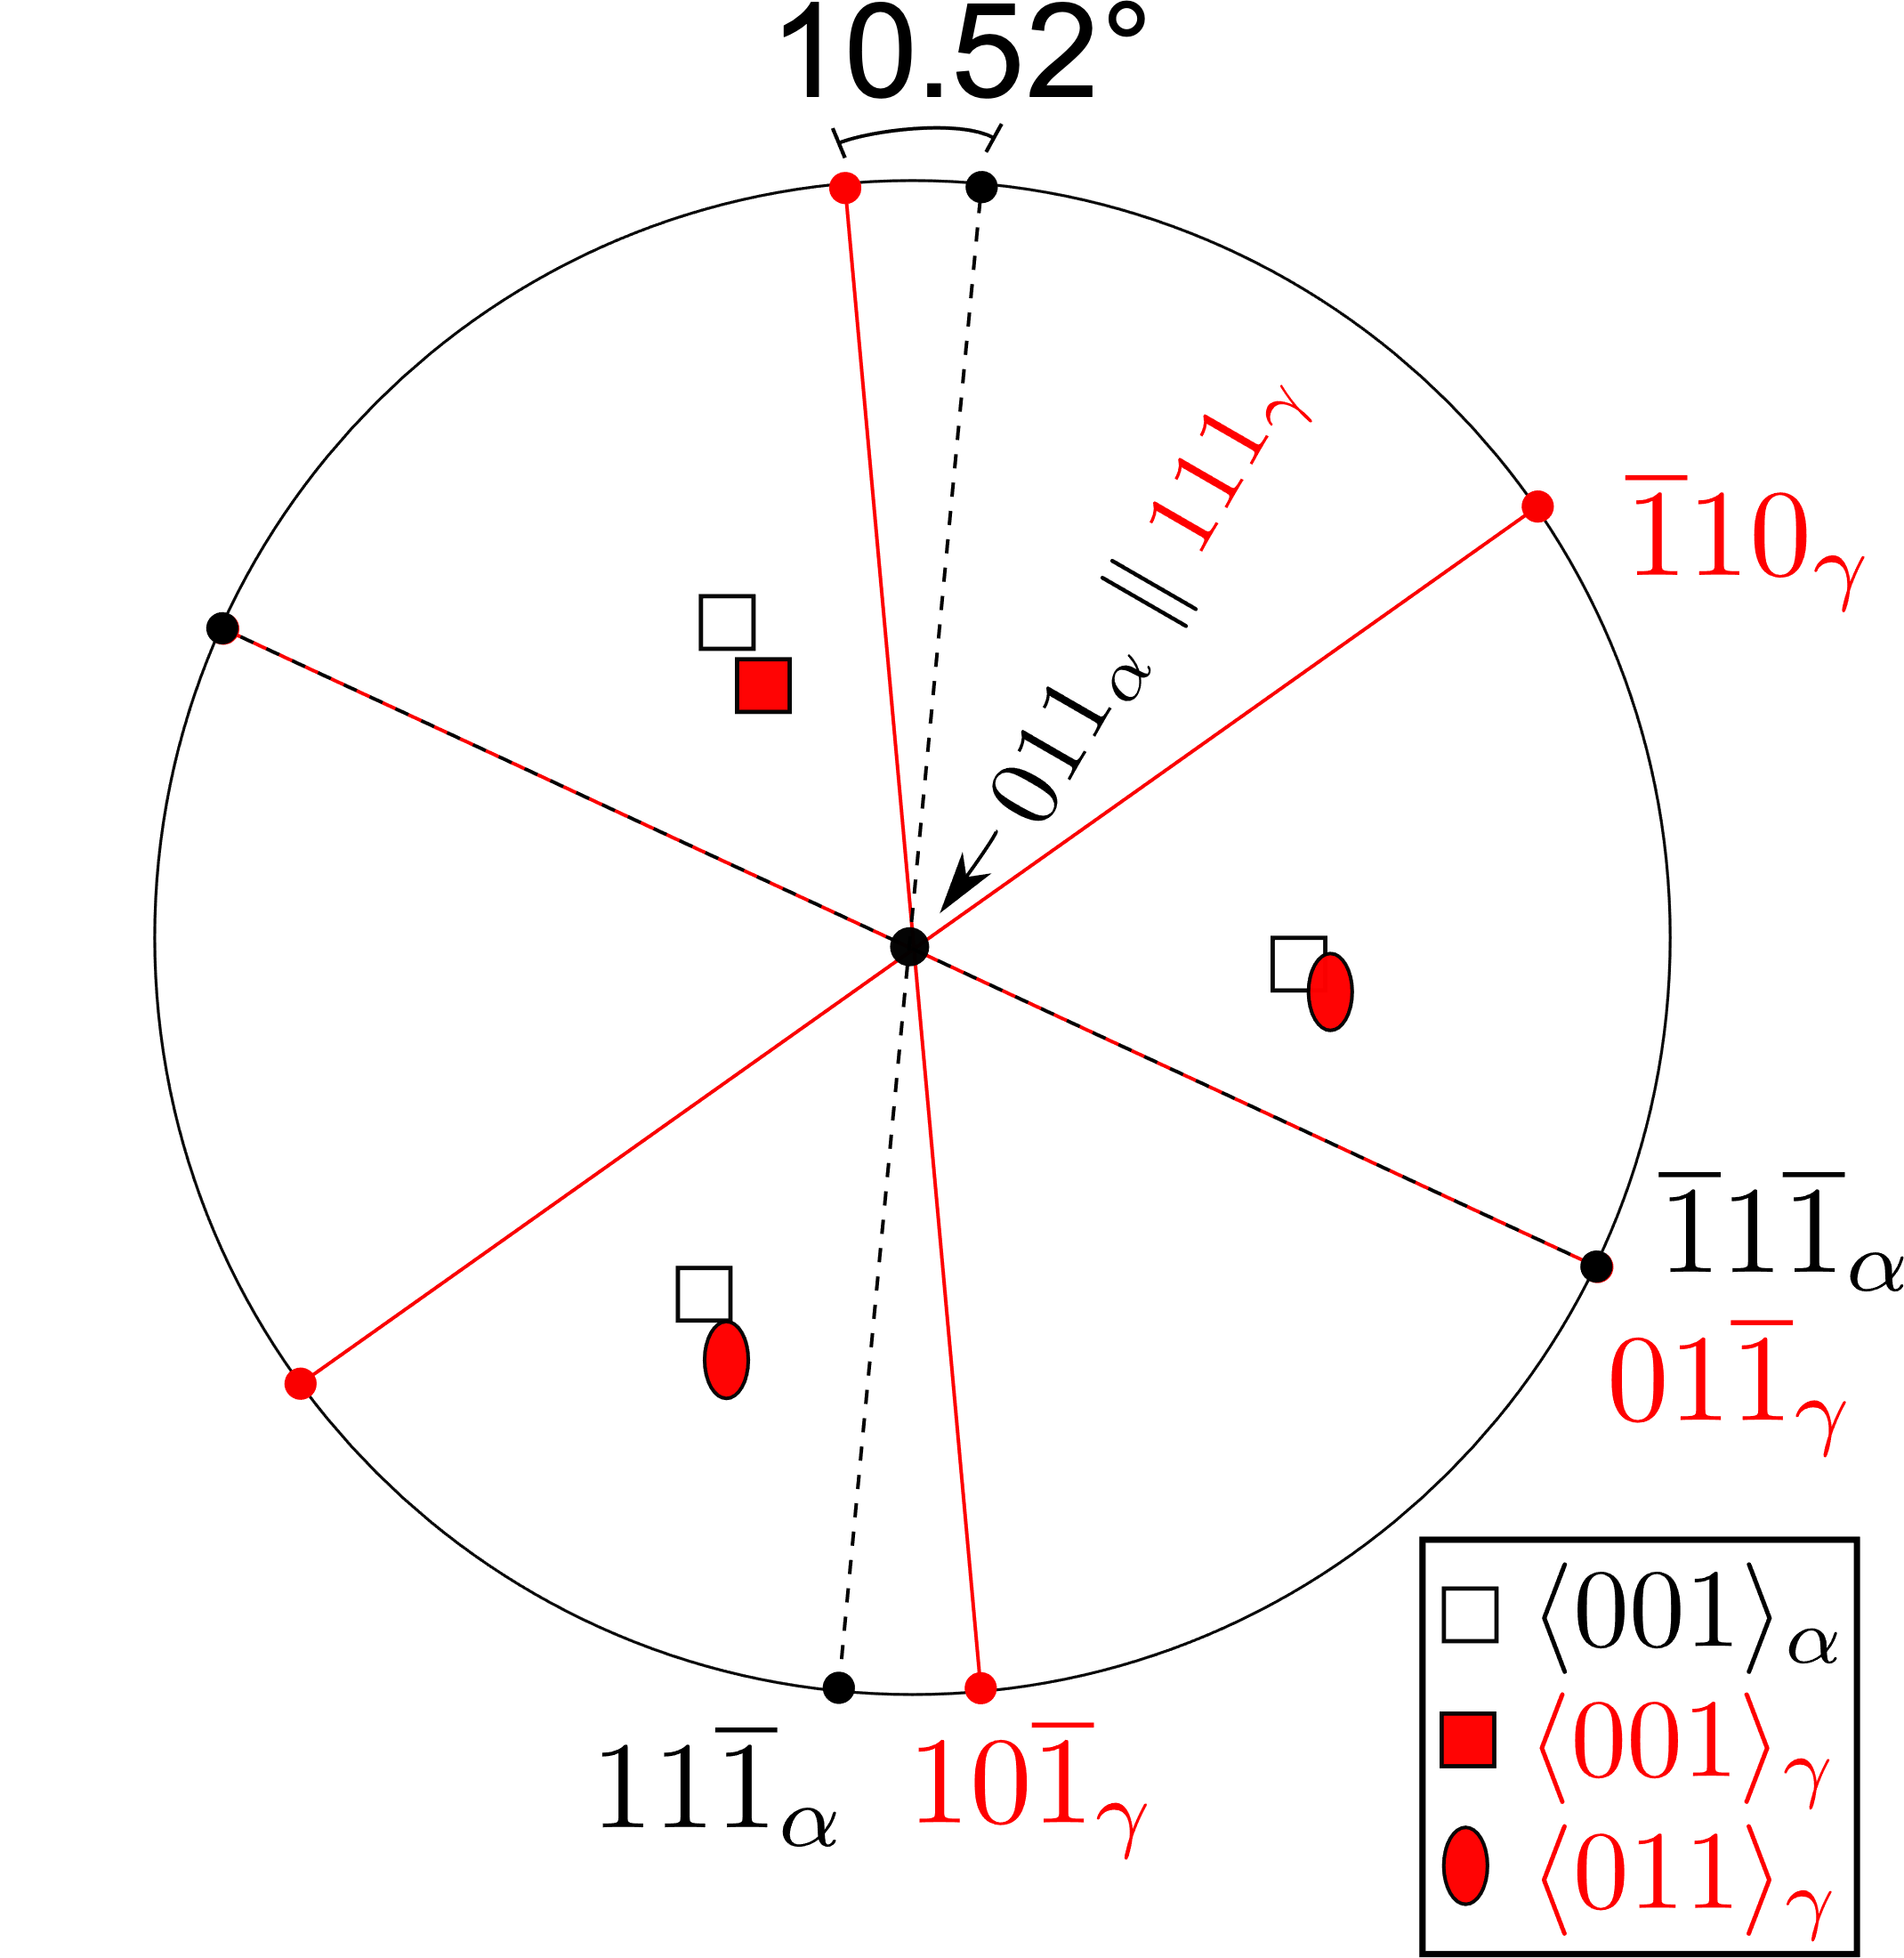

Slide 24
Kurdjumov-Sachs

Slide 25
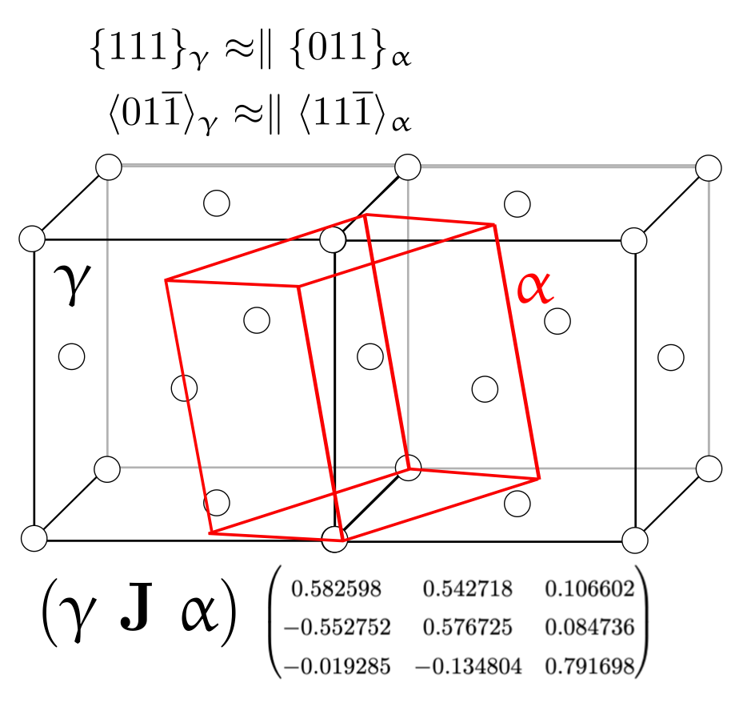
actual orientation
irrational

Slide 26
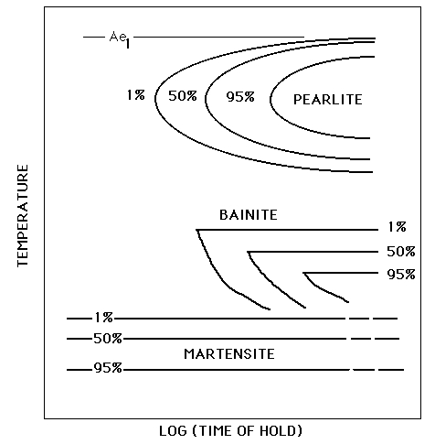
athermal transformation

Slide 27
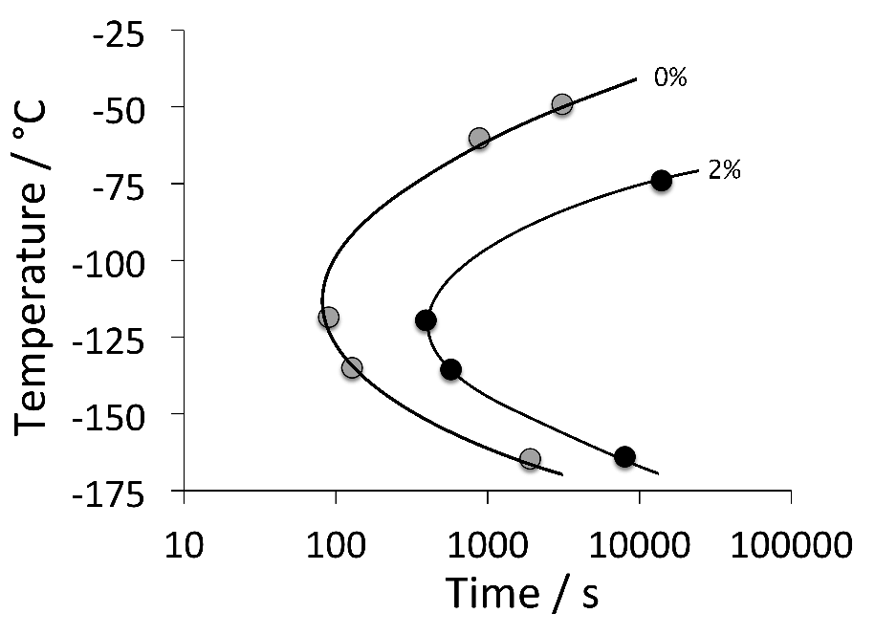
Fe-0.05C-24Ni-3Mn-0.2Cu wt%
Kurdjumov GV, Maksimova OP. Kinetics of austenite to martensite transformation at low temperatures. Doklady Akademii Nauk SSSR. 61 (1948) 83-86.

Slide 28
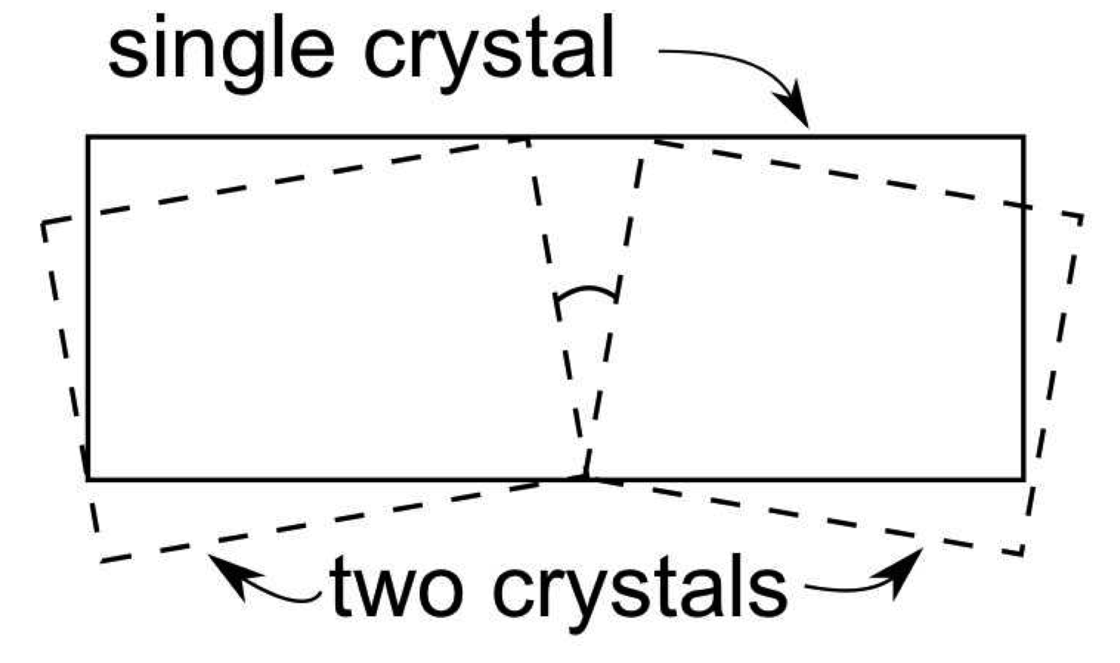

Slide 29
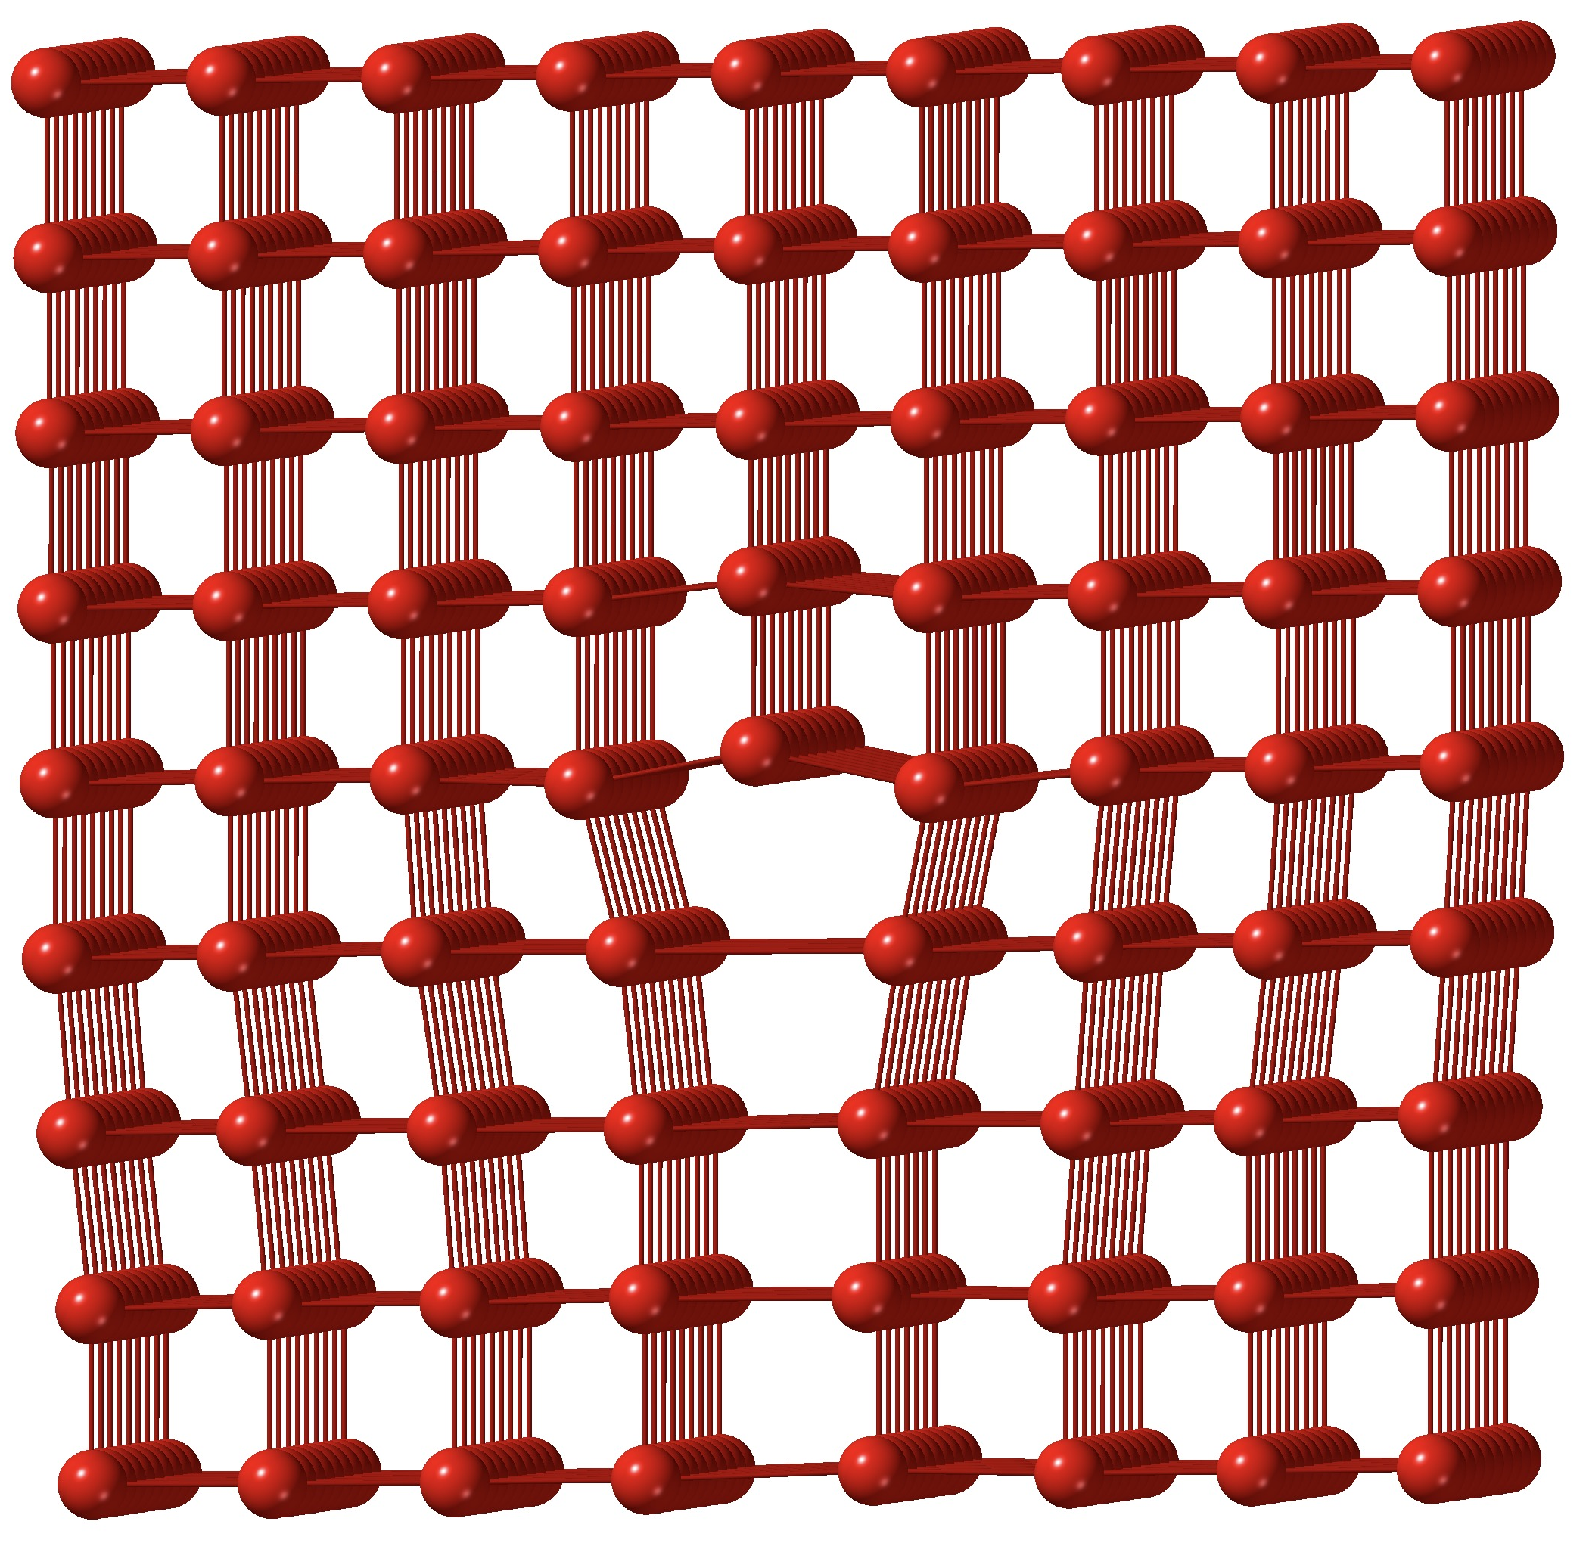

Slide 30
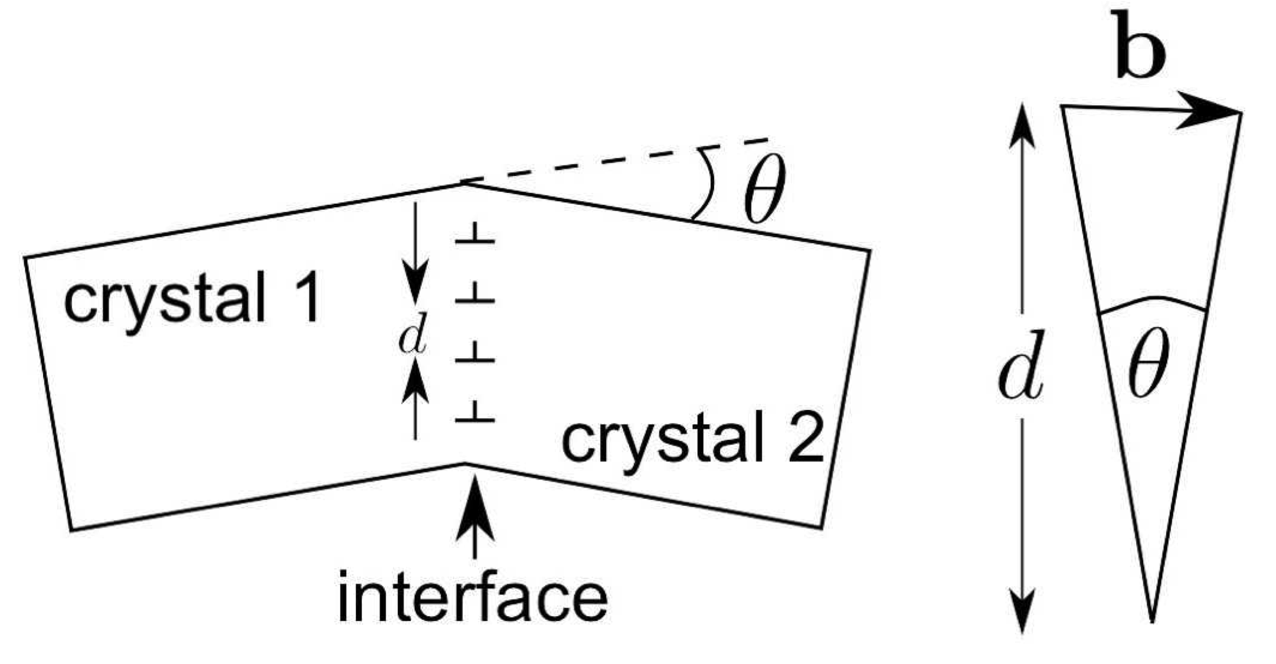
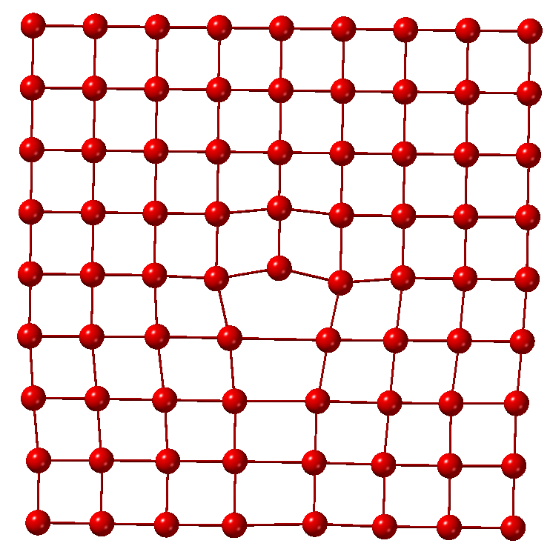
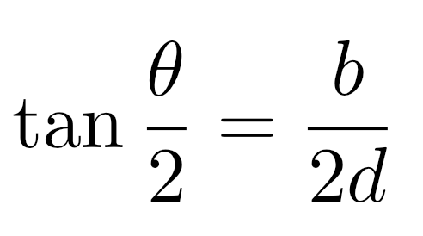

Slide 31
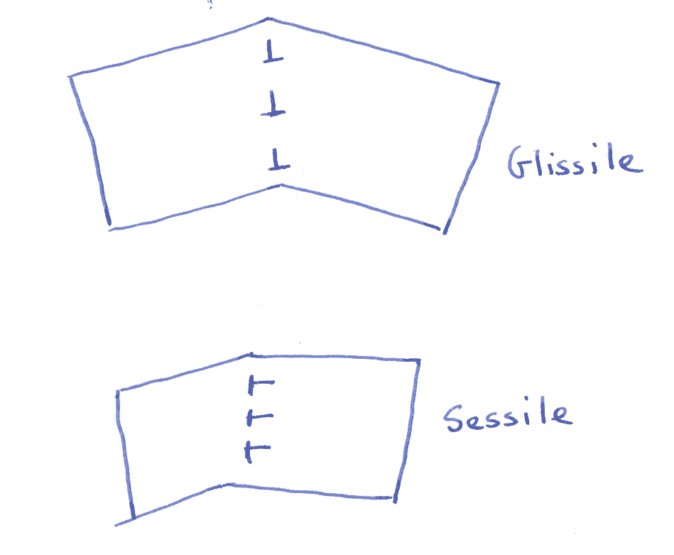
Glissile interface

Slide 32
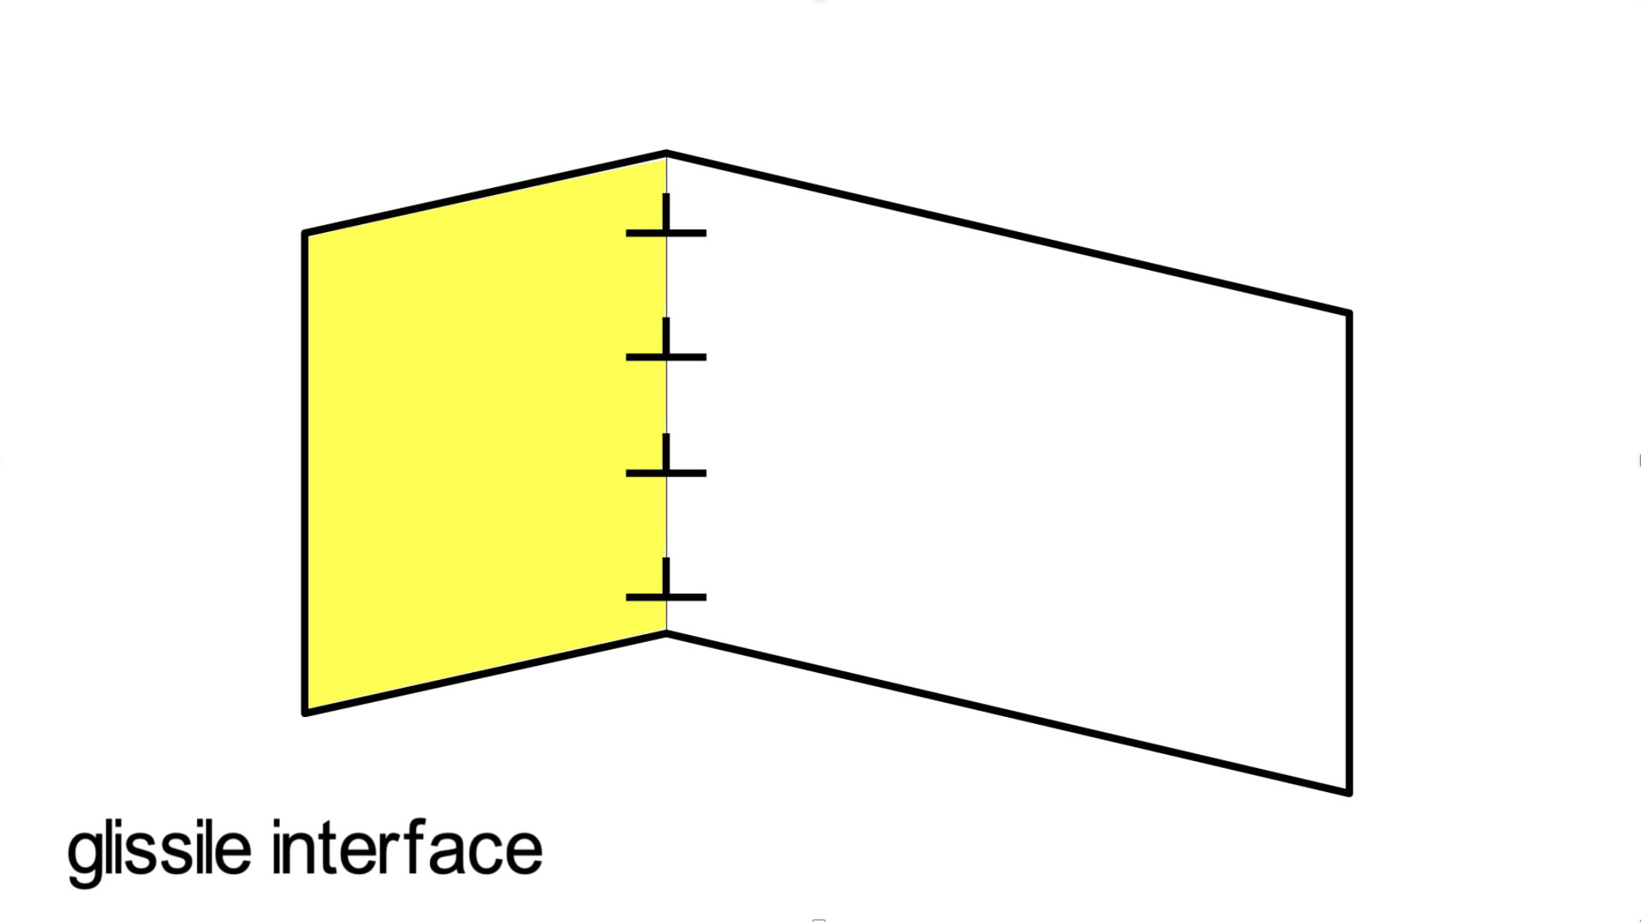

Slide 33
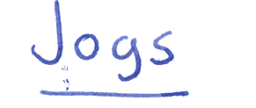
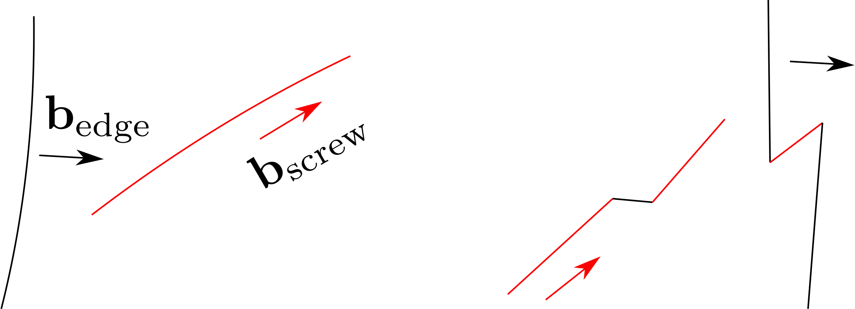

Slide 34
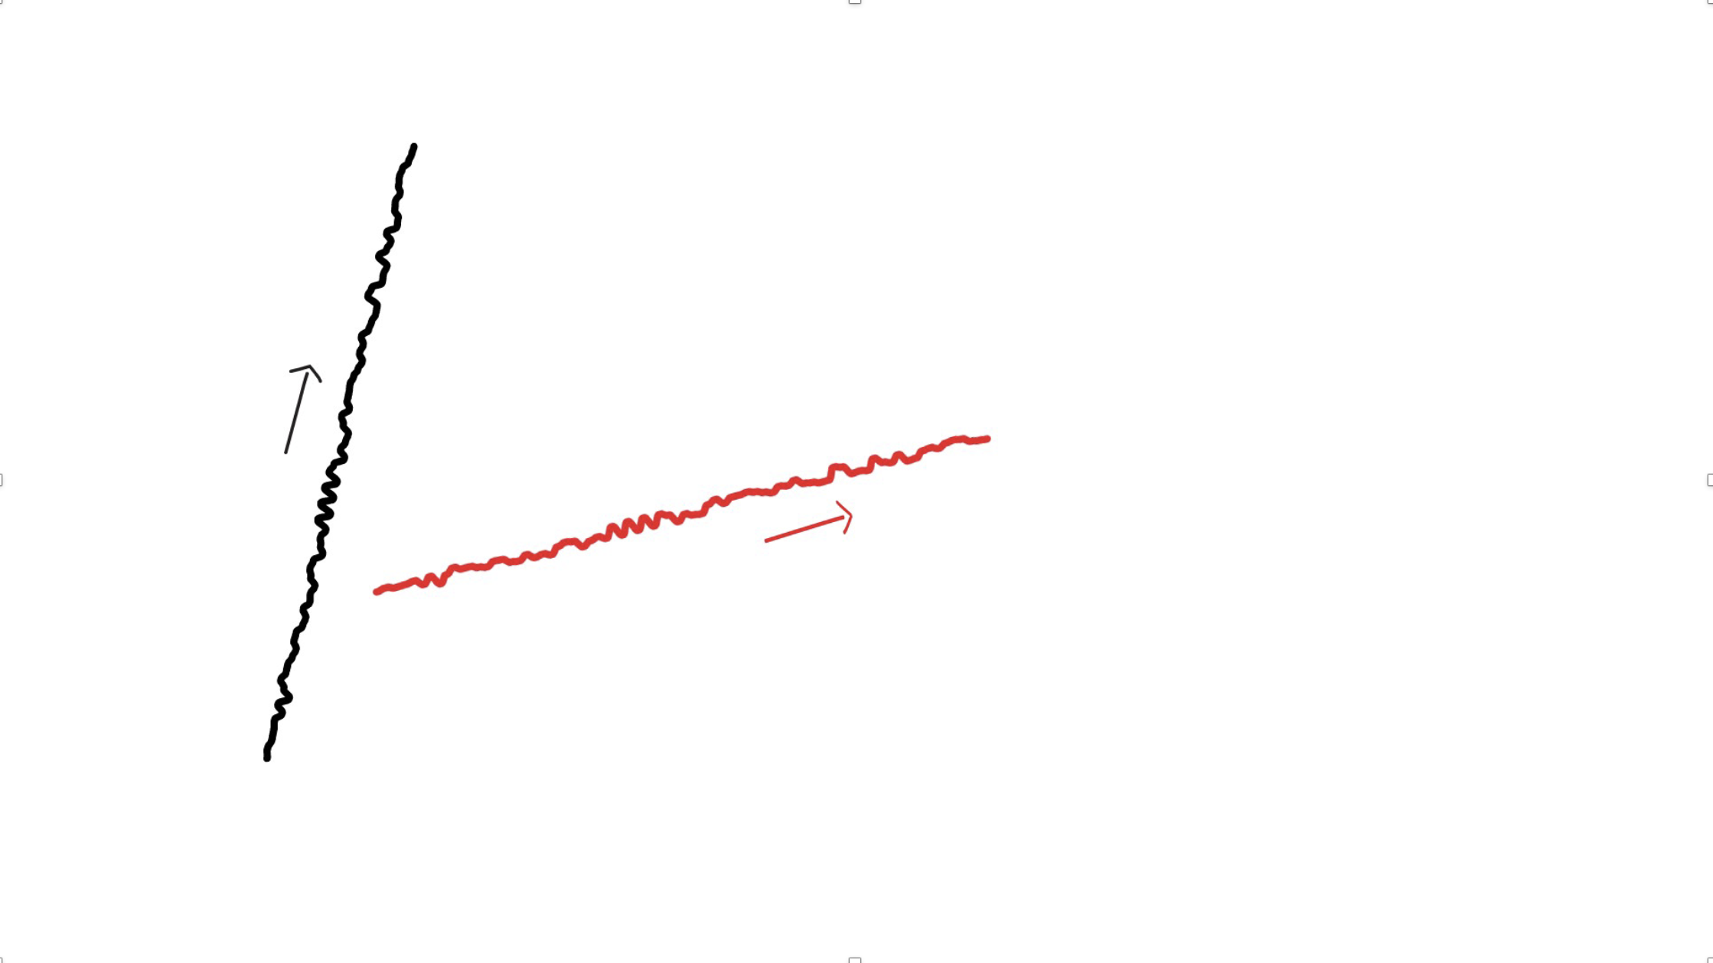

Slide 35
Glissile interface cannot contain >1 set of dislocations.
Martensitic transformation only possible if γ→α’ deformation leaves 1 line undistorted and unrotated, i.e. an invariant-line.
Deformation is an invariant-line strain.

Slide 36
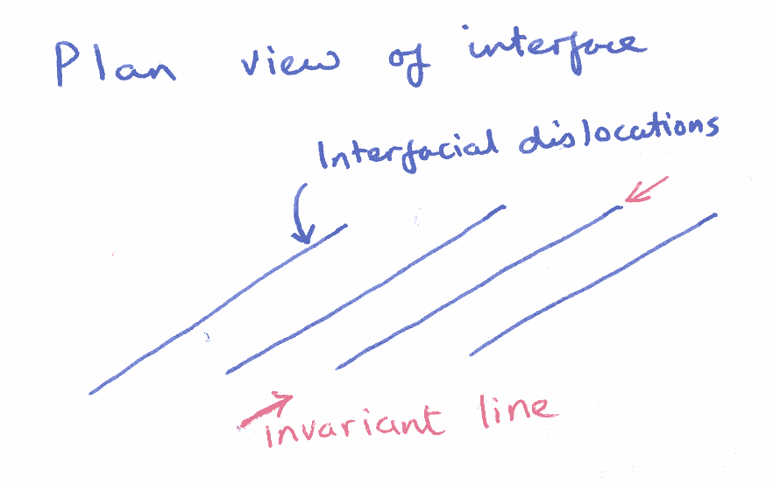

Slide 37
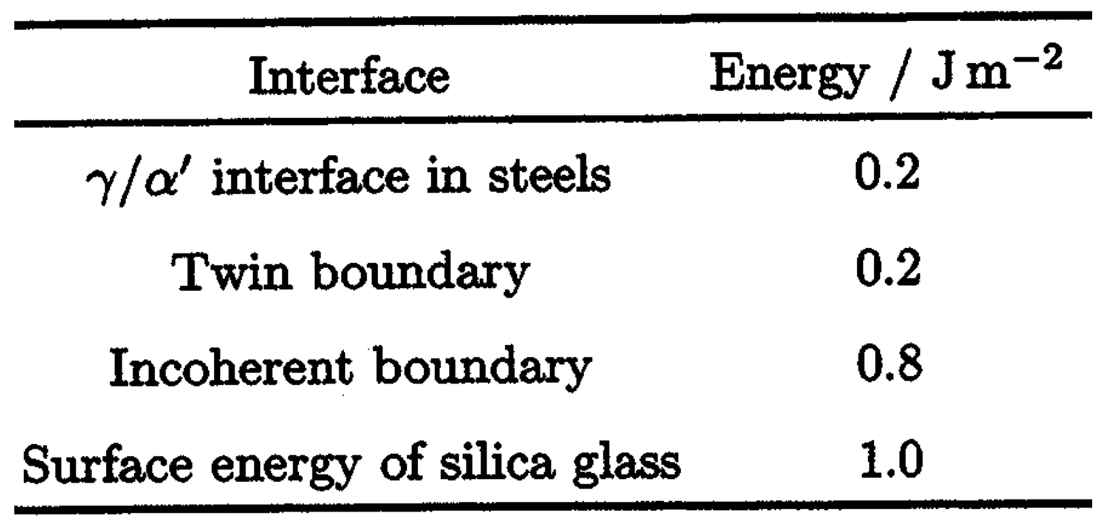

Slide 38
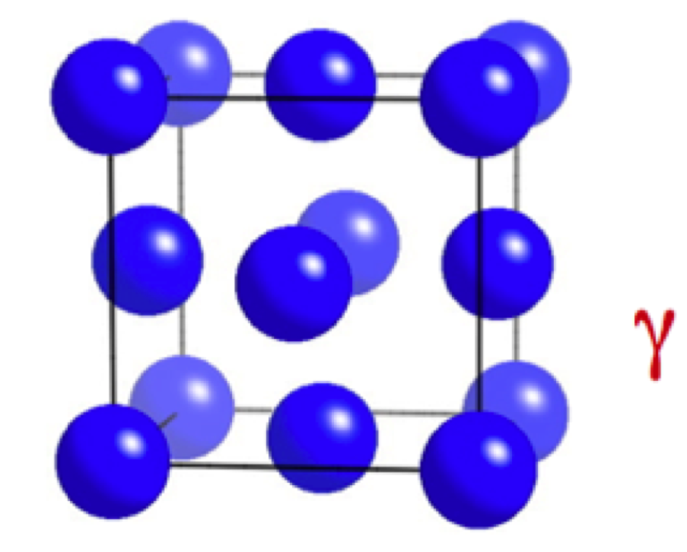
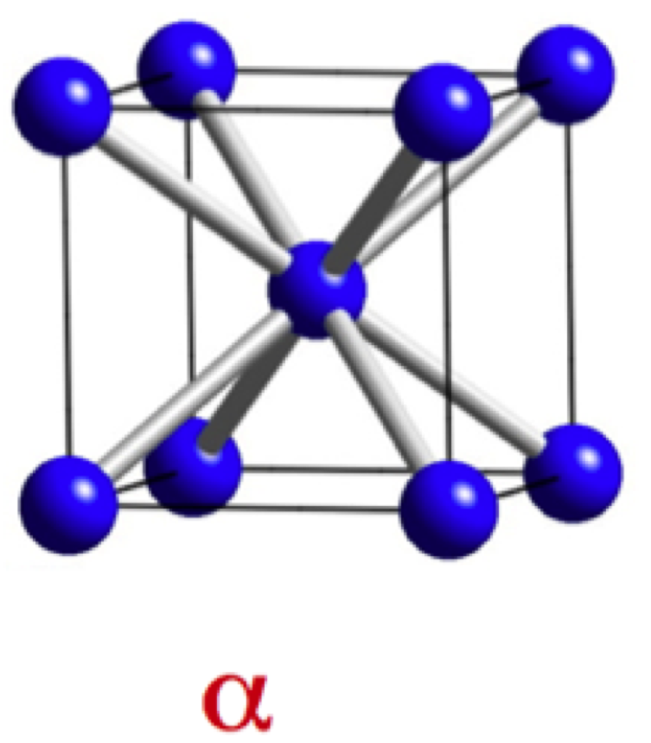

Slide 39


Slide 40

Wirtschaftsvereinigung Stahl, Düsseldorf
courtesy of Professor Hans Werner Zoch

Slide 41

M. Benke, V. Mertinger, Institute of Physical Metallurgy, Metalforming and Nanotechnology, University of Miskolc
http://www.matsci.uni-miskolc.hu/new/

Slide 42

unit length

Slide 43

J. W. Christian, Accommodation strains in martensite formation, the use of the dilatation parameter, Acta Metallurgica 6 (1958) 377.

Slide 44


