Slide 1



Steels: TRIP steels
Lecture 9
Fabio Miani
Harry Bhadeshia
Professor of Metallurgy
Queen Mary University of London
Emeritus Tata Steel Professor of Metallurgy
University of Cambridge
2022

Slide 2
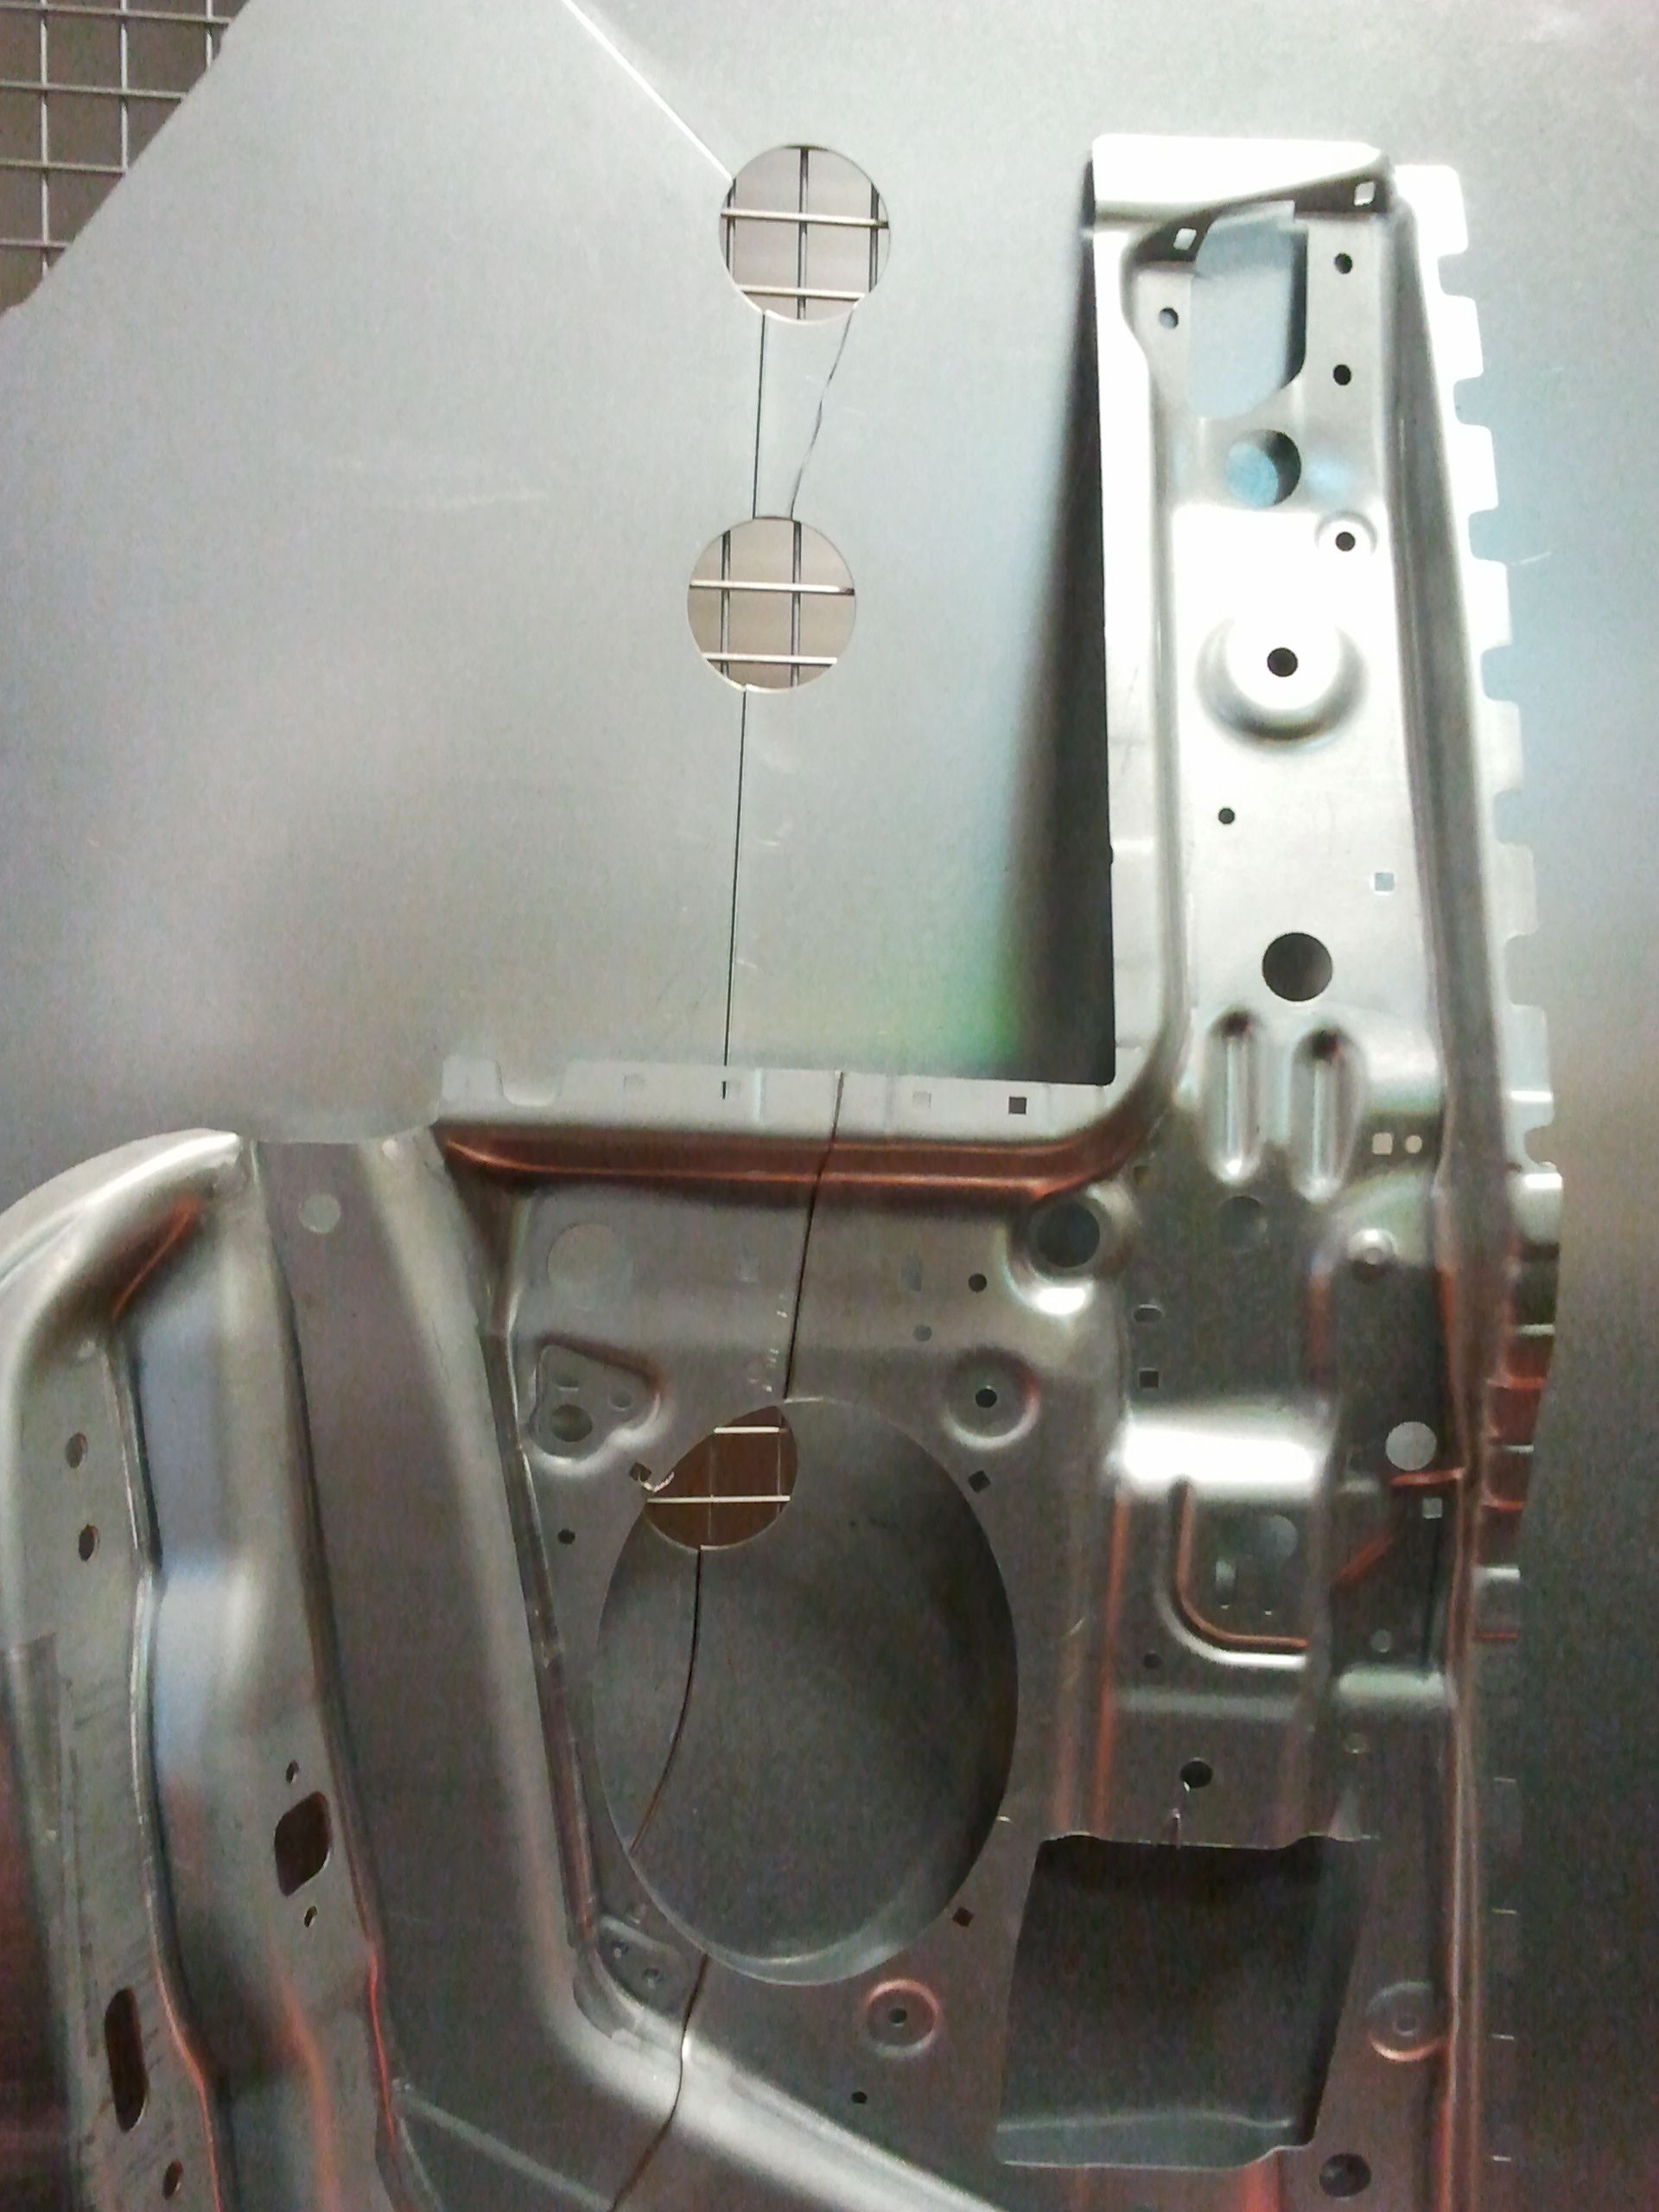
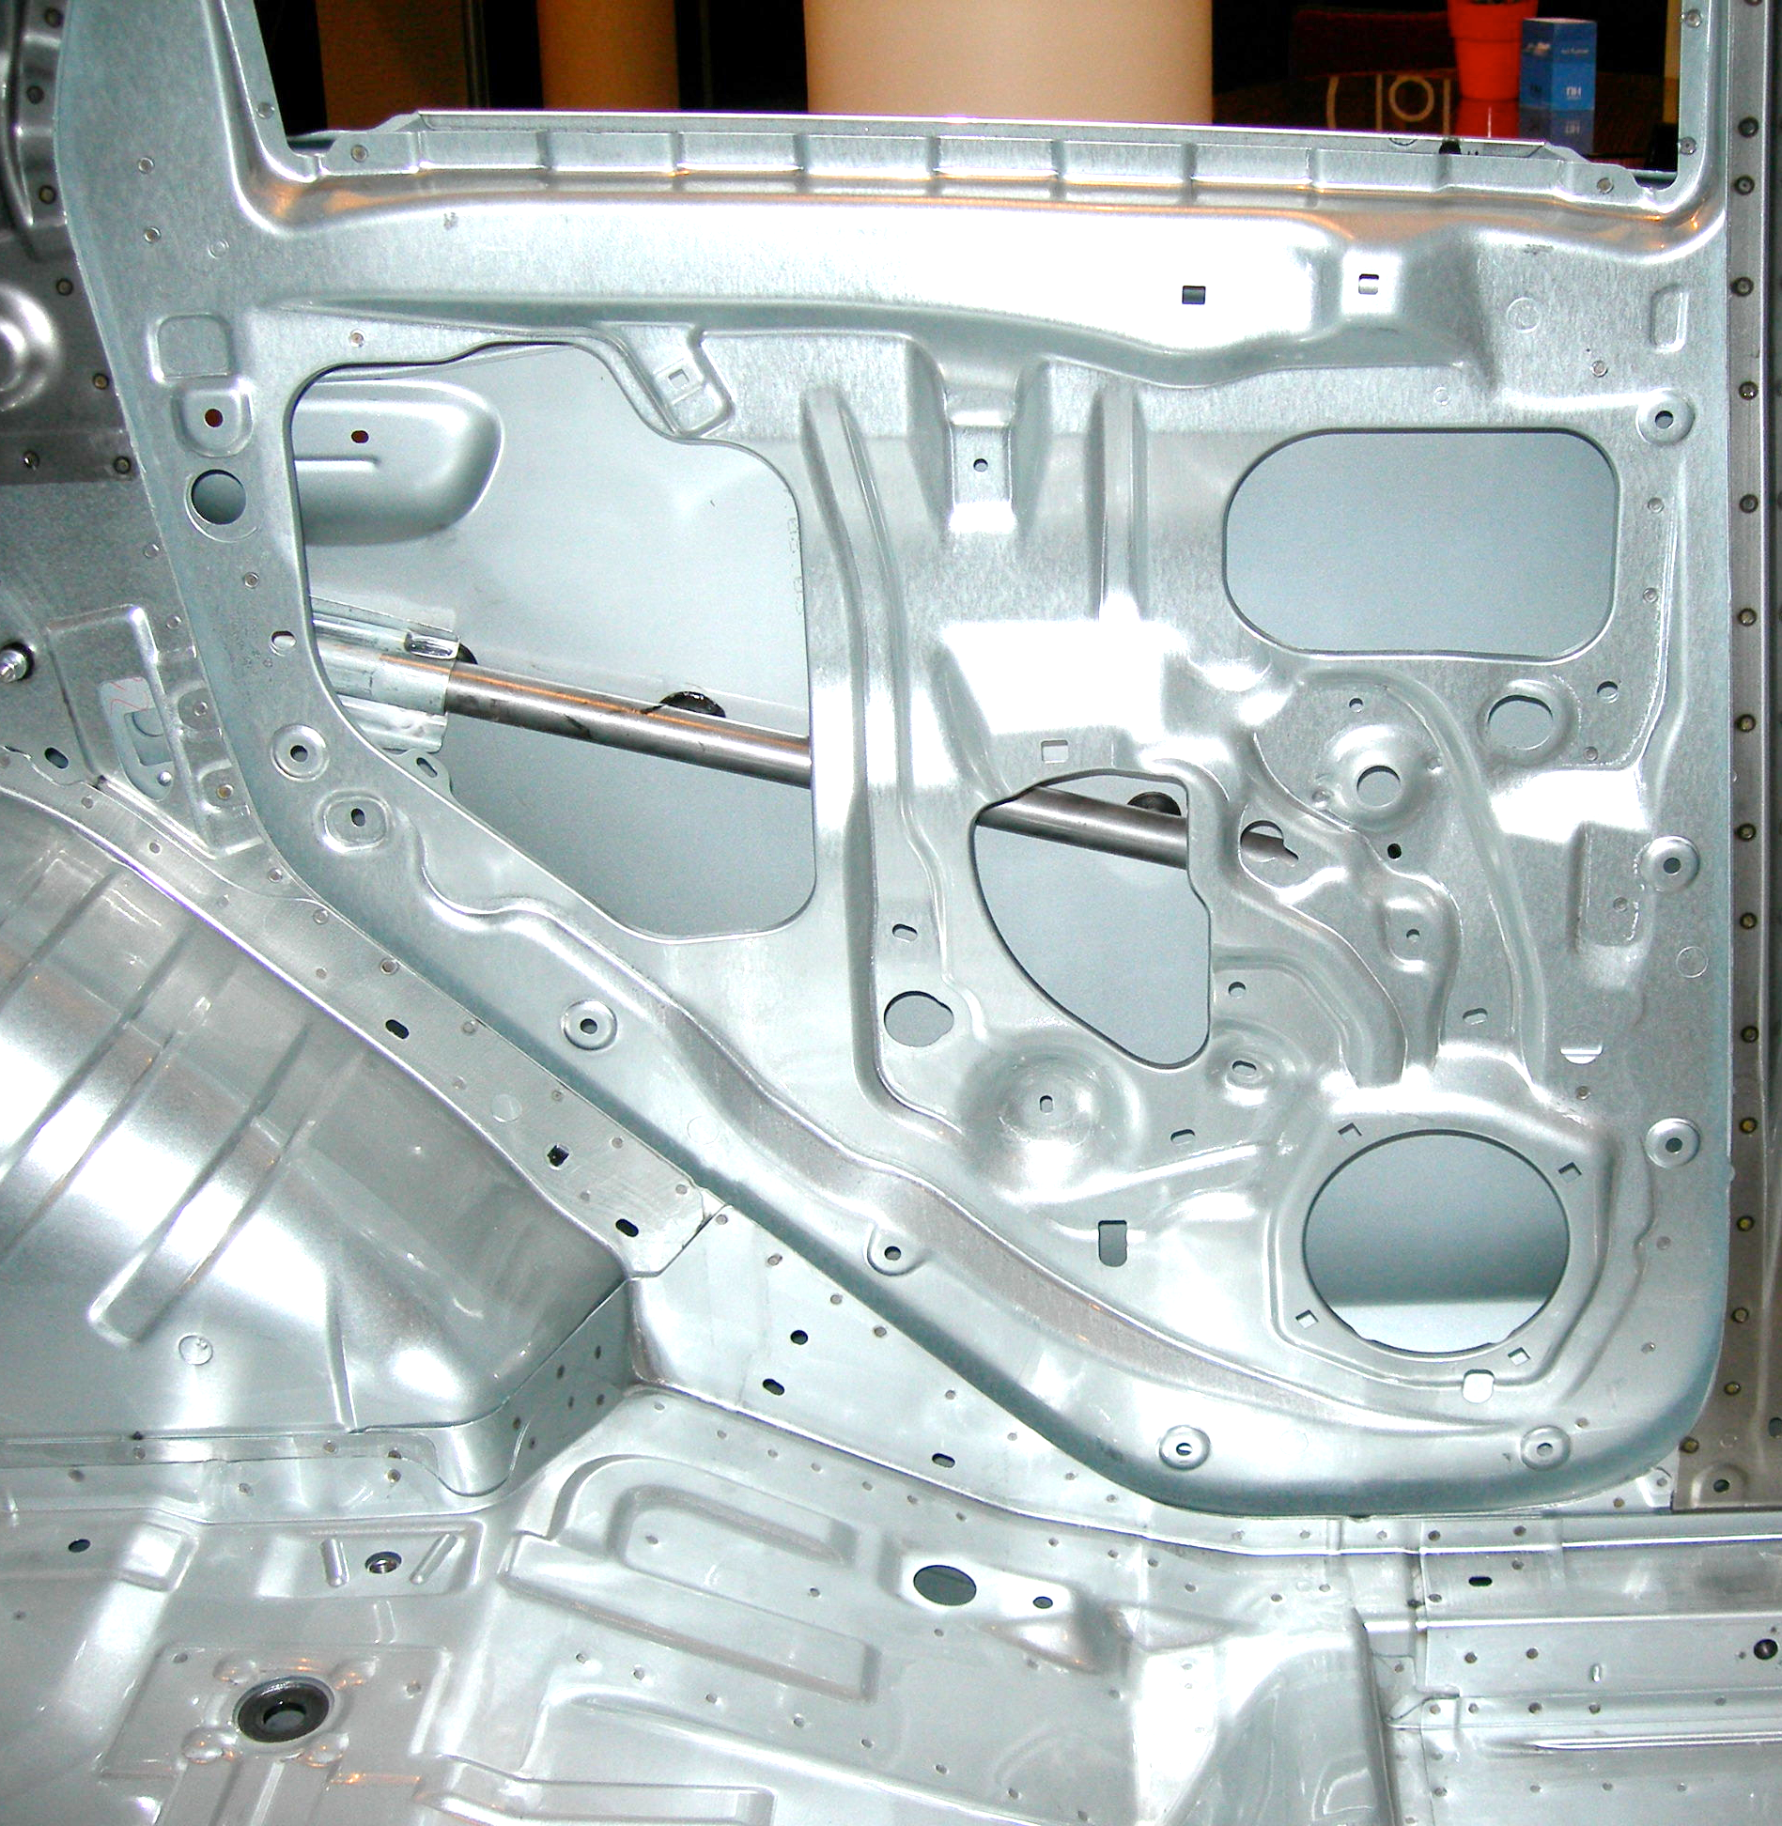
Tailored blanks

Slide 3
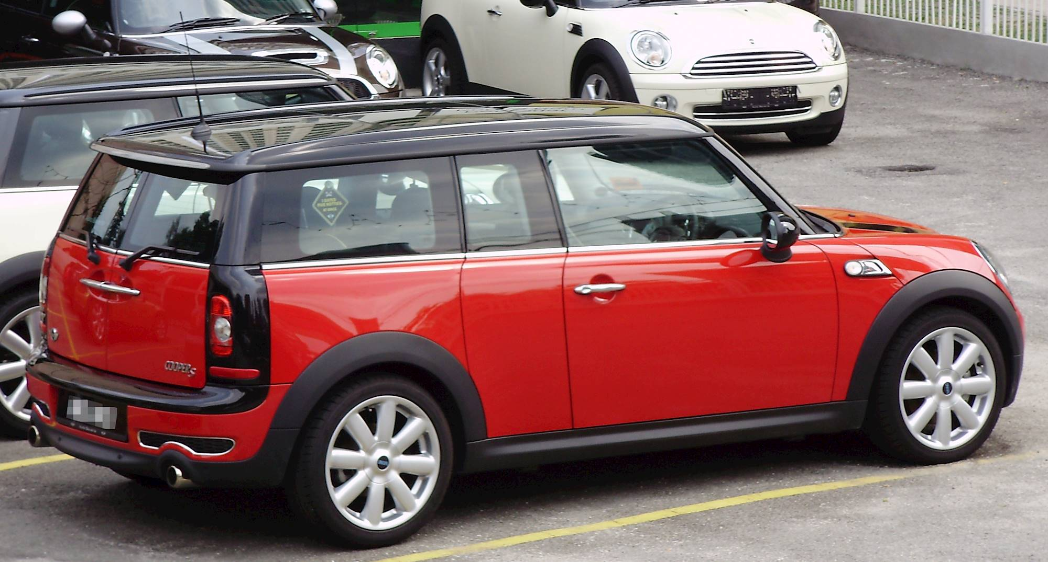
Inner panels of both doors and side panel use tailored blanks

Slide 4
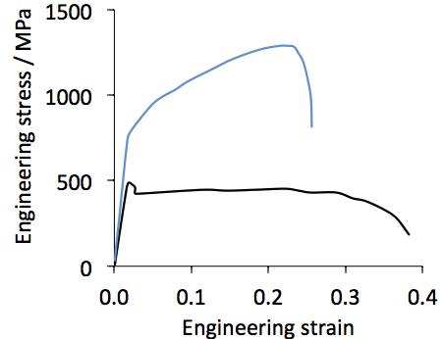
TRIP-steel
aluminium-killed
Mizui et al. (1997)

Slide 5
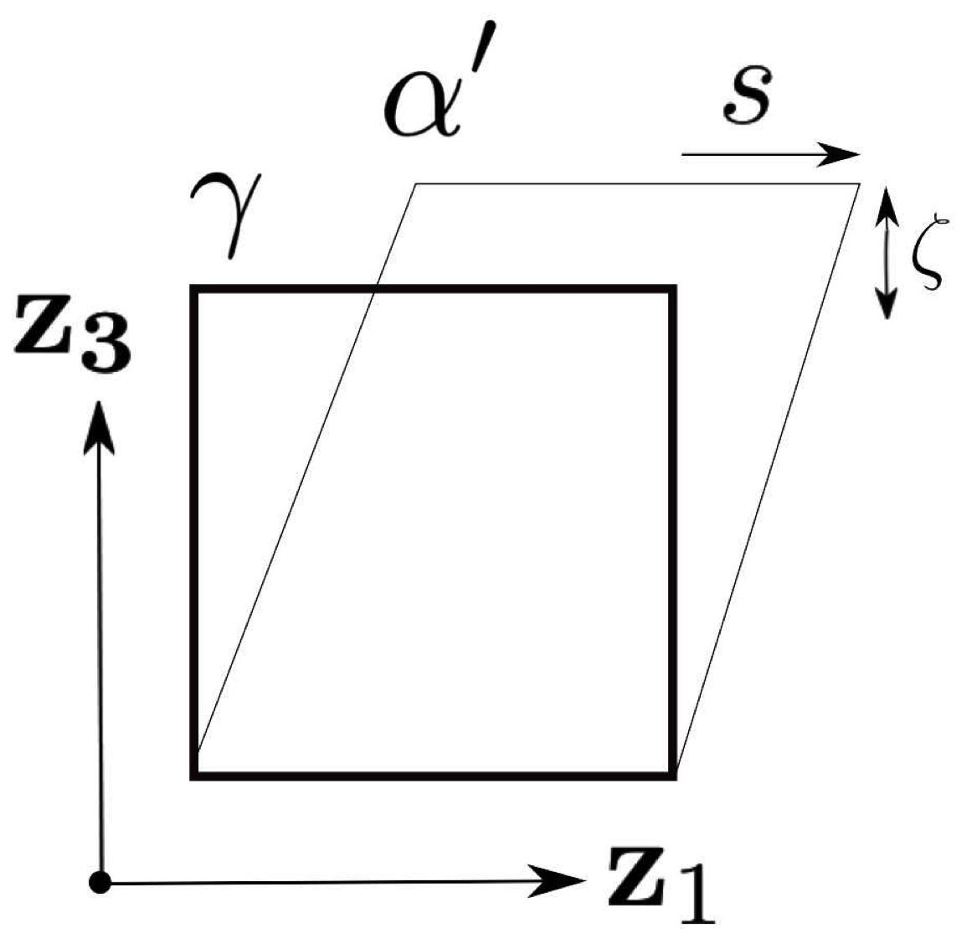
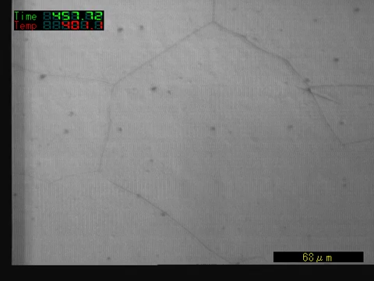
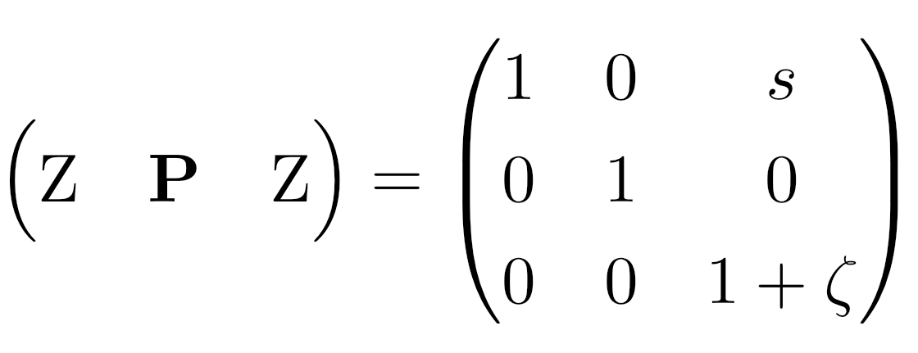
shape deformation
orthonormal coordinates
Fe-0.18C-0.2Si-0.9Mn-2.9Ni-1.5Cr-0.4Mo wt%
Professor Toshihiko Koseki of The University of Tokyo

Slide 6
u
v

Slide 8
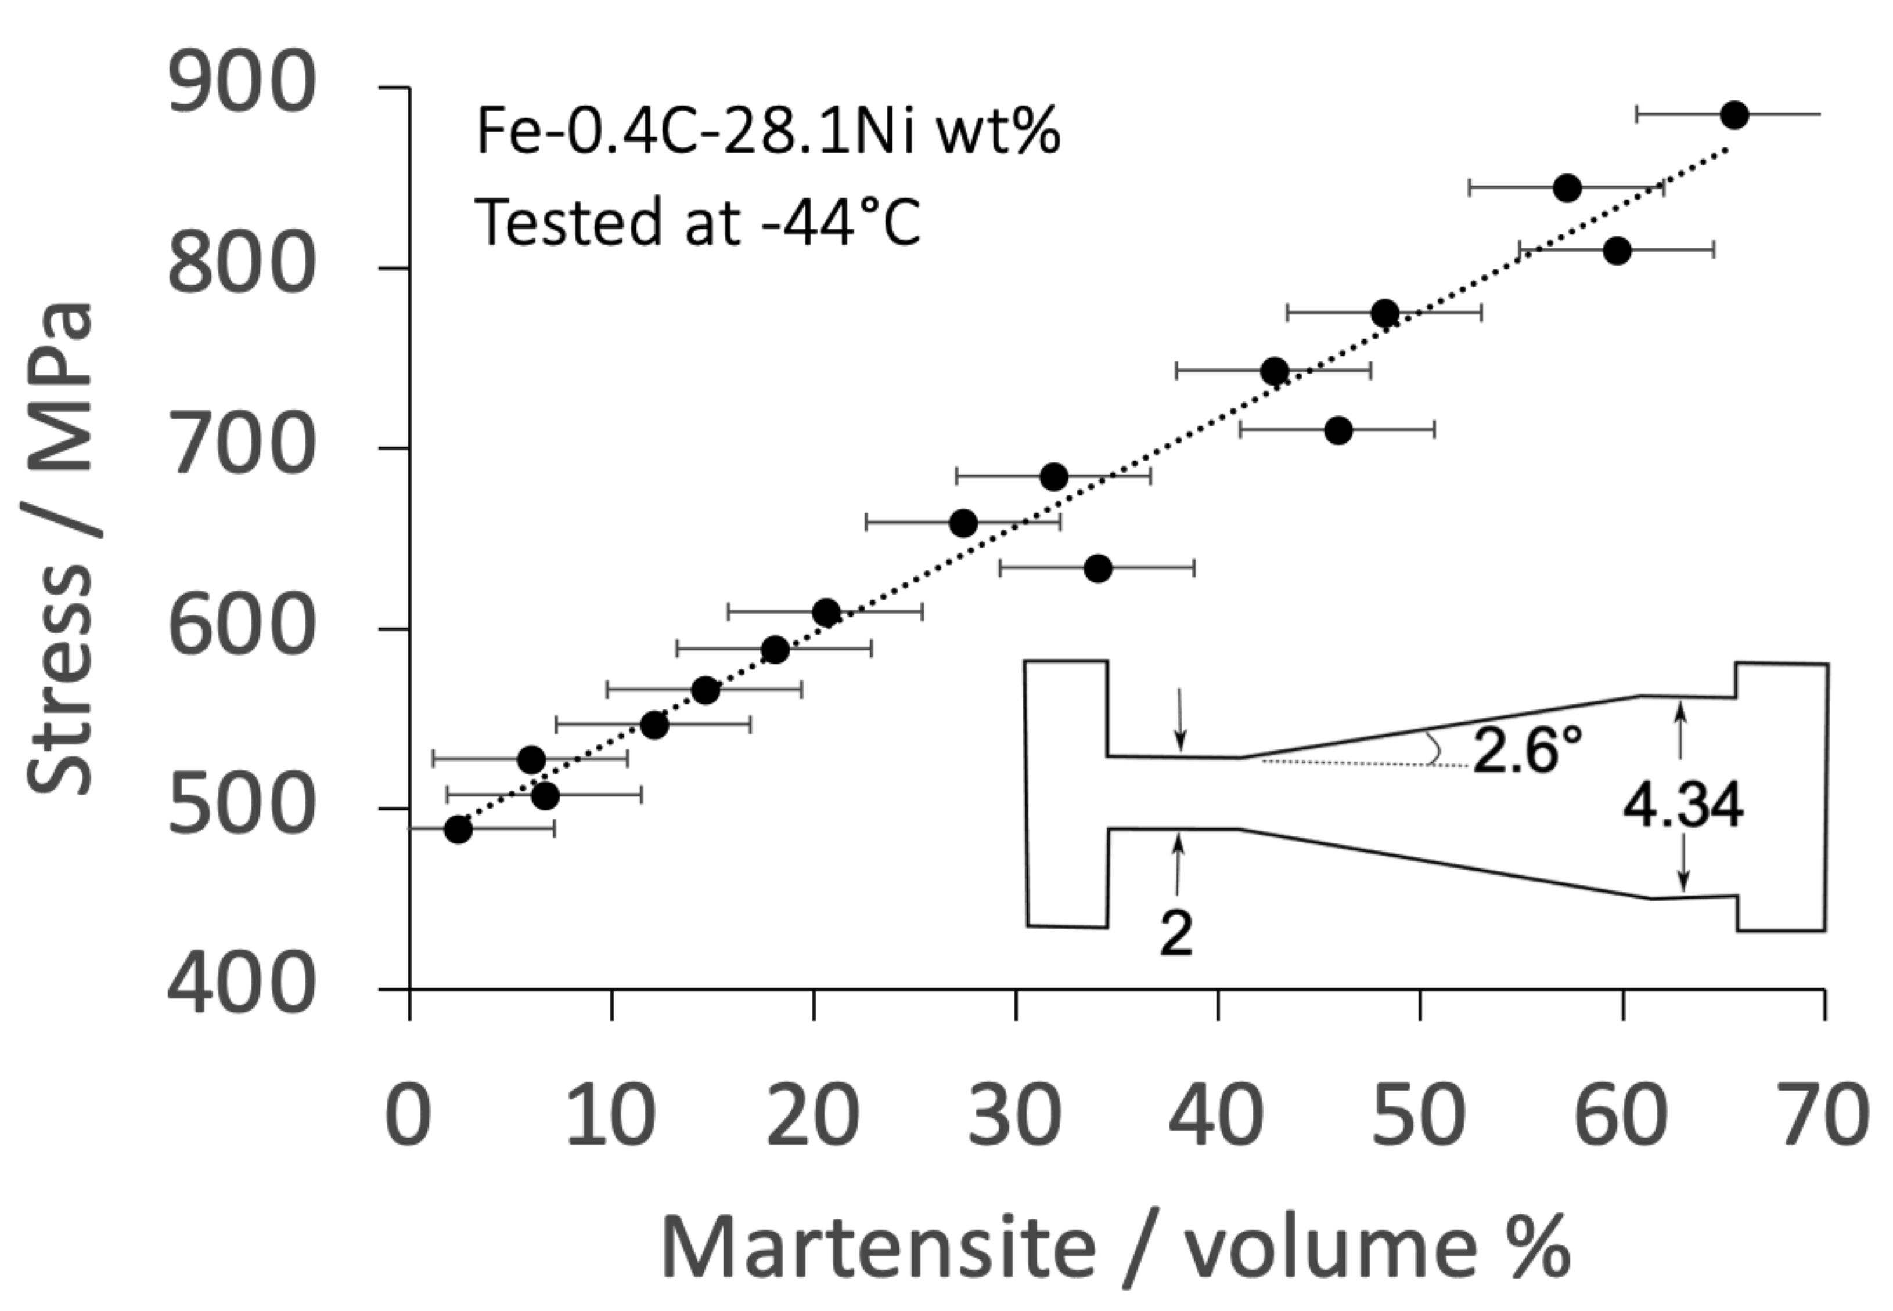
Bhadeshia HKDH. An aspect of the nucleation of burst martensite. Journal of Materials Science. 1982;17:383-6.

Slide 9
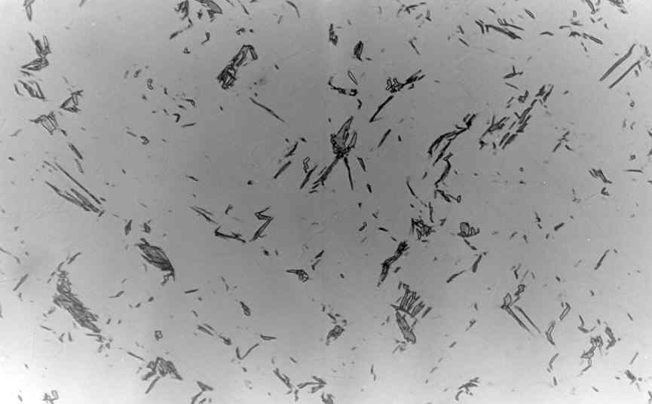
polycrystalline austenite
σ
Bhadeshia HKDH. An aspect of the nucleation of burst martensite. Journal of Materials Science. 1982;17:383-6.
50 μm

Slide 10
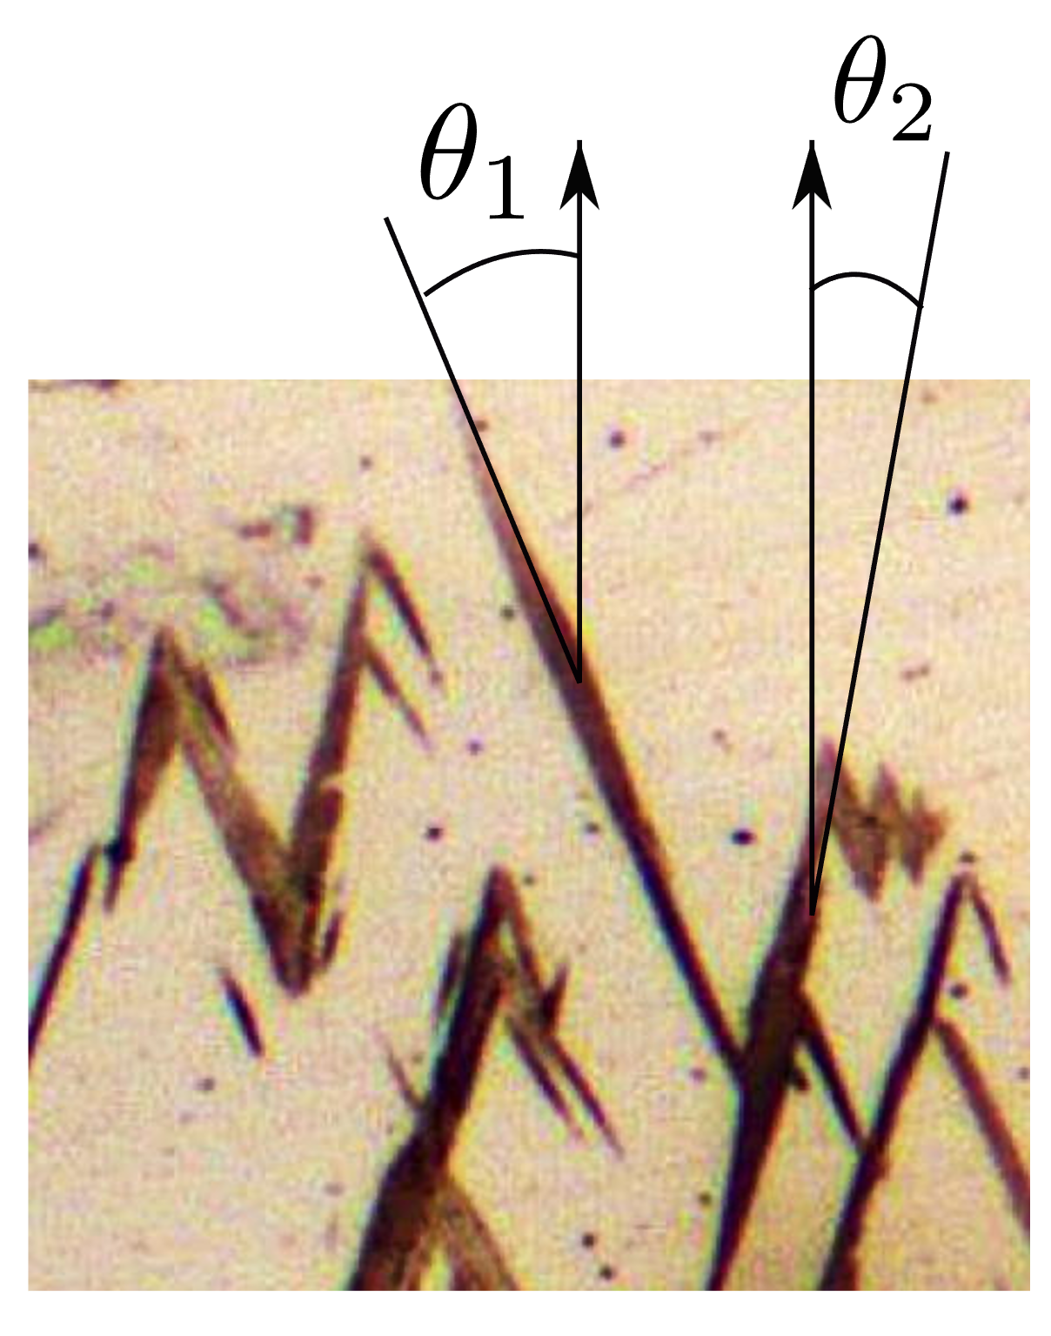

Slide 11
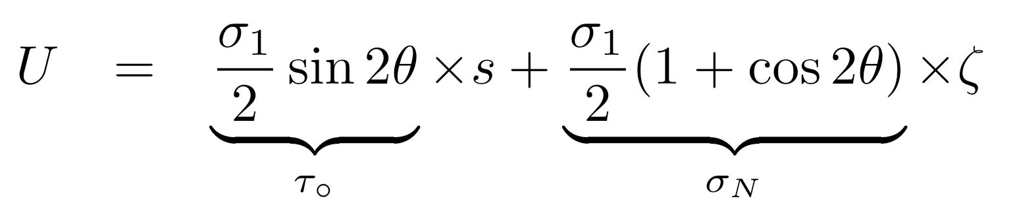
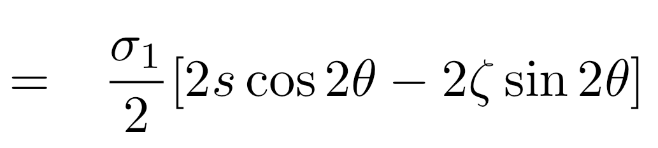


Slide 12
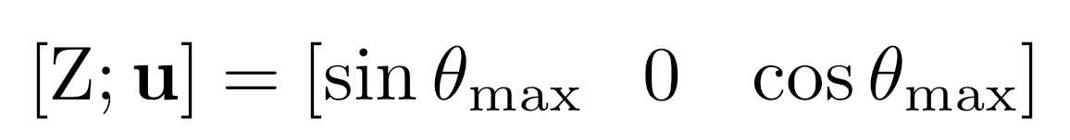
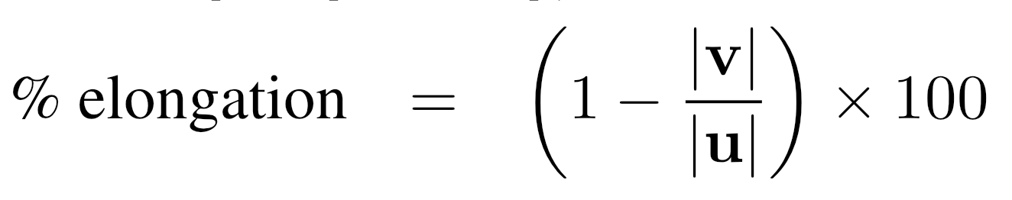
Bhadeshia HK. TRIP-assisted steels? ISIJ international. 2002;42:1059.
41.7°
tensile axis
= 15%

Slide 13
Transformation plasticity does not contribute much to elongation, so what gives TRIP-steels their large elongation, typically 25%?
Necking during tension is a plastic instability
..... any localised stress concentration must be balanced by work hardening

Slide 14
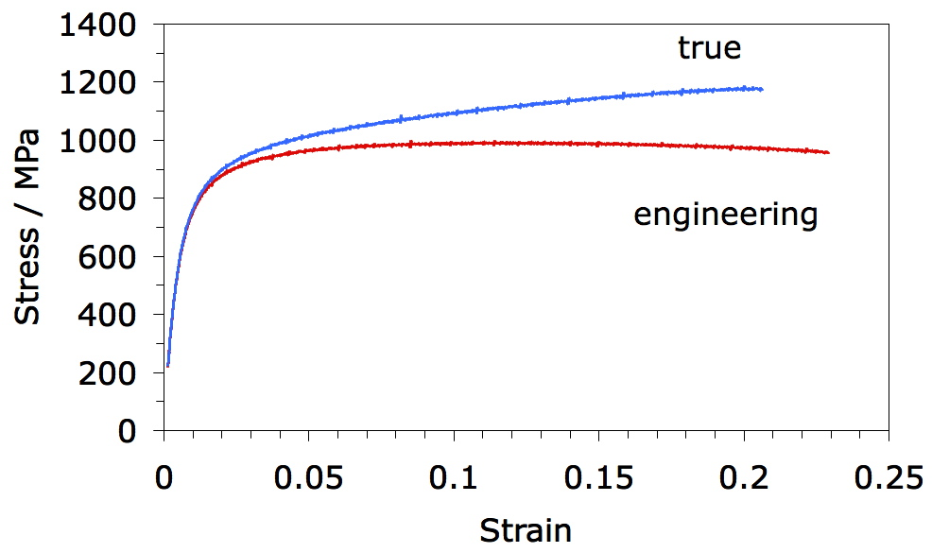
tested at room temperature
Chatterjee S, Murugananth M, Bhadeshia HKDH. δ TRIP steel. Materials Science and Technology. 2007;23:819-27.
14.3% γ
7% γ

Slide 15
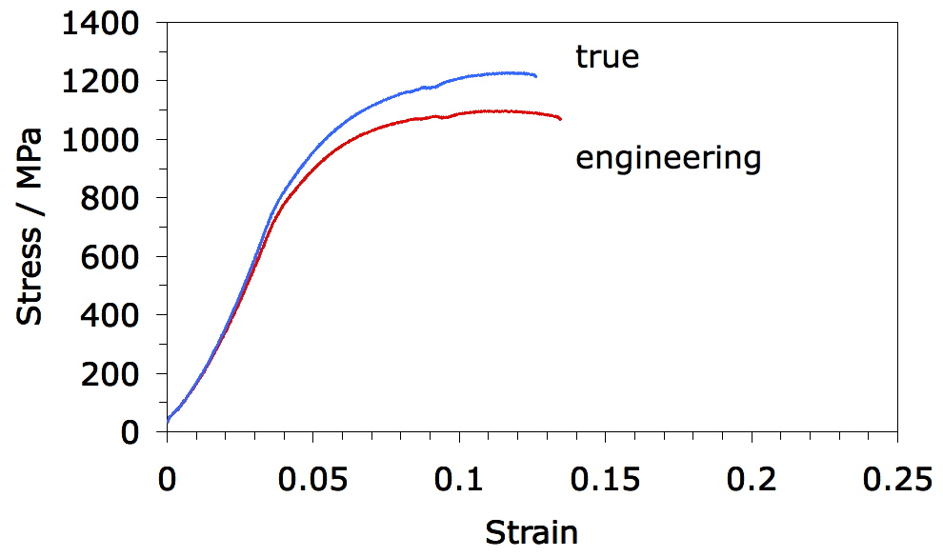
tested at 100 °C
Chatterjee S, Murugananth M, Bhadeshia HKDH. δ TRIP steel. Materials Science and Technology. 2007;23:819-27.
14.3% γ
13% γ

Slide 16
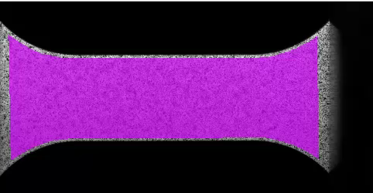
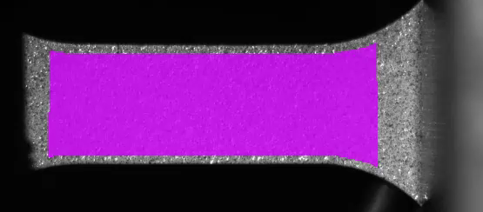
Austenitic stainless steel
25 ∘C
200 ∘C
(Courtesy Prof. Nobuhiro Tsuji)

Slide 17
TRIP steels that are fully austenitic are expensive
How do we produce cheap austenite?

Slide 18
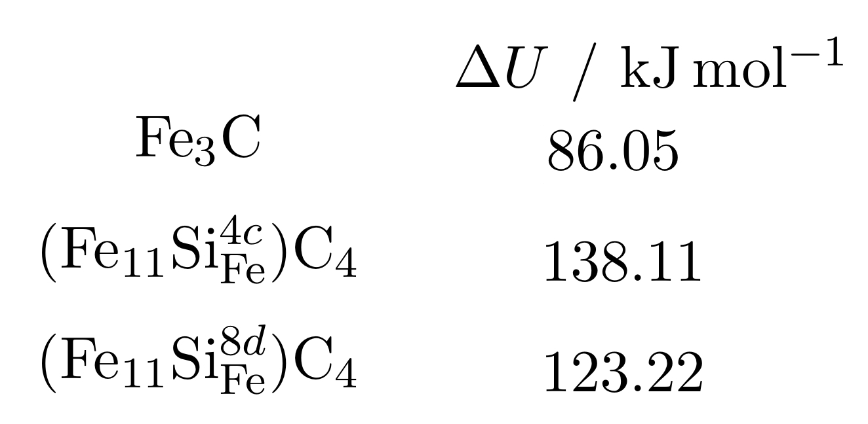
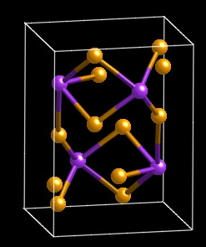
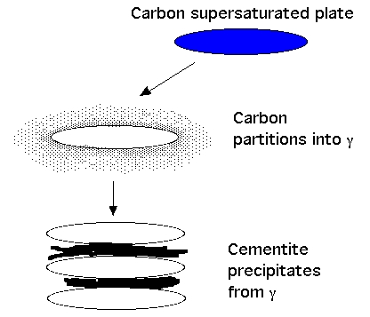
TRIP-Assisted Steels
austenite is expensive
carbon can be cheap
too much carbon is bad
Jae Hoon Jang, In Gee Kim
Notes:
18

Slide 19
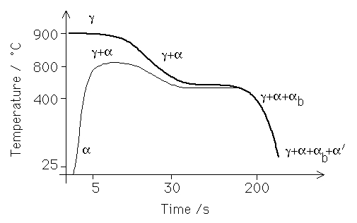

Slide 20
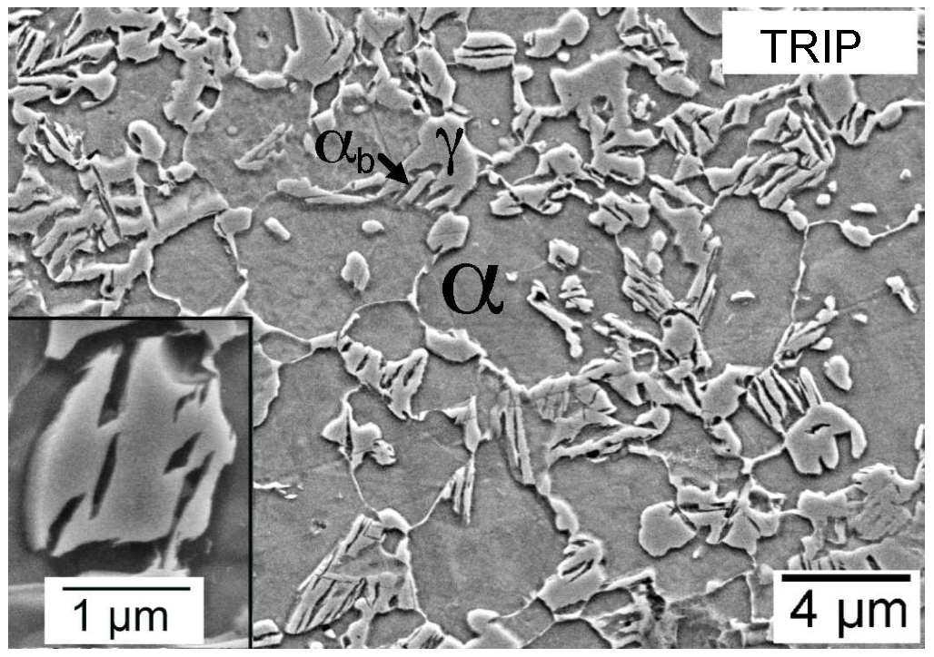
Typical composition Fe-0.15C-1.5Si-1.5Mn wt%

Slide 21

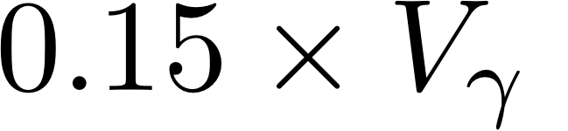
Typical microstructure:
70% allotriomorphic ferrite
16% bainitic ferrite
14% retained austenite
2.1% elongation due to TRIP

Slide 22
work hardening!
TRIP-steel
aluminium-killed
Mizui et al. (1997)

Slide 23
Elongation of TRIP-assisted steel
not due to transformation plasticity
work hardening due to hard martensite

Slide 24
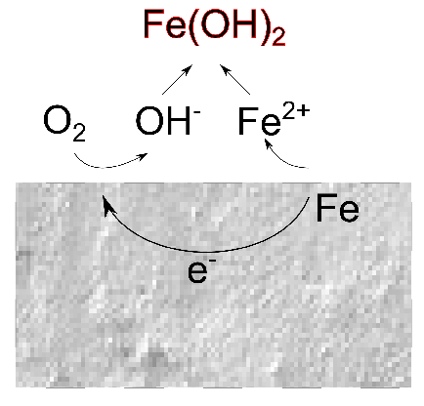
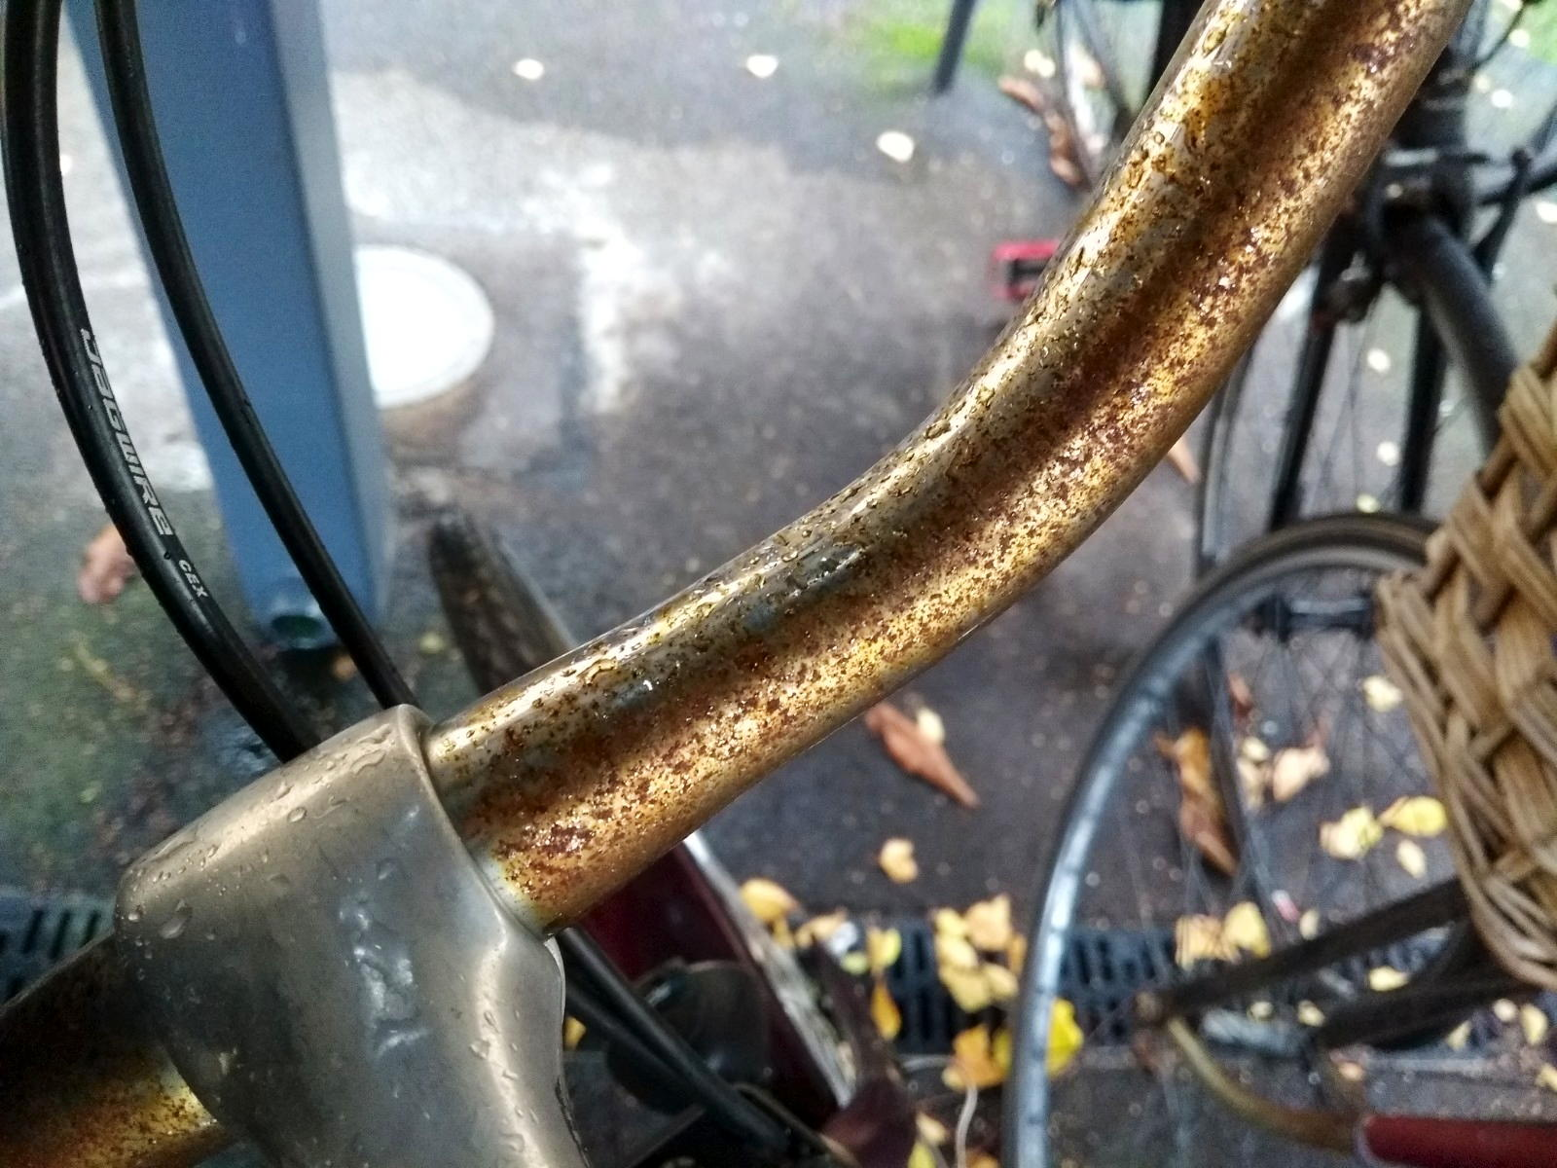

Slide 25
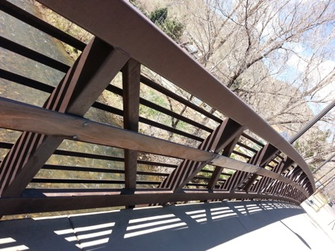
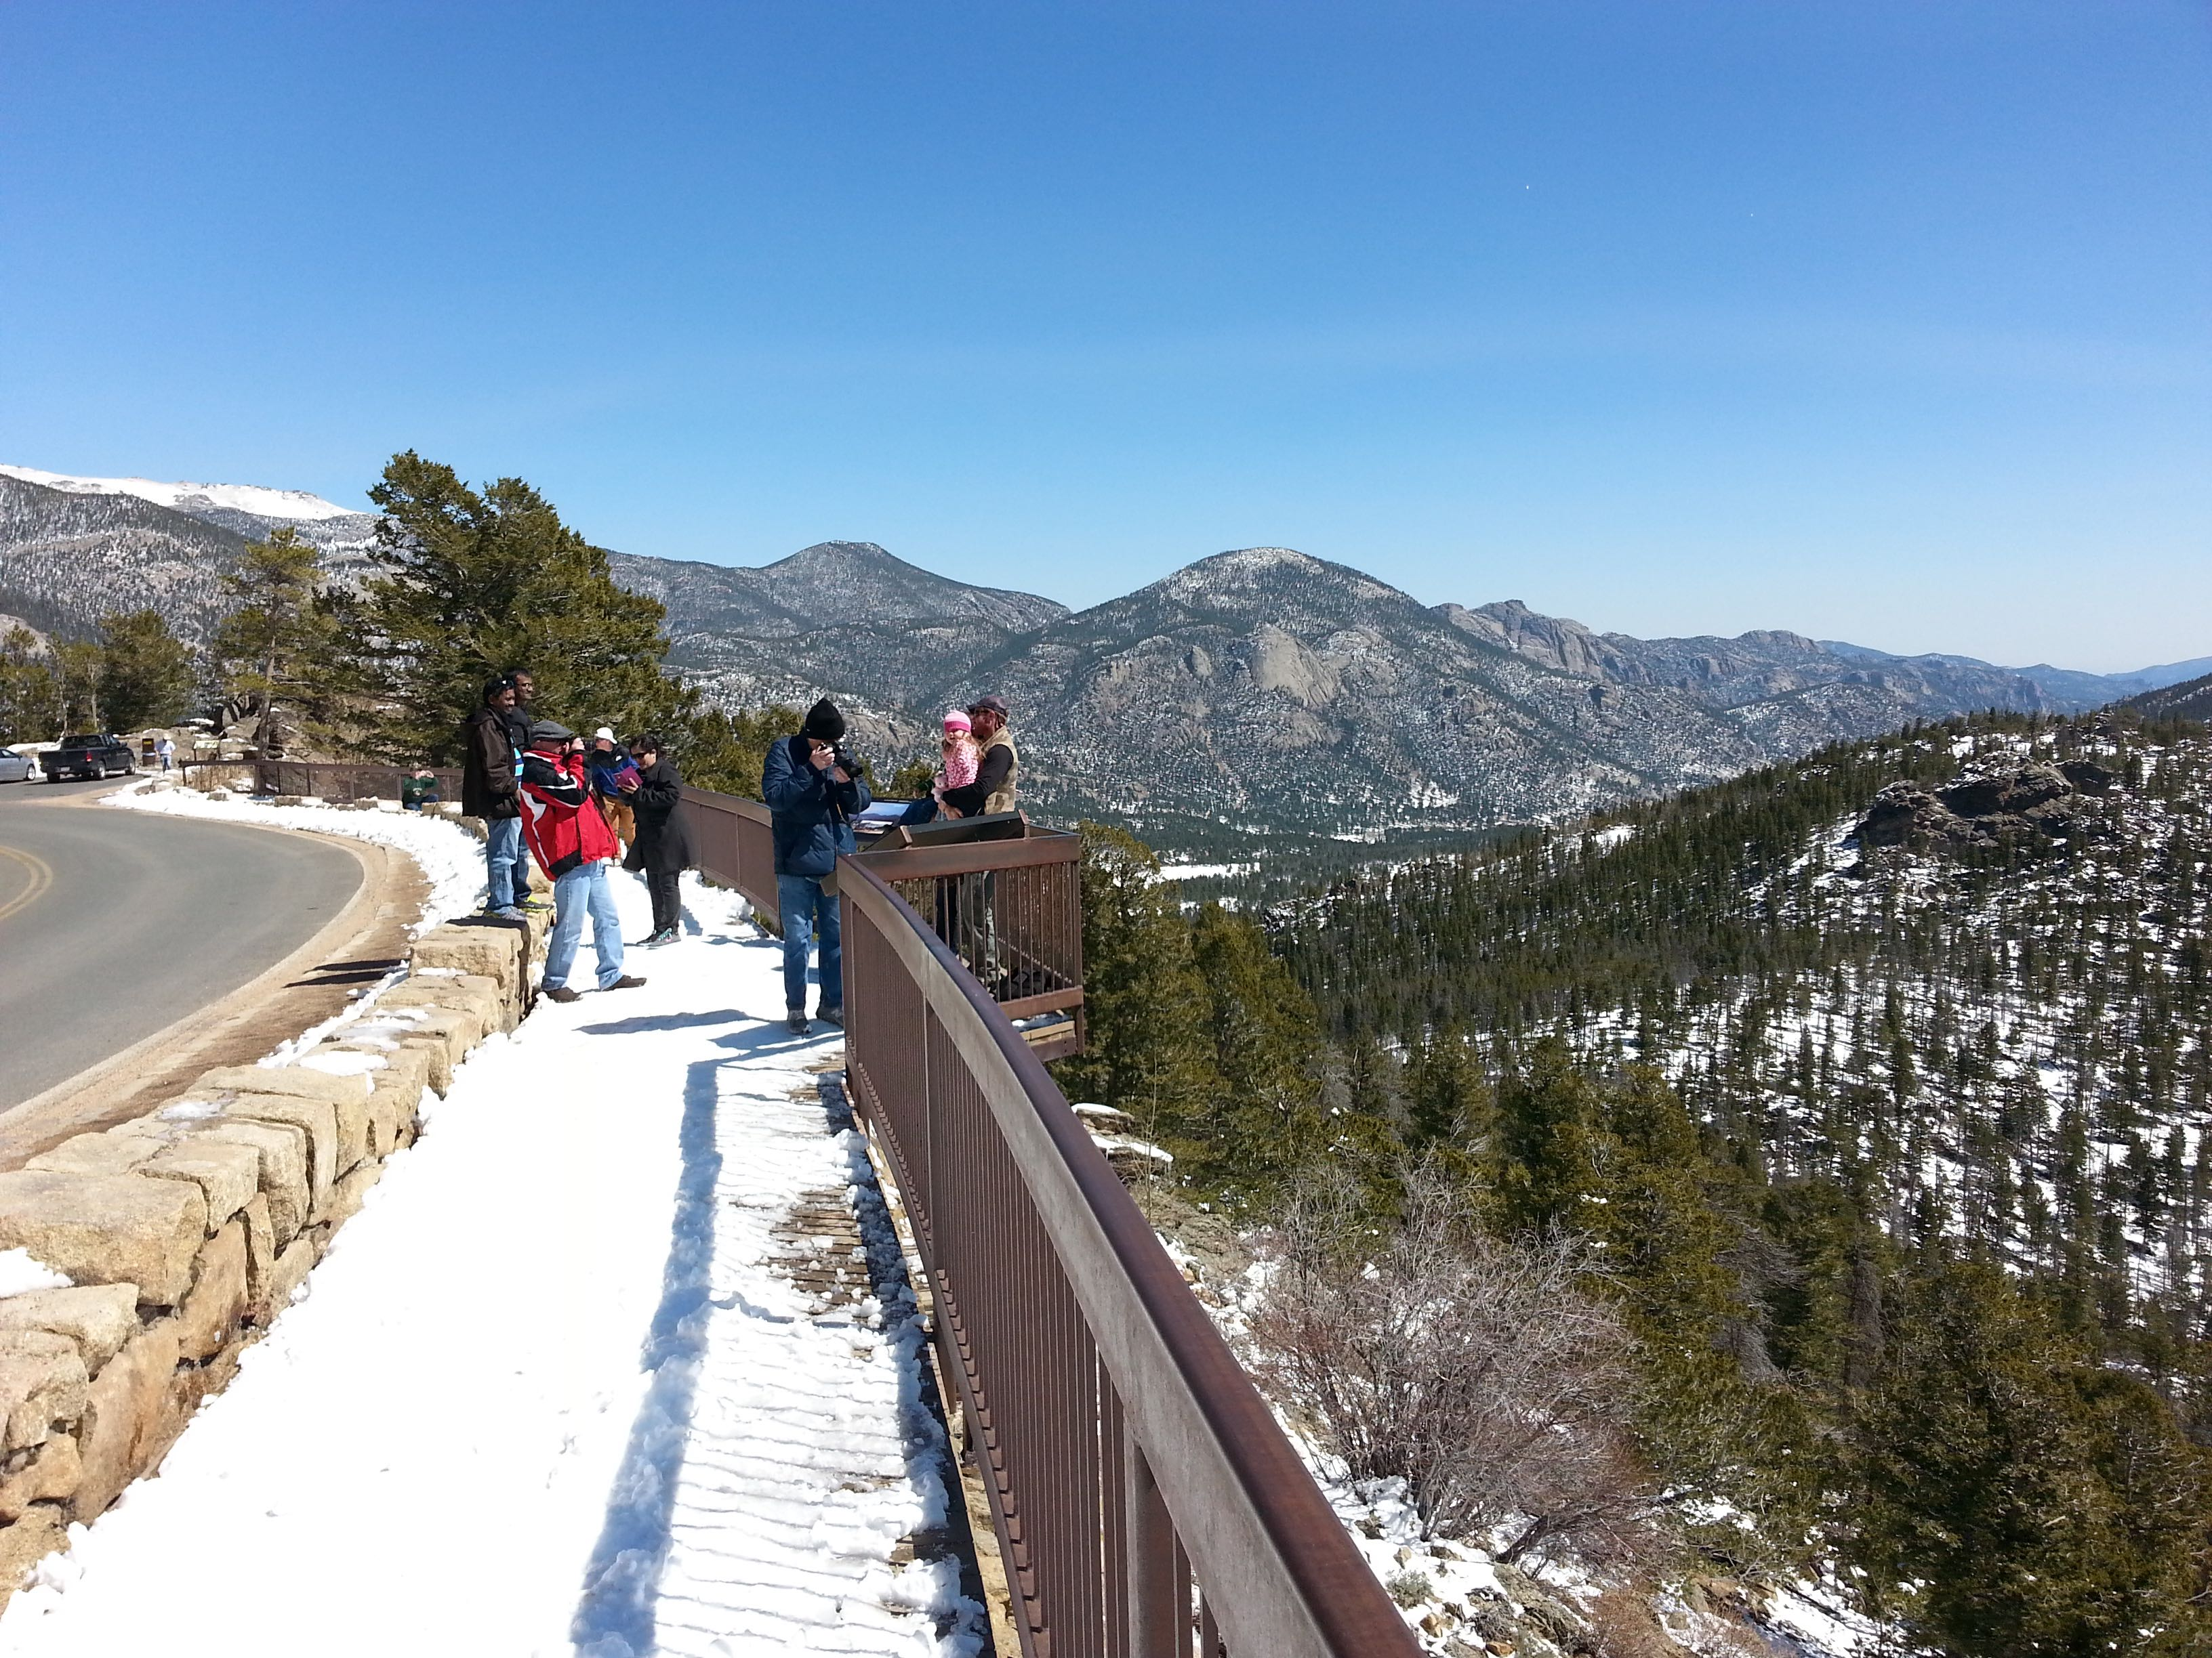
Corten is a weathering steel with 0.25-0.55Cu and 0.5-1.25Cr wt% develops a patina

Slide 26
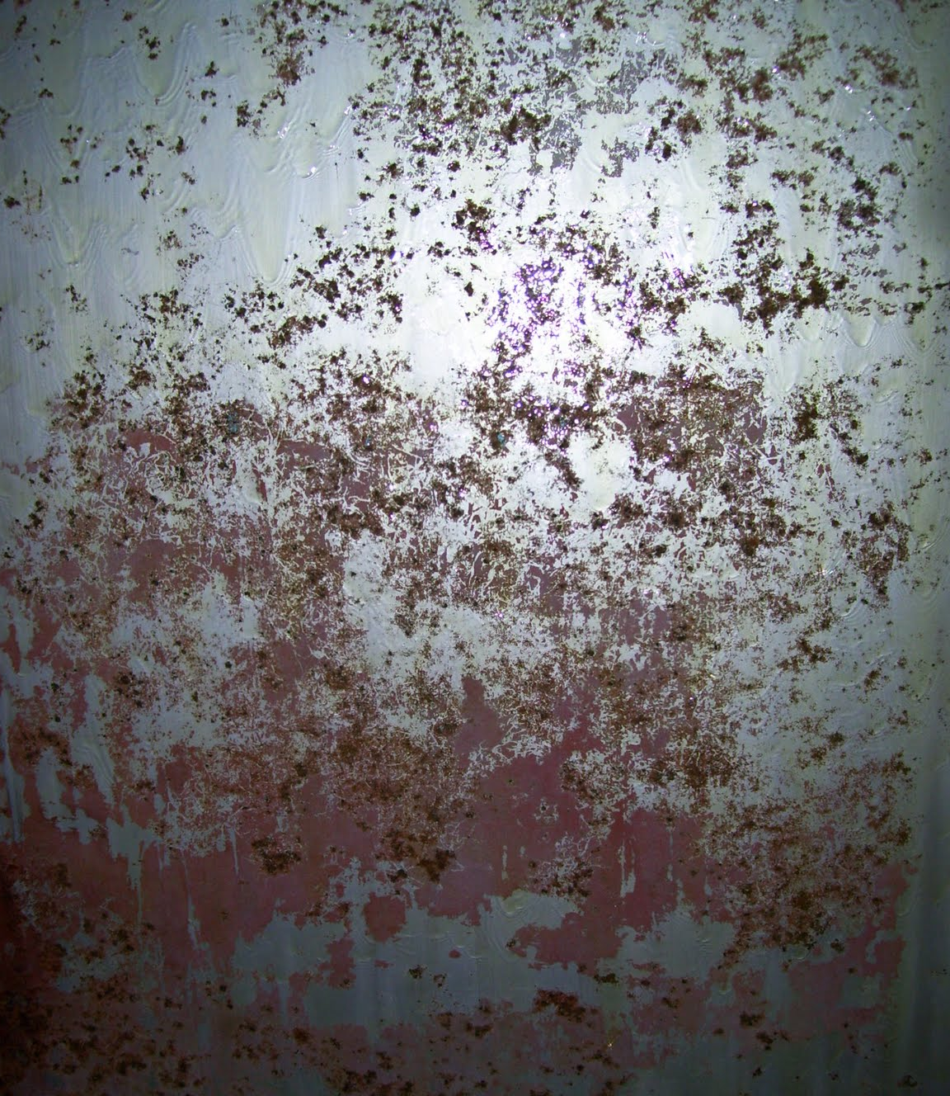
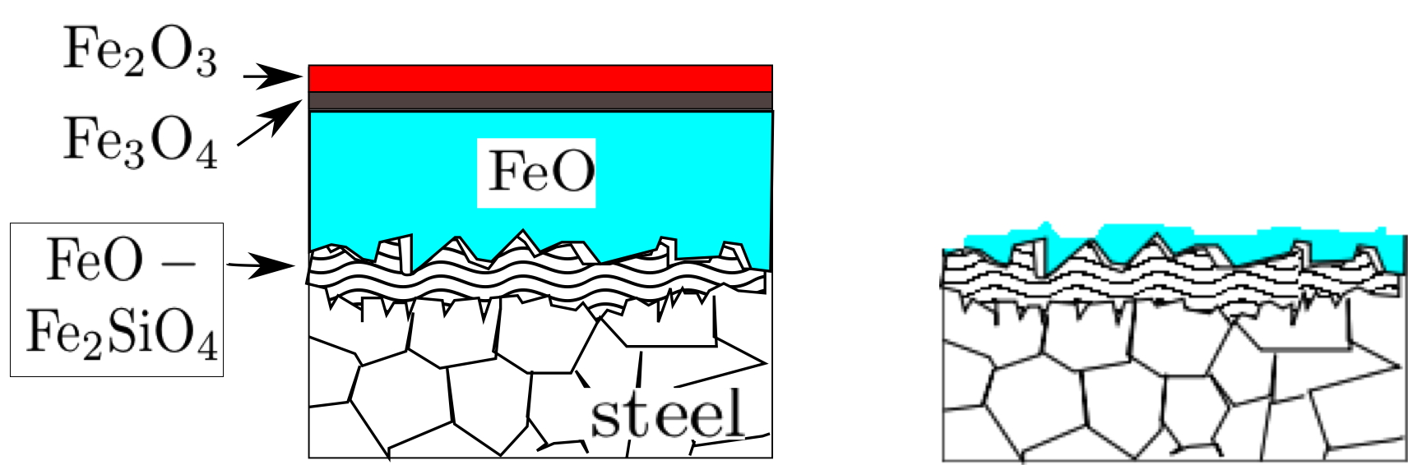
TRIP-Assisted Steels
too much silicon is bad
Notes:
26

Slide 27
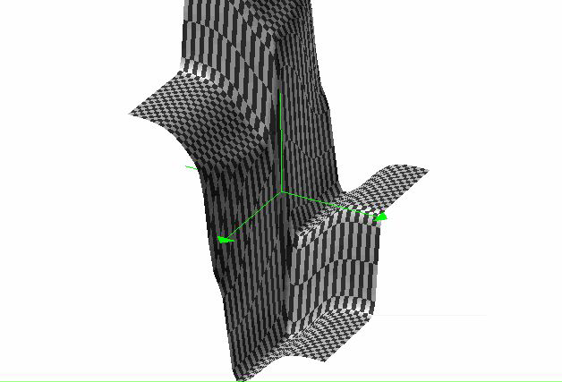
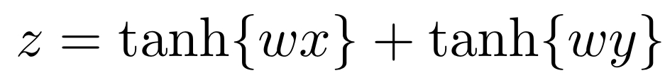
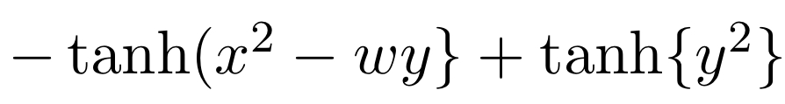

Slide 30
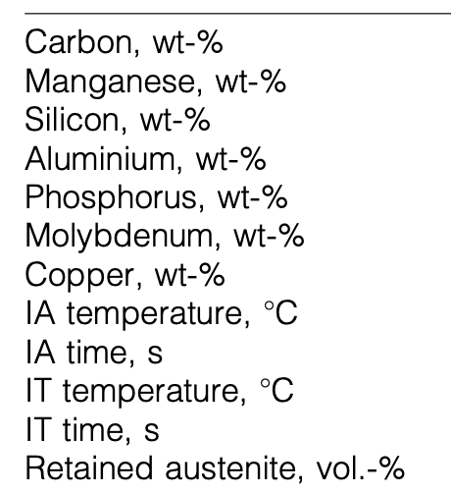
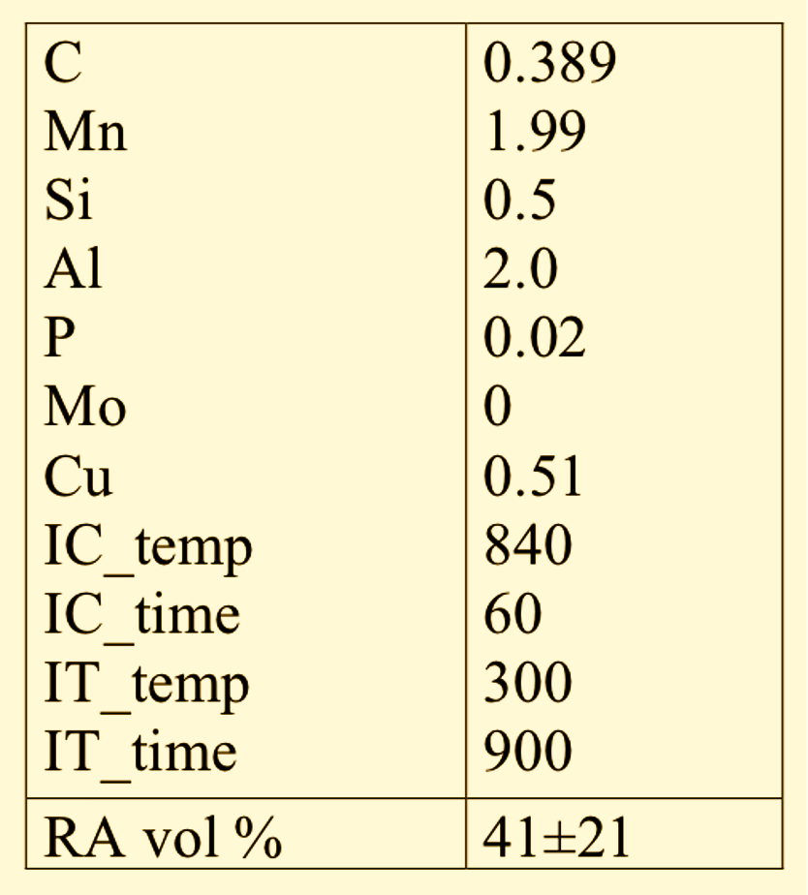

Slide 31
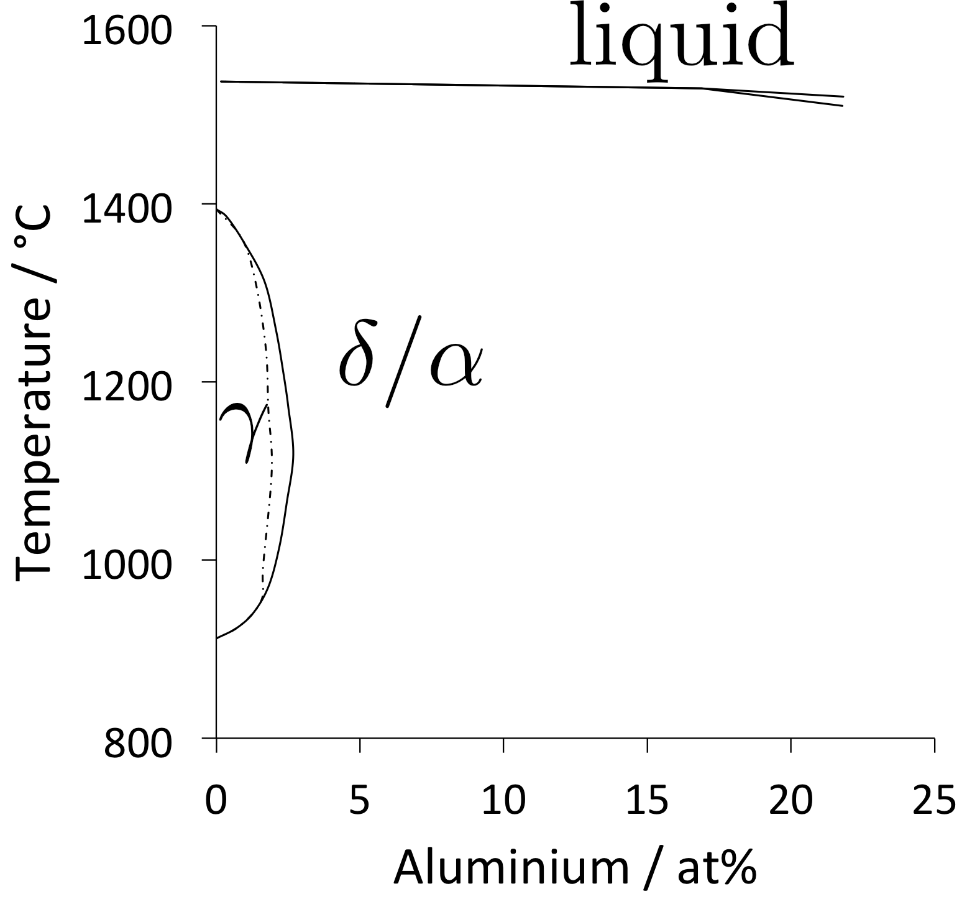

Slide 32
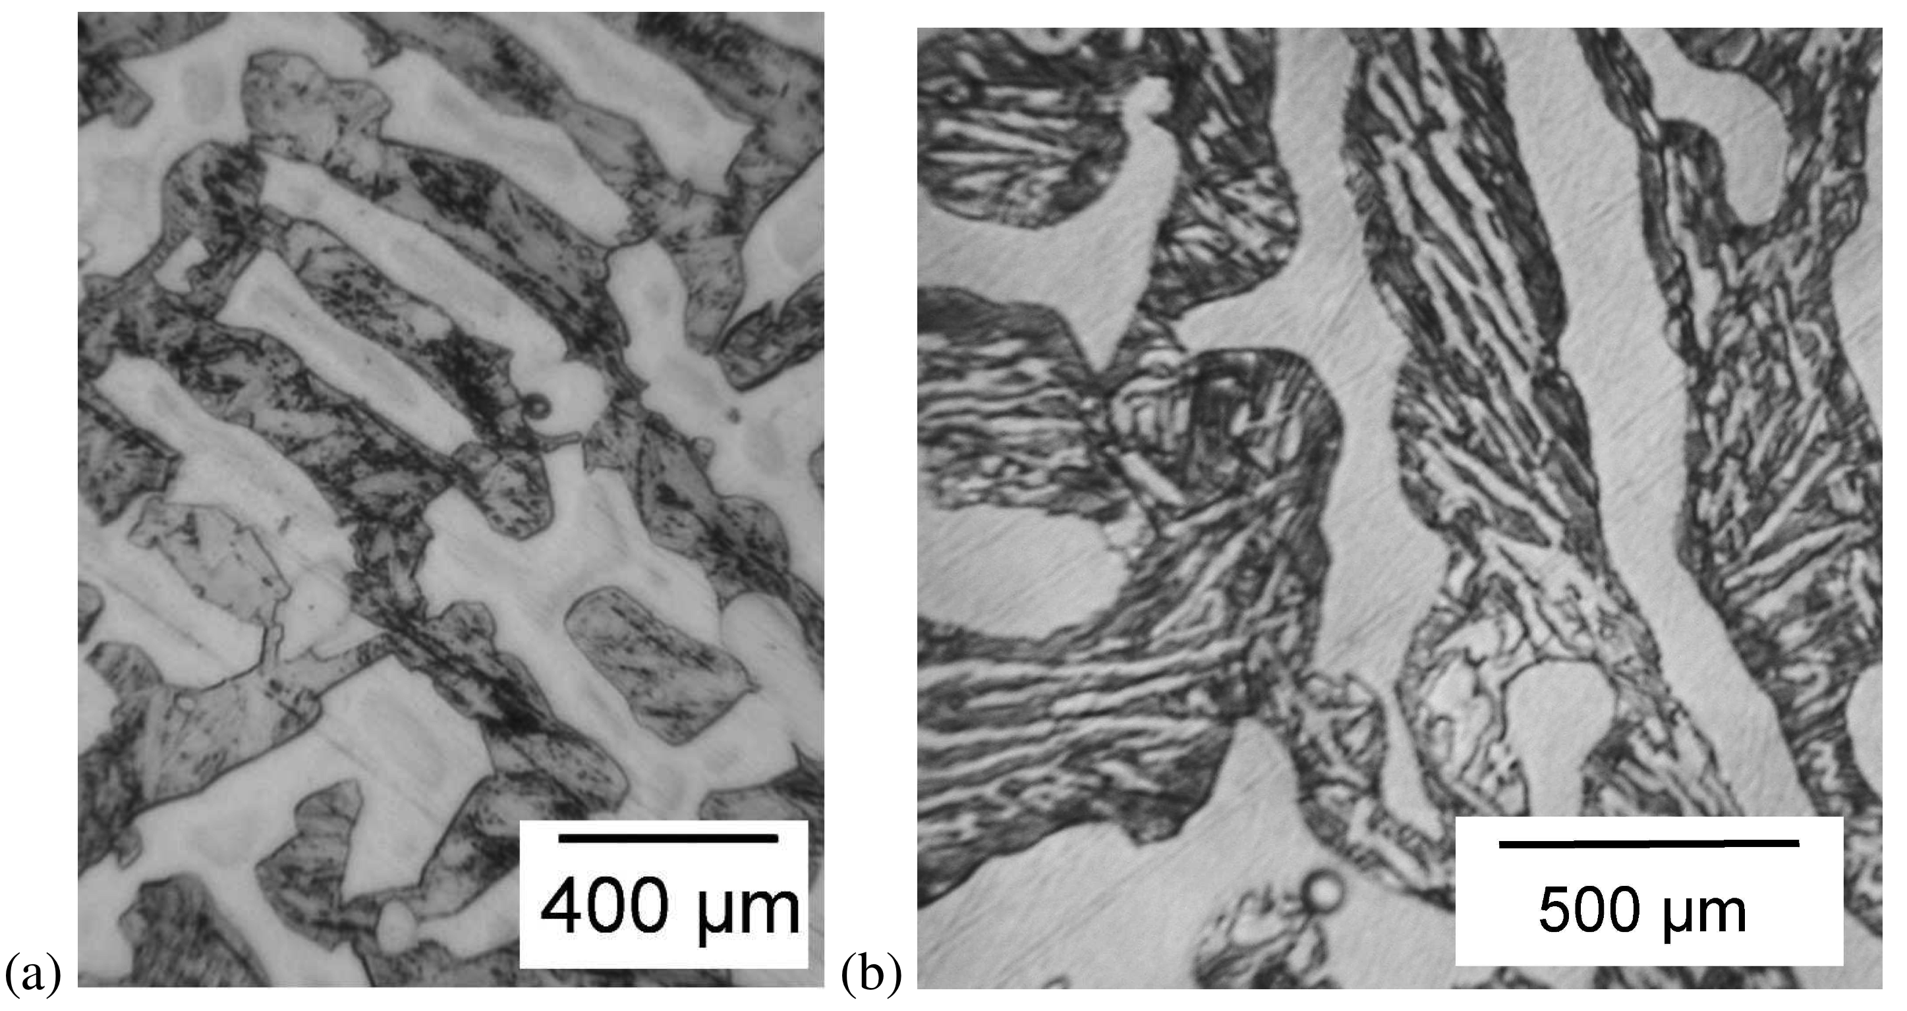
Notes:
32

Slide 33
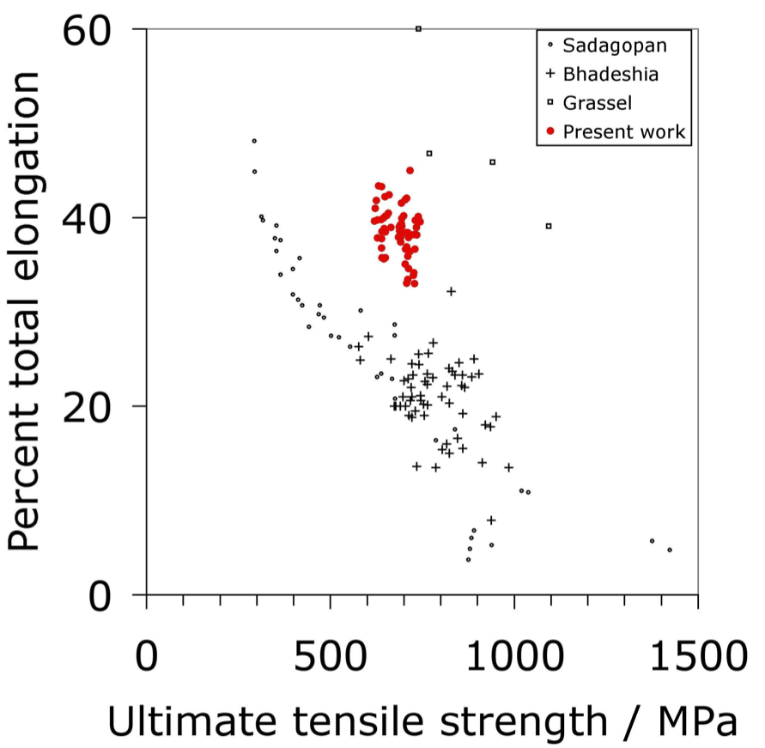
Notes:
33

Slide 34
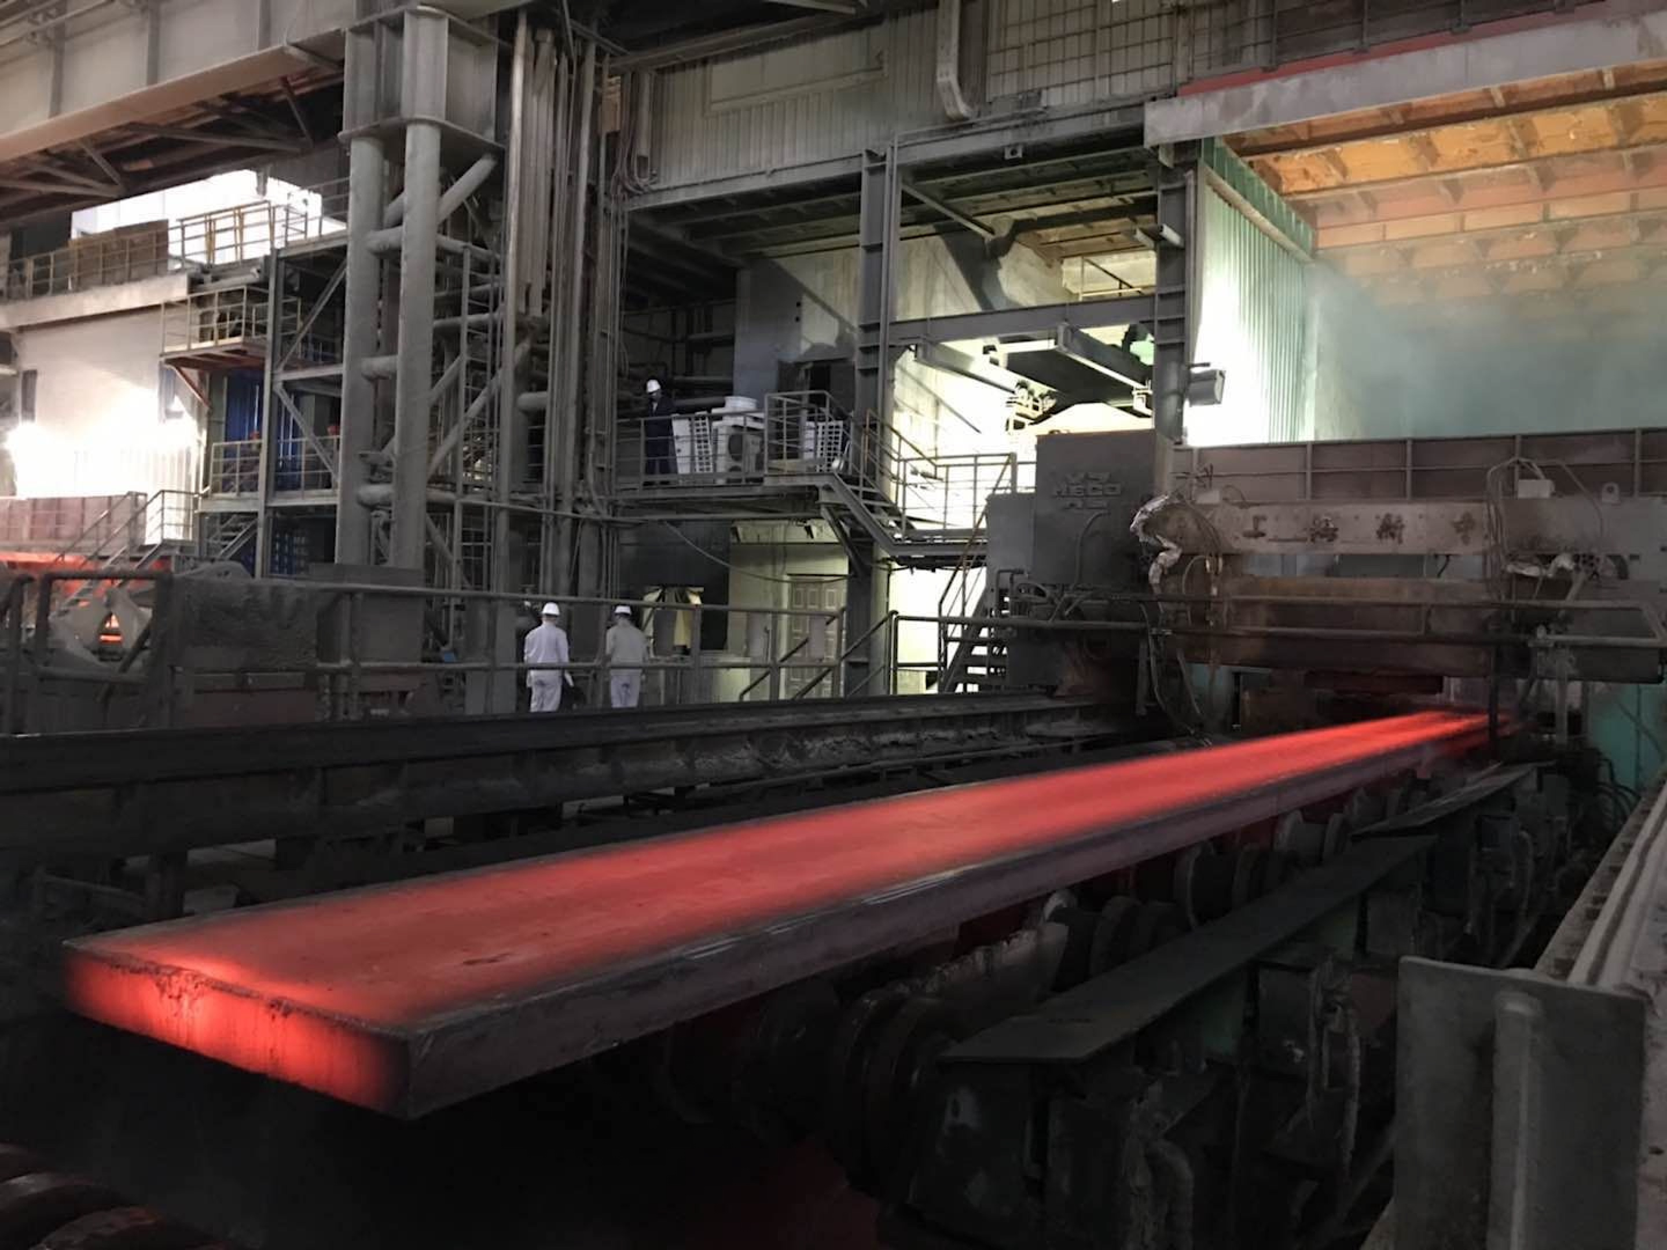
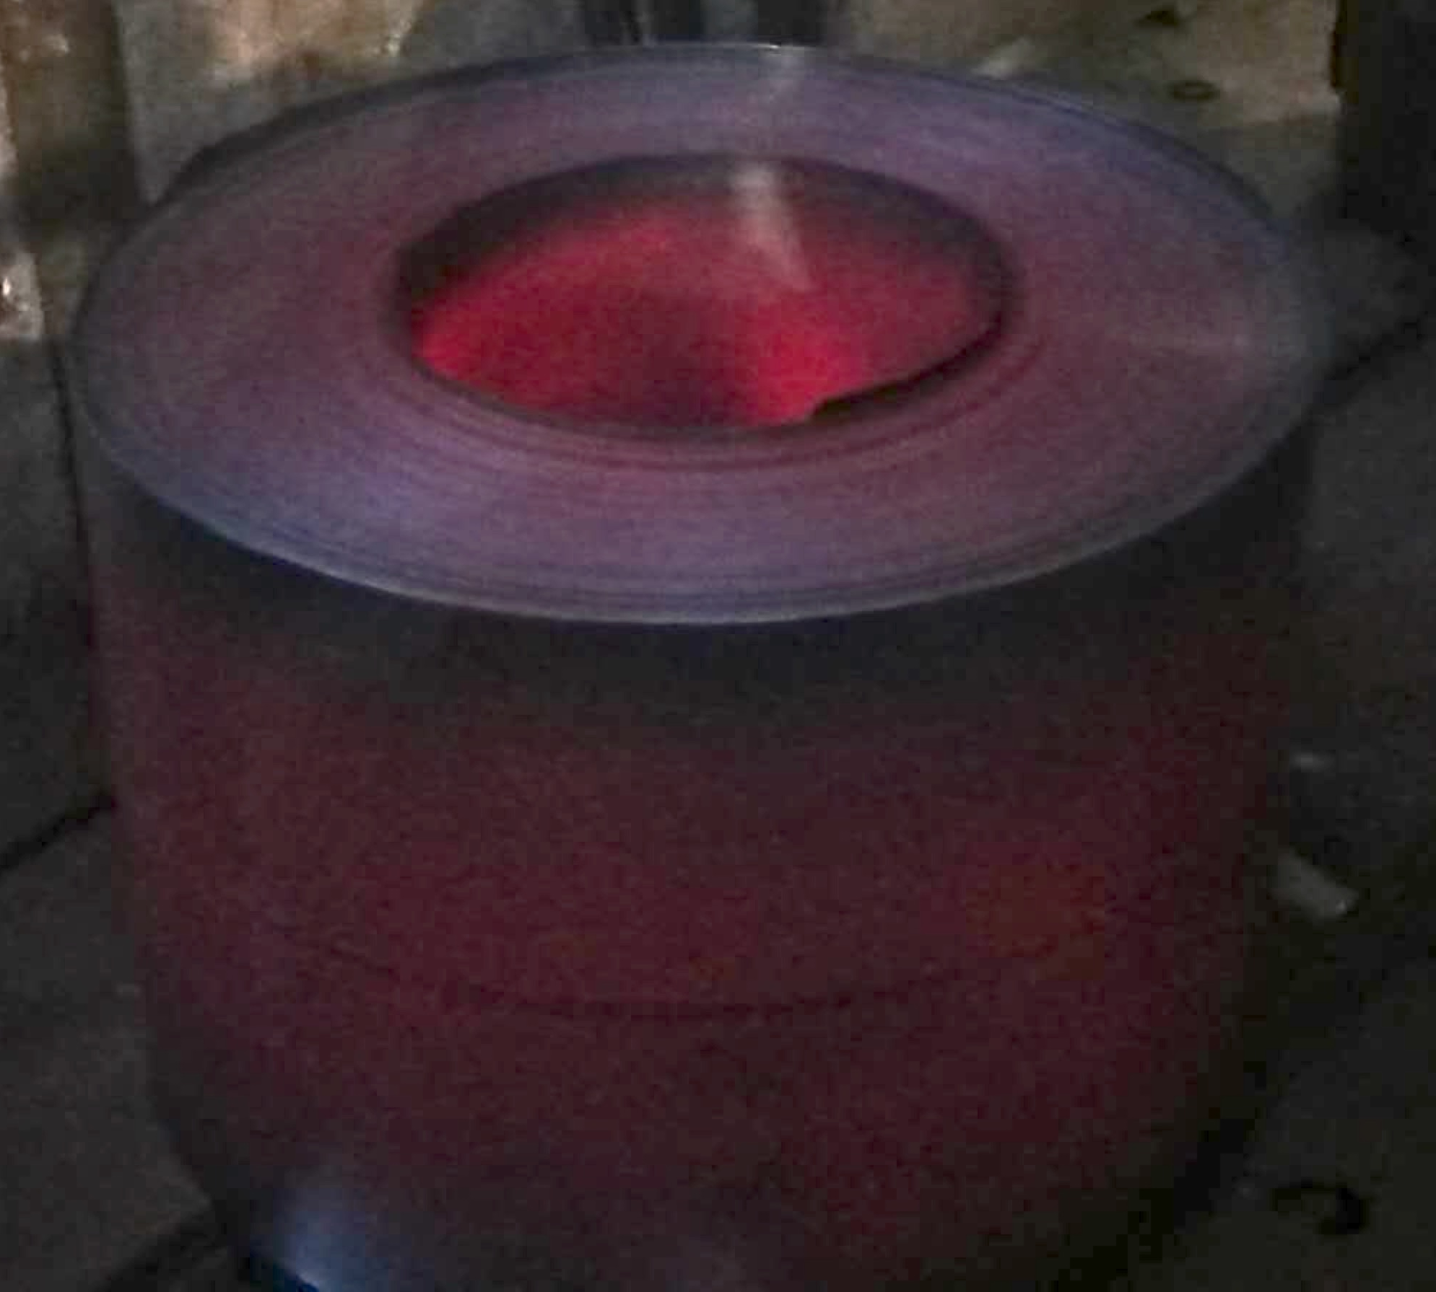
after hot-rolling
continuous casting
(Prof. Hongliang Yi, Northeastern University, China)

Slide 35
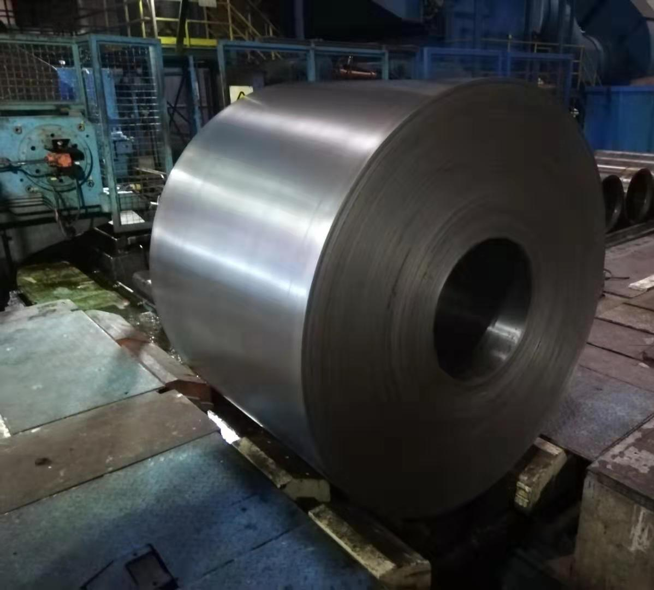
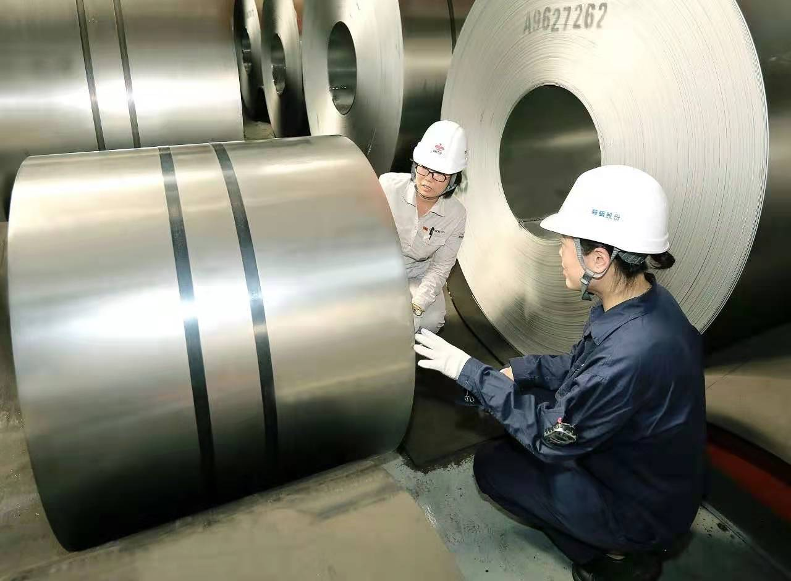
after cold-rolling
after continuous annealing
(Prof. Hongliang Yi, Northeastern University, China)

