Slide 1



Steels: TWIP steels
Lecture 10
Fabio Miani
Harry Bhadeshia
Professor of Metallurgy
Queen Mary University of London
Emeritus Tata Steel Professor of Metallurgy
University of Cambridge
2022

Slide 2
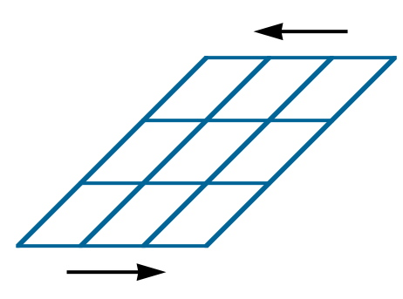
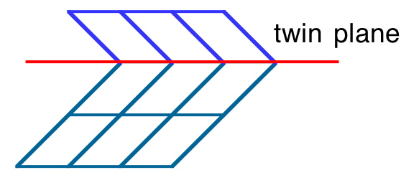
mechanical twinning

Slide 3
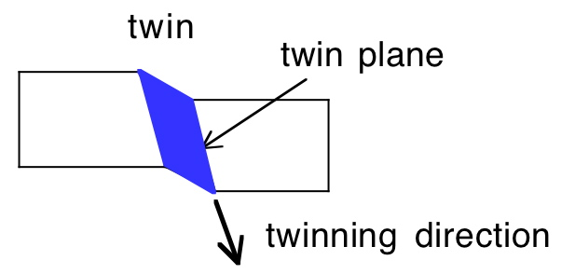
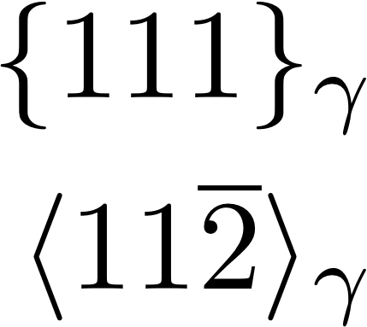
Austenite

Slide 4
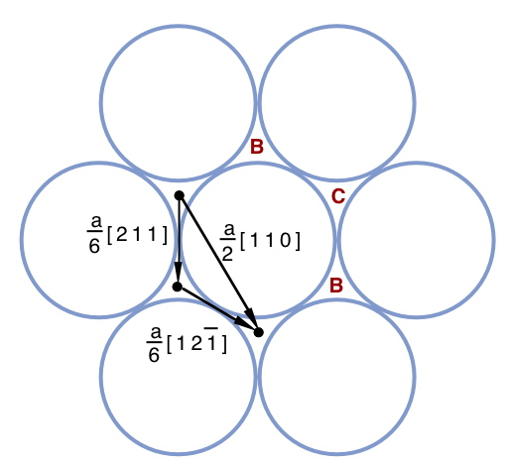
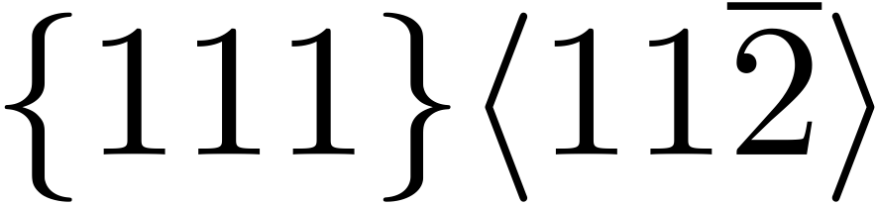
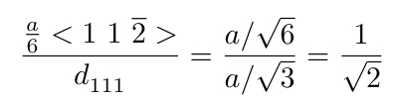
A

Slide 5
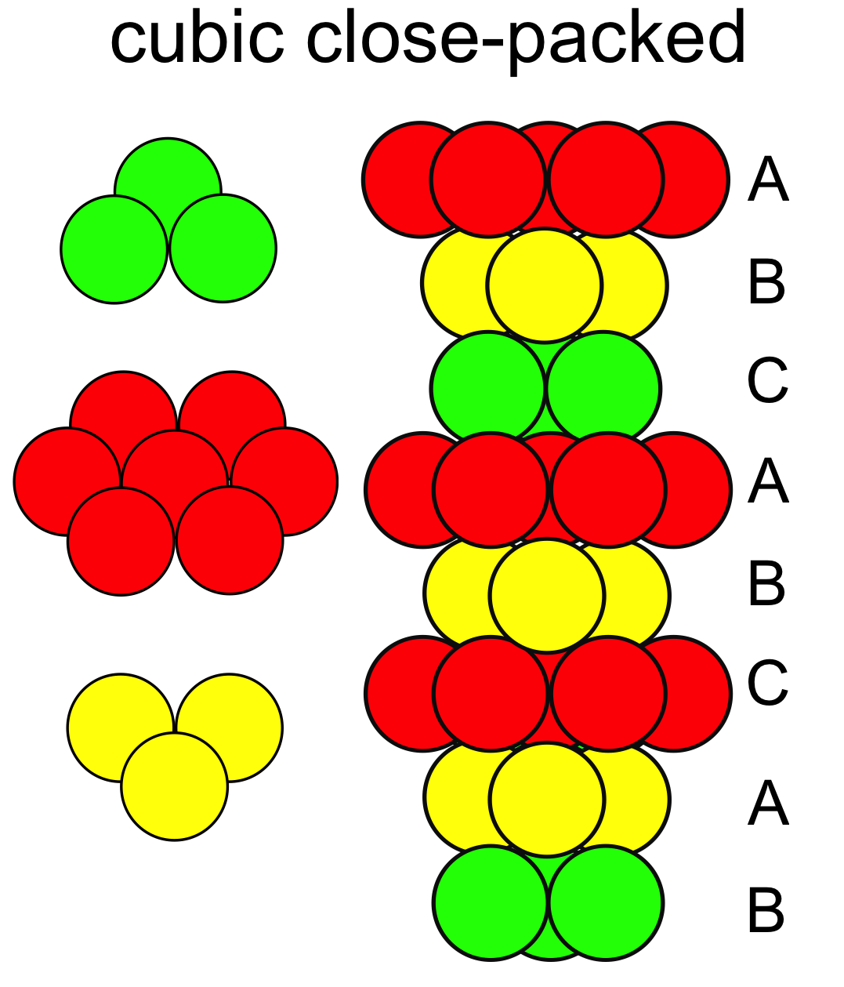


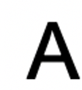
A
A
B
CA
B
A
B
CBC
A
B
CBA

Slide 6
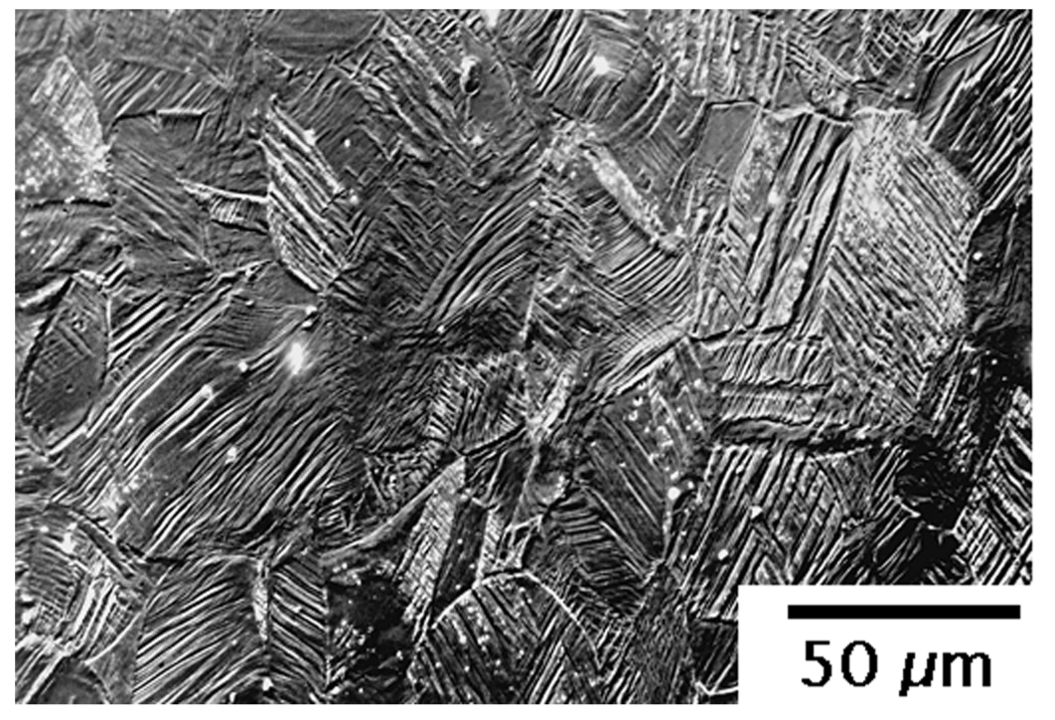
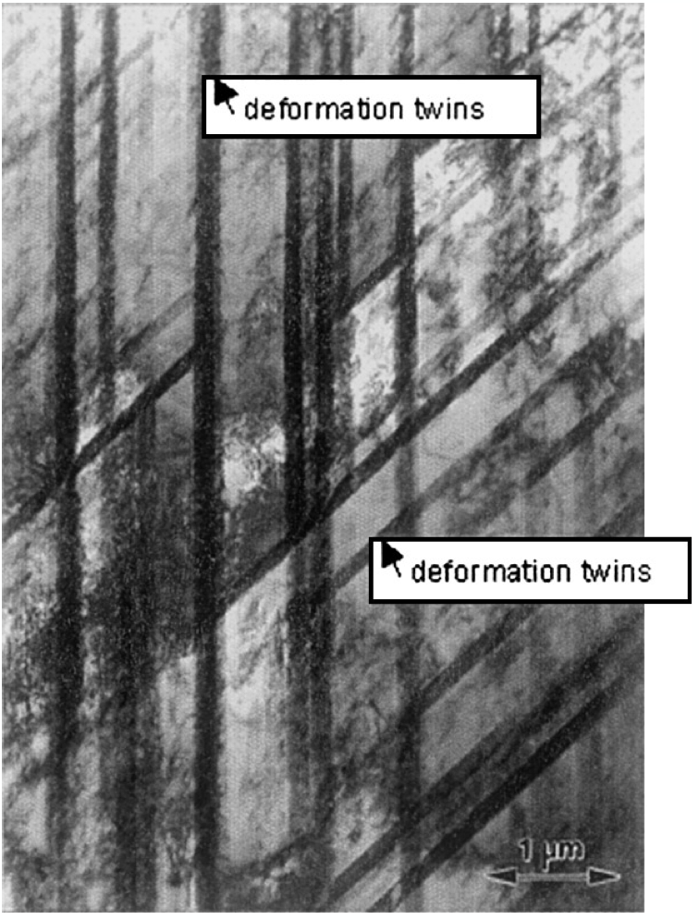
Frommeyer, Brux and Neumann

Slide 7
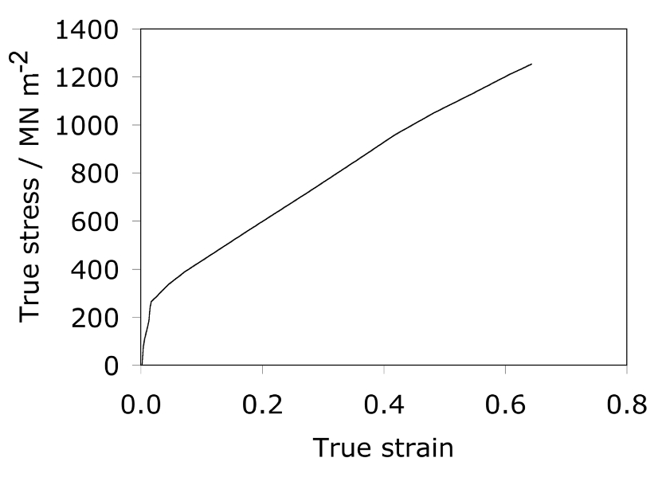
dynamic Hall-Petch effect
Frommeyer, Brux and Neumann

Slide 8
TWIP Steels
Fe-25Mn-3Si-3Al wt%
density 7.3 g cm⁻³
fully austenitic
maintain attractive properties to -150°C
and at high strain rates (10³ s⁻¹)
Data from: Frommeyer G, Brüx U, Neumann P. Supra-ductile and high-strength manganese-TRIP/TWIP steels for high energy absorption purposes. ISIJ international. 2003;43:438-46.

Slide 9
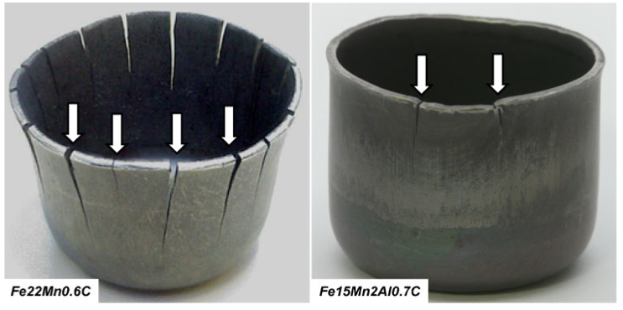
delayed fracture
difficult to produce
high thermal expansion
Courtesy of Bruno de Cooman

Slide 10
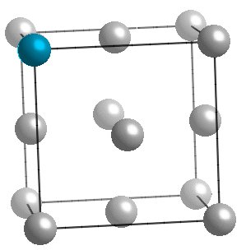
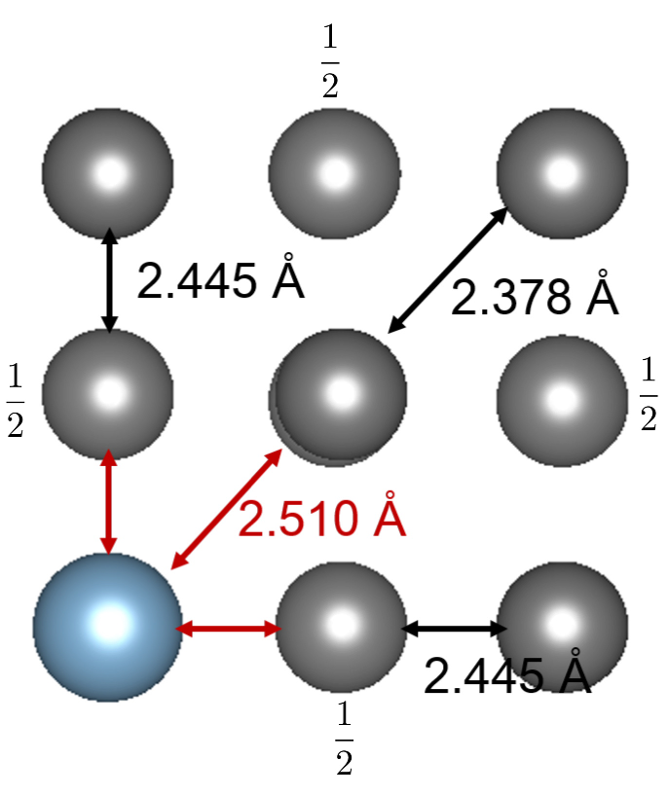
Atomic traps for hydrogen
Fe
Al
Song EJ, Bhadeshia HKDH, Suh DW. Interaction of aluminium with hydrogen in twinning-induced plasticity steel. Scripta Materialia. 2014;87:9-12.

Slide 11
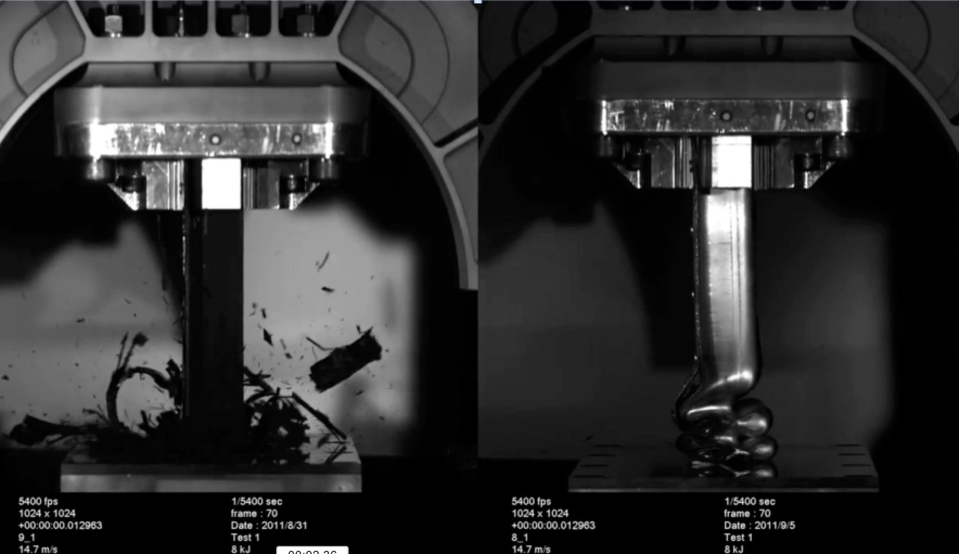
Sanjeev Sharma and Richard Dashwood of the International Manufacturing Centre, WMG University of Warwick.

Slide 12
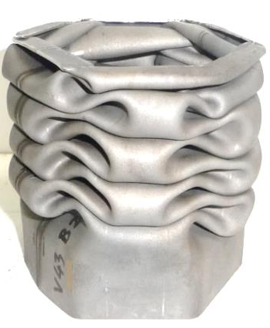
courtesy of
Professor Wolfgang Bleck

Slide 13
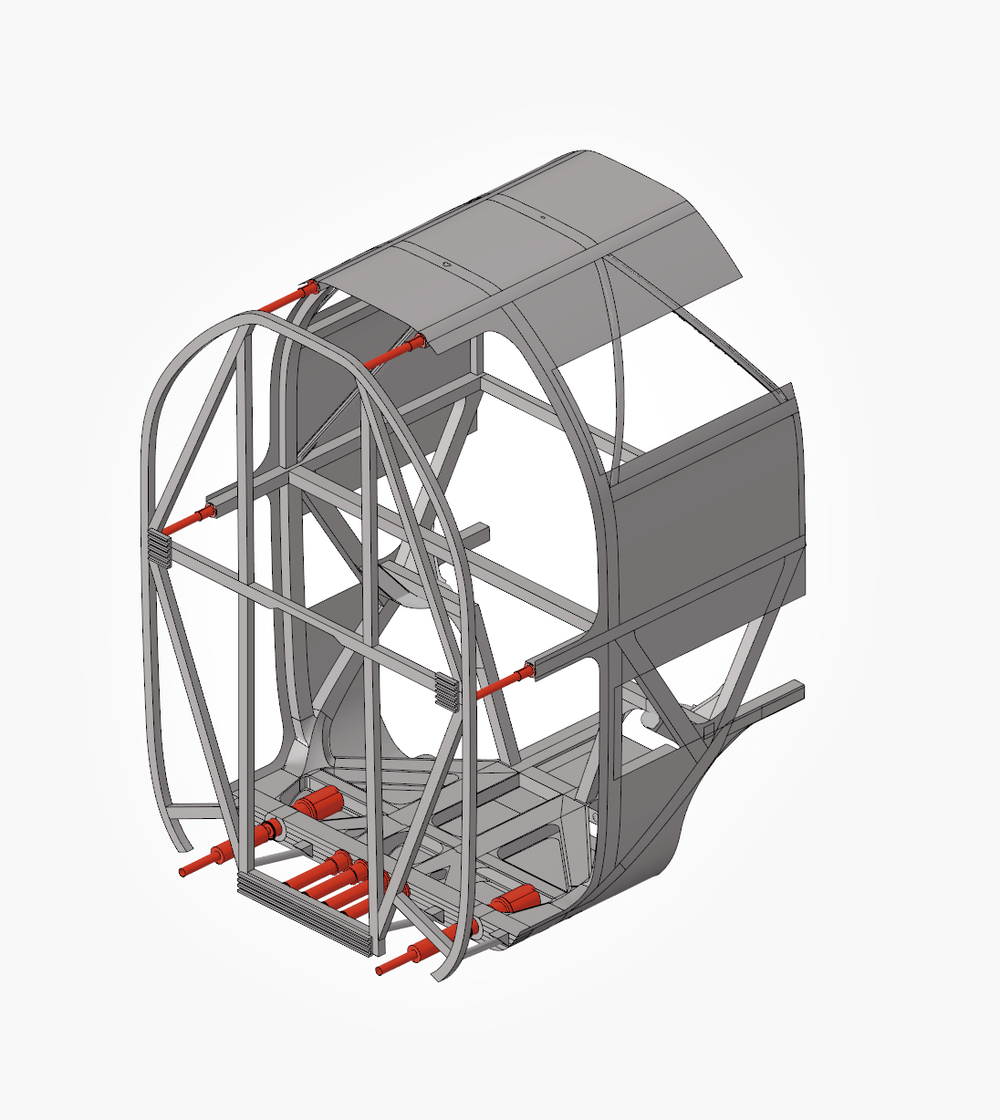
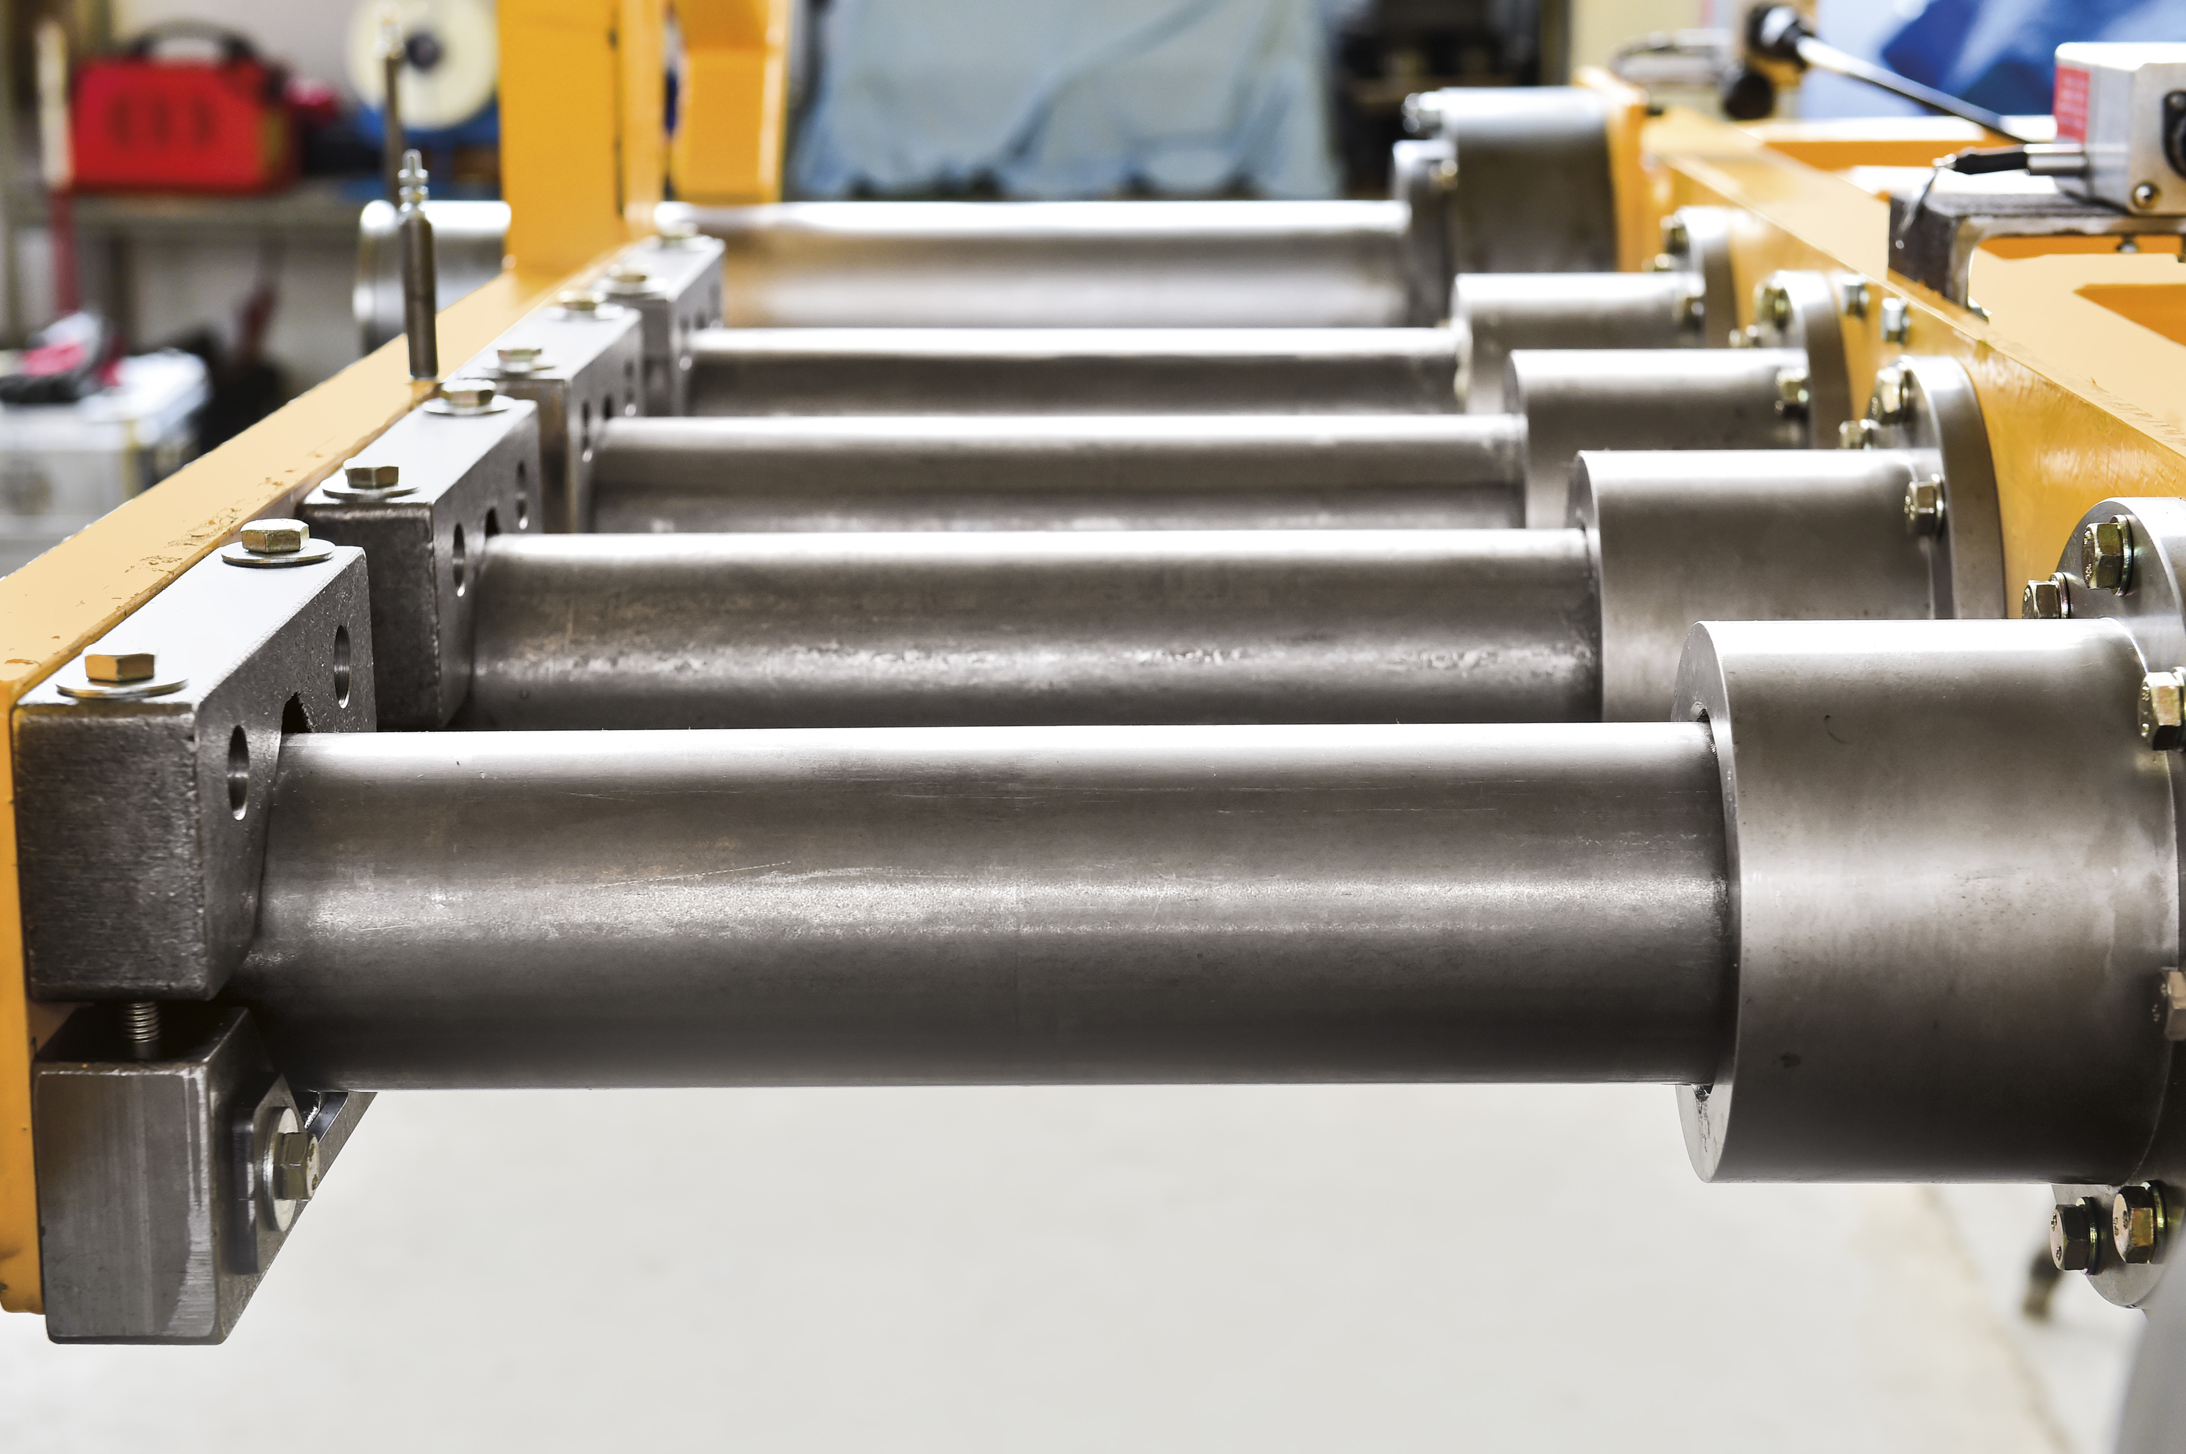
photo & graphics: DLR
https://www.stahl-innovationspreis.de/news/gewinner-2018-sichere-zuege-dank-stahlforschung-und-entwicklung/
Steel innovation award 2018

Slide 14
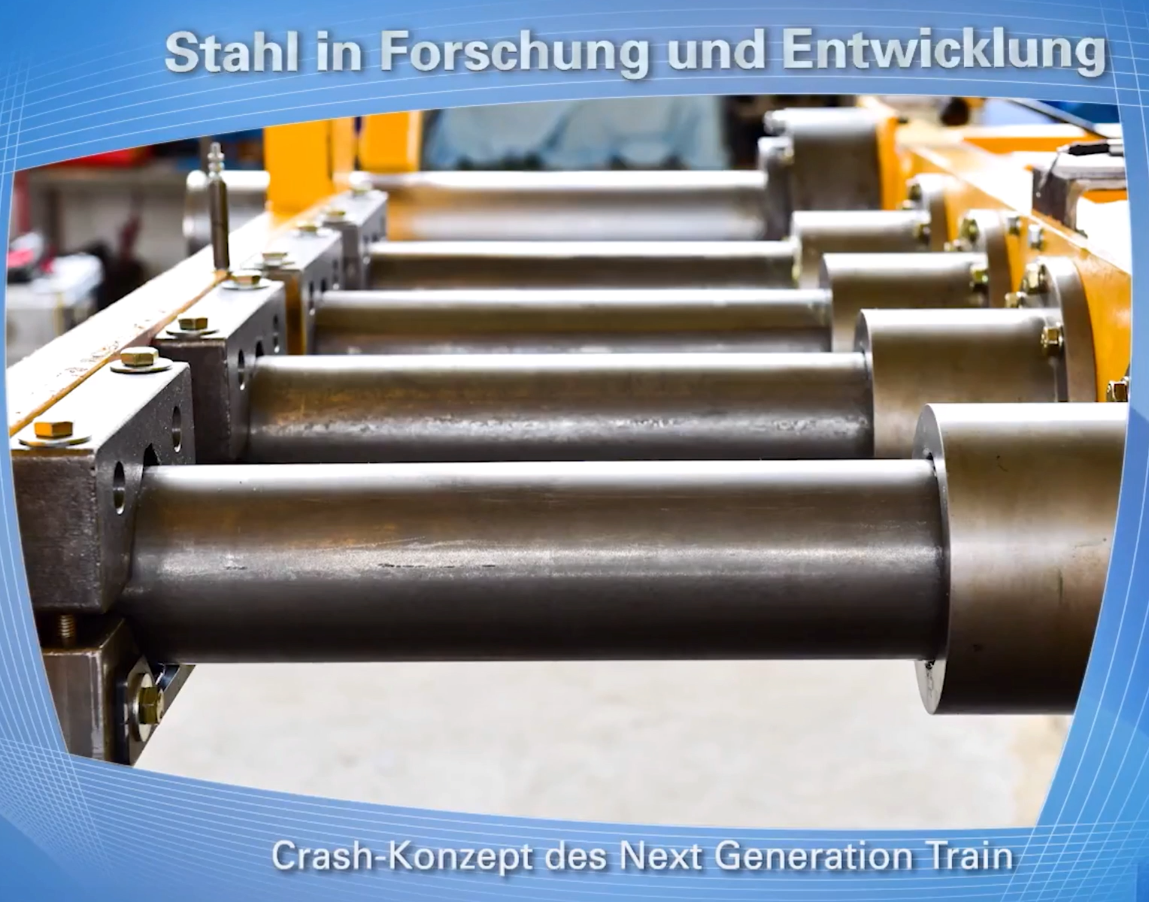

Slide 15
TRIP, TWIP:
transformation or twinning deformations under an external stress
enhanced work hardening
greater strength and ductility
Suppose a material develops internal stress:
can TRIP be used to stop that stress from developing?

Slide 16
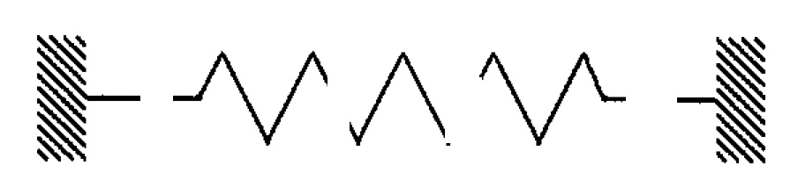
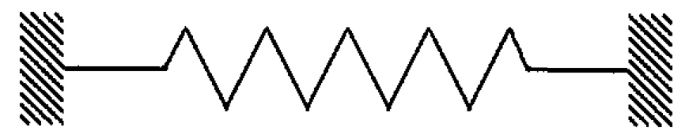
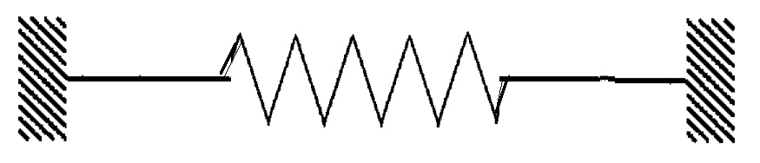
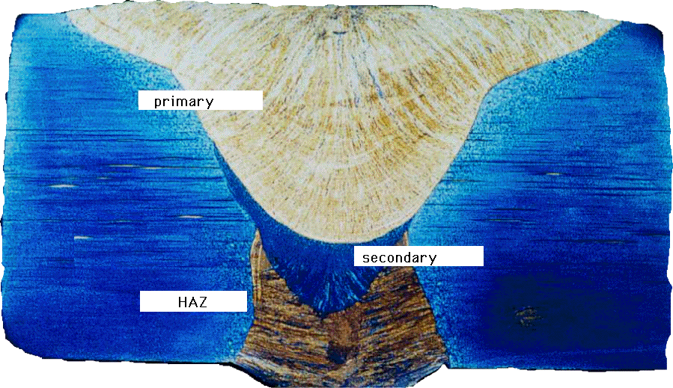
Weld: liquid metal solidifies, cools, contracts, stress
liquid
solid
contraction
Compensate for thermal contraction
Notes:
16

Slide 17
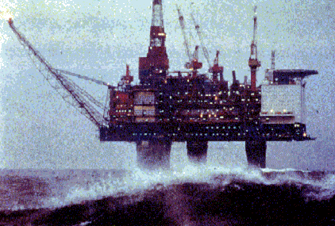
Residual stress
Notes:
17

Slide 18
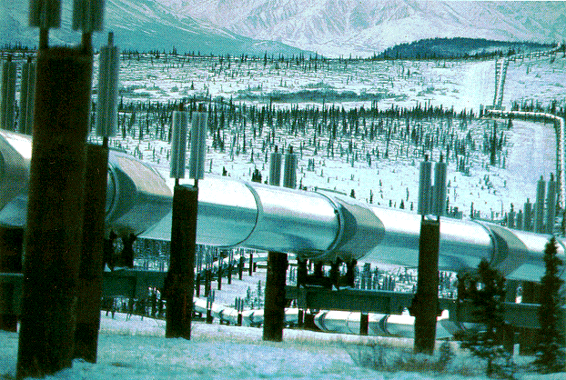
Notes:
18

Slide 19
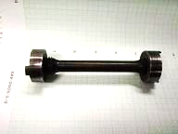
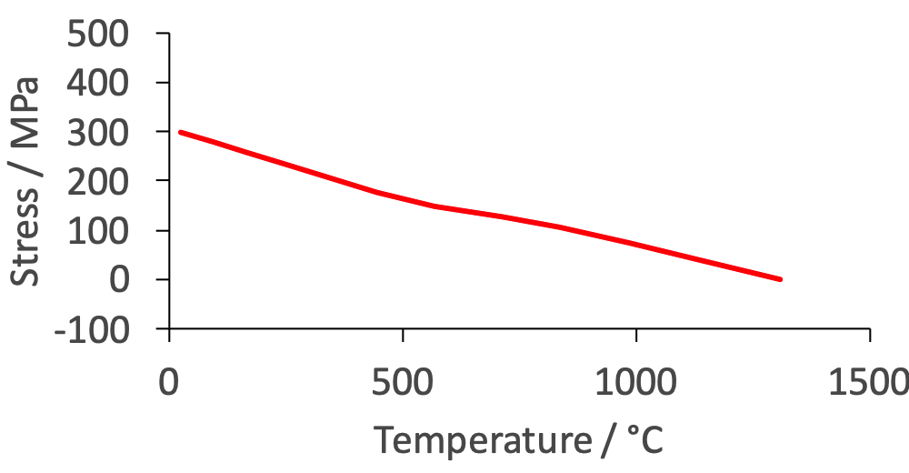
Notes:
19

Slide 20
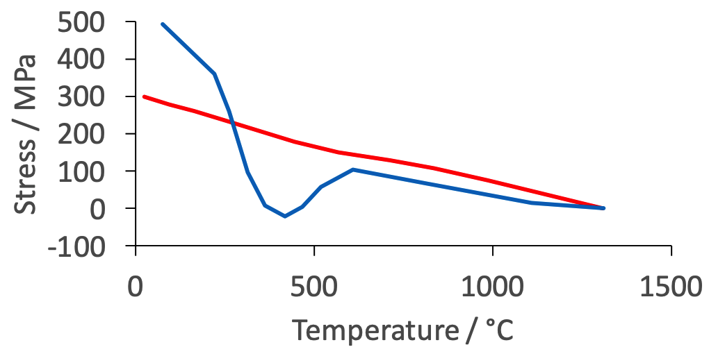
Notes:
20

Slide 21
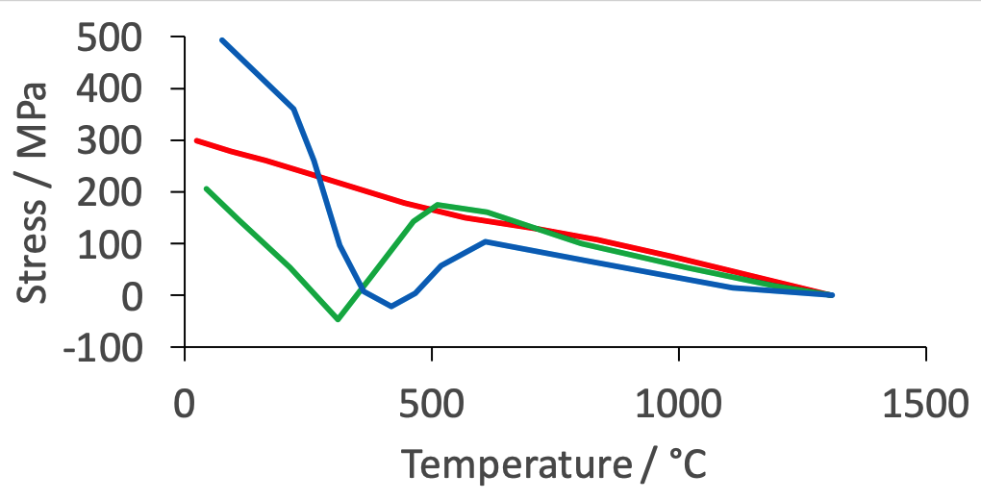
Jones & Alberry, 1977
Notes:
21

Slide 22
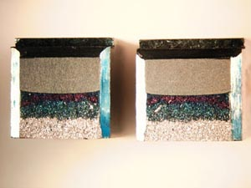
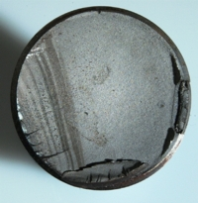
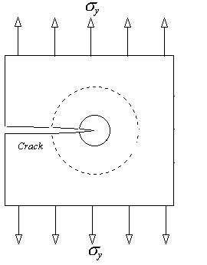
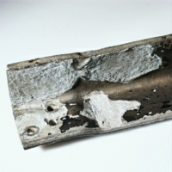
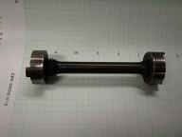
Charpy
fatigue
tensile
critical stress intensity
corrosion
Notes:
22

Slide 23
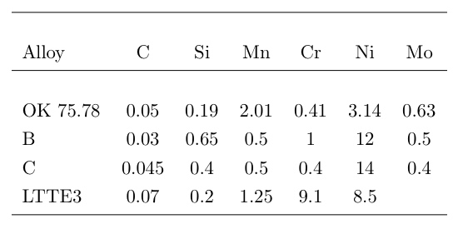
Notes:
23

Slide 24
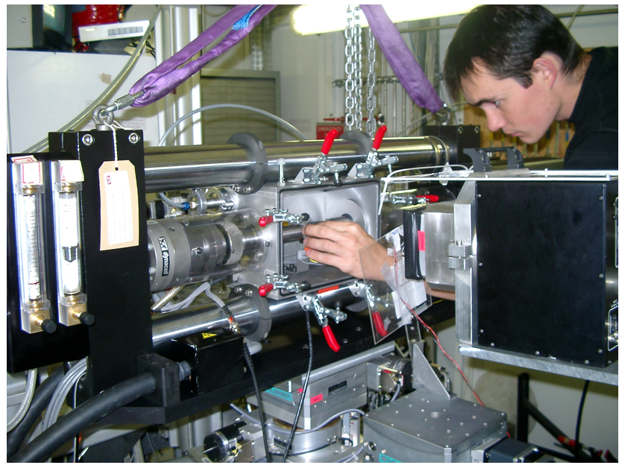
Notes:
24

Slide 25
Notes:
25

Slide 26
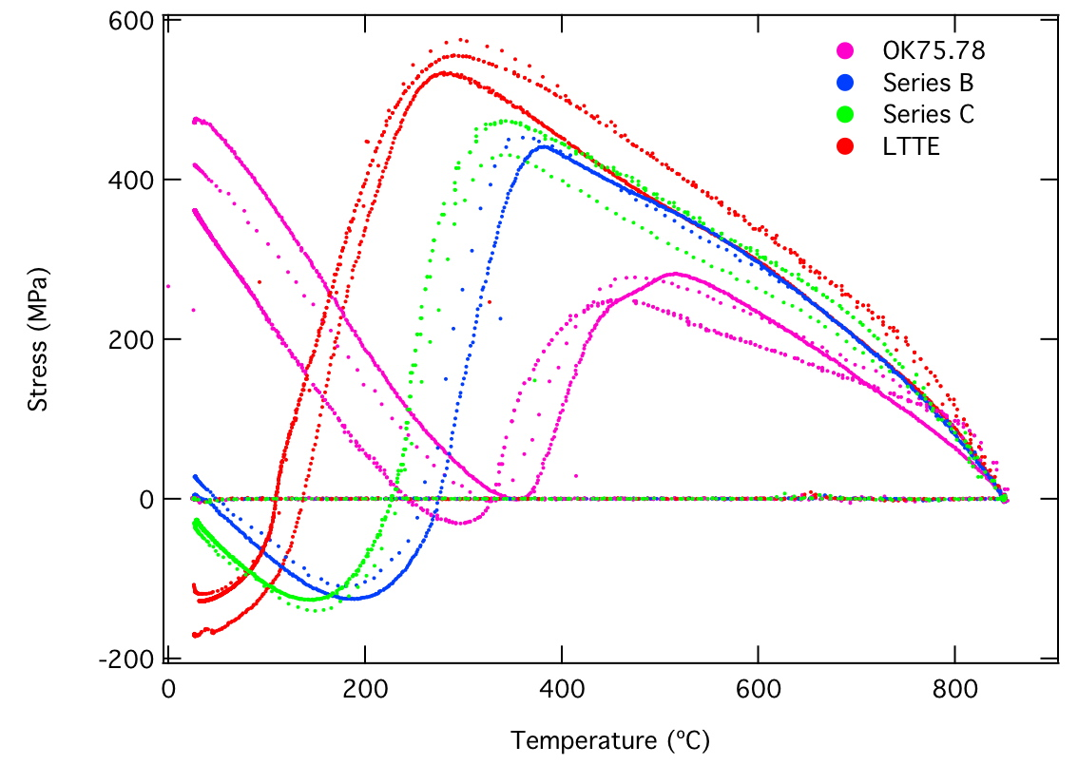
Notes:
26

Slide 27
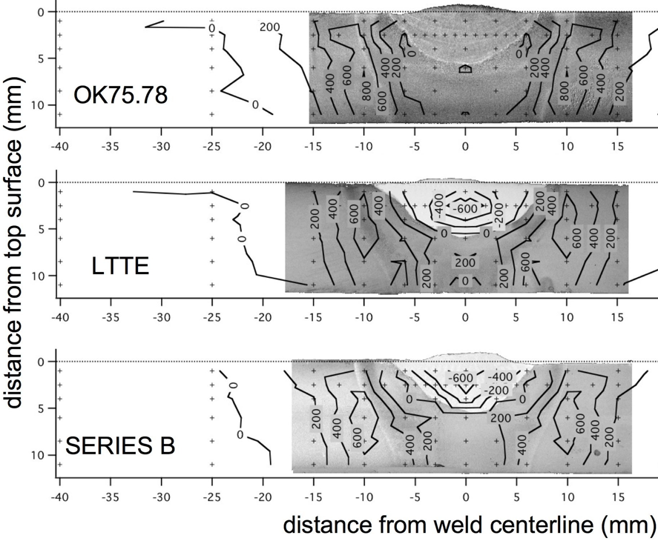
Notes:
27

Slide 28
Criteria for design of stainless steel welding consumable
Cr concentration > 12 wt%
Carbon concentration minimal
Low M_{S} temperature but not too low
Suppress M_{S} with solutes other than carbon
Capable of becoming fully austenitic
Solidification as δ-ferrite

Slide 29
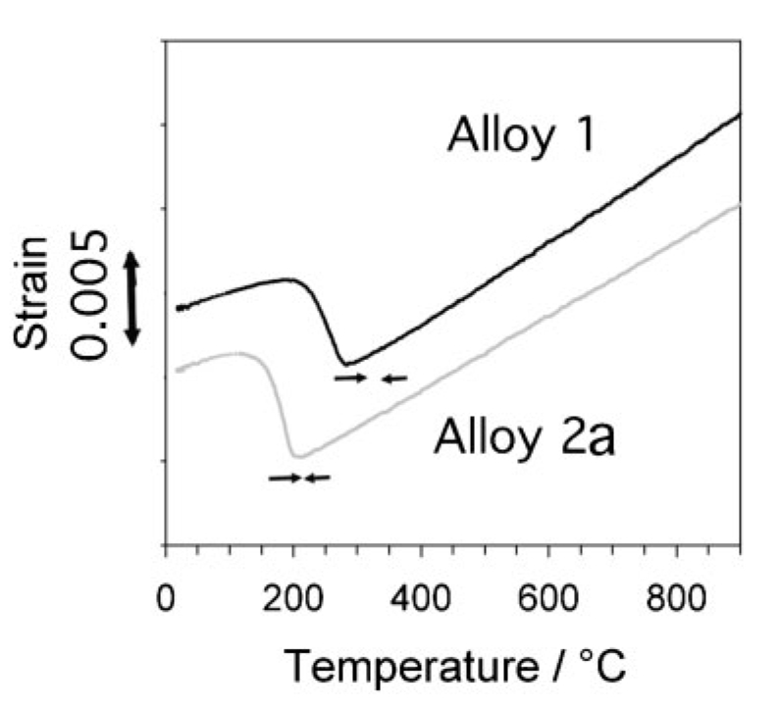
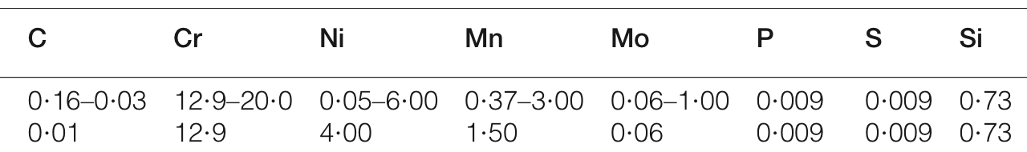

Slide 30
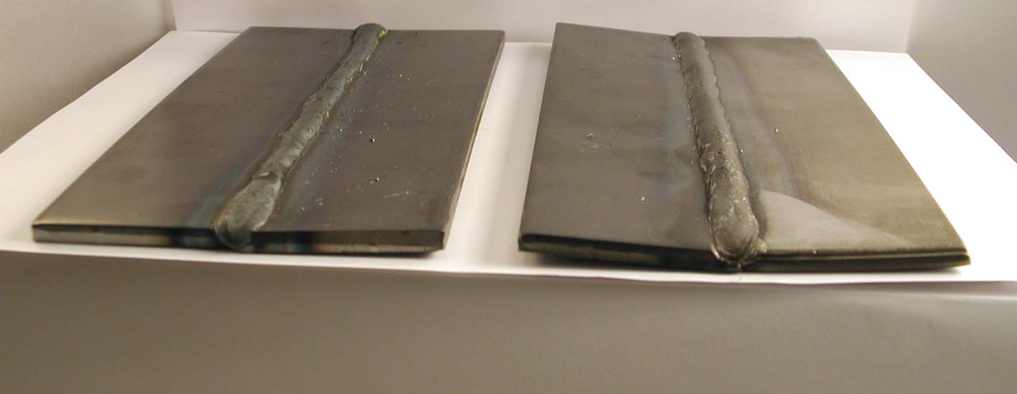
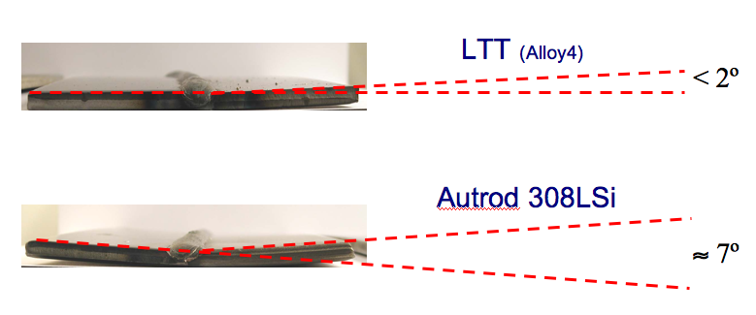
Dramatically reduced distortion
Leif Karlsson
Notes:
30

