Slide 1



Steels: Bulk nanostructured steels
Lecture 11
Fabio Miani
Harry Bhadeshia
Professor of Metallurgy
Queen Mary University of London
Emeritus Tata Steel Professor of Metallurgy
University of Cambridge
2022

Slide 2
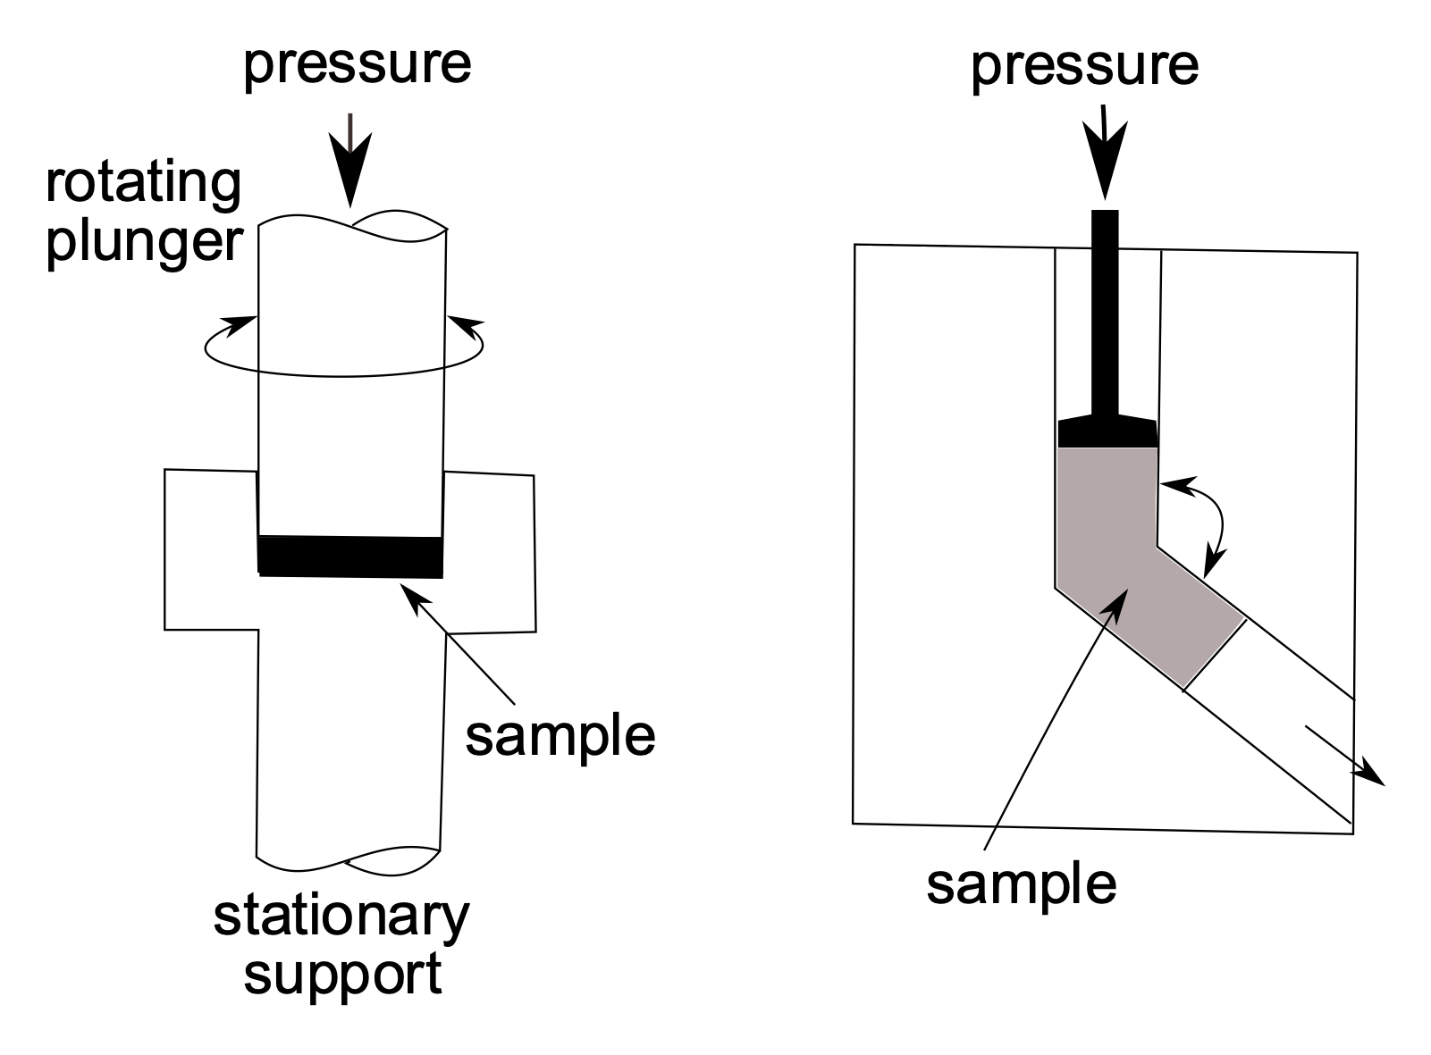
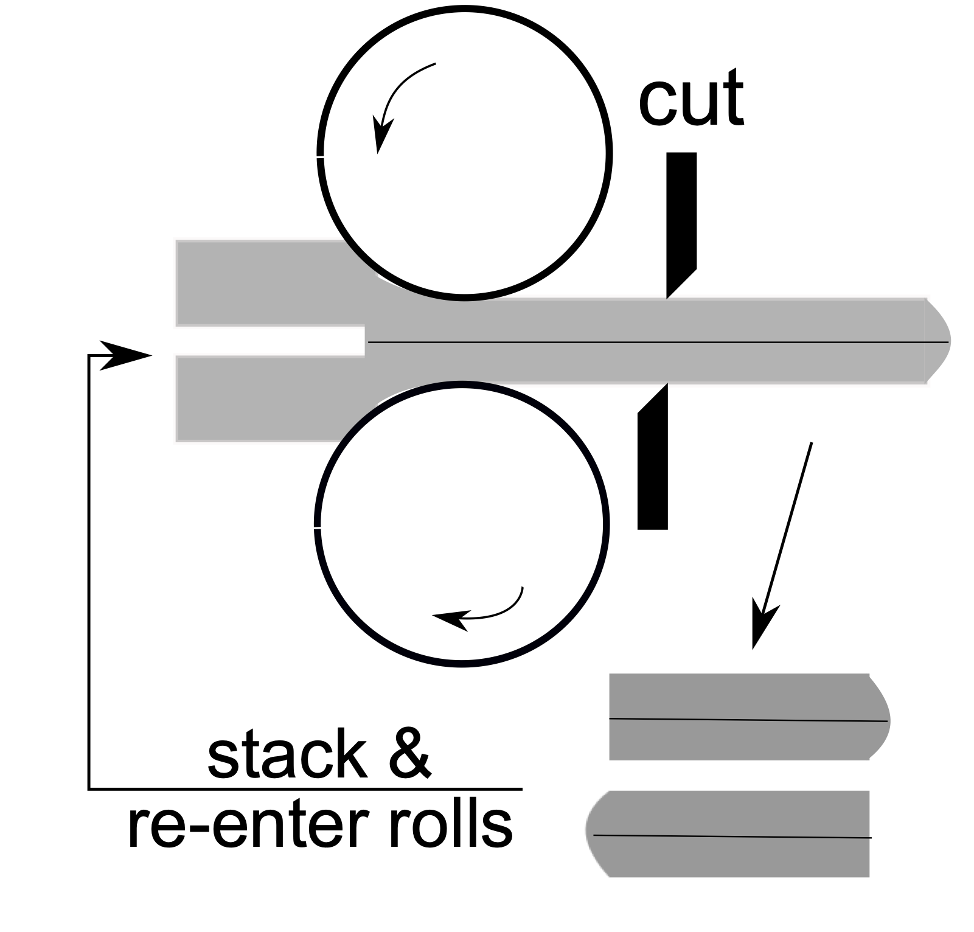
shape-preserving deformations
torsion-compression
(unlimited strain)
equal-channel
angular extrusion
accumulative
roll-bonding

Slide 3
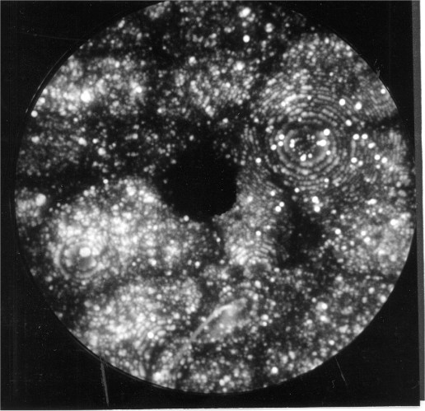
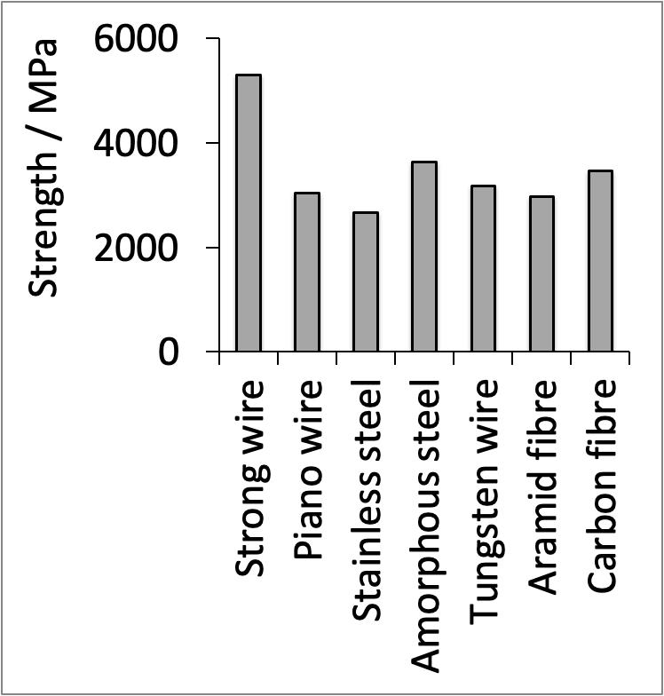
shape-altering deformations
wire drawing

Slide 4
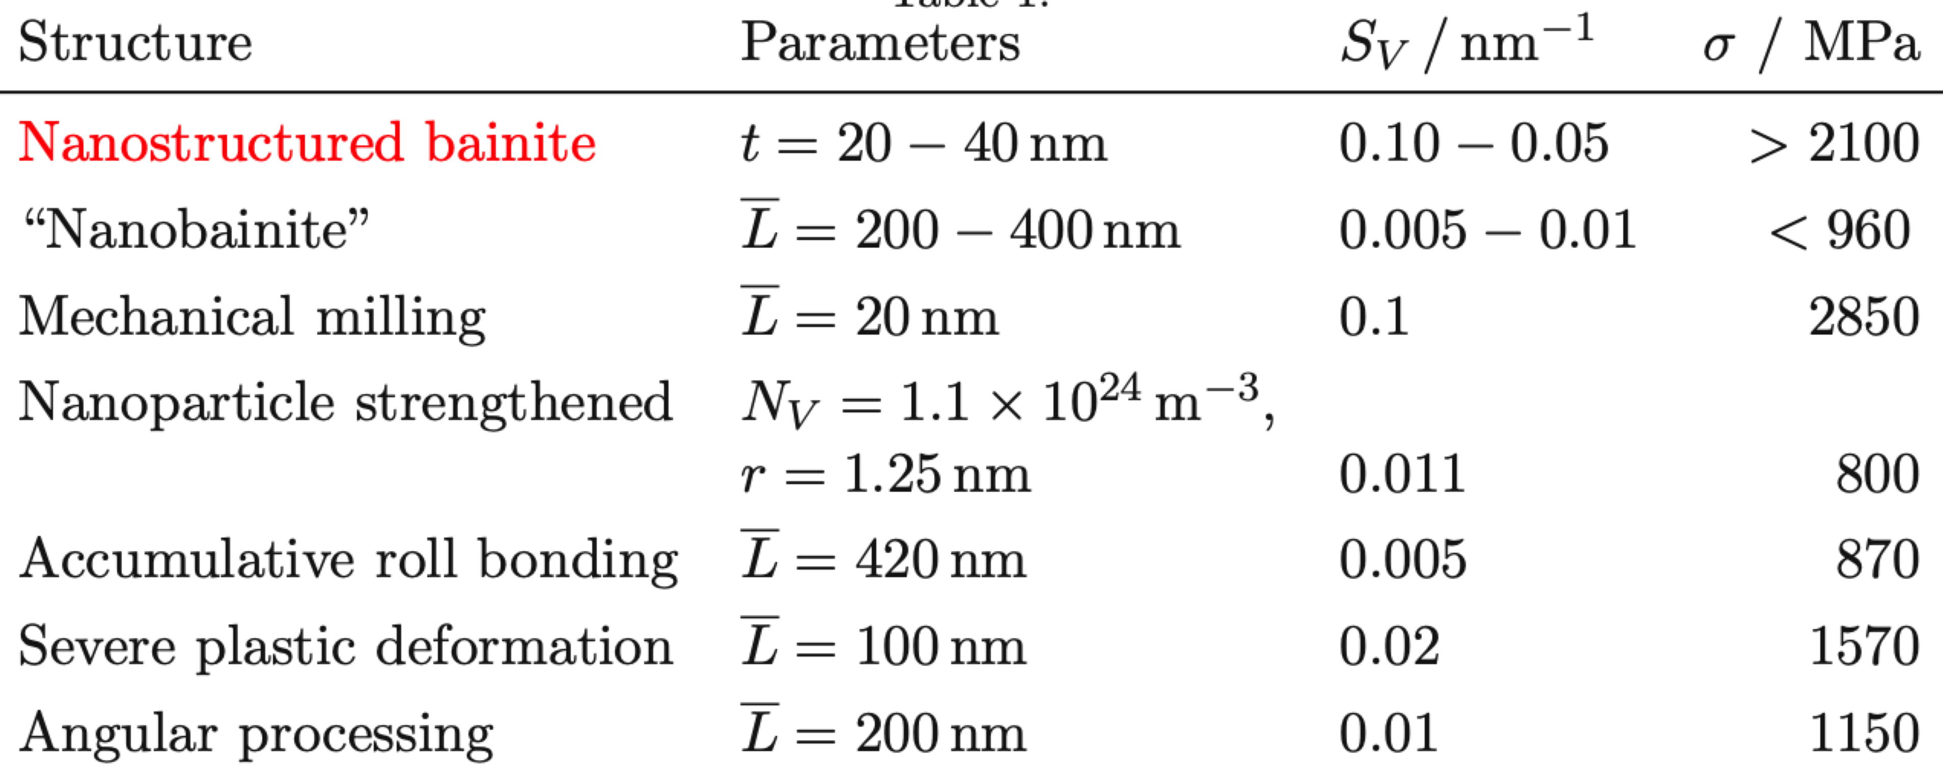
What is a nanostructure?

Slide 5
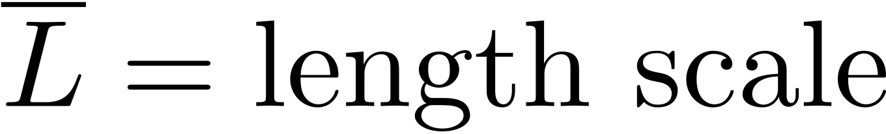
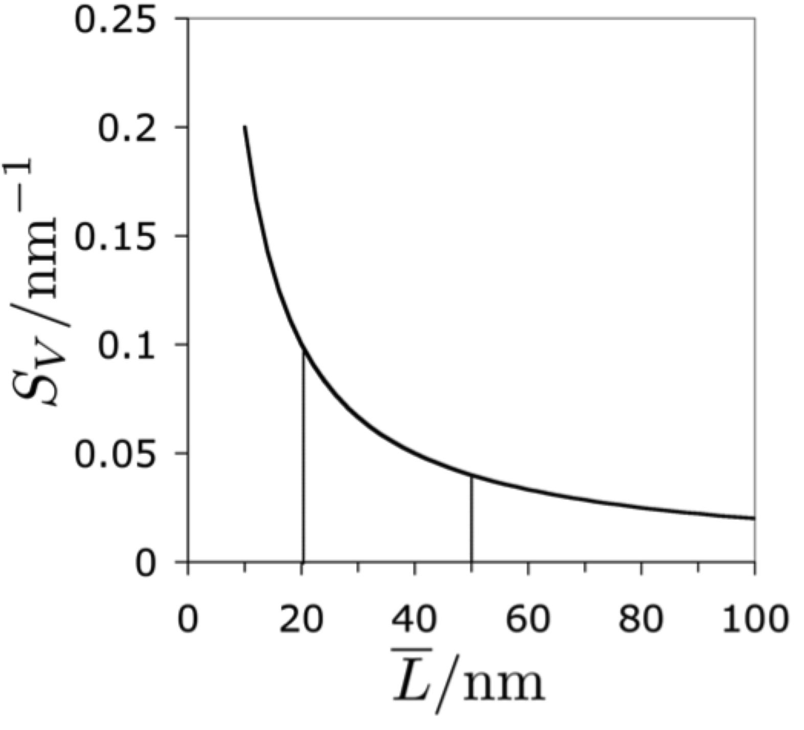
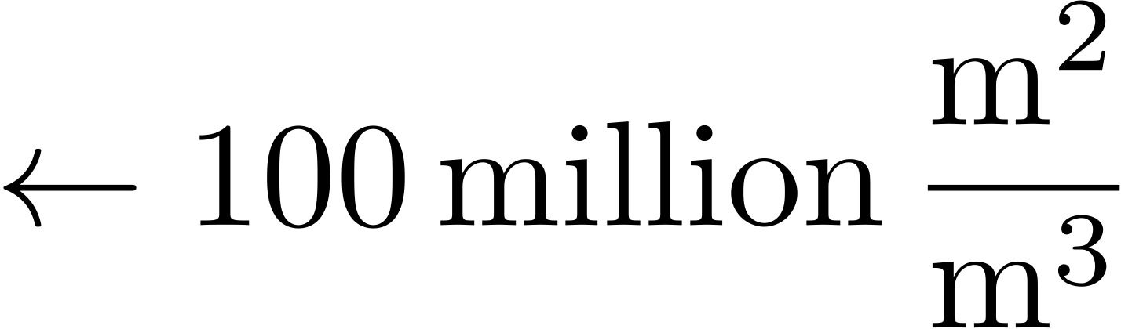
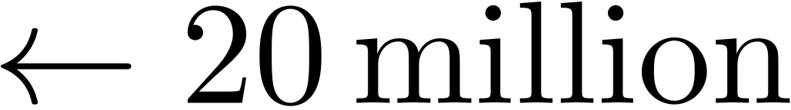

Slide 6
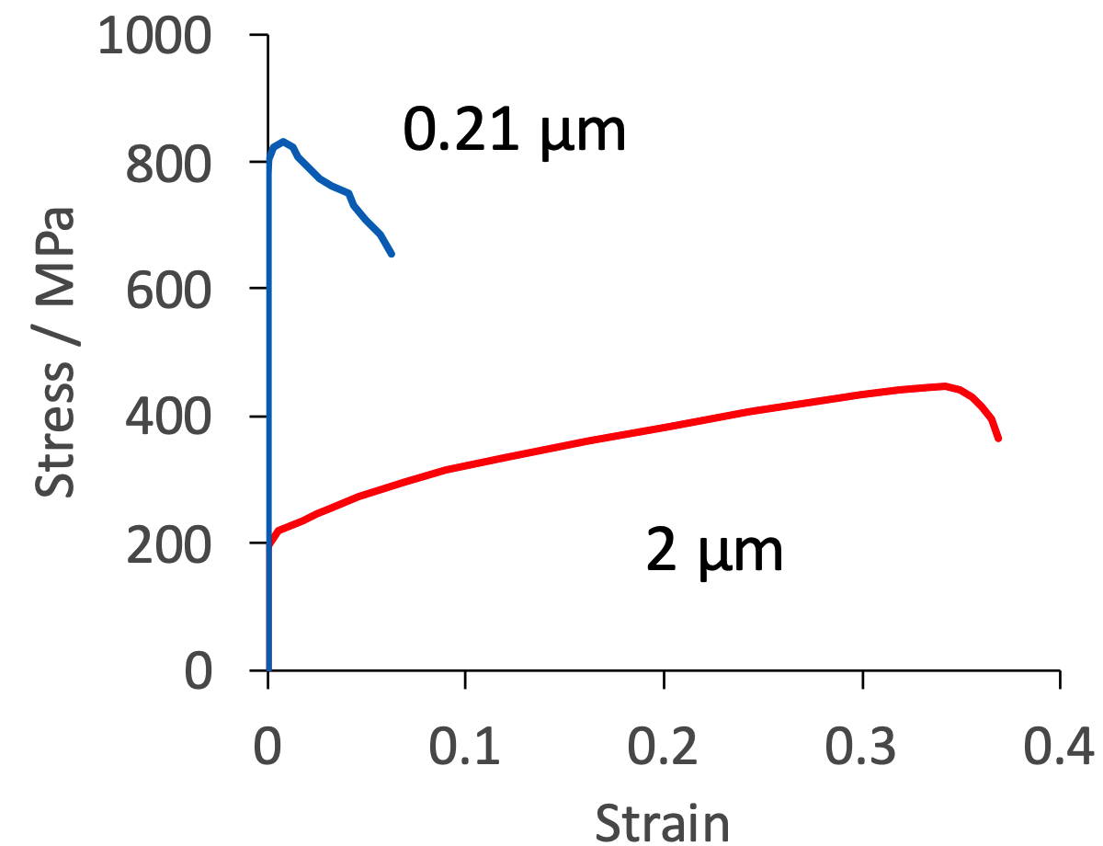
adapted using selected data from
Tsuji et al. Scripta Mat. 47 (2002) 893

Slide 7
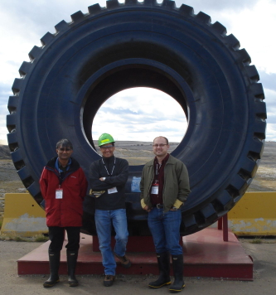

…. bulk nanocrystalline steel which is very strong, tough, cheap ….

Slide 8
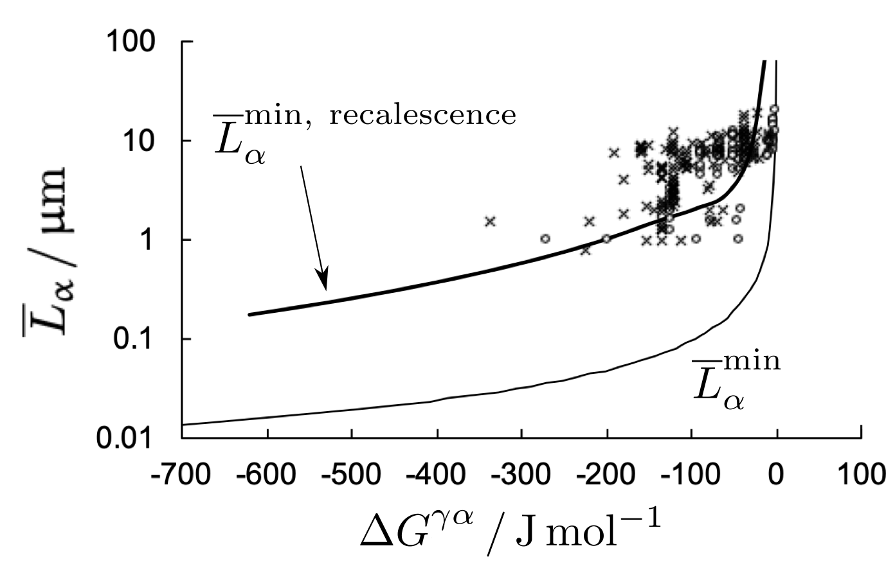
Yokota T, Mateo CG, Bhadeshia HKDH. Formation of nanostructured steels by phase transformation. Scripta Materialia. 2004;51:767-70.

Slide 9
Fine crystals by transformation
Introduce work-hardening capacity
Need to store the heat
Reduce rate
Transform at low temperature

Slide 10
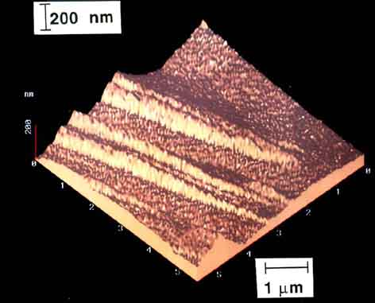
Swallow and Bhadeshia, 1996

Slide 11
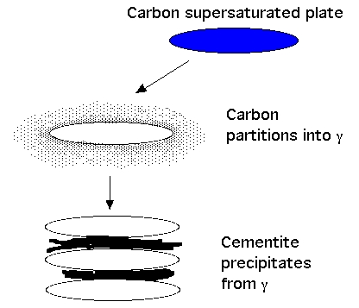

Slide 12

Cementite suppressed using silicon
1 µm

Slide 13
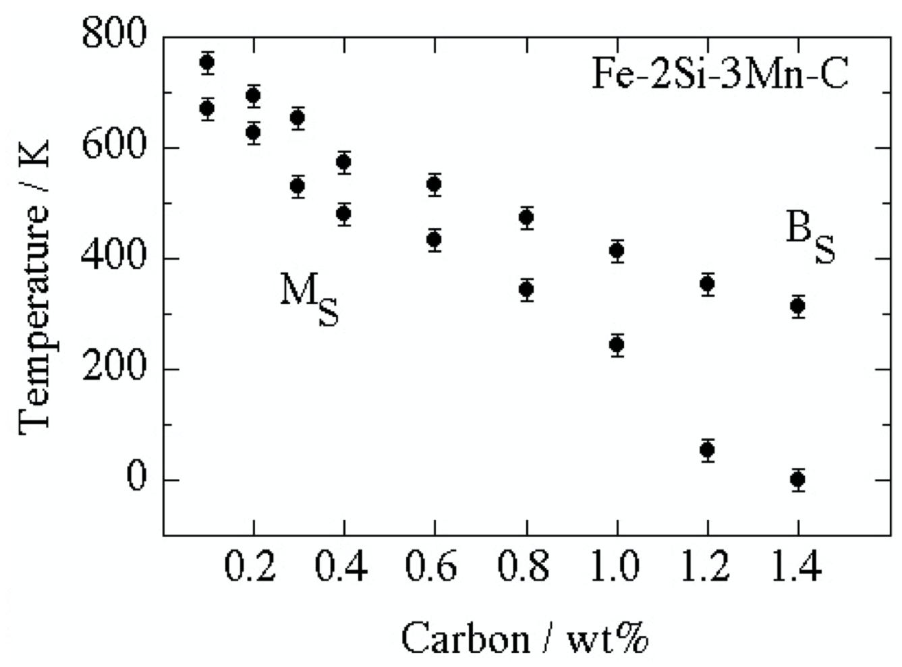
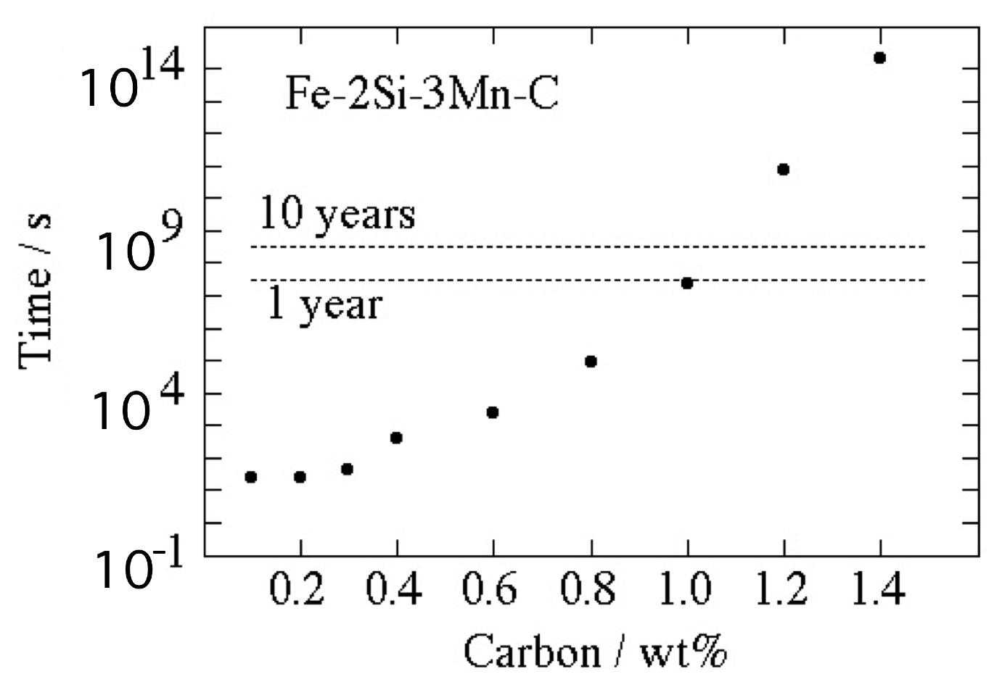

Slide 14
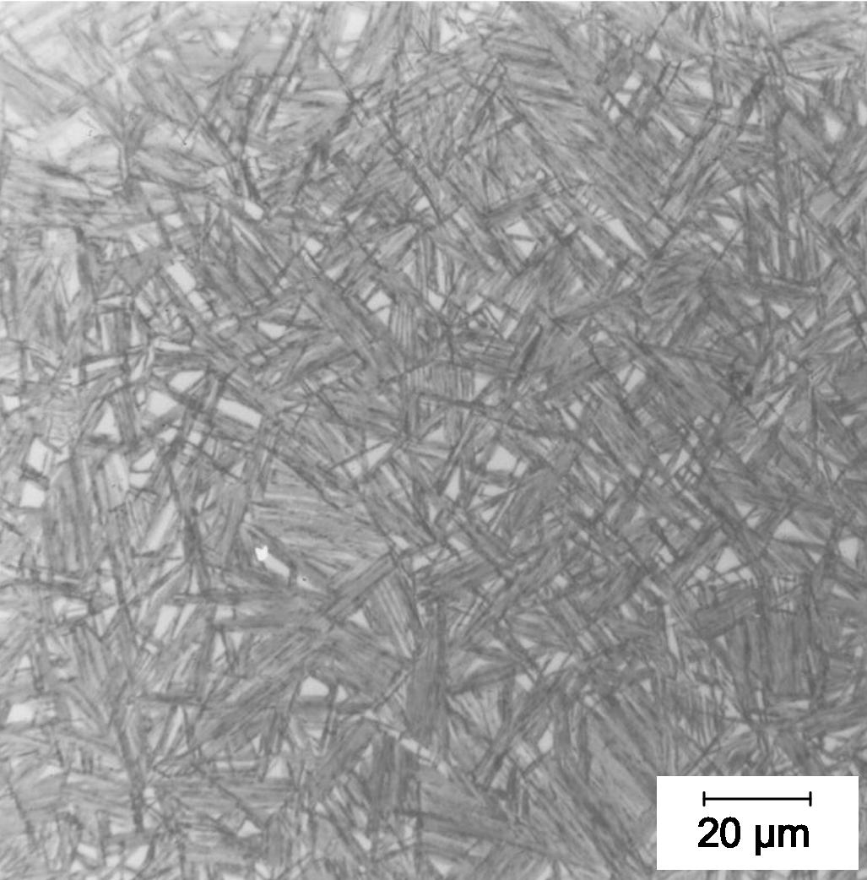
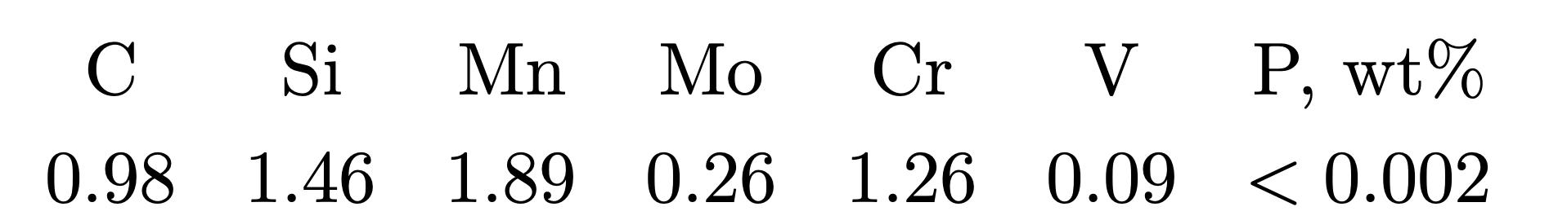
Low transformation temperature
Bainitic hardenability
Reasonable transformation time
Elimination of cementite
Austenite grain size control
Avoidance of temper embrittlement

Slide 15
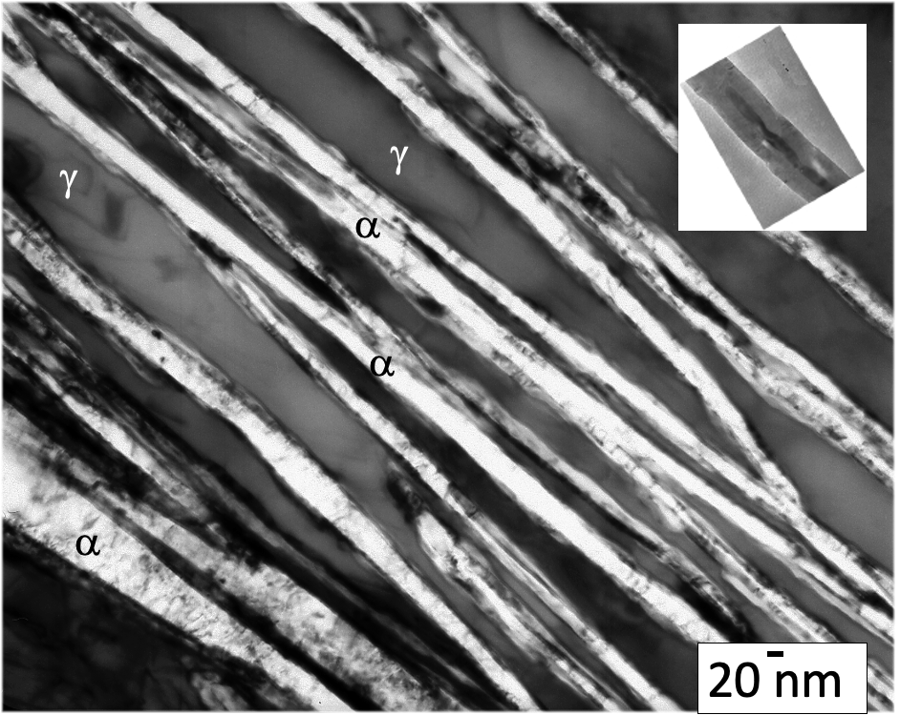
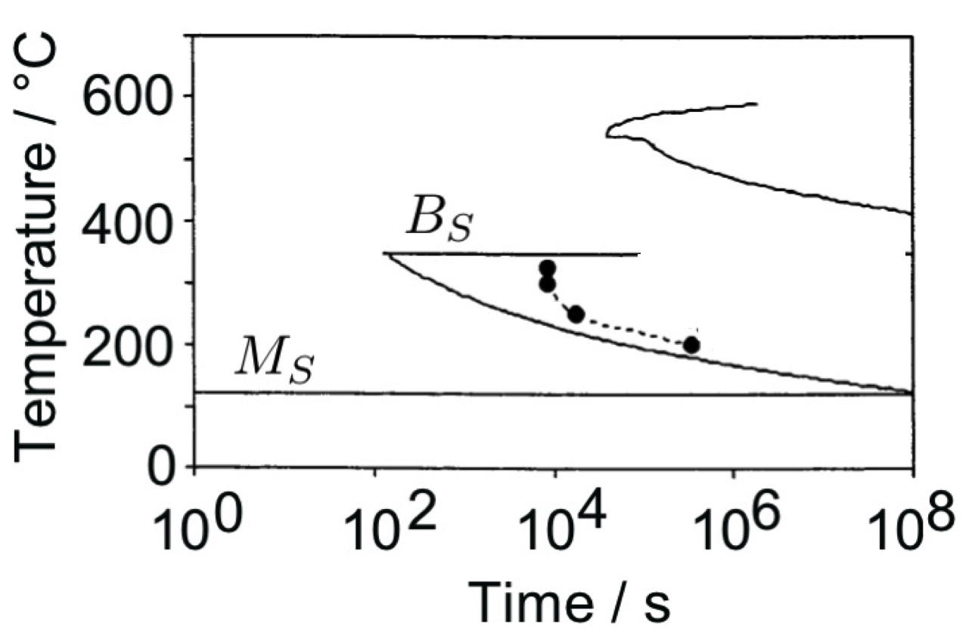
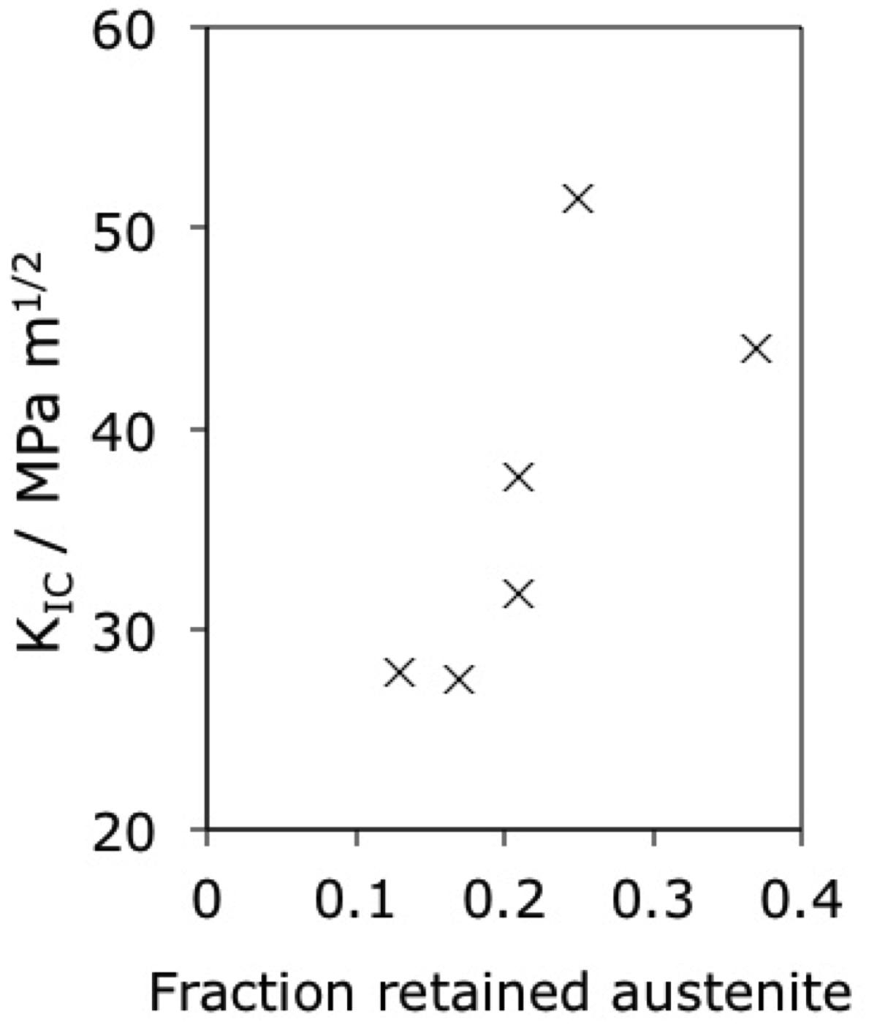
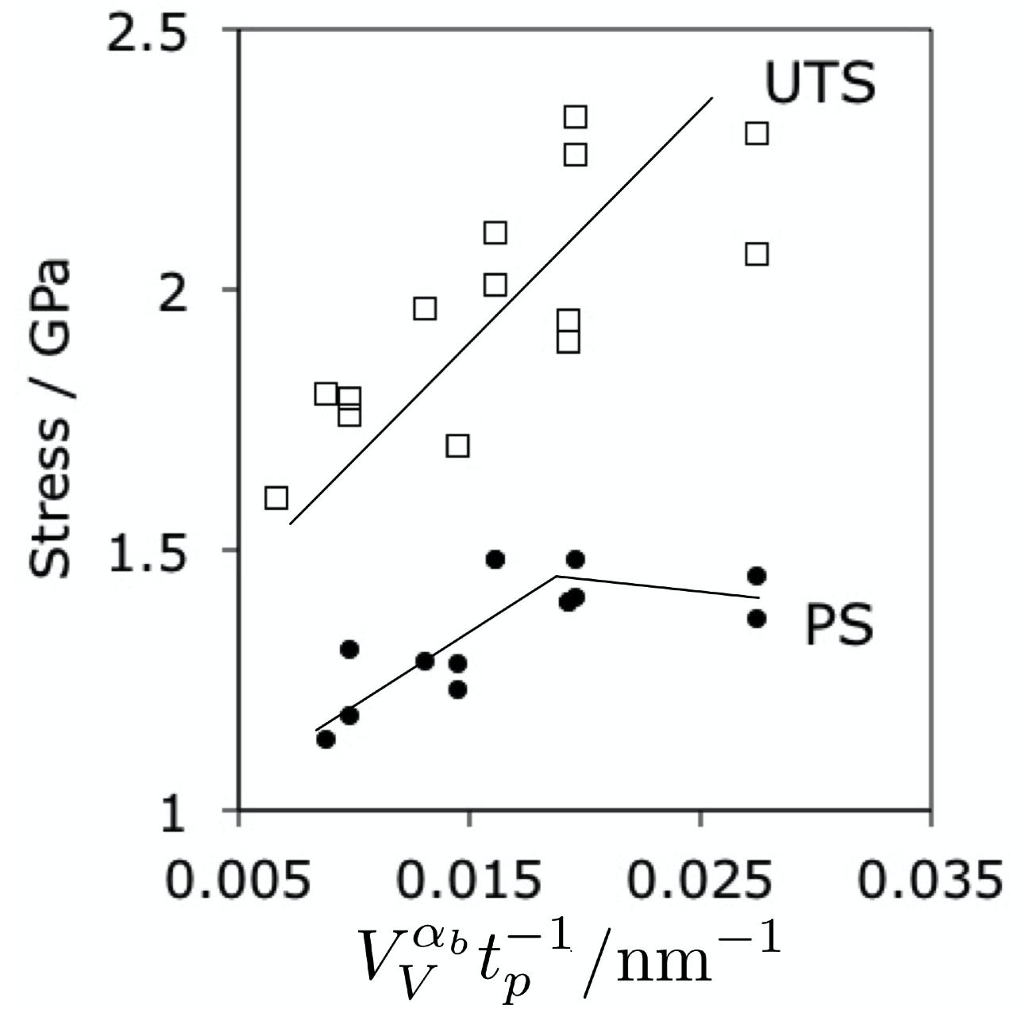

Slide 16
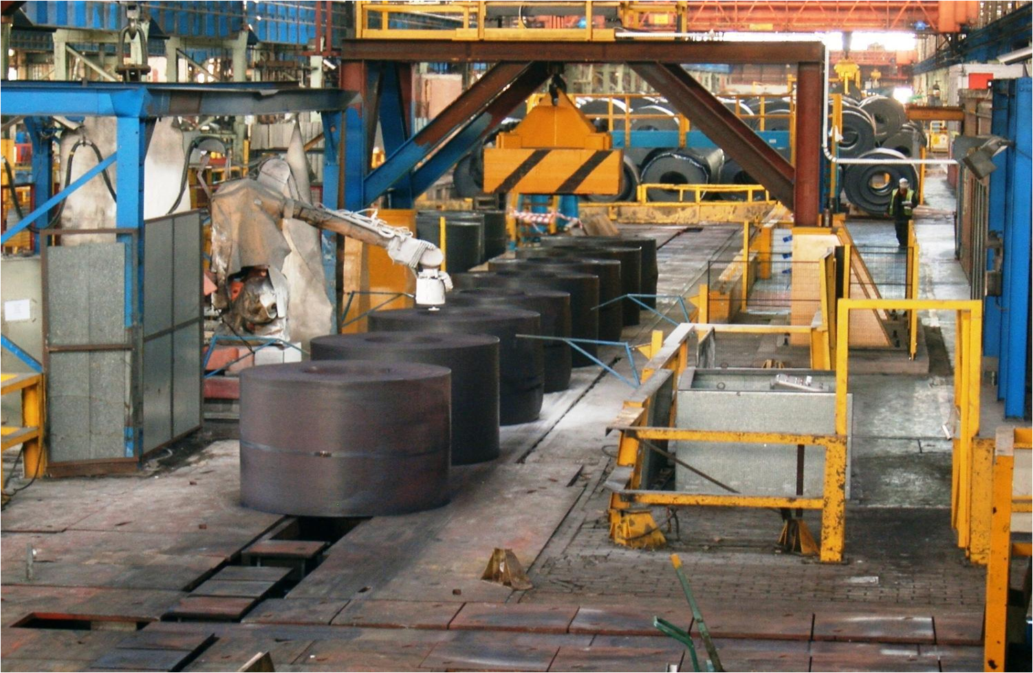
Paul Davies, Tata Steel, 2012

Slide 17


Slide 18

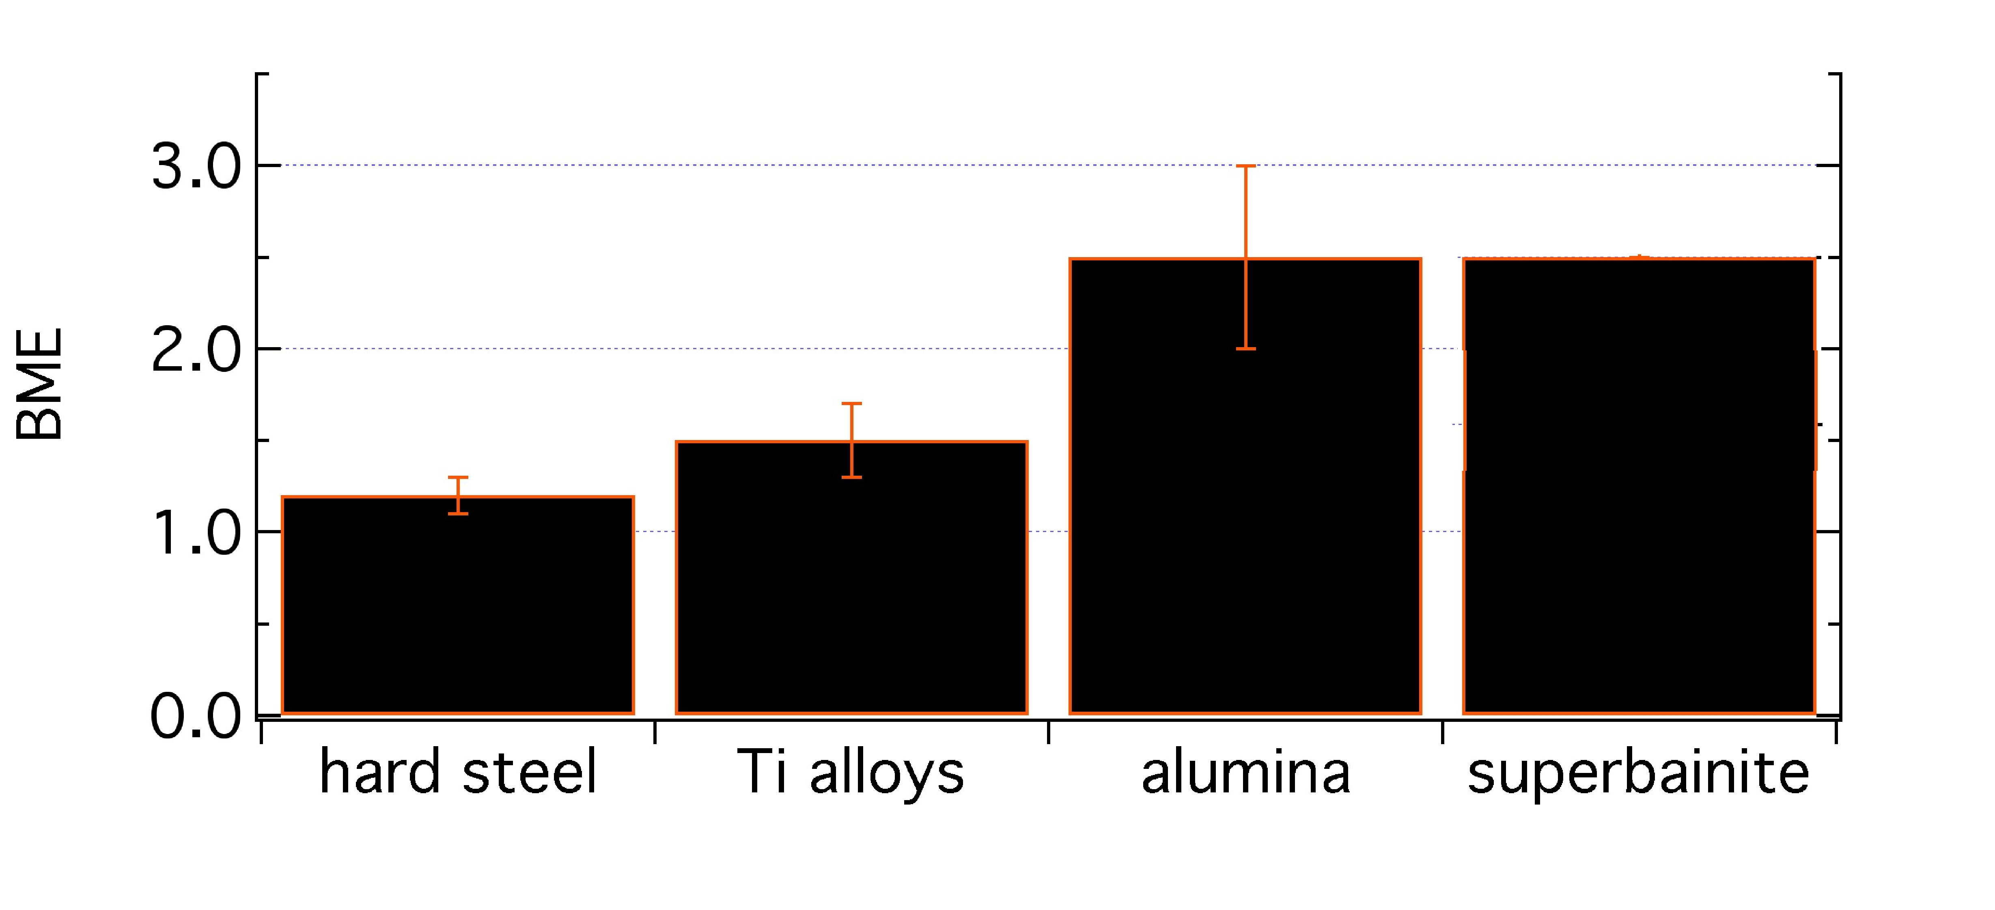
ballistic mass efficiency
consider unit area of armour

Slide 19
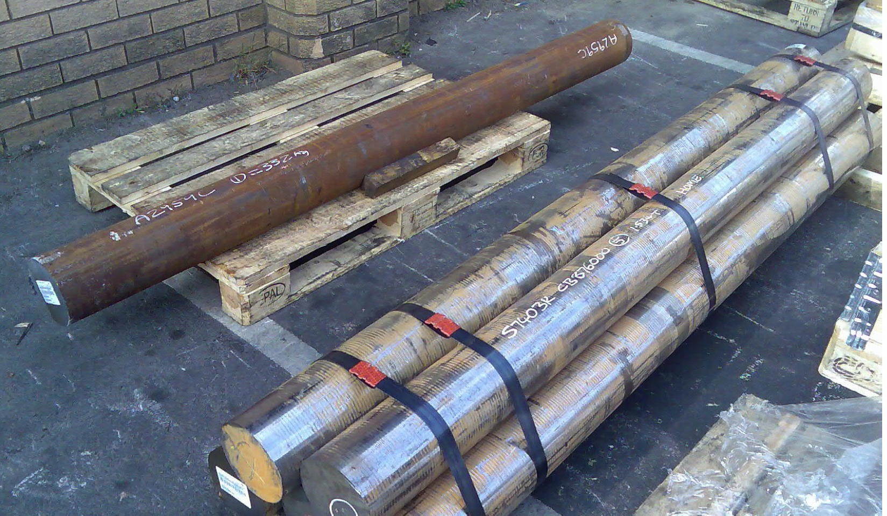
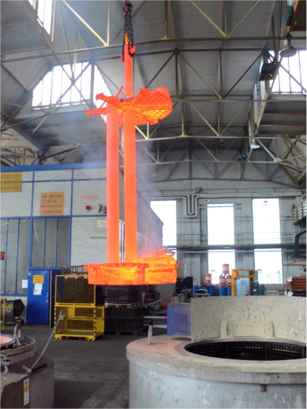
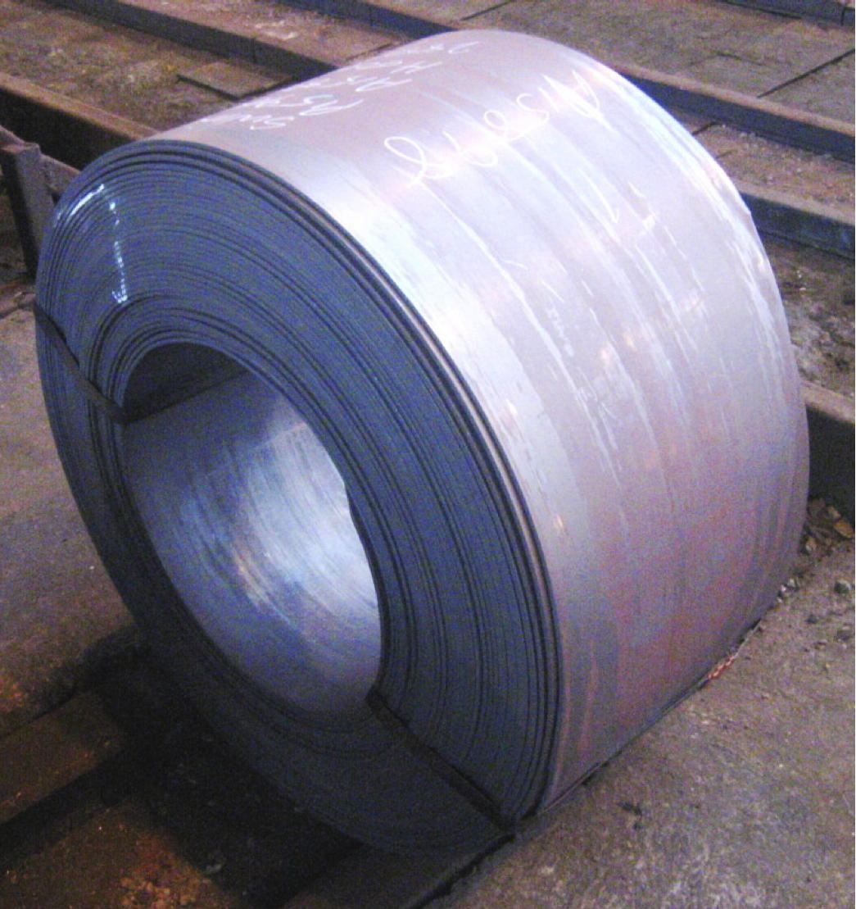
Real images of nanostructured bainite

Slide 20
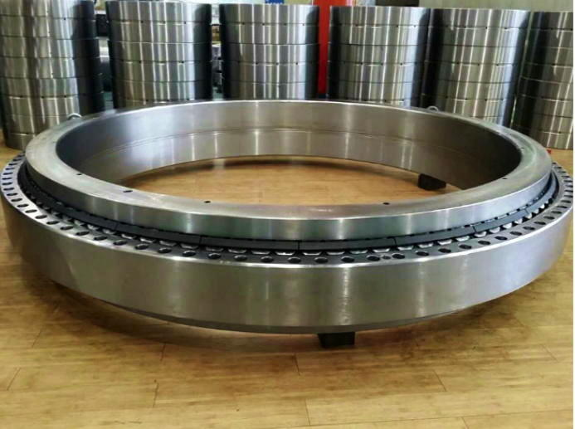

Zhang & Yang, 2019
wind turbines +rolling mill, vibration machinery

Slide 21
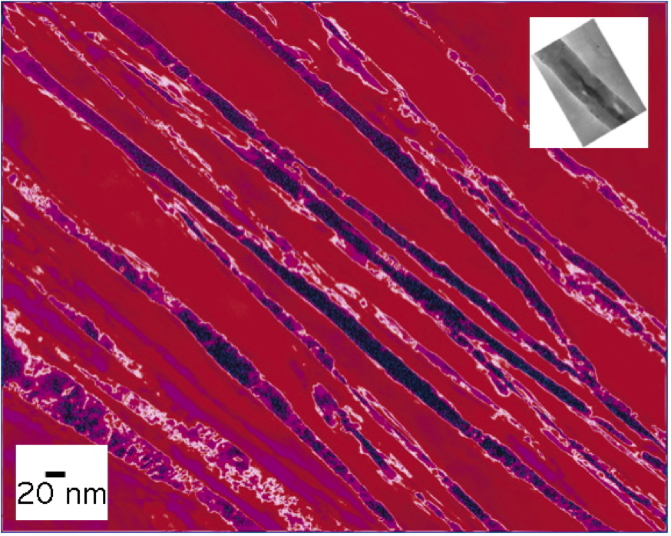
Very strong
Huge uniform ductility
γ
γ
No deformation
No rapid cooling
No residual stresses
Cheap
Uniform in very large sections
α

Slide 22
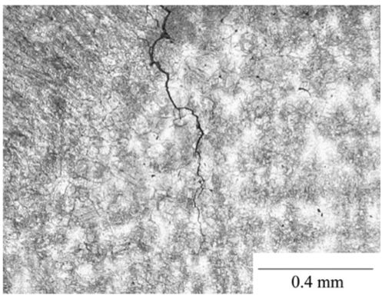
Cannot easily
be welded
Fang, Yang, Liu, Song, Fang, Bhadeshia, Materials and Design, 50 (2013) 38

Slide 23

Steel with impossible combination of properties
>2 GPa
30% ductility at conventional strain rates
ductility at very high strain rate
toughness and Charpy impact at -40°C
weldable
cheap, large in all dimensions
mass production
Mathew Peet

Slide 24
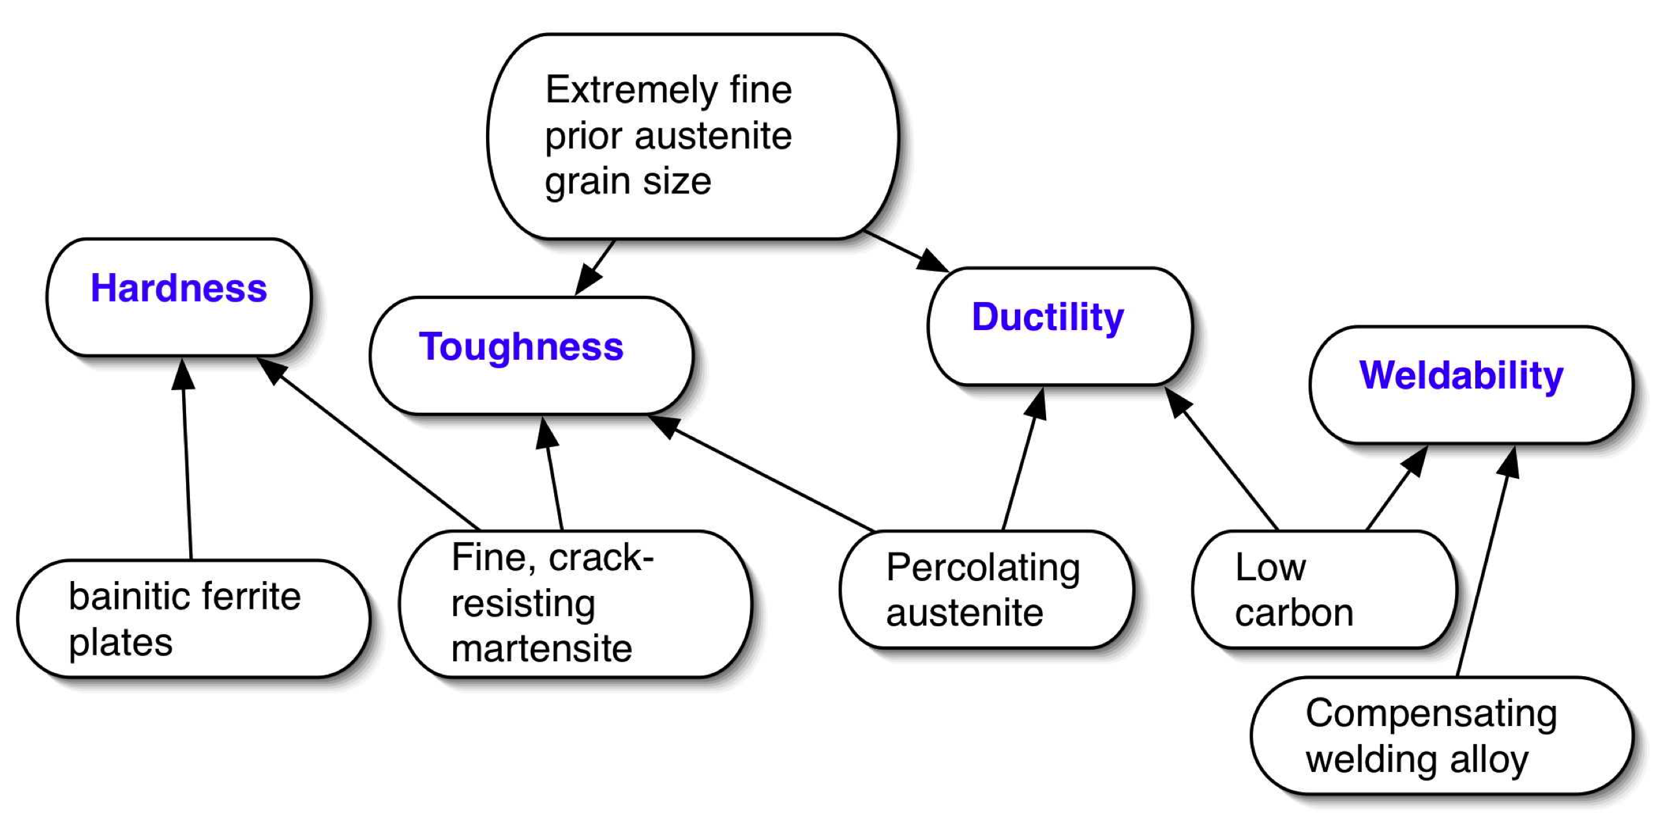

Slide 25
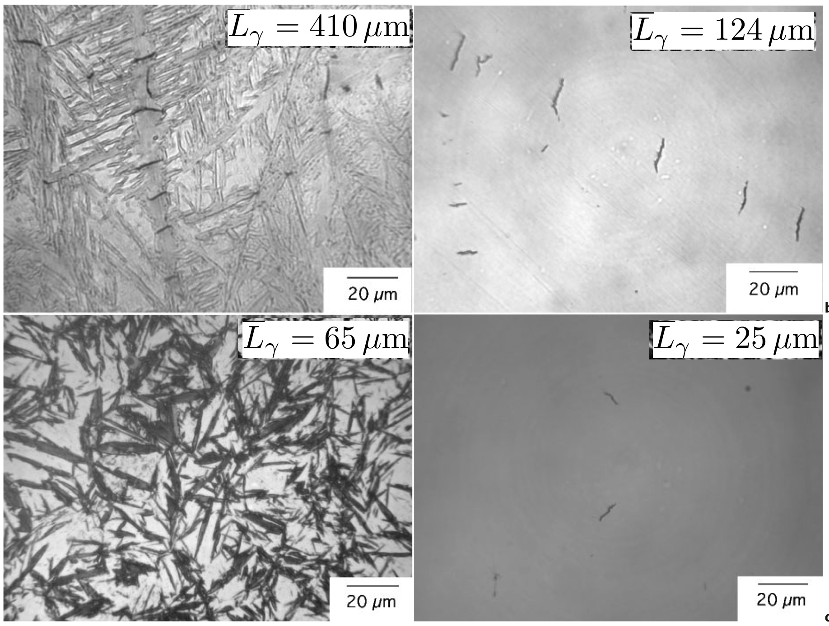

Slide 26
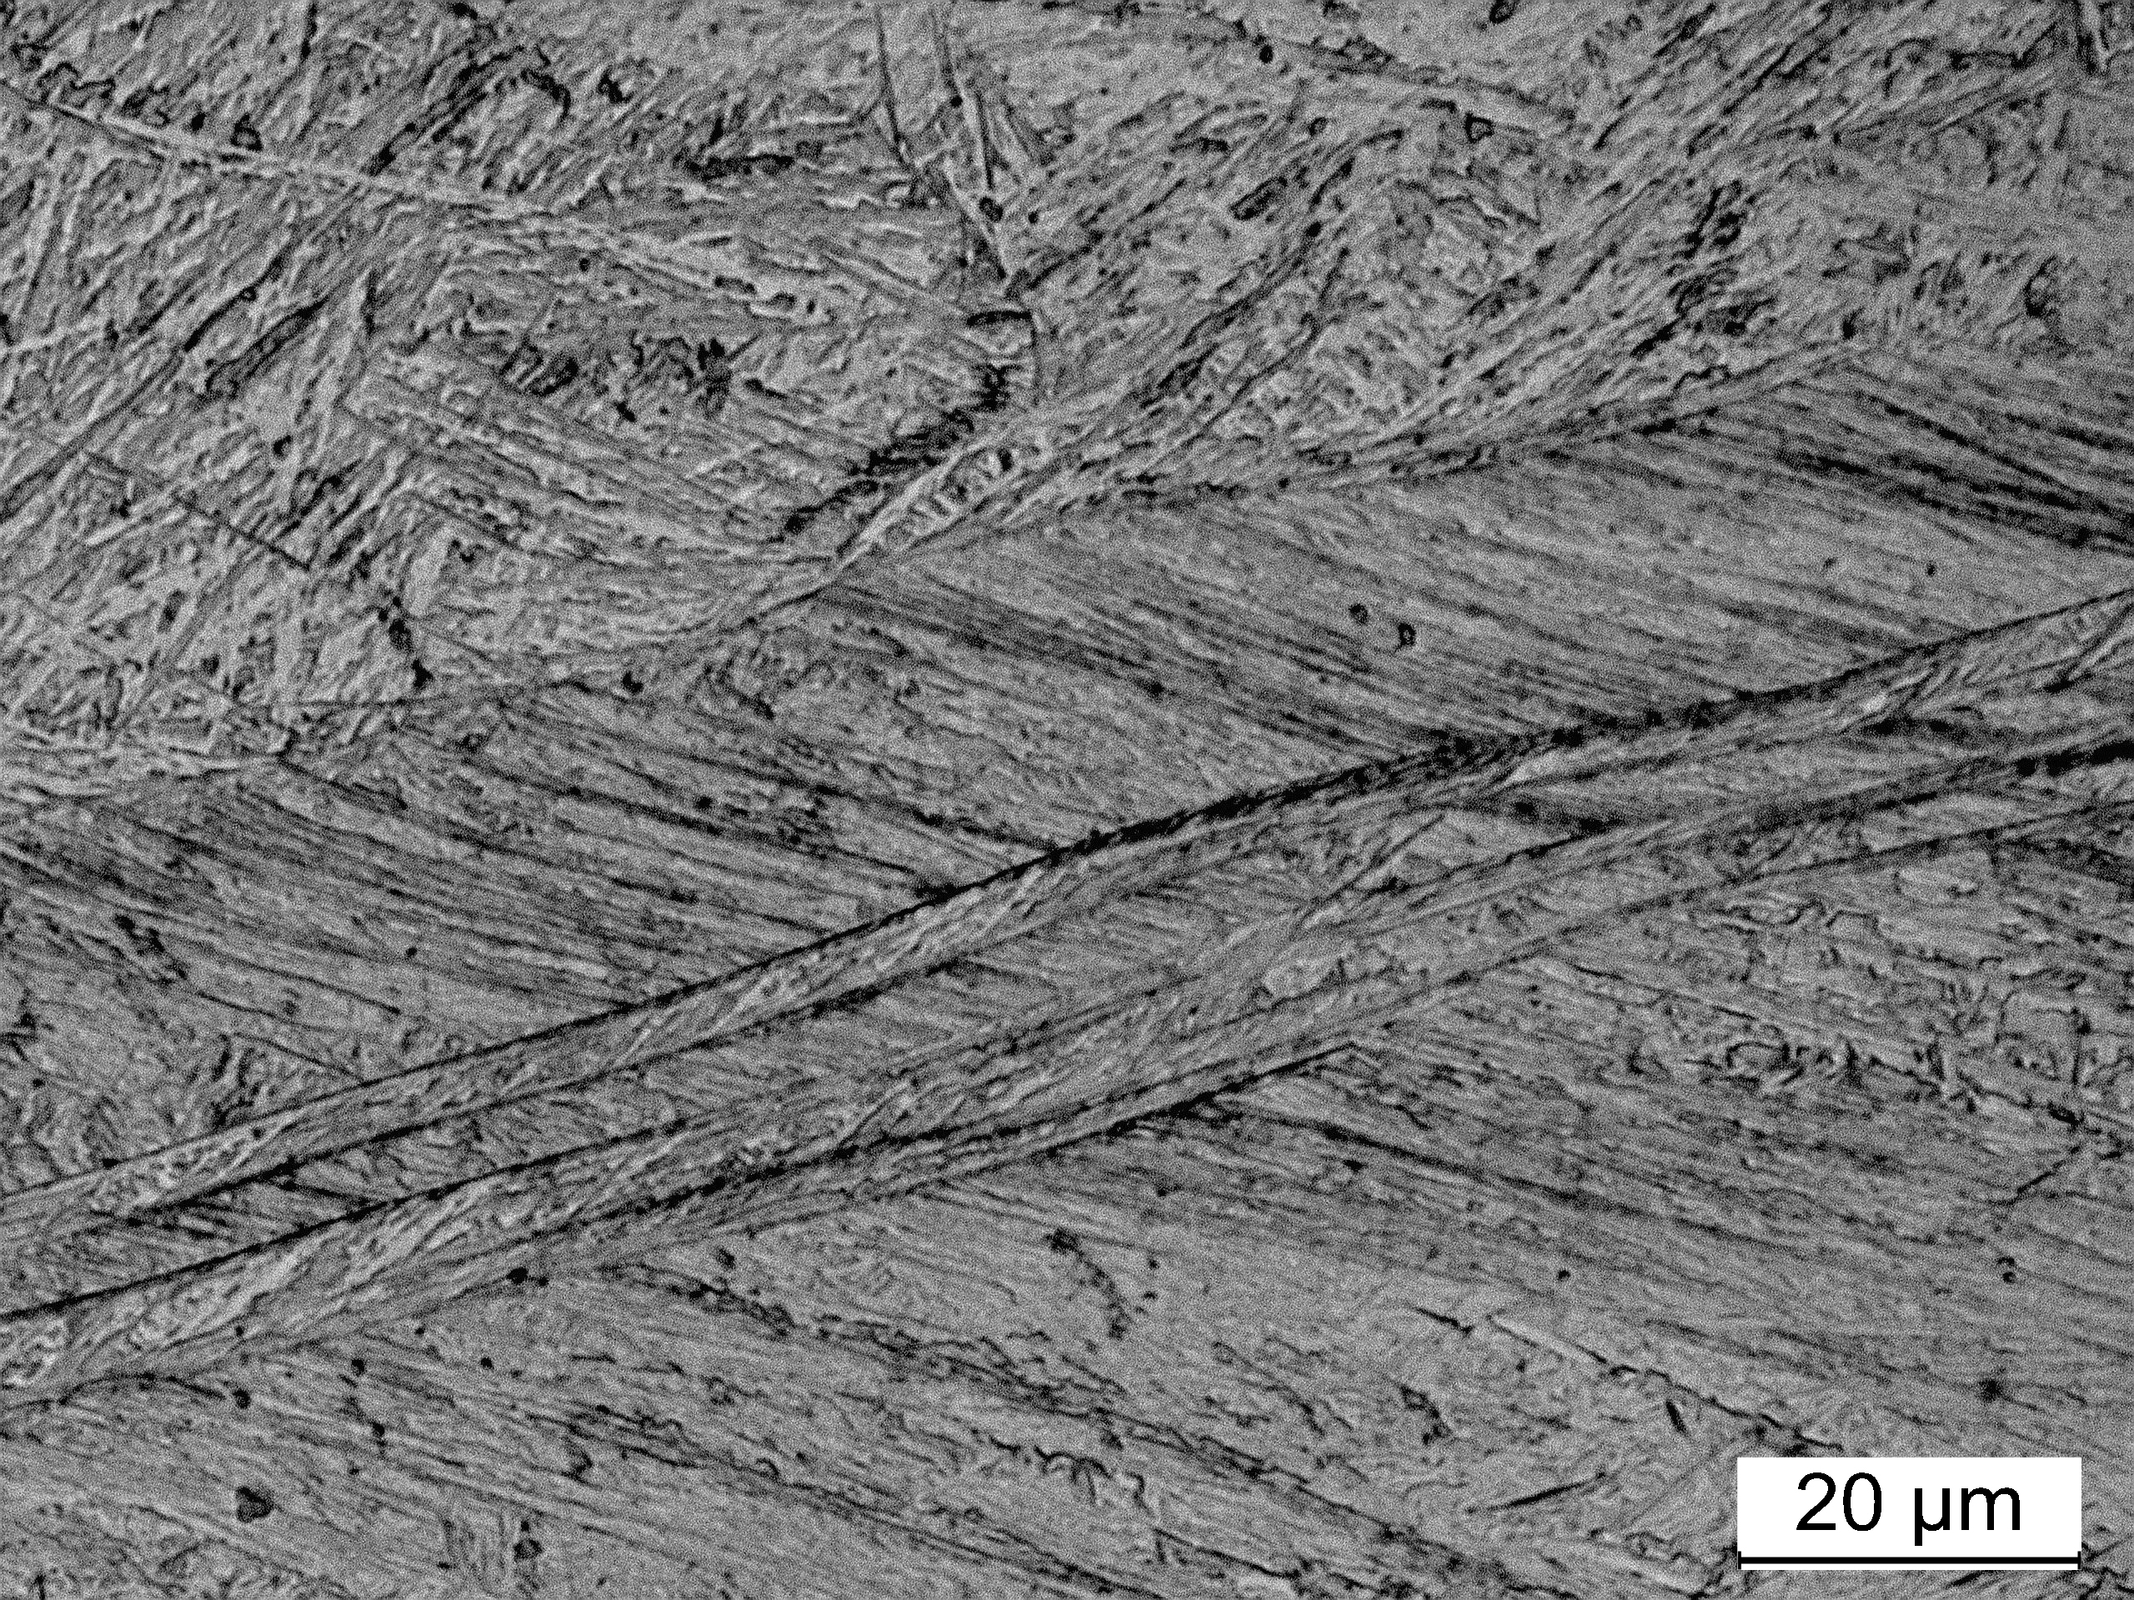
Saurabh Kundu

Slide 27
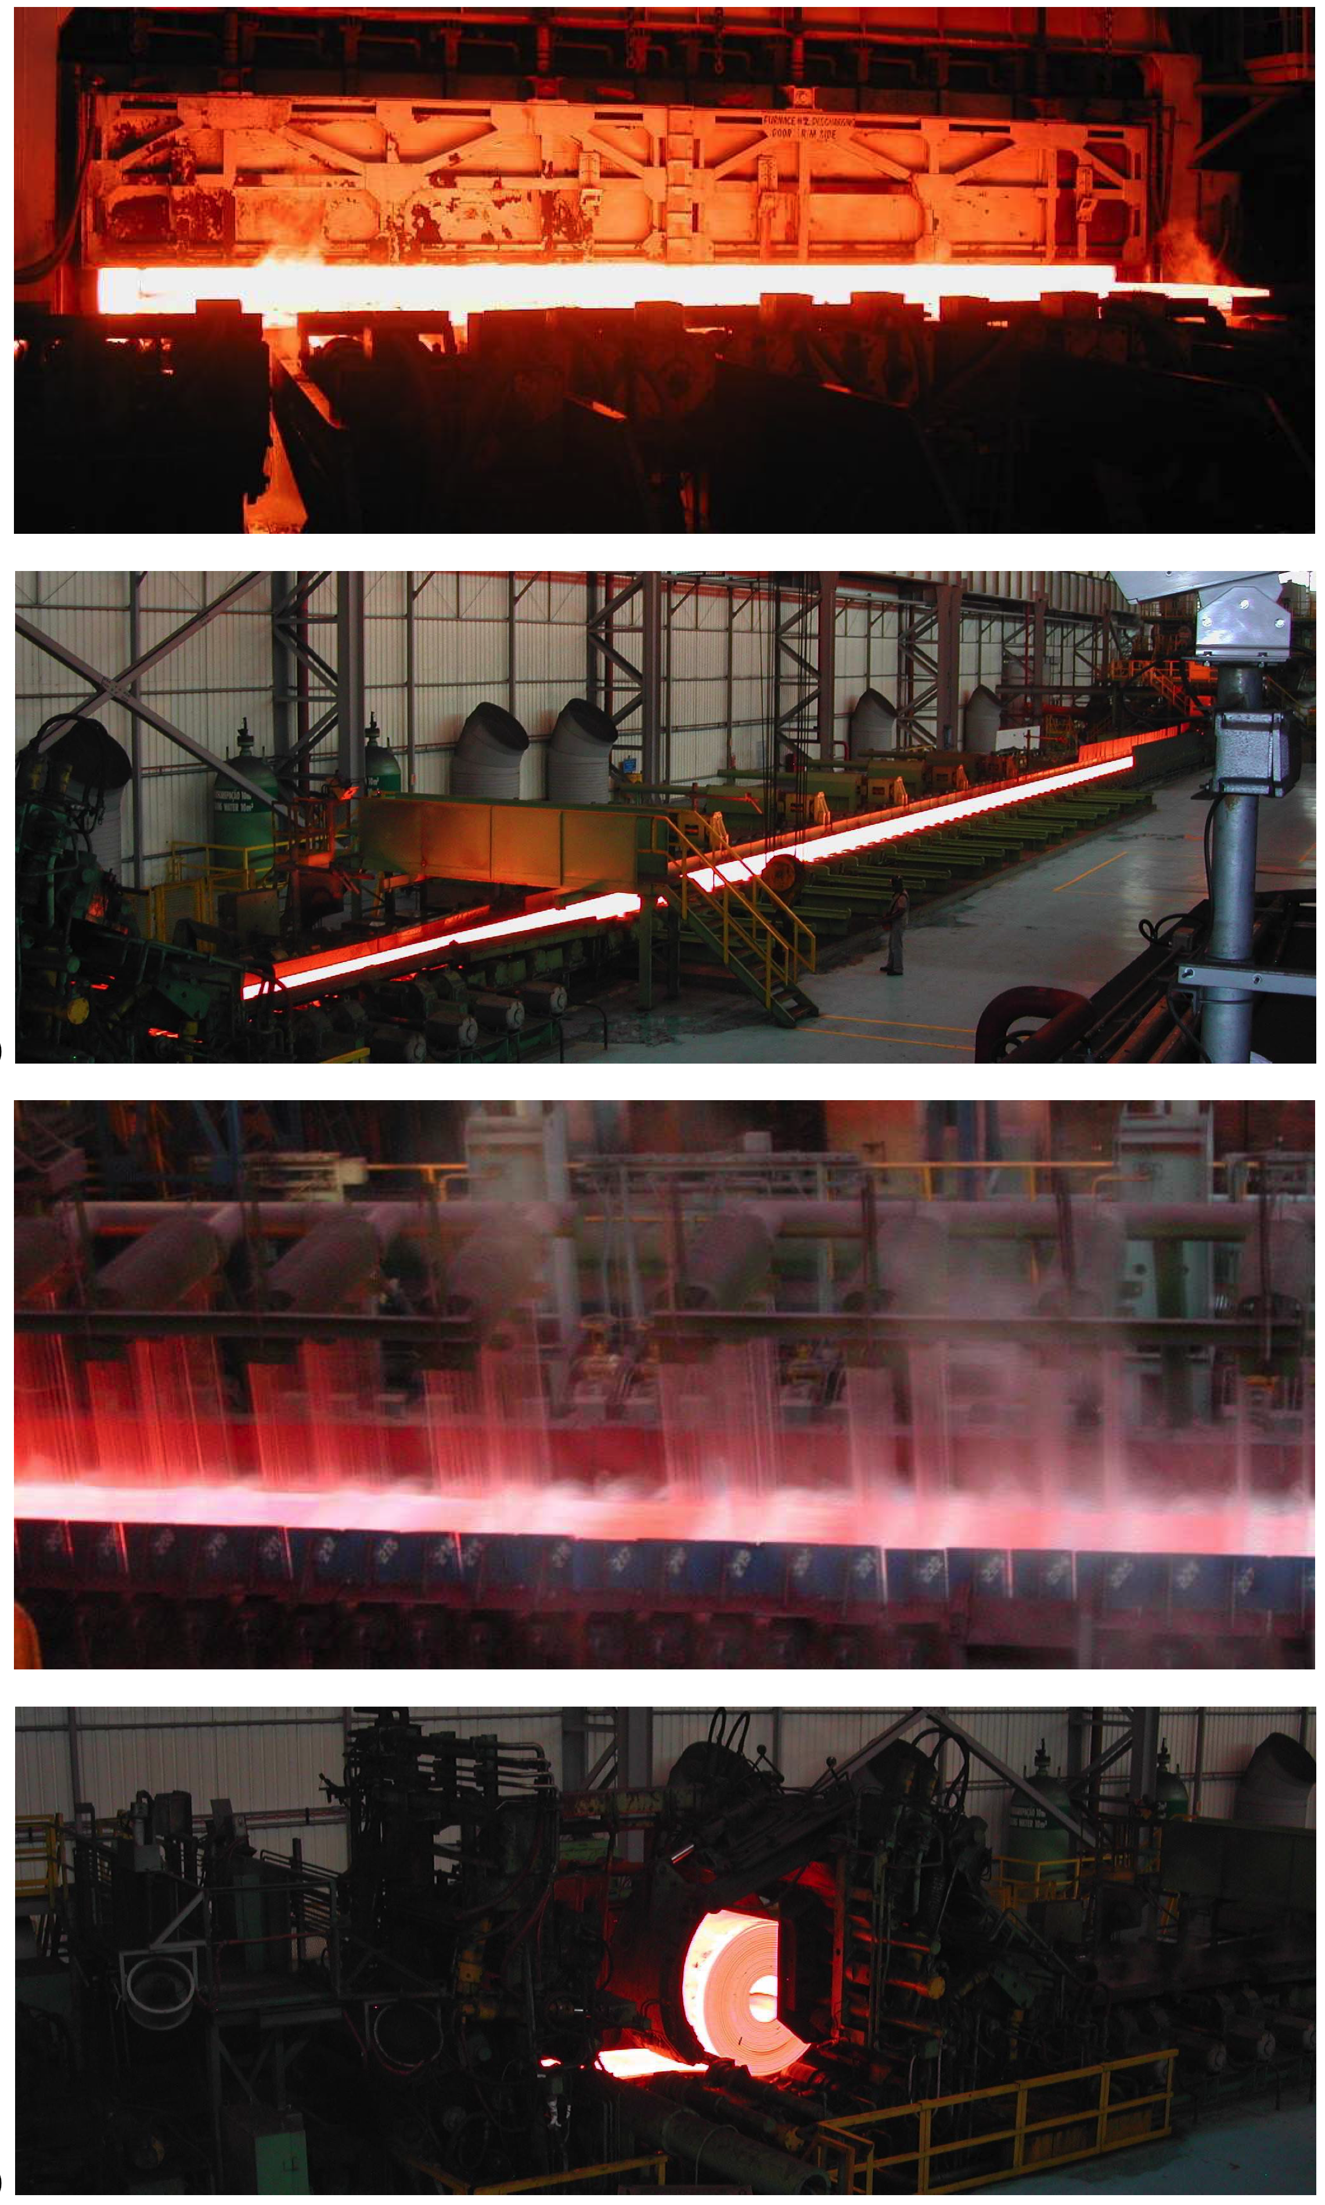
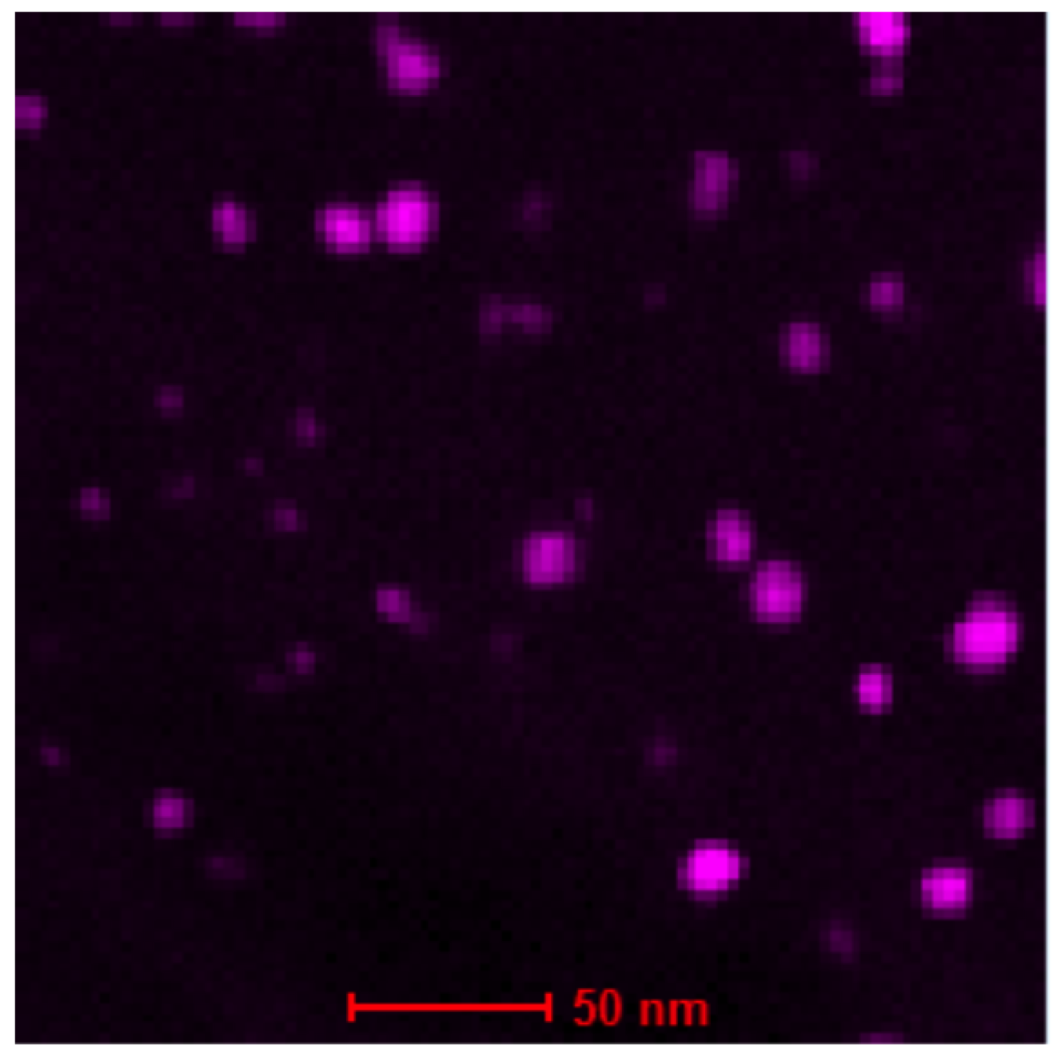

Slide 28
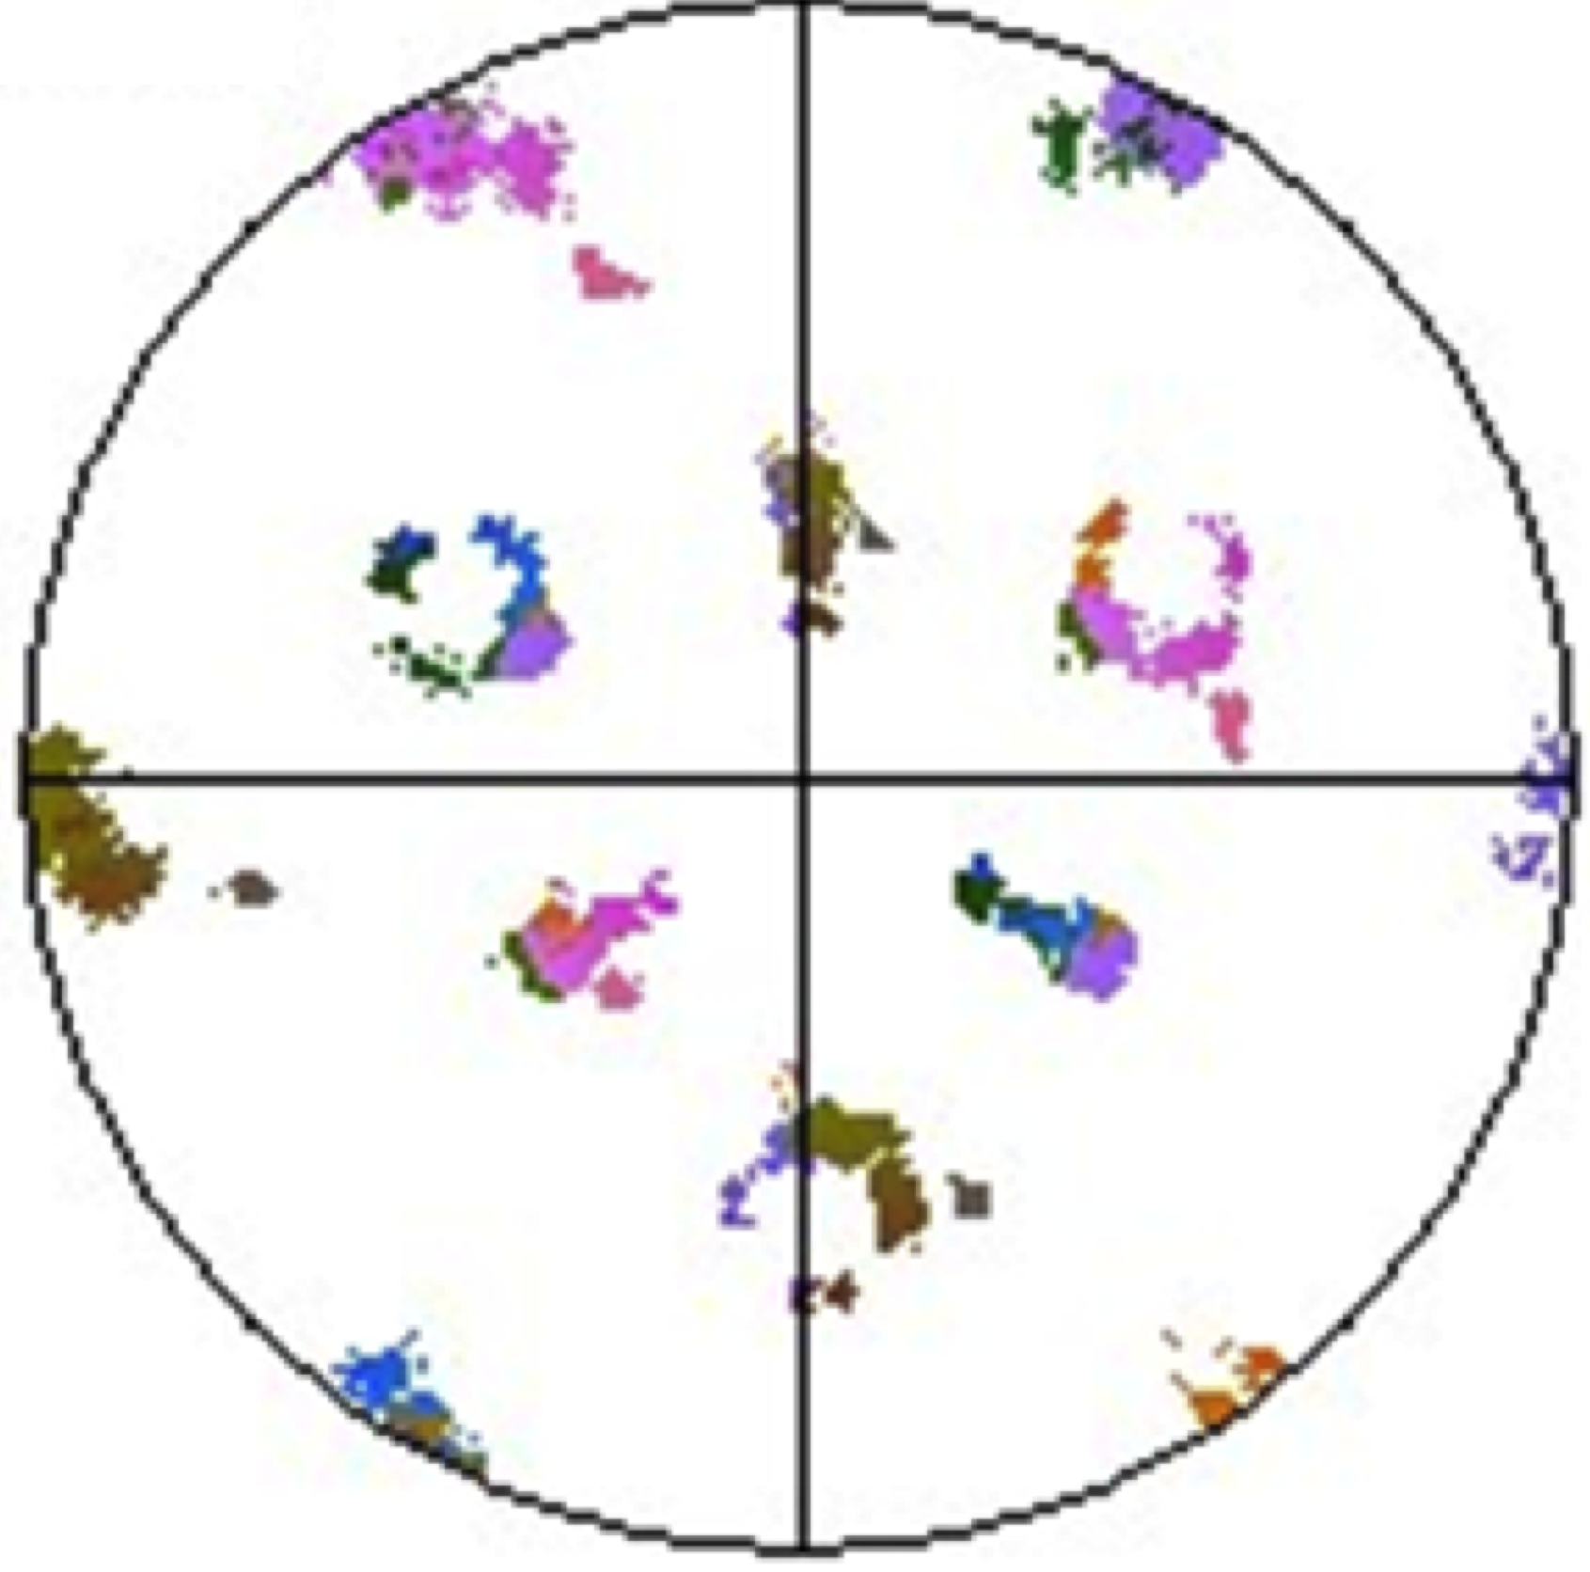
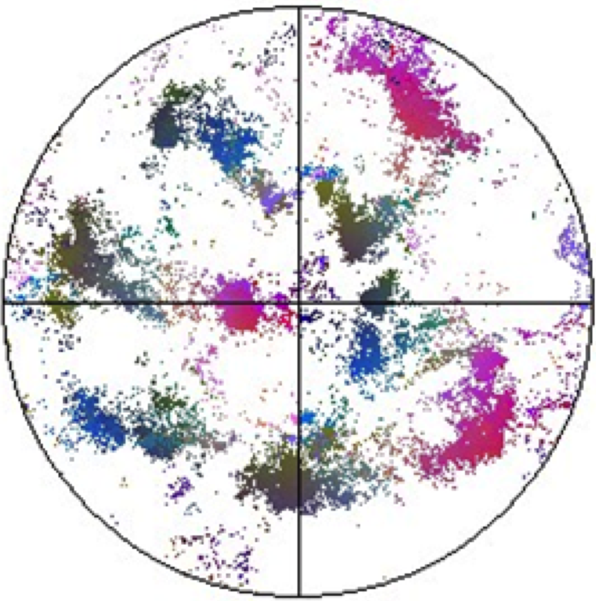
Saurabh Kundu

Slide 29
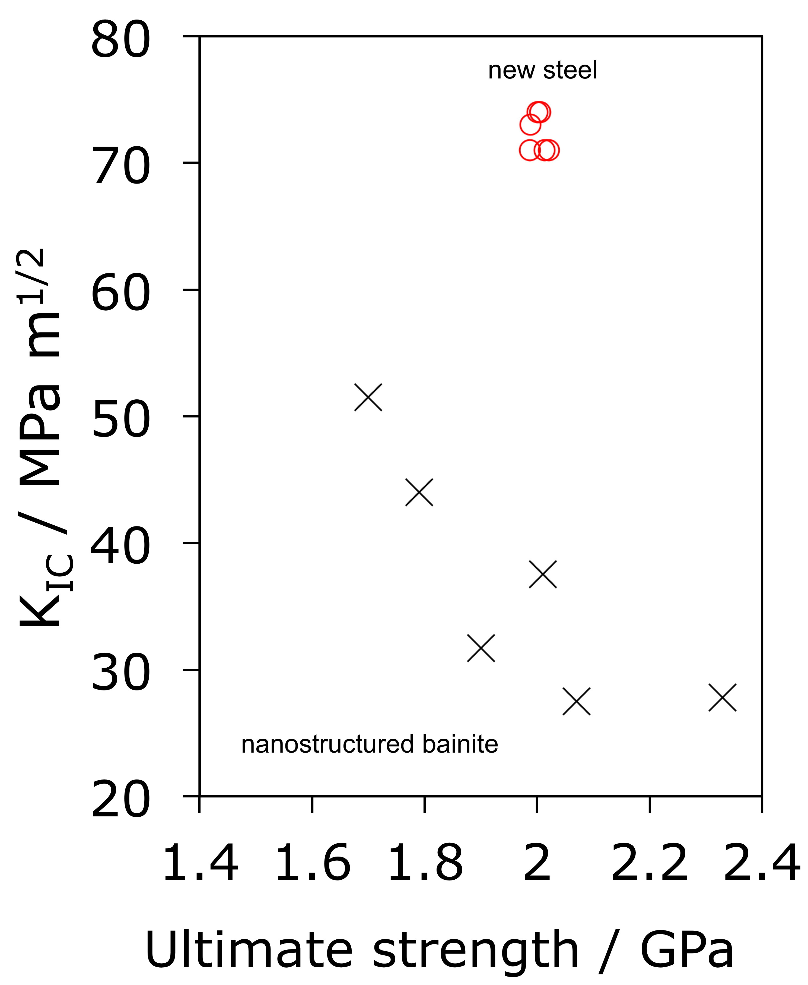

Slide 30
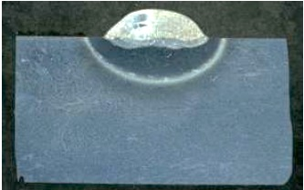
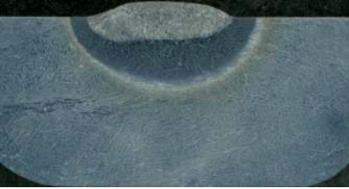
Two pass
Single pass
12 mm

Slide 31

High speed video
V₀ = 445 m s⁻¹
Vickram Deshpande, Mathew Peet

Slide 32
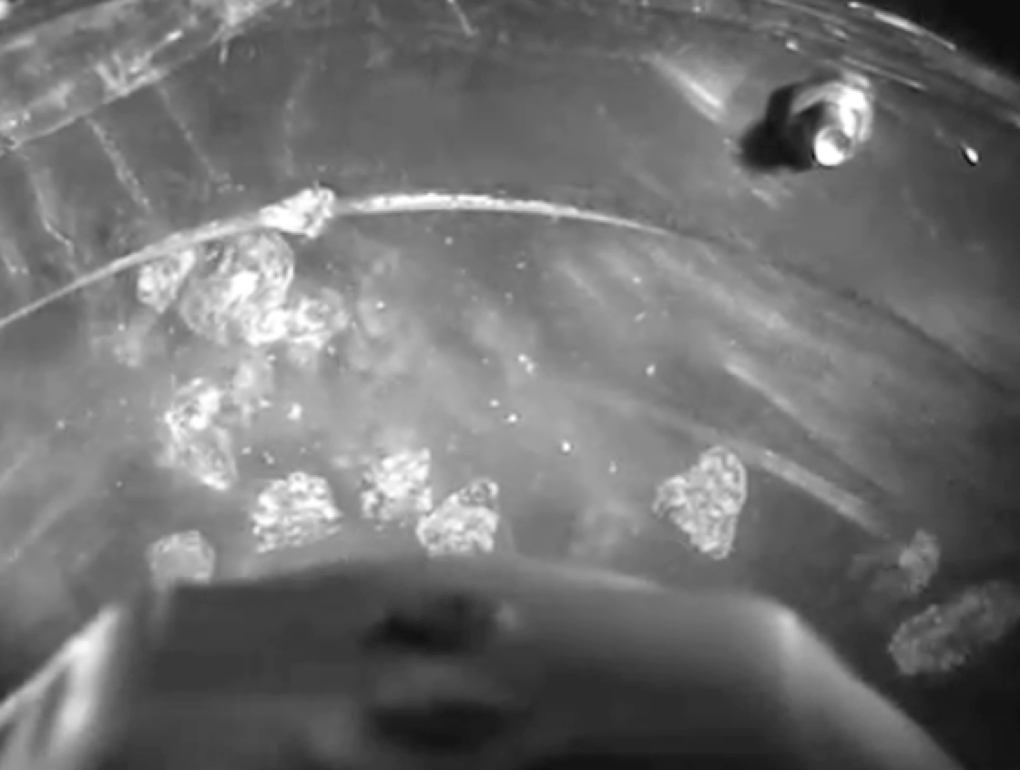
Impact abrasion
courtesy of Kati Valtonen
Tampere University Wear Centre

Slide 33
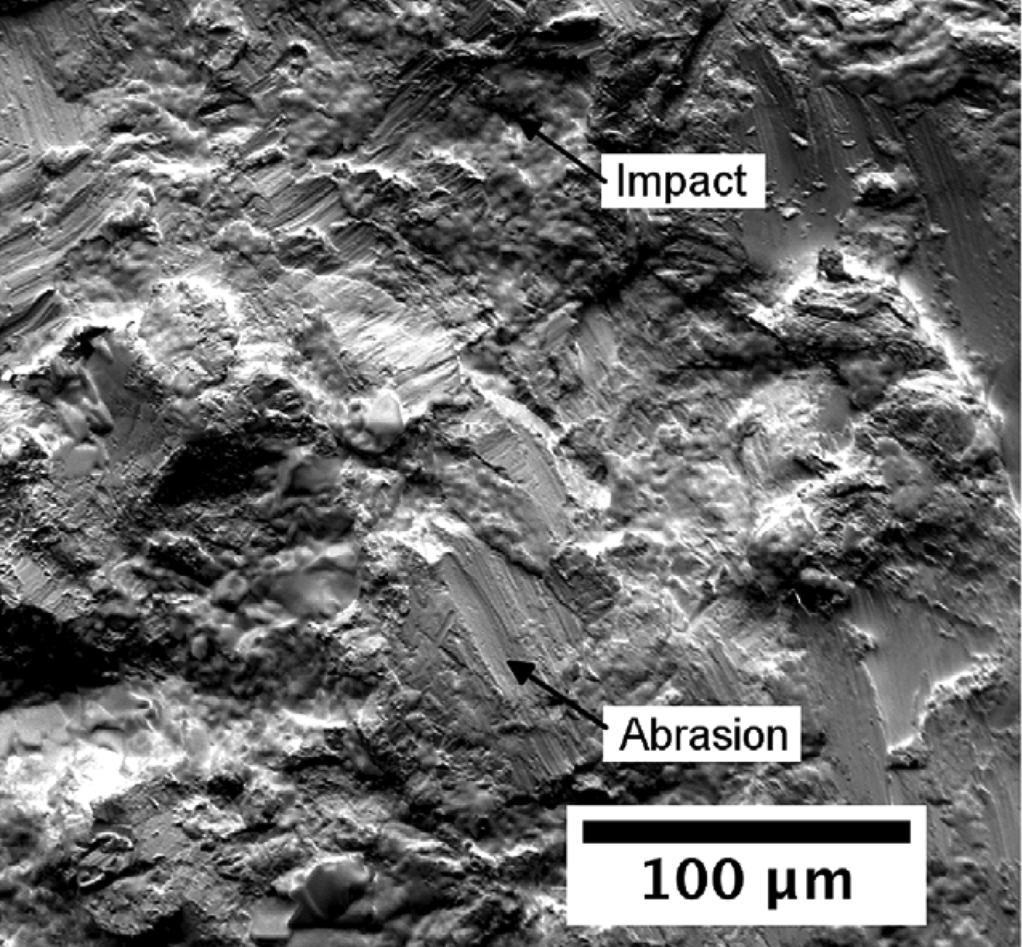

Slide 34
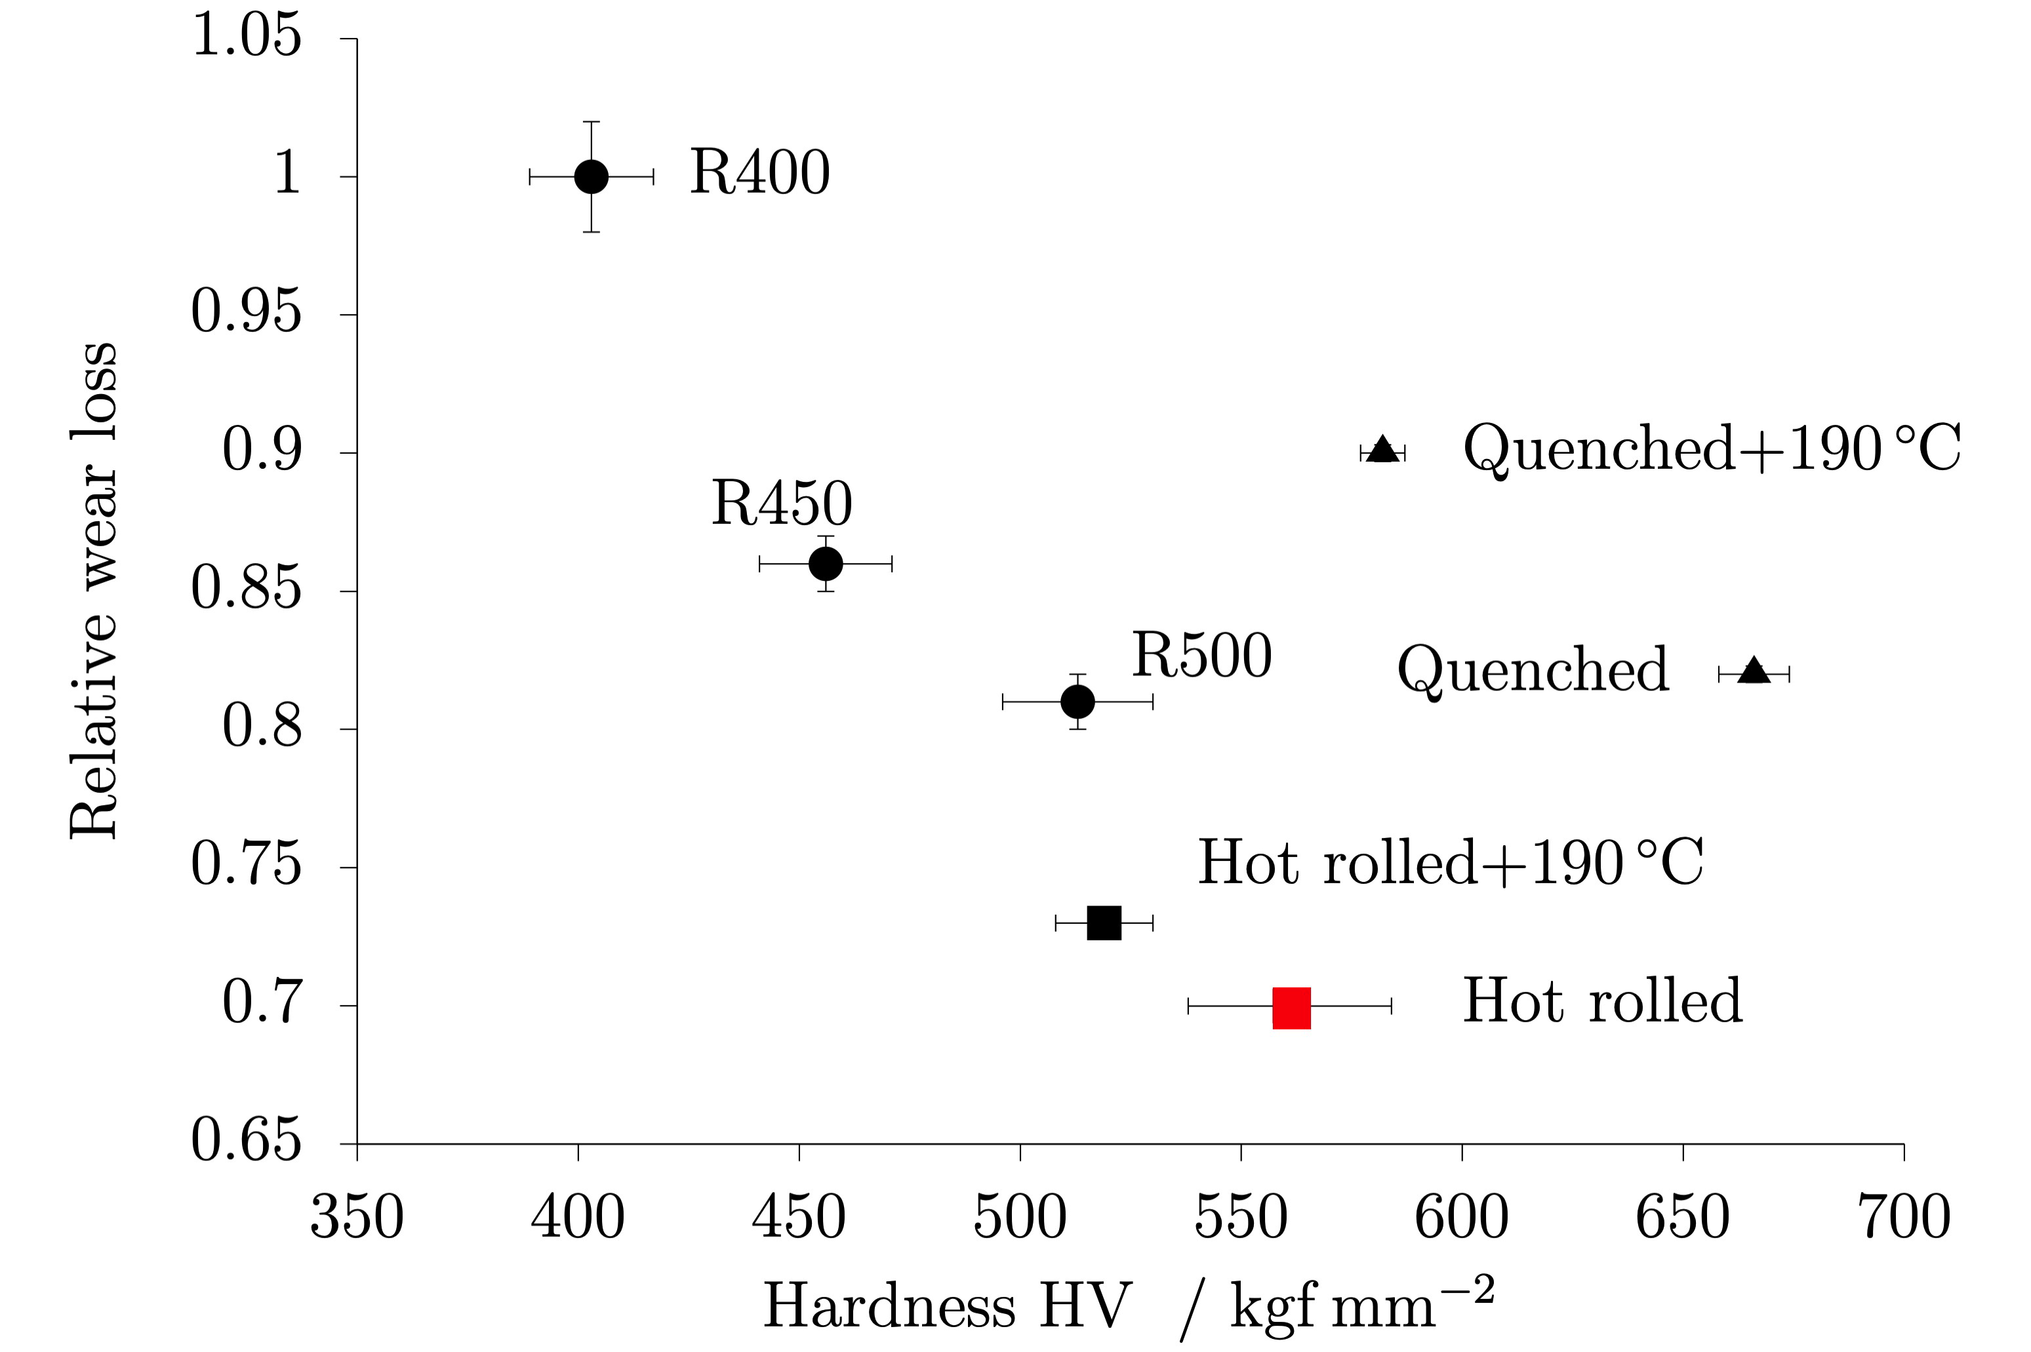

Slide 35
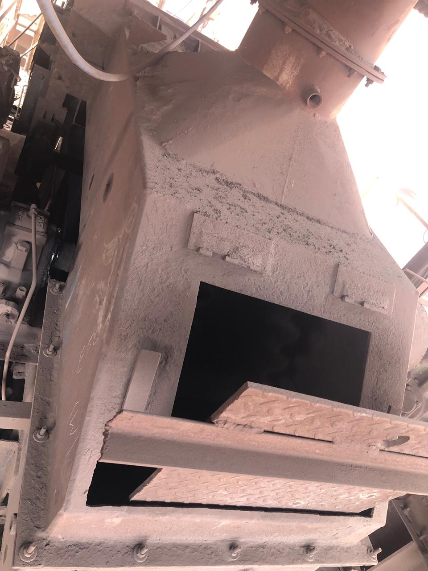
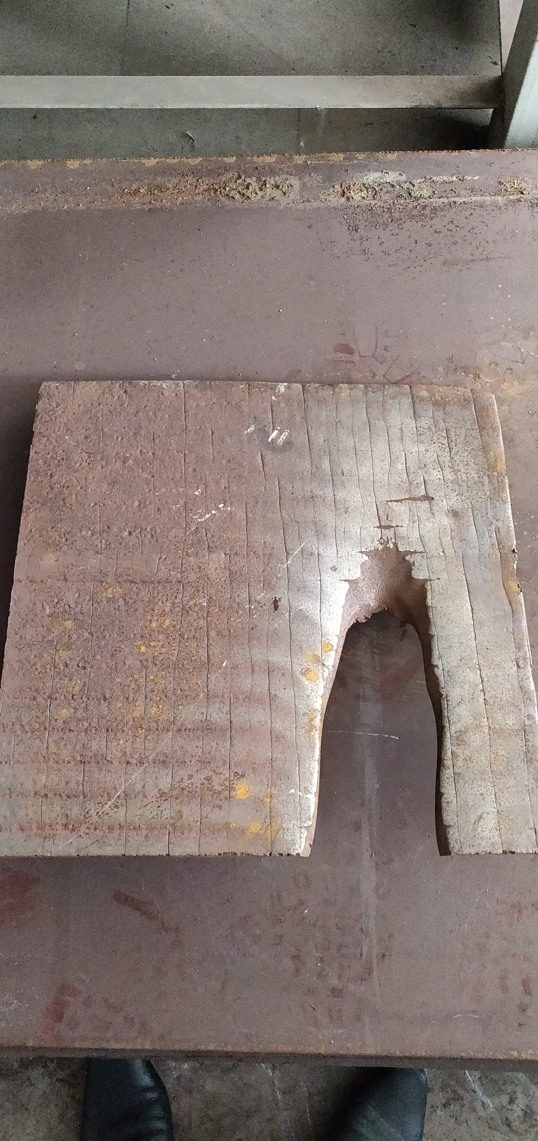

Slide 36
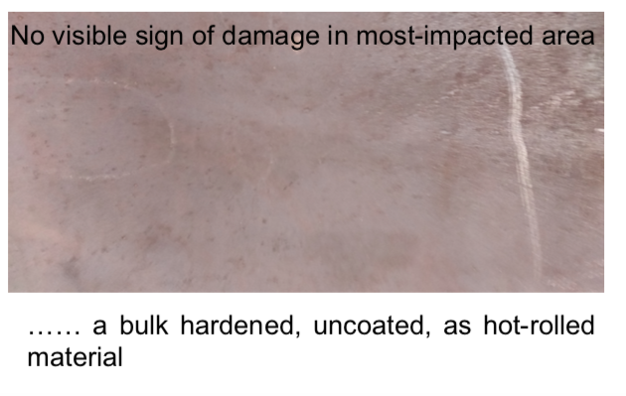

Slide 37
