Slide 1



Steels: bainite
... the connection between theory and manufacture
Lecture 4
Fabio Miani
Harry Bhadeshia
Professor of Metallurgy
Queen Mary University of London
Emeritus Tata Steel Professor of Metallurgy
University of Cambridge
2022

Slide 3
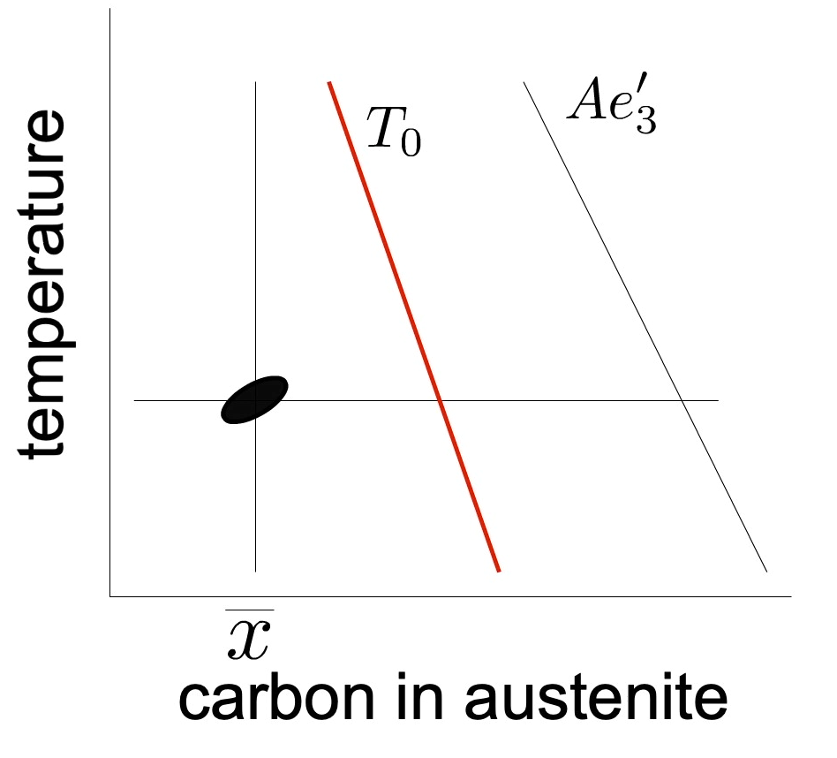
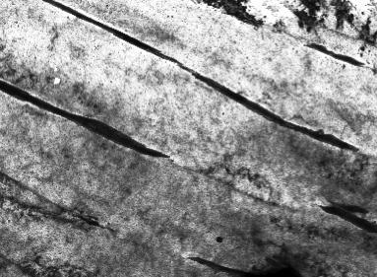
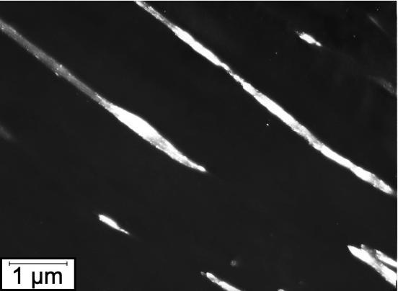
Fe-0.05C-1.55Mn-0.12Si-0.1Nb wt%
600°C, 30 s
Yan P, Bhadeshia HKDH. Mechanism and kinetics of solid-state transformation in high-temperature processed linepipe steel. Metallurgical and Materials Transactions A. 2013 Dec;44(12):5468-77.

Slide 4
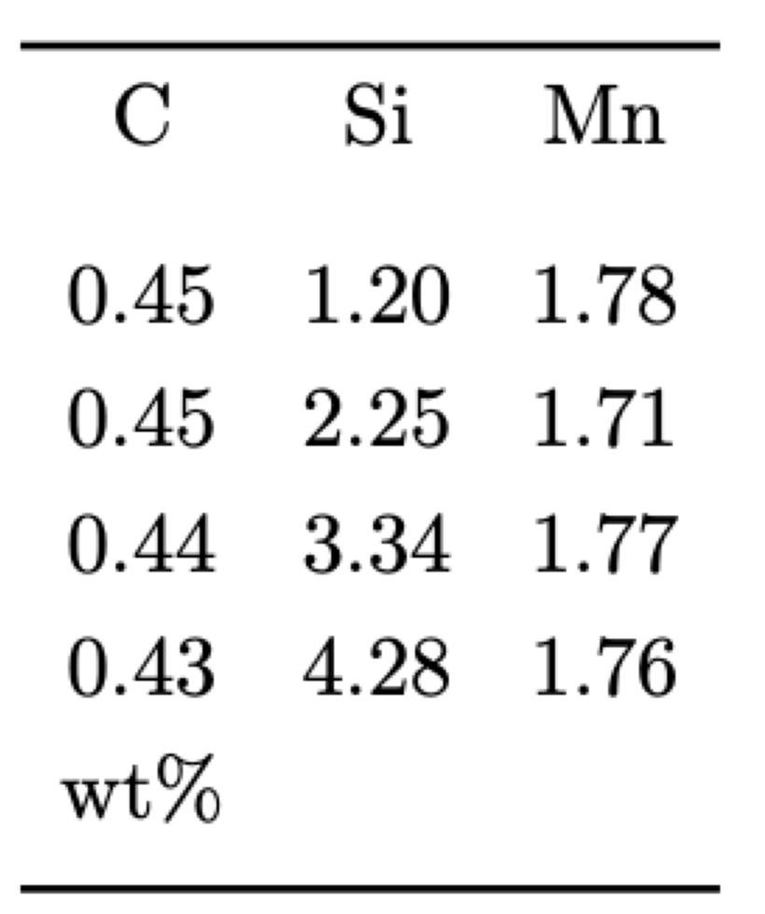
T₀
Ae₃'
T₀'
Lin S, Borgenstam A, Stark A, Hedström P. Effect of Si on bainitic transformation kinetics in steels explained by carbon partitioning, carbide formation, dislocation densities, and thermodynamic conditions. Materials Characterization. 2022 Feb 3:111774

Slide 5
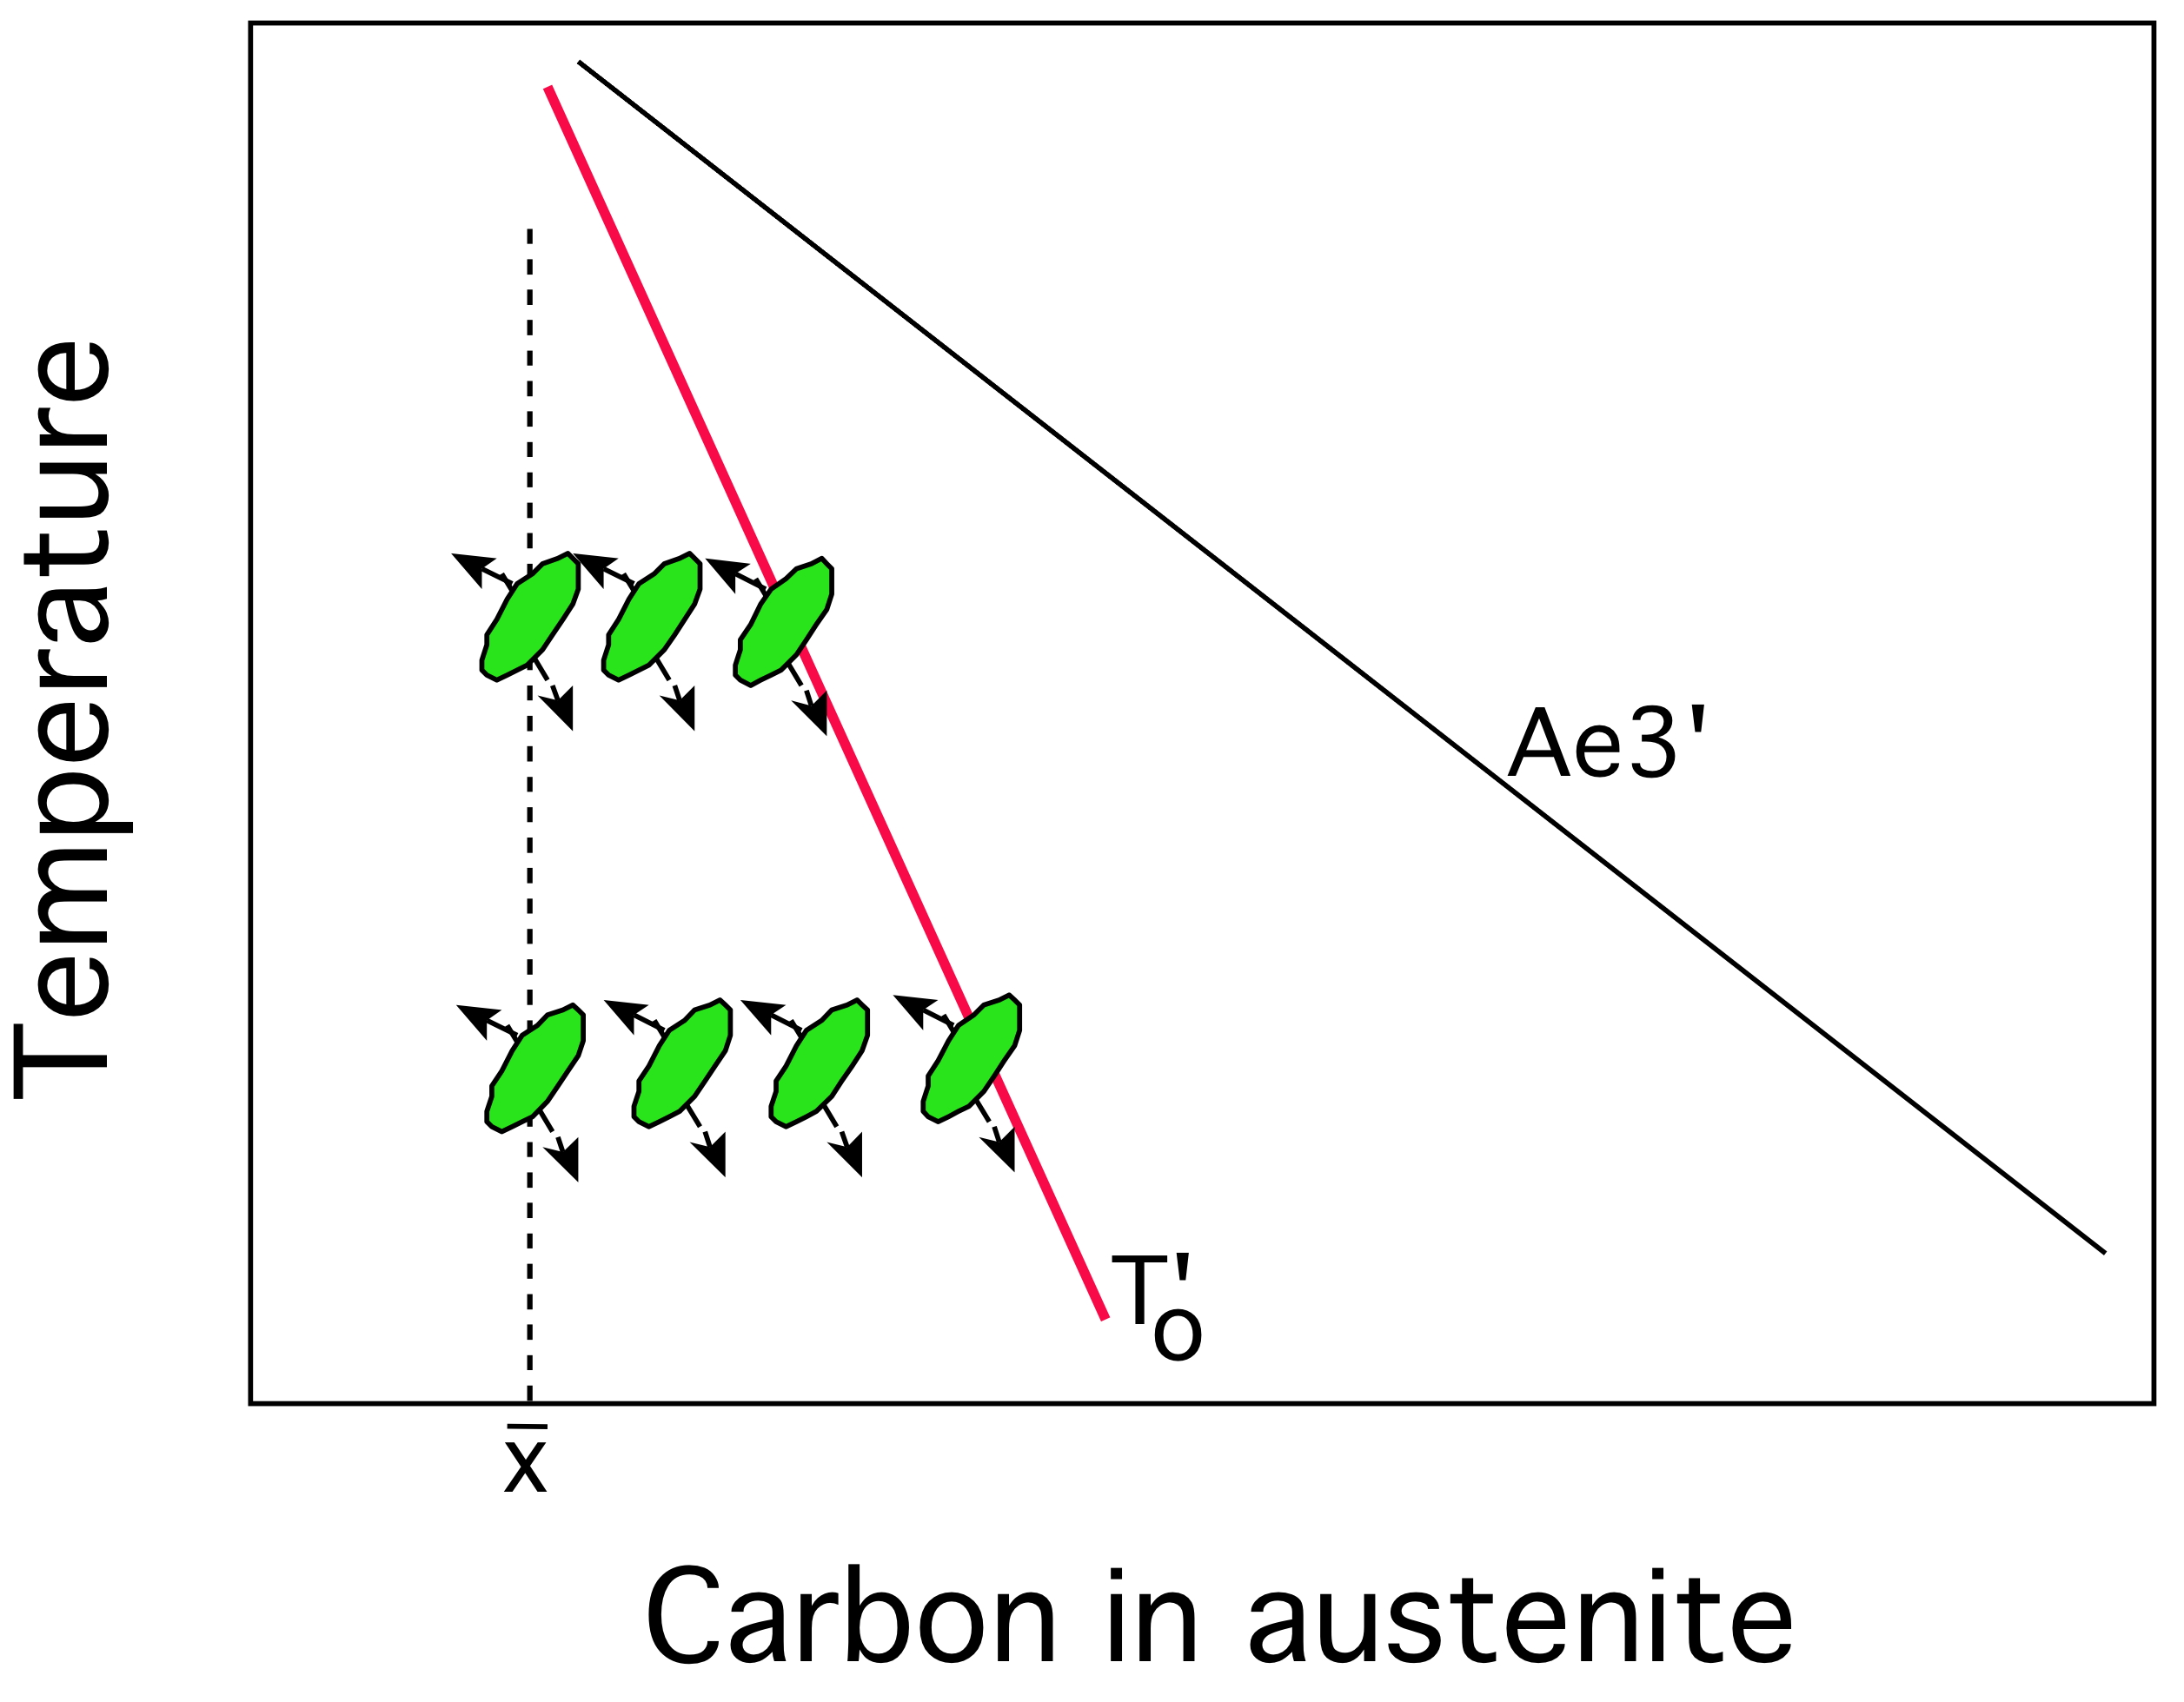

Slide 6
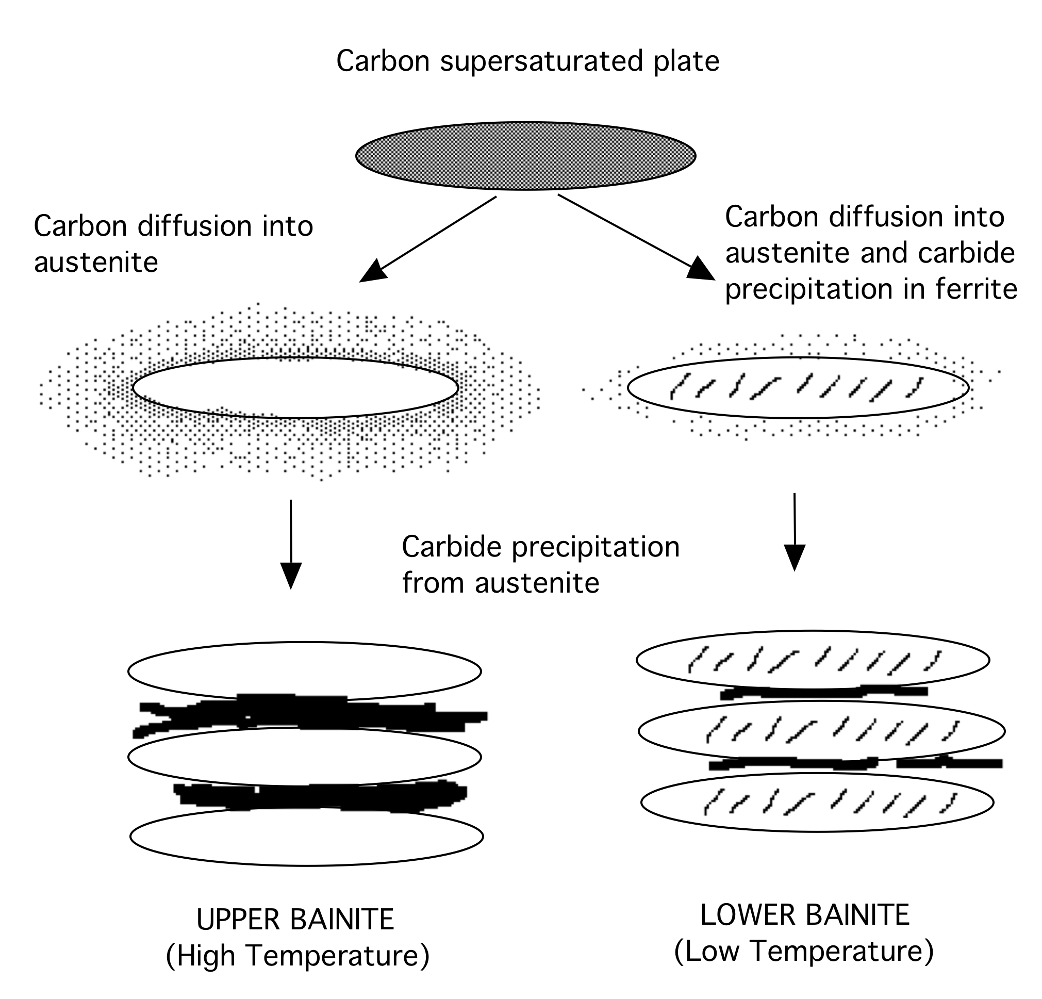

Slide 7
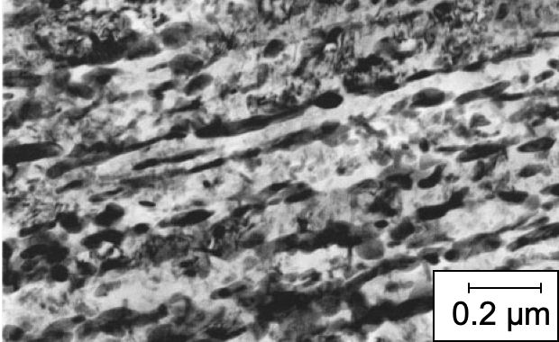
uncontrolled cementite precipitation

Slide 8
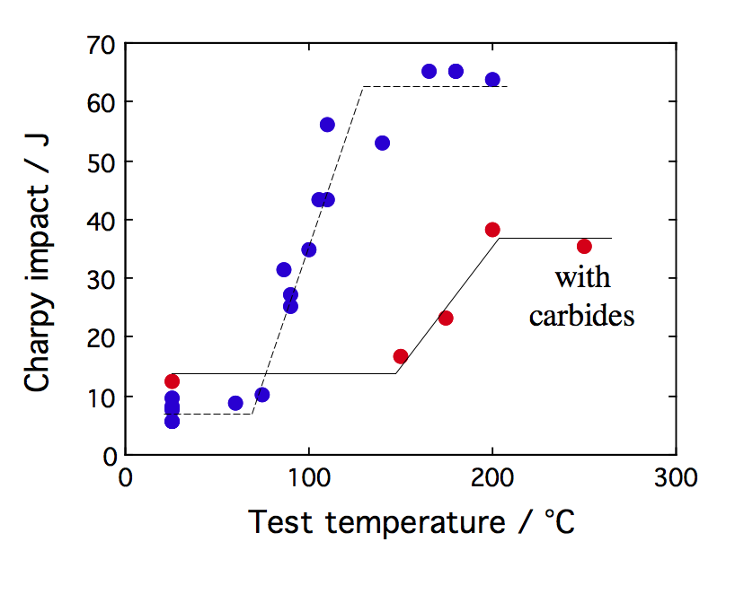

Slide 9
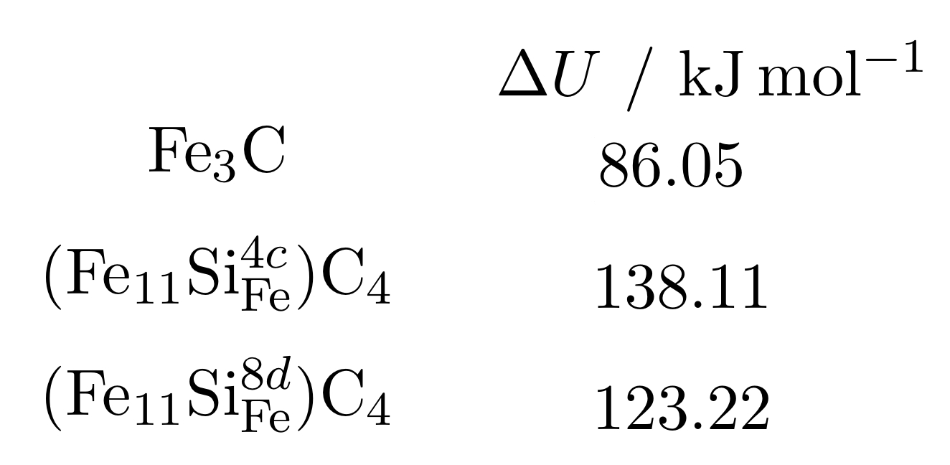
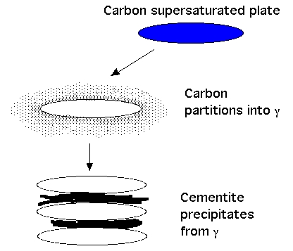
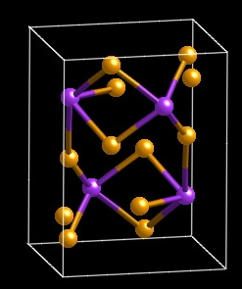
Jang, Kim, Bhadeshia (2009)
Notes:
9

Slide 10
Simple, carbide-free alloys
Fe-0.4C-3Mn-2Si wt%
hardenability
suppress
cementite

Slide 11
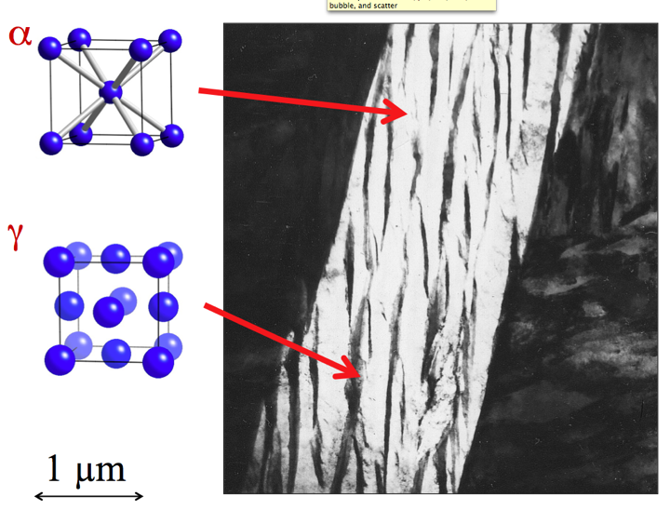
11

Slide 12
Fine structure
Retained austenite:
TRIP effect
no ductile-brittle transition
barrier to hydrogen
No cementite
Small concentration of C in ferrite

Slide 13

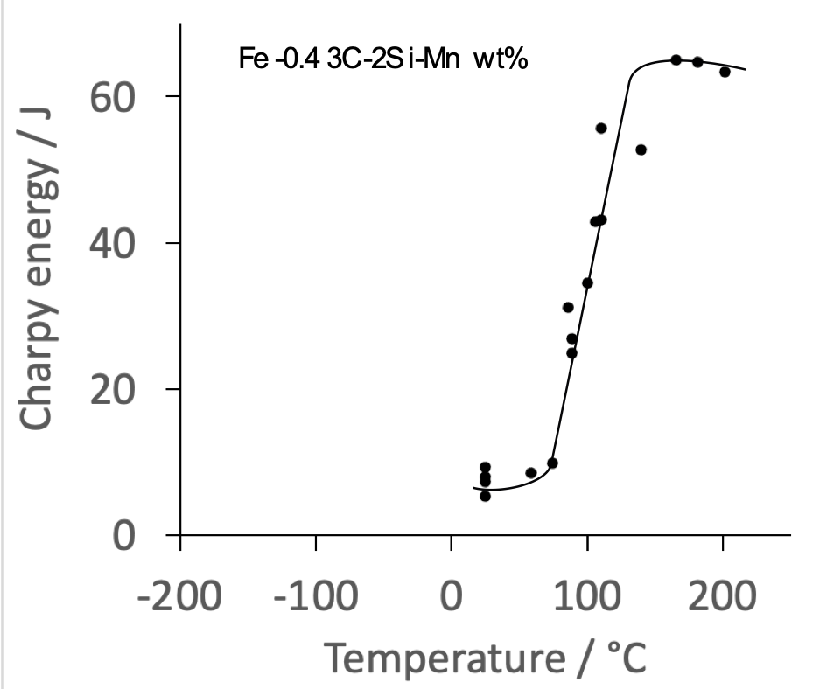
Very poor toughness!

Slide 14
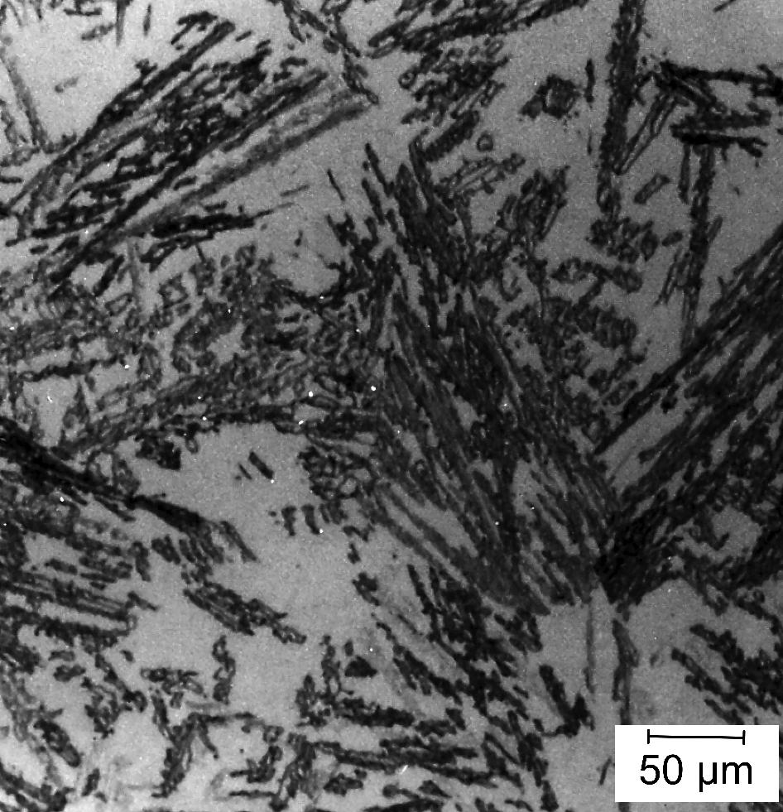

Slide 15
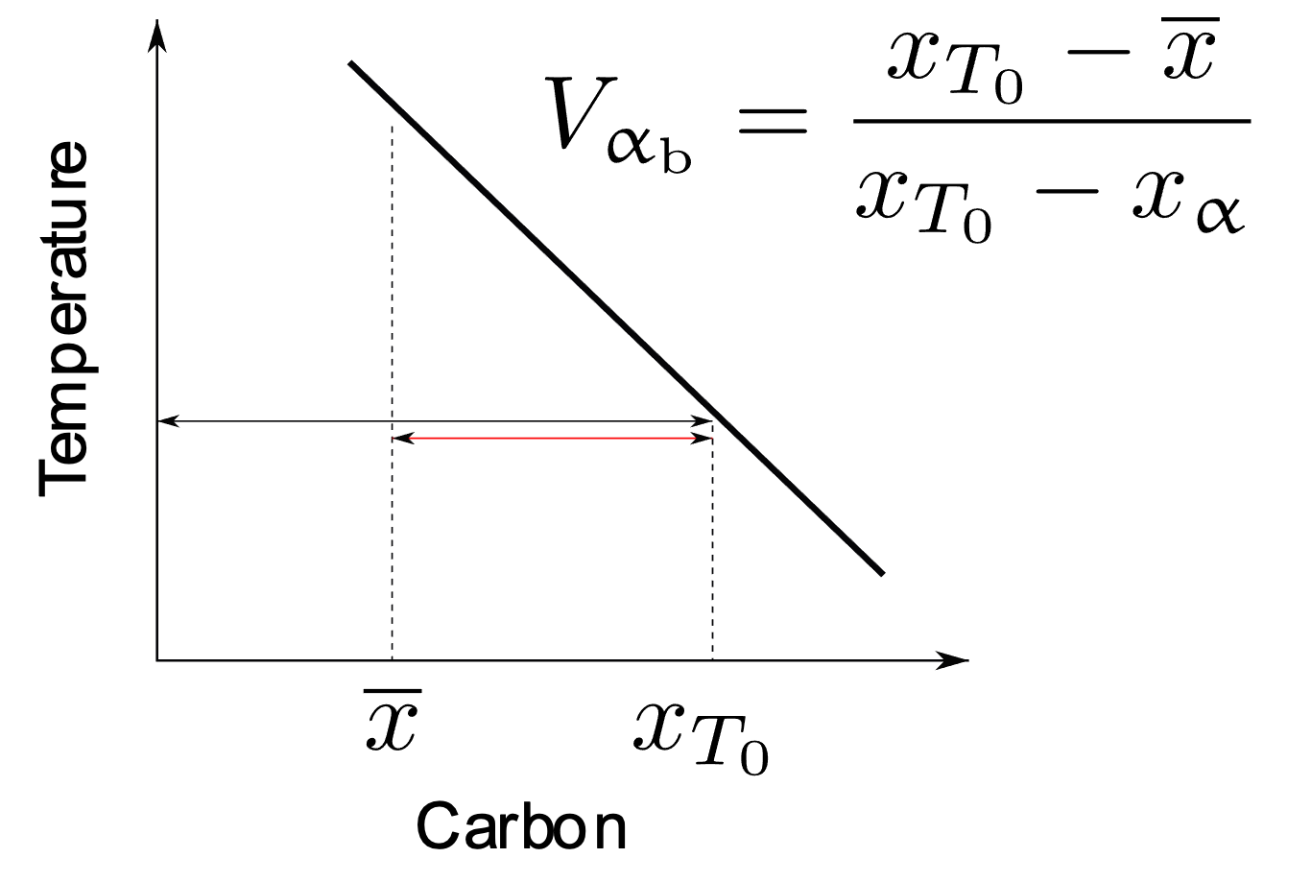

Slide 16
Carbide-free alloys
Fe-0.4C-3Mn-2Si
Fe-0.2C-3Mn-2Si
Fe-0.4C-4Ni-2Si wt%
Notes:
16

Slide 17
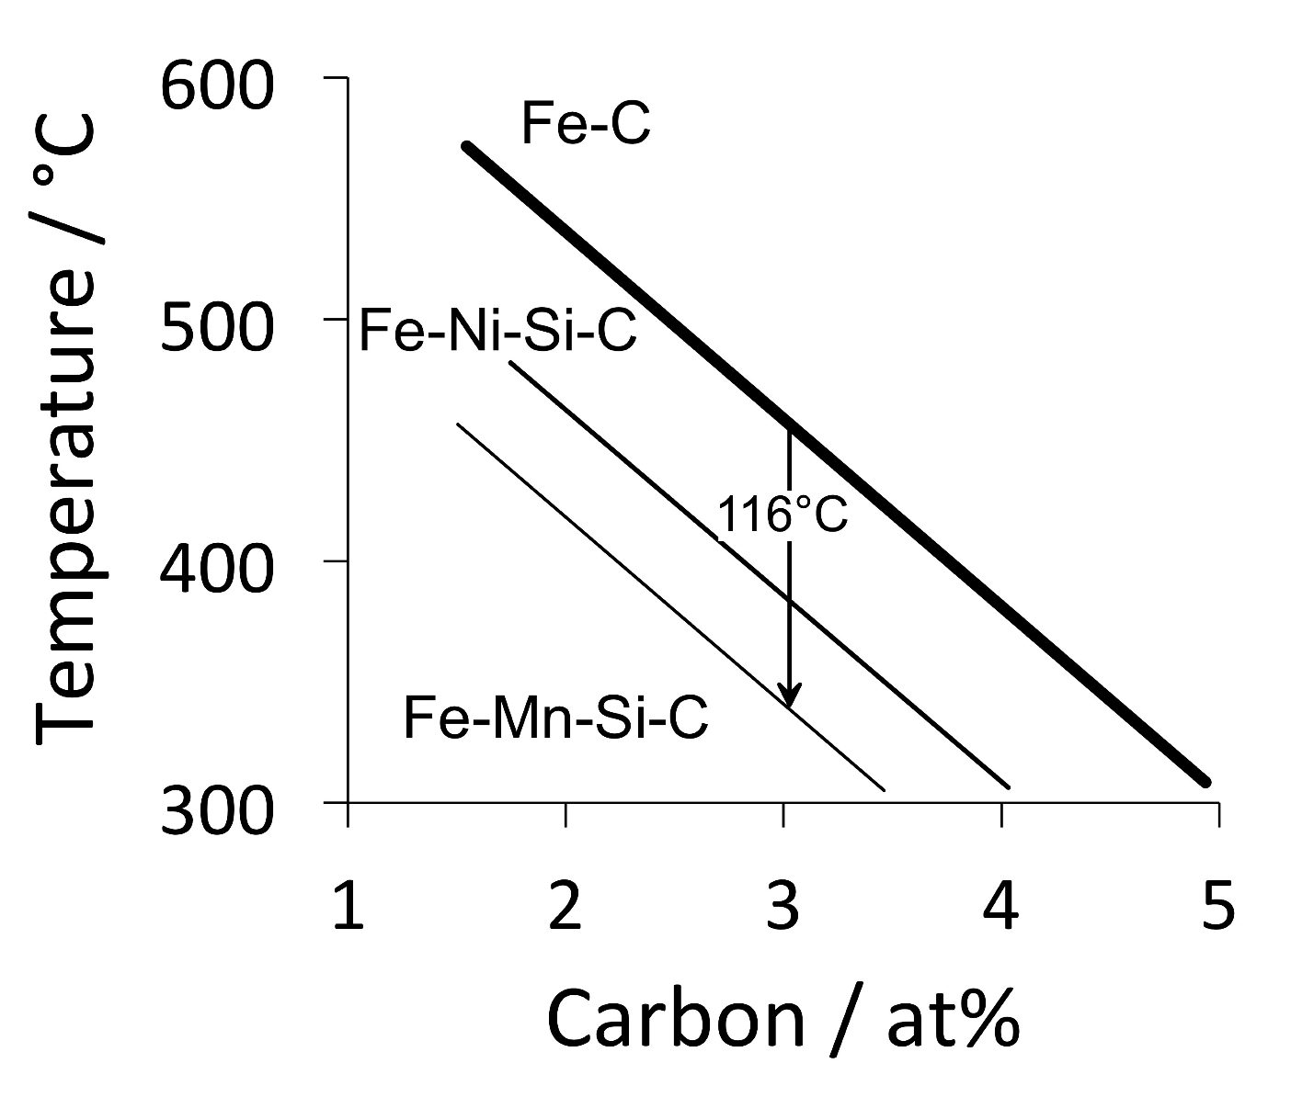

Slide 18
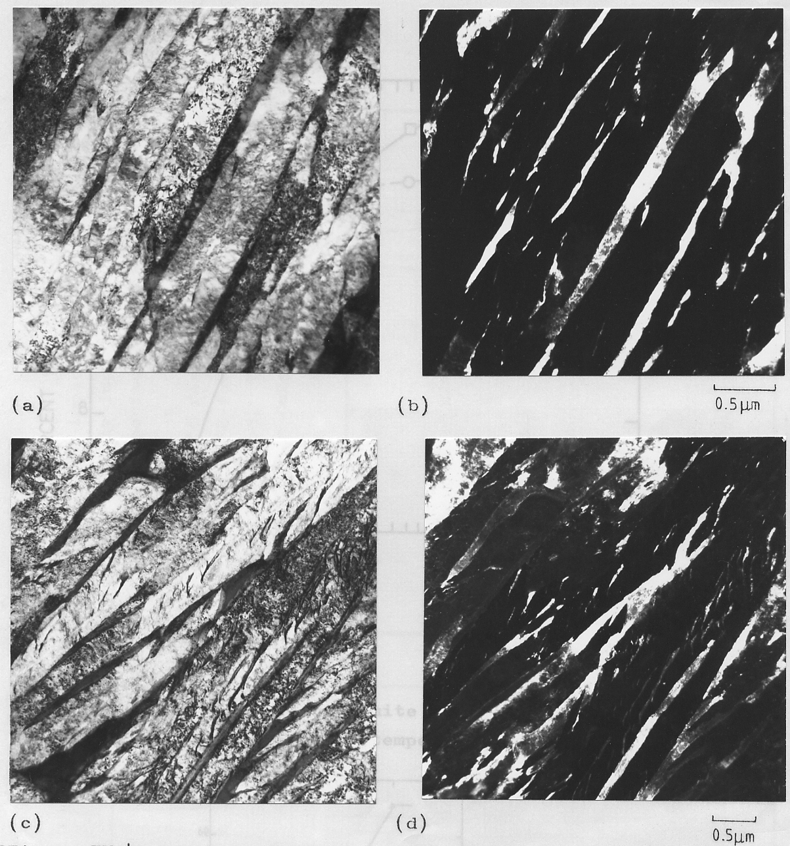
0.5 μm

Slide 19
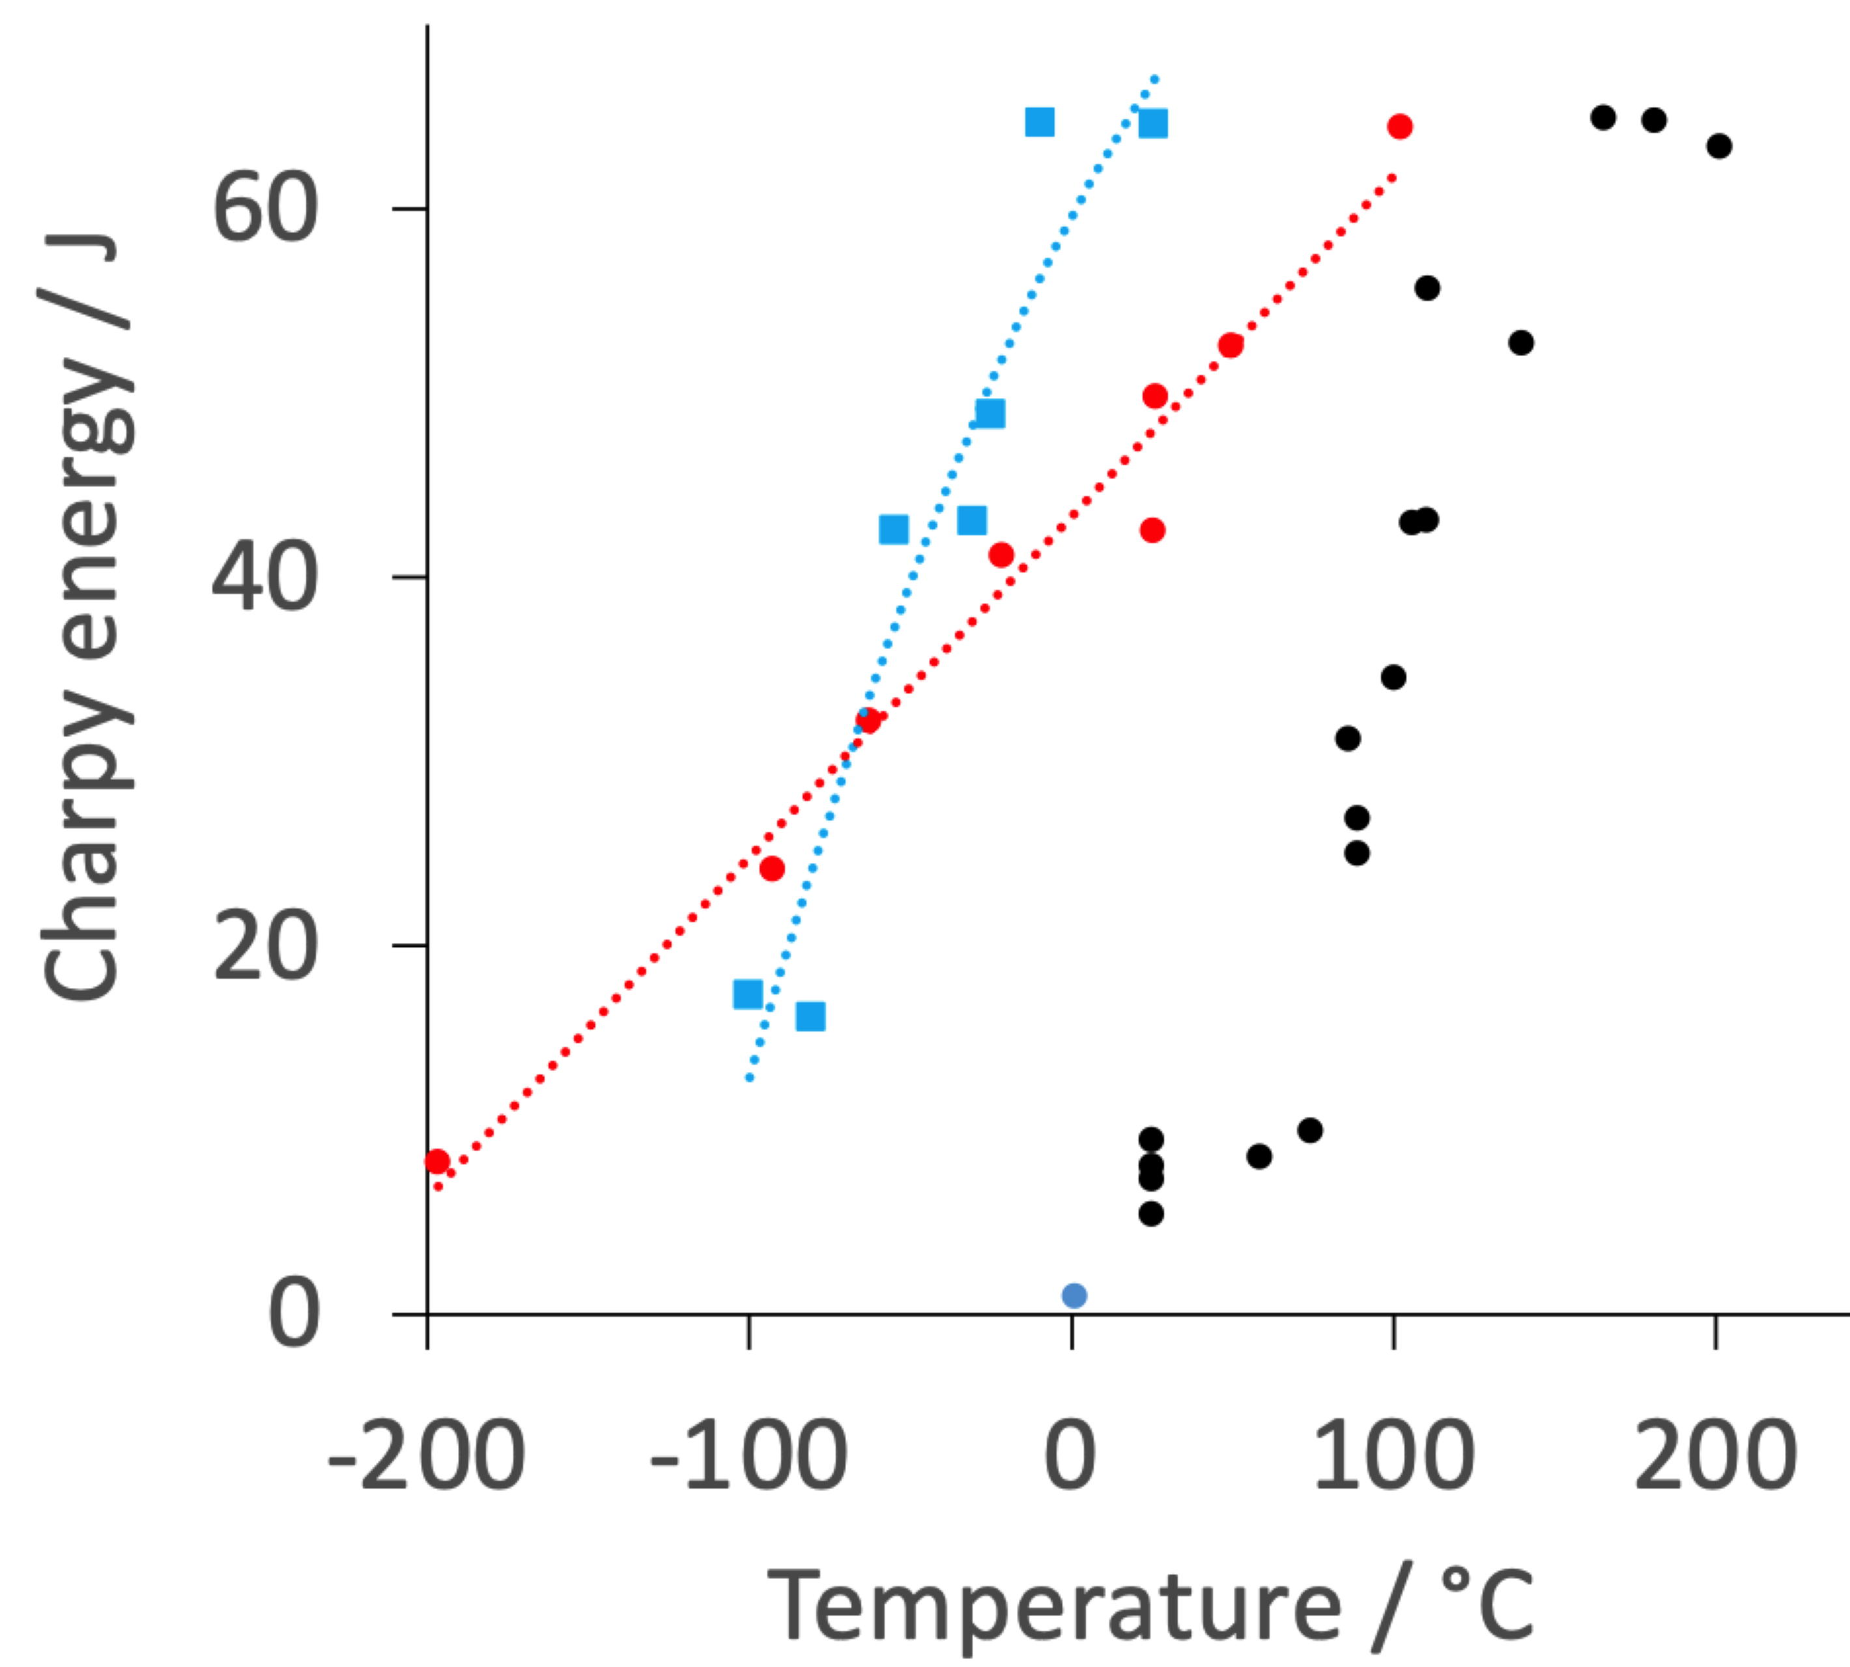
0.4C-2Si-4Mn
0.2C-2Si-3Mn
0.4C-2Si-4Ni

Slide 20
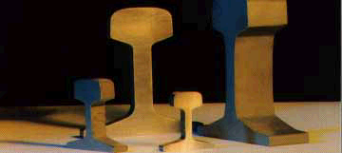

Slide 21
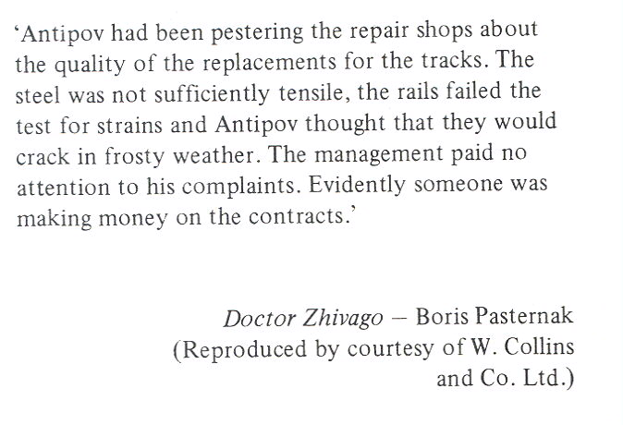

Slide 22
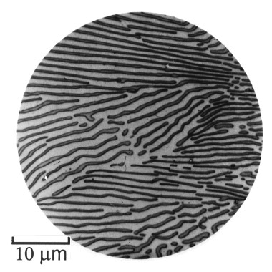
Bain: alloying elements in steels (1939)

Slide 23
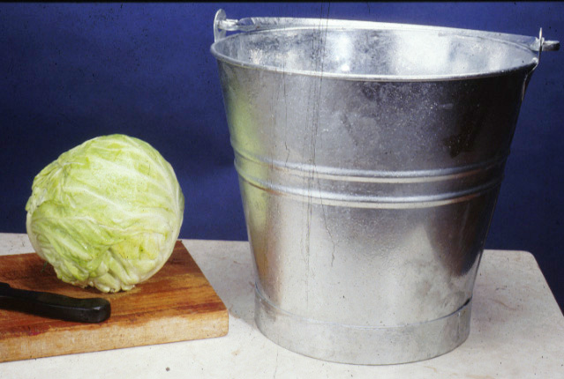

Slide 24
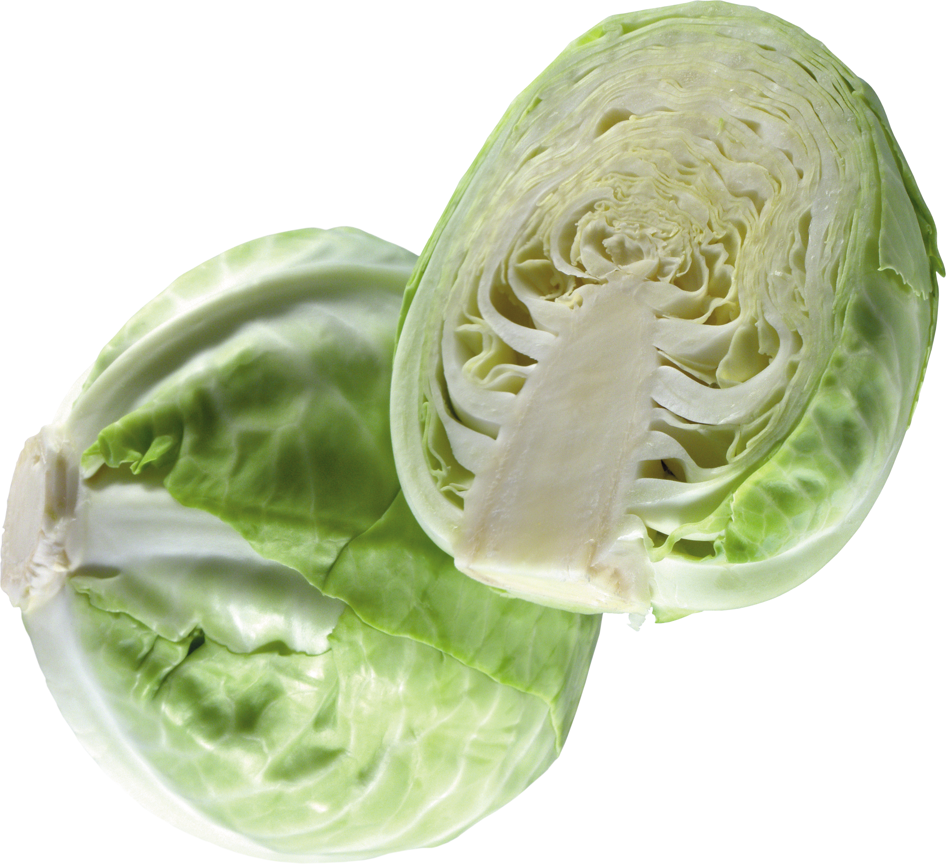
wish to design
rail steels using
the carbide-free
bainitic steel
image courtesy of pngimg.com
Creative Commons 4.0 BY-NC
https://creativecommons.org/licenses/by-nc/4.0/

Slide 25
Rail steel – requirements:
Rolling-contact fatigue.
Wear resistance.

Slide 26
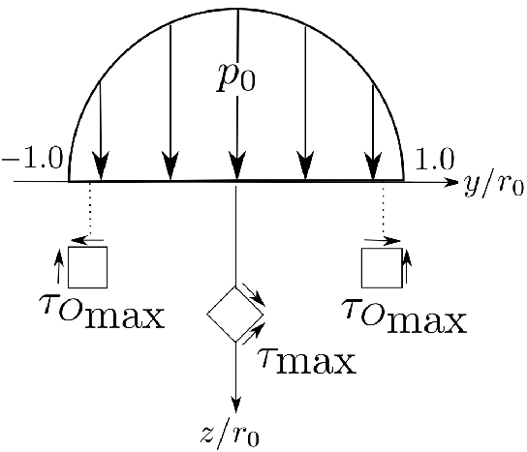
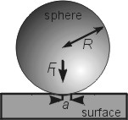
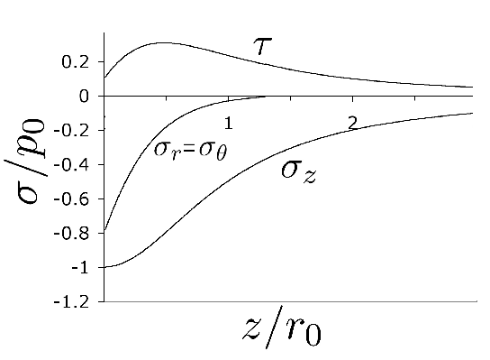

Slide 27
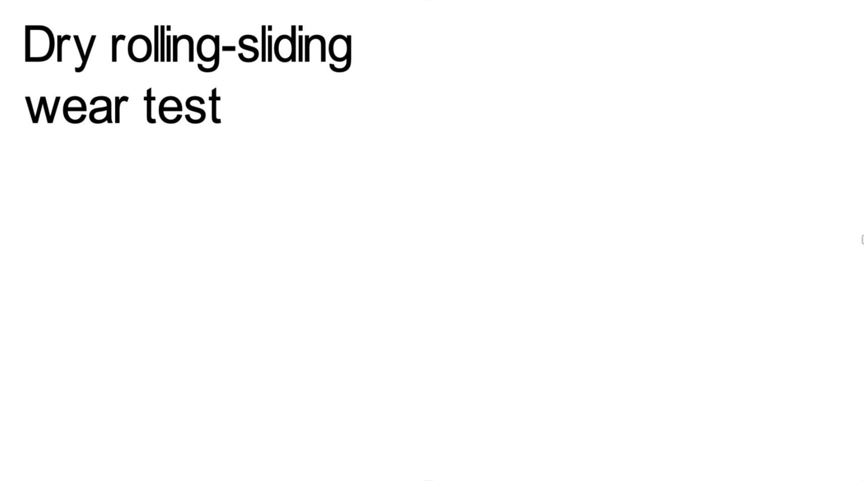

Slide 28
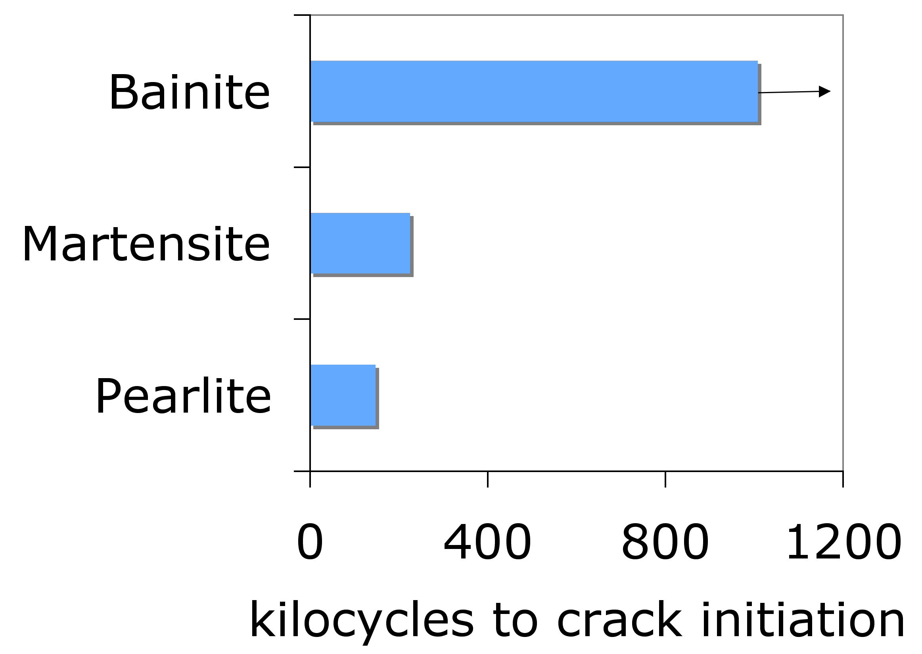
Yates, Jerath, Bhadeshia
Notes:
28

Slide 29
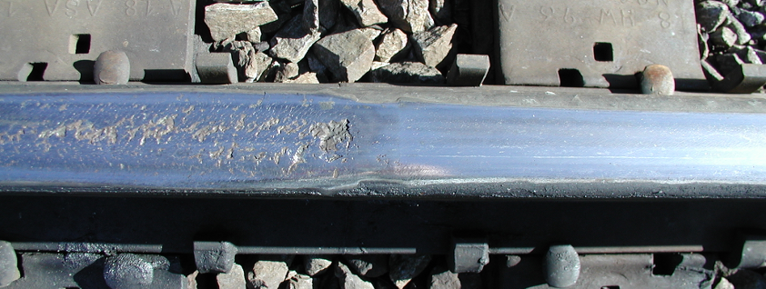
carbide-free bainitic rail
Carbide-free bainite has no hard particles,
Just bainitic ferrite and retained austenite
Kevin Sawley: 90 million gross tonnes of traffic on curve

Slide 30
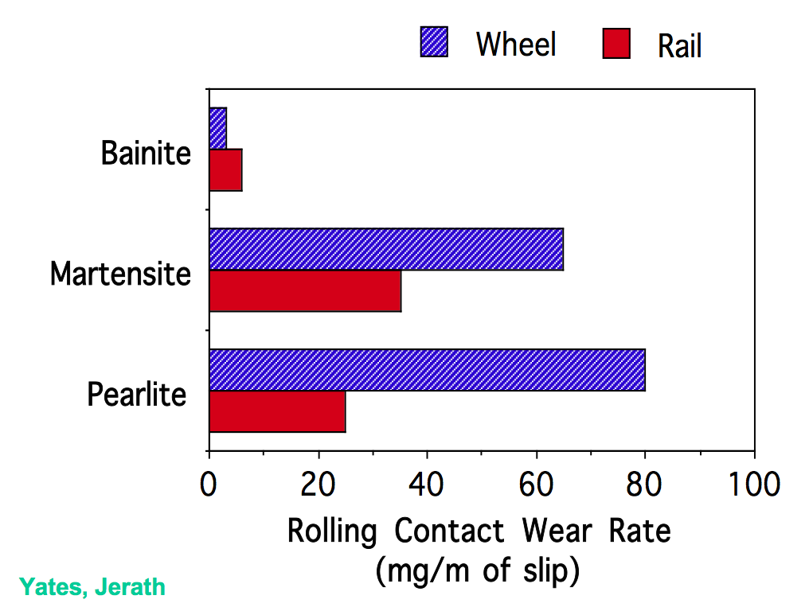
Notes:
30

Slide 31
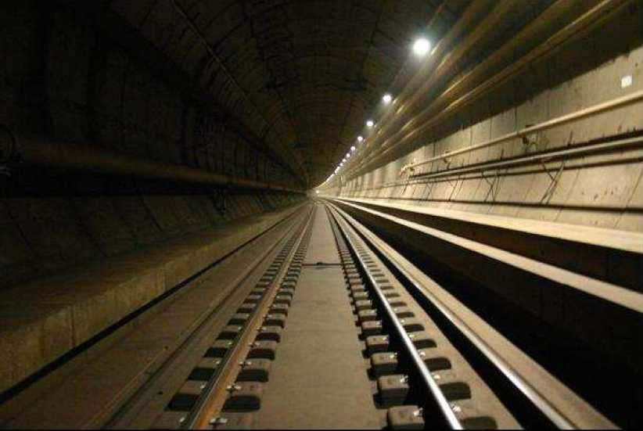
November 2019: 1 billion gross tonnes of traffic achieved
Notes:
31

Slide 32
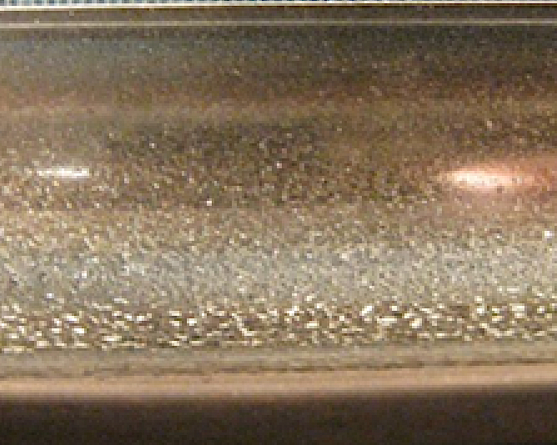
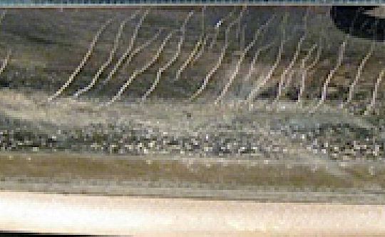
Carbide-free bainitic rail in the tunnel has
completed >1000,000,000 gross tonnes of traffic
without developing fatigue, without need for grinding.
Pascal Secordel (Francerail), Jay Jaiswal (Arrail)
April 2020

Slide 33
Advances in carbide-free bainitic steels
180
160
140
120
18 wt% Ni
maraging steel
Fracture toughness / MPa √m
100
80
60
40
QT
20
1000
1500
2000
2500
Ultimate tensile strength / MPa

Slide 34
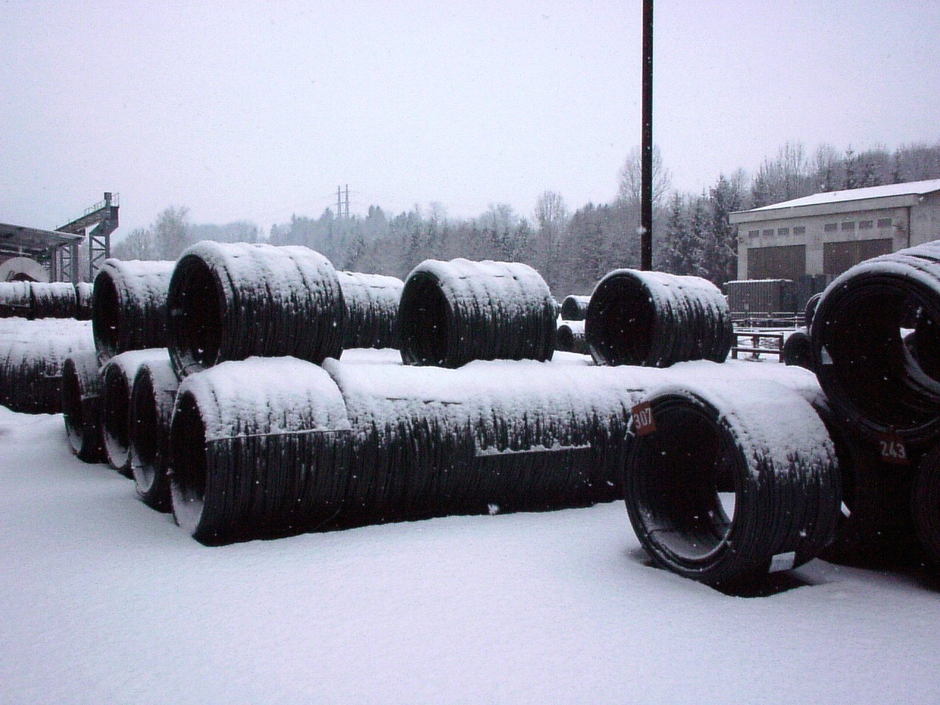
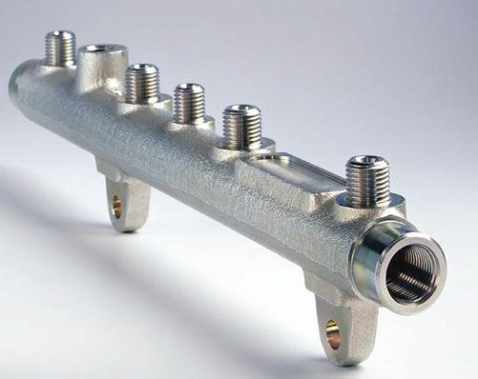
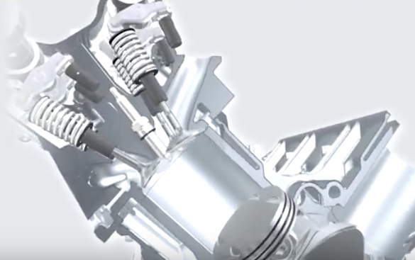
Ascometal
airbags, wheelchairs, tool holders

Slide 35
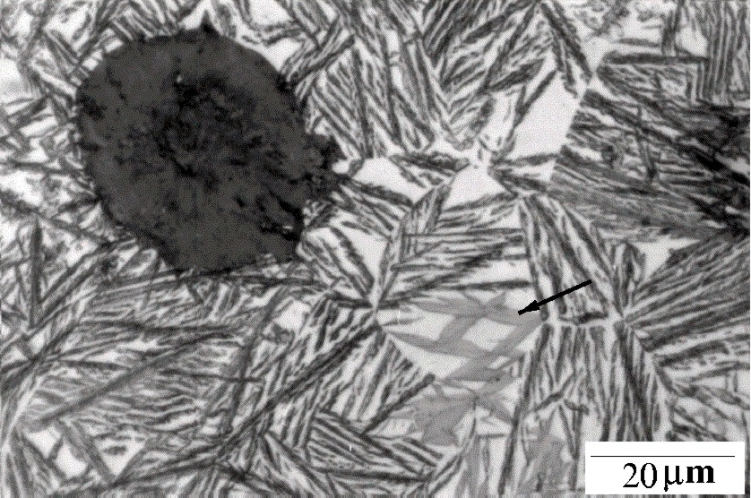
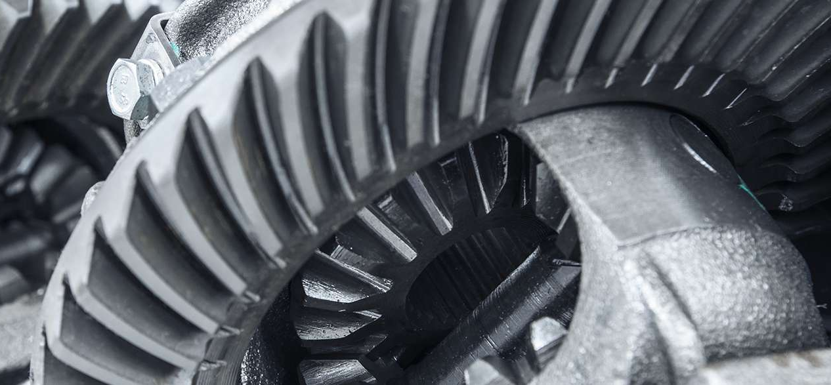
Charpy 120 J at 25°C
Strength > 1100 MPa

Slide 36
