Slide 1



Steels: Widmanstätten ferrite
Lecture 5
Fabio Miani
Harry Bhadeshia
Professor of Metallurgy
Queen Mary University of London
Emeritus Tata Steel Professor of Metallurgy
University of Cambridge
2022

Slide 2
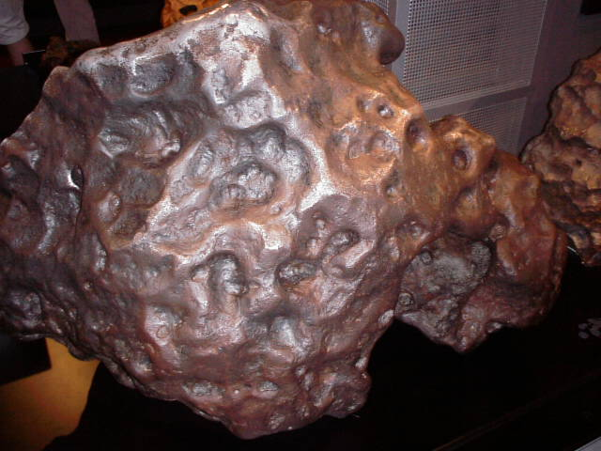
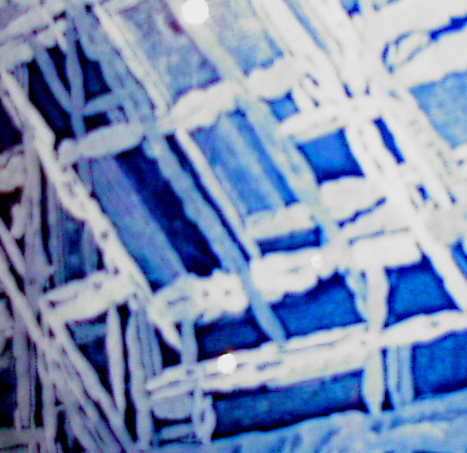
Widmanstätten ferrite
1808: Alois de Widmanstätten, Hradschina meteorite, Imperial Porcelain Works, Vienna
1900: Floris Osmond, head of steel ingot
2 m

Slide 3
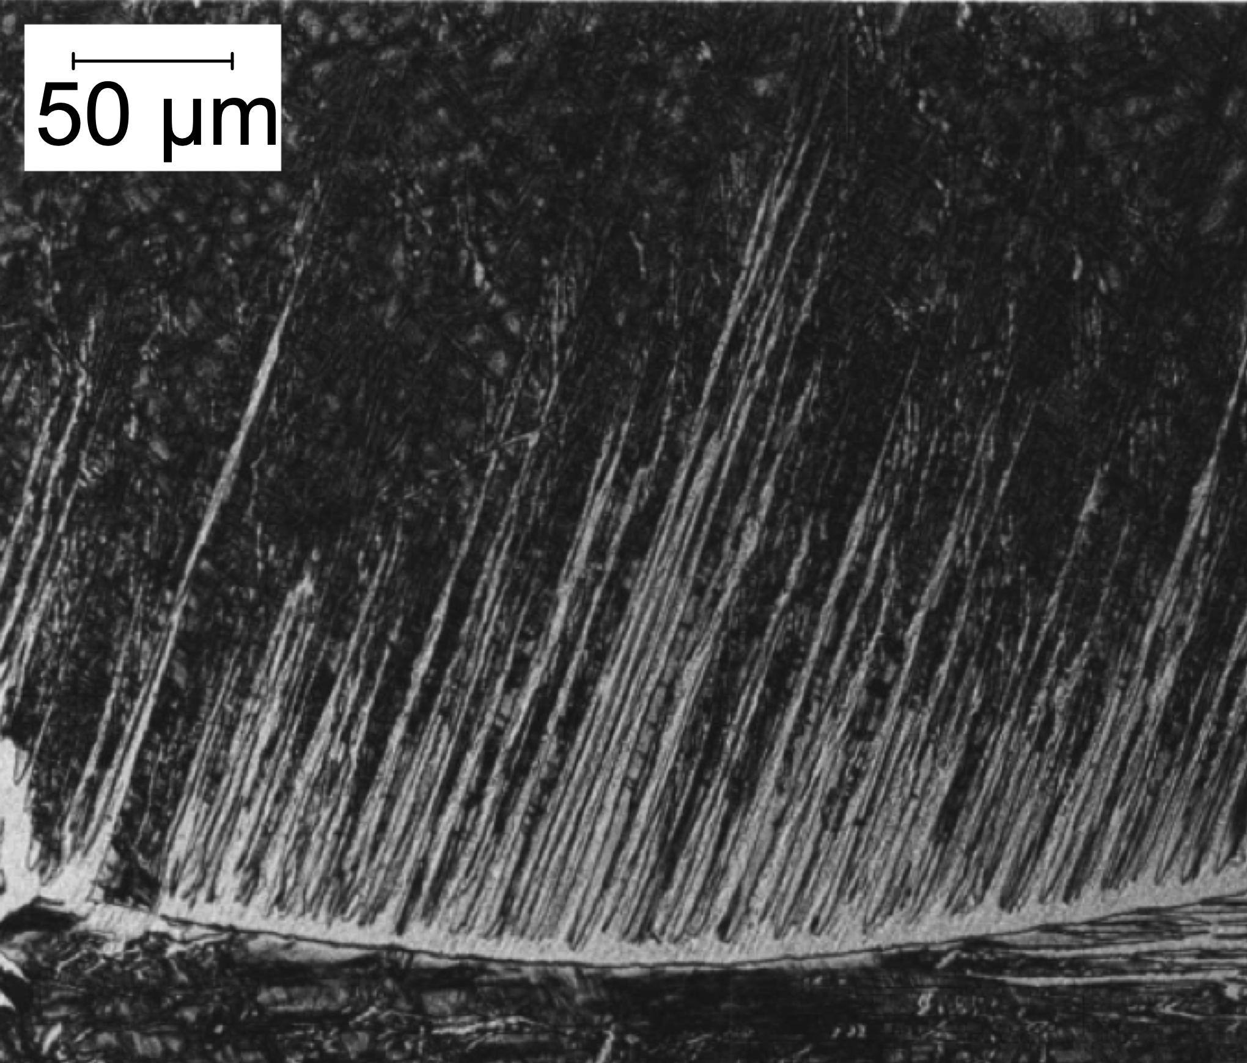
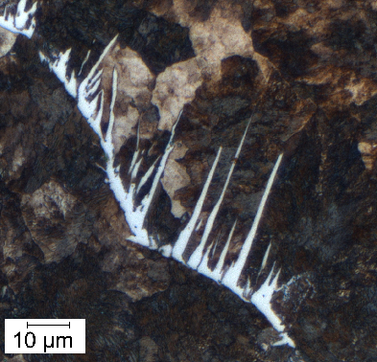
Ali and Bhadeshia
Micrograph courtesy of
Rolando M. Núñez Monrroy of the Pontifical Catholic University of Peru.
Notes:
3

Slide 4
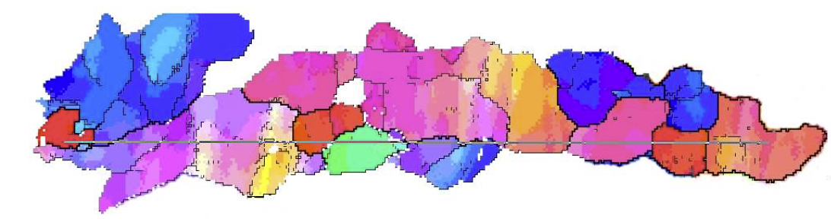
Crystallographic grain size
cleavage facet corresponds to the distance between large-misorientation boundaries that force crack deflection
Pickering FB: Proc. Symp. ‘Transformation and hardenability in steels’.
Ann Harbor, MI, February 1967, Climax Molybdenum Co. and The University of Michigan, 109–129.
cleavage facet corresponds to crystallographic grain size
Gourgues A.-F., Flower HM, Lindley TC. Electron backscattering diffraction study of acicular ferrite, bainite, and martensite steel microstructures. Materials Science and Technology. 2000;16:26-40.

Slide 5
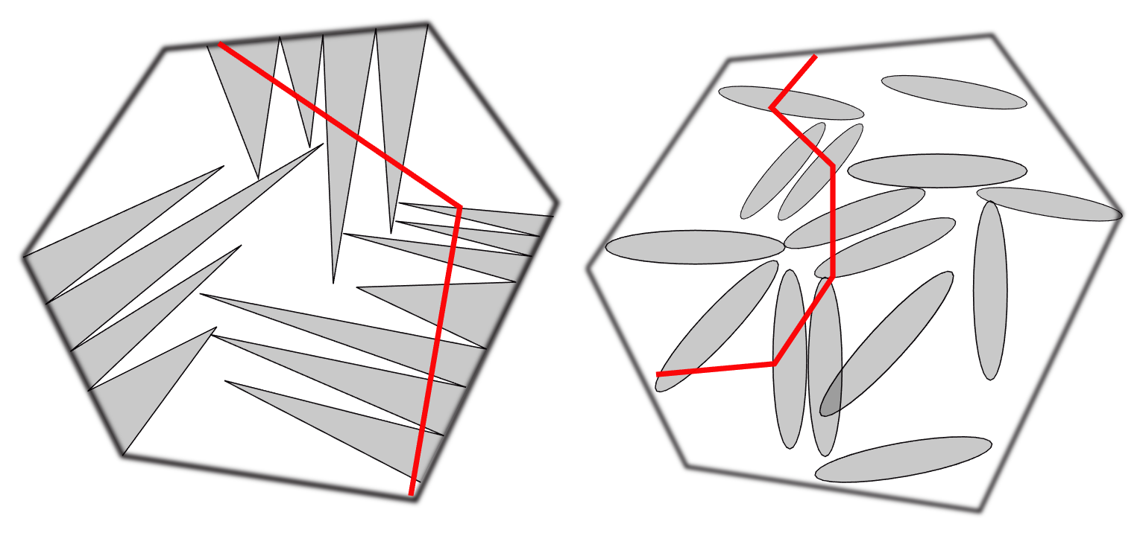
Crystallographic grain size
Gourgues A.-F., Flower HM, Lindley TC. Electron backscattering diffraction study of acicular ferrite, bainite, and martensite steel microstructures. Materials Science and Technology. 2000;16:26-40.

Slide 6
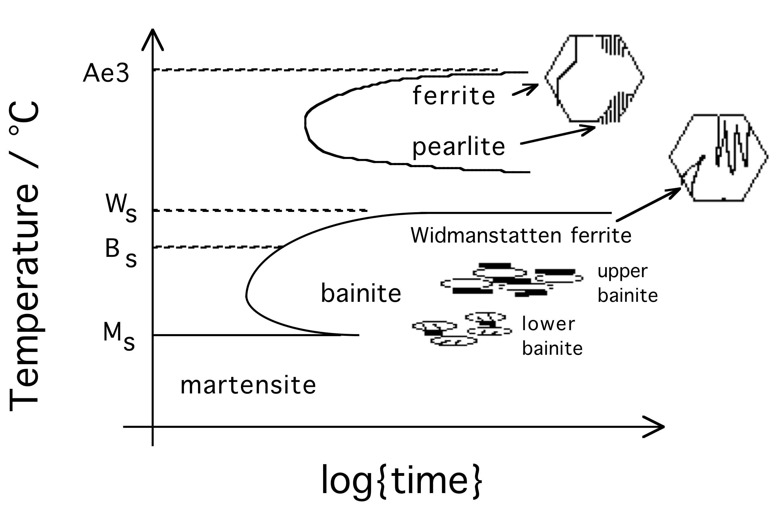
Notes:
6

Slide 7
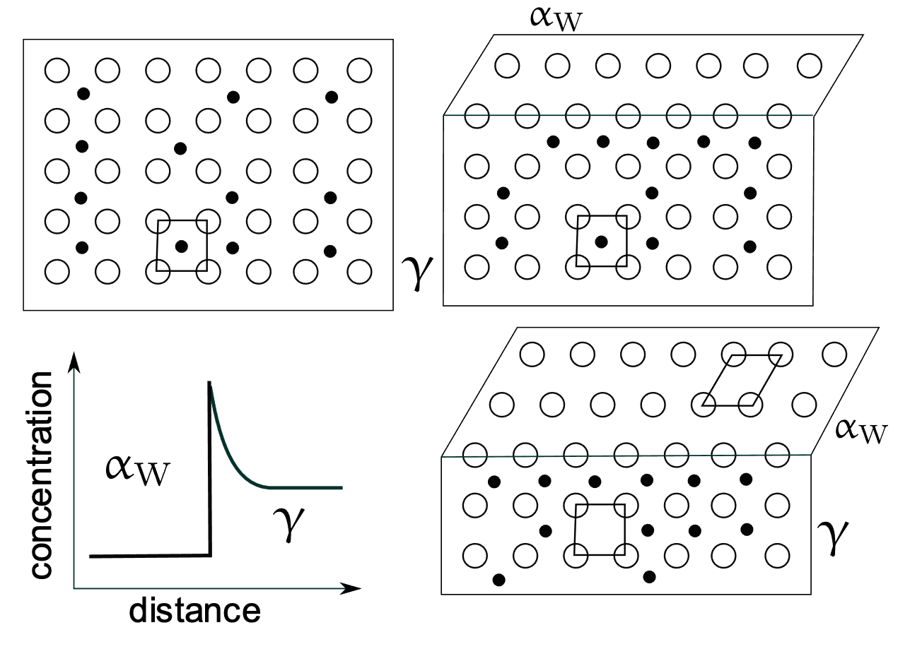
Notes:
7

Slide 8
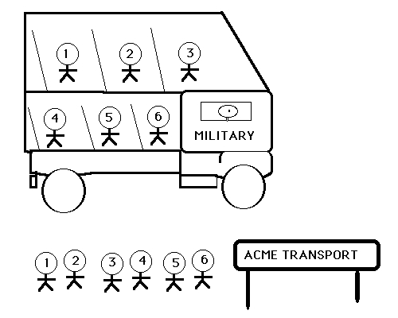
Notes:
8

Slide 9
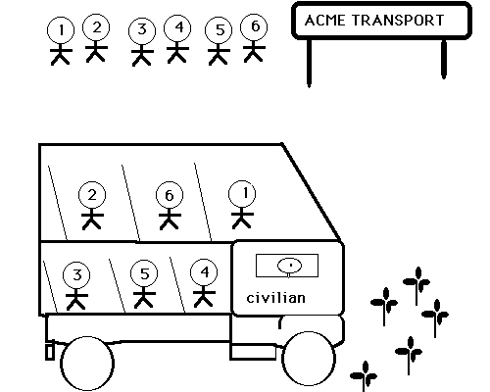
Notes:
9

Slide 10
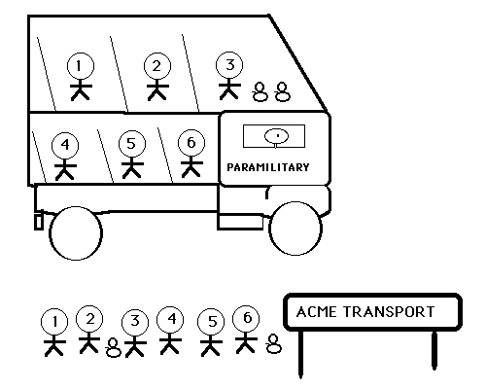
Notes:
10

Slide 11
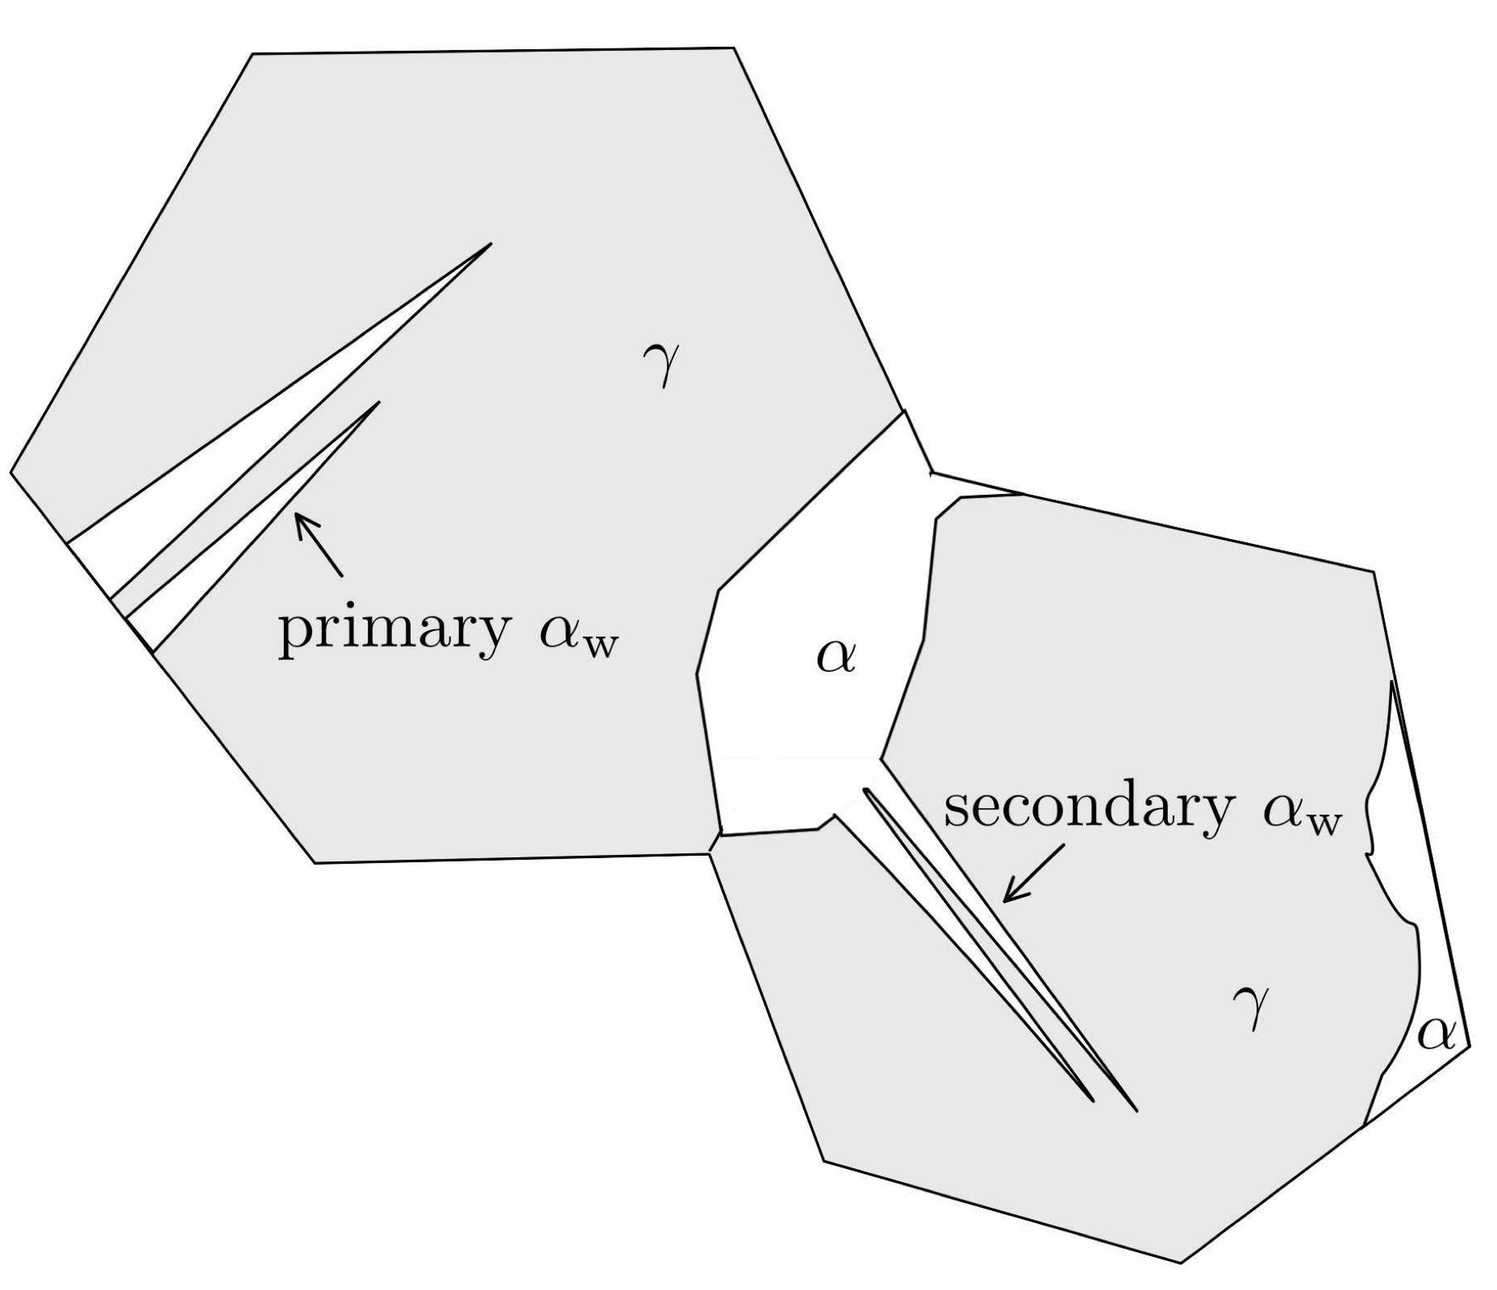
Notes:
11

Slide 12
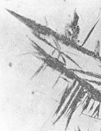
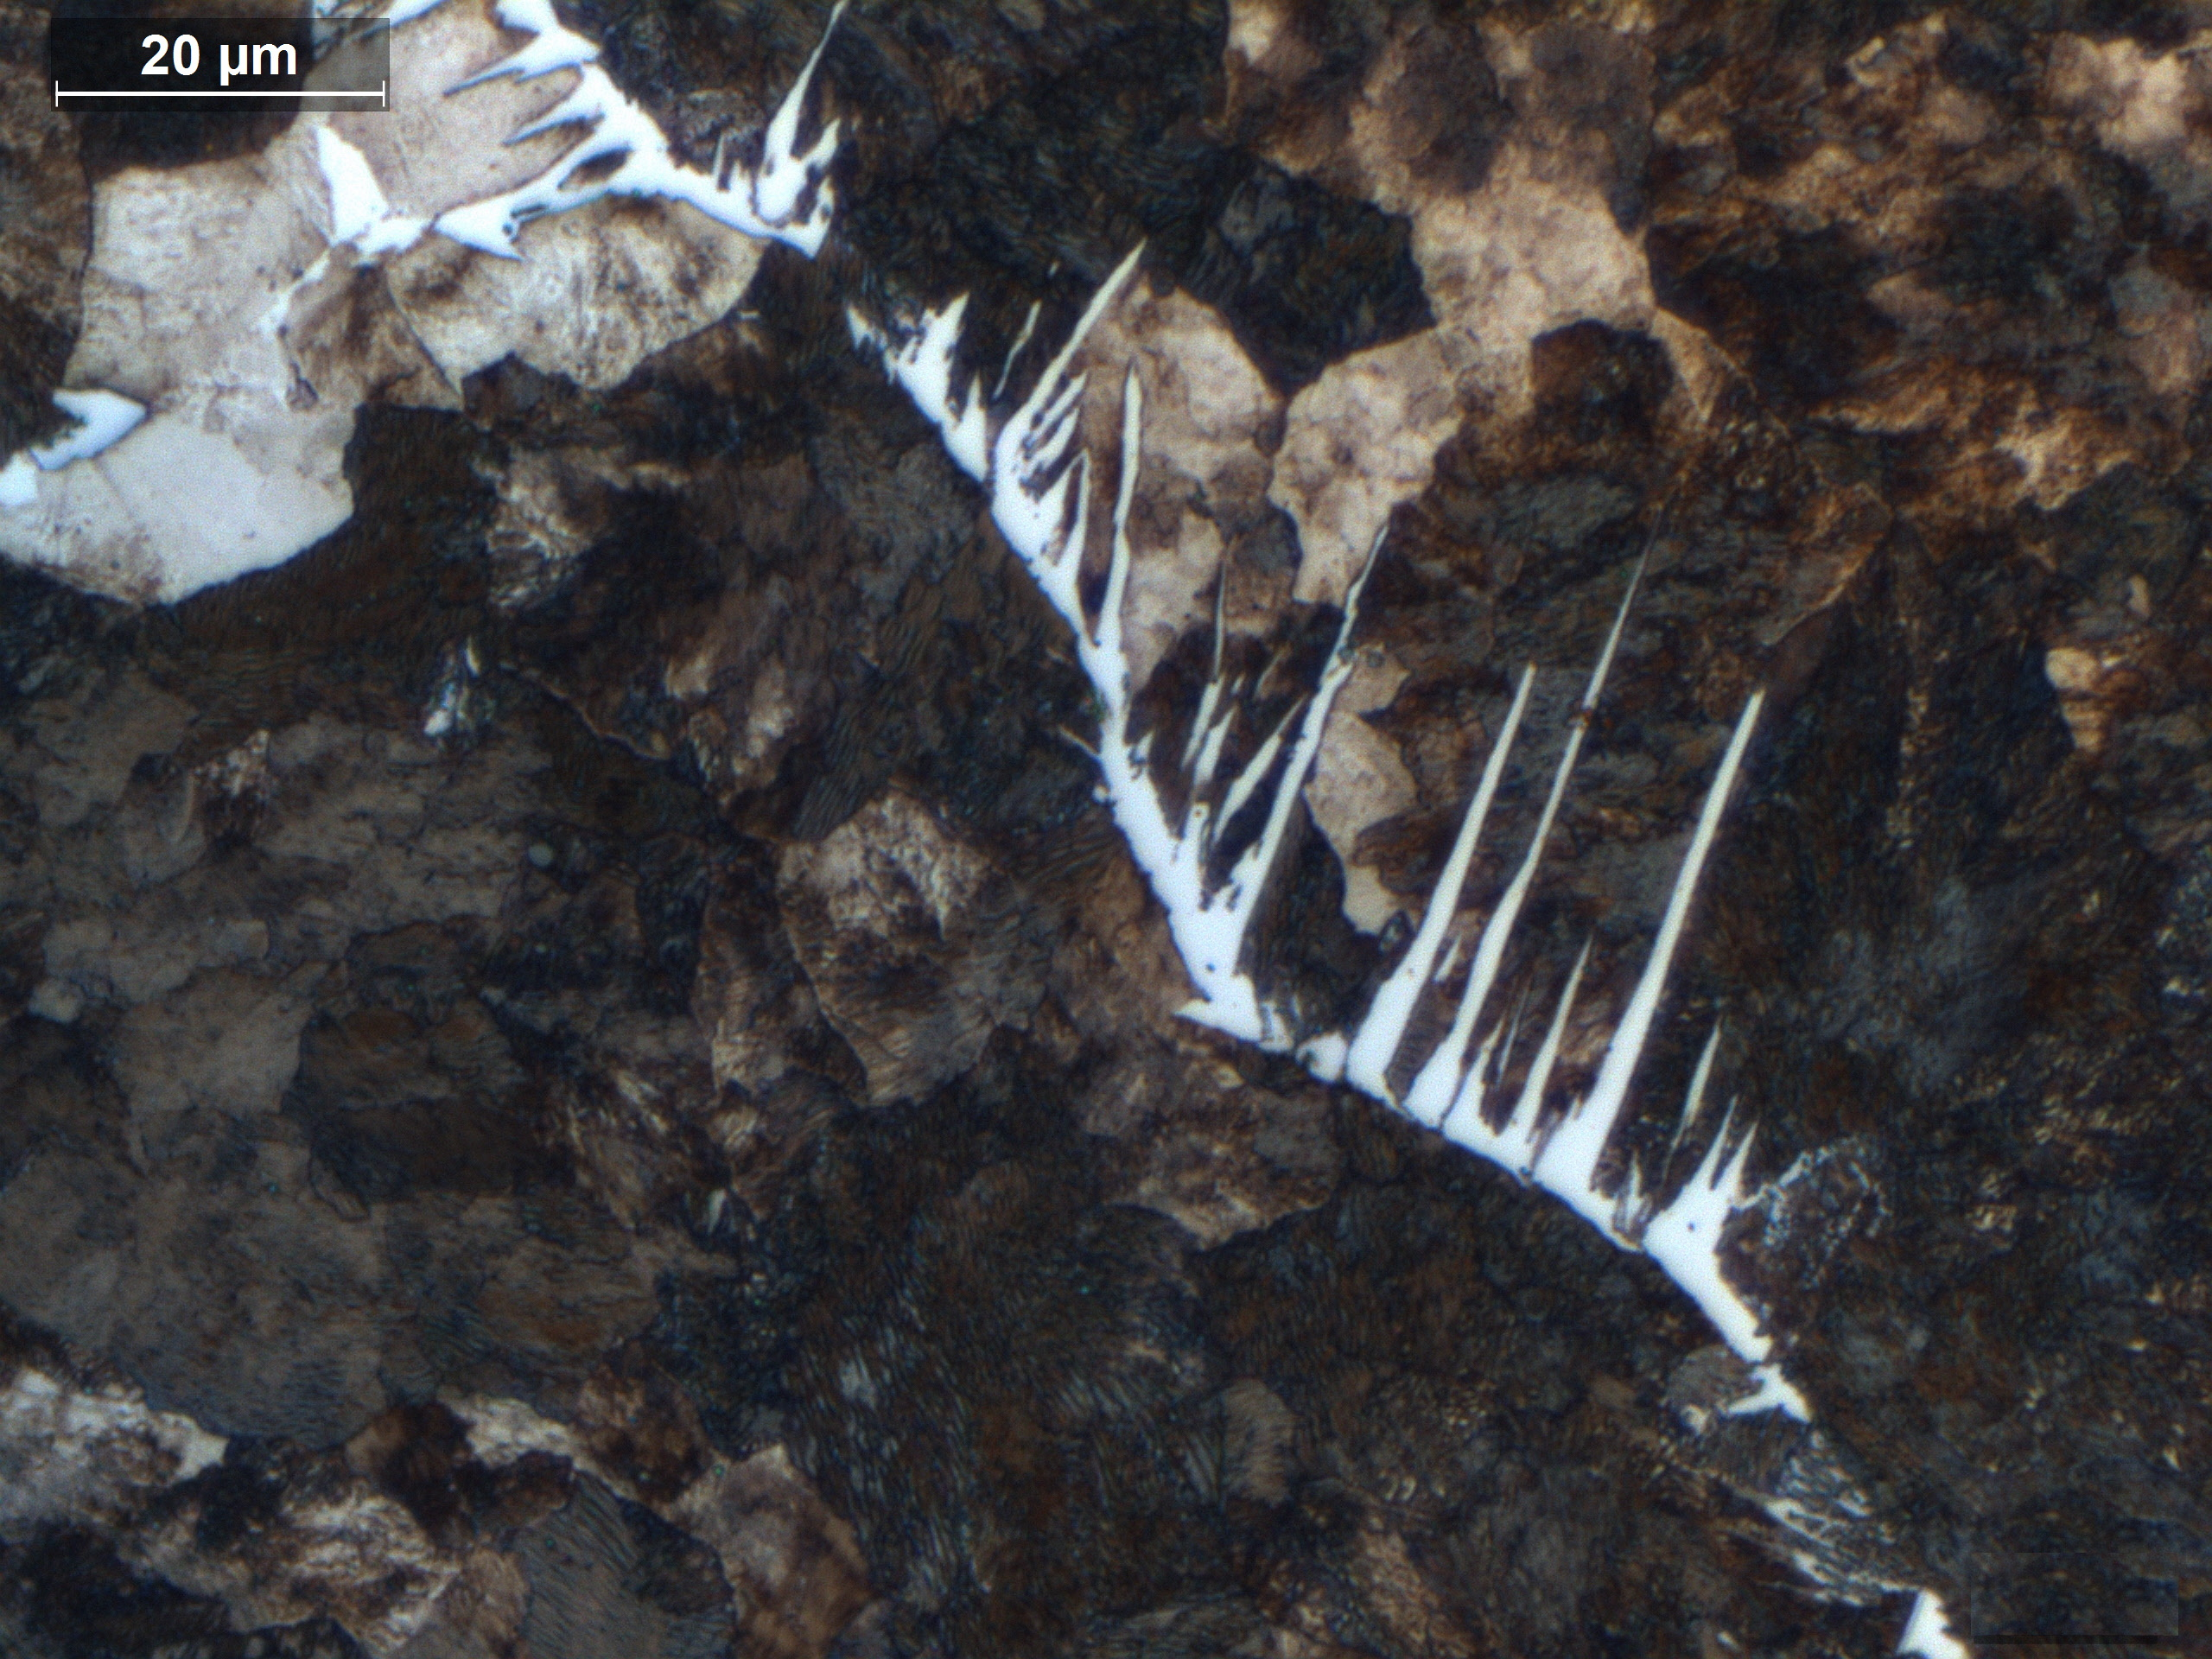
50 µm

Slide 13
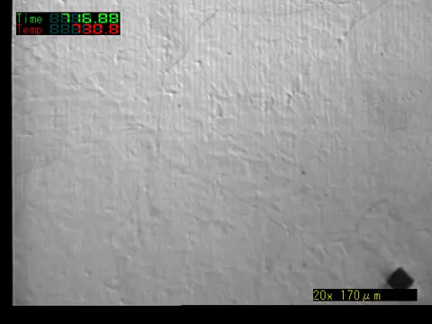
Courtesy of N. Oku, K. Asakura, J. Inoue and T. Koseki,
Tetsu-to-Hagane, Vol. 94 (2008) 363-368.

Slide 14
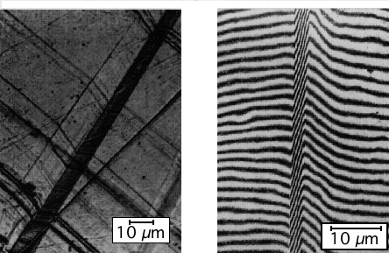
Watson and McDougall, 1973
Notes:
14

Slide 15
- Widmanstätten ferrite can grow at small undercoolings
at temperatures well above T₀
carbon diffusion essential during transformation

Slide 16
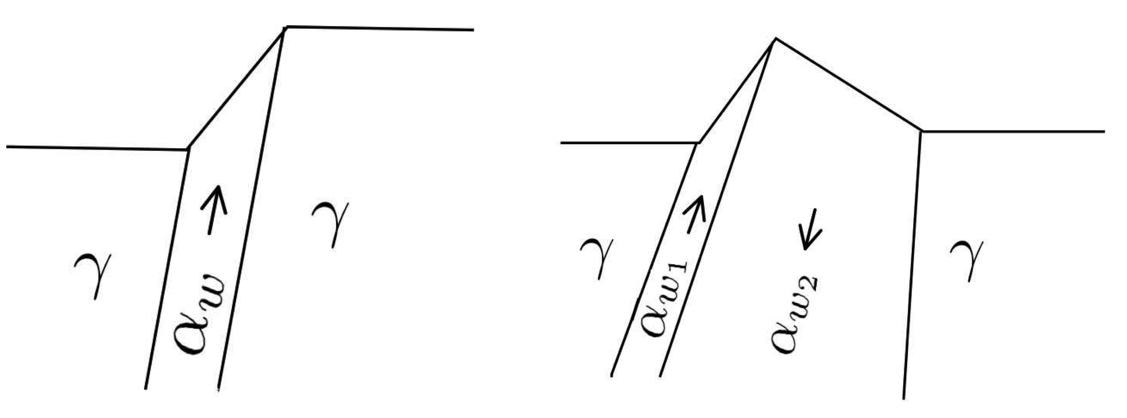
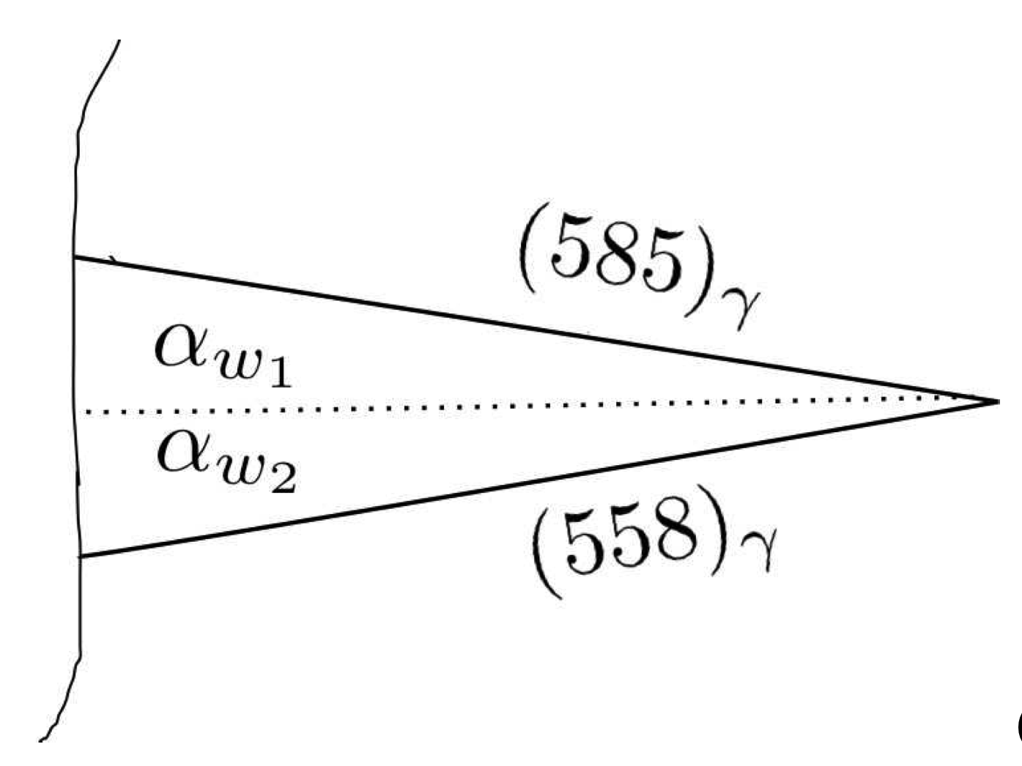
Notes:
16

Slide 17
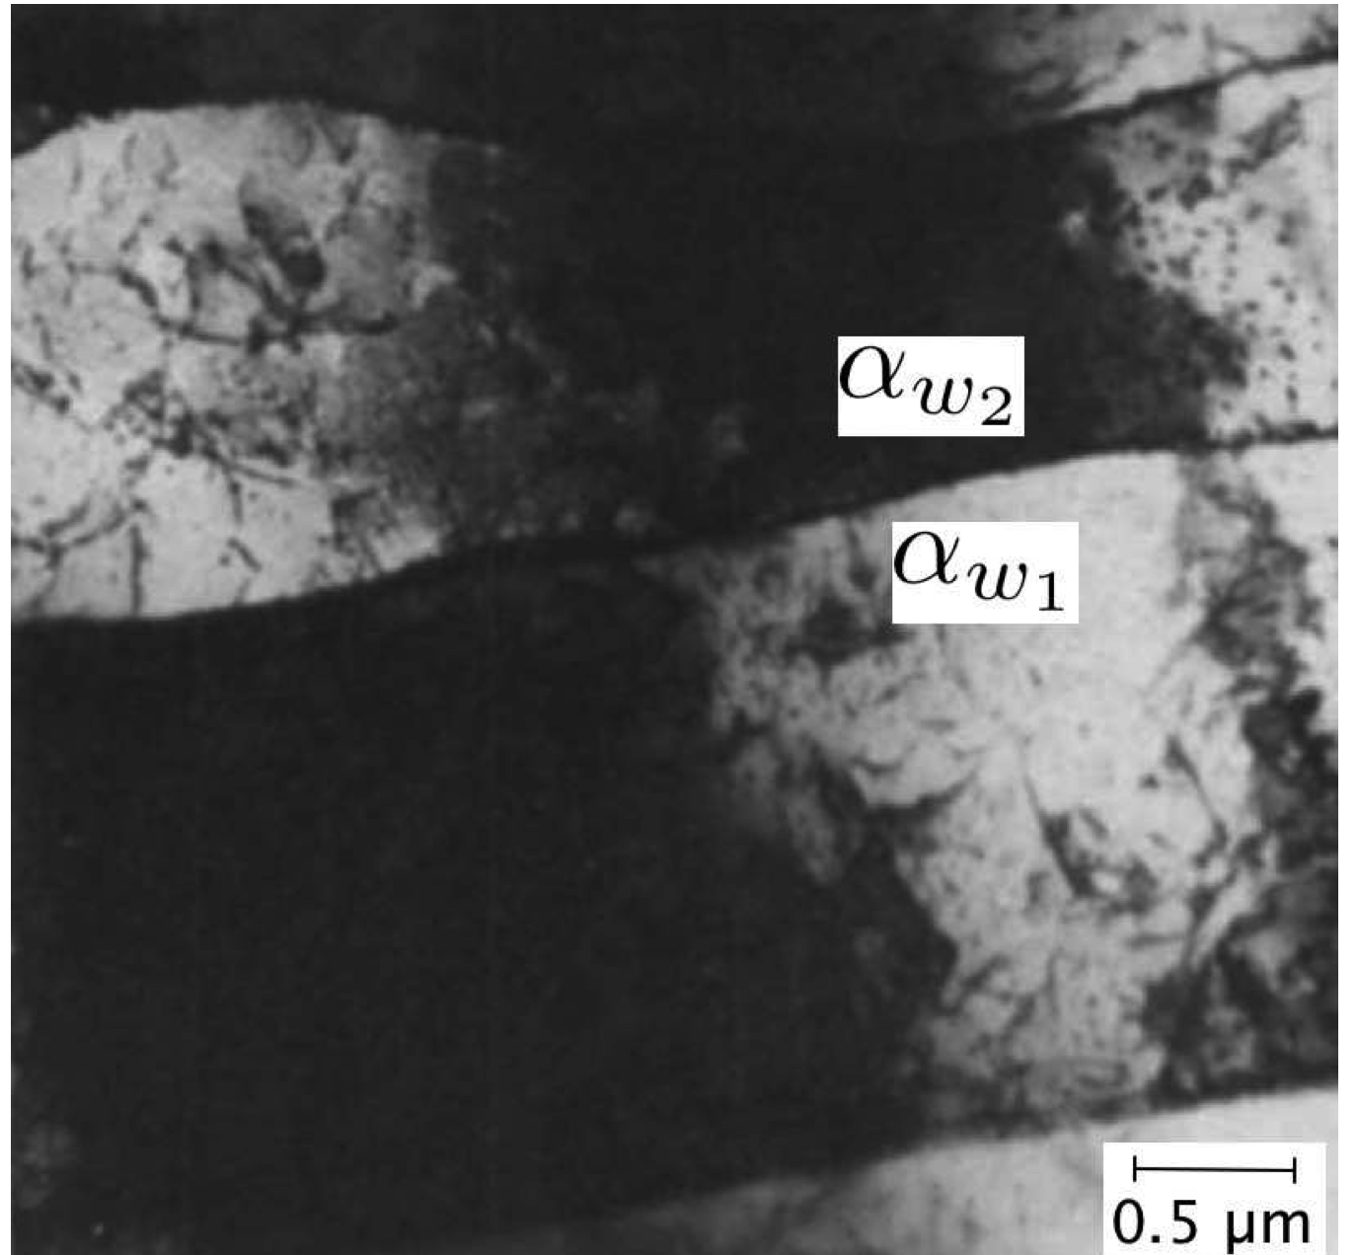
Notes:
17

Slide 18
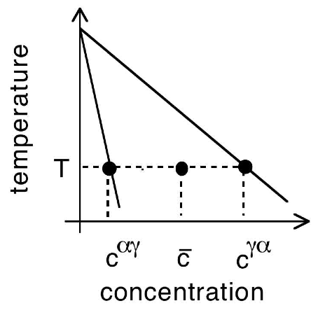
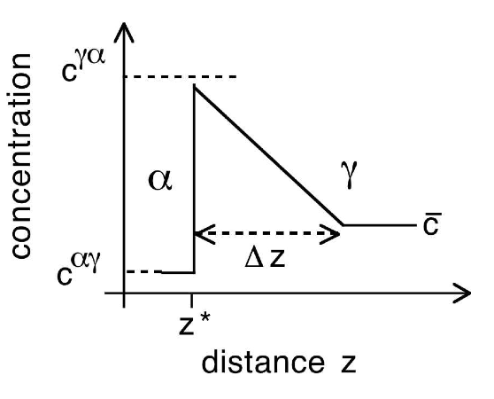
conditions at the transformation interface

Slide 19
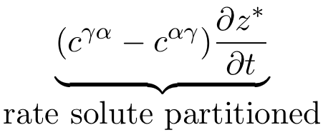
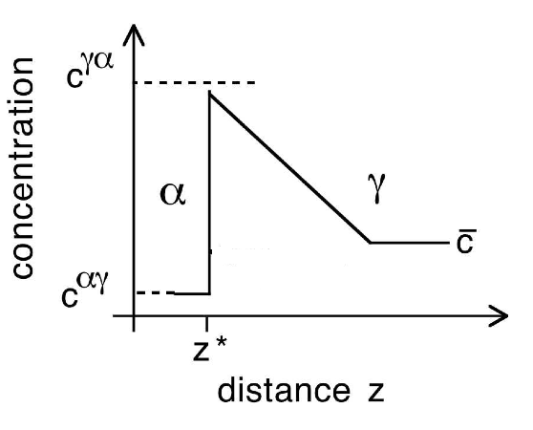

Slide 20
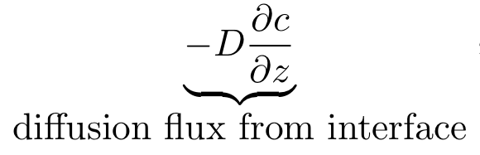
diffusion

Slide 21
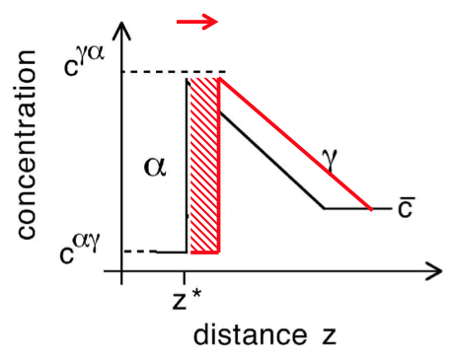
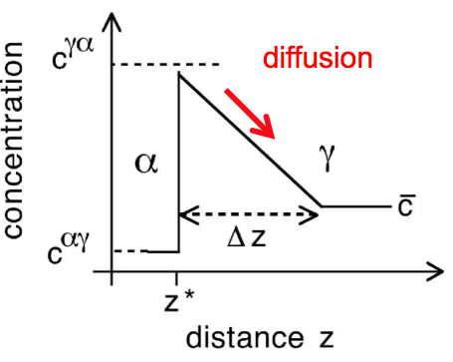
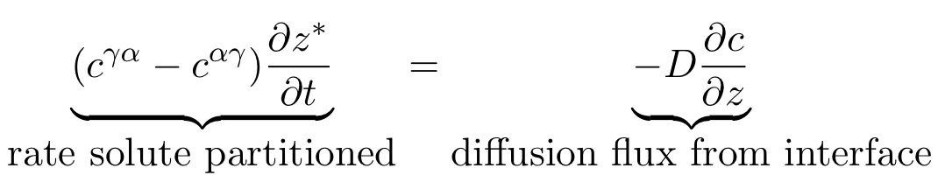
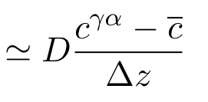

Slide 22
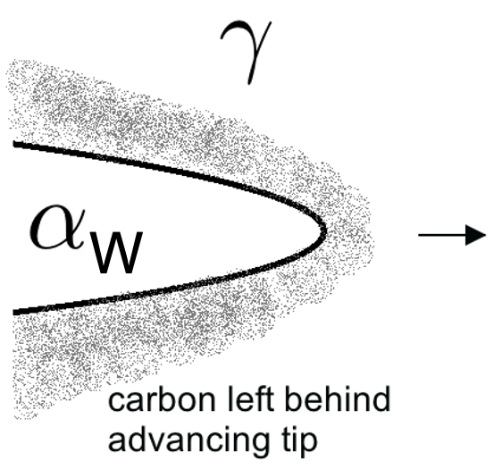

Slide 23
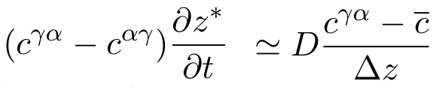
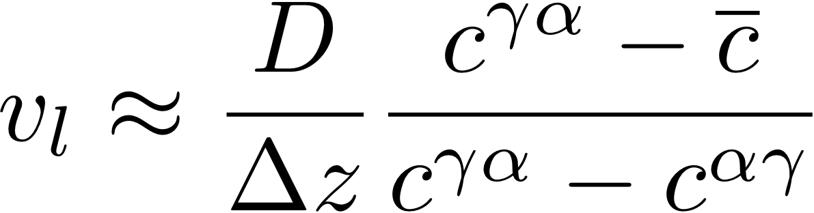
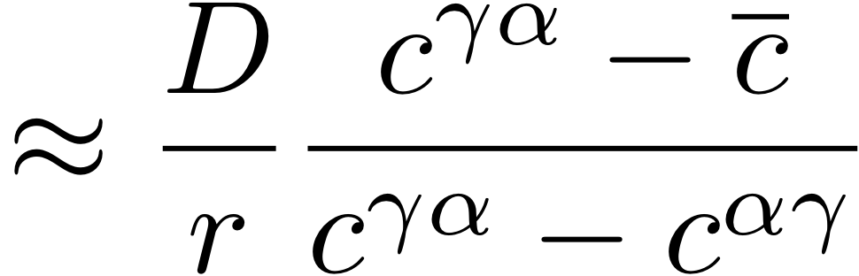
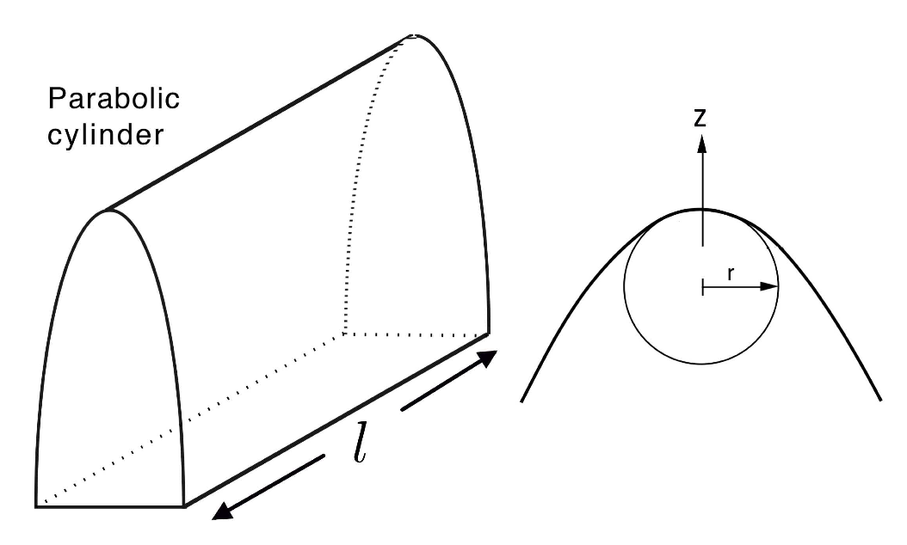

Slide 24
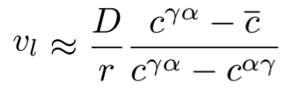

Slide 25

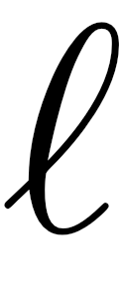
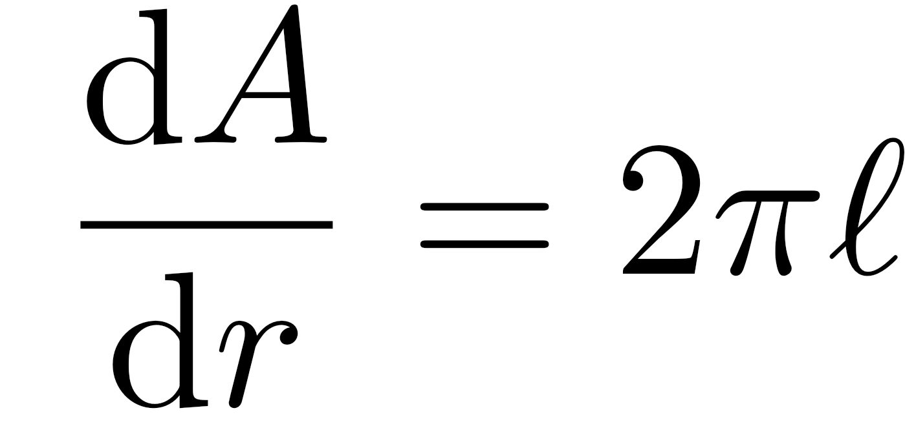
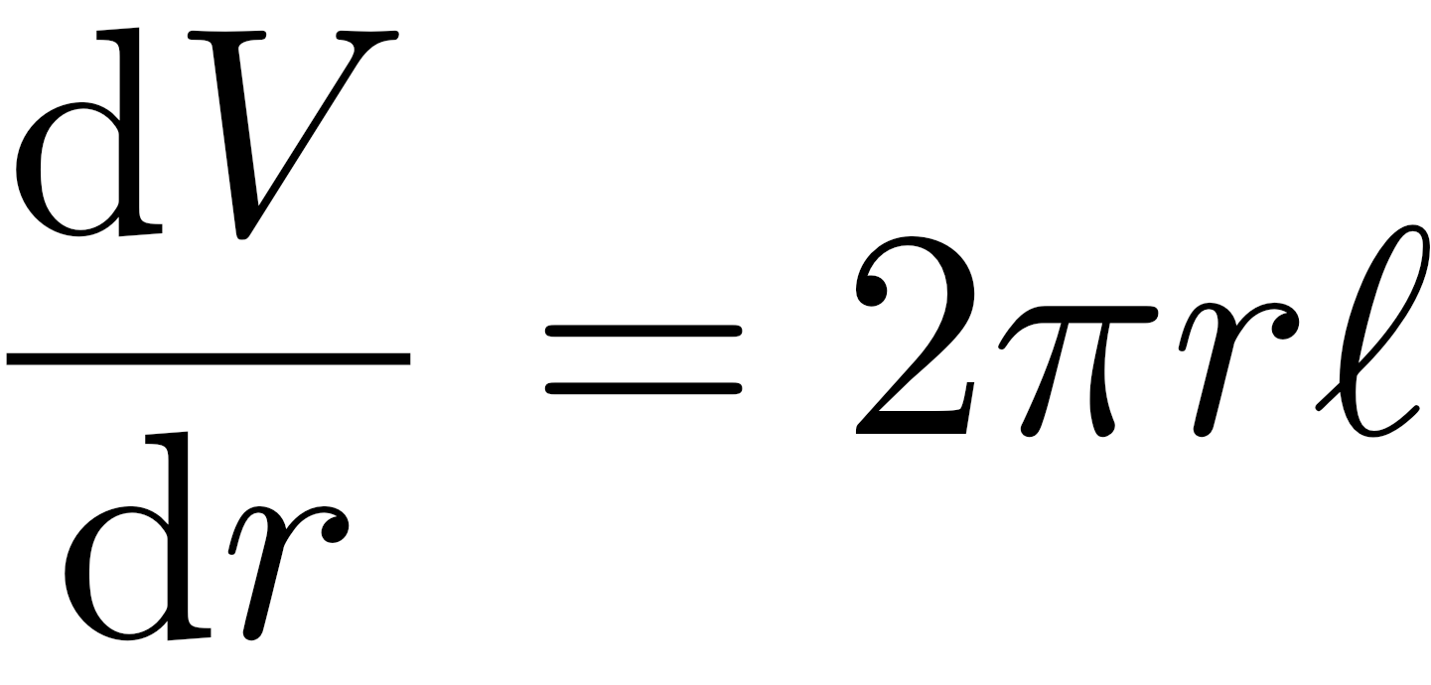
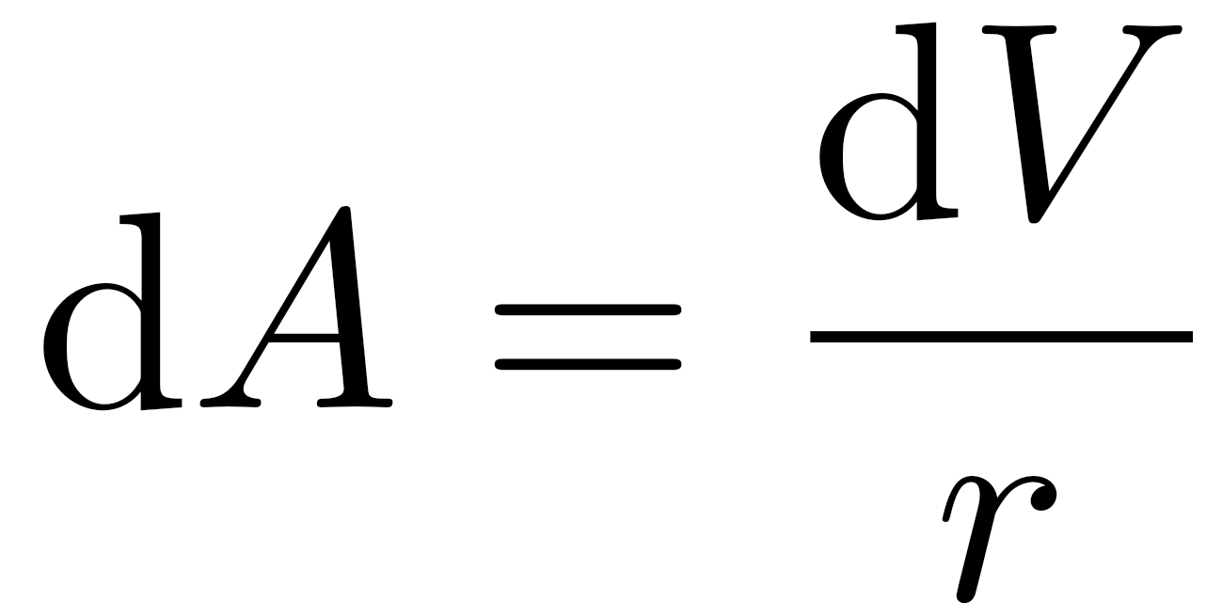
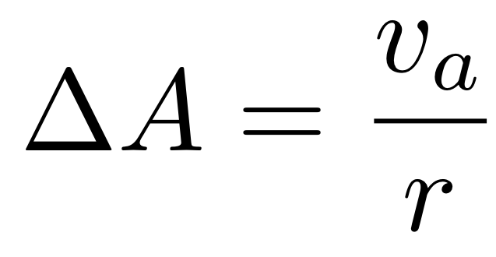
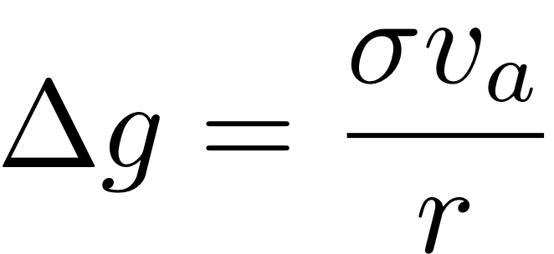
consider a cylinder

Slide 26
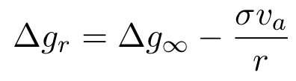



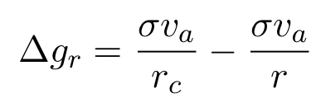
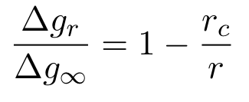
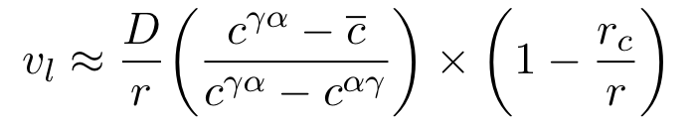

Slide 27
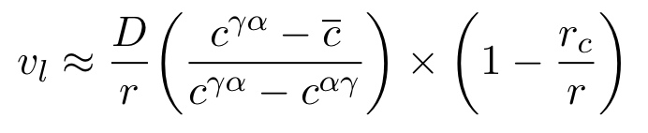

Slide 28
Notes:
28

Slide 29
Summary
Mechanism displacive but carbon must partition during growth.
Pairs of plates grow together to minimise strain.
The plates can grow in carbon-free alloys of iron, in which case, the lengthening rate would be controlled by the mobility of the glissile transformation interface.
Notes:
29

Slide 30
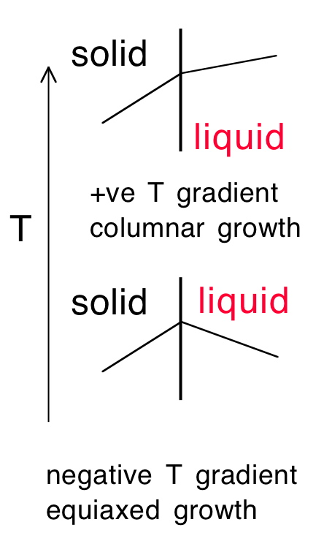
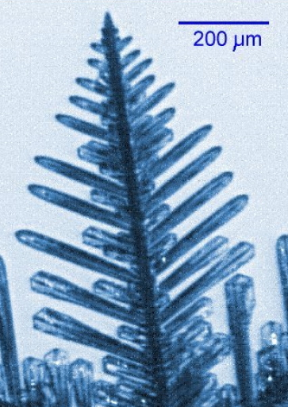

Slide 31
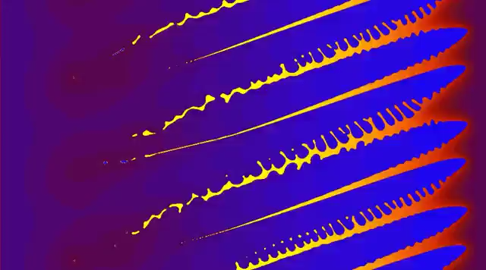
Phase field simulation of solidification
Video courtesy of
V. Pavlik and U. Dilthey of the ISF-Welding Institute of Aachen University in Germany

Slide 32
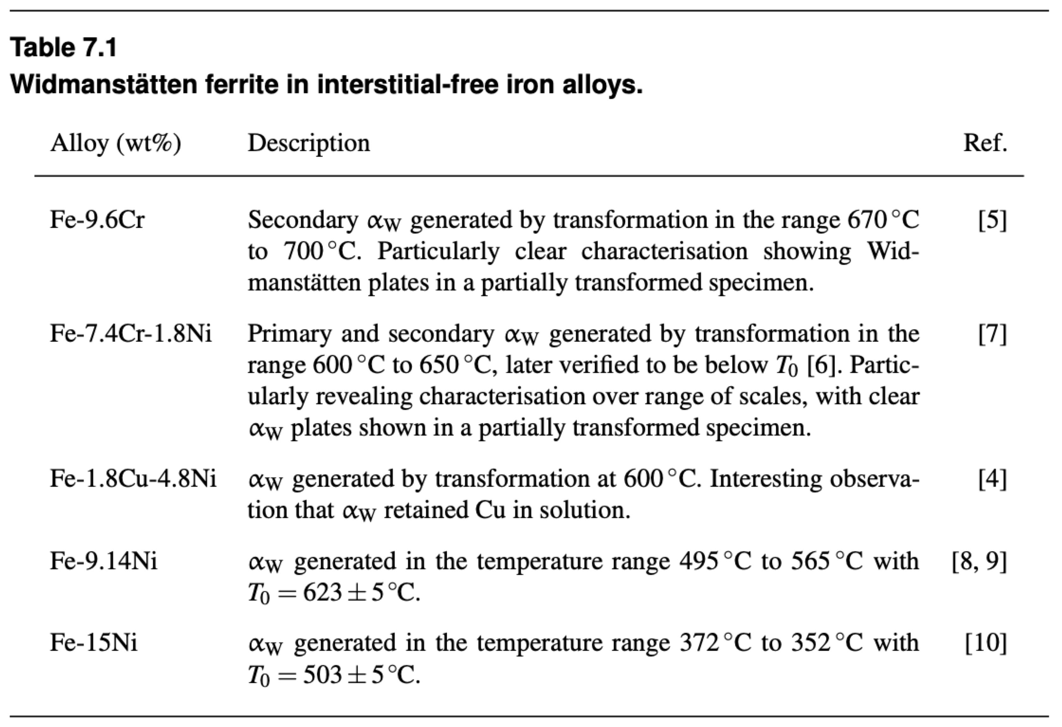
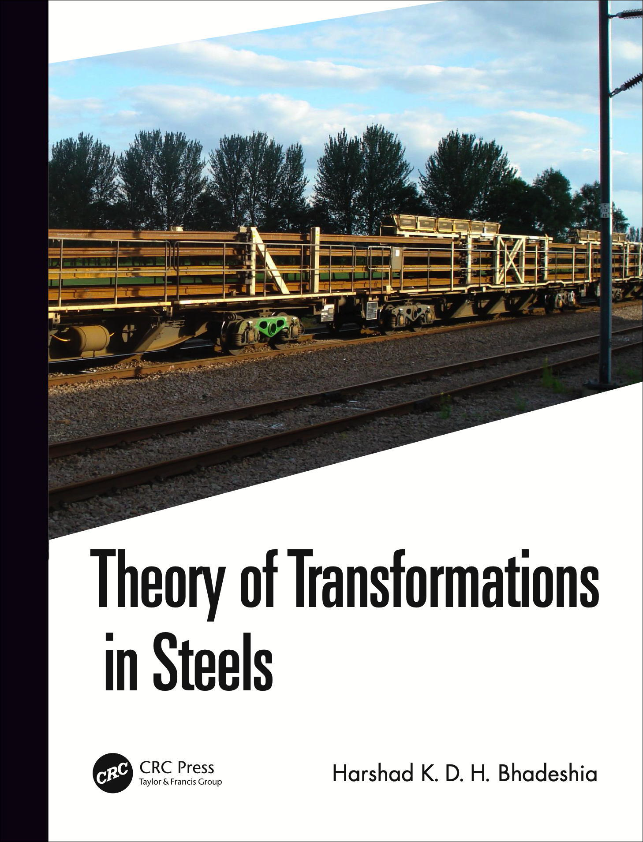

Slide 33

Fe-7.4Cr-1.8Ni wt%
Ricks RA, Bee JV, Howell PR. The decomposition of austenite in a high purity iron-chromium-nickel alloy. Metallurgical Transactions A. 1981;12:1587-1594.

Slide 34

Bhadeshia HKDH. A rationalisation of shear transformations in steels. Acta metallurgica. 1981 Jun 1;29(6):1117-30.

Slide 35


Slide 36

Bhadeshia HKDH. A rationalisation of shear transformations in steels. Acta metallurgica. 1981 Jun 1;29(6):1117-30.

Slide 37


