Slide 1



Steels: Ferrite
Lecture 6
Fabio Miani
Harry Bhadeshia
Professor of Metallurgy
Queen Mary University of London
Emeritus Tata Steel Professor of Metallurgy
University of Cambridge
2022

Slide 2
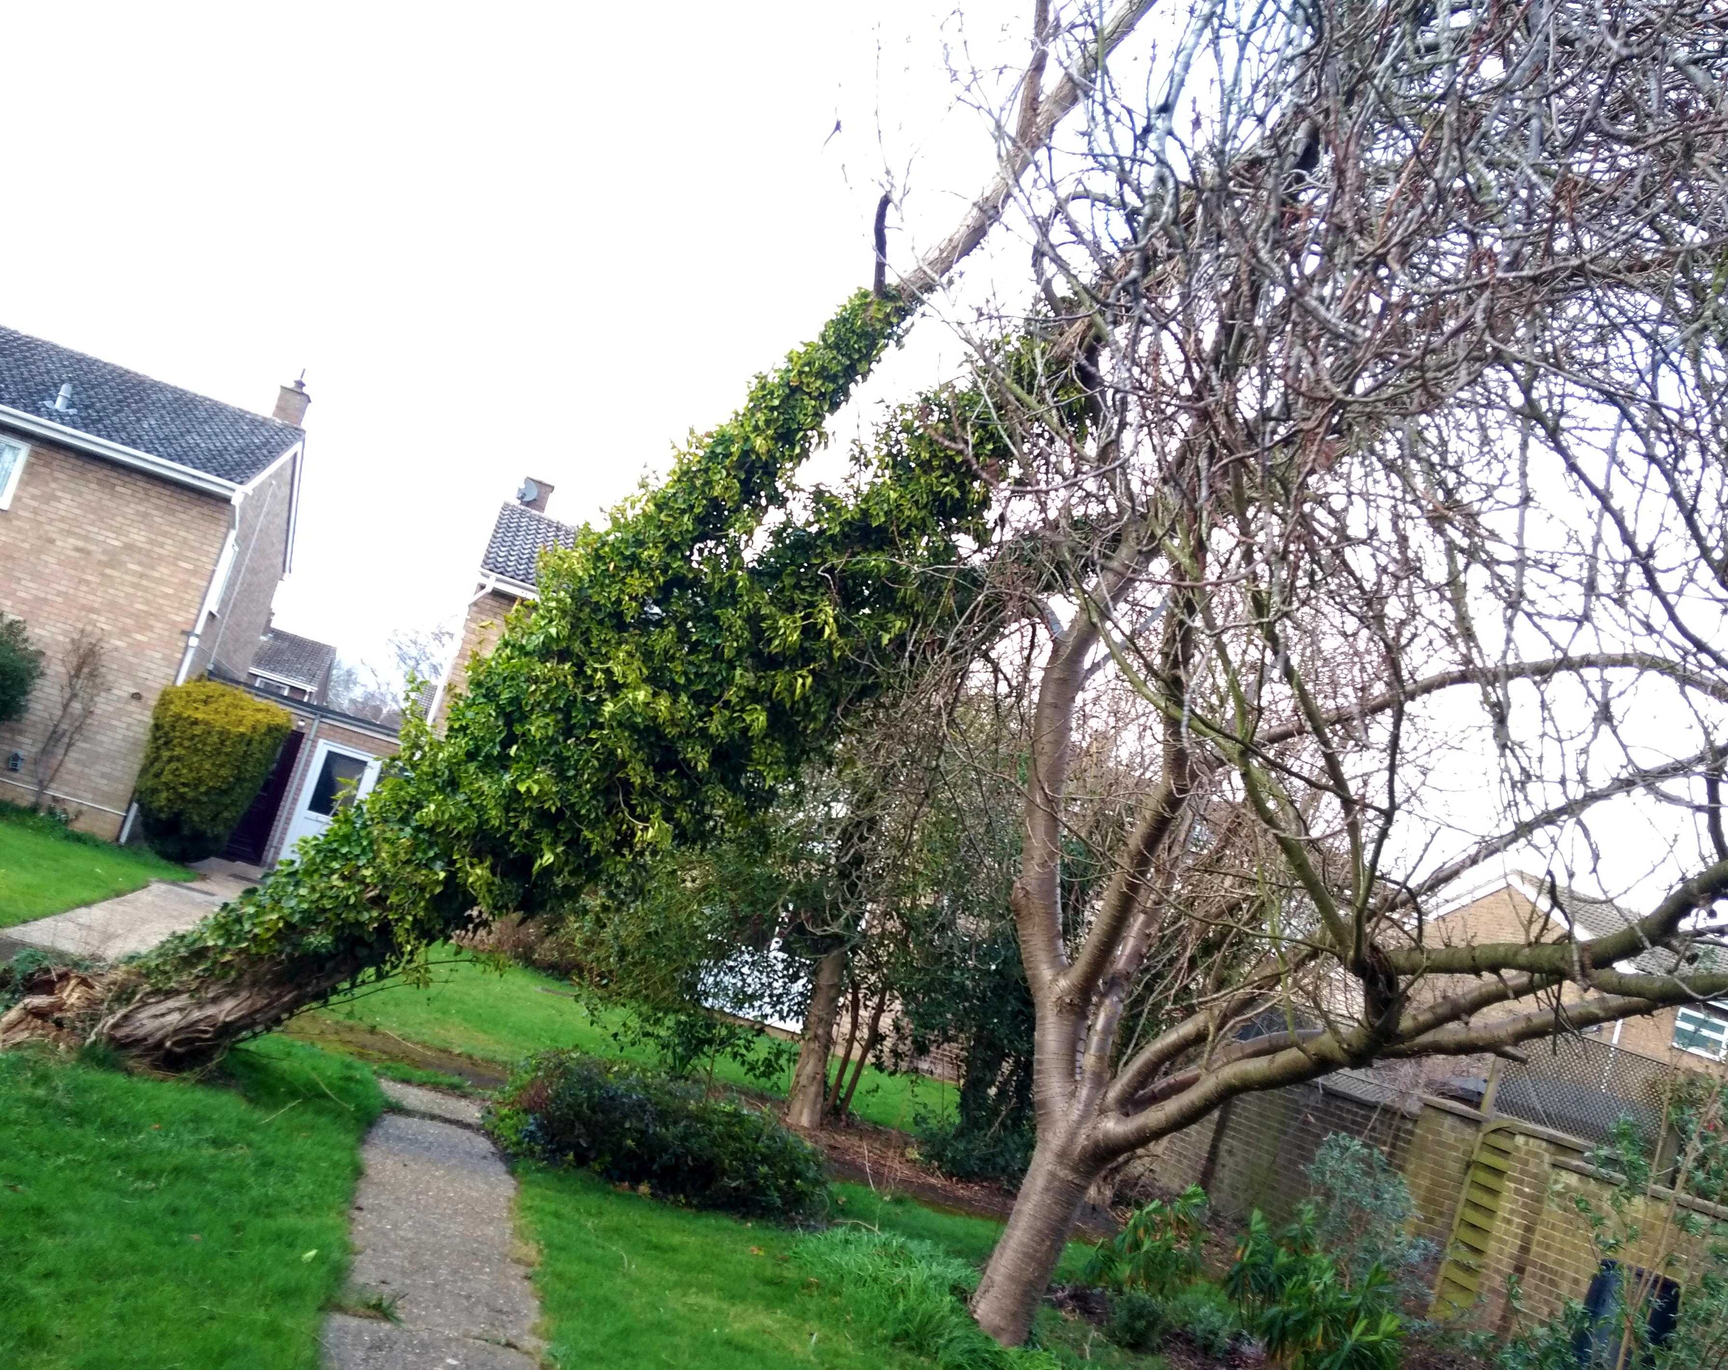
Storm Eunice, today,
my garden!

Slide 3
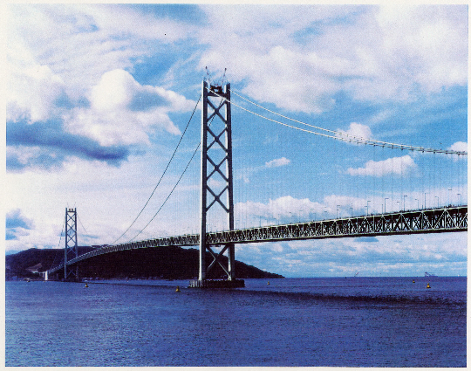
Akashi Kaikyo
Image courtesy of Nobutaka Yurioka

Slide 4


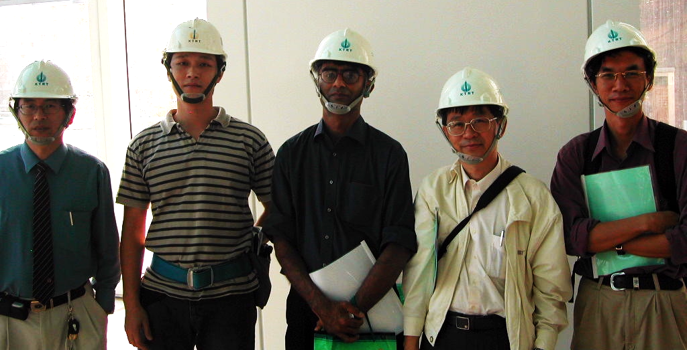
www.phase-trans.msm.cam.ac.uk/2005/t101/t101.html
Photograph authorised by Jessie Lin of Taipei 101

Slide 5
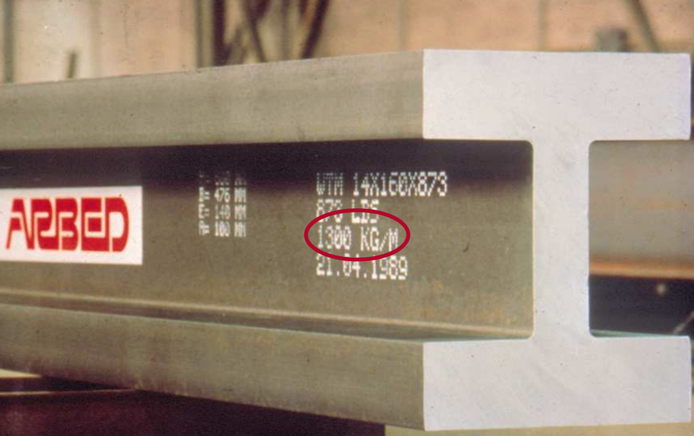

Slide 6
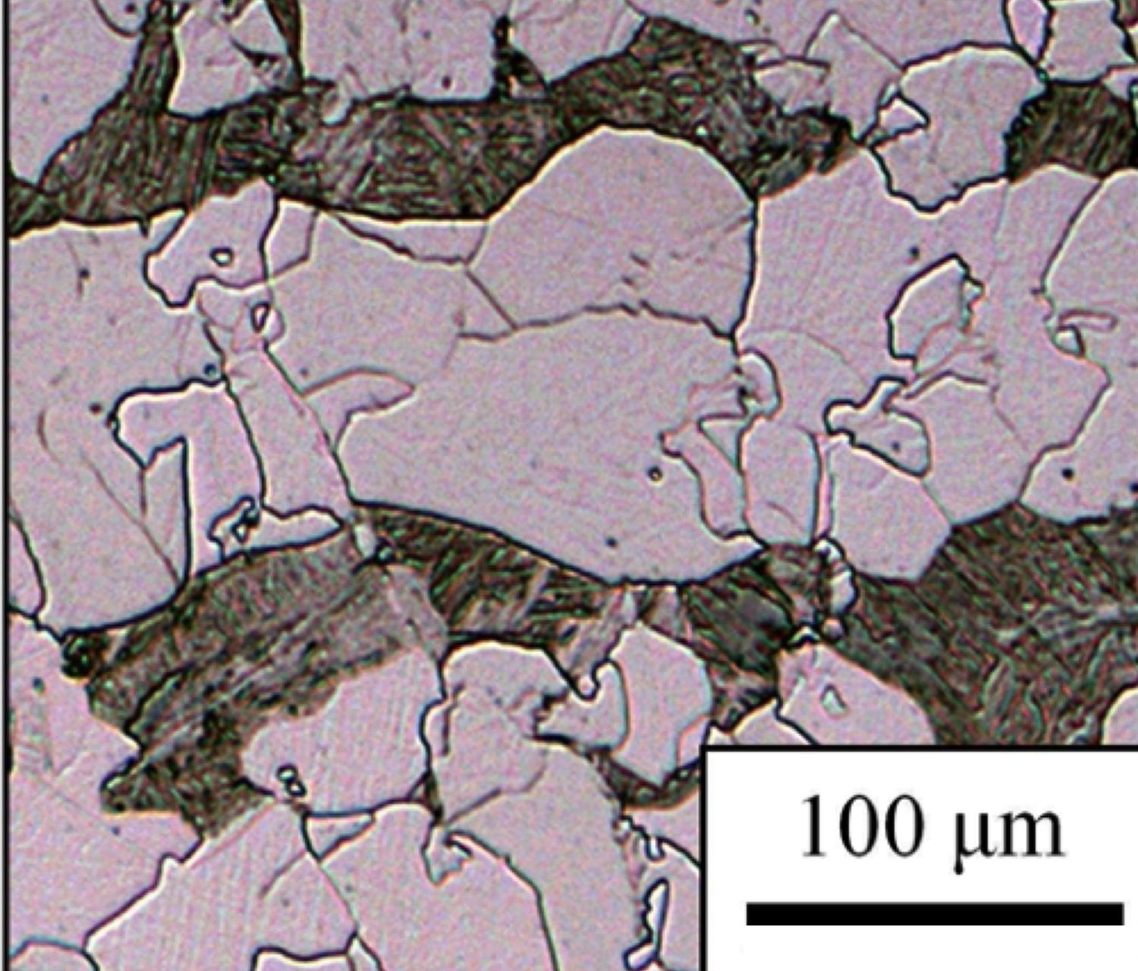
Fe-0.04C-0.2Si-1.5Mn-0.095Ti-0.2Mo wt%
Jang JH, Heo YU, Lee CH, Bhadeshia HKDH, Suh DW. Interphase precipitation in Ti–Nb and Ti–Nb–Mo bearing steel. Materials Science and Technology. 2013;29:309-313.

Slide 7
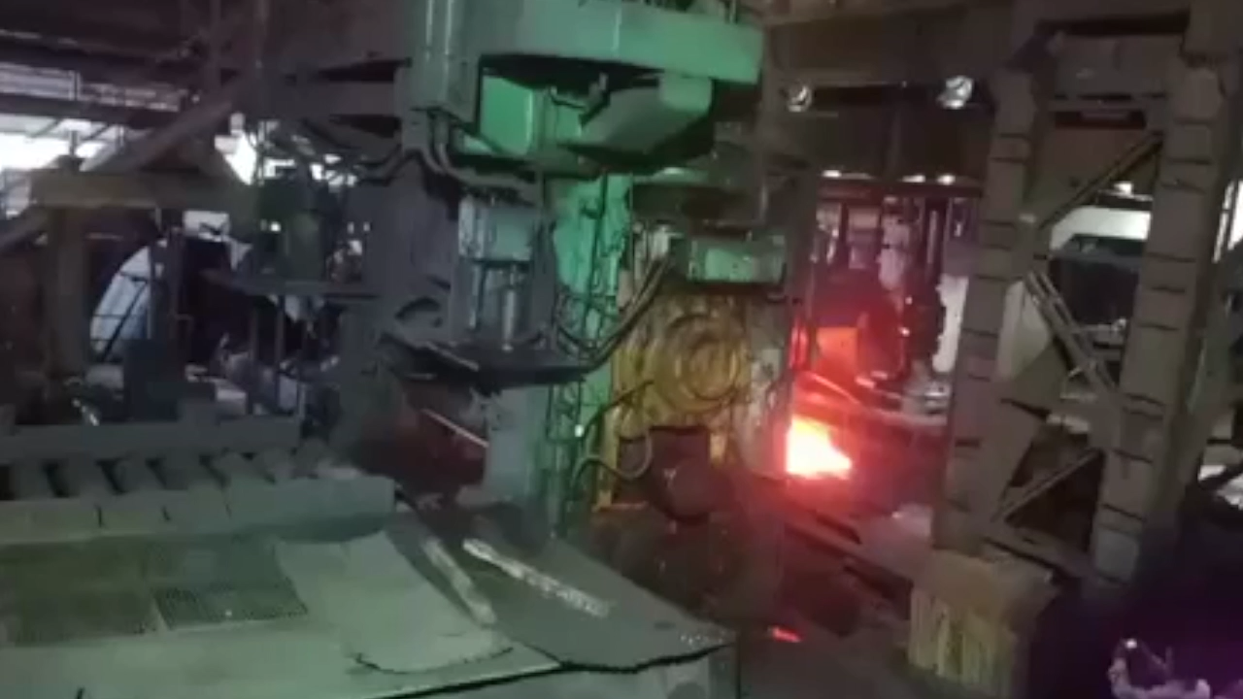
Austenite grain refinement

Slide 8
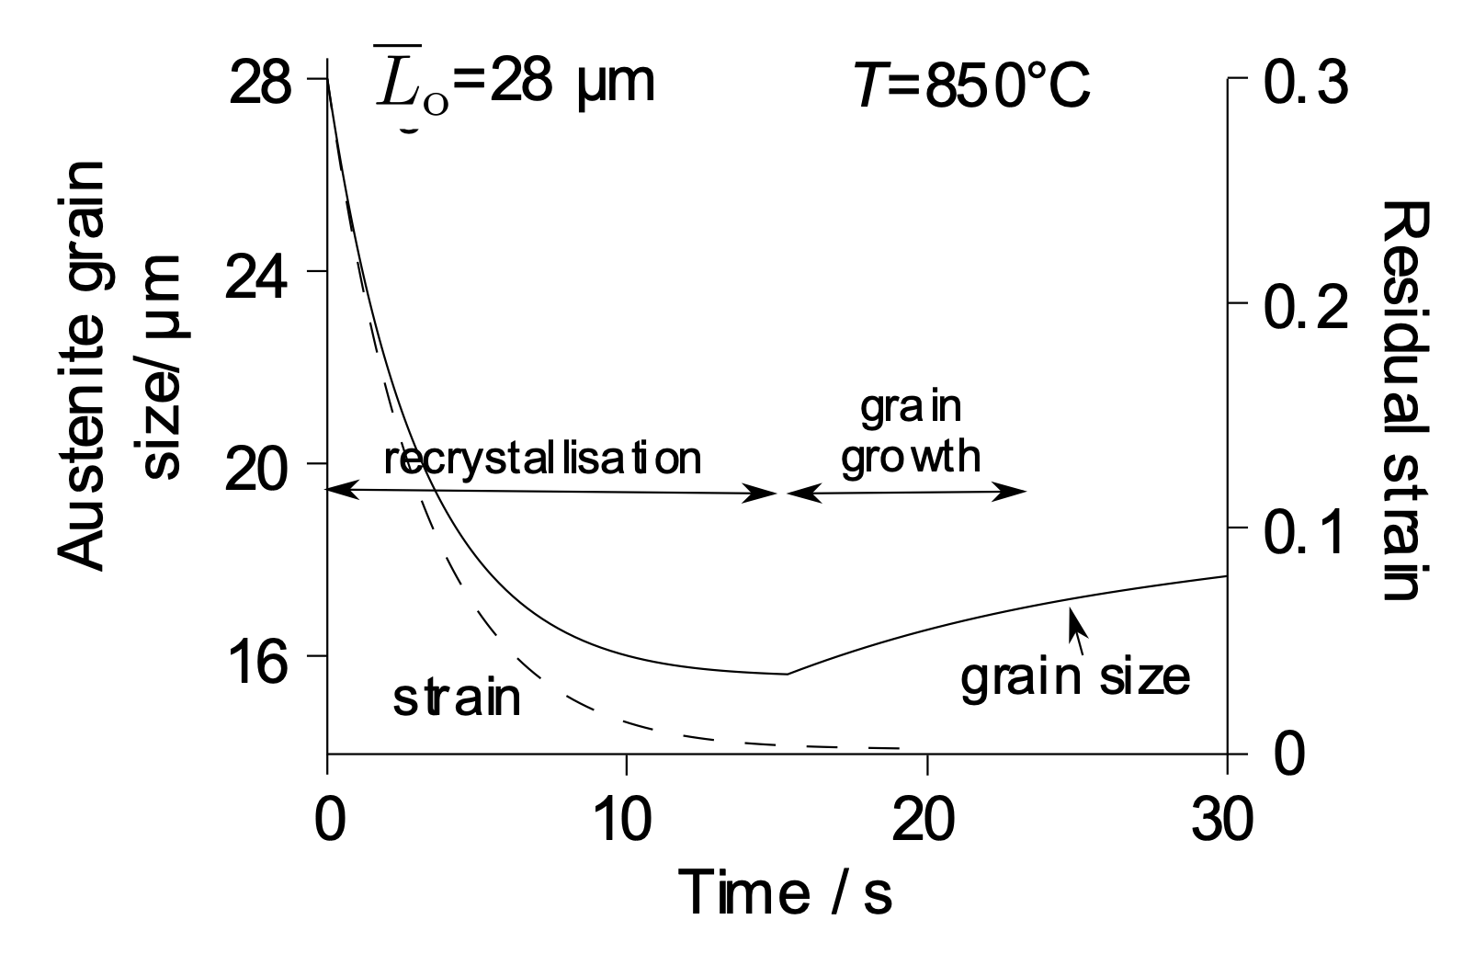
Austenite grain refinement

Slide 9
Sellars CM. Modelling microstructural development during hot rolling. Materials Science and technology. 1990;6:1072-81.

Slide 10
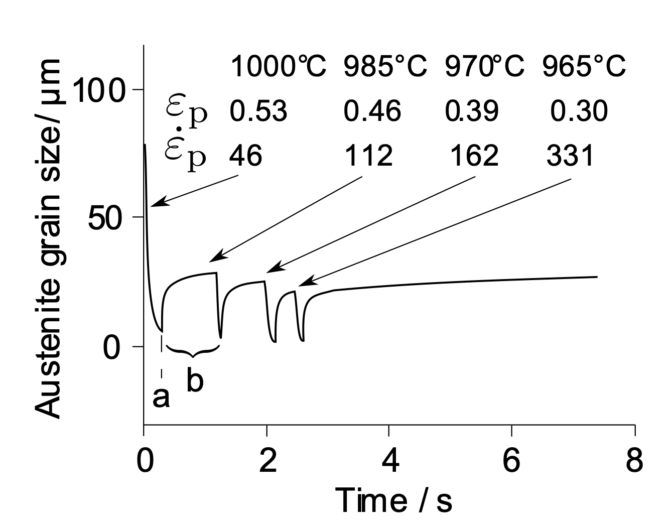
Bombac D, Peet MJ, Zenitani S, Kimura S, Kurimura T, Bhadeshia HKDH. An integrated hot rolling and microstructure model for dual-phase steels. Modelling and Simulation in Materials Science and Engineering. 2014;22:045005.

Slide 11
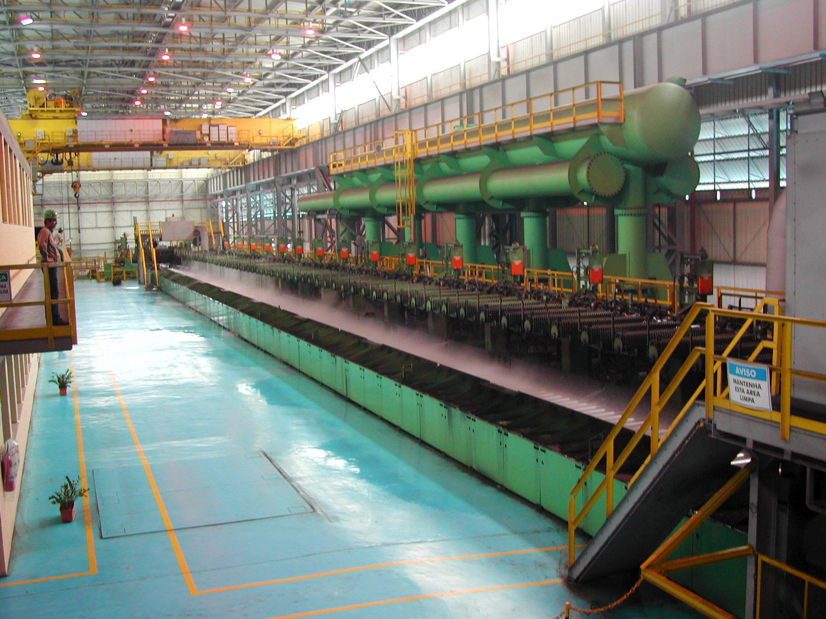
Evolution of ferrite grain size

Slide 12
Yokota T, Mateo CG, Bhadeshia HKDH. Formation of nanostructured steels by phase transformation. Scripta Materialia. 2004;51:767-70.

Slide 13
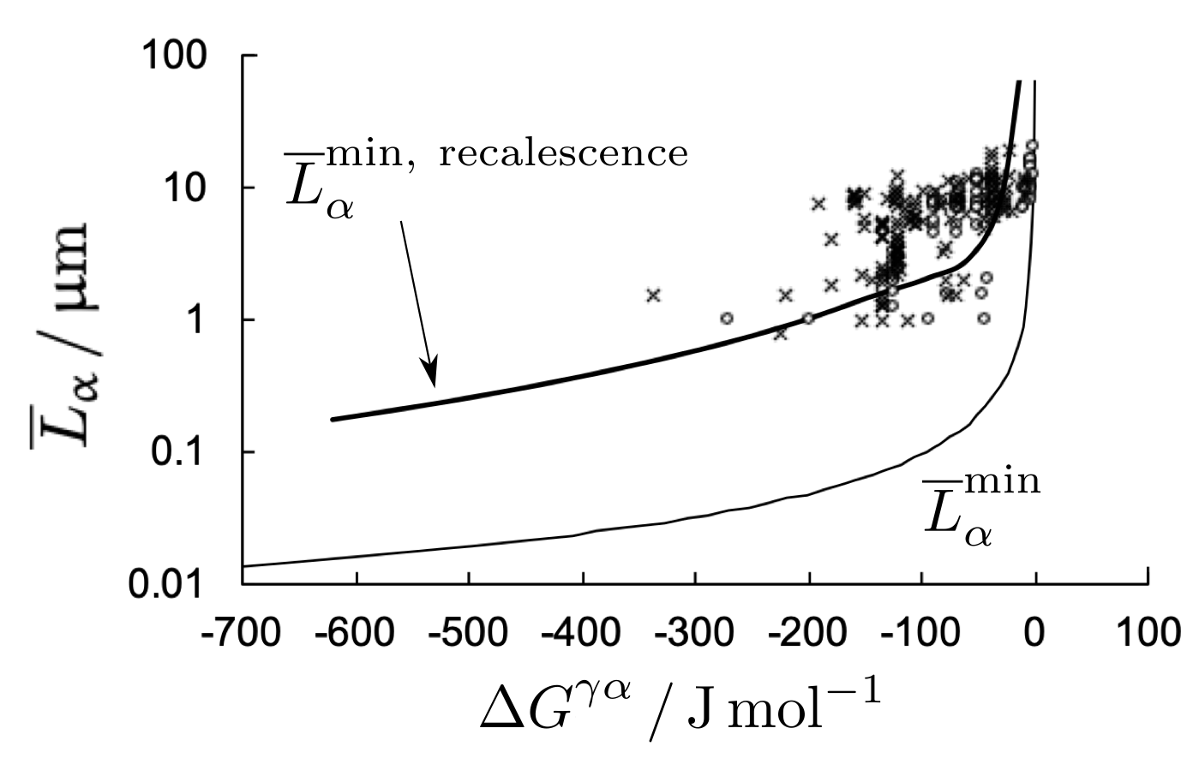
Yokota T, Mateo CG, Bhadeshia HKDH. Formation of nanostructured steels by phase transformation. Scripta Materialia. 2004;51:767-70.

Slide 14
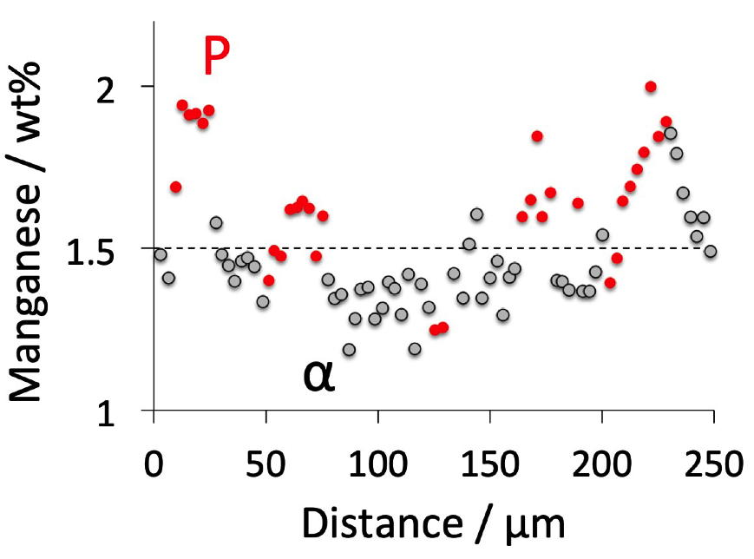
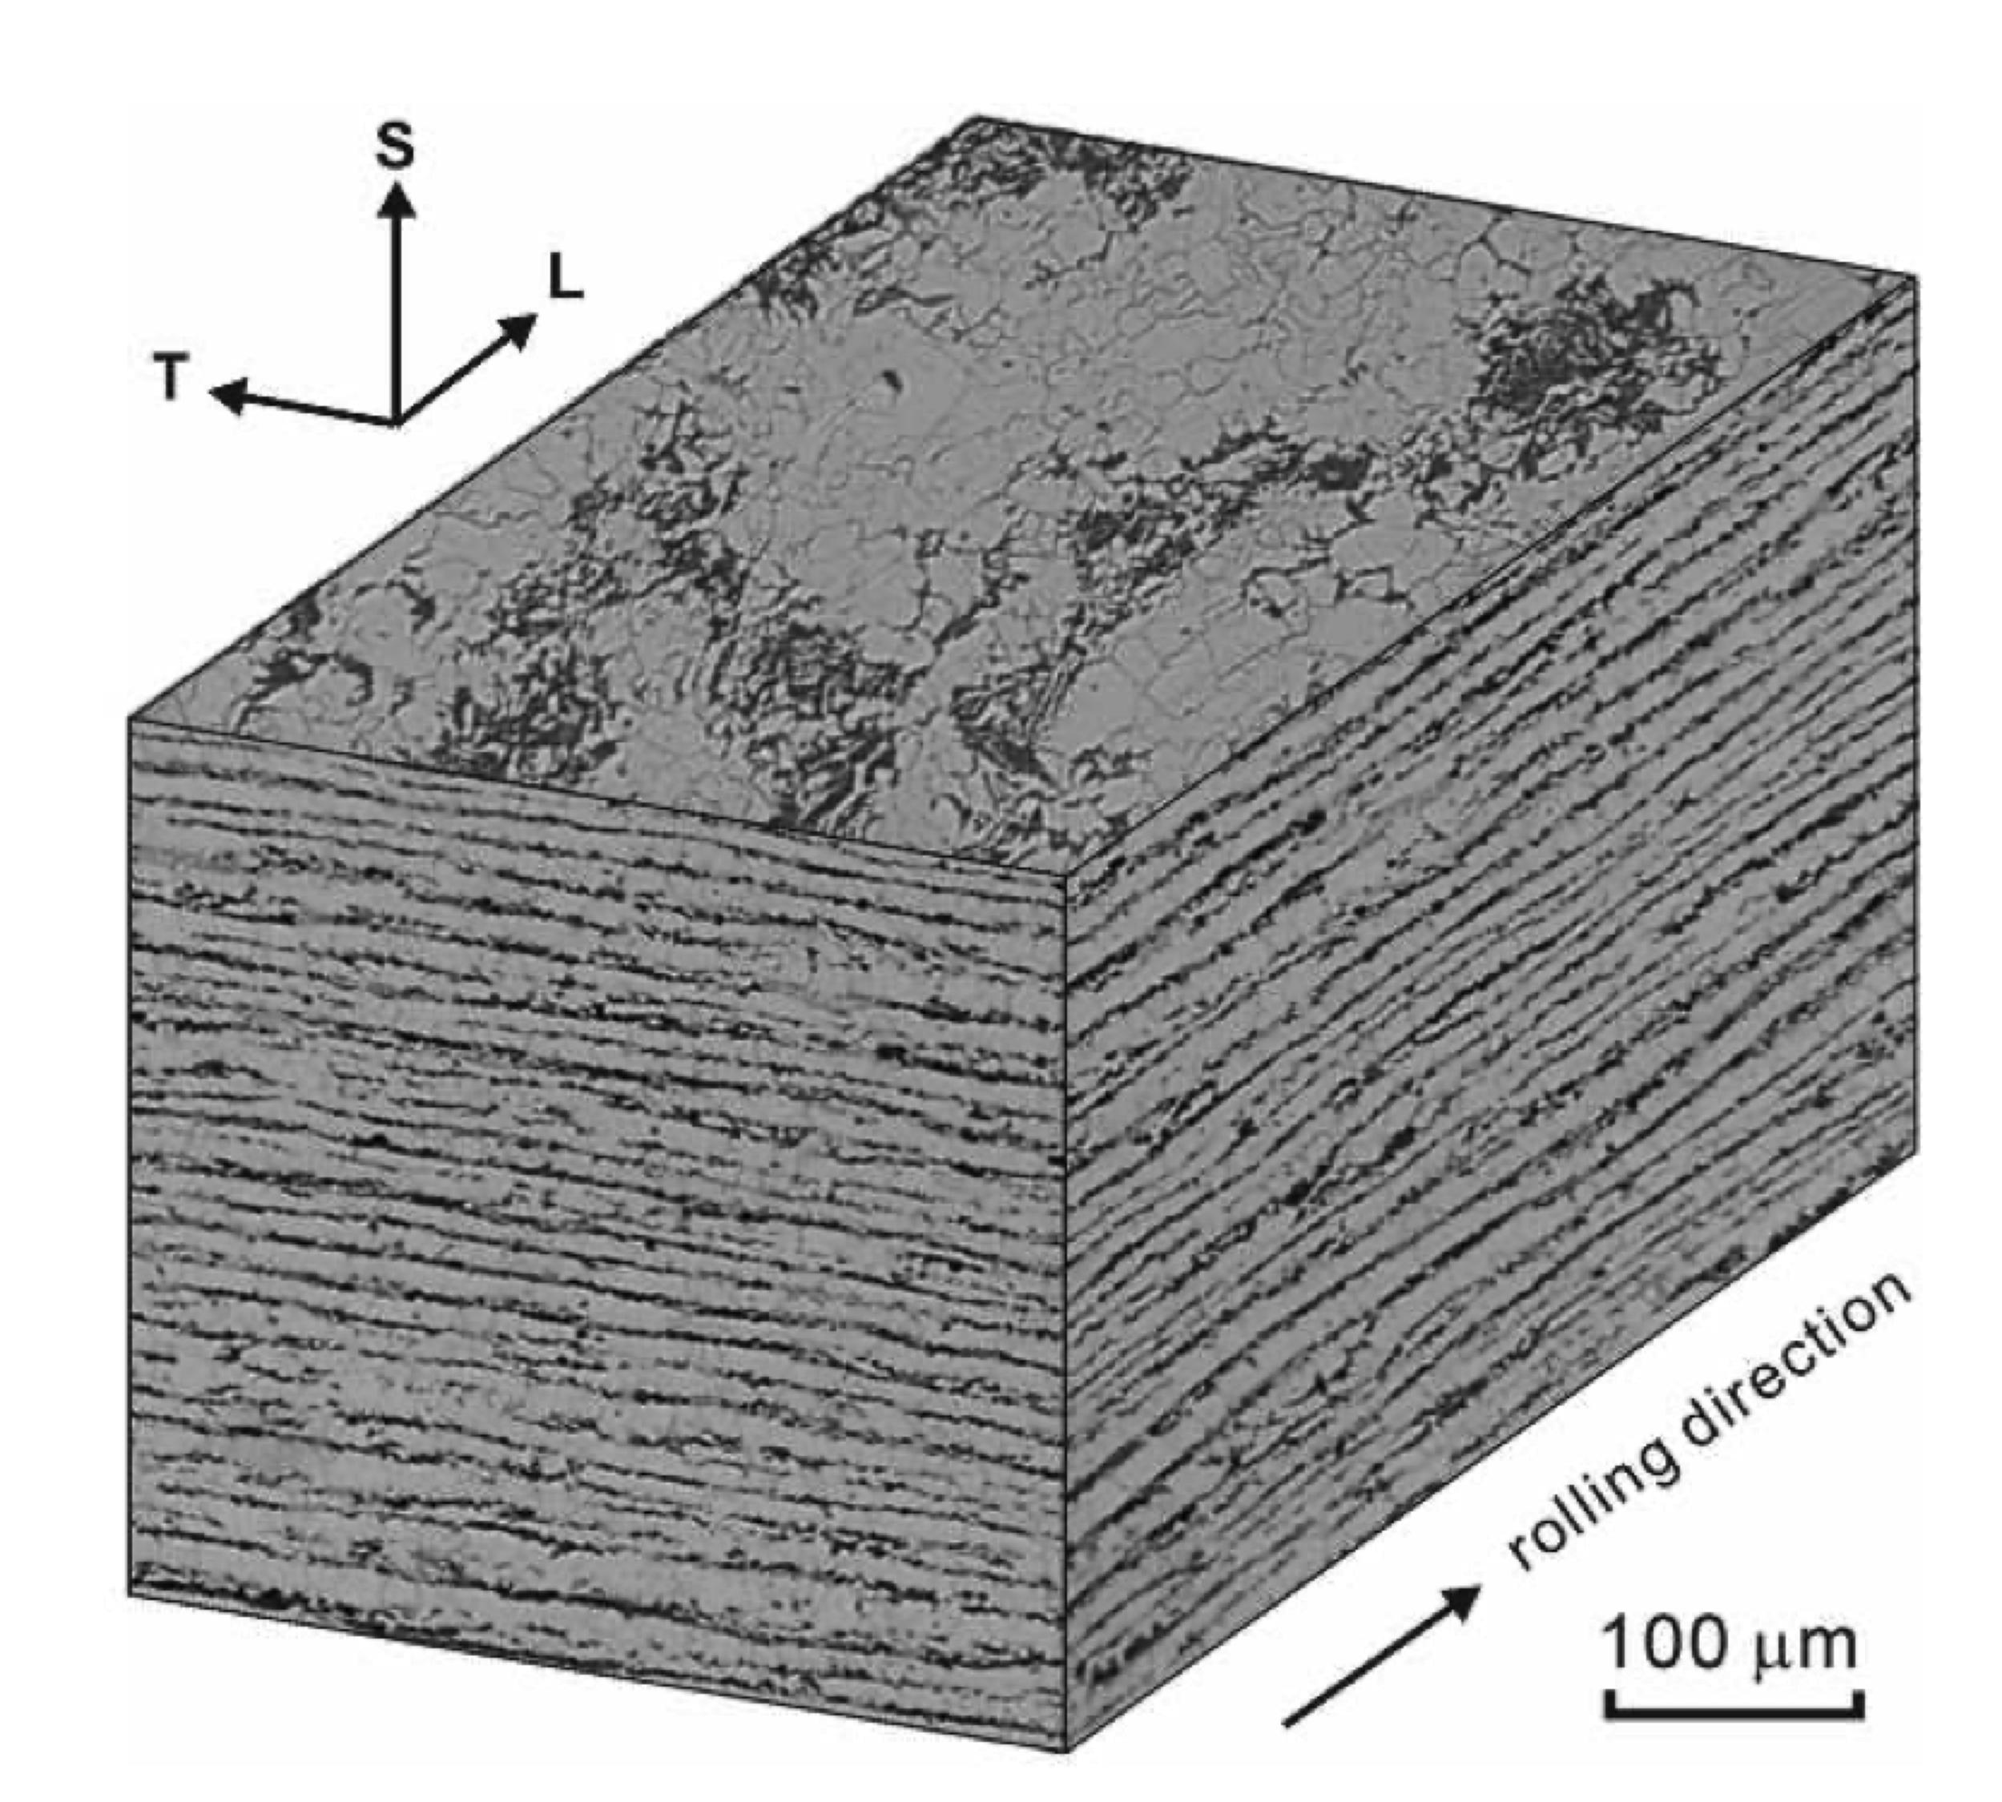
Image courtesy of
Y. Mutoh
Data from:
Thompson SW, Howell PR. Factors influencing ferrite/pearlite banding and origin of large pearlite nodules in a hypoeutectoid plate steel. Materials Science and Technology. 1992;8:777-84.

Slide 15
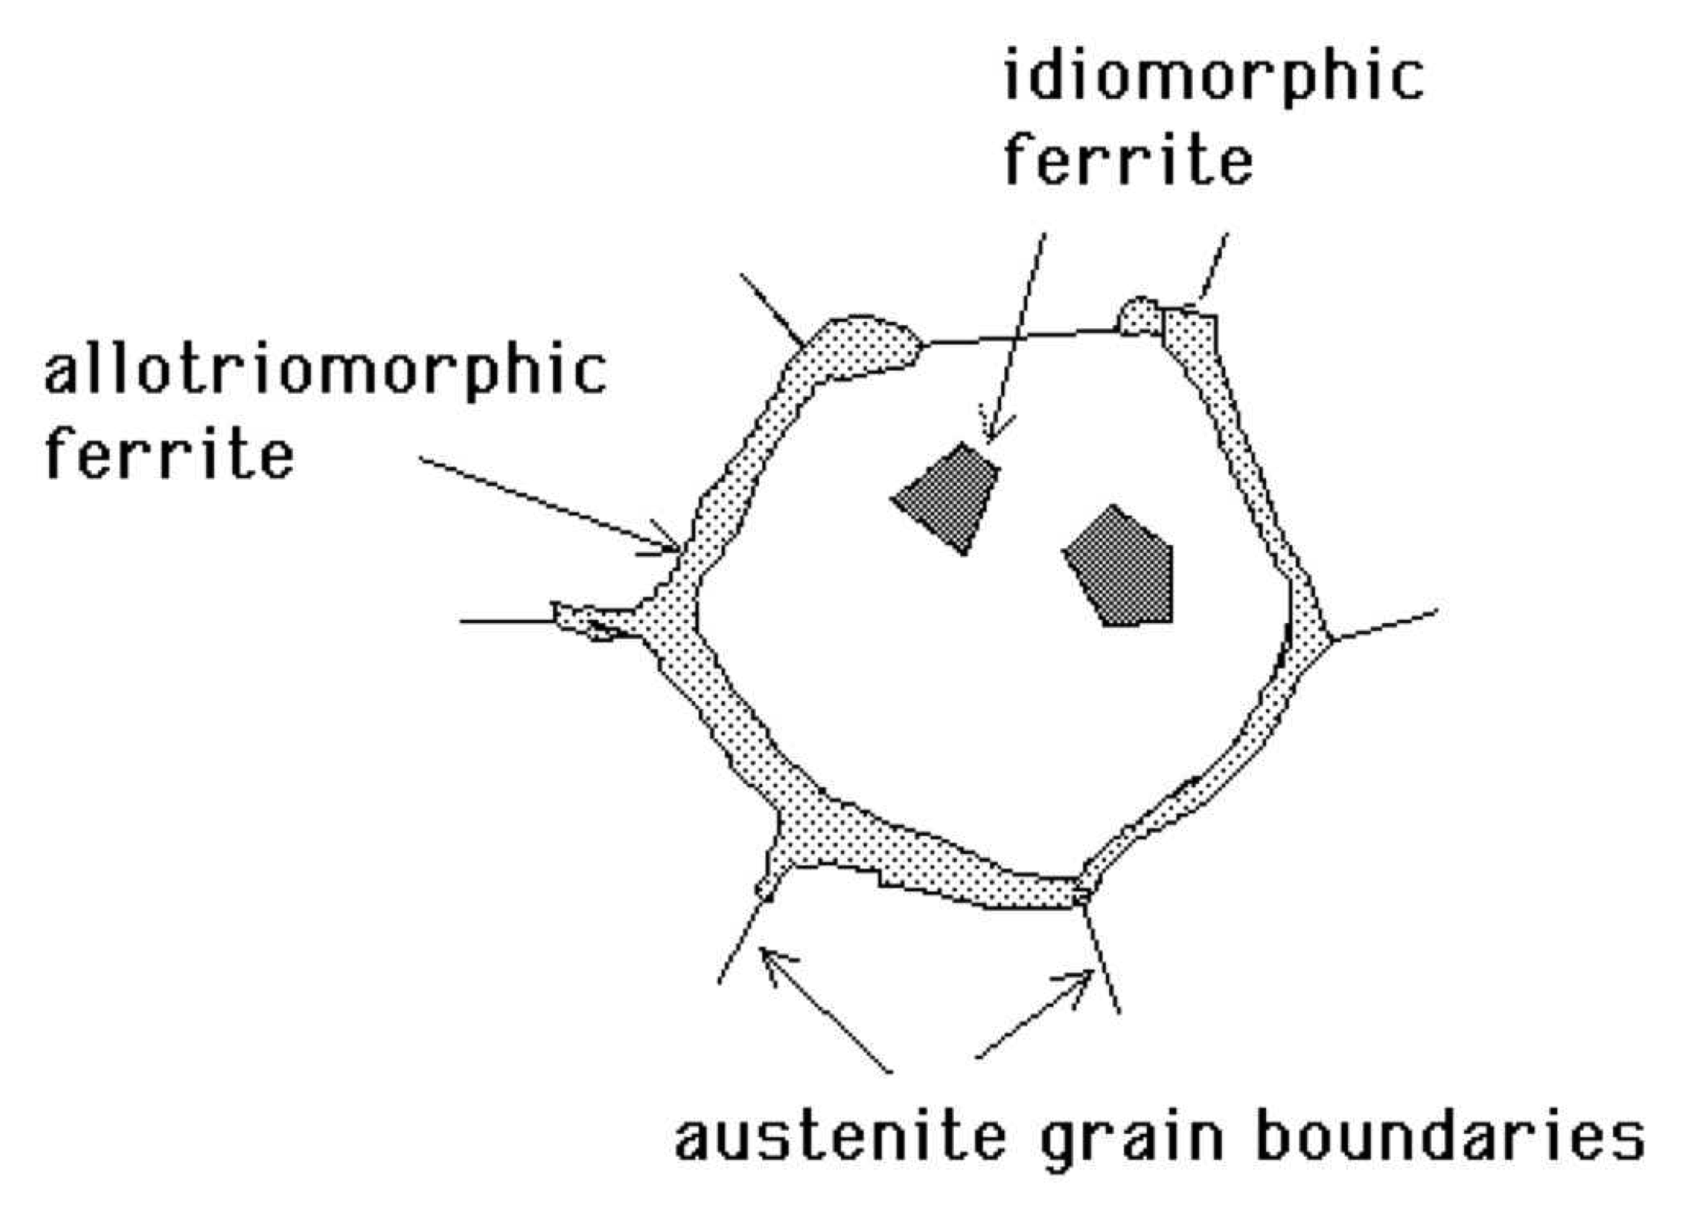
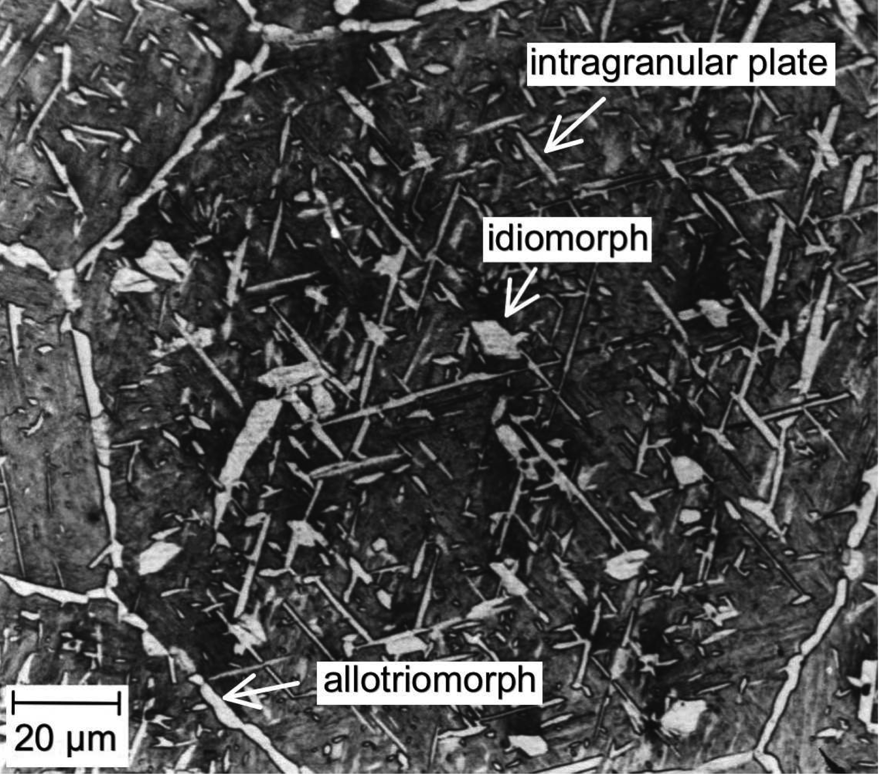
Ferrite

Slide 16
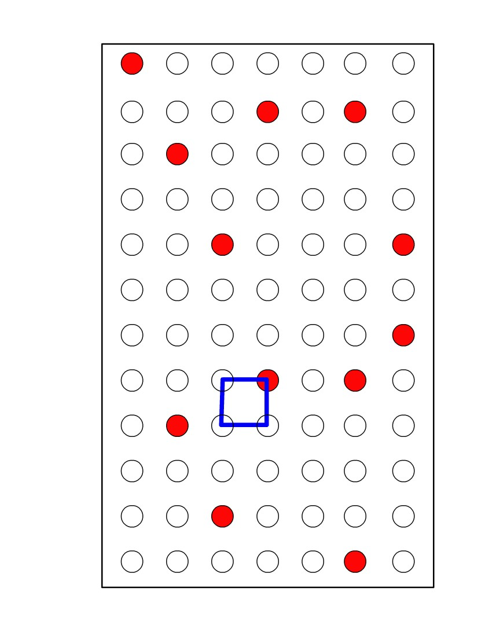
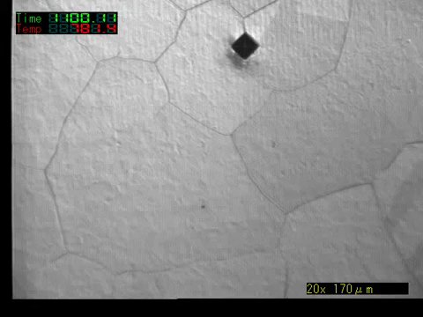
Reconstructive
transformation
T. Koseki, University of Tokyo

Slide 17
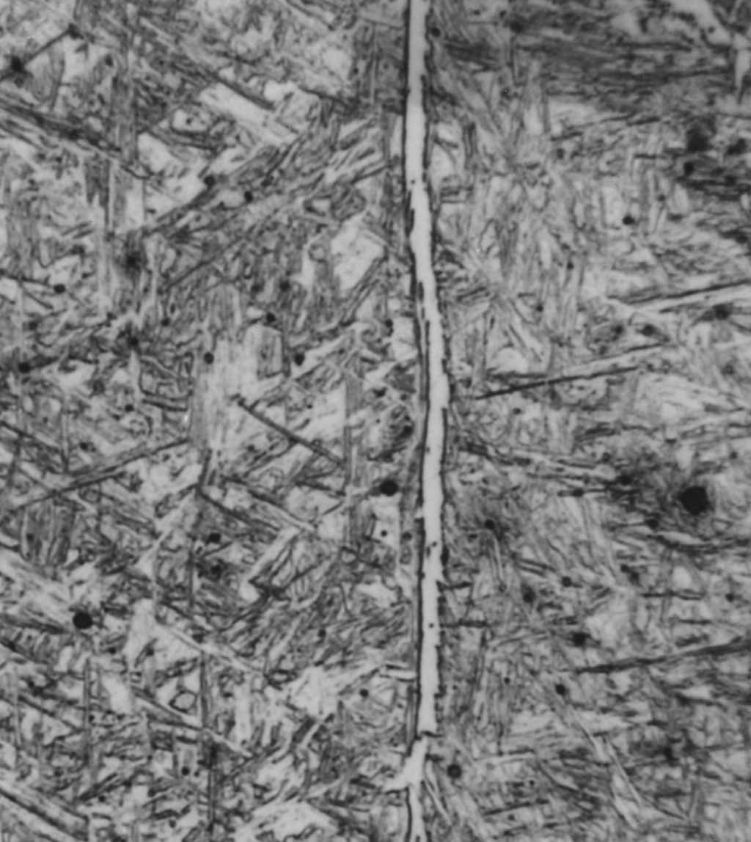
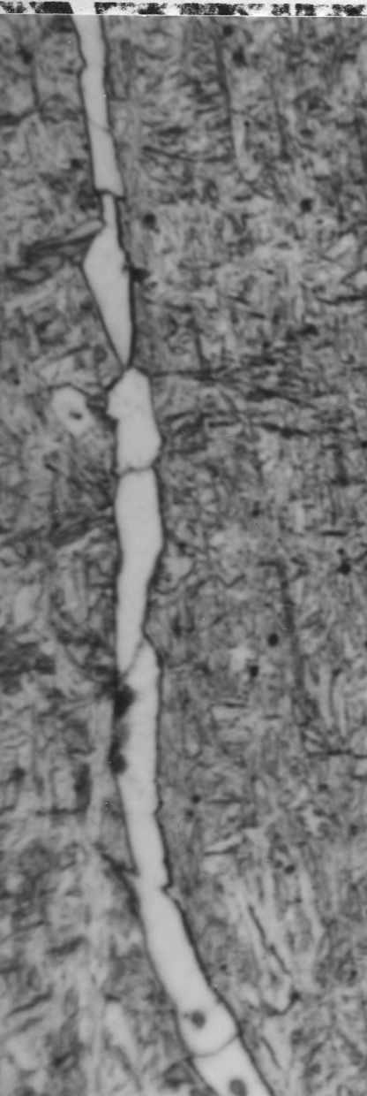
Barrite, 1982
20 µm

Slide 18
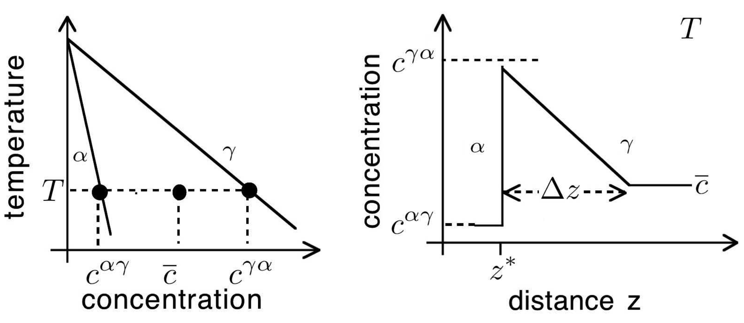

Slide 19
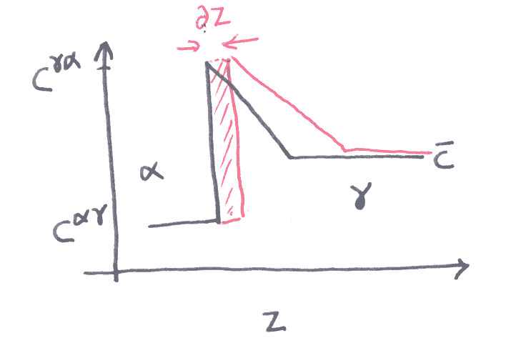
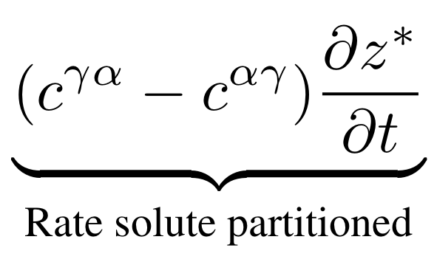

Slide 20
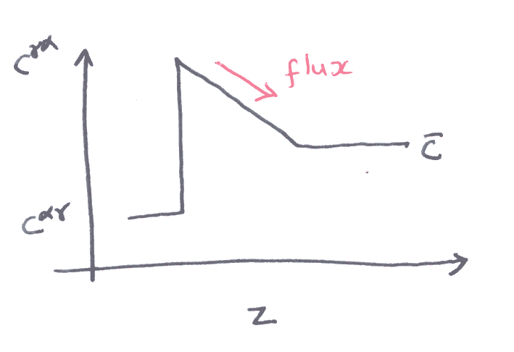
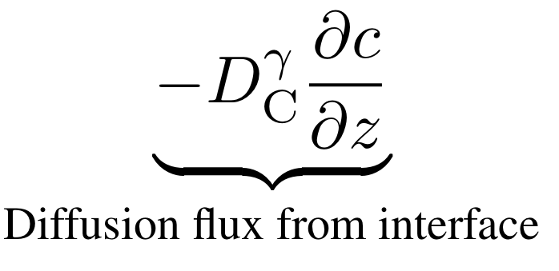

Slide 21
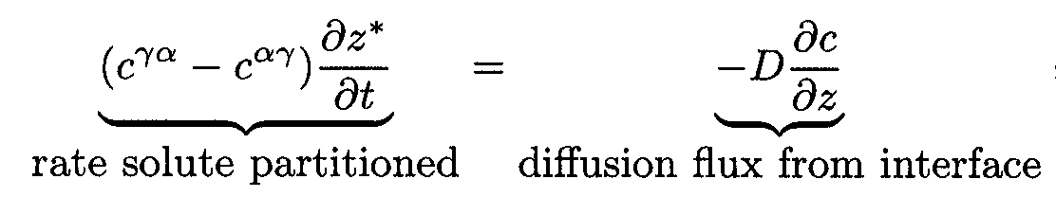
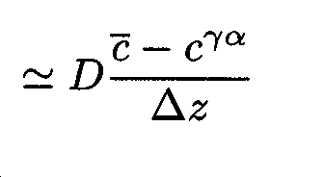
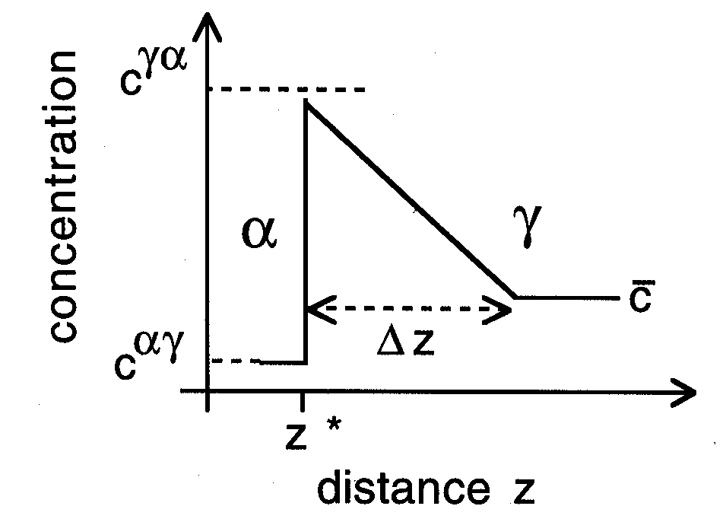

Slide 22
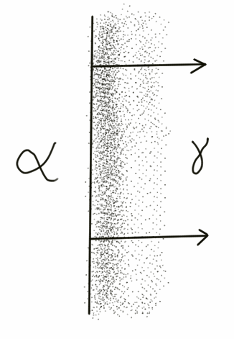
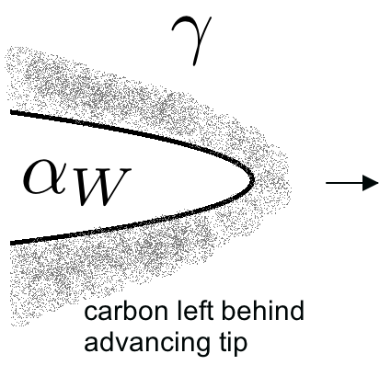

Slide 23
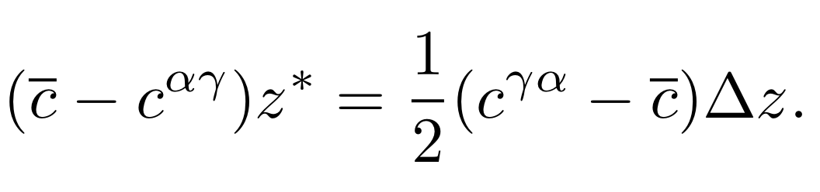
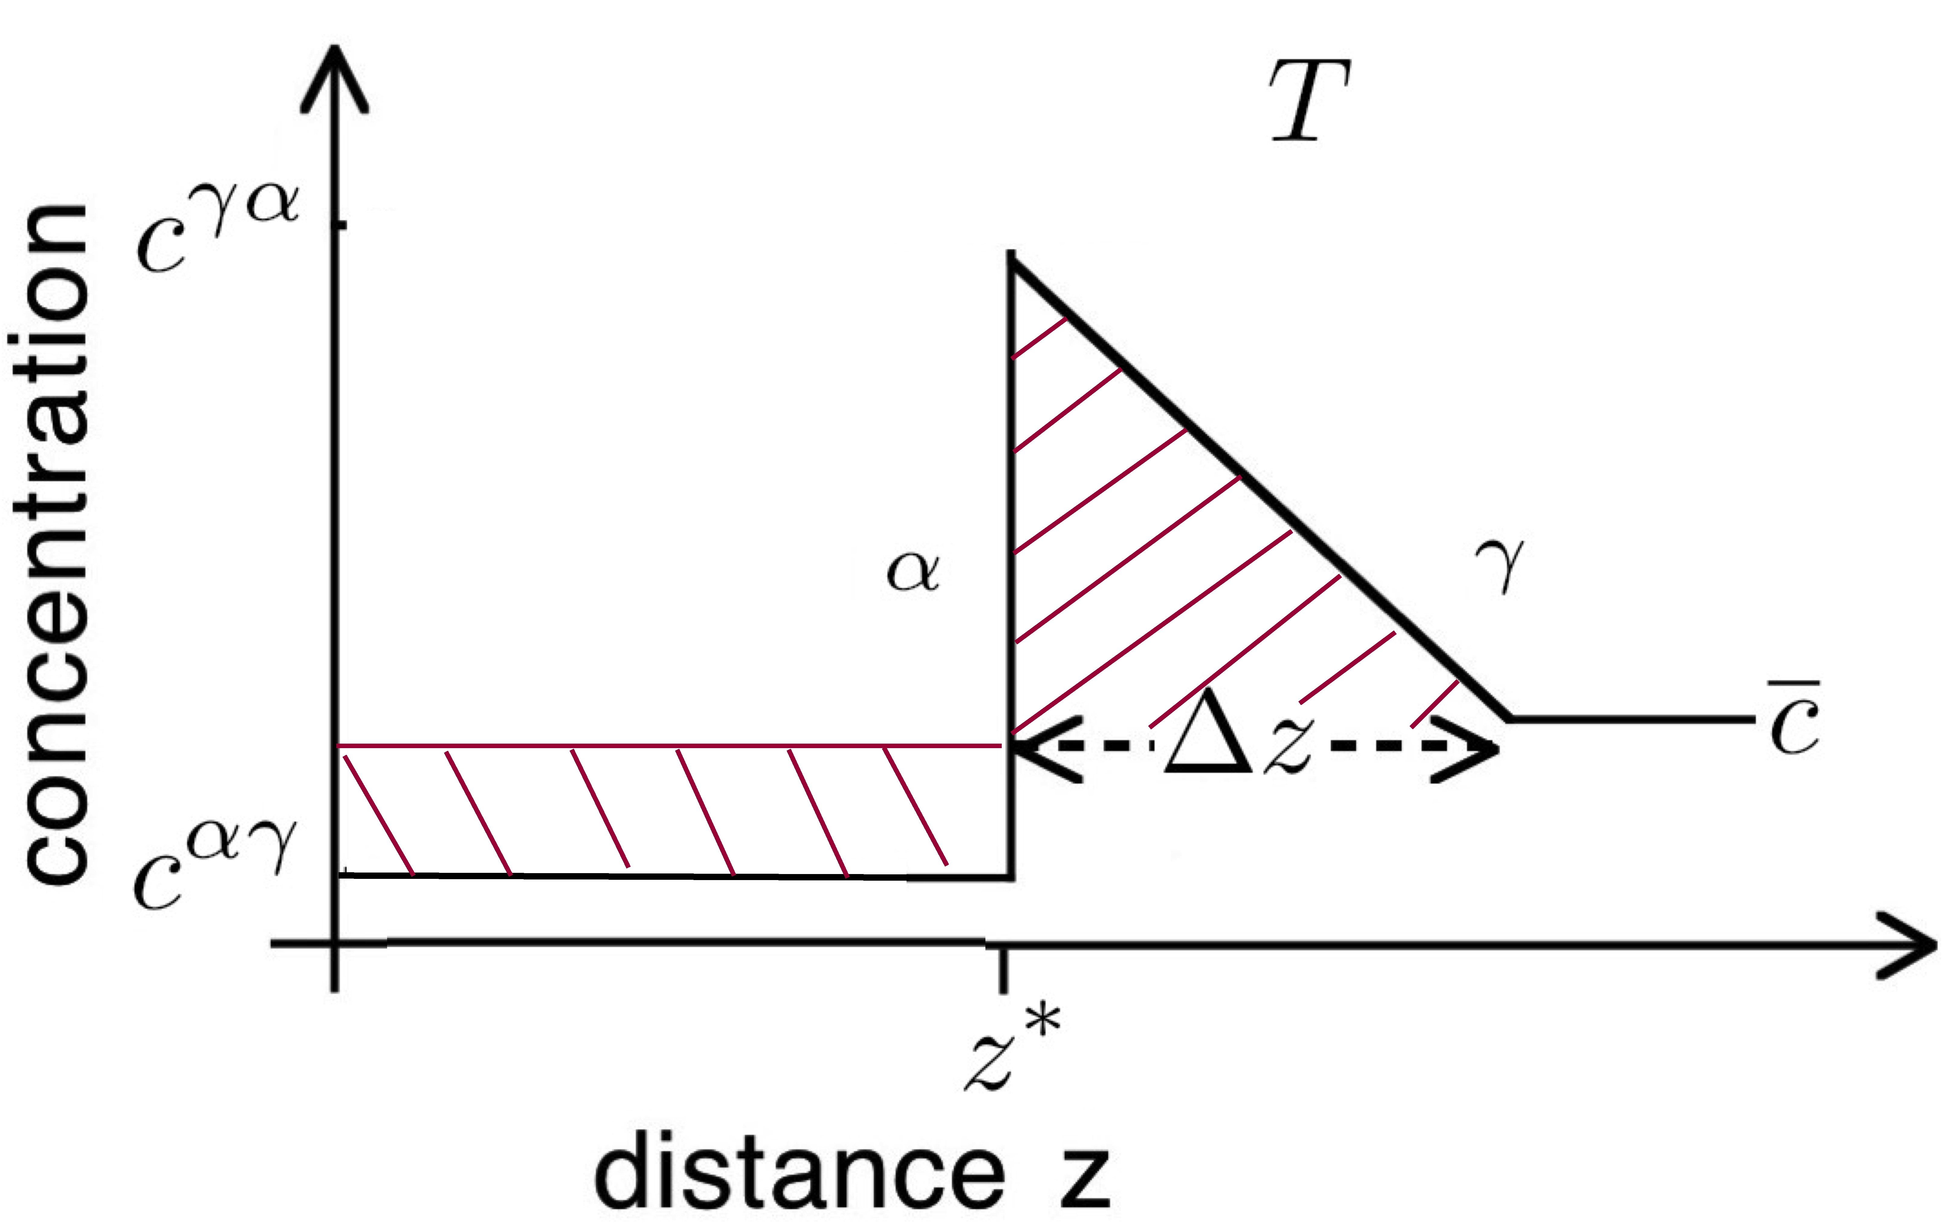

Slide 24

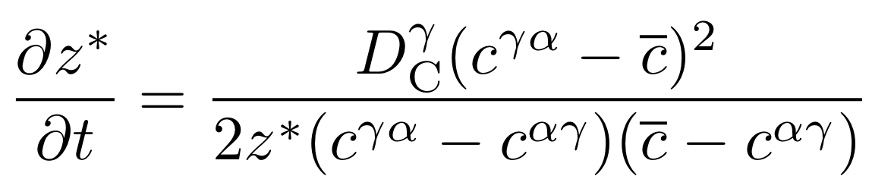
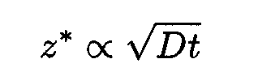

Slide 25
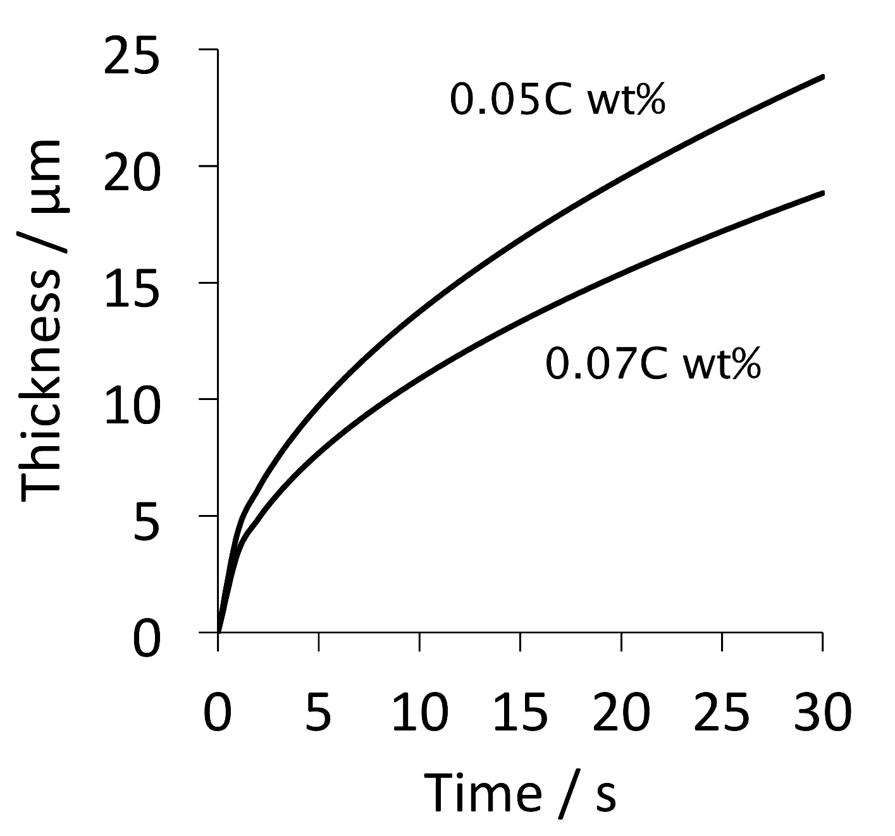

Slide 26
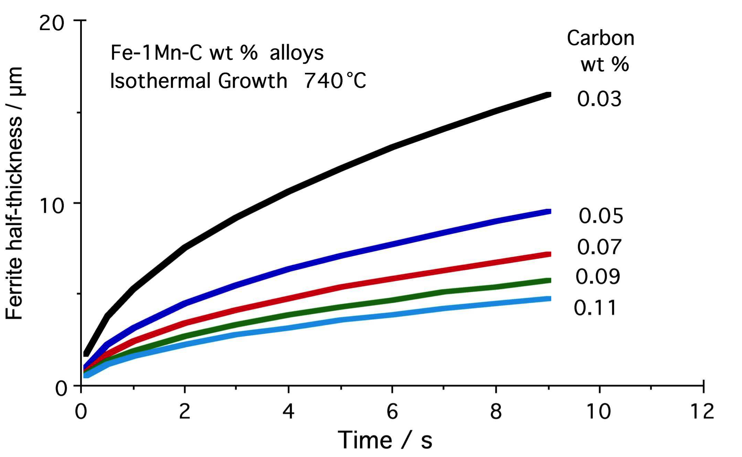

Slide 27
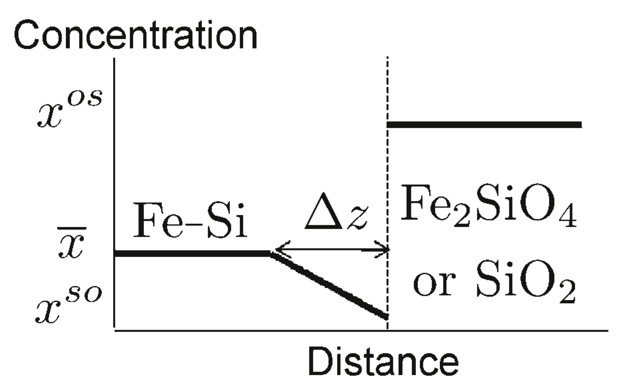
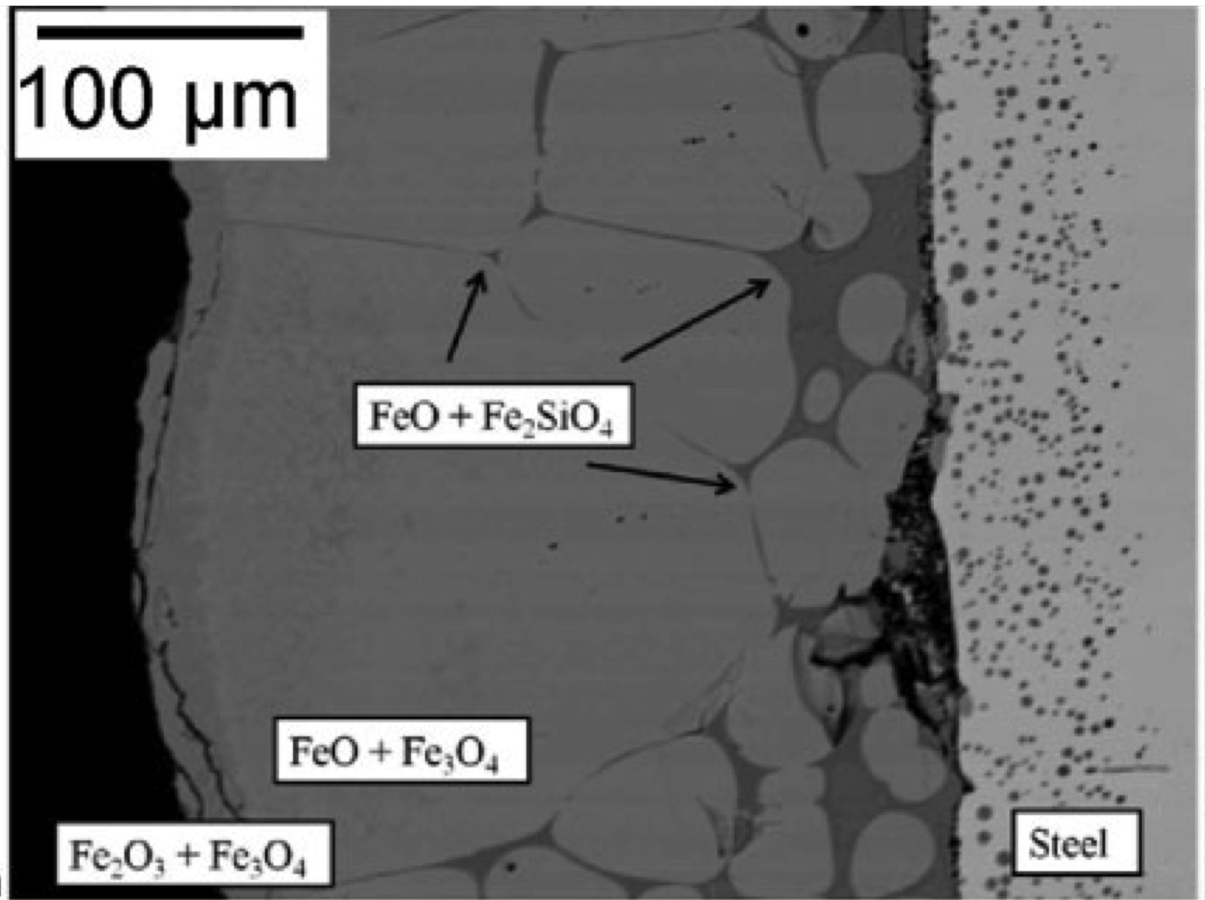
Song, Suh, Bhadeshia
Ironmaking & Steelmaking
39 (2012) 599

Slide 28
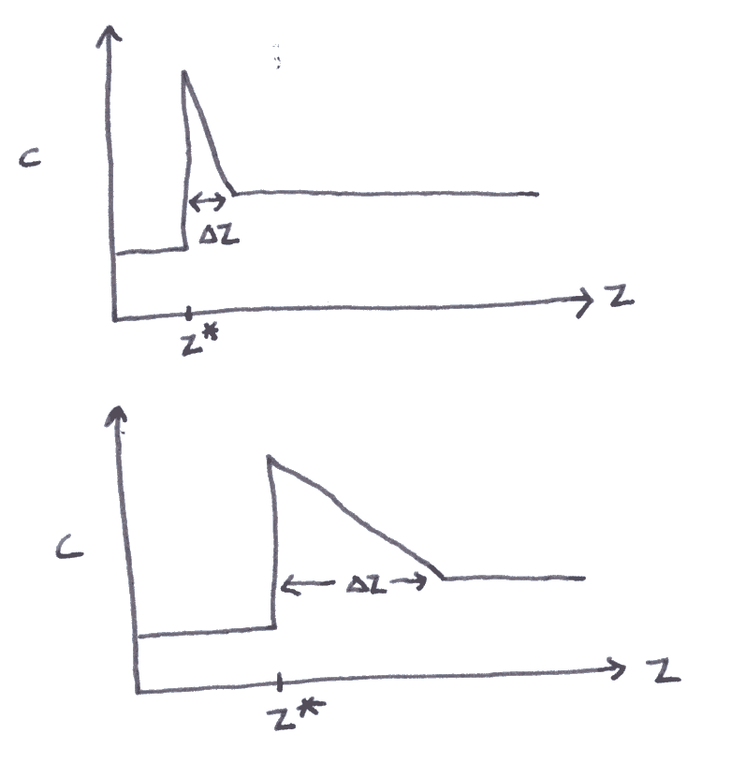

Slide 29
Approximations:
Far field composition does not change.
Growth is diffusion-controlled.
One-dimensional growth.

Slide 30
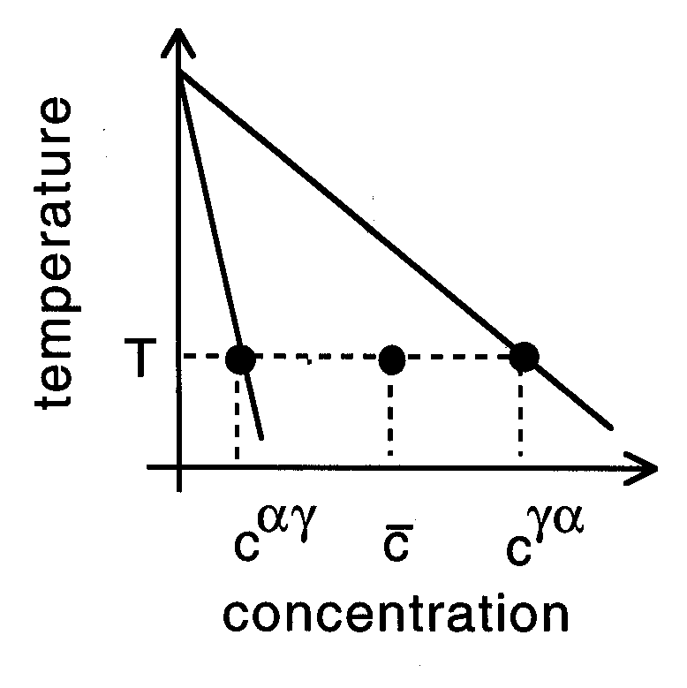

Slide 31
μ
o
B
μ
o
Gibbs free energy per mole
A
μ
A
G{x}
μ
B
A
B
x
Composition

Slide 32
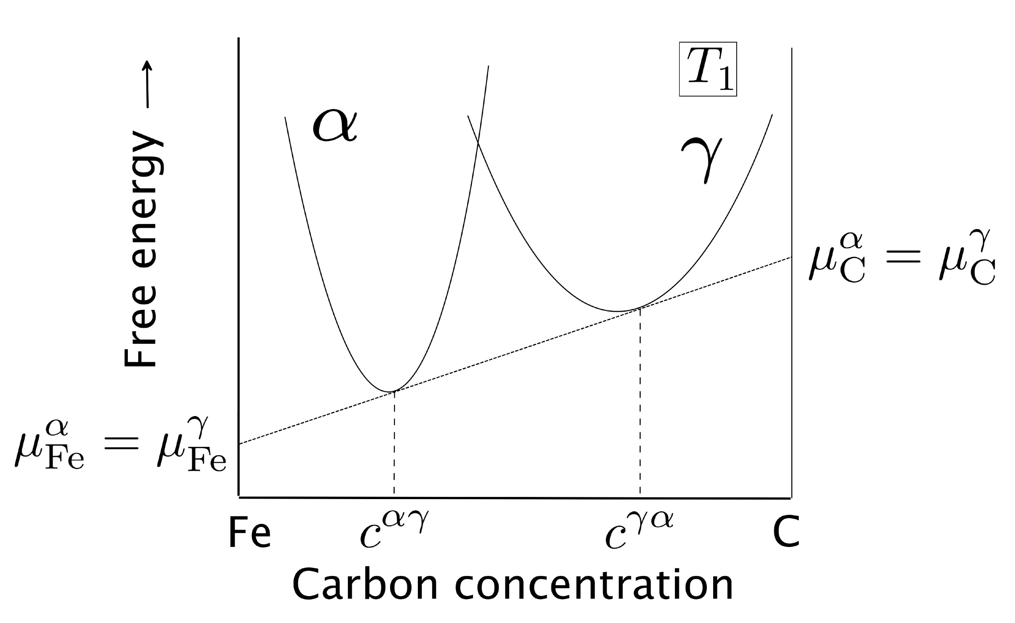

Slide 33
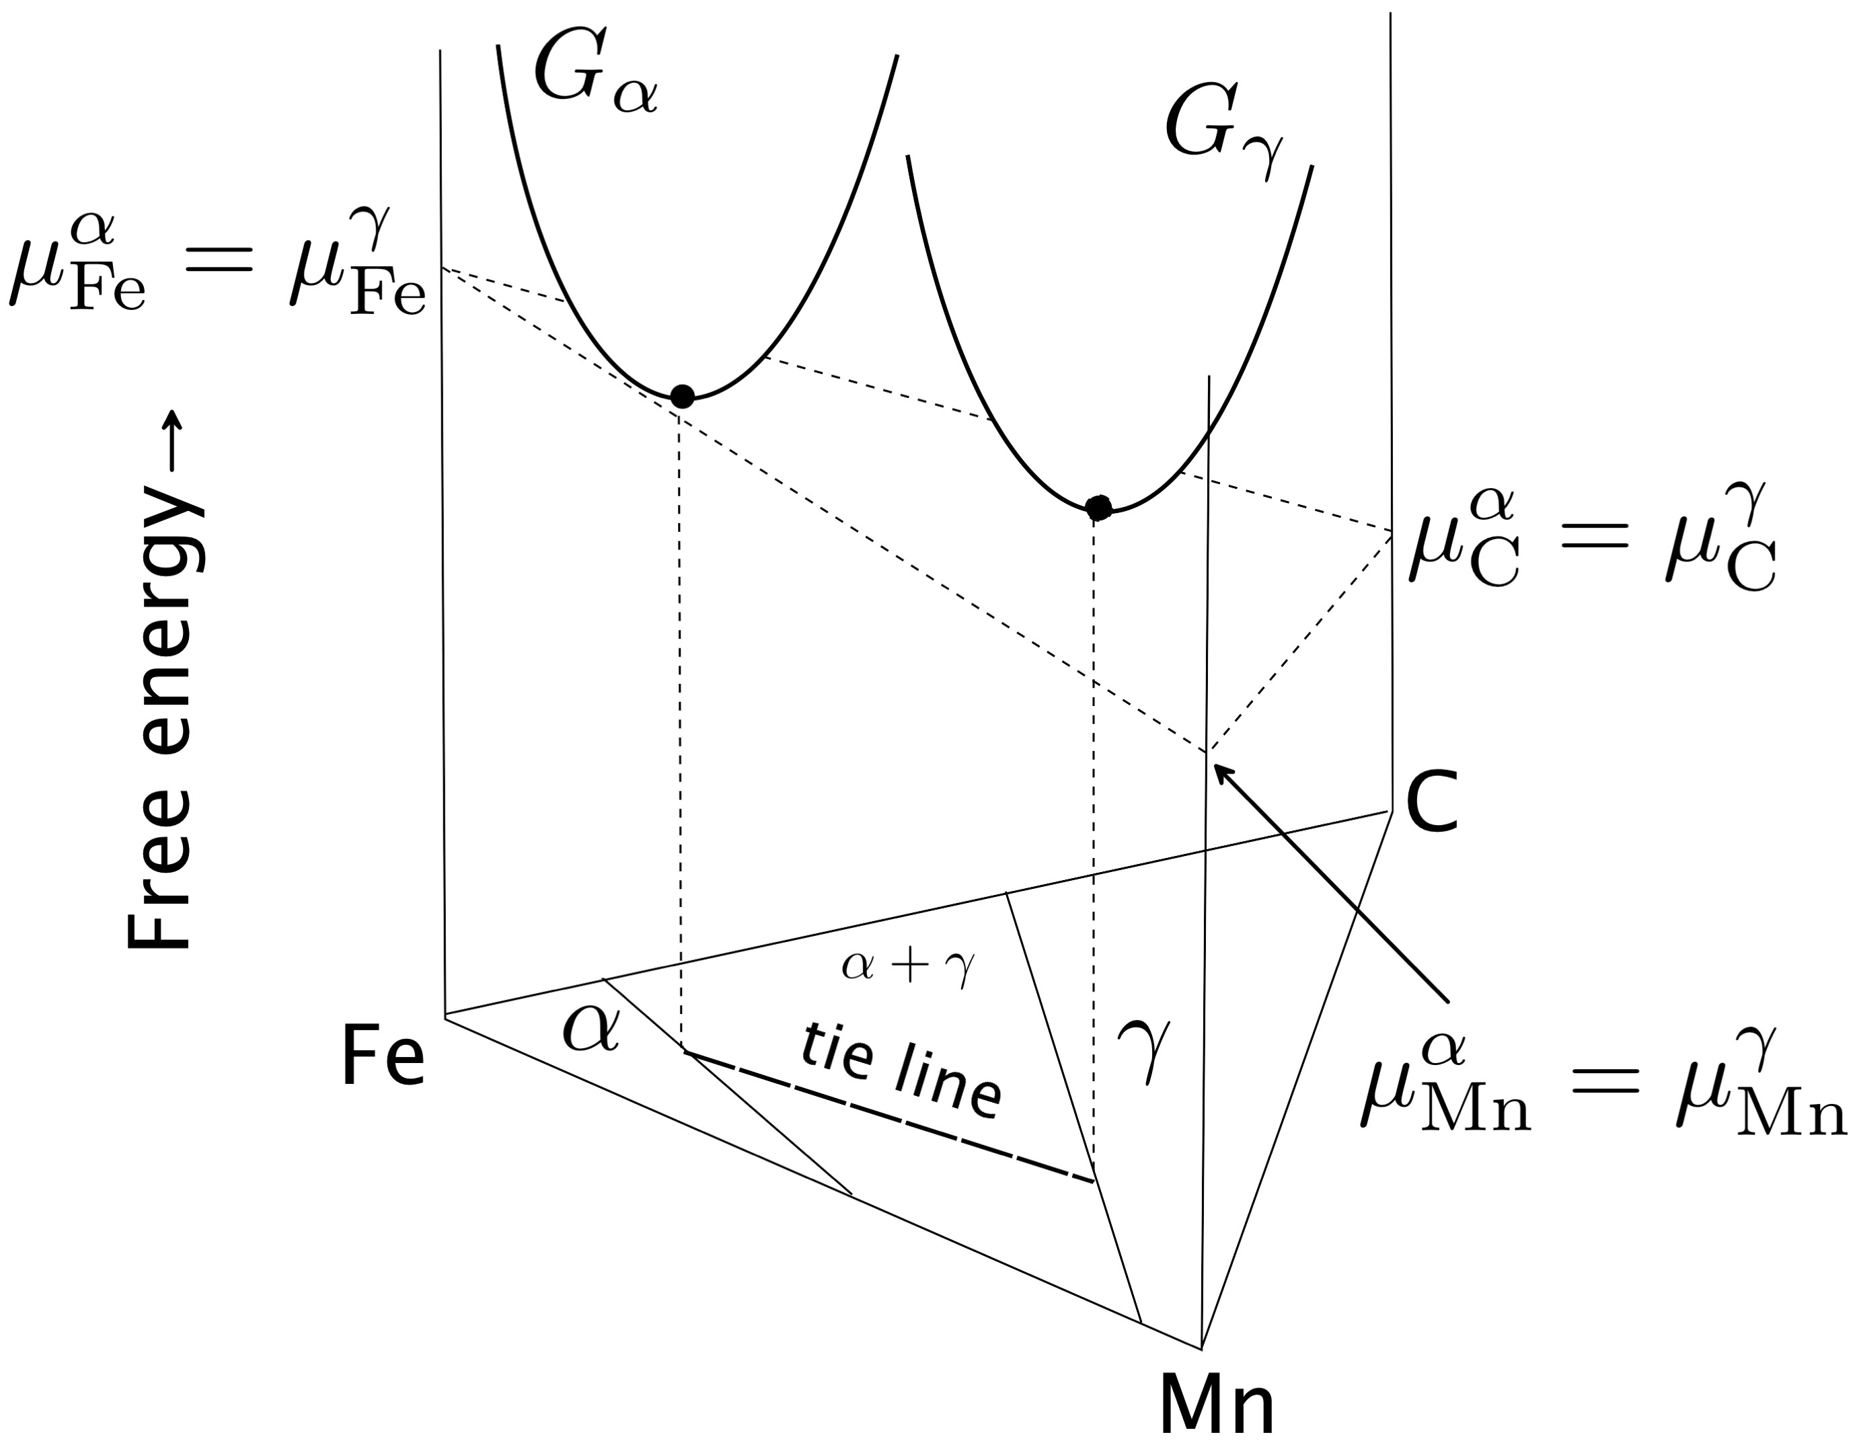

Slide 34
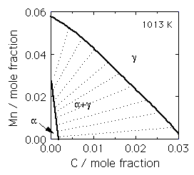

Slide 35
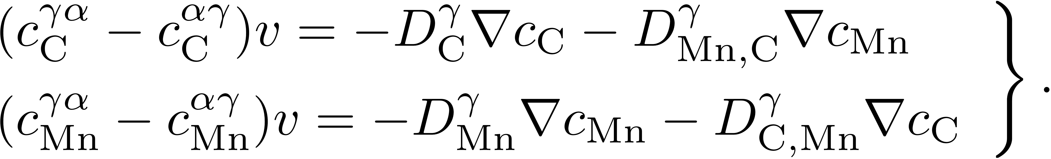
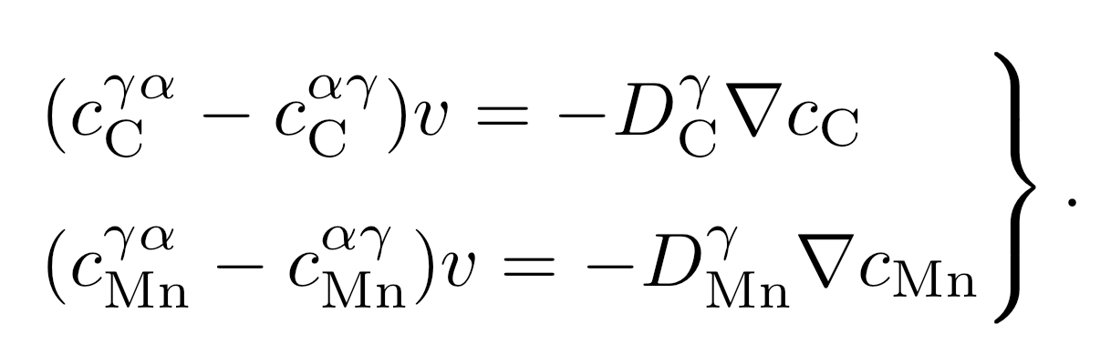

Slide 36

γ
Manganese
γ
α
α
α+γ
Carbon
α
γ

Slide 37
γ
Manganese
α
α
γ
α+γ
Carbon
α
γ

Slide 38
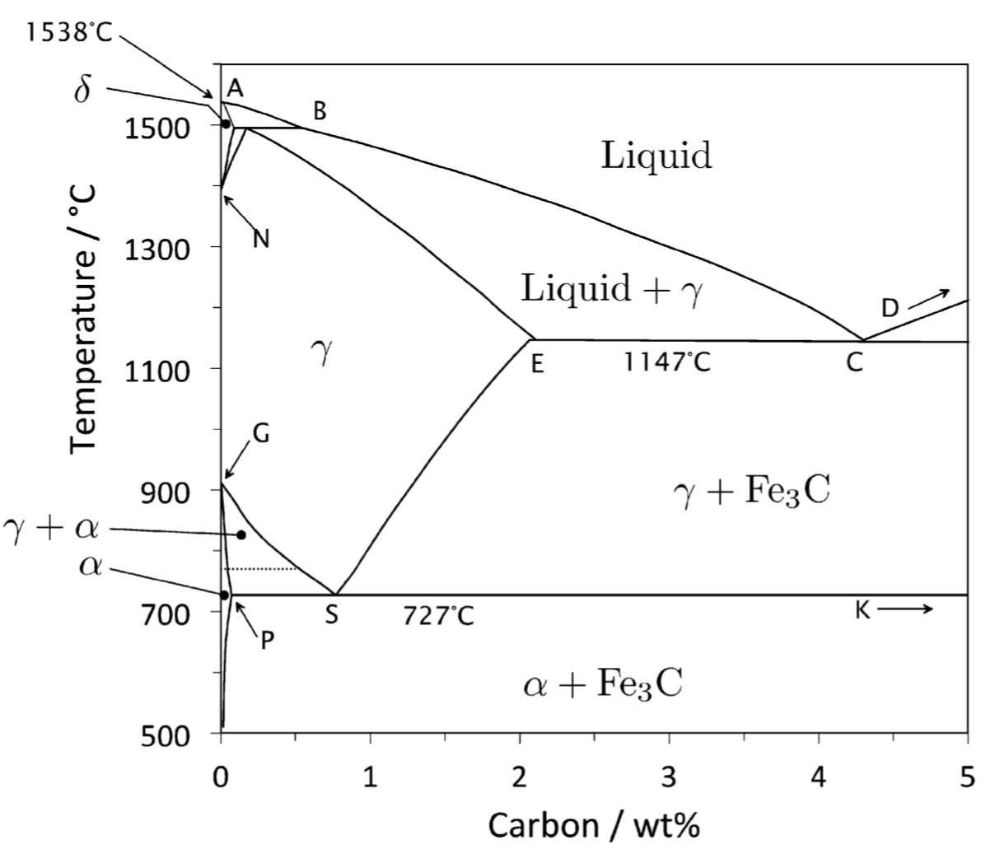

Slide 39
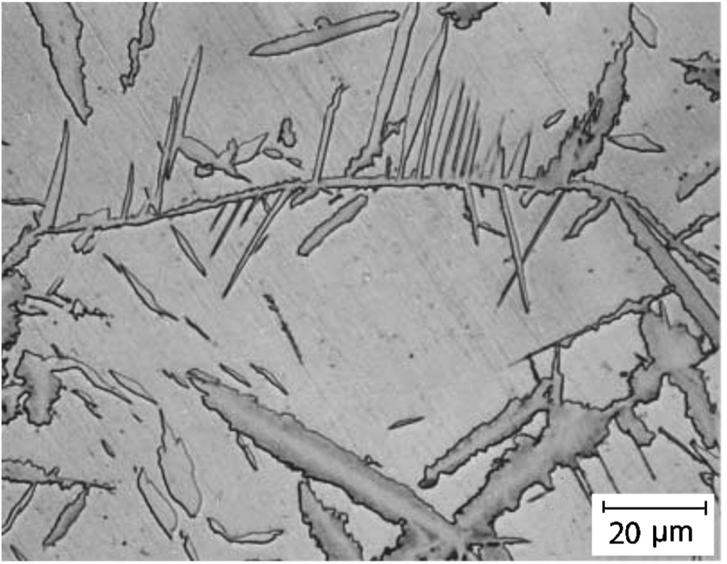
Cementite in hypereutectoid steel

Slide 40
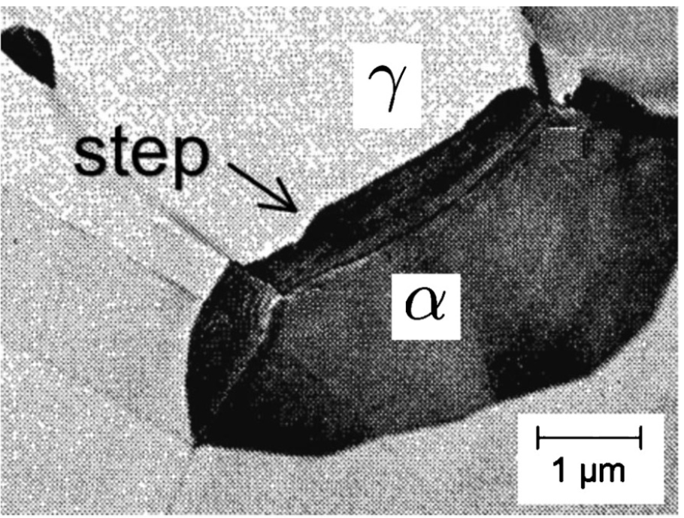
Edmonds and Honeycombe

Slide 41
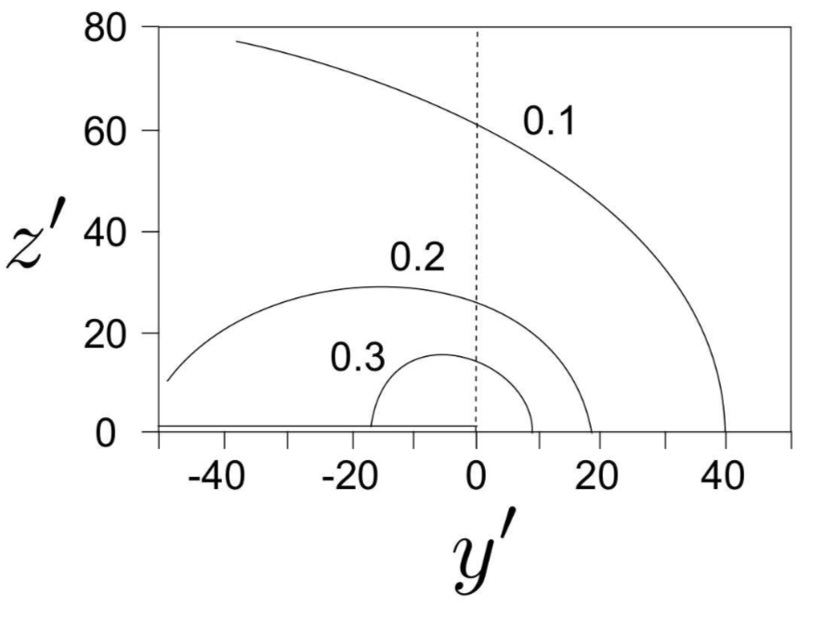

Slide 42
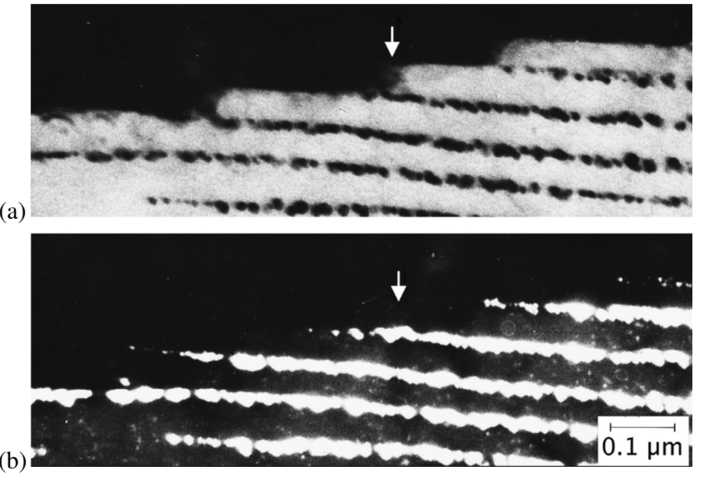
Campbell and Honeycombe
Fe-12Cr-0.2C wt%

Slide 43
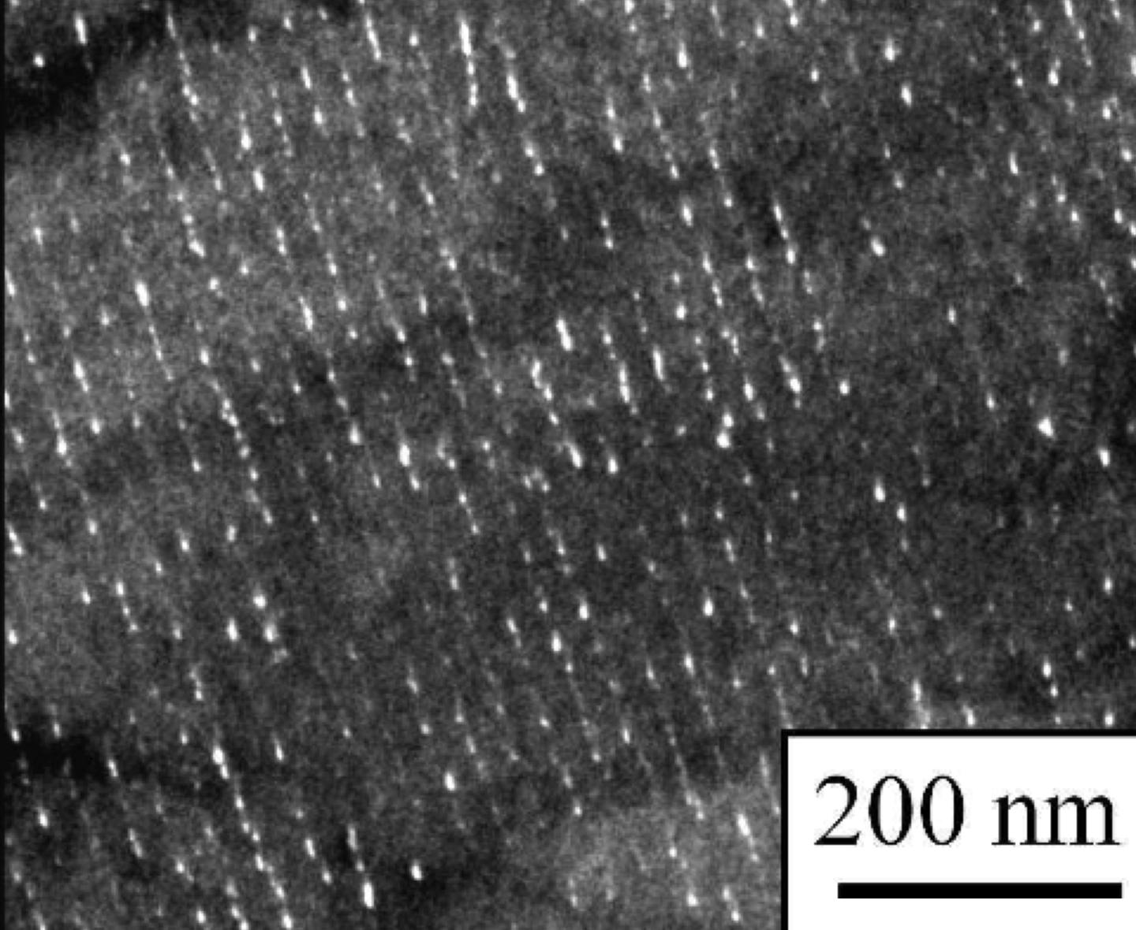
Fe-0.04C-0.2Si-1.5Mn-0.095Ti-0.2Mo wt%
Jang JH, Heo YU, Lee CH, Bhadeshia HKDH, Suh DW. Interphase precipitation in Ti–Nb and Ti–Nb–Mo bearing steel. Materials Science and Technology. 2013;29:309-313.

Slide 44
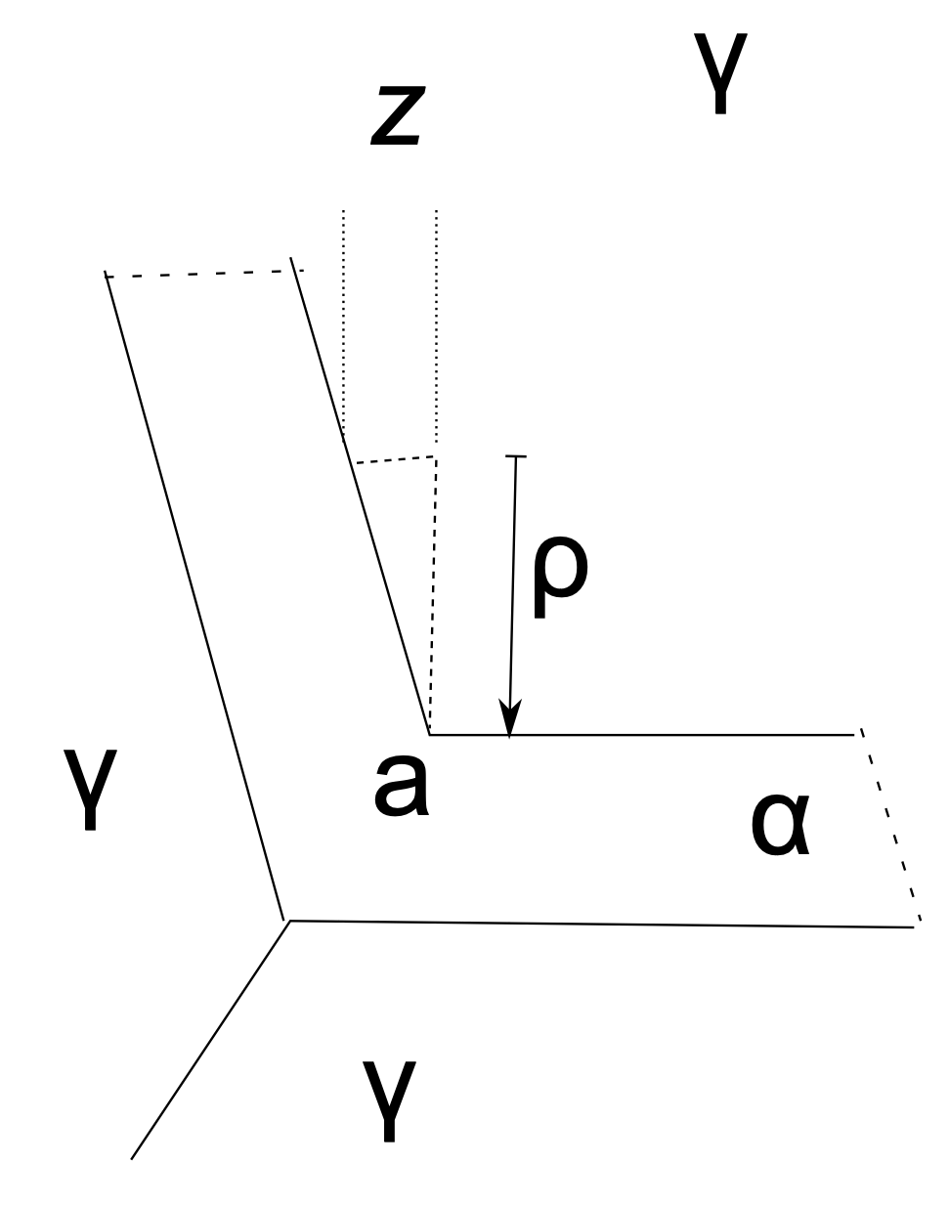
Bhadeshia HKDH. Diffusional transformations: A theory for the formation of superledges. physica status solidi (a). 1982;69:745-50.

Slide 45


data from Batte and Honeycombe
page 223

