Slide 1



Steels: Pearlite
Lecture 7
Fabio Miani
Harry Bhadeshia
Professor of Metallurgy
Queen Mary University of London
Emeritus Tata Steel Professor of Metallurgy
University of Cambridge
2022

Slide 2
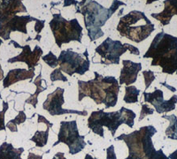
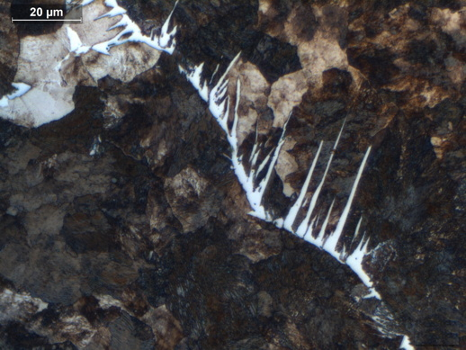
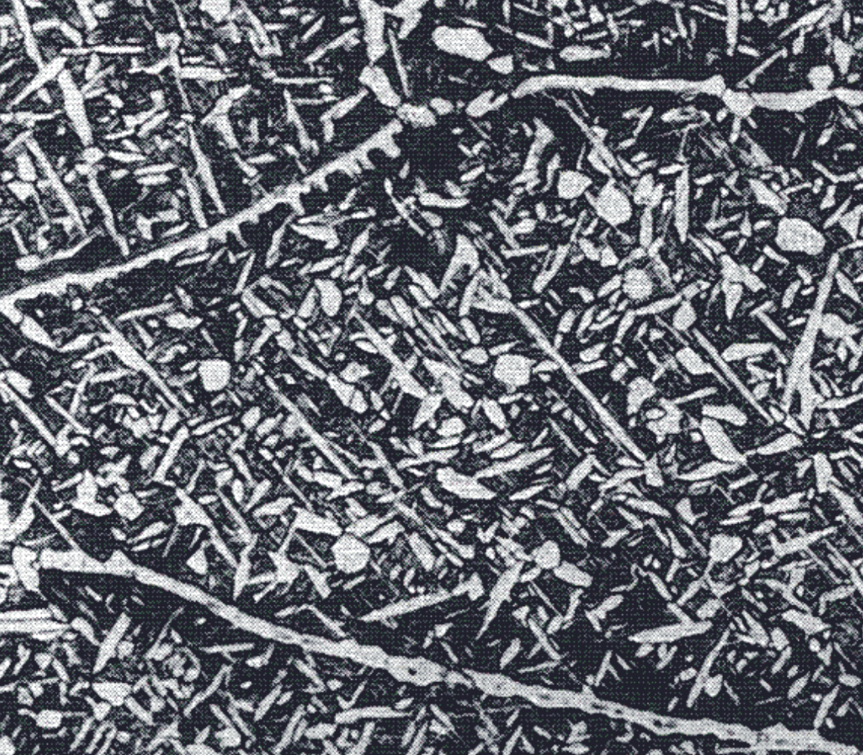
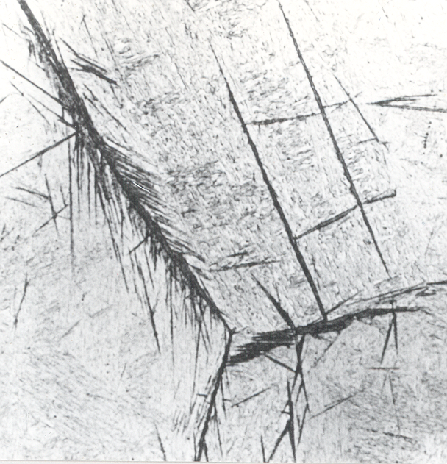
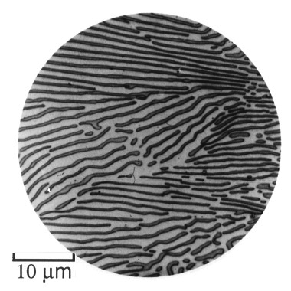
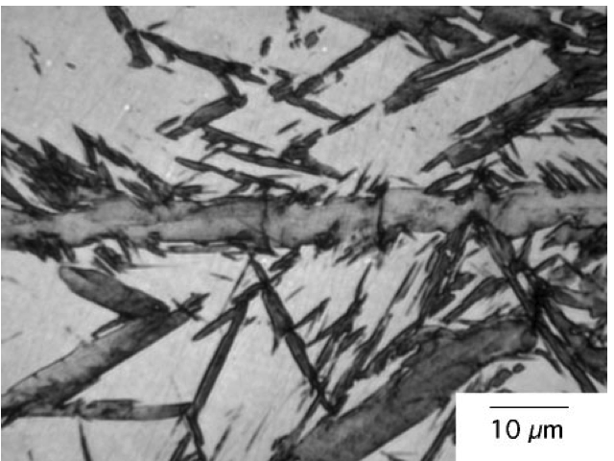

Slide 3
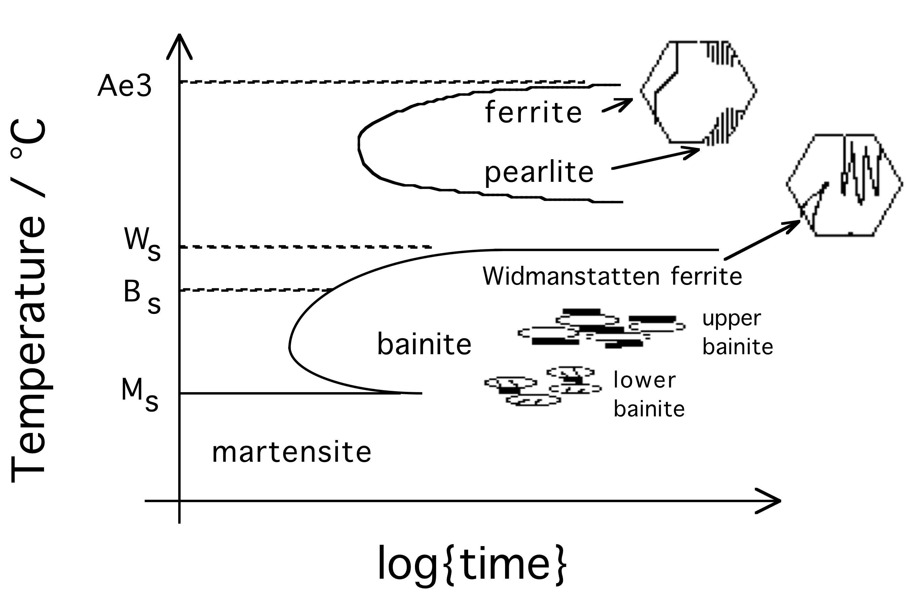
Notes:
3
3

Slide 4
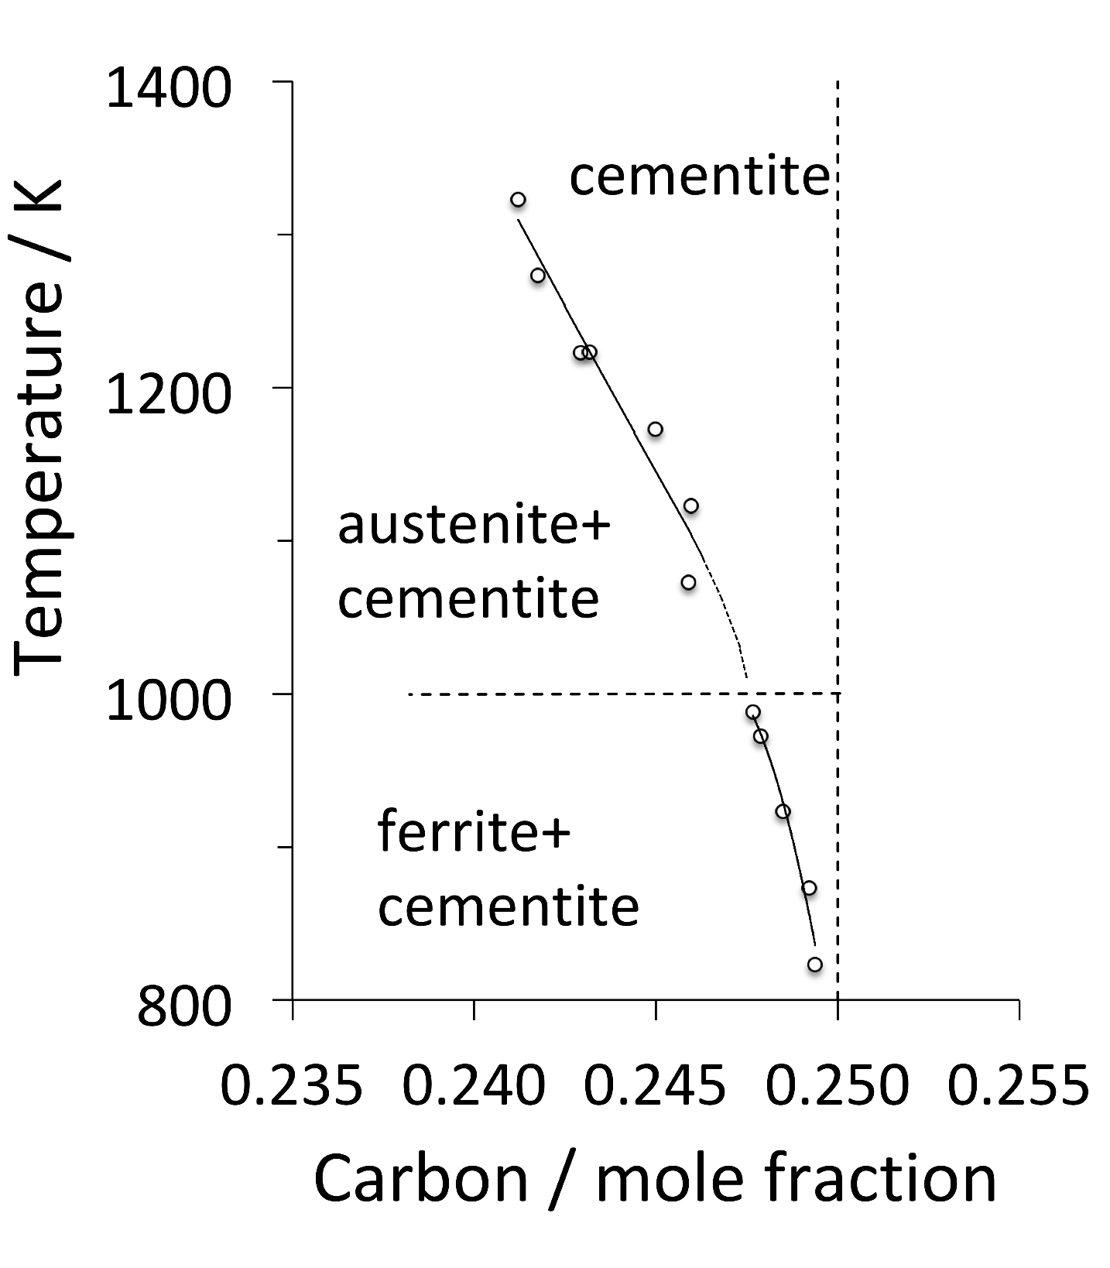
Fe₃C?
Cementite

Slide 5
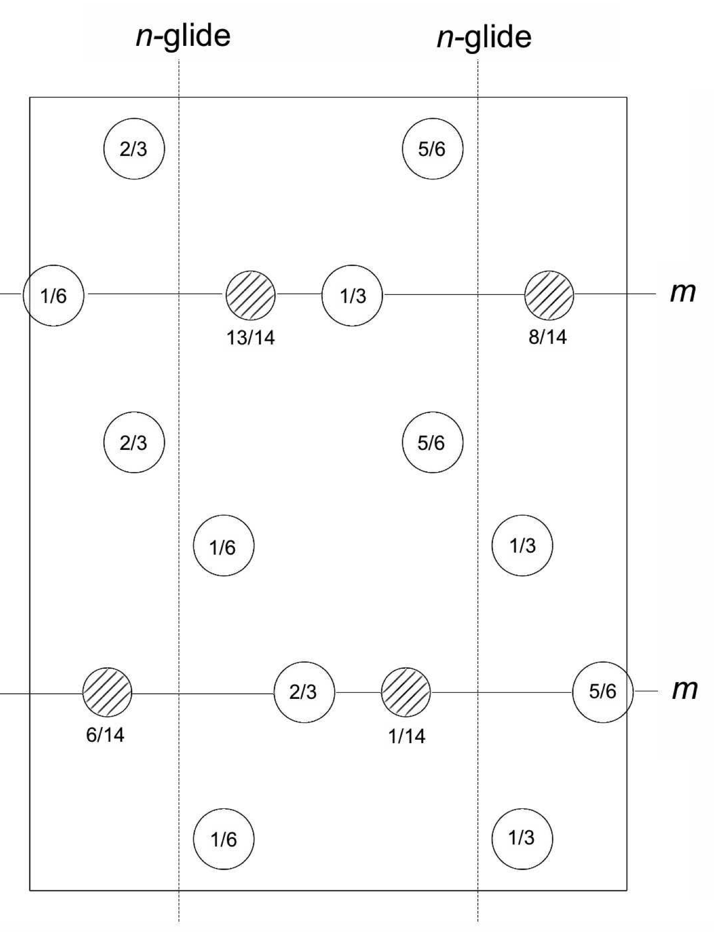
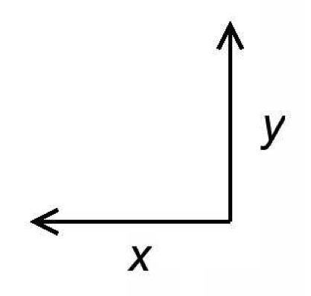
Cementite
a=0.51
b=0.68
c=0.45 nm
Pnma

Slide 6
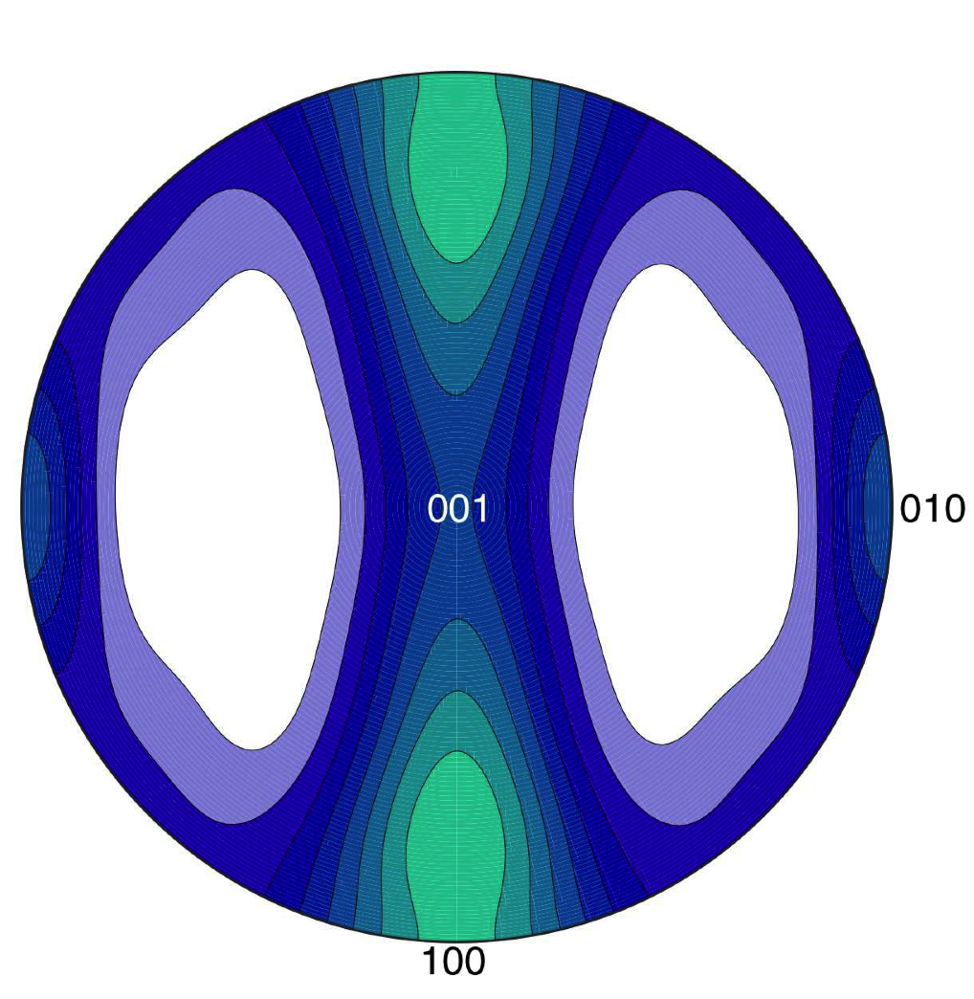
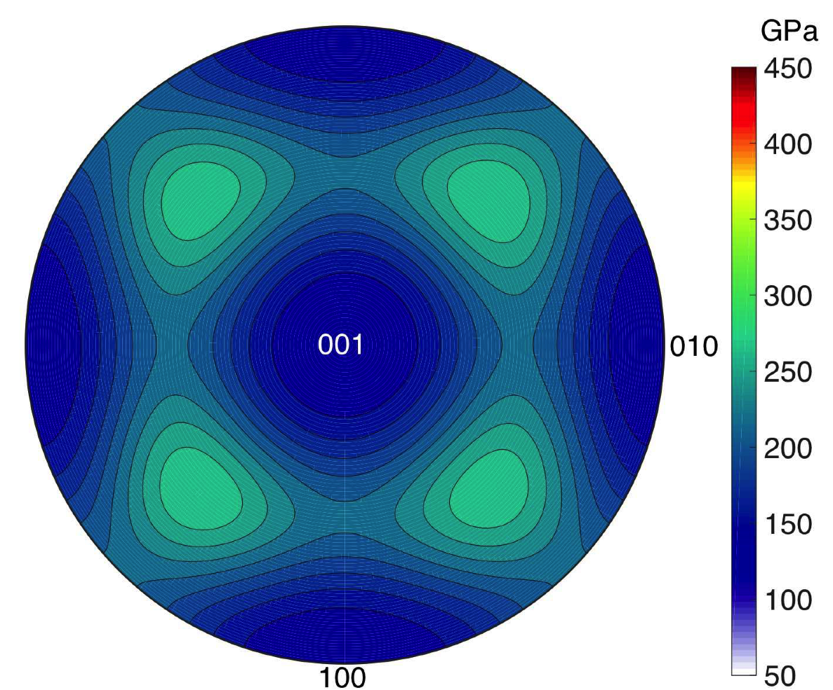
Cementite

Slide 7
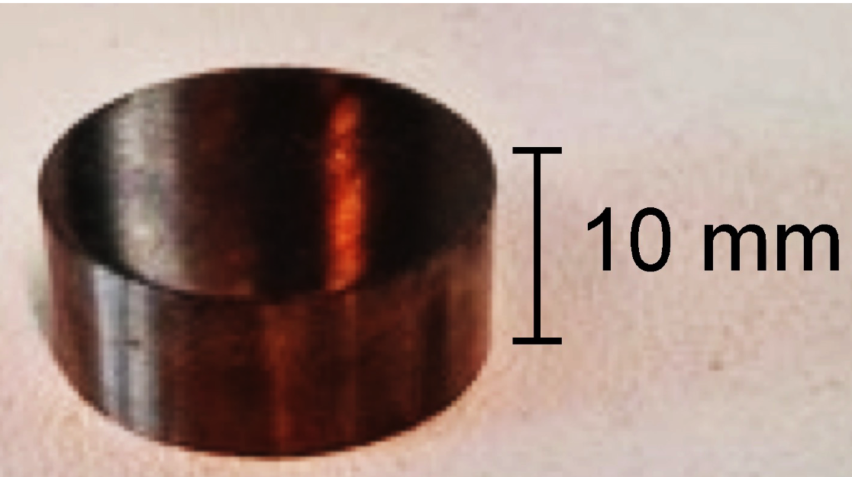
Cementite
Courtesy Umemoto, Toyohashi University

Slide 8
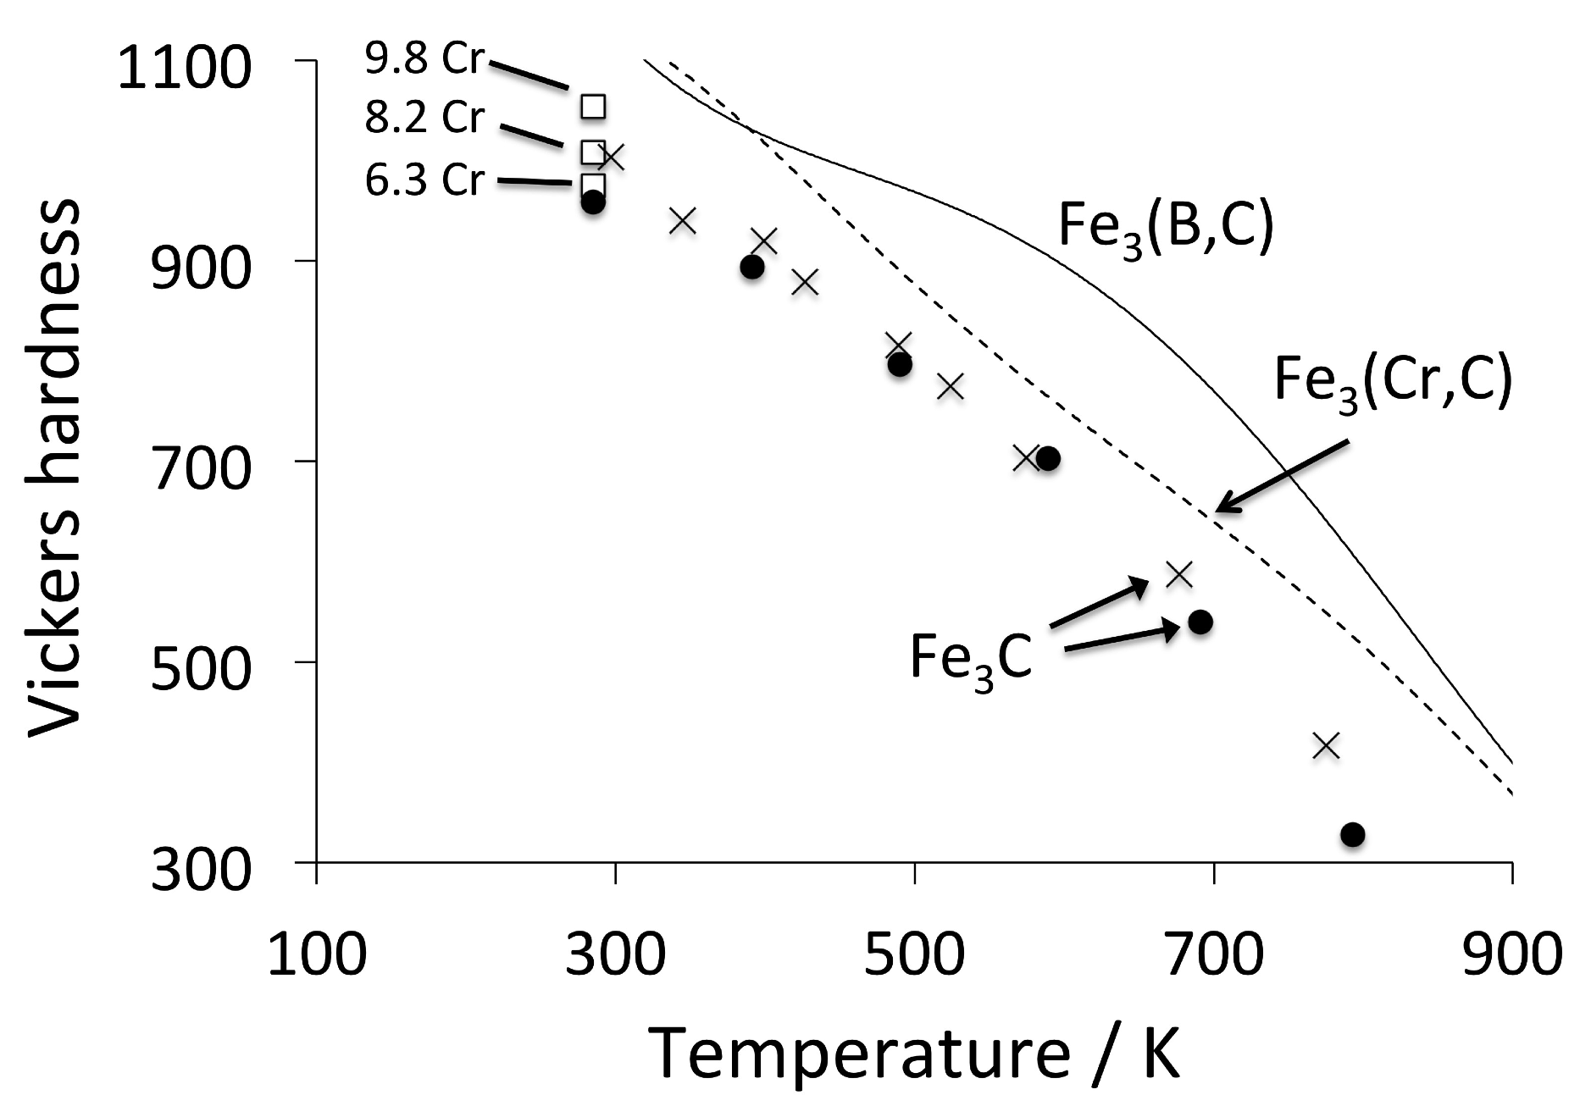
Cementite

Slide 9
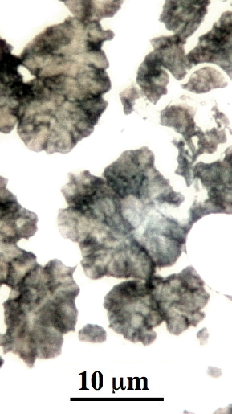
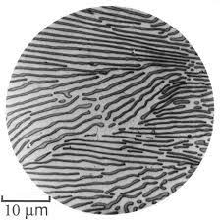
The Pearlite Reaction
(Bain, Alloying elements in steels)

Slide 10
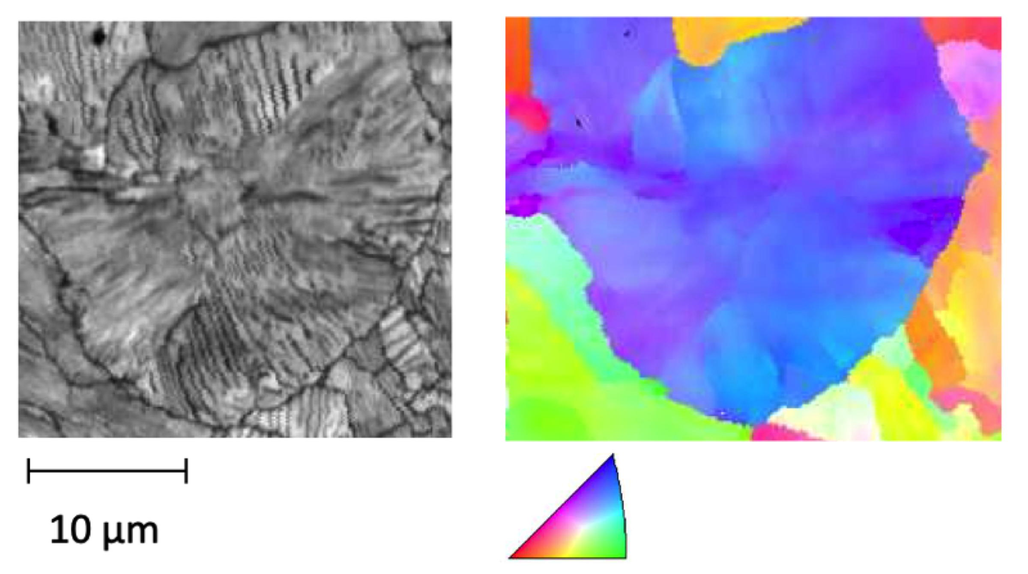
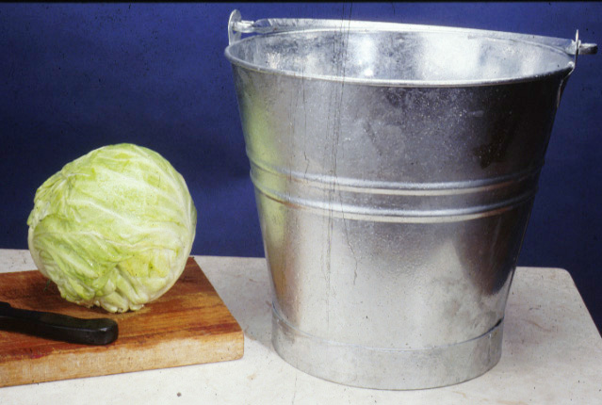
Pearlite nodule

Slide 11
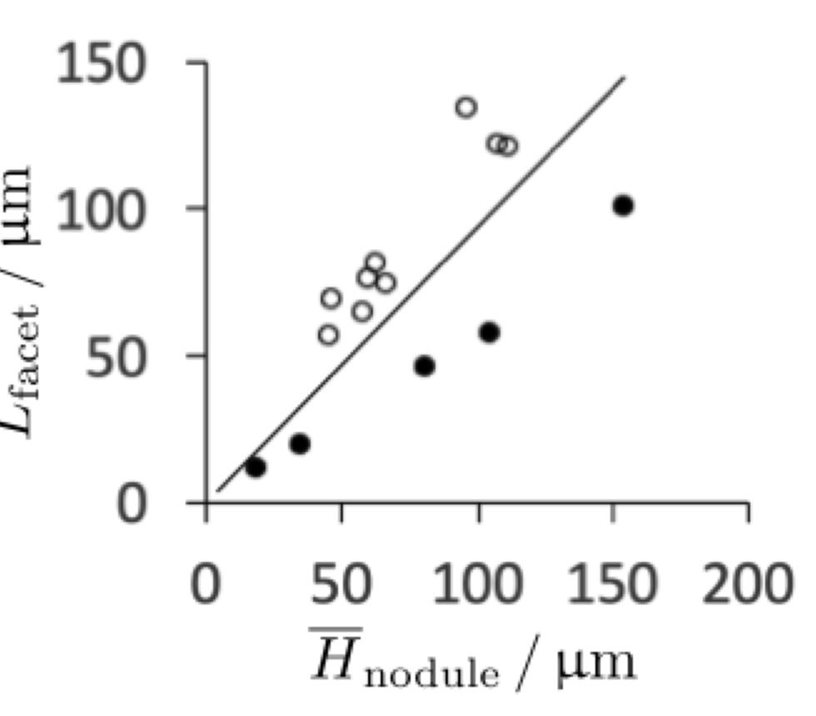
Data from:
Behera S, Barik RK, Sk MB, Mitra R, Chakrabarti D. Recipe for improving the impact toughness of high-strength pearlitic steel by controlling the cleavage cracking mechanisms. Materials Science and Engineering: A. 2019;764:138256.

Slide 12
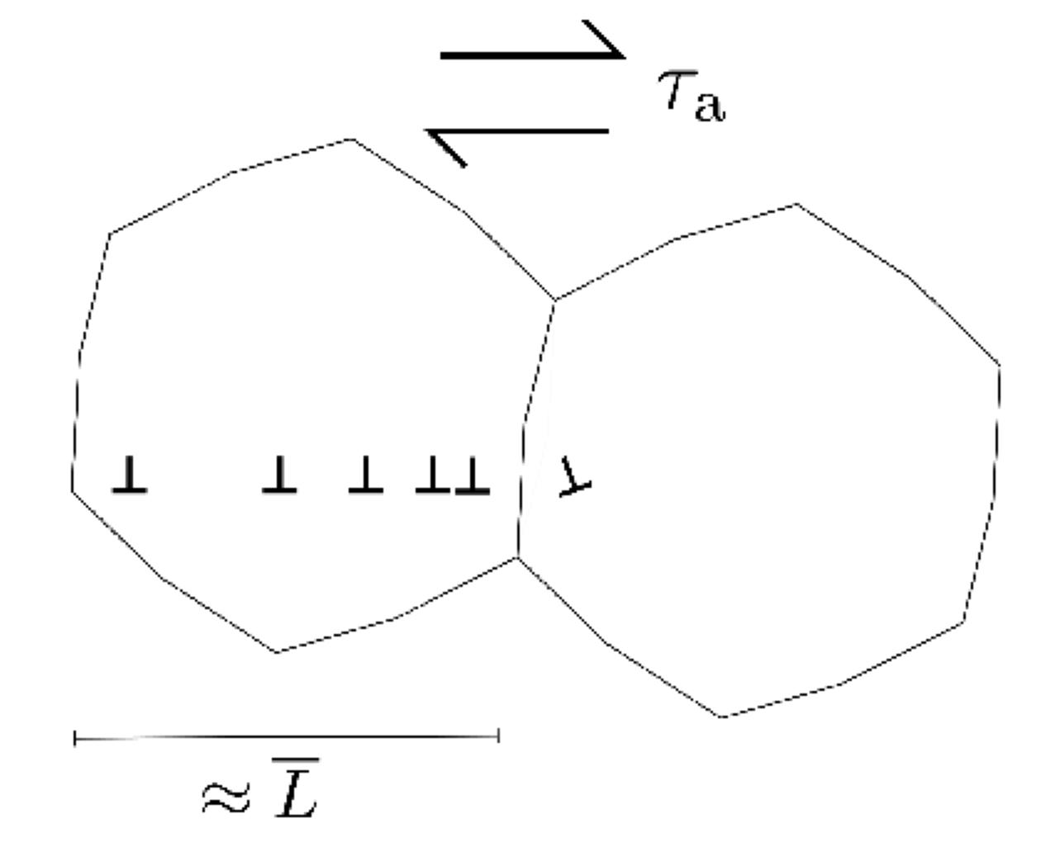
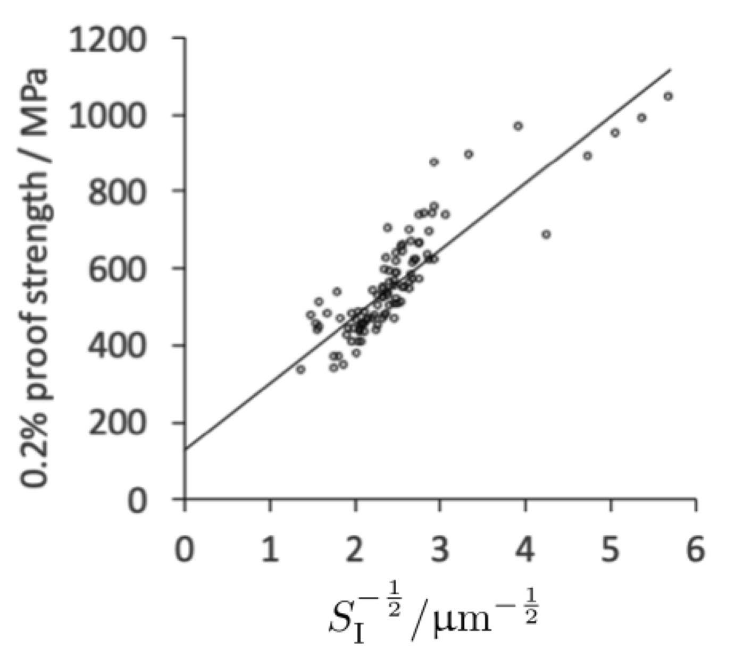
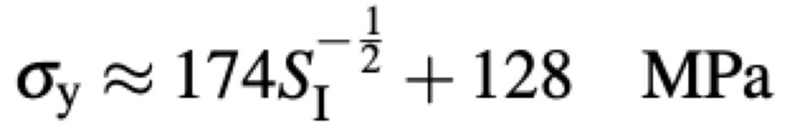

Slide 13
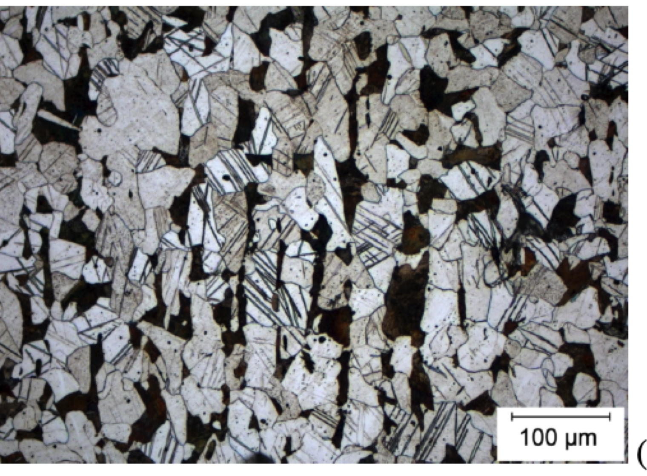
Image courtesy of Ivan Bataev, Novosibirsk State Technical University

Slide 14
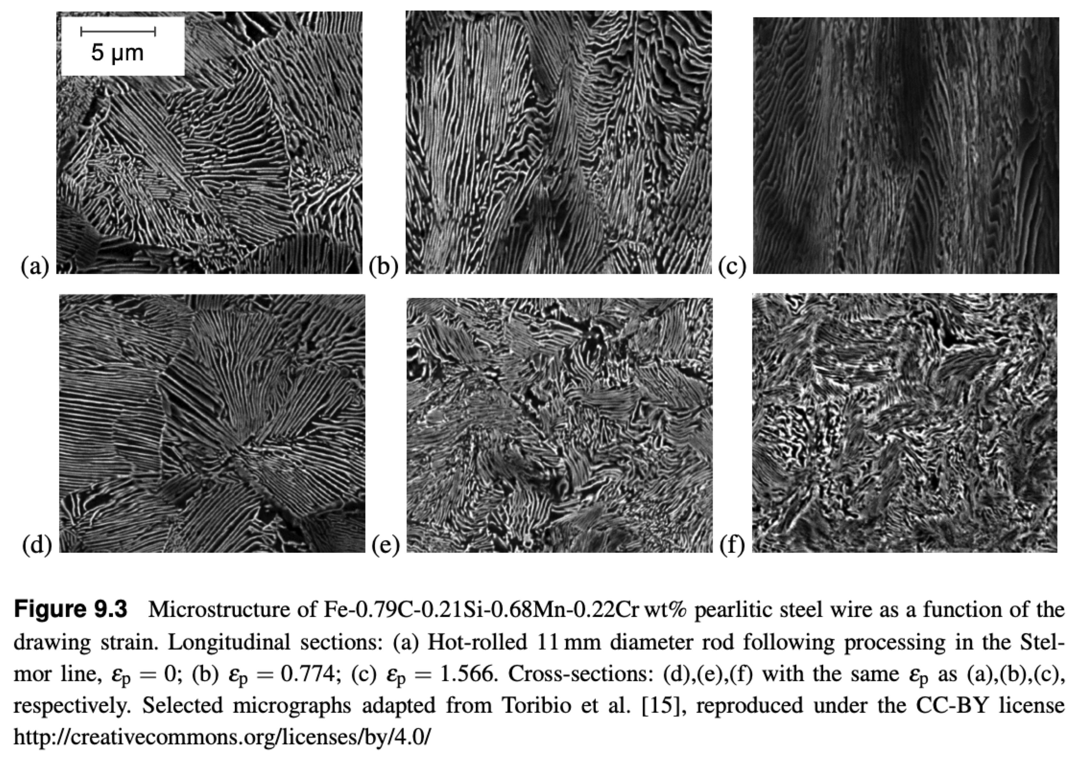

Slide 15




J. D. Embury, and R. M. Fisher: The structure and properties of drawn pearlite,
Acta Metallurgica, 1966, 14, 147–159

Slide 16
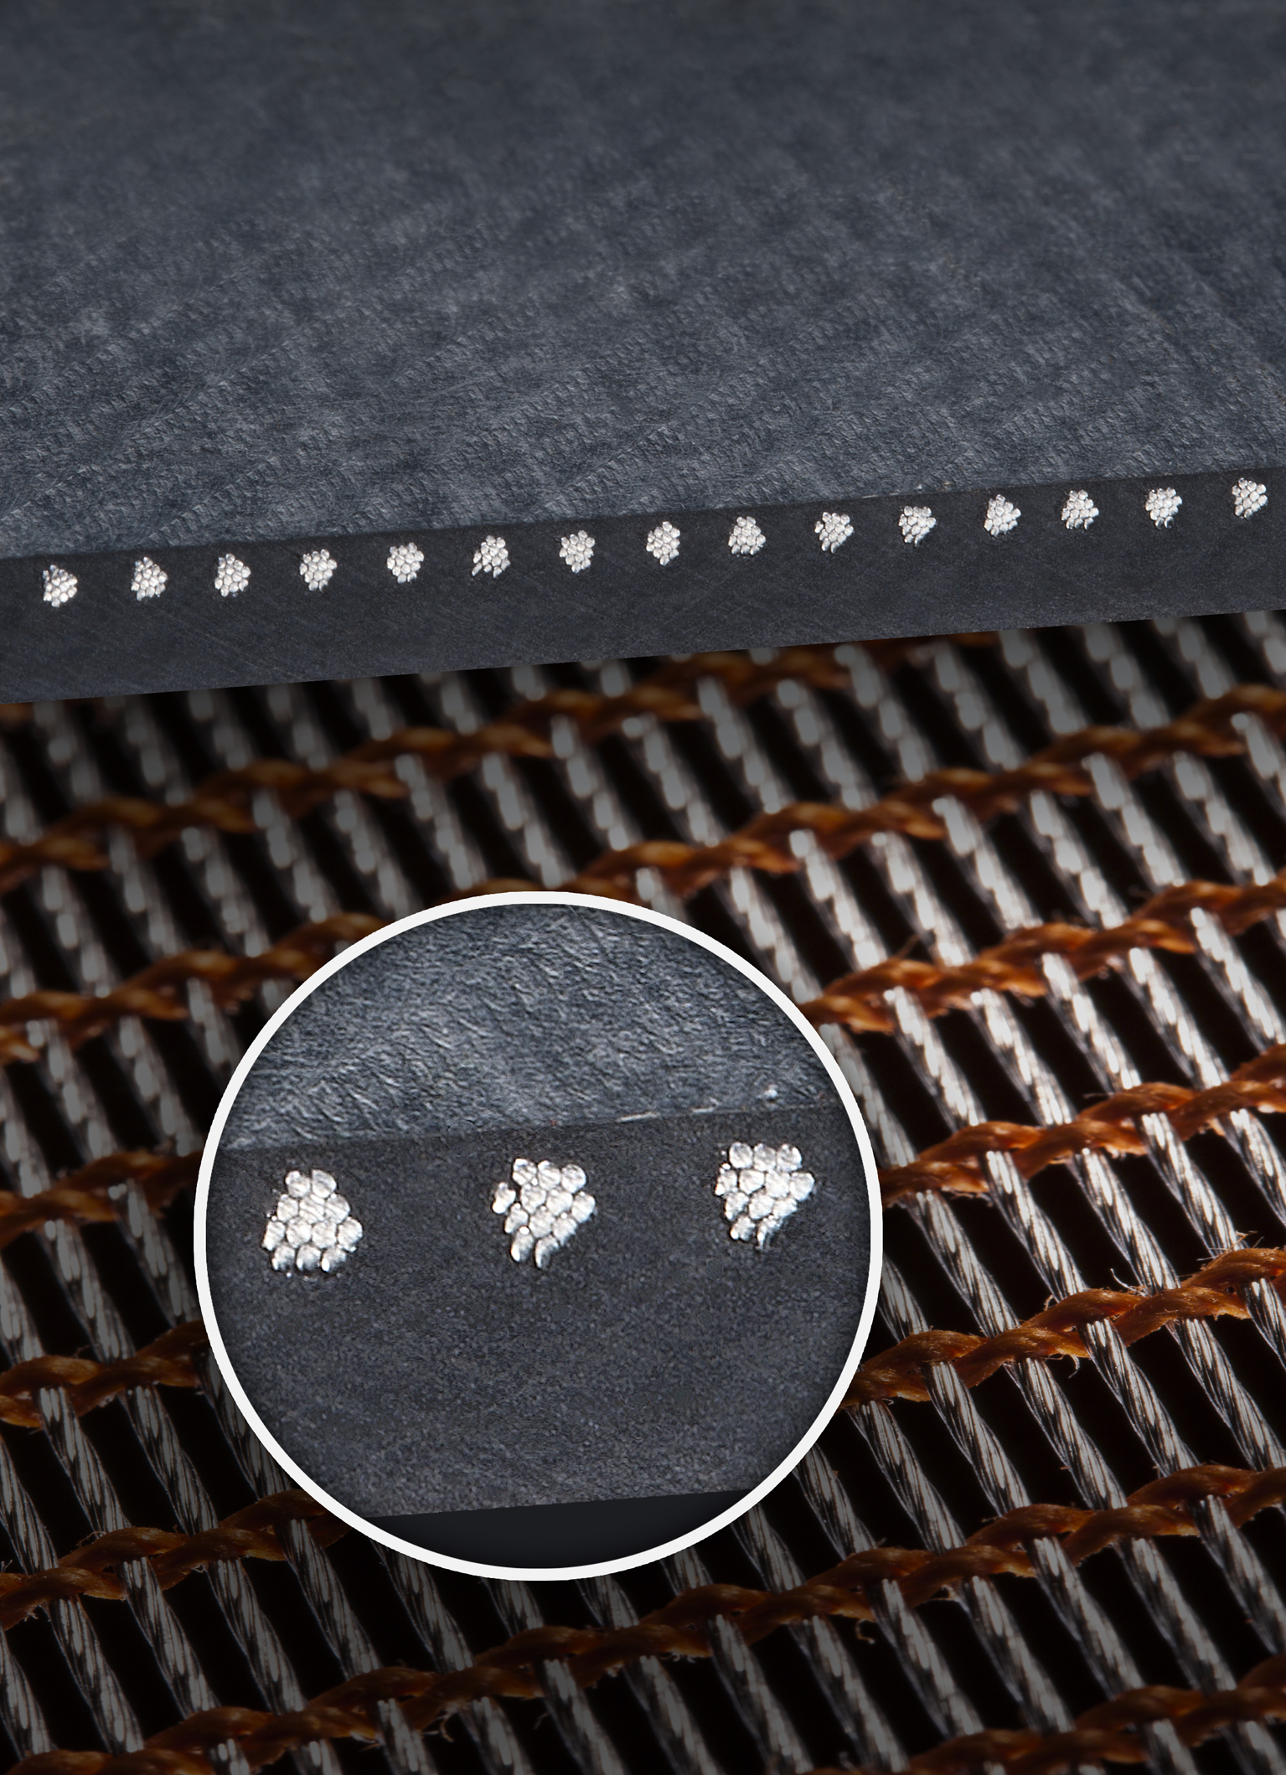
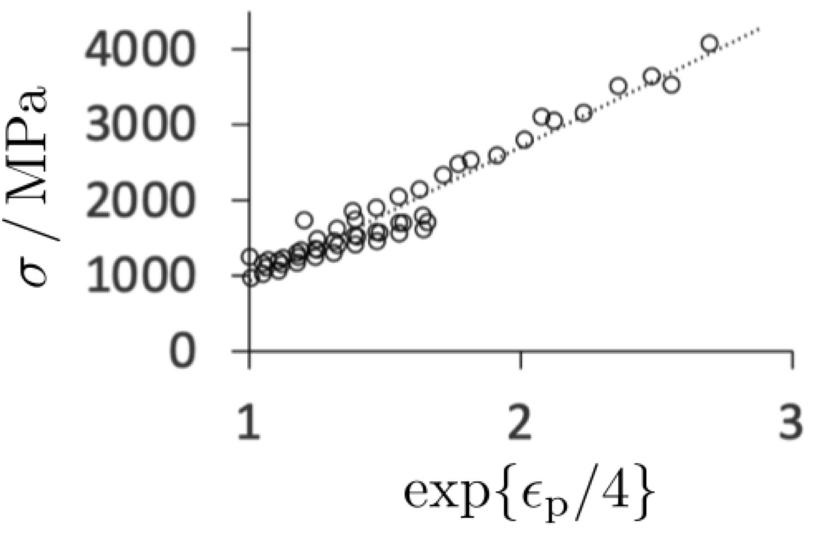
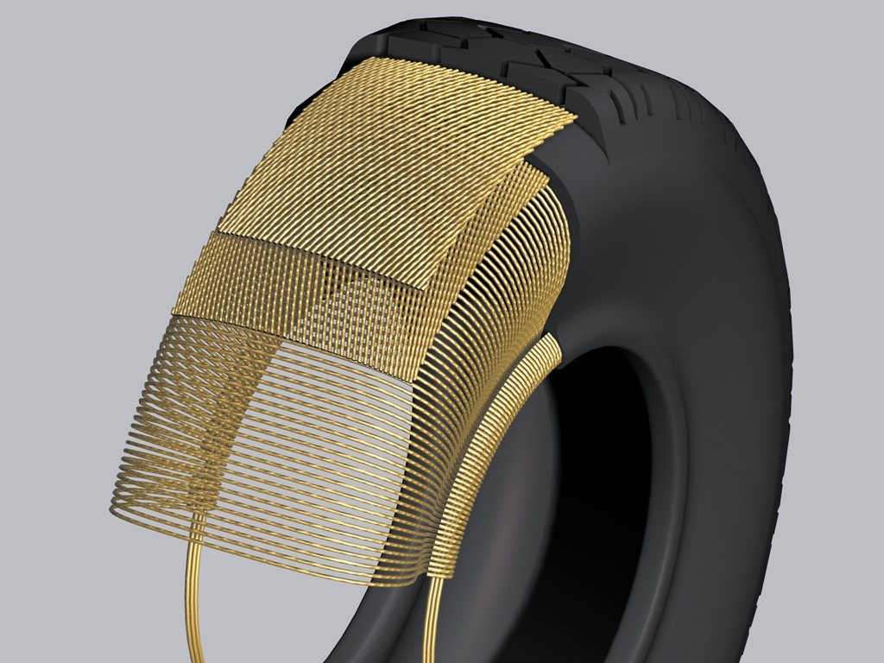
crash absorbing plastic
Images courtesy of:
Pascal Antoine, Baekert

Slide 17
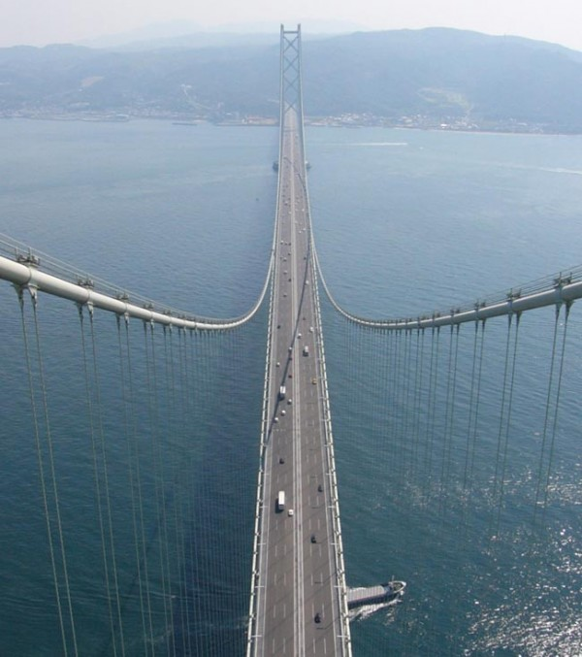
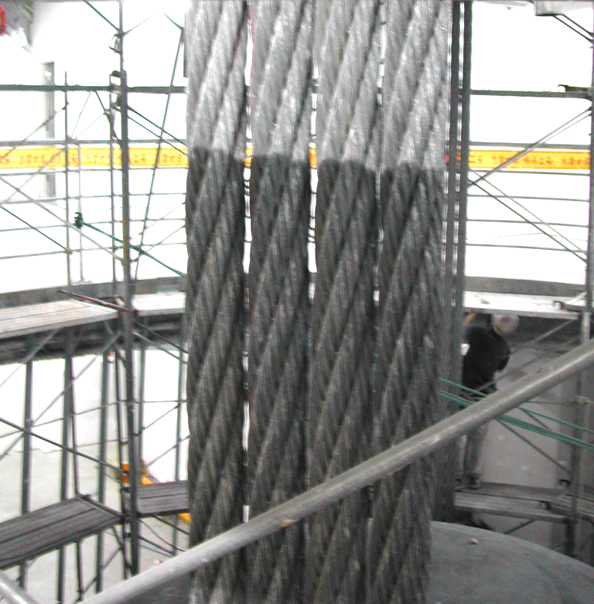
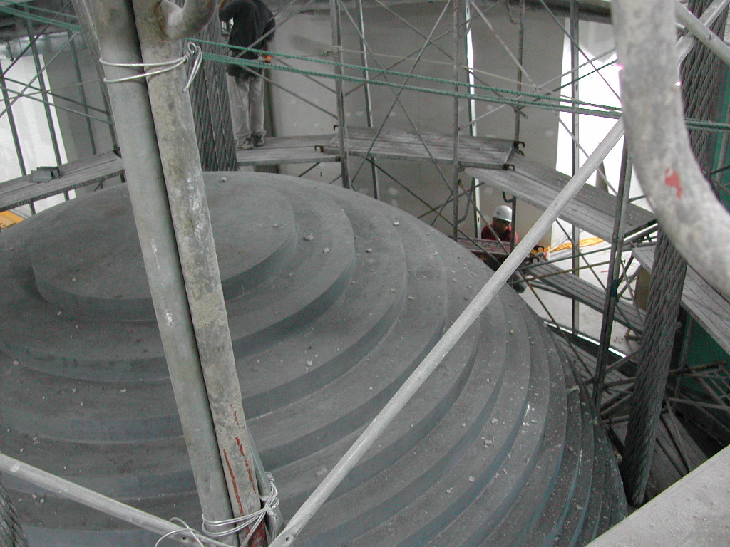
largest central span in the world, 2 km of free navigation underneath, Japan. Image courtesy of Nobutaka Yurioka

Slide 18
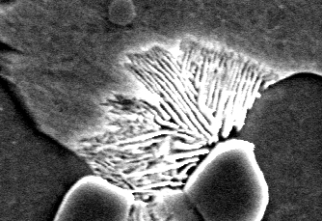
Nucleation begins either with ferrite or cementite depending on whether the steel is hypo- or hyper-eutectoid

Slide 19
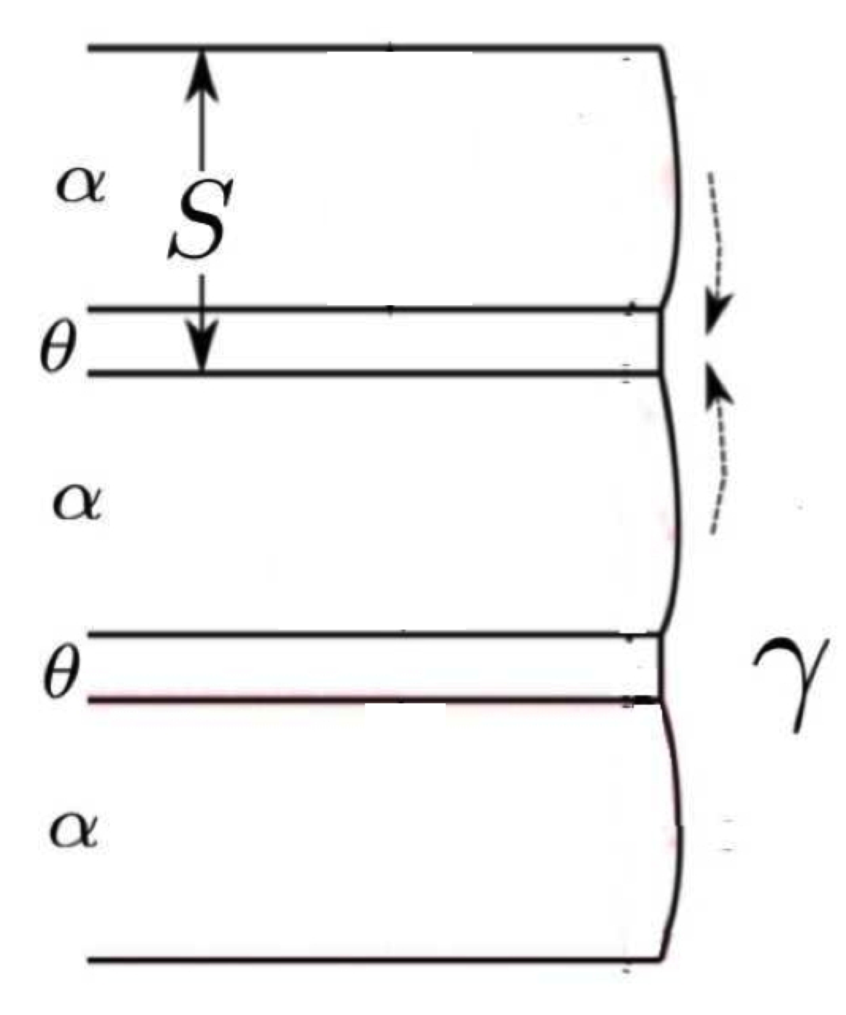

Slide 20
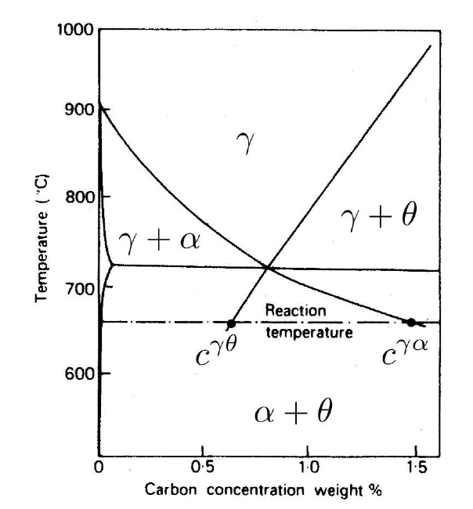
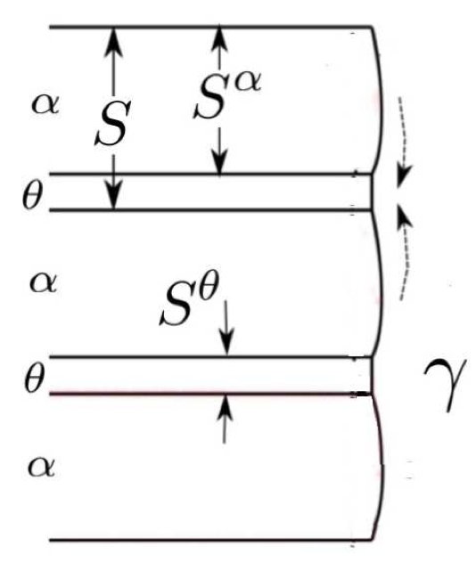

Slide 21
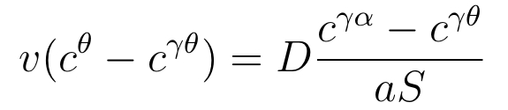
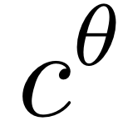


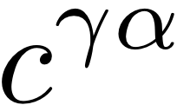
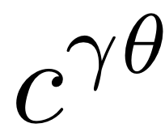
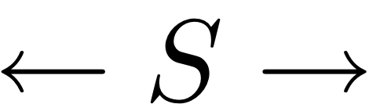

Slide 22
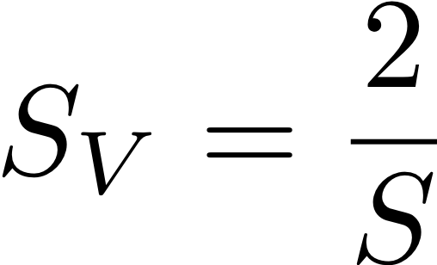
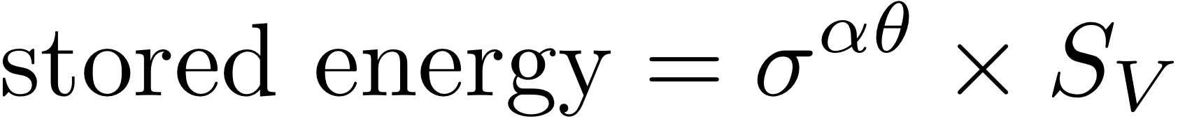
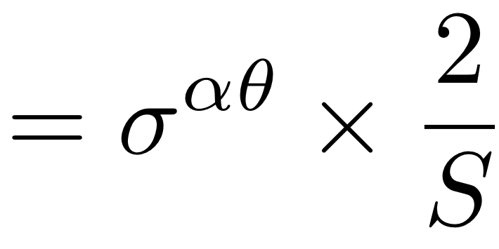
Energy stored in interfaces
S
2S
2S
2S

Slide 23
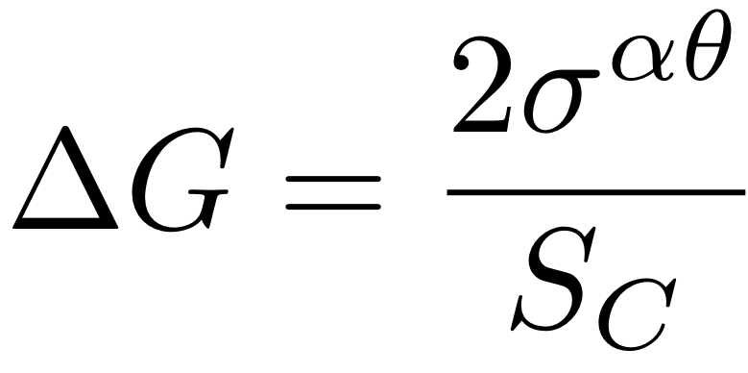
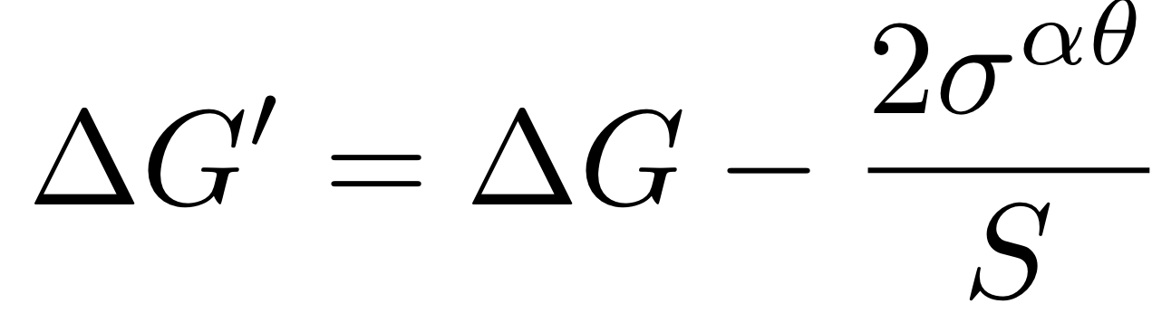
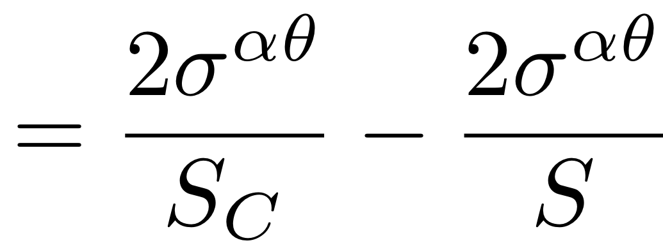
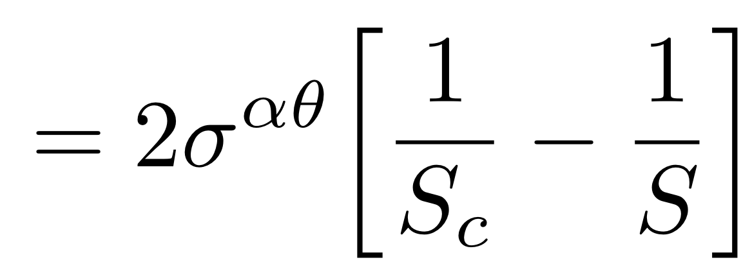
when all free energy
consumed as interface
effective driving force

Slide 24
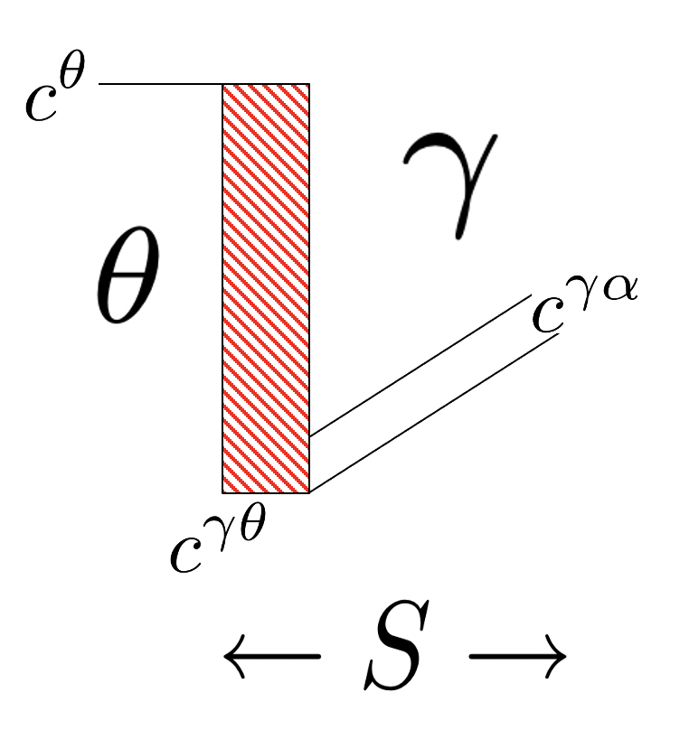
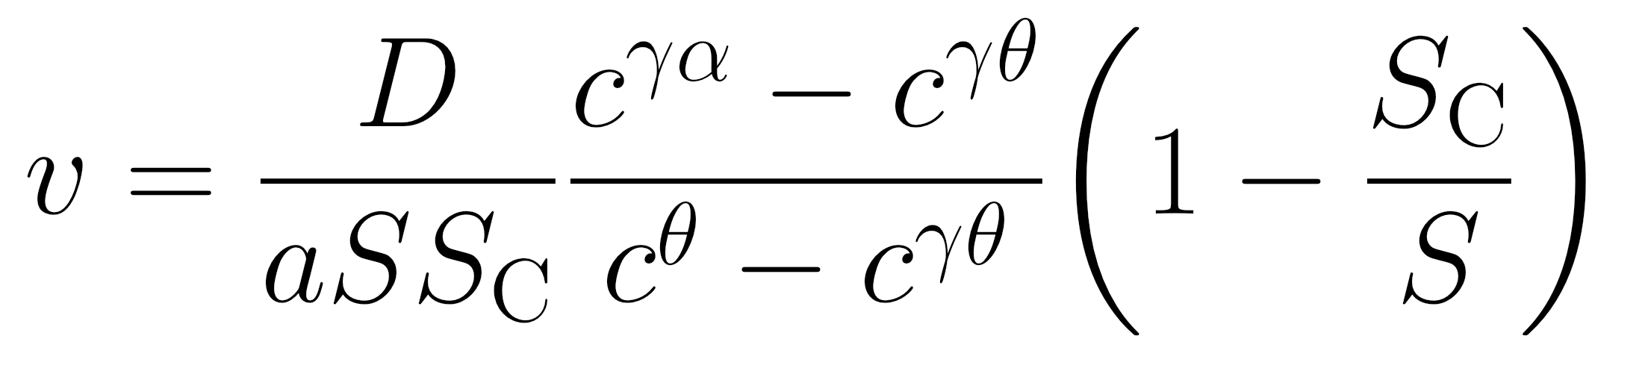

Slide 25
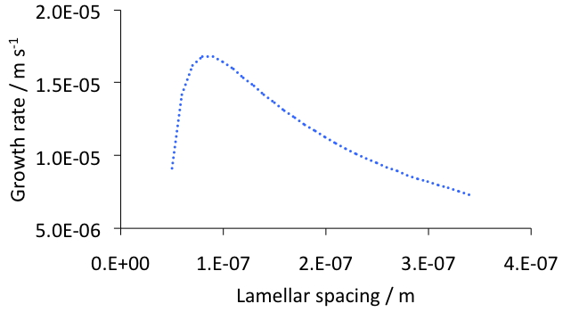

Slide 26
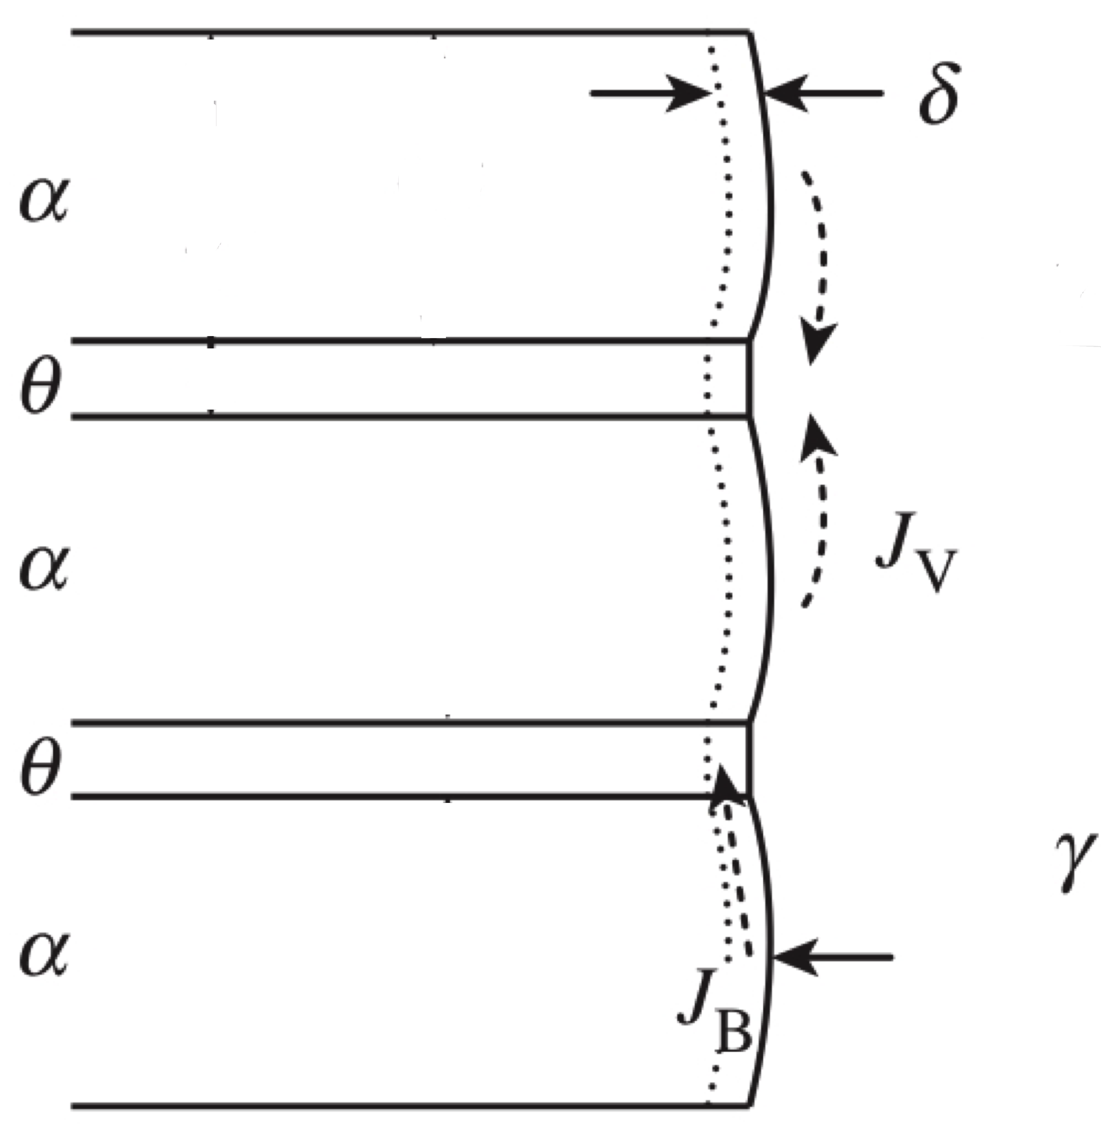
+ flux term due to flux
through interface

Slide 27

interface
volume
mixed
Fe-C

Slide 28


Slide 29

Divergent pearlite
To see a real image of divergent pearlite,
Figure 4.17 of “Steels” book.

