Slide 1
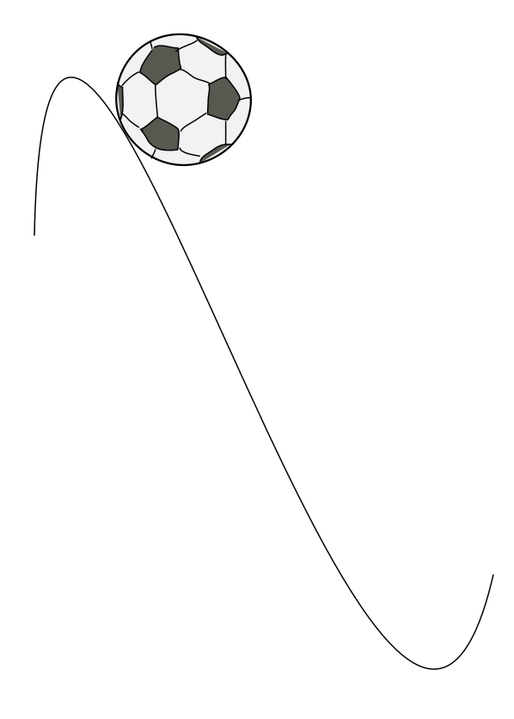
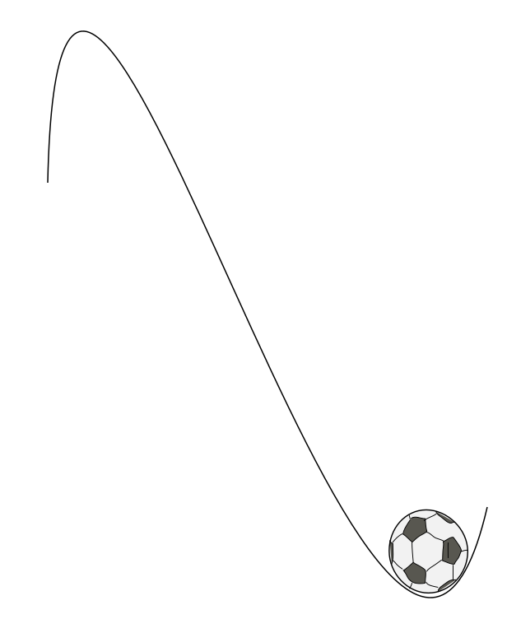

Slide 2
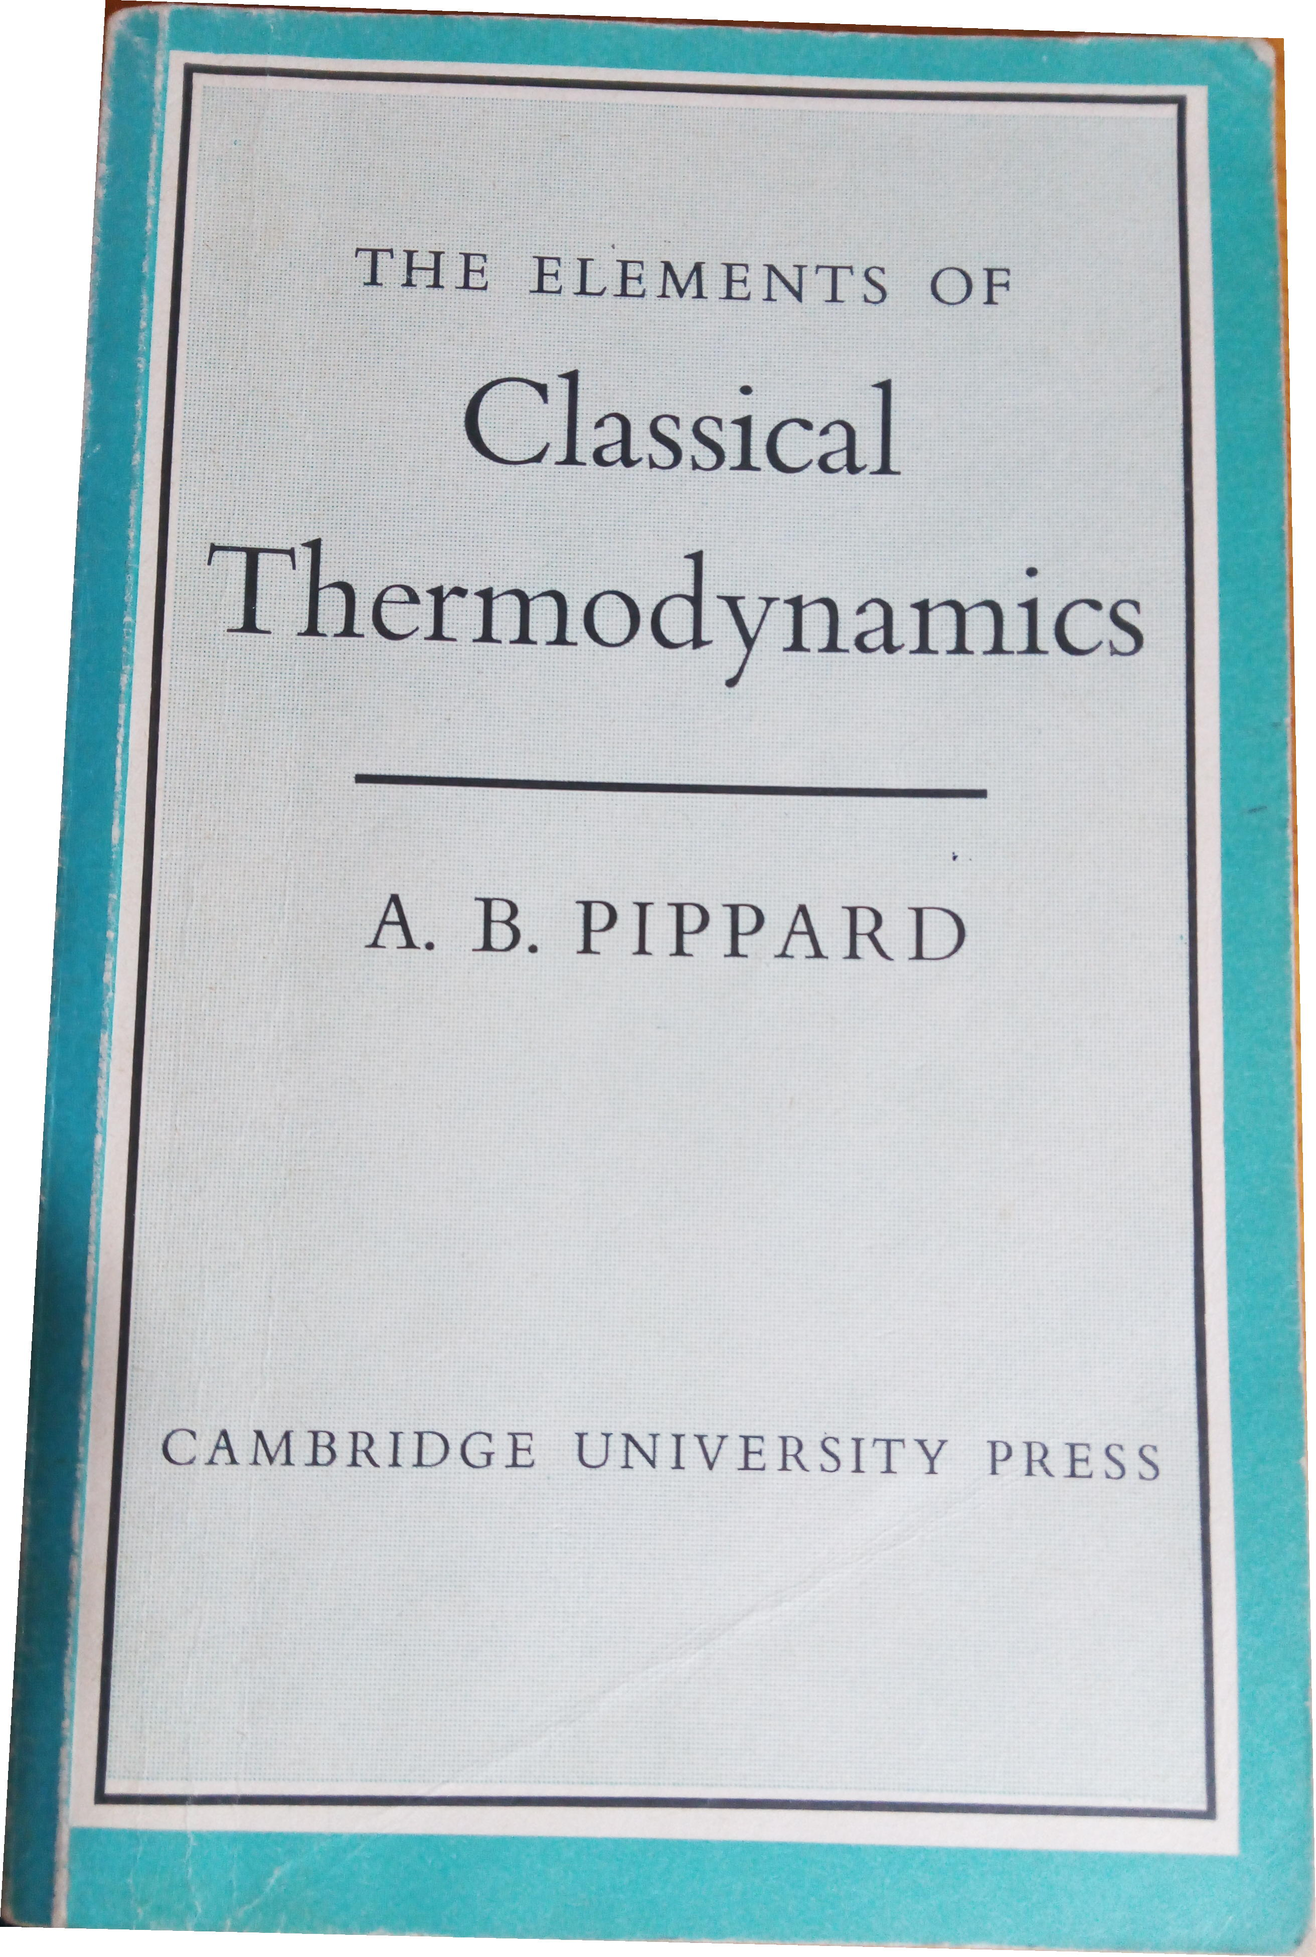
Phase transitions elementary thermodynamics
Harry Bhadeshia
Haixue Yan
“many observable properties so that they can be seen to be a consequence of a few”
photograph courtesy of Sunita Hansraj from her Antarctica expedition

Slide 3
Internal energy
measure of total energy of all particles in substance
includes kinetic energy
includes chemical potential energy due to bonds

Slide 4
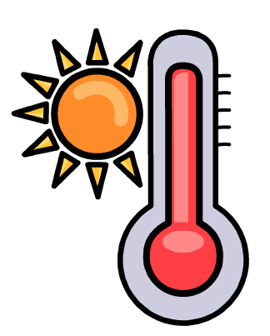

change in internal energy
heat added and work done by the system are positive

Slide 5
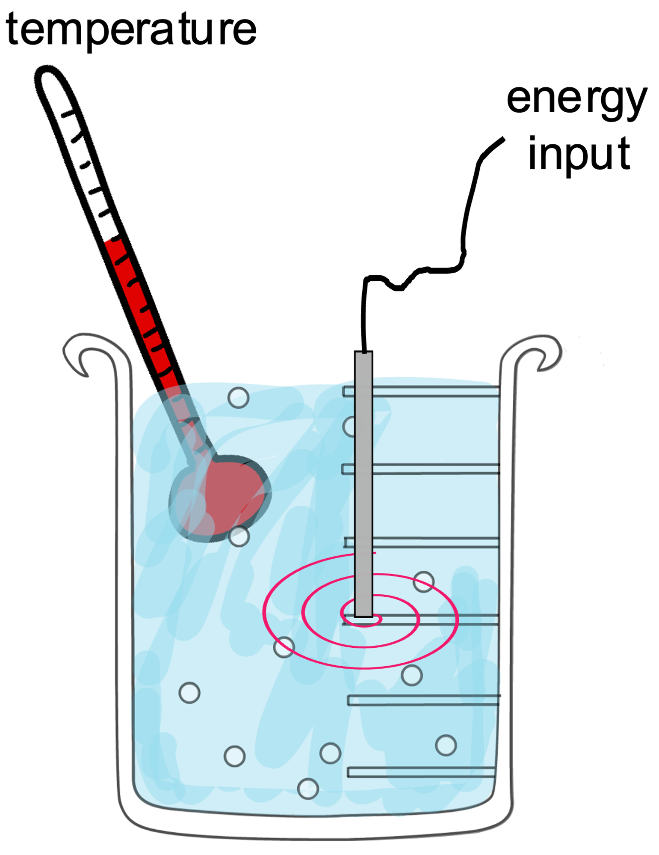


Slide 6

pendulum at any instant has kinetic and potential energy
For a molecule stimulated by thermal energy, .........

Slide 7
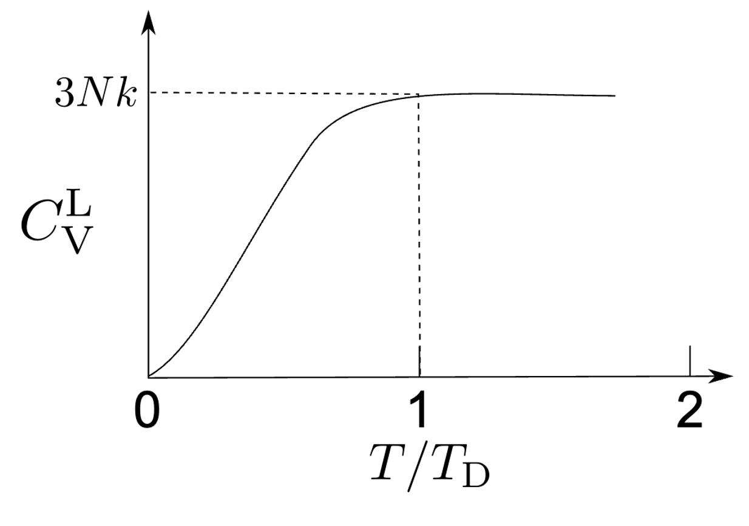
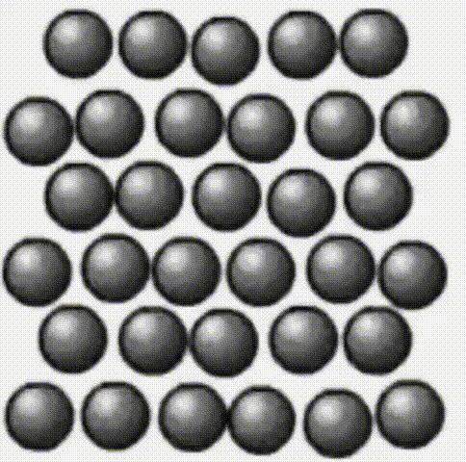
Notes:
for alpha and gamma, Debye temperatures about 400 K

Slide 8
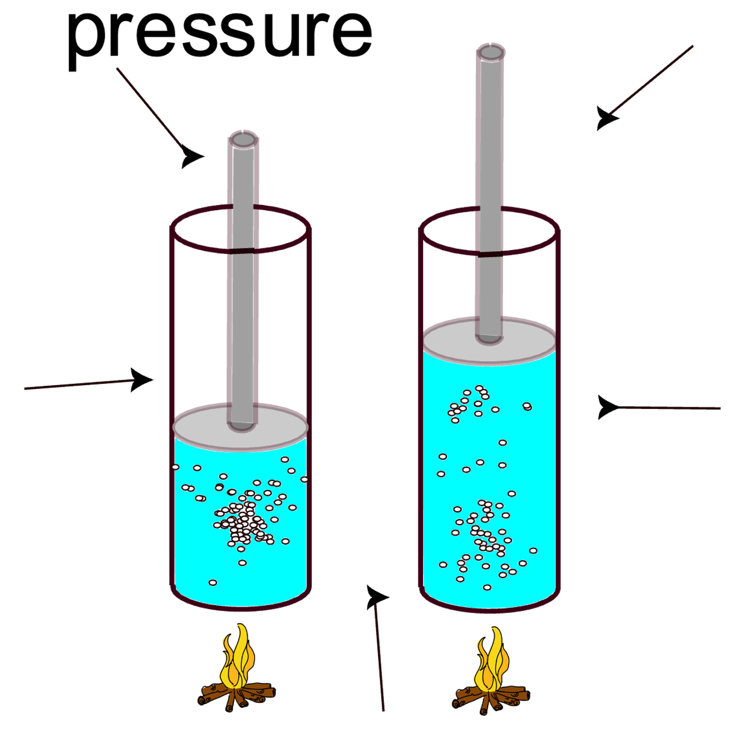

Slide 10
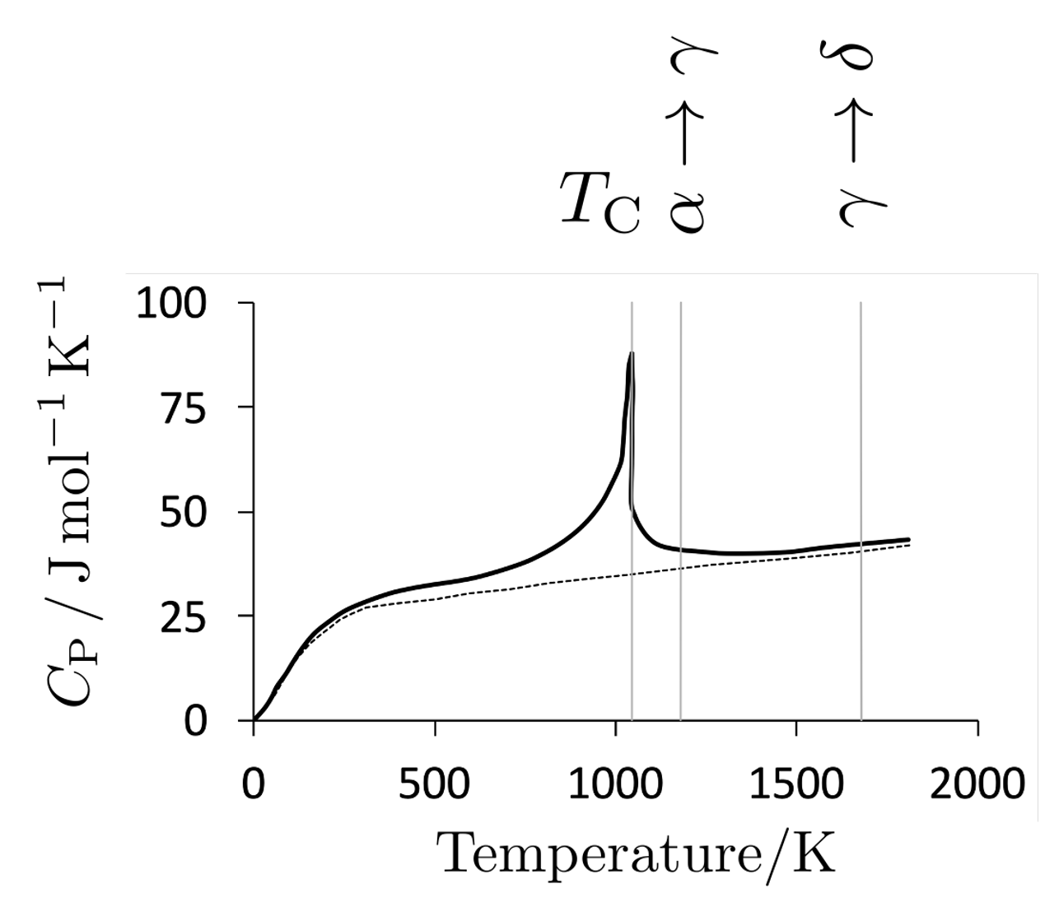
many components to heat capacity

Slide 11
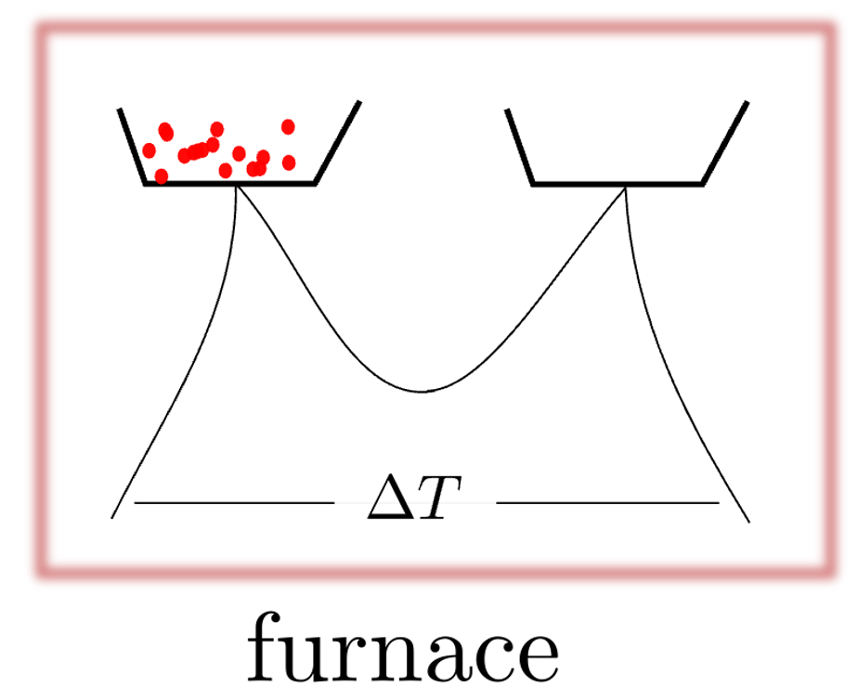
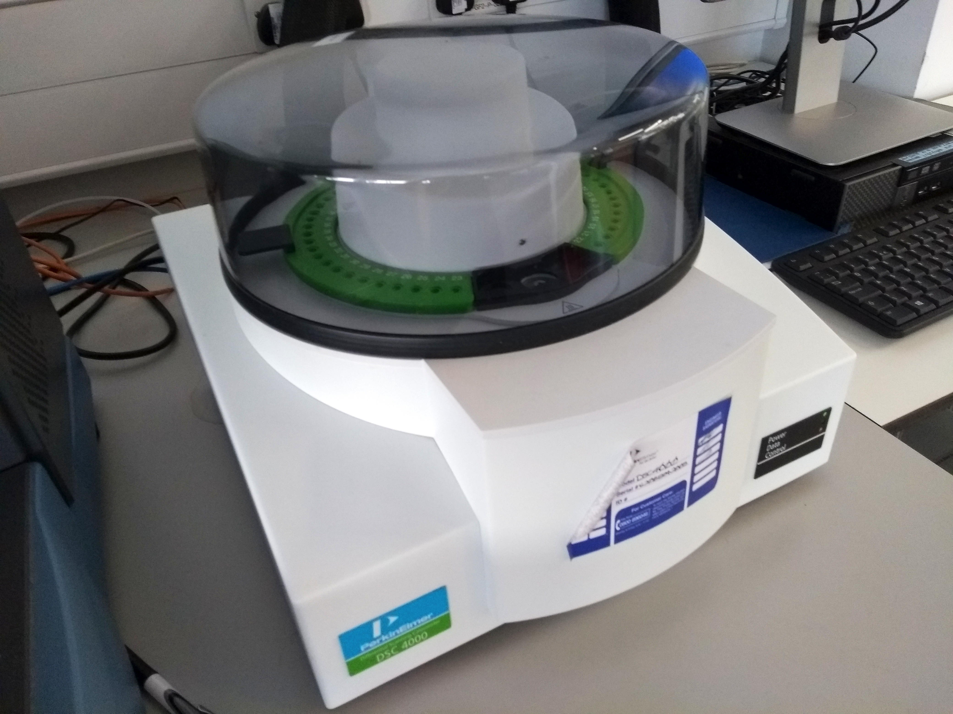
differential scanning calorimetry

Slide 12
differential scanning calorimetry

Slide 14
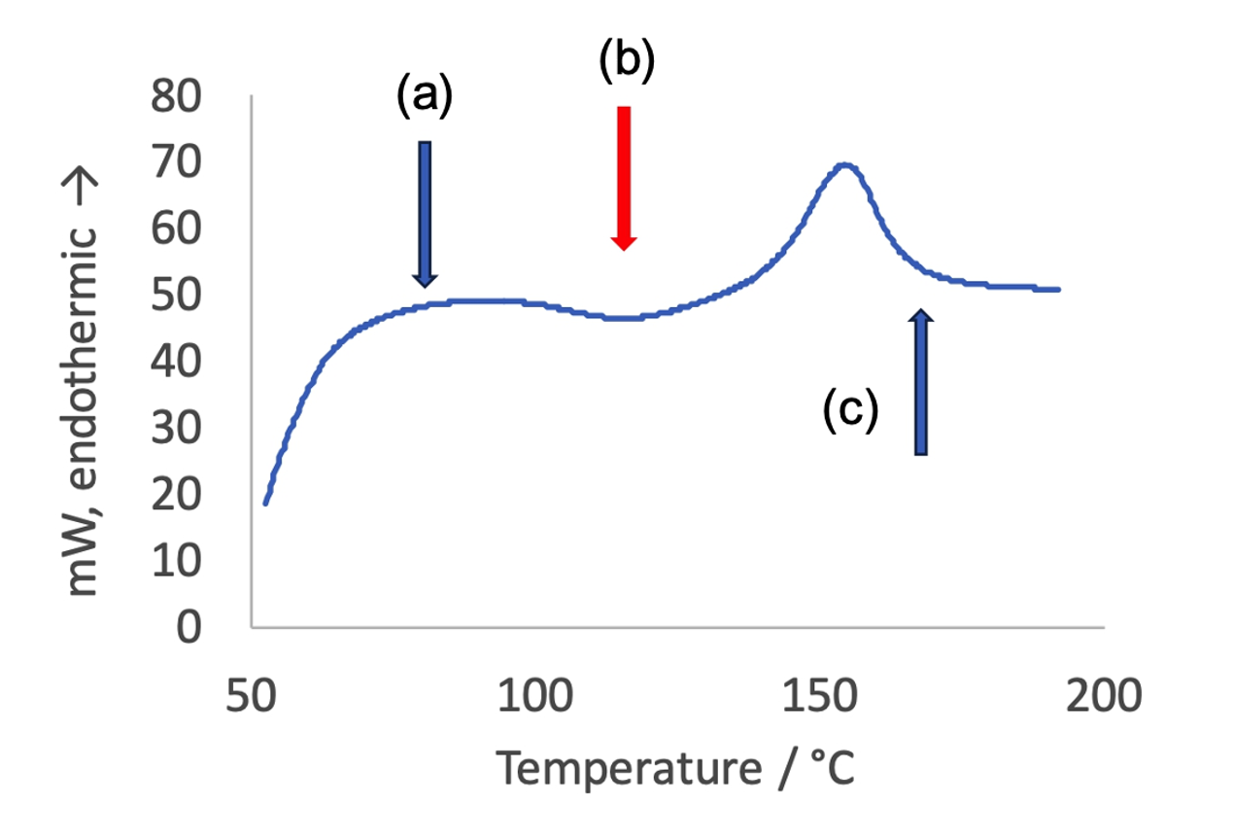
Problem: what is happening at arrows ? exothermic or endothermic?

Slide 16
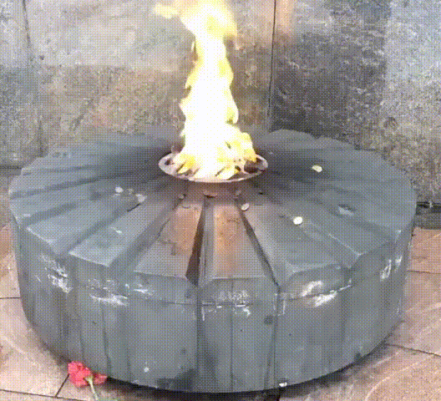

reactions happen whether they absorb or emit heat

Slide 17
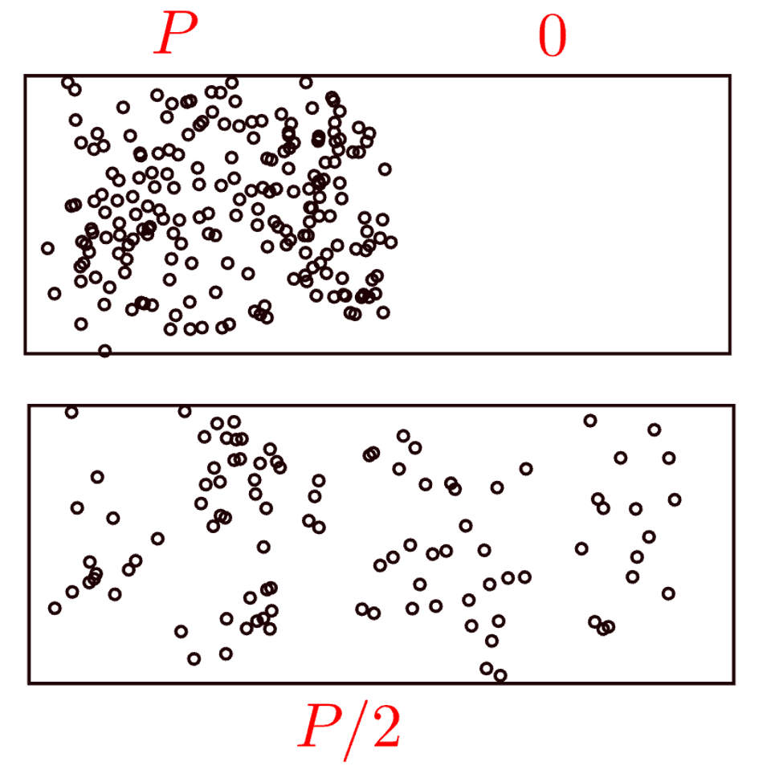
consider ideal gas
ordered
disordered

Slide 18


Slide 19
reaction spontaneous only if

Slide 20
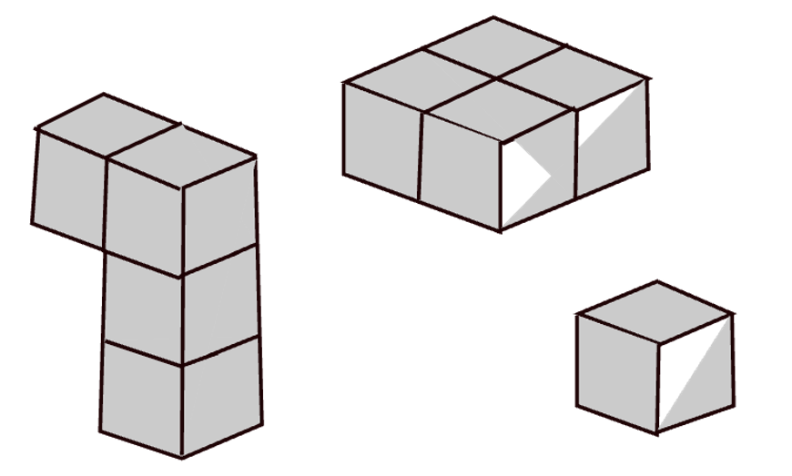
configurations
essentially means “arrangements”
some more probable than others

Slide 21
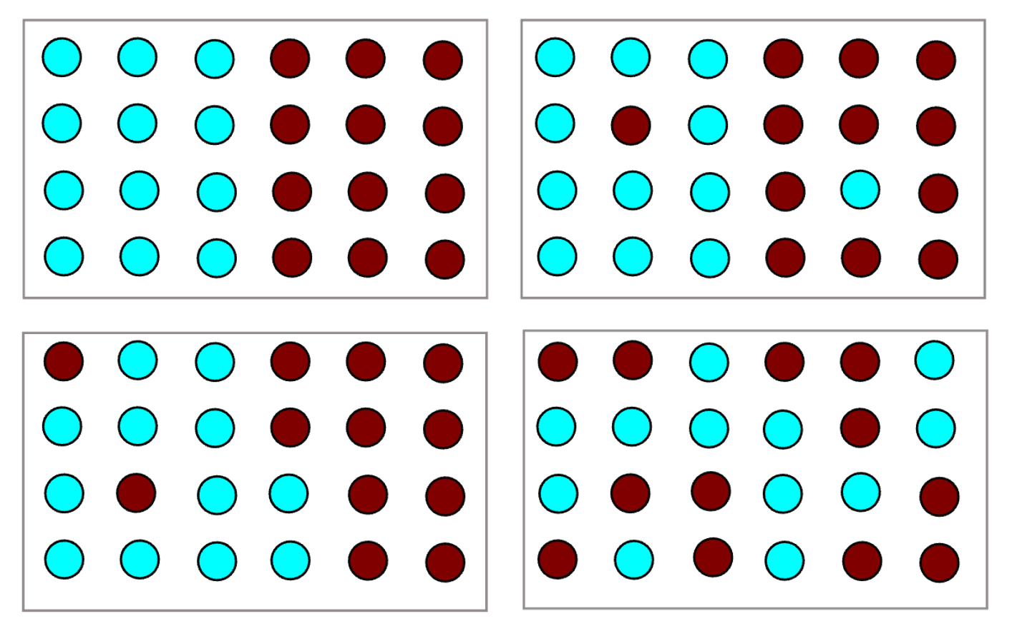

Slide 22
Problem:
How many distinguishable ways can these atoms be arranged on lattice?
atoms
lattice
2 configurations

Slide 23
Problem:
How many distinguishable ways can these atoms be arranged on lattice?
atoms
1 configuration
lattice

Slide 24
1
1
1
1,2,3
1,3,2
2,1,3
2,3,1
3,2,1
3,1,2
2
3
1,2
2,1
2

Slide 25
+

Slide 26
logarithm of large number

Slide 28
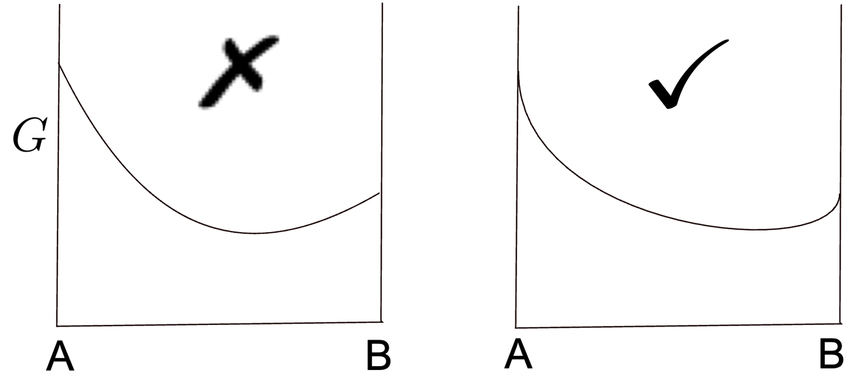

Slide 31
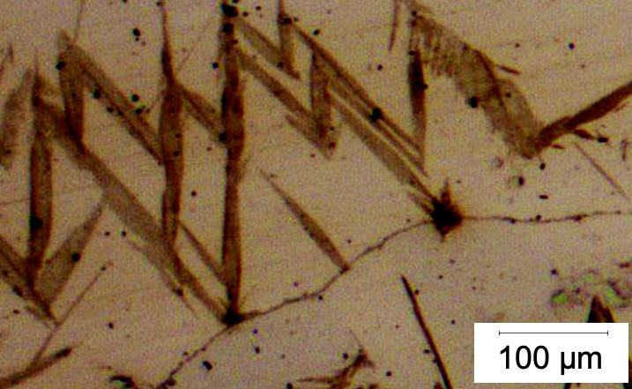
displacive transformation products are stopped at parent grain boundaries

Slide 35
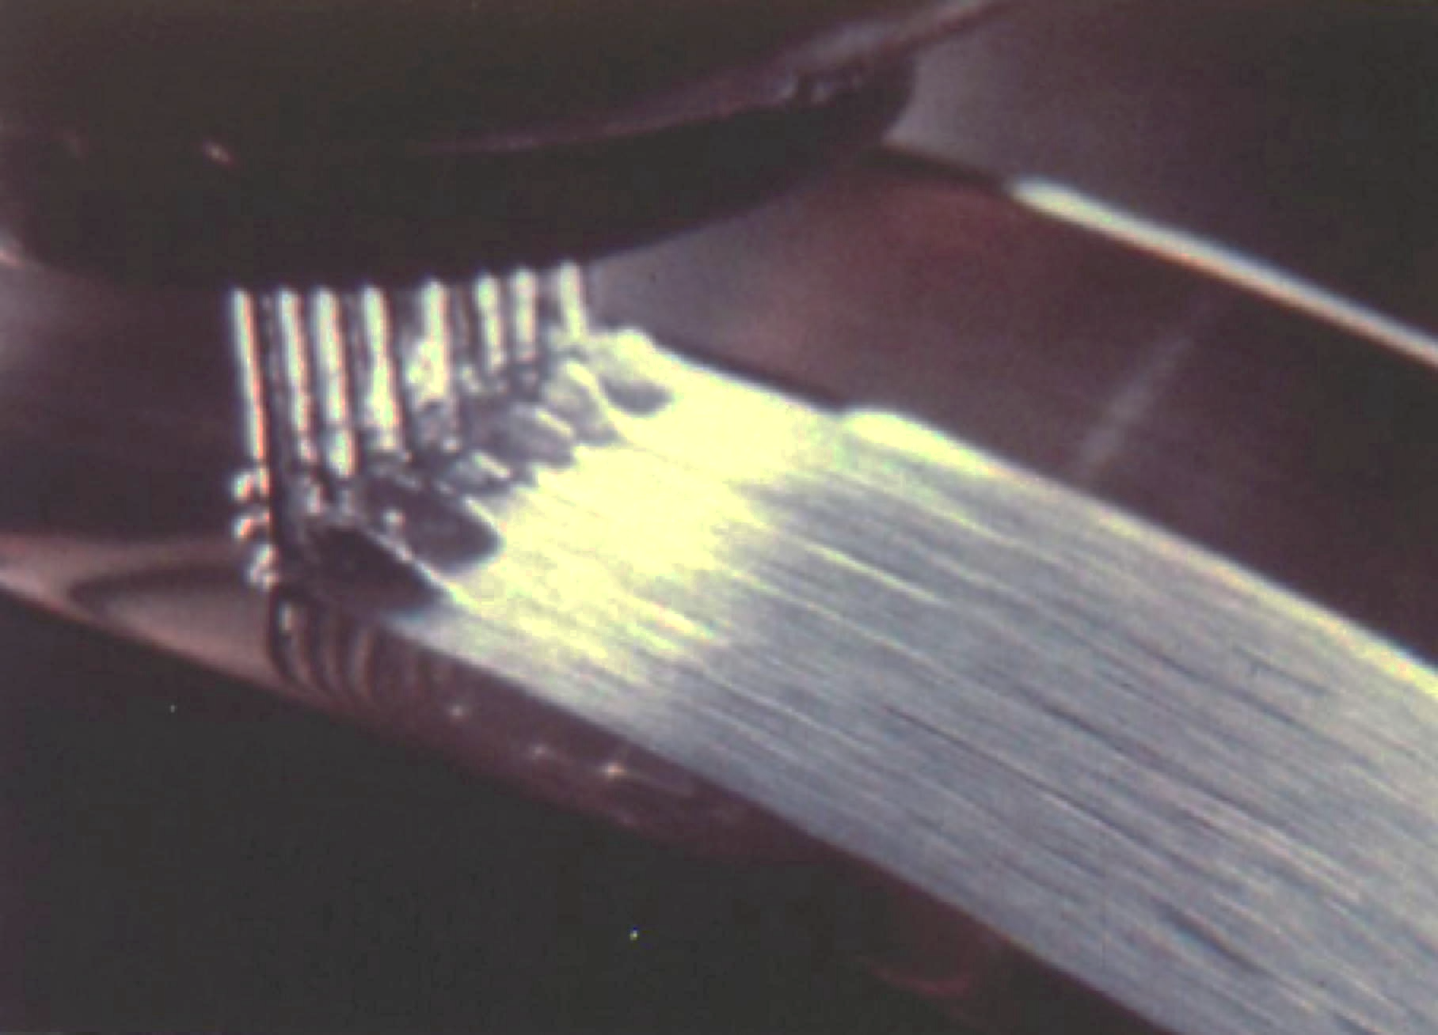
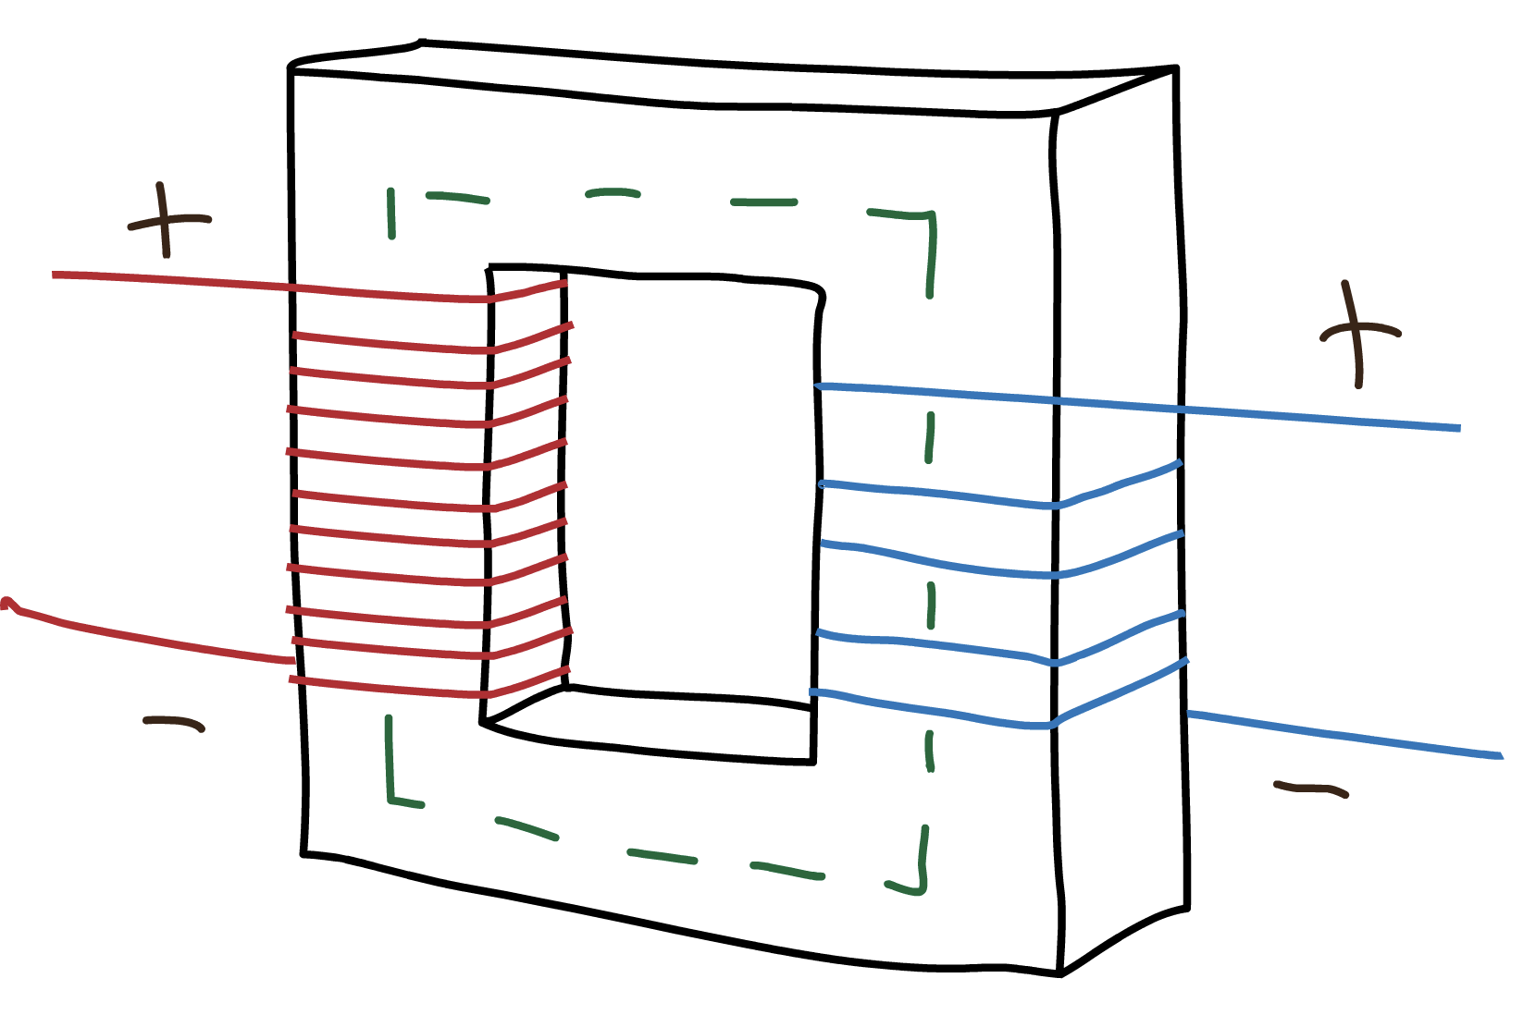
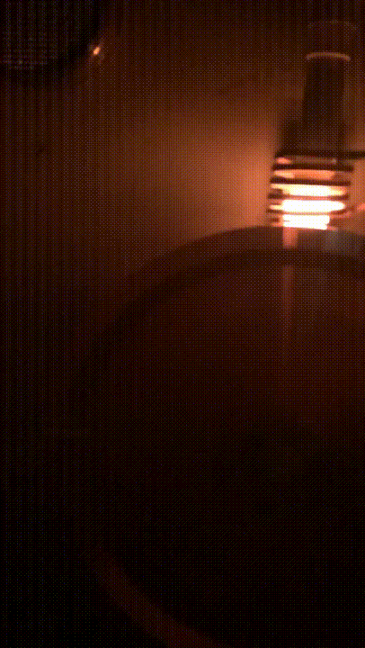
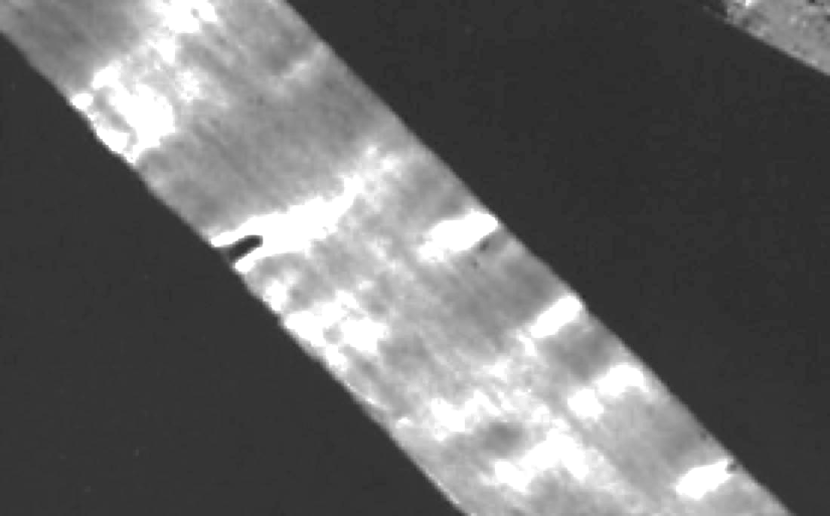
metallic glass

Slide 36
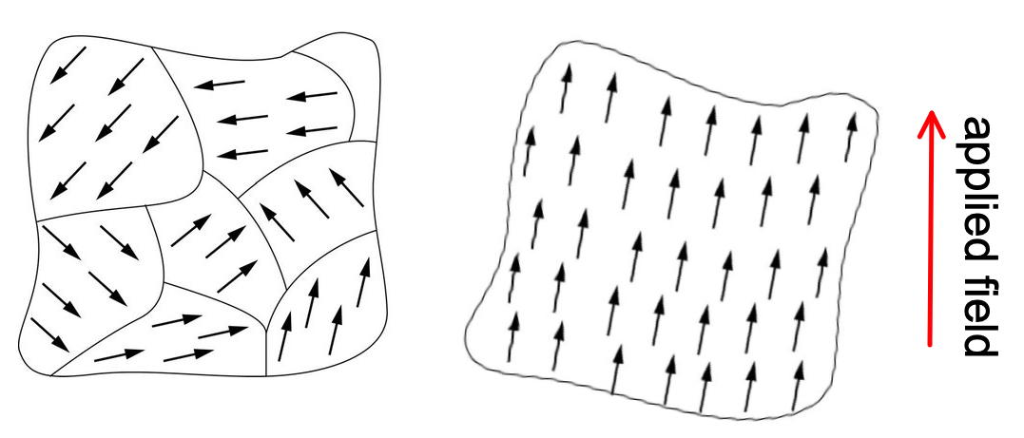
domain boundaries
glass: no structure
∴ magnetically soft

Slide 37
Wish to know melting temperature of a five-component system (Fe,Mn,Al,Au,Mg).
What are the variables?
concentration
crystal structure
pressure

Slide 38
have thermodynamic data, e.g.,
how “energy” of each element varies with temperature
how “energy” of each element, changes with its structure
how these “energies” change when elements mixed – models for mixtures

Slide 39
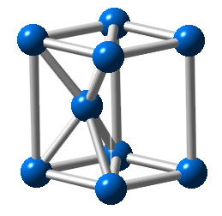
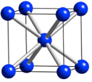
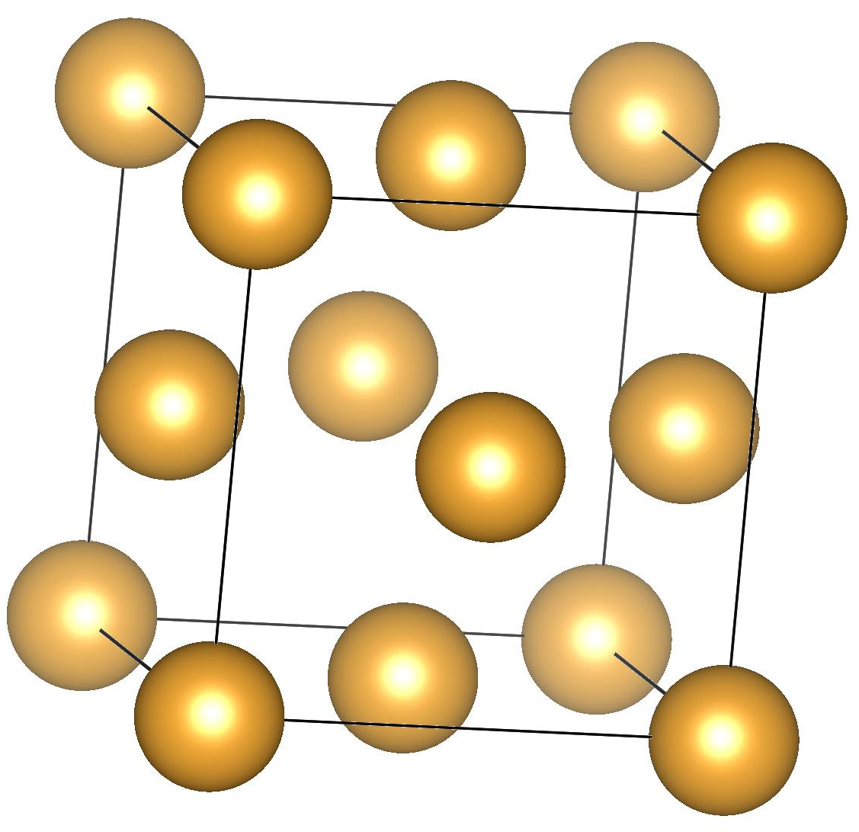
Crystal structures at high temperatures
Fe, Mn
Au, Al
Mg

Slide 40
melting temperature Fe+Au+Mn+Al+Mg
 | T_{m} / K
Fe | 1811
Fe-4Au wt% | 1793
Fe-4Au-4Mg | 723
Fe-4Au-4Mn | 1763
Fe-4Au-4Mn-4Al | 1763
calculations in steps of 10 K,
only liquid and BCC allowed to exist

Slide 41
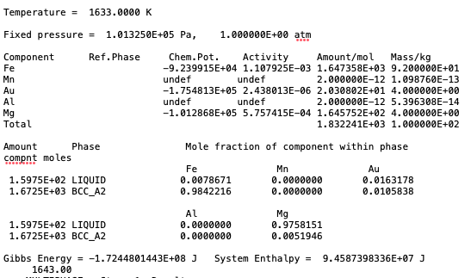
melting temperature of hexagonal Mg = 923 K

Slide 42
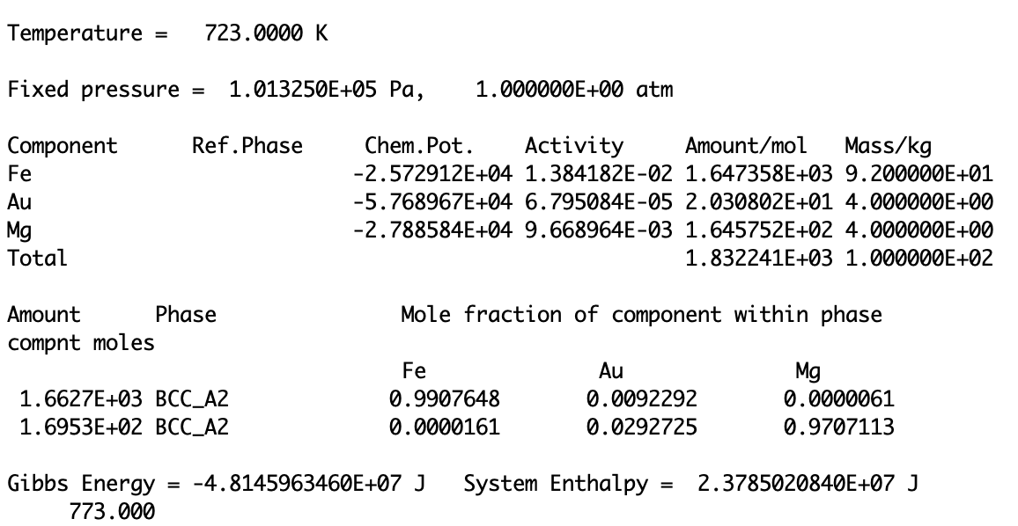

Slide 43

heat transfer permitted in both cases
closed system allows transfer of heat but not mass

